Slide 2
Applied Communication in Nursing
KRCHN
Year 1 Sem 1
Lydiah Cheyech

Slide 3
Module Competence
The module is designed to enable the learner counsel clients/patients and apply critical thinking skills in the provision of quality and comprehensive nursing care

Slide 4
Objectives
By the end of the module, the learner should be able to:
Apply critical thinking skills in provision of nursing care
Develop appropriate skills for counseling
Apply the principles of student centered learning for life long learning

Slide 5
Module Units
Critical thinking skills and reflection
Counseling
Introduction to student centered learning
Introduction to information and technology
Customer care and public relations

Slide 6
Critical Thinking Skills and Reflection
UNIT 1

Slide 7
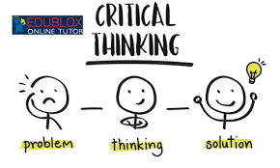
Critical Thinking is ...
Vital to nursing.
More than gathering facts and figures.
A search for the best answer - not just any answer.
A systematic way of thinking.

Slide 8
Critical Thinkers ask...
What am I taking for granted?
Did I explore all points of view?
Do I understand the question?
What information do I need?
What are the implications?

Slide 9
Critical thinking
Critical thinking is reflective, reasonable thinking
It is not just doing, it is asking “why?” Critical thinking involves inquiry, interpretation, analysis, and synthesis.
It is the art of thinking about thinking that enables you to think better.

Slide 10
CT in Nursing
The practice of nursing requires critical thinking and clinical reasoning.
Critical thinking is the process of intentional higher level thinking to define a client’s problem, examine the evidence-based practice in caring for the client, and make choices in the delivery of care.

Slide 11
Clinical reasoning
is the cognitive process that uses thinking strategies to gather and analyze client information, evaluate the relevance of the information and decide on possible nursing actions to improve the client’s physiological and psychosocial outcomes

Slide 12
Cont.…
Clinical reasoning requires the integration of critical thinking in the identification of the most appropriate interventions that will improve the client’s condition

Slide 13
Purpose of critical thinking
1. Reflect knowledge from other subjects and fields.
E.g, when providing care to a client at the end of life, it is important to have knowledge of culture and religion to enhance the delivery of culturally sensitive care and enhance the client’s spiritual well-being to promote a good death.

Slide 14
Purpose
2. Help deal with change in stressful environments.
A client’s condition may rapidly change and routine protocol may not be adequate to cover every unexpected situation.
Critical thinking enables the nurse to recognize important cues, respond quickly, and adapt interventions to meet specific client needs at the right time

Slide 15
Purpose….
3. To make important decisions.
Every day, and every moment during the day, nurses use critical thinking skills and clinical reasoning to make judgments about a client’s care.
E.g a client who is experiencing an acute asthma attack and gasping will also experience anxiety-The nurse must administer a medication to improve breathing before addressing the client’s anxiety.

Slide 16
Creative thinking
Creativity is thinking that results in the development of new ideas and products. Creativity in problem solving and decision making is the ability to develop and implement new and better solutions for health care outcomes.

Slide 17
Cont.….
Creativity is required when the nurse encounters a new situation or a client situation in which traditional interventions are not effective.
Creative thinkers must assess a problem and be knowledgeable about the underlying facts and principles that apply.

Slide 18
Cont…
The use of creativity provides the nurse with the ability to:
Generate many ideas rapidly.
Be generally flexible and natural; that is, able to change viewpoints or directions in thinking rapidly and easily.
Create original solutions to problems.
Be independent and self confident, even when under pressure.
Demonstrate individuality.

Slide 19
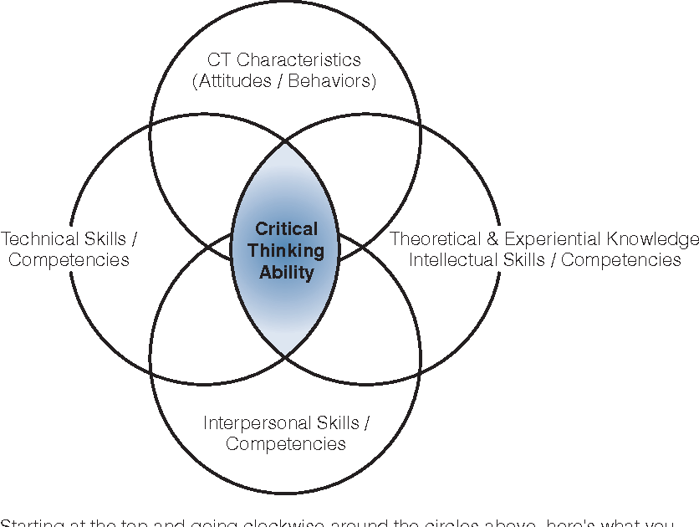
Critical Thinking Ability

Slide 20
Developing CT
Develop a critical thinking character.
Hold yourself to high standards.
Make a commitment to developing critical thinking characteristics such as; honesty, fair-mindedness, creativity, patience, and confidence.

Slide 21
Self-aware: Clarifies biases, inclinations, strengths, and limitations; acknowledges when thinking may be influenced by emotions or self-interest. • Genuine/authentic: Shows true self; demonstrates behaviors that indicate stated values. • Effective communicator: Listens well (shows deep understanding of others’ thoughts, feelings, and circumstances); speaks and writes with clarity. •

Slide 22
Health: Promotes a healthy lifestyle; uses healthy behaviors to manage stress. • Careful and prudent: Knows own limits—seeks help as needed; suspends or revises judgment as indicated by new or incomplete data. • Confident and resilient: Expresses faith in ability to reason and learn; overcomes disappointments

Slide 23
2. Take responsibility and seek out learning experiences to help you get the theoretical and experiential knowledge to think critically.
Practice intellectual skills such as assessing systematically and comprehensively. Just as practicing physical skills improves your ability to perform physically, practicing thinking skills improves your ability to perform intellectually.

Slide 24
3. Gain interpersonal skills such as teamwork, resolving conflict, and being an advocate.
Keep in mind that “being too nice” problems (e.g., not giving constructive criticism because of concerns of not offending someone) can be as bad as “not being very nice” problems (e.g., demonstrating arrogance, sarcasm, and or intolerance of other ways of doing things). Learn how to give and take feedback. To improve you must get through the negative aspects of criticism.

Slide 25
Practice related technical skills (e.g., using computers, managing IV’s). Until these skills become like second natures, they create a “brain drain” making it difficult to focus on other important things such as monitoring patient responses to care

Slide 26
Principles of Critical Thinking
Intellectual Humility
Know what you don’t know.
Know your limits.
Be aware of your biases and prejudices.
Intellectual Courage
Be open and listen to other points of view.

Slide 27
Principles of Critical Thinking
Intellectual Empathy:
Put yourself in another’s shoes, so that you can understand his or her perspective.
Intellectual Integrity
Maintain high standards.
2. Hold yourself to the same standards as you do others and fairness.

Slide 28
Principles of Critical Thinking
Intellectual Perseverance
Persist to find the answer or reach understanding.
Faith in Reason
Look out for the best interest for all involved.
Consider the consequences

Slide 29
Principles of Critical Thinking
Reasoning .
is the ability to differentiate fact (truth) from assumptions (beliefs). It can be deductive or inductive.
You will use both deductive and inductive reasoning to assess your patient and interpret the data.

Slide 30
Principles of Critical Thinking
Reflection
allows you to step back and think, considering “if . . . then” possibilities.
Experience and new evidence may result in changing opinions.
Integrating what you know from past experience with new evidence allows for change.

Slide 31
Principles of Critical Thinking
Creativity
allows you to “think outside of the box.” Creativity involves identifying multiple solutions/approaches, realizing there is more than one way to approach a problem.
Creativity is also listening to your “gut”—intuitive thinking. Intuitive thinking develops over time with experience

Slide 32
Principles of Critical Thinking
Clarification
involves addressing assumptions, comparing and contrasting. Ask yourself, “What is similar?” “What is different?”
Basic Support
based on sound, credible, known facts. Evidence-based practice that is research based leads to best practice

Slide 33
Principles of Critical Thinking
Intellectual Sense of Justice
Divergent thinking

Slide 34
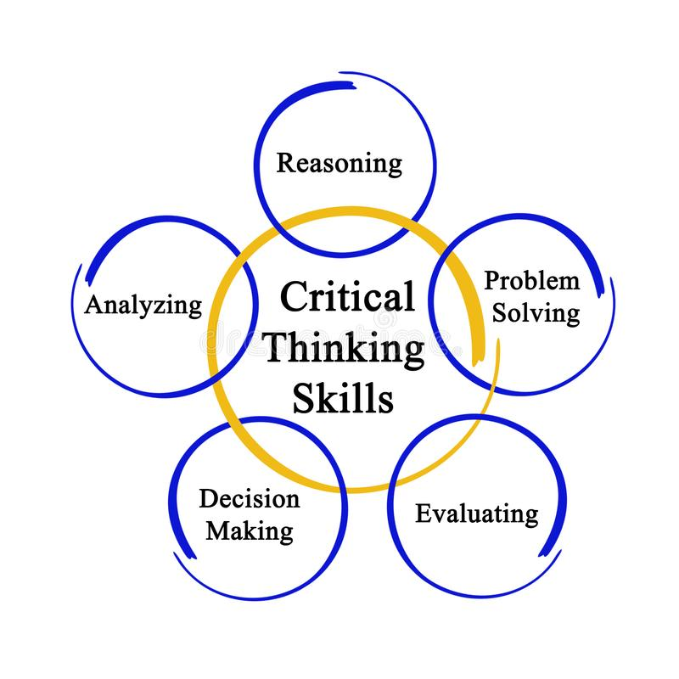
Critical Thinking Skills

Slide 35
Other Critical Thinking Skills
Reading
Listening
Speaking
Writing

Slide 36
To Improve Critical Reading...
Highlight the main ideas as you read. If most of the text is highlighted you are not reading critically.
Join a study group and see if your main idea is the same as fellow group member’s.
Dialogue with yourself to identify the main idea of your reading.
Try to state the main idea in your own words.

Slide 37
To Improve Critical Listening...
Restate the points made in a discussion with another student to see if you’ve understood him or her.
Focus on what a speaker is saying and listen for key points.
While listening, make note of anything you find confusing, and ask about it later.

Slide 38
To Improve Critical Writing
Summarize, in your own words, what you’re going to write about.
Put your writing away for a day and then reread it.
Ask yourself if you understand the most important points?
Ask a friend for input.

Slide 39
To Improve Critical Speaking
Maintain clear and accurate logic.
Avoid ambiguous statements.
Listen to yourself for any personal biases.
Practice in front of a small group and ask for feedback.

Slide 40
Problem Solving
A process whereby an individual utilizes his/her previous knowledge and experience to respond to the requirements of an unfamiliar situation
Problem solving is a mental activity in which a problem is identified that represents an unsteady state. It requires the nurse to obtain information that clarifies the nature of the problem and suggests possible solutions.

Slide 41
Problem solving requires critical thinking process in a broader approach to identify and classify problems with the underlying factors and then develop viable solutions

Slide 42
Problem Solving Skills
It involves diagnosing a problem and solving it
Organizations rely on people who can assess both kinds of situations and calmly identify solutions.
Problem-solving skills helps determine the source of a problem and find an effective solution.

Slide 43
PS Approach
Intuition is the understanding or learning of things without the conscious use of reasoning. It is also known as sixth sense, instinct, feeling, or suspicion.
As a problem-solving approach, intuition is viewed by some people as a form of guessing and, as such, an inappropriate basis for nursing decisions.

Slide 44
However, others view intuition as an essential and legitimate aspect of clinical judgment acquired through knowledge and experience. Clinical judgment in nursing is a decision-making process to ascertain the right nursing action to be implemented at the appropriate time in the client’s car

Slide 45
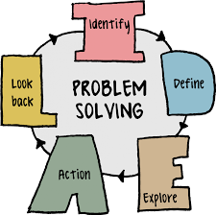
Process…..

Slide 46

Cont….

Slide 47
Problem Solving Skills
Active listening
Analysis
Research
Creativity
Communication
Decision making
Team-building

Slide 48
Reasoning is ...
The process of solving problems by using critical thinking skills.
An attempt to figure something out, solve a problem, or settle a question.

Slide 49
All Reasoning ...
has purpose.
Has a point of view.
is based on data and information.
is expressed through concepts.
contains inferences.
has implications and consequences.

Slide 50
inductive reasoning
generalizations are formed from a set of facts or observations.
When viewed together, certain bits of information suggest a particular interpretation.
Inductive reasoning moves from specific examples (premises) to a generalized conclusion- A nurse who observes a client who has dry skin, poor turgor, sunken eyes, and dark amber urine and who is determined to be dehydrated (premise) concludes that the presence of those signs in other clients indicates that they are dehydrated

Slide 51
Deductive reasoning
, by contrast, is reasoning from general premise to the specific conclusion.
Note
In critical thinking, the nurse also differentiates statements of fact, inference, judgment, and opinion

Slide 52
A Disciplined Thinker is ...
One who reasons through problems using their critical thinking skills.

Slide 53
Importance of Critical Thinking
Nurses’ critical thinking heavily impacts patient care- nurses must be able to think critically in order to anticipate patient needs.”
It's vital to recognizing shifts in patient status- nurses are trained to use a standardized practice of care- assessment, diagnosis, outcomes and planning, implementation and evaluation: save lives.

Slide 54
Cont….
It’s integral to an honest and open exchange of ideas
It helps nurses find quick fixes-nurses learn to expect the unexpected
Critical thinking can lead to innovative improvements
It plays a role in rational decision making

Slide 55
Reference
Green, C. (2000). Critical Thinking in Nursing. Upper Saddle River, NJ: Prentice Hall.

Slide 56
UNIT 2: COUNSELING
KRCHN

Slide 57
Content
Definition
Theories of counseling
Principles of counseling
Process of counseling
Skills and techniques of therapeutic communication
Nurse -patient relationship (phases and interpersonal skills)

Slide 58
History of Counseling
The origin of counseling can be traced back to the work of Frank Parsons who was concerned about helping young people make decisions about choices in their career.
Parsons regarded career decision making as a rational process with guided self-appraisal, analysis of work opportunities, and matching self with opportunities.
The early development of the counseling profession focused on developing techniques and ways of helping people better assess their aptitude, opportunities and interests in career and occupational aspects.

Slide 59
History cont..
This approach to counseling became popularly known as directive counseling since the role of the counselor is to advise clients about their career choices through matching personal traits and factors that contribute to successful decision making.
Feelings and emotions were not so much regarded as important in making the evaluation.

Slide 60
Cont..
Generally, counselors who are nondirective focus on affections and view clients as able to direct themselves with the help of counselors.
In contrast, counselors who adopt the directive approaches tend to be more prescriptive and view themselves as the experts giving directions to their clients.

Slide 61

COUNSELING

Slide 62
Definition
An interactive process characterized by a unique relationship between the counsellor and the client (counselee).
It is the act of working together with a client to clarify personal goals and find ways of overcoming their problems.

Slide 63
Cont….
The goal of counseling is to achieve better personal, social adjustment and growth in maturity, by stimulating the counselee to exploit his/her potentials and optimize use of resources.
Those people going for counseling are normal people who just need help to cope with different kinds of problems.

Slide 64
Theories of Counseling
The Analytic Approaches
The Experiential and Relationship-Oriented Approaches
The Action Therapies
The System Perspectives

Slide 65
Other Classification
Psychoanalytic,
Cognitive- behavioral
Humanistic theories

Slide 66
The Analytic Approaches
These are counseling approaches focusing on analyzing unconscious motivation, personality development and childhood experiences.
Psychoanalytic therapy by Sigmund Freud
Adlerian therapy by Alfred Adler.

Slide 67
The Experiential and Relationship-Oriented Approaches
These approaches focus on creating a good relationship between counselor and client, as well as having good and positive views of human nature.
The existential approach by Viktor Frankl, Rollo May and Irvin Yalom
Person- centered approach by Carl Rogers
Gestalt therapy by Frederick and Laura Perls.

Slide 68
The Action Therapies
These approaches focus on clients current behavior and developing a clear plan for changing unproductive behavior with a new one.
Reality Therapy by William Glaser
Behavior Therapy by B. F. Skinner, Arnold Lazarus and Albert Bandura
Rational Emotive Therapy by Albert Ellis
Cognitive Therapy by A. T. Beck.

Slide 69
The System Perspectives
These approaches stress on the importance of understanding clients in the context of the surrounding, environment, or system.
The Feminist Therapy
Family System Therapy

Slide 70
GOALS
Outcome goals are described in terms of change in the client that will manifest after the counselling and outside the counsellor’s office.
Process goals are plans for events that take place during the counselling sections and in the counsellor’s office.
They are events that the counsellor considers helpful and instrumental in achieving outcome goals

Slide 71
Cont..
Counseling leads to changes in the counselee in one or more of the following areas:
Behavior; changes in the ways the counselee acts, copes, makes decisions or relates
Beliefs; ways of thinking about one self, others and the world or emotional concerns about these perceptions
Level of emotional distress; uncomfortable feelings or reactions to environmental stress
Attitudes; negative attitudes towards self or others

Slide 72
Principles of Counseling
The principles of counselling can also be referred to as the features of counselling
Understanding
You should have a thorough understanding of human behavior in its social and cultural context and be able to apply that understanding to the particular set of problems or circumstances of each client.

Slide 73
Principles cont..
Change:
The ultimate purpose of the counselling experience is to help the client achieve some kind of change that he or she will regard as satisfying.
The Quality of the relationship:
Respect rather than rejection, empathy rather than sympathy, genuineness rather than inconsistency, self-disclosure rather than being closed, immediacy rather than escapism to the past or future.

Slide 74
Principles cont..
Self-disclosure and self-confrontation
The counselling process consists primarily of self-disclosure and self-confrontation on the part of the client, facilitated by interaction with the counsellor.
The client's hard work comes in the effort to understand what is difficult to understand, in the endurance of confusion, conflict and in the commitment to disclose to him or herself that which it is painful to think about.

Slide 75
Confidentiality
Disclose only to professions who are involved in the case of the client

Slide 76
Ethical Conduct
Providing professional counselling obligates you to function in an ethical manner.
Codes of ethics published by the relevant professional associations will serve to set some needed parameters.

Slide 77
Ethics
Autonomy: Counselors should encourage and enable clients to take control of the direction of their own lives wherever possible
Non-maleficence: Counselors’ chosen action or inaction should never intentionally cause harm
Beneficence: Mental health and well-being should be a priority for the good of the individual and for society more broadly

Slide 78
Ethics….
Justice: Counselors should treat all people fairly and equitably
Fidelity: Counselors should honor all personal and professional commitments, promises and responsibilities

Slide 79
Counseling Process
A planned structural dialogue between a counselor and the client
It’s a procedure used by the counselor when conducting counseling sessions

Slide 80
Stages of Counseling process
Initial stage/Entry
In-depth exploration/working
Termination/closure

Slide 81
Entry Phase
Initial contact starts to build up a relationship ,the good communication skills both verbal and non-verbal apply.
It involves engaging clients to explore issues directly affecting them
The first interview is important because the client is reading the verbal and non verbal messages to make inferences about the counselor and the counseling situation
.

Slide 82
1. Entry phase- Roles
R- relax before the client
O- open up and establish good rapport ,be empathetic ,avoid crossing your arms across your chest
L- lean forward a bit towards the client and use bodily language e.g. postures and gestures which show that you care.
E -maintain eye conduct
S- sit squarely in a respectable /comfortable position

Slide 83
Disclosure
Effective counselling procedures in the initial disclosure stage lead to sustained self-disclosure by the client for the following purposes: -
To let the counsellors know what has been occurring in the client's life and how the client thinks and feels about those events.
To encourage the client to gain some feeling of relief through the process of talking about his or her problems.
To encourage the client to develop a clearer definition of his or her concerns and greater understanding of exactly what is disturbing.
To help the client connect components of his or her story which may lead to new insight.

Slide 84
Trust-promoting conditions
Empathy - understanding another's experience as if it were your own, without ever loosing the "as if" quality
Congruence or genuineness - being as you seem to be, consistent over time, dependable in the relationship.
Unconditional positive regard - caring for your client without giving pre-conditions. (avoiding the message "I will care about you if you do what I want").
Concreteness - using clear language to describe the client's life situation.

Slide 85
2 .Working Phase
Problem exploration –ask him/her his needs or problems. Listen carefully, observe non-verbal communication, gather all information and specific facts the client is telling you about the problems.
The client should reach clear understanding of his or her life concerns and begin to formulate a new sense of hope and directions.

Slide 86
Cont….
Set goals- Get all the necessary information to solve the problem.
Use available resources to solve the problem. Agree with the client on no. of sessions to hold.
Agree on the number of problems or issues to discuss during the session and set priorities
You also agree on the length of each session and the time of reporting

Slide 87
Goal setting
Goals are the results or outcomes that the client wants to achieve at the end of the counseling period
Goals give direction to be followed during counseling
Goals should be stated in positive terms and should be within the counselors knowledge and skills
They should be achievable

Slide 88
Working phase cont;-
Techniques of termination.
Introduce the idea of termination
Encourage client to rely on him/herself –the counselor tries to make client to be self reliant, hence gradually separates him/herself from the client .

Slide 89
The role of the counselor is to;-
C-clarify the needs of the clients.
L-listen attentively to what the client is telling you
E-encourage interaction-talk to the client let him respond .
A-acknowledge what the client is saying and probe further
R - reflect back to the client, clarify what he/she says and summarizes .

Slide 90
3. Closure /terminating the session
Termination means ending the counseling relationships.
This is decided when the client, shows signs of improvement and ability to solve his problems.
Prepare your client to be ready for termination of counseling relationship.

Slide 91
In Termination…
The Counselor summarizes the important points discussed during the session.
Both counselor and client have to agree on the steps to be taken next.
Agree on return date and any assignments client is expected to do at home.
Client is given enough time to ask questions which require clarification.

Slide 92
Cont…
Some may require further counseling support after termination ,therefore encourage gradual termination and allow the client the opportunity to visit you when need arises.
Termination is considered not just at the end of successful relationship but is also considered when it seems counseling is not being helpful

Slide 93
Process of Separation
1. Denial –disbelief, refusal, panic on idea of termination
Help client by convincing him/her of the achievement
Identify specific changes which have occurred since commencing counseling sessions.

Slide 94
2. Anger -
When a client looses a person who is so close and helpful, he or she may react by refusing to eat ,talk or cry.
As a counselor, help the client to overcome the state of anger by talking to the client and sharing his/her feelings but be empathetic. The client has to face and accept the reality in order to move on

Slide 95
3. Bargaining stage:
the client wishes the counselor will change his/her mind and continue with the counseling sessions.
The client will even argue with the counselor to lengthen the discussion.
As a counselor, listen attentively to the clients arguments.
Tell the client the achievements he/she has made since he/she started attending the counseling sessions.
Emphasize on the importance of being independent

Slide 96
4. Depression:-
occurs when the truth dawns on the client
He/she may express depression by withdrawing from the norms
a lot of counseling will help the client to come out of this situation. A lot of patience is also required.

Slide 97
5. Acceptance-
The client now accepts the reality and plans how to cope with the situation.
He/she gains confidence and moves on.
He will continue with his life as usual with new vigor and strength.

Slide 98
Preparation for Counseling
Conducted in a private quiet room.
Spacious to allow comfort.
Enough ventilation and furniture ,lighting, clean and tidy.
A good table and comfortable chairs.
Free from noise, no distracting equipment or pictures on the wall .
Client and counselor should sit facing each other.
Preparation of the room depends on the type of interview to be conducted

Slide 99
Steps in Counseling Process
G-greet and welcome the client .
A- ask the client about himself and family ,Ask help –why consulting .
T-tell the client what you can/cannot do to resolve the problem .
H-help her/him formulate course of action and identify resources to resolve the problem.
E-explain available services and location cost
R-return appointment to the client

Slide 100
Therapeutic communication
Process of interacting that focuses on advancing the physical and emotional well-being of a patient.
Communication forms a major component of the therapeutic process.
Building a strong and effective therapeutic alliance is often considered crucial to effective counseling outcome in most every counseling endeavor.

Slide 101
Cont…
Therapeutic communication is a collection of techniques that prioritize the physical, mental and emotional well-being of patients.
Nurses provide patients with support and information while maintaining a level of professional distance and objectivity.

Slide 102
Skills and techniques
Using Silence
At times, it’s useful to not speak at all. Deliberate silence can give both nurses and patients an opportunity to think through and process what comes next in the conversation.
Active Listening
Seeking Clarification
Reflecting
Offering Hope and Humor
Observation skills
Summarizing

Slide 103
Nurse -patient relationship
A therapeutic relationship, also known as a helping relationship, refers to the relationship between a healthcare professional and a patient.
1. Trust. Initially, trust in a relationship is fragile, so it’s especially important that a nurse keep promises to a client.
If trust is breached, it becomes difficult to re-establish.
2. Respect is the recognition of the inherent dignity, worth and uniqueness of every individual, regardless of socio-economic status, personal attributes and the nature of the health problem.

Slide 104
Cont…
3. Professional intimacy is essential in the type of care and services that nurses provide.
Professional intimacy involve psychological, spiritual and social elements that are identified in the plan of care. Access to the client’s personal information also contributes to professional intimacy.
4

Slide 105
Cont….
Power: The nurse-client relationship is one of unequal power. The nurse has more authority and influence in the health care system, specialized knowledge, access to privileged information and the ability to advocate for the client and the client’s significant others.

Slide 106
Cont…
The appropriate use of power, in a
caring manner, enables the nurse to partner with the client to meet the client’s needs.
A misuse of power is considered abuse.

Slide 107
Four phases of therapy
1. Establishing a Relationship
The counselor establishes an equal partnership with the client in terms of equal respect, rights and responsibilities.
The counselor accepts the client without any conditions and encourages the person to identify his or her strengths and abilities.
Focus is on the fact that the client can make a change if he or she wishes to.
The client must feel safe, especially if he or she is to reveal his or her inner thoughts

Slide 108
2. Gathering Information
The counselor gathers information about the client by observing the way he or she enters the room, sits, speaks and behaves during the counseling sessions.
The counselor will analyze the clients lifestyle by examining his/her birth order and family environment, as well as early memories especially during the first few years of life.
Early recollections are used as a diagnostic tool to evaluate the clients present attitudes and current lifestyle.
The counselor asks directly why the client has come and much can be learned by what he or she tells and does not tell.

Slide 109
3. Giving Insight
The counselor will help clients gain an insight into their present behaviors.
The counselor can use confrontation where he challenges the clients private logic. Asking the what questions encourages clients to explore possibilities.
By now, the counselor will have some idea about the clients view of themselves, their view of the world and their unconscious decisions about how to move through life.

Slide 110
4. Encouraging Reorientation
This is the most difficult phase where the counselor guides and encourages the client to find a way to change.
The counselor will point out the clients strengths and encourage him to find a way to move on.
Tasks which are achievable are set for the client; especially those that challenge his private logic and are hindering the person from changing.

Slide 111
Cont…
To acquire new behavior is an uphill task, and the counselor should make an effort to congratulate achievement.
The counselor may make reference to earlier counseling sessions where certain issues that were discussed may be helpful to the client at this phase of the counselling process.
The counsellor may end the sessions by assigning tasks if appropriate.

Slide 112
Interpersonal skills in a relationship
Nurses use a wide range of effective communication strategies and interpersonal skills to appropriately establish, maintain, re-establish and terminate the nurse-client relationship.
Nurses achieve therapeutic communication by
introducing themselves to clients by name and category; giving clients an opportunity to express themselves without diminishing the clients’ feelings or immediately giving advice

Slide 113
Cont.…..
Telling clients about the role of the health care team and that information will be shared with other members of the team.

Slide 114
Cont…
2. being aware of their verbal and non-verbal communication style and how clients may perceive it.
For example, if you stand with your arms crossed while listening to a client, the client may feel you are not interested.
It’s also essential to use communication resources as necessary. For example, when language or literacy is hampering communication, you may use a translator or provide an easy-to-read pamphlet.

Slide 115
3. recognizing that all behavior has meaning.
They try to understand the cause of a client’s unusual comment, attitude or behavior. For example, the meaning behind a client refusing to eat may be that the client is fasting as part of a religious practice.
Throughout the relationship, engage the client in discussions on how the client will meet care needs after the nurse-client relationship ends.
For example, you’ll need to discuss discharge planning and arrange follow-up appointments or a referral to a community agency.

Slide 116
4.Client-Centred Care
by actively including the client and significant others as partners in the care;
identifying the client’s goals, wishes and preferences and making these the basis of the plan of care;
recognizing that the client’s well-being is affected by the nurse’s ability to establish and maintain a therapeutic relationship;
acknowledging that biases and feelings can affect the nurse-client relationship; and requesting to transfer care when the relationship is not evolving therapeutically.

Slide 117
Clients Rights in Counseling
Information: As a service provider, you should ensure that clients receive adequate information regarding all the services provided within your facility. Ensure you provide your clients with adequate and accurate information on the method of their choice.
Access to Services: All clients, including adolescents and people with disabilities have the right to services at all levels of care.

Slide 118
Cont.….
Informed Choice: Clients should be counseled on the range of services.
Privacy and Confidentiality: Care should be individualized and discrete.
You should protect your clients from both auditory and visual exposure.
Client information should be protected from access by anyone who is not directly involved in his or her care.

Slide 119
Cont..
Dignity, Comfort, Expression of Opinion: Clients should be treated with dignity and friendliness. Precautions should be taken to ensure minimal discomfort. Clients’ opinions should be sought and their wishes and perspectives respected.
Continuity of Care: The clients’ records and follow-ups should be accurately and completely documented to ensure appropriate client management and clinical safety.

Slide 120
Assignment
Discuss the barriers to effective counseling
Explain the qualities of a counselor

