Slide 1
Areas of the neck
The areas of the neck are
  Anterior triangle
  Posterior triangle

Slide 2
The Posterior Triangle of the Neck
The posterior triangle of the neck is an anatomical area located in the lateral aspect of the neck.
Borders
Its boundaries are as follows:
  Anterior – posterior border of the sternocleidomastoid.
  Posterior – anterior border of the trapezius muscle.
  Inferior – middle 1/3 of the clavicle.

Slide 3
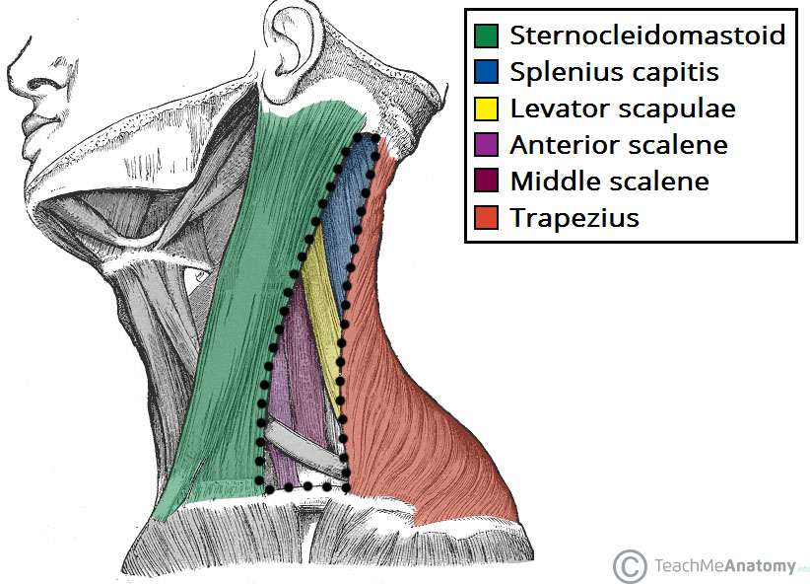
The borders and floor of the posterior triangle of the neck.

Slide 4
contents
Muscles
The posterior triangle of the neck contains many muscles, which make up the borders and the floor of the area.
A significant muscle in the posterior triangle region is the omohyoid muscle. It is split into two bellies by a tendon. The inferior belly crosses the posterior triangle, travelling in an supero-medial direction, and splitting the triangle into two. The muscle then crosses underneath the SCM to enter the anterior triangle of the neck.

Slide 5
A number of vertebral muscles (covered by prevertebral fascia) form the floor of the posterior triangle:
  Splenius capitis
  Levator scapulae
  Anterior, middle and posterior scalenes
Vasculature
The external jugular vein is one of the major veins of the neck region. Formed by the retromandibular and posterior auricular veins, it lies superficially, entering the posterior triangle after crossing the sternocleidomastoid muscle. Within the posterior triangle, the external jugular vein pierces the investing layer of fascia and empties into the subclavian vein.
The subclavian vein is often used as a point of access to the venous system, via a central catheter.

Slide 6
The transverse cervical and suprascapular veins also lie in the posterior triangle
The subclavian, transverse cervical and suprascapular veins are accompanied by their respective arteries in the posterior triangle.
The distal part of the subclavian artery can be located as it emerges between the anterior and middle scalene muscles. As it crosses the first rib, it becomes the axillary artery, which goes onto supply the upper limb.

Slide 7
The Anterior Triangle of the Neck
The anterior triangle is a region located at the front of the neck.
Note: it is important to note that all triangles discussed below are paired; they are located on both the left and the right sides of the neck.

Slide 8
Borders
The anterior triangle is situated at the front of the neck. It is bounded:
Superiorly – inferior border of the mandible (jawbone).
Laterally – anterior border of the sternocleidomastoid.
Medially – sagittal line down the midline of the neck.
Investing fascia covers the roof of the triangle, while visceral fascia covers the floor. It can be subdivided further into four triangles

Slide 9
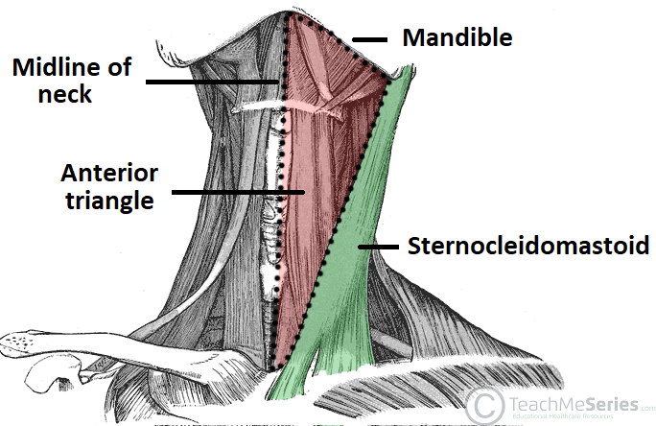
Borders of the anterior triangle of the neck.

Slide 10
contents
The contents of the anterior triangle include muscles, nerves, arteries, veins and lymph nodes.
The muscles in this part of the neck are divided as to where they lie in relation to the hyoid bone. The suprahyoid muscles are located superiorly to the hyoid bone, and infrahyoids inferiorly.

Slide 11
There are several important vascular structures within the anterior triangle. The common carotid artery bifurcates within the triangle into the external and internal carotid branches. The internal jugular vein can also be found within this area – it is responsible for venous drainage of the head and neck.

Slide 12
Numerous cranial nerves are located in the anterior triangle. Some pass straight through, and others give rise to branches which innervate some of the other structures within the triangle. The cranial nerves in the anterior triangle are the facial [VII], glossopharyngeal [IX], vagus [X], accessory [XI], and hypoglossal [XII] nerves.

Slide 13
Suprahyoid Muscles
Stylohyoid
Digastric
Mylohyoid
Geniohyoid
Infrahyoid Muscles
Omohyoid
Sternohyoid
Thyrohyoid
Sternothyroid

Slide 14
Subdivisions
The anterior triangle is subdivided by the hyoid bone, suprahyoid and infrahyoid muscles into four triangles.
Carotid Triangle
The carotid triangle of the neck has the following boundaries:
Superior – posterior belly of the digastric muscle.
Lateral – medial border of the sternocleidomastoid muscle.
Inferior – superior belly of the omohyoid muscle.

Slide 15
contents
The main contents of the carotid triangle are the common carotid artery (which bifurcates within the carotid triangle into the external and internal carotid arteries), the internal jugular vein, and the hypoglossal and vagus nerves.
The carotid triangle also contains the carotid sinus – a dilated portion of the common carotid and internal carotid arteries. It contains specific sensory cells, called baroreceptors. The baroreceptors detect stretch as a measure of blood pressure. The glossopharyngeal nerve feeds this information to the brain, and this is used to regulate blood pressure.

Slide 16
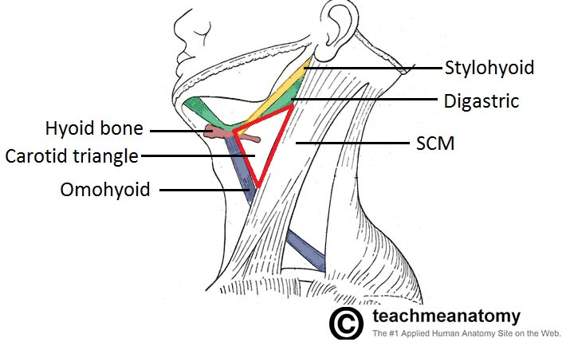
Carotid triangle of the neck

Slide 17
Submental Triangle
The submental triangle in the neck is situated underneath the chin. It contains the submental lymph nodes, which filter lymph draining from the floor of the mouth and parts of the tongue.
It is bounded:
  Inferiorly – hyoid bone.
  Medially – midline of the neck.
  Laterally – anterior belly of the digastric
The floor of the submental triangle is formed by the mylohyoid muscle, which runs from the mandible to the hyoid bone.

Slide 18
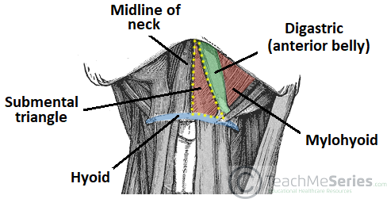
Submental triangle of the neck

Slide 19
Submandibular triangle of the neck
The submandibular triangle is located underneath the body of the mandible. It contains the submandibular gland (salivary), and lymph nodes. The facial artery and vein also pass through this area.
The boundaries of the submandibular triangle are:
  Superiorly – body of the mandible.
  Anteriorly – anterior belly of the digastric muscle.
  Posteriorly – posterior belly of the digastric muscle.

Slide 20
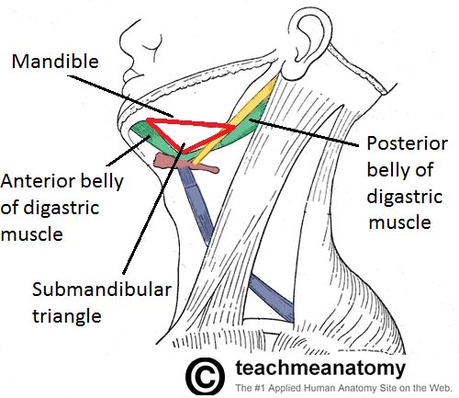
Submandibular triangle of the neck

Slide 21
Muscular triangle
The muscular triangle is situated more inferiorly than the subdivisions. It is a slightly ‘dubious’ triangle, in reality having four boundaries. The muscular triangle contains some muscles and organs – the infrahyoid muscles, the pharynx, and the thyroid, parathyroid glands.
The boundaries of the muscular triangle are:
  Superiorly – hyoid bone.
  Medially – imaginary midline of the neck.
  Supero-laterally – superior belly of the omohyoid muscle.
  Infero-laterally – inferior portion of the sternocleidomastoid muscle.

Slide 22
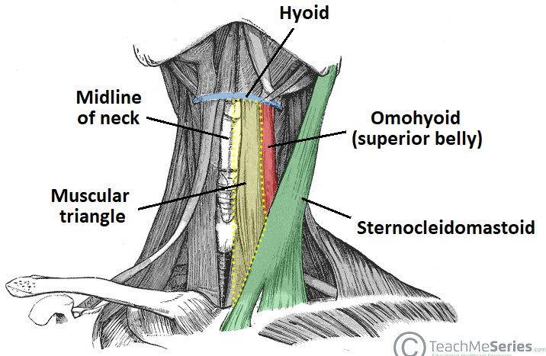
Muscular triangle of the neck

Slide 23
Areas of the head
The areas of the head are;
  Cranial fossa- anterior, posterior and middle
  Mastoid fossa
  Scalp
  Infratemporal fossa
  Pterygopalatine fossa

Slide 24
1. Cranial fossa
Anterior cranial fossa
The floor of the cranial cavity is divided into three distinct depressions. They are known as the anterior cranial fossa, middle cranial fossa and posterior cranial fossa. Each fossa accommodates a different part of the brain.
The anterior cranial fossa is the most shallow and superior of the three cranial fossae. It lies superiorly over the nasal and orbital cavities. The fossa accommodates the anteroinferior portions of the frontal lobes of the brain.

Slide 25
Borders
The anterior cranial fossa consists of three bones: the frontal bone, ethmoid bone and sphenoid bone.
It is bounded as follows:
Anteriorly and laterally it is bounded by the inner surface of the frontal bone.
Posteriorly and medially it is bounded by the limbus of the sphenoid bone. The limbus is a bony ridge that forms the anterior border of the prechiasmatic sulcus (a groove running between the right and left optic canals).
Posteriorly and laterally it is bounded by the lesser wings of the sphenoid bone (these are two triangular projections of bone that arise from the central sphenoid body).
The floor consists of the frontal bone, ethmoid bone and the anterior aspects of the body and lesser wings of the sphenoid bone

Slide 26
contents
There are several bony landmarks present in the anterior cranial fossa.
The frontal bone is marked in the midline by a body ridge, known as the frontal crest. It projects upwards, and acts as a site of attachment for the falx cerebri (a sheet of dura mater that divides the two cerebral hemispheres).
In the midline of the ethmoid bone, the crista galli (latin for cock’s comb) is situated. This is an upwards projection of bone, which acts as another point of attachment for the falx cerebri.

Slide 27
On either side of the crista galli is the cribriform plate which supports the olfactory bulb and has numerous foramina that transmit vessels and nerves
The anterior aspect of the sphenoid bone lies within the anterior cranial fossa. From the central body, the lesser wings arise. The rounded ends of the lesser wings are known as the anterior clinoid processes. They serve as a place of attachment for the tentorium cerebelli (a sheet of dura mater that divides the cerebrum from the cerebellum). The lesser wings of the sphenoid bone also separate the anterior and middle cranial fossae.

Slide 28
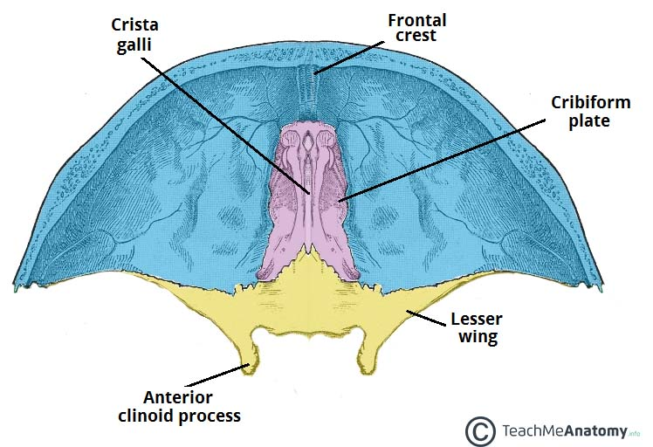
Bony landmarks of the anterior cranial fossa.

Slide 29
Foramina
The ethmoid bone in particular contains the main foramina (openings that transmit vessels and nerves) of the anterior cranial fossa. The cribriform plate is a sheet of bone seen either side of the crista galli which contains numerous small foramina – these transmit olfactory nerve fibres (CN I) into the nasal cavity. It also contains two larger foramen:
Anterior ethmoidal foramen – transmits the anterior ethmoidal artery, nerve and vein.
Posterior ethmoidal foramen – transmits the posterior ethmoidal artery, nerve and vein.

Slide 30
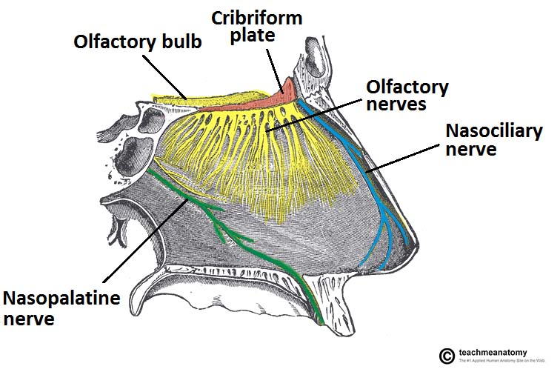
Lateral view of the nasal septum. Note the close relationship of the olfactory bulb and cribriform plate

Slide 31
Middle cranial fossa
The floor of the cranial cavity is divided into three distinct depressions. They are known as the anterior cranial fossa, middle cranial fossa and posterior cranial fossa. Each fossa accommodates a different part of the brain.
The middle cranial fossa is located, as its name suggests, centrally in the cranial floor. It is said to be “butterfly shaped”, with a middle part accommodating the pituitary gland and two lateral parts accommodating the temporal lobes of the brain

Slide 32
Borders
The middle cranial fossa consists of three bones – the sphenoid bone and the two temporal bones.
Its boundaries are as follows:
Anteriorly and laterally it is bounded by the lesser wings of the sphenoid bone. These are two triangular projections of bone that arise from the central sphenoid body.
Anteriorly and medially it is bounded by the limbus of the sphenoid bone. The limbus is a bony ridge that forms the anterior border of the chiasmatic sulcus (a groove running between the right and left optic canals).

Slide 33
Posteriorly and laterally it is bounded by the superior border of the petrous part of the temporal bone.
Posteriorly and medially it is bounded by the dorsum sellae of the sphenoid bone. This is a large superior projection of bone that arises from the sphenoidal body.
The floor is formed by the body and greater wing of the sphenoid, and the squamous and petrous parts of the temporal bone.

Slide 34
contents
The middle cranial fossa consists of a central portion, which contains the pituitary gland, and two lateral portions, which accommodate the temporal lobes of the brain.
Both parts of the fossa are marked by numerous bony landmarks which are discussed below

Slide 35
Central Part
The central part of the middle cranial fossa is formed by the body of the sphenoid bone. It contains the sella turcica (latin for Turkish saddle), which is a saddle-shaped bony prominence. It acts to hold and support the pituitary gland, and consists of three parts:
The tuberculum sellae (horn of the saddle) is a vertical elevation of bone. It forms the anterior wall of the sella turcica, and the posterior aspect of the chiasmatic sulcus (a groove running between the right and left optic canals).
The hypophysial fossa or pituitary fossa (seat of the saddle) sits in the middle of the sella turcica. It is a depression in the body of the sphenoid, which holds the pituitary gland.

Slide 36
The dorsum sellae (back of the saddle) forms the posterior wall of the sella turcica. It is a large square of bone, pointing upwards and forwards. It separates the middle cranial fossa from the posterior cranial fossa.
The sella turcica is surrounded by the anterior and posterior clinoid processes. The anterior clinoid processes arise from the sphenoidal lesser wings, while the posterior clinoid processes are the superolateral projections of the dorsum sellae. They serve as attachment points for the tentorium cerebelli, a membranous sheet that divides the brain.

Slide 37
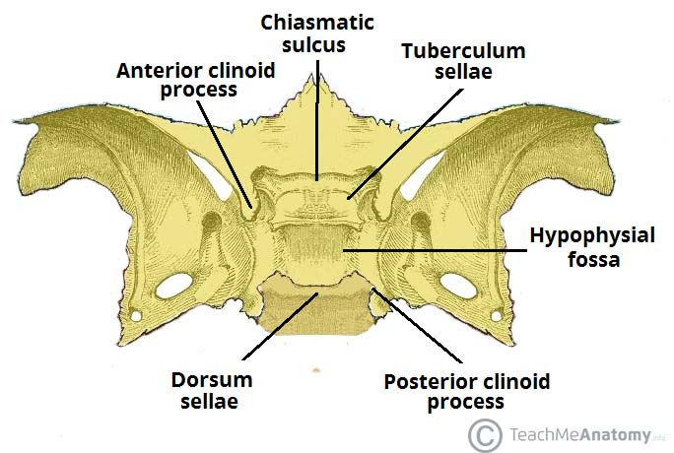
Bony landmarks of the central part of the middle cranial fossa.

Slide 38
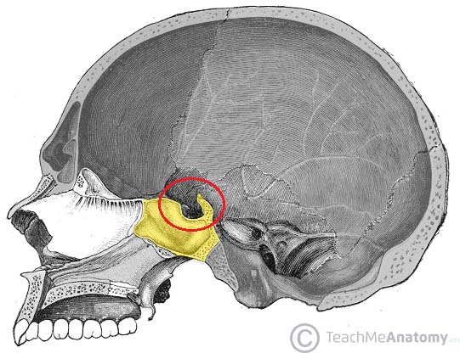
Sagittal section of the skull, showing the saddle-like sella turcica.

Slide 39
Lateral parts
The depressed lateral parts of the middle cranial fossa are formed by the greater wings of the sphenoid bone, and the squamous and petrous parts of the temporal bones. They support the temporal lobes of the brain. It is the site of many foramina – small holes by which vessels and nerves enter and leave the cranial cavity

Slide 40
Foramina
There are many foramina that transmit vessels and nerves into and out of the middle cranial fossa. These foramina will be discussed in relation to the bones they are situated in.
Foramina of the Sphenoid Bone
The optic canals are situated anteriorly in the middle cranial fossa. They transmit the optic nerves (CN II) and ophthalmic arteries into the orbital cavities. The optic canals are connected by the chiasmatic sulcus, a depressed groove running transversely between the two.
Immediately lateral to the central part of the middle cranial fossa are four foramina:
The superior orbital fissure opens anteriorly into the orbit. It transmits the oculomotor nerve (CN III), trochlear nerve (CN IV), ophthalmic branch of the trigeminal nerve (CN V1), abducens nerve (CN VI), opthalmic veins and sympathetic fibres.

Slide 41
The foramen rotundum opens into the pterygopalatine fossa and transmits the maxillary branch of the trigeminal nerve (CN V2).
The foramen ovale opens into the infratemporal fossa, transmitting the mandibular branch of the trigeminal nerve (CN V3) and accessory meningeal artery.
The foramen spinosum also opens into the infratemporal fossa. It transmits the middle meningeal artery, middle meningeal vein and a meningeal branch of CN V3.

Slide 42
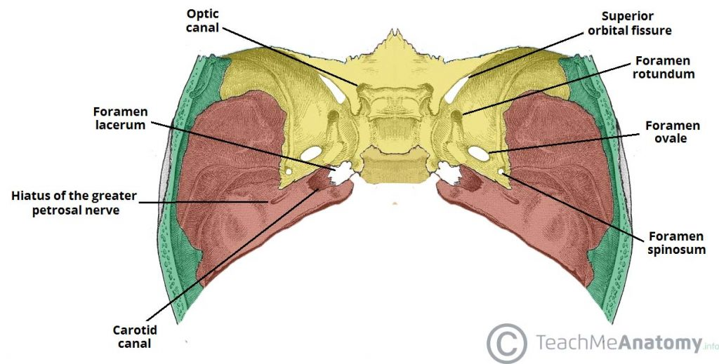
Foramina of middle fossa

Slide 43
Foramina of the Temporal Bone
The temporal bone is marked by three major foramina:
Hiatus of the greater petrosal nerve – transmits the greater petrosal nerve (a branch of the facial nerve), and the petrosal branch of the middle meningeal artery.
Hiatus of the lesser petrosal nerve – transmits the lesser petrosal nerve (a branch of the glossopharyngeal nerve).
Carotid canal – located posteriorly and medially to the foramen ovale. This is traversed by the internal carotid artery, which ascends into the cranium to supply the brain with blood. The deep petrosal nerve also passes through this canal.
At the junction of the sphenoid, temporal and occipital bones is the foramen lacerum. In life, this foramen is filled with cartilage, which is pierced only by small blood vessels.

Slide 44
Posterior cranial fossa
The floor of the cranial cavity is divided into three distinct depressions. They are known as the anterior cranial fossa, middle cranial fossa and posterior cranial fossa. Each fossa accommodates a different part of the brain.
The posterior cranial fossa is the most posterior and deep of the three cranial fossae. It accommodates the brainstem and cerebellum.

Slide 45
Borders
The posterior cranial fossa is comprised of three bones: the occipital bone and the two temporal bones.
It is bounded as follows:
Anteriorly and medially it is bounded by the dorsum sellae of the sphenoid bone. This is a large superior projection of bone that arises from the body of the sphenoid.
Anteriorly and laterally it is bounded by the superior border of the petrous part of the temporal bone.
Posteriorly it is bounded by the internal surface of the squamous part of the occipital bone.
The floor consists of the mastoid part of the temporal bone and the squamous, condylar and basilar parts of the occipital bone.

Slide 46
contents
The posterior cranial fossa houses the brainstem and cerebellum.
The brainstem is comprised of the medulla oblogata, pons and midbrain and continues down through the foramen magnum to become the spinal cord. The cerebellum has an important role in co-ordination and fine motor control – more information here.
Alongside the gross anatomical structures of the brainstem and cerebellum, the posterior cranial fossa also accommodates associated arteries and nerves. Some key structures are discussed with regards to their foramina below.

Slide 47
Foramina
There are several bony landmarks and foramina present in the posterior cranial fossa (a foramen is simply a hole that allows the passage of a structure – usually a blood vessel or nerve).
Temporal Bone
The internal acoustic meatus is an oval opening in the posterior aspect of the petrous part of the temporal bone. It transmits the facial nerve (CN VII), vestibulocochlear nerve (CN VIII) and labyrinthine artery.

Slide 48
Occipital Bone
A large opening, the foramen magnum, lies centrally in the floor of the posterior cranial fossa
It is the largest foramen in the skull. It transmits the medulla of the brain, meninges, vertebral arteries, spinal accessory nerve (ascending), dural veins and anterior and posterior spinal arteries. Anteriorly an incline, known as the clivus, connects the foramen magnum with the dorsum sellae.

Slide 49
The jugular foramina are situated either side of the foramen magnum. Each transmits the glossopharyngeal nerve, vagus nerve, spinal accessory nerve (descending), internal jugular vein, inferior petrosal sinus, sigmoid sinus and meningeal branches of the ascending pharyngeal and occipital arteries.
Immediately superior to the anterolateral margin of the foramen magnum is the hypoglossal canal. It transmits the hypoglossal nerve through the occipital bone.
Posterolaterally to the foramen magnum lies the cerebellar fossae. These are bilateral depressions that house the cerebellum. They are divided medially by a ridge of bone, the internal occipital crest.

Slide 50
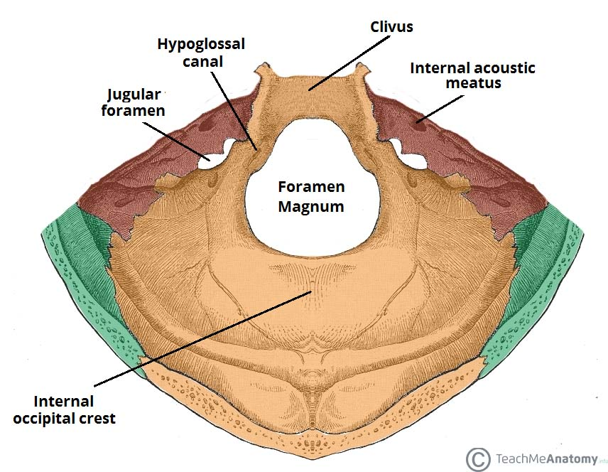
The bony landmarks and foramina of the posterior cranial fossa.

Slide 51
2.The Mastoid Fossa (MacEwen’s Triangle)
The mastoid fossa (also known as MacEwen’s triangle or suprameatal triangle) is a triangular shaped depression in the external surface of the temporal bone.
It serves as an important anatomical landmark in otologic surgery.

Slide 52
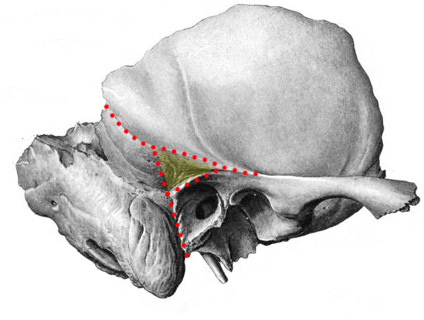
The mastoid fossa (shaded yellow) is a surface landmark of the external surface of the temporal bone

Slide 53
Borders
The mastoid fossa is a triangular shaped area with superior, anterior, and posterior borders:
Superior – Supramastoid crest
  Extension of the upper border of the posterior root of the zygomatic process.
Anterior – Suprameatal spine (spine of Henle)
  Projection of bone at the posterosuperior aspect of the opening of the external acoustic meatus, immediately inferior to the root of the zygomatic process.
Posterior – Hypothetical vertical line
  Tangential to the mid-point of the posterior wall of the external auditory canal

Slide 54
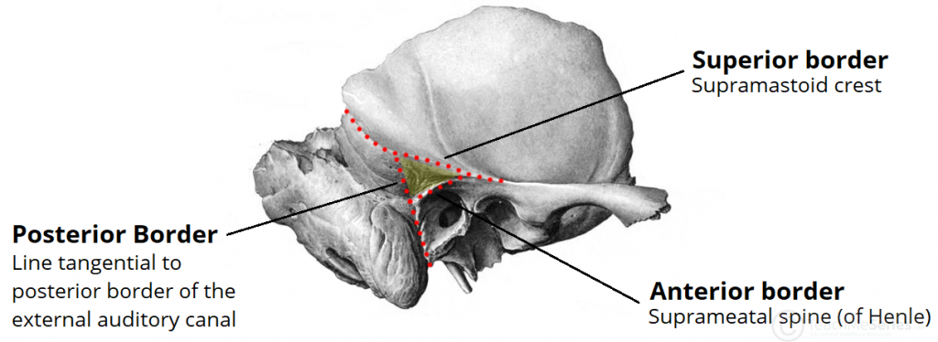
The mastoid fossa is triangle shaped. It has superior, anterior, and posterior borders.

Slide 55
Contents
Contents
The mastoid fossa is a bony landmark on the external surface of the temporal bone.
It overlies the mastoid antrum – the largest of the mastoid air cells.
The mastoid fossa does not contain any other important structures. This is why it is so significant in otologic surgery – it demarks a ‘safe area‘ to begin the traditional drilling approach during a cortical mastoidectomy.

Slide 56
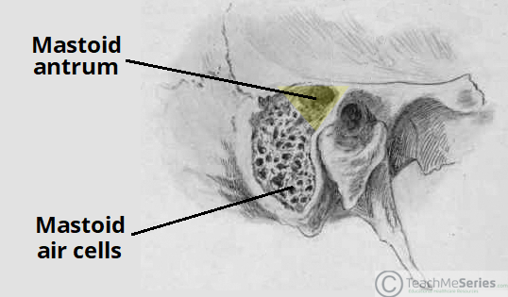
The mastoid fossa highlighted in yellow with the underlying mastoid antrum.

Slide 57
3. Infratemporal fossa
The infratemporal fossa is a complex area located at the base of the skull, deep to the masseter muscle.
It is closely associated with both the temporal and pterygopalatine fossae and acts as a conduit for neurovascular structures entering and leaving the cranial cavity.

Slide 58
Borders
The infratemporal fossa can be said to have a wedge shape. It is located deep to the masseter muscle and zygomatic arch (to which the masseter attaches).
The fossa is closely associated with both the pterygopalatine fossa, via the pterygomaxillary fissure, and also communicates with the temporal fossa, which lies superiorly

Slide 59
The boundaries of this complex structure consists of both bone and muscle:
Lateral – condylar process and ramus of the mandible bone
Medial – lateral pterygoid plate; tensor veli palatine, levator veli palatine and superior constrictor muscles
Anterior – posterior border of the maxillary sinus
Posterior – carotid sheath
Roof – greater wing of the sphenoid bone
Floor – medial pterygoid muscle

Slide 60
The roof of the infratemporal fossa, formed by the greater wing of the sphenoid bone, provides an important passage for the neurovascular structures transmitted through the foramen ovale and spinosum. Among these are the mandibular branch of the trigeminal nerve and the middle meningeal artery.

Slide 61
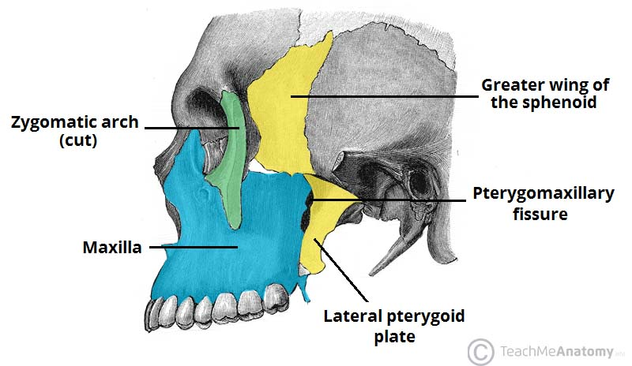
The bony features of the infratemporal fossa. The ramus of the mandible has been removed in this image.

Slide 62
Contents
The infratemporal fossa acts as a pathway for neurovascular structures passing to and from the cranial cavity, pterygopalatine fossa and temporal fossa.
It also contains some of the muscles of mastication. In fact, the lateral pterygoid splits the fossa contents in half – the branches of the mandibular nerve lay deep to the muscle, while the maxillary artery is superficial to it.

Slide 63
Muscles
The infratemporal fossa is associated with the muscles of mastication. The medial and lateral pterygoids are located within the fossa itself, whilst the masseter and temporalis muscles insert and originate into the borders of the fossa.

Slide 64
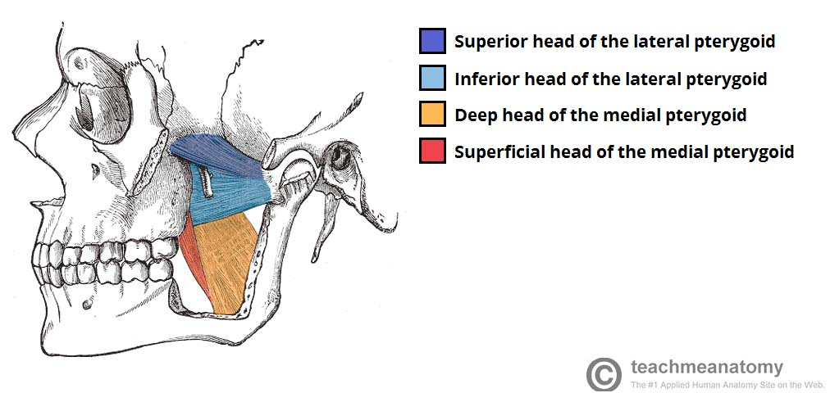
The medial and lateral pterygoids.

Slide 65
Nerves
The infratemporal fossa forms an important passage for a number of nerves originating in the cranial cavity :
Mandibular nerve – a branch of the trigeminal nerve (CN V). It enters the fossa via the foramen ovale, giving rise to motor and sensory branches. The sensory branches continue inferiorly to provide innervation to some of the cutaneous structures of the face.
Auriculotemporal, buccal, lingual and inferior alveolar nerves – sensory branches of the trigeminal nerve.
Chorda tympani – a branch of the facial nerve (CN VII). It follows the anatomical course of the lingual nerve and provides taste innervation to the anterior 2/3 of the tongue.

Slide 66
Otic ganglion – a parasympathetic collection of neurone cell bodies. Nerve fibres leaving this ganglion ‘hitchhike’ along the auriculotemporal nerve to reach the parotid gland.
By 2021)

Slide 67
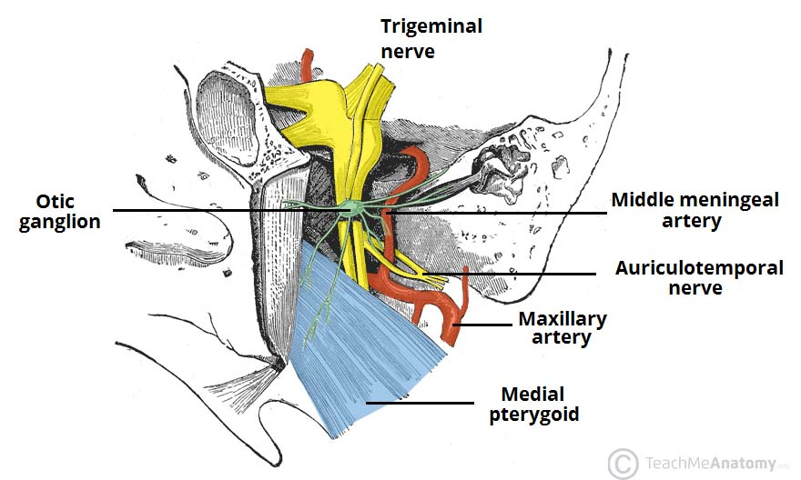
Some of the contents of the infratemporal fossa.

Slide 68
Vasculature
The infratemporal fossa contains several vascular structures:
Maxillary artery – the terminal branch of the external carotid artery. It travels through the infratemporal fossa.
  Within the fossa, it gives rise to the middle meningeal artery, which passes through the superior border via the foramen spinosum.
Pterygoid venous plexus – drains the eye and is directly connected to the cavernous sinus.
  It provides a potential route by which infections of the face can spread intracranially.
Maxillary vein
Middle meningeal vein

Slide 69
4. pterygopalatine fossa
The pterygopalatine fossa is a bilateral, cone-shaped depression extending deep from the infratemporal fossa all the way to the nasal cavity via the sphenopalatine foramen.
It is located between the maxilla, sphenoid and palatine bones, and communicates with other regions of the skull and facial skeleton via several canals and foramina. Its small volume combined with the numerous structures that pass through makes this a complex region

Slide 70
Borders
The borders of the pterygopalatine fossa are formed by the palatine, maxilla and sphenoid bones:
Anterior: Posterior wall of the maxillary sinus.
Posterior: Pterygoid process of the sphenoid bone.
Inferior: Palatine bone and palatine canals.
Superior: Inferior orbital fissure of the eye.
Medial: Perpendicular plate of the palatine bone
Lateral: Pterygomaxillary fissure

Slide 71
Contents
The Pterygopalatine Fossa contains many important neurovascular structures. Here we will discuss the maxillary nerve and its branches, the pterygopalatine ganglion and the maxillary artery and its branches.
Maxillary Nerve
The maxillary nerve is the second branch of the trigeminal nerve (CNV₂). It passes from the middle cranial fossa into the pterygopalatine fossa through the foramen rotundum.

Slide 72
The main trunk of the maxillary nerve leaves the pterygopalatine fossa via the infraorbital fissure. Here, it enters the infraorbital canal of the maxilla and exits below the orbit in the infraorbital foramen to contribute to the sensory innervation of the face
While in the pterygopalatine fossa, the maxillary nerve gives of numerous branches including the infraorbital, zygomatic, nasopalatine, superior alveolar, pharyngeal and the greater and lesser palatine nerves. The maxillary nerve also communicates with the pterygopalatine ganglion (discussed below) via two small trunks, the pterygopalatine nerves (figure 2.1). These nerves suspend the ganglion within the pterygopalatine fossa.
By \

Slide 73
Pterygopalatine Ganglion
The pterygopalatine ganglion sits deep within the pterygopalatine fossa near the sphenopalatine foramen. It is the largest parasympathetic ganglion related to branches of the maxillary nerve (via pterygopalatine branches) and is predominantly innervated by the greater petrosal branch of the facial nerve (CNVII).
Postsynaptic parasympathetic fibres leave the ganglion and distribute with branches of the maxillary nerve (CNV₂). These fibres are secretomotor in function, and provide parasympathetic innervation to the lacrimal gland, and muscosal glands of the oral cavity, nose and pharynx.

Slide 74
Maxillary Artery
The maxillary artery is a terminal branch of the external carotid artery. The terminal portion of the maxillary artery lies within the pterygopalatine fossa. Here, it separates into several branches which travel through other openings within the fossa to reach the regions they supply.
These branches include, but are not limited to:
  Sphenopalatine artery (to the nasal cavity).

Slide 75
  Descending palatine artery – branches into greater and lesser palatine arteries (hard and soft palates).
  Infraorbital artery (lacrimal gland, and some muscles of the eye).
  Posterior superior alveolar artery (to the teeth and gingiva).
At their terminal ends, the sphenopalatine and greater palatine arteries anastomose at the nasal septum.

Slide 76
Foramina
There are seven openings (also known as foramina) that connect the pterygopalatine fossa with the orbit, nasal and oral cavities, middle cranial fossa and infratemporal fossa. The openings transmit blood vessels and nerves between these regions.
Pterygomaxillary Fissure
The pterygomaxillary fissure connects the infratemporal fossa with the pterygopalatine fossa (see figure 1). It transmits two neurovascular structures:
Posterior superior alveolar nerve – a branch of the maxillary nerve. It exits through the fissure into the infratemporal fossa, where it goes on to supply the maxillary molars.
Terminal part of the maxillary artery – enters the pterygopalatine fossa via the fissure.

Slide 77
Foramen rotundum
The foramen rotundum connects the pterygopalatine fossa to the middle cranial fossa. It is one of three openings in the posterior boundary of the pterygopalatine fossa. It conducts a single structure, the maxillary nerve.
Pterygoid and Pharyngeal Canals
These two canals, along with the foramen rotundum, are the three openings in the posterior wall of the pterygopalatine fossa:
Pterygoid canal – runs from the middle cranial fossa and through the medial pterygoid plate. It carries the nerve, artery and vein of the pterygoid canal.
Pharyngeal canal – communicates with the nasopharynx. It carries the pharyngeal branches of the maxillary nerve and artery.

Slide 78
Inferior Orbital Fissure
The inferior orbital fissure forms the superior boundary of the pterygopalatine fossa and communicates with the orbit. It is a space between the sphenoid and maxilla bones.
The zygomatic branch of the maxillary nerve and the infraorbital artery and vein pass through the inferior orbital fissure.

Slide 79
Greater palatine canal
The greater palatine canal lies in the inferior boundary of the pterygopalatine fossa, and communicates with the oral cavity. The canal is formed by a vertical groove in the palatine bone which is closed off by an articulation with the maxilla. Branching from the greater palatine canal are the accessory lesser palatine canals.
The greater palatine canal transmits the descending palatine artery and vein, the greater palatine nerve and the lesser palatine nerve.

Slide 80
Sphenopalatine Foramen
This foramen is the only opening in the medial boundary. It connects the pterygopalatine fossa to the nasal cavity – specifically the superior meatus.
It is formed by the sphenopalatine notch at the superior aspect of the perpendicular plate of the palatine bone and the body of the sphenoid.
The sphenopalatine foramen transmits the sphenopalatine artery and vein, as well as the nasopalatine nerve (a large branch of the pterygopalatine ganglion – CNV₂).

Slide 81
5. Scalp –refer to the notes we have already discussed prior

