Slide 1
BLOOD AND LYMPHATIC SYSTEM
CLINICAL MEDICINE CLASS
MEDICAL PHYSIOLOGY

Slide 2
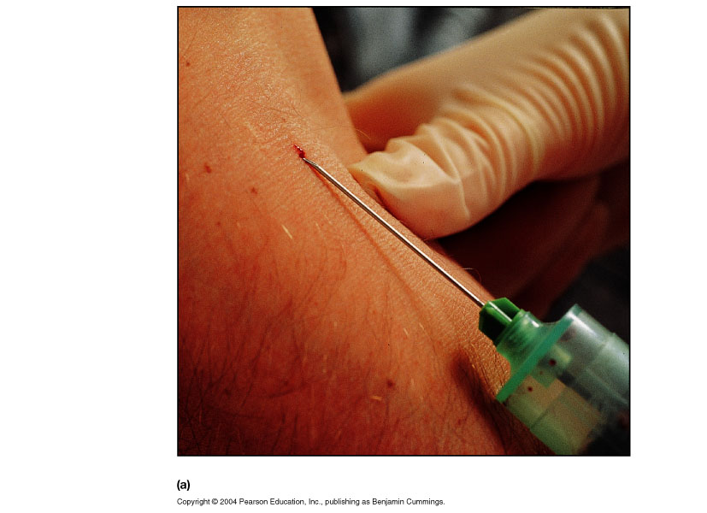
BLOOD
Provides a mechanism for rapid transport of nutrients, waste products, respiratory gases and cells
Powered by the pumping action of the heart

Slide 3
FUNCTIONS OF BLOOD
Transportation → the blood transports dissolved gases, nutrients, hormones and metabolic wastes.
Protection → the blood restricts fluid losses through damaged vessels. Platelets in the blood and clotting proteins minimize blood loss when a blood vessel is damaged.
Regulation
  Blood regulates the pH and electrolyte composition of the interstitial fluids.
  Blood regulates body temperature.

Slide 4
COMPOSITION OF BLOOD
Contains cellular and liquid components
A specialized connective tissue
  Blood cells – formed elements
  Plasma – fluid portion and fibrinogen
Blood volume
  Males: 5 – 6 liters
  Females: 4 – 5 liters
The pH of blood is about 7.35-7.45

Slide 5
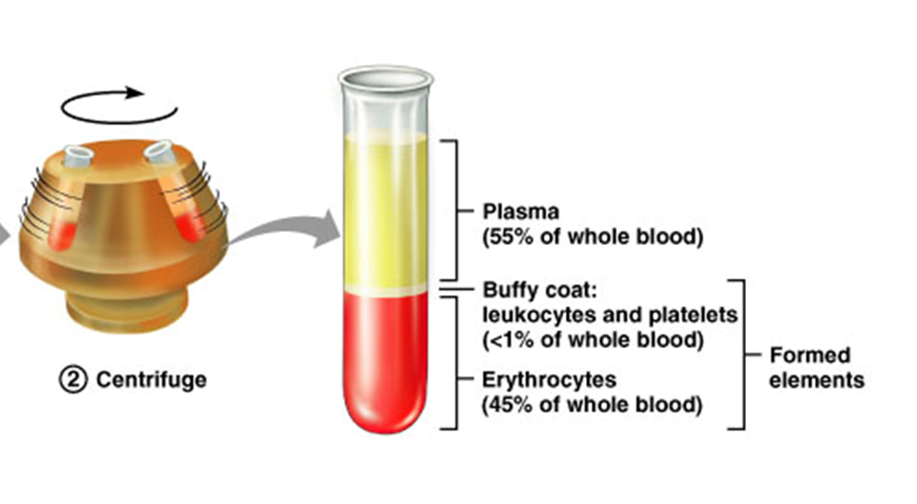
BLOOD CENTRIFUGATION
Spinning at an angle
  Centrifugal force separates the blood elements
  Three layers
    Plasma layer
    Buffy coat (leucocytes)
    Erythrocyte layer

Slide 6
FORMED ELEMENTS
Blood cells
  Erythrocytes, leukocytes, and platelets
Staining of blood cells
  Acidic dye – eosin – stains pink
  Basic dye – methylene blue – stains blue and purple

Slide 7
BLOOD PLASMA
Straw-colored, sticky fluid portion of blood
Approximately 90% water
Contains:
  Ions → Na+ and Cl-
  Nutrients → sugars, amino acids, lipids, cholesterol, vitamins and trace elements
  Three main proteins → Albumin (60%), globulin (35%), fibrinogen (4%)
  Dissolved Gasses → including O2 and CO2
  Waste Products → other protein wastes such as urea and bilirubin

Slide 8
BLOOD PLASMA
Plasma proteins:
  Constitute 7-9% of plasma.
    Albumin:
      Accounts for 60-80% of plasma proteins.
      Provides the colloid osmotic pressure needed to draw H₂0 from interstitial fluid to capillaries.
        Maintains blood pressure.

Slide 9
BLOOD PLASMA
Plasma proteins:
  Globulins:
    α globulin:
      Transport lipids and fat soluble vitamins.
    β globulin:
      Transport lipids and fat soluble vitamins.
    γ globulin:
      Antibodies that function in immunity.

Slide 10
BLOOD PLASMA
Fibrinogen:
  Constitutes 4% of plasma proteins.
  Important clotting factor.
    Converted into fibrin during the clotting process.

Slide 11
BLOOD PLASMA
Serum:
  Fluid from clotted blood.
    Does not contain fibrinogen.
Plasma volume:
  Number of regulatory mechanisms in the body maintain homeostasis of plasma volume.
    Osmoreceptors.
    ADH.
    Renin-angiotensin-aldosterone system.

Slide 12
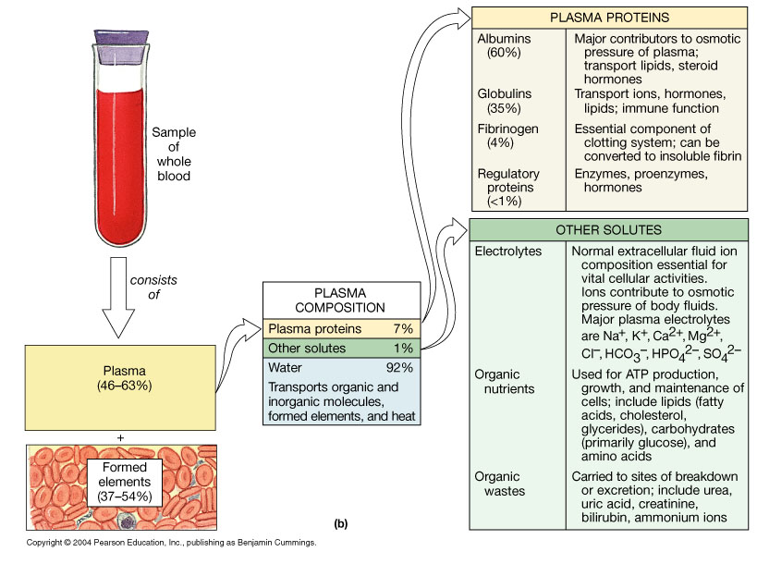
Figure 19.1b

Slide 13
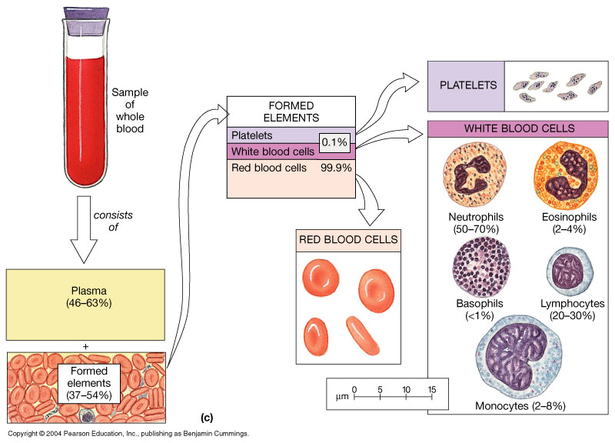
Figure 19.1c

Slide 14
ERYTHROCYTES – RED BLOOD CELLS (RBCS)
Oxygen-transporting cells
  7.5 µm in diameter (diameter of capillary 8 – 10µm)
Most numerous of the formed elements
  Females: 4.3 – 5.2 million cells/cubic millimeter
  Males: 5.2 – 5.8 million cells/cubic millimeter
Made in the red bone marrow in long bones, cranial bones, ribs, sternum, and vertebrae
Average lifespan 100 – 120 days

Slide 15
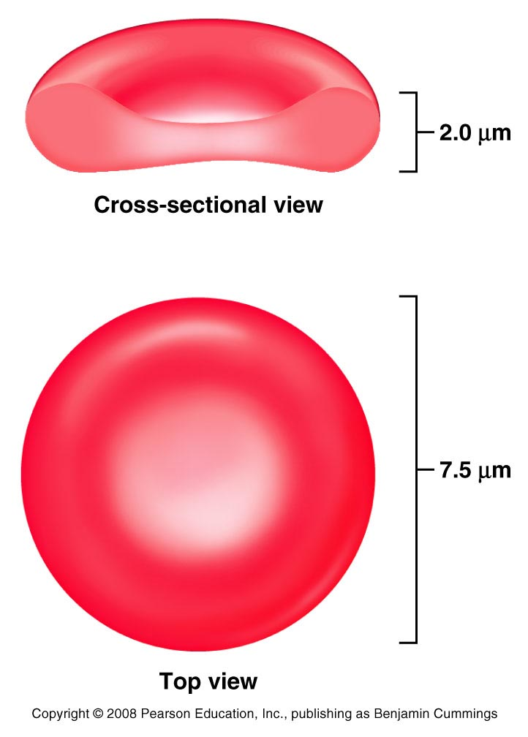
RBC Structure And Function
Have no organelles or nuclei
Hemoglobin – oxygen carrying protein
  Each RBC has about 280 million hemoglobin molecules with 4 heme chains
Biconcave shape – 30% more surface area

Slide 16
ERYTHROCYTES
Removed from circulation by phagocytic cells in liver, spleen, and bone marrow.
Red blood cells are broken down and hemoglobin is released.
The globin part of the hemoglobin is broken down into amino acid components → recycled by the body.
The iron is recovered and returned to the bone marrow to be reused.
The heme portion is excreted as bile pigment (bilirubin) by the liver.

Slide 17
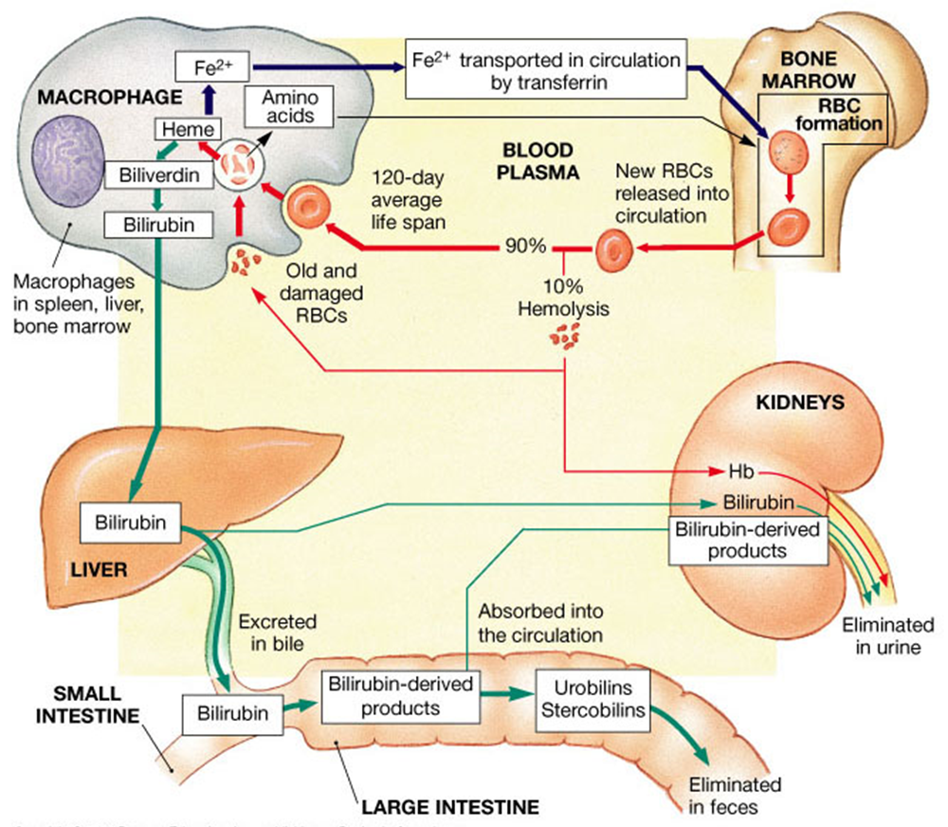

Slide 18
LEUKOCYTES – WHITE BLOOD CELLS (WBCS)
Protect the body from infectious microorganisms
4,800 – 11,000/cubic millimeter
Function outside the bloodstream in loose connective tissue
WBCs have a nucleus and mitochondria
Are larger than RBCs
Most produced in bone marrow
Lifespan of 12 hours to several years

Slide 19
LEUKOCYTES
Move in amoeboid fashion.
  Can squeeze through capillary walls (diapedesis).
Diapedesis → circulating leukocytes leave the capillaries
Almost invisible, so named after their staining properties.

Slide 20
LEUKOCYTES
  Granular leukocytes:
    Help detoxify foreign substances.
      Release heparin.
  Agranular leukocytes:
    Phagocytic.
      Produce antibodies.
Neutrophils, Eosinophils, and Basophils are granular leukocytes.
Lymphocytes and Monocytes are agranular leukocytes.

Slide 21
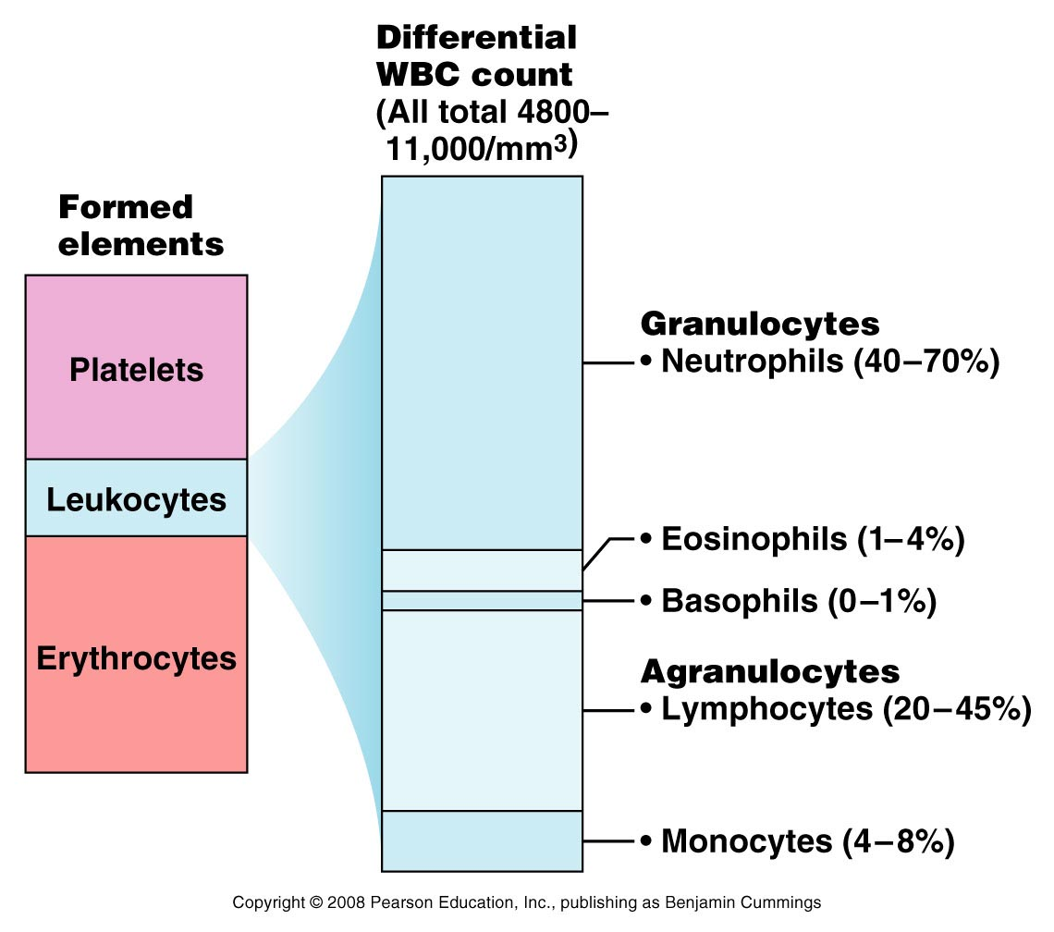
LEUKOCYTES
Differential WBC Count
  Never
  Let
  Monkeys
  Eat
  Bananas

Slide 22
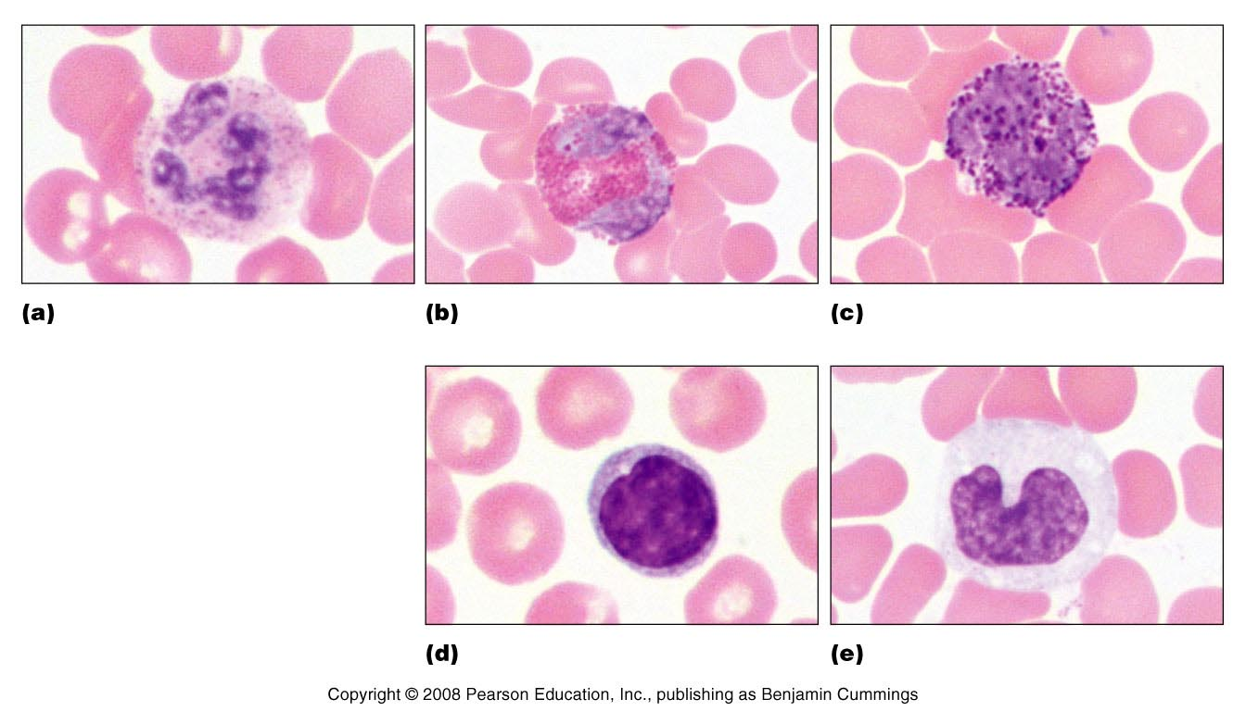
GRANULOCYTES
Neutrophils
  most numerous WBC
  Phagocytize and destroy bacteria
  Nucleus – has two to six lobes
  Granules pick up acidic and basic stains

Slide 23
GRANULOCYTES
Eosinophils
  compose 1 – 4% of all WBCs
  Play roles in ending allergic reactions, parasitic infections
Figure 17.4b

Slide 24
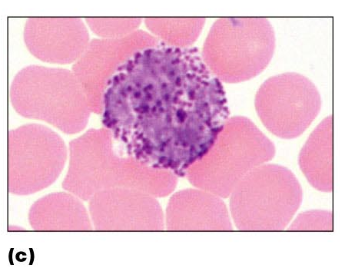
GRANULOCYTES
Basophils
  about 0.5% of all leukocytes
  Nucleus – usually two lobes
  Granules secrete histamines
  Function in inflammation mediation, similar in function to mast cells

Slide 25
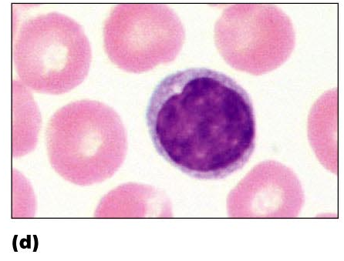
AGRANULOCYTES
Lymphocytes →compose 20 – 45% of WBCs
  The most important cells of the immune system
  Nucleus – stains dark purple
  Effective in fighting infectious organisms
  Act against a specific foreign molecule (antigen)
Two main classes of lymphocyte
  T cells – attack foreign cells directly
  B cells – multiply to become plasma cells that secrete antibodies

Slide 26
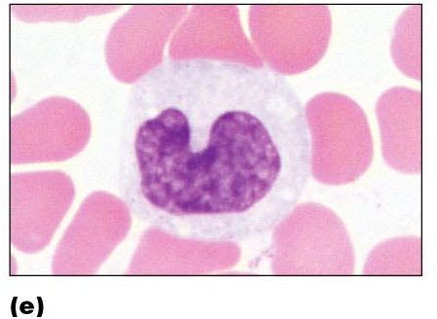
AGRANULOCYTES
Monocytes → compose 4–8% of WBCs
  The largest leukocytes
  Nucleus – kidney shaped
  Transform into macrophages
    Phagocytic cells

Slide 27
Type Of White Blood Cells | % By Volume Of WBC | Description | Function
Neutrophils | 60 – 70 % | Nucleus has many interconnected lobes; blue granules | Phagocytize and destory bacteria; most numerous WBC
Eosinophils | 2 – 4 % | Nucleus has bilobed nuclei; red or yellow granules containing digestive enzymes | Play a role in ending allergic reactions
Basophils | < 1 % | Bilobed nuclei hidden by large purple granules full of chemical mediators of inflammation | Function in inflammation medication; similar in function to mast cells
Lymphocytes (B Cells and T Cells) | 20 – 25 % | Dense, purple staining, round nucleus; little cytoplasm | the most important cells of the immune system; effective in fighting infectious organisms; act against a specific foreign molecule (antigen)
Monocytes | 4 – 8 % | Largest leukocyte; kidney shaped nucleus | Transform into macrophages; phagocytic cells

Slide 28
PLATELETS
Smallest of formed elements.
  Are fragments of megakaryocytes.
  Lack nuclei.
Capable of amoeboid movement.
Contain several clotting factors – calcium ions, ADP, serotonin
Their production is regulated by the hormone called Thrombopoietin
Function
  Involved in stopping bleeding when a blood vessel is damaged; Process is called hemostasis

Slide 29
PLATELETS
Important in blood clotting:
  Constitute most of the mass of the clot.
  Release serotonin to vasoconstrict and reduce blood flow to area.
Secrete growth factors:
  Maintain the integrity of blood vessel wall.
Survive 5-9 days.

Slide 30
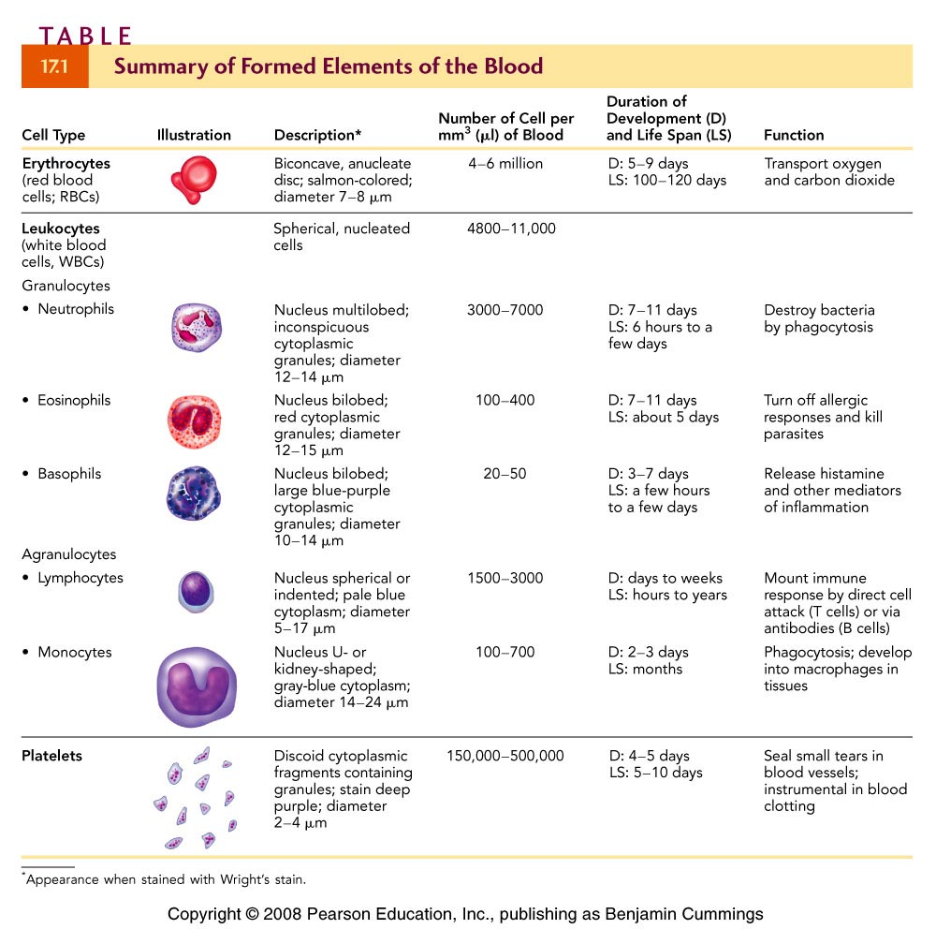

Slide 31
BLOOD CELL FORMATION
Hematopoiesis → process by which blood cells are formed
100 billion new blood cells formed each day
Takes place in the red bone marrow of the humerus, femur, sternum, ribs, vertebra and pelvis
  Red marrow → actively generates new blood cells
    Contains immature erythrocytes
    Remains in epiphyses, girdles, and axial skeleton
  Yellow marrow → dormant
    Contains many fat cells
    Located in the long bones of adults

Slide 32
HEMATOPOIESIS
  Tissue framework for red marrow
    Reticular connective tissue
All blood cells originate in bone marrow
All originate from one cell type
  Blood stem cell (pluripotential hematopoeitic stem cell)
    Lymphoid stem cells → give rise to lymphocytes
    Myeloid stem cells → give rise to all other blood cells

Slide 33
HAEMATOPOIETIC TISSUES
Myeloid tissues
  Blood forming tissues identified as the "red marrow" of bones.
  The amount and location of red marrow is different in the fetus and the adult
Lymphoid tissues
  Some lymphocytes of peripheral blood arise from proliferation within lymphoid tissues.
  Lymphoid tissues are elements of the larger lymphatic system
    Lymph nodes,
    Tonsils,
    Peyer's patches, etc

Slide 34
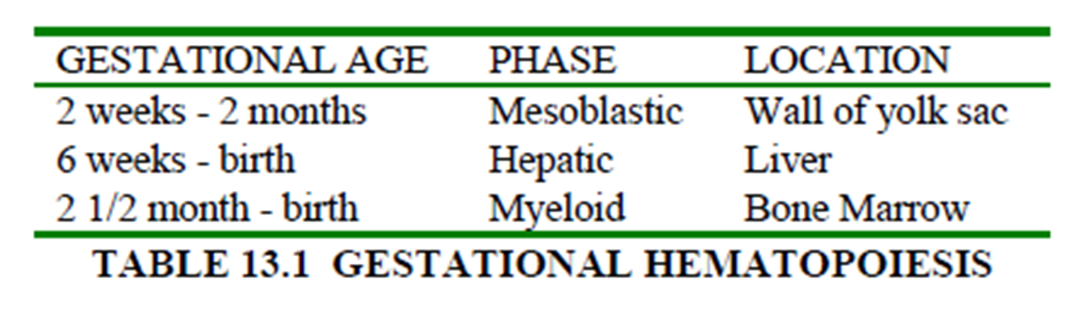

Slide 35
ERYTHROPOIESIS
Active process.
  2.5 million RBCs are produced every second.
Primary regulator is erythropoietin.
  Binds to membrane receptors of cells that will become erythroblasts.
  Erythroblasts transform into normoblasts.
  Normoblasts lose their nuclei to become reticulocytes.
  Reticulocytes change into mature RBCs.
    Stimulates cell division.

Slide 36
ERYTHROPOIESIS
Old RBCs are destroyed in spleen and liver.
  Iron recycled back to myeloid tissue to be reused in hemoglobin production.
Need iron, vitamin B₁₂ and folic acid for synthesis.

Slide 37
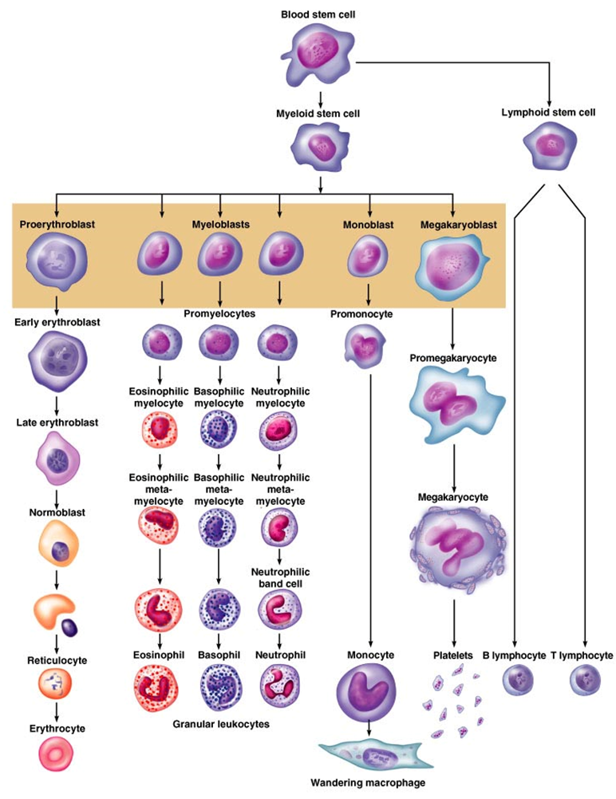

Slide 38
LEUKOPOIESIS
Cytokines stimulate different types and stages of WBC production.
Multipotent growth factor-1, interleukin-1, and interleukin-3:
  Stimulate development of different types of WBC cells.
Granulocyte-colony stimulating factor (G-CSF):
  Stimulates development of neutrophils.
Granulocyte-monocyte colony stimulating factor (GM-CSF):
  Simulates development of monocytes and eosinophils.
  Granulocytes form from myeloblasts
  Monoblasts enlarge and form monocytes

Slide 39
LEUKOPOIESIS
Lymphopoiesis→ Formation and differentiation of lymphocytes→ Common lymphoid progenitor (CLP)→ Differentiates into Lymphoblast→ Develops into Prolymphoblast→ Contains cell markers for T cells and B cells
T lymphocytes
  Formed in bone marrow
  Migrate to thymus to mature
    Antigen free environment
B lymphocytes
  Formed and mature in bone marrow and spleen
  Move to peripheral lymphoid tissue
    For antigen recognition

Slide 40


Slide 41
THROMBOPOIESIS
Process of formation of platelets.
  Megakaryoblast
    Large cell with a big nucleus
    Situated close to sinuses
    Differentiates into
  Promegakaryocyte
    Larger than a megakaryoblast
    Contains a voluminous polyploid nucleus
    Develops platelet demarcation channels

Slide 42
THROMBOPOIESIS
Megakaryocyte
  A giant cell with a large polyploid nucleus
  Platelet demarcation channels very distinct.
  A massive protrusion of the cell penetrates a sinus and fragments into platelets
Thrombocyte
  The final end product which circulates in the peripheral blood.
  Responsible for primary hemostasis (clot formation)
Control of thrombopoiesis
  Thrombopoietin
    Serum glycoprotein
    Stimulates megakaryocytes and platelet production

Slide 43
FACTORS AFFECTING HAEMATOPOIESIS
Infection
Hemorrhage
Tumors
Hormonal factors
Nutritional factors
Other factors may induce increases or decreases in the level of hematopoiesis in one or more of the blood cell lines.
Several growth factors and other products affect the proliferation and differentiation of hematopoietic cells.

Slide 44
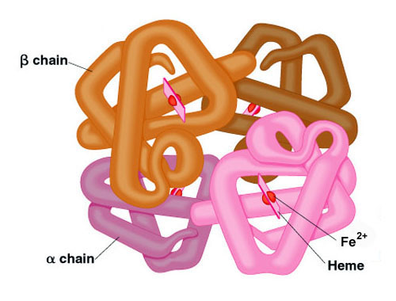
HEMOGLOBIN
Red pigment molecule which gives RBCs (and blood) its color
Contains
    Quaternary structure
  4 molecules of heme
    Porphyrin + iron (Ferrous – F²⁺)
  4 of globin
    2 alpha chains
    2 beta chains
Each molecule of heme contains one iron ion
  Binding site for oxygen
1 RBC contains 280 million hemoglobin molecules

Slide 45
HEMOGLOBIN
Synthesis
  Majority synthesized at the polychromatophilic normoblast stage
Regulation
  Stimulated by tissue hypoxia
  Hypoxia causes the kidneys to increase production of EPO, which increases RBC and hemoglobin production
Function
  Carry oxygen from the lungs to the tissues
  Remove CO₂
  Buffering action, maintains blood pH as it changes from oxyhemoglobin (carrying O₂) to deoxyhemoglobin ( without O₂)

Slide 46
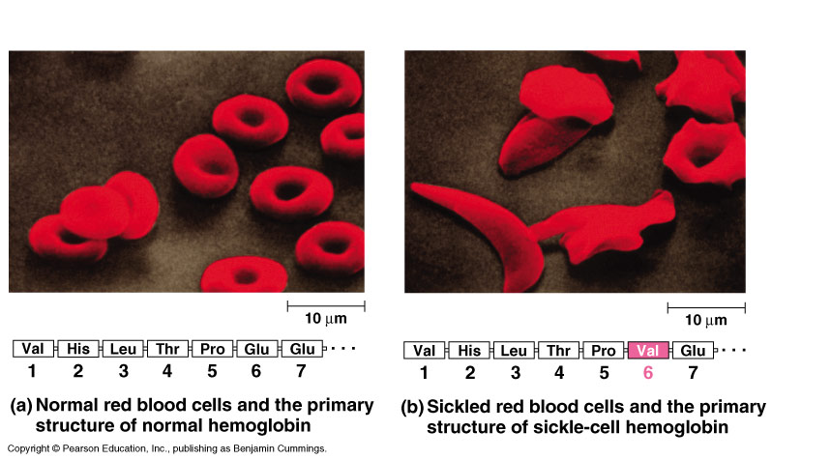
HEMOGLOBINOPATHIES: ABNORMAL HEMOGLOBIN
Sickle cell anemia (Hb S disease):
  Genetic disorder
  Mutation in β-globin
    The mutation occurs in 6th position of β-chain
    Glutamic acid is replaced by valine
  RBCs assume sickle-shaped leading
    Fragile walls
    High rate of hemolysis.

Slide 47
HEMOGLOBINOPATHIES: ABNORMAL HEMOGLOBIN
Thalassemia:
  A group of genetic diseases
  Defect in the rate of synthesis of one or more of Hb chains, but the chains are structurally normal.
  This is due to a defect or absence of one or more of genes responsible for synthesis of α or β chains leading to premature death of RBCs.
Hydrops fetalis:
  When all α globin genes are defective.
  Causes fetal death because α globin chains are required for synthesis of Hb F.

Slide 48
NON-FUNCTIONAL HEMOGLOBIN'S
Carboxyhemoglobin
  Oxygen molecules bound to heme are replaced by carbon monoxide.
  Slightly increased levels of carboxyhemoglobin are present in heavy smokers and as a result of environmental pollution.
  Can revert to oxyhemoglobin.
Methemoglobin
  Iron in the hemoglobin molecule is in the ferric (Fe³) state instead of the ferrous (Fe²) state.
  Incapable of combining with oxygen.
  Can occur as a result of strong oxidative drugs or to an enzyme deficiency.
  Can revert to oxyhemoglobin
Sulfhemoglobin
  Hemoglobin molecule contains sulfur.
  Caused by certain sulfur-containing drugs or chronic constipation.
  Cannot revert to oxyhemoglobin and may cause death.

Slide 49
RED CELL INDICES
Hematocrit (HCT) is the percent of a volume of whole blood occupied by intact red blood cells. Measured in percent.
  Normal range for women: 36 - 46%
  Normal range for men: 41 - 53%
Hemoglobin (HGB) measures the concentration of hemoglobin expressed as grams of hemoglobin per deciliter (100 ml) of whole blood.
  Normal range for women: 12 - 16 g/dL
  Normal range for men: 13.5 - 17.5 g/dL

Slide 50
RED CELL INDICES
RBC count is the number of red blood cells per microliter of whole blood. Measured in millions of RBCs per microliter of whole blood.
  Normal range for women: 4.0 - 5.2 x10⁶/mm³
  Normal range for men: 4.5 - 5.9 x10⁶/mm³
Mean Corpuscular Volume (MCV) is the average size of red blood cells.
  Normal range: 80-100 fL (femtolitre)
  Low = “microcytic” (“too small”) High = “macrocytic” (“too big”)
  Normal = “normocytic” (“just right”)

Slide 51
RED CELL INDICES
Red Cell Distribution Width (RDW) measures the variability in the size of red blood cells.
  Normal range: 11.5-14.5%
  On a peripheral blood smear, high RDW is described as “anisocytosis”
Mean Corpuscular Hemoglobin (MCH) is the amount of hemoglobin in an average red blood cell.
  Normal range: 26-34 pg/cell (picograms)
Mean Corpuscular Hemoglobin Concentration (MCHC) is the average concentration of hemoglobin in an average RBC.
  Normal range: 31-37 g/dL
  “Hypochromic” = “too pale” “Normochromic” = “just right”

Slide 52
RED CELL INDICES
Mean Corpuscular Volume (MCV) is the average size of red blood cells.
  If anemia is present, MCV is a useful tool to guide further testing
  If anemia is not present, MCV is of little value:
    Low MCV without anemia suggests thalassemia minor (trait)
    High MCV without anemia can be caused by certain medications (Dilantin, oral contraceptives, methotrexate) and is a “soft” marker of possible alcohol overuse
Red Cell Distribution Width (RDW) measures the variability in the size of red blood cells.
  Not useful in the absence of anemia

Slide 53
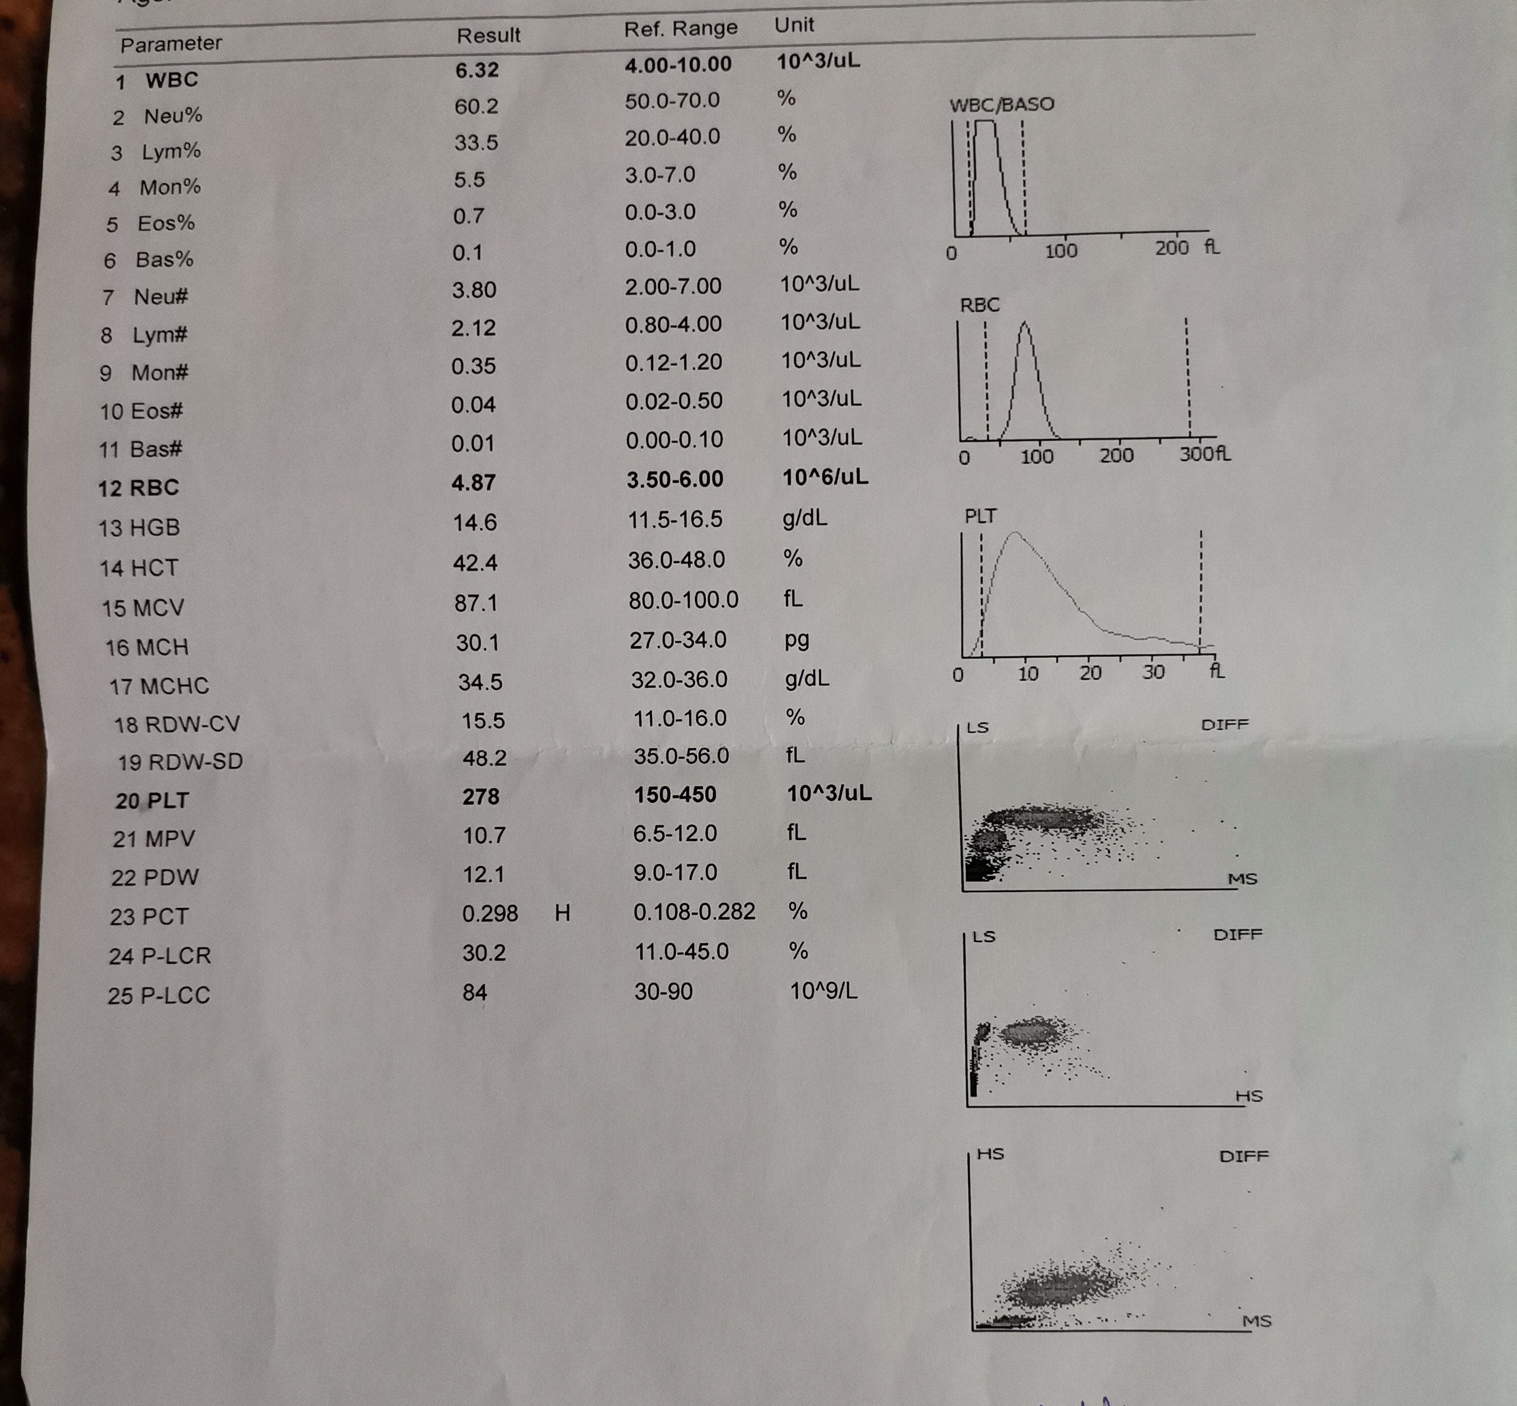

Slide 54
BLOOD GROUPS: ABO BLOOD GROUPING
Blood group antigens are actually sugars attached to the red blood cell.
Antigens are “built” onto the red cell.
Individuals inherit a gene which codes for specific sugar(s) to be added to the red cell.
The type of sugar added determines the blood group.

Slide 55
LANDSTEINER’S RULE
Individual’s will form immune antibodies to ABO blood group antigens they do not possess.
Substances are present in nature which are so similar to blood group antigens which result in the constant production of antibodies to blood group antigens they do not possess.
Critical for understanding compatibility between ABO blood groups

Slide 56
ANTIBODY CLINICAL SIGNIFICANCE
Immunizations are frequently done to protect us from disease.
  Hepatitis B immunization.
    Actual bits of hepatitis virus injected.
    Body recognizes as foreign and produces an immune antibody.
    Subsequent exposure to real Hepatitis B virus will result in destruction of the virus by immune antibodies.
ABO antibodies are immune and will result in destroying incompatible cells which may result in the death of the recipient.

Slide 57
INHERITANCE
Blood group antigens are “codominant”, if the gene is inherited, it will be expressed.
Some aberrant genotypes do occur but due to the rarity will not be discussed.
Understanding of basic inheritance important.

Slide 58
GENETICS
Two genes inherited, one from each parent.
Individual who is A or B may be homozygous or heterozygous for the antigen.
Heterozygous: AO or BO
Homozygous: AA or BB
Phenotype is the actual expression of the genotype, ie, group A
Genotype are the actual inherited genes which can only be determined by family studies, ie, AO.

Slide 59
EXAMPLES
Mom | Dad | Offspring Blood Group
AA | BB | 100% AB
BO | OO | 50% each of B or O
OO | OO | 100% O
OO | AO | 50% each of A or O

Slide 60
GROUP O
Approximately 45% of the population is group O.
No A or B antigens present, think of as “0” antigens present.
These individuals form potent anti-A and anti-B antibodies which circulate in the blood plasma at all times.
Universal Donors

Slide 61
GROUP A
Approximately 40% of the population is group A.
No B antigens present.
These individuals form potent anti-B antibodies which circulate in the blood plasma at all times.

Slide 62
GROUP B
Approximately 11% of the population is group B.
No A antigens present.
These individuals form potent anti-A antibodies which circulate in the blood plasma at all times.

Slide 63
GROUP AB
Approximately 4% of the population is group AB.
Both A and B antigens present.
These individuals possess no ABO antibodies.
Universal Recipients

Slide 64
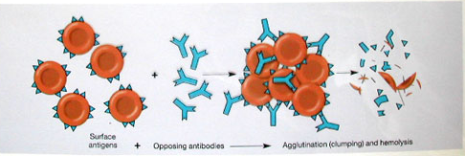
HEMOLYSIS
If an individual is transfused with an incompatible blood group destruction of the red blood cells will occur.
This may result in the death of the recipient.

Slide 65
Rh (D) ANTIGEN
Rh refers to the presence or absence of the D antigen on the red blood cell.

Slide 66
Rh (D) ANTIGEN
Unlike the ABO blood group system, individuals who lack the D antigen do not naturally make it.
Production of antibody to D requires exposure to the antigen.
The D antigen is very immunogenic, ie, individuals exposed to it will very likely make an antibody to it.
For this reason all individuals are typed for D, if negative must receive Rh (D) negative blood.

Slide 67
Rh (D) ANTIGEN
The most important patient population to consider is females of child-bearing age.
If immunized to Rh (D) antigen the antibody can cross the placenta and destroy Rh (D) positive fetal cells resulting in death.
This is why Rh negative women are given Rhogam after birth of Rh positive baby.

Slide 68
BLOOD TRANSFUSIONS
A blood transfusion is a procedure in which blood is given to a patient through an intravenous (IV) line in one of the blood vessels.
Blood transfusions are done to replace blood lost during surgery or a serious injury.
A transfusion also may be done if a person’s body can't make blood properly because of an illness.

Slide 69
BLOOD TRANSFUSIONS
Who can give you blood?
People with TYPE O blood are called Universal Donors, because they can give blood to any blood type.
People with TYPE AB blood are called Universal Recipients, because they can receive any blood type.
Rh + → Can receive + or -
Rh - → Can only receive -

Slide 70
BLOOD DONORS AND RECIPIENTS
Universal donor
  O negative
Universal recipient
  AB positive
Universal Donor
O
A
B
AB
Universal Recipient

Slide 71
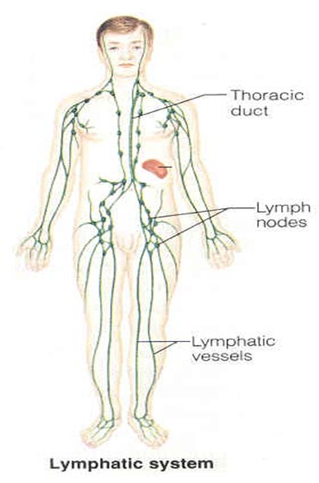
LYMPHATIC SYSTEM
overview

Slide 72
LYMPHATIC SYSTEM
This system involves a set of vessels that transports tissue fluid back into the blood stream and a set of organs that are involved in the immune system.
The lymph vessels are as branched and abundant as arteries and veins.
They collect lymph- tissue fluid arising from fluid that has leaked from the capillaries.

Slide 73
LYMPHATIC SYSTEM
Proteins also leak from capillaries and are returned to the blood system by the lymph vessels.
The lymphatic system also collect lipids from the digestive tract and is involved in exposing pathogens to the immune system.
Essentially a drainage system accessory to venous system
larger particles that escape into tissue fluid can only be removed via lymphatic system

Slide 74
COMPONENTS OF THE LYMPHATIC SYSTEM
Lymph
Lymphatic Vessels
  Lymphatic Capillaries
  Lymphatic Vessels
  Lymphatic Trunks
  Lymphatic Ducts
Lymphatic Organs
  Thymus
  Lymph Nodes
  Spleen
  Tonsils
Lymphatic cells

Slide 75
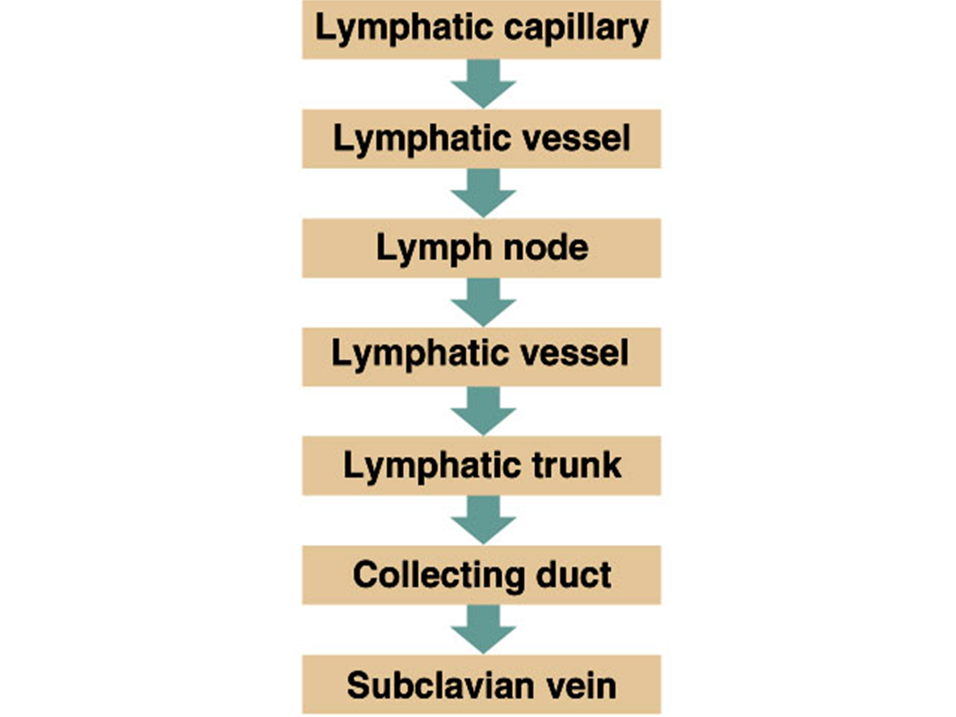

Slide 76
FUNCTIONS OF THE LYMPHATIC SYSTEM
Reabsorbs excess interstitial fluid
  returns it to the venous circulation
  maintain blood volume levels
  prevent interstitial fluid levels from rising out of control.
Transport dietary lipids
  transported through lacteals
  drain into larger lymphatic vessels
  eventually into the bloodstream.
Lymphocyte development (Hemopoiesis)
Immune response

Slide 77
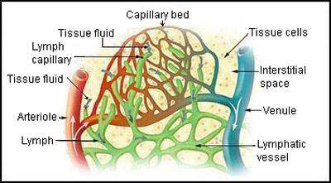

Slide 78
LYMPH
What is lymph ?
Tissue fluid (interstitial fluid) that enters the lymphatic vessels
Contains more white blood cells than plasma
Enters node through afferent lymphatic vessels
Flows through node in one direction

Slide 79
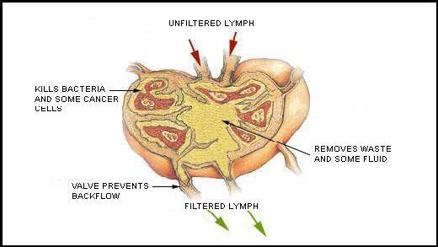

Slide 80
LYMPH
Flows through sinuses in lymph node cortex and then into the medulla
Exits the lymph node through efferent lymphatic vessels
Must be returned to blood stream to maintain blood volume and pressure

Slide 81
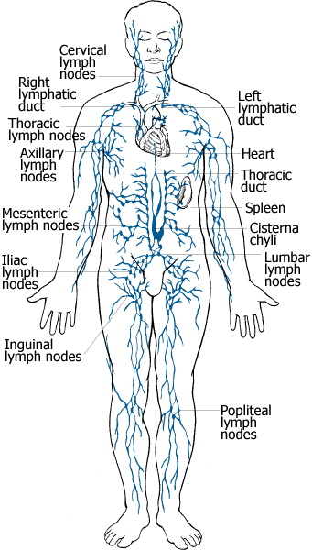

Slide 82
LYMPH CAPILLARIES
Microscopic closed-ended vessels- Blind end
Located next to blood capillaries in tissue spaces
Larger diameter than blood capillaries
Single layer of overlapping endothelial cells
Are very permeable and collect tissue fluid and proteins
More permeable than that of blood capillary
Lymph capillaries merge to form larger lymph vessels
Absent from avascular structures, brain, spinal cord splenic pulp and bone marrow

Slide 83
LYMPH CAPILLARIES
The small intestine contains special types of lymphatic capillaries called lacteals.
Lacteals pick up not only interstitial fluid, but also dietary lipids and lipid-soluble vitamins.
The lymph of this area has a milky color due to the lipid and is also called chyle.

Slide 84
LYMPH VESSELS
Three layered wall - resemble veins but have thinner walls and more valves
Ends of endothelial cells overlap
- act as one-way valves allowing interstitial fluid to flow in but not out
More numerous valves than in vein
Attached to surrounding tissue by anchoring filaments
They contain bulges making the vessel resemble a beaded string.
Arranged in superficial and deep sets

Slide 85
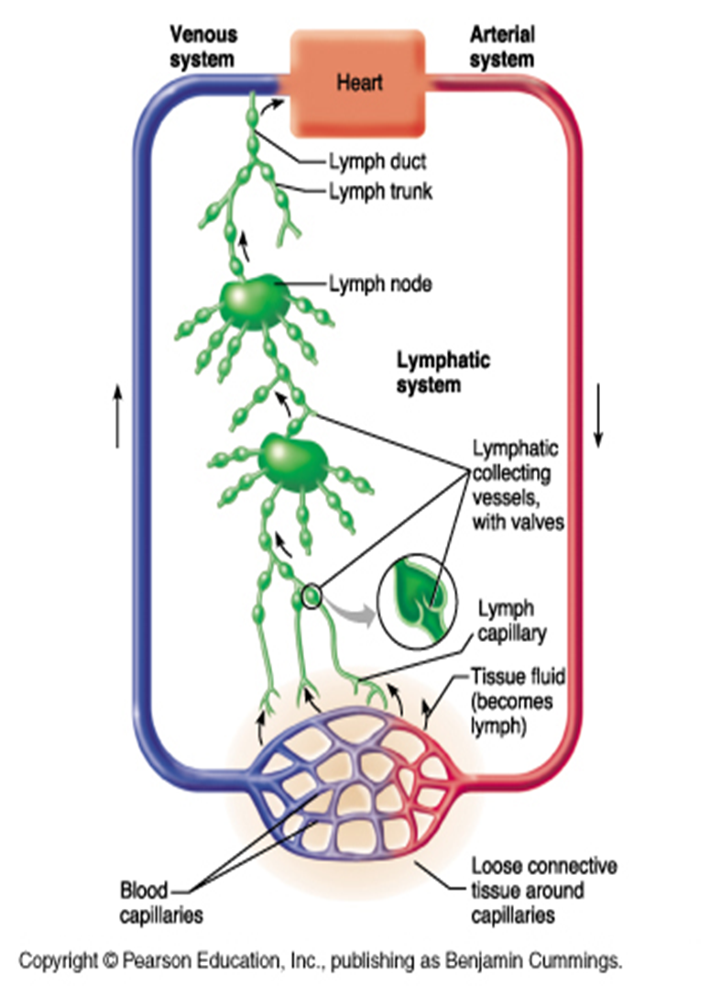

Slide 86
LYMPH VESSELS
No pump for lymph
Lymph is kept moving by:
- constriction of vessels
- skeletal muscle pump
- respiratory pump
At intervals along vessels lymph flows into lymph nodes
Lymphatic vessels unite to form lymph trunks

Slide 87
LYMPH TRUNKS
Formed by lymphatic vessels uniting
Large tubes
Empty their lymph into lymphatic ducts
They drain large areas of the body.
Five major locations are:
  right and left jugular trunks
  right and left subclavian trunks
  right and left bronchomediastinal trunks
  right and left lumbar trunks
  intestinal trunk

Slide 88
LYMPHATIC DUCTS
Lymph empties into two conducting ducts:
- the thoracic duct (left lymphatic duct)
- the right lymphatic duct
Lymph from these ducts enters the blood stream via the left subclavian vein and the right subclavian vein

Slide 89
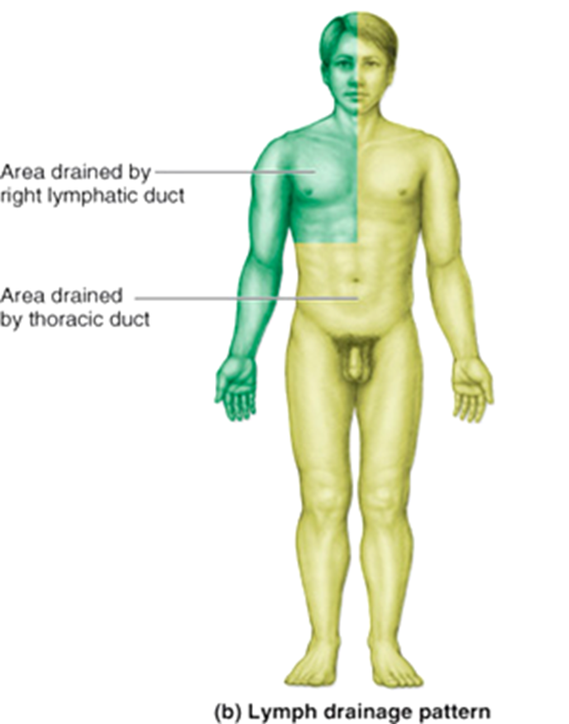

Slide 90
LYMPHATIC CELLS
Also called lymphoid cells.
Located in both the lymphatic system and the cardiovascular system.
Work together to elicit an immune response.
Types of lymphatic cells are:
  macrophages
  epithelial cells
  dendritic cells
  lymphocytes

Slide 91
LYMPHATIC ORGANS
Primary organs
Red bone marrow
Thymus gland
Secondary organs
Lymph nodes
Lymph nodules
Spleen

Slide 92
LYMPH NODES
Organs along the lymphatic collecting vessels that accumulate the pathogens carried by lymph.
This is an area highly concentrated with lymphocytes ready to activate an immune response.

Slide 93
BIOLOGICAL FILTRATION
As lymph passes through a node bacteria and other foreign materials are trapped by reticular fibers within the node
Bacteria are then phagocytized by macrophages
Plasma cells produce antibodies to antigens in the lymph
Antibodies, lymphocytes, and monocytes are eventually returned to the blood via subclavian veins

Slide 94
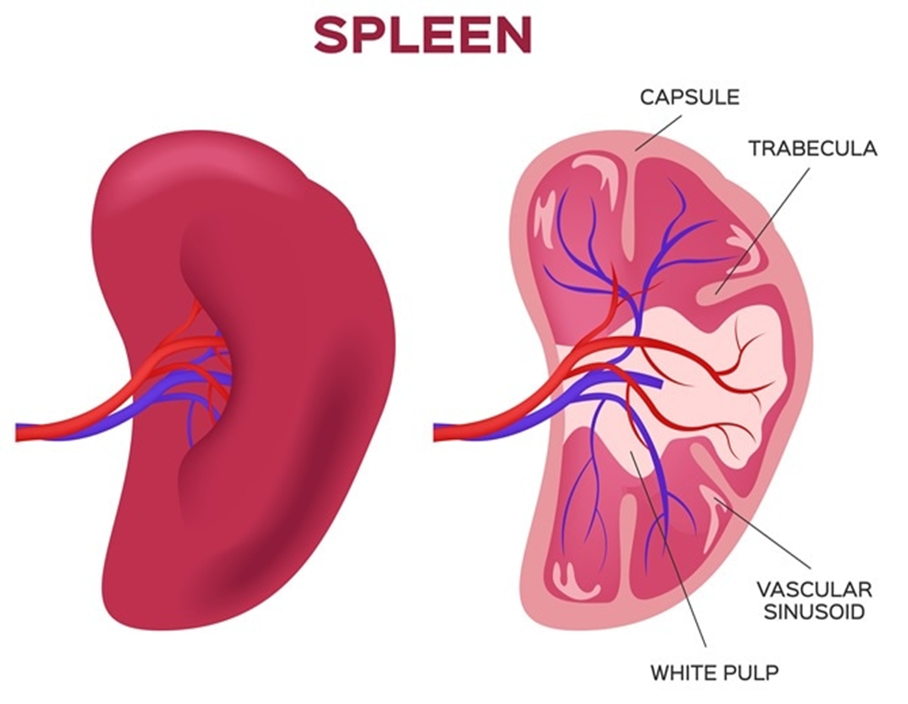
SPLEEN
Largest lymphatic organ
FUNCTIONS OF SPLEEN
Formation of RBC
Removal of unwanted elements from the blood.
Reservoir function,ie store blood.
Role in defense mechanism
Storage and metabolism of iron

Slide 95
SPLENOMEGALY
A clinically palpable spleen is called splenomegaly.
Hematological causes:
Haemolytic anaemias
Haemoglobinopathies
Leukemias
Lymphomas
Inflammations:
Rheumatoid Arthritis
Infections:
Acute: typhoid
Chronic: tuberculosis
Parasitic: malaria, kalaazar
Others:
Portal hypertension
Cancers

Slide 96
RETICULOENDOTHELIAL SYSTEM (RES)
Also known as:
  Monocyte-Macrophage System
  Mononuclear Phagocytic System
  Lymphoreticular system
Collection of cells united by the common property of phagocytosis.
It is a generalized phagocytic system located in all tissues.
Especially in those tissues where large quantities of particles, toxins, and other unwanted substances must be destroyed.

Slide 97
RETICULOENDOTHELIAL SYSTEM (RES)
System of cells which have highly phagocytic properties.
RES consists of:
  Monocytes
  Mobile (wandering) tissue macrophages
  Fixed tissue macrophages

Slide 98
MONOCYTES
Largest leucocytes.
Immature cells present in blood, with little ability to fight infectious agent.
After 72 hours they enter the tissues to become ‘tissue macrophages’.
In the tissue they swell to become large in size and cytoplasm is filled with lysosomes.

Slide 99
FUNCTIONS OF MONOCYTES
1. Enter tissue and form tissue macrophages – act as scavengers.
2. Phagocyte several bacteria. (up to 100)
3. Engulf large particulate matter, dead tissue cells and senile cells.
4. Along with macrophage involved in phagocytosis & destruction of necrotic material.
5. Co-operate with B & T lymphocyte in both Humoral & Cellular immunity.

Slide 100
WANDERING TISSUE MACROPHAGES
Monocytes leaving the blood become activated and differentiate into macrophages.
Those that have recently left the blood are sometimes referred to as wandering macrophages.
Monocyte changes during maturation:
  A. Increase in cell size
  B. Number and complexity of intracellular organelles increase→ Golgi, mitochondria, lysosomes
  C. Increase in intracellular digestive enzymes

Slide 101
FIXED TISSUE MACROPHAGES
Known by different names in different sites
Liver➔ Kupffer cells
Lungs →Alveolar macrophages
Skin→ Langerhans cells
Connective tissue→ Histiocytes
CNS→ Microglia
Bones→ Osteoclasts
Spleen/Bone marrow/Lymph nodes →Reticular or Dendritic cells

Slide 102
FUNCTIONS OF MACROPHAGES
1. Engulf inorganic particulate matter (carbon & dust particles).
2. When confronted with large insoluble particle, plenty of macrophage fuse together to become ‘Multinucleated Giant Cell’
3. Organic foreign matter such as thorn, fish bone, catgut are destroyed by enzyme action & lysis.
4. Engulf micro-organism, senile WBC, RBC, tissue debris & some parasites.
5. Help ‘T’ & ‘B’ lymphocyte in the acquired immunity by presenting antigens.

Slide 103
FUNCTIONS OF THE RES
Phagocytic Function
  Bacteria, other foreign bodies and tissue debris are engulfed and digested by the lysosomes of the macrophages.
Destruction of senile red cells.
Storage and metabolism of iron.
Formation of bile pigments.

Slide 104

THE END

