Slide 1
BLOOD TRANSFUSIONS

Slide 2
Objectives
Identify various types of blood and blood products and the reasons for their administration to a patient
Identify the risks of blood transfusion
Identify the essential steps necessary in the safe administration of blood and blood products to a patient
Discuss nursing interventions for the patient with a transfusion reaction
State indications for initiating the massive blood transfusion protocol and set up the Ranger blood warmer to correct hypothermia

Slide 4
Transfusion of blood and its products is very common medical procedure in the practice of modern medicine.
Nursing staff plays a very important role and crucial role in the blood transfusion procedure as they are called upon to procure and blood products from the blood transfusion laboratory and conduct supervise the transfusion.
Blood transfusion is the process of transferring blood or blood-based products from one person into the circulatory system of another.
Reaches patient’s blood vessels and enters the circulatory system
Blood Transfusions are relatively safe, but can be fatal if incorrectly administered
Notes:
Transfusion of the whole blood or its component such as blood cells or plasma

Slide 5
Critical points where errors occur most frequently
Patient identification.
Sampling/labeling of the pre-transfusion specimen.
Removal of blood from the blood fridge before transfusion.
Checking the identification of both the patient and the blood component at the bedside.

Slide 6
Purpose
Restore blood volume
Replace clotting factors
Improve oxygen carrying capacity
Restore blood elements that are depleted
Prevent complications
To raise the haemoglobin level
To provide antibodies

Slide 7
Indications
Replacement of blood lost during surgery, trauma or haemorrhage
The correction of anaemia as in bone marrow failure, chronic diseases, and haemoglobinophathies
The correction of deficiencies in other blood and plasma components, such as platelets or clotting factors
To prepare for invasive procedures, treat bleeding & correct clotting factor deficiencies
Preoperative or bleeding patients who require replacement of multiple plasma coagulation factors (dilutional coagulopathies)
Patients with massive transfusion who have clinically significant coagulation deficiencies
Patients on warfarin who are bleeding or need to undergo invasive procedure before Vit K could reduce effect
Patients with thrombotic thrombocytic purpura (TTP)
Patients with coagulation factor deficiencies for which no specific plasma concentrates are available

Slide 8
Patient safety goal
GETTING THE RIGHT BLOOD, TO THE RIGHT PATIENT, EVERY TIME
ABO blood system
O can only receive blood from: O A can receive blood from: A and O B can receive blood from: B and O AB can receive blood from: AB, A, B and O
Rh blood system
Rh+ can receive blood from: Rh+ and Rh- Rh- can receive blood from: Rh-
Blood Type & Rh: Mismatch leads to hemolysis

Slide 9
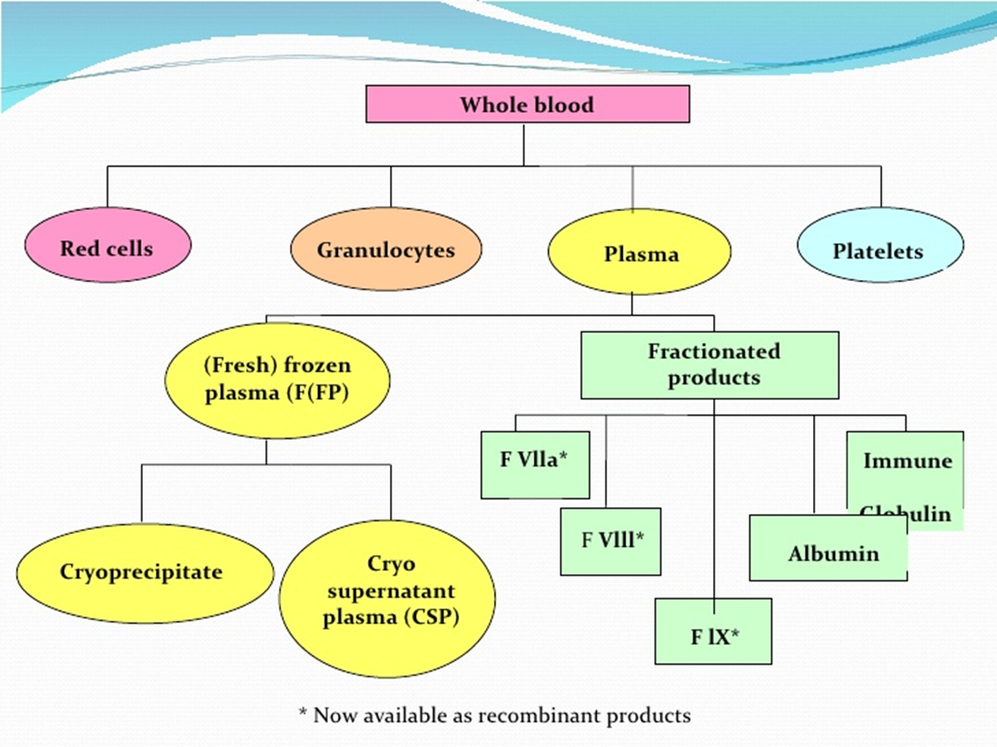
Blood Management Principles
Many types of transfusable products can be derived from one unit of whole blood

Slide 10
BLOOD PRODUCTS
Fresh Frozen Plasma (FFP) - Plasma is the liquid component of blood; it has proteins called clotting factors. Expands blood volume and provides clotting factors. Contains no RBCs . 1 unit of FFP = increases level of any clotting factor by 2-3%
Platelets - Also known as thrombocytes. Tiny cell structures necessary in blood clotting process. Replaces platelets in clients with bleeding disorders, or platelet deficiency. 1 unit = increases the average adult client’s platelet count by about 5,000 platelets/microliter
Whole Blood - Not commonly used except for extreme cases of acute hemorrhage. Replaces blood volume and all blood products
Autologous Red Blood Cells - Used for blood replacement following planned elective surgery. Must be donated 4-5 weeks prior to surgery
Albumin and Plasma Protein Fraction - Blood volume expander. Provides plasma protein
Clotting Factors and Cryoprecipitate - A portion of plasma containing certain specific clotting factors. Used for clients with clotting factor deficiencies. Contains Fibrinogen

Slide 11
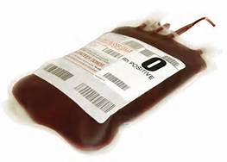
RBCs
RBCs: Packed, washed, irradiated
Indication: To increase the oxygen-carrying capacity in anemic patients. Used for volume and hemodynamic stability in actively bleeding patients.
Must be ABO compatible
70% Hct in pRBC compared to 40% Hct in whole blood
Transfusion trigger: Hgb 7, or case specific with Hgb 7-10 in patients with ischemic heart disease
Each unit increases Hgb by 1 gram/dl and increases hematocrit by 3%
Transfusion rate is per patient’s tolerance, less than 4 hours, with blood-y transfusion filter.
“RBC transfusion is indicated only for symptomatic anemia or a critical oxygen-carrying deficit”

Slide 12
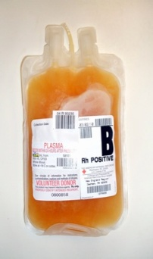
Fresh Frozen Plasma (FFP)
FFP
Plasma
Indications
Reverse effects of Coumadin- If time allows use Vit. K first (6-8 hours)
Additional Information
FFP is stored in frozen state for up to 1 year-thawed in water bath
Use standard blood filter, prime with NS
Water- 92%
Vital Proteins - 7 % (Albumin, gamma globulins, AHF, & other clotting factors)
Mineral salts
Sugar
Hormones
Fat
Vitamins
Massive blood transfusions
Coagulation factor deficiencies for which no specific plasma concentrate exists
Management of bleeding patients with DIC & liver disease
Treat bleeding & correct clotting factor deficiencies
Do not use for volume expansion when blood volume can be replaced safely with other volume expanders (NS)
Must be ABO compatible, but not Rh compatible
Type AB-positive plasma can be transfused to patients of all blood types
1%
Lab to monitor:
PT/INR
Notes:
Indications: To prepare for invasive procedures, treat bleeding & correct clotting factor deficiencies
Preoperative or bleeding patients who require replacement of multiple plasma coagulation factors (dilutional coagulopathies)
Patients with massive transfusion who have clinically significant coagulation deficiencies
Patients on warfarin who are bleeding or need to undergo invasive procedure before Vit K could reduce effect
Patients with thrombotic thrombocytic purpura (TTP)
Patients with coagulation factor deficiencies for which no specific plasma concentrates are available

Slide 13
FFP Compatibility Chart
Plasma has ABO antibodies, so must be ABO compatible with recipient
DONOR
Good for all blood types
R
E
C
I
P
I
E
N
T
 | A | B | AB | O
A
B
AB
0
Rh Compatibility: Not an issue. Plasma products have no RBCs.

Slide 14
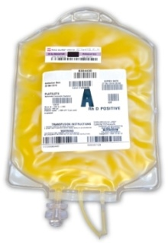
Platelets
Platelets
Indications
Additional Information
Compatibility testing is not necessary. May transfuse pt. with any type of blood group. Exception: Should be ABO compatible with recipient in infants or with large volumes of transfusion.
For actively bleeding patients with thrombocytopenia.
Prevention of spontaneous bleeding
Usual adult dose is 4-8 units.
Start slow, then transfuse as fast as tolerated, must be less than 4 hrs.
Lifespan of transfused platelets = 3-4 days
Platelets are transfused in preparation for invasive procedures
Massive blood loss (1:1:1 ratio) RBCS, FFP, Platelets
Goal: Transfuse immediately to keep platelet levels above 50,000 in most bleeding situations and 100,000 in patients with DIC or CNS bleeding.
Use NEW standard blood tubing for transfusion
Leukocyte Reduced Platelets
Pooled Platelets (6 pack)
Single Donor Platelets (Apheresis) = 6 units
Platelets
Platelets are stored at room temperature= increased chance for bacterial growth
Normal platelet count=150,000-400,000
Notes:
Platelets are frequently the culprit. That's because platelets are stored at 68? – 75? F (20? – 24? C), a temperature warm enough to foster bacterial growth.5,9 For this reason, the Blood Banks' standards now require blood banks to check platelets for bacteria before releasing them for transfusion - The color of platelets should be yellow to light strawberry. There should be no visible clumps. Platelets should not be transfused in same filter after RBCs transfusion. Platelets can become trapped in the red blood cell debris left in filter. Microaggregate filters can filter out platelets, making the transfusion ineffective.
Pooled platelets — A single unit of platelets can be isolated from every unit of donated blood, by centrifuging the blood within the closed collection system to separate the platelets from the red blood cells (RBC). The number of platelets per unit varies according to the platelet count of the donor; a yield of 7 x 10¹⁰ platelets is typical [1]. Since this number is inadequate to raise the platelet count in an adult recipient, four to six units are pooled to allow transfusion of 3 to 4 x 10¹¹ platelets per transfusion [2]. These are called whole blood-derived or random donor pooled platelets. Advantages of pooled platelets include lower cost and ease of collection and processing (a separate donation procedure and pheresis equipment are not required). The major disadvantage is recipient exposure to multiple donors in a single transfusion and logistic issues related to bacterial testing.
Apheresis (single donor) platelets — Platelets can also be collected from volunteer donors in the blood bank, in a one- to two-hour pheresis procedure. Platelets and some white blood cells are removed, and red blood cells and plasma are returned to the donor. A typical apheresis platelet unit provides the equivalent of six or more units of platelets from whole blood (ie, 3 to 6 x 10¹¹ platelets) [2]. In larger donors with high platelet counts, up to three units can be collected in one session. These are called apheresis or single donor platelets. Advantages of single donor platelets are exposure of the recipient to a single donor rather than multiple donors, and the ability to match donor and recipient characteristics such as HLA type, cytomegalovirus (CMV) status, and blood type for certain recipients. (See 'Ordering platelets' below.) Issues related to the effects of platelet pheresis on the donor are covered elsewhere. (See "Procedures used for blood donor screening: Protection of potential blood donors and recipients", section on 'Apheresis platelet donors'.)
Both pooled and apheresis platelets are contaminated with some white blood cells (WBC) that were collected along with the platelets. These WBC can cause febrile non-hemolytic transfusion reactions (FNHTR), alloimmunization, and transfusion-associated graft-versus-host disease (ta-GVHD) in some patients. (Uptodate)

Slide 15
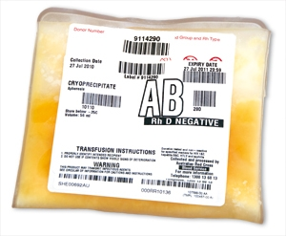
Cryoprecipitate
Cryoprecipitate contains blood clotting proteins:
FFP is thawed and a precipitate is removed from the top - this is cryoprecipitate. Contains von Willebrand factor, factor VIII, XIII, fibrinogen, and fibronectin
One unit of cryoprecipitate will increase fibrinogen concentration by 50mg/dL
Indications:
Patients with von Willebrand’s Dz unresponsive to Desmopressin
Bleeding patients with vWD
Bleeding patients with fibrinogen levels < 80-100mg/dL
Hemophilia A
Administer rapidly through a standard blood filter
ABO compatibility preferred
Fibrinogen: 150-400 mg/dL
Fibrinogen is vital to blood clotting.
Notes:
Fibrinogen: 150-400 mg/dL

Slide 16
GENERAL INSTRUCTIONS FOR GIVING BLOOD TRANSFUSIONS
Donors;
Donor shall be free of diseases
No history of any diseases
They have not donated blood within the previous 90 days. (3 months).
They should be physically healthy, and should be between 18 and 65 years.
Donor must have a normal temperature, pulse and blood pressure.
They must not have been pregnant within the last 6 months.
Their haemoglobin level must be above 12 grams per 100ml.
The donors are disqualified who have a history of recent dental surgery or major surgery, receipt of blood or blood components, immunizations or vaccinations, use of narcotics etc.

Slide 17
Before the blood transfusion, the ABO grouping and Rh typing with the recipient’s blood should be done
Before the blood is transfused, the donor’s blood must be cross matched with the recipient’s serum (plasma) and the recipient’s red blood cells
Explain the procedure to the donor and reassure him/her to with confidence and co-operation.
Blood should not be collected to the empty stomach.
Before the donor is allowed to leave the hospital, his pulse rate should be questioned as to have any giddiness.
A second withdrawal of blood should not be made until the blood volume and constitutes have returned to normal, that is usually after 3 months.

Slide 18
COLLECTION, STORAGE AND TRANSPORTATION OF BLOOD
Collection of blood from the donor is done in the laboratory by the laboratory techniques. The donor’s blood collected into a sterile container containing anticoagulant solution. The anticoagulant used is ACD solution (acid citrate dextrose) or citrate phosphate dextrose.
All the articles used for the collection of blood should sterile. They should be pyrogen free.
Each donor unit must labeled in clear, readable letters, bearing the following information to be verified at the time of administration:
Name of the donor, Donor number, ABO grouping, Rh typing, Date of drawing blood, Date of expiry, Results of tests for hepatitis and syphilis

Slide 19
The donor blood, immediately after it is withdrawn, should be placed in the refrigerator. Usually it is stored temperature of 1 to 6 degree centigrade.
Stored blood shall be inspected daily and before use evidence of hemolysis or bacterial contamination.
The transportation of the blood in the hospital should be done within 30 minutes after it is taken from the place of storage.
Freezing and heating of the blood will destroy the blood cells.

Slide 20
REGARDING ADMINSTRATION OF BLOOD TO THE RECIPIENT
When sending the recipient blood sample for grouping and cross matching, it must be carefully labeled at the bedside of the recipient
A request from should accompany the specimen and it should contain the following data :
The recipient’s name , Hospital number , Bed number , Ward number, Name of the physician, Exact amount of blood component requested, Diagnosis of the patient, Any blood transfusion given earlier,

Slide 21
It is essential that the physician writes all orders for typing, cross matching and administration of whole blood and blood products.
When blood or blood products have to be administered, it is recommended that two registered nurse or a physician and a registered nurse should independently verify all identifying information on the report of the cross match, unit label and patient’s identifications.
Any error in the identification, results in the major adverse reactions. Should there be any discrepancy, the unit should be returned to the blood bank with the remarks.

Slide 22
Whole blood and the blood products should be administered through an appropriate, sterile, pyrogen free transfusion set containing a filter which will remove clots and larger aggregates of leucocytes and platelets.
Care is to be taken to prevent introduction of air into the apparatus.
It is recommended to use 18 gauge needle for infusion, to prevent damage to the red cells and provide an adequate rate of flow.
No medication- antibiotics, vitamins, calcium, etc. should be added to the unit of blood or administered through the same intravenous system as they may cause damage to the red cells.
If I.V infusion is to be given immediately before, during or after the blood transfusion, always use physiologic saline to prevent haemolysis of the blood in the tubing. Dextrose should be avoided. If another I.V. fluid is to be given, rinse the infusion set with normal saline before starting the solution

Slide 23
Prior to administer of blood, the patient’s vital signs should be recorded correctly on the nurse’s record to provide a baseline for further observation.
Adjust the rate of flow to 5 to 10 ml per minute during the first 30 minutes of transfusion, to detect any complication as early as possible. Give the blood at a slower rate if the patient is elderly, suffering from heart disease and lung disease, anemia, debilitating diseases etc.
Whole blood and packed cells administered cold. No attempt is made to heat the blood. However, blood may be allowed to stand at the room temperature for 30 to 45 minutes before it is administered to the patient.
Once the blood is exposed to the atmosphere ( the unit is opened), it should be discarded.
The procedure involved in administration of the blood is the same as that of administration of I.V. infusions. Watch the patient carefully for the onset of any complications. Any reaction developed in the patient should be reported to the charge nurse and physician immediately.

Slide 24
The following observation are made throughout the procedure :
Rate of flow , Signs of circulatory overloaded , Urinary output
The needle site of signs of infiltration, hematoma, and dislodgement of needle etc.
Blood level in the container, Never allow the blood bottle to be completely empty to prevent the entry of air , Reaction to the blood transfusion , Patency of the infusion set

Slide 25
Keep the patient warm and comfortable with blankets if necessary.
Offer bedpan before starting the procedure and as necessary.
Record on the nurse’s record with date and time:
The amount of blood administered , The group and the type of blood administered , The rate of flow , Any reaction observed , Any medication administered e.g., antihistamines.
When leaving the ward, the charge nurse should report the following to the relieving nurse;
The name and the bed number of the patient receiving the blood transfusions, The time at which the drip has started, The type of blood that is given, Amount of blood that is administered and the quantity to be given more , Any specific precautions to be followed, The specific rate of flow  Any reactions observed, Any medications administered , General condition of the patient

Slide 26
What is a Blood Transfusion Reaction?
Any major change in a patient’s condition during and/or after a blood product transfusion. Changes warrant investigation…
SOB
Fever
HIves
Chest pain
Chills
Back pain
Tachycardia
Rash
hypotension
Notes:
Untoward effects of blood transfusion are not unexpected and in many cases are benign. However, some reactions cause serious morbidity and may be fatal [1]. The problem is that the initial symptoms of reactions with serious or relatively benign consequences are often similar. (UptoDate)
Most transfusion reactions are diagnosed by exclusion; thus, any significant change in a patient's condition during transfusion should prompt an investigation. Successful investigation of a transfusion reaction depends on detailed observation, documentation and reporting of the patient's vital signs, before and after the transfusion, and the signs and symptoms that prompted the investigation. (What every physician should know about a blood transfusion)

Slide 27
IMMEDIATE IMMUNOLOGIC
TRANSFUSION REACTIONS
Acute hemolytic transfusion reaction (AHTR)
Febrile non-hemolytic transfusion reaction (FNHTR)
Allergic reaction
Anaphylactic reaction
Transfusion related acute lung injury (TRALI)
AHTR
FNHTR
Anaphylactic Reaction
Allergic Reaction
TRALI

Slide 28
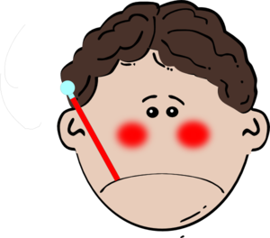
Febrile Non Hemolytic Reactions
Most common transfusion reaction:
Fever
Chills
Rigors
Mild dyspnea
Anxiety
2 degree F unexplained rise in baseline temperature during or shortly after the transfusion
Platelets are often the culprit and leukocytes
Often caused by cytokines produced during blood collection and storage
**Stop the transfusion. Rule out sepsis & hemolytic reaction
Treatment: Treat the symptoms (Tylenol & Demerol). Pre-medicate with antipyretics and use leukoreduced components in subsequent transfusions
Notes:
Most common in pregnant patients, patients who have had previous transfusions, and patients that receive platelets. Less common with apheresis platelets than pooled platelets. Risk is small with components with that don’t contain WBCs (FFP, Cryo, and factor concentrates)
Platelets, more often than red blood cells, are the cause of febrile nonhemolytic transfusion reaction because they are stored at room temperature, which is conducive to leukocyte activation and cytokine accumulation. When caused by red blood cells, febrile nonhemolytic transfusion reactions are usually mediated by recipient antibodies against donor leukocytes; therefore, removing leukocytes from blood products before transfusion can reduce this type of reaction.
Cytokines=intercellular chemical messenger released by white blood cells

Slide 29
Hemolytic Reactions
Can occur after only 5-20 mls of blood
ABO/Rh Mismatch: Antibodies in recipient’s plasma react against antigens on donor’s RBCs
Rapid intravascular hemolysis of donor RBCs -
Complications: Hemoglobinemia, hemoglobinuria, DIC, renal failure, and cardiovascular collapse
1/77,000 units - Clerical error
Tx/Support: Fluid/vasopressors/airway/manage
DIC

Slide 30
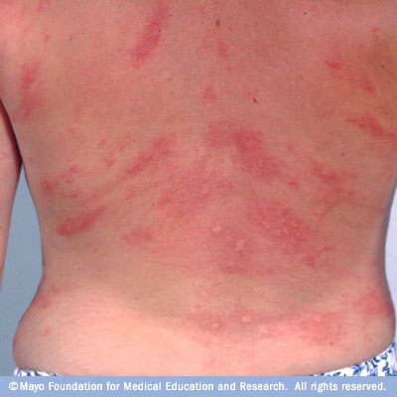
Allergic/Anaphylactic Rxs
Allergic Reactions: Common
Most classic symptom= Hives
Itchy skin
Wheezing
Swelling of face, lips, throat
Anaphylactic Reactions: Rare
Mild cough
Severe hypotension or shock
Chills
Tachycardia
SOB, bronchospasm, tightness in chest
N/V/D, abdominal cramps
Hives, flushed skin
Anxiety, ALOC
Recipient is overly sensitive to the plasma proteins in the blood component
These reactions have been reported in IgA-deficient patients who develop antibodies to IgA antibodies.
Treatment:
Stop the transfusion
Oxygen
Antihistamines (Benadryl)
Epinephrine and corticosteroids

Slide 31
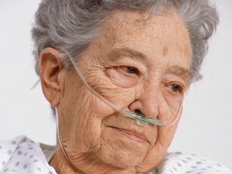
TACO (Transfusion Associated Circulatory Overload)
Tachypnea
Orthopnea
Pulmonary edema
Cyanosis
Systolic hypertension
Peripheral edema
S3 on auscultation
Increased jugular distention
NO FEVER
Circulatory system is unable to deal with a sudden increase in blood volume
Risk factors:
Cardiac disease, renal disease, elderly, neonates
Large volumes
Rapid transfusion
Treatment:
Slow down the transfusion
Lasix between units
Oxygen & mechanical ventilation, if necessary
Notes:
No fever and hypertension

Slide 32
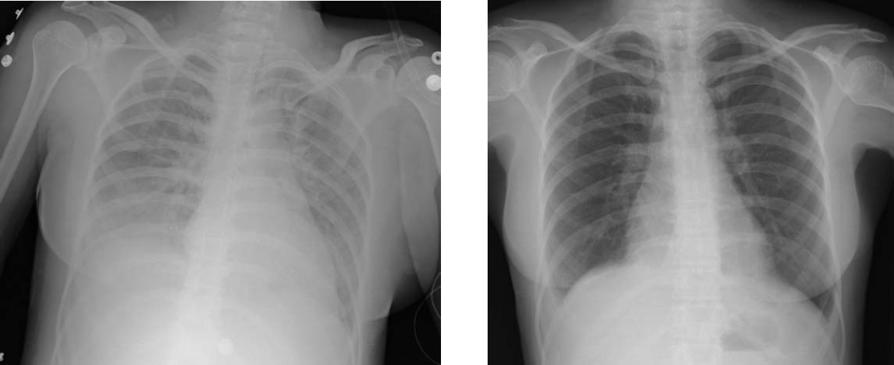
TRALI (Transfusion Related Acute Lung Injury)
Immediate immunologic transfusion reaction
TRALI: Caused by inflammatory immune response
Uncommon, but can be fatal
WBC antibodies in donor’s blood react against recipient's WBCs.
WBCs clump in pulmonary capillaries & cause lung damage
Primarily FFP, but can occur with all types of blood products
Onset: During or within 6 hours after transfusion
Symptoms:
Acute onset hypoxemia
Non-cardiogenic pulmonary edema
Fever, tachycardia & hypotension
Treatment: Stop the transfusion. Aggressive respiratory support, often mechanical ventilation & diuretics. Prevention: Leukocyte reduction & avoid multiparous plasma donors
CXR usually improves within 96 hours
Notes:
Various stimuli in blood components, most commonly white blood cell (WBC)
antibodies from donors sensitized during pregnancy or prior transfusion or
transplantation, or proinflammatory molecules that accumulate in stored blood
components, may cause TRALI
Inflammatory immune response
Usually patients are ex-tubated within 48 hours
Prevention:
Transfusion-related acute lung injury (TRALI) is characterized by the acute onset of
hypoxemia and noncardiogenic pulmonary edema within 6 hours of a blood or blood
component transfusion in the absence of other causes of acute lung injury or circulatory
overload. Various stimuli in blood components, most commonly white blood cell (WBC)
antibodies from donors sensitized during pregnancy or prior transfusion or
transplantation, or proinflammatory molecules that accumulate in stored blood
components, may cause TRALI. These mechanisms may not be mutually exclusive and
may act synergistically with underlying patient factors to lead to a final common pathway
of acute lung injury. These stimuli may trigger an inflammatory response, granulocyte
activation and degranulation, and injury to the alveolar capillary membrane, and the
development of permeability pulmonary edema. Although most TRALI cases are Circular of Information for the Use of Human Blood and Blood Components 5 associated with donor antileukocyte antibodies, rare cases have implicated recipient
antileukocyte antibodies that reacted with donor leukocytes. Widespread leukoreduction
of blood components has likely mitigated this latter risk. Laboratory testing of blood
donors for antileukocyte antibodies or blood components for biologic mediators does not
alter management of this reaction, which is diagnosed on clinical and radiographic
findings. Treatment of TRALI involves aggressive respiratory support, and often
mechanical ventilation. The preferential use of plasma collected from male donors has
been associated with a significant reduction in the number of reported TRALI cases and
associated fatalities. Transfusion services should immediately report suspected TRALI to
the blood collection facility to facilitate the retrieval of other components associated with
the involved donation(s) or prior donations. (AABB)
Transfusion-related acute lung injury (TRALI) is a rare but potentially fatal complication of blood product transfusion. TRALI has been defined by both a National Heart, Lung, and Blood Institute (NHLBI) working group as well as a Canadian Consensus Conference, as new acute lung injury (ALI)/acute respiratory distress syndrome (ARDS) occurring during or within six hours after blood product administration (table 1) [1,2]. When a clear temporal relationship to an alternative risk factor for ALI/ARDS coexists, a formal diagnosis of TRALI cannot be made. In these circumstances, the diagnostic terminology to be used is “possible TRALI.” Prior to the institution of TRALI risk mitigation strategies, plasma components and apheresis platelet concentrates conferred the highest risk of TRALI per component. Currently, due to transfusion of a much larger number of red cell units compared with plasma and platelets, the largest number of TRALI-related deaths in the United States and other developed countries occur with red blood cell transfusion [3]. (See 'Prevention' below.) Historical estimates suggest that TRALI occurs at a rate of approximately 0.04 to 0.1 percent of transfused patients or in approximately 1 in 5000 transfused blood components [4-7]. However, the true incidence of TRALI is not known, largely due to poor syndrome recognition, the reliance on passive reporting rather than active surveillance strategies, and the inclusion of cases that did not meet the NHLBI or Canadian Consensus Conference definitions of TRALI in some reports [3,8-11]. Additionally, due to the contribution of specific recipient risk factors, TRALI incidence is also likely to depend on the population of interest. As an example, estimates suggest that the rate of TRALI in critically ill populations may reach 5 to 8 percent [12,13]. (See 'Recipient risk factors' below.
(Uptodate)

Slide 33
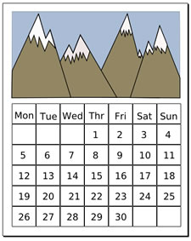
DELAYED IMMUNOLOGIC TRANSFUSION REACTIONS
Delayed Hemolytic Reaction
Alloimmunization
Post-Transfusion Purpura (PTP)
Transfusion-Associated Graft-vs-Host Disease (TA-GVHD)
2-14 days
RARE
RARE
First week-Several weeks
7-10 days
Notes:
Delayed hemolytic reactions occur in previously red-cell-alloimmunized patients in
whom antigens on transfused red cells provoke anamnestic production of antibody. The
anamnestic response reaches a significant circulating level while the transfused cells are
still present in the circulation; the usual time frame is 2 to 14 days after transfusion. Signs
may include unexplained fever, development of a positive DAT, and unexplained
decrease in hemoglobin/hematocrit. (AABB)
Posttransfusion purpura (PTP) is a rare syndrome characterized by the development of
dramatic, sudden, and self-limited thrombocytopenia, typically 7 to 10 days after a blood
transfusion, in a patient with a history of sensitization by either pregnancy or transfusion
Alloimmunization to antigens of red cells, white cells, platelets, or plasma proteins may
occur unpredictably after transfusion. Blood components may contain certain immunizing
substances other than those indicated on the label. For example, platelet components may
also contain red cells and white cells. Primary immunization does not become apparent
until days or weeks after the immunizing event, and does not usually cause symptoms or
physiologic changes.
Transfusion-associated graft-vs-host disease (TA-GVHD) is a rare but extremely
dangerous condition that occurs when viable T lymphocytes in the transfused component
engraft in the recipient and react against recipient tissue antigens

Slide 34
NON-IMMUNOLOGIC TRANSFUSION COMPLICATIONS
Infectious:
HIV, Hepatitis, Syphilis, CJD
CMV
Bacterial Sepsis
Transfusion Related Circulatory Overload (TACO)
Hypothermia
Metabolic Complications:
Citrate Toxicity,
Low Ionized CA++, Acidosis/Alkalosis,
+/-K
Notes:
Citrate “toxicity” reflects a depression of ionized calcium caused by the presence in
the circulation of large quantities of citrate anticoagulant. Because citrate is promptly
metabolized by the liver, this complication is rare.

Slide 35
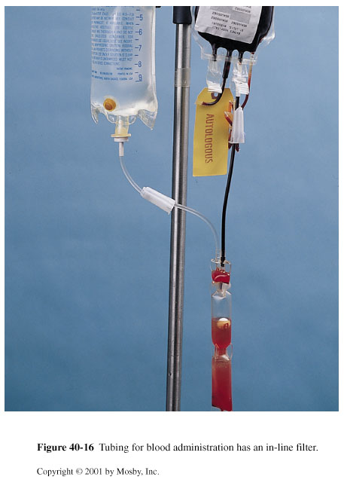
Blood Transfusion Administration
“A blood transfusion is a human tissue transplant”
Blood must be hung or returned to blood bank within 30 minutes of issue
Transfusion must be completed within four hours
Nothing other than 0.9% NS may be added to blood
No medications may be added to IV or blood unit
Do not piggyback blood into another IV line
Blood administration tubing may be used for two units or up to 4 hrs.
Start transfusion slowly: 25mls over first 15 minutes (100mls/hr.)
Watch closely. Stay with the patient for the first 15 minutes of the transfusion
If no reaction is noted, increase rate per patient tolerance
Take & document vital signs pre-transfusion, at 15 minutes, 30 minutes, 1 hour, 2 hours , 1 hour post transfusion, and as necessary
Document patient tolerance
Notes:
To minimize the risk of bacterial growth, the transfusion must be completed within 4 hours of removing it from refrigeration.

Slide 36
Two Nurse Bedside Verification
Verify blood product matches physician order
Compare ‘Blood Transfusion Record’ to patient’s wristband. Have pt. state their name & date of birth. Verify match.
Compare and verify (‘Blood Transfusion Record’ to requisition/ tag attached to the unit of blood)
Donor Unit Number
Recipient Group & Rh
Donor Group & Rh
Expiration Date & Time
Unit inspection: Ok? Yes or No
Two signatures are required at the bottom of the ‘Blood Transfusion Record’ to certify the blood or blood component has been verified and is correct
If the blood bag label is incomplete, do not transfuse the unit.
Notes:
Invert bag and squeeze, check for leaks or missing ports. Check color, cloudiness, clumps

Slide 37
Procedure for Transfusion Reaction
IF TRANSFUSION REACTION IS SUSPECTED:
Stop the transfusion and notify physician stat
Remove transfusion tubing (save) and hang new IV tubing with NS infusion
At the bedside, check for possible clerical errors
Notify the blood bank.
Complete “Transfusion Reaction Report.” (Forms Fast)
Order “Transfusion Reaction” on order entry (Draw one pink topped tube)
Send first voided urine and again in 5 hours
Document signs & symptoms
Take & record vital signs Q 15 minutes until stable, then Q 2 hours x2, then Q 4 hours x 24 hours.
Follow physician’s orders for case-specific interventions
Notes:
IF TRANSFUSION REACTION IS SUSPECTED:
Stop the transfusion and notify physician stat
Remove transfusion tubing (save) and hang new IV tubing with NS infusion
At the bedside, check all labels, forms & patient ID to determine if the correct patient received the intended component
Notify the blood bank. Complete “Transfusion Reaction Report.” Return unit with saline bag and tubing attached & completed “Blood Transfusion Record”
Order “Transfusion Reaction” & draw a new clot & lavender tube or one pink topped tube
Send first voided urine specimen to lab & again in 5 hours
Describe & document patient’s signs & symptoms fully in nurse’s notes
Take & record vital signs Q 15 minutes until stable, then Q 2 hours x2, then Q 4 hours x 24 hours.
Follow physician’s orders for treatment

Slide 38
After blood transfusion Continue to monitor patient: Remember some transfusion reactions are delayed
Return empty blood transfusion units and yellow portion of the “Blood Transfusion Record” paperwork to the Lab in a bio- hazardous bag
Notes:
The surface antigens found on white blood cells, along with lesser known antigens on red cells and even those found on platelets, are responsible for most nonhemolytic reactions. Sensitivity often develops with multiple transfusions, or in those who are immunocompromised.6 - See more at: http://www.modernmedicine.com/modern-medicine/news/your-guide-safe-transfusions#sthash.W5kCIPh5.dpuf

Slide 39
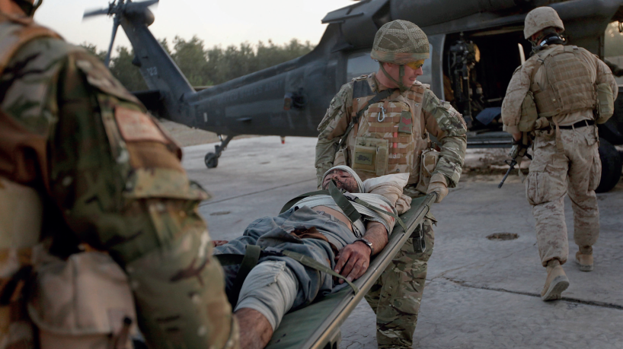
Massive Blood Transfusion
Definitions:
the replacement entire blood volume within a 24 hour period
transfusion of 10 units of red cells in a few hours
or loss of 50% blood volume within 3 hours
or loss of 150ml/min
Primary goals when managing traumatic shock are :
Restoration of oxygen delivery to end organs
Maintenance of circulatory volume
Prevention of ongoing bleeding through source control
Correction of coagulopathy
DAMAGE CONTROL RESCUSITATION
• Early delivery of blood component therapy
– pRBC
– FFP
– PLT
• Permissive hypotension (sbp 90)
• Minimal crystalloid based resuscitation
1:1:1
Notes:
 Coagulopathy
 Volume overload
 Hypothermia
 Hyperkalemia
 Metabolic acidosis and hypokalemia (citrate)
 Hypo calcemis due to citrate toxicity - especially
with hepatic failure, CHF, or other low-output
states

Slide 40
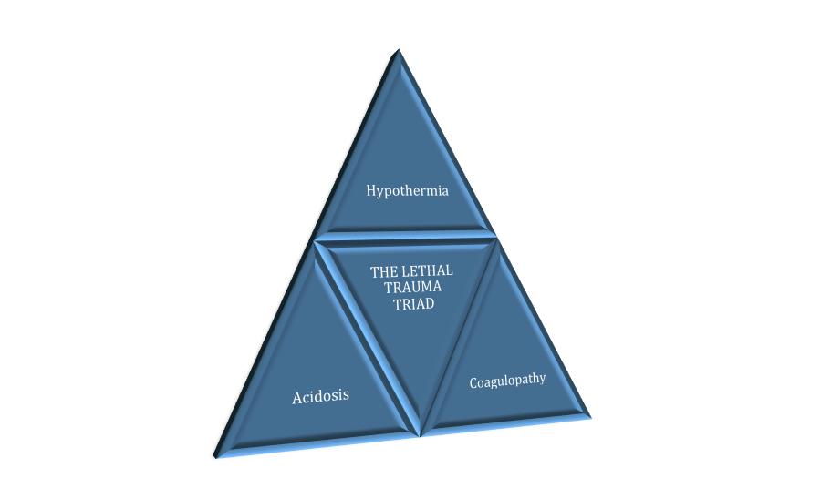
COMPLICATIONS OF TRAUMA
COMPLICATIONS OF Massive Blood Transfusions
Alteration in coagulation system
Acidosis
Hypothermia
Citrate Toxicity
Hyperkalemia
Hypocalcemia & alkalosis
Notes:
Citrates in blood products bind with calcium, increasing the risk of extreme hypotension and depressed heart function, so have a supply of calcium chloride on hand to prevent the low levels of ionized calcium that can occur after rapid transfusion.

Slide 41
Questions?

