Slide 1
BASIC LIFE SUPPORT AND FIRST AID

Slide 2
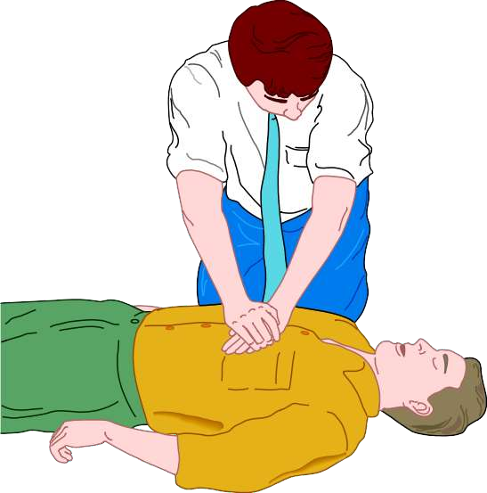
OBJECTIVES
Define BLS
Explain steps & components of BLS
Explain chain of survival
Explain about defibrillator
2

Slide 3
INTRODUCTION
According to recent statistics sudden cardiac arrest is rapidly becoming the leading cause of death.
Once the heart ceases to function, a healthy human brain may survive without oxygen for up to 4 minutes without suffering any permanent damage.
Unfortunately, a typical EMS response may take 6, 8 or even 10 minutes.
3

Slide 4
It is during those critical minutes that CPR (Cardio Pulmonary Resuscitation) can provide oxygenated blood to the victim's brain and the heart, dramatically increasing his chance of survival.
And if properly instructed, almost anyone can learn and perform CPR.
4

Slide 5
WHAT IS BLS ?
Basic Life Support (BLS) refers to the care healthcare providers and public safety professionals provide to patients who are experiencing respiratory arrest, cardiac arrest or airway obstruction.
BLS includes psychomotor skills for performing high-quality cardiopulmonary resuscitation (CPR), using an automated external deﬁbrillator (AED) and relieving an obstructed airway for patients of all ages
5

Slide 6
RESPIRATORY ARREST
If the patient is not breathing but has a deﬁnitive pulse, the patient is in respiratory arrest.
To care for a patient experiencing respiratory arrest, ventilations must be given.
6

Slide 7
CARDIAC ARREST
If there is no breathing, no pulse and the patient is unresponsive, the patient is in cardiac arrest.
Cardiac arrest is a life-threatening situation in which the electrical and/or mechanical system of the heart malfunctions resulting in complete cessation of the heart’s ability to function and circulate blood efﬁciently.
7

Slide 8
CARDIAC CAUSES
ELECTROLYTE IMBALANCE
MI
Hyper kalemia
Heart failure
Hyper/hypo calcemia
Dysrythmia
Cardiac tamponade
PULMONARY CAUSES
PROCEDURES
Respiratory failure
PA catheterisation
Airway obstruction
Cardiac catheterisation
ARDS
Surgery
OTHERS
Pneumothorax
Pu₂₆l₋m_{Jan-}o₁₈nary embolus
Drug toxicity
8

Slide 9
Components of BLS
Ensure safety
Check for response
Activate EMS
Chest compressions
Check airway and ventilate
Defibrillate

Slide 10
ENSURE SAFETY
Safety Of Self
Safety Of Patient
Movement of a trauma victim – only when absolutely necessary
[unstable cervical spine – injured spinal cord]

Slide 11

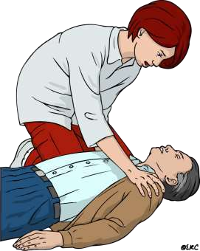
ASSESS RESPONSE
Ask the person “Are you ok ?”
Tap and shout
If the client responds
Leave the client and call for help.
Return as quick as possible and reassess the condition of the person

Slide 12
Activate EMS
Lone Rescuer
Two Rescuers
Begins CPR
Return to the victim
Activate EMS
CPR followed by defibrillation
Defibrillation
16

Slide 13
ACTIVATE EMS
Call 108 / 102
Describe the emergency to the operator-
-includes where you are (address and location)
-condition of patient

Slide 14
CHANGE FROM A-B-C TO C-A-B
The vast majority of cardiac arrests occur in adults, and the highest survival rates from cardiac arrest are reported among patients of all ages who have a witnessed arrest and an initial rhythm of VF or pulseless VT.
In these patients, the critical initial elements of BLS are chest compressions and early defibrillation.
In the A-B-C sequence, chest compressions are often delayed while the responder opens the airway to give mouth-to-mouth breaths, retrieves a barrier device, or gathers and assembles ventilation equipment.

Slide 15
CIRCULATION
Check pulse. If pulse is not definitely felt within 10 seconds, proceed with chest compressions.
Position of victim
Must be supine on a firm flat surface for CPR to be effective
Victim lying facing down – logroll the victim

Slide 16
Prone CPR
Standard CPR is performed with the person in supine position.
Prone CPR or reverse CPR is CPR performed on a person lying on their chest, by turning the head to the side and compressing the back. Due to the head's being turned, the risk of vomiting and complications caused by aspiration pneumonia may be reduced.
The American Heart Association's current guideline recommends to perform CPR in the supine position, and limits prone CPR to situations where the patient cannot be turned.

Slide 17
Pregnancy
During pregnancy when a woman is lying on her back, the uterus may compress the inferior vena cava and thus decrease venous return. It is therefore recommended that the uterus be pushed to the woman's left; if this is not effective, either roll the woman 30° or healthcare professionals should consider emergency resuscitative hysterotomy.
Cervical spine stabilization
Use cervical collar if available
Any hard objects that restrict neck movement
Firm surface(backboard or floor)

Slide 18
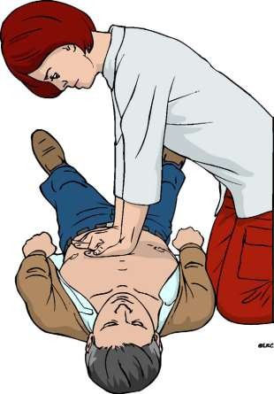
Firm surface(backboard or floor)
Kneel beside victim’s chest or stand beside bed
Heel of one hand on inter-mammary line (which is the lower half of the sternum)
Heel of other hand on top of the first so that the hands are overlapped and parallel
Lock elbows

Slide 19
Rhythmic applications of pressure over the lower half of the sternum.
It Increase intrathoracic pressure and directly compress heart

Slide 20
CHARACTERISTICS OF GOOD COMPRESSION
“Push hard push fast”. Push at a rate of 100-120 min.
Compression depth- at least 2 inches(5cm) not more than
2.5 inches
Release completely to allow the chest to fully recoil.
A compression-ventilation ratio of 30:2 .
Do not bounce your hands up and down on the victim's chest.
24
Never use the palm of your hand, use the heel of your hand.

Slide 21
CHEST COMPRESSIONS
When 2 or more rescuers available,
  Switch the compressor about every 2 minutes (or after 5 cycles of compressions and ventilations at a ratio of 30:2).
  Accomplish this switch in ≤5 seconds.
Advanced airway and 2 rescuers-
  Continuous chest compressions at a rate of 100-120 /min without pauses for ventilation.
  The rescuer delivering ventilation provides 8 to 10 breaths per minute.
25
Lay rescuers should continue CPR until an AED arrives

Slide 22
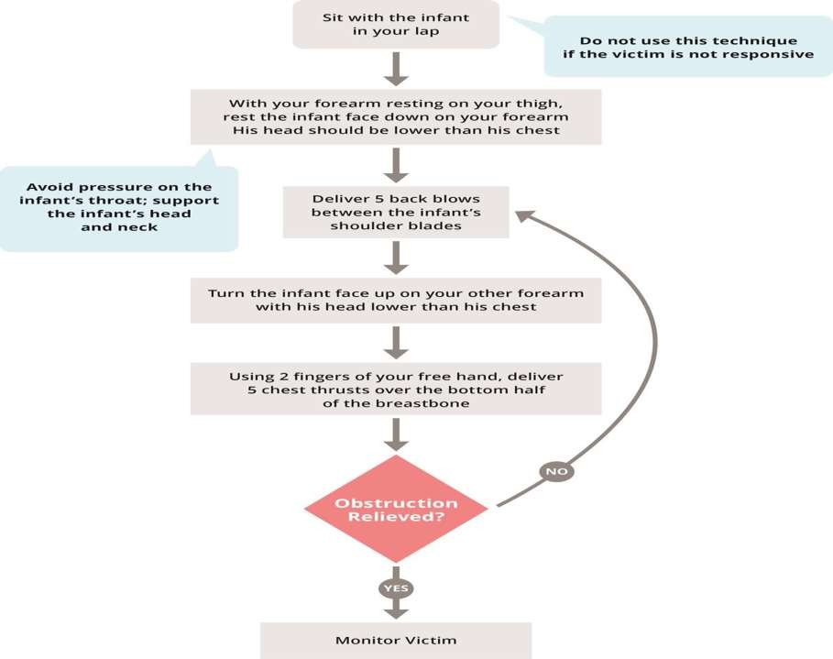
For infants

Slide 23
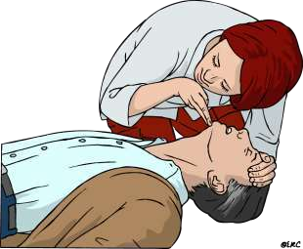
BREATHING
Check breathing.
No “look, listen, feel” for signs of breathing in new guidelines.
After the first set of chest compressions, the airway is opened and the rescuer delivers 2 breaths.

Slide 24
GIVING RESCUE BREATHS
Use a barrier device of some type while giving breaths.
Deliver each rescue breath over 1 second.
Give a sufficient tidal volume to produce visible chest rise (500- 600ml).
Avoid rapid or forceful breaths.
When an advanced airway is in place during 2-person CPR, ventilate at a rate of 8 to 10 breaths per min.

Slide 25
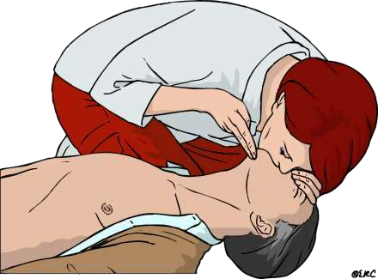
METHODS OF RESCUE BREATHS
Mouth-to-Mouth Rescue Breathing
Mouth-to–Barrier Device Breathing
Mouth-to-Nose and Mouth-to-Stoma Ventilation
Ventilation With Bag and Mask
Ventilation With an Advanced Airway
32

Slide 26
EARLY DEFIBRILLATION
AED – Automatic external Defibrillator
A battery operated device
On applying to victim detects and assesses cardiac rhythm and prompts the user for further action
AED BOX contains –
AED machine with battery and charger
Two self sticking pads with cables & connectors one razor
35
26-Jan-18

Slide 27
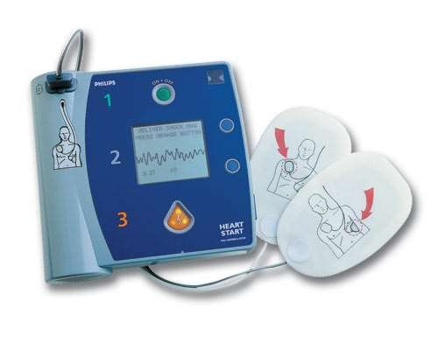
AED MACHINE
26-Jan-18
On/Off switch
Plug with flashing light near it
Shock delivery button(orange)
Speaker & volume control for voice prompt
Battery

Slide 28
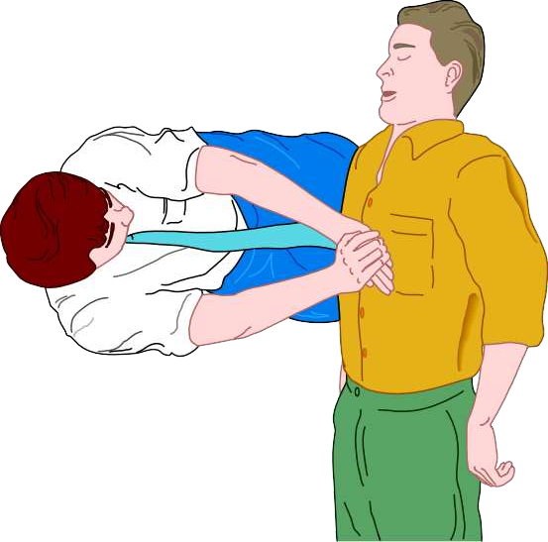
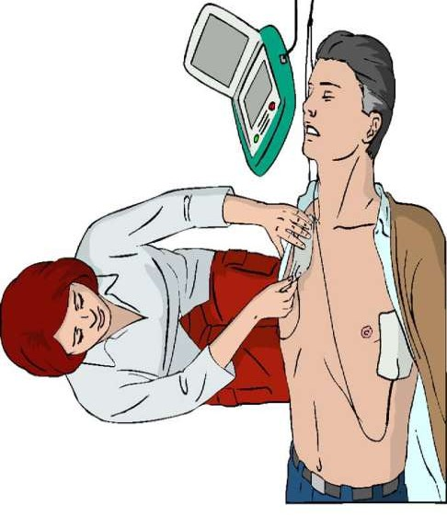
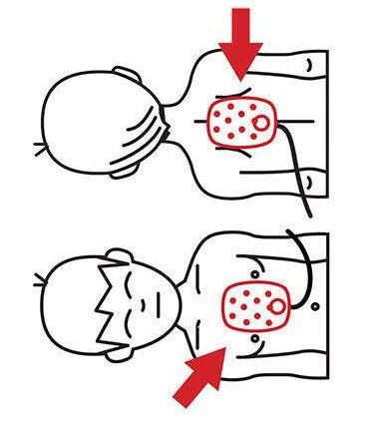
26-Jan-18
37

Slide 29
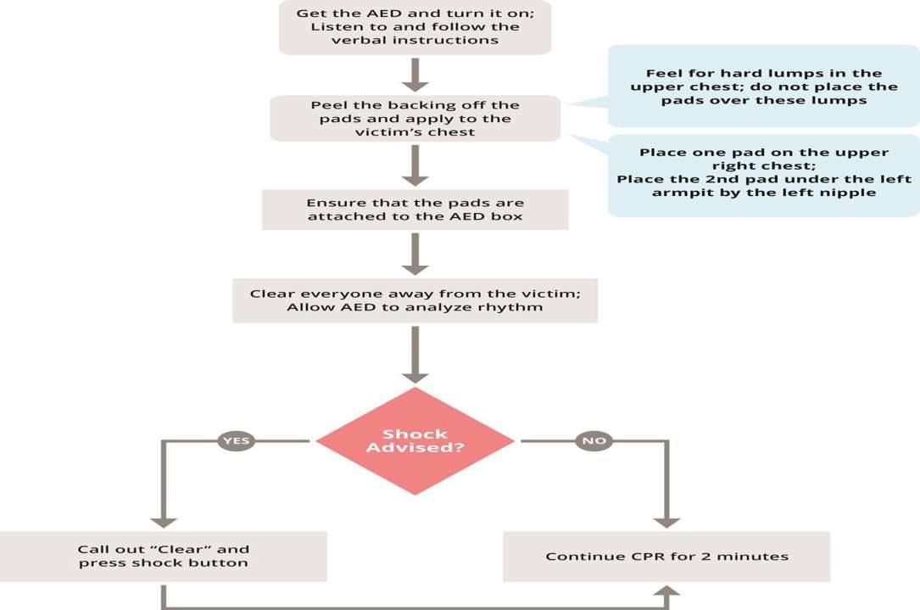
26-Jan-18

Slide 30

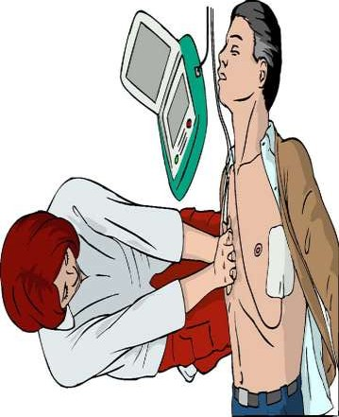
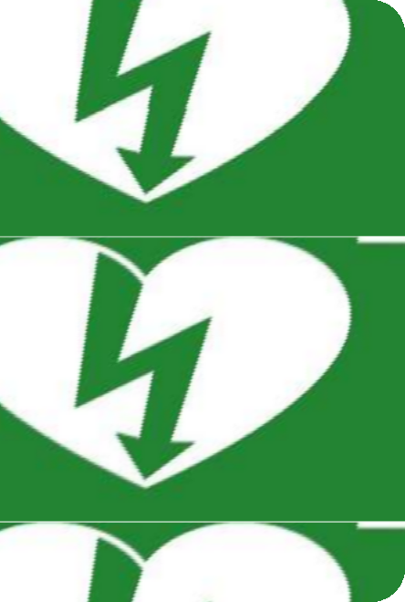
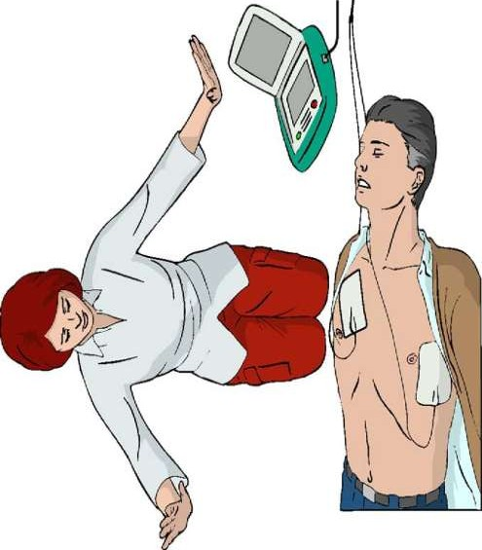
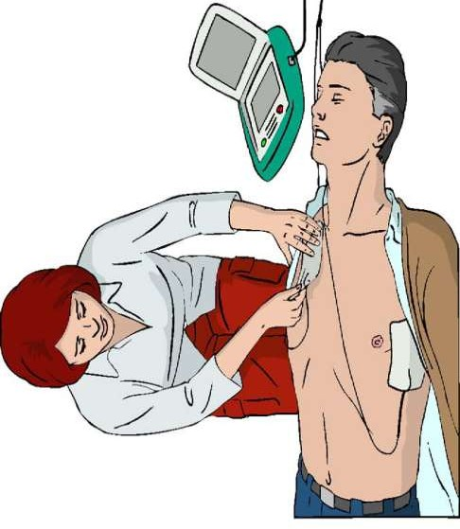
26-Jan-18
39

Slide 31
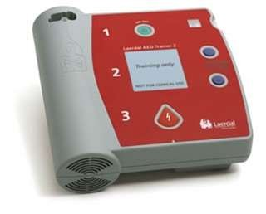
Give ONE shock each time AED advises “SHOCK”
Resume CPR immediately- 5 cycles ( 2 min ) starting with chest compressions
After 2 minutes, AED will automatically start analyzing again & prompt accordingly
Non-shockable rhythm- AED prompts to check for “signs of circulation” - Check Pulse (< 10sec)
No pulse : continue CPR
Pulse : discontinue CPR
40
26-Jan-18

Slide 32
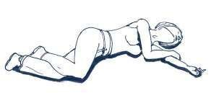

THE RECOVERY POSITION
If the victim responds, position him in the recovery position and monitor breathing until help arrives.
41
26-Jan-18
56
Infant Recovery Position

Slide 33
DEFIBRILLATION SAFETY
PATIENT
5 point check
Pacemaker
Jewellery
Hair on chest
Damp/Wet skin
Patches (NTG)
AED
In good working order
Do Not use in Heavy rain
Do Not use if they lay in a pool of water
Do Not use in an explosive environment
42
26-Jan-18

Slide 34
CONTINUE RESUSCITATION UNTIL
Qualified help arrives and takes over
Victim revives: The victim starts breathing normally
Rescuer becomes exhausted

Slide 35
RESPIRATORY ARREST BY OPIOIDS – BYSTANDER USE OF NALOXONE
New in 2015, bystanders may administer naloxone to victims who are apparently suffering from a opioid overdose.
Unresponsive opioid users can benefit from timely administration of naloxone (2 mg intranasal or 0.4 mg intramuscular).

Slide 36
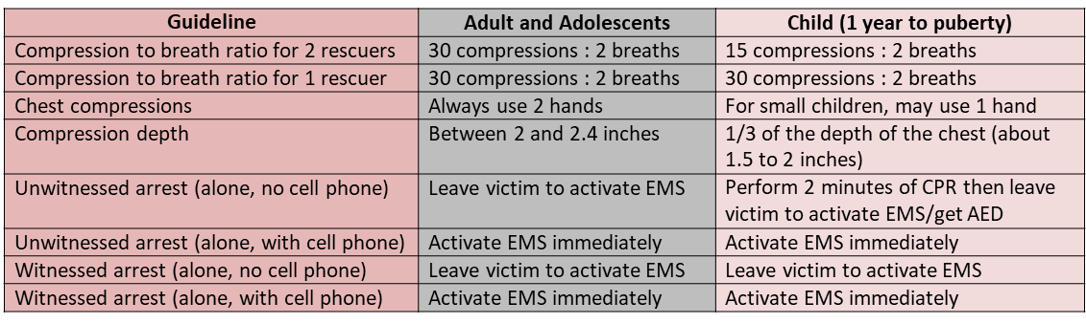
BLS DIFFERENCES

Slide 37
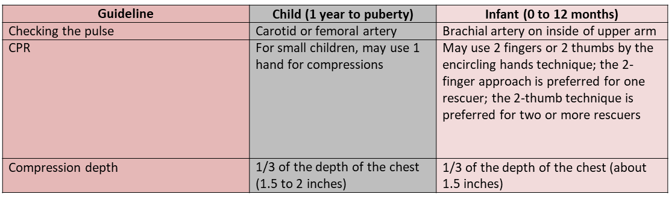
49

Slide 38
CONCLUSION
CPR is responsibility of a team of personnel.
For patients with cardiac arrest, early appropriate resuscitation, involving CPR, early defibrillation, and appropriate implementation of post–cardiac arrest care, leads to improved survival and neurologic outcomes.

