Slide 1
BONE MARROW ASPIRATION

Slide 2
Objectives
By the end of the lesson the student should be able to:
Review the anatomy and physiology of the bone marrow.
Define BMA
State the sites of BMA
Give the indications and contraindications of BMA
State the complications of BMA
Requirements and procedure for BMA
Describe the nursing role during BMA procedure
Describe the patient care after undergoing BMA

Slide 3
Review of anatomy and physiology of the bone marrow
Bone marrow is the flexible tissue found in the interior of bones.
In humans, red blood cells are produced in the heads of long bones (femur, humerus),the pelvic bone and the sternum, in a process known as hematopoesis. Producing about 500 bilion blood cells per day.
Bone marrow is also a key component of the lymphatic system, producing the lymphocytes that support the body's immune system.

Slide 4
Review of anatomy and physiology of the bone marrow……
Bone marrow transplants can be conducted to treat severe diseases of the bone marrow, including certain forms of cancer, congenital defects and autoimmune disorders.
Bone marrow barrier the blood vessels of the bone marrow constitute a barrier, inhibiting immature blood cells from leaving the marrow

Slide 8
Diseases of the bone marrow
The normal bone marrow architecture can be damaged or displaced leading to a decrease in the production of blood cells and blood platelets, this can be caused by aplastic anemia, malignancies, leukemia, infections such as tuberculosis, exposure to radiations and chemotherapy

Slide 9
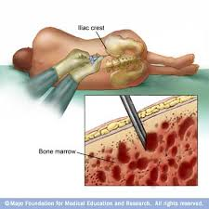
Definition of BMA
Bone marrow aspiration is the aspiration of a specimen of red bone marrow for diagnostic purposes.

Slide 10
Normal aspirate- semifluid state
Aspiration - cytologic assessment, with analysis directed towards assessing the morphology and obtaining a differential cell count.
Biopsies, on the other hand, allow evaluation of the marrow’s overall cellularity, detection of focal lesions, and determination of the extent of infiltration by various pathologic entities.
Sites
Pelvic bone- iliac crest, anterior and posterior iliac spines
Breast bone i.e. over the sternum
Rarely at the epiphysis of long bones- tibia, fibula

Slide 11
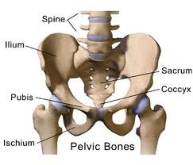
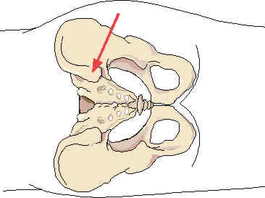
Sites of BMA
Pelvis
Breast bone (
sternum)

Slide 12
Indications
To aid diagnosis in aplastic anemia and leukaemia.
To aid in diagnosis of infections such as tuberculosis of the bone.
To aid assessment of the effect of treatment during the course of a disease on the bone marrow.
Aspirate bone marrow for lab exam of RBCs, WBCs and megakaryocytes
Examine bone marrow for presence of neoplasm
Remove bone marrow for Rx and readminstration intravenously as a bone marrow transplant

Slide 13
Contraindications
Severe Bleeding disorders haemophilia.
Skin or soft tissue infection over the site.
Known coagulation defects, although the test may be performed if the importance of the information to be obtained outweighs the risks involved in carrying out the test

Slide 14
complications
Bleeding at the puncture site
Soreness lasting for 12- 24 hours.
Infections (invasive procedure)

Slide 15
Preparation
Vital signs- hemodynamic stability
Coagulation profile (INR, PT, Platelet count)- risk of bleeding
Consent
Comfort
Explain the procedure

Slide 16
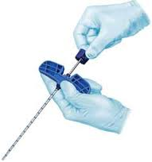
BMA needle

Slide 17
Requirements top shelf
A sterile pack with;
Sterile disposable scapel
2 pair of disecting forceps
Sterile BMA needles
Galipot
Dressing towel
Swabs
Handtowel
Sterile 20ml syringe for aspiration of bone marrow
Sterile adhesive dressing.

Slide 18
Bottom shelf
Local anaesthetic and equiptment for its administration.
Sterile surgical gloves
Completed laboratory forms
Sterile specimen containers well labeled
Alcohol based antiseptic
Pair of scissors

Slide 19
bottom shelf…
Needles and syringes
Sterile plastic spray and adhesive dressing
Strapping
Container with disinfectant(JIK)
Receiver for swabs and sharps container
mackintosh

Slide 20
Procedure
Done by medical practitioner,
Explain the procedure to the patient and obtain consent
Sedatives given before the procedure to relieve anxiety.
Wash hands and administer local anaesthesia in the chosen site(lidocaine/procaine)
Wash hands and put on sterile gloves
Clean patient skin using antiseptic solution.

Slide 21
Procedure…
A small stab incision may be made and an aspirate needle is inserted through the skin using manual pressure and force until it abuts the bone.
Then, with a twisting motion of clinician's hand and wrist, the needle is advanced the hard outer layer of the bone and into the marrow cavity.
Once the needle is in the marrow cavity, a syringe is attached and used to aspirate ("suck out") liquid bone marrow.. Following aspiration of the specimen of red bone marrow, the syringe is disconnected, the stilet is replaced and the needle withdrawn.
Pressure applied on the puncture site till bleeding ceases.
Apply adhesive dressing.

Slide 22
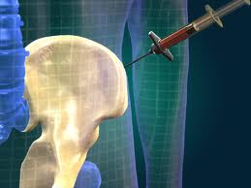
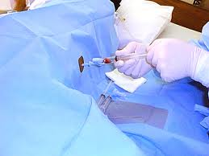

Slide 23
Nursing role during the procedure
Ensure the patient has understood the procedure and consent has been obtained.
Wash and dry hands
Give patient sedation if prescribed
Prepare the equipment and trolley as required.
Ensure patients privacy
Assist the patient in the correct position according to choosen site; supine if site is sternum and lateral or side lying if site is illiac crest.

Slide 24
Nursing role during the procedure…
Assist medical practitioner as necessary e.g handing over equipment
Remain with the patient and help maintain his potion as required during procedure.
Observe any change in the patients condition throughout the procedure
Dispose off equipment safely
Dispatch the labelled specimen to laboratory immediately with the completed laboratory forms
Document the nursing practice appropriately
Monitor after effects and report abnormal findings immediately.

Slide 25
Patient care after the procedure
Patient allowed to rest quietly for an hour after the procedure to allow wearing off of sedative effects. Confine the patient in bed for an hour or longer
Vital signs taken half hourly for the first two hours.
Observe puncture site for bleeding or hematoma formation. If bleeding present apply pressure and bandage
Any sudden change in patients condition should be reported as it may signify injury to underlying vital organs especially in the case where the sternal site is used.

Slide 26
Patient care after the procedure….
Give paracetamol to ease soreness
Monitor for signs of infection in puncture area( increasing pain over the site, redness, fever, swelling on the site)
Label the specimen and take them to lab with request form
Patient asked not to wash puncture until after 24hours after the procedure.
Advise the patient not to make the biopsy site wet by showering until 24 hrs are over
They should avoid vigorous activity or exercises for a day or two- this helps minimize bleeding and discomfort

Slide 27
summary
The bone marrow is a soft tissue found in the hollow of the bones.
BMA is a medical procedure where the bone marrow is aspirated for diagnostic purposes in such conditions as leukemia, aplastic anemia, malignancy of the bone.
BMA is contraindicated in a patient with severe bleeding disorder and in a situation where there is an infection in the site to be punctured.
The patient should be explained the procedure and consent asked

Slide 28
Summary…
Aseptic technique is observed during the procedure.
Observe the patient for any changes during and after the procedure.
Apply pressure on puncture site after the procedure to stop bleeding.
Keep the patient in bed resting for about two hours after the procedure.
Label the specimens well and take to the laboratory together with completed laboratory forms.
Dispose off the wastes according to infection control guidelines.

Slide 29
Assignment
Mrs. X who is admitted to medical ward with a chronic unexplained anemia has been indicated for BMA, draw a nursing care plan for Mrs. X giving five priority nursing diagnoses.

Slide 30
Further reading
Bone marrow harvesting and transplant.

Slide 31
https://www.youtube.com/watch?v=NkdsLHBCreI
https://www.youtube.com/watch?v=EYd7OnCt7ug

