Slide 1
BONE TUMOURS
PREPARED BY
MADAM ESTHER

Slide 17
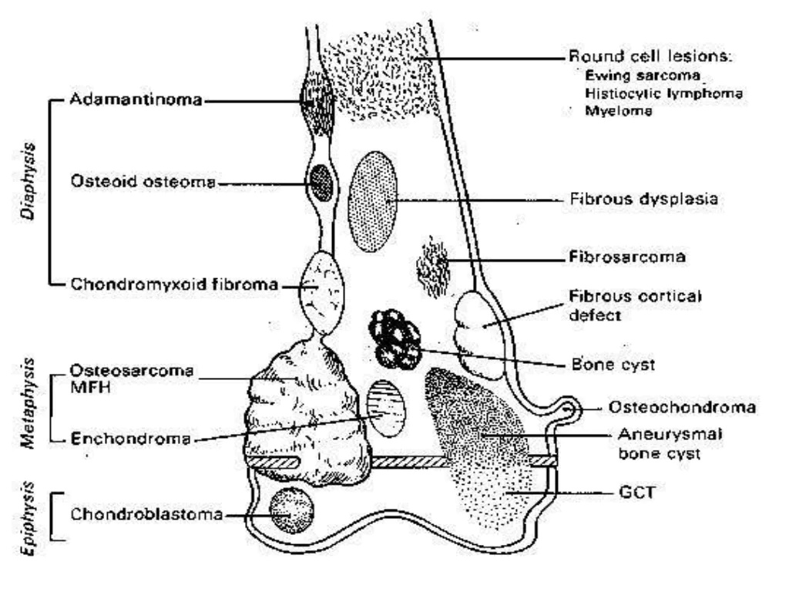

Slide 38
