Slide 1
BOWEL DISORDERS

Slide 2
INTESTINAL CONDITIONS
Inflammatory (IBD) Crohns, Ulcerative colitis
Obstructions
Diverticular
Other Inflammations
Infections

Slide 3
1. Ulcerative Colitis
Is an ulcero-inflammatory disease affecting the colon, which is limited to the mucosa and submucosa, except in the most severe cases.
It begins in the rectum and extends proximally in a continuous fashion sometimes involving the entire colon (Pancolitis).

Slide 4
Causes
Heredity
Overactive immunity
Drugs: Antibiotics, corticosteroids, NSAIDs,
Stress may trigger
Predisposing factors
Any age, but more rampant in between 15 and 30 ^{yrs}
older than 60 ^{yrs}
Positive Family history
Jewish descent-challenged

Slide 6
Clinical features
Bloody mucoid diarrhea
Cramps ( a painful & involuntary muscular contraction)
Tenesmus (painful spasm of the anal sphincter along with the urgent desire to defecate without the significant production of feces)
Colicky lower abdominal pain
Fever
Weight loss

Slide 7
Extra-intestinal symptoms
Migratory polyarthritis,
Sacroilitis,
Ankylosing spondilitis,
Uveitis,
Erythema nodosum and
Hepatic involvement (pericholangitis and
Primary sclerosing (cholangitis).

Slide 9
Diagnosis
Medical and family history
Physical exam: distended abdomen, increased bowel sounds, tenderness
Lab tests: Hb (low), occult blood, cell count
Endoscopies of the large intestine

Slide 10
Management
Aminosalicylates to reduce inflammation
corticosteroids
Immunomodulators to reduce inflammation e.g azathioprine, 6-mercaptopurine, or 6-MP
biologics, also called anti-TNF therapies E.G humira
Colectomy, complete

Slide 11
Complications:
Perforation,
Peritonitis,
Abscess
Toxic megacolon
Venous thrombosis
Carcinoma

Slide 12
2.CROHN’S DISEASE
Crohn's Disease causes inflammation of the bowel.
It most commonly affects the lower small intestine (ileum) and the large intestine (colon), but may involve any part of the digestive tract from the mouth to the anus.
The inflammation extends through the entire thickness of the bowel wall.

Slide 13
Pathophysiology
The immune system seems to overreact to substances and bacteria in the intestine. White blood cells invade the intestinal lining and produce inflammatory toxins causing chronic tissue swelling, injury and ulceration. The precise cause of this abnormal immune response is unknown.

Slide 14
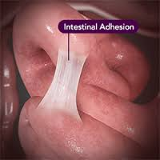
Causes
Abnormal immune response
Genetical
Diagnosis
Colonoscopy
Complications
Adhesions
Obstruction
Malnutrition from poor absorption
Anal fissures
Fistula

Slide 15
Summary of Differences
Crohn’s disease
Inflammation may develop anywhere in the GIT
Common at the end of the small intestine
May appear in patches
May extend through entire thickness of bowel wall
About 67% of people in remission will have at least 1 relapse over the next 5 years
Ulcerative colitis
Limited to the large intestine (colon and rectum)
May involve a part of or the entire colon
Appears in a continuous pattern
Inflammation occurs in innermost lining of the intestine
About 30% of people in remission will experience a relapse in the following year

Slide 16
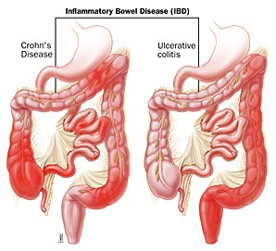

Slide 17
Indeterminate Colitis Histopathologic and clinical overlap between ulcerative colitis and Crohn’s disease is common, and it is not possible to make a distinction in up to 10% of patients with IBD.
In such cases, termed indeterminate colitis, the small bowel is not involved, and the continuous pattern of colonic disease typically would indicate ulcerative colitis.

Slide 18
Management
Physical and psychological rest
Nutrition ( high calories, minerals, Vitamins, low fats, high fibers)
Fluid and electrolyte balance
Drugs-corticosteroids
Surgery

Slide 19
3. DIVERTICULAR DISEASE
Dfn-small pouches of colonic mucosa that protrude into the peritoneal cavity through the circular muscle fibers of the colon
Diverticulitis-Inflammation of the outpouched mucosa
Diverticulosis-presence of the diverticuli
Diverticula–a pouch on a mucous lining of the body due to a defect or normally

Slide 21
Causes
Damaged collagen due to infection
Age: Collagen becomes weak
Increased intraluminal pressure from tonic and rhythmic contractions
Lack of fibre: binds water and salt in the colon, thus, bulkier and voluminous easy to pass. Without enough fiber, the stools are small and hard, colon contracts harder to expel them. That extra pressure on the wall of the narrow colon causes diverticulosis

Slide 22
Clinical manifestations
Pain at the left iliac fossa
Constipation
Vomiting
Tachycardia
Fever
Diarrhea
Abdominal distention
Obstruction
Diagnosis
CT Scan
Barium meal

Slide 23
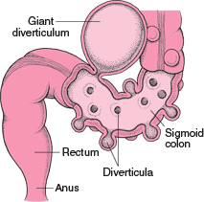

Slide 24
Management
Complications
Chronic diverticular
Diverticulitis
Abscess
High fibre diet
Broad spectrum antibiotic
IV fluid replacement
Analgesics
Monitor vital signs
Colectomy
Patients education

Slide 25
4. INTESTINAL OBSTRUCTION
Obstruction
A mechanical blockage in small or large bowel arising from a structural abnormality that presents a physical barrier to the progression of gut contents.
Accounts for 5% of all acute surgical admissions
Patients are often extremely ill requiring prompt assessment, resuscitation and intensive monitoring

Slide 26
-Can be partial or complete.
Types/causes
A)mechanical( Dynamic)
B) Non mechanical (Adynamic)

Slide 27
Dynamic | Adynamic
Physical /mechanical obstruction. It may occur in an acute or chronic form. Strong peristalsis in trying to clear the obstruction | Peristalsis Absent
Obstruction lesion may be: Intraluminal (impacted feces, foreign bodies, gallstones) Intramural (malignant or inflammatory strictures) Extramural (intraperitoneal bands and adhesions, hernias, ca ovary, ca stomach, volvulus or intussusceptions.) | l ILEUS, esp. post surgical ¡ INFARCTION ¡ MOTILITY DISEASES, esp., HIRSCHSPRUNG DISEASE

Slide 28
Dynamic Obstruction
Pathophysiology
As mechanical obstruction becomes established, the proximal bowel produces increasingly vigorous contractions in an effort to overcome the obstruction. This accounts for the abdominal colicky pain.
It also begins to dilate, initially due to accumulation of air and increased intestinal secretions. Stagnation of fluid encourages anaerobic bacterial overgrowth leading to fermentation and production of gas, manifesting as dilated bowel loops on plain abdominal radiography

Slide 29
The products of fermentation in the bowel lumen also increase the osmotic gradient causing intraluminal fluid and electrolyte shifts, which compounds the problem leading to abdominal distension.
The bowel distal to the obstruction eventually evacuates its contents and collapses, accounting for eventual absence of flatus and feces (absolute constipation).
Vomiting may occur as this process evolves. The timing of onset depends on the level of obstruction. The vomitus contains gastric contents initially, then becomes bile stained, and finally feculent.

Slide 30
With increased intraluminal pressure the tension in the bowel wall increases, which subsequently impairs venous drainage of the bowel, leading to capillary congestion and mural edema.
Arterial inflow becomes compromised leading to ischemia. This results in loss of the bowel's innate immunoprotective mechanism, predisposing to translocation of intraluminal bacteria into the circulation with associated signs of sepsis.
This process is more likely in a 'closed loop obstruction' whereby a closed loop is formed between the proximal and distal segments of the obstructed bowel.

Slide 31
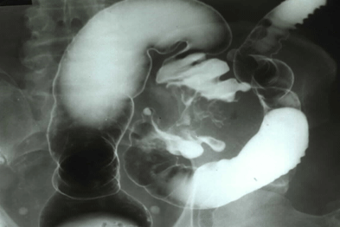
Notes:
-volvulus: Intestinal volvulus is defined as a complete twisting of a loop of intestine around its mesenteric attachment site.
-incarceration: passage of a loop of intestine through a small orifice, e.g. inguinal canal, with resulting swelling, obstruction and occlusion of blood supply
-Obstruction:partial or complete blockage of the bowel that prevents the contents of the intestine from passing through
-intussusception: process in which there is telescoping of a proximal segment of intestine invaginates into the (distal) adjoining intestinal lumen

Slide 32
Diagnosis
Physical exam
INSPECTION: Abdominal distention, scars, visible peristalsis.
PALPATION: has abdominal pain, vomiting, increased bowel sounds initially. Mass, tenderness, guarding
PERCUSSION: Tymphanic, dullness
AUSCULTATION: Bowel sound are high pitch and increase in frequency

Slide 33
Lab tests
Complete blood count (CBC): The portion of the blood sample made up of red blood cells.
Electrolyte levels
Urinalysis
Abdominal x-ray
Barium enema

Slide 34
Obstruction by adhesions
Peritoneal irritation→ local fibrin production→ produces adhesions between apposed surfaces
As early as 4 weeks post laparatomy. The majority of patients present between 1-5 years
Colorectal Surgery 25%
Gynaecological 20%
Appendectomy 14%
Prevention: good surgical technique, washing of the peritoneal cavity with saline to remove clots, etc, minimizing contact w/ gauze, covering anastomosis & raw peritoneal surfaces

Slide 35
Management
Surgery to release

Slide 36
Obstruction by hernias
Hernia is a general term used to describe a bulge or protrusion of an organ through the structure or muscle that usually contains it.

Slide 38
Accounts for 20% of SBO
Commonest 1. Femoral hernia
2. direct / indirect inguinal
3. Umbilical
4. Others: incisional (ventral)
Site of obstruction is the neck of hernia
The compromised viscus is within the sac.

Slide 40
Terms in hernia
Reducible: A hernia that can be gently pushed back into place or that disappears when the person lies down.
Irreducible: Emergency
Incarcerated: That has mild symptoms does not exaggerate on coughing; reducible but has fecal content.
Strangulated:The intestine is blocked and the blood supply cut off. Emergency

Slide 41
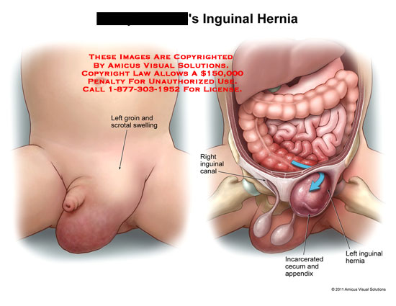
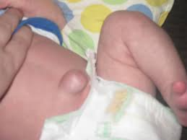
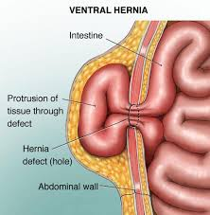

Slide 42
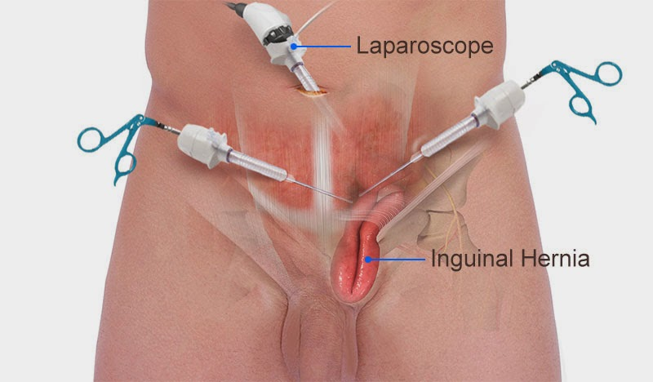
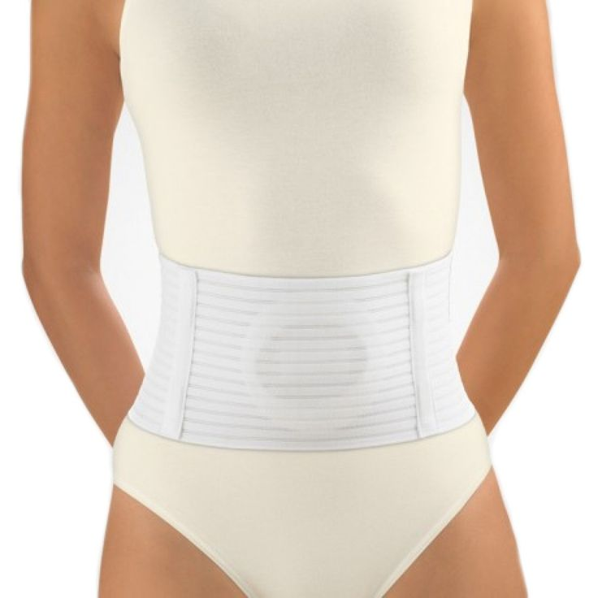
Management
Conservative: pressure
Herniorrhaphy
Surgery: Herniotomy
Herniorraphy
Hernioplasty

Slide 43
Obstruction by a Volvulus
A twisting or axial rotation of a portion of bowel about its mesentery. When complete it forms a closed loop obstruction→ ischemia
SURGICAL EMERGENCY!!!!!!!

Slide 44
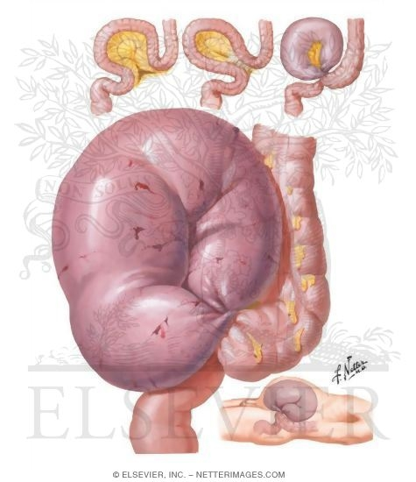
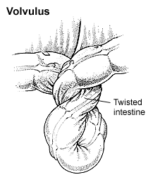

Slide 45
Can be primary or secondary:
1°: congenital malformation of the gut
(e.g: volvulus neonatorum, cecal or sigmoid volvulus)
2°: more common, due to rotation of a piece of bowel around an acquired adhesion or stoma
Commonest spontaneous type in adult is sigmoid, can be relieved by decompression per anal
Surgery is required to prevent or relieve ischemia

Slide 46
Surgical Management
Laparascopy
Laparatomy
Sigmoidoscopy

Slide 47
Acute intussusceptions SURGICAL EMERGENCY!!!!
Occurs when one portion of the gut becomes invaginated within an immediately adjacent segment.
Common in 1st year of life or after a viral illness→ enlargement of Peyer’s patches(grp of lymph nodes)
Ileocolic is the commonest variety in child.
Colocolic intussusception commonest in adult

Slide 48
An intussusceptions is composed of three parts :
the entering or inner tube;
the returning or middle tube;
the sheath or outer tube (intussusceptions).

Slide 49
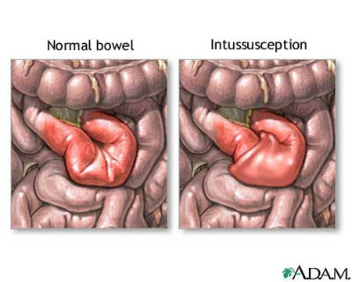

Slide 50
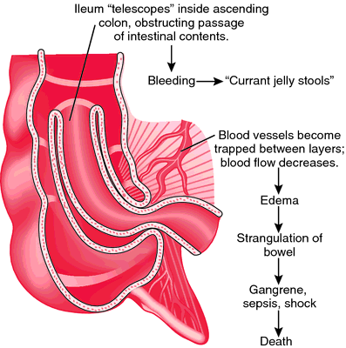
Red currant jelly stools

Slide 51
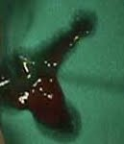
Signs & symptoms: child
Classically, a previously healthy infant presents with colicky pain and vomiting (milk then bile).
Between episodes the child initially appears well.
Later, they may pass a ‘red currant
jelly’ stool.

Slide 52
CARDINAL FEATURES:
Colicky pain
Vomiting
Abd distention
Constipation
OTHER FEATURES:
Dehydration
Hypokalaemia
Pyrexia
Abd tenderness

Slide 53
INVESTIGATIONS:
Lab:
FBC (leukocytosis, anaemia, hematocrit, platelets)
Clotting profile
Arterial blood gasses
U& Crt, Na, K, Amylase, LFT and glucose, LDH
Group and save (x-match if needed)
Optional (ESR, CRP, Hepatitis profile)

Slide 54
Radiological:
Plain ABDOMINAL xrays
USS ( free fluid, masses, mucosal folds, pattern of paristalsis, Doppler of mesenteric vasulature, solid organs)
Other advanced studies (CT, MRI, Contrast studies)

Slide 55
TREATMENT OF INTESTINAL OBSTRUCTION
Supportive
1. Resuscitation
2. Ryle tube free flow with 4 hourly aspiration
-Decompression of proximal to the obstruction, reduce subsequent aspiration during induction of anesthesia and post extubation.
3. IV drip normal saline / Hartmann
4. Broad spectrum antibiotic (not mandatory but need in all patient undergoing surgery.

Slide 56
Surgical
Ind: obstructed / strangulated external hernia, Internal intestinal strangulation and acute obstruction
Midline incision usually look on CECUM
Operative decompression
Look at viability of intestine
Large bowel obstruction: colostomy
Notes:
Immediate intervention:
Evidence of strangulation (hernia….etc)
Signs of peritonitis resulting from perforation or ischemia
In the next 24-48 hours
Clear indication of no resolution of obstruction ( Clinical, radiological).
Diagnosis is unclear in a virgin abdomen
Viable:
-dark color comes lighter, peristalsis, shiny peritoneum, maesentery bleeds if pricked, firm intestinal musculature, pressure ring may or may not disappear
Non viable:
-dark color remains, no peristalsis, dull and lusterless peritoneum, no bleeding if mesentery is pricked, flabby, thin, and friable intestinal musculature, pressure ring persist.
Resuscitation then opened abdomen through midline incision
Assess caecum : distension means large bowel involvement
Removable lesion found in caecum, ascending colon, or proximal transverse colon→ right hemicolectomy should be performed
Lesions is irremovable, a proximal stoma or ileo transverse bypass should be considered

Slide 57
INDICATIONS FOR SURGERY
Absolute
Generalised peritonitis
Localised peritonitis
Visceral perforation
Irreducible hernia
Relative
Palpable mass lesion
'Virgin' abdomen
Failure to improve
Trial of conservatism
Incomplete obstruction
Previous surgery
Advanced malignancy
Diagnostic doubt - possible ileus

Slide 58
MANAGEMENT FOR LARGE BOWEL OBSTRUCTION
All patients require
Adequate resuscitation
Prophylactic antibiotics
Consenting and marking for potential stoma formation
At operation
Full laparotomy should be performed
Liver should be palpated for metastases
Colon inspected for synchronous tumors

Slide 59
Complications associated with intestinal obstruction repair
excessive bleeding
infection
formation of abscesses (pockets of pus)
leakage of stool from an anastomosis
adhesion formation
paralytic ileus (temporary paralysis of the intestines)
reoccurrence of the obstruction.

Slide 60
ADYNAMIC OBSTRUCTION
Adynamic can be due to:
neurological causes
Is a result of excessive sympathetic stimulation or lack of parasympathetic stimulation
( paralytic ileus )
vascular obstruction
Atheroma in the blood vessels
Embolism
Ileus 2º to mechanical obstruction

Slide 61
Neurological causes: 1. PARALYTIC ILEUS
A state in which there is a failure of transmission of peristaltic waves 2° to neuromuscular failure ( in Auerbach’s and Meissner’s plexuses)
Stasis → leads to accumulation of fluid and gas within bowel:-distension, vomiting, absence of bowel sound and absolute constipation
Varieties factors: postoperative, infection, reflex ileus and metabolic
Radiological: gas filled loops of intestines with multiple fluid levels
Notes:
Postoperative: only 24 to 72 hours. Prolonged in hypoproteinemia, and metabolic abnormality
Infection: intraabdominal sepsis
Metabolic: uremia and hypokalemia
Reflex ileus: spine, rib, retroperitoneal hemorrhage and application of plaster jacket

Slide 62
Management:
Essence of treatment→ prevention with use of nasogastric suction and restriction of oral intake until bowel sound and passage of flatus return
Maintain electrolyte balance
Specific treatment:
Remove primary cause
Decompressed GI distension
If prolong paralytic ileus , consider laparotomy→ exclude hidden cause and facilitate bowel decompression

Slide 63
2. Hirschsprung’s Disease
Hirschsprung disease is a developmental disorder characterized by absence of ganglia in the distal colon, resulting in a functional obstruction.
Diagnosed early in life and should be considered in any newborn who does not pass stool in the first 24-48 hrs of life
Surgical removal of the aganglionic portion is done

Slide 64
PSEUDO-OBSTRUCTION
Obstruction usually colon- occur in the absence of mechanical cause or acute intra-abdominal disease.
Associated with a variety of syndromes in which there is underlying neuropathy and/or a range of other factors

Slide 65
Small intestinal pseudo-obstruction
may be primary (i.e. idiopathic or associated with
familial visceral myopathy or secondary.
There’s recurrent subacute obstruction.
The diagnosis is made by the exclusion of a mechanical cause.
Treatment consists of
initial correction of any underlying disorder.
Metoclopramide and erythromycin may be of use.

Slide 66
Colonic pseudo-obstruction (Ogilvie’s syndrome )
Can be acute / chronic. Usually acute.
Radiographs :colonic obstruction, with marked cecal distension
Confirmation of absence of mechanical cause by colonoscopy or single contrast water soluble barium enema or CT should be done.
Treated by colonoscopic decompression

Slide 67
Vascular obstruction: Acute Mesenteric Occlusion
Acute ischemic of mesenteric vessel.
Causes: Atrial fibrillation(AF), Mural thrombosis, atheromatous plaque from aortic aneurysm and valve vegetation from endocarditis
Features:Sudden onset of severe abd. pain in pt with AF and atherosclerosis, Persistent vomiting and defecation, melena stools, Hypovolemic shock

Slide 68
Investigations:
- Neutrophil leukocytosis
- Abd Xray: Absence of gas in thickened small intestines
Treatment: - Anti-coagulant
- Embolectomy
- Revascularization
- Colectomy

Slide 69
5. CANCER OF RECTUM AND COLON
Most prevalent intestinal cancer
Occurs both in male and female
Etiology
Associated with:
Diverticulosis
Ulcerative colitis
Low fibre diet
Excessive fat or protein

Slide 70
Pathophysiology
It is thought that the intestinal bacteria produce microbial metabolites
Carcinogens from the dietary fat and from the bile steroids
Clinical manifestation
Rectal bleeding
Alternating constipation and diarrhea
Pain in the lower quadrant
Anemia-hypochromic
A lump in the iliac fossa
Abdominal distention
Weakness and general malaise

Slide 71
Management
Diagnosis
Management
Barium enema
Barium meal
Sigmoidoscopy
Fibre optic colonoscopy
Surgical excision and creation of colostomy
Chemotherapy
Radiation
Pre-op management
Post-management
Care of colostomy

Slide 72
6. HAEMORRHOIDS
Etiology
Prolonged constipation
Straining when defecating
Pregnancy
Heavy lifting
Large pelvic tumors
Liver disease
Dilated veins at the anal area
Types
External-small dilated veins situated on the anal margin
Internal-found inside the bowel

Slide 73
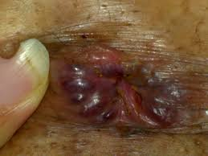
Patients in lithotomy position with hemorrhoids

Slide 74
Clinical manifestations
Bleeding during defecation
Feels a mass in the rectum
Prolonged constipation
Pain of the prolapse

Slide 75
Management
Warm compressions or sitz births
Diet high in fibers
Drugs( laxatives, steroid suppositories hemorrhoids)
Sclerotherapy (quinine, polidocanol or zinc chloride)
Rubber band ligation (banding)
Hemorrhoidectomy-post op care

Slide 76
Post-op Complications
Pain in their anal region afterwards.
Bowel movements and sitting can hurt as a result.
Bleeding
wound infections, abscesses,
narrowing of the anus (anal stenosis), and – rarely
fecal incontinence.

Slide 77
7. PERITONITIS
Peritonitis is an inflammation of the peritoneum, the serous membrane that lines part of the abdominal cavity.
Localized or generalized, and may result from infection and from a non-infectious process.

Slide 78
Classification/types
1-Infected peritonitis (localized or generalized infected peritonitis) or none infected peritonitis
2 Primary or secondary peritonitis

Slide 79
Primary peritonitis is caused by the spread of an infection from the blood and lymph nodes to the peritoneum.
Secondary peritonitis is the more common type of peritonitis, happens when the infection comes into the peritoneum from the gastrointestinal or biliary tract

Slide 80
Risk factors
1º
Liver disease (cirrhosis)
Ascites
Weak immune system
PID
2⁰
Appendicitis (inflammation of the appendix)
Stomach ulcers, Twisted intestine, Pancreatitis
Inflammatory bowel disease, Injury caused by an operation.
Peritoneal dialysis, Trauma.

Slide 81
Infected peritonitis
pyogenic bacteria - E-coli
Aerobic and anaerobic streptococci staphylococci
Causative organisms

Slide 82
Perforation of the distal colon
perforation of the stomach as peptic ulcer, gastric carcinoma
perforation of the duodenum (peptic ulcer)
perforation of the remaining intestine (e.g., appendicitis, inflammatory bowel disease, intestinal infarction, intestinal strangulation, colorectal carcinoma.

Slide 83
Or perforation of the gall bladder (cholesystitis).
Other possible reasons for perforation include abdominal trauma, ingestion of a sharp forgin body, perforation by an endoscope or catheter.
Disruption of the peritoneum, even in the absence of perforation of a hollow viscus, may also cause infection by letting micro-organism into the peritoneal cavity. Examples include trauma, surgical wound, continuous ambulatory peritoneal dialysis, and intra-peritoneal chemotherapy.

Slide 84
Non-infected peritonitis
Leakage of sterile body fluids into the peritoneum, such as blood, gastric juice (e.g., peptic ulcer, gastric carcinoma), bile (e.g., liver), urine (pelvic trauma), pancreatic juice (pancreatitis).

Slide 85
Direct entry through an operative or traumatic wound.
Intra-peritoneal dialysis predisposes to peritoneal infection
Though blood spread in cases of septicemia and pyemia but is rare.
Systemic or localized infections (such as tuberculosis) may rarely have a peritoneal localization.

Slide 86
Note: While these body fluids are sterile at first, they frequently become infected once they leak out of their organ, leading to infectious peritonitis within 24 to 48 hours.
Sterile abdominal surgery under normal circumstances, causes localized or minimal generalized peritonitis through a foreign body reaction and/or fibrotic adhesions.

Slide 87
Pathophysiology
In normal conditions, the peritoneum appears greyish and glistening. It becomes dull 2–4 hours after the onset of peritonitis, initially with serous or slightly turbid fluid.
Peritonitis is caused by leakage of contents from abdominal organs into the abdominal cavity, usually as a result of inflammation, infection, ischemia, trauma, or tumor perforation.

Slide 88
Bacterial proliferation occurs.
Edema of the tissues results and exudation of fluid develops in a short time. This fluid in the peritoneal cavity becomes turbid with increasing amounts of protein, white blood cells, cellular debris, and blood. Immediate hypermotility of intestines develops followed by paralytic ileus with an accumulation of air and fluid in the bowel. Later on, the exudate becomes creamy and suppurative. It may spread to the whole peritoneum

Slide 89
Nursing process:
A-Assessment through:
Signs and symptoms of peritonitis:
Abdominal pain and tenderness. At first, a diffuse type of pain is felt. The pain tends to become constant, localized, and more intense near the site of the inflammation.

Slide 90
Diffuse abdominal rigidity, Swelling and tenderness in the abdomen with pain ranging from dull aches to severe, sharp pain is often present, especially in generalized peritonitis
Fever and chills, loss of appetite, thirst, nausea and vomiting.

Slide 91
Reduced urine output
Not being able to pass gas or stool
Sinus tachycardia
Paralytic ileus with nausea, vomiting, distension.
Auscultation reveals absent of bowel sound due to paralytic ileus
In neglected cases the patient will present by sunken eyes

Slide 92
Diagnostic parameters:
A diagnosis of peritonitis is based on the clinical manifestations.
Blood picture for leukocytosis.
hypokalemia, hypernatremia, and acidosis may be present, but they are not specific findings.
Abdominal X-rays may reveal dilated, edematous intestines,

Slide 93
Computed tomography may be useful in differentiating causes of abdominal pain.
Paracentesis.
Culture of the peritoneal fluid
B-Nursing diagnosis:
Abdominal pain.
Fluid volume deficit.
Alteration in tissue perfusion

Slide 94
C- Nursing intervention:
Monitor and document the severity, consistency, location and other characteristics of pain.
The patient is placed on the side with knees flexed; this position decreases tension on the abdominal organs and maximize comfort.

Slide 95
Accurate recording of all intake and output and central venous pressure assists in calculating fluid replacement.
Monitor the quantity and quality of output from nasogastric tube
Maintain intravenous therapy.
Monitor the patient for signs and symptoms of shock.

Slide 96
Monitor the patient's bowel sounds by assessing for flatus or bowel movement.
Monitor the patient's mental, cardiac, and pulmonary status.
Monitor Signs that indicate that peritonitis is subsiding include a decrease in temperature and pulse rate, softening of the abdomen, return of peristaltic sounds, passing of flatus, and bowel movements.
Increase fluid and food intake gradually and reduces parenteral fluids as prescribed.

Slide 97
Medical /Surgical Treatment of peritonitis:
General supportive measures such as intravenous rehydration and correction of electrolyte disturbances.
Antibiotics are usually administered intravenously, but they may also be infused directly into the peritoneum.
laparotomy is needed to perform a full exploration and lavage of the peritoneum.

Slide 98
Preoperative preparation:
A nasogastric tube is inserted to deflate the stomach and bowels and to prevent vomiting during induction of anesthesia.
Intravenous fluids as saline or ringer solution are administered to correct the hypovolemia.
Antibiotics: a combination of ampicillin, an aminoglycoside and metroniazol can cover all aerobic and anaerobic organisms.

Slide 99
Analgesics are given for pain relieve.
Foley catheter is inserted to check the urine output and the adequacy of fluid replacement.

Slide 100
Post operative care:
Continuous antibiotic treatment.
Drains are inserted during the surgical procedure, and the nurse must observe and record the character of the drainage postoperatively.
Care must be taken when moving and turning the patient to prevent the drains from being dislodged.
Prepare the patient and family for discharge by teaching him to care for the incision and drains if he will be sent home with the drains.

Slide 101
Complications
Sequestration of fluid and electrolytes, as revealed by decreased central venous pressure, may cause electrolytes disturbances.
Hypovolemia, leading to shock and acute renal failure.

Slide 102
A peritoneal abscess.
sepsis may develop, so blood cultures should be obtained.
The fluid may push on the diaphragm, causing splinting and subsequent breathing difficulties.
Formation of fibrous tissue in the peritoneum
Adult respiratory distress syndrome.

Slide 103
8. ACUTE APPENDICITIS
Appendicitis = Inflammation of the appendix.
Mostly young people (age 10-20) but can present at any age
M>F (1.4:1)
Common – 7-9% lifetime risk

Slide 104
Appendix lumen may become obstructed by:-
Fecal material-
Foreign body-
Carcinoma of the cecum-
Stenosis-
Inflammation-
Kinking of the organ

Slide 105
Pathophysiology
Appendix fills and empties as the cecum.
If obstruction from any of the above factors occurs, the appendix subsequently becomes filled with mucus and swells, increasing pressures within the lumen and the walls of the appendix, resulting in thrombosis and occlusion of the small vessels, and stasis of lymphatic flow.

Slide 106
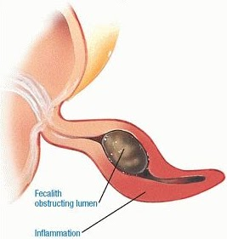
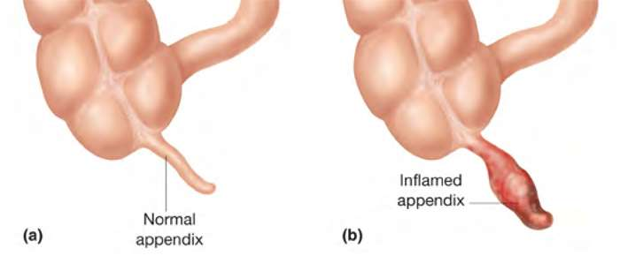
Fecalith obstructing lumen
inflammation

Slide 107
“Typical” Presentation
Dull, crampy central abd pain
Malaise/vomiting/anorexia/low grade fevers
Pain worsens & localises to RIF with cough/movement tenderness
Systemic symptoms

Slide 108
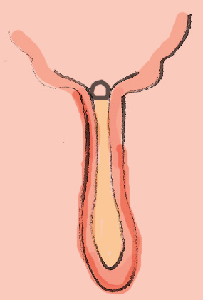
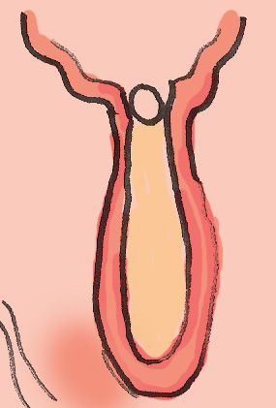
Early Appendicitis
Pain:
Location: Periumbilical
Character: Dull
Over time: Colicky
Associated symptoms:
Vomiting
Anorexia
obstruction
distension
mucus

Slide 109
Later Appendicitis
Exam findings:
“peritonism”
Guarding
rebound tenderness
percussion tenderness
Rovsing, Psoas, other signs
Pain:
Location: R. Iliac Fossa
Character: Localised
Over time: Constant
Aggravating: going over bumps, coughing, walking
Relieving: hip flexion, staying still

Slide 110
Late Appendicitis
Pain:
Location: lower abdominal/generalised
Character: diffuse, severe
Over time: constant
Aggravating: movement, coughing, palpation, rebound
Associated: Fever
Exam findings:
Systemic features- fever, tachycardia, hypotension
Abdominal – severe, generalised “peritonism”
RIF mass (sometimes)

Slide 111
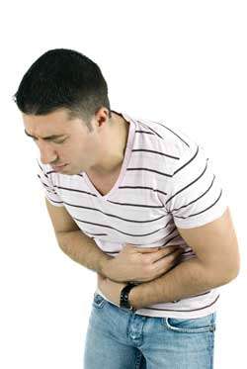
Special Clinical signs
Abdominal examination
Psoas Sign – pain on hip extension
Rovsing Sign – R. iliac fossa pain on palpating LIF
“The walk” – walk with R hip flexed, bent over
Pain on coughing/unable to cough

Slide 112
Complications
Rupture and sepsis
Periappendiceal Abscess

Slide 113
Clinching the diagnosis
Appendicitis is usually a clinical diagnosis- ie history + examination.
However sometimes you’re just not sure! All those ovaries, fallopian tubes, ureters, atypical presentations…perhaps you could order some tests?

Slide 114
Pathology/Lab investigations
White cell count (WCC) – usually mildly elevated.
C. reactive protein (CRP) – also elevated
Urinalysis sometimes positive for blood, leuks; not very helpful in discriminating vs UTI
Electrolytes, renal function, haemoglobin, platelets, liver function, coagulation should all be normal unless profoundly unwell- if abnormal think of other things.

Slide 115
Imaging
CT
Good for getting an overview of all the structures esp bowel
Accurate- sensitive and specific >90%
Less good at pelvic anatomy than abdominal anatomy
Radiation exposure
Ultrasound(will rule out other conditions)

Slide 116
Diagnostic Laparoscopy
Safe
Useful for when diagnosis is unclear
Esp in females w/ suspected gynecological pathology e,g endometriosis/menstruating/ovulating)
Management
Supportive / symptomatic management
Antibiotics/fluids/etc
Treatment of underlying cause
3. Appendectomy

Slide 117
Septic shock
Systemic inflammatory response- usual appropriate local responses make no sense when :-
Generalised vasodilation (flushing), capillary leak- fluid leaves central circulation
Hypotension, tachycardia- organs not perfused properly
Either fever or hypothermia
Other complications like coagulopathy/DIC/multiorgan failure present
ARDS in severe sepsis- hypoxia ocuurs

Slide 118
Treatment of infection, sepsis
Antibiotics- in appendicitis cover gram negs (gentamicin/ceftriaxone), enterococcus (ampicillin/vancomycin), anaerobes (metronidazole)
Drain pus, remove infected material
Replace fluid that is lost peripherally – IV cannula, fluid resuscitation
Blood tests, imaging, other tests- find source
Correct other organ dysfunction
If necessary ICU and advanced life support

Slide 119
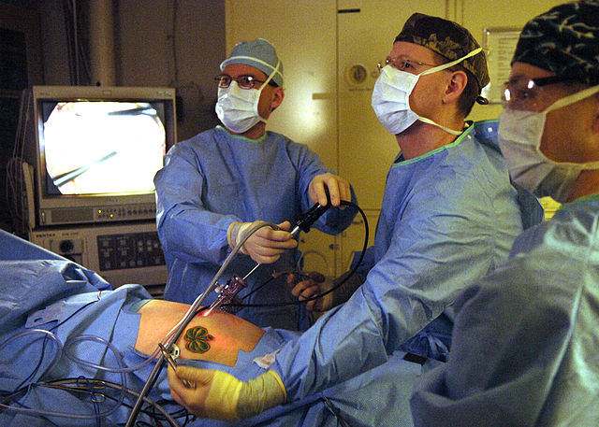
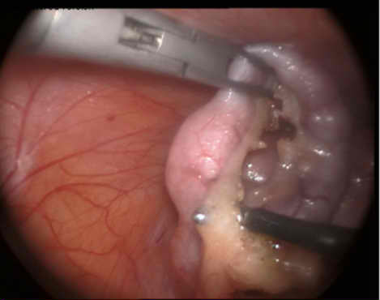
Appendectomy - Laparoscopic
“Keyhole” surgery
Lower complication rate, quicker recovery
Sometimes difficulty in mobilisation requiring open procedure

Slide 120
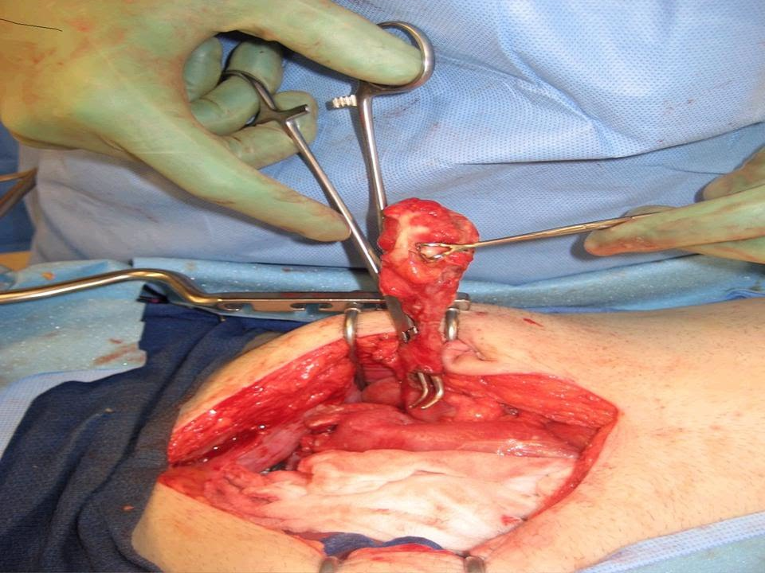
Appendicectomy - Open
Incision over McBurney’s point or point of maximal tenderness
Straightforward, good exposure, technically easier
Longer recovery, risk of hernia &
adhesions, can’t see pelvic structures as well

Slide 121
Anal Fissure
Definition: tear or ulceration in the lining of anal canal results from constipation, child birth & trauma
Clinical Features
Severe pain during a bowel movement, with the pain lasting minutes - hours afterward.
The pain leading to a cycle of worsening constipation, harder stools, and more anal pain.
Bright red blood on the toilet paper or stool but no significant bleeding
Mucous anal discharge and pruritus ani are also common

Slide 122
Diagnosis
History taking
Physical examination
Rectal examination
Sigmoidoscopy

Slide 123
Management
The goals of treatment are to relieve the constipation and pain thus to break the cycle of hard bowel movement, associated pain, and worsening constipation and spasm of internal anal sphincter.
Initial therapy for an anal fissure is medical in nature, and more than 80% of acute anal fissures resolve without further therapy.
Softer bowel movements are easier and less painful for the patient to pass.
Conservative treatment ( stool softener, sitz bath, analgesics )
Anal dilatation & fissure excision

Slide 124
Treatment
Conservative treatment (sitz bath, laxative, high residual diet, anesthetic ointments & rest)
Injection of sclerosing solutions
Rubber band ligation procedure
Hemorrhoidectomy

Slide 125
First-line medical therapy
Diet modification increase -water and fibres-fruits and vegetables.
Stool-bulking agents/Stool softeners -such as fiber supplementation and stool softeners-polyethylene glycol
Laxatives are used as needed to maintain regular bowel movements.-Lactulose
Mineral oil may be added to facilitate passage of stool without as much stretching or abrasion of the anal not used for long.
Sitz baths after bowel movements - symptomatic relief as they relieve painful internal sphincter muscle spasm.

Slide 126
2nd medical therapy
Topical application of 0.2% nitroglycerin (NTG) ointment directly to the internal sphincter.
NTG ointment is thought to relax the internal sphincter and to help relieve some of the pain associated with sphincter spasm; it also is thought to increase blood flow to the anal mucosa.
main adverse effects are headache and dizziness; could be used directly before bedtime

Slide 127
Nursing management
Pre-operative: cleansing enema, shaving & cross match, Hb + IV fluids
Post-operative: analgesia ½ hour before defecation, sitz bath in warm saline & remove the back
Conservative treatment (sitz bath, laxative, high residual diet, anesthetic ointments & rest)
Injection of sclerosing solutions
Rubber band ligation procedure
Hemorrhoidectomy

Slide 128
COLOSTOMY
An artificial opening for elimination of faecal matter
Indication
-Cancer
-Perforated diverticular
-Enteric fistula
-Intestinal obstruction
-Penetrating injuries

Slide 129
Types
-Ascending
-transverse ( loop and double barrel)
-Descending/ sigmoid
Pre op care
-Psychological care and counseling
-Involve the relatives in the care
-Health messages
-allay anxiety

Slide 130
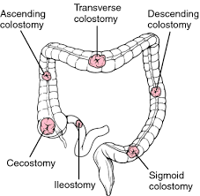

Slide 131
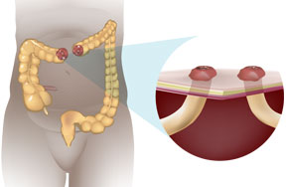
Both ends of the bowel are brought through the abdomen to the skin surface as two separate sections.
Distal colon is not removed but bypassed.
The proximal stoma, diverts feces to the abdominal wall.
Distal stoma lets out mucus

Slide 132
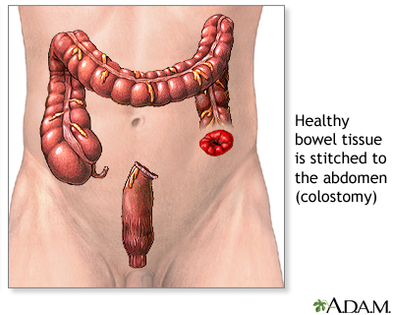

Slide 133
Skin preparation
Apply adhesives to ascertain allergies
Correct any fluid electrolyte imbalance
Post op care
Observe stoma for color
Observe for drainage and rule out obstruction
Change colostomy bag appropriately
Dress the stoma as directed

Slide 134
Colostomy irrigation
-Patients education
Complications
-Infections
-Bowel prolapse
-Perforation
-Blockage

Slide 135
Patient to seek medical care if:-
Severe cramps lasting more than two or three hours
Unusual odor lasting more than a week
Unusual change in stoma size and appearance
Obstruction at the stoma and/or prolapse of the stoma
Excessive bleeding from the stoma opening, or a moderate amount in the pouch

Slide 136
Severe injury or cut to the stoma
Continuous bleeding at the junction between stoma and skin
Watery discharge lasting more than five or six hours
Chronic skin irritation
Stenosis of the stoma (narrowing)
Unable to wear the pouching system for 2-3 days without leakage

