Slide 1
CLASSIFICATION OF MICRO ORGANISMS

Slide 2
Microbiology
Content
Classification of bacteria
Properties of bacteria
Clinical importance of microorganisms
Concept of infection- terms, stages, nosocomial infection

Slide 3
Microorganisms can either be;
Eukaryotic microorganisms – organisms whose cells contain a nucleus and other structures enclosed within membranes e.g. fungi, protozoa
Prokaryotic microorganisms – is a single-celled organism that lacks a membrane-bound nucleus , mitochondria, or any other membrane-bound organelle

Slide 4
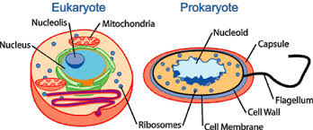
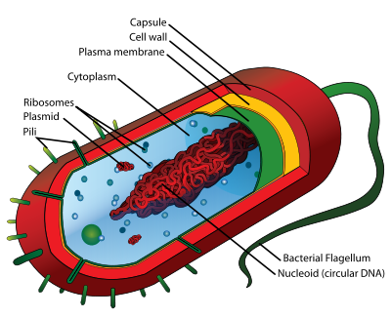
Eukaryote cell vs prokaryote cell
.
Prokaryote

Slide 5
How useful is medical microbiology?
Health risks can be identified and prevented
Monitoring of virulent or resistant strains of microbes
Educating the community and helping in the design of health practices
Preventing or controlling epidemics and outbreaks of disease
Development of antibiotics and other treatment methods

Slide 6
Medical Microbiology can be classified into;
Bacteriology – the study of bacteria.
Mycology- study of fungi
Virology – The scientific study of viruses Parasitology – it is the study of parasites, their hosts and the relationship between them

Slide 7
Factors promoting growth and development of microorganism
Nutrients: all microorganisms need food primarily from carbon and nitrogen form substances e.g carbohydrates, proteins, fats and air
Temperature – the higher the temperature, the more easily microorganisms can grow to a certain point. Very high or very low temperatures obstruct enzyme activities in Microorganisms. Can be divided to :
Psychrophilles – prefer temperature of 0-5 degrees
Mesophilles - prefer temperature of 20-45 degrees
Thermophilles – prefer temperature of above 55 degrees
PH levels – Most prefer a neutral PH, some a high PH. Acidic PH tends to break down their enzymes
Moisture – free flow of water is important to microorganisms tor their cells to exchange nutrients and for metabolic processes. All microorganisms require water, some less. The more moisture, the more microorganisms will be found
Oxygen and nitrogen–Many microorganism require an oxygen rich environment (aerobic) but others flourish in low oxygen surroundings (anaerobic) or some can survive in either

Slide 8
Oxygen requirements
Obligate aerobe- are bacteria that only grow in presence of oxygen
Microaerophilic- are those that grow in low oxygen concentration
Obligate anaerobe- are those bacteria that grow in absence of free oxygen
Facultative anaerobe- are those that grow in absence or presence of oxygen

Slide 9
Importance of Microbiology
In Health
Helps in identifying the pathogenic microbes and how they cause illness thus help in devising prevention and treatment of the illnesses
Microorganisms are related to production of antibiotics, enzymes, vitamins and vaccines thus can be used in drug and vaccine development e.g penicillin
Microorganisms found in the body as normal flora prevents potential pathogens from gaining access to our body, help in processes such as digestion, production of Vitamin K and B
In Industry
Industrial processes such as fermentation e.g breweries, wastewater treatment and preservation are related to microorganisms. produce various food products; cheese, pickles, sauerkraut, green olives, yoghurt, soy sauce, vinegar, bread, Beer, Wine, Alcohol
In agriculture – plant microorganisms, animal microorganisms, soil microorganisms applied in agro and veterinary medicine
Using bacteria to control the growth of insects e.g Bacillus thuringiensis to control caterpillars, bollworms, corn borers
In environment –
Cause biodegradation of wastes, Bacteria are primary decomposers - recycle nutrients back into the environment (sewage treatment plants)
Form part of food chain

Slide 10
BACTERIA
STRUCTURE OF BACTERIA
Bacteria are the smallest cells and can only be viewed by a microscope – approx 1um and are visible via a light microscope that has a resolution of 0.2um
Animal and plant cells are much larger ranging from 7um(diameter of RBC)
Each cell has genetic material in its DNA that transcribes genetic information to mRNA and translates mRNA to proteins.
Each cell also has mechanisms for producing energy enclosed within the membrane
Bacteria can survive and grow in hostile environments e.g low osmotic pressures, extreme temperatures, dry areas where most eukaryotic cells would not survive. They have evolved structures and functions to survive.

Slide 11
.
Bacteria are prokaryotes
Bacteria are prokaryotic organisms – simple, unicellular, no clear nuclear membrane no golgi apparatus and no endoplasmic reticulum.
They reproduce via asexual division
All bacteria have a cell wall encircling the cell membrane made of peptidoglycans. Some bacteria lack this and compensate by surviving only inside host cells or in a hypertonic environment.
The size (0.5 - 5um), shape (spheres, rods, spirals), and arrangement (single cells, chains, clusters are used for preliminary classification. The phenotypic(observable physical and biochemical properties) and genotypic properties form the basis of definitive classification.
We are surrounded by bacteria in our environment

Slide 12
Comparison btn eukaryotes and prokaryotes
 | Eukaryotes (animals, plants fungi, protozoa) | Prokaryotes (bacteria)
Approx.size | Above 5um | 0.5 – 3um
Nucleus | Classic membrane | No nuclear membrane
 | Strands of DNA. | Single, double stranded, circular DNA. Not contained in nucleus but in a discrete area known as nucleoid. Has also plasmids that contain extrachromosomal DNA
Mitochondria, golgi bodies,endoplasmic reticulum | Present | Absent
Ribosomes | Present | Present – for protein synthesis
Cytoplasmic membrane (cell membrane) | Present – has steroids | Present – no steroids – for transport, ion transport to maintain membrane potential and energy production
Cell wall | Absent (or made of chitin in plants) | Complex structure made of peptidoglycans
Reproduction | Sexual or asexual | Asexual (binary fusion)
External structures | Not present | Simple flagellum , capsule, fimbriae present
Respiration | Via mitochondria | Via cytoplasmic membrane(cell membrane

Slide 13
Prokaryotic cell; bacteria

Slide 14
Classification of bacteria
1. Morphology
Size
Shape – cocci, bacillus, curved or spiral
Staining characteristics
Appearance of colonies – some are hemolytic, some form chains, clusters
Metabolic characteristics
2. Biochemical tests;can identify a microorganism with precision. E.g
Cogulase test
Catalase test
3. Serological tests
Refers to determining an organism by their specific antigen. Used to identify organisms that are biochemically inert. E.g Treponema pallidum – cannot grow colonies or cannot run tests
4. Analyzing patterns of susceptibility to different antibiotics
5.Genotyping – Refers to use of DNA sequence to define an organism or defining an organism using its genetic characteristics

Slide 15
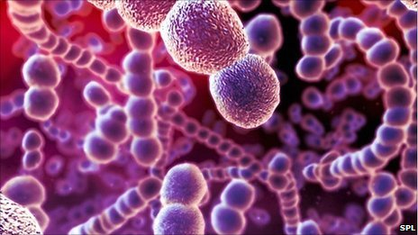
Morphology continues
cocci
A spherical bacteria is a coccus – staphylococcus
a) Cocci in cluster—staphylococci e.g Staphylococcus aureus
(d) Cocci in groups of four—tetrad
(b) Cocci in chain—streptococci e.g Streptococcus pyogenes
(e) Cocci in group of eight—sarcina
(c) Cocci in pair—diplococci e.g Nesseria species
.

Slide 16
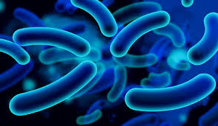
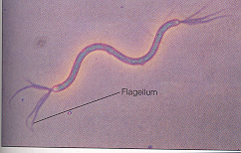
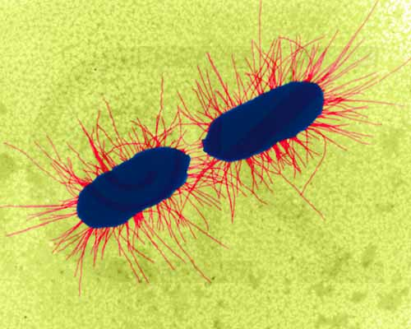
Morphological classification cont
bacillus
A rod shaped bacteria is a bacillus – they are;
Coccobacilli; length may approximate the width of the organisms, e.g. brucella.
Chinese letter arrangement e.g corynebacteria.
Vibrio: comma shaped,
Spirochaetes; coiled like hair (spirillum) e.g Treponema pallidum
Actinomycetes ; branching filamentous bacteria like radiating sunrays.
Mycoplasma are organisms which lack cell wall and so do not possess a stable morphology. They are round or oval bodies with interlacing filaments.
.
spirillum
filaments.

Slide 18
Classification by staining
Commonly used stains are Gram staining and Acid fast staining
1. Gram stain
A powerful easy test that allows one to distinguish between 2 classes of bacteria – Gram +ve and Gram -ve.
It uses the properties of the peptidoglycan cell wall to distinguish the gram + and gram – bacteria. Takes 10minutes
Common stains used are crystal violet, gram iodine and safranin
Gram +ve bacteria - turns purple (Retain crystal violet) – the stain gets trapped in a thick, mesh like peptidoglycan layer surrounding the cell (P-Purple-positive)
Gram –ve – turn red – do not retain the crystal violet and are counterstained by safranin – they have a thin peptidoglycan layer that does not retain crystal violet and has to be counterstained by safranin.
Not dependable for starved (old) or stationary bacteria.
Gram- and gram + bacteria have similar internal but very different external structures.
Staining

Slide 19
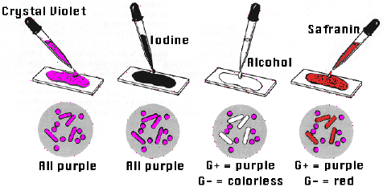
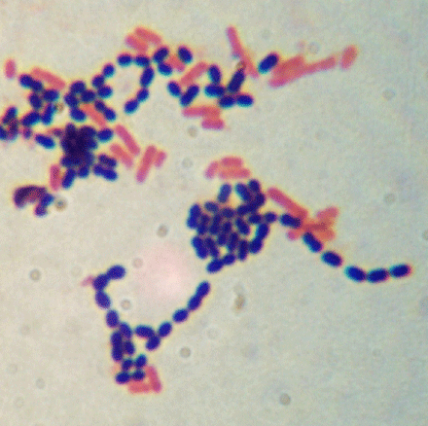
.
Staining
mordant
decolourization
Counterstain

Slide 20
Bacterial cell wall
Cytoplasmic membrane of most bacteria/ prokaryotes are surrounded by a rigid peptidoglycan layer (cell wall). The exceptions are Archaeobacteria and mycoplasma. The cell wall provides rigidity that determines the shape of cell
It is the Target for drugs that can attack and kill bacteria without harming the host cell

Slide 21
Gram +ve bacteria cell wall
Cell wall is composed of thick peptidoglycan, techoic and lipotechoic acid
The cell wall is porous to allow diffusion
It helps in replication and survival in hostile environment
During infection, it interferes with phagocytosis.
It is susceptible to degradation by lysozyme. Without the cell wall, bacteria lyses due to large osmotic pressure differences
Lysozyme is a Digestive enzyme found in tears, saliva & mucus that damages bacterial cell walls
Techoic and lipotechoic acid are surface antigens that help in serotyping – they are important factors in virulence – can attach to host receptors and initiate toxic activities.

Slide 22
Gram –ve bacteria
Have a thin peptidoglycan layer with no teichoic and lipotechoic acid
Have an outer membrane outside the peptidoglycan layer – unique to gram –ve bacteria
The periplasmic space has hydrolytic enzymes for metabolism and lysis in cases of pathogenesis.
The outer membrane is stiff and maintains shape and is a permeability barrier to large molecules e.g. lysozymes
outer membrane protects the cell from adverse environment
The outer membrane also has lipopolysaccharides (lipid A and O antigen) that acts as a powerful endotoxin – stimulates immune response to activate B cells, macrophages that result in fever and shock e.g. Neisseria meningitides
Disruption of the outer membrane by antibiotics weakens the bacteria

Slide 23
Cell wall cont’
Other components of bacterial cell wall common in both gram + and – include
NAM (N-acetylmuramic acid) amino sugars
NAG (N- acetylglucosamine)
Tetrapeptide side chain- form bonds
Pentaglycine crossbridges- essential for cell integrity
MANY ANTIBIOTICS are specifically directed at Cell Wall Synthesis
Penicillin
works by damaging the pentaglycine crossbridges of the peptidogylcan layer
Works best against Gram (+) bacteria

Slide 24
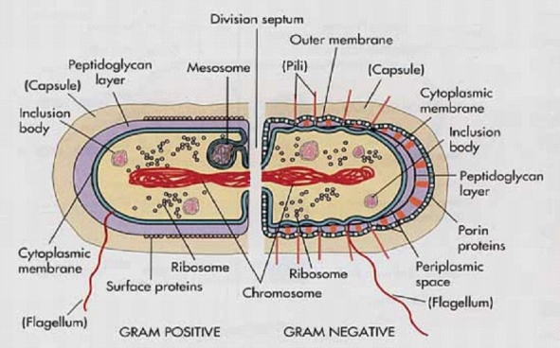
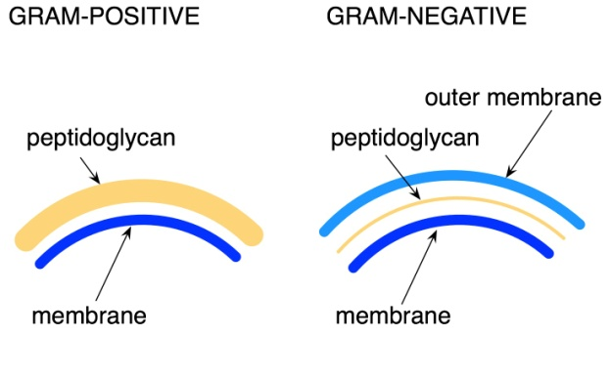
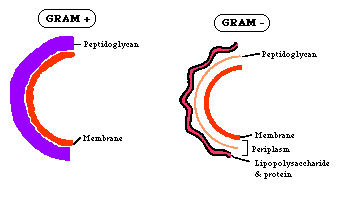
.

Slide 25
Acid - Fast Stain
Differential Stain - divides bacteria into 2 groups
Acid - Fast
Non Acid - Fast
Used to identify organisms in the Genera Mycobacterium (high lipid and wax content in cell wall)
Mycobacterium tuberculosis and Mycobacterium leprae
Mycobacteria have a peptidoglycan with a different structure (made of mycolic acid) and are described as acid – fast (AAFB – acid alcohol fast bacilli) staining. The coat is responsible for virulence and is anti phagocytic

Slide 27
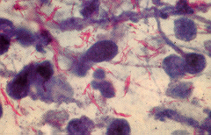
Acid fast staining involves;
Carbolfuchsin (Red)
Acid Alcohol
Counterstain with Methylene Blue
Acid - Fast Cells Red
Non Acid - Fast Blue

Slide 28
Cell Membrane (Plasma Membrane)
2 structural component
double layer of phospholipids
proteins
Functions
Selective barrier (selectively permeable)
Enzymes for cell wall synthesis
Secretes exoenzymes
amylases
lipases
peptidases

Slide 29
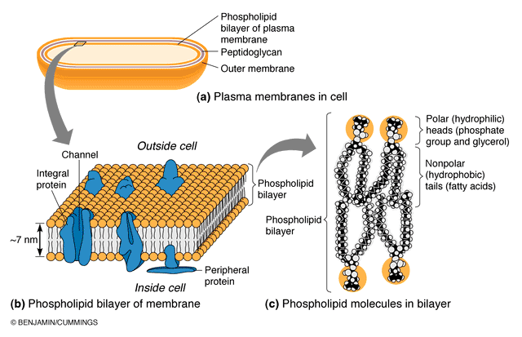

Slide 30
External Structures
Capsule
Some bacteria (gram +or-) are surrounded by a capsule made of loose polysaccharide or protein layer
In cases where it is loose, non adherent and non uniform in density, it is referred to as a slime layer.( capsule and slime layer are also called glycocalyx).
The capsule and slime layer do not participate in bacterial growth but are important for survival in the host.
It is poorly antigenic and antiphagocytic and is a major virulence factor.e.g Streptococcal Pneumonia
The capsule also acts as a barrier to hydrophobic molecules e.g detergents and promotes adherence to other bacteria and host tissue.
Flagella
Are rope like propellers anchored on the bacterial membrane. May be one or several
They provide motility for bacteria allowing them to swim towards food and away from poison (Chemotaxis).
The flagella also express antigenic and strain determinants

Slide 31
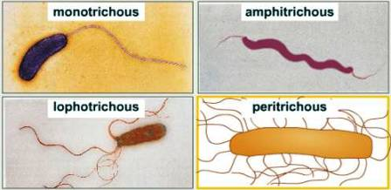
Types of flagella
a) monotrichous - a single flagellum at one end of the cell.
b) lophotrichous - a tuft of flagella (2 or more) at one end of Cell.
c) amphitrichous - one or more flagella at the opposite ends of the cell.
d) peritrichous - flagella present around the entire body of the cell

Slide 32
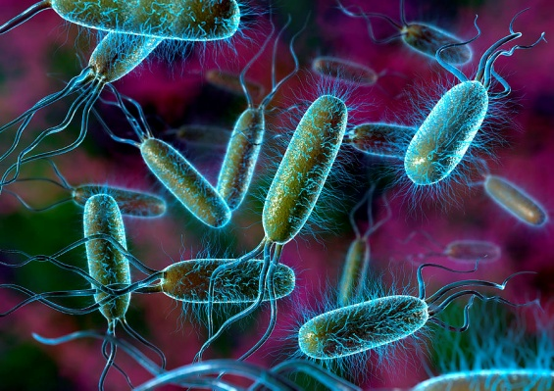
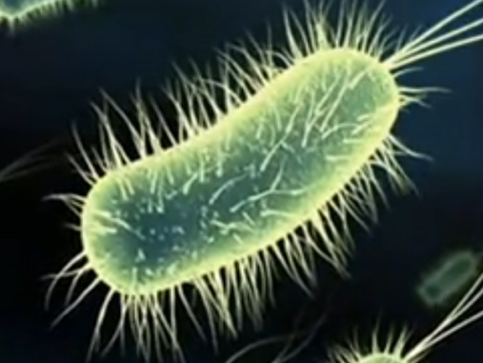
Flagella
Fimbriae or pili
Hair like structures outside the bacteria. They are smaller and not coiled (unlike the flagella). They are arranged uniformly around the bacteria.
They promote adherence to other bacteria or to host. This is an important virulence factor e.g Nesseria gonorrhea. Adherence is also important for Eschericia coli colonization and infection of the urinary tract
Some pili have chromosomes that allow transfer of genetic material between bacteria
.
pili

Slide 33
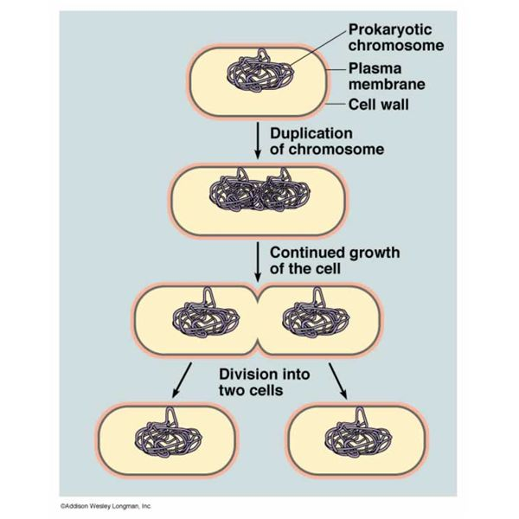
BACTERIAL CELL DIVISION
1. Bacteria reproduce asexually via binary fusion
Replication of bacterial chromosome triggers initiation of cell division
Cell wall extends, septum is formed
Septum grows and cleaves the daughter cell. Incomplete cleavage of the septum can cause bacteria to remain linked forming chains – streptococcus or clusters – Staphylococcus

Slide 34
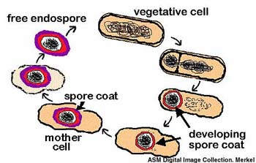
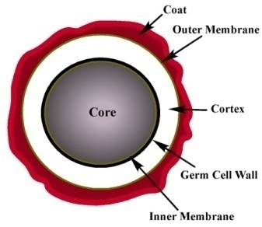
Bacterial cell division cont’
2. spore formation
Some gram +ve bacteria species form spores e.g Bacillus sp. and Clostridia Sp. Esp in harsh envoronment such as lack of nutrients
Gram –ve bacteria do not form spores
The spore has a copy of the chromosome, ribosomes and essential proteins, outer membrane, 2 peptidoglycan layers and an outer keratin like protein layer.
The spore protects bacterial DNA from dessication, intense heat, radiation and attack by eznymes and chemicals
Are so resistant that they can remain viable for centuries
They are difficult to decontaminate with standard disinfectants.
.

Slide 35
Bacterial metabolism
In general, bacteria require a source of carbon, nitrogen, an energy source, water and various ions for growth. Pathogenic bacteria derive energy from metabolizing sugars, fats and proteins.
Not all bacteria require oxygen for growth:
Obligate anaerobes – cannot grow in the presence of oxygen e.g clostridium perfringes
Obligate aerobes – require oxygen for growth e.g Mycobacterium tuberculosis
Facultative anaerobes – grow in either the presence or absence of oxygen

Slide 36
Bacterial growth
For bacterial growth to occur, there must be sufficient metabolites to support synthesis of bacterial components.
When bacteria are added to a medium, they require time to adapt to the new environment before they start dividing. This is the lag phase
They then grow and divide during the log or exponential phase
Eventually the culture runs out of metabolites and toxins build up . the bacteria stop growing and enter the stationary phase.

Slide 37
The lag phase:
The population remains temporarily unchanged. During this period, individual cells increase in size. The cells are physiologically very active in new environment and are synthesizing new protoplasm including necessary enzymes.

Slide 38
The logarithmic or exponential phase:
During this period, the cells divide steadily at a constant rate, and the log of the number of cells plotted against time results in a straight line. The population is most nearly uniform in terms of chemical composition of cells, metabolic activity and other physiological characteristics.

Slide 39
The stationary phase:
The log phase begins to taper off after several hours to another straight (horizontal) line, the stationary phase.
The trend towards cessation of growth can be attributed to exhaustion of some nutrients, and production of toxic products during growth.
The population remains constant for a time, perhaps as a result of complete cessation of division or perhaps the reproduction rate is balanced by an equivalent death rate

Slide 40
The phase of decline or death
Following the stationary phase, the bacteria may die faster than new cells are produced.
Conditions contribute to bacterial death, include depletion of essentials nutrients and accumulation of inhibitory products such as acids. During the death phase, the number of viable cells decreases exponentially - inverse of growth during the log phase

Slide 41
The survival phase:
Bacteria die at different rates, some rapidly so that there may be very few cells left in a culture after 72 hours or less. Other species die so slowly that viable cells may persist for months or even years.

Slide 42
List of common bacteria
GRAM –ve | GRAM +ve
Borellia – spirochete | Streptomyces
Bordatella – Rod | Streptococcus – cocci in chains
Campylobacter – curved rod | Staphylococcus – cocci in clusters
Treponema - spirochete | Nocardia
Vibrio – rod | Listeria - rods
Yersinia – rod | Lactobacillus
Chlamydia | Gardnerella - rods
Enterobacter | Enterococcus
Escherichia – Rods | Corynebacteria
Helicobacter – curved Rods | Clostridium- spore forming
Hemophillus - Rods | Bacillus – rods, some spore forming
Klebsiella – rods | Actinomyces
Legionella – rods
Leptospira - spirochete | EXCEPTIONS
Nesseria – diplococcus | Mycoplasma – No cell wall
Pseudomonas - rod | Mycobacteria – Acid fast bacilli
Ricketssia
Salmonella – rod
Shigella – rod

Slide 43
1.Explain the following terms
a. Thermophilic organisms
b. obligate aerobes
c. Mesophilic anaerobes
d. Facultative anaerobes
2. Give two types of bacteria that produces spores
3. Explain the difference between gram negative and gram positive bacteria giving examples of each

Slide 44
FUNGI
Study of fungi is referred to as mycology
Fungi cause diseases in humans
They also contribute to food spoilage, are a major cause of plant disease and destroy timber, textiles and several synthetic materials
They play a role in the decay of plant and animal remains in the soil
Fungi are also beneficial to humans in that they are used in production of antibiotics, steroids, products of fermentation – alcohol, cheese, wine, bread making
They occupy many niches in the environment
They are free living and abundant in nature, only few exist as normal flora in humans
Fewer of them are associated with human disease
Fungi do not need to colonise or infect tissues of animals or man to perpetuate or preserve the species ( with the exception of candidiasis and tinea versicolor)

Slide 45
Structure
Have a typical eukaryotic cell
They have a cell wall made of chitin
Some fungi have a polysaccharide capsule around the cell wall to isolate it from the environment. This helps in virulence if the fungi are pathogenic
Most fungi respire aerobically, others are strict anaerobes and others are facultative anaerobes
They have special staining to identify them
fungi are heterotrophic ( “other feeding,” must feed on preformed organic material), not autotrophic ( “self feeding,” make their own food by photosynthesis).
- Unlike animals (also heterotrophic), which ingest then digest, fungi digest then ingest they produce exoenzymes to accomplish this
Most fungi store their food as glycogen (like animals). Plants store food as starch.
Fungal cell membranes have a unique sterol, ergosterol, which replaces cholesterol found in mammalian cell membranes

Slide 46
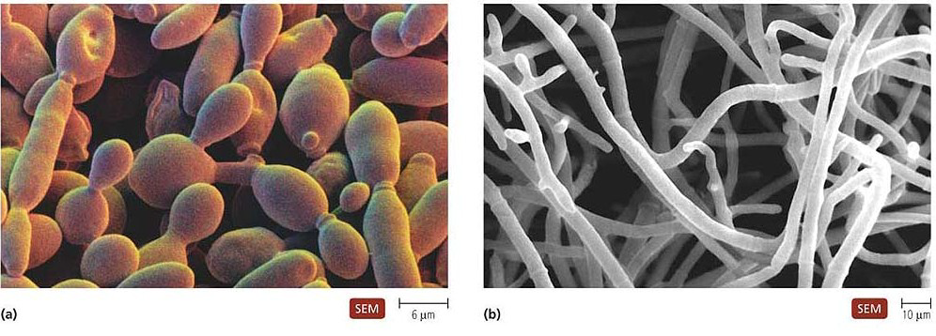
Structure cont’
The body of fungi is termed thallus (non reproductive)
The thalli of yeast are small, globular and are single celled
The thalli of mold are composed of long, branched tubular filaments called hyphae.

Slide 47
Classification
Fungi can be divided into 2 basic morphological forms:
Yeast – unicellular, reproduce asexually by budding or fission
Molds (Hyphae) – branching, thread like, tubular filaments.they elongate at their tips by a process called apical extension. A mass of hyphae forms a mycelium ( commonly known as mold)
The morphology of fungi is not fixed. Some can exist in hyphae or yeast form (dimorphic) depending on the environment (i.e in soil, decaying tissue or in host tissue)
Most pathogenic fungi are dimorphic fungi
At 37o C yeast-like
At 25o C mold-like
Can also occur with changes in CO2

Slide 48
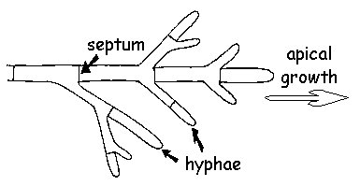
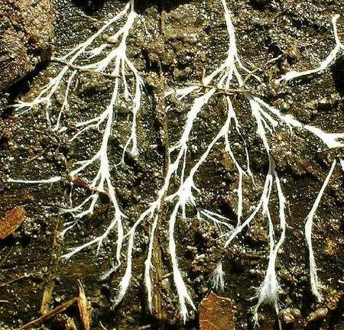
Hyphae

Slide 49
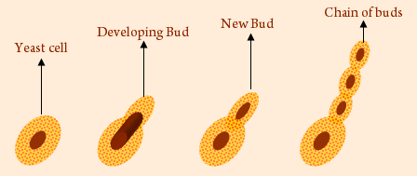
Most reproduce by budding

Slide 50
Examples
Candida albicans – part of the normal flora of mouth, GIT and vaginal wall
Malassezia furfur – causes skin infection
HIstoplasma capsulatum
Blastomyces dermatitidis
Coccidiodes immitis
Trichophyton and Microsporum sp. – cause ring worm
Cryptococcus neoformans – cryptococcal meningitis

Slide 51
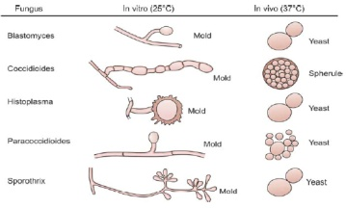

Slide 52
Human pathological fungi
The majority of most human pathogenic fungi appear to be soil inhabiting species where they live as saprobes, but given the appropriate conditions, i.e. if the person is not healthy, an open wound is present, direct injection of fungus into your system.

Slide 53
Superficial infections/ cutaneous
Are caused by fungi that attack the skin or its appendages (nail, feathers and hair). Some examples of these infection include ringworms, jock-itch and athlete's foot. These fungi are known as dermatophytes
Ringworm and Related Dermatophytes
Ringworm usually occurs on the exposed parts of the body, forming circular growths that may appear darker or lighter than the normal skin color, with symptoms that include skin lesion, rash and itching of the infected area
Caused by Trichophyton and Microsporum sp
They include;
Tinea capitis: Ringworm of the scalp, eyebrow and lashes.
Tinea corporis: Ringworm of the body.
Tinea cruris: Ringworm of the groin, perineum and perianal region. Infections are commonly referred to as "jock itch".
Tinea unguium: Ringworm of the nail.
Tinea barbae: Ringworm of the beard.
Tinea pedis: Ringworm of the feet. Infections are commonly referred to as athlete's foot.
Tinea manuum: Ringworm of the hand.

Slide 54
Systemic or Deep-Seated Mycoses
Coccidioides immitis, the cause of Coccidioidomycosis (Valley Fever)
Coccidioides immitis is contracted by inhalation of spores and primarily causes a respiratory disease in animals and people, but from the lungs it may spread throughout the body by way of the bloodstream
Histoplasma capsulatum and Histoplasmosis
Histoplasmosis occurs in people and dogs, rarely has it occurred in other domestic or wild animals. Infection occurs through inhalation of spores from this fungus.
Blastomyces and Blastomycosis
There are two species of this genus, Blastomyces dermatitidis and B. brasiliensis Infection apparently comes from spores or mycelium in the soil and any part of the body may be invaded. Infections usually are first detected as skin lesions; the lesions may remain localized or may gradually enlarge. In some case the fungus can spread throughout the whole body, resulting in extensive ulceration.

Slide 55
Intermediate Infections (subcutaneous)
These are diseases that are intermediate between the first two categories. These fungal infections may extend to a considerable depth within the tissue, but unlike the systemic diseases will not be distributed to the rest of the body. One of the most common intermediate infection is Candida albicans.
Candida albicans and Candidiasis
Candida albicans is a dimorphic fungus. That is, it grows as both mycelium and yeasts..
This fungus normally occurs in the mouth, digestive tract, and vagina of perfectly healthy people, but under some circumstances, and for reasons unknown, it may cause severe and even fatal infections, with lesions and eruptions of the skin, nails, mouth, bronchial tubes and lungs. Oral infections known as thrush is relatively common..
Aspergillus fumigatus and Aspergillosis
Aspergillus fumigatus sometimes parasitizes animals, especially birds, infecting mainly lungs and causing heavy mortality in birds.
In people, the disease can lead to a chronic lung infection which is apparently very contagious. The fungus is thought to cause death, but that is not certain. In patients that have died and A. fumigatus has been isolated, many have also had underlying disease that possibly lowered their resistance to the fungus.

