Slide 1
Blood diseases
Septicemia
By
Irene Cherutich
Supervised by
Mr J. Otin

Slide 2
Learning Outcome
By the end of the lesson , the learner should be able to gain and demonstrate knowledge on septicemia an

Slide 3
Objectives
To define septicemia
To identify causes of septicemia
To describe diagnosis and symptoms of septicemia
To explain pathophysiology of septicemia
To ellaborate the medical and nursing management of septicemia

Slide 4
Definition of Septicemia
Septicemia is a serious bloodstream infection.
It is the clinical name for blood poisoning by bacteria
an infection caused by large amounts of bacteria entering the bloodstream
It is often a result of another infection in the body (Cavaillon et al.,2019)

Slide 5
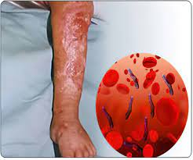

Slide 6
Historical Background for Septicemia
Sepsis was first mentioned by scriptures in Ancient Greece. The word sepsis comes from the Greek word “sepo”, which means “I rot”, and has its first use in medical context in Homer's poems. It is also mentioned in the writings of Hippocrates, a physician and philosopher, around 400 B

Slide 7
Historical Background for Septicemia
Dates back to 1879–1880, when Louis Pasteur showed for the first time that bacteria were present in blood from patients with puerperal septicemia.
In 1928, at St. Mary's Hospital, London, Alexander Fleming discovered penicillin. This discovery led to the introduction of antibiotics that greatly reduced the number of deaths from infection

Slide 8
Causes of Septicemia
These infections are most often associated with sepsis:
Lung infections (pneumonia)
Urinary tract infections
Skin infections
Infections in the intestines or gut
(Al-Asady et al.,2020)

Slide 9
Causes of Septicemia Cont.
Pathogens enter the bloodstream in many ways, for example:
Abscess on a tooth.
Germs on medical equipment (such as surgical tools and needles).
Kidney infection.
Pneumonia
Skin ulcers or other wounds.
Urinary tract infection.

Slide 10
Causative Agents
Staphylococcus aureus (staph)
Escherichia coli (E. coli)
Some types of Streptococcus
Fungus

Slide 11

Microorganisms
Al-Asady
(Al-Asadyet al.,2020)
Al-Asady

Slide 12
Stages of Septicaemia
Sepsis :happens when your immune system overreacts to an infection.
Severe sepsis: organs rendered to malfunction. A result of inflammation throughout your body.
Septic shock: This is the last stage of infection characterized by extremely low blood pressure despite lots of IV (intravenous) fluids.

Slide 13
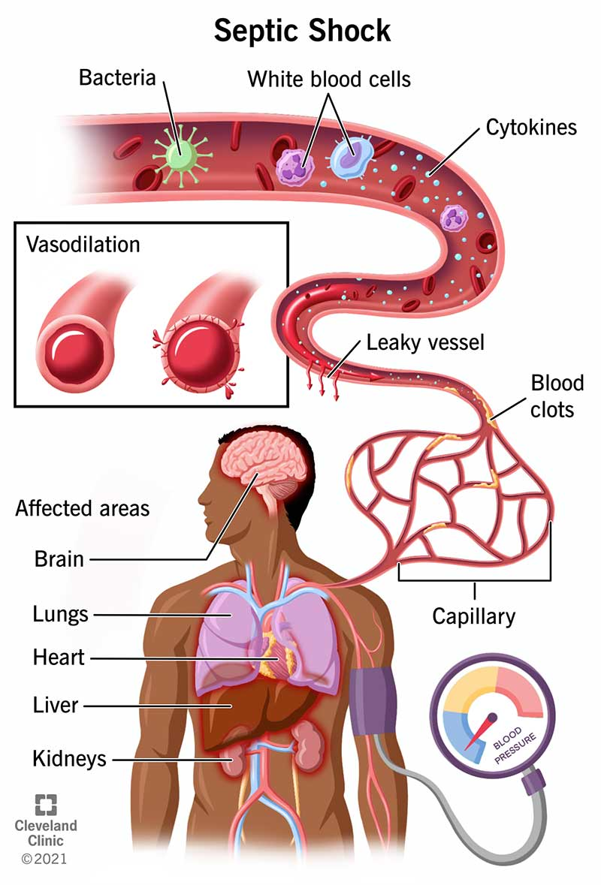
Pathophysiology of Septicemia

Slide 14
Pathophysiology of Septicemia Cont
A wound or tissue damage or entry of a foreign object into the body can cause the tissue adjacent to the damaged or infected region to become swollen or reddened, causing pain
Stress, infection, or chronic diseases can put the body in a proinflammatory state

Slide 15
Pathophysiology of Septicemia Cont.
Infective chemicals (bacteria) released in the bloodstream to fight an infection trigger inflammation throughout the body.
This causes a cascade of changes that damage multiple organ systems, leading them to fail, sometimes even resulting in death.

Slide 16
Pathophysiology of Septicemia Cont.
The immune system becomes primed and ready to create an inflammatory response.
Systemic inflammation occurs when the immune system is constantly defending the body.

Slide 17
Pathophysiology of Septicemia Cont
Immune response cause body to recognize and defend itself against bacteria, viruses, and substances that appear foreign and harmful.
Immune system protects the body from possibly harmful substances by recognizing and responding to antigens.

Slide 18
Pathophysiology of Septicemia Cont
Antigens are substances on the surface of cells, viruses, fungi, or bacteria.
Nonliving substances such as toxins chemicals, drugs, and foreign particles can also be antigens.
The immune system recognizes and destroys, or tries to destroy, substances that contain antigens.

Slide 19
Pathophysiology of Septicemia Cont.
The inflammatory response occurs when tissues are injured
The damaged cells release chemicals including histamine, bradykinin, and prostaglandins
These chemicals cause blood vessels to leak fluid into the tissues, causing swelling.

Slide 20
Pathophysiology of Septicemia Cont
This helps isolate the foreign substance from further contact with body tissues.
The chemicals attract white blood cells called phagocytes that "eat" germs and dead or damaged cells.(phagocytosis)
Phagocytes eventually die.
Pus is formed from a collection of dead tissue, dead bacteria, and live and dead phagocytes.

Slide 21
Pathophysiology of Septicemia Cont
The inflammatory response recognize the damaged tissue,
recruitment of inflammatory cells follows,
removal of extraneous objects, and
Repair of the damaged tissue take place

Slide 22
Pathophysiology of Septicemia Cont
Redness (rubor) – secondary to vasodilatation and increased blood flow
Heat (calor) – localised increase in temperature, also due to increased blood flow
Swelling (tumour) – results from increased vessel permeability, allowing fluid loss into the interstitial space
Pain (dolor) – caused by stimulation of the local nerve endings, from mechanical and chemical mediators
Loss of function

Slide 23
Pathophysiology of Septicemia Cont.
The body usually can remove a small number of germs naturally. But if germs continue to grow and spread, that can lead to septicemia.
(Minasyan, 2017).

Slide 24
Symptoms of Septicemia
Early septicemia symptoms are:
High fever.
Chills.
Weakness.
Sweating.
Drop in blood pressure.

Slide 25
Symptoms of Septicemia
difficulty breathing
Low blood pressure, Fast heart rate
Mental confusion.
(Jones et al., 2021)

Slide 26
Complications of Septicemia
Septicemia can lead to sepsis, which is a life-threatening medical emergency. It can cause tissue damage, organ failure and even death
(Keynan et al., (2013).

Slide 27
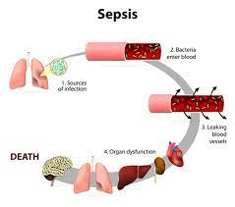
Complications of Septicemia cont.

Slide 28
Diagnosis and Tests
Septicemia diagnosis is based on:
Presence of septicemia symptoms.
Blood tests to identify a bacterium, virus or fungus.
Test results combined with information about illness and physical examination, help your doctor determine if you have sepsis:

Slide 29
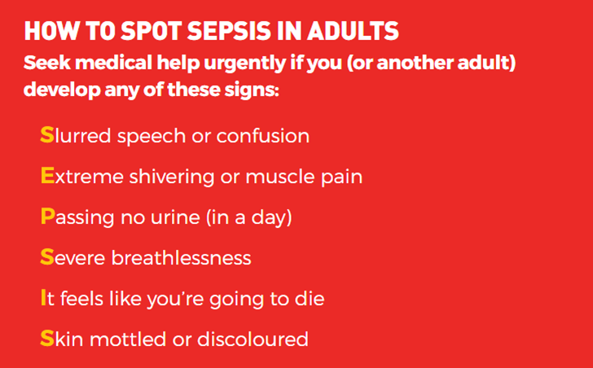

Slide 30
Diagnosis and Tests Cont.
Complete blood count (CBC)
C-reactive protein (CRP)
Blood culture
Procalcitonin (PCT)
Urinalysis
Chest x-ray
Computerized tomography (CT) scan

Slide 31
Diagnosis and Tests Cont.
Magnetic resonance imaging (MRI)
Lumbar puncture
A throat culture and swap
Sputum test
Pulse oximetry
Liver function test

Slide 32
Management and Treatment
Broad-spectrum antibiotics are the first-line medications.
These antibiotics work against several of the more common bacteria
These are intravenous antibiotics so they can get into the blood system quickly and efficiently.

Slide 33
Management and Treatment Cont.
Ensure blood flow to organs using intravenous fluids(IV)
Treat the source of the infection.
Give oxygen to supply oxygen to the organs.
Vasopressor to narrow blood vessels and help increase blood pressure.

Slide 34
Management and Treatment Cont.
Gram-positive organisms such as methicillin-susceptible Staphylococcus aureus (MSSA) and Streptococcal species, give antibiotics; piperacillin/tazobactam, ceftriaxone, cefepime, meropenem, and imipenem/cilastatin and surgical intervention
Draining blood and fluid from the infected area.
(Latif et al., 2019).

Slide 35
Nursing Interventions and Management
Management of fever. Monitor the patient closely for shivering.
Pharmacologic therapy. Administer prescribed IV fluids and medications; antibiotic agents and vasoactive medications.
(Hussien et al.,2019)

Slide 36
Nursing Interventions and Management Cont.
Monitor blood levels. Monitor antibiotic toxicity, BUN, creatinine, WBC, hemoglobin, hematocrit, platelet levels, and coagulation studies.
Assess physiologic status. Assess the patient’s hemodynamic status, fluid intake and output, and nutritional status.

Slide 37
Nursing Interventions and Management Cont.
Infection control. All invasive procedures must be carried out with aseptic technique after careful hand hygiene.
Collaboration. The nurse must collaborate with the other members of the healthcare team to identify the site and source of sepsis and specific organisms involved.

Slide 38
Prevention of Septicemia
Strict infection control practices. To prevent invasion through effective aseptic techniques
Prevent central line infections
Early debriding of wounds to remove infective necrotic tissue

Slide 39
Prevention of Septicemia
Equipment cleanliness; especially the ones involved in invasive procedures, must be properly cleaned and maintained to avoid harboring harmful microorganisms that can enter the body by sterilization(CSSD)
(Negussie et al., 2015)

Slide 40


Slide 41
Summary
Septicemia is a serious bloodstream infection
infections are most often associated with sepsis
inflammatory response occurs when tissues are injured
Test results combined with information about illness and physical examination, help your doctor determine if you have sepsis:

Slide 42
Summary Cont.
Treatment includes antibiotics
Nursing interventions is key in assessing patient response to treatment

Slide 43
References
Cavaillon, J. M., & Chrétien, F. (2019). From septicemia to sepsis 3.0–from Ignaz Semmelweis to Louis Pasteur. Microbes and Infection, 21(5-6), 213-221.
Al-Asady, F. M., Al-Saray, D. A., & Obed, A. W. (2020). Incidence of septicemia. Etiology and antimicrobial susceptibility testing among patients admitted to tertiary care hospital. The Journal of Infection in Developing Countries, 14(12), 1387-1394.
Jones, T. W., Smith, S. E., Van Tuyl, J. S., & Newsome, A. S. (2021). Sepsis with preexisting heart failure: management of confounding clinical features. Journal of Intensive Care Medicine, 36(9), 989-1012.

Slide 44
References Cont.
Minasyan, H. (2017). Sepsis and septic shock: Pathogenesis and treatment perspectives. Journal of critical care, 40, 229-242.
Keynan, Y., & Rubinstein, E. (2013). Staphylococcus aureus bacteremia, risk factors, complications, and management. Critical care clinics, 29(3), 547-562.
Latif, A., Kapoor, V., Vivekanandan, R., & Reddy, J. T. (2019). A rare case of Shewanella septicemia: risk factors, environmental associations and management. BMJ Case Reports CP, 12(9), e230252.

Slide 45
References Cont.
Hussien, A. H., Khalil, S. S., & Mohammed, G. T. (2019). Effect of Nursing Educational Protocol on Nurses’ Knowledge and Practice Regarding Septicemia among Burned Patients. ARC Journal of Nursing and Healthcare, 5(2), 19-26.

Slide 46


