Slide 1
Bone Infection

Slide 2
CLASSIFICATION OF ORTHOPAEDIC DISORDERS
Most orthopaedic disorders fall within the following groups:
Deformities
Congenital deformities
Acquired deformities
General affections of the skeleton
Bone dysplasias
Inborn errors of metabolism
Metabolic bone disease
Endocrine disorders

Slide 3
Infections of bone and joints
Infections of bone
Joint infections
Bone tumours and other local conditions
Tumours of bone
Osteochondritis
Cystic change
Soft tissue tumours and other diseases
Tumours of soft tissue

Slide 4
Inflammatory lesions of soft tissue
arthritis and other joint disorders
Arthritis
Dislocation and subluxation
Internal derangements
Neurological disorders
Cerebral palsy
Spina bifida
Poliomyelitis
Peripheral nerve lesions

Slide 5
Bone Infection (osteomyelitis)

Slide 6
Definition:
Osteomyelitis is an infection of bone & bone marrow that may be caused by direct inoculation of an open traumatic wound or by blood-borne organisms (hematogenous).

Slide 8
Classification :
Acute hematogenous osteomyelitis
Acute osteomyelitis
Chronic osteomyelitis
Subacute osteomyelitis

Slide 9
Acute Hematogenous Osteomyelitis

Slide 10
Osteomyelitis may occur at any age.
Most common in ages 3-12 years.
It affected boys twice frequently as girls .
A microbial ethiology is confirmed in three fourth of osteomyelitis and two thirds of cases of septic joint

Slide 11
PATHOGENESIS
Hematogenous
Direct spread from a contiguous focus of infection.
Osteomylitis in children is most often the consequence of bacterremia.

Slide 12
Pathogenesis (con)
involves growing bone . Particularly the metaphyses of the long bone .
Femur and tibia are equally and together almost half of the all cases .
(distal femur , proximal tibia ,distal humerus , distal radius)

Slide 13
Pathogenesis (con)
Bacteria lodge in nutrient arteries supplying the growth plates of bones.
Blood in the large sinusoidal veins flows slowly
No phagocytic cells present in this area.
Obstruction of flow by bacterial microemboli produces small areas of avascular necrosis and metaphyseal abscess .

Slide 14
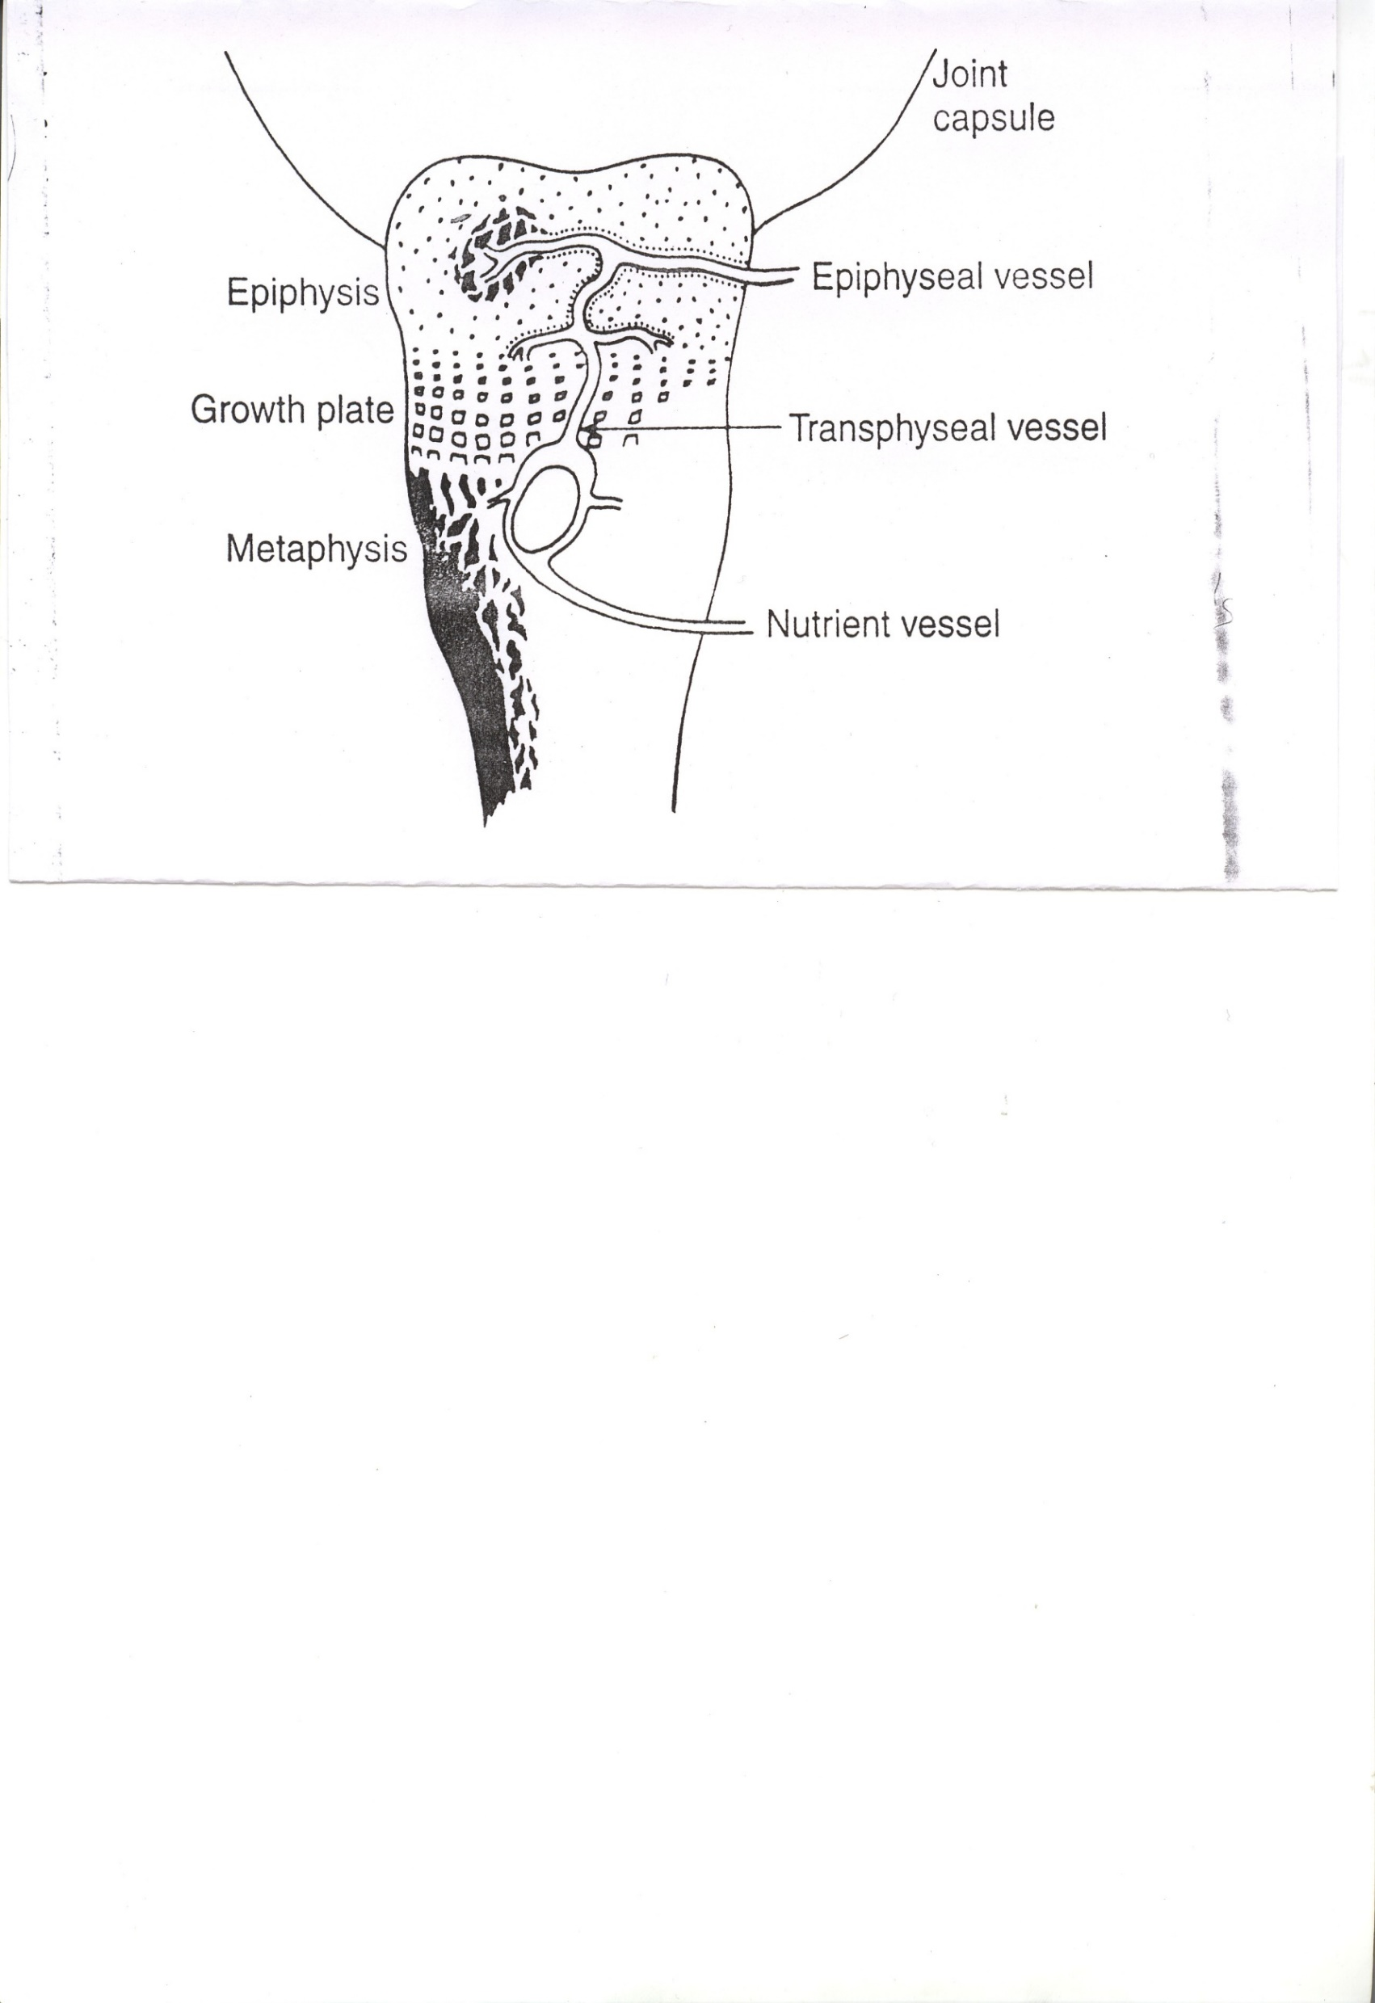
Bacteria lodge in nutrient arteries supplying the growth plates of bones.
Blood in the large sinusoidal veins flows slowly.
No phagocytic cells present in this area.
3. obstruction of flow by bacterial micro emboli produces small areas of avascular necrosis and metaphyseal abscess .

Slide 15
pathogenesis
(con)
Trauma often is noted before the onset of osteomyelitis. (in about one third)
In infant<1 yr the capillaries perforate the epiphyseal growth plate .
Spread across the epiphysis ,which causes a septic arthritis .

Slide 16
pathogenesis (con)
Pyartheritis complicating osteomyelitis is common in joints :
that capsule inserts to the metaphysis proximal to the epiphyseal plate .
( hip, elbow, shoulder , knee)

Slide 17
Etiology
Aerobic organisms
Gram positive : Staphylococcus aureus , Streptococcus pyogens
Streptococcus pneumoniae
-Gram negative : Haemophilus influenza,
E.coli, Pseudomonas aeruginosa,
Proteus mirabilis,
Anaerobic organisms
Bacteroides fragilis

Slide 18
Etiology con..
furunculosis , infected burns ,varicella, trauma,
drug abuse ,prolong IV or central parenteral alimentation
Sickle cell anemia : ( salmonella , staphylococcus and less common S.pneumonia)
Cat or dog bite ( pasteurella multocida)
Puncture wounds ,IV drug abuse (pseudomonas)

Slide 19
Pathology
Inflammation
Suppuration
Necrosis
New bone formation
Resolution

Slide 20
Inflammation
First 24 hours
Vascular congestion
Polymorphonuclear leukocyte infiltration
Exudation
Intraosseus pressure  intense pain
 intravascular thrombosis  ischemia

Slide 21
Suppuration
2-3 days
Pus formation
Subperiosteal abscess
via Volkmann canals
Pus spreading
epiphysis
joint
medullary cavity
soft tissue

Slide 22
Necrosis
Bone death by the end of a week
Bone destruction ← toxin
← ischemia
Epiphyseal plate injury
Sequestrum formation
small  removed by macrophage,osteoclast.
large  remained

Slide 23
New bone formation
By the end of 2nd week
Involucrum (new bone formation from deep layer of periosteum ) surround infected tissue.
If infection persist- pus discharge through sinus to skin surface Chronic osteomyelitis

Slide 24
Resolution
Antibiotics
Surgical drainage
Infection is controlled
Bone remodeling

Slide 25
Resolution
Infection is controlled
Intraosseous pressure release
With healing – new bone formation + periosteal reaction  bone thickening and sclerosis
Remodeling to normal contour or deformity

Slide 26
Infection persist
Chronic drainage
Chronic Osteomyelitis

Slide 27
Subacute osteomyelitis: is usually discovered radiologically in a patient with a painful limp and no systemic (and often no local) signs or symptoms.

Slide 28
Chronic osteomyelitis
When the duration of osteomyelitis is more than 3 weeks, its called ch. Osteomyelitis.
Causes-
Trauma causing open fractures.
Post operative.
Osteomyelitis with chronic etiology-
TB
Brodies' abscess.
Fungal osteomyelitis.

Slide 29
Chronic hematogenous osteomyelitis
Inadequate treatment of acute phase
Failure to diagnosis acute osteomyelitis
INFECTED DEAD BONE → sequestrum + bacteria that able to survive and multiply in Haversian canals → cloaca in the involucrum , sinus track & sequestrectomy
Residual painful, swelling, loss of function, 1/> draining sinuses.
Radiographic diagnosis: usually apparent

Slide 30
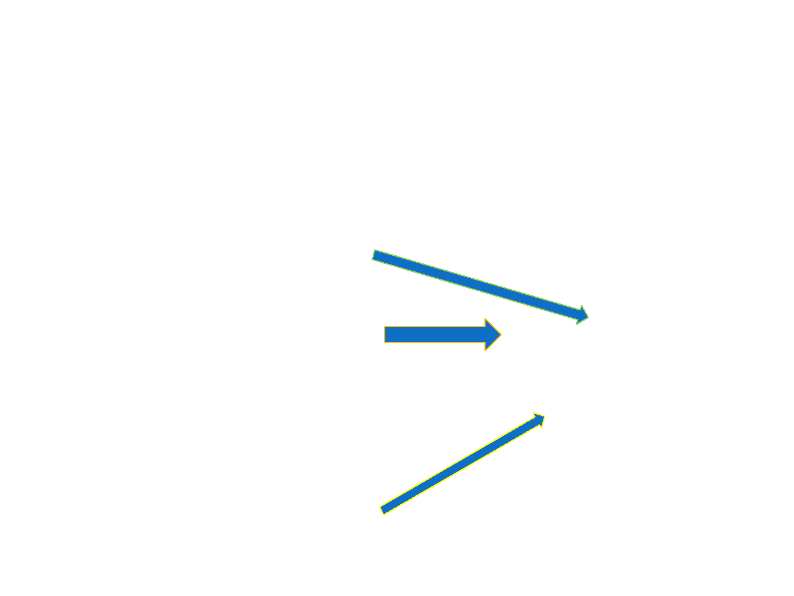
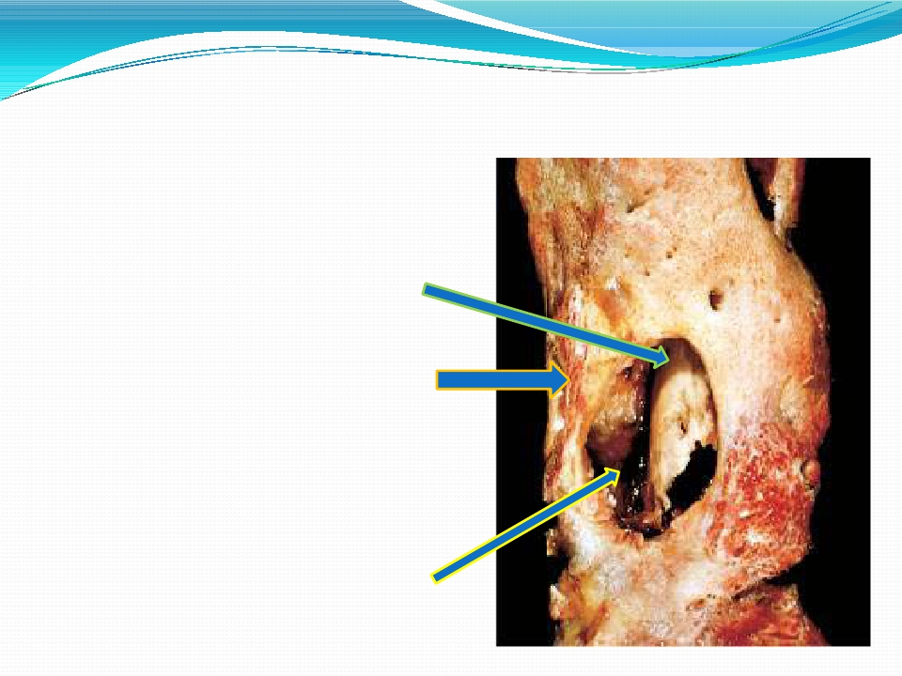
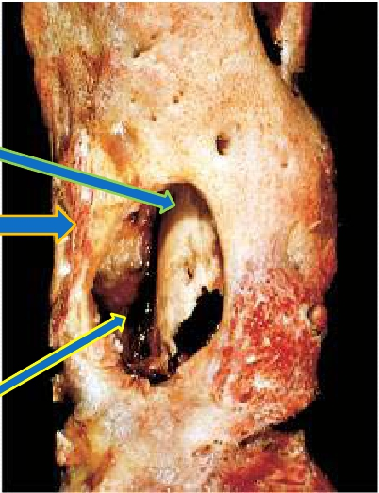
 Sequestrum is the necrotic
bone that is embedded in the
pus/infected granulation
tissue.
 Involucrum is the new bone
laid down by the periosteum
that surrounds the sequestra.
 Cloaca is the opening in the
involucrum through which
pus & sequestra make their
way out.

Slide 31
Signs and Symptoms in infant
Drowsy
Irritable
Fails to thrive
history of birth difficulties
History of umbilical artery catheterization
Metaphyseal tenderness and resistance to joint movement

Slide 32
Signs and Symptoms in child
Severe pain
Malaise
Fever
Toxemia
History of recent infection
Local inflammation pus
escape from bone
Lymphadenopathy

Slide 33
Acute osteomyelitis in adult
1.Uncommon
2.History of DM.
3.Immunosuppressive drug
4.Drug addict
5.Elderly patients.

Slide 34
Signs and Symptoms in adult
Fever
Pain
Inflammation
Acute tenderness
Common site is thoraco-lumbar spine

Slide 35
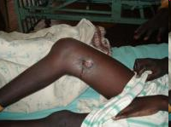
Clinical features of chronic osteomyelitis
Pain, swelling.
Discharging sinus.
Bone thickening.
Deformity.
Joint stiffness.
Shortening of limb,
Pathological fracture.
Sinus track malignancy.
.
Discharging sinus

Slide 36
Pathology of chronic osteomyelitis
Bone is destroyed in a discrete area or diffuse
Cavities containing pus and sequestrum are surrounded by vascular bone and sclerosis bone resulted from reactive new bone formation
Sequestra, foreign implants act as substrates for bacterial adhesion, ensuring the persistence of infection and sinus drainage
Pathological fracture

Slide 37
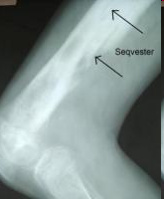
Investigation.
CBC, ESR.
Pus for c/s.
X – ray – sequestrum deformity.
- periosteal thickening, sclerotic lesion.
- irregular soft tissue shadow.
- regional osteoporosis.
- pathological fracture , micro fracture.
-no concrete radiographic evidence of bone infection in acute osteomyelitis
CT and MRI

Slide 38
Differential diagnosis for acute osteomyelitis
Cellulitis
Acute suppurative arthritis
Acute rheumatism
Gaucher’s disease – Pseudo- osteitis, resembling osteomyelitis, enlargement of spleen and liver. Because of predisposing to infection, antibiotics should be given.
Sickle-cell crisis – mimic osteomyelitis, in endemic area of Salmonella, it is wise to treat with antibiotics until infection is excluded

Slide 39
Differential diagnosis for chronic osteomyelitis
TB osteomyelitis- watery discharge.
- previous h/o TB, sinus with undermined margin with blue colour.
2. Ewing's sarcoma- A primary malignant tumor of bone, usually arising as a central tumor in long bone. (biopsy)
3. Soft tissue chronic infection. (X-ray)

Slide 40
Treatment for acute osteomyelitis
Supportive treatment
Splint
Antibiotic therapy
Surgical drainage

Slide 41
Supportive treatment
Analgesics
Correction of dehydration

Slide 42
Splint
Plaster slab
traction
Prevent joint contracture

Slide 43
Surgical drainage
Early treatment no need surgery
Late treatment surgical drainage about 1/3 of cases. If pus found and release no need to drill bone. But drilling one or two holes if no obvious abscess.

Slide 44
Antibiotics
Initial antibiotics “ BEST GUESS ”
- according to smear findings
- according to incidences , age.
Proper antibiotics
- according to culture and sensitivities test

Slide 45
Guideline for initial antibiotics
Age | Pathogen | Drugs
1.Older children and previously fit adults | -Staphylococcal infection | - Fluclaxocillin and fusidic acid IV 3-4 day oral 3-6 wks
2.Children <4 years | -Gram neg. infection -Haemophilus infection | -2nd generation Cephalosporins or Amoxycillin with clavulanic acid
3.Sickle-cell patient | -Salmonella infection | - Co-trimoxazole - Amoxycillin with clavulanic acid
4.Heroin addicts and immuno-compromised patients | -Unusual infection : pseudomonas , proteus, bacteroides | -3rd or newer generation Cephalosporins

Slide 46
Acute osteomyelitis
When infection subside, movement is encourage. Walk with crutches and full weight bearing is possible after 3-4 weeks.

Slide 47
Complications:
Early:
Death from the associated septicemia
Abscess formation
Septic arthritis
Late:
Chronic osteomyelitis
Pathological fracture
Joint contracture
Local growth disturbance

Slide 48
Treatment for chronic osteomyelitis
Medical treatment
Local treatment
Surgical treatment

Slide 49
Antibiotics
To stop spreading of infection
To control acute flare
Capable of penetrating sclerotic bone and non-toxic to body

Slide 50
Surgical treatment
Sequestrectomy + saucerization (excavation of the tissue of a wound to form a shallo )
Continuous irrigation 3-6 weeks.

Slide 51
Postoperative osteomyelitis
Mixture of pathogenic bacteria: S. aureus, Proteus, Pseudomonas, Staph. Epidermidis
Factors that favor bacterial invasion are:
Soft tissue damage and bone death
Poor contact between implant and bone
Loosening of implant
Corrosion of implant
Fragmentation of polymeric material

Slide 52
Prevention is better than cure
Avoiding operation on immune-depressed patient
Eliminating any focus of infection
Insisting in optimal operative sterility
Using high quality implant material
Ensuring close fit and secure fixation of the implant
Preventing or counteracting later intercurrent infection

Slide 53
Treatment
Operation without implant – treatment same as post traumatic infection – debridement, antibiotics, drainage
Infection after internal fixation of fracture
Appropriate antibiotics
Abscess – drain and the wound left open
Excision infected and necrotic material plus irrigation and drainage to prevent becoming chronic osteomyelitis

Slide 54
Treatment
Infection following joint replacement
Early – antibiotics, drainage, excision of dead and avascular tissue
Late infection – flexible strategy
Prosthesis stable – symptomatic Rx, sinus D/S,
Prosthesis loose – depend on patient’s condition
Unfit – antibiotics + restrict activities
Fit – Revision op. either one or two stages op.
alternative is remove the implant and bone cement

Slide 55
Brodie’s abscess
- it is an intraosseous abscess walled by reactive bone
Cause- staph.aureus.
Common site- metaphysis of long bone, cancellous bone.
Clinical features- `boring`
pain, fever, swelling, thickening of bone,

Slide 56
X- ray
radiolucent area in sub periosteum surrounded by sclerotic bone.
Treatment-
Fenestration + antibiotics (two days of intravenous antibiotics and then oral antibiotics for six weeks )

Slide 57
SEPTIC ARTHRITIS
.

Slide 58
Septic Arthritis
Collection of pus inside the joint
It occurs most commonly during the first 2 yr of life and adolescence.
Half of all cases occur by 2 yr and three fourths occur by 5 yr .
Joints of the lower extremity constitute three fourth of all cases. Common in knee and hip

Slide 59
Pathogenesis
Hematogenous dissemination of bacteria.
Contaguous spread from surrrounding tissues.
Spread of osteomyelitis through the epiphysis into the joint space in young children .
Presenting in the first 3 days more often represent the hamatogenous spread of bacteria .

Slide 60
pathogenesis
Post infectious joint effusion :
Which is sterile .
caused by antigen- antibody complex.
Developed after 7 days of bacterial illness.
( bacteremia, meningitis, diarrhea , urethritis)

Slide 61
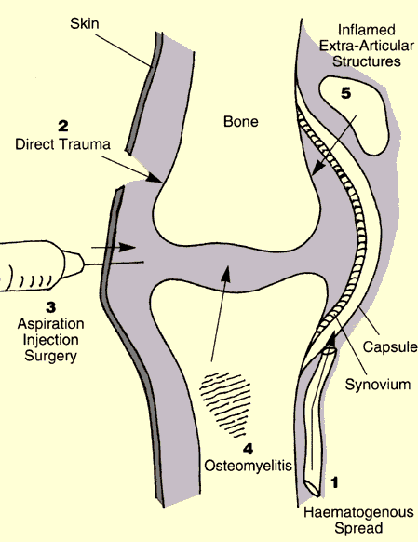

Slide 62
Mode of infection
Microbes → synovial membrane → inflammation (synovitis). → increased synovium formation → seorus/ seropurulent discharge → erosion of cartilage → - spreading of pus to the bone and destruction of bone.
- escaping of pus outside the joint through sinus.

Slide 63
Oganism
Synovial membrane
Acute inflammatory
reaction
Seropurulent exudate pus
Bacterial enzyme
Synovial enzyme
Joint destruction

Slide 64
Etiology
S.aureus is the most common agent.
H.influ type b is the most common factor in 3 month to -4 yr .
Streptococci , pneumococci, meningococci that may occure in the absence of sepsis or meningitis.
Gonococcal arthritis most common cause of polyartheritis and monoarticular artheritis in adolecent.

Slide 65
Clinical presentation
Typical features are acute pain and swelling in a single large joint ,commonly the knee & the hip in adults, however any joint can be affected.
The most commonly involved joint is the knee (50% of cases), followed by the hip (20%), shoulder (8%), ankle (7%), and wrists (7%). interphalangeal, sternoclavicular, and sacroiliac joints each make up 1-4% of cases.

Slide 66
Symptoms in newborns or infants:
The emphasis is on septicemia rather than joint pain.
Irritability ,Fever, refuses to feed, rapid pulse.
Unable to move the limb with the infected joint (pseudoparalysis) .
Cries when infected joint is moved (diaper changing)
Infection is usually suspected ,but it could be anywhere so the joints should be carefully felt and moved to elicit the local signs of warmth ,tenderness and resistance to movement.
Umbilical cord or the site of injection should be examined for possible source of infection.
If the baby is distressed and wont move his/her leg think of hip infection.

Slide 67
Signs and symptoms in children
acute pain in single joint : hip.
Pseudoparesis.
Swelling and inflammation of the joint.
Child looks ill.
Limit movement of the joint.
Look for a source of infection : toe, boil, otitis media

Slide 68
Signs and symptoms in adult
Often superficial joint : knee, wrist, ankle
Pain
Swelling and inflammation
Restricted movement
Examined for gonococcal infection or drug abuse.

Slide 69
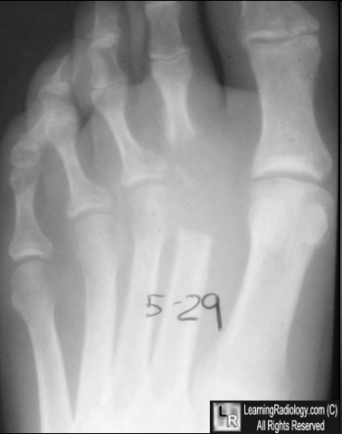
Investigation.
CBC, ESR.
Pus for c/s , gram staining.
Blood for c/s
X-ray – initially normal.
- initially increased joint space.
- later joint space decreases.
- osteopenia.
USG- collection of pus inside the joint space.

Slide 70
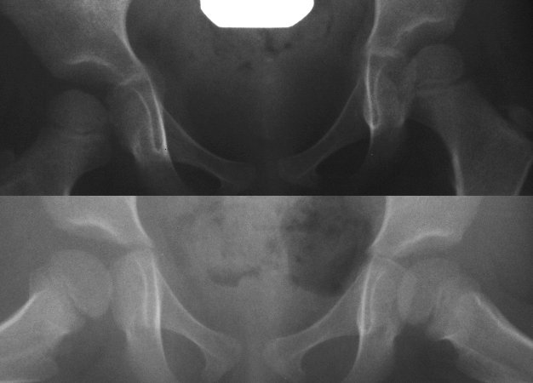
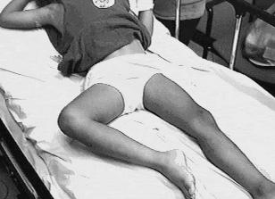

Slide 71
2-Ultrasonography
This study is very sensitive in detecting joint effusions generated by septic arthritis.
Ultrasound can be used to define the extent of septic arthritis and help guide treatment.
Ultrasound helps to differentiate septic arthritis from other conditions (e.g., soft tissue abscesses, tenosynovitis) in which treatment may differ.

Slide 72
3-Radio-isotope bone scan:
Show increase uptake of the isotope in the region of the joint. (may help in difficult site as sacroiliac & sternoclavicular joints
4- CT scan:
This study may help to diagnose sternoclavicular or sacroiliac joint infections.
5-MRI:
MRI is most useful in assessing the presence of periarticular osteomyelitis as a causative mechanism.

Slide 73
D/D
Acute osteomyelitis.
Haemarthrosis.- post traumatic.
- aspiration.
Acute rheumatism.
Haemophilic joint
Gout.

Slide 74
Treatment of septic arthritis
Supportive care : analgesics, fluid supplement , splint, traction
Antibiotics : same as acute osteomyelitis
Drainage : Aspiration, arthrotomy

Slide 75
Treatment
General Measures:
The first priority is to aspirate the joint and examine the fluid, treatment is then started without further delay.
Analgesics and splinting of the involved joint in the position of maximal comfort alleviate pain.
Fluid replacement and nutritional support may be required.
Other foci of infection and any coexisting medical conditions must be identified and treated appropriately.

Slide 76
Intravenous antibiotics should be given empirically and started as soon as joint fluid and blood sample have been taken for culture.
If gram –positive organisms are identified ,Flucloxacillin is suitable . If in doubt ,a third generation cephalosporin will cover both game+ and gram- organisms.
Children less than 4 yr( if suspicion of H.Infl) treated with Ampicillin.
Once the bacterial sensitivity is known the appropriate drug is substituted.
Intravenous administration is continued for several weeks and is followed by oral antibiotics for a further 2 or 3 weeks.

Slide 77
Drainage:
Indication of Surgical Drainage:
1Joints that do not respond to antimicrobial therapy and daily arthrocentesis
2Any joint with limited accessibility, including the sternoclavicular or the hip joint
3Patients with underlying disease, including diabetes, rheumatoid arthritis, immunosuppression, or other systemic symptoms, should be treated more aggressively with earlier surgical intervention

Slide 78
Treatment of septic arthritis
Once the conditions improved, if the articular cartilage is preserved – gentle and gradually increasing active motion
If articular cartilage is destroyed – the joint is immobilized in optimal position until ankylosis is sound

Slide 79
Complication:
Joint contracture
Pathological fracture
Amyloid disease
Malignant changes in the epidermis (epidermoid carcinoma)

