Slide 1
CARBON DIOXIDE TRANSPORT
HENRY

Slide 2
INTRODUCTION
Carbon dioxide is transported in the blood primarily in the form of bicarbonate (HCO 3 −) , which is released when carbonic acid dissociates.
Carbonic acid is produced mostly in the red blood cells as blood passes through systemic capillaries.

Slide 3
Carbon dioxide is carried by the blood in three forms:
dissolved CO2 in the plasma—carbon dioxide is about 21 times more soluble than oxygen in water, and about one tenth of the total blood CO2 is dissolved in plasma;
carbaminohemoglobin —about one-fifth of the total blood CO2 is carried attached to an amino acid in hemoglobin.
NB. (carbaminohemoglobin should not be confused with carboxyhemoglobin, formed when carbon monoxide binds toNthe heme groups of hemoglobin);
3. bicarbonate ion, which accounts for most of the CO2 carried by the blood.

Slide 4
II Carbon Dioxide Transport
Method Percentage
Dissolved in Plasma 7 - 10 %
Chemically Bound to
Hemoglobin in RBC’s 20 - 30 %
As Bicarbonate Ion in
Plasma 60 -70 %

Slide 5
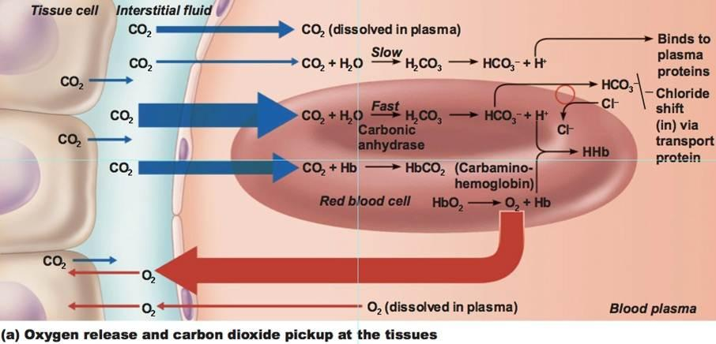

Slide 6
..
C02 is able to combine with water to form carbonic acid spontaneously in the plasma at a slow rate, but more rapidly within the red blood cells because of the catalytic action of the enzyme carbonic anhydrase.
Since this enzyme is confined to the red blood cells, most of the carbonic acid is produced there rather than in the plasma.
The formation of carbonic acid from CO2 and water is favored by the high PCO2 found in the capillaries of the systemic circulation.
carbonic anhydrase
C O 2 + H 2 O H 2 CO 3
high PCO 2

Slide 7
The Chloride Shift
The buildup of carbonic acid concentrations within the red blood cells favors the dissociation of these molecules into hydrogen ions(protons, which contribute to the acidity of a solution) and HCO 3 −
equation:
H 2 C O 3 H+ + HCO3 −

Slide 8
CO₂ Transport and Cl⁻ Movement

Slide 9
chloride shift
The hydrogen ions (H + ) released are largely buffered by their combination with deoxyhemoglobin within the red blood cells.
Although the unbuffered hydrogen ions are free to diffuse out of the red blood cells, more bicarbonate diffuses outward into the plasma than does H + .
As a result of the “trapping” of hydrogen ions within the red blood cells by their attachment to hemoglobin and the outward diffusion of bicarbonate, the inside of the red blood cell gains a net positive charge.
This attracts chloride ions (Cl − ), which move into the red blood cells as HCO 3 − moves out.
This exchange of anions as blood travels through the tissue capillaries is called the chloride shift

Slide 10
.
The unloading of oxygen is increased by the bonding of H + (released from carbonic acid) to oxyhemoglobin.
This is the Bohr effect, and results in increased conversion of oxyhemoglobin to deoxyhemoglobin.
Now, deoxyhemoglobin bonds H + more strongly than does oxyhemoglobin, so the act of unloading its oxygen improves the ability of hemoglobin to buffer the H + released by carbonic acid.
Removal of H + from solution by combining with hemoglobin, in turn, favors the continued production of carbonic acid and thereby improves the ability of the blood to transport carbon dioxide

Slide 11
Discuss Mechanism of Haldane effect
.

Slide 12
The Reverse Chloride Shift
When blood reaches the pulmonary capillaries deoxyhemoglobin is converted to oxyhemoglobin.
Because oxyhemoglobin has a weaker affinity for H+ than does deoxyhemoglobin, hydrogen ions are released within the red blood cells.
This attracts HCO 3 − from the plasma, which combines with H + to form carbonic acid:
H+ + HCO3− H2CO3

Slide 13
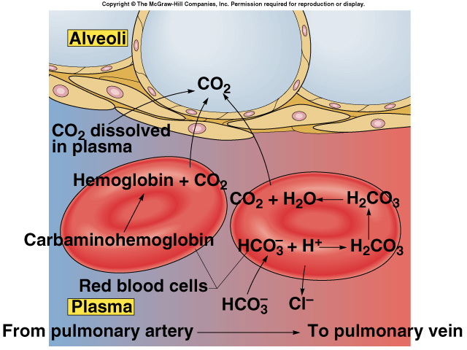

Slide 14
The Reverse Chloride Shift
Under conditions of lower P CO 2 , as occurs in the pulmonary capillaries, carbonic anhydrase catalyzes the conversion of carbonic acid to carbon dioxide and water:
carbonic anhydrase
H2CO3 C O 2 + H 2 O
low P CO 2

Slide 16
ACID-BASE BALANCE OF THE BLOOD

Slide 17
The pH of blood plasma is maintained within a narrow range of values through the lungs that regulate the CO2 concentration of the blood, and the kidneys regulate the bicarbonate HCO3- concentration

Slide 18
Principles of Acid-Base Balance
The blood plasma within arteries normally has a pH between 7.35 and 7.45, with an average of 7.40.
Because carbonic acid can be converted to a gas, carbonic acid is referred to as a volatile acid, and its concentration in the blood is controlled by the lungs through proper ventilation (breathing)
All other acids in the blood— including lactic acid, fatty acids, ketone bodies, and so on— are nonvolatile acids.

Slide 19
Under normal conditions, the H + released by nonvolatile metabolic acids does not affect the blood pH because these hydrogen ions are bound to molecules that function as buffers.
The major buffer in the plasma is the bicarbonate ( HCO 3 − ) ion.
HCO3 − + H+ H2CO3
Excessive H + is eliminated in the urine by the kidneys.
Through this action, and through their ability to produce bicarbonate, the kidneys are responsible for maintaining a normal concentration of free bicarbonate in the plasma

Slide 20
A fall in blood pH below 7.35 is called acidosis because the pH is to the acid side of normal. Acidosis does not mean acidic (pH less than 7); a blood pH of 7.2, for example, represents serious acidosis.
A rise in blood pH above 7.45 is called alkalosis.
Both of these conditions are categorized into respiratory and metabolic components of acidbase balance

Slide 21
respiratory component …
Respiratory acidosis is caused by inadequate ventilation (hypoventilation), which results in a rise in the plasma concentration of carbon dioxide, and thus carbonic acid.
Respiratory alkalosis, by contrast, is caused by excessive ventilation (hyperventilation)

Slide 22
Since the respiratory component of acid-base balance is represented by the plasma carbon dioxide concentration and the metabolic component is represented by the free bicarbonate concentration.
A normal arterial blood pH is obtained when there is a proper ratio of bicarbonate to carbon dioxide.
The pH can be calculated given these values, and a normal pH is obtained when the ratio of these concentrations is 20 to 1.

Slide 23
Henderson-Hasselbalch equation:
This is given by the Henderson-Hasselbalch equation:
pH = 6.1 + log[HCO3 −]
0.03 PCO2
where PCO2 is the partial pressure of CO 2 , which is proportional to its concentration.
NB: a primary disturbance in one area (eg, metabolic acidosis) will be accompanied by secondary changes in another area (eg respiratory alkalosis)

Slide 24
Metabolic acidosis
Metabolic acidosis can result from excessive production of nonvolatile acids; eg, it can result from excessive production of ketone bodies in uncontrolled DM.
It can also result from the loss of bicarbonate, in which case there would not be sufficient free bicarbonate to buffer the nonvolatile acids. (This occurs in diarrhea because of the loss of bicarbonate derived from pancreatic juice.)

Slide 25
Metabolic alkalosis
Metabolic alkalosis, by contrast, can be caused by either too much bicarbonate (perhaps from an intravenous infusion) or inadequate nonvolatile acids (perhaps as a result of excessive vomiting).
Excessive vomiting may cause metabolic alkalosis through loss of the acid in gastric juice, which is normally absorbed from the intestine into the blood

Slide 26
EFFECT OF EXERCISE AND HIGH ALTITUDE ON RESPIRATORY FUNCTION
Ventilation During Exercise
As soon as a person begins to exercise, breathing becomes deeper and more rapid to produce a total minute volume that is many times the resting value.
This increased ventilation, particularly in well-trained athletes, is exquisitely matched to the simultaneous increase in oxygen consumption and carbon dioxide production by the exercising muscles.
The arterial blood PO2 , PCO2 , and pH thus remain surprisingly constant during exercise.

Slide 27
It is tempting to suppose that ventilation increases during exercise as a result of the increased CO2 production by the exercising muscles.
Ventilation and CO2 production increase simultaneously, however, so that blood measurements of PCO2 during exercise are not significantly higher than at rest.

Slide 28
Two kinds of mechanisms— neurogenic and humoral — have been proposed to explain the increased ventilation that occurs during exercise.
Possible neurogenic mechanisms include:
sensory nerve activity from the exercising limbs may stimulate the respiratory muscles, either through spinal reflexes or via the brain stem respiratory centers, and/or
input from the cerebral cortex may stimulate the brain stem centers to modify ventilation.

Slide 29
Rapid and deep ventilation continues after exercise has stopped, suggesting that humoral (chemical) factors in the blood may also stimulate ventilation during exercise.
Because the PO2 , PCO2 , and pH of the blood samples from exercising subjects are within the resting range, these humoral theories propose that:
the PCO2 and pH in the region of the chemoreceptors may be different from these values “downstream,” where blood samples are taken, and/or
that cyclic variations in these values that cannot be detected by blood samples

Slide 30
Lactate Threshold and Endurance Training
The cardiopulmonary system may be unable to deliver adequate amounts of oxygen to the exercising muscles at the beginning of exercise, because of the time lag required to make proper cardiovascular adjustments.
During this time, therefore, the muscles metabolize anaerobically, and a “stitch in the side”— possibly due to hypoxia of the diaphragm—may develop.
After numerous cardiovascular and pulmonary adjustments have been made, a person may experience a “second wind” when the muscles are receiving sufficient oxygen for their needs.

Slide 31
Continued heavy exercise can cause a person to reach the lactate threshold, which is the maximum rate of oxygen consumption that can be attained before blood lactic acid levels rise as a result of anaerobic metabolism.
This occurs when 50% to 70% of the person’s maximal oxygen uptake has been reached.
The rise in lactic acid levels is due to the aerobic limitations of the muscles; it is not due to a malfunction of the cardiopulmonary system.
Indeed, the arterial oxygen hemoglobin saturation remains at 97%, and venous blood draining the muscles contains unused oxygen.

Slide 32
The lactate threshold, however, is higher in endurance trained athletes than it is in other people.
These athletes, because of their higher cardiac output, have a higher rate of oxygen delivery to their muscles.
Endurance training also increases the skeletal muscle content of mitochondria and Krebs cycle enzymes, enabling the muscles to utilize more of the oxygen delivered to them by the arterial blood

Slide 33
Acclimatization to High Altitude
When a person from a region near sea level moves to a significantly higher elevation, several adjustments in respiratory function must be made to compensate for the decreased PO2 at the higher altitude.
These adjustments include changes in ventilation, in hemoglobin affinity for oxygen, and in total hemoglobin concentration

Slide 34
Changes in Ventilation
Starting at altitudes as low as 1,500 meters (5,000 feet), the decreased arterial PO2 stimulates the carotid bodies to produce an increase in ventilation.
This is known as the hypoxic ventilatory response.
The increased breathing is hyperventilation, which lowers the arterial PCO2 and thus produces a respiratory alkalosis.
The pH of cerebrospinal fluid (CSF) similarly becomes alkalotic.
After a couple of days, the kidneys increase their urinary excretion of bicarbonate and there is a reduced amount of bicarbonate in the CSF.
This helps move the pH of blood and CSF back toward normal.
However, the carotid bodies remain sensitive to the low PO2 , and so the total minute volume becomes stabilized after a few days at about 2.5 L/min higher than at sea level.

Slide 35
The Affinity of Hemoglobin for Oxygen
As a partial compensation for the decrease in oxygen content at high altitude, the affinity of hemoglobin for oxygen is reduced, so that a higher proportion of oxygen is unloaded.
This occurs because the low oxyhemoglobin content of red blood cells stimulates the production of 2,3-DPG, which in turn decreases the affinity of hemoglobin for oxygen

Slide 36
Increased Hemoglobin and Red Blood Cell Production
Kidney cells sense a decreased tissue oxygen concentration (hypoxia), and in response produce and secrete erythropoietin
Erythropoietin stimulates the bone marrow to increase its production of hemoglobin and red blood cells.

