Slide 1
THE CARDIOVASCULAR SYSTEM
PRESENTER:
CAROLINE MWENDWA

Slide 2
INTRODUCTION
The cardiovascular system is divided for descriptive purposes into two main parts.
The circulatory system, consisting of the heart, which acts as a pump, and the blood vessels through which the blood circulates
The lymphatic system, consisting of lymph nodes and lymph vessels, through which colourless lymph flows.
The two systems communicate with one another and are intimately associated.

Slide 3
THE CIRCULATORY SYSTEM

Slide 4
INTRODUCTION
It ensures a continuous flow of blood to all body cells
Should the supply of oxygen and nutrients to body cells become inadequate, tissue damage occurs and cell death may follow.
Generally its functions are
the transport of nutrients, oxygen, and hormones to cells throughout the body
removal of metabolic wastes (carbon dioxide, nitrogenous wastes).

Slide 5
THE HEART
The heart is a roughly cone-shaped hollow muscular organ.
It is about 10 cm long and is about the size of the owner's fist.
It weighs about 225 g in women and is heavier in men (about 310 g).

Slide 6
FUNCTIONS OF THE HEART
Contractions of the heart produce pressure needed for blood flow through the blood vessels
The heart separates the pulmonary and systemic circulations which ensures the flow of oxygenated blood to tissues
Securing one-way blood flow. Through action of heart valves.

Slide 7
POSITION OF THE HEART IN THE BODY
The heart lies in the thoracic cavity in the mediastinum between the lungs.
It lies obliquely, a little more to the left than the right, and presents a base above, and an apex below.
The apex is about 9 cm to the left of the midline at the level of the 5th intercostal space, i.e. a little below the nipple and slightly nearer the midline.
The base extends to the level of the 2nd rib.

Slide 8
ORGANS ASSOCIATED WITH THE HEART
Inferiorly — the apex rests on the central tendon of the diaphragm
Superiorly — the great blood vessels, i.e. the aorta, superior vena cava, pulmonary artery and pulmonary veins
Posteriorly — the esophagus, trachea, left and right bronchus, descending aorta, inferior vena cava and thoracic vertebrae
Laterally — the lungs — the left lung overlaps the left side of the heart
Anteriorly — the sternum, ribs and intercostal muscles

Slide 9
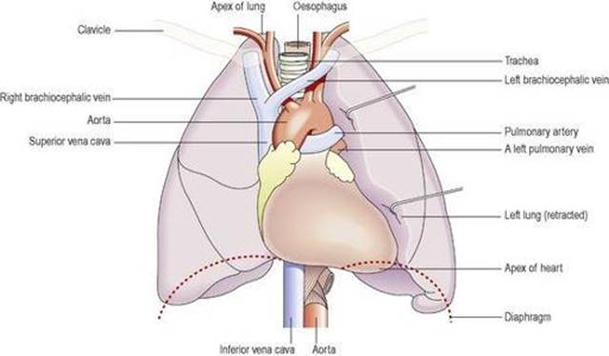

Slide 10
STRUCTURE OF THE HEART
The heart is divided by a muscular wall known as the septum into 2 sides -right and left. There is normally no communication between these two sides after birth.
Each side of the heart is further subdivided into an upper collecting chamber called an atrium and a lower pumping chamber called the ventricle.

Slide 11
Structure….ct
The atrium and ventricle of each side communicate with one another by means of atrio-ventricular openings which are guarded by valves. On the right side is the tricuspid valve composed of three flaps and on the left is the mitral or bicuspid valve composed of two flaps
The atrio- ventricular valves permit the passage of blood in one direction only.ie from atrium to ventricle and prevent blood flowing backward from ventricles to atrium

Slide 13
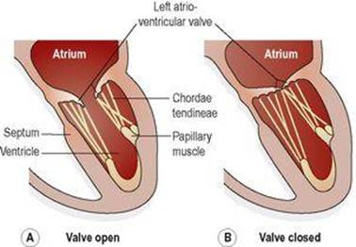

Slide 14
Structure….ct
The heart wall is composed of three layers of tissue:
Pericardium
It is the outermost layer covering the outer surface of the heart
made up of two layers;
Fibrous pericardium- an outer layer consisting of fibrous tissue
serous pericardium- inner layer consisting of a continuous double layer of serous membrane.

Slide 15
Pericardium…ct
The outer layer of the serous membrane is known as the parietal pericardium while the inner layer is known as the visceral pericardium
The serous membrane secretes serous fluid into the space between the visceral and parietal layers which allows smooth movement between them when the heart beats

Slide 16
Myocardium
It is the middle layer composed of specialized cardiac muscle found only in the heart.
It is not under voluntary control
The myocardium is thickest at the apex and thins out towards the base reflecting the amount of work each chamber contributes to the pumping of blood. It is thickest in the left ventricle.

Slide 17
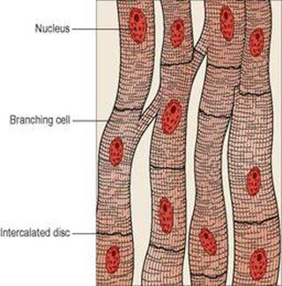

Slide 18
Endocardium
It is the innermost layer which forms the lining of the myocardium and the heart valves.
It is a thin, smooth, glistening membrane consisting of simple squamous epithelial cells.

Slide 19
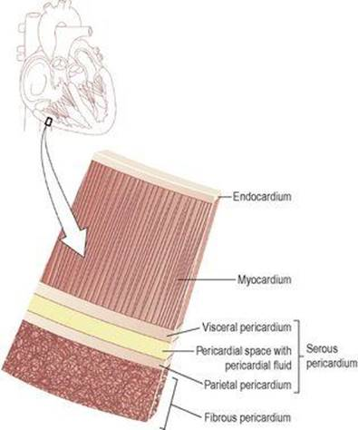

Slide 20
FLOW OF BLOOD THROUGH THE HEART
The two largest veins of the body, the superior and inferior venae cavae, empty their contents into the right atrium.
This blood passes via the right atrioventricular valve into the right ventricle, and from there it is pumped into the pulmonary artery or trunk (the only artery in the body which carries deoxygenated blood).
The opening of the pulmonary artery is guarded by the aortic pulmonary valve which prevents the back flow of blood into the right ventricle when the ventricular muscle relaxes.

Slide 21
Flow of blood ….ct
After leaving the heart the pulmonary artery divides into left and right pulmonary arteries, which carry the venous blood to the lungs where exchange of gases takes place: carbon dioxide is excreted and oxygen is absorbed.
Two pulmonary veins from each lung carry oxygenated blood back to the left atrium.
Blood then passes through the left atrioventricular valve into the left ventricle, and from there it is pumped into the aorta, the first artery of the general circulation. The opening of the aorta is guarded by the aortic semilunar valve.

Slide 23
BLOOD SUPPLY TO THE HEART
Arterial supply
The heart is supplied with arterial blood by the right and left coronary arteries which branch from the aorta immediately distal to the aortic valve.
The coronary arteries receive about 5% of the blood pumped from the heart, although the heart comprises a small proportion of body weight. This large blood supply, especially to the left ventricle, highlights the importance of the heart to body function.
The coronary arteries traverse the heart, eventually forming a vast network of capillaries.

Slide 24
Venous drainage
Most of the venous blood is collected into several small veins that join to form the coronary sinus which opens into the right atrium.

