Slide 1
CASTING TOOLS

Slide 2
PLASTER SHEARS/LORENZ

Slide 3
PLASTER SHEARS/LORENZ

Slide 4
Its usually nickel plated
They are larger shears that are used to open strong casts but unnecessary if you have an electric saw.

Slide 5
The rounded handles allow comfortable essay gripping during manual manipulation
Features two expertly crafted joints and an open jaw incorporating a blade with a reinforced back
This special design allows easy precise and consistent cast removal without injuring adjacent skin
It is notched and rust proof
Made from highest grade stainless steel i.e. 22cm,stainless steel, reusable and fully auto cleavable and measures11.5 inches (29cm)

Slide 6
Standards of a plaster shear
CE marked
Conforms to medical directive 93/42/EEC
Covered by our lifetime guarantee

Slide 7
Scissors.
These are hand –operated shearing tools
Consist of metal blades pivoted so that the sharpened edges slide against each other when the handles (bows) opposite to the pivot are closed
Used for cutting various thin material such as paper
Cardboard, metal foil, cloth, rope and wire
A large variety of scissors exist for specialized purposes
Modern scissors are often designed ergonomically with composite thermoplastic and rubber handles which enable the user to exert either a power grip or a precision grip

Slide 8
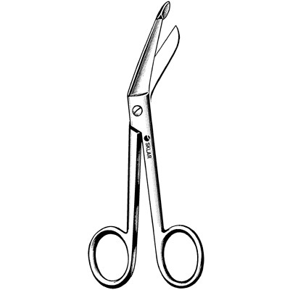

Slide 9
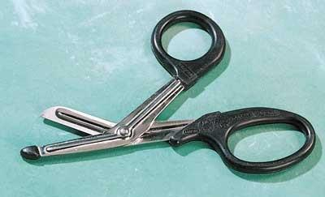
Scissors.

Slide 11
Examples of scissors
Surgical scissors
Hair cutting shears
Blade shearing

Slide 12
Surgical scissors:
Are surgical instruments usually used for cutting
They include :
bandage scissors,
dissecting scissors,
Irish scissors,
Metzenbaum scissors are surgical scissors designed for cutting delicate tissue and blunt dissection. The scissors come in variable lengths and have a relatively long shank-to-blade ratio. They are constructed of stainless steel and may have tungsten carbide cutting surface inserts.,
plastic surgery scissors
mayo scissors- Straight-bladed Mayo scissors are designed for cutting body tissues near the surface of a wound. As straight-bladed Mayo scissors are also used for cutting sutures, they are also referred to as "suture scissors". Curved-bladed Mayo scissors allow deeper penetration into the wound than the type with straight blades.

Slide 13
Surgical scissors are usually made of very hard material stainless steel for ongoing toughness
Some scissors have tungsten carbide reinforcements along their cutting edges
Its hardness allows the manufactures to create sharper edges which allows for easier and smoother cuts and keeps it sharp for long
Come in different shapes and sizes

Slide 14
Oscillating machine (plaster saw)
An improved tool which is effective in cutting casts and other hard materials
If the cutter accidentally touches human skin and does not cut fabrics or other objects, it will not cut or damage the skin surface or material unless they are quite strict support
Powered by electricity
Only vibrates with no rotation therefore the skin can withstand contact without being cut

Slide 16
Plaster spreader (cast spreader)
Strong and durable medical tool used for plaster and fiberglass casting removal
Made of stainless steel material
Spreads a cut plaster apart after being cut with a plaster cutting tool to enable efficient and safe removal
Uses: when heated and becomes adhesive at body temperature, it is used to:- keep wound edges in position, protects raw surfaces, used to apply drugs to the surface to obtain their systemic effects

Slide 17
Plaster spreader

Slide 18
Hammer.
A tool consisting of a weighted head fixed to a long handle that is swung to deliver an impact to a small area of an object
Examples of uses:
To drill a nail into wood
To shape a metal
To crush a rock
Driving
Shaping
Breaking applications

Slide 19
The head is made of steel which has been heat treated for hardness
The handle (haft or helve) is typically made wood or plastic
Claw hammer has a claw to pull nails out of wood
Sizes, shapes and structures vary depending on their purposes

Slide 20
Types of hammers
Sledge hammers- are ideal for striking wood, metal or stone and feature a fiberglass core for added strength, durability and reduced vibration.
Mallets
Ball peen hammers
Powered hammers
Trip hammers
Note: all the types of hammers are used to deliver forces beyond the capacity of the human arm

Slide 21
Parts of a hammer.
Head
Handle
Shaft

Slide 22
Introducer(T-holder
Used in orthopaedic surgery
Used to introduce Steinman pin in open surgery procedures

Slide 23
plaster/cast bender

Slide 24
Bohler stirrup

Slide 25
Manual bone hand drill

Slide 26
Steinman pin:
Are rigid stainless steel pins of varying length, 4 to 6 mm diameter.
After insertion a special, stirrup (Bohler stirrup) is attached to the pin.
The Bohler stirrup allows the direction of the traction to be changed without turning the pin in the bone.

Slide 28
Denham Pin :
Similar to Steinmann’s pin except for a short threaded length situated in the center and held in the introducer.
It engages the bony cortex and reduces the risk of pin sliding.
Used in
a) cancellous bones
b) osteporotic bones

Slide 30
Kirschner wire:
Is of small diameter and is insufficiently rigid until pulled taut in a special stirrup, rotation of the stirrup is imparted to the wire.
Though they are thin but if proper special stirrup is used they can withstand a large traction force because the stirrup provides longitudinal tension force which increases the rigidity of the K-wire.

Slide 31
Kirschner wire:

Slide 33
K-wire
Common sites for application of skeletal traction
1. Olecranon: - K- wire is passed 3cms distal to tip of the olecranon.
passed medial to lateral at right angle to the longitudinal axis of ulna deep to subcutaneous border to avoid injury to ulnar nerve
2. For supra condylar and trans condylar # humerus
3. Unstable # shaft of humerus
4. A screw eye can also be used
b)Metacarpals: - Placed through diaphysis of 2nd and 3rd metacarpals.
It transverses 2nd and 3rd metacarpal at right angle to longitudinal axis of radius

Slide 34
Skeletal traction set

Slide 35
WEIGHTS
Weights provide the constant (isotonic) force to keep the fracture/dislocation reduced.
Pulleys maintain the constant direction necessary until healing.
For this to happen, the ropes must be able to glide freely (no knots in the pulleys) and the weights must be suspended above ground to Prevent any friction.
Never have a weight suspended over any body part of a patient as it can cause injury.
Make sure that bed linens or pillows etc. are not interfering with the weight, ropes and pulley system.
The initial weight applied should be enough to correct limb length and reduce the fracture. It will be dependent of the patient’s weight and muscle status.

Slide 36
For maintenance of traction:
- Femur fractures: 10 % of the patient’s body weight
- Pelvis fractures: 15 % of body weight for longitudinal traction, 5 –7 kg for lateral traction
Humerus fractures: 2.5 kg initially and then increase until scapula is just lifted off the bed
Tibia fractures: 10 percent of body weight in kg

