Slide 1
CASTING AND SPLINTING TECHNIQUES
CODE: CST203
HOURS: 30
CREDIT: 3

Slide 2
MODULE COMPETENCE
This module is designed to enable learners understand casting and splinting in orthopedic and trauma patients.

Slide 3
MODULE OUTCOMES
By the end of this modules the learner should have learned the following modules;
Definition of casting and splinting
The uses of casting and splinting
Materials used in casting and splinting
Types of casting of upper and lower limb
Types of splinting of upper and lower limb
Complications of the cast of upper and lower limb.
Understand occupational health safety in casting

Slide 4
HISTORY OF PLASTER OF PARIS(CASTING)
Plaster of Paris is produced by removing the impurities from the mined gypsum and then heating it under controlled conditions to reduce the amount of water of crystallization.
Plaster of Paris was well known as a building material for many centuries before it was introduced as casting material.
One account mentions King Henry III who visited Paris in 1254 and was so impressed by fine white walls that he introduced similar plastering in England where it became known as plaster of Paris.
The first use of plaster of Paris as a cast for injured limbs took place through a technique known as plâtre coulé that became popular in Europe at the beginning of 19th century.
This technique involved pouring plaster of Paris around injured limbs encased in a wooden construct.
Some surgeons used it for lower limbs only and some using it for both upper and lower.

Slide 5
What is a plaster
Plaster – is the common name for calcium suphate hemi hydrated made by heating the mineral gypsum, the common name for sulphate for lime plaster was made about 9000 years ago and has been used by ancient Egyptians Greek and roman civilization however, it wasn’t used on a large scale until 1700s when it was require to be used in all construction in Paris in 1666, a fire raged a cross London destroying many parts of it thus during the early 18th century, Paris became the centre of plaster production and hence the name plaster of Paris started

Slide 6
INTRODUCTION TO CASTING AND SPLINTING (PLASTER OF PARIS)
Definition:
Casting involves circumferential application of plaster or fiberglass to an extremity.
Splint is a noncircumferential application of plaster of Paris and fiber cast to immobilize part of the limb that accommodate swelling.

Slide 7
CASTING AND SPLINTING
Cast and splints are hard wraps used to support and protect injured bones, ligaments tendon, and other soft tissue. they help fractures heal by keeping the fragment ends together and as straight as possible cast and splints also help with pain and swelling and protects the injured area from more harm.

Slide 8
Definition of a cast
The term cast implies that the plaster or fiberglass encase the part of the body
externally applied structure that hold bones in one position
I s a rigid protective material of plaster or fiberglass

Slide 9
Contu-
An orthopedic cast, body cast, plaster cast or surgical cast is a shell, frequently made from plaster, encasing a limb to stabilize and hold anatomical structures, most often a broken bone in place until healing is confirm it is similar in function to a splint
Nowadays bandages of synthetic are often used .

Slide 10
CASTING (PLASTER ROOM) ENVIRONMENT
Equipment’s
Personnel
Records
Applications
Environment

Slide 11
Casting room
Casting is being done in cast room and so the distinguishing features of such a location are;
Sink with a plaster trap to protect blockage of the drains by plaster fragments.
A floor which can be washed down easily, a gutter should drain into a plaster trap.
Suitable furniture, couch, chair, table and suspension.

Slide 12
Equipment
They can be placed into two groups;
That which can protect the patient.
The implements used for applying and removing cast.
Protection
The following is an example of basic equipment’s.
Dust sheets and other covering material to protect the patient’s clothing are essential.
Apron and boots will protect the operator.
Sandbags and supportive pillows for comfort and support of the patient.
Ring cutters.
Instruction cards to guide the patient when away from hospital supervision.

Slide 13
(cont.’)
Equipment
The average plaster trolley carries the following items;
Protective materials – stockinette, felt wool bandages of varying widths.
Plaster bandages of varying widths.
Slabs of various widths.
Plaster Shears and Plaster spreaders, examination coach, x-ray viewer, computer, cabinet, hip spica table, plaster traction table, chairs
Plaster scissors, plaster knife, marking pencil.
Orthopaedic pad/softban of varying length.
Electric Plaster Cutter.
Water buckets.
Triangular bandages/arm sling/collar and cuff.
Walking heels, boots/iron for lower limb.
Steel basin

Slide 14
Cast application(equipment)
STOCKINETTE-is usually the first layer applied over to be cast
Orthopeadic cast- comes of width 5-15cm;the smallest one are5-10cm; should be for upper extremity then 10-15cm for the lower extremity
PLASTER 0F PARIS - plaster is the most used casting material
BUCKET –the bucket should be filled with water at room temperature

Slide 15
Personnel
The number of staff required to support the operator will depend on the type of cast to be applied.
An assistant is very necessary.
The assistant should be aware of the procedure you want to carry out and sure of the role to play.

Slide 16
Records
A book, card fill/other form of record of each patient should be retained.
The essential requirements are;
Name, address and age.
Diagnosis and plaster type applied, anaesthetic given, manipulation, simple application.
Instructions given.
Supplementary appliances given, e.g crutches.
Date of next return.

Slide 17
Applications
With the equipment’s ready and buckets filled with the water.
The patient sits comfortably with suitable protective covering.
The patient must understand what is happening.
Ensure privacy of the patient.
The assistant must hold the patient in the desired way.
Put suitable padding especially around the pressure areas (bony prominence).

Slide 18
Bandages
Immerse the bandage fully in water at angle of 45 degrees so as to encourage the release of the bubbles.
Hold the bandage gently- otherwise will not penetrate between the layers so effectively.
After five (5) seconds – the bubbles ceases.
Keep the leading end free when handling the bandage and squeeze in order to expel water using two hands.
Keep the leading end free when handling the bandage to the operator.
Immerse another bandage as the operator unrolls the wet bandage round the limb in an even manner.
Use circular and spiral turn and no reverse turns should be made.
Molding of the bandage should be done by constant smoothing with the palm of the wet hands.
After obtaining the thickness, the extremities of the cast may require trimming – for free movement of the digits.
To be done when the cast is still wet not fully dry.

Slide 19
Slabs
Measure the length required and the width.
Measure the length and the width of the pad.
Roll the slabs end to end.
Immerse in water.
Remove immediately.
Smooth carefully and quickly on a flat surface.
Compress the layers together and exclude the bubbles.
Operator can carry out the remaining procure using gauze roll/crepe bandage.

Slide 20
CAST PADDING
The best form of the cast purely for the benefits of the fracture is non – padded cast because it is close contact with the fractured bone.
However, this method has several disadvantages;
Limiting allowance for swelling.
Friction of the hard cast against the skin and the bone may cause sores.
There is no padding to act as a protective barrier against shears and saws on removal of the cast.
NB.
Therefore all casts should be adequately padded with the exception of the non – padded removal cast.
Usually two layers of padding are used;
Tabular gauze/stockinette
Cotton wool/sofban

Slide 21
A cast is a rigid external immobilizing device that is molded to contours of the body
•It can be said to be a shell, frequently made from plaster or fiberglass, encasing a limb (or, in some cases, large portions of the body) to stabilize and hold anatomical structures, most often a fractured bone (or bones), in place until healing is confirmed.
• Various materials have been used since ancient times.
Plaster of Paris bandages were first used by Antonius Matthysen , A Dutch military surgeon in 1852
•It is commercially available since 1931.

Slide 22
USES OF A CAST
To Support fractured bones, controlling movement of fragments and resting the damaged tissues
• A plaster back slab can provide excellent pain relief
• To stabilize and rest joints in ligamentous injury
• To support \ immobilize joints & limbs post operatively until healing has occurred
• To correct a deformity
• External splint for blocking movements in cases of nerve ,tendon , vessel injury , after arthroplasty
• To make negative mold of a part of body
• Helps to prevent or decrease muscle contractions
• A splint for un - displaced fractures
• External splint to aid with the internal fixation of the fractures ,osteotomies

Slide 23
AN IDEAL CAST
•Suitable for direct application
•Easy to mold
•Nontoxic for patient
•Unaffected by water
•Transparent to x-rays
•Quick setting
Able to transmits air, water, odour and pus
•Strong but light in weight
•Non-inflammable
•Non messy application and removal
•Long shelf life
•cheap

Slide 24
CAST MATERIALS
Plaster of Paris (white in color)
•Fiberglass (comes in a variety of colors, patterns, and designs)
•Thermoplastics
•Polyester / cotton knit

Slide 25
WHAT IS PLASTER OF PARIS
Plaster of Paris is calcined gypsum (roasted gypsum), ground to a fine powder by milling
• The Plaster bandages consist of a cotton bandage that has been combined with plaster of Paris
• When water is added, the more soluble form of calcium sulfate returns to the relatively insoluble form, and heat is produced
•It hardens after it has been made wet.
2 (CaSO4·½ H2O) + 3 H2O → 2 (CaSO4.2H2O) +Heat[1]

Slide 26
WHAT IS PLASTER OF PARIS-2
The first step after application is called the setting stage with a slight expansion in volume.
• The second stage is the hardening stage
•Movement of plaster while it is setting will cause gross weakening
•Plaster is still widely popular, it is cheap, non-irritant and easy to apply.

Slide 27
Know Your Materials
• Plaster of Paris (POP)
Synthetically based fiberglass

Slide 28
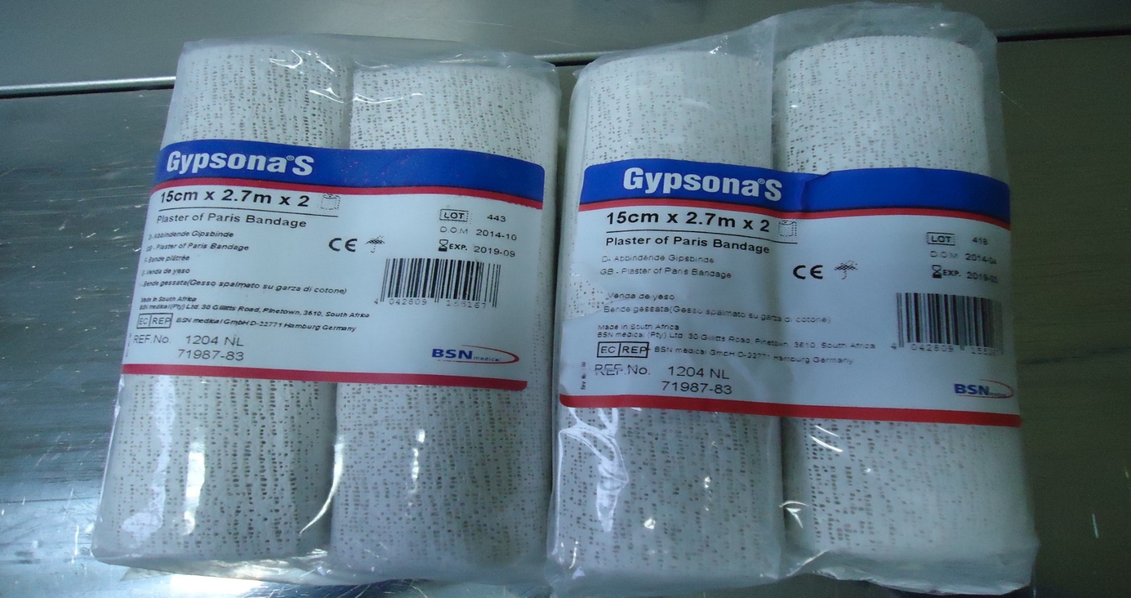
Plaster of Paris sizes
Plaster of paris comes in different sizes.
They are : 2” ,4” ,6” ,8”.

Slide 29
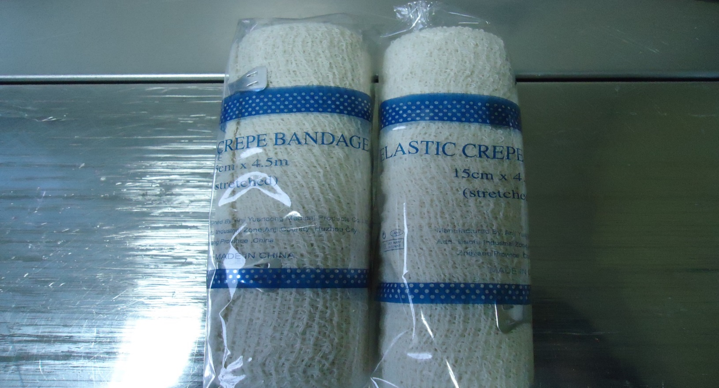
Crepe bandages
They come in different sizes.
They are : 2” ,3” ,4” ,6” ,8” .

Slide 30
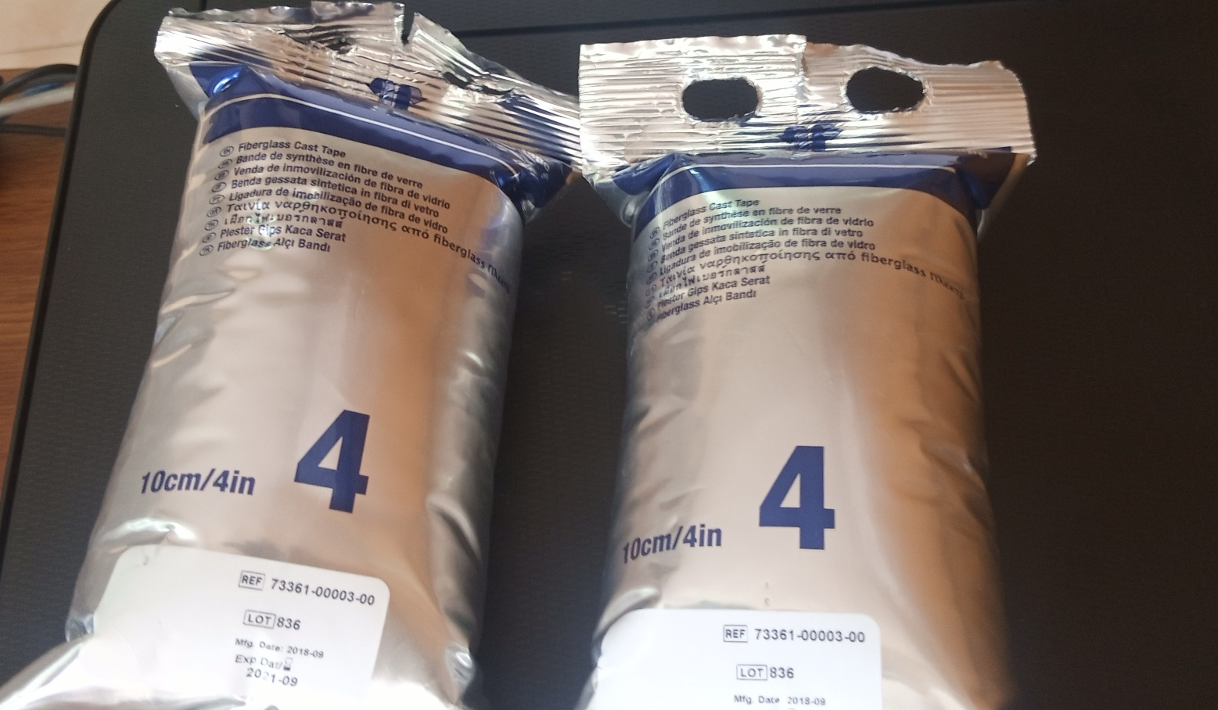
Fibreglass sizes
Comes in different sizes.
They are : 2” ,3” ,4” ,5” .

Slide 31
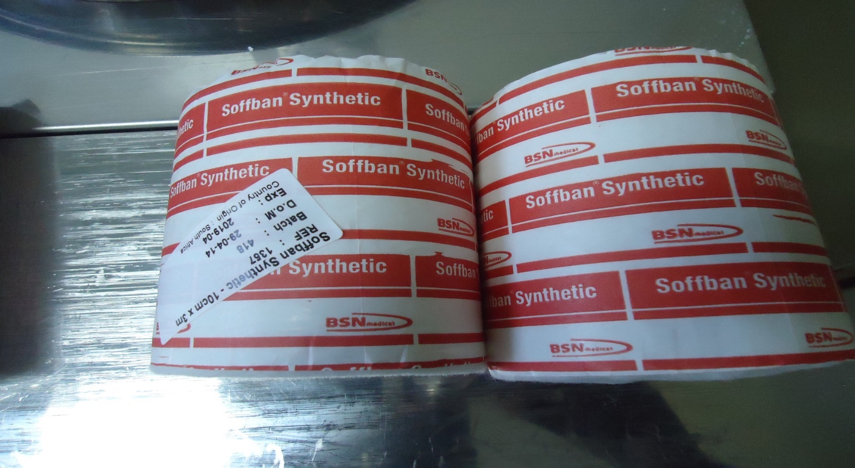
Softban sizes
They come in different sizes.
They are : 2” ,4” ,6” ,8”.

Slide 32
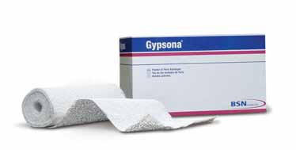
POP
The time tested form of immobilization.
Hemihydrate calcium sulfate
First described in 1852

Slide 33
TRAINING
Today, casts are routinely applied by midlevel orthopeadic providers (i.e., cast room technicians, physician assistants), thus further decreasing the amount of training orthopeadic residents receive in casting. Despite these limitations in training and
exposure, cast immobilization remains a mainstay of
treatment for many orthopeadic conditions.

Slide 34
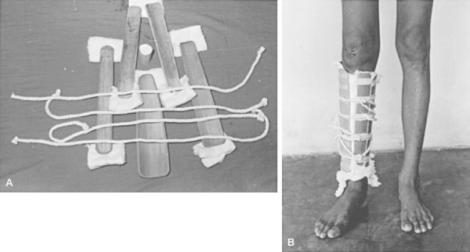

Slide 35
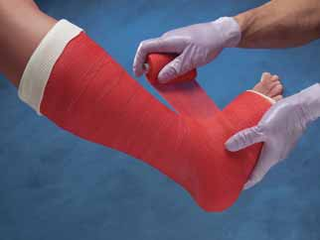
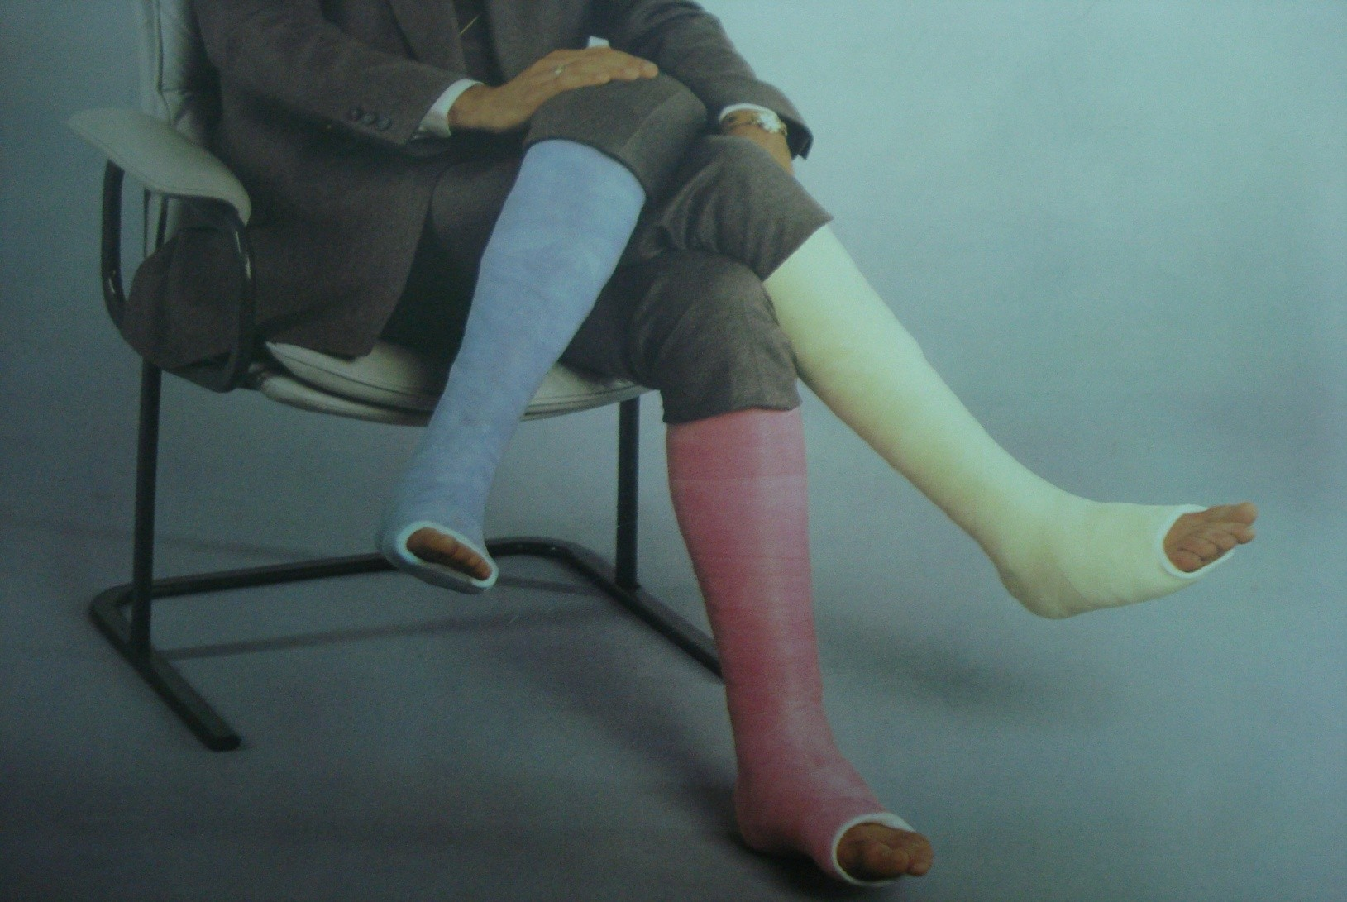
SYNTHETIC FIBREGLASS MATERIALS

Slide 36
PADDING
Simple cotton
– The cheapest
– The most commonly used
– Can be applied under both plaster and
fiberglass cast material.

Slide 37
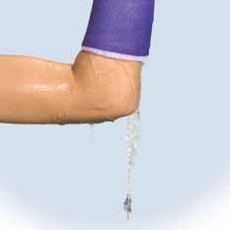
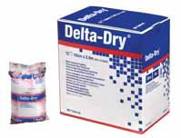
PADDING
• Synthetic materials
• Newer waterproof liners and padding
– Much more expensive
– Variable water resistance

Slide 38
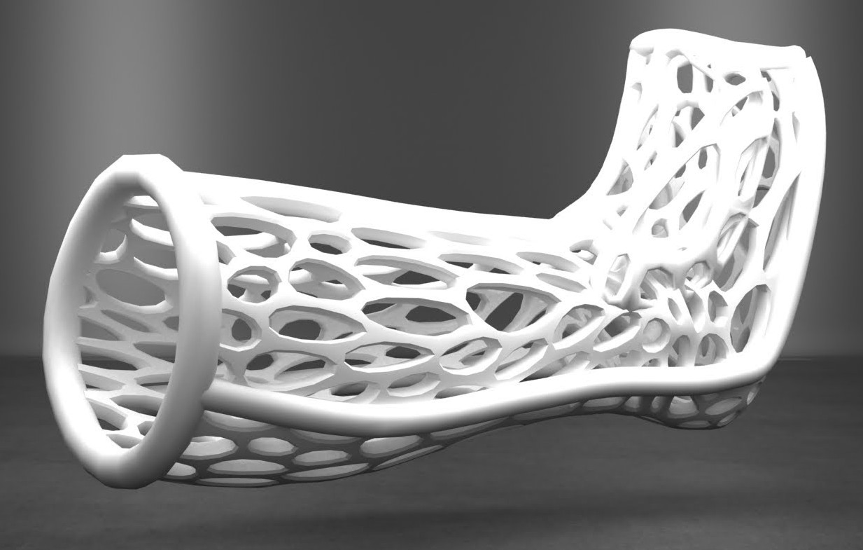

Slide 39
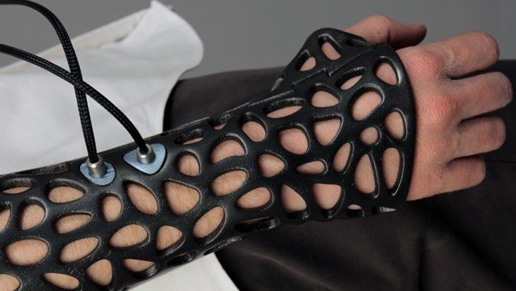

Slide 40
CASTING OVER THE WOUND
Never dress the wound with circumferential cotton fiber gauze.
– Cotton fibers absorb blood, which hardens and may become constrictive around the limb as edema increases.

Slide 41
SELECTING THE APPROPRIATE CAST MATERIAL
Considerations:
– Goals and anticipated duration of immobilization
– Patient and financial factors

Slide 42
SELECTING THE APPROPRIATE CAST MATERIAL
• When to Use POP:
– When a well-molded cast is crucial to maintain reduction
• Acute paediatric forearm fractures that requires closed reduction and immobilization
• Clubfoot
– The immobilized limb is small
– Maintaining position is essential
– Life span of each cast is short.
– In the busy nonsurgical fracture clinic
• Many casts are regularly applied
• Plaster might be chosen for both its increased pliability and its lower cost

Slide 43
SELECTING THE APPROPRIATE CAST MATERIAL
When to Choose Fiberglass:
– When cast immobilization is used simply to offer support and hold a limb in an anatomic position
• e.g. in stable minimally displaced fractures. – For postoperative casting
• After the initial postoperative edema has abated.
Advantages:
– High strength-to-weight ratio allows for easier mobilization postoperatively
– Durability is ideal for walking casts

Slide 44
BEWARE
Do not use a fiberglass cast in the acute setting unless the patient will be under close observation in the hospital.
• Never use it in the acute setting on an obtunded patient.

Slide 45
WELL MOLDED CAST
Application of a well-molded cast is the key to preventing soft-tissue irritation and loss of fracture reduction.
• Each cast should closely mimic the limb it is immobilizing.

Slide 46
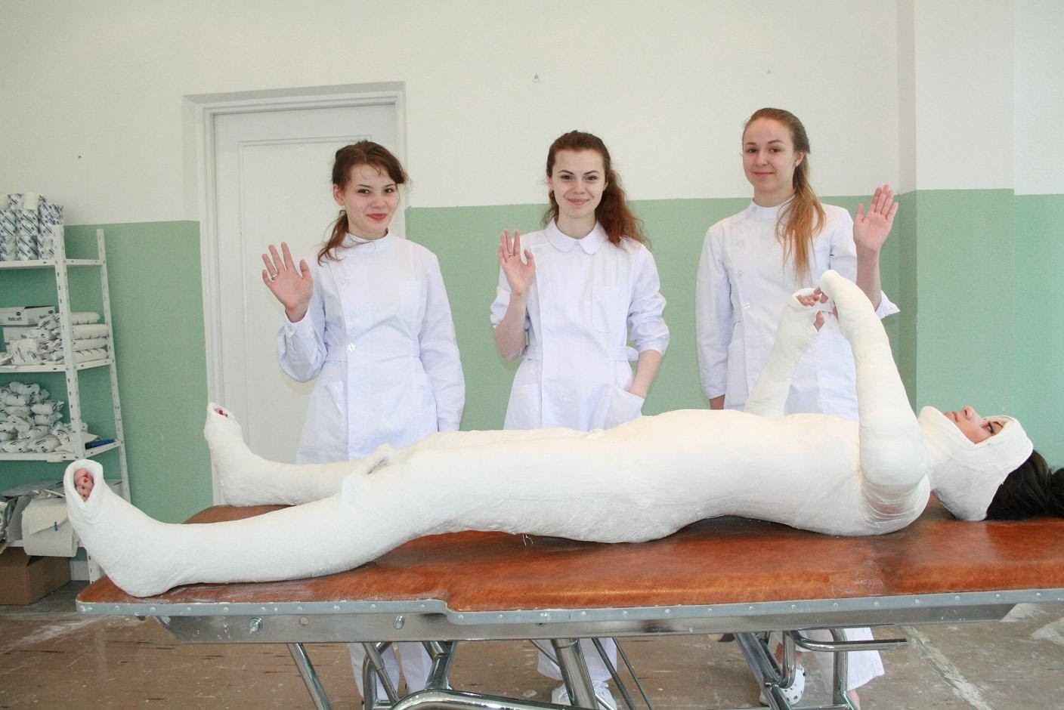

Slide 47
“WELL MOLDED ” DOES NOT MEAN TIGHT
A cast that is wrapped too tightly acts like a rigid tourniquet to the extremity.

Slide 48
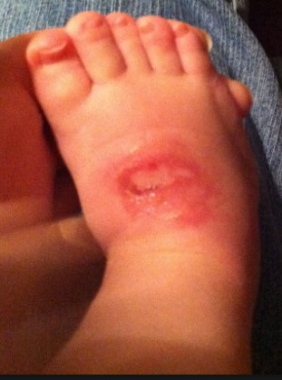
AVOID DIMPLING THE CAST
Areas of increased pressure lead to foci of decreased perfusion, resulting in
pressure sores.
Every assistant should be well trained to hold the limb
without producing divots or dimples in the cast.

Slide 49
AVOID AIR POCKETS
Avoid air pockets or bubbles in the plaster, which form a stress riser inside the cast and lead to structural failure.

Slide 50
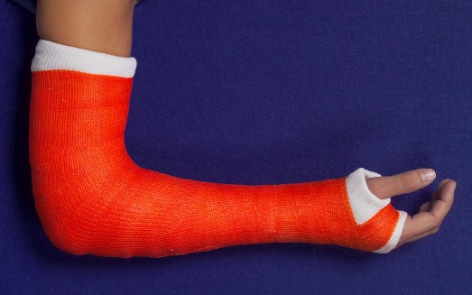
NO DIRECT CONTACT
Avoid direct contact between the skin and plaster, which can result in abrasions and lacerations.

Slide 51
ROLE OF PADDING
Some try to avoid pressure sores by increasing the amount of padding under the cast.
This is a misconception!
• Excessive padding leads to a cast that is too loose
– This paradoxically increases skin irritation from shear stress at the skin/padding interface.
• The loose-fitting cast can also cause malunion due to loss of fracture reduction.
Proximal migration of fingers or toes should alert the clinician that there is a problem.
Bony prominences and cast edges should be well padded and the cast molded to fit snugly without undue pressure.

Slide 52
CAST INDEX
The cross-section of an appropriate forearm plaster should resemble an oval, not a circle.
For optimal cast fitting in distal forearm fractures treated, the sagittal-to-coronal ratio should be 0.7.
Well-fitting plasters are important with any immobilized limb.

Slide 53
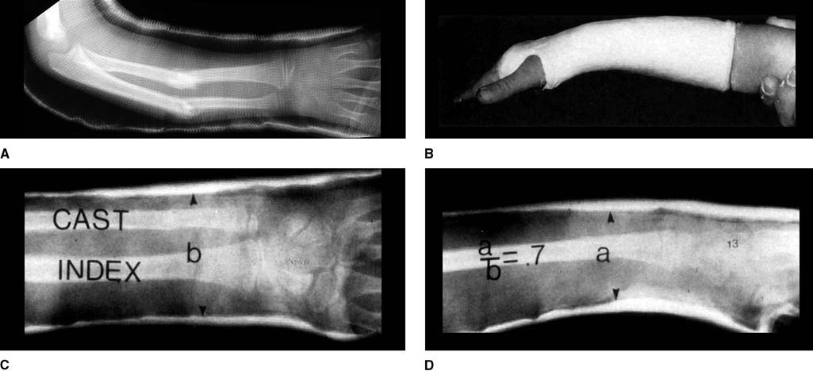

Slide 54
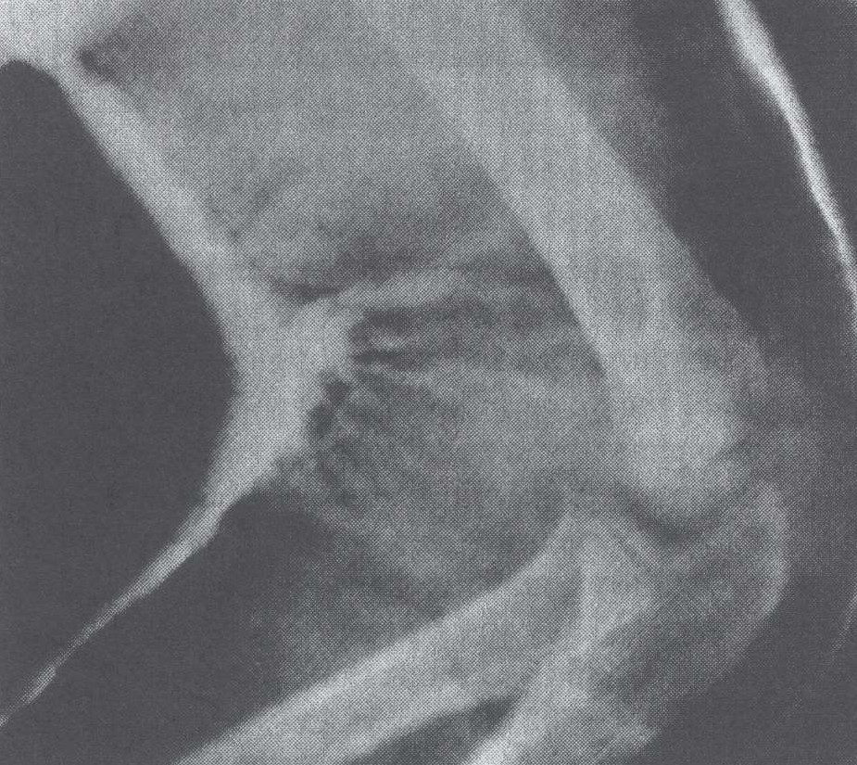
DON’T CHANGE THE POSITION ONCE YOU FINISH THE CAST
Don’t change the limb
position once the casting
material is applied (i.e. during
the curing process).
• This will weaken the cast,
resulting in increased
bunching of casting material
and, thus, increased pressure
in the flexion crease

Slide 55
POSITION OF IMMOBILIZATION
Unless a pressing reason exists to do otherwise, each joint should be immobilized in the optimal position to retain joint mobility after the cast/splint is removed.

Slide 56
POSITION OF IMMOBILIZATION
Elbow: 90º of flexion
• Wrist: 30º of extension
• Thumb: midway between maximal radial and palmar abduction
• Hand: intrinsic plus (MCP joints in at least 70º of flexion and IP joints in extension)
– Position of Safe Immobilization (POSI)

Slide 57
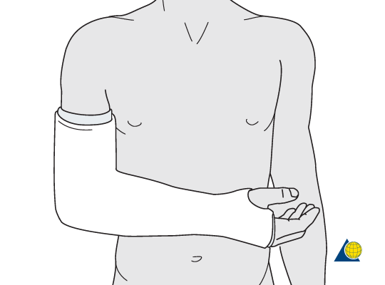
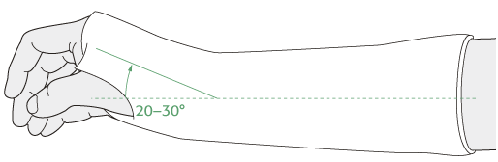
Position

Slide 58
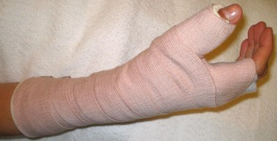
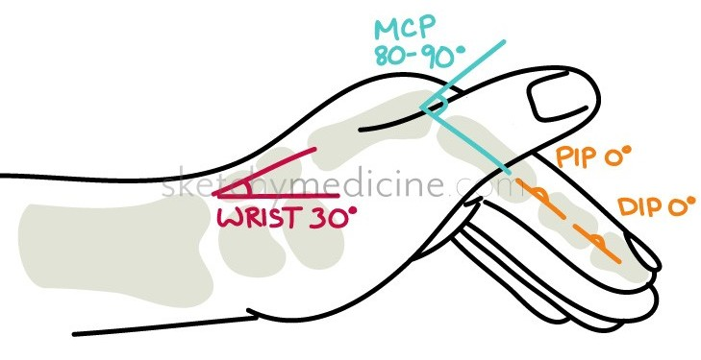
Position

Slide 59
THE HAND
Position of Safe Immobilization (POSI)
• A position used to rest the hand during periods of immobilization to minimize/prevent joint stiffness & intrinsic contractures.
• In the early 1960’s, James recognized that the MCP joints recover better from a period of immobilization when placed in flexion and the IP joints recover better when in extension.
• Since then, extensive research emphasized the importance of this position.

Slide 60
THE HAND
Wrist: Moderate extension (10-45º)
• MCP joints: Flexion (70-90º)
• PIP joints: Neutral
– The exact degrees can vary slightly depending on
• reason for splinting
• conditions of the patient’s hand (e.g. injury, surgery, existing problems)

Slide 61
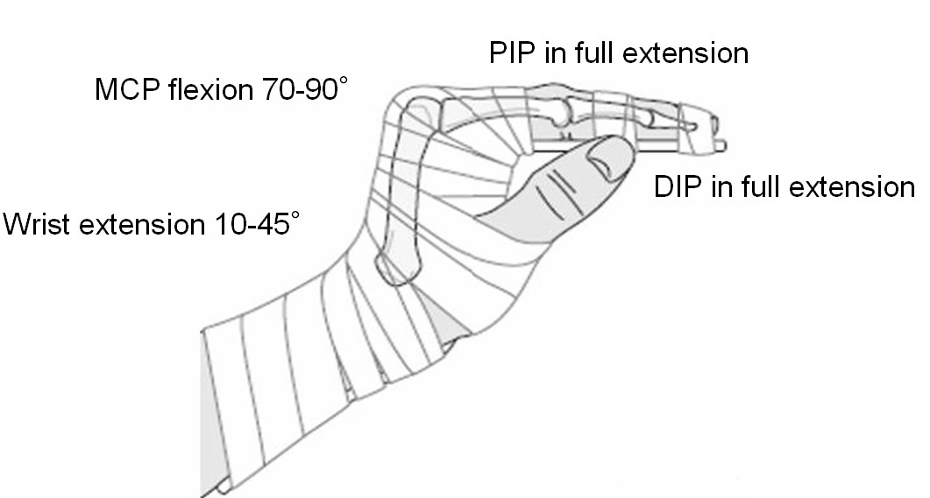

Slide 62
THE HAND
Position of Safe Immobilization (POSI)
• Apply the splint to the volar surface of the hand.
• Use your own hands to emphasise and achieve the position.
• If you feel the person’s hand is not in an ideal intrinsic plus position it is important to correct the position as soon as possible.
– Changes to soft tissue can begin after 3 days

Slide 63
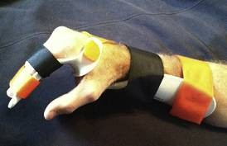
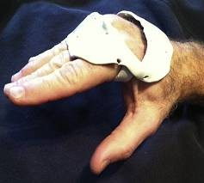
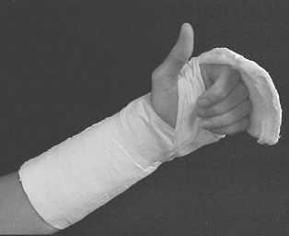
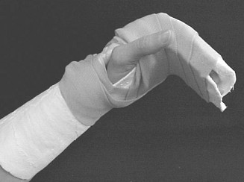

Slide 64
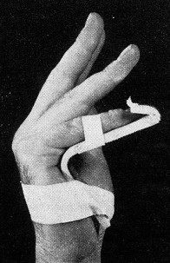
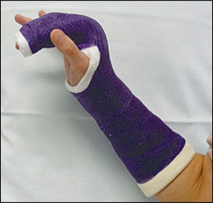
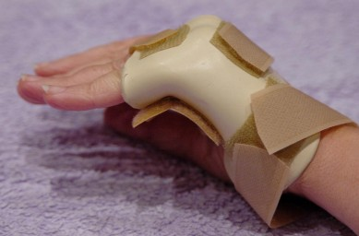
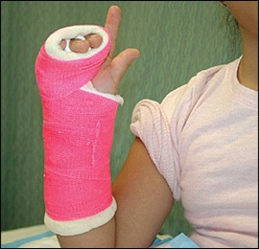

Slide 65
BEWARE
Upper extremity casts extending beyond the metacarpal heads should be avoided because they inhibit finger motion, resulting in stiffness.

Slide 66
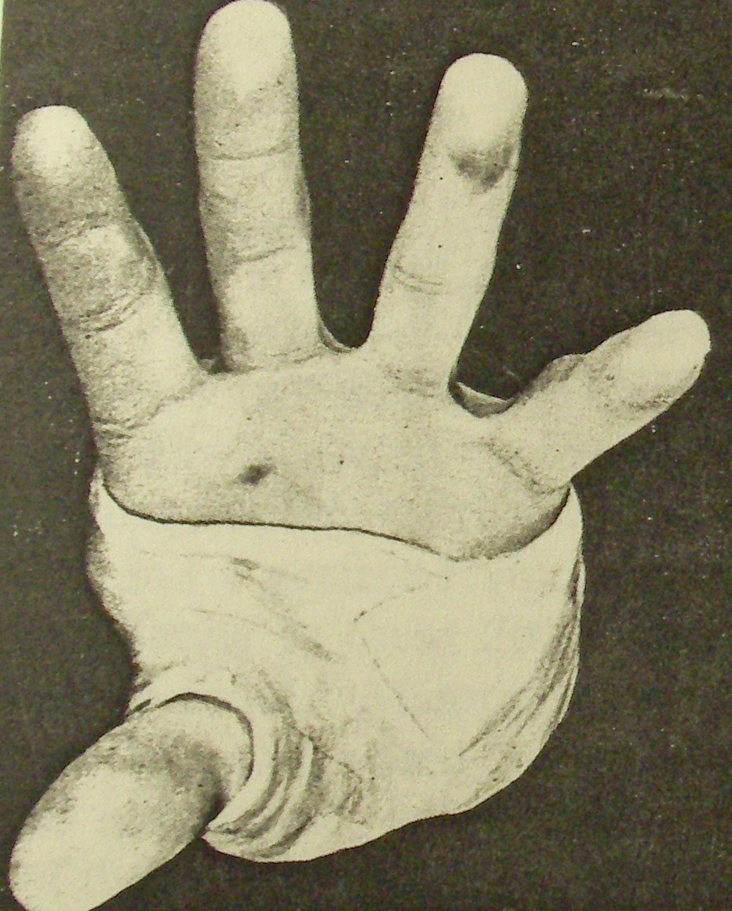
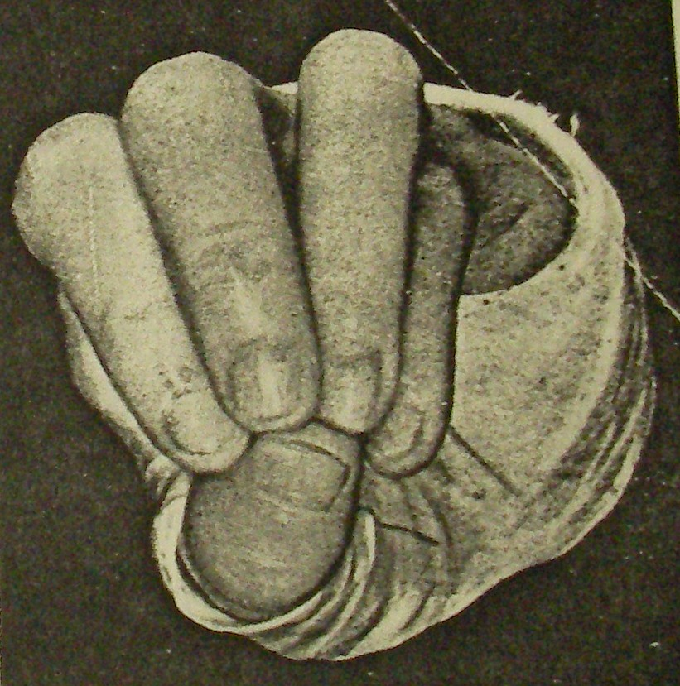

Slide 67
WHAT ABOUT THE LOWER LIMB
Hip:
–10-30º of abduction
–20-45º of flexion
–15º of external rotation
• Knee: 15-30º of flexion
• Ankle: Neutral dorsiflexion

Slide 68
CAST WEDGING
• When a fresh fracture (= significant callus formation has not yet occurred) is found to have an unacceptable loss of reduction within the plaster and the cast appears to be well-fitting, cast wedging may be attempted to regain correction.
• Many techniques for cast wedging have been described.

Slide 69
CAST WEDGING
Bebbington et al:
• A radiograph of the injured area is used to trace the long axis of the maligned bone onto a sheet of paper.
• The piece of paper is cut along this line, and the cut edge is traced onto the cast.
• The position of the apex of the deformity is determined from the radiographs.
• Next, the plaster is cut nearly circumferentially at this level, leaving a bridge of intact plaster only at the apex.
• Corks or cast wedges are applied opposite this bridge, until the line transferred onto the cast is straight.
• If this fails, the cast may need to be removed and the fracture re-manipulated or treated in some other manner.

Slide 70
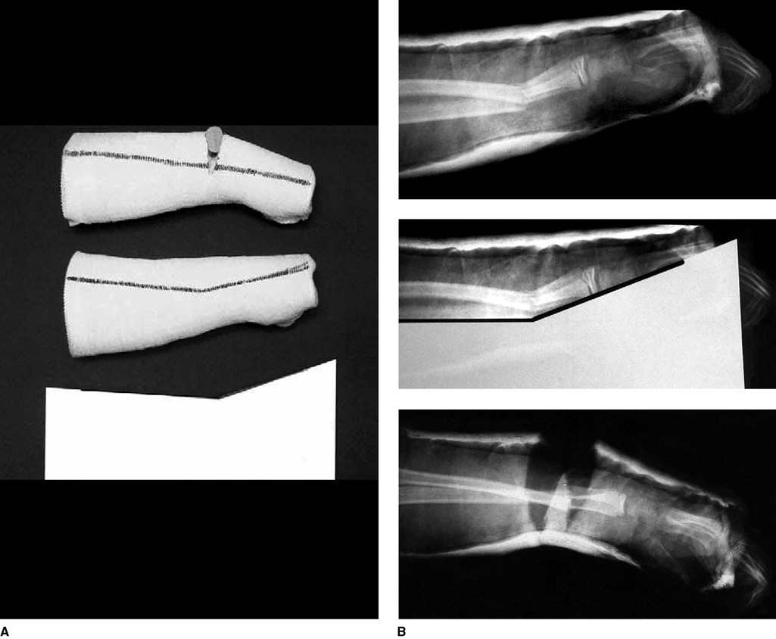

Slide 71
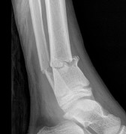
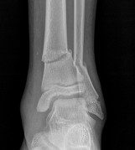
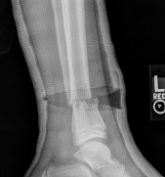
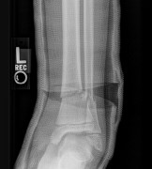

Slide 72
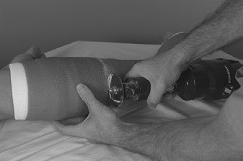
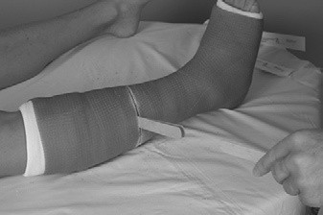
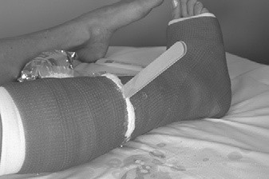
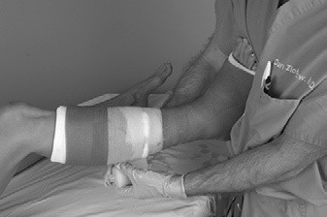

Slide 73
WHY COMMON COMPLICATIONS OCCUR
Improperly and irregularly applied padding → Pressure sores beneath the cast
• Inadequate padding material at the ends of the cast → sharp edges and skin irritation
• Aggressive cast molding → Pressure sores beneath the cast
• Inadequate casting material → cast breakdown and loss of control of the unstable fracture
• Tight application of casting material or failure to allow for underlying injury swelling → Compartment syndrome
• Hot dip water → elevated setting temperatures and skin burns

Slide 74
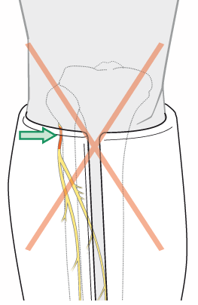
BEWARE
Avoid ending below-knee casts at the fibular neck.
• This places pressure over this area and are notorious for
causing peroneal nerve palsy.

Slide 75
CAST SPREADING
If the cast is too tight, the first intervention should be to relieve circumferential pressure by splitting the cast.

Slide 76
CAST SPREADING
Plaster cast:
– Cutting and spreading (univalving) reduce pressure by 40-60%.
– Release of padding may reduce pressure an additional 10-20%.

Slide 77
CAST SPREADING
Fiberglass cast:
– Fiberglass casts have to be bivalved to see similar decreases in pressure.
– In casts applied with the stretch relaxation method, univalving may be sufficient as long as the cast can be spread and held open.
– It is wise to use plastic cast wedges to help hold open these split casts.
• Synthetic casts tend to spring back to their original position after simply cutting one side of the cast.

Slide 78
DURATION OF IMMOBILIZATION
Excessive length of immobilization may lead to problems such as joint stiffness, muscle atrophy, cartilage degradation, ligament weakening, and osteoporosis.
• This must be weighed against the bony healing gained in prolonged immobilization.

Slide 79
Tabular gauze/stockinette
The first layer, applied directly to the skin, is synthetic mesh called tabular or thicker stockinette.
Stockinette is more expensive and preferably used with the synthetic casts
Functions of the tabular gauze/stockinette
It helps prevent the limb-hairs from becoming caught in the plaster.
It removes any roughness caused by the plaster casts edges (the edge of the tabular gauze are turned back over the cast and sealed; this creates a smooth edge which will prevent chaffing of the skin.
It allows the conduction of perspiration from the limb.
It aids in the removal of the cast.

Slide 80
Cont.’
NB.
Tabular gauze may not be used following operation procedure and where gross swelling is likely to occur as it may be difficult to split the plaster cast.
Orthopaedic padding required. It is unrolled firmly over the full area of the limb to be covered the Plaster of Paris. (Wool Padding)

Slide 81
Conti-
N.B.
Tabular gauze may not be used following operation procedure and where gross swelling is likely to occur as it may be difficult to split the plaster cast.
WOOL PADDING
Reasons .
To protect bony prominences e.g. the ulna and styloid of the lower arm , those areas must have extra padding. As the plaster cast dries out, it becomes loose and any movement over the bony prominences may cause some friction and sores if the skin is inadequately protected by padding.
Where swelling is anticipated extra padding may be required over the whole length of the limb.
Where electric saws or shears are used for removal of the cast , padding is needed to protect the skin.
It Increases patient comfort.
To help to absorb blood and serious fluid.
Orthopaedic padding required . It is unrolled firmly over the full area of the limb to be covered the plaster of Paris.(wool padding)

Slide 82
Indications of padding
Where swelling is expected/present i.e. in almost every acute conditions.
Where the limb is thin and the bones are very superficial.
When electric plaster cutter are used for removal.
When wedging is needed.
It is always wise to protect bony prominences e.g. around joints when any plaster is applied.
It increases patient comfort.
To help to absorb blood and serous fluid.

Slide 83
The function of a cast is to rigidly protect an injured bone or joint .
It serves to hold the fracture in proper alignment and prevent it from moving while it heals.
Cast may also be used to help rest a bone or joint to relieve pain that is cause by moving it
different types of cast and splint are available depending on the reason for the immobilization and type of fracture.
Cast are usually made of either plaster or fiberglass material

Slide 84
Why do we use plaster of Paris
It is used extensively as a mean of securing accurate and well –fitting external splintage of any part of human frame
we find that traditional methods of fixing required be manufactured and maintained by technician and skilled constant supervision was essential if the accuracy of use was to be sustained
In comparison plaster has an advantage of immediacy. We use skilled trained plaster tech.

Slide 85
Various form of plaster of Paris cast
Slab-only a part of circumference of the limb is incorporated
Cast –encircle whole circumference of the limb
Spica
Support like, brace

Slide 86
Orthopedic uses of cast
To Support fractured bones, controlling movement of fragments and resting the damaged tissues
To stabilize and rest joints in ligamentous injury
To support and immobilize joints and limbs post operatively until healing has occurred
To correct a deformity
To ensure rest of infected tissues
To make negative mold of a part of body

Slide 87
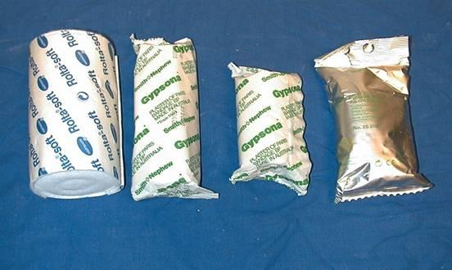
DIFFERENT TYPES OF CASTING MATERIALS
Plaster of Paris (POP)
Synthetic resin

Slide 88
CLOSE REDUCTION (CR)
Manipulation of the fracture to improve the position of the fragments.
As soon as possible
Under appropriate anesthesia/muscle relaxant/sedation
Maneuver :
  Traction-distal part of the limb is pulled in line of the bone
  Counter-traction
  Manipulation-as the fragments disengaged, they are repositioned (by reversing the original direction of forces)
  May need to exaggerate the deformity first

Slide 89
POP
Application of cast.
Maintain the position with a “3-point fixation” casting.

Slide 90
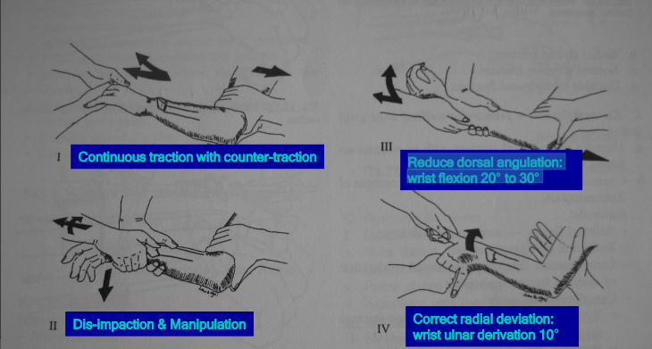
Closed reduction of colles’ fracture

Slide 91
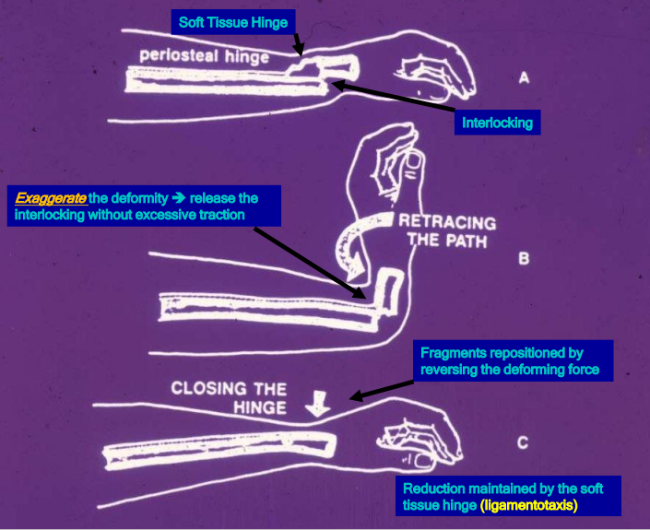

Slide 92
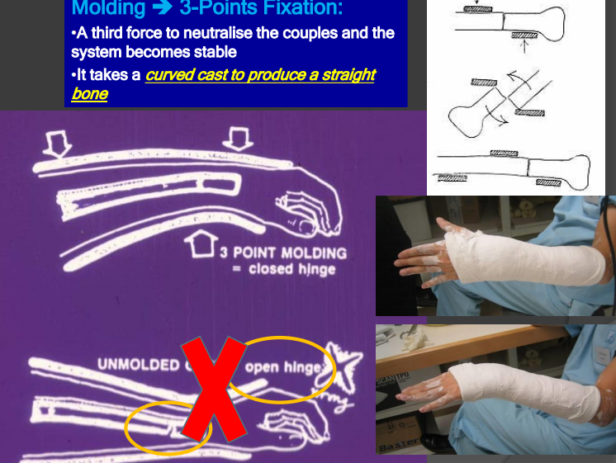

Slide 93
POOR MANIPULATION AND REDUCTION
Insufficient relaxation
Inadequate reduction
Poor understanding
Fail to hold the alignment after reduction.

Slide 94
Preparation before casting
Determine the aim : temporary vs definitive.
Choose the appropriate casting material
Use the appropriate size bandage e.g. 4” hand and forearm, 6”leg, 8”thigh
Pain control for close reduction
Get an assistant.

Slide 95
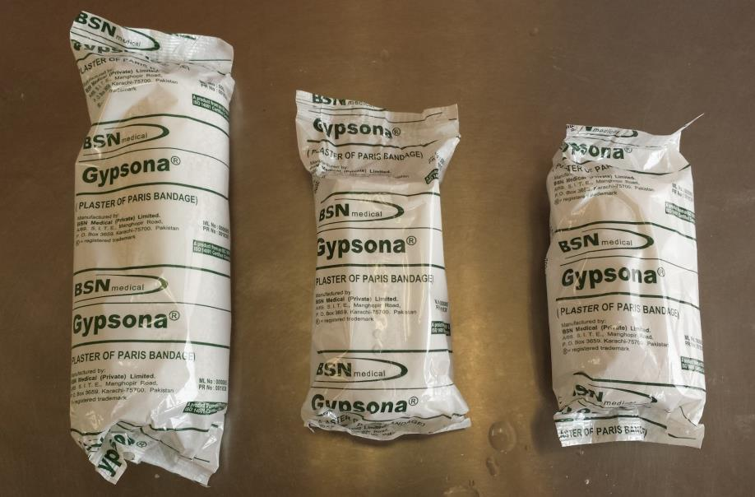
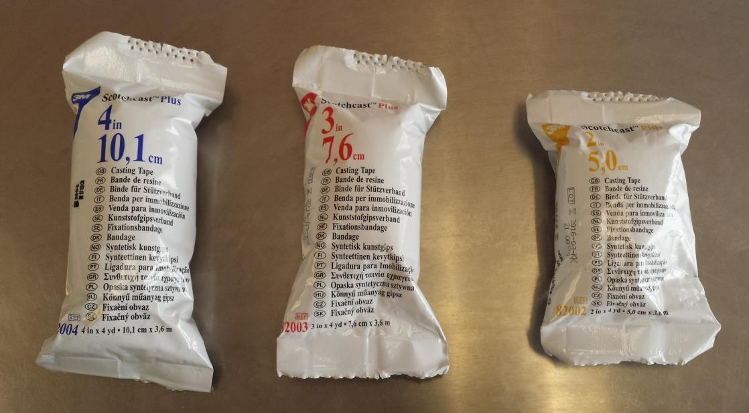

Slide 96
Basic steps for plaster application
Reduction of fracture
Padding
  Tubegauze/stockinette
  Velban application
Activate plaster bandage
Plaster bandage application
Molding
Trimming and reinforcement
Follow up monitoring and care
Removal

Slide 97
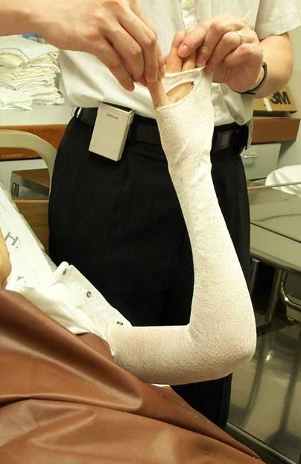
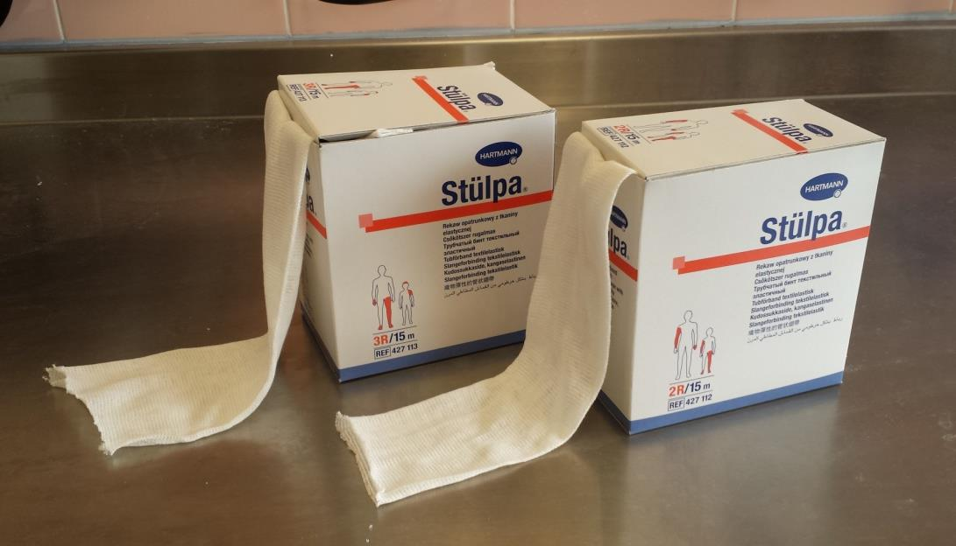
Basic steps for plaster application.(cont.)
Stockinette first
Extending to the joint above and longer than the limb for easy handling of the extremity

Slide 98



Padding- Velban

Slide 99

Plaster bandage activation
Lifted with dry hands
Thorough immersion in water at room temperature
Gently squeezed out water until no more bubbles
Remove from water and further squeeze out excessive water.

Slide 100




Plaster bandage application

Slide 101




Trimming

Slide 102


Reinforcement

Slide 103

Wound inspection
Making a hump with thick gauze over the wound site for opening of window.
Cut out the hump after POP set

Slide 104

¾ slab for distal radius

Slide 105

U-slab for humerus

Slide 106

Sarmiento cast for tibia

Slide 107

Oscillating electric saw

Slide 108


Oscillating electric saw

Slide 109

Do not split plaster on the convex side

Slide 110

Always split on the concave side

Slide 111

Spreader

Slide 112



Spreader using in casting

Slide 113

Plaster cutting shears

Slide 114


Pressure sores

Slide 115
CHEMISTRY OF PLASTER OF PARIS
Plaster of Paris is derived from gypsum, which is calcium sulfate in its nature state the formula of gypsum is 2(caso4.2h20)
. The reaction is endothermic and is described by the following chemical equation.
2 (caso4-2H2O) changes (CaSo4).H2o + 3H20
Gypsum P.O.P water

Slide 116
ADVANTAGES OF PLASTER OF PARIS
Low allergic response
Offers rigid protection
Easy to apply
Shape better than synthetic cast because of easy moldability.
Excellent molding properties.
Low Plaster loss.
Flexible working time.
Strong.
Smooth finish.
Cost – effective.
Versatile range.
Easy removal.

Slide 117
Disadvantage of plaster of Paris
Causes circulatory calatrphes
Cause pressure sores
Stiffness of joint
Joint becomes osteoporotic
loss of position of the fracture
Not waterproof
Heavy and inconvenient to the patient

Slide 118
The Major Categories Of Cast Are
Upper and lower extremities
Extremity cast incorporates all or a portion of the designated extremity
Spinal and cervical
Spinal and cervical cast incorporate all or a portion of the body or the cervical area
Spica
Spica refers to a cast that incorporate part or the entire trunk of the body.

Slide 119
Rules of application plaster of Paris
Pop are in different sizes; 8inch,6inch,4inch,2inch.
One joint above and joint below
Mould with palm
Not too tight or too loose,adequate padding
dip pop vertically into water till water air bubbles ceases to come
uniform thickness of plaster is preferred

Slide 120
Cast application
Before casting material is applied (plaster or synthetic), a "stockinette" is usually placed on the skin where the cast begins and ends (at the hand and near the elbow for a wrist cast). This stockinette protects the skin from the casting material.
After the stockinette is placed, soft cotton patting material (also called cast padding or Webril) is rolled on. This cotton patting layer provides both additional padding to protect the skin and elastic pressure to the fracture to aid in healing.
Next, the plaster or synthetic cast material is rolled on while it is still wet.
The cast will usually begin to feel hard about 10 to 15 minutes after it is put on, but it takes much longer to be fully dry and hard.
Be especially careful with a plaster cast for the first 1 to 2 days because it can easily crack or break while it is drying and hardening. It can take up to 24 to 48 hours for the cast to completely harden.

Slide 121
Using sub-standard “plaster of Paris
Exothermic reactions – serious burns to patients.
Medico – Legal costs.
Serious health hazards – breathing excess dusts.
Huge costs to the hospitals – repeat applications and rejects.

Slide 122
SETTING TIME IN PLASTER OF PARIS
Setting time: time taken to change from powder form to crystalline form.
Drying time: time taken to change from crystalline form to anhydrous form.
Average setting time: 3 – 9 minutes.
Average drying time: 24 – 72 hours.

Slide 123
FACTORS DECREASING SETTING TIME
Hot water
Salt
Borax
Resin

Slide 124
FACTORS INCREASING SETTING TIME
Cold water
Sugar

Slide 125
Factors That Affect Setting Times for Casts and Splints
The dipping water should be kept clean and fresh.
In general, the temperature of the water should be tepid or slightly warm for plaster, and cool or room temperature for synthetic tape material.
These temperatures allow for a workable setting time and have not been associated with increased risk of significant burns.
Applying excess material or using an overly compressive elastic wrap also increases the risk of excessive heat production.
Therefore, it is best to use only the amount of splinting material and compression required to stabilize the injury.

Slide 126
CHARACTERISTICS OF PLASTER OF PARIS
It soaks rapidly.
Smooth when molding.
It is creamy and
Innocuous to the skin (Innocuous-harmless)
It sets fast- can be molded as desired.
Light cast translucent to X-rays.
It has a combined strength with durability.
Low plaster loss properties depending with the brand, examples, gypsona.
Setting time-3-9 minutes
Drying time 24-72 hours

Slide 127
Indication of plaster of Paris(Cast)
Immobilization of fracture
Immobilization of diseased bone and joint
Correction of deformities e.g. C.T.E.V
Prevention of deformities
Emergency splint age
Immobilization in the treatment of burns and soft tissues injuries

Slide 128
Immobilization of fractures
It must always be remembered that the surrounding soft tissues are damaged when a bone is broken.
When P.O.P is used
Accuracy of alignment is secured and maintained.
Immobilized limb can be x-rayed and progression towards healing may be observed without any disturbance to the fixation of the limb.
The patient can retain at least some mobility.
With Plaster fixation body function is retained during immobilization

Slide 129
Immobilization of the diseased bones or joints
Resting the diseased bones/joints to prevent complications and deformities resulting from the original conditions. e.g.Chronic Osteomyelitis

Slide 130
Correction of deformities
This can be obtained by two methods :
(a) Serial Plaster
It is whereby procedure routine is repeated as often as necessary using P.O.P so that you can achieve the correction of the deformity e.g.club foot.
(b) Wedging and turnbuckle correction of deformities
Two instances where wedging may be used.
(i) Adjustment of the alignment of a fracture.
(ii) In the correction of basic deformities in congenital club foot.
NB: Care should be taken when cutting a Plaster of Paris.

Slide 131
Prevention of deformities
A patient may sustain a wrist drop or foot drop due to variety of causes. If light removable Plaster Shells/Splints are made.
(i) Power may be restored.
(ii) Function may also be restored

Slide 132
Emergency splintage
Packed units consisting of Plaster Slab and circular paper bandage are available as First Aid kits.

Slide 133
PURPOSE OF THE CAST
Immobilize parts of the body.
Hold bone fragments in reduction (reduction is bringing the fractured on its anatomical position).
Apply uniform compression.
Stabilize joint.
Correct deformities.
Support weakened limb.
Permit early weight bearing on affected side

Slide 134
Classification of casts
Based on Pattern Of Application
Slab:
  POP encloses partial circumference eg Short arm back Slab
Cast :
  POP encloses full circumference ex Short leg full Plaster
Spica:
  includes trunk and one or more limbs ex : Hip Spica
Brace:
  Splintage which can allow motion at adjacent joints

Slide 135
Complication of plaster of Paris
Plaster sores
Impaired circulation
Tighten of plaster
Loss of power
Crack of plaster
Loss of position of fracture fragments

Slide 136
Loss of position
Swelling is the main feature of any fracture.
A cast technician should apply a firm padded plaster to anticipate swelling and ensure the limb is elevated and the extremities exercised.
A cast can be loose when the swelling has subsided leading to loose plaster- if left like that there will be movement of fragments
Loss of position of the fracture.
Solve that –change P.O.P if swelling subsides.

Slide 137
Plaster sores
Comes as a result of the following :
  Technique ; Inadequate skeletal protection. Failure to trim the extremities of the cast correctly
  Instruction ; Failure of the patient to understand how to care for the cast can result to cracking, wetting or friction occurring with inevitable skin damage.
  Supervision ; Observation for signs of tightness and looseness should be accurate and prompt action taken depending on circumstances
  Foreign bodies ; Children in Cast can put small toys, coins and sweets inside the cast and cause pressure sores.

Slide 138
Recognition of sores
Friction major cause
Clinical features
Burning
Itching
Stabbing pain
In young children increase in temperature/disturbed sleep.

Slide 139
Important featues of plaster sores on examination
  Heat and swelling of the digits.
  Increase in the area of staining which has already been marked in the immediate post-operative period.
  Odor detected locally when the extent of the cast has been sniffed over carefully.
  A pronounced odour and visible pus. Discharging show that a sore has developed.

Slide 140
Action to be taken
Encourage the patient to pin point the area and then mark it. Patient to report at once.
Window the part and inspect the underlying skin.
Cut by electric plaster cutter, plaster saw.
Dress the sore.

Slide 141
Loss of power
Inability to extend the fingers, toes suggest loss of power.
It can be due to;
  Pressure of the P.O.P on the superficial nerve.
  Post-operative-due to prolonged tourniquet pressure.
  It is also feature of impairment of circulation.
Management- Split the cast to relieve tension.

Slide 142
Impairment of circulation(Impairment venous return)
• Coldness to the extremities blueness and swelling.
• Colour change, bluish and swelling of the extremities.
Management
• If there is swelling-elevate the part affected.
• Ensure that digital exercise is done.
• If the problem persist and the patient experience a lot of discomforts, split the .PO.P and elevate the limb.

Slide 143
General constitutional complications of plaster
Stiffness of the joint due to inactivity. Free joints are to be kept mobile -. Encourage exercises.
Muscle wasting- keep the muscles in tone e.g encouraging exercises.
Venous thrombosis- common sites coronary and pulmonary infarction. Comes about due to blood flow cut off.
Advise on exercise to maintain general circulation.

Slide 144
Complications of plaster
Complications of plaster cast can be divided in systemic, which affects whole body or local which affects limb where plaster has been applied.
Local complications of plaster can be further classified as : immediate and delayed.

Slide 145
Immediate local complications plaster cast
Swelling of the Part
A plaster produces constricting effect on the limb and most of it is well tolerated but a moderate constriction will produce compression of the veins, damming the blood, and causing swelling, discomfort or pain, and a blue color in the skin and under the nails.
Temporary remedies such as elevation of the limb and exercising the digits may be tried, but, if persistent, the constriction must be relieved. The cast can be split and eased or bivalved, taking care not to damage the skin.

Slide 146
Immediate local complication plaster cast
Pain
Pain has many causes. This may be due to tissue damage at injury or reduction, swelling within the cast, muscle spasm, pressure on blood vessels or nerves, skin irritation or sores. Although diagnosis may be difficult, persistent pain or intermittent acute pain should not be ignored. Medical advice must be sought.

Slide 147
Immediate local complication plaster cast
Impaired Arterial Supply
A pale skin which is cool and without a palpable pulse indicates that the arterial supply is disrupted. This is a serious complication. Medical advice must be sought immediately.
Splitting the cast may relieve the arterial compression but sometimes surgery may be necessary.
Incomplete arterial occlusion may present with pain or aching with loss of power. If in doubt ask for medical advice.

Slide 148
Delayed local complications of plaster cast
Plaster sore
Loss of position
Nerve damage

Slide 149
Plaster sores
The most common cause of sores is pressure of the plaster on the skin due to poor cast application.
The patient may report burning, itching or stabbing pain.
Children may have disturbed sleep and elevated temperature.

Slide 150
Loss of position
Because swelling occurs with most fractures especially after reduction, the technician puts padding under the cast to protect the skin. This padding gets compressed. After 48 hours when the oedema is subsiding, the cast may be too loose to hold the bone ends in position against undesirable muscle action.
Such displacement may be sudden and cause pain or gradual displacement being first noticed on the next x-ray. This complication may seriously delay sound healing and may produce permanent deformity.
Medical advice must be sought if the position is suspect.

Slide 151
Nerve damage
Loss of power, tingling and numbness distal to the cast are signs of impaired nerve function. The cause may be direct compression by bone ends or plaster pressure, indirect compression of oedematous tissue or tourniquet effect, or reduced blood flow.
Routine testing of power and sensation will detect any defect quickly. Corrective action includes relieving cast pressure, supporting and protecting paralyzed parts, and physiotherapy to help restore normal function of muscle and joints.

Slide 152
Avoiding complications of plaster cast
Complications of plaster cast can be reduced by taking all precautions of application of cast, keep a vigilant eye and making sure that patient is well instructed about care of cast.
Application of the plaster cast should be done by a skilled person in proper manner.
Patient, as a routine should always be called for follow up examination next day. Strict elevation of the limb should be instructed.
Patient should report on pain that is not relieved, swelling, bluishness or pallor of distal part.
Patient should be carefully examined in the follow up for probable complications of plaster cast.

Slide 153
plaster sores
Comes as result of the following
Technique,instruction,supervision,foreign bodies
-Technique- failure to trim the extremities of the cast correctly
-instructions-failure of the patient to understand how to care for cast.
Children with cast can put small toys,coins,etc

Slide 154
Plaster casts
Plaster cast is made from rolls or pieces of dry muslin that have starch or dextrose and calcium sulfate added
When plaster cast get wet , a chemical reaction happen(between the water and the calcium sulfate
The temp of the water used to wet the plaster affects the rate the which the cast sets
plaster cast are usually smooth and white.

Slide 155
Principles of casting and splinting
The ability to properly apply cast and splint is a technical skill easily mastered with practice and an understanding of basic principles. The initial approach to casting and splinting requires assessment of the injured extremity for proper diagnosis. Once need for immobilization is ascertained, casting and splinting start with application of stockinet, splint are faster and easier to apply, allow for the natural swelling that occurs during the acute inflammatory phase of an injury.

Slide 156
splinting versus casting
Casts and splint serve to immobilize orthopedic injuries
They promote healing
Maintain bone alignment
Relieve pain
Protect the injury
Compensate for surrounding muscular weakness

Slide 157
Splint comparison casts
Splint/cast | construction | indication | advantages
splint | no circumferential | Acute and definite treatment of select fracture ,soft tissue injuries (sprains, tendon). acute management of injuries awaiting orthopedic intervention
cast | circumferential | definitive management of simple ,complex,unstable,or potentially unstable fractures, | More effective immobilization

Slide 158
When to cast
Indication –circumferential cast may be used
Fractures
Severe sprains
Dislocation
Protection of post-operative repairs
Gradual correction of a deformity with serial casting

Slide 159
Evaluation
Before cast application certain examination must be performed;
Complete exam of the affected region
note the quality of the skin in the region to be cast
Radiographs as necessary

Slide 160
Contraindication; circumferential casts should not be used
Open fractures
Severe swelling compartment syndrome
Ulcers or draining

Slide 161
Taking Care of Your Cast
Always keep the cast dry.
If the cast becomes very loose as the swelling goes down, call the doctor for an appointment, especially if the cast is rubbing against the skin.
Cover the cast with a plastic bag or wrap the cast to bathe ( and check the bag for holes before using the bag a second time). Some drug stores or medical suppliers have cast covers –plastic bags with Velcro straps or rubber gaskets to seal out water for protection during bathing .
If the cast gets wet enough that the skin gets wet under the cast , contact the doctor . If the skin is wet for a long period of time, it may break down , and infection may occur.
Sweating enough under cast to make it damp may cause mold or mildew to develop. Call the doctor if mold or mildew or any other odor comes from the cast.

Slide 162
Conti-
Do not try to scratch the skin under the cast with any sharp objects ; it may break the skin under the cast and lead to an infection. Do not put any powders or lotions inside the cast.
Do not trim the cast or break off any rough edges because this may weaken or break the cast. If a fiberglass cast has a rough edge , use a metal file to smooth it. If rough places irritate the skin , call the doctor for an adjustment.
An arm sling may be needed for support if the cast is on the hand, wrist, arm or elbow. Wrapping a towel or cloth around the strap that goes behind the neck can help protect the skin on the neck from becoming sore and irritated.
If the cast is on the foot or leg , do not walk on or put any weight on the injured leg, unless the doctor allows it.

Slide 163
Conti-
Do not lean on or push on the cast because it may break.
Do not put anything inside the cast.
If the doctor allows walking on the cast , be sure to wear the cast boot ( if given one by the doctor) . The boot is to keep the cast from wearing out on the bottom and has a tread to keep people in casts from falling .
Crutches may be needed to walk if a cast is on the foot, ankle or leg. Make sure the crutches have been adjusted properly before leaving the hospital or the doctor’s office and make sure you understand and can demonstrate proper use of crutches.
If a fiberglass cast gets damp , dry it ( make sure it dries completely )

Slide 164
How a Cast Is Removed.
Do not try to remove the cast.
When it is time to remove the cast, the doctor will take it off with a cast saw and a special tool. - A cast saw is a specialized saw made just for taking off casts. It has a flat and rounded metal blade that has teeth and vibrates back and forth at a high rate of speed. - The cast saw is made to vibrate and cut through the cast but not to cut the skin underneath. - After several cuts are made in the cast ( usually along either side), it is then spread and opened with a special tool to lift the cast off. - The underlying layers of cast padding and stockinet are then cut off with scissors.
.

Slide 165
Conti-
After a cast is removed , depending on how long the cast has been on , the underlying body part may look different than the other uninjured side . -The skin may be pale or a different shade . - The pattern and length of hair growth may also be different. - The injured part may even look smaller or thinner than the other side because some of the muscles have weakened and have not been used since the cast was put on. - If the cast was over a joint , the joint is likely to be stiff. It will take some time and patience before the joint regains its full range of motion.
Complications of plaster cast can be divided in systemic , which affects whole body or local which affects limb where plaster has been applied.
Local complications of plaster can be further classified as immediate and delayed

Slide 166
Plaster Beds.
Aim
To secure complete physical relaxation of the body and immobilization of the spine and hip region.
What care is required?
The wet casts
P.O.P sets in about 3 to 5 minutes depending on water temperature and cast thickness.
Cast takes about 36- 72 hours to dry.
Wet cast when tapped gently with the knuckles the still-damp cast will emit a dull sound .
But the sound from dry cast will be crisp and clear.
Damage Due to Pressure.
Patients must be warned not to rest the wet cast on any hard/firm surface e.g unpadded chair.
Dent the cast and produce a ridge on the internal surface which may cause soreness to apart.( plaster sores).

Slide 167
Drying the Cast.
Natural Method.
Most commonly accepted method to dry in the presence of circulating air.
Patient in bed should leave the cast uncovered.
If possible patients position to be changed after two or four hours to ensure each drying of both surfaces.
The outpatient should be advised to expose the cast to warm air.
Artificial Method.
The use of electrically heated bed cradles for drying cast is discouraged.
Patient can suffer from overheating and cast can dry too quickly , unevenly and become brittle.
The amount of heat used must be controlled accurately.
Example – routine is a half – hourly of direct heat followed by half routine without heat.
Parts of the patient not enclosed in the plaster must be protected from scorching.

Slide 168
The dry cast.
Once the cast is safe from the danger of pressure- walking Plaster sole of wood /rubber may be applied ./bohler iron inserted to give sole protection.
Canvas boots may also be used to give protection from damp /wet.
Instructions to Patients.
Cards of written instructions regarding the care of Plaster casts should be given to all patients who are going home wearing Plaster cast.
Orthopaedic department.
Please read the following instructions careful;
Do not wet , cut, or otherwise interfere with the plaster cast.

Slide 169
Conti-
Report at once; cast
If it cracks , becomes loose/ otherwise uncomfortable.
If there is any pain.
If there is any discharge.
If the fingers /toes become numb /difficult to move.
If the fingers /toes become swollen /blue.
Advice to the Patient.
The plaster cast may feel tight for sometime after application.
This can usually be relieved by lying arm/leg on one moving pillows by constantly moving those joints of the arm and the leg that are not covered by the Plaster Cast.
Patient sign for the instruction cards.

Slide 170
Conti-
Recognition of Sores.
Friction major cause;
Clinical features.
Burning
Itching
Stabbing pain.
In young children increase in temperature /disturbed sleep.
Important Features of Plaster Sores on Examination.
Heat and swelling of the digits.
Increase in the area of staining which has already been marked in the immediate post-operative period.
Odour detected locally when the extent of the cast has been sniffed over carefully.
A pronounced odour and visible pus. Discharging show that a sore has developed.

Slide 171
Conti-
Action to be Taken.
Encourage the patient to pin point the area and then mark it. Patient to report at once.
Window the part and inspect the underlying skin.
Cut by electric plaster cutter , plaster saw.
Dress the sore.

Slide 172
Conti-
In children the electric Plastic cutter is discouraged so use the plastic shears.
Procedure.
You should explain the procedure to the patient and the apparatus introduced – This helps to reduce fear of the patient.
Gain the patient co-operation and attention –assisting in some ways.
Encourage the patient to play a role.
Use of Plaster Shear.
The size depends on the dimension of the Cast.
Draw a guideline along the cast to avoid the bony prominence.
Try to insert the shear between the cast and the padding wool.
As you use it, shear must lie parallel to the skin with the handle.
Align the shear correctly after every cut made.

Slide 173
Conti-
Reasons for the above instructions ;
Discomfort
Injury
Bruising
Even laceration to the skin.
After every four to six cuts remove the shear to clear the cutting area . Patient can also relax. Gives position of shearing in good alignment .
NB.
It is not easy – most operators get tired because of arm movement.
Elbow joint should remain stiff; cutting force should originate from shoulder girdle. These method conserve energy and give the operator controlled power.

Slide 174
Uses of Electric Plaster Cutter.
Used in removing completely padded cast. It has got a cable.
Position the patient on the desired way.
Warnings – Electric plaster cutter must not be used in oxygen or any other inflammable gases, since it has the sparks .
Should be serviced regularly to ensure safety.
Operator should not use if his/her hands are wet.
Mark the Guideline.
Introduce the patient to then sound or the noise of the motor.
Assure the patient that the blade only cuts a hard object but not a soft material.
Fine oscillation but not through revolution.
Cutter may sometimes become hot ( patient feels scorched ) stop immediately and inspect the area when the patient complains.
Position the blade lightly at the start of the guideline . Exert gentle pressure on the trigger. Move the cutter on along the line smoothly built with a gentle pressure.

Slide 175
Advantages of Electric Plaster Cutter.
Faster / speedy.
Gives a clean cut compared to plaster shear.
Precaution – never ignore any complain from the patient when using electric plaster cutter.
Consideration of the Part released from the cast.
Remove the Plaster completely.
Bivalve of the cast.
Bivalves for inspection . X- ray taking , skin preparation prior to operation.
Special Precautions.
Two halves are replaced together and then held with bandages until further direction is given.
When you remove the two halves you are supposed to support between the sand bags.
Inspect it fully or any sign of trauma caused during removal procedure.
Wash and dry the part . Gently massage with oil and spirit mixture to restore normal nutrition and elasticity of the skin.
After extend of immobilization ,oedema is likely to be there.
Use – Elastoplast.
Elastocrepe
Advice the patient to extend his/her activities gradually.
Patient should be advised to rest the part at regular interval when maintaining digital movement when at rest.
Plaster removed prior to surgery , skin texture and nutrition should be improved by massage. This can stimulate wound healing.

Slide 176
CAST SETTING
The ‘setting ‘ of a cast is the change of Plaster of Paris to crystalline gypsum. The dipping of the bandages releases the Plaster from the carrier fabric ,primarily after application.
The plaster reacts with water and forms long slender crystals that interlock with each other through the gauze layers, creating slender crystals that interlock with each other through the gauze layers , creating a rigid unlaminated piece of gypsum. If motion occurs during setting, the crystals will be short and join as rigidly , thus weakening the completed cast.
The time interval Plaster of Paris takes to form a rigid dressing after the contact with water is the “setting time “.
The cast should be applied rapidly enough to set as one unit.
Warm or hot water speeds the chemical reaction. Plaster bandages thoroughly squeezed of excess water prior to application are said to set faster.
The commercially available Plaster Bandages usually fall into two categories; the fast-setting plaster which hardens in 5 to 8 minutes , and the extra-fast bandage , requiring 2 to 4 minutes.
.
IDEAL PLASTER CAST.
Fit – the cast should have a glove like fit and be molded precisely to the part.
Extent – plaster to cover enough of the body to effectively immobilize the injured part. The joint above and the joint below should be included in the cast.
A long arm cast is required to adequately immobilize elbow joint motion and forearm pronation and supination are transmitted to the fracture site through the proximal fragments.
A fracture of the Tibia and Fibula requires a long cast to control both knee and ankle joints.
DANGERS AND COMPLICATIONS CASTS.
Pressure.
Skin cast pressure on the bony prominences e.g. ( acromion process, olecranon , radial syloid, iliac crests, head of the fibula and the ankle malleoli) compresses the skin and the subcutaneous tissues directly against the underlying bone causing;
localized ischemia.
Prolonged ischemia results in tissue necrosis.
Development of pressure sore.
Area of compression may cause pain , however with tissue death nerves are devitalized and the patients lose his symptoms.
Nerve – Pressure sores are not only squeal of a poorly padded or ill fitted cast.
A superficial peripheral nerve may be compressed by the cast against underlying bone.
The common preoneal nerve if compressed – prevents the transmission of the nerve impulses and results in anesthesia and paralysis.
Complete common peroneal nerve palsy is manfested by the ‘foot drop’ and loss of sensation on the dorsolateral aspect of the foot.
Neurologic damage may be incomplete or complete , reversible or not. If recognized the compression on the nerves must be relieved by windowing the cast.
Constriction.
Constriction of the limb is caused by circumferentially rigid pressure applied to the extremity by the cast. The forces are sufficient to impeded or prevent the venous and arterial circulation.
When venous return is diminished and arterial flow continues , the distal extremity will become swollen and engorged with blood. If thee arterial blood supply is embarrased or stopped , the distal limb is rendered ischaemic and the stage is set for gangrene.
Constriction caused by improper plaster cast technique is avoidable.
Constriction from within.
Most frequent cause of constriction is swelling of the limb after cast application. If a circular cast is applied prior to maximum tissue reaction, continued swelling against the unyielding Plaster may occlude venous and arterial flow.
Blood soaked and clotted dressings under Plaster cast that do not yield to the tissue swelling . These may bind the limb tightly and occlude the circulation.
Recognition of constriction.
Begins with the suspicion . The diagnosis is confirmed by subjective and objective findings.
The five p’s identified below are a valuable checklist.
Symptoms.
Pain.
Is the symptom of developing circulatory embarrassment from the cast?
The pain is burning or cramping in quality and is not localized . The evaluation of pain must be individualised.
Paresthesia.
The patient may complain of numbness of the exposed fingers or toes. This sensation may be prickly , tingly , or burning in quality consistent with paresthesia.
Paralysis.
The patient may or may not be aware of the inability to move the fingers , toes . The pain may be so severe as to inhibit any attempt at motion. Paralysis may be both symptom and a sign.

Slide 177
GREEN CAST.
The plaster cast which has just set is in “ green stage” . Chemical reaction of Plaster of Paris is promoted by an abundance of water ; however, the water is not completely bound in the crystalline latticework. This excess water accumulates in pocket and explains the dampness and increased weight of the green cast. Maximum cast strength requires evaporation of the unbound water.
CAST DRYING.
The cast dries by the evaporation the excess water. The result is a mature cast containing multiple air pockets that lighter the cast and make it permeable.
The skin ‘ breathes’ by these air vents through the Plaster bandages.
Cast drying time depends on the amount of water to be evaporated and the thickness of the Plaster Cast.
A thin cast reaches maturity more rapidly than a thick one.
Evaporation is also promoted or retarded by the surrounding environment.
A “ green cast” in a humid atmosphere created by covering blanket dries slowly.
The moisture evaporates more rapidly if the cast is exposed to dry, warm, circulating air. All ‘ green casts’ should be kept uncovered until dry

Slide 178
SIGNS.
Pulseless.
If vascular embarrassment is suspected , areas affected should be windowed to allow for palpation of the vessels.
Gentle pressure on the nail bed will cause blanching on removal of the pressure the rapidity with which the nail bed returns to its normal colour is an indication of the adequacy of circulation . A pulses limb may demonstrate adequate capillary refill in the nail beds.
Pallor and Poikilothermia.
The exposed fingers and toes are pale and cool with arterial insufficiency . Examining the opposite side both visually and by touch will make this evident . The digits may have decreased sensation to pin prick and light touch . Hypethesia and anesthesia are ominous signs.

Slide 179
Paralysis.
Motor Paralysis is a late finding in the ischaemic limb. The patient becomes unable to actively move the fingers or the toes.
Paralysis maybe based on primary nerve injury . If pain is severe , vascular impairment must be considered .
Correction of Constriction.
The result of prolonged circulating insufficiency may be amputation or the irreversible tissue damage of a volkmann’s ischaemic contracture.
Constriction of a limb by a rigid cast or dressing must immediately relieved by removal of cast and the division of all padding and dressing down to the skin. A skin may be bivalve and spread.
In summary.
There is first suspicion , then the observation and the recognition , and finally the prompt action to relieve compression.
AFTER CARE OF P.O.P.
The “ green”cast is protected from stress and supported as necessary with the pillows.
The plaster is kept uncovered to promote cast drying.
The patient is instructed in the danger signals and advised how to care for the cast.
The supplies and equipment are cleaned , replaced and readied for further use.

Slide 180
Methods of P.O.P application of cast
There are three methods of applying a POP cast.
Skin tight cast:
Here the cast is directly applied over the skin. Dangerous as it may cause pressure sores. It is difficult to remove as the hairs may be incorporated into the cast and hence it is not recommended.
Bologna cast:
How generous amount of cotton padding is applied to the limb before putting the cast. This is the commonly employed method.
Three tier cast:
Here stockinette is used first, over which cotton padding is done before applying the POP cast. It is an ideal method, but it is expensive.

Slide 181
TYPES OF CAST
TYPE OF CAST | LOCATION | USES
Short arm cast | Applied below the elbow to the hand | Forearm or wrist fractures. Also used to hold the forearm or wrist muscles and tendons in place after surgery.
Long arm cast | Applied from the upper arm to the hand. | Elbow, or forearm fractures. Also used to hold the arm or elbow muscles and tendons in place after surgery
Arm cylinder cast | Applied from the upper arm to the wrist | To hold the elbow muscles and tendons in place after a dislocation or surgery
Shoulder spica cast | Applied around the neck and trunk of the body | After surgery on the neck or upper back area

Slide 182
TYPES OF CAST
TYPE OF CAST | LOCATION | USES
Minerva cast | Around the neck and trunk of the body | After surgery on the neck or upper back area
Short leg cast | Applied to the area below the knee to the foot | Lower leg fractures ,severe ankle sprains /strain ,or fractures.
Leg cylinder cast | From the upper thigh to the ankle | knee ,or lower leg fracture ,knee dislocations ,or after surgery on the leg or knee area
Unilateral hip spica cast | Applied from the chest to the foot on one leg. | Femoral fractures. To hold the hip or thigh muscles and tendons in place after surgery to allow healing.

Slide 183
TYPES OF CAST
TYPE OF CAST | LOCATION | USES
One and one-half hip spica cast | Applied from the chest to the foot on one leg to the knee of the other leg. A bar is placed between both legs to keep the hips and legs immobilized | Femoral fracture. -To hold the hip or thigh muscles and tendons in place after surgery to allow healing
Bilateral long leg hip spica cast | Applied from the chest to the feet. A bar is placed between both legs to keep the hips and legs immobilized | Pelvis, hip or femora fractures., to hold the hip or thigh muscles, tendons in place after surgery to allow healing
Short leg hip spica cast | Applied from the chest to the thighs or knees | To hold the hip muscles and tendons in place after surgery to allow healing
Abduction boot cast | Applied from the upper thighs to the feet. A bar is placed between both legs to keep the hips and legs immobilized | To hold the hip muscles and tendons in place after surgery to allow healing

Slide 184



Slide 185



Slide 186


Slide 187



Slide 188
THE PROCEDURE
BEFORE PROCEDURE
Make sure to identify the patient
Examine the limb and fracture site,
Check for any skin lesions
Assess neurovascular status
Radiographs should also be reviewed thoroughly to determine fracture pattern

Slide 189
THE PROCEDURE -2
BEFORE PROCEDURE -2
Examination of the displacement and assessment of the forces required to reduce and hold reduction
Determine the type of cast that is needed
Explain the procedure to the patient and expected outcome
Obtain informed consent
Assemble what you need for the procedure

Slide 190

THE PROCEDURE-3

Slide 191


Slide 192
THE PROCEDURE - 4
Casting materials are available in various widths :
  6 inch for thigh
  3 - 4 inch for lower leg
  3 - 4 inch for upper arm
  2 - 4 inch for forearm

Slide 193
THE PROCEDURE -5
Having reduced the fracture
Place joint in position of function
The padding ( or Stockinette )is measured and applied to cover the area and extend about 6 cm beyond each end of the intended cast site
Put POP inside a bowl of water and allow air bubbles to escape
Roll padding distal to proximal
50 % overlap
2 layers minimum
Extra padding at bony prominences eg malleoli, patella, and olecranon

Slide 194

POSITIONING OF THE LIMB

Slide 195
PROCEDURE - 6
Padding or Stockinette should not be too tight
Wrinkling over flexion points and bony prominences
should be minimized by smoothing or trimming
Bring out POP , squeeze out water ,apply and mold
Avoid molding with anything but the heels of the palm in order to avoid pressure points
Excess stockinette is folded back over the edges of the splint to form a smooth, padded edge.

Slide 196

THE PROCEDURE-APPLICATION OF PADDING

Slide 197


THE PROCEDURE-HANDLING OF AUTOBAND/PLASTER BANDAGES

Slide 198
RULES OF APPLICATION OF POP CAST
Choose the correct size
Usually the joint above and a joint below should ideally be included.
This is done to eliminate movements of the joints on either side of the fractures.
It should be moulded with the palm and not with the fingers for the fear of indentation.
The joints should be immobilized in functional position.
The plaster should be snugly fit and should not be too tight or too loose.
Uniform thickness of the plaster is preferred.

Slide 199
IMMEDIATE POST APPLICATION PRECAUTION
Inform patient about thermal changes after application of plaster
Observe for changes in skin Colour which can indicate impairment of circulation
Whenever possible , the injured limb should be elevated
In case of arm and forearm a sling may be used
In case of lower limb the leg may be elevated on pillows and the end of the bed raised
Check X Ray should be done after application of each cast to confirm the acceptability of reduction.

Slide 200
ASSISTIVE DEVICES FOR PATIENTS WITH CASTS
Crutches
Walkers (children)
Wheelchairs
Reclining wheelchairs

Slide 201
WHEN TO COMEBACK TO THE HOSPITAL
Cast is too tight
Develops Fever
Increased pain
Increased swelling above or below the cast
Complaints of numbness or tingling
Drainage or foul odor from the cast
Cool or cold fingers or toes
Can’t move fingers or toes

Slide 202
COMPLICATION OF PLASTER
Due to improper applications :
  Joint stiffness and malposition of limb.
  Plaster blisters and sores.
  Pressure Sores
  Due to plaster allergy :
  Allergic contact dermatitis –
  The skin symptoms of irritation are usually all mild and Temporary.
  Quaternary ammonium compound BENZALKONIUM CHLORIDE is the allergen responsible for plaster of Paris-induced allergic contact dermatitis
  Purulent dermatitis

Slide 203
COMPLICATION OF PLASTER
Due To Tight Cast
Oedema distal to the plaster
Compartment syndrome
Nerve Palsy
Circulatory Complications Others
Gangrene complicating fractures
Deep vein Thrombosis
Hypostatic pneumonia
Disuse osteoporosis and renal calculus formation

Slide 204
PLASTER DISEASE
When a limb is put into Plaster and the joints immobilized for a long period ,
  joint stiffness,
  muscle wasting and
  osteoporosis are unavoidable.
This syndrome can be reduced to a minimum by the early use of
  functional braces,
  isometric exercise and
  early weight bearing.
These in turn promote a rapid retrieval of function.

Slide 205
FRACTURE DISEASE
Prolonged immobilization can lead to :
  vicious cycle of pain,
  swelling, and
  unresolved edema.
Edema fluids congeal and gets converted to a gelatinous material and deposited around joints and tendons causing :
  joint stiffness,
  contracture and
  tendon adhesions.
Muscle atrophy, brawny skin /induration, and osteoporosis follow
Reflex sympathetic dystrophy may sometimes occur and further complicate the picture

Slide 206
REMOVING A CAST
• Duration to keep Plaster or cast in place is dependent upon:
  the fracture site,
  Type
  soft tissue condition
  Functional condition of the limb
Roughly the time duration be :
For children :
  Upper limb-3 weeks
  Lower limb-6 weeks
For adult :
  Upper limb-6 weeks
  Lower limb-12 weeks

Slide 207

REMOVING A CAST

Slide 208


REMOVING - 2

Slide 209
REMOVING A CAST -2
Using shears
Heel of the shears must lie between plaster and skin,
avoiding bony prominences
Avoid cutting over concavities
The route of the shears should lie over compressible soft tissue
The lower handle should be parallel to the plaster

Slide 210
REMOVING A CAST
Using electric saw:
Do not use unless there’s wool padding
Do not use over bony prominences
The cutting movement should be up and down not lateral
Do not use blade if bent, broken or blunt

Slide 211
CONTRAINDICATIONS
Open fractures
Impending compartment syndrome
Neurovascular compromise
Developing or active reflex sympathetic dystrophy
Skin infection or ulcers
Swelling of the limb
Allergy to cast materials
Comminuted fractures

Slide 212


DEFINITION OF CAST AND SLAB
A plaster cast / fiber glass cast is a rigid immobilizing device that is moulded to countour of body to encase an injured part.

Slide 213
A POP slab / fiber glass slab can be applied firstly for temporary period while waiting for definitive treatment or it could be definitive treatment in itself.

Slide 214




Slide 215
PURPOSE OF CAST/SLAB
FOR SLAB
Applied as first treatment to immobilize the bone or joints.
Acts as a splint, to apply pressure on bone.
To correct further complications.
To observe signs & symptoms after application (minimum one week after making cast)

Slide 216
PURPOSE OF CAST/SLAB
FOR CAST
Applied after slab, means (full observation of injured part).
To immobilize the body part in specific position.
To apply uniform pressure on bone.
To provide support / stability for weakened joints.
To prevent micro-movements in joints, bone fracture.

Slide 217

SHOULDER SPICA
In this the trunk is covered from shoulder of the involved side (other side is below arm pit), to ileac crest
and involved limb is covered
till wrist or hand.

Slide 218


FINGER OR THUMB SPICA
It includes long arm cast and short arm cast covering thumb or fingers

Slide 219

BODY CAST/PLASTER JACKET
(Rarely used) (In spinal problem)
An encasement or covering for trunk, especially thorax.
In this cast the anterior thorax and anterior abdomen area is remained open.

Slide 220

MINERVA CAST/MINERVA JACKET
(Rarely used)
It is applied to trunk and head , with spaces cut out for face and ears.
It extends from sternum and distal rib border anteriorly & across the distal rib border posteriorly

Slide 221


BIVALVE CAST
A cast cut into two halves
When frequent inspection is needed.

Slide 222
ARTICLES REQUIRED FOR APPLICATION OF CAST
A TRAY CONTAINING | RATIONALE
POP bandages / fiber glass bandages | To make cast
Stockinet | To cover skin before cast
Cotton roll (generally used) | To cover the body part
Soft cotton roll (medicated with glycerin) | To cover or to prevent allergy
Cotton bandage | To dress the part
Scissor | To cut the bandage
Short trimming knife | To remove hairs before cast
Mackintosh | To protect bed sheet
Plastic apron / gown | To protect ourselves
Gloves | To protect hands from POP
Bowel with luke warm water | To rinse the POP bandage
Fracture table | To support extremity
Measuring tape | To measure the part

Slide 223

FRACTURE BED

Slide 224
REMOVAL OF CAST/SLAB
The removal of cast / slab is a procedure that is done by qualified and experienced medical personnel involving different methods of cast removal.
Removal of slab is being done after complete observation of body part for any complication for minimum 1 week after (1 month or 45 days after).
Cast is being removed after the joining of the fractured bone (confirming by X-ray exma.)

Slide 225

PLASTER CUTTING SCISSORS

Slide 226

PLASTER CUTTING SAW

Slide 227

VIBRATOR

Slide 228


CAST SPREADER

Slide 229
PROCEDURE FOR CAST/SLAB REMOVAL
Assess the patient’s condition.
Explain the procedure to patient.
Provide the proper position to patient as required (sitting or lateral), and place the sandbags as required.
Spread the mackintosh over the bed .
Arrange all articles as needed.
Don gloves and start the procedure.
Place the casted part into the water bucket, this helps in dissolving and softening the POP bandage.

Slide 230
CONT.
If you are using plaster cutter scissor to cut the POP cast/slab or fiber glass cast/slab.
    – In this one blade is placed inside the cast under the padding wool and another blade over the cast,
    – then start cutting the plaster slowly slowly , the handle should be in parallel to the skin position.
    – After each cut the blade should be realigned before next cut is made.
    – Never try to cut round corners.
    – Always remove the blades and cut from opposite side end of line.

Slide 231
CONT.
If you are using the vibrator to remove POP or fiberglass cast/slab:
  – first mark the area line by which you have to make cut ,
  – then apply vibrator over the marked line and start it ,
  – and change the placement of vibrator according to marked lines.
  – After the cut has been made then use dilator to dilate the cast and easily remove it out.
Remove the gloves, replace the articles.
Remove the stockinet and examine the skin condition (any trauma due to cast removal).

Slide 232
CONT.
Wash and dry the part , massage with oil or cream to restore normal elasticity.
If there is edema then apply crepe bandage as advised.

Slide 233
CONCLUSION
Cast application is given for treatment of fractures and other orthopedic ailments
Though a very safe mode of treatment , complications may occur
For the successful treatment of patients, it is important to appreciate :
  how cast works,
  how it should be used, and
  what can go wrong.
• We should remember that Ambulation with casts is important and patient may require assistive devices
• It is important to form a therapeutic alliance with patient / care giver and help them understand their role in care of cast and overall outcome of the treatment plan.

Slide 234
PATIENT INSTRUCTIONS.
Danger Signs.
Pain.
Patient must immediately report to the physician any increased discomfort after cast application.
Immediately after cast application the patient may be concerned by the heat of the Plaster, reassurance – this is normal and will pass in 10- 15 minutes.
2. Swelling.
This swelling may be reduced by elevation of the part above the level of the heart , increasing venous and lymphatic return.
3. Miscellaneous.
An untoward medical event should also be reported to and evaluated by the physician . Nausea , vomiting , chills, fever or rash may all reflect a complication under the Plaster Cast.

Slide 235
DOS.
Keep uncovered . The ‘’ green” cast should be left exposed to air until mature. The drying time varies with the thickness of the plaster cast but is usually 24hours to 48hours.
Protect. A cast does not reach maximum strength until completely dry and should be protected. Upper extremity casts are placed in slings until maturity is reached. Lower extremities casts, weight bearing or not , are initially protected by crutches. Patient should be instructed not to bear weight on a walking cast for 24hours to 48hours after application.
Keep clean. The cast must be kept clean, for this prevents cast breakdown and somewhat restricts the patient from undesirable activities.
Avoid moisture. The cast must be kept dry . Water causes the mature plaster to crumble and become soft. The gypsum is washed out and only the gauge bandage remains.
Exercise joints. The patient should be encouraged to move all the adjacent joints not immobilized by the cast.
Above knee Plaster cast – patient should exercise the hip joint and toes.
Above elbow plaster cast- shoulder , thumb and fingers for exercise.
Isometric exercises of the muscles immobilized by the cast may be important to maintain good muscular tone.

Slide 236
NB. This exercise is not routine and must be advised only on the recommendation of the physician.
DON’TS .
Don’t scratch. Many patients develop a tremendous desire to scratch an itch beneath a plaster. Manipulating devices such a coathanger , back scratcher , or pencil beneath a plaster is prohibited.
Inserted foreign bodies – no foreign objects should be introduced under the cast. FB may cause localized pressure on the skin with the possibility of pressure sore.
Toothbrushes , coins, good luck charms , and may other objects have been associated with skin and tissue necrosis.
Do not remove padding – padding aids in immobilization and alleviates much of the uncomfortable sensation of the cast saw.

Slide 237
Conti-
Methods of Applying Plaster of Paris Cast.
Every Orthopaedist has his own pet method of applying Plaster of Paris cast , but in essence , there are three schools.;
1. The Skin Tight Cast.
Was advocated by Bohler , the famous Viennese fracture surgeon. The Plaster of Paris is applied directly to the skin without intervening padding , in an effort to gain most efficient immobilization possible.
This type of cast is rarely ( if ever) used now.
It required a great deal of skill to apply , was fraught with danger of pressure sores and circulatory embarrassment , and was uncomfortable to remove because the patient’s hair was incorporated into the cast . Unpadded cast.

Slide 238
Conti-
Skin Tight.
Stokinette lining – can’t be called padding. They are discouraged because there is a possibility that it can damage the skin.
Advantages .
Skilled Operator,
A light weight.
Comfortable.
Perfectly fitting cast is achieved.
Indication.
Can be used only in situations where swelling is unlikely to develop.

Slide 239
2. The Bologna Cast.
Emanating from the Rizzori Institute , is advocated by charnley , and in contrast to contrast to Bohler’s method , generous amounts
of cotton wading are applied to the limb and compressed by the plaster bandage with “ just the right amount of tension, “ This
technique is said by Charnley to be demanding , so that most people split the difference and apply a padded cast without tension .
We shall call this the third way.
3. In the Third Way.
Most people use stockinette , a tubular knitted stoking , which stretches freely in diameter but sparingly in length.
It makes the cast look tidy and pads the sharp margins --- main use.
Following the stockinette , sheet wadding is applied from the distal to proximal end of the limb, as smoothly aspossible. Each turn
should be applied transversely , tearing the border that transverses the greater diameter of the limb so that it lies smoothly.

Slide 240
Removal of Plaster of Paris(Equipments).
Plaster Shears.
Plaster Spreader.
Plaster Saw.
Electric Plaster cutter.
Mackin Tosh.
Removal of Plaster requires much skills and care just as in the Application.
Equipment should be available to wash the limb.
Apply in supportive bandage.
NB.
It is not applicable to cut the Plaster Cast when facing the patient but the operator should be in a position that you can see the patient. ( observation done ). Choice of the operators to be used depends on the following;
Unpadded cast/skin tight – use Plaster Shear.
Well- padded cast- you can use the electric plaster cutter.

Slide 241
Removing plaster/cast
Slabs are removed by cutting the bandage, carefully avoiding nicking the skin
For casts
  – Using shears
  » Heel of the shears must lie between plaster and skin, avoiding
  bony prominences
  » Avoid cutting over concavities
  » The route of the shears should lie over compressible soft tissue
  » The lower handle should be parallel to the plaster
  – Using electric saw
  » Do not use unless there’s wool padding
  » Do not use over bony prominences
  » The cutting movement should be up and down not lateral
  » Do not use blade if bent, broken or blunt

Slide 242


Removing plaster/cast

Slide 243
Instructions given to the patients
Don’t wet, cut, heat or otherwise interfere with this plaster cast.
Report at once if;
It cracks,becomes loose/otherwise uncomfortable.
There is any pain
If there is any discharge
If the fingers/toes become numb/difficult to move.
If the fingers/toes become swollen/blue.

Slide 244
Advice to the patient
The Plaster cast may feel tight for some time after application.
This can usually be relieved by lying arm/leg on one moving pillows and by constantly moving those joints of the arm and the leg that are not covered by the Plaster cast.
Patient sign for the instruction cards.

Slide 245
Splintage
Is a device used for support or immobilization of a limb or the spine. it can be used in multiple situation include temporary immobilization of potentially broken bone or damage joint and support for joint during activity.
To correct deformity
To stabilize and rest the limb when ligament has occurred
To rest infected tissue

Slide 246
CAST WEDGING
When fracture reduction is incompletely obtained in a cast, wedging may be viable technique to correct deformity and avoid surgical intervention.

Slide 247
Types of cast wedging
Open wedging
Closed wedging
Combination of opening and closing wedging.

Slide 248
Open wedging
More commonly used.
Avoids the risks that accompany closing wedges.

Slide 249
Closed wedging
Possible complications:
  Pinching of the skin(may cause skin breakdown)
  Accumulation of cast padding at the wedge site(may also cause skin breakdown).
  Fracture shortening
  Reduction of the volume of the cast(may result in compartment syndrome).

Slide 250
Indication for the application of a plaster of Paris (pop) backslab
To immobilise, splint and support an injured limb.
As part of therapeutic management of specific fractures / injuries.
As a pain relieving intervention.
To prevent further injury.

Slide 251
Steps in application of slabs
Plaster to be used is dipped completely with both hands into tepid or slightly warm water and held there till bubbling stops
Prior to this, for slabs, the required length is measured and layered. On average 10-12 layers for upper limb and 12-16 layers for lower limb would suffice
Lift out and momentarily bunch up at an angle to expel excess water.
If a slab is to be created, the wet plaster is kept on a flat surface and the hand is run from one end to another to get rid of air bubbles which may cause slab to be brittle and the layers to separate when dry.

Slide 252
Cont.
Slab is measured into required length
For upper extremities use 8-10 layers and for lower extremities use 12-15 layers or upto 20 depending on size of the person
One joint above and one joint below.
Joints should be immobilized in functional position.
Not too tight or too loose i.e. adequate padding
Uniform thickness of plaster is preferred.
Trimmed to the requirement of of the area of application

Slide 253
Cont.
Molded with palm and not with fingers to avoid indentation.
Consolidate the layers of the slab to remove excess of air as retained air causes reduction of plaster strength.
Slab is positioned and smoothened out with the hands so that the slab fits closely to the contours of the limb.
Wet bandage is applied to avoid tightening from shrinkage after coming in contact with the slab.

Slide 254
Splinting in the Accident &Emergency Room

Slide 255
Splinting vs cast
First do no harm.
A splint can always be made into a cast.
Duration of treatment
  – Short term : splint
  – Long term : cast or splint

Slide 256


SPLINT
CAST

Slide 257



Slide 258




Slide 259
INDICATIONS FOR SPLINTING OR CASTING
Fracture
Sprain
Post op
Infection
Acute inflammation

Slide 260
Principles of splinting
Immobilize the joint above and below
Padding – not too much, not too little
Positioning – keep joints in functional position
Well molded – if the splint don’t fit you must acquit
Hold splint until it fully cures
Plaster – 10 layers 15 layers for lower extremity thick for upper extremity

Slide 261


BAD MOLD
GOOD MOLD

Slide 262


MOLDING
Interosseous Mold
– Upper extremity fractures, especially forearm, and distal radius/ulna
Ideal Cast Index of <0.81 to prevent displacement

Slide 263

CAST INDEX
Cast Index = X/Y
Sagittal width divided by coronal width.
Ideal Cast Index of <0.81 to prevent displacement

Slide 264
EXTREMITY POSITIONING
Positioning is critical. Improperly positioned splints lead to poor outcomes.
Upper Extremity
  – MCP joints: leave free if not location of injury.
  – Wrist: neutral to intrinsic plus
  – Elbow: 90 deg. Or slight extension
Lower Extremity
  – Ankle: neutral dorsiflexion
  – Knee: Depends on weight bearing status
  Slight flexion to clear foot when in crutches.
  If NWB may flex up to 80-90 deg. in noncompliant patient.

Slide 265
COMPLICATIONS FROM SPLINTING
Blisters
Ulcers
Skin Breakdown
Burns
Skin Breakdown
Ulcers
Pressure Sores
Compartment Syndrome
Skin breakdown
Thumb prints
Creases
Lost objects
  –Toys
  –Scratchers
  –Spoons

Slide 266


Complications from splinting

Slide 267


Complications

Slide 268

Complications
• Compartment Syndrome
– Too tight
– Swelling under circumferential dressing
• Roll webril, cast padding, ace bandage,
coban LOOSE
• Bivalve all casts placed in acute settings

Slide 269
Types of splints
Upper extremity
-Volar/Dorsal Slab
– Sugar Tong
– Thumb Spica
– Long Arm Posterior slab
– Coaptation
– Ulnar Gutter
– Radial Gutter
– Finger Splint

Slide 270
Types of splints
Lower extremity
  – Posterior Slab
  • long or short
  – Stirrup / U Splint
  • Sugar tong of leg

Slide 271
Sugar tong splint
Place stockinette
Unroll Webril from palmar crease around elbow to dorsal Metacarpal heads
4-5 layers thick of Webril
Measure length of plaster/ortho glass to an inch short of Webril
10 layers thick of plaster
Wet plaster or ortho glass
Lay plaster on Webril
Place splint on arm
Wrap with Webril
Roll back stockinette
Wrap with Ace bandage

Slide 272



Slide 273
Long arm posterior splint
Indications: Elbow, forearm, distal humerus injuries
Immobilizes elbow and wrist
Steps
Place stockinette
Measure Webril from 5th metacarpal head to a few inches below axilla
4-5 layers Webril
Measure plaster/ ortho glass slightly shorter than Webril
10 layers plaster
Wrist in neutral rotation
Roll back stockinette
Lay on and wrap with Webril and Ace bandage

Slide 274

Long arm posterior splint

Slide 275
Patient education
Don’t get the cast or splint wet.
Don’t stick anything in the cast or splint.
If it itches: Hair dryer on cool setting, Tap on cast
Elevation of extremity to reduce swelling
Signs and symptoms of compartment syndrome

Slide 276
Key indicators in the HPI
Monkey Bars – Supracondylar Humerus, Lateral Condyle, Both bone forearm
FOOSH – Distal Radius/Ulna, Buckle fractures, BBFA
Trampoline – Proximal tibia, Toddler’s Fracture
Unwitnessed fall/injury - NAT
Refusal to bear weight – Recent trauma? Illness? Transient synovitis, buckle fracture

Slide 277
When to refer
Emergency room
• Obvious deformity or Displaced fracture
• Functional deficit, nerve palsy
• Suspect compartment syndrome
Clinic
Clavicle Fracture – sling and swathe, safety pin affected arm to clothes at 90 deg. flexion.
• Buckle Fracture – Velcro wrist brace
• Toddler’s Fracture – initial x-ray can be negative. Positive exam = fracture until proven otherwise.
• Metatarsal/Toe – Hard sole shoe.

Slide 278
Plaster splints
Plaster splint are ready- made in difference sizes
Short narrow splint
Short wide splint
Long wide splint
Extra long wide splint

Slide 279
Commonly used splints
Sugar- tong splint-used for forearm or wrist
Ulna-gutter splint- used for #4th/5th metarcarplanxs
Volar wrist splint -used for wrist injuries
Thumb-spica splint – injuries of thumb
Posterior lower leg splint—ankles injuries with swelling
Posterior full leg splint-injuries of leg with swelling
Posterior elbow splint- injuries of elbow
Finger splint- used for the fingers
Wrist/arm splint-used for wrist injuries
Ankle splint-used for ankle injuries

Slide 280
Reasons for splinting
Reduces pain
Reduces further damage to vessels and nerves
Reduces risk of inadvertently a closed# into and open #
Facilities pts transport
Splint jet above and below the broken bone to immobilized the fracture site

Slide 281

Why Do We Splint?
To stabilize the extremity
To decrease pain
Actually treat the injury

Slide 282
Complications of Splinting
Abrasions
Sores
Neurovascular compromise (tight fitting splints)
Contact dermatitis
Pressure ulcers
Thermal burns

Slide 283


How to prevent complications
Apply splint by trained professional
Us!
What we do!
Apply splint correctly
Collaboration with the Docs!
Monitor neurovascular status.

Slide 284
The 6 P’s of extremity assessment
Pain: Palpate the entire extremity for increase pain | Pallor: Note color and temperature and capillary refill | Pulses: Palpate proximal and distal pulses
Paresthesia: Assess for burning, tingling, numbness | Paralysis: Assess motor function (both active and passive | Pressure: Palpate for firmness of compartment

Slide 285
Equipment need for application
Cotton bandage( soft roll, cotton roll) Pad entire area to be splinted
Plaster slabs or pre padded fiberglass (Orthoglass), immobilize above and below injury
Room temperature water (apply generously)
Elastic bandage
Adhesive tape or fastners

Slide 286
Types of Splints
Yes,its broken and needs a splint!
Why sure Doctor, not a
problem!

Slide 287

Volar Splint
The Volar short arm splint is used for:
Fractures of the wrist
Fractures of the second to fifth metacarpals,
Carpal tunnel syndrome
Soft tissue injuries

Slide 288

Finger Splint
Finger Splints are used for phalangeal fractures
(A&B) commercial splints
© is custom splint

Slide 289

Gutter Splint
Two types: radial and ulnar
Gutter splints are used for:
Phalangeal fractures
Metacarpal fractures
Two types: radial and ulnar

Slide 290

Figure Eight Splint
Used to stabilize a clavicle fracture
To be applied properly the patient must be erect with hands on his iliac crest with shoulders in abduction (as seen in picture)

Slide 291

Buddy taping of toes
Secure the fractured toe to the adjacent toe with adhesive strips
Sheet wadding between toes prevents maceration

Slide 292

Posterior Leg Splint
This splint is used for:
Distal leg fractures
Ankle fractures
Tarsal fractures
Metatarsal fractures

Slide 293

Stirrup Splint
To prevent inversion or eversion of the ankle
Immobilizes the ankle for fractures near the ankle
Apply from below the knee and wrap around the ankle

Slide 294

Thumb Spica Splint
This splint is used for :
Scaphoid fractures
Extraarticular fractures of the thumb
Ulnar collateral ligament injuries

Slide 295
What do you do after you have applied your splint???

Slide 296
Grade of Sore.
Sore are graded according to depth of the involvement.
Grade I – Redness of skin.
Grade II – Involvement of subcutaneous tissue or cellulitis.
Grade III – Involvement of muscles.
Grade Iv – Bone Deep.
The treatment of sore depends upon the grade . While grade I only requires removal of offending pressure others require treatment that varies from simple dressings to surgical debridement and reconstructive procedures.
The fracture needs to be splinted throughout. In some cases it might be pertinent to shift to external fixation of the fracture.
Apart from immediate complications and plaster sores there are many other problems that can arise with plaster application.

Slide 297
REMOVABLE SPLINT .
Bivalve Casts.
Splints.
It can (P.O.P) be used in making splints. Any complete split can be converted into a
Removable splint by bivalving it.
A bivalved cast is simply one that has been cut into two pieces,usually an interior and posterior
half.
A cast that is cut in half to detect or relieve pressure underneath,especially when a patient has
decreased or no sensation in the portion of body surrounded by the cast.”Windows” are often
cut out of the cast over the pressure areas to assess circulation or open wound sunder the cast.
.

Slide 298
Conti-
To bivalve a cast means to cut it on both sides from top of the cast to the toes so it can “open up”
and allow for swelling. After cut, the cast is usually held together with an ace bandage to keep it
in place. A cast is usually bivalved after surgery or immediately after an injury to stabilize a
body part and allow for swelling.
Indication for Bivalving .
To facilitate daily dressing of a wound and immobilization is to continue.
To facilitate care of a complication ( pressure sore ) when immobilization remains necessary.
To support the foot and wrist in the appropriate position.
A bivalve cast may may be used for immobilization during the rest periods or at night.
To facilitate exercise programs between periods of immobilization.
Note.
We find that the anterior and posterior sections are both preserved and held in place by a firm cotton / bandage

Slide 299
What is the difference between a Cast and a Splint?
A cast wraps all the way around an injury and can only be removed in the hospital . All casts are custom –made with fiberglass or plaster.
A splint is like a “ half cast “ . The hard part of a splint does not wrap all the way around the injured area. It is held in place by an elastic bandage or other material. Unlike casts , splints can be easily removed or adjusted . Many splints are custom- made from fiberglass or plaster. Others are premade ( ‘off – the – shelf ‘) and come in lots of shapes and sizes for different injuries . The term cast implies that the Plaster or fiberglass encases the entire part of the body.
A splint supports rather than encases the trunk or extremity.
A splint provides less immobility , is frequently used on part time rather than full time basis, and is removable

Slide 300
Splinting Versus Casting.
When considering whether to apply a splint or a cast the physician / Technician must assess the stage and severity of the injury, the potential for instability , the risk of complications ,and the patient’s functional requirements . Splinting is more widely used in primary care for acute as well as definitive management ( management following the acute phase of an injury )of orthopedic injuries. Splints are often used for simple or stable fractures , sprains , tendon injuries , and other soft – tissue injuries; casting is usually reserved for definitive and /or complex fracture management.
Casts and splints serve to immobilize orthopedic injuries. They promote healing , maintain bone alignment , diminish pain , protect the injury , and help compensate for surrounding muscular weakness. Improper or prolonged application can increase the risk of complications from immobilization ; therefore , proper application technique and timely follow-up are essential.

Slide 301
ADVANTAGES OF SPLINTING.
Splints are faster and easier to apply.
They may be static ( i.e , prevent motion ) or dynamic ( i.e, functional ,assist with controlled motioned).
Because a splint is noncircumferential , it allows for the natural swelling that occurs during the initial inflammatory phase of the injury.
Pressure – related complications ( e.g., skin breakdown , necrosis , compartment syndrome) increase with severe soft tissue swelling , particularly in a contained space such as a circumferential cast. Therefore , splinting is the preffered method of immobilization in the acute care setting. Furthermore , a splint may be removed more easily than a cast, allowing for regular inspection of the injury site.
Both custom – made and standard “ off-the- shelf “ splints are effective .
DISADVANTAGES OF SPLINTING.
Lack of patient compliance.
Excessive motion at the injury site.
Splints also have limitations in their usage .
Fractures that are unstable or potentially unstable ( e.g., fractures requiring reduction , segmental or spiral fractures , dislocation fractures ) may be splinted acutely to allow for swelling or to provide stability while awaiting definitive care.
However , splints themselves are inappropriate for definitive care of these types injuries . Such fractures are likely to require casting and orthopedic referral.

Slide 302
Back Slab
The backslab is the simplest and the safest form of plaster splint . Instead of using encircling bandages , the Plaster Slabs are applied longitudinally to the limb and bandaged in place while still soft. As the plaster firms up , the slabs conform to the contours of the limb to provide support with less risk of limb constriction than with a complete cast.
Indications for backslab includes;
Buckle injuries and minor physeal injuries at the wrist.
Fresh fractures where swelling is expected.
Posterior slabs – indicated for injuries around the joints , supracondylar fractures in children.
Most elbow fractures . Complete casts are not necessary and are dangerous, even if split.
Temporary support for many hand and foot injuries.
Tibial fractures with significant swelling.
Crush injuries and open fractures.

Slide 303
Slabs for strengthening areas of potential weakness.
Slabs are prepared in two ways ;
By unrolling a gypsona bandages to a required length.
The average thickness is 5 to 6 layers . Should avoid short ends.
Any inequality in length can cause wrinkle /ridge to form.
Areas required to be strengthened.
Large joint areas e.g . Hip joints region.
Where the pull of gravity is considerable such as shoulder joint region. ( prevent cracking and loss of apposition.)
Areas as a sole of the foot which are subject able to considerably weight stresses and dampness from sweat.
If a patient is obese-extra care must be taken to ensure that the cast is suitably reinforced.
Use of slab to reduce the overall weight of the cast.
This is mainly confined to large casts especially those that cover the trunk i.e Plaster Jackets . They can be made lighter and less bulky if slabs are applied.

Slide 304
The Procedure.
Measured slabs should be placed a long superior and inferior borders.
Measured slabs should be placed anteriorly from the sternal notch to the symphysis pubis and posteriorly from upper border to the sacrum along the line of the spine.
Measured slabs should be placed laterally from lower border of the axillae to a point mid-way between the iliac crests and the greater tronchanter.
After that the bandages can be encircled to cover the slabs . Both strength and lightness is achieved.

Slide 305
DynaCast Prelude Synthetic Splint System.
The Dynacast Prelude Synthetic Splint System is a synthetic splinting system specifically incorporating incorporating fiberglass , covered by a polypropylene padding , to offer easy application for the support and immobilisation of fresh fractures and soft tissue injuries. It is presented in a roll format for versatility in use and application . The DynaCast Prelude is a versatile splinting system for individual patient application and is a clean modern alternative to plaster , being as strong and light but with no plaster mess. The DynaCast Prelude is ideally suited to the theatre and ward environment for his reason and the continous roll format ensures the clinician will only use what is required and provides versatility to choose the length of splint to suit the indication.
The DynaCast Prelude is made with strong resin coated fiberglass making it resistant to breakdown. Soft polypropylene padding also covers the fiberglass splint which minimizes the risk of pressure points.

Slide 306
Conti-
Features of the DynaCast Prelude Synthetic Splint System.
Can be used throughout then rehabilitation process.
All in one roll for ease of application.
Set within 3-5 minutes, weight bearing in 20 minutes.
No mess and will not break down, unlike plaster casts.
Naturally aids moisture transmission away from the skin to enhance patient comfort.
The DynaCast Prelude Synthetic Splint System is available in various dimensions in White.
The DynaCast AS Ankle Splint is a uniquely designed mouldable solution for external ankle support following injury or chronic instability. The DynaCast AS is lightweight but also strong and durable. They will fit easily into a shoe or boot. The DynaCast AS therapy solution can be used continuously throughout the entire rehabilitation process.

Slide 307
Features of the DynaCast AS Ankle Splint.
Allows for a precise fit for increased patient comfort.
6-ply stirrup splint with micro-perforated foam covering.
Allows the use of normal footwear.
All in one treatment from acute to rehabilitation.
The DynaCast AS Ankle Splint dispenser pack contains 10 splints and 10 elastic straps which are latex- free.

Slide 308
Conti-
The DynaCast Prelude Solo Synthetic Splint System is a fibreglass splinting system of great strength that is also covered by a thin , breathable material that is available in a variety of individually wrapped widths and lengths. The DynaCast is stronger and more versatile than traditional Plaster of Paris splints or slabs . DynaCast Prelude Solo is easy to apply and clean and will provide stable support for fractures.
Features of the DynaCast Prelude Solo.
Stronger than traditional plaster cast.
Reduces weight and bulk to patient.
No dust or mess associated with casts.
Interlocking strength technology minimises wrinkling.

Slide 309
CLOSED REDUCTION
All displaced fractures should be reduced to minimize soft tissue complications, including those that require ORIF
Adequate analgesia and muscle relaxation are critical for success
Correct/restore length, rotation, and angulation
Immobilize joint above and below.

Slide 310
Basic principles of fracture treatment
Reduction
Immobilization
Temporarily plaster cast
Definitive
Rehabilitation

Slide 311

Splint
Is a device used for support or immobilisation of a limb or spine.
Any Material Used to support a fracture is a splint
• Conventional
• Non Conventional

Slide 312





Slide 313
Outlines
Functions
Indications
Preparation
Types
Care of a patient on splinting

Slide 314
Functions
• Temporary immobilization of sprains, fractures, and reduced dislocations
Control of pain
Facilitates patient transportation
Prevention of further soft tissue or neurovascular injuries
Decreases risk of converting a minor injury to a major injury

Slide 315
Indications
Fractures
Sprains
Joint Infections
Tenosynovitis
Acute Arthritis/Gout
Lacerated wounds over Joints
Puncture wound or animal bite over the hand and feet
To Stabilize or rest the Joint in Ligamentous injury
To correct deformity
To Support and immobilize joints post op.

Slide 316
Preparation
Define injury and what splint is required
Splint in position of function
Clean and repair skin lesions prior to splint application
Document neurovascular examination before splint application
Anticipate ability for the patient to remove clothes after splint is applied

Slide 317
Cramer wire splint
Ladder splint.
Used for temporary splintage of fractures during transportation.
Made of 2 thick parallel wires with interlacing wires.
Can be bent into different shapes.

Slide 318


Cramer wire splint

Slide 319

Thomas splint
Devised by H.O Thomas initially for T.B Knee

Slide 320
Parts
Padded oval metal ring
To which are attached inner and outer side bars
Ring set at an angle of 120* to inner bar
The two side bars joined at the distal end in the form of `W`
Outer bar angled out 5cm below the ring

Slide 321
Choosing the Thomas splint
Measure the oblique circumference of thigh immediately below the gluteal fold –equals the internal circumference of padded ring
Measure the distance from crotch to heel and add 6-9 inches-equals the length of inner bar

Slide 322
Preparing a Thomas splint
Fashion slings between side bars-cut an adequate length of 6` wide domette bandage.
PASS THE BANDAGE OVER THE INNER BAR AND THEN PASS BOTH ENDS ABOVE THE OUTER BAR
Fasten the two ends under outer bar with 2 large safety pins
Distal sling must end 6cm above heel
Proximal sling leaves a triangular area of thigh unsupported –avoided by passing bandage around the ring as well as the side bars
Line the sling with gamgee tissue(cotton wool between 2 layers of gauze)
Place a large pad 9/6/2 inches ,transversely under thigh
After splint has been fitted bandage the limb in to the splint

Slide 323


Preparing Thomas splint

Slide 324

Bohler Braun splint

Slide 325

Bohler Braun Splint

Slide 326

Materials used
Plaster of Paris(POP)
•Fiberglass(Orthoglass)
  Rapid action (20mins)
  stronger
  lighter
  Water resistant

Slide 327


Prefabricated splints
Plastic shells lined with air cells, foam or gel components.
Pros and cons same as fiberglass splints

Slide 328
Pre/post splint checks
F- Function
A- Arterial pulses
C- Capillary refill
T- Temperature
S-Skin

Slide 329

Figure of 8 splint
Clavicle
Most are prefabricated and simple to apply
Apply with patient standing and hands on the iliac crest
Shoulders should be abducted

Slide 330

Shoulder immobilizer/sling and swathe
Clavicle in Adults
Scapula

Slide 331

Aeroplane splint
Brachial plexus injuries
Pre/Post-operative shoulder management
Contracture prevention
Post-muscle release/tendon transfer of shoulder
Burn management in the axillary region.

Slide 332


Long arm posterior splint
Indications
- Distal humerus #
- Both-bone forearm #
-Unstable proximal radius or ulna # (sugar-tong better)

Slide 333

Forearm sugar tong
Indications
- Unstable Proximal radius and Ulnar #
- Distal radius and ulnar #
Extends around distal humerus to give rotational control
Padding should be atleast 3-4 layers thick with extra layers at the elbow

Slide 334

Double sugar tong
Indications
- Elbow and forearm #
- Prox/mid/distal radius and ulnar #
Better for most distal forearm and elbow because limits flex/extension and pronation / supination.

Slide 335
Coaptation splint
Shaft of humerus
Consist of a U slab applied to the medial and lateral aspects of the arm, encircling the elbow and overlapping the shoulder(over the deltoid)
Medially it ends in the axilla and must be well padded to avoid skin breakdown

Slide 336

Coaptation splint

Slide 337
Forearm volar splint aka ‘cockup’ splint
Indications
Soft tissue hand / wrist injuries - sprain, carpal tunnel night splints,
etc.
Most wrist #, 2nd -5th metacarpal #
Most add a dorsal splint for increased stability - ‘sandwich splint’ (B).
Radial Nerve Palsy
Not used for distal radius or ulnar # - can still supinate and pronate.

Slide 338

Forearm volar splint aka ‘cockup’ splint

Slide 339


Radial and ulna gutter
Fractures, phalangeal and metacarpal, and soft tissue injuries of the little and ring fingers.

Slide 340


Radial and ulna gutter
Fractures, phalangeal and metacarpal, and soft tissue injuries of index and long fingers

Slide 341
Thumb spica
Scaphoid # seen or suspected (check snuffbox tenderness)
Thumb Phalanx # or Dislocations
De Quervain tenosynovitis.
Gamekeeper’s/Skiers Thumb
Notching the plaster (shown) prevents buckling when wrap around thumb.
Wine glass position

Slide 342


Thumb spica

Slide 343



Finger splints
Sprains- Dynamic Splinting(Buddy Strapping)
Volar/Dorsal finger splints- Phalangeal (Although gutter splints better for proximal #)

Slide 344

Stack splint
Management of mallet finger

Slide 345
Aluminium splint
Phalangeal
Mallet Finger

Slide 346


Oval 8 finger splint
Mallet/Baseball Finger
Trigger finger
Swan neck
Boutonniere
Fractures
Arthritis
Lateral/Medial Deviations

Slide 347


Slide 348

Tri point splint
Swan Neck Deformity
Boutonniere Deformity

Slide 349
Lower extremity
Von Rosen Splint
Congenital Dislocation of Hip
H Shaped Malleable splint
Hip should be properly reduced before its splinted
Hip held in flexion and Abduction
Extreme positions avoided and joint allowed some movement in the splint

Slide 350


Lower extremity

Slide 351
Hip spica cast
Shaft of Femur in Children and in young adults once the fracture becomes sticky
Encircles one or both the legs and the chest or trunk
Generally strengthened with a reinforcement bar
Cast trimmed at the anal and genital regions to allow the passage of urine and stool

Slide 352


Hip spica cast

Slide 353
Single/unilateral hip spica cast
Indication
Shaft femur fractures
Lower 3rd femur fractures
Distal femur fractures

Slide 354
1 ½ hip spica cast
Fracture proximal femur
Fracture upper third femur

Slide 355
Bilateral hip spica cast
Both limbs proximal femur, distal femur, shaft femur

Slide 356
Knee splints
Knee Injuries
Proximal Tibia/Fibula Fractures
Place knee in full extension
Plaster is placed from posterior buttocks to 3 inches above the malleoli

Slide 357


Knee splints

Slide 358
Ankle
Posterior ankle splint
Distal tibia/fibula .
Reduced dislocations
Severe sprains
Tarsal / metatarsal fx
Use at least 12-15 layers of plaster placed from metatarsal heads on plantar surface foot, extends up back of leg to level of fibular neck
NOTE - Adding a coaptation splint (stirrup) to the posterior splint eliminates inversion / eversion - especially useful for unstable fx and sprains.

Slide 359



Posterior ankle splint

Slide 360

Foot
Dennis Brown Splint
Congenital Talipes Equino Varus (C.T.E.V.)
Used after successful correction of deformity to prevent relapse.
Used throughout the day before child starts walking.
Once child starts walking ,a DB splints is used at night and CTEV shoes during the day.

Slide 361

Buddy strapping
Phalangeal fractures of the toes
Fractured toe secured to adjacent toe with tape
Use a small piece of wadding and place between the injured toe and an adjacent toe to prevent maceration

Slide 362
Spine
Cervical collar
Flexible foam/Rigid/Adjustable collar
Encircles the neck to support the skull against the thorax inferiorly
Motion control and keeping warm at cervical level
Soft tissue injury, minor sprains for first few days after injury
Post operative immobilization
Note :- They are not useful for very unstable injury pattern

Slide 363


Soft cervical collar/Thomas collar
• Commonly used for mild soft tissue strains and sprains

Slide 364

Semi rigid/Philadelphia collar
Can provide access to the trachea
Moderate Control of ROM( b/w occiput and C3)

Slide 365
SOMI(Sternal occipital mandibular immobilizer)
Cervical spine injury
Rigid Frame Design
Commonly used in stable fractures and Moderate to Severe soft tissue damage
Limits Flexion and Extension
Extends Inferior into the Thoracic Region for greater control of all cervical levels
Effective in controlling forward flexion b/w C1-C4 esp at the C1-C2 joint.
Doesn’t control extension and Lateral flexion

Slide 366

SOMI(Sternal occipital mandibular immobilizer)

Slide 367
Four post collar
Neck immobilisation in cervical spine injury
More stable than cervical collar
Applying pressure to mandible , occiput , sternum and up per thoracic spine
They can be uncomfortable

Slide 368


Four post collar

Slide 369
Splinting and casting
S
PLINTING AND
ASTING
C
“Excellence in Orthopaedics Through Education”

Slide 370
Learning Objectives
• Fundamentals of splinting and
casting through a “Show One, Do One”
approach to hands-on learning.
• Learn splinting and casting precautions
patient monitoring and discharge guide
lines.
• Demonstrate application techniques that all participants can immediately implement into their practice to increase your comfort level while saving you time and money.
• Facilitate a comfortable interactive environment by providing personalized instruction to each participant.
Learn how to improve patient care and
compliance without increasing treatment
costs.
• Understand and apply the most innovative
application techniques in the orthopedic
field today.
• The hands-on skills lab is designed to
demonstrate and practice the following
splinting and casting applications:

Slide 371
Agenda
Splinting
Preparation guidelines
Tips for better splinting
Splinting applications
Niche immoblization options (sling on a roll / Soft cast ankle)
Casting
Purpose of a cast
Immobilization defined
Tips for better casting
Precautions
Preparation guidelines
Potential cast complications
Casting applications
  Patient Monitoring & Discharge Instructions
  Question & Answer Session

Slide 372
Featured Applications
Splinting:
Volar Splint – Distal Radius fracture
Thumb Spica Splint – UCL Sprain, Scaphoid
Boxer/Ulnar Gutter – 4th & 5th metacarpal fractures
Sugar Tong – mid shaft forearm fracture
Posterior Ankle Splint – Distal Tib /Fib, Achilles Tendon tears
Casting:
Short Arm
Thumb Spica
Short Leg

Slide 373
Splinting Products
Splinting
Synthetic Splinting
Elastic Band
Water bottle
Scissors

Slide 374
Tips for Better Splinting
Use “elastic bandage test” to determine optimal splint
width.
Use clean, room-temperature water-minimum water
required
Smooth the splint on without squeezing, use your palms
not your fingertips smooth before placing on patient.
Roll elastic bandage on the extremity only apply slight
tension over the splint & not the patient.
Protect or pad edges of a splint.
Leave finger tips exposed to check for circulation.
Patient should stay still until the heat subsides from the
splint
Pre & post splint checks (F.A.C.T.S)

Slide 375
Precautions
Be sure to monitor the patient’s injury using “F.A.C.T.S.”, which checks:
Function
Arterial pulse
Capillary refill
Temperature-skin
Sensation
check for basic functional movement
always check for pulse
leave tips of fingers exposed
should fall within normal range
should not have super-sensitivity

Slide 376
Patient Instructions
• Re-check patient’s injury using “F.A.C.T.S.”
• Explain to patient “R.I.C.E.” instructions.
• Patient should protect splint/cast from getting wet.
• Patient should not remove splint/cast unless directed by physician.
• If toes/fingers become blue, cold, numb or painful, patient should notify doctor immediately.
• Exercise fingers/toes regularly each day unless otherwise directed.
Rest
Ice
Compression
Elevation

Slide 377






Preparation Guidelines – Splinting Material
1
2
Cut
Seal
Remove
Wet
Squeeze
Apply
3
4
5
6

Slide 378



Volar Splint
Possible Indications
• Wrist Sprains
• Carpal Tunnel Syndrome
• Lacerations
• Night Splints
Recommended Width
• 3” or 4” for most patients
2.
1.
3.

Slide 379




Thumb Spica Splint
Possible Indications
• Navicular/Scapoid Fractures
• Thumb Dislocations
• Ulnar Collateral
Ligament Sprains
• Tendinitis
Recommended Width
• 3” for most patients
1
2
3
4

Slide 380




4th & 5th Metacarpal Splint
1.
2.
Possible Indications
• 5th Metacarpal Fractures
• 4th Metacarpal Fractures
Recommended Width
• 4” or 5” for most patients
3.
4.

Slide 381




Posterior Ankle Splint
Possible Indications
• Distal Tib / Fib Fractures
• Ankle Sprains
• Achilles Tendon Tears
• Metatarsal Fractures
Recommended Width
• 4” or 5” for most patients
1
2
3
4

Slide 382
Required Materials
Posterior Ankle Splint
4” x 30” Splinting Material
Scissors
Water Bottle
4” Elastic Bandage

Slide 384
Immobilization
Prevents displacement, angulations, shortening.
Prevents movement of bony fragments.
Permits normal healing.
Relieves pain.
Permits earlier use of limb.

Slide 385
Purpose of a Cast
A rigid encasement that surrounds a fracture area.
It must extend far enough on either side of the fracture to ensure immobility of the site.
They can be molded precisely to fit the contours of the affected area.
Synthetic materials, such as fiberglass are most often used.
  Focused Rigidity Casting Techniques

Slide 386
Precautions
Remove all jewelry before applying splints/casts
Neurovascular check – pre and post application
Document what patient states

Slide 387
Precautions
Be sure to monitor the patient’s injury using “F.A.C.T.S.”, which checks:
Function – check for basic functional movement
Arterial pulse – always check for pulse
Capillary refill – leave tips of fingers exposed
Temperature-skin – should fall within normal range
Sensation – should not experience super-sensitivity
• Be sure cast removal equipment is kept in good repair, replacing blades when necessary

Slide 388





Casting Tips
Activation
• Use room temperature water
• Submerge tape
• Squeeze
• Remove
*longer working time = more water
*shorter working time = less water
Weight Bearing
Cast cures to functional strength
in 20 minutes.

Slide 389
Casting Products
Casting
•Synthetic Casting
Cotton or Synthetic Padding
Stockinette

Slide 390
Required Materials
Short Arm Cast
2“ or 3” Synthetic Casting
2” or 3” Stockinette
3”Cast Padding/ Padding
Gloves
Scissors
Cast Saw

Slide 391

Short Arm Cast
Cast Dimensions
Fit like a glove.
• Full range of motion at elbow
(Oppose all fingers to thumb).
• Distal border – At distal palmer crease.
• Proximal border – 2 finger breadths below elbow.

Slide 392

Short Arm Cast
Stockinette Selection
2” or 3”
Length - distal to MCPs and proximal into antecubital fossa.
Cut thumb hole, 3 inches from distal end and 1/4 inch into stockinette.

Slide 393




Short Arm Cast
Padding
Size – use 3” padding.
Typically wrap with 2 layers, except bony prominences, where 4 to 5 layers are required.
Begin wrapping twice around wrist, over the dorsum of the hand and twice through the web space. Proceed up the arm, overlapping by 50 percent. At the proximal end, double padding.
1
2
3
4

Slide 394

Short Arm Cast
Thumb Protector
Cut 6” length of 2” stockinette.
On one side, make a cut 1/4 way up the length of stockinette.
Roll the remaining stockinette to create thumb cushion.
Place over thumb with cut side facing index finger.

Slide 395



Short Arm Cast
1
2
Casting Technique
Use 3” casting tape.
Begin wrapping twice around the wrist.
Make transverse cut leaving 1/4 inch to 1/2 inch, allowing for you to go between web space.
Wrap web space again and continue application proximally.
3

Slide 396


Short Arm Cast
Casting Technique
Roll back stockinette, repeat step 4. Mold cast with palm until set.
2
1

Slide 397

Thumb Spica Cast
Indications
For fractures and dislocations of the navicular, trapezuim, first metacarpal and their articulations.

Slide 398


Thumb Spica Cast
1
Stockinette Selection
Wide enough to not restrict widest part of limb.
Cut 4-5 inch length of 1 inch stockinette for thumb.
Extra length to roll back at
both ends.
Cut thumb hole 3 inches from distal end and 1/4 inch into stockinette.
2

Slide 399



Thumb Spica Cast
Padding
• Size – use largest width that can be controlled.
1
2
3

Slide 400



Thumb Spica Cast
First Roll
Place hand in “pop can” position.
For average adult,
2 rolls of 3”.
Cut half way through tape when wrapping thumb for more comfortable fit.
Wrap & cut twice around thumb.
1
2
3

Slide 401


Thumb Spica Cast
First Roll
Fold back stockinette at proximal and distal borders.
1
2

Slide 402

Thumb Spica Cast
Second Roll
Repeat thumb cut and wrap technique as for 1st tape.
Finish and mold in normal fashion.

Slide 403
Required Materials
Short Leg Walking Cast
3” or 4” Synthetic Casting
3” or 4” Stockinette
4” Cast Padding
Gloves
Scissors
Cast Saw

Slide 404

Short Leg Walking Cast
Indication
Distal Tib/Fib fractures, sprains, strains and dislocations of the ankle.
Achilles tendon ruptures and some metatarsal fractures.

Slide 405
Short Leg Walking Cast
Cast Dimensions
Distal end just beyond
metatarsal head.
Proximal to 2” below tibial tuberosity.
Back of cast low to allow knee flexion.

Slide 406



Short Leg Walking Cast
1
Stockinette
3” size for large children
and adults.
Length allows for distal and proximal roll back of stockinette over cast.
Accommodate ankle dorsiflex with transverse cut from malleolus to malleolus and overlap of stockinette material.
2
3

Slide 407

Short Leg Walking Cast
Padding
Place foot and ankle in neutral position.
Extend pad beyond metatarsal heads.
Wrap spirally, overlapping by
50 percent.
Apply extra padding on lateral
side of fibular head to protect peroneal nerve.
Use accessory padding over Achilles area, lateral and medial malleolus, and heel.

Slide 408



Short Leg Walking Cast
First Roll Application
Wrap distally from metatarsal heads up to 1” from end of padding, overlapping 50 percent.
Roll back stockinette at the proximal end of cast.
3
1
2

Slide 409



Short Leg Walking Cast
Second Roll
Weight bearing roll.
Wrap from metatarsal heads to just above ankle.
Reinforce around the heel.
Dorsal toe cutout.
Fold stockinette.
1
2
3

Slide 410

Short Leg Walking Cast
Third Roll
Wrap distal to proximal, incorporating stockinette.
Mold cast until set.

Slide 411
Short Leg Walking Cast
Strap-on standard cast shoe
1. Allow extra minutes for set up of 1st roll before weight bearing.
2. Use for all ambulation on weight bearing casts.
Removal Technique
1. Follow removal steps for short arm casts.
2. Bivalve medially and laterally.
3. Cut to remove stockinette and padding.

Slide 412

Plaster in Orthopaedics

Slide 413
Principles of Casting and Splinting
The ability to properly apply casts and splints is a technical skill easily mastered with practice and an understanding of basic principles
The initial approach to casting and splinting requires a thorough assessment of the skin, neurovascular status, soft tissues, and bony structures to accurately assess and diagnose the injury
Once the need for immobilization has been determined, the physician must decide whether to apply a splint or a cast

Slide 414
Immobilization techniques
Casts and splints serve to immobilize orthopedic injuries
  They promote healing,
  Maintain bone alignment,
  Diminish pain,
  Protect the injury, and
  Help compensate for surrounding muscular weakness
Improper or prolonged application can increase the risk of complications from immobilization

Slide 415

Indications

Slide 416


Slide 417
Splinting Versus Casting
When considering whether to apply a splint or a cast, the physician must assess
  The stage and severity of the injury,
  The potential for instability,
  The risk of complications, and
  The patient’s functional requirements
Splinting is more widely used in primary care for acute as well as definitive management (management following the acute phase of an injury) of orthopedic injuries
  Splints are often used for simple or stable fractures, sprains, tendon injuries, reduced joint dislocations, sprains, severe soft tissue injuries, and post-laceration repairs
Casting is usually reserved for definitive and/or complex fracture management

Slide 418

Splinting Versus Casting

Slide 419
Clinical Recommendation
Splinting is the preferred method of fracture immobilization in the acute care setting.
Casting is the mainstay of treatment for most fractures.
Plaster should be used for most routine splinting applications.
  However, when weight or bulk of the cast or the time to bearing weight is important, a synthetic material chosen principally on the basis of cost is indicated.

Slide 420

'No, no - don't get up. I'll show myself out.'

Slide 421
Advantages of Splinting
Splint use offers many advantages over casting
  Splints are faster and easier to apply.
  May be static (i.e., prevent motion) or dynamic (i.e., functional; assist with controlled motion).
  Splints being non-circumferential, allow for the natural swelling that occurs during the initial inflammatory phase of the injury
  Pressure related complications increase with severe soft-tissue swelling, particularly in a contained space such as a circumferential cast
  Therefore, splinting is the preferred method of immobilization in the acute care setting
  Furthermore, a splint may be removed more easily than a cast, allowing for regular inspection of the injury site.
    Both custom-made and standard “offthe- shelf” splints are effective

Slide 422

Disadvantages of splinting
Disadvantages of splinting include
  Lack of patient compliance and excessive motion at the injury site.
  Splints also have limitations in their usage.
  Fractures that are unstable or potentially unstable (e.g., fractures requiring reduction, segmental or spiral fractures, dislocation fractures) may be splinted acutely to allow for swelling or to provide stability while awaiting definitive care.
  However, splints themselves are inappropriate for definitive care of these types of injuries.
  Such fractures are likely to require casting and orthopedic referral

Slide 423


Advantages and Disadvantages of Casting
Casting is the mainstay of treatment for most fractures
Casts generally provide more effective immobilization, but,
  Require more skill and time to apply, and,
  Have a higher risk of complications if not applied properly

Slide 424
Materials and Equipment
Plaster has traditionally been the preferred material for splints
  Plaster is more pliable and has a slower setting time than fiberglass, allowing more time to apply and mold the material before it sets.
  Materials with slower setting times also produce less heat, thus reducing patient discomfort and the risk of burns.
Fiberglass is a reasonable alternative because the cost has declined since it was first introduced
  It produces less mess, and it is lighter than plaster
  Fiberglass is commonly used for nondisplaced fractures and severe soft-tissue injuries.
Previous literature has demonstrated the benefits of using plaster rather than fiberglass following fracture reduction

Slide 425


Slide 426
Plaster of Paris
Plaster of Paris is a hemi hydrated calcium phosphate.
  To make plaster of paris, gypsum is heated to drive off water.
  When water is added to the resulting powder original mineral forms and is set hard.
2(Caso₄ 2H₂O) +Heat 2(Caso₄ 1/2 H₂O) + 3H₂O

Slide 427
Historical background POP
The name Plaster of paris originated from an accident to a house built on deposit of gypsum near the city of paris
  The house was accidentally burnt down.
  When it rained on the next day, it was noted that the foot prints of the people in the mud had set rock hard.
Plaster of paris was first used in orthopedics by Mathysen, a Dutch surgeon, in 1852
It is made from gypsum which is a naturally occurring mineral
It is commercially available since 1931.

Slide 428
Types of POP
Indigenous
  Prepared from ordinary cotton bandage role smeared with POP powder.
Commercial
  Plaster of paris rolls commercially prepared consists of rolls of muslin stiffened by starch POP powder and an accelerator substance like alum.
  This commercial preparation sets very fast and gives a neat finish unlike the indigenous ones.

Slide 429
Plaster
Plaster bandages and splints are made by impregnating crinoline with plaster of paris [CaSO₄)₂H₂O].
  When this material is dipped into water, the powdery plaster of paris is transformed into a solid crystalline form of gypsum.
The amount of heat given off is determined by the amount of plaster applied and the temperature of the water.
The more plaster and the hotter the water, the more heat is generated.
The interlocking of the crystals formed is essential to the strength and rigidity of the cast.

Slide 430
Motion during the critical setting period interferes with this interlocking process and reduces the ultimate strength by as much as 77%.
The interlocking of crystals (the critical setting period) begins when the plaster reaches the thick creamy stage, becomes a little rubbery, and starts losing its wet, shiny appearance.
Cast drying occurs by the evaporation of the water not required for crystallization.
The evaporation from the cast surface is influenced by air temperature, humidity, and circulation about the cast.
Thick casts take longer to dry than thin ones.
Strength increases as drying occurs.

Slide 431
Plaster is available as bandage rolls in widths of 8, 6, 3, and 2 inches and splints in 5- Ã— 45-inch, 5- Ã— 30-inch, and 3- Ã— 15-inch sizes.
Additives are used to alter the setting time.
Three variations are available.
  Extra-fast setting takes 2 to 4 minutes,
  Fast setting takes 5 to 6 minutes, and
  Slow setting takes 10 to 18 minutes.

Slide 432
Advantages Plaster of Paris
It is cheap
It is easily available
It is comfortable
It is easy to mould
It is strong and light
It is easy to remove
It is permeable to radiography
It is permeable to air and hence underlying skin can breathe.
It is non inflammable

Slide 433
Various forms of POP
Plaster of Paris is used in four forms as
  Slab,
  Cast,
  Spica and
  Functional cast brace

Slide 434
Slab
It is a temporary splint used in the initial stages of fracture treatment and also during first aid, it is useful to immobilize the limbs postoperatively and in infections.
It is made up of half by POP and half by bandage roll hence can accommodate the swelling in the initial stages of fractures.
Is prepared according to the required length.

Slide 435
Slab
There are three methods of applying slab.
  Dry method:
    Here the slab is prepared first and then dipped in water (commonly employed)
  Wet method:
    Here the slab is prepared after dipping the POP roll in water. This is rare and requires experience.
  Pattern Method:
    Here the slabs are fashioned in the desired way before dipping in water.

Slide 436
Cast
Here the POP completely encircles the limb.
  It is used as a definitive form of fracture treatment and also to correct deformities.
There are three methods of applying a POP cast.
  Skin tight cast:
    Here the cast is directly applied over the skin. Dangerous as it may cause pressure sores. It is difficult to remove as the hairs may be incorporated into the cast and hence it is not recommended.
  Bologna cast:
    How generous amount of cotton padding is applied to the limb before putting the cast. This is the commonly employed method.
  Three tier cast:
    Here stockinette is used first, over which cotton padding is done before applying the POP cast. It is an ideal method, but it is expensive.

Slide 437
Spica
Spica encircles a part of the body,
  e.g., hip spica for fracture around the hip,
  thumb spica for fracture scaphoid

Slide 438
Functional cast brace
Functional cast brace is used for fracture tibia after initial immobilization of 3 to 4 weeks.

Slide 439
Fiberglass cast
In recent years, a number of companies have developed materials to replace plaster of paris as a cast.
Most of these are a fiberglass fabric impregnated with polyurethane resin.
The prepolymer is methylene bisphenyl diisolynate, which converts to a nontoxic polymeric urea substitute.
The exothermic reaction does not place the patient's skin at risk for thermal injury
These materials are preferred for most orthopaedic applications except in acute fractures in which reduction maintenance is critical
Fiberglass casts do not provide higher skin pressure when compared to plaster casts when properly applied .

Slide 440
Important issues relating to a plaster
Factors influencing plastering
  Preparation of the patients.
  Plaster application principles.
  Care of the cast.
  Instructions to patients.
  Complications.
  Removal of plaster casts.

Slide 441
Advantages and Disadvantages of fiberglass cast
Advantages
  These materials are strong, lightweight, and resist breakdown in water; they are also available in multiple colors and patterns
Disadvantages.
  They are harder to contour than plaster of paris
  The polyurethane may irritate the skin
  Fiberglass is harder to apply, although the newer bias stretch material is an improvement.
  Patients are commonly under the impression that fiberglass casts can be gotten wet. This is incorrect; if submerged, they need to be changed to avoid significant skin maceration.

Slide 442
Factors influencing plastering
Temperature
Strength
Padding
Incorporation
Absorption
Time
Notes:
Temperature
If a bandage is immersed in cold water the initial set will be delayed and thus working time lengthened.
However, if a very rapid set is required, soaking the bandage in warm water will accelerate the rate of reaction.
However, over 50°c, the setting rate slows and at 100°c no set occurs.
Strength
The final strength of the cast depends on the crystal structure.
If the cast is manipulated after the initial set or prevented from drying out it will be weak.
Drying out will be delayed in cold or moist conditions and accelerated in a warm and dry environment.
Obviously, the cast strength is dependent upon the quality and thickness of plaster and the shape of the cast which follows the contours of the affected limb.
However, excess plaster will also increase weight and bulk and heat released.
Therefore these different factors must be weighed against each other.
Padding
Padding is used under a plaster cast to mechanically protect the skin, soft tissue and bony abrasion during cast removal
Padding is necessary to protect the skin from thermal injury because of the exotherm generated during setting.
Poorly applied padding may reproduce sores.
Over padding will reduce the closeness of the fit of the cast and possibly permit excess movement at the fracture site resulting in impaired healing.
Thus, skill in padding is as essential as plaster moulding in production of a therapeutic cast.
Incorporation
Because plaster of paris is infinitely mouldable in the wet state, it can be set around cast brace, hinges and walking heels with ease, however, for maximum strength the plaster should dry out first and the walking attachment should be affixed with a fresh plaster of bandage.
Absorption
Too much exudates from inside or moisture from outside the cast will reduce the strength of the cast and make it liable to break down.
Time
The strength of plaster of paris builds up over a period of time and so load may be gradually increased.
Excessive premature loading will produce a breakdown of the cast and patients need to be advised how much load they can apply and at what time.

Slide 443

Factors influencing plastering

Slide 444
Application-Cast
Casting and splinting both begin by placing the injured extremity in its position of function.
  Casting continues with application of stockinette, then circumferential application of two or three layers of cotton padding, and finally circumferential application of plaster or fiberglass.
  In general, 2-inch padding is used for the hands, 2- to 4-inch padding for the upper extremities, 3-inch padding for the feet, and 4- to 6-inch padding for the lower extremities.

Slide 445
Splint
Splinting may be accomplished in a variety of ways.
  One option is to begin as if creating a cast and, with the extremity in its position of function, apply stockinette, then a layer of overlapping circumferential cotton padding.
  The wet splint is then placed over the padding and molded to the contours of the extremity, and the stockinette and padding are folded back to create a smooth edge
  The dried splint is secured in place by wrapping an elastic bandage in a distal to proximal direction.
  For an average-size adult, upper extremities should be splinted with six to 10 sheets of casting material, whereas lower extremities may require 12 to 15 sheets.

Slide 446

Ulnar gutter splint with underlying stockinette and circumferential padding.

Slide 447
Splint
An acceptable alternative is
  To create a splint without the use of stockinette or circumferential padding.
  Several layers of padding that are slightly wider and longer than the splint are applied directly to the smoothed, wet splint.
  Together they are molded to the extremity and secured with an elastic bandage
  Prepackaged splints consisting of fiberglass and padding wrapped in a mesh layer also exist.
    These are easily cut and molded to the injured extremity; however, they are more expensive and are not always available.
  Prefabricated and over the counter splints are the simplest option, although they are less “custom fit,” and their use may be limited by cost or availability.

Slide 448

Padded thumb spica splint

Slide 449
Rules of application of pop casts
Choose the correct size
A joint above and a joint below should ideally be included.
  This is done to eliminate movements of the joints on either side of the fractures.
It should be moulded with the palm and not with the fingers for the fear of indentation.
The joints should be immobilized in functional position.
The plaster should be snugly fit and should not be too tight or too loose.
Uniform thickness of the plaster is preferred.
Notes:
Choose the correct size, 8 inches for the thigh 6 inches for the leg 4 inches for the forearm.
A joint above and a joint below should be included.
Accordingly we have an above elbow or below elbow POP cast or slab and above knee or below knee POP cast or slab. This is done to eliminate movements of the joints on either side of the fractures. However this is not a hard and fast rule in certain fractures like a below elbow cast in colles fracture which often suffices.
It should be moulded with the palm and not with the fingers for the fear of indentation.
The joints should be immobilized in functional position.
The plaster should be snugly fit and should not be too tight or too loose.
Uniform thickness of the plaster is preferred.

Slide 450
Common casting errors
The most common casting errors are:
  Poor choice of cast type: failure to immobilize a joint above and below injury
  Redundancy and bunching in cast liner or padding secondary to careless, uneven application or extremity repositioning after application with resultant “pressure point” formation and skin breakdown (antecubital fossa)
  Excessively tight padding or cast material application
  Inadequate padding at pressure points (olecranon and ulnar border)
  Failure to extend cast to appropriate proximal and distal levels
  Poor molding technique with subsequent cast displacement or loss of reduction
  Acceptance of a suboptimal cast

Slide 451
Stages of plaster application
First Stage
  The first stage involves the application of POP slab or cast.
Second stage or cast –setting stage
  Change of pop to gypsum
  Defined as the time taken to form rigid dressing after contact with water.
Third stage or Green stage
  The just set wet cast.
Fourth Stage or cast Drying
  By evaporation of excess of water when the cast dries.
  This results in a mature cast with multiple air pockets through which the skin breathes.

Slide 452
General Application Procedures
Preparing the Injured Area
  Stockinette is measured and applied to cover the area and extend about 10 cm beyond each end of the intended splint site
  Excess stockinette is folded back over the edges of the splint to form a smooth, padded edge.
  Stockinette should not be too tight
  Wrinkling over flexion points and bony prominences should be minimized by smoothing or trimming the stockinette.
  Generally, 2 to 3 inches wide stockinette is used for the upper extremities and 4 inches wide for the lower extremities.

Slide 453




Slide 454
Once a physician is proficient in splinting, a splint can be created without the use of a stockinette.
  This technique may be particularly useful if dramatic swelling is anticipated and care is being taken to avoid using any circumferential materials that are not essential.
  Padding that is slightly wider and longer than the splinting material should be applied in several layers directly to the smoothed, wet splint.
Together, the padding and splinting material are molded to the extremity.

Slide 455
Next, layers of padding are placed over the stockinette
  To prevent maceration of the underlying skin and to accommodate for swelling.
Padding is wrapped circumferentially around the extremity, rolling the material from one end of the extremity to the other, each new layer overlapping the previous layer by 50 percent.
  This technique will automatically provide two layers of padding.
  Extra layers may be added over the initial layers, if necessary.
  The padding should be at least two to three layers thick without being constrictive, and should extend 2 to 3 cm beyond the intended edges of the splint

Slide 456


Slide 457
Extra padding is placed at each end of the intended splint border, between digits, and over areas of bony prominence.
Prominences at highest risk are the
  Ulnar styloid,
  Heel,
  Olecranon, and
  Malleoli.
If significant swelling is anticipated, more padding may be used
  Care must be taken not to compromise the support provided by the splint by using too many layers.
  Both too much and too little padding are associated with potential complications and poor fit of the splint or cast

Slide 458


Slide 459
Joints should be placed in their proper position of function before, during, and after padding is applied to avoid areas of excess wrinkling and subsequent pressure.
In general,
  The wrist is placed in slight extension and ulnar deviation, and,
  The ankle is placed at 90 degrees of flexion.
Padding comes in several widths
  In general, padding 2 inches wide is used for the hands,
  2 to 4 inches for upper extremities,
  3 inches for feet, and,
  4 to 6 inches for lower extremities.

Slide 460


Slide 461

Complications of Immobilization
These conditions can occur regardless of how long the device is used
  To maximize benefits while minimizing complications, the use of casts and splints is generally limited to the short term.

Slide 462
Local Complications
Encasement of the limb or trunk in plaster may produce
  Pain
  Pressure sores
  Stiff joints,
  Muscle wasting and
  Impaired circulation
  Peripheral nerve injury
Physiotherapy and good nursing can help reduce these complications and speed the final recovery
Due to plaster allergy
  Allergic dermatitis.

Slide 463
Systemic Complications
The most serious is deep venous thrombosis leading to pulmonary embolism.
  Pain in the calf is an important sign needing medical advice.
Immobilization in trunk plasters or plaster beds may also produce
  Nausea, abdominal cramps, retension care of urine and abdominal distension.
Good nursing, and diet with regular exercises will help ensure that the initial period of extensive immobilization is achieved without complications.

Slide 464
Support & Braces
Wrist Support Elbow Splints
By Zacharia Kimengich

Slide 465

RH401 - Finger Baseball Splint
Size: S, M, L
Feature:
For protection and support to tip of finger
Its flaps fold to maintain the finger in fixed position.
Application :
To prevent contractures due to burns
In case of fractures and sprains

Slide 466

RH402 - Finger Cot
Size: S, M, L
Feature:
V shaped malleable Aluminium splints designed for easy application
Poly foam padding for comfort
Fits any finger, meant to keep straight for given period of time.
Application:
Fractures of distal inter phalangeal joints
Collateral ligament injury of the distal inter phalangeal joint.
Protection from Nail bed injuries of fingers.

Slide 467

RH404 - Straight Splint
Size: S, M, L
Feature:
Flat design with velcro straps. Malleable splint with foam padding.
Application:
During conditions requiring support and immobilization of inter phalangeal joints. Dislocations or sprain during sports and crushed fractures due to accidents.

Slide 468

RH403 - Frog Splint
Size: S, M, L
Feature:
Foam padded aluminium splint in unique shape to cover the dorsal surface of finger to remain open
Four extended arms to ensure good fitting.
Application:
To hold distal inter phalangeal joints in correct alignment
Collateral ligament injuries of distal inter phalangeal joint
Hyper flexion injuries
Swan neck deformity

Slide 469

RH405 - Finger Extension Splint
Size: Universal
Feature:
Malleable aluminium used to keep interphallangeal joints in right position
Polyfoam padding for comfort
Fits any finger
Can be moulded by bare hands
Application:
Extensor tendon injuries of the finger
Collateral ligament injuries of the inter phalangeal joint
Boutonniere's deformity
Immobilization to the fractured finger

Slide 470

RH409 - Thumb Spica Splint
Size: Universal
Feature:
High quality fabric with suede lining for comfort and durability
Allows performance of routine tasks in comfort as it limits extreme motion of the joint of the thumb.
Application:
Designed for patients with painful wrists and thumb tendentious
Splint provides light compression to assist in decreasing pain and relieving inflammation

Slide 471

RH416 - Wrist Brace with Thumb
Size: Universal
Feature:
Thumb hole present to fit through the thumb to the wrist region
Sets of velcro present on elastic for adjustment.
Application :
Sprains and strains
Post trauma compression support.

Slide 472

RH417 - Wrist Brace With Double Lock
Size: S, M, L, XL
Feature:
Elastic strap with two sets of velcro closures for better compression
Easy to apply and peel to open.
Application:
Sprain, strains post trauma compression support
Preventive support during sports activities.

Slide 473

RH418 - Wrist And Forearm Splint
Size: S, M, L, XL (Left, Right)
Feature:
Pre shaped splint for immobilization in dorsiflexion.
High quality fabric and foam padding for comfort wear.
Thumb flap with velcro closure.
Application:
Minor fractures of the wrist and distal forearm..
Strain and sprain in the wrist.
Early cast removal.

Slide 474

RH423 - Tennis Elbow Support
Size: S, M, L, XL
Feature:
Foam padded synthetic strap with velcro and buckle provision for proper fittings.
Application:
Tennis elbow syndrome or lateral epicondylitis.
Preventive care support for tennis elbow syndrome.

Slide 475

RH424 - Elbow Brace
Size: S, M, L, XL
Feature:
Soft yarn and heat resistant rubber thread for comfortable and prolonged use.
Gives graduated compression.
Application:
Relieves discomfort from tired, aching or swollen elbow.

Slide 476

RH425 - Finger Mallet Splint
Size: Universal
Feature:
Splint keeps the finger joints in hyper extension.
Aluminium made with padding for comfort wear.
Application:
Hyper flexion injuries like mallet finger

Slide 477


Slide 478
Closed Reduction, Traction, and Casting Techniques

Slide 479
Closed Reduction Principles
All displaced fractures should be reduced to minimize soft tissue complications, including those that require ORIF
Use splints initially
  Allow for swelling
  Adequately pad all bony prominences

Slide 480
Closed Reduction Principles
Adequate analgesia and muscle relaxation are critical for success
Reduction maneuver may be specific for fracture location and pattern
Correct/restore length, rotation, and angulation
Immobilize joint above and below

Slide 481

Closed Reduction Principles
Reduction may require reversal of mechanism of injury, especially in children with intact periosteum
When the bone breaks because of bending, the soft tissues disrupt on the convex side and remain intact on the concave side
Figure from Chapman’s Orthopaedic Surgery 3rd Ed. (Redrawn from Charnley J. The Closed Treatment of Common Fractures, 3rd ed. Baltimore: Williams & Wilkins, 1963.)

Slide 482

Closed Reduction Principles
Longitudinal traction may not allow the fragments to be disimpacted and brought out to length if there is an intact soft-tissue hinge (typically seen in children who have strong perisoteum that is intact on one side)
Figure from Chapman’s Orthopaedic Surgery 3rd Ed. (Redrawn from Charnley J. The Closed Treatment of Common Fractures, 3rd ed. Baltimore: Williams & Wilkins, 1963.)

Slide 483

Closed Reduction Principles
Reproduction of the mechanism of fracture to hook on the ends of the fracture
Angulation beyond 90° is usually required
Figure from Chapman’s Orthopaedic Surgery 3rd Ed. (Redrawn from Charnley J. The Closed Treatment of Common Fractures, 3rd ed. Baltimore: Williams & Wilkins, 1963.)

Slide 484

Closed Reduction Principles
Three point contact (mold) is necessary to maintain closed reduction
Removal of any of the three
forces results in loss of reduction
Figure from: Rockwood and Green: Fractures in Adults, 4th ed, Lippincott, 1996.
Notes:
Figure from: Rockwood and Green: Fractures in Adults, 4th ed, Lippincott, 1996.

Slide 485
Closed Reduction Principles
Cast must be molded to resist deforming forces
“Straight casts lead to crooked bones”
“Crooked casts lead to straight bones”

Slide 486
Anesthesia for Closed Reduction
Hematoma Block - aspirate hematoma and place 10cc of Lidocaine at fracture site
  Less reliable than other methods
  Fast and easy
  Theoretically converts closed fracture to open fracture but no documented increase in infection

Slide 487
Anesthesia for Closed Reduction
IV Sedation
Versed - 0.5 – 1 mg q 3 minutes up to 5mg
Morphine - 0.1 mg/kg
Demerol - 1- 2 mg/kg up to 150 mg
  Beware of pulmonary complications with deep conscious sedation - consider anesthesia service assistance if there is concern
  Pulse oximeter and careful monitoring are recommended

Slide 488
Anesthesia for Closed Reductions
Bier Block - superior pain relief, greater relaxation, less premedication needed
Double tourniquet is inflated on proximal arm and venous system is filled with local
  Lidocaine preferred for fast onset
  Volume = 40cc
  Adults 2-3 mg/kg Children 1.5 mg/kg
  If tourniquet is deflated after < 40 minutes then deflate for 3 seconds and re-inflate for 3 minutes - repeat twice
  Watch closely for cardiac and CNS side effects, especially in the elderly

Slide 489

Common Closed Reductions
Distal Radius
Longitudinal traction
Local or regional block
Exaggerate deformity
Push for length and reversal of deformity
Apply splint or cast with 3-point mold
Figure from: Rockwood and Green: Fractures in Adults, 4th ed, Lippincott, 1996.
Notes:
Figure from: Rockwood and Green: Fractures in Adults, 4th ed, Lippincott, 1996.

Slide 490


Common Joint Reductions
Elbow Dislocation - traction, flexion, and direct manual push
Figures from Rockwood and Green, 5th ed.
Notes:
Figures from Rockwood and Green, 5th ed

Slide 491


Common Joint Reductions
Shoulder Dislocation - relaxation, traction, gentle rotation if necessary
Figures from Rockwood and Green, 5th ed.
Notes:
Figures from Rockwood and Green, 5th ed..

Slide 492


Common Joint Reductions
Hip Dislocation
Relaxation, flexion, traction, adduction and internal rotation
Gentle and atraumatic
Relocation should be palpable and permit significantly
improved ROM. This often requires very deep sedation.
Figures from Rockwood and Green, 5th ed.
Notes:
Figures from Rockwood and Green, 5th ed.

Slide 493

Splinting
Non-cicumferential – allows for further swelling
May use plaster or prefab fiberglass splints
(plaster molds better)

Slide 494
Common Splinting Techniques
“Bulky” Jones
Sugar-tong
Coaptation
Ulnar gutter
Volar / Dorsal hand
Thumb spica
Posterior slab (ankle) +/- U splint
Posterior slab (thigh)

Slide 495

Sugar Tong Splint
Splint extends around the distal humerus to provide rotational control
Padding should be at least 3 - 4 layers thick with several extra layers at the elbow

Slide 496

Humeral Shaft Fracture Coaptation Splint
Medially splint ends in the axilla and must be well padded to avoid skin breakdown
Lateral aspect of splint extends over the deltoid
Figure from Rockwood and Green, 4th ed.
Notes:
Figure from Rockwood and Green, 4th ed.

Slide 497
Fracture Bracing
Allows for early functional ROM and weight bearing
Relies on intact soft tissues and muscle envelope to maintain alignment and length
Most commonly used for humeral shaft and tibial shaft fractures

Slide 498

Convert to humeral fracture brace 7-10 days after fracture
(i.e. when fracture site is not tender to compression).
Allows early active elbow ROM
Fracture reduction maintained by hydrostatic column principle
Co-contraction of muscles
  - Snug brace during the day
  - Do not rest elbow on table
Patient must tolerate a snug fit for brace to be functional
Figure from Rockwood and Green, 4th ed.
Notes:
Figure from Rockwood and Green, 4th ed.

Slide 499
Casting
Goal of semi-rigid immobilization while avoiding pressure / skin complications
Often a poor choice in the treatment of acute fractures due to swelling and soft tissue complications
Good cast technique necessary to achieve predictable results

Slide 500
Casting Techniques
Stockinette - may require two different diameters to avoid overtight or loose material
Caution not to lift leg by stockinette – stretching the stockinette too tight around the heel may case high skin pressure

Slide 501


Casting Techniques
To avoid wrinkles in the stockineete, cut along the concave surface and overlap to produce a smooth contour
Figure from Chapman’s Orthopaedic Surgery 3rd Ed.

Slide 502

Casting Techniques
Cast padding
  Roll distal to proximal
  50 % overlap
  2 layers minimum
  Extra padding at fibular head, malleoli, patella, and olecranon
Figure from Chapman’s Orthopaedic Surgery 3rd Ed.

Slide 503
Plaster vs. Fiberglass
Plaster
  Use cold water to maximize molding time
Fiberglass
  More difficult to mold but more durable and resistant to breakdown
  Generally 2 - 3 times stronger for any given thickness

Slide 504
Width
Casting materials are available in various widths
  6 inch for thigh
  3 - 4 inch for lower leg
  3 - 4 inch for upper arm
  2 - 4 inch for forearm

Slide 505

Cast Molding
Avoid molding with anything but the heels of the palm in order to avoid pressure points
Mold applied to produce three point fixation
Figure from Chapman’s Orthopaedic Surgery 3rd Ed.

Slide 506
Below Knee Cast
Support metatarsal heads
Ankle in neutral – flex knee to relax gastroc
Ensure freedom of toes
Build up heel for walking casts - fiberglass much preferred for durability

Slide 507


Padding for fibular head and plantar aspect of foot

Slide 508

Flexed knee
Padded fibular
head
Neutral ankle
position
Toes free
Assistant or foot stand required to maintain ankle position
Figure from: Browner and Jupiter: Skeletal Trauma, 2nd ed, Saunders, 1998.
Notes:
Figure from:Figure from: Browner and Jupiter: Skeletal Trauma, 2nd ed, Saunders, p 2221 1998.

Slide 509

Short Leg Cast
When working alone, the patient can help maintain proper ankle position by holding onto a muslin bandage placed beneath the toes
Figure from Chapman’s Orthopaedic Surgery 3rd Ed.

Slide 510
Above Knee Cast
Apply below knee first (thin layer proximally)
Flex knee 5 - 20 degrees
Mold supracondylar femur for improved rotational stability
Apply extra padding anterior to patella

Slide 511

Anterior padding
Support lower
leg / cast
Extend to
gluteal crease
Figure from: Browner and Jupiter: Skeletal Trauma, 2nd ed, Saunders, 1998.
Notes:
Figure from:Figure from: Browner and Jupiter: Skeletal Trauma, 2nd ed, Saunders, p 2221, 1998.

Slide 512
Forearm Casts & Splints
MCP joints should be free
  Do not go past proximal palmar crease
Thumb should be free to base of MC
  Opposition of thumb to little finger should be unobstructed

Slide 513

x
x

Slide 514

Examples - Position of Function
Ankle - Neutral dorsiflexion – No Equinus
Hand - MCPs flexed 70 – 90º, IPs in extension
70-90 degrees
Figure from Rockwood and Green, 5th ed.
Notes:
Figure from Rockwood and Green, 5th ed.

Slide 515
Cast Wedging
Early follow-up x-rays are required to ensure reduction is not lost
Cast may be “wedged” to correct reduction
Deformity is drawn out on cast
Cast is cut circumferentially
Cast is wedged to correct deformity and the over-wrapped
Example of cast wedging to correct loss of reduction of a pediatric distal both bone forearm fracture. From Halanski M, Noonan KJ. J Am Acad Orthop Surg. 2008.

Slide 516
Complications of Casts & Splints
Loss of reduction
Pressure necrosis – may occur as early as 2 hours
Tight cast → compartment syndrome Univalving = 30% pressure drop Bivalving = 60% pressure drop
    Also need to cut cast padding
Notes:
Loss of reduction is the most common complication of cast treatment as the swelling decreases and the padding compresses while the patient regains mobility. Careful casting technique can avoid this (careful molding, attention to detail—deforming forces:gravity and muscle). Appropriately time radiographic reevaluation and correction of problems will lead to a satisfactory outcome.

Slide 517
Complications of Casts & Splints
Thermal Injury - avoid plaster > 10 ply, water >24°C, unusual with fiberglass
Cuts and burns during removal
Keloid formation as a result of an injury during cast removal. From Halanski M, Noonan KJ. J Am Acad Orthop Surg. 2008.

Slide 518
Complications of Casts & Splints
DVT/PE - increased in lower extremity fracture
  Ask about prior history and family history
  Birth Control Pills are a risk factor
  Indications for prophylaxis controversial in patients without risk factors
Joint stiffness
  Leave joints free when possible (ie. thumb MCP for below elbow cast)
  Place joint in position of function

Slide 519
Fiberglass
Fibre glass cast and splint material is available from suppliers in ready-made rolls. it is lighter than plaster and resistant to water, but is more difficult to remove and is more expensive.

Slide 520
Fiber glass
Fiber glass/ Synthetic Casting Tape.
Synthetic in form – polyurethane.
Indications.
Non- displaced fracture.
Fitted when swelling has subsided.
Long term Casting.

Slide 521
Fiberglass casts
Fiberglass casts are also applied starting from a roll that becomes wet.
After the roll is wet, it is rolled on to from the cast. Fiberglass casts also become warm and harden as they dry.
Fiberglass casts are rough on the outside and look like a weave when dry. Fiberglass are available in many colors.

Slide 522
Advantages of fiber glass cast
Advantages.-fibre glass
Light weight – less bulky.
Easy to apply .
Moisture proof.
Fast drying. (15min)
With different colors.
Early weight bearing.
Radiolucent ( x-ray vision can past)
Feels color in hot weather.
Three times stronger than POP.

Slide 523
Disadvantages of fiberglass cast
Disadvantages .
Application requires speed and accuracy.
Not usually used in acute fractures.
High risk for irritation – tissue breakdown under the cast – extra rigidity.
Expensive.
Inner layer dries slowly .
Risk for over physical mobility – light .
Less pliable so more difficult to mold i.e. more stiff.
High risk of pressure on and constriction of the limb.
Carcinogenic ???

Slide 524
Six advantages to Fiberglass Impregnated with polyurethane as a Cast Material.
Lightweight.
Durable.
Porous. ( has breathability ) .
Waterproof.
Sets in 5 minutes , weight bearing in 10 – 20 minutes.
Areradiolucent.
Six disadvantages to Fiberglass impregnated with polyurethane as a Cast Material.
More expensive than plaster cast.
Doesn’t mould as easily as plaster cast.
Extremely rigid so can cause pressure sores if applied unevenly.
Mildly irritating ( wear gloves when applying ).
Packages of casting material cannot freeze.
If package has hole , moisture can get in causing it to harden.

Slide 525
FIBREGLASS CAST APPLICATION.
Although plaster casts have been used forcenturies , there are several disadvantages .One is the weight of the plaster . Under ordinary circumstances and with small casts , the weight does not pose a major problem; with large cast, however , especially for a patient who does not have good muscular control , the weight of the plaster may inhibit ambulatory potential. An additional disadvantage of the plaster cast is its inability to maintain immobility when it becomes wet.
These disadvantages have prompted research over the years to develop a material that will offer the same degree of immobilization as a plaster cast but it will alleviate the disadvantages. Within the past decade , fiberglass immobilization was introduced. This form of cast alleviates some of the disadvantages of plaster but it’s quite expensive. It is currently used by some orthopaedic surgeons and institutions , but on a selective rather than on a general basis. Its degree of popularity , however , at least warrants familiarity with equipment and the materials used in the construction.

Slide 526
WHAT ABOUT FIBERGLASS CAST
A fiberglass cast is the plaster cast made from fiberglass material
Also called glass-reinforced plastic[GRP] or glass fiber reinforced plastic [GFRP] , synthetic cast
It is a fiber reinforced polymer made of a plastic matrix reinforced by fine fibers of glass.
Fiberglass bandages are impregnated with polyurethane
Used mostly in those cases where the healing process has already begun.

Slide 527
Conti-
A fiber cast applied with special materials and eqiupment.The lining or padding of the cast is specially designed stockinette that is much heavier than the type used with a plaster “. A coarsely woven padding is rolled over the stockinette. The fiberglass material glass material is supplied in rolls and splints of various sizes. Its open – meshed and the application is similar to that of plaster cast. The fiberglass material has a rather strong odour until is “ cured” and should be applied in a well – ventilated room. Rubber gloves and special cream facilitate handling of the fiberglass material. Because the edges tend to be extremely sharp, a special compound is used to smooth the edges. In addition , a finishing tape , made of a finer mesh, secures the stockinet and padding over the edges of the cast.
A special ultraviolet light is used to cure or harden the fiberglass. The time required depends on the size of the cast and the number of layers of the size of the cast and the number of layers of fiberglass applied. Because the cast is porous it dries fairly quickly. Of course, the larger the cast the longer the drying period necessary . The weight of this cast is considerably less than a plaster cast.

Slide 528
Fracture Care and Casting for Primary Care Physicians

Slide 529



Goal
Provide an intro to fracture management and casting for family physicians

Slide 530
Objectives
Identify common fractures in Primary Care
Proper use of a splint versus a cast
Identify commonly used casting materials and when to use them
Demonstrate proper cast application and removal
Describe appropriate patient education with regards to casting

Slide 531

Introduction
Orthopedic problems are over 10% of all primary care visits
1.6% of all visits to any physician are fracture related
16% of all fracture care is handled by family physicians

Slide 532
Fractures seen by FPs
Fracture | Eiff | Hatch | Alcoff
Finger | 17% | 18% | 12%
Metacarpal | 16 | 7 | 5
Radius | 14 | 10 | 16
Toe | 9 | 9 | 1
Fibula | 7 | 7 | 7
Metatarsal | 6 | 5 | 4
Clavicle | 5 | 6 | 7

Slide 533



Fractures seen by FPs
4th digit distal phalanx fracture
4th and 5th metacarpal fracture
Distal radius fracture

Slide 534


Fractures seen by FPs
Other Fractures:
Radius and ulna
Carpal
Ulna
Humerus
Tibia
Tarsal

Slide 535

Casting and Splinting

Slide 536

Overview
Mainstay of treatment for most fractures
Joint above and a joint below
Avoid pressure points
  Excessive molding
  Cast indentations
Appropriate padding
  More at bony prominence
  Not too much at fracture site
Consider skin wounds

Slide 537
Splinting

Slide 538

Splinting
Purpose
Reduce pain
Reduce bleeding and swelling
Prevent further soft tissue damage
Prevent vascular constriction
What to splint
Fracture
Dislocation
Tendon rupture

Slide 539


Specific splints
Forearm and wrist
  Ulnar gutter
    Metacarpal
  Thumb spica
    Scaphoid
Ankle
  Posterior splint
  “L and U” or Sugartong

Slide 540


Casting
Jones Fracture

Slide 541


Supplies
Stockinette
Padding material
Cast material
  Plaster: cheaper, long shelf life, easier to work with
    May be fragile, disintegrate in water
  Fiberglass: more durable, lighter, dry quicker, multiple colors, water tolerant
  Newer synthetic materials

Slide 542


Procedure
Apply stockinette
  Protect skin and provide smooth edge
Apply padding
  Protect bony prominence
  Allows for swelling
Wet the casting material
  Hot water hardens faster
  Squeeze out excess water
Apply splint or cast

Slide 543

Patient Education
Keep injured limb elevated and iced
Warning signs
  Numb extremity
  Inability to move extremity
  Discoloration, Cold
  Increased pain
Avoid getting wet
  Completely with plaster
  May use hair dryer on cool setting if fiberglass

Slide 544
Patient Education
Keep cast clean
Do not stick objects into cast
Do not pull out the padding
Watch for skin irritation
Do not modify your cast
Watch for cracking and breaking of cast

Slide 545



Cast Removal
Cast saw
Vibrates, doesn’t rotate
Biggest concern is burn

Slide 546
Take Home Points
You will see fractures
Know your comfort level and when to refer
Splint acutely and with active swelling
Variety of materials
  Know what you have, be comfortable with it
Educate your patients

Slide 547
OCCUPATIONAL HEALTH AND SAFETY

Slide 548
Definition
Occupational health is a multidisciplinary activity aimed at:
The protection and promotion of the of workers by preventing and controlling occupational diseases and accidents and by eliminating occupational factors and conditional hazardous to health and safety at work.
The development and promotion of healthy and safe work, work environments and work organizations.
The enhancement of the physical, mental and social well-being of workers and support for the development and maintenance of their working capacity, as well as professional and social development at work.
Enabling workers to conduct socially and economically productive lives and to contribute positively to sustainable development.

Slide 549
Introduction
Occupational exposure to dust can cause hazardous health problems including breathing problems, gastrointestinal irritation, eye damage and skin irritation. Power tools are a recognized cause for producing occupational dust and the Health and Safety Executive (HSE) places limits on workplace dust exposure. Dust generated by the process of cast removal is a potential hazard to those in frequent contact, such as workers in the plaster room.

Slide 550
Biohazard containers can safely contain used:
Sharps
Needles
IV catheters

Slide 551
Medical waste may include :
Paper towels or wipes contaminates
Gloves used in procedures
Syringes without needles
Syringes with needles or sharp objects
Bandages or dressings with small amounts of dry blood or fluid
Any other material from medical care

Slide 552
Best practices in disposal sharp objects
Healthcare staff should follow best practices for safe sharps handling and disposal. Important rules include handling sharps as little as possible, then immediately discarding them in a puncture-resistant, sealed container.
Sharps containers themselves are covered by several safe handling standards. Containers should be filled only to the “fill line,” closed between uses, and kept out of reach of the public.

Slide 553
Safe handling of sharp tools
Sharps should not be passed from hand to hand.
Used needles must not be broken or bent before disposal.
Used sharps must immediately be discarded in a sharps container.

Slide 554
Sharps containers should :
Must be located to avoid spillage.
Must be kept at a height that allows safe sharps disposal.
Must be kept away from public access.
Must not be overfilled.
Must be disposed of once full.
Should be closed between uses.
Must not be used for purposes other than sharps disposal.
Should be disposed of after 3 months even when not full.

Slide 555
Incase of a cut or prick by sharp:
Wash the cut/needlestick with soap and water.
Flush any splashes to your skin, mouth, or nose with water.
Irrigate eye contamination with saline, sterile irrigants, or clean water.
Report the needlestick or cut to a supervisor.
Seek immediate medical treatment.

Slide 556
Conclusion
Sharps disposal is one of the most important duties of any healthcare worker. Proper disposal keeps us safe from bloodborne pathogens. Improper disposal opens us up to infection and hefty fines.
The key to staying safe from needle sticks and cuts is knowing what sharps are, and how to dispose of them. A reliable disposal company can carry the lion’s share of the sharps disposal burden.
A good partner can provide the sharps containers and systems that can keep your employees safe, and the training to ensure their proper use. A reliable waste disposal company like MedPro can do it all with $15 million in insurance, all at up to 50% less cost than other options.

Slide 557

Storage of waste

Slide 558

Storage of waste disposal

Slide 559

Storage waste

Slide 560

General waste storage

Slide 561

Infectious waste storage

Slide 562

Pathological waste storage

Slide 563

Sharp waste storage

