Slide 1
CELL INJURY
By Silas Mkombe

Slide 2
CELL INJURY
At the end of the lesson the learner should be competent to:
Outline the structure and functions of the cell components
Define cell injury and death
Describe causes and effects of cell damage
Describe the principal mechanisms of cell injury

Slide 3
Intro.
The cell is the essential unit of all living things as it is the basic building unit of larger forms of life-the cell is the fundamental organizational unit of life”.
Types of Cells
Labile cells – have rapid proliferation and cell turnover e.g. cells lining the gut and epithelial cells
Stable cells – have a slow proliferation and cell turnover e.g. the liver cells and heart
Permanent cells – these are cells that are not able to proliferate e.g. brain cells

Slide 4
Cont.
Cell injury
Cell death is a critical endpoint of injury inflicted on the cell.
Injury is defined as an alteration in cell structure and function resulting from some stress that exceeds the ability of the cell to compensate through normal physiological adaptive mechanisms.

Slide 5
Cont.
Aetiology of cell injury
Ischaemia/hypoxia
Defective nutrition (nutritional derangement)
Physical damage/mechanical damage
Chemicals and drugs

Slide 6
Cont.
Microbial agents – bacterial Infections, viruses, parasitic
Immunological reactions
Genetic defects
Metabolic – e.g. thiamine deficiency leading to citric acid cycle inhibition
Psychological factors

Slide 7
Cont.
1.Ischaemia (Hypoxia)
Hypoxia results in oxygen deficiency in the cells which causes reduction in ATP production by the mitochondria through oxidative phosphorylation.
This results in reduced energy available and the hence the cells cannot function.
Ischaemia results from reduced blood supply and oxygen deprivation of tissues (anaemia, carbon monoxide poisoning, cardio-respiratory insufficiency and increased demand of tissues)

Slide 8
Cont.
Hypoxic injury results from insufficient oxygen supply and it may be reversible or irreversible depending on type of cell involved, duration of ischaemia, its adaptability ,nutritional and hormonal state.
For example neurones suffer irreversible injury in 3-5 minutes, cardiac muscle, liver, and kidney – 30 minutes – 2 hours, skeletal muscles take a longer time.

Slide 9
Cont.
2.Physical agents
Physical agents cause mechanical trauma (e.g. road accidents), thermal trauma, electricity, radiation (ultraviolet and ionising) and rapid changes in atmospheric pressure.

Slide 10
Cont.
3.Chemicals and Drugs
Chemical poisons (e.g. cyanide, arsenic, mercury), strong acids and alkalis, environmental pollutants, insecticides and pesticides, oxygen at high concentrations, hypertonic glucose, alcohol, therapeutic drugs and narcotic drugs.

Slide 11
Cont.
4.Microbial agents
Infections caused by bacteria, rickettsia, viruses, fungi and parasites
5.Immunologic agents
The immune system protects the host but it can cause cell injury when it results in an abnormal response.
This can occur in situations such as hypersensitivity reactions, anaphylactic reactions and autoimmune diseases.

Slide 12
Cont.
6.Nutritional
This results from nutritional imbalances.
Nutritional deficiency diseases such as starvation (lack of all nutrients), marasmus (lack of energy and proteins), kwashiorkor (protein), anaemia (iron, minerals), and trace elements (zinc, magnesium, copper) all result in damage of cells.
Nutritional excess for example obesity and Atherosclerosis may result in heart disease and hypertension

Slide 13
Cont.
7.Metabolic
There are instances when the body fails to regulate certain chemicals in the body such as sugar, uric acid.
Take for example gout, diabetes, hypertension, and liver disease.

Slide 14
Cont.
8.Psychological
Mental stress, anxiety, overwork, frustration, drug addiction problems, alcoholism, smoking are associated with diseases such as liver damage, lung cancer, peptic ulcer, hypertension, ischaemic heart disease.

Slide 15
Cont.
9.Genetic Defects
Inherited or acquired mutations in important genes can alter the synthesis of crucial cellular proteins leading to developmental defects or abnormal metabolic functions.

Slide 16
Cont.
Mechanisms of cell injury
Cell injury is associated with damage to the structural and functional molecules of the cell.
The four biochemical systems particularly vulnerable to injury are the cell membrane, mitochondria , ribosomes and nucleus.
ATP depletion and membrane damage are the central factors in the pathogenesis of irreversible cell injury.

Slide 17
Cont.
Outcome of cellular injury
Outcome of cell injury depends on both the cell (cell vulnerability) and injurious agent (dose intensity).
Cell vulnerability is influenced by specialization of cells, cell state and regenerative ability of the cells.
The characteristics of the injurious agent that determine outcome include type of injury and exposure time.

Slide 18
Cont.
The eventual outcome of cell injury could be reversible cell injury , irreversible cell injury or adaptation changes as influenced by cell vulnerability and dose intensity.
Adaptation changes occur due to increased or decreased functional demand.
Mild to moderate stress leads to reversible cell injury and severe persistent stress causes irreversible cell injury.

Slide 19
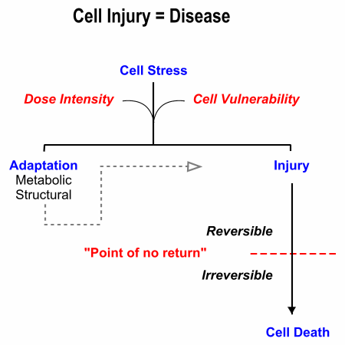

Slide 20
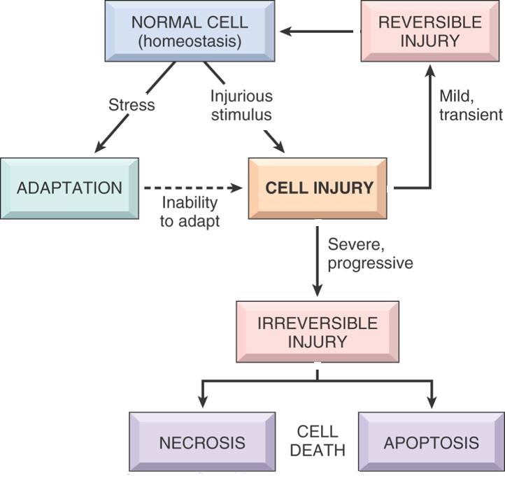

Slide 21
Cont.
1. Reversible cell injury
Pathogenesis
The reversible cell injury that ensues from ischaemia occurs thorough the following stages:
There is decreased oxygen supply due to failure of aerobic respiration resulting in decreased ATP, no cellular energy
Anaerobic glycolysis generates ATP from glycogen resulting in rapid depletion of glycogen, accumulation of lactic acid, reduced intracellular pH, damage to cell membrane thereby increasing permeability

Slide 22
Cont.
Reduced pH causes clumping of nuclear chromatin
Low ATP results in lack of energy hence failure of sodium-k pump leading to accumulation of sodium inside the cell favouring inflow of water into the cell hence swelling while potassium diffuses out of the cell

Slide 23
Cont.
There is reduced protein synthesis due to damaged ribosomes and cytoskeleton damage that results in loss of microvilli
Finally there is Total swelling of the cell organelles such as the mitochondria, endoplasmic reticulum
If the hypoxia is halted at this stage the changes can be reversed but if hypoxia is sustained the injury becomes irreversible.

Slide 24
Cont.
Features of Reversible Cell Injury
Cell swelling due to hydropic change and vacuole degeneration
Mitochondrial swelling
Endoplasmic reticulum swelling
Detachment of ribosomes

Slide 25
Cont.
Loss of microvilli
Clumping of nuclear chromatin
Lipid deposition
Degenerative changes in lipid membranes giving myelin figures and lipid fragments.
Surface blebs

Slide 26
Cont.
2. Irreversible cell injury
Irreversible cell injury occurs as result of sustained hypoxia or injurious agent.
It is determined by the inability to reverse mitochondrial dysfunction and disturbance of the functions of the cell membrane.
There is an association with depletion of proteins, leakage of enzymes, low pH and reduced ATP.

Slide 27
Cont.
Features of Irreversible Cell Injury
Cell membrane disruption
Nuclear changes
  Nuclear shrinkage ( pykonosis)
  Nuclear dissolution (karyolysis)
  Nuclear breakup (Karyorrhexis)

Slide 28
Cont.
Cytoskeletal changes - breakage of microfilaments and intermediate filaments
Mitochondrial damage
Lysosome rupture – release enzymes

Slide 29
END
THANK YOU

