Slide 1
CELLS IN THE BODY
By F.R.KURIA

Slide 2
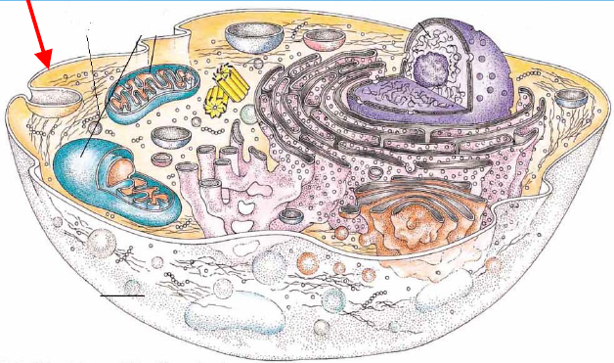
introduction
A cell is a basic living unit in the body.
Or
A cell is the fundamental working unit of an organisms
Or
A cell is a basic unit of life

Slide 3
Organisms are divided in unicellular or multicellular organisms.
Unicellular organism are organisims with only one single cell e.g bacterias,proctis
Multicellular organisms are organisms with multiple cells which perform different functions in the body e.g animals,plants,fungi

Slide 4
The Unicellular Organisms
One cell
Bacteria and proctists
Carry out all the functions of life in one cell
main cause problems in clinical practice
Multicellular Organisms
More than one cell
Plants, animals, and fungi
Cells are differentiated (specialized

Slide 5
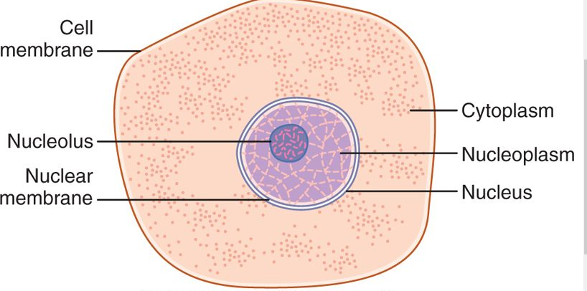
CELL
A typical cell, as seen by the light microscope, has two major parts
1 the nucleus 2 the cytoplasm.

Slide 6
The nucleus is separated from the cytoplasm by a nuclear membrane, and the cytoplasm is separated from the surrounding fluids by a cell membrane, also called the plasma membrane.
The nucleus is the control center of the cell. it contains large quantities of genetic materials(DNA), which are the genes.
The cytoplasm contains organelles.

Slide 7
TYPES OF CELLS -There are two types of cells -Prokaryotes -Eukaryotes
Prokaryotes / Prokaryotic
First organisms, simple structure
Generally smaller than eukaryotic
Has one circular chromosome which floats in cytoplasm
Has no membrane bound organelles
Can have slim layer / pili / capsule
Bacteria and some protests
Eukaryotes / Eukaryotic
More evolved, complex cells
Generally larger than prokaryotic
Has two or more chromosomes
Has some membrane bound organelles
Has mitochondria
Some protists, most fungi, most plants, and all animals

Slide 9
Organelles in the cytoplasm

Slide 11
Plasma membrane/Cell Membrane
The cell membrane (also called the plasma membrane), is a thin, semipermeable, elastic structure.
It is composed almost entirely of proteins and lipids. The approximate composition is
proteins, 55 percent.
phospholipids, 25 percent
cholesterol, 13 percent
other lipids, 4 percent
carbohydrates, 3 percent.

Slide 12
Structure of the plasma membrane

Slide 13
CELL MEMBRANE LIPIDS
The lipid layer is a bilayer and is composed of phospholipid molecules with two ends. One end of the phospholipid molecule is soluble in water; that is, it is hydrophilic and the other end is soluble only in fats; that is, hydrophobic
Because the hydrophobic portions of the phospholipid molecules are repelled by water but are mutually attracted to one another, they have a natural tendency to attach to one another in the middle of the membrane

Slide 14
Arragement of the phospholipids

Slide 15
CELL MEMBRANE PROTEINS
There are two types of cell membrane proteins:
INTEGRAL PROTEINS that protrude all the way through the membrane
PERIPHERAL PROTEINS that are attached only to one surface of the membrane and do not penetrate all the way through.

Slide 17
INTEGRAL PROTEINS provide structural channels (or pores) through which water molecules and water-soluble substances, especially ions, can diffuse between the extracellular and intracellular fluids.
These protein channels also have selective properties that allow preferential diffusion of some substances over others.

Slide 18
Other integral proteins act as carrier proteins for transporting substances that otherwise could not penetrate the lipid bilayer. Sometimes the integral proteins transport substances in the direction opposite to their electrochemical gradients for diffusion, which is called "active transport."
others act as enzymes.

Slide 19
Transport Across Cell Membranes
There are several mechanisms of transport across cellular membranes.
Primary pathways include
-exocytosis
-endocytosis
-primary and secondary active transport.
-diffusion
-osmosis

Slide 20
EXOCYTOSIS
Vesicles containing material for export are targeted/attached to the the cytoplasmic sides of the cell membranes inside the cell then the two membranes fuse and the area of fusion then breaks down, leaving the contents of the vesicle outside and the cell membrane intact.
This is the Ca²⁺-dependent process of exocytosis
ENDOCYTOSIS
It’s the reverse of exocytosis but the two non cytoplasmic sides fuse and transport substances inside the cell.

Slide 22
Active transport is movement of substances against the concentration gradient by use of energy i.e ATP
Osmosis is movement of substances from an area of low concentration to an area of high concentration.
Diffusion is movement of substances from area of high concentration to area of low concentration.

Slide 23
Cytoplasm and Its Organelles
It’s a Jelly-like substance that fills in the space between other organelles
The clear fluid portion of the cytoplasm in which the particles are dispersed in is called cytosol; it contains mainly dissolved proteins, electrolytes, and glucose.
Dispersed in the cytoplasm are neutral fat globules, glycogen granules, ribosomes, secretory vesicles, and five especially important organelles: the endoplasmic reticulum, the Golgi apparatus, mitochondria, lysosomes, and peroxisomes

Slide 25
Endoplasmic Reticulum (ER)
There are Two types Endoplasmic Reticulum
1. Rough Endoplasmic reticulum
has bound ribosomes for protein synthesis
2. Smooth Endoplasmic Reticulum
does not have bound ribosomes
contains enzymes for lipid synthesis
Has Folded membrane that acts as the cell’s delivery system

Slide 26
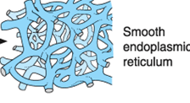

Slide 27
Golgi Apparatus
They are a series of flattened sacs where newly made lipids and proteins from the ER are “repackaged” and shipped to the plasma.
small "transport vesicles" (also called endoplasmic reticulum vesicles, or ER vesicles) continually pinch off from the endoplasmic reticulum and shortly thereafter fuse with the Golgi apparatus. In this way, substances entrapped in the ER vesicles are transported from the endoplasmic reticulum to the Golgi apparatus. The transported substances are then processed in the Golgi apparatus to form lysosomes, secretory vesicles, and other cytoplasmic components

Slide 29
LYSOSOMES
Lysosomes are vesicular organelles that form by breaking off from the Golgi apparatus and then dispersing throughout the cytoplasm.
lysosomes provide intracellular(hydrolase) digestive system that allows the cell to digest
(1) damaged cellular structures
(2) food particles that have been ingested by the cell
(3) unwanted matter such as bacterias

Slide 30
Peroxisomes
They are similar physically to lysosomes, but they are different in two important ways.
1 they are believed to be formed by self-replication (or perhaps by budding off from the smooth endoplasmic reticulum) rather than from the Golgi apparatus.
2 they contain oxidases rather than hydrolases. Several oxidases are capable of combining oxygen with hydrogen ions in different intracellular chemicals to form hydrogen peroxide (H₂O₂). Which is used in association with catalase to oxidize many substances that might be poisonous to the cell

Slide 31
Secretory vesicles
Their main function is secretion of special chemical substances out of the cells.
Almost all such secretory substances are formed by the endoplasmic reticulum-Golgi apparatus system and are then released from the Golgi apparatus into the cytoplasm in the form of storage vesicles called secretory vesicles or secretory granules

Slide 33
Mitochondria
Also known as the “powerhouse of the cell”
Its the centre of metabolism in the cell where they Produce energy in the form of ATP(adenosine triphosphate ) for the cell.
Has a highly folded inner membrane known as cristae
Provides high surface area for energy production

Slide 35
NUCLEUS
The nucleus is the control center of the cell.
It contains large quantities of DNA, which are the genes.
The genes determine characteristics of the cell's proteins, including the structural proteins, as well as the intracellular enzymes that control cytoplasmic and nuclear activities
genes also control and promote reproduction of the cell itself.

Slide 36
Structure of the nucleus

Slide 37
Vacuoles
They are sacs of fluid surrounded by a membrane and are used to store food, fluid, or waste products

Slide 38
Ribosomes
There are two types of ribosomes:-
1. Free / non-membranous ribosome
2. Bound ribosome (on rough endoplasmic reticulum)
Function of ribosomes
They are sites of protein synthesis where they translates RNA into proteins.

