Slide 1
CERVICAL CANCER

Slide 2
Introduction
Occurs in the cells of the cervix.
Is predominantly squamous cell carcinoma.
Cervical cancer numbers have reduced over the years thanks to early detection.

Slide 3
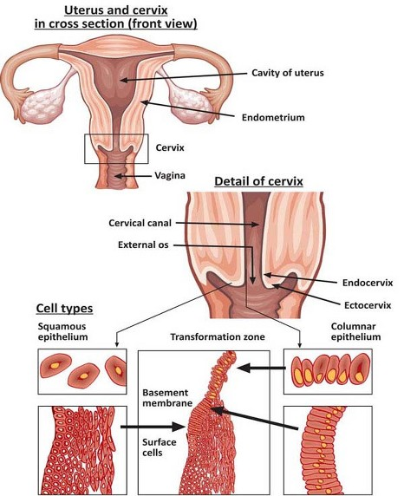

Slide 4
Risk factors
HPV infection (type 16 and 18)
Early sexual activity (younger than 20)
Early childbearing
Immunodeficiency
Obesity
Chronic cervical infection
Multiplessex partners

Slide 5
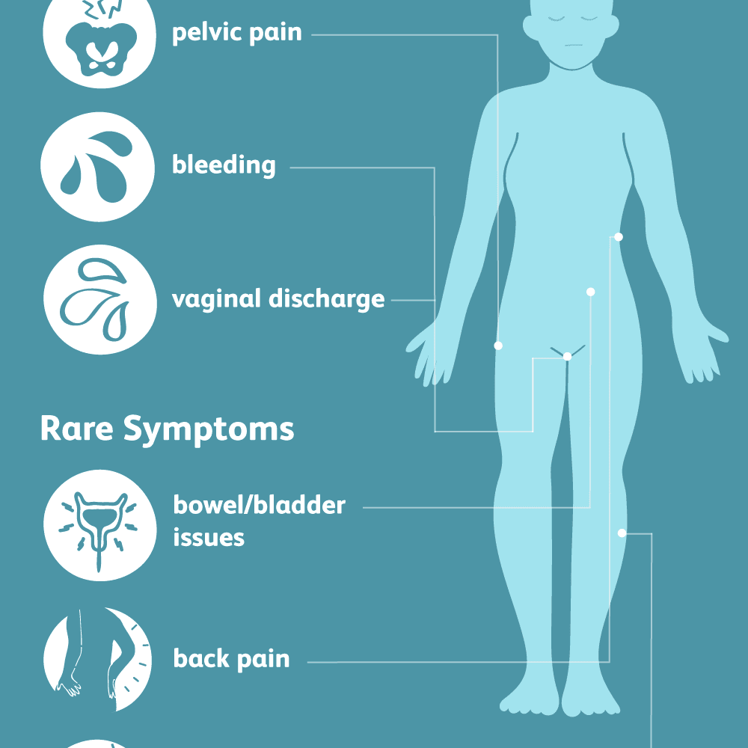
Symptoms

Slide 6
Diagnosis
PAP smear
Cone biosy
Curretage
Ct scans or MRI
Barium X-ray studies
Urography
Colposcopy

Slide 7
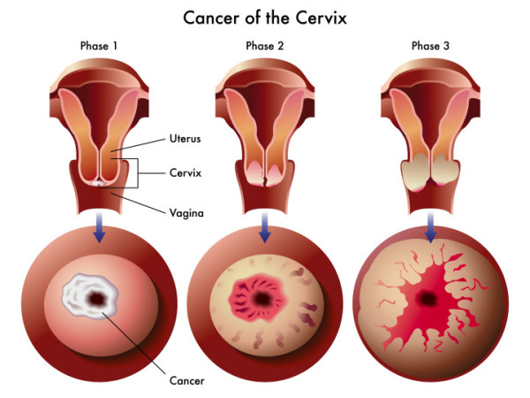

Slide 8
Stages of cervical cancer
Stage I. Cancer is confined to the cervix.
Stage II. Cancer is present in the cervix and upper portion of the vagina.
Stage III. Cancer has moved to the lower portion of the vagina or internally to the pelvic side wall.
Stage IV. Cancer has spread to nearby organs, such as the bladder or rectum, or it has spread to other areas of the body, such as the lungs, liver or bones.

Slide 9
management
PREINVASIVE LESIONS
  LEEP (laser)
  Cryotherapy ( use of NO)
INVASIVE LESIONS
  Surgery combined with radiation therapy
  Hysterectomy (conservative or radical)
  Pelvic exenteration
PALLIATIVE CARE

Slide 10
complications
Sciatica
Unilateral leg edema
Ureteral obstruction
PE
DVT
CVA
Sepsis

