Slide 1
CHRONIC HYPERTENSIVE COMPLICATIONS
Samuel Ngigi K.
KMTC

Slide 2
OUTLINE
INTRODUCTION
DEFINITION
EPIDEMIOLOGY
THE COMPLICATIONS
MANAGEMENT
SUMMARY

Slide 3
INTRODUCTION
HPT is common,asymptomatic
Readily detectable
Leads to fatal complications if left untreated
The % of undiagnosed hypertension in the west is about 33%
No studies in our set up
Prevalence of ESRD is on the rise as a result of hypertension
ESRD DOUBLED in the last decade

Slide 4
Definition of Hypertension
The level of BP above which investigation and treatment is of proven benefit
to the patient

Slide 5
DEFINITION-JNC-7
Category SBP mmHg DBP mmHg
Normal <120 and <80
Prehypertension 120–139 or 80–89
Hypertension, Stage 1 140–159 or 90–99
Hypertension, Stage 2 ≥160 or ≥100

Slide 6
EPIDEMIOLOGY
Prevalence of HPT depends on the racial composition of pop studied
Criteria used to define the condition also determine prevalence
In the west 20% of pop studied had >160/95mmHg and >50% had >140/90mmHg
An even higher prevance in the non-white pop
Prevalence of secondary HPT varies 6-35%

Slide 7
Epidemiology
10-15%
20-30%
x10

Slide 8
FUELLING FACTORS
Poor dietary habits that include excessive salt consumption
Foods that lead to obesity/MS
Occupations
Alcohol intake
Sedentary lifestyles
Smoking
Diabetes
Insulin resistance

Slide 9


Slide 10


Slide 11
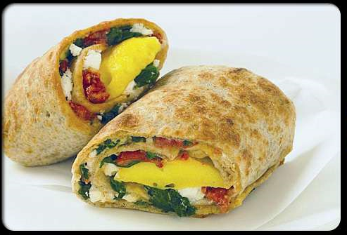

Slide 12


Slide 13
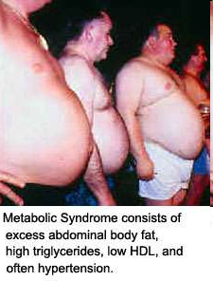

Slide 14
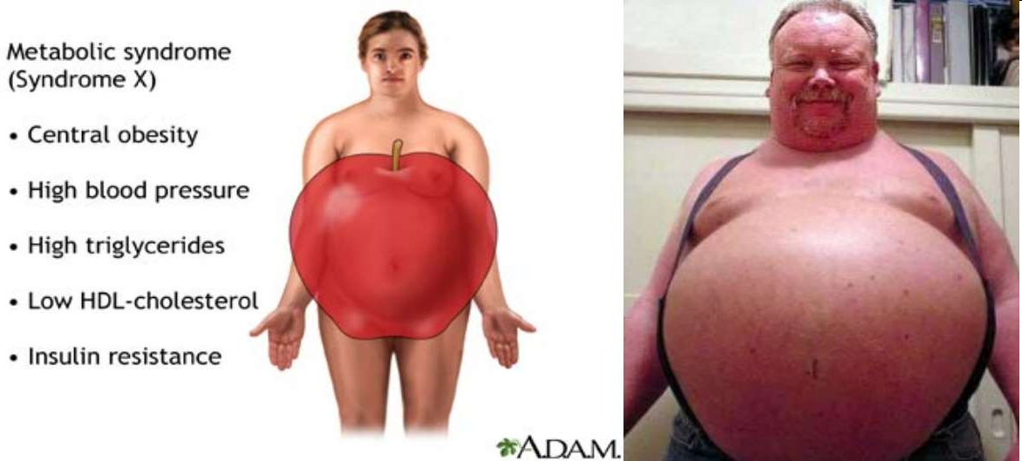

Slide 15
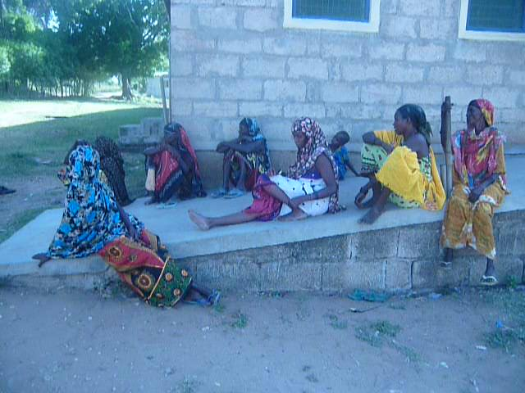

Slide 16
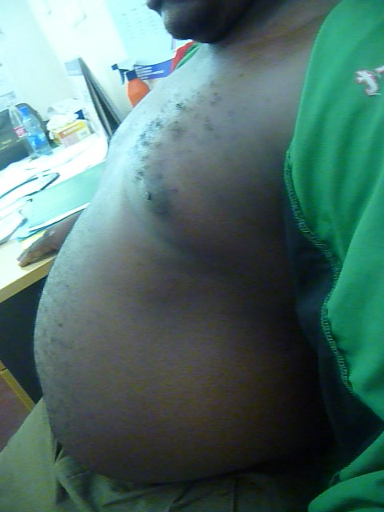

Slide 17
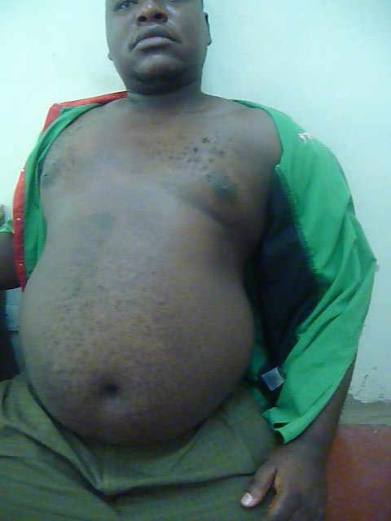

Slide 18
THE EFFECTS:THE CHICKENS ARE COMING HOME TO ROOST

Slide 19
THE HEART
Concentric Left Ventricular Hypertrophy(LVH)
The cavity then dilates
Signs and symptoms of heart failure ensue
Angina pectoris as CAD is acclerated and increased O2 requirements

Slide 20
Cardiac Effects of Hypertension
Thickening of wall
of left ventricle
Short
Term
Contractility
Cardiac output
Increasing weakness
and impaired function
Long
Term
Contractility
Causing LVH and Heart Failure
Cardiac output

Slide 21
ACS-UA,STEMI and NSTEMI
There is a prominent left ventricular impulse
Murmurs of AR
Most deaths due to HPT occur as a result of MI/CHF
Heart damage aided by aldosterone and Ang II

Slide 22
LVH:
as a Risk Factor in the Framingham Study
risk
SUDDEN DEATH
MYOCARDIAL INFARCTION
200
150
100
50
0
ECG LVH
None
Voltage Only
Definite
men
women
men
women
Kannel et al 1983

Slide 23
NEUROLOGIC-EYE
Hypertensive retinopathy-retina
Hypertensive choroidopathy-the choroid
Hypertensive neuropathy-optic nerve head

Slide 24
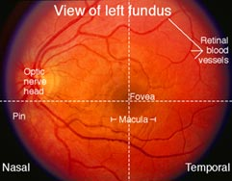

Slide 25
Retinal-Keith-Wagner-Barker classification
Stage1:mild generalized constriction of retinal arterioles
Stage2:constriction and arteriovenous nipping
Stage 3:2 plus cotton wool spots and hemorrhages
Stage4:severe stage 3plus papilledema
Other pathologies:retinal vein occlusion and retinal arterial microaneurysms

Slide 26
CNS CHANGES
Occipital headaches,dizziness,light-headedness,vertigo,tinnitus,dimmed vision or syncope
Cerebral infarction-due to atherosclerosis
Cerebral hemorrhage-due to elevated BP and Charcot-Bourchard aneurysms
Hypertensive encephalopathy-severe HPT,decr consiousness,incr ICP,retinopathy and papilledema and seizures

Slide 27
KIDNEY
Arteriosclerotic lesions of afferent/efferent arterioles and the glomerular capillary tufts
Results in decr GFR and tubular dysfunction
Proteinuria and microscopic hematuria
10% of the deaths due to HPT occur due to RF
Blood loss in these pts occurs through the kidneys,epistaxis,hemoptysis and metrorrhagia

Slide 28
PERIPHERAL VESSELS
Acclerated atherosclosis leading to narrowing of the peripheral arteries
Risks the pt getting arterial occlusions with disastrous consequences
Leads to gangrene,chronic leg ulcers and digital ulcers
Leads to intermittent claudication,erectile dysfunction

Slide 29
leads to structural changes in peripheral blood vessels......
Normal
Structural wall thickening
Increased neural or humoral
constrictor activity
Hypertrophy
Vasoconstriction

Slide 30
THE PREGNANT WOMAN
May lead to preclampsia,eclampsia,acute and chronic RF,HELLP syndrome,stroke
Prematurity
Placental insufficiency
Intrauterine growth restriction
Placental abruption

Slide 31
Summary of the Consequences of Hypertension
Increased risk
of stroke
Renal
damage
Retinal
haemorrhage
& papilloedema
Myocardial
infarction and
angina due to
atherosclerosis
Heart Failure
Peripheral
vasculature
disease due to
atherosclerosis

Slide 32
MANAGEMENT
Patient evaluation to:
  Uncover secondary causes of HPT
  Establish a pretreatment baseline
  Assess factors that may influence therapy
  Determine if target organ damage is present
  Determine the presence of other CV risks
History and P/E
Lab investigations

Slide 33
Diagnostic work up
Obtain laboratory tests: urinalysis, blood glucose, hematocrit and lipid panel, serum potassium, creatinine, and calcium.
Optional: urinary albumin/creatinine ratio.
Obtain electrocardiogram(ECG).
others:TFTs,wbc,CXR,ECHO
Special studies:renal duplex doppler study,MRI angiography,24hr urine for VMAs,cortisol,plasma aldosterone,renin activity

Slide 34
SECONDARY HPT
Sleep apnea
• Drug induced
• Chronic kidney disease
• Primary aldosteronism
• Renovascular disease
• Cushing’s syndrome or steroid
therapy
• Pheochromocytoma
• Coarctation of aorta
• Thyroid/parathyroid disease

Slide 35
BENEFITS OF RX FOR HPT
Reduces the following cardiovascular endpoints:-
  Stroke by 35-40%
  Myocardial infarction by 20-25%
  HF by 50%

Slide 36
TREATMENT
Treat to BP <140/90 mmHg
BP <130/80 mmHg in pts with DM or CKD(chronic kidney dx) or stroke.
If proteinuria present goal is 125/75mmHg
• Majority of pts will require two medications to reach goal.

Slide 37
Rule of halves
Of all the hypertensive pts a practice has,
Only 50% are diagnosed,
Of those diagnosed,only 50% are treated,
Of those treated,only 50% are well controlled.

Slide 38
LIFESTYLE MODIFICATIONS
Encourage healthy lifestyles for all individuals.
Prescribe lifestyle modifications for all pts with prehypertension and hypertension.
Components of lifestyle modifications include weight reduction, DASH eating plan, dietary Na reduction, aerobic physical activity, and moderation of alcohol consumption

Slide 39


Slide 40
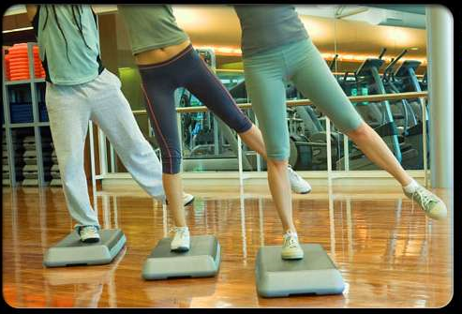

Slide 41


Slide 42


Slide 43
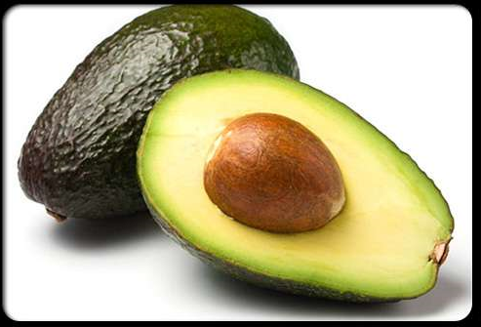

Slide 44
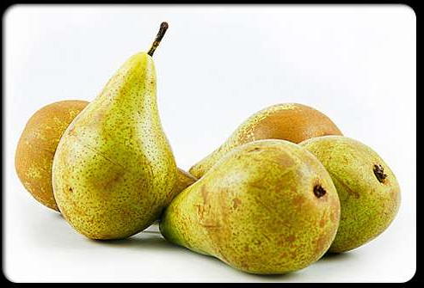

Slide 45
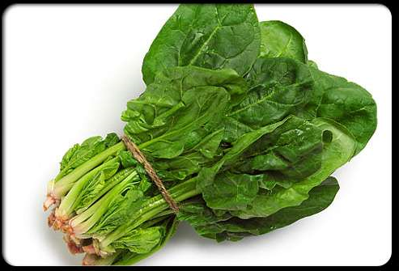

Slide 46
Stage 1-without compelling indications
Hypertension
Thiazide-type diuretics
for most.
May consider
ACEI, ARB, BB, CCB,
or combination.
Stage 2
Hypertension
2-drug combination for
most (usually thiazide type
diuretic and ACEI,
or ARB, or BB, or CCB).

Slide 47
Drug(s) for the compelling indications
• Heart failure THIAZ, BB, ACEI, ARB, ALDO ANT
• Post myocardial infarction BB, ACEI, ALDO ANT
• High CVD risk THIAZ, BB, ACEI, CCB
• Diabetes THIAZ, BB, ACEI, ARB, CCB
• Chronic kidney disease ACEI, ARB
• Recurrent stroke prevention THIAZ, ACEI
Optimize dosages or add additional drugs until goal blood pressure is
achieved.
Consider consultation with hypertension specialist if goal not achieved

Slide 48
CVA
In stroke pts who present with hypertension, lower BP rapidly with hydralazine only when BP>220/120mmHg
If below this lower the BP slowly over the next few days
Otherwise this will lower the CPP,increase infarct size around the penumbra
May actually worsen and cause death

Slide 49
SUMMARY
HPT is a worldwide tsunami in our hands
Is fuelled by lifestyle adaptations
Can also be mitigated by lifestyle changes
The effects of hypertension on the organs are usually silent until advanced hence the term SILENT KILLER
Easily detectable and treatable
Cardiovascular morbidity increases linearly from a BP of 115/75mmHg and this risk doubles every 20/10mmHg increase in BP

Slide 50
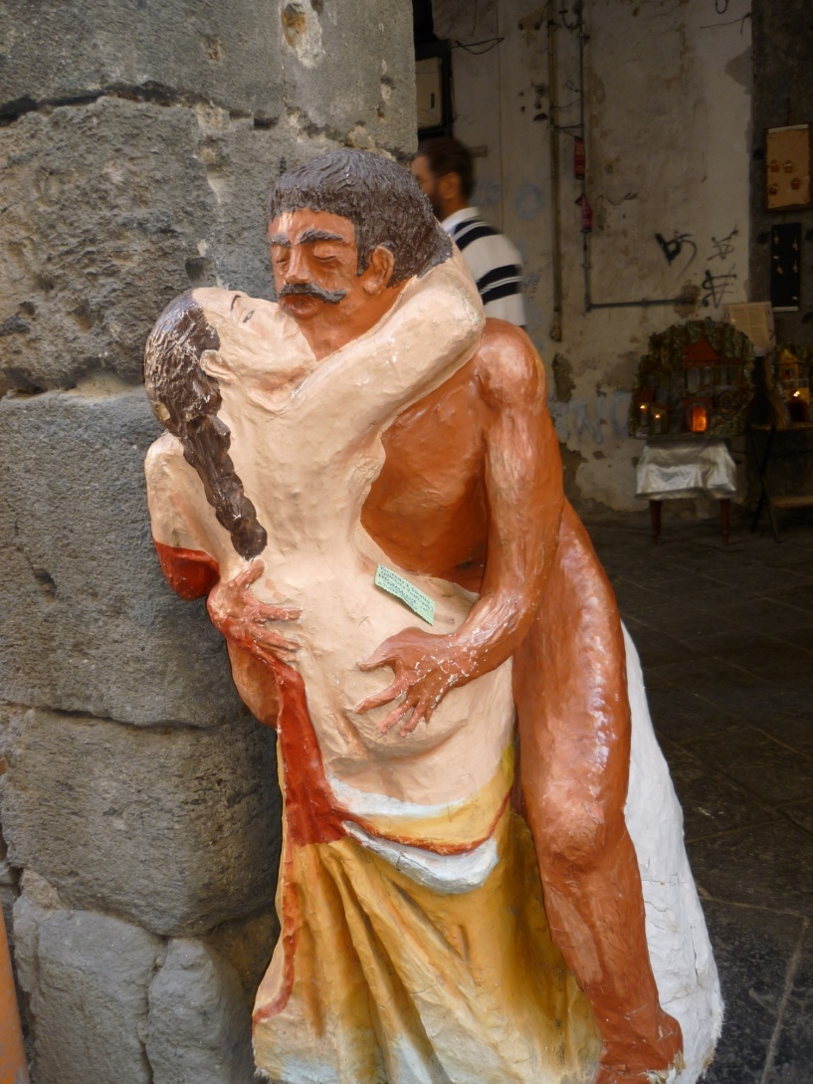
THANKS

