Slide 1
CLINICAL METHODS

Slide 2
Aims of Clinical Methods
A student should learn the art of taking detailed informative history. A good history is an important aspect of medicine.
Both the important positive and important negative physical signs should be noted so as to reach a conclusion.
Clinical methods are acquired by a combination of study and experience
There is always something new to learn

Slide 3
CONT’
It requires:
Knowledge of disease and its patterns of presentation
Ability to interpret a patient's symptoms and signs

Slide 4
Patient – Doctor Relationship
It is essential that both patient and clinician feel at ease, neither feels threatened by the encounter
  Does the patient smile, or appear anxious?
  Do they make good eye contact?
  Are they frightened or depressed?
  Are posture and stance normal?
  Is the patient short of breath, or wheezing?
Students/clinicians need to approach patients not as “cases” or “diseases”, but as individuals whose problems/symptoms are to be heard empathetically.

Slide 5
Skills in History Taking
It is vital for the doctor to steer and mould the process
Ensures information gathered is complete, coherent and, logical
It is very important to use words the patient will understand and use appropriately
During any consultation non-verbal communication is as important as what the patient says
The history of a patient should contain all the facts of medical significance in the life of a patient
The history should be recorded in a chronological order, and recent events should be given most attention.
Allow the patients to narrate his/her history in his/her own way and language without any interruption.
Physicians/clinicians should be careful not to suggest the answers to the questions being posed.

Slide 6
NB: History taking is not a mere records of some questions and answers between the doctor and the patient, listen to the patient, he/she is telling you the diagnosis.

Slide 7
History Techniques
If a patient gives a positive response it leads to further questioning e.g.
Headache – which part, when, always on/off etc, while a negative response moves the clinician on the next question
Technical words should be avoided , the patient need to understand what is being asked/said
Remember the public/lay men are increasingly aware of medical terms or medical matters through the internet and mass media, but this does not necessarily mean they understand the terms
Therefore certain terms having different meaning may be clarified if used by the patient

Slide 8
Types of Enquires/Questions
1) Open ended questions:- they do not exclude any answer category. They give minimal structure and direction to the answer so that the client has the freedom to answer in his/ her own way.
Examples
Tell me about yourself
When you are unable to sleep, what are you thinking about?
2) Closed ended questions:- they provide limited options for answers which are often short(yes or no). They are easily suggestive/leading
Example
Was the discharge smelling
Is the abdominal pain on the right or the left
4) PROBING-This is whereby you try to encourage the patient to give more specific information e.g what happened next, how did it make you feel .

Slide 9
GENERAL HISTORY TAKING
This is an important component of medical and health care practice because it is what provides the necessary information and the relevant details for making of a diagnosis and subsequently the decision on patient management

Slide 10
Requirements
A quiet and conducive consultation room.
Table, chair, examination couch.
Writing materials
An interpreter/ informant
Chaperon.

Slide 11
Procedure for history taking
Welcome the patient(greet) and ensure his or her comfort(offer a seat/ the couch)
Introduce yourself
Assure confidentiality
Establish the language of communication
Conduct the interview using relevant communication skills.
Quick assessment of the patient
Does the patient smile, or appear furtive or anxious?
Does the patient make good eye contact?
Is he frightened or depressed?
Are posture and stance normal?
Is he short of breath, or wheezing?
Note taking is important during consultations while being able to see the patient and establish eye contact. Show empathy and awareness of his needs during the discussion of symptoms, much of which may be distressing or even embarrassing.

Slide 12
Challenges in History Taking
Anger/hostility
Intoxicated patients
Handling depressed cases
Sexually attractive or seductive patients
Confusing behavior /histories
Limited intelligence interfering with recall
Development disabilities, mental retardation
Communication barriers – due to language social, cultural, religion differences, sight , speech, hearing impairments
Unconscious patients- clinician not able to get facts relating to the illness.

Slide 13
AIM OF HISTORY TAKING
To understand patients owns perception of their problem and to start or complete the diagnosis process. This requires knowledge of disease pattern and ability to interpret patients signs and symptoms.
Symptoms: what a patient complains of
Signs: what you find on examination of the patient

Slide 14
History taking
Components of history taking
(i) Patients Particulars (Biodata)
Date & time- for medical records, administrative and legal purposes, to judge and determine the progress of patient who are admitted in the ward.
3 names (to avoid confusion, coincidence of names, mistaken identity)
Exact age (for admission purposes, making diagnosis, prescription purposes)
Sex/gender (to decide the ward for admission, for making diagnosis)
Inpatient/outpatient number (for record keeping, for identification purposes)
Occupation (some conditions are related to a person’s occupation),
Marital status
Religion ((religious believes have dimensions on management, the religion could have contributed to the disease, some religion forbids some form of treatment- blood transfusion)
Address and residence (including telephone contacts, physical address i.e. the village, sub-location, location, county. Helps to identify common diseases in certain areas- epidemic diseases, for patient follow-up or home visits. For tracing relatives and next of kin incase of death or abscondement for legal and medical purposes
Informant (this is the person who gives information or history of the patient on behalf of the patient/if the patient is not able to speak- very ill/children/patients who are in coma. The information can be given by a parent, relative, friend, neighbour, colleague, policeman. In case of a child, the best informant would be the mother/caretaker.
Next of kin (important to trace relatives in case of death or abscondement, for legal and medical purposes)

Slide 15
(ii)Chief Complain (CC)
Main complaints for which the patient is seeking medical attention and the duration, this is the patient’s chief symptom(s) in their own words e.g. haemoptysis vs. coughing up blood.
Ask the patient an open ended question such as “what is your problem today”? “What brought you to hospital today?”
The complaints may be one, two or more. All should be recorded in a chronological order.
Always seek clarification of the patients symptoms
Headache on and off x 2/12
Difficulty in breathing x 2/52
Chest pain x 1/7
The duration of a complaint may be difficult especially in elderly patients or in uneducated patients. In such situations, approximate duration may be asked.
NB: Make every attempt to use /quote the patient own words e.g. what is your main complaint and when were you last in your usual state of health.

Slide 16
(iii) History of the Presenting Illness (HPI)
Ask the patient to tell the detailed story of his/her illness from the day it started till that day he/she has sought medical attention.
Patient should not be interrupted while narrating the history
Ask about and document the details of the presenting complaint, nature of the problem, how it started.
For each symptom determine;
  The exact nature of symptom
  The onset- the time/date it began (suddenly/gradually), if longstanding, why is the patient seeking help now?
If the patients describes the complaints in medical terms rheumatism/arthritis (to mean joint pains), malaria (to mean chills/rigors), migraine (to mean headache), then he /she should be asked to tell what actually happens during these complaints.
Periodicity and frequency- is the symptom constant or intermittent
Change of the symptom over time- is it improving or deteriorating over time
Exacerbating factors- what makes the symptom worse
Relieving factors- what makes the symptom better
Any other associated symptom
Clinician should enquire about each and every complaints presented by the patient.

Slide 17
For example: Analysis of a complaint / symptoms
The most common complaint that brings the patient to hospital is pain. Ask about the following in relation to pain.
Site- where exactly is the pain, ask the patient to point to the site with one finger
Onset- mode and rate of onset, how did it start, over how long (the duration)?
Radiation- is the pain static or moves from one place to another?
Character- is the pain dull, aching, stabbing or burning?
Severity – how severe is the pain does it interfere with his/her daily activities? Pain is scored out of 10 (0-10).
Timing- is there specific time when patient experiences this pain, is it on /off?
Exaggeration- what brings about the pain, what makes the pain worse?
Relief – what relief the pain, what makes it better e.g. change in position, rest, food, defecation or passage of wind.
Other associated symptoms- is the pain associated with other symptoms e.g. nausea, vomiting, dyspepsia, shortness of breath etc

Slide 18
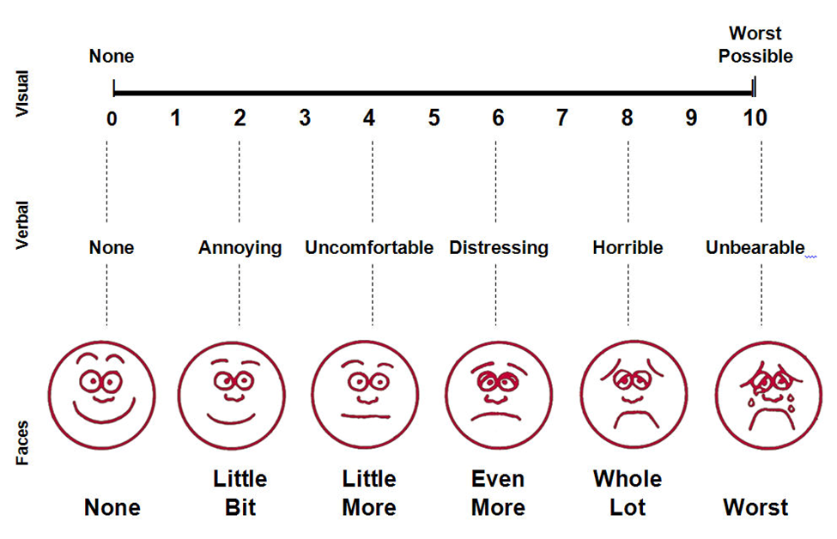
Analyzing pain severity

Slide 19
Cont’
NB: It is important to include important positives and important negatives while recording the history because this will help in making diagnosis and to exclude other similar conditions e.g. hypertensive with headache, blurring of vision but has no swollen lower limbs no orthopnoea, dyspnoea on exertion.

Slide 20
(iv) Review of systems
Inquire about symptoms in other systems not represented in the chief complain.
Perform a brief screen of the other bodily systems
Finding symptoms that the patient had forgotten
Identifying secondary, unrelated, problems that can be addressed

Slide 21
(a) Respiratory system
Ask whether the patient has cough- If present, is it dry or productive, at what time is it worst, is it associated with pain, what quantity?
The colour of sputum, oduor and consistency, is it blood stained (haemoptysis)?
Ask about dyspnoea- Is the patient- dyspnoeic, does dyspnoea occur in paroxysm, does the dyspnoea occur at rest or after exercise, what sort of activities provokes dyspnoea e.g. walking upstairs?
Ask about wheezing– When does wheezing occur, is it constant or intermittent, is it provoked by anything e.g. dust, pollen, strong smells, is wheezing worse at particular time of the day or night?
Ask about chest pain- What is the exact site i.e. central or peripheral is it aggravated by deep breathing or coughing, is it acute in onset?
Ask about haemoptysis (blood in sputum) - If present, how often does it occur and for how long, is the blood seen alone, or is it accompanied by purulent sputum?

Slide 22
(b) Cardiovascular System.
Ask about dyspnoea (shortness of breath)- when does it occur –at rest or on exertion what degree of exertion is necessary to produce it, are there attacks of shortness of breath at night (paroxysmal nocturnal dyspnoea-PND), does the patient have dyspnoea while lying flat (orthopnoea)?
Ask about chest pain/ tightness/discomfort- what is its exact site, what is its character-dull, severe, stabbing, tearing etc?
Is there any radiation of the pain to the left arm, neck, shoulder or what precipitates it, what relieves it, is the pain present at rest or during exertion, is the pain relieved by rest?
Ask about palpitations- (awareness of heart beats) what brings palpitations and how long does it last?
Is it paroxysmal or intermittent, it is induced or relieved by exercises?
Is the heart beats regular/irregular and whether patient experience any missing of heart beat?
Ask about cramp-like pains in the calves when walking relieved by rest.
Ask about ankle swelling- does the patient have ankle or leg swelling the duration, when is the swelling worse (day/night) are the clothes or shoes tight?
Ask about cough-as in respiratory system.
Ask about bluish coloration of extremities (cyanosis) is there coldness or redness of the extremities.

Slide 23
(C) Gastro-intestinal system
Ask about abdominal pain- the exact site of the pain lower/upper abdominal, how severe is it, is it continuous or intermittent, does it radiate to any other site or direction?
What is the duration of the pain, is the pain related to meals?
What are the aggravating factors, what are the relieving factors- food, vomiting, defecation, medication, passage of flatus?
Ask about appetite –is it reduced or increased, if reduced, is the appetite poor or the patient is afraid of taking foods due to pain?
Ask about vomiting- what is the frequency (how many times in 24hrs)?
What is the colour of the vomitus, does the vomitus contain blood, residues of food taken, does vomiting relieve abdominal pain, when does it occur –day or night morning or evening.
Ask about flatulent dyspepsia – does the patient experience wind moving upwards or downwards, does either relieve symptoms?

Slide 24
Cont’
Ask about water brash- does the patient get excessive secretion of saliva into the mouth?
Ask about heartburn –does the patient feel any pain or burning sensation behind the sternum, is the pain associated with lying down or sitting up?
Ask about dysphagia- is there difficulty in swallowing, is it worse with solids or liquids, is swallowing painful ,is there other associated symptoms e.g. vomiting?
Ask about sour eructations- does the patient experience acidic taste in the mouth, does it have any relation to a specific type of food, does it occur during lying down, is there any receiving factors?
Ask about diarrhea- the frequency (times in 24 hrs), what is the duration of diarrhea, is the diarrhea related to meals or to special foods what is the colour of the stools?
Are stool formed, (solid) or unformed liquid or porridge – like, frothy or watery, has the patient ever passed any blood, is there incontinence of stool (involuntary passage of stool), any other associated symptoms?
Ask about constipation- what is the patient usual bowel habit, is there any change in this habit, if yes, then is the change related to change in diet, medications etc. is there any colicky pain, is there blood in stool?
Ask about abdominal distension- is there any increase in abdominal girth, is there associated flatulence or dyspepsia, is the distension associated with meal; does the patient have diarrhea or constipation?

Slide 25
(d) Central Nervous system
Ask about headache
Which part, when, always on/off?
Is it intermittent or continuous?
Is it associated with visual disturbance or not?
Is the headache unilateral, frontal or generalized?
Is the headache induced by stress (tension headache)?
Is it radiating to other part(s) etc?
What relieves the headache?

Slide 26
Cont’
Ask about dizziness
Is it intermittent?
Does it relate to change in head position?
Is there history of deafness?
Is there history of trauma or any infections?
When does it become worse?
Are there other associated symptoms such as ataxia (lack of voluntary coordination of muscle movements), speech disturbance, double vision, facial weakness?

Slide 27
Cont’
Ask about convulsions/Fits
Are they generalized or focal?
From where do they begin and end?
Does the patient fall?
Has the patient ever hurt him/herself?
Does he/she bite the tongue?
Does the patient micturate or defaecate during the fit?
Are there any after symptoms (post-ictal symptoms) - automatism, sleep, headache, paralysis?
Is there any mental disturbance associated with it?

Slide 28
Cont’
Ask about weakness/paralysis- reduction in normal power of one or more muscles. “Plegia” means weakness that is severe and complete while “Paresis” means partial weakness. “Hemi”- one half of the body, “para” refer to both the lower limbs and “quadri” refers to all the four limbs.

Slide 29
Cont’
Enquire about paralysis/weakness
Is there inability to move the limb, part of the body or any side of the body?
Did the weakness start slowly/gradually or suddenly?
Is it stationary or has progressed, if yes, how it progressed?
Which part of the body is involved?
What movements are affected?
Is there difficulty in combing the hair, trying to reach high shelves or difficulty in getting out of a chair or taking a high step?
Does the weakness increase with effort and improve after rest?
Are there any associated sensory or other symptoms?

Slide 30
Cont’
Ask about tingling sensation
Tremors
Fainting episodes
Black-outs
NB: (i) Vertigo- is an illusory/hallucinatory sense of self or environmental movement most commonly due to a disturbance in the vestibular system.
(ii) Dizziness- is a common symptom that patient use to describe a variety of sensations such as light-headedness, faintness, spinning.
(iii) Syncope- is loss of postural tone, inability to maintain erect posture followed by unconsciousness. It is a symptom resulting from reduced cerebral perfusion.

Slide 31
Cont’
Ask about stroke (sudden onset of neurological difficult i.e. weakness, sensory loss, or visual disturbance on one side of the body)
This may recover in few minutes or less than 24 hours (transient ischaemic attack- TIA) or may resolve in neurological deficit (reversible ischaemic neurological deficit-RIND) or may recover incompletely (stroke), was headache, vomiting associated with the cerebrovascular disease e.g. hypertension, heavy smoking, diabetes or hyperlipidaemia, or a positive family history of heart disease especially vascular diseases.

Slide 32
Cont’
Ask about epilepsy- causing seizures consists of repetitive, even stereotype convulsive events.
What was the age at the fist attack, describe the first attack?
How frequent do these attacks occur, what is the shortest and longest interval between the attacks?
Do they occur at night during sleep, is there any aura or warning what is the nature of the aura during attack (complete partial) seizure) or not (simple partial seizure)?
Does the patient bite the tongue during the attack? ( if yes examine for tongue injury)
Does the patient have incontinence (involuntary passage of stool and urine) during the attack?
Is there post-ictal phenomenon e.g. headache, somnolence, automatism or Todd’s paralysis?
Is the patient on treatment? –take the treatment history.
Ask about predisposing or precipitating events e.g. infection, brain injury, fever and family history.

Slide 33
(e) Musculoskeletal System
Is there pain/swelling or stiffness in joint(s)?
Is the pain constant or episodic?
Are there any recurrent attacks of joint pains?
Does the joint pain moves from one joint to another (migratory joint pains of rheumatic fever and gonococcal arthritis)
What is the distribution of the joint pains i.e. whether it involves small joints (rheumatoid arthritis) or large joints (osteoarthritis)?
Is the joint visibly swollen?
Is there any family history of gout or other rheumatic disorders?
Is there any gait/posture abnormality?
Are there soft tissue symptoms such as pain, tenderness and swelling?
If present, what is the site of these symptoms?
Is there any history of trauma or overuse during sports?
Are there symptoms of bone disease e.g. fracture, dislocation, deformity, pain, swellings?
If yes, is there any history of trauma or stress?
Is there congenital or family history of bone disorder?

Slide 34
(f) Genito-urinary system
Is the urine altered in amount?
Is the stream of urine normal or reduced in flow?
Is urine altered in colour, is it clear/turbid when passed?
Is the blood in urine (haematuria), if yes, at what period of micturation?
Is there increased micturation frequency during the day (polyuria) or night (nocturia)?
Is the frequency associated with undue thirst?
Is there pain during micturation (dysuria)? If present, is it before, during or after micturation?
What is the character of the pain and where is it felt?
Male patient- is there any urethral discharge, swelling of scrotum?
If there is discharge, when does it occur, i.e. at the initiation or end of micturation?
Is there any history of contact with other woman/women other than the wife?
Female patient- is there vaginal discharge (same as in males)?
Are there any menstrual problems?
Enquire about sexual functional complaints e.g. impotence, premature ejaculation, infertility, anxiety about masturbation or homosexuality.

Slide 35
(v)Past medical and Surgical History
Any previous/past history should be asked.
This must be verified by asking what actually happened during that illness which made him/her to be admitted – when was it, which hospital , for how long, what treatment was given, what was the outcome….
Relevant past history pertaining to the present symptoms should be asked e.g. acute rheumatic fever in cases in cases with rheumatic heart disease, jaundice in the past in case of liver diseases.
Patient with diabetic (not curable) thus ask about age of onset, its progression, drugs used, any complications in the past, adherence to drugs
Childhood illnesses e.g. measles, rubella mumps, whooping cough, chickenpox, rheumatic fever, polio is relevant.
Adult medical illness e.g. diabetes, hypertension, Tuberculosis, asthma, hepatitis, HIV diseases must be asked ( menstruation history , birth control, sexual function) carry significance in female presenting with gynaecological complaints
NB: The patient should narrate the history himself/herself unless otherwise indicate.

Slide 36
(vi) Drug History
List all the medication the patient is taking, including the dose and frequency
The patient may not consider some medications to be drugs:
    Eye/ear drops.
    Inhalers.
    Sleeping pills.
    Oral contraception.
    Over the counter drugs
    Herbal remedies.

Slide 37
(vii) Personal , Social & Economic History
Ask about the exact nature of work occupation, former occupation if any. Ask about domestic and marital relations in both males and females; ask about marital status, homosexuality is common in single men.
Ask about the type of housing owned or rented the patient lives in – permanent, semi –permanent, temporary housing, ventilation
Ask about sanitary conditions disposal (pit, bush etc)
Ask about education level

Slide 38
(viii)Smoking & Alcohol Use
Ask about social habits i.e. smoking, alcohol drinking, any drug abuse which is contributes to some diseases
In smoking determine the pack years i.e. the number of sticks taken divide by 20 times the number of years smoked
If patient is an ex-smoker, note the length of time since the patient stopped smoking or taking alcohol
Should attempt to quantify.
Remember to ask about passive smoking
Patient may be trying to please you/ feel embarrassed about openly admitting their true consumption
Beware of appearing judgmental

Slide 39
Do CAGE Assessment for alcohol dependency
NB: Some patient may deny history of drug abuse, firm and persistent to get full information either from the patient or from a relative, staining on fingers or teeth should raise strong suspicion that patient is or until recently was a heavy smoker.
(Read about CAGE assessment)- Assignment

Slide 40
(x) Family history
Note the patient’s position in the family, the ages of the siblings and their health, status of the parents (alive/dead), if dead the cause of death if known
Ask about any diagnosed condition in other living family members
Important illness, age and causes of death of immediate relatives, ask about any known familiar/hereditary disease (haemophilia, SCD) and chronic diseases (diabetes, hypertension coronary artery disease, renal diseases, hyperlipidaemia) cancer & the specific type of cancer, asthma, arthritis, mental illness, epilepsy, allergies etc.
Status of parents –whether alive or dead if dead , the cause of death (if known)

Slide 41
xi) Gynae History taking to the females- Enquire about LMP, the flow of the menses( if heavy or light, number of pads used in a day, colour, etc).

Slide 42
xii) Summarizing a case
Purpose of the summary- provides sufficient information to understand the factors which led to the present illness, something of the person in whom the illness is found, and sufficient detail of history, clinical findings and special investigations for the reasoning behind your diagnosis to be appreciated. This is described in detail below. However, it is frequently necessary to describe a patient’s problems in outline only, without formally presenting the case.

Slide 43
Cont’
Important points to remember;
For a summary, make sure that every point you make is a vital point; do not be tempted to rehash the whole presentation. Make sure the few points you choose to give are stated in a logical order; i.e. beginning with the factors which underlie the current illness, proceeding to the details of that current illness, and followed by subsequent course and plans. For a summary, brevity( concise/exact use of words) is vital. Your summary should not require more than 4 or 5 sentences.

Slide 44
xiii) General examination
    It is assumed that you clinicians/physicians will act with professionalism, integrity, honesty, and with respect for the dignity and privacy of your patients
    Chaperone should be present during any intimate examination- ideally be the same gender as the patient

Slide 45
The right approach
    One important rule is that you should always stand at the patient's right hand side.
    This gives them a feeling of control over the situation (most people are right handed)
    All the standard examination techniques are formulated with this orientation in mind
    The general examination starts as soon as the patient enters the examination room. The physician should always try to assess the patient’s general appearance which include demeanour, personal cleanliness/hygiene and the nature and status of clothing
    Use all senses well (sight,hearing,tactile,smell etc)
    A good general examination requires a co-operative patient and a quiet, warm and well lit room. Day light is better than artificial light, which may mask changes in skin colour e.g. the faint yellow tinge of slight jaundice.

Slide 46
Cont’
    Every attempt should be made to reassure and relax the patient
    A chaperone should always be present when a male physician/clinician is examining a female patient and vice versa and during rectal and vaginal examination- both to reassure the patient and to protect the physician from subsequent accusations of improper conduct
    Expose appropriately
    Start the examination in a manner that will appear relevant to the patient e.g. a patient presenting with cough, chest pains, start with examination of the chest (affected system)

Slide 47
Instruments required in examination of patients.
Stethescope
Opthalmoscope
Otoscope
Nasal speculum
Tuning fork
Percussion(reflex) hammer
Tape measure
Pen touch (pen light)
Sphygmomanometer – BP Machine
Thermometer
Watch
Snellens chart
Wooden spatula
Gloves

Slide 48
Cont’
Observation at glance/First impressions
Is the patient comfortable or distressed?
Is the patient well (fair general condition) or ill (sick looking)?
Is there a recognizable syndrome or facies?
Is the patient well nourished and hydrated?
Bed-side clues
  Additional clues as to the patient's state of health in the objects around them
  Examples: Oxygen tubing, inhalers, insulin injections, glucose meter, or cigarettes
Observe facial appearance of the patient, the built, complexion, state of clothing. Example a startle look is seen in Grave’s disease, apathy or blunt expression is seen in depression, agitation is indicates hypomania, toxic look with swinging temperatures indicate septicaemia or toxaemia.
NB: The recognition of looks of pain, fear, anxiety and grief alerts the clinician to explore the possibility of underlying psychiatric disorder.

Slide 49
Cont’
State of clothing and personal hygiene- inspection of clothing gives information about personality and state of mind. Patients with dementia are shabbily dressed and may have soiling of underwear.
Excessive clothing may reflect the cold intolerance of hypothyroidism, or to hide skin rash/disease or needle marks.
Mental state/consciousness- is the patient conscious? Patient’s conscious level should be assessed (GCS).
Note whether the patient is co-operative and answers your questions or non-cooperative and avoids or overlooks your question.
Posture/Gait and abnormal movements- observe the gait of the patient while getting into the examination room this may give a valuable information e.g. patients with congestive cardiac failure may sit up on the bed due to orthopnoea, patients with asthma are dyspnoeic at rest, patients with colics are restless and will toss themselves in bed in agony, patients with neurological disorders produce a characteristic posture e.g. neck retraction in meningitis, opisthotonus in Tetanus
Sound/voice/speech- normal speech is produced by coordination of the tongue, lips, palate, nose and voice box in the larynx. Some non-neurological causes may produce disturbances in speech such as cleft palate, nasal obstruction, loose denture and dryness of the mouth.
Hoarseness of voice may be due to local causes (Laryngitis) or a neurological disorder.
Some other sound may help in diagnosis e.g. wheezing, rattling or stridor help in differentiation of dyspnoea.

Slide 50
Cont’
Sounds during cough may be characteristic of some disorders such as whooping cough which is suggestive of Pertussis, brassy cough indicate bronchial obstruction (adenoma), barking cough suggests tracheobronchitis
Smell/Odour- normal smell or odour from the body is due to sweat. Pungent smell may be due to excessive sweating and poor personal hygiene.
Malodour (odour of dirty and soiled clothing and smell of dried-out urine) occurs in elderly or physically disabled /bed ridden patients or those with dementia.
Offensive/faecal smell from the body occurs in gastrocolic fistula.
Halitosis means malodorous breath which often goes unrecognized by the patient but is offensive to others.
Causes of Halitosis
Malodorous breath (halitosis)- Bronchiectasis, lung abscess, oral sepsis (stomatitis, gingivitis), extensive carries, atrophic rhinitis, smoking and idiopathic.
A fishy odour (fetor hepaticus)- hepatic failure
Ammonical or urinary smell- uraemia, azotaemia
Sweet or fruity oduor- diabetic or starvation ketoacidosis

Slide 51
Example
On general examination, the patient is fully conscious, cooperative, well oriented in time, person and place, and lying/sitting comfortably in bed. He/she is having a normal built, physical appearance and maintaining good personal hygiene. He is well nourished and well hydrated. He/she is not pale, not cyanosed, not jaundiced, not dehydrated, has no finger clubbing and has no lymphadenopathy.
The vitals- BP…………, PR…................ RR…………….. and T………………are within normal ranges.

Slide 52
Examination of general parameters
(1) Examine for Pallor
Inspecting the palpebral conjunctiva, nail beds,toungue and palms for changes of the skin
Peripheral vasoconstriction or poor blood flow causes skin and conjunctival pallor, even in the absence of blood loss
Facial pallor is often a sign of severe anaemia

Slide 53
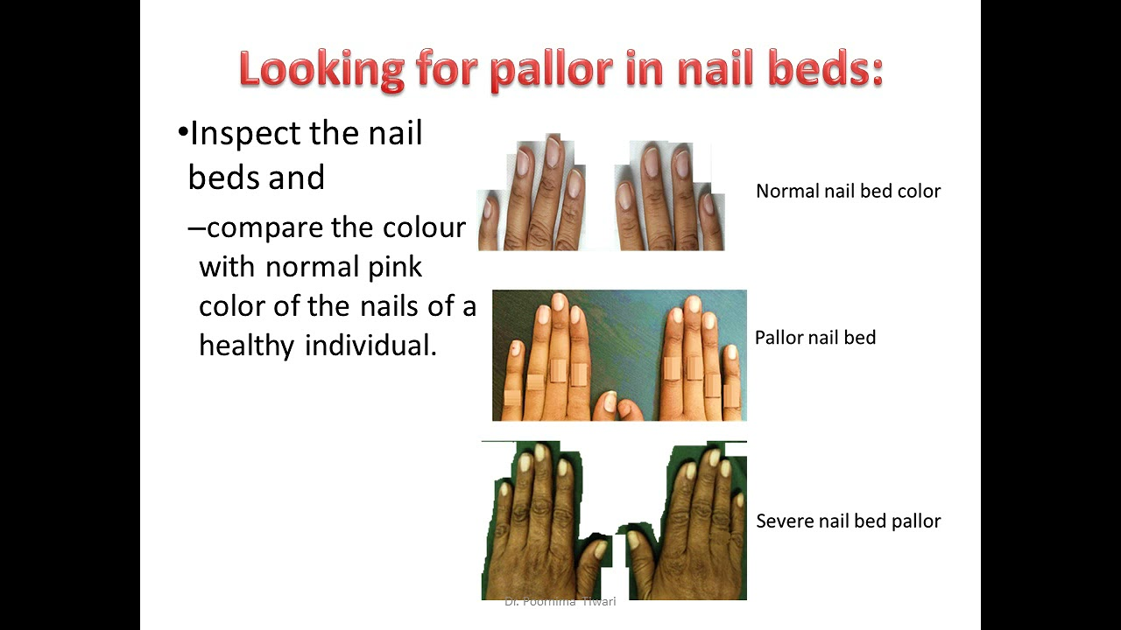

Slide 54
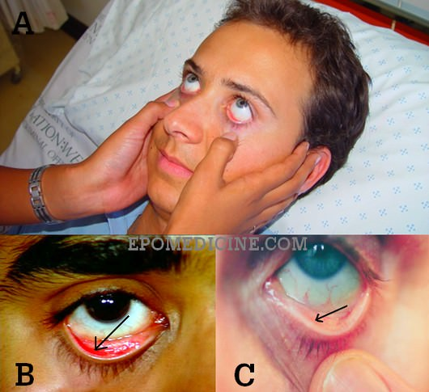
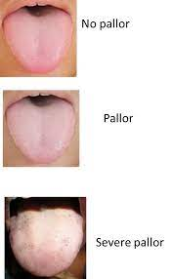

Slide 55
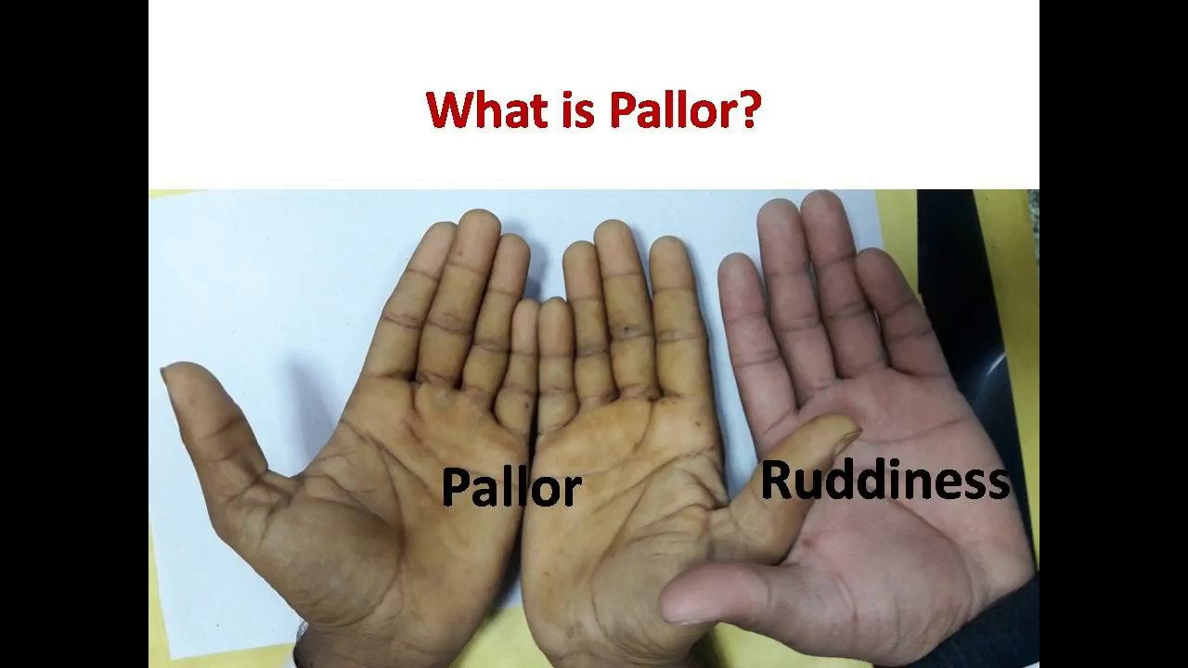

Slide 56
(2) Examine for Cyanosis
Cyanosis refers to a bluish discoloration of the skin and mucous membranes, produced by presence of reduced haemoglobin in the blood either locally as in impaired peripheral circulation or generally, when oxygenation of the blood is defective.

Slide 57
Cont’
Cyanosis occur due to reduction in blood supply or a slowing of the peripheral circulation.
Arises through exposure to cold, reduced cardiac output or peripheral vascular disease.
One cannot have central cyanosis without demonstrating peripheral cyanosis, but peripheral cyanosis can occur alone

Slide 58
Types of Cyanosis
Central cyanosis- results from imperfect oxygenation of blood, as seen in heart failure and some lung disease or from mixture of desaturated venous blood with arterial blood due to right to left (venous-arterial) shunt in the heart.
In this case the cyanosis is general and characteristically affects the tongue, lips which appear blue as well as the limbs. The cyanosed extremities are warm.
Peripheral cyanosis- is due to excessive reduction of Oxyhaemoglobin in the capillaries when the flow of blood is slowed. This happens due to exposure to cold, when there is venous obstruction or in heart failure. The cyanosed extremities (toes, fingers) appear blue and are cold, the tongue is unaffected.
Cyanosis of heart failure is often due to both central and peripheral causes. Carbon monoxide poisoning produces a generalized cherry-red discolouration, due to the presence of carboxyhaemoglobin

Slide 59
3) Examine for Jaundice
Jaundice is yellow pigmentation/discolouration of those tissues in the body which contain elastin (skin, sclera, and mucosa) Occurs due to an increase in plasma bilirubin (visible at >35µmol/L or ≥ 2.5mg %) The level of bilirubin < 2.5mg % produce sub-clinical jaundice which may not be detected.

Slide 60
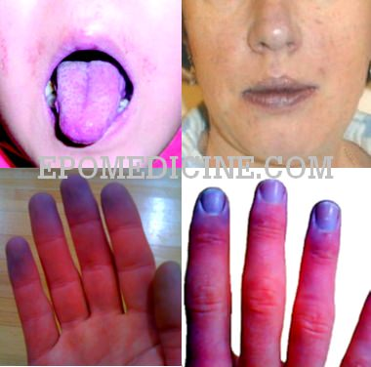

Slide 61
Causes of Jaundice
a) Pre- Hepatic Cause- Jaundice result from increased breakdown of red blood cells leading to increased serum bilirubin
Congenital red blood cells casing abnormal shape e.g. in SCD, hereditary Spherocytosis, hereditary elliptocytosis
Enzyme deficiency- Glucose 6 phosphate dehydrogenase (G6PD) deficiency), pyruvate kinase deficiency
Haemoglobin abnormalities- Thalassaemia
Auto-immune haemolytic anaemia
Drugs- Penicillins
Infections- Malaria
Mechanical- DIC
Transfusion reactions
Paroxysmal nocturnal haemoglobinuria

Slide 62
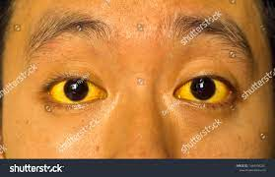
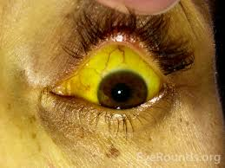

Slide 63
Cont’
b) Hepatic Causes- there is disorders of uptake, conjugation and secretion
Viruses- Hepatitis A, Hepatitis B, Hepatitis C, Epstein Barr virus (EBV)
Alcohol
Autoimmune disorders
Drugs- Isoniazid, Rifampicin, Acetaminophen, Penicillins, oral contraceptives, Chlorpromazine
Liver malignancies- primary or secondary metastatic tumours
Cholestasis

Slide 64
Cont’
C) Post-Hepatic causes- results from obstruction to elimination of bilirubin
Gallstones
Inflammation of the gall bladder
Gall bladder cancer
Pancreatitis
Cancer of pancreas
Bilary tree obstruction from gall stones, compression from pancreatitis, pancreatic tumour, lymphn nodes, biliary atresia
Cholangiocarcinoma
Post-operative stricture
Primary sclerosing cholangitis

Slide 65
4) Examine for Hydration Status
Mucous membranes- inspect the tongue and mucous membranes for moisture
Skin turgor/skin elasticity- demonstrated by pinching up a fold of skin and then released. It remains as a ridge and subsides slowly if skin elasticity is lost, otherwise it returns immediately to its normal position.
Loss of elasticity is not a true index of hydration as it is lost in old age and due to loss of collagen in the skin.
Intraocular tension- low tension indicates dehydration; the eyeballs are soft and sunken

Slide 66
Cont;
Causes of Dehydration
Gastrointestinal loss- diarrhoea, vomiting, gastroenteritis (food poisoning)
Cutaneous loss- burns, perspiration (excess sweating)

Slide 67
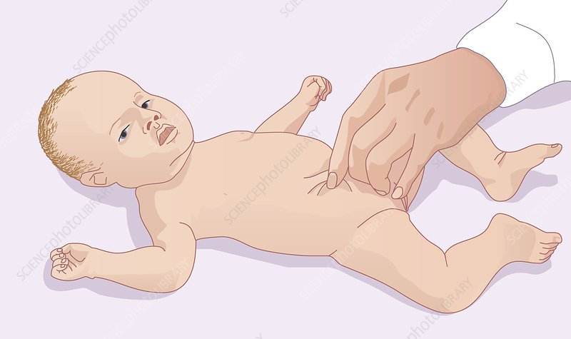
Checking for dehydration

Slide 68
5) Examine for Oedema
Oedema refers to fluid accumulation in the subcutaneous tissues.
Check for ankle and sacral oedema
Compress on a skin over bony area for 10 seconds( ankle joint at the medial malleolus_2cm above the ankle joint, dorsum oedema and sacral oedema)
Oedema can be reported as either, tender or non-tender, pitting or non-pitting.

Slide 69
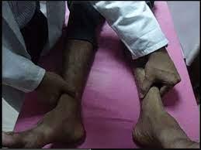
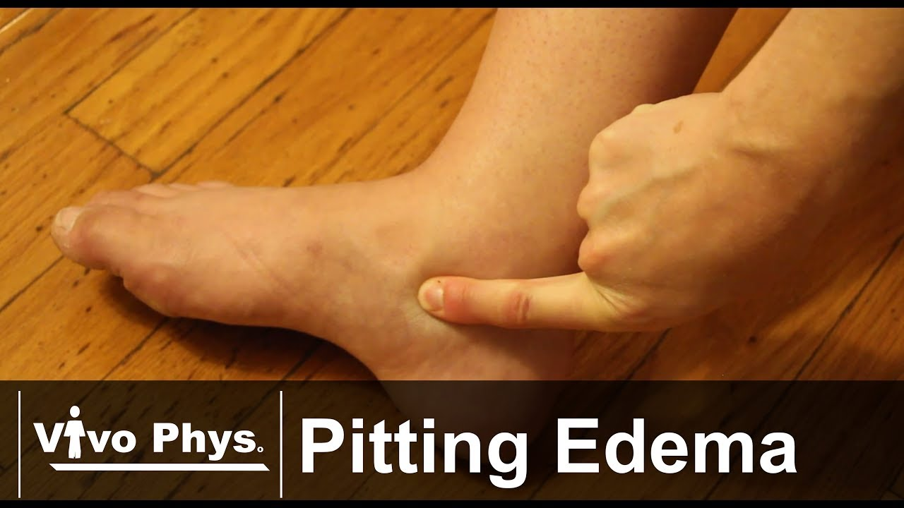

Slide 70
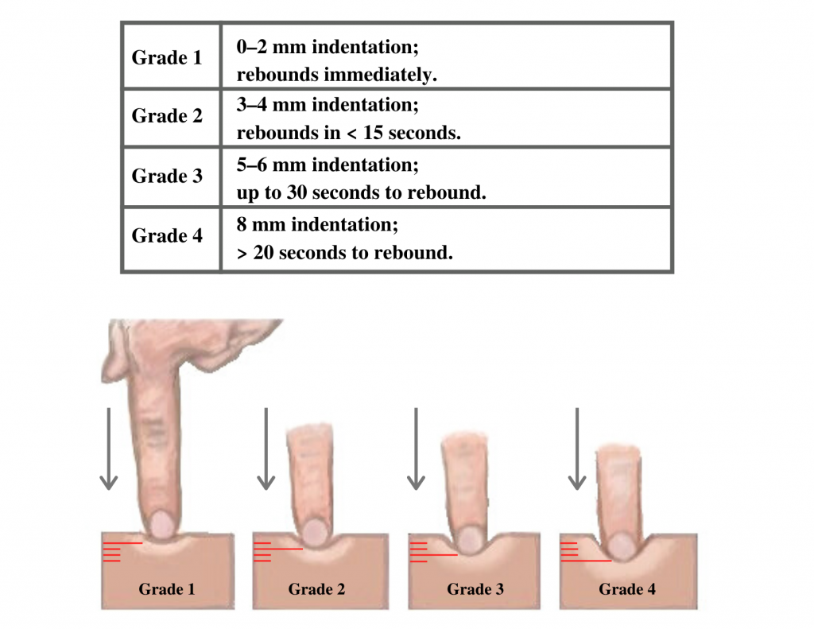
Grading pitting oedema

Slide 71
6) Examine for Lymphadenopathy
Lymphadenopathy is the enlargement of lymph nodes.
In health patients, palpable glands can be detected especially in the axilla and the groin. They are usually less than 1cm in diameter; lymph nodes greater than 2cm in groin are considered abnormal and pathological

Slide 72
Important groups of lymph nodes includes:
Pre-auricular- in front of the ear
Post-auricular (posterior auricular)- superficial to the mastoid process behind the ear.
Occipital- below the occiput at the base of the skull.
Tonsilar- at the angle of the mandible
Submandibular- midway between the angle and the tip of the mandible
Submental- in the midline, a few centimeters behind the tip of the mandible
Superficial cervical- superficial to sternocleidomastoid
Posterior cervical- along the anterior of the trapezius
Deep cervical- lymph node chain deep to the sternocleidomastoid and often inaccessible to examination
Supraclavicular- deep to the angle formed by the clavicle and sternocleidomastoid
Axillary- 5 groups i.e. lateral group, central group, apical group, pectoral group and subscapular group
Inguinal and femoral lymph nodes- horizontal and vertical groups
Popliteal lymphnodes- behind the knee

Slide 73
Reporting following lymph nodes examination
Site: Acute and chronic infections and metastatic carcinoma will cause localized lymphadenopathy
Number: how many nodes are enlarged?
Size: normal nodes are not palpable. Palpable nodes therefore are enlarged. Measure their length and width
Consistency: malignant lymph nodes feel firm or hard and irregular.
Enlarged nodes secondary to infection may feel rubbery
Tenderness: painful, tender nodes usually imply infection.
Fixation: nodes that are fixed to surrounding tissue are highly suspicious of malignancy.
Matted glands may occur in tuberculous lymphadenopathy.
Overlying skin: inflamed nodes may cause redness and swelling in the overlying skin.
Spread of a metastatic carcinoma into the surrounding tissue may cause oedema and surface texture changes

Slide 74
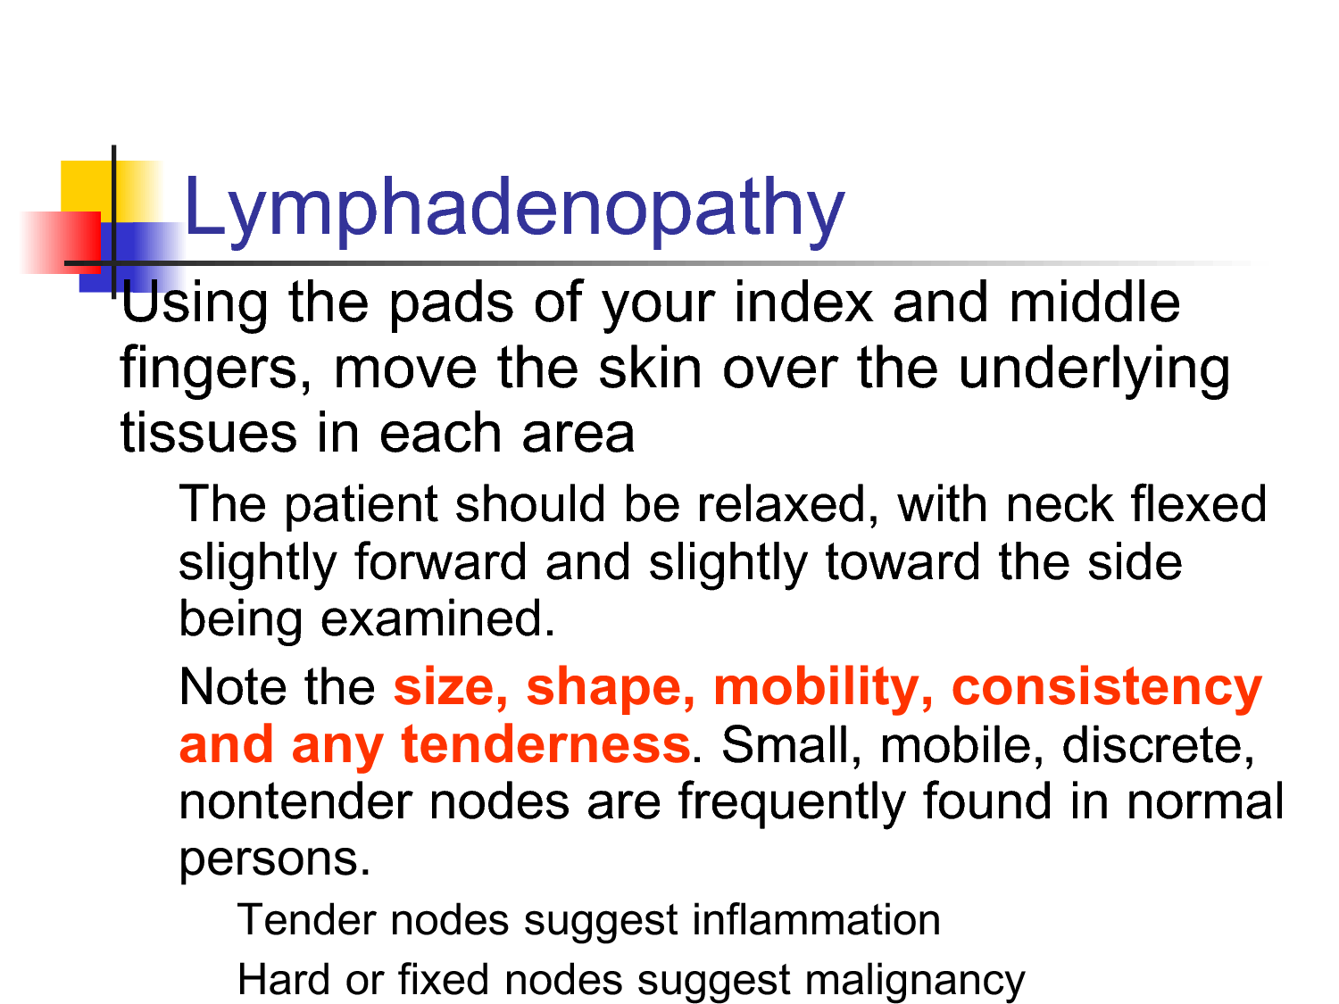
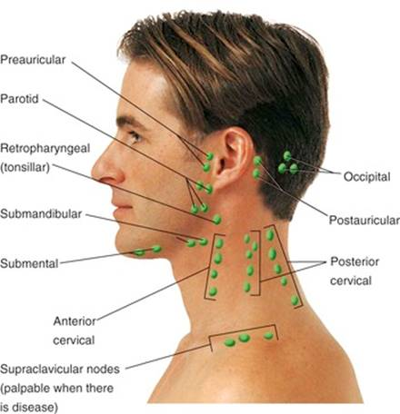

Slide 75
7) Examine for Finger Clubbing
Early clubbing: softening of the nail bed but this is very difficult to detect. Progression leads to a loss of the angle at the base of the nail
Eventually to gross curvature and deformity
Clubbing leads to a loss of the diamond-shaped gap (Schamroth's sign)

Slide 76
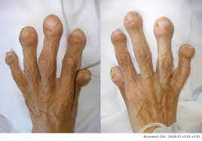
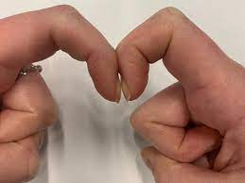
Clubbed fingers
Examining for Finger clubbing

Slide 77
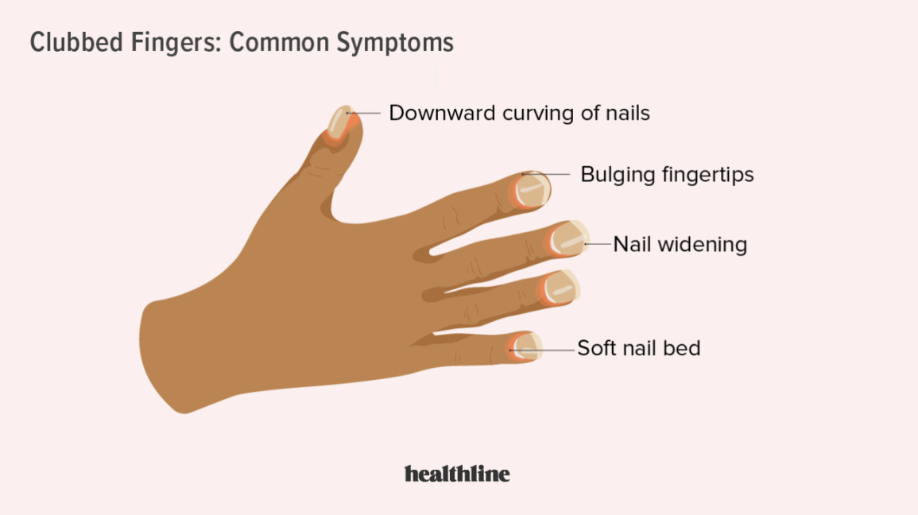

Slide 78
Examine the Nutritional Status of the patient
Assessment of nutritional state of a patient is an important part of clinical examination because nutritional depletion may eventually result in malnutrition which has its functional consequences such as reduced immune response, muscle weakness, oedema, confusion, or neuropathy.
Examine for wasting or thinness of muscles, oedema, pallor, weakness, loss of skin elasticity, and other signs of nutrients and vitamins deficiency are pointers towards poor nutrition or malnutrition

Slide 79
Conclusion
The purpose of each clinical assessment is to establish reliable data from the history and the physical examination in order to facilitate diagnosis and plan treatment
It is therefore essential that clinical information be organized in such a way that it can be easily accessed and utilized

