Slide 1
CNS PATHOLOGY
Sila.M.M

Slide 2
Congenital Abnormalities
Estimated at 1-2% life births.
Oftenly result into mental retardation, cp or neural tube defects.
Mutations in genes that regulate differentiation, maturation or intercellular communication of neurons
Teratogenic chemicals & infections.

Slide 3
Neural Tube Defects
Neural tube gives rise to the ventricular system, brain & spinal cord.
Partial failure/reversal of neural tube closure leads to malformations in the neural tissue, meninges overlying bone & soft tissue.
Folate deficiency, administration of folic supplements to women of child bearing age is protective.

Slide 4
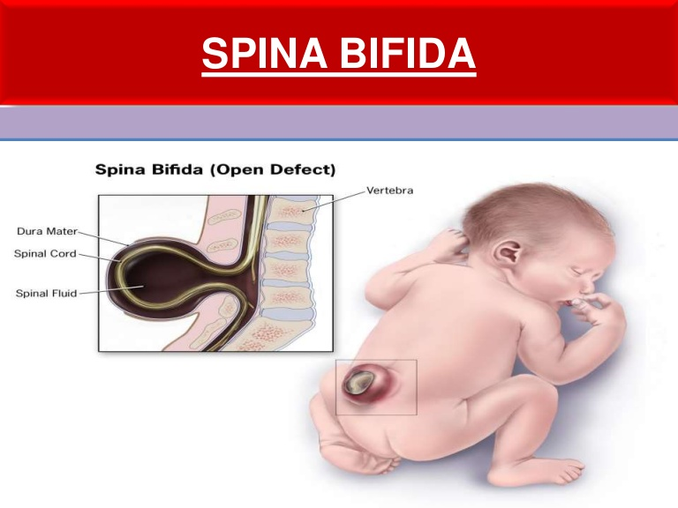

Slide 5
Early diagnosis is by imaging studies & detection of elevated
alpha fetoprotein in pregnancy.
Spina bifida occulta; posterior neural tube defect presenting with asymptomatic bony defects.

Slide 6
Spina bifida; severe malformation with a flat, disorganized segment of spinal cord associated with overlying meningeal outpouching.

Slide 7
Myelomeningocele; extension of CNS tissue through a defect in the vertebral column, commonly the lumbar-sacral. Pts have both motor & sensory deficits in lower limbs, lack bladder & bowel control.
Infections of the thin/ulcerated overlying skin compound the morbidity.

Slide 8
Anencephaly; malformation of the anterior end of the neural tube , leads to absence of the forebrain & the skull.

Slide 9
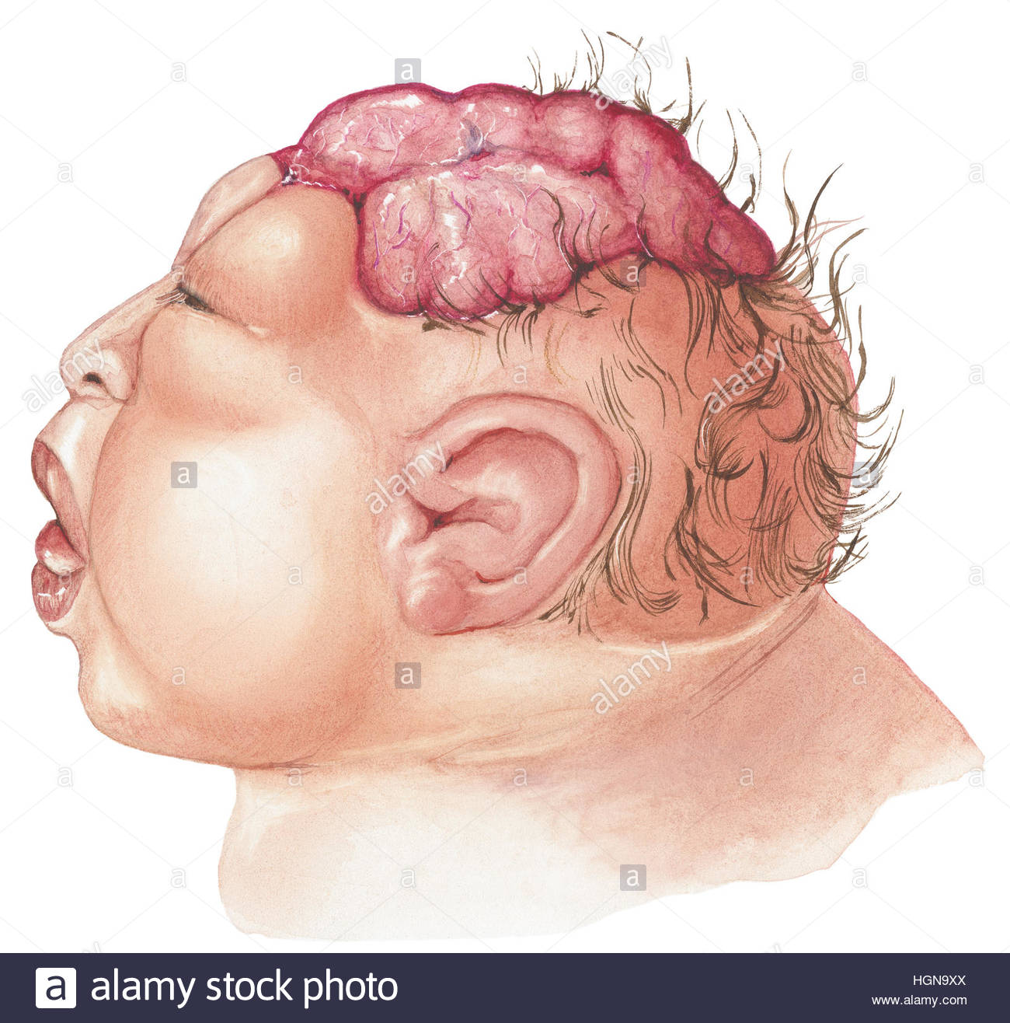
Fetal anencephaly image

Slide 10
An encephalocele; diverticulum of malformed CNS tissue extending through a defect in the cranium. Oftenly affects occipital/ posterior fossa.
Extension into sinuses occurs with anterior defects.

Slide 11
2. Forebrain Malformation
Microencephaly; small volume of brain, often associated with a microcephaly.
Causes range from chromosomal abnormalities to fetal alcohol syndrome, HIV & vertical zika virus infection.
Associated with decreased number of cerebral cortex neurons.

Slide 12
3. Posterior Fossa Anomalies
Results in misplacement/absence of cerebellum.
Arnold-Chiari malformations (type II); small posterior fossa with a misshapen midline cerebellum & downward extension through the foramen magnum, hydrocephalus & a lumbar myelomeningocele.

Slide 13
Chiari type I malformations; low lying cerebellar tonsils that extend through the foramen magnum.
Excess tissue in the foramen magnum obstruct the CSF flow, compress the medulla leading to headaches & CN deficits.

Slide 14
Hydrocephalus
increase in volume of csf within the ventricular system.
Etiology; disturbance in CSF formation, flow or absorption ,
leads increase in volume occupied by this fluid in the central nervous system.

Slide 15
CSF Physiology
Produced by choroid plexus in the lateral,3rd & 4th ventricles.
Flows from the lateral ventricles to the 3rd through the interventricular foramen of Monro.
3rd to 4th ; cerebral aqueduct of Sylvius.

Slide 16
Cont. …
4th to subarachnoid space thro 2 lateral foramen of Luschka & 1 medial foramina of Magendie.
Absorption into bloodstream in the arachnoid villi of superior sagittal sinus.
500 mls produced a day, reabsorbed to the normal volume of 100-160 mls.

Slide 17
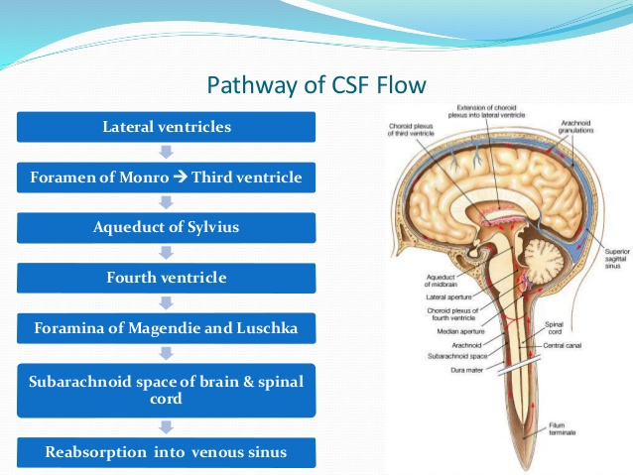

Slide 18
Communicating Hydrocephalus.
full communication occurs between the ventricles and the subarachnoid space.

Slide 19
Etiology
overproduction of CSF (rarely)
defective absorption of CSF (secondary to damage to the arachnoid granulation tissue by conditions such as intracranial hemorrhage or meningitis)
venous drainage insufficiency (occasionally

Slide 20
Non Communicating Hydrocephalus
CSF flow is obstructed within the ventricular system or in its outlets to the arachnoid space
impairment of the CSF from the ventricular to the subarachnoid space.
caused by intraventricular or extra ventricular mass occupying lesions that disrupt the ventricular anatomy.

Slide 21
Congenital Hydrocephalus
ventriculomegaly that develops intrauterine, often associated with macrocephaly .
The most common causes are obstruction of cerebral aqueduct flow , Arnord –Chiari malformation or Dandy-walker Malformation.

Slide 22
Cont. …
The patients may however stabilize in later years due to compensatory mechanisms but may decompensate especially following minor head injuries.
hydranencephaly; the brains cerebral hemispheres are absent to varying degrees and the remaining cranial cavity is filled with CSF.

Slide 23
Signs and symptoms
Vary depending on patients age, cause & the location of the obstruction ,its duration, and its rapidity of onset.
infants have poor feeding, irritability, reduced activity ,and vomiting.

Slide 24
Symptoms in children and adults
Slowing of mental capacity, cognitive deterioration.
Headaches (initially in the morning)
Neck pain suggesting tonsillar herniation.
Vomiting more significant in the morning.
Double vision related to unilateral or bilateral sixth nerve palsy
Drowsiness.
Difficulty in walking secondary to spasticity.
Blurred vision :a consequence of papilledema and later of optic atrophy.

Slide 25
Diagnosis
Examination in infants;
Head enlargement, splaying of sutures, dilated scalp veins, tense/bulging fontanelle, sun set eyes, increased limb tone.

Slide 26
Labs
genetic testing and counselling in suspected x- linked hydrocephalus .
LP for CSF evaluation in posthemorrhagic & post-meningitic hydrocephalus.

Slide 27
Imaging studies
Ct scan; the size of ventricles and other structures.
MR; Chiari malformation/cerebellar/periaqueductal tumors.
U/s; through anterior fontanelle in infants.

Slide 28
Management
Surgical treatment is the preferred therapeutic option
Most patients undergo shunt placements which include
Ventriculoperitoneal shunt
Ventriculo-atrial shunt
Lumboperitoneal shunt

Slide 29
Meningitis
clinical syndrome characterized by inflammation of the meninges.
If the infection spreads to the underlying brain, it is termed as meningoencephalitis.
infectious or non infectious

Slide 30
Non Infectious Meningitis
Chemical meningitis-a response to a nonbacterial irritant such as debris from a ruptured epidermoid cyst.
Carcinomatous meningitis- spread of metastatic cancer cells to the subarachnoid space

Slide 31
Infectious Meningitis
Acute pyogenic / bacterial
causative organisms are ;E. coli & group B streptococci in (infants),N. meningitides (young adults) ,strep. pneumoniae or listeria monocytogenes(older adults).

Slide 32
S/S; meningeal irritation, neurologic impairment, headache, photophobia ,irritability ,clouding of consciousness and neck stiffness.
LP; increased CSF pressure
CSF biochemistry; neutrophils ,elevated protein ,and reduced glucose

Slide 33
Aseptic (Viral Meningitis)
acute illness with meningeal s/s that is believed to be of viral origin.
less fulminant than in pyogenic meningitis and is typically self-limiting.
CSF microscopy; lymphocytosis ,moderate protein elevation ,a normal glucose level .

Slide 34
Causative organisms ; enteroviruses, measles ,influenza species ,lymphocytic choriomeningitis virus .
encephalitis include ;Herpes simplex viruses ,cytomegalovirus ,HIV ,west Nile virus , progressive multifocal leukoencephalopathy.

Slide 35
Chronic Meningitis
Mycobacterium tuberculae is a common cause.
TBM presents with headache , malaise , mental confusion and vomiting .

Slide 36
CSF microscopy; elevated cellularity , with mononuclear cells or a mixture of PMCN & mononuclear cells; markedly elevated proteins , glucose content typically is moderately reduced or normal
Infection with mycobacterium tuberculosis also may result in a well circumscribed intraparenchymal mass (tuberculoma) which may be associated with ICP

Slide 37
Rickettsia ,spirochetes and fungi
These ones also cause meningitic syndromes.
Causative organisms include Rickettsia rickettsia , T. Pallidum , Cryptococcus neoformans ,C albicans , Histoplasma capsulatum ,Coccidioides immitis.
C. neoformans – causes both meningitis and meningoencephalitis .

Slide 38
CSF microscopy/biochemistry ; few cells but elevated protein and the mucoid encapsulated yeasts can be visualized on Indian ink preparations .
Histoplasma capsulatum –common in people with HIV .presents with increased CSF protein , mildly decreased glucose & mild lymphocytic

Slide 39
Pathophysiology
infectious agents access the CNS via any of the following pathways
Invasion of the bloodstream and subsequent hematogenous seeding .
A retrograde neuronal pathway (e.g. olfactory and peripheral nerves)
Direct contiguous spread (e.g sinusitis ,otitis media or direct inoculation during cranial manipulation )

Slide 40
Signs and symptoms
Projectile vomiting ,photophobia , confusion, irritability, delirium, comma
Features of increased ICP

Slide 41
Physical examination
Infants may have;
Bulging fontanelle, Hypotonia, high pitched cries and irritability.
Adults presents with signs of meningeal irritation;
Nuchal rigidity Positive kerning & Brudzinski sign

