Slide 1
COMMUNICABLE DISEASES
TYPHOID

Slide 2
Etiology of Typhoid fever
Enteric fever,also known as typhoid fever
This is an infectious bacterial disease caused by
salmonella typhi
It is transmitted through the ingestion of food or drink that are contaminated by faeces or urine of an infected person
characterized by high continuous fever,malaise and involvement of lymphoid tissue and spleen

Slide 3
Classification
Enteric fevers; Typhoid fever
; Parathyroid A and B

Slide 4
Transmission
Humans are the only reservoir/carriers
Transmission is by faecal-oral route
Salmonellae are passed out in faeces and urine of carriers
The main ways of spread are through contaminated water and food
It is usually most common at the end of dry season and at the start of rains
Also common in areas where there is insufficient water for hand washing

Slide 5
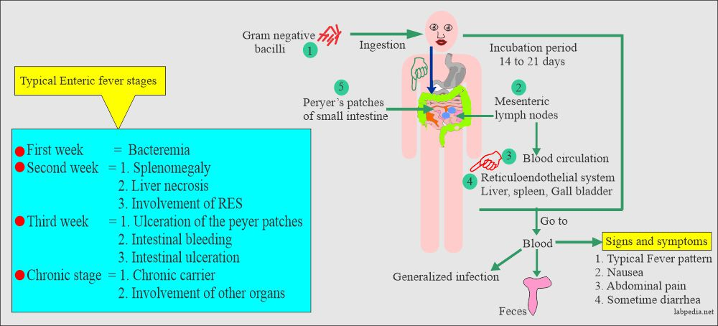

Slide 6
Clinical symptoms
The incubation period of typhoid fever is 7 - 21
days.
The disease has a gradual onset which
progresses through the following four stages.

Slide 7
First Week
During the first week and early in the disease, the patient has
severe headache,
malaise,
Loss of appetite,
body pains and aches
tendency to nose-bleed.
The body temperature rises day by day or insteps to 39.5ºC or higher.
Most patients cough because they develop bronchitis
may also complain of constipation.

Slide 8
Second Week
In the second week;
temperature continues to rise
There is swelling of lymphoid tissue in the intestines as well as
Peyer's patches, necrosis and ulcers, which cause the abdomen to become distended and tender.
The high temperature and toxaemia causes mental confusion and disorientation in the patient.
Half the patients may develop greenish watery ('pea-soup') diarrhoea and bronchopneumonia.

Slide 9
Third Week
Body temperature decreases step by step and the patient improves slowly.
If there is no improvement, the Peyer's patches in theintestines perforate and toxaemia increases.
The patient becomes delirious and incontinent of urine and stool muscles twitch and coma may precede death.

Slide 10
Fourth Week
For the patients who do not suffer the serious complications of the third week, the fourth week is a period of convalescence.
The temperature drops back to normal and the
patient recovers gradually.

Slide 11
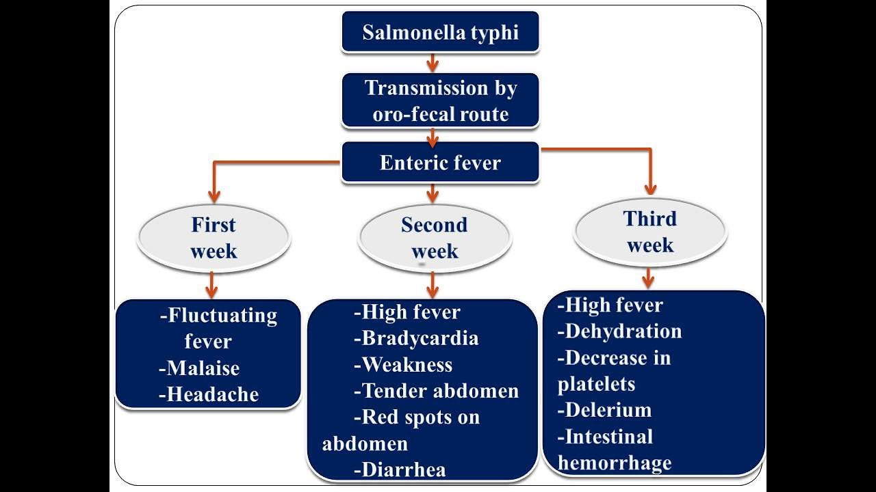

Slide 12
Diagnosis
The best way to diagnose typhoid fever is through ;
a blood culture. This may be positive during the first week and for a variable period after this.
Stool and urine cultures can also be made although they are only positive after the first week.
Other tests which are undertaken include:
Widal test during the first and second week, that is indicative of high and rising

Slide 13
WBC count which indicates low levels(leucopenia) with raised lymphocyte count
Stool to check for presence of occult blood which is found in 100% of the cases

Slide 14
How reliable is the Widal test in typhoid diagnosis?
Although the Widal test is still very useful,especially when two tests are performed four to five days apart after the end of the first week, its
interpretation is full of difficulties especially in endemic areas and in people who have had the typhoid vaccine.
That is why it is a good idea to also carry out one of the other laboratory tests.

Slide 15
Treatment
The treatment of typhoid fever includes the following:
Fluid replacement due to diarrhoea
Oral norfloxacin 400mg 12 hourly for 10- 14 days

Slide 16
Oral ciproxacin 500mg bd. for 14 days
Oral corticosteroids to prevent Jarisch-Herxheimer's reaction
Patient should be isolated in fly-proof room
Contaminated articles should be disposed by incineration
Stools and urine should be disposed of in a pit latrine or septic tank
Surgical treatment for perforated bowels

Slide 17
Prevention and Control
The prevention and control of typhoid fever is similar to that of many diarrhoea diseases. It includes:
Identification of the carriers especially those who work as food handlers and treat them promptly
Administration of typhoid vaccine
Safe water supply
Improvement in food hygiene

Slide 18
Complications
Gastrointestinal perforation
Gastrointestinal bleeding
Myocarditis
Pneumonia
Pancreatitis
UTI
Psychosis

Slide 19
Paratyphoid Fever
This is the second type of enteric fever .
It is caused by bacteria known as salmonella paratyphi types A, B and
C.
The disease runs a milder course than typhoid fever and also has enlargement of the spleen, bloodstained diarrhoea and swelling of
the Peyer's patches.
May present like typhoid fever ,but most cases present as gastroenteritis

Slide 20
Treatment
The treatment of paratyphoid fever is as follows:
Intravenous fluid if diarrhoea is severe
Oral rehydration if diarrhoea is mild
Oral cotrimoxazole two tablets bd. For five to seven days

Slide 21
Prevention and Control
The prevention and control measures are similar
to those that were covered under typhoid fever.

Slide 22
END
THANK YOU

