Slide 1
COMMUNITY DIAGNOSIS II
EUGENE M.

Slide 2
Objectives
By the end of the lesson, the learner should be able to:
Explain the process of community assessment
Outline the components of a community diagnostic statement
Define community mobilization
Outline steps in community mobilization
Describe community health action

Slide 3
Community Assessment
Community assessment is a systematic process of collecting, validating, analyzing and interpreting information about a given community.
Many parameters are available in the community, thus it is not possible to assess all of them.
It is therefore important to tailor your survey to suit specific needs.

Slide 4
Community assessment…
Community assessment involves:
Exploration
Planning for the survey
Developing and pre-testing survey tools
Execution of the survey and data analysis
Report writing and feedback

Slide 5
Community Exploration
Exploration simply means mapping out a community in order to learn more about it.
It is done during community entry and comprises of 3 main activities:
Seeking permission from authorities
Involving community members and seeking their reaction
Gathering background data about the community.
In approaching relevant individuals in the community, introduce yourself and clearly state the objectives of the survey and your plan of action
Notes:
For the survey to succeed you must seek permission from community leaders.
Start by channeling your request through the official hierarchy of administrative leaders in that community:
Health personnel such as Medical Officer in Charge
Governmental officials such as Chiefs or District Officers
Community leaders through, for example, the village health committee.
Gather information as you move around the community by:
Questioning
Observing
Smelling
Listening

Slide 6
Planning for the survey
While planning, ask yourself the following questions;
Why is the Survey Being Done?
Where Will it Take Place?
Who Will be Interviewed?
When Will the Survey Take Place?
What Will be Covered in the Survey?
Why are certain variables included and others left out?
What instruments will be used to measure the community’s health status?
How will data be collected and with what resources?
How do we select and train the official interviewers?

Slide 7
Guidelines for Interviewers
Establish rapport by greeting the respondents and introducing themselves
Explain carefully why they have come and what is the purpose of the survey
Ask if they are welcome to interview the family and if it is convenient for them at that time
Explain that they will be recording the information they collect
Emphasize that all information collected is confidential
Give them a chance to ask questions for clarification

Slide 8
SAMPLING
Not all parameters of the population can be assessed due to resource and time limitation.
A representative portion of the population is therefore obtained through sampling.
Sampling is the process of selecting a portion of the population to carry out a study.
The sample population represents the whole population.

Slide 9
Sampling Techniques
Broadly there are 2 categories of sampling techniques:
Probability sampling methods-all population parameters are known and readily available.
Non probability methods- population parameters not well known.

Slide 10
PROBABILITY METHODS
Here, every member of the given population has a known and equal chance of being selected.
Statistical techniques are successfully applied in the validation of the obtained results.
When to use probability methods
When the intended population of study is diverse.
When creation of accurate samples is needed
When the researcher needs to reduce the sampling bias.

Slide 11
Probability sampling methods
Below are examples of sampling methods
Simple random sampling-Elements in a sampling frame are numbered and then a table of random numbers or an online randomizer is used to draw random sample of the desired population.
Systematic random sampling- the population is first divided into two or more strata, from which elements are randomly selected.
Stratified random sampling-the person intending to carry out a study chooses the n^{th} participant in a list of people.

Slide 12
Probability sampling…
Multistage sampling-participants are randomly selected from a list that is too large in that simple random sampling can’t be applied.
Cluster sampling-a more complex form of cluster sampling which contains two or more stages in sample selection .

Slide 13
NON-PROBABILITY SAMPLING METHODS
Non random methods used by researchers in which not every element has a chance to be selected.
It is widely used in qualitative research.
When to use non-probability sampling methods

Slide 14
Non probability sampling
Convenience sampling- majorly involves selecting the most conveniently available people as the participants in the research.
Purposive sampling-The researcher chooses the sample based on what is appropriate for the study.
Snowballing- the existing subjects provide referral to recruit samples required for research study
Quota sampling-the sample assembled has the same proportion of individuals as the entire population with respect to the known trait ,characteristics and phenomenon

Slide 15
Sample size determination
A sample size can be obtained through various ways. Below are some:
Conduct a census-in a small population
Use sample size from a similar study-literature review
Table of sample sizes
Calculation-slovin’s formula, fisher’s formula

Slide 16
Data collection methods
Primary Data Collection
Key informant interview
Mapping
Administering questionnaire • Interview
Observation
Focus Group Discussion
Anthropometric Survey
Secondary Data Collection
Review of records

Slide 17
Data collection tools
Primary Data Collection
Questionnaire
Observation Check List
Interview Guideline
FGD Guideline
Measurements, physical examination and laboratory tests
Secondary Data Collection
Review format

Slide 18
Questionnaire
A questionnaire is a set of standardized questions designed to collect information about a specific aspect or issue in the community.
It is therefore a tool for collecting information. Keep it short and simple (KISS).
Information from a questionnaire helps you to make plans for your health services and to evaluate them.
Reading assignment: read and make notes on qualities of a good questionnaire

Slide 19
Advantages of Questionnaire
Economical
Wide coverage
Puts less pressure on the respondents
Uniformity
Anonymity of respondents

Slide 20
Disadvantages of Questionnaire
Lack of clarification for ambiguous questions
Respondents may be have less motivation to respond
Low response rate
Some respondents may give dishonest answers.

Slide 21
Focus Group Discussions (FGDs)
This is a group discussion that gathers together people from similar backgrounds or experiences to discuss a specific topic of interest to the researcher.
The group of participants are guided by a moderator (or group facilitator), who introduces topics for discussion and helps the group to participate in a lively and natural discussion amongst themselves.

Slide 22
Pre-testing the Instruments
It is very important to pre-test all the instruments you intend to use before they are finally administered.
This enables the interviewing team to make necessary changes prior to actual data collection.
Pre-testing also gives you the opportunity to discover if the various parts of the questionnaire flow in a logical order.
Pre-testing is done by conducting the study on 10% of the sample size.

Slide 23
Execution of the Survey
Involves going out to the field to collect information from the sample population you have selected
There are three stages in data collection:
1. establishing contact with respondents
2. Data collection
3. Data handling
#Use Hildergard Peplau’s theory of interpersonal relationships

Slide 24
Execution of the survey…
During the survey, interviewers should:
Introduce themselves by name and institution they are affiliated to
Show their identity cards for the activity
Show their letter of permission to carry out the exercise
Explain why they have come and the purpose of the survey
Establish rapport with the respondents so that they can feel
Ask if it is convenient to interview the person at that time
Should the person refuse to cooperate, the interviewers should not force them to participate.

Slide 25
Data Analysis
The data obtained from the field is known as ‘raw data’.
In this state, it does not give much information and is therefore difficult to interpret.
That is why it needs further work known as data analysis
Data analysis is the separation and categorization of numerical data into groups in order to understand its meaning using statistical methods.
Data analysis can be descriptive or inferential

Slide 26
Data analysis methods
Can be descriptive or inferential
Descriptive statistics uses measures of dispersion and central tendency to define data characteristics.
Inferential statistics are mainly used when one wants to make some generalizations about a given community parameter.
In this presentation descriptive statistics will be explored further.

Slide 27
DESCRIPTIVE STATISTICS
Descriptive statistics refers to parameters used to infer basic features of data in a study.
They give simple summaries about the research sample and measures.

Slide 28
Frequency distributions
Refers to an arrangement of numeric values from the lowest t the highest and an account of how many times each value has appeared.
Frequency data can be displayed on a frequency polygon where the scores are on the horizontal line and percentages or counts are on the vertical line.

Slide 29
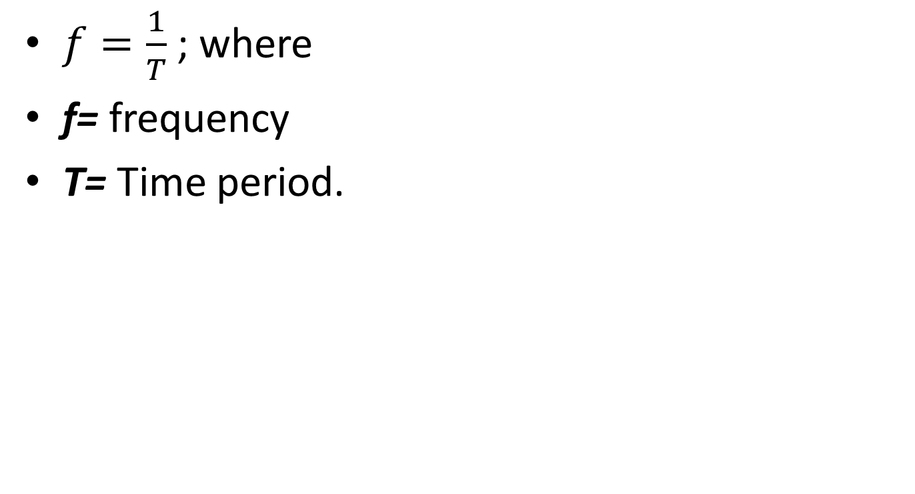
$f=\frac{1}{T}$ ; where
f= frequency
T= Time period.

Slide 30
Measures of central tendency
They indicate “typical” findings in a given data set.
Three indexes are used as measures of central tendency and they include;-
        Mean
        Mode
        Median

Slide 31
Mean
It is the average value for all participants.
Obtained by summing up all values in a given data set then dividing the result by the number of participants.

Slide 32
Mode
Value that occurs most frequently in a distribution.
Example; research CAT scores among 7 year 3 nursing students. 1,2,3,3,4,6,7,3. 3 has the highest frequency hence it is the mode.

Slide 33
Median
This is the value separating data sample in to two halves, the lower half and the higher half.
The median is found by ordering the set from lowest to highest and finding the exact middle.
Example;
1,3,4,4,7,9,10,12
Median=7
1,4,6,8,9,10
Median=(6+8)/2=7

Slide 34
Variabilities
These indices show deviations among related data sets.
The most commonly used index is the Standard deviation.
Standard deviation is closely related to variance.

Slide 35
Standard deviation (SD)
It is the measure of amount of dispersion in a given data set.
This index simply estimates the degree of error when we use mean to describe an entire sample.
Standard deviation usually is the square root of it’s variance.
It is calculated based on every value in a distribution.

Slide 36
Data analysis…
Data analysis can either be Qualitative analysis or Quantitative analysis.
Qualitative analysis is usually applied on data which can be counted but cannot be measured, such as, color.
It allows the analysis of the information in a systematic way in order to reach some useful conclusions and recommendations.
Quantitative analysis is usually applied to data that can be given a numerical basis or can be measured, for example, age in years, weight in kilograms, etc.

Slide 37
Data analysis…
Steps in data analysis:
Data cleaning
Sorting or tallying
Coding and entering data
Analysis of results

Slide 38
Data Presentation
Statistical analysis simplifies data for ease of presentation.
Data should be presented in such a way that it is simple and sufficiently explained.
The ways of presenting data are:
Numerical presentation-numbers & words
Tabular presentation- use of tables i.e. contingency tables and frequency distribution tables.
Graphical presentation- use of graphs i.e. Histogram, Frequency polygon, Bar graph, Pie chart.

Slide 39
Feedback and Report Writing
After survey is done, members of the community are entitled to receive some form of feedback.
They want to know what was found.
Feedback means giving comments about how well or badly a group is doing in order to help them do better.
It is a form of communication.
All individuals in the community who are concerned with the health of the people are entitled to feedback.

Slide 40
Types of Feedback
Individual Results
The individuals who formed part of the survey sample as well as those who provided specimens and tests deserve to be given feedback on their findings
Preliminary Report
This report covers the general impressions of the community’s health status as well as preliminary survey findings.
This goes to the community in which the diagnosis was conducted in order to thank them for their cooperation.
It is given soon after the field work is completed by arranging meetings for the people and their leaders.

Slide 41
Types of feedback…
They are given information on obvious points like disease outbreak, hygiene, sanitation, attitudes, nutrition, practices and utilization of health services.
They should be promised a more detailed report later.
This increases the community’s awareness of their health problems and their responsiveness to suggested interventions.

Slide 42
Non-Medical Reports
This report is less scientific and is usually produced for non-medical people.
It comes out after full analysis has been done and conclusions and recommendations have been formulated.
The contents of this report should cover the reasons for doing the community diagnosis and the findings which help to define the situation.
This report is a social or political tool to shed light on the improvements that need to be done in the community’s health services.
Therefore, the recommendations should be made practical.

Slide 43
Community Diagnosis Report
Is a detailed scientific report which provides an account of the planning and execution of the survey as well as the results.
It should present the data collected fully and adequately and give accurate interpretations of the analyses.
A well written community diagnosis report is made up of distinct sections or components which fall under the following headings:
Title
Table of contents
Lists of tables and figures

Slide 44
Community Diagnosis Report…
List of abbreviations and acronyms
Acknowledgements
Introduction
Aims and objectives of the study Good objectives should be ‘SMART’
Materials and Methods
Limitations of study
Results/ Findings

Slide 45
COMMUNITY DIAGNOSIS
Once a community assessment has been completed, priority health problems are identified and presented in a community diagnostic statement.

Slide 46
Community Diagnosis
There are four parts to a community diagnostic statement;
A problem statement, response, or state(risk, concern, issue, potential or actual),
Etiological factors related to the problem,
The aggregate population, the community, or focus (who is affected?) and
The signs and symptoms that are characteristic of the problem (defining characteristics).

Slide 47
Community Diagnosis…
Here are examples of a community Diagnostic statement
Risk of low birth weight among pregnant adolescents in the downtown area related to inadequate income and use of tobacco as evidenced by insecure housing, use of the food bank, unemployment rates, and smoking rates among pregnant teens.
Diarrheal disease among children below 5 years in Kondele area related to poor waste disposal and unhygienic food handling as evidenced by presence of open defecation areas, kitchen waste near houses and feeding children without washing hands.

Slide 48
Community diagnosis is derived from…
assessing the health status, resources, and vulnerability of a community or population and its subgroups;
identifying the social and environmental factors associated with that health status, that is, patterns of health-illness relationships in the community;
evaluating the group's ability to deal with deficits in its health status;
assessing and setting priorities of health goals and intervention options.
The resulting diagnosis requires ongoing review and revision to accommodate new data that describe changes in the group, its health status, and its environment over time.

Slide 49
PLANNING
Planning activities in the community involves mobilization of resources and sensitizing the community on their utilization.

Slide 50
Mobilization of Community Resources
Community mobilization involves increasing community awareness of priority problems and availing more resources to deal with the problem.
This helps to empower communities and enable them to initiate and control their own development.
Steps of community mobilization
Bringing people together
Raise people’s awareness
Assist in the delivery of resources and services
Facilitate and strengthen community participation.

Slide 51
Community Mobilization…
Community based rehabilitation (CBR) applies community mobilization to ensure that negative attitudes and behaviors towards people with disabilities and their families change by;
Creating awareness about the needs of people with disabilities and their family members and motivating them to improve the quality of life.
Reducing barriers in the community
Communities are knowledgeable about CBR and how community resources can be used to sustain the programs.
Communities participate in planning, implementing and managing CBR resources.

Slide 52
Role of the nurse in community Mobilization
The nurse plays important roles during community mobilization.
Some of them include:
Advising community leaders on resource allocation for given problems.
Advocating for the rights of community members.
Coordinating community mobilization activities
Providing health education to community members
Potentiating community action.
Providing consultation services on community health matters

Slide 53
IMPLEMENTATION
During community implementation of community interventions, the community takes action to address their priority problems.

Slide 54
Community Action
Joint efforts by health workers and the community.
Together, they develop interventions that aim at addressing identified health problems.
Mobilize Community Action
You can mobilize the community through a number of interventions, i.e.
  Making them aware of their problems and promoting primary health care
  Health education
  Immunization
  Environmental improvement

Slide 55
Evaluation
Health workers rarely conduct evaluation after community diagnosis.
However, it is important to evaluate community health interventions to:
Assess the effectiveness of the interventions
make improvements on the ongoing interventions.
Identify any unintended effects of the interventions and address them accordingly.

Slide 56
The End
Any Questions?

Slide 57
References
Basavanthappa, B. (2013). Community health Nursing 2nd ed. New Delhi: Jaylee Brothers. Medical Publishers
Bennet, F. (1979). Community Diagnosis and Health Action for Tropical and rural areas Manual: Macmillan Ltd.
Denise, S.P., & Beck, C. T. (2018). Essentials of Nursing Reasearch: Appraising evidence for Nursing Research: Philadelphia
Khasnabis. C., Heinicke, K., Achu. K, et al., editors (2010). Community-Based Rehabilitation: CBR Guidelines.

