Slide 1
Community Diagnosis and Community Mobilization

Slide 2
Community Diagnosis
Definition it is “a quantitative and qualitative description of the health of citizens and the factors which influence their health.
It identifies problems,
Proposes areas for improvement and
Stimulates action”.

Slide 3
community diagnosis
Community diagnosis is the identification and quantification of health problems in a given population using health indicators to define those at risk or those in need of care and the opportunities and resources available to address these factors.

Slide 4
Indicators of Community Diagnosis
Demographic
Environmental
Socioeconomic
Health resources and services
Health policies
Study of target groups

Slide 5
Types of community Diagnosis
?
Comprehensive Community Diagnosis is a- Comprehensive Community Diagnosis which focuses more on obtaining general information about the community.
Problem-oriented Community Diagnosis The problem-oriented community diagnosis is the type of assessment that responds to a particular need of a target group.
Example-1. a nurse is confronted by the community with health and medical problems resulting from mine tailings being disposed into the river systems by a mining company.
2.Recognizing the signs of respiratory distress

Slide 6
Importance Of Community Diagnosis
To act as a data reference for the district or the referral level
To provide an overall picture of the local community and the residents’ concerns
To suggest priority areas for intervention and the feasible solutions
To indicate the resource allocation and the direction of work plans
To create opportunities for intersectoral collaboration and media involvement

Slide 7
Process Of Community Diagnosis
The process of community diagnosis involves four stages:
1. Initiation
2. Data collection and analysis
3. Diagnosis
4. Dissemination Basic Principles of Healthy Cities

Slide 8
1.Initiation
To initiate a community diagnosis project, a dedicated committee or working group should be set up to manage and coordinate the project.
The committee should involve relevant parties such as government departments, health professionals and non-governmental organizations.
At an early stage, it is important to identify the available budget and resources to determine the scope of the diagnosis.

Slide 9
Areas of study in initiation
Health status,
Lifestyles,
Living conditions,
Socioeconomic conditions,
Physical and social infrastructure,
Inequalities,
Public health services and policies
Once the scope is defined, a working schedule to conduct the community diagnosis, production and dissemination of report should be set

Slide 10
2.Data collection and analysis
The project should collect both quantitative and qualitative data.
Moreover, Population Census and statistical data e.g. population size, sex and age structure, medical services, public health, social services, education, housing, public security and transportation, etc.
can provide background of the district.

Slide 11
Cont.
As for the community data, it can be collected by:
Conducting surveys through self-administered questionnaires,
Face to face interviews,
Focus groups and
Telephone interviews.

Slide 12
Cont.
In order to ensure reliability of the findings, an experienced organization such as an academic institute can be employed for conducting the study.
The sampling method should be carefully designed and the sample size should be large enough to provide sufficient data to draw reliable conclusions.
Therefore, study results derived can truly review the local community

Slide 13
Cont.
The study results derived can truly review the local community.
Collected data can then be analyzed and interpreted by experts.
Data analysis and presentation:
statistical information is best presented as rates or ratios for comparison
trends and projections are useful for monitoring changes over a time period for future planning
local district data can be compared with other districts or the whole population
graphical presentation is preferred for easy understanding

Slide 14
3.Community Diagnosis
Diagnosis of the community is reached from conclusions drawn from the data analysis.
It should preferably comprise three areas:
Health status of the community
Determinants of health in the community
Potential for healthy city development

Slide 15
4.Dissemination
The production of the community diagnosis report is not an end in itself, efforts should be put into communication to ensure that targeted actions are taken.
The target audience for the community diagnosis includes policy-makers, health professionals and the general public in the community
Report can be disseminated through channels below:
presentations at meetings of the health boards and committees
Forums organized for voluntary organizations

Slide 16
Cont.
Local community groups and the general public
Press release
Thematic events (such as health fairs and other health promotion programs)
It is important to realize that Community Diagnosis is not an one-off project, but is part of a dynamic process leading to health promotion in the community.
Therefore community diagnosis should be conducted at regular intervals to allow the HCP be continuously improved.

Slide 17
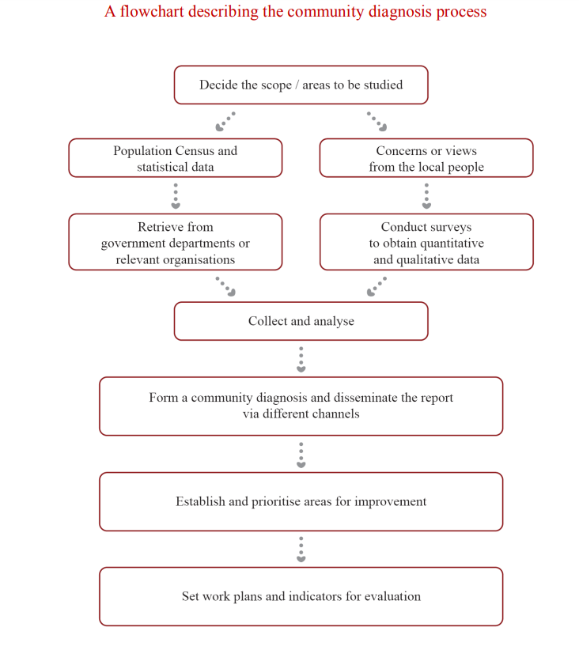

Slide 18
Social Mobilization
Social mobilization:
Social mobilization is when individuals in the society get together to achieve a particular goal.

Slide 19
Cont.
Types of community mobilization
Activities such as door-to-door outreach,
Public meetings
Health fairs
Participatory theatre

Slide 20
Objectives of Social Mobilization
It aims at empowering individuals and communities to identify their needs, their rights, and their responsibilities, change their ideas and beliefs and organize the human, material, financial and other resources required for socioeconomic development.

Slide 21
Strategies Of Social Mobilization
Step 1: Assess community needs, issues and resources. ...
Step 2: Design a social mobilization strategy. ...
Step 3: Identify and partner with local organizations. ...
Step 4: Design, test and produce social mobilization materials. ...
Step 5: Choose and train social mobilizers. ...
Step 6: Implement and monitor social mobilization activities.

Slide 22
Channels Of Community Mobilization
Radio,
Large-scale community-based activities,
Interpersonal communication,
Community-based surveillance and
Mobile phone technology.

Slide 23
Tools Of Social Mobilization
Social Mobilization.
Microfinance and Enterprise Development.
Physical Infrastructure and Technology Development.
Social Sector Services.
Human Resource Development.
Environment and Natural Resource Management.
Information Technology.
Social and Human Protection.

Slide 24
Steps for community mobilization
Creating a community profile. ...
Community survey. ...
Creating a working group. ...
Working group analysis. ...
Meeting the working group's needs. ...
Prioritization of problems within the coalition. ...
Working out an advocacy strategy. ...
Developing an action plan.

Slide 25
Components of a mobilized Community
Leadership.
Organizational capacity.
Communications channels.
Assessments.
Problem solving.
Resource mobilization.
Administrative and operational management.

Slide 26
Concepts Of Social Mobilization
Social mobilization generates dialogue,
Negotiation
Consensus
Engaging a range of players in interrelated
Complementary efforts
Taking into account the needs of people

Slide 27
Stages Of Community Mobilization
Conducting initial preparation
Organizing the community for action
Exploring the health issues and
Setting priorities
Planning
Acting and evaluating together
Scaling up

Slide 28
Community Mobilization Importance
Community mobilization increases the capacity of a community to identify and address its own needs while generating local solutions to problems.
Social mobilization acts as a catalyst for organizing the members of a community to take group action by sharing their problems
Seeking their own solutions by pooling their own resources,
Assist the community obtaining external help
It enhance community to participate actively in the decision-making processes that shape their lives as individuals

Slide 29
Benefits Of Social Mobilization
Social mobilization strengths participation of rural poor in local decision making ,
Improve their access to social and productive services
There is efficiency in the use of locally available financial resources a
Enhance opportunities for assets building by the poorest of the poor.

