Slide 1
COMMUNITY HEALTH
CHN 1102
BY
CLINTON OTIENO
BSc NURSING

Slide 2
The concept of community
The concepts of community and health together provide the foundation for understanding community health. Broadly defined, a community is a collection of people who share some important feature of their lives. In this text, the term community refers to a collection of people who interact with one another and whose common interests or characteristics form the basis for a sense of unity or belonging.

Slide 3
Cont'
It can be a society of people holding common rights and privileges (e.g., citizens of a town), sharing common interests (e.g., a community of farmers), or living under the same laws and regulations (e.g., a prison community).

Slide 4
Cont'
The function of any community includes its members’ collective sense of belonging and their shared identity, values, norms, communication, and common interests and concerns (Anderson &McFarlane, 2004)
Although most communities of people share many aspects of their experience, it is useful to identify three types of communities that have relevance to community health practice: geographic, common interest, and health problem or solution.

Slide 5
Geographic community
A community often is defined by its geographic boundaries and thus is called a geographic community. A city, town, or neighborhood is a geographic community. In community health, it is useful to identify a geographic area as a community. A community demarcated by geographic boundaries, such as a city or county, becomes a clear target for the analysis of health needs.

Slide 6
Geographic community cont '
A geographic community is easily mobilized for action. Groups can be formed to carry out intervention and prevention efforts that address needs specific to that community. Such efforts might include more stringent policies on day care, shelters for battered women, work site safety programs in local hazardous industries, or improved sex education in the schools. Furthermore, health actions can be enhanced through the support of politically powerful individuals and resources present in a geographic community.

Slide 7
Common-interest Community
A community also can be identified by a common interest or goal. A collection of people, even if they are widely scattered geographically, can have an interest or goal that binds the
members together. This is called a common-interest community. The members of a church in a large metropolitan area,the members of a national professional organization, and women who have had mastectomies are all common-interest communities. Sometimes, within a certain geographic area,a group of people develop a sense of community by promoting their common interest.

Slide 8
Common-interest community cont'
Disabled individuals scattered throughout a large city may emerge as a community through a common interest in promoting adherence to federal guidelines for wheelchair access, parking spaces, toilet facilities,elevators, or other services for the disabled. The residents of an industrial community may develop a common interest in air or water pollution issues, whereas others who work but do not live in the area may not share that interest.

Slide 9
Common-interest community cont '
Common-interest communities whose focus is a health related issue can join with community health agencies to promote their agendas. A group’s single-minded commitment is a mobilizing force for action. Many successful prevention and health promotion efforts, including improved services and increased community awareness of specific problems,have resulted from the work of common-interecommunities.

Slide 10
Community of solution
A type of community encountered frequently in community health practice is a group of people who come together to
solve a problem that affects all of them. The shape of this community varies with the nature of the problem, the size of the geographic area affected, and the number of resources needed to address the problem. Such a community has been called a community of solution. For example, a water pollution problem may involve several counties whose agencies and personnel must work together to control upstream water supply, industrial waste disposal, and city water treatment.

Slide 11
Community of solution cont '
This group of counties forms a community of solution focusing on a health problem.

Slide 12
THE CONCEPT OF HEALTH
Health, in the abstract refers to a person’s physical, mental,and spiritual state; it can be positive (as being in good health)or negative (as being in poor health).The World
Health Organization (WHO) defines health positively as “a state of complete physical, mental, and social well-being ana not merely the absence of disease or infirmity” (Ustin &Jakob, 2005).
Community health practitioners place a strong emphasis on wellness, which includes this definition of health, but also incorporates the capacity to develop a person’s potential to lead a fulfilling and productive life—one that can be measured in terms of quality of life

Slide 13
The concept of health cont'
In some cultures, health is viewed differently. Some see
it as the freedom from and absence of evil. Illness may be
seen as punishment for being bad or doing evil (Lipson &
Dibble, 2005). Many individuals come from families in
which beliefs regarding health and illness are heavily influ￾enced by religion, superstition, folk beliefs, or “old wives’
tales.

Slide 14
The Health Continuum: Wellness–Illness
Society suggests a polarized or “either/or” way of thinking about health: people either are well or they are ill. Yet wellness is a relative concept, not an absolute, and illness is a state of being relatively unhealthy. There are many levels and degrees of wellness and illness, from a robust 7-year-old woman who is fully active and functioning at an optimal level of wellness, to a 70-year-old man with end-stage renal disease whose health is characterized as frail. Someone recovering from pneumonia may be mildly ill, whereas a teenaged boy with functional limitations because of episodic depression may be described as mildly well.

Slide 15
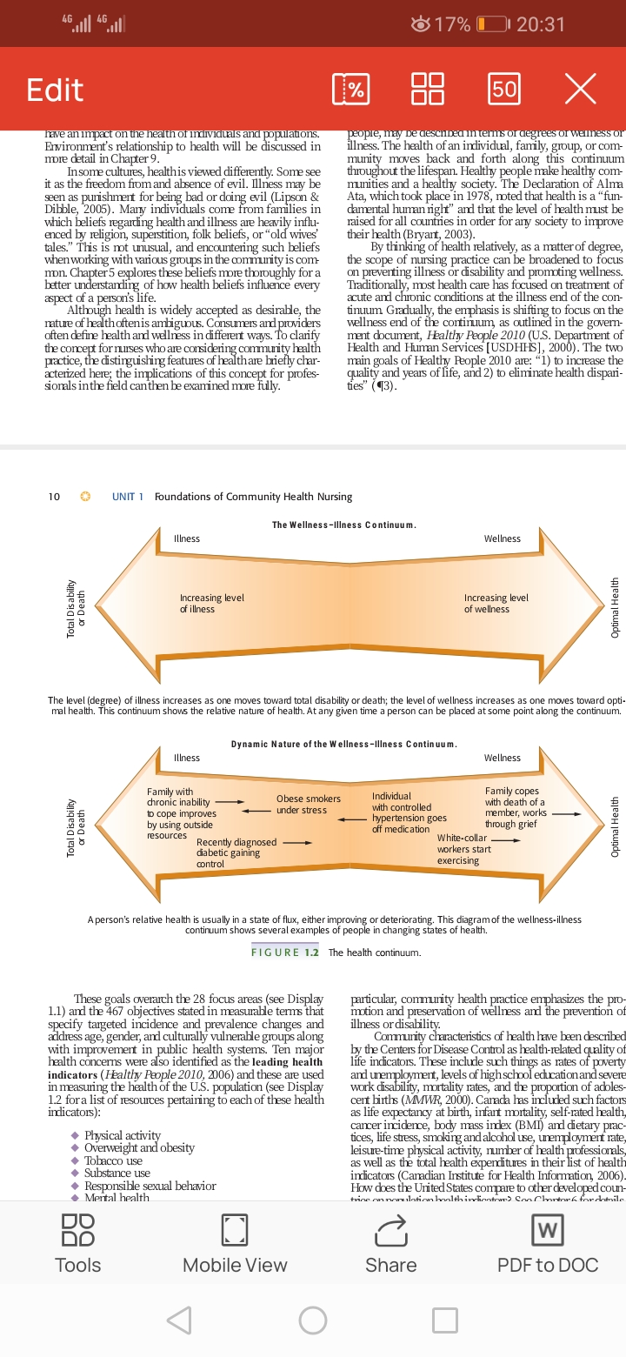
The Health Continuum: Wellness–Illness

Slide 16
Cont'
Community health practice ranges across the entire health continuum; it always works to improve the degree of health in individuals, families, groups, and communities. In particular, community health practice emphasizes the promotion and preservation of wellness and the prevention of illness or disability.

Slide 17
COMPONENTS OF COMMUNITY
HEALTH PRACTICE
Community health practice can best be understood by examining two basic components—promotion of health and prevention of health problems. The levels of prevention area key to community health practice.
Promotion of Health
Health promotion includes all efforts that seek to move people closer to optimal wwell-being or higher levels of wellness. Nursing, in particular, hahas social mandate for engaging in health promotion (PenDer, Murdaugh & Parsons, 2006)Health promotion programs and activities include many forms of health education—for example, teaching the dangers of drug use, demonstrating healthful practices such as regular exercise, and providing more health-promoting options such as heart-healthy menu selections.

Slide 18
Health promotion cont'
Community health promotion, then, encompasses the development and management of preventive health care services that are responsive to community health needs.The goal of health promotion is to raise levels of wellness for individuals, families, populations, and communities. Community health efforts accomplish this goal through a three-pronged effort to:
1. Increase the span of healthy life for all citizens
2. Reduce health disparities among population groups
3. Achieve access to preventive services for everyone

Slide 19
Prevention of Health Problems
Prevention of health problems constitutes a major part of community health practice. Prevention means anticipating and averting problems or discovering them as early as possible in order to minimize potential disability and impairment.
It is practiced on three levels in community health: primary prevention, secondary prevention, and tertiary prevention(Neuman, 2001)

Slide 20
Prevention of Health Problems cont'
Primary prevention obviates the occurrence of a
health problem; it includes measures taken to keep illness or
injuries from occurring. It is applied to a generally healthy
population and precedes disease or dysfunction. Examples
of primary prevention activities by a community health
nurse include encouraging elderly people to install and use
safety devices (e.g., grab bars by bathtubs, hand rails on
steps) to prevent injuries from falls; teaching young adults
healthy lifestyle behaviors, so that they can make them
habitual behaviors for themselves and their children; or
working through a local health department to help control
and prevent communicable diseases such as rubeola,
poliomyelitis, or varicella by providing regular immuniza￾tion programs.

Slide 21
Prevention of Health Problems cont'
Primary prevention involves anticipatory planning and action on the part of community health professionals, who must project themselves into the future, envision potential needs and problems, and then design programs to counteract them, so that they never occur. A community health nurse who instructs a group of overweight individuals on how to follow a well-balanced diet while losing weight is preventing the possibility of nutritional deficiency.

Slide 22
Secondary prevention
Secondary prevention involves efforts to detect and
treat existing health problems at the earliest possible stage,
when disease or impairment is already present. Hypertension
and cholesterol screening programs in many communities
help to identify high-risk individuals and encourage early
treatment to prevent heart attacks or stroke. Other examples
are encouraging breast and testicular self-examination, regular mammograms and Pap smears for early detection of
possible cancer, and providing skin testing for tuberculosis
(in infants at 1 year of age and periodically throughout life,
with increasing frequency for high-risk groups).

Slide 23
Secondary prevention cont'
Secondary prevention attempts to discover a health problem at a point when intervention may lead to its control or eradication.

Slide 24
Tertiary prevention
Tertiary prevention attempts to reduce the extent and severity of a health problem to its lowest possible level, so as to minimize disability and restore or preserve function.
Examples include treatment and rehabilitation of persons after a stroke to reduce impairment, postmastectomy exercise programs to restore functioning, and early treatment and management of diabetes to reduce problems or slow their progress. The individuals involved have an existing illness or disability whose impact on their lives is lessened through tertiary prevention.

Slide 25
Tertiary prevention cont'
In community health, the need to reduce disability and restore function applies equally to families, groups, communities, and individuals In broader community health practice, tertiary prevention is used to minimize the effects of an existing unhealthy community condition. Examples of such prevention are insisting that businesses provide wheelchair access, warning urban residents about the dangers of a chemical spill, and recalling a contaminated food or drug product.

Slide 26
Tertiary prevention cont'
When a community experiences a disaster such as an earthquake, a fire, a hurricane, or even a terrorist attack, preventing injuries among the survivors and volunteers during rescue is another example of tertiary prevention—eliminating additional injury to those already experiencing a tragedy.

Slide 27
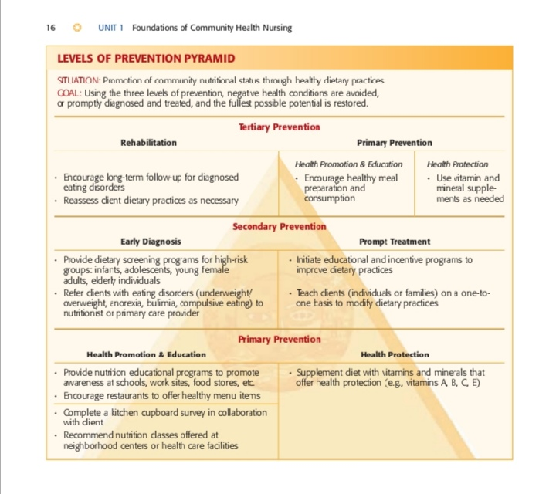
Tertiary prevention
Diagram

Slide 28
Questions??

