Slide 1
COMMUNITY HEALTH IV
CLINICAL MEDICINE
MARCH 2019
KMTC VOI

Slide 2
1.FAMILY HEALYH CARE
DEFINITIONS
FAMILY
OBJECTIVES
PRINCIPLES
APPROACHES ( Family as the context, family as the client.
Family as a component of society-merits, demerits, range.
Role of a clinical officer
Family assessment, home visits, health beliefs
Identifying families at risk for health problems.

Slide 3
2. UNIVERSAL HEALTH CARE
Definitions
Objectives,
Components
Health care financing,
Health service delivery
Health workforce
Health facilities
Quality assurance mechanisms
Information systems
Benefits of UHC
Risk sharing in health insuarance

Slide 4
3. HOME BASED CARE
Introduction to HBC
Objectives of HBC
Components and rationale of HBC
Infection control in the community
Diseases covered in HBC
Advantages and disadvantages of HBC

Slide 5
4.Field trips

Slide 6
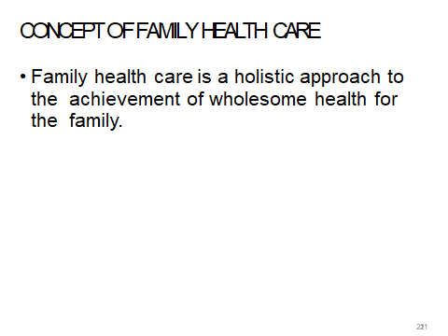

Slide 7
Aims of Family Health Care
Identifying and appraising health problems of the family
Providing health education for the promotion of health and
prevention of diseases
Sharing health information with the family to enable members to understand and accept health problems
Providing community health nursing services according to the
needs of the family

Slide 8
Helping the family to develop competence at assessing their health problems and at carrying out remedial health action through health education, instructions and demonstrations
Contributing needed materials for personal and social development of family members
Helping and encouraging the family members to utilize available resources to maintain all aspects of the health of the family

Slide 9
The family
The family is the smallest recognised group of individuals in a community
It begins with a marriage union in which husbands and wives have certain rights and obligations.
It is one of the oldest institutions that mankind has known.
It defines time, boundaries, cultures and human
understanding.

Slide 10
Types of families
There are different types of families in a
community.
The Nuclear Family
This consists of a husband and a wife with or
without children. This type of family brings forth
children (family of procreation). Children born in
this family consider it to be the family of their origin.

Slide 11
Strengths
Children are raised by both parents
Consistency
Focus on communication

Slide 12
weaknesses
Exclusion of other extended members of the family can lead to stress
Struggle with conflict resolution
Too child focused resulting in self centred children
Neglect of other important issues

Slide 13
Extended family
The Extended Family
This is also called a joint extended family.
This family includes members of nuclear families and other relatives, aunts, uncles, cousins, nephews and grandparents

Slide 14
Strengths
Care and respect for the elderly
Social support
Work is divided among the members of the house hold
Conflict resolution is easy due to eased consultations

Slide 15
weaknesses
Lacks privacy
Heavy financial implications
Family competitions

Slide 16
Single parent family
Single Parent Family
This is formed when one parent brings up
children alone either because of divorce,
separation, death or desertion of their spouse

Slide 17
Strengths
Sore decision maker
Conflicts are minimal

Slide 18
weaknesses
Financial problems
loneliness
Disciplining the children could be a problem
Work/responsibility over load

Slide 19
The Blended Family
This type of family is formed when husband and wife bring into the new marriage unrelated children from their previous marriages.
Cohabitation and homosexual marriages are also referred to as blended families

Slide 20
Strengths
Expense reduction
Improve the quality of life of the people
Social and financial support

Slide 21
weaknesses
Lack of authority of one parent
Step children may be resentful
Conflicts between children of blended families

Slide 22
Others
Childless family
Grand parent family

Slide 23
Functions of the Family
Bringing about a sense of togetherness and
a balance between individual and shared
(mutual) action by each family member;
nurturance and trust; stability and integrity of
the group;
interdependence and the ability to meet demands for survival and development.
Socialising its members into the larger community

Slide 24
Teaching respect for individual members
and their property.
This includes respect for differences among
the family members and others.
Teaching tolerance, fairness and a sense of
right or wrong among its members and
Others
Caring for its members and developing a
sense of trust between and among its
Members
Maintaining a healthy home environment conducive to the development of its members

Slide 25
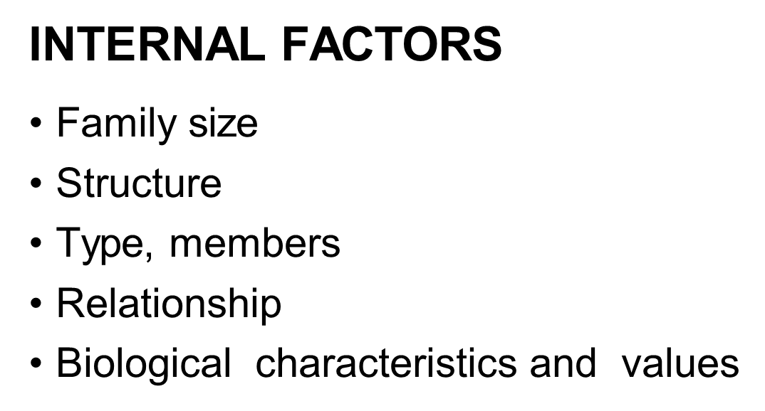
Factors affecting family Health

Slide 26
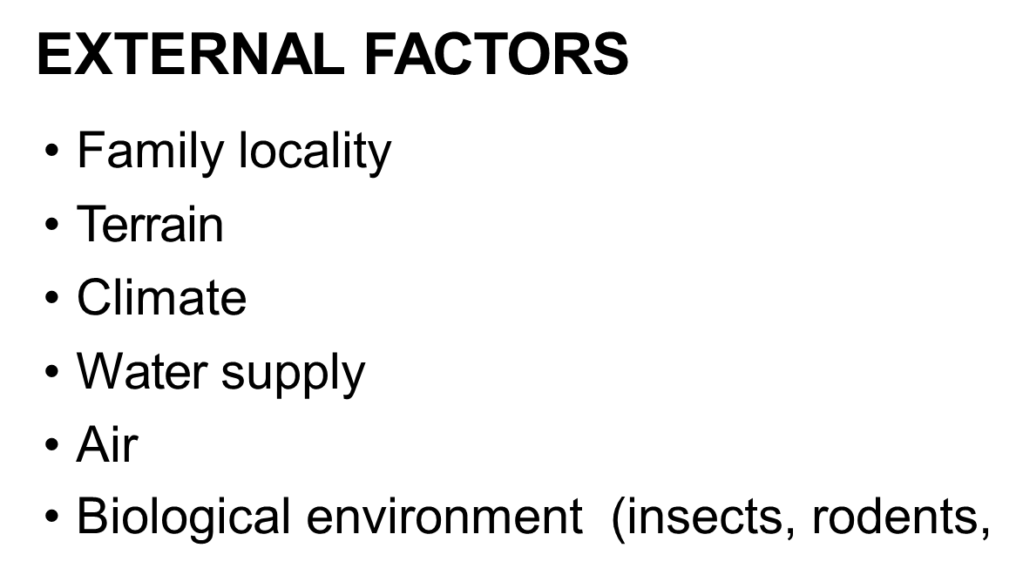

Slide 27
Community subsystems
A community is made up of various sub-
systems, all of which have a bearing on how
people live and behave.
For a community to function smoothly the various sub-systems must work in harmony. There are eight sub-systems found in

Slide 28
Cont. community subsystems
. A community has eight essential sub-systems, which interact and interrelate continuously and how they influence the health of people living within a community.
Socio-cultural System This system is made up of all the customs and beliefs, family and kinships, leadership and power structures in society.
This sub-system exerts a powerful influence on the lifestyles of the community members, their priorities and their attitudes and values towards health and illness.
For example some cultural factors promote either acceptance or stigma towards a certain illness. High-risk behaviour may be a result of cultural traditions.

Slide 29
cont
. Political System This sub-system is made up of the government and its development policies as well as political organisations.
If there is political support towards improving health care delivery, the government provides the mechanism and structure for the planning, implementation and evaluation of the health care delivery system.
The constitution of Kenya contains a declaration for the elimination of poverty, ignorance and disease; hence the establishment of the Ministry of Health and several other ministries .

Slide 30
cont
Economic System The government’s ability to provide health and other services to its citizens depends on the state of the economy. The poorer the economy of the country, the more disadvantaged its people will be.
Low economic status is highly associated with malnutrition and communicable diseases

Slide 31
. Education System Education is the main tool of changing behaviour and improving individual and community health. Low educational status perpetuates under- development, harmful traditions and superstitions.
The educational system can be effectively used to pass health related information and messages that could significantly transform the perception of the communities on healthy living and prevention of illnesses.

Slide 32
cont
Religious System The religious system may be a source of health promotion when its values and teachings positively influence lifestyles and healthy behaviour,
for example, forbidding smoking, alcohol consumption, pre-marital and extra- marital sex.
On the other hand, religious teachings may promote ill health, for example, by forbidding the followers from seeking treatment in hospitals.

Slide 33
cont
Environmental System Environmental sanitation is one of the leading promoters of individual and community health. Clean water supply, proper disposal of waste and adequate housing are key to community wellness.
Environmental pollution is a cause of various illnesses.

Slide 34
cont
Communication and Transport System Communication includes all the means of contacting and exchanging information with one another such as roads, bridges, railroad, telephone, television, radio, computers, internet, fax, and postal services.
The communication system is important in spreading health messages. Transport aids in communication by moving people

Slide 35
cont
Health Care system The health care system exists to provide promotive, preventive, curative and rehabilitative services in hospitals, nursing homes, clinics, health centres, dispensaries, and through special health projects and programs.
The health care system is enhanced through linkages that bring together the government, non-governmental organisations, private institutions and individuals in providing continuous and comprehensive health services.
These linkages strengthen the multi-sectoral approach of achieving health for all.

Slide 36
Family health
Family-two or more individuals coming from the same or different kingship groups who are involved in continuous living arrangement usually residing in the same household experiencing common emotional bonds, and sharing certain obligations toward each other and towards others

Slide 37
cont
Family health-a condition including the promotion and maintenance of physical,mental,spiritual,and social health for the family unit and for individual family members.

Slide 38
family health nursing
Family health nursing is the practice of directed towards maximizing the health and well being of all individuals within in a family system. The goals of the family health nursing include optimal functioning for the individual and for the family as a unit.

Slide 39
Objectives of family health
To identify health and nursing needs/problems of each family
To ensure the family understands and accept the identified needs/problems
To plan and provide health nursing services with the active participation of family members
To help families develop abilities to deal with their heal needs/problems independently

Slide 40
cont
To contribute to family's performance of developmental functions and tasks
To help family make intelligent use of promotive, preventive, therapeutic and rehabilitative health and allied facilities and services in the community.
To educate, counsel and guide family members to cultivate good personal health habits, practice safe cultural practices and maintain wholesome physical,psychological,a and spiritual environment.

Slide 41
Concepts of family health
The family structure provides an important foundation for the physical and emotional health of the individual and the community.
Marital and family status and interactions among family members affect each person’s health and the well-being of the community and nation.
The family exists and functions within the context of cultural, economic, legal, and social patterns unique to each society, with important commonalities of the role of the family in health.

Slide 42
cont
However, each person is a unique individual who passes through life stages with changing health needs and support systems not only in the family, but also in peer groups and society more widely
Family health issues relate to phases involving marital status, fertility and pregnancy, infancy, childhood, adolescence, adulthood, and old age, as well as the relationships among family members
Family health care is a holistic approach to the achievement of wholesome health for the family

Slide 43
AIMS OF F AMILY HEALTH CARE
Identifying and appraising health problems of the family
Providing health education for the promotion of health and
prevention of diseases
Sharing health information with the family to enable members to understand and accept health problems

Slide 44
cont
Providing community health nursing services according to the needs of the family
Helping the family to develop competence at assessing their health problems and at carrying out remedial health action through health education, instructions and demonstrations

Slide 45
cont
Contributing needed materials for personal and social development of family members
Helping and encouraging the family members to utilise available resources to maintain all aspects of the health of the family

Slide 46
Principles of Family Health Care
In order for you to work successfully with a family and achieve your goals of promoting health and preventing disease, you must observe the following principles:
Establish a good working relationship with the family
Plan relevant health education and sharing of clear health messages, which will guide them on how to take care of themselves

Slide 47
cont
Gather relevant information about the family which will enable them to identify health problems and set priorities
Provide need-based support and services to the family regardless of sex, age, income, and religion, in order to improve their health status
Work in collaboration with other health service agencies to avoid duplicating family health care

Slide 48
Nursing process approach in the care of families
Step 1: Assessment
You need to assess the family so as to identify (diagnose) the family health problems, needs and resources.
This involves collecting data using interviews, observation, communication, subjective appraisal, and reviewing available records and reports

Slide 49
cont
Step 2: Planning
This involves planning for health action by choosing effective and affordable alternatives and setting priorities after considering the available internal and external resources.
You should work hand-in-hand with the family members at all stages of planning

Slide 50
cont
Step 3: Implementation
You should implement the interventions or health actions agreed with the family members.
Implementing also includes increasing the family’s ability to function effectively and removing barriers to health care as well as assisting the family to do those things which they cannot do by themselves

Slide 51
cont
Step 4: Evaluation
This involves evaluating or measuring whether the expected outcome has been achieved.
If no achievements have been made, find out what factors interfered and change your approach accordingly

Slide 52
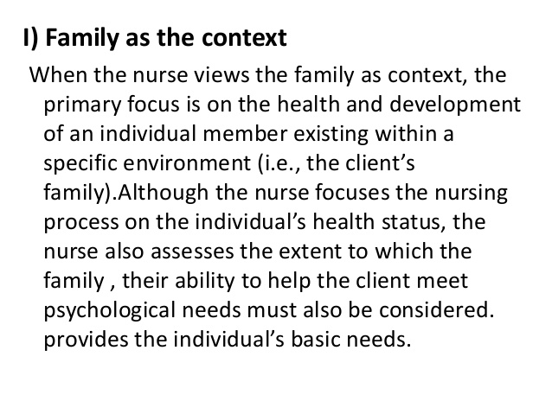
Approaches of family health

Slide 53
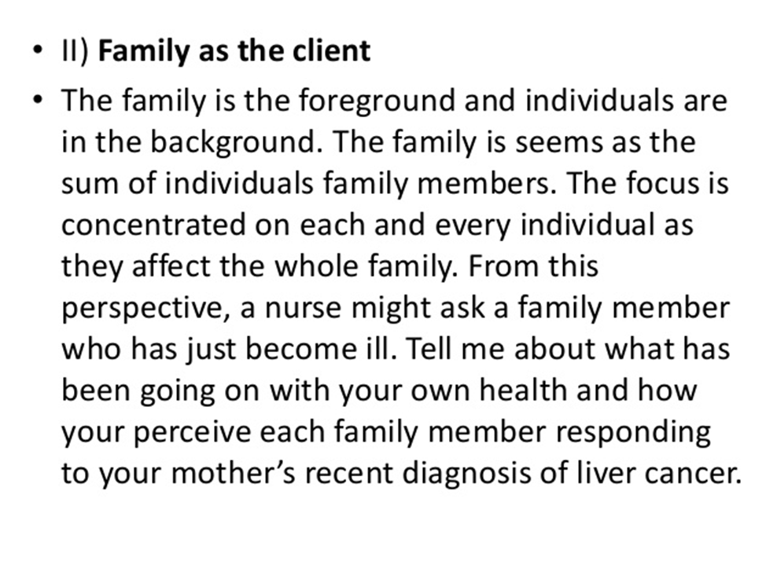
Family as the client

Slide 54
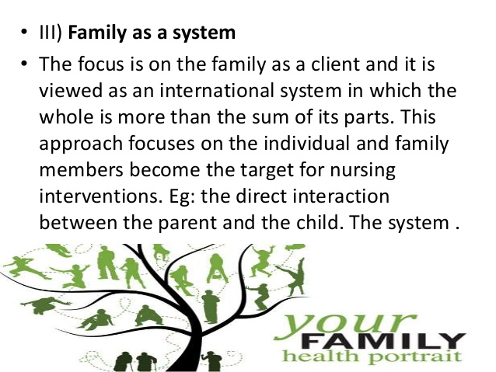
Family as a system

Slide 55
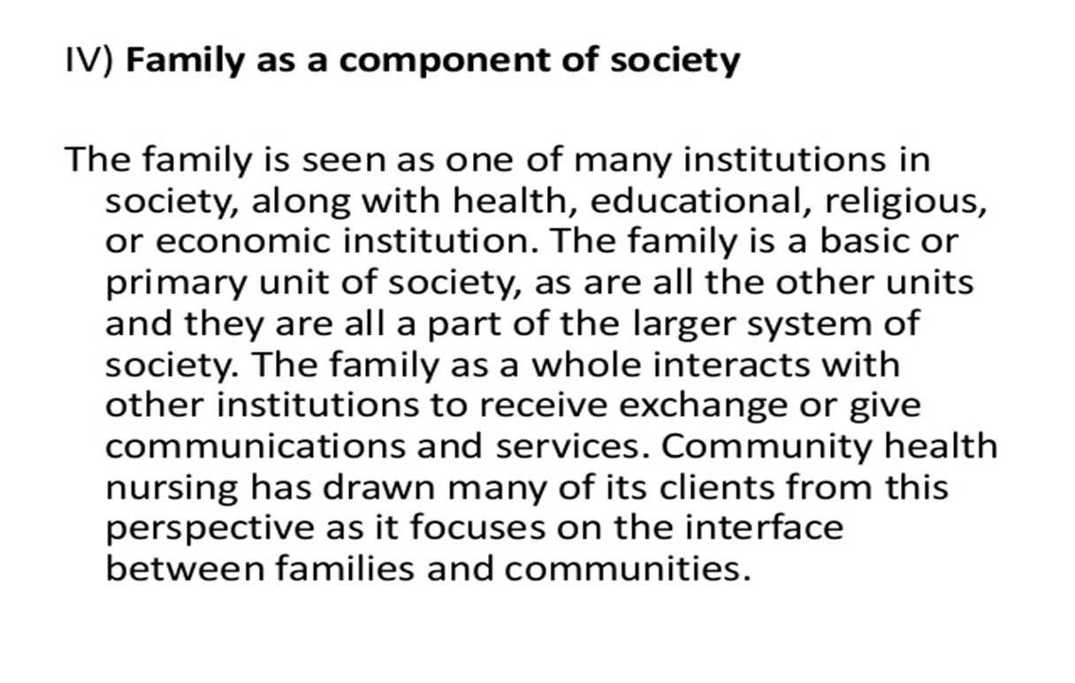
Family as a component of society

Slide 56
Role of Nurse in family Health
The unique function of a nurse in family health care is assisting the family cope effectively with health problems by increasing its capacity to perform the health tasks
Health educator-the nurse teaches the family about family wellness,illness,relations,and parenting.

Slide 57
cont
Coordinator and collaborator-the family nurse coordinates the care that families receive, collaborating with the family to plan care
Deliverer and supervisor-the family nurse either delivers or supervises the car that families receive in various setting
Advocate-the family nurse advocates for families with whom they work, the nurse empowers family members to speak with their own voice or the nurse speaks out on their behalf .

Slide 58
cont
Consultant-the family nurse serves as a consultant to families whenever asked or whenever need a rises
Counsellor –the family nurse plays a therapeutic role in helping individuals and families solve problems or change behaviour
Case finder and epidemiologist-the family nurse gets involved in case finding and a tracker of a disease

Slide 59
cont
Environmental modifier-the family nurse consults with families and other health care professionals to modify the environment
Clarifier/interpretor-the family nurse clarifies and interprets data to families in all settings
Researcher-the family nurse should identify practice problems and find the best solution for dealing with these problems through the process of scientific investigation

Slide 60
Roles cont
Role model-the family nurse is continually serving as a role model to other people through his/her activities
Case manager –the family nurse as a case manager it involves coordination and collaboration between a family and the health care system

Slide 61
Home visiting
Home visiting-it’s a family centred health services provided to the client in their own homes mainly on prevention of diseases, promotion of health and curative services when necessary.

Slide 62
Home Visiting
You could assess family members when they visit your health facility. However, in order to get a comprehensive picture of a family’s health, you need to visit them at home.
Home visits are an important part of your work as a community health nurse as they allow you to see families and their needs in their own homes.

Slide 63
Home visiting main purposes.
Home visiting is one of the essential community health services that you should provide:
It allows you to follow up individual families at home to find out why some health problems persist in the community despite efforts to prevent or control them, for example malnutrition, communicable diseases, or repeated failure to attend clinics, especially if the family is at risk
It keeps you aware of what is going on in your catchment area

Slide 64
Home Visiting
In order for you to conduct home visiting successfully, you need to have the following skills:
Good technical skills and knowledge of preventive and therapeutic measures
Good communication skills and teaching ability
Good leadership skills and rational thinking to make sound judgments
Good counselling skills and an understanding of human relations

Slide 65
Principles of Home visiting
Home visits should be:
Planned and of benefit to the patient
Purposeful, clear and meet the patient‘s needs
Regular and flexible according to the needs of the patient
Educative to the patient. Home visits provide an excellent opportunity for health education

Slide 66
CONT
Used to demonstrate principles of health
Convenient and acceptable to the patient
Respectful of the patient‘s right to refuse care
Recorded in the appropriate case file

Slide 67
The Process of Home Visiting
The process of home visiting is carried out in five phases
Entry or Initiation Phase
The community health nurse shares information with the patient on the reason and purposes for home visits.
This interaction may occur in a hospital ward or at a clinic
Pre-visit Activities
Before the actual home visit, you have to look for information regarding the patient and the family

Slide 68
continuation
You also need to gather information regarding the location of the house, distance from your health facility and the physical address.
During pre-visit activities, you should investigate the community resources, assemble supplies and prepare for the first contact with the patient at their doorstep

Slide 69
CONT
Activities During Home Visiting
This is the working phase during which you put into action your planned health activities
During this phase you must establish trust and rapport with the patient and the family so that there can be a positive interpersonal relationship
(a professional nurse-patient relationship).
This relationship will enhance the achievement of the mutually determined health-oriented goals

Slide 70
CONT
Termination Phase of Visit
This occurs when the health oriented goals have been met. Termination of home visits can occur due to any of the following reasons:
The patients’ health has been restored and the
patient can function without the nurse
The patient has changed their residence
The community health nurse has transferred the
patients’ care to another nurse or agency

Slide 71
CONT
Post-visit Activities
Post-visit activities include recording and reporting important events of the home visits, and sharing the reports with the appropriate authorities and individuals about the patient family

Slide 72
Advantages of Home Visiting
It provides an opportunity to learn about the home and family situation.
It provides an opportunity to render health care services to the family members in their own surroundings.
It creates a good understanding between the nurse and the patient and builds a good image of nurses.

Slide 73
CONT
It provides an opportunity to clarify the doubts and misconceptions raised by family members.
It provides an opportunity to observe and appreciate family practices and progress of care given by the nurse and others

Slide 74
Disadvantages of Home Visiting
Home visits consume a lot of the nurse's time and energy as well as transport fuel (petrol or diesel) or bus fare.
Unforeseen events may occur during home visits, which will interfere with planned activities.

Slide 75
cont
The patient’s family may not accept the nurse due to various factors such as cultural or religious differences, personal characteristics of the nurse and the patient or to some extent, socio-economic status of the nurse and the patient.
Confusion of the nurse’s role in a community where there may be a lack of knowledge and understanding of the role of the community health nurse

Slide 76
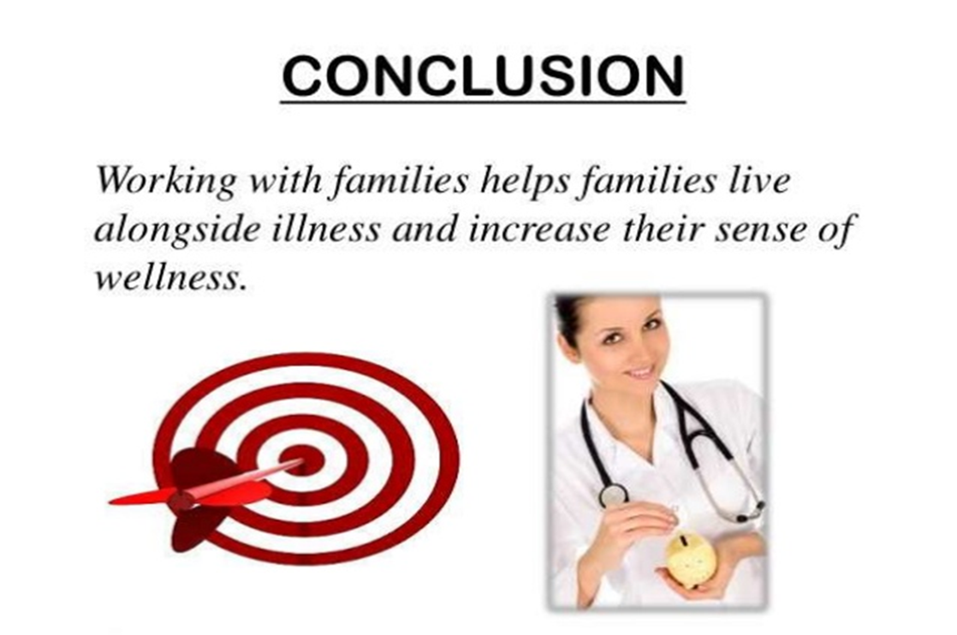
END

Slide 77
References
Lankester,T(2007)Setting up community health programs: practical manual for use in developing countries,oxford:macmillan
http://thepoint.Iww.com/activate

