Slide 1
COMMUNITY HEALTH NURSING

Slide 3
COMMUNITY HEALTH NURSING
DEFINITION

Slide 4
COMMUNITY HEALTH DEFINITION
The WHO defines community health as: environmental, social, and economic resources to sustain emotional and physical well being among people in ways that advance their aspirations and satisfy their needs in their unique environment.
Community health nursing involves the identification of high-risk aggregates in the community, and the development of appropriate and workable policies and interventions to ensure accessible services for all groups of the population.

Slide 5
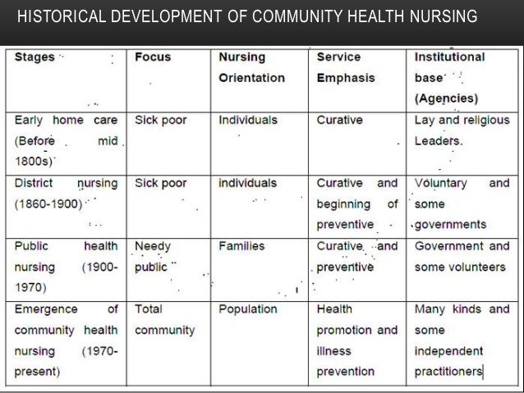

Slide 6
GLOBAL HISTORY OF COMMUNITY HEALTH NURSING.
The word nursing originally came from the Latin word “nutrire” meaning to suckle, referring to a wet nurse in the 16thcentury. Earliest times nursing was in people’s culture practices both in Christendom and Muslim World. In Europe before modern nursing, Catholic nuns and military often provided nursing like services until 20thcentury nursing became a secular profession.

Slide 7
ANCIENT HISTORY
Extension of wet nurse function of women. Buddhist indian rulere (268 B.C.E-232 B.C.E) Ashoka built hospitals along routes of travels and they were provided with minerals and vegetable drugs, with roots and fruits, skillful physicians appointed by the state administered them. This was until the fall of Buddhism in India 750 C.E. around 100 B.C.E Charaka Samhita was written in India ; good medical practices requires patient, physician, nurse and medicine for everyone.
First Christian nurse Phoebe in Roman 16;1 ,St. Paul sent deaconesses named Phoebe to Rome as first visiting nurse. From earliest days, following edicts of Jesus Christianity devotes cared for the sick, they nursed them, gave food to them and helped also during smallpox and measles outbreak around AD 250 regardless of religion.

Slide 8
ANCIENT HISTORY
After first council of Nicae in 325 AD, when Christianity became official religion of the Roman Empire services were expanded e.g. St Basil Hospital housed doctors and nurses and separate building for various patients and lepers were made, eventually there was construction of hospital in every cathedral town.
Christianity emphasis on charity gave rise to development of systematic nursing and hospital and end of persecution of early church. Ancient church leaders like St. Benodict of Nursia emphasized medicine as an aid to provision of hospitality (480-547). Some hospitals maintained libraries and training programs and documents filed as manuscripts. By the end of 12thcentury Constantinople had two well organized hospitals by both female and male doctors, systematic treatment procedure and specialized wards. In 17thcentury Rufaid Al- Aslamia

Slide 12
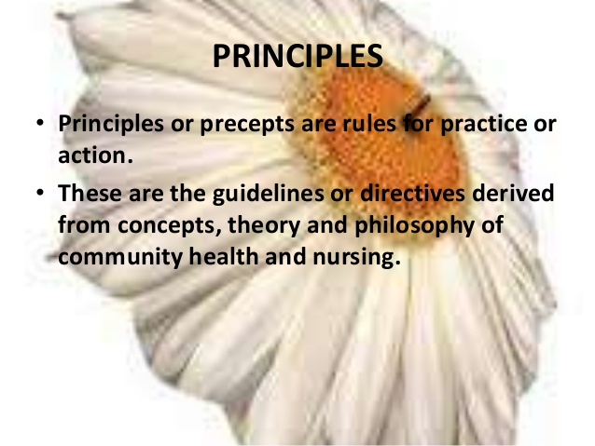

Slide 13
Notes:
WHY DO WE NEED PRINNCIPLES?

Slide 22
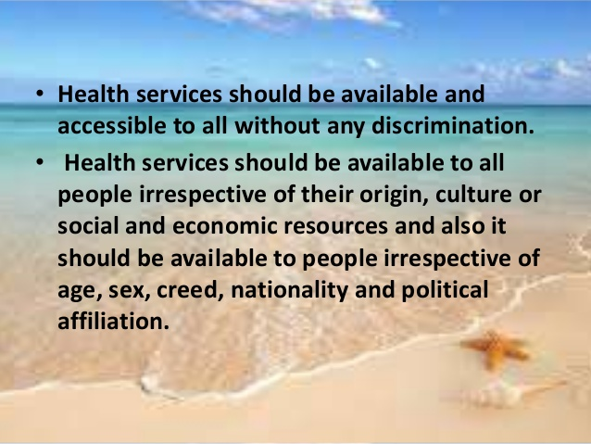

Slide 23
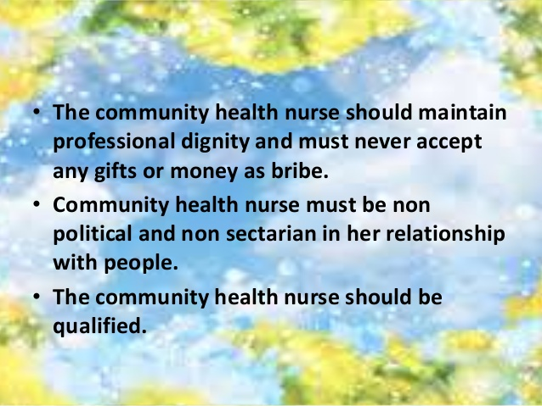

Slide 32
CHARACTERISTICS OF A SUCCESSFUL HEALTH PROGRAM
Effective rural health programs have key features that help make them successful. Not all programs need to have all of these characteristics, but these factors do help contribute to successful rural community health programs.

Slide 33
Evidence-based: evidence-based and promising practices are instrumental to having a strong program model. Evidence-based practice is conscientious, explicit, and judicious use of current best evidence in making decisions about care of the individual patient, program planning, and decision making for public health and healthcare. It means integrating individual clinical expertise with the best available evidence from systematic research.
Implementing a program with an evidence-based model can help guide rural practitioners to make decisions about which strategies will best address a particular problem. This can help avoid wasting time and resources implementing a less effective program. Multiple registries that review evidence-based and promising practices exist that can help communities identify program models that work for them.

Slide 34
COMMUNITY ENGAGEMENT: One key feature of successful programs is the engagement of many different stakeholders within a rural community. Programs that include a variety of different providers, agencies, and investors in their programs are typically more effective. The engagement from multiple levels of the community provides each rural health program with a connection to the community, increases knowledge about community issues, and shows that the program wants to address community problems.

Slide 35
STRONG PARTNERSHIPS: In addition to building support from the community, it is important for rural health programs to develop strong partnerships with other organizations. Organizations with similar missions can partner with each other and work together to achieve similar goals. Partnerships can also help to maximize the use and efficient allocation of resources, as well as provide expert opinions and community buy-in for rural health programs. Partnerships can be formed with local school systems, community-based organizations, hospitals, medical centers/clinics, or local government agencies. For example, several rural obesity programs have partnered with local schools to serve as implementation sites for their program, so that the program could more easily access obese youth populations.

Slide 36
SUSTAINABILITY PLANS: Sustainability is an important program component to address early in the planning and implementation stages, so that systems can be established to actually keep the program functioning and improving health in a community. A sustainability plan is a roadmap for achieving long-term goals and documents strategies to continue the program, activities, and partnerships. Sustainability can be defined in different ways—the sustainability of the values that the project promotes, the sustainability of relationships between organizations, and the sustainability of services.

Slide 37
EVALUATION SUPPORT: Evaluation is a key to helping determine program effectiveness. Some rural community health programs will have staff with evaluation expertise. Other programs may consider establishing a relationship with researchers at a local university to provide external feedback on program implementation, or evaluate the impact of the program. There are also organizations that specialize in program evaluation and technical assistance, which can provide similar service.

Slide 38
IDENTIFY AND TARGET COMMUNITY CHALLENGES AND ASSETS: A rural community will have challenges that are specific to their population based on resources, social determinants of health, and needs. If program implementers identify the existing challenges that impact the target population, as well as anticipated challenges with program implementation, they will be better prepared to combat those challenges when they arise. Similarly, if the program implementers are aware of community assets, they can leverage those assets in program activities.

Slide 39
Community problems
Group discussion

Slide 49
RELATIONSHIP BETWEEN INDIVIDUAL, FAMILY AND COMMUNITY

Slide 50
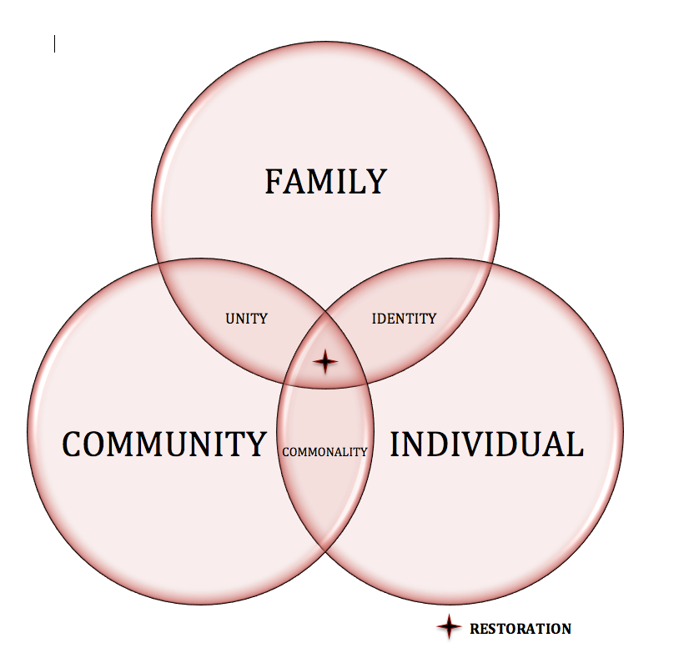

Slide 51
FAMILY HEALTH NURSING.
Family health care nursing is an art and a science that has evolved over the last 20 years as a way of thinking about and working with families.

Slide 52
INTRODUCTION
Family nursing comprises a philosophy and a way of interacting with clients that affects how nurses collect information, intervenes with patients, advocate for patients, and approach spiritual care with families. This philosophy and practice incorporates the assumption that health affects all members of families that health and illness are family events, and that families influence the process and outcome of health care.

Slide 53
TERMINOLOGIES
FAMILY: Two or more individuals coming from the same or different kinship groups who are involved in a continuous living arrangement, usually residing in the same household, experiencing common emotional bonds, and sharing certain obligations toward each other and toward others.

Slide 54
FAMILY HEALTH.
A condition including the promotion and maintenance of physical, mental, spiritual, and social health for the family unit and for individual family members.

Slide 55
FAMILY PROCESS
The ongoing interaction between family members through which they accomplish their instrumental and expressive tasks.
“””The nursing process considers the family, not the individual, as the unit of care.

Slide 56
FAMILY CENTERED NURSING:
Nursing that considers health of the family as a unit in addition to the health of individual family members.

Slide 57
FAMILY HEALTH NURSING
• Definition and meaning of family health nursing.
Family health nursing is a nursing aspect of organized family health care services which are directed or focused on family as the unit care with health as the goal. It is thus synthesis of nursing care and health care.

Slide 58
FAMILY HEALTH NURSING.
It helps to develop self care abilities of the family and promote, protect and maintain its health. Family health nursing is……
generalized, well balanced and integrated comprehensive and continuous are requiring comprehensive planning to accomplish its goal.

Slide 59
FAMILY HEALTH NURSING
The goals of the family health nursing include optimal functioning for the individual and for the family as a unit.

Slide 60
OBJECTIVES OF FAMILY HEALTH NURSING
The broad objectives of family health nursing are
• To identify health & nursing needs and problems of each family.
• To ensure family’s understanding and acceptance of these needs and problems.
• To plan and provide health and nursing services with the active participation of family members.
• To help families develop abilities to deal with their health needs and health problems independently.

Slide 61
OBJECTIVES CTD…
To contribute to family’s performance of developmental functions and tasks.
To help family make intelligent use of promotive, preventive, therapeutic and rehabilitative health and allied facilities and services in the community.
To educate, counsel and guide family members to cultivate good personal health habits, practice safe cultural practices and maintain wholesome physical, psychosocial, and spiritual environment.

Slide 64
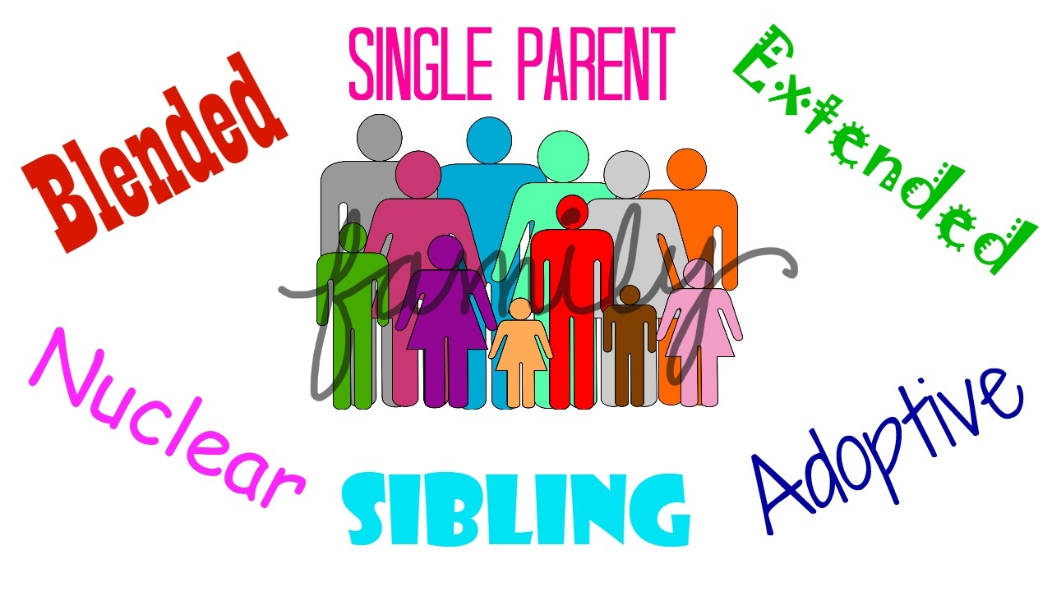
TYPES OF FAMILY

Slide 67
CHARACTERISTICS OF FAMILY
OUT OFDEFINITIONS THE FOLLOWING CHARACTRISTICS CAN BE DEDUCTED:-
1.A MATING RELATIONSHIP
A family comes into existence when a man and a woman establish mating relation between them. This relation may be of a shorter duration or lifelong. When the marital relations break up, the family disintegrates.

Slide 68
2.A SYSTEM OF NOMENCLATURE.
Every family is known by a name and has its own system of reckoning descent. Descent may be reckoned through the male line or through the female line. Usually the wife goes and joins her husband’s relatives but sometimes the husband also may go and join his wife’s relatives. There are said to be instances where annual alterations take place between the two systems, patrilocal and matrilocal

Slide 69
3 AN ECONOMIC PROVISION.
Every family needs an economic provision to satisfy the economic needs. The head of the family carries on certain profession and earns money to maintain the family

Slide 70
4. A COMMON HABITATION
A family requires a home or house-hold for its living. Without a dwelling place the task of child bearing and child rearing cannot be adequately performed.
The family thus is a biological unit implying institutionalized sex relationship between husband and wife. What distinguishes the family is that it results from the physiological union of two married persons who create the other members of the unit. Its members are biologically more closely related to one another through the process of reproduction than are the members of another group. It is based on the fact of sex having the production and nurture of children as its important function. Strictly defined, it consists of parents and children. It is both an association and institution. It is a universal institution found in every age and every society. It is the primary cell out of which the community develops.

Slide 71
5.A FORM OF MARRIAGE
Mating relationship is established through the institution of marriage. Marriage may be solemnized in a simple way or in a cerebration like manner with long processes. It may take any form, monogamous or polygamous. Partners may be selected by parents or by elders or the choice may be to the wishes of the individuals concerned.

