Slide 1
COMPLICATIONS OF OTITIS MEDIA

Slide 2
OUTLINE
Introduction
Epidemiology
Anatomy
Pathophysiology
Classification
Controversies
Future
References

Slide 3
INTRODUCTION
Complications of otitis media result from its spread from the middle ear cleft to adjacent structures.
Have high morbidity and mortality16%¹
21000 pple die yearly²
More likely to occur in chronic and recurrent infections.
Wanna gb et al 2010. Contemporary management of complications of otitis media
Institute of maternal and child health Trieste Italy UN/WHO

Slide 4
EPIDEMIOLOGY
Overall incidence has reduced with the advent of antibiotics.
Pre antibiotic era (25-50% )post(0.02%)³
Low SES⁴
80% extracranial, 70% intracranial
Black vs non black²⁹
3.Kangsnarak 1993 Intracranial complications of suppurative otitis media
4.Oconnor 2009 Medical journal of Australia
29.Jenson 2015, Ethnicity and treatment of Otitis media

Slide 5
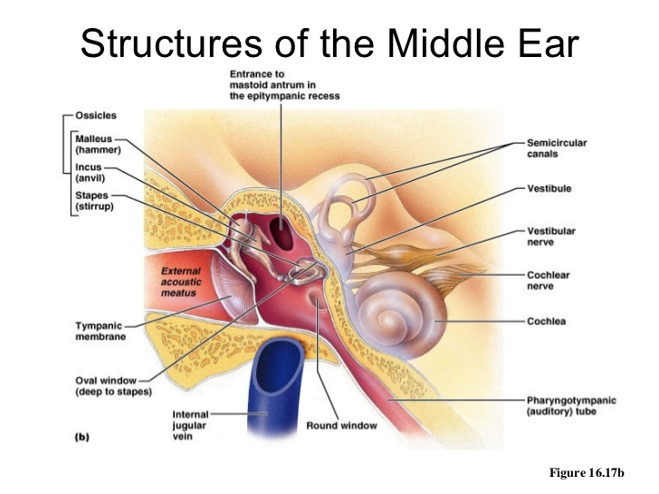
ANATOMY

Slide 6
PATHOPHYSIOLOGY
PATHWAYS OF INFECTION
Natural communications
Direct erosion of bone.
Abnormal preformed pathways.
Vascular channels

Slide 7
PATHOPHYSIOLOGY
PREDISPOSING FACTORS
Virulence of organism
Patient attributes
Adequacy of treatment
Obstruction of drainage
Cholesteatoma formation

Slide 8
CLASSIFICATION
INTRACRANIAL
-Extradural
-Intradural
EXTRACRANIAL
-Extratemporal
-Intratemporal

Slide 9
INTRACRANIAL
EXTRADURAL | INTRADURAL
Extradural abscess | Subdural abscess
Meningitis | Brain abscess
Lateral sinus thrombosis CSF Otorrhea | Otitic hydrocephalus

Slide 10
EXTRACRANIAL
EXTRATEMPORAL | INTRATEMPORAL
Lucs abscess | Facial palsy
Citelli abscess | Mastoiditis
Bezolds abscess | Labyrinthitis
 | Petrositis
 | Subperiostal abscess

Slide 11
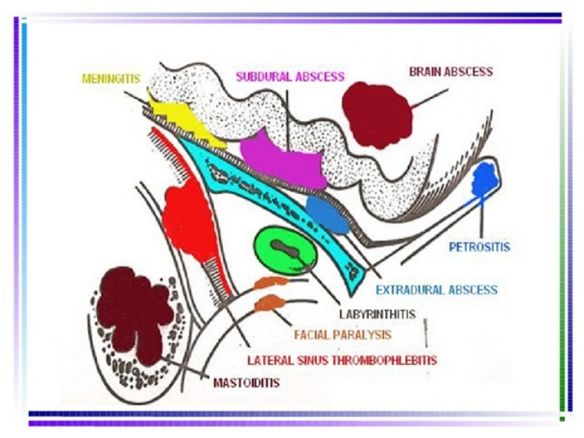

Slide 12
Bacteriology
 | AOM | COM
CHILDREN | S.Pneumonia,H.Influenza M.Catarrhalis, S.aureus | P.aeruginosa, proteus, E.coli, S.aureus, Klebsiella,Bacteriodes
ADULTS | S.pneumoniae, H.Influenza, M.Catarrhalis, S.aureus | P.aeruginosa, proteus, E.coli, S.aureus, Klebsiella,Bacteriodes

Slide 13
BACTERIOLOGY
BACTERIA | KNH 2009 | GARISSA 2013
Staphylococcus aureus | 39% | 12.8%
Pseudomonas aeroginosa | 36% | 11.3%
Proteus spp | 6% | 32.7%
Enterococcus | - | 28.6%
E.coli | 6% | -
5. E.Mwaniki2009 Evaluation of bacterial flora and antimicrobial susceptability at KNH
6. H.Obura, I. macharia, p.mugwe2013 Bacteriology of CSOM in children in Garrissa

Slide 14
MASTOIDITIS
ACUTE MASTOIDITIS
Can occur when acute otitis media fails to resolve.
Oral antibiotics – lack of bony penetrance⁷
Occurs in approx. 1/3 of pts with recurrent AOM ⁸
7. Spartley et al 2000 Acute mastoiditis in children
8. Luntz et al 2001 Acute mastoiditis- the antibiotic era; a multicentre study

Slide 15
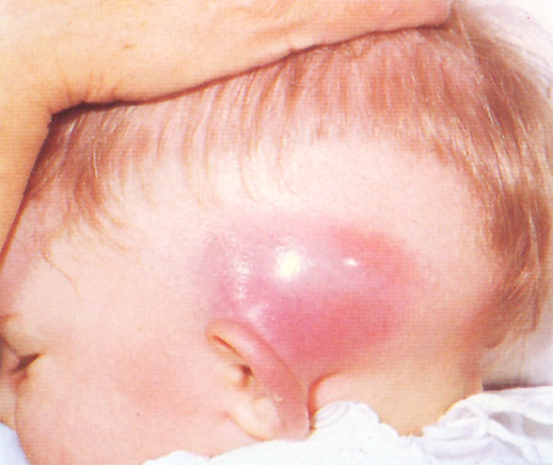
Symptoms
Pain, otorrhea
Signs
Mastoid tenderness
Auricular protusion
Bulging TM
Management
IV antibiotics
Drainage of abscess⁹
9. Bauer 2002

Slide 16
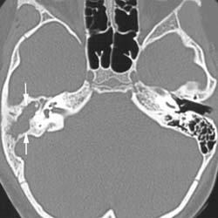
COALESCENT MASTOIDITIS
Persistence of AOM and mastoiditis for 2-4wks
Signs sagging of eac
Mnx – Iv antibiotics
-mastoidectomy

Slide 17
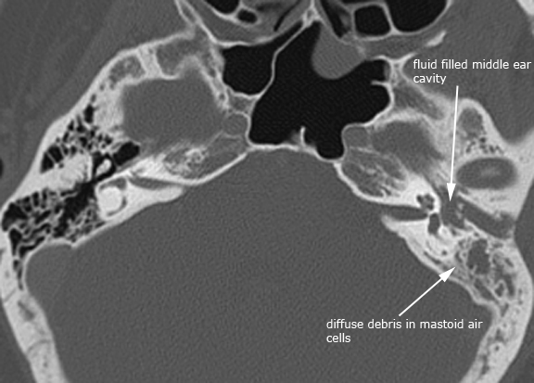
CHRONIC MASTOIDITIS
Associated with
Longstanding TM perforation
Cholesteatoma.
Complaints subtle

Slide 18
Management
Intact canal wall mastoidectomy
Modified radical mastidectomy
Tympanoplasty +/- canaloplasty
Revision mastoidectomy
Second stage ossicular reconstruction

Slide 19
SUBPERIOSTAL ABSCESS
Purulent material from mastoid empyema tracks from the mastoid tip into potential space beneath the periosteum.
Most common site – post auricular – through haematogenous spread – macewens triangle
S/S – anteroinferior displacement of pinna, pain, fever, otorrhea

Slide 20
Investigations – CT scan
Management
IV antibiotics for 5-7days then orals for 5-7 days. Drug resistance¹⁰
Abscess drainage and mastoidectomy
10.Ongkasuwan 2008 Pneumoccal mastoiditis in children

Slide 21
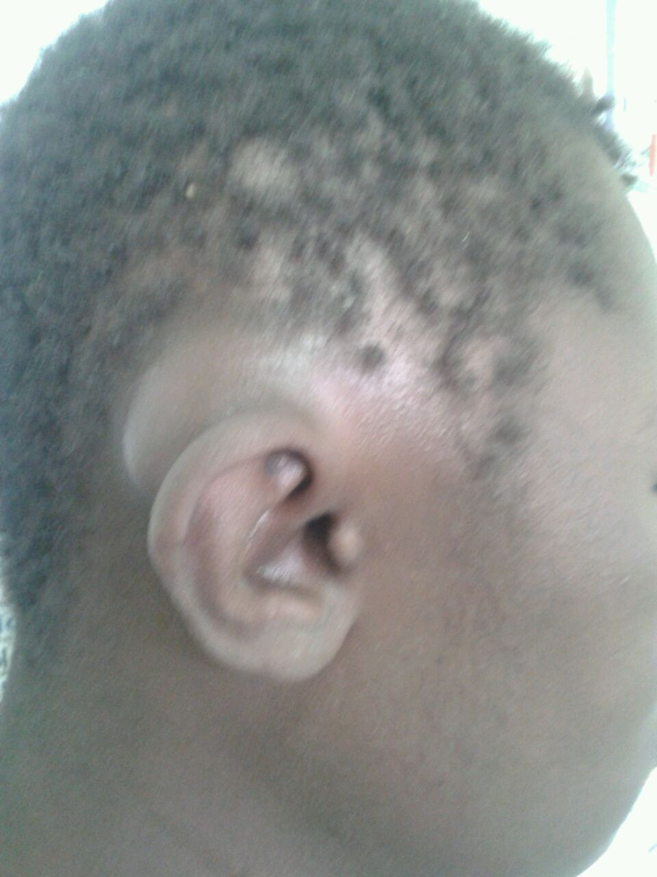
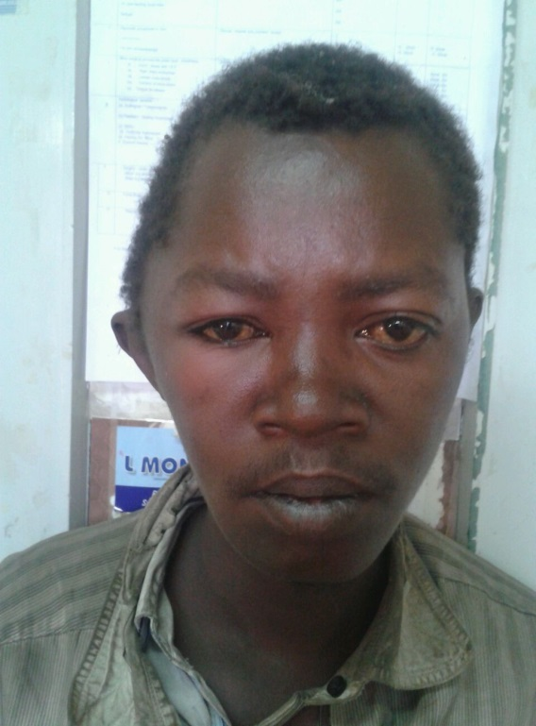
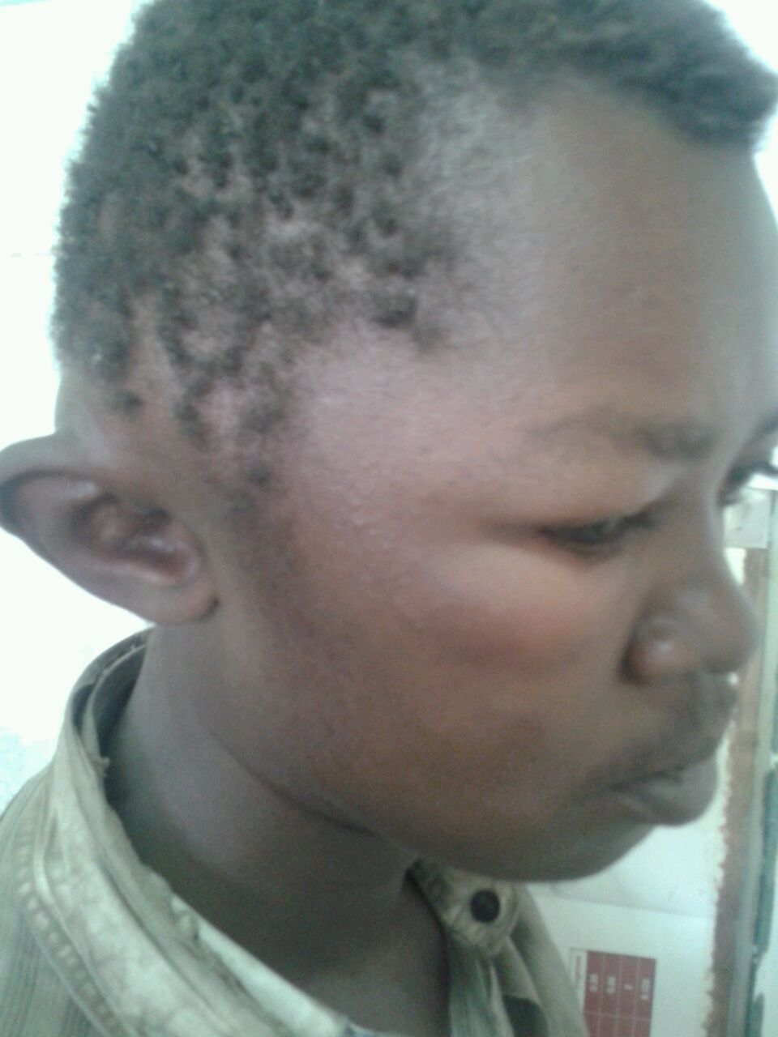

Slide 22
Bezolds abscess – Occurs when there is perforation of mastoid tip into digastric groove.
Lucs abscess – collection of pus within the temporalis muscle.
Citelli’s abscess – behind mastoid towards the occipital region
Parapharyngeal/Retropharyngeal abscess

Slide 23
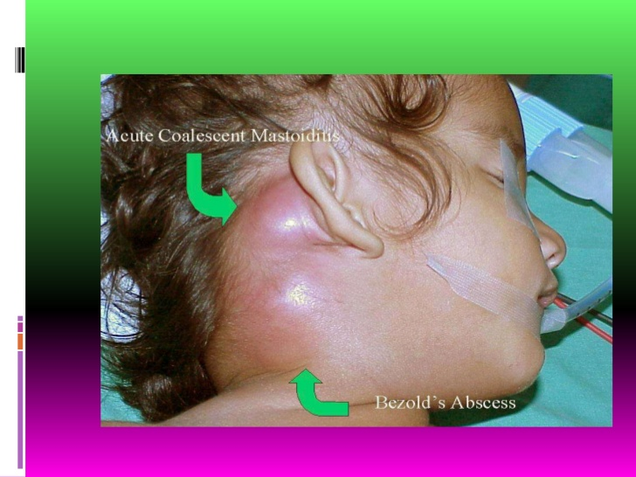

Slide 24
LABYRINTHITIS
Schuknecht 1993 | Bluestone 2002
Serous(toxic) | Acute
Suppurative | Subacute
Meningogenic suppurative | Chronic
 | Labyrinthitis ossificans
11. Schuknecht hf 1993 Pathology of the ear; Lea and Febriger
12. Bluestone CD Gates 2002 classification of otitis media and its complications
Notes:
Schuknecht HF ; Pathology of the ear 2nd ed Philadelphia. Lea and Febiger 1993
Bluestone CD Gates GA Seventh international symposium in recent advances in otitis media

Slide 25
Acute serous – fluctuating SNHL +/- vertigo
- presence of nystagmus
Acute suppurative – sudden onset vertigo, nausea, vomiting and deep seated pain.
Chronic – common with cholesteatoma
- fistula formation in lateral scc
- gradual onset vertigo, tinnitus, HL
Notes:
Nausea vomiting and deep seated pain is absent

Slide 26
DIAGNOSIS
Labyrinthine fistula test
Electronystagmography
CT scan
MANAGEMENT
IV Antibiotics
Steroids
Surgery – ventilation tubes¹³, mastoidectomy, labyrinthectomy
Vestibular rehabilitation
13.Chul ho jang 2005 case report

Slide 27
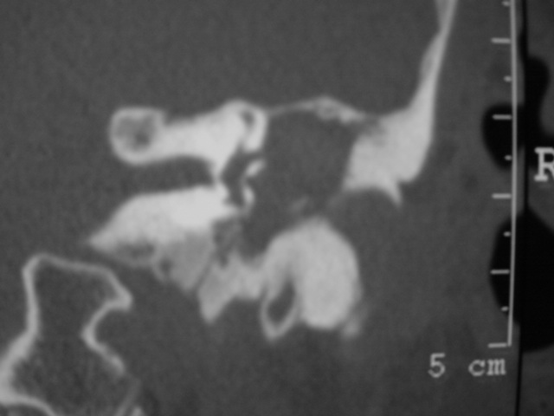

Slide 28
FACIAL NERVE PALSY
Can present as one of the earliest signs of otitis media.
Dehiscence of fallopian canal

Slide 29
Management
Medical – antibiotics, steroids¹⁵
Recovery HBI – 85%, HBII – 15%¹⁴
Mastoidectomy – subperiostal abscess, coalescent mastoiditis
Surgical decompression¹⁶
14. Sau Paulo 2009 University of Sau paulo
15. Brikena, 2012 Balkan medical journal
16. Goldstein 1998

Slide 30
PETROSITIS
Infection of the middle ear and mastoid into the petrous part of the temporal bone.
Acute or chronic
Gradenigo syndrome
Retro-orbital pain
Abducens nerve palsy
Aural discharge

Slide 31
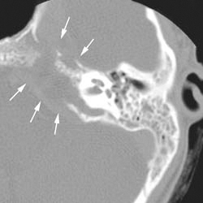
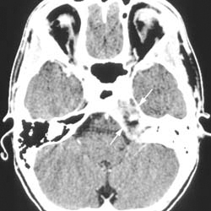
Diagnosis – CT scan¹⁷
Management
IV antibiotics
Mastoidectomy
Petrosectomy
Staged approach¹⁸
17. Cocker and jenkins 2001
18. Nelly and wallace 2001

Slide 32
MENINGITIS
Inflammation of the meninges secondary to middle ear infection
Incidence
2.0% of complications¹⁹
Major sequale
Minor sequale
19. Ghaffar et al 2001 Acute mastoiditis in children

Slide 33
Pathogenesis
Direct invasion through the bony wall of the middle ear/mastoid
Spread from the middle ear to the inner ear to cerebrospinal fluid.
Sympathetic inflammatory response to infection from adjacent space

Slide 34
SYMPTOMS | SIGNS
Fever and irritability | Bulging fontanelle
Lethargy and vomiting | Kerning’s/Brudzinski’s sign
Previous hx of otalgia and otorrhoea | Cranial nerve palsy
Headache and neck stiffness | Hemiplagia and hemiparesis
Anorexia | Bulging opacified TM with red/yellow discoloration Mastoiditis – erythema/swelling behind ear Otorrhea

Slide 35
Investigations – LP, CT scan(brain,temporal region)
Management
IV antibiotics – 3rd generation cephalosporins and vancomycin – strep pneumoniae
Steroids protect against deafness^{20,21} no benefit²²
cortical mastoidectomy.
20. Odio et al 1991 Beneficial effects of early dexamethasone in menengitis
21. Wald et al 1995 Dexamethasone therapy for bacterial menengitis in children
22. De gans van boek 2002 Dexamethasone in adults with bacterial menengitis

Slide 36
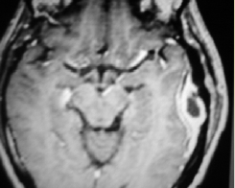
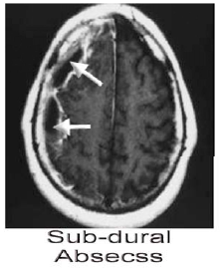
EXTRADURAL/SUBDURAL ABSCESS
Epidural abscess- collection of pus/granulation tx btw dura and temporal bone.
Subdural abscess- collection of pus btw dura and arachnoid.

Slide 37
Symptoms/Signs
EPIDURAL | SUBDURAL
Headache | Headache
Otorrhea- creamy profuse pulsatile | Fever
Fever | CNS manifestations of seizures, somnolence, neck stiffness, photophobia and motor deficits
Otalgia

Slide 38
Management
Epidural
IV antibiotics
Radical/Modified Radical Mastoidectomy
Canal wall down mastoidectomy- if large cholesteatoma firmly adheres to dura.
Notes:
When drilling in suspected cases, bones over tegmen and sigmoid is thinnned to examine underlying dura
Grommets-if TM is intact and inadequate ventilation

Slide 39
Subdural
Neurosurgeons take lead role
IV antibiotics , anticonvulsants
Evacuation of abscess – craniotomy, burr holes
Mastoidectomy¹⁸
18. Nealy and wallace 2001 Surgery of acute infections and their complications
Notes:
Craniotomy – better exposure mayb more loculated and tenaciuis than expected Burr holes- less morbidity
Non surgical approach – preserved mental status, nonfocal neurological deficit, localized limited pus, rapid clinical improvement

Slide 40
BRAIN ABSCESS
Infection within the brain parenchyma
Incidence
0.04-0.15%²³
33% of all intracranial complications³
Assoc with high morbidity and mortality rate
Common- temporal lobe, cerebellum²⁴
23. Delbrouk et al 1996 Mansbach AL, Acta Otorhinolaryngology
24. Sennarolgou L et al. Otogenic brain abscess review of 41 cases
3. Kangsnarak et al 1993 Intracranial comlications of CSOM
Notes:
Erosion of tegmen tympani – temporal lobe abscess
Erosion of trautmanns triangle – cerebellar abscess and sigmoid sinus

Slide 41
Symptoms
Otorrhea
Headache, fever, vomiting, irritability, change in consciousness
Signs
Temporal abscess – visual field defects, aphasia, seizure
Cerebellar abscess – vertigo, nystagmus, ataxia

Slide 42
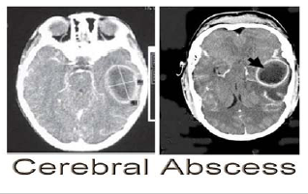
Diagnosis – CT scan, MRI
Management
IV antibiotics
Neurosurgical drainage
Mastoidectomy
Stability of pt
Obstructing granuloma or polyps
Concommitant complication
Notes:
Mastoidectomy – when pt is stable--

Slide 43
LATERAL SINUS THROMBOSIS
First described in 1826 by Lebert
A perisinus abscess is formed which causes inflammation of the outer and inner wall of the sinus and mural thrombus formation.

Slide 44
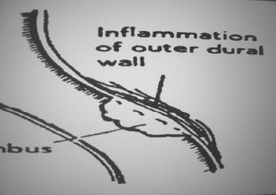
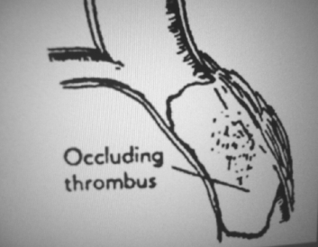
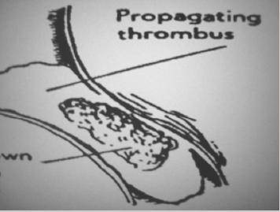

Slide 45
High index of suspicion
Symptoms
Fever – picket fence fever
Aural discharge
Headache
Signs
Griensinger sign – mastoid tenderness and edema
Cranial nerve palsy IX, X, XI – jugular foramen syndrome
Tobey – Ayer- Queckenstedt test
CT scan – delta sight, MRI – blood flow occlusion

Slide 46
Management
IV antibiotics
No role for anticoagulants²⁵vs use²⁶
Cortical mastoidectomy
Canal wall down mastoidectomy if presence of cholestatoma
25. Southwick 1986
26. Sharma 2015 case presentation

Slide 47
OTITIC HYDROCEPHALUS
Assoc. with otitis media with increased intracranial pressure and normal CSF findings.
Exact pathogenesis unknown²⁷
Increased production of CSF
Increased cerebral blood flow and volume
Change in blood brain barrier
Increased resistance to CSF outflow.
27. Komorsky 2001 Pseudotumor cerebri

Slide 48
Symptoms
10% asymptomatic²⁷
Headache, visual disturbances, retrobulbar pain.
Signs
Cranial nerve palsies III, IV, VI.
Diagnosis
CT scan, MRI
27. Komorsky et al 2001 Pseudotumor cerebri

Slide 49
Management
Spontaneous recovery
IV antibiotics
Medical – corticosteroids, hyperosmolatic agents (acetazolamide), furosemide.
Mastoidectomy
Serial lumbar punctures/lumbar drain
Ventriculoperitoneal/Lumboperitoneal shunts.

Slide 50
CSF OTORRHEA
Results from defect in tegmen tympani
Otorrhea – clear fluid
Herniation of intracranial contents
CT scan – will show defect, presence of cholesteatoma
Repair of defect through mastoidectomy

Slide 51
CONTROVERSIES
Aspiration of thrombi in lateral sinus thrombosis
Use of anticoagulants in LST^{25,26}
Use of corticosteroids in meningitis^{21,22}
Mastoidectomy and intracranial abscess- one sitting or staged.

Slide 52
FUTURE
Different drug delivery method²⁸
Vaccines development
Eustachian tuboplasty
28. Yadau 2014

Slide 53
REFERENCES
Wanna GB 2010 University of vanderbilt
UN/WHO Institute of maternal and child health Italy
Kangsnarak et al, Navacharoven N, Foovonant S, Ruchkphaopont K. Intracranial complications of suppurative otitis media; 13 years experience.Am J Otol 1995;16;104;9
Medical Journal of Australia 2009, Indeginous vs non-Indigenous populations in complications of otitis media
Erastus mwaniki 2009 thesis evaluation and bacterial flora and antimicrobial susceptability of CSOM at Kenyatta National Hospital
Bacteriology of CSOM in children in Garrissa District. H Oburra, I Macharia, P.Mugwe, Dickens SO Oduda
Spartley J, Silvera H, Alvarez I, Pais-clemente M. Acute mastoiditis in children; Review of current status. Int.J Pediatric. Otorrhinolaryngol 2000;56;33-40
Luntz M, Keren G, Nusem et al.Acute mastoiditis-the antibiotic era; a multicentre study.Int J paeds Otorhinolaryngology 2001
Bauer 2002
Ongkasowan 2008. Emergence of multi drug resistance serotype 19A.
Schuknecht HF; Pathology of the ear. 2ned.Philadelphia – Lea and Febrigrer 1993
Bluestone CD, Gates GA, Klein 30 et al committee report; terminology and classification of otitis media and its complications and sequale. Seventh International Symposium in Recent Advances in Otitis Media 2002.
Chol ho jang 2005. Case report
Sao Paulo 2009 Revista Brasileira de Otorrhinlaringologia
Brikena 2012, Balkan medical journal
Goldstein NA, Casselbrant ML, Bluestone CD, Kurs-Lasky M. Intratemporal complications of acute otitis media in infants and children. Otol Head Neck Surg 1998;119;144-54

Slide 54
17. Cocker NJ, Jenkins HA; Atlas of otologic surgery, Philadelphia WB, Saunders 2001
18. Neely JG, Wallace MS. Surgery of acute infections and their complications In. Brachmann DE, Shellon C, Arriaga MA Otologic surgery 2nd ed. Philadelphia, WB Saunders 2001
19. Ghaffar FA, Wodermann M, McCracken GH Jr. Acute mastoiditis in children; a seventeen year experience in Dallas Texas. Pediatric infection Dis J2001; 20
20.Odio CM, Faingezicht I, Paris M et al. The beneficial effects of early dexamethasone administration in infants and children with bacterial meningitis N Engl J Med 1991;324;1525-31
21.Wald ER, Kaplan S, Maron E et al. Dexamethasone therapy for bacterial meningitis in children. Pediatrics 1995; 95;21-8.
22. De Gans JD, van de Beek D. Dexamethasone in adults with bacterial meningitis.N Engl J Med 2002;347; 1549-56
23. Delbrouck C, Mansbach AL, Blonbiou p. Otogenic thrombosis of the lateral sinus. Acta Otol 1996;50;221 – 6
24. Sennaroglu L, Sojeri B. Otogenic brain abscess review of 41 cases. Otol Head Neck Surg 2000;123;751-5
25. Southwick FS, Richardson EP Js, Swartz MN. Septic thrombosis of the dural venous sinuses 1986
26.Sharma 2015 case presentation
27.Komorsky G, Pseudotumor cerebri. Neurosurg clinic Am2001
28. Yadau 2014
29. Ethnicity and complications of otitis media 2015

