Slide 1
COPD
Chronic obstructive pulmonary disease

Slide 2
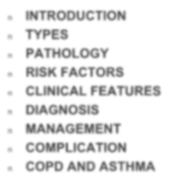
Outline
n INTRODUCTION
n TYPES
n PATHOLOGY
n RISK FACTORS
n CLINICAL FEATURES
n DIAGNOSIS
n MANAGEMENT
n COMPLICATION
n COPD AND ASTHMA

Slide 3
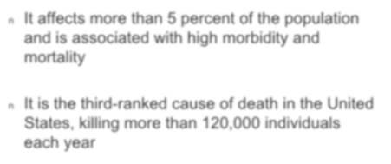
INTRODUCTION
n It affects more than 5 percent of the population and is associated with high morbidity and mortality
n It is the third-ranked cause of death in the United States, killing more than 120,000 individuals each year

Slide 4
Burden of COPD
The burden of COPD is projected to increase in coming decades due to continued exposure to COPD risk factors and the aging of the world’s population.
COPD is associated with significant economic burden.
© 2015 Global Initiative for Chronic Obstructive Lung Disease

Slide 5
Definition of COPD
COPD, a common preventable and treatable disease, is characterized by persistent airflow limitation that is usually progressive and associated with an enhanced chronic inflammatory response in the airways and the lung to noxious particles or gases.
© Global Initiative for Chronic Obstructive Lung Disease

Slide 6
COPD includes
Chronic Bronchitis
Emphysema

Slide 7
Chronic bronchitis
Defined as a chronic productive cough for three months in each of two successive years in a patient in whom other causes of chronic cough have been excluded

Slide 8
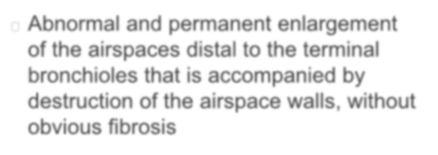
Emphysema
Abnormal and permanent enlargement of the airspaces distal to the terminal bronchioles that is accompanied by destruction of the airspace walls, without obvious fibrosis

Slide 9
PATHOLOGY

Slide 10
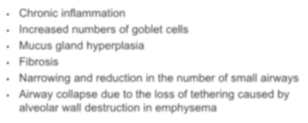
Airways
Chronic inflammation
Increased numbers of goblet cells
Mucus gland hyperplasia
Fibrosis
Narrowing and reduction in the number of small airways
Airway collapse due to the loss of tethering caused by
alveolar wall destruction in emphysema

Slide 11
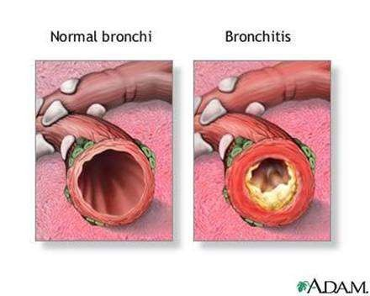

Slide 12
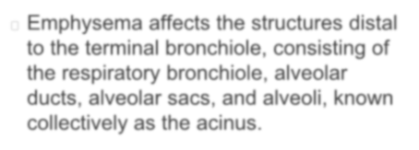
Lung Parenchyma
Emphysema affects the structures distal to the terminal bronchiole, consisting of the respiratory bronchiole, alveolar ducts, alveolar sacs, and alveoli, known collectively as the acinus.

Slide 13
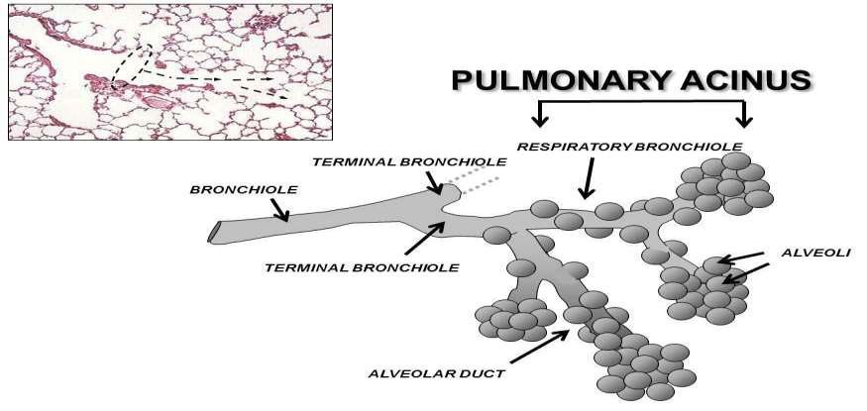
Normal Acinus

Slide 14
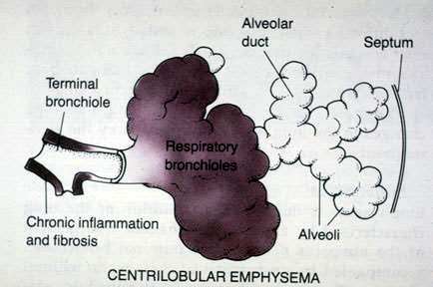
Subtype of emphysema.
Centrilobular emphysema (Proximal acinar)
Abnormal dilation or destruction of the respiratory bronchiole, the central portion of the acinus. It is commonly associated with cigarette smoking,

Slide 15
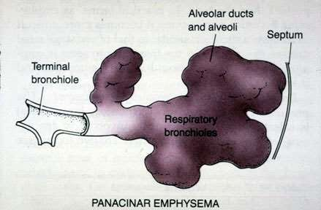
Panacinar emphysema
Refers to enlargement or destruction of all parts of the
acinus.
Seen in alpha-1 antitrypsin deficiency and in smokers

Slide 16
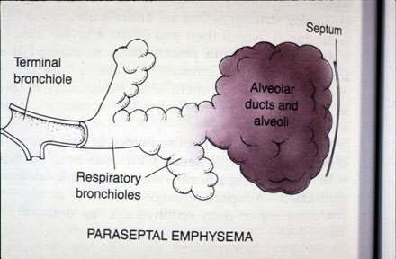
Paraseptal emphysema
Distal acinar - the alveolar ducts are predominantly affected.

Slide 17
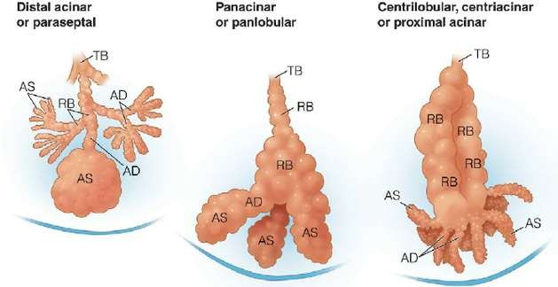
Emphysema

Slide 18
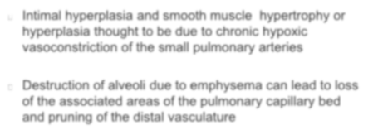
Pulmonary vasculature
Intimal hyperplasia and smooth muscle hypertrophy or hyperplasia thought to be due to chronic hypoxic vasoconstriction of the small pulmonary arteries
Destruction of alveoli due to emphysema can lead to loss of the associated areas of the pulmonary capillary bed and pruning of the distal vasculature

Slide 20
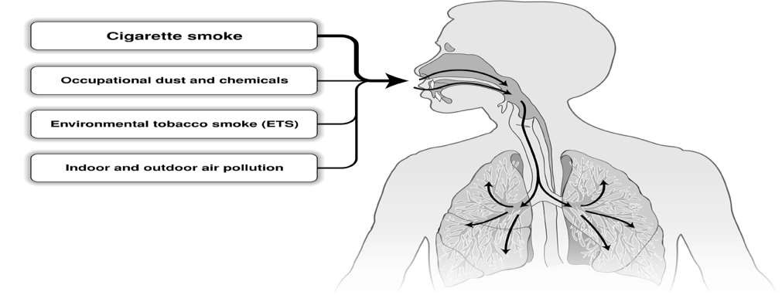
Risk Factors for COPD
Genes
Infections
Socio-economic status
Aging Populations
© 2015 Global Initiative for Chronic Obstructive Lung Disease

Slide 21
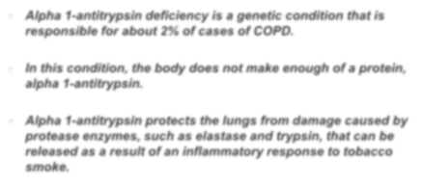
Genetics
Alpha 1-antitrypsin deficiency is a genetic condition that is
responsible for about 2% of cases of COPD.
In this condition, the body does not make enough of a protein, alpha 1-antitrypsin.
Alpha 1-antitrypsin protects the lungs from damage caused by protease enzymes, such as elastase and trypsin, that can be released as a result of an inflammatory response to tobacco smoke.

Slide 22
Symptoms of COPD
The characteristic symptoms of COPD are chronic and progressive dyspnea, cough, and sputum production that can be variable from day- to-day.
Dyspnea:
Progressive, persistent and characteristically worse with
exercise.
Chronic cough: May be intermittent and may be unproductive.
Chronic sputum production: COPD patients commonly cough up sputum.
© 2015 Global Initiative for Chronic Obstructive Lung Disease

Slide 23
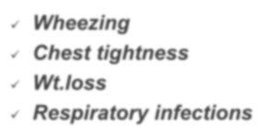
Other Clinical features
Wheezing
Chest tightness
Wt.loss
Respiratory infections

Slide 24
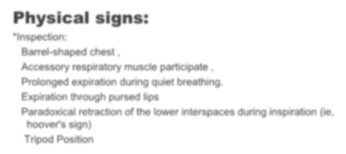
Physical signs:
*Inspection:
Barrel-shaped chest ,
Accessory respiratory muscle participate , Prolonged expiration during quiet breathing. Expiration through pursed lips
Paradoxical retraction of the lower interspaces during inspiration (ie, hoover's sign)
Tripod Position

Slide 25
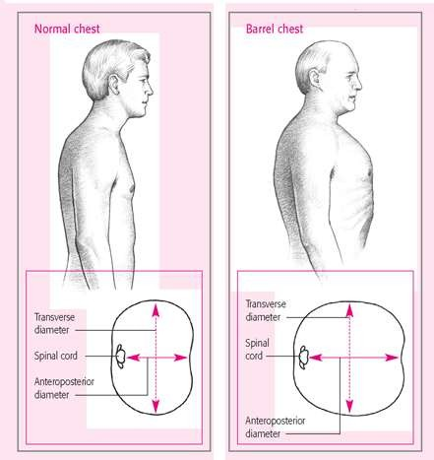

Slide 26
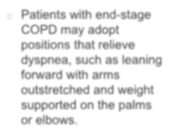
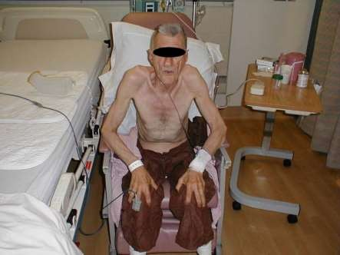
Tripod Position
Patients with end-stage COPD may adopt positions that relieve dyspnea, such as leaning forward with arms outstretched and weight supported on the palms or elbows.

Slide 27
Clinical Manifestation
*Palpation:
Decreased fremitus vocalis
*Percussion :
Hyperresonant
Depressed diaphragm,
Dimination of the area of absolute cardiac dullness.
*Auscultation:
Prolonged expiration ；
Reduced breath sounds;
The presence of wheezing during quiet breathing
Crackle can be heard if infection exist.

Slide 28
Diagnosis of COPD
EXPOSURE TO RISK FACTORS
tobacco
occupation indoor/outdoor pollution
SYMPTOMS
shortness of breath
chronic cough sputum
è
SPIROMETRY: Required to establish diagnosis
© 2015 Global Initiative for Chronic Obstructive Lung Disease

Slide 29
Diagnosis
The presence of a post-bronchodilator FEV1/FVC < 0.70 confirms the presence of persistent airflow limitation and thus of COPD.
© 2015 Global Initiative for Chronic Obstructive Lung Disease

Slide 30
Spirometry: Normal Trace Showing FEV₁ and FVC
FVC
5
Volume, liters
4
FEV₁ = 4L FVC = 5L
FEV₁/FVC = 0.8
3 4 5 6
Time, sec
3
2
1
1 2
© 2015 Global Initiative for Chronic Obstructive Lung Disease

Slide 31
Spirometry: Obstructive Disease
5
4
3
2
1
Normal
Volume, liters
FEV₁ = 1.8L FVC = 3.2L FEV₁/FVC = 0.56
2 3 4 5 6
Time, seconds
Obstructive
1
© 2015 Global Initiative for Chronic Obstructive Lung Disease

Slide 32
Classification of Severity of Airflow Limitation in
COPD*
In patients with FEV₁/FVC < 0.70:
FEV₁ > 80% predicted
50% < FEV₁ < 80% predicted
30% < FEV₁ < 50% predicted FEV₁ < 30% predicted
GOLD 1: Mild
GOLD 2: Moderate
GOLD 3: Severe
GOLD 4: Very Severe
*Based on Post-Bronchodilator FEV₁
© 2015 Global Initiative for Chronic Obstructive Lung Disease

Slide 33
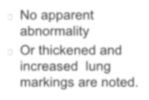
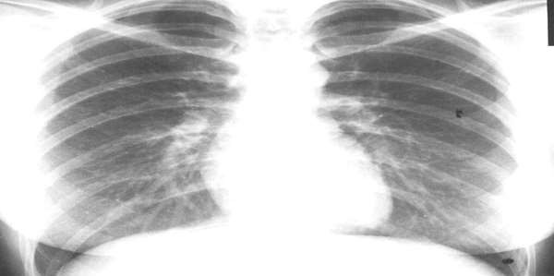
Chest x-ray-Chronic bronchitis
No apparent abnormality
Or thickened and increased lung markings are noted.

Slide 34
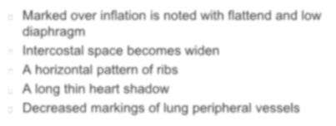
Chest X-Ray --emphysema
Marked over inflation is noted with flattend and low diaphragm
Intercostal space becomes widen
A horizontal pattern of ribs A long thin heart shadow
Decreased markings of lung peripheral vessels

Slide 35
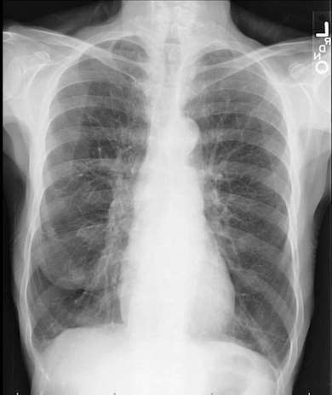

Slide 36
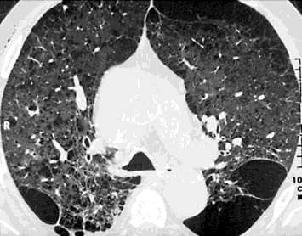
CT(Computed tomography)
Greater sensitivity and specificity for emphysema For evaluation of bullous disease

Slide 37
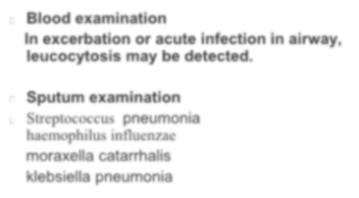
Labortory Examination
Blood examination
In excerbation or acute infection in airway,
leucocytosis may be detected.
Sputum examination
Streptococcus pneumonia
haemophilus influenzae
moraxella catarrhalis
klebsiella pneumonia

Slide 38
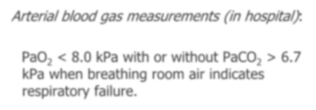
Arterial blood gas measurements (in hospital):
PaO₂ < 8.0 kPa with or without PaCO₂ > 6.7 kPa when breathing room air indicates respiratory failure.

Slide 39
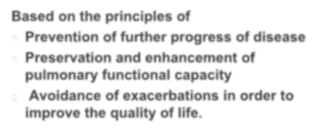
Management
Based on the principles of
Prevention of further progress of disease
Preservation and enhancement of pulmonary functional capacity
Avoidance of exacerbations in order to improve the quality of life.

Slide 40
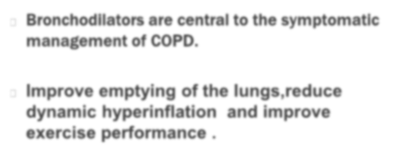
1.Bronchodilators
Bronchodilators are central to the symptomatic management of COPD.
Improve emptying of the lungs,reduce dynamic hyperinflation and improve exercise performance .

Slide 41
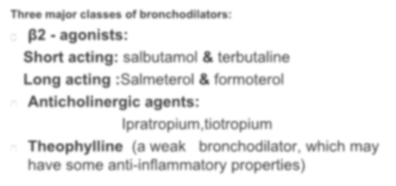
Bronchodilators
Three major classes of bronchodilators:
β2 - agonists:
Short acting: salbutamol & terbutaline Long acting :Salmeterol & formoterol Anticholinergic agents:
Ipratropium,tiotropium
Theophylline (a weak bronchodilator, which may have some anti-inflammatory properties)

Slide 42
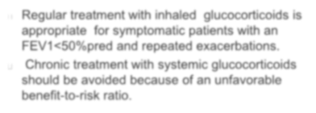
2.Glucocorticoids
Regular treatment with inhaled glucocorticoids is appropriate for symptomatic patients with an FEV1<50%pred and repeated exacerbations.
Chronic treatment with systemic glucocorticoids should be avoided because of an unfavorable benefit-to-risk ratio.

Slide 43
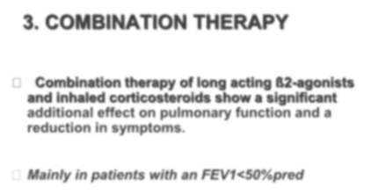
3. COMBINATION THERAPY
Combination therapy of long acting ß2-agonists and inhaled corticosteroids show a significant additional effect on pulmonary function and a reduction in symptoms.
Mainly in patients with an FEV1<50%pred

Slide 44
4.Others:
Antioxidant agents Mucolytic

Slide 45
Phosphodiesterase-4 Inhibitors
In patients with severe and very severe COPD (GOLD 3 and 4) and a history of exacerbations and chronic bronchitis, the phospodiesterase-4 inhibitor, roflumilast, reduces
exacerbations treated with oral glucocorticosteroids.
© 2015 Global Initiative for Chronic Obstructive Lung Disease

Slide 46
Other Pharmacologic Treatments
Influenza vaccines can reduce serious illness.
Pneumococcal
polysaccharide vaccine is recommended for COPD patients 65 years and older and for COPD patients younger than age 65 with an FEV1 < 40% predicted.
The use of antibiotics, other than for treating infectious exacerbations of COPD and other bacterial infections, is currently not indicated.
© 2015 Global Initiative for Chronic Obstructive Lung Disease

Slide 47
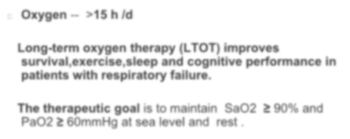
Oxygen Therapy
Oxygen --
>15 h /d
Long-term oxygen therapy (LTOT) improves survival,exercise,sleep and cognitive performance in patients with respiratory failure.
The therapeutic goal is to maintain SaO2 ≥ 90% and
PaO2 ≥ 60mmHg at sea level and rest .

Slide 48
Other Treatments
Pulmonary rehabilitation
Nutrition
Surgery:
Bullectomy
Lung volume reduction surgery
Lung transplantation

Slide 49
Smoking cessation
Smoking cessation has the greatest capacity to influence the natural history of COPD
Pharmacotherapy and nicotine replacement reliably increase long-term smoking abstinence rates.
© 2015 Global Initiative for Chronic Obstructive Lung Disease

Slide 50
Smoking Cessation
Nicotine replacement therapy (nicotine gum, inhaler, nasal spray, transdermal patch, sublingual tablet, or lozenge) as well as pharmacotherapy with varenicline, bupropion, and nortriptyline reliably increases long-term smoking abstinence rates and are significantly more effective than placebo.
© 2015 Global Initiative for Chronic Obstructive Lung Disease

Slide 51
Brief Strategies to Help the Patient Willing to Quit Smoking
ASK - -Systematically identify all tobacco users at every
visit
ADVISE - Strongly urge all tobacco users to quit
ASSESS - Determine willingness to make a quit attempt
ASSIST - Aid the patient in quitting
ARRANGE - Schedule follow-up contact.
© 2015 Global Initiative for Chronic Obstructive Lung Disease

Slide 52
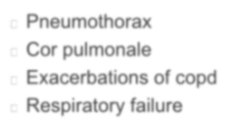
Complications
Pneumothorax Cor pulmonale
Exacerbations of copd Respiratory failure

Slide 53
COPD Comorbidities
COPD patients are at increased risk for: Cardiovascular diseases Osteoporosis
Respiratory infections Anxiety and Depression Diabetes
Lung cancer
Bronchiectasis
These comorbid conditions may influence mortality and hospitalizations
and should be looked for routinely, and treated appropriately.
© 2015 Global Initiative for Chronic Obstructive Lung Disease

Slide 54
COPD and Asthma
COPD
l Onset in mid-life
l Symptoms slowly
progressive
l Long smoking history
ASTHMA
lOnset early in life (often childhood) lSymptoms vary from day to day lSymptoms worse at night/early morning
lAllergy, rhinitis, and/or eczema also present
lFamily history of asthma
© 2015 Global Initiative for Chronic Obstructive Lung Disease

