Slide 1
Cardiopulmonary resuscitation (CPR)
Samuel Ngigi K.
KMTC

Slide 2

Cardiopulmonary resuscitation (CPR) is a lifesaving technique useful in many emergencies, including heart attack or near drowning, in which someone's breathing or heartbeat has stopped.

Slide 3


Cardio Pulmonary Resuscitation is a technique of basic life support for oxygenating the brain and heart until appropriate, definitive medical treatment can restore normal heart and ventilatory action.

Slide 4


To maintain an open and clear airway (A).
To maintain breathing by external ventilation (B).
To maintain Blood circulation by external cardiac massages (C).
To save life of the Patient.
To provide basic life support till medical and advanced life support arrives.

Slide 5


Cardiac Arrest
Ventricular fibrillation (VF)
Ventricular tachycardia (VT)
Asystole

Slide 6
Respiratory Arresst
This may be result of following:
Drowning
Stroke
Foreign body in throat
Smoke inhalation
Drug overdose
Suffocation
Accident, injury
Coma

Slide 7




To restore effective circulation and ventilation.
To prevent irreversible cerebral damage due to anoxia. When the heart fails to maintain the cerebral circulation for approximately four minutes the brain may suffer irreversible damage.

Slide 8


SEQUENCES OF PROCEDURES PERFORMED TO RESTORE THE CIRCULATION OF OXYGENATED BLOOD AFTER A SUDDEN PULMONARY AND/OR CARDIAC ARREST
CHEST COMPRESSIONS AND PULMONARY VENTILATION PERFORMED BY ANYONE WHO KNOWS HOW TO DO
IT, ANYWHERE, IMMEDIATELY, WITHOUT
ANY OTHER EQUIPMENT

Slide 9



Approach safely
Check response
Shout for help
Open airway
Check breathing
Call 999
30 chest compressions
2 rescue breaths

Slide 10
APPROACH SAFELY!
Approach safely
WATCH OBSERVE
Check response
Shout for help
Open airway
Check breathing
Call 108
30 chest compressions
2 rescue breaths

Slide 11
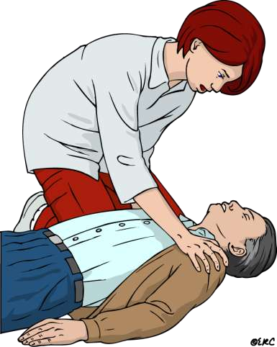
CHECK RESPONSE
Approach safely
Check response
Shout for help
Open airway
Check breathing
Call 112
30 chest compressions
2 rescue breaths

Slide 12
CHECK RESPONSE
Shake shoulders gently Ask “Are you all right?” If he responds
Leave as you find him.
Find out what is wrong.
Reassess regularly.

Slide 13
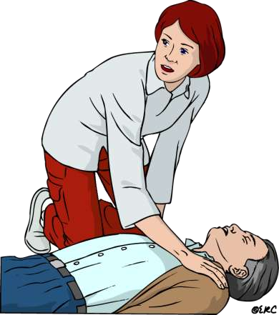
SHOUT FOR HELP
Approach safely
Check response
Shout for help
Open airway
Check breathing
Call 112
30 chest compressions
2 rescue breaths

Slide 14
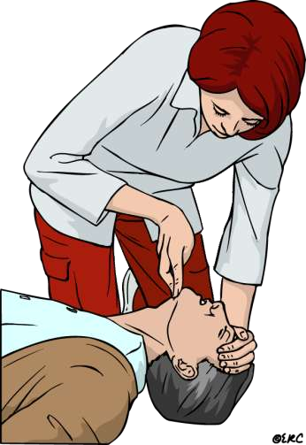
OPEN AIRWAY
Approach safely
Check response
Shout for help
Open airway
Check breathing
Call 112
30 chest compressions
2 rescue breaths

Slide 15
OPEN AIRWAY
Head tilt and chin lift
No need for finger sweep unless solid material can be seen in the airway

Slide 16
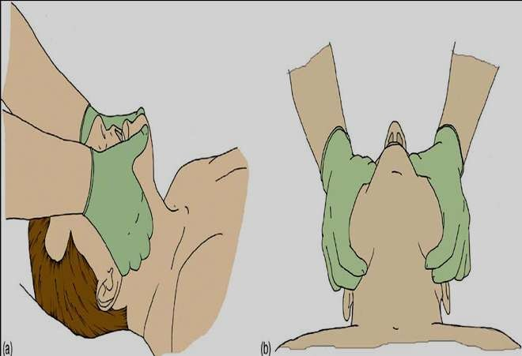
OPEN AIRWAY
Head tilt, chin lift / jaw thrust

Slide 17
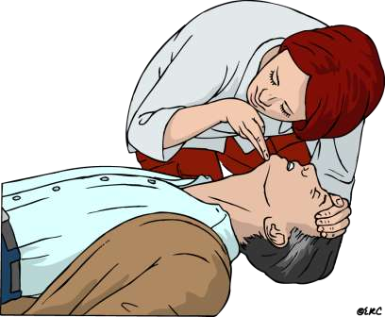
CHECK BREATHING
Approach safely
Check response
Shout for help
Open airway
Check breathing
Call 108
30 chest compressions
2 rescue breaths

Slide 18
CHECK BREATHING
Look, listen and feel for NORMAL breathing
Do not confuse agonal breathing with NORMAL breathing

Slide 19

Occurs shortly after the heart stops in up to 40% of cardiac arrests
Described as barely, heavy, noisy or gasping breathing
Recognise as a sign of cardiac arrest
Notes:
Agonal breathing is the medical term used to describe struggling to breathe or gasping.

Slide 20

Approach safely
Check response
Shout for help
Open airway
Check breathing
Call 999
30 chest compressions
2 rescue breaths

Slide 21
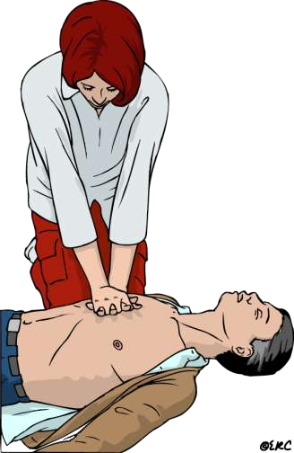
30 CHEST COMPRESSIONS
Approach safely
Check response
Shout for help
Open airway
Check breathing
Call 108
30 chest compressions
2 rescue breaths

Slide 22
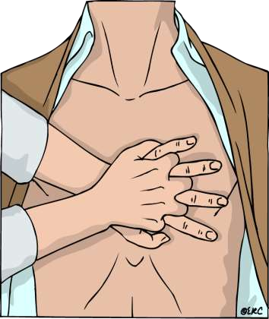
CHEST COMPRESSIONS
Place the heel of one hand in the centre of the chest
Place other hand on top
Interlock fingers
Compress the chest
  Rate 100 min⁻¹
  Depth 4-5 cm (1.5 to 2 inch)
  When possible change CPR operator every 2 min

Slide 23
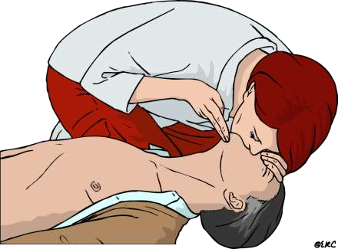
RESCUE BREATHS
Approach safely
Check response
Shout for help
Open airway
Check breathing
Call 112
30 chest compressions
2 rescue breaths

Slide 24

Pinch the nose
Take a normal breath
Place lips over mouth
Blow until the chest rises
Take about 1 second
Allow chest to fall
Repeat

Slide 25

RECOMMENDATIONS:
Tidal volume
500 – 600 ml
Respiratory rate
give each breaths over about 1s with enough volume to make the victim’s chest rise
Chest-compression-only
continuously at a rate of 100 min

Slide 26
CONTINUE CPR
30
2

Slide 27

Coronary vessel injury
Diaphragm injury
Hemopericardium
Hemothorax
Interference with ventilation

Slide 28
Liver injury
Myocardial injury
Pneumothorax
Rib fractures
Spleen injury
Sternal fracture

Slide 29

Adrenaline
Adrenaline (epinephrine) is the main drug used during resuscitation from cardiac arrest.
Atropine
Atropine as a single dose of 3mg is sufficient to block vagal tone completely and should be used once in cases of asystole. It is also indicated for symptomatic bradycardia in a dose of 0.5mg - 1mg.
Amiodarone
It is an antiarrhythmic drug.

Slide 30

Maintains airway patency with use of airway adjuncts as required (suction, high flow oxygen with O2 or bag valve mask ventilation).
Assist with intubation and securing of ETT
Inserts gastric tube and/or facilitates gastric decompression post intubation as required.
Assists with ongoing management of airway patency and adequate ventilation

Slide 31
Supports less experienced staff by coaching/guidance e.g. drug preparation
If a shockable rhythm is present (VF/VT) ensure manual defibrillator pads are applied and connected.
If CPR is in progress, prepare and independently double check the dose of adrenaline
Prepare and administer IV fluids
Document medications administered (including time)

Slide 32


