Slide 1
.
COMMUNITY SERVICE LEARNING
IN JUNIOR SECONDARY

Slide 2
Session Objectives
By the end of the session, the participant should be able to:
state the benefits of Community Service Learning (CSL) to the learner and the community,
explain the steps in the CSL project
demonstrate the ability to support learners in applying the CSL project strategies .

Slide 3


KWL
1. What I know about ….........
2. What I want to know about …............
Notes:
The outcome is linked to the outcome of the previous session on Audio based and video based modes of remote learning

Slide 4
It is increasingly being acknowledged globally that involving learners in community service has a lasting and positive impact on themselves and society at large. Community Service Learning (CSL) extends learning beyond the classroom into the community.
Learning happens through experiential learning strategies that integrate classroom learning and community service to enable learners to reflect, experience and learn from the community.
CSL combines classroom learning and community service, allowing learners to work with community members to solve local problems and to learn from their own experiences.
ESSENCE STATEMENT
.

Slide 5
CONTINUED…..
Summative Evaluation Report of 2009 revealed that Kenyan curriculum was heavily academic and examination oriented, consequently limiting flexible education pathways for identification and nurturing aptitudes, talents and interests of learners, early enough to prepare them for the world of work, career progression and sustainable development.
CSL is therefore being emphasized as it enhances holistic development of learners (BECF, 2017). In addition, CSL promotes transformation of society with respect to embracing desirable values, including the ethos of providing service to the community (Taskforce Report, 2020).
Kenya Vision 2030 emphasises the link between education and the labour market. Learners need to be supported to develop entrepreneurial competencies and strengthen partnerships with the private sector.
.

Slide 6
CONTINUED…..
Kenya Vision 2030’s social pillar aims to build a just and cohesive society where social equity, a clean and secure environment are cherished.
CSL will provide opportunities for empowering the citizens with the necessary knowledge, 21st Century skills and competencies to realize the national development goals.
This is also in line with the Constitution of Kenya 2010 which upholds such values and principles as social justice, equity, inclusiveness and sustainable development (Republic of Kenya, 2010).

Slide 7
GENERAL LEARNING OUTCOMES OF CSL
By the end of the Middle School level, the learner should be able to:
Apply knowledge, values and positive attitudes to address needs and challenges in their immediate community.
Utilise basic research, leadership, communication, financial and entrepreneurship skills to address challenges in their immediate community.
Participate in relevant projects within the school and the community for mutual benefit and learning.
Participate in local and national community activities as responsible citizens.
Embrace moral values and positive attitudes in their day-to-day life.
Appreciate diversity for harmonious living within the community.
.

Slide 8
Principles of CSL in Basic Education
.
The following principles will guide the implementation of CSL:
1.Training and Continuous Professional Development
2. Community Empowerment and Engagement
3. Reflective Learning
4. Whole School Approach
5. Inclusivity

Slide 9
Implementation of CSL in Basic Education
Early Years and Upper Primary(G4-6)
Curriculum designs provide for age-appropriate CSL activities for each strand (where applicable) in every grade.
The suggested CSL activities correlate with the subject matter.
Learners engage in age-appropriate community-based activities are intended to support the achievement of learning outcomes.

Slide 10
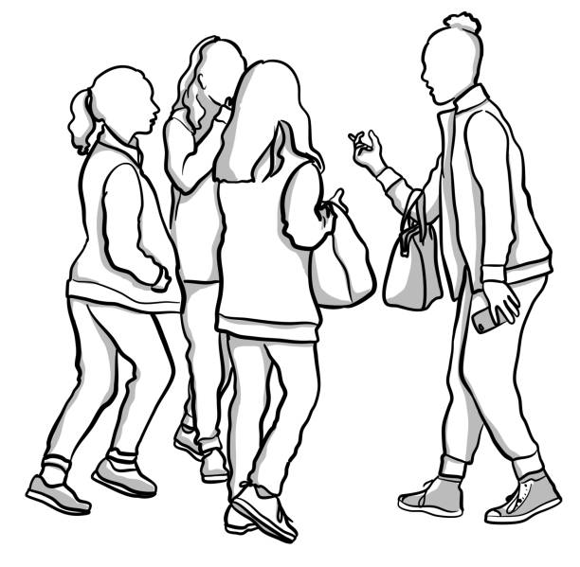
COMMUNITY SERVICE LEARNING PROJECT FOR GRADE 7
CSL learning activities are domiciled in Life Skills Education. Below is the strand and its sub strands.
1.0 Definition of terms
3.2 General Steps in a CSL project
3.3 Importance of CSL in the community
3.4 Accomplish a CSL project
Community Service Learning

Slide 11
CONTINUED….
Life Skills Education at grade 7 will give an insight into the concept of CSL and give guidance on how to carry out a CSL project
Learners will undertake one integrated group project in this grade. The activity will give learners an opportunity to practice the CSL Project skills covered under LSE.This CSL project will be assessed.
The learning approach will take the form of a whole school approach, where the entire school community will be engaged in the learning process.
Teachers will guide learners to execute a simple school based integrated CSL class activity. This activity can be done outside the classroom time.

Slide 12
CONTINUED….
The steps for carrying out a CSL project include:
a) Identifying a problem in the community through research
b) Planning to solve the identified problem in the community(What data collection tools will be used? Where will the data be collected? Target group)
c) Designing solutions/strategies to address the identified problem-(how will the groups be divided ? What resources will be used?)

Slide 13
CONTINUED….
d) Implementing the recommended solution(s) to address the problem
e) Sharing /reporting/ on findings of the project
done
f) Reflecting on own learning and relevance of the project

Slide 14
CSL Skills to be covered:
Research : Learners will develop research skills as they investigate PCIs to address the activity, ways and tools to use in collecting the data, manner in which they will analyse information and present their findings.
Communication:Learners will develop effective communication skills for as they engage with peers and school community members. These will include listening actively, asking questions, presentation skills using varied modes etc.
Citizenship: : Learner will be able to explore opportunities for engagement as members of the school community and providing a service for the common good.
Leadership: Learners develop leadership skills as they take up various roles within the CSL activity.
Financial Literacy Skills: Learners consider how they can undertake the project as well as sourcing and utilising resources effectively and efficiently.
Entrepreneurship: Learners consider ways of generating income through innovation for the CSL class activity.

Slide 15

Continued…
In carrying out the project, it is expected that the learners will use knowledge and skills learnt in various subjects. This in essence will bring about the aspect of integration of CSL.
An example:
Learners may do a project that seeks to find ways of conserving water in the school community.
They may use knowledge and skills learnt in various subjects to carry out the tasks in the project as shown….

Slide 16
Strategy to carry out project task | Knowledge /skill used | Learnt from which subject
Write simple questionnaires to seek the school community members’ views | Writing skill | English
Analyse the questionaries | Finding percentages | Mathematics
Do posters advocating best practices on water conservation in the school | Painting/graphic design | Visual arts
Create songs /dances advocating best practices on water conservation in the school | Making dance costumes | Performing arts

Slide 17
COMMUNITY SERVICE LEARNING PROJECT FOR GRADE 8
Learners will prepare for an integrated CSL group project. This project will have milestones that will be documented and assessed.
They will:
Identify a problem in the community through research
Make plans to solve the identified problem in the community(What data collection tools will be used? Where will the data be collected? Target group)
Design solutions/strategies to address the identified problem- (how will the groups be divided ? What resources will be used?)

Slide 18
COMMUNITY SERVICE LEARNING PROJECT FOR GRADE 9
Learners will carry out an integrated project done in group work. The project will be a continuation of Community Service Learning activity at grade 8 and will focus on implementation, showcasing and reflection as follows:
They will:
Implement the recommended solution(s) to address the problem
share /report/ on findings of the project done
Reflect on the learnings and relevance of the project

Slide 19
CSL in Senior Secondary School(G10-12)
CSL is a core, stand-alone subject. Each learner will be expected to carry out at least 135 hours of community service throughout their three years in senior school.
Identified individuals assigned to support the learner undertaking the community service will sign a logbook against the hours served. The learner will be provided with a log book developed by KICD.
The capstone CSL project will form part of the summative assessment.

Slide 20

Self-Reflection
1. I learnt…….
2. I need to learn more about…….
3.How I will apply what I have learnt
Suggestions I have for improvement of the session
Upload your responses on https://forms.office.com/r/7nHVcLMZrt
Facilitators to use this link to View Responses: https://tinyurl.com/KWL-Facilitators

Slide 21
THANK YOU

