Slide 1
ASSESSMENT OF THE CARDIOVASCULAR SYSTEM By selline

Slide 2
Case Study
Mr. J. K., 57year old male, was admitted to the ward with the following signs & symptoms
15.02.19
Admission - SOB, frequent cough with pinkish white sputum & bilateral limb edema;
V/S temp 35.5ºC, HR 84/min, BP 90/60mmHg, RR 36bpm, SPO₂ 95%.
CXR – cardiomegally.
Labs- Na+ 153, K+ 3.4, Cl- 106, Urea 16, Creat 161, Hb 13g/dl

Slide 3
Cont…
Past medical hx- Previous admission Dx heart failure. Rx on aldactone 50mg,warfarin
Family social hx- Married with 4 children all alive & well. Consumes alcohol, smoking a packet of cigarettes a day.
Allergies:- No known food or drug allergies

Slide 4
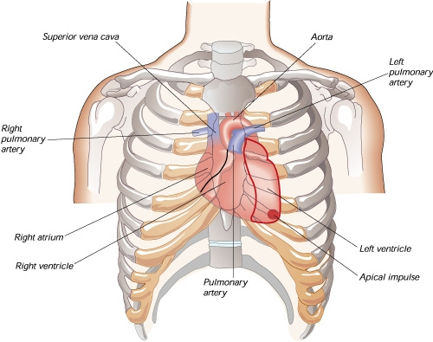

Slide 5
Sources of data
History
Physical Examination
Laboratory Assessment
Cardiovascular diagnostic procedures

Slide 6
S & S of CVS Disease

Slide 7
S & S of CVS Disease

Slide 8
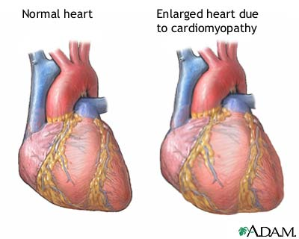

Slide 9
Collecting Data
SUBJECTIVE DATA
Current symptoms
Chest pains
Easily fatigued or tired
Dyspnea, difficulty in breathing
Shortness of breath (SOB)
Palpitations
Dizziness
Nocturia
Edema/ swelling of the feet, ankles or legs

Slide 10
Cont…
Past Medical history
Childhood
Murmurs, cyanosis, streptococcal infections, rheumatic fever
Adult
Heart failure, heart valve disease, DM, HTN, dysrhythmias, visual defects, DVT, edema
Family history
History of hypertension, myocardial infarction, coronary artery disease.

Slide 11
Cont…
Surgical History
Open heart surgery, Bypass surgery, valvular replacement, pacemaker, defibrillators, implants
Allergies
Emergency medication (lidocaine, morphine), antibiotics radiographic contrast agents or iodine
Recent Dental work or Infection

Slide 12
Cont…
Current Medication Usage
ACE Inhibitors, anticoagulants, anti HTN, B-Blockers, CCB, statins, digitalis, diuretics, nitrates, oral contraceptives, Herbal remedies

Slide 13
Cont…
Health habits:
Use of tea, coffee, OTC, contraceptives
exercise & sleep
BMI calculation
Monitoring of BP
Obesity
Diet – fatty, salty, high cholesterol
Use of illegal recreational drugs e.g. cocaine
Use of alcohol
Smoking
Lifestyle pattern & responsibilities e.g. sedentary
Social support systems
Stress

Slide 14
Cont…
Modifiable risk factors
Obesity
Sedentary
High waist circumference
Hyperlipidemia
Smoking
Hypertension
Nonmodifiable factors
Age
Heredity
Gender
Race

Slide 15
Physical Examination
Techniques applied are:
Inspection
Auscultation
Palpation

Slide 16
Inspection
Face
Facial puffiness
Cyanosis, pallor or jaundice, pain expression or apprehensive
Lips, tongue & mucus membranes
Central cyanosis is a bluish discoloration of the tongue and sublingual area

Slide 17
Cont…
Peripheral cyanosis, a bluish discoloration of the nail bed, is more commonly seen. Peripheral cyanosis occurs as a result of a reduction in the quantity of oxygen in the peripheral extremities secondary to arterial disease or decreased cardiac output.

Slide 18
Cont…

Slide 19
Neck Vessels
Carotid artery
Inspection
For obvious pulsation of the artery.

Slide 20
Cont…
Inspection
Jugular veins
These are inspected for a noninvasive estimate of intravascular volume & pressure. The external jugular veins are observed for jugular vein distention (JVD). JVD occurs in fluid volume overload & right ventricular dysfunction.

Slide 21
Central Venous Pressure (CVP)
Measurement of pressure in the right atrium of the heart.
Indicator of the volume status of the patient.
Normal 5 – 12cmH₂0
A CVP < 5, fluid depletion, dehydration
A CVP > 12, fluid overload, CCF

Slide 22
Inspection of the Hepatojugular reflux
Aka Abdominojugular reflex
Test that is sensitive in detecting right ventricular failure.
Place pt flat in bed, or elevated to 30º if the jugular veins are visible. Remind pt to breath normally.
Using single/ bimanual palpation, press firmly on the right upper quadrant for 30 to 60 sec.
Observe the neck for elevation in JVP
Normally, this should not elicit any change in the jugular veins.
Abnor. – A rise in JVP with this technique is suggestive of right-sided CHF or fluid failure.

Slide 23
Thoracic Reference Points
Sternal notch
Angle of Louis (sternal angle)
Intercostal spaces
Sternum
Clavicle
Axillary lines (ant., Mid & Post.)
PMI
Phlebostatic axis

Slide 24
Thoracic Palpation & Auscultation Points
Aortic area
Pulmonic area
Erb’s point
Tricuspid area
Mitral area
Epigastric area

Slide 25
Precordium
Inspection
Apical pulsations - normally at 5th ICS, MCL. May be obscured in obesity, large breasts and great muscularity. Done when the client is 30-45 degrees supine.
Palpation
Apical beat-use of palmer surface to locate it and the palpate with finger pads on the 5th ICS MCL.

Slide 26
Auscultation
BP measurement
HTN is diagnosed as a systolic BP 140mmHg or higher, or a diastolic BP of 90mmHg or above.
BP can be measured directly (invasive) or indirectly (noninvasive)
Correct cuff size is crucial
Rotate frequently to avoid excessive irritation
Pulse pressure (Normal 40mmHg)
Orthostatic hypotension occurs when a patient's BP drops 15 to 20 mm Hg or more when rising from a supine to sitting or standing position.

Slide 27
Stethoscope
Diaphragm
Larger surface area
Brings out high frequency, filters out low frequency
Use for listening to S₁ S₂
Bell
Smaller surface area
Filters out high frequency, brings out/ accentuates low frequency low pitched sounds (BELLOW)

Slide 28
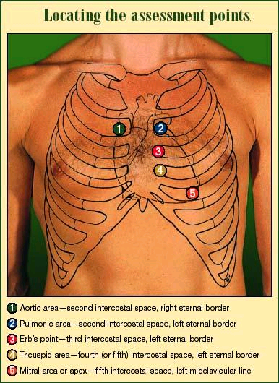
Auscultation
Auscultatory areas.

Slide 29
Cont…
Aortic area - 2ICS, RSB
Pulmonic area - 2ICS, LSB
Erb’s point - 3ICS, LSB
Tricuspid area - 4ICS, LSB
Mitral/ apical area - 5ICS, MCL

Slide 30
Auscultate for
S₁ - (lub) louder at the apex. Closure of the Mitral & tricuspid valves
S₂ - (dub) loudest at the Aortic area. Closure of the pulmonic & Aortic valves

Slide 31
Murmurs
Murmurs are produced by turbulent flow of blood in the following situations.
Murmurs are either high- or low-pitched sounds that usually last longer than normal heart sounds.
They're caused by
A stiffened valve that leaves only a narrow passage for blood to get through (stenosis), or by a weak, floppy valve that allows blood to backflow (regurgitant).
Blood flowing turbulently through a hole in the septal wall (VSD).
A murmur is always the result of a pathologic event or condition, such as ischemia, infection, drug toxicity, or a disease that's inherited or acquired.

Slide 32
Cont…
Weight
The weight in proportion to the height is assessed to determine whether the pt is obese or cachectic.
BMI = Weight in kgs
(height in meters) x (height in meters)
Interpretation
BMI(kg/m²) Weight status
Under 18.5 Underweight
18.5 – 24.9 Normal weight
25 – 29.5 Overweight
> 30 Obese

Slide 33
Peripheral Vascular Assessment
Inspection of the upper and lower limbs
Size and shape bilaterally.
Edema - if present
Color- consistent with client’s skin color Vs pallor, redness.
Temperature- a cold extremity indicates arterial insufficiency.

Slide 34
Cont…
Fingers and toes for clubbing.
Capillary refill- normally within 2 secs.
>2secs occurs in shock, arterial occlusion, hypothermia.
Measure the calf circumference.
Pulses to palpate for and note their rate, rhythm and strength (bilateral).
Radial pulse.
Brachial pulse.
Femoral pulse.
Popliteal pulse.
Dorsalis pedis pulse.
Posterior tibial pulse.

Slide 35
Pulses sites

Slide 36
???
List the central pulses
List the peripheral pulses

Slide 37
Cont…
Central pulses (carotid and femoral) &
Peripheral pulses (brachial, radial, popliteal, posterior tibial, and dorsalis pedis).
These pulses are routinely assessed during the physical assessment.
All these pulses should be assessed especially in patients/ clients with peripheral vascular disease (atherosclerosis, arteriosclerosis, diabetes mellitus, aneurysm), patient’s post cardiac catheterization and vain ligations.

Slide 38
Cont…
Pulsus alternans – describes a regular pattern of pulse amplitude changes that alternate between stronger & weaker beats
Pulsus paradoxus – an inspiratory decline in systolic BP of greater than 10mmHg is diagnostic of clinical conditions e.g. cardiac tamponade.

Slide 39
Laboratory Assessment
Electrolyte levels
Potassium (K+)
Normal K+ levels:- 3.5 – 4.5 mEq/L
Sodium (Na+)
Normal Na+ levels:- 135 – 145 mEq/L
Cardiac biomarkers
These are proteins released from severely damaged myocardial tissue cells.
Troponin I,
Creatine phosphokinase (CPK),
Creatine kinase MB (CK MB),
Lactate dehydrogenase (LDH)

Slide 40
Hematologic studies
RBCs
3.8 – 5.8x 10⁹/L
Anemia is the clinical condition that occurs when not enough RBCs are available to carry oxygen to tissues
Polycythemia is the condition that occurs when excess RBCs are produced.
Hb 12 – 16g/dL
Hct – is the volume % of RBCs in whole blood.
Platelets (150 – 450x10⁹/L)
WBCs

Slide 41
Serum lipid levels
Triglycerides (TGs)
Cholesterol
Low Density Lipoprotein (LDL) – ‘bad cholesterol’
High Density Lipoprotein (HDL)

Slide 42
Cont…
Lipid profile;
Cholesterol (Normal: 140 to 200 mg/dL.)
Triglycerides (Normal: 150 mg/dL)
Phospholipids (Normal: 125 to 380 mg/ dL.
Lipoproteins (Desirable: LDL less than HDL)
Hemodynamic monitoring; Blood pressure, cardiac and pulmonary pressure abnormalities.

Slide 43
Thyroid Hormone Levels
Elevated levels of T3 & T4 may result in thyrotoxicosis & a hyperdynamic state of the CVS (palpitations, tachycardia, bounding pulses)
Decreased thyroid levels may explain fatigue, dysnea on exertion, decreased CO & heart failure.

Slide 44
Diagnostic Tests / Procedures
The following are purposes of common diagnostic investigations.
Chest x-ray; Heart enlargement; calcifications; fluid around heart
Magnetic resonance imaging (MRI); cardiac abnormalities
Electrocardiogram (ECG); Dysrhythmias; enlarged heart chamber size; myocardial ischemia or infarction; electrolyte imbalances.

Slide 45
Cont…
Holter monitoring; Recording of ECG for up to 48 hours to match abnormalities with symptoms recorded in patient’s diary. Normal: Normal sinus rhythm. Dysrhythmias; MI ischemia occurring less often.
Cardiac Stress Test. This test simulates sympathetic nervous system (fight or flight) stimulation. It shows the heart’s response to increased oxygen needs. Evaluates effects of exercise on heart and vascular circulation; ECG and vital signs are continuously monitored. Test stopped if symptoms develop. Dysrrythmias and ischemia

Slide 46
Cont…
Echocardiogram; Transducer transmits sound waves that bounce off heart to produce heart images and show blood flow. Provides audio and graphic data; Heart enlargement, coronary artery disease, valvular abnormalities, thickened cardiac walls or septum, pericardial effusion
Cardiac enzymes; elevation indicates damage cardiac cells. The enzymes include; creatine kinase (CK), CK-MB, myoglobin and cardiac troponin I or T.

Slide 47
Central venous pressure (CVP); Catheter inserted into a vein and threaded into vena cava. Normal: 2 to 6 mm Hg. Monitors CVP, which reflects intravascular fluid volume status.
Angiography; Assesses vessel patency, injury, or aneurysm.
Cardiac catheterization; Cardiac disease
Doppler ultrasound; Sound waves bounce off moving blood, producing recordings. Evaluates Peripheral Vascular Diseases.

Slide 48
ANY QUESTIONS?
THANKS

