Slide 1
CARDIAC OUTPUT
Lect. Samuel Ngigi
BCM, MCM(A&E)
KMTC

Slide 2
Cardiac Output
Cardiac output is the quantity of blood pumped into the aorta each minute by the heart. This is also the quantity of blood that flows through the circulation.
Cardiac output is one of the most important factors to consider in relation to the circulation because it is the sum of the blood flows to all the tissues of the body.
Cardiac output varies widely with the level of activity of the body.

Slide 3
Venous Return
Venous return is the quantity of blood flowing from the veins into the right atrium each minute.
The venous return and the cardiac output must equal each other except for a few heartbeats at a time when blood is temporarily stored in or removed from the heart and lungs.

Slide 4
Methods Of Measurement
There several methods of measuring cardiac output:
Doppler combined with echocardiography
Direct Fick’s method and the
Indicator dilution method.

Slide 5
Direct Fick’s Method
The Fick’s principle states that the amount of a substance taken up by an organ (or by the whole body) per unit of time is equal to the arterial level of the substance minus the venous level (A-V difference) times the blood flow.
The principle can be used to determine cardiac output by measuring the amount of O₂ consumed by the body in a given period and dividing this value by the A-V difference across the lungs.
Because systemic arterial blood has effectively the same O₂ content in all parts of the body, the arterial O₂ content can be measured in a sample obtained from any convenient artery. A sample of venous blood in the pulmonary artery is obtained by means of a cardiac catheter.

Slide 6
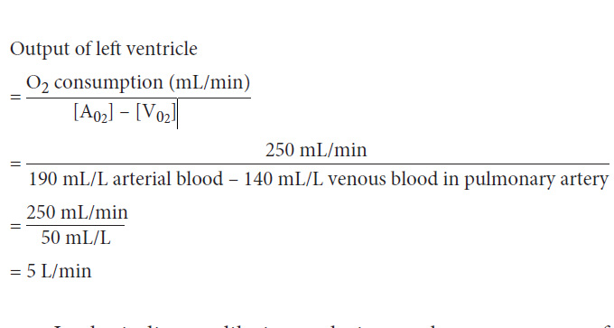
Example: (using a typical set of values)

Slide 7
Indicator Dilution Technique
A known amount of a substance such as a dye or, more commonly, a radioactive isotope is injected into an arm vein and the concentration of the indicator in serial samples of arterial blood is determined.
The output of the heart is equal to the amount of indicator injected divided by its average concentration in arterial blood after a single circulation through the heart.

Slide 8
Factors Controlling Cardiac Output
The cardiac rate is controlled primarily by the autonomic nerves, with sympathetic stimulation increasing the rate and parasympathetic stimulation decreasing it.
Stroke volume is also determined in part by neural input, with sympathetic stimuli making the myocardial muscle fibers contract with greater strength at any given length and parasympathetic stimuli having the opposite effect.
The cardiac accelerator action of the catecholamines liberated by sympathetic stimulation is referred to as their chronotropic action, whereas their effect on the strength of cardiac contraction is called their inotropic action.

Slide 9
Factors Controlling Cardiac Output
The force of contraction of cardiac muscle depends on its preloading and its afterloading. The preload is the degree to which the myocardium is stretched before it contracts and the afterload is the resistance against which blood is expelled.
When the muscle is stretched, the developed tension increases to a maximum and then declines as stretch becomes more extreme. Starling’s law of the heart or (Frank-Starling law) states that; “Energy of contraction is proportional to the initial length of the cardiac muscle fiber”
For the heart, the length of the muscle fibers (i.e. the extent of the preload) is proportional to the end-diastolic volume.

Slide 10
The relation between ventricular stroke volume and end-diastolic volume is called the Frank-Starling curve.
When cardiac output is regulated by changes in cardiac muscle fiber length, this is referred to as heterometric regulation. Conversely, regulation due to changes in contractility independent of length is sometimes called homometric regulation.

Slide 11
Effect of changes in myocardial contractility on the Frank-Starling curve.
The curve shifts downward and to the right as contractility is decreased.
The major factors influencing contractility are summarized on the right.
The dashed lines indicate portions of the ventricular function curves where maximum contractility has been exceeded; that is, they identify points on the “descending limb” of the Frank-Starling curve.
EDV:- is end-diastolic volume.

Slide 12
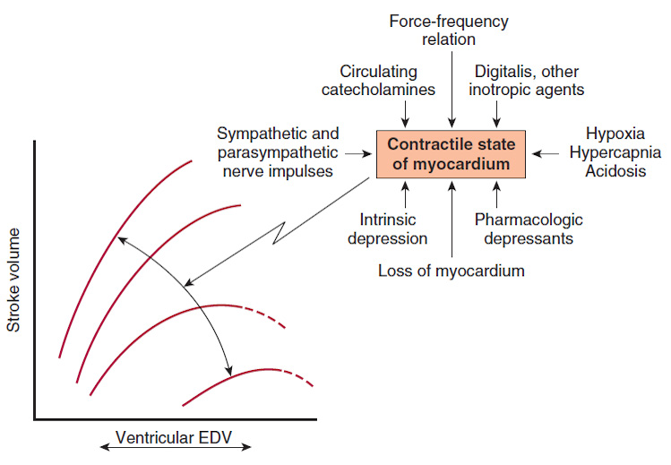

Slide 13
Factors Affecting End-diastolic Volume
When systolic contractions are reduced, there is a primary reduction in stroke volume. Diastolic function also affects stroke volume, but in a different way.
An increase in intrapericardial pressure (e.g. as a result of infection or pressure from a tumor) limits the extent to which the ventricle can fill, as does a decrease in ventricular compliance (i.e. an increase in ventricular stiffness produced by myocardial infarction, infiltrative disease, and other abnormalities).
Atrial contractions aid ventricular filling.

Slide 14
Factors affecting the amount of blood returning to the heart likewise influence the degree of cardiac filling during diastole. An increase in total blood volume increases venous return.
Constriction of the veins reduces the size of the venous reservoirs, decreasing venous pooling and thus increasing venous return.
An increase in the normal negative intrathoracic pressure increases the pressure gradient along which blood flows to the heart, whereas a decrease impedes venous return.
Standing decreases venous return, and muscular activity increases it as a result of the pumping action of skeletal muscle.

Slide 15
Myocardial Contractility
The contractility of the myocardium exerts a major influence on stroke volume.
The positive inotropic effect of norepinephrine (sympathetic nerves) liberated at the nerve endings is augmented by circulating norepinephrine, and epinephrine has a similar effect.
Conversely, there is a negative inotropic effect of vagal stimulation on both atrial and (to a lesser extent) ventricular muscle.
Changes in cardiac rate and rhythm also affect myocardial contractility (force–frequency relation)- myocardial contractility increases as the heart rate increases, although this effect is relatively small.

Slide 16
Myocardial Contractility
Catecholamines exert their inotropic effect via an action on cardiac β₁-adrenergic receptors and Gs, with resultant activation of adenylyl cyclase and increased intracellular cyclic adenosine 3′,5′-monophosphate (cAMP).
Xanthines such as caffeine and theophylline that inhibit the breakdown of cAMP are predictably positively inotropic.
The positively inotropic effect of digitalis and related drugs, is due to their inhibitory effect on the Na⁺, K⁺ ATPase in the myocardium, and a subsequent decrease in calcium removal from the cytosol by Na⁺/Ca²⁺ exchange.

Slide 17
Hypercapnia; hypoxia; acidosis; and drugs such as quinidine, procainamide, and barbiturates depress myocardial contractility.
The contractility of the myocardium is also reduced in heart failure (intrinsic depression). The causes of this depression are not fully understood but may reflect down-regulation of β-adrenergic receptors and associated signaling pathways and impaired calcium liberation from the sarcoplasmic reticulum.
In acute heart failure, such as that associated with sepsis, this response could be considered an appropriate adaptation (so-called “myocardial hibernation”) to a situation where energy supply to the heart is limited, thereby reducing energy expenditure and avoiding cell death.

Slide 18
Integrated Control Of Cardiac Output
All the discussed mechanisms operate in an integrated way to maintain cardiac output. For example, during muscular exercise, there is increased sympathetic discharge, so that myocardial contractility is increased and the heart rate rises.
The increase in heart rate is particularly prominent in normal individuals, and there is only a modest increase in stroke volume.
Patients with transplanted hearts are able to increase their cardiac output during exercise in the absence of cardiac innervation through the operation of the Frank-Starling mechanism. i.e.

Slide 19
If venous return increases and there is no change in sympathetic tone, venous pressure rises, diastolic inflow is greater, ventricular end-diastolic pressure increases, and the heart muscle contracts more forcefully.
Circulating catecholamines also contribute.
Trained athletes have lower heart rates, greater end-systolic ventricular volumes, and greater stroke volumes at rest. Therefore, they can potentially achieve a given increase in cardiac output by further increases in stroke volume without increasing their heart rate to as great a degree as an untrained individual.

Slide 20
Oxygen Consumption By The Heart
Basal O₂ consumption by the myocardium is about 2 mL/ 100 g/min, consumption by the beating heart is about 9 mL/100 g/min at rest. Increases occur during exercise and in a number of different states.
Cardiac venous O₂ tension is low, and little additional O₂ can be extracted from the blood in the coronaries, so increases in O₂ consumption require increases in coronary blood flow.
O₂ consumption by the heart is determined primarily by the intramyocardial tension, the contractile state of the myocardium, and the heart rate.

Slide 21
Ventricular work per beat correlates with O₂ consumption. The work is the product of stroke volume and mean arterial pressure in the pulmonary artery or the aorta (for the right and left ventricle, respectively).
Because aortic pressure is seven times greater than pulmonary artery pressure, the stroke work of the left ventricle is approximately seven times the stroke work of the right.
In theory, a 25% increase in stroke volume without a change in arterial pressure should produce the same increase in O₂ consumption as a 25% increase in arterial pressure without a change in stroke volume.

Slide 22
However, for reasons that are incompletely understood, pressure work produces a greater increase in O₂ consumption than volume work. In other words, an increase in afterload causes a greater increase in cardiac O₂ consumption than does an increase in preload.
This is why angina pectoris due to deficient delivery of O₂ to the myocardium is more common in aortic stenosis than in aortic regurgitation.
In aortic stenosis, intraventricular pressure must be increased to force blood through the stenotic valve, whereas in aortic regurgitation, an increase in stroke volume with little change in aortic impedance occurs.

Slide 23
Law of Laplace; states that “the tension developed in the wall of a hollow viscus is proportional to the radius of the viscus.” When the heart is dilated, its radius is increased. O₂ consumption per unit time increases when the heart rate is increased by sympathetic stimulation because of the increased number of beats and the increased velocity and strength of each contraction. However, this is somewhat offset by the decrease in end-systolic volume and hence in the radius of the heart.

Slide 24
Cardiac Output In Various Conditions
The amount of blood pumped out of the heart per beat, the stroke volume, is about 70 mL from each ventricle in a resting man of average size in the supine position.
The output of the heart per unit of time is the cardiac output. In a resting, supine man, it averages about 5.0 L/min (70 mL × 72 beats/min).
Effects of various conditions on cardiac output include:

Slide 25
Condition or Factor | Effect
Sleep Moderate changes in environmental temperature | No change
Anxiety and excitement (50–100%) Eating (30%) Exercise (up to 700%) High environmental temperature Pregnancy Epinephrine | Increases
Sitting or standing from lying position (20–30%) Rapid arrhythmias Heart disease | Decreases

Slide 26
In conclusion:
Changes in cardiac output reflect variations in heart rate, stroke volume, or both; these are controlled, in turn, by neural and hormonal input to cardiac myocytes.

Slide 27
End of Presentation
Thank You for Listening

