Slide 1
CARDIOVASCULAR DISORDERS
MARGARET GICHUKI
welcome

Slide 2
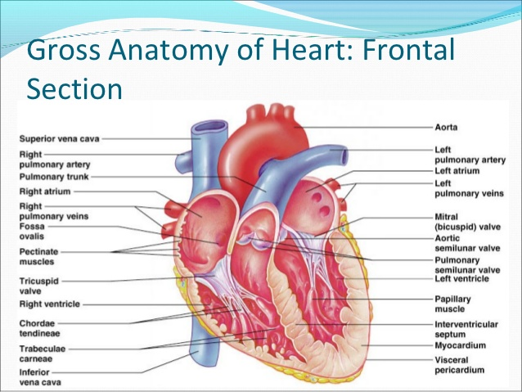
MAIN OBJECTIVE
To promote health, prevent illnesses, diagnose and manage patients suffering from common cardiovascular disorders.

Slide 3
Specific objectives
Define concepts in cardiovascular system
Review A $ P of the cardiovascular system
Recognize individuals with disorders of the cardiovascular system
Describe common disorders of the cardiovascular system
Demonstrate ability to care for individuals with common disorders of the cardiovascular system

Slide 4
Course outline
Review of anatomy and physiology
Arteriosclerosis
Atherosclerosis
Myocardial infarction
Congestive cardiac disease
Intermittent claudication
Sub-acute bacterial endocarditis
Acute bacterial myocarditis
Rheumatic heart disease
Hypertension
Coronary artery disease
Deep venous thrombosis

Slide 5
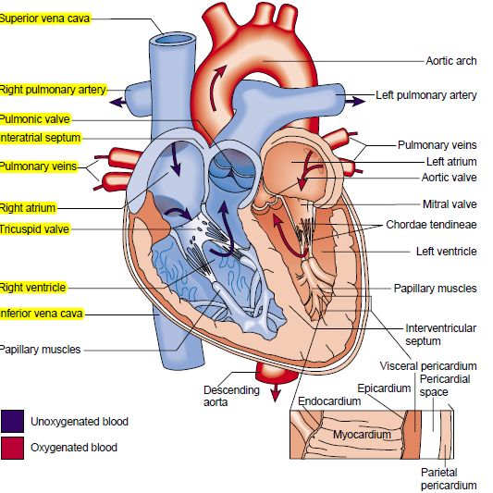
Overview of anatomy of the heart

Slide 6
HEART
Muscular organ in the mediastinum(btw lungs)
Right and left atria and ventricles
Pumps blood to tissues. Supply O2 &nutrients
By contraction(systole) and relaxation (diastole)
Systole-Ventricles contract and blood is ejected
Diastole- Heart muscle relaxes and the chambers fill with blood
Normal adult- 60-80 bpm
About 5 L in a min

Slide 7
.
3 layers of the heart
a)Endocardium- inner layer
b)Myocardium-middle layer(responsible . for pumping action)
c)Epicardium- exterior layer (visceral pericardium)
Heart enclosed in a pericardium(serous pericardium) –has two layers.
.visceral pericardium—attached to epicardium
.parietal pericardium– attached to the great vessels, diaphragm, sternum and vertebral column.
The space btw the two– pericardial space
Has about 30 ml of fluid (pericardial fluid) that lublicates the heart in systole

Slide 8
HEART CHAMBERS
The right & left chambers each composed of two chambers.- an atrium & a ventricle.
Wall between the right & left chambers is called the septum.
Ventricles eject blood into the arteries.
Atria receive incoming blood from the veins to act as temporary storage reservoirs, then emptying into the ventricles.

Slide 9
Left ventricle ejects blood against high systemic pressure
Right ventricle ejects blood against the low resistance pulmonary vasculature.
Left heart has increased work, hence the left ventricular wall is about 2 times as thick as the right ventricular wall.

Slide 10
HEART VALVES
Permit blood to flow only in one direction through the heart.
Valves open & close in response to pressure changes & blood movement.
Entrance valves- atrioventricular valves.
Exit valves- semilunar valves.

Slide 11
Right atrioventricular valve/ tricuspid valve-Has three cusps/flaps(hence the name tricuspid valve). Opens for blood to flow freely from right atrium to the right ventricle. As the right ventricle contracts, the valve closes so that blood cannot flow back to the right atrium, hence flowing into the pulmonary artery.

Slide 12
Left atrioventricular valve/ bicuspid valve(a.k.a mitral valve)- has two valves which open allowing blood to flow freely from the left atrium to the left ventricle. Closes when the ventricles contract preventing blood from flowing back into the left atrium hence flowing into the aorta.

Slide 13
Pulmonic valve- is between the right ventricle & the pulmonary artery that leads to the lungs.
The aortic valve- is between the left ventricle and the aorta. The aortic valve closes to prevent the flow of blood back from the aorta to the ventricle.

Slide 14
CARDIAC BLOOD FLOW
Cardiac blood flow
The mammalian heart is a double pump in which the right side operates as a low-pressure system delivering de-oxygenated blood to the lungs, while the left side is a high pressure system delivering oxygenated blood to the rest of the body.

Slide 15
The walls of the right ventricle are much thinner than those of the left, because the work load is lower for the right side of the heart.
The ventricular muscle is relatively stiff, and it would take some time to fill with venous blood during diastole. The thin, flexible atria serve to buffer the incoming venous supply, and their initial contraction at the beginning of each cardiac cycle fills the ventricles efficiently in a short space of time.

Slide 16
Starling’s Law
Ventricular contraction is proportional to muscle fiber stretch
The law states that the stroke volume of the heart increases in response to an increase in the volume of blood in the ventricles, before contraction (the end diastolic volume), when all other factors remain constant
Aortic output pressure rises as the venous filling pressure is increased
Increased venous return – increase cardiac output – up to a point!

Slide 17
Regulation of cardiac output
Stroke volume is defined as end-diastolic volumeminus end-systolic volume; cardiac output is the stroke volume times the heart rate.
Each ventricle fills up to 120mls, pumps 70mls, residue 50mls
CO=SV X HEART RATE(HR)
70 X 72
~ 5L /minute; dependent on:
Heart rate- 72 beats/min.
Stroke volume- 70ml/beat

Slide 18
Preload- ventricular end
diastolic volume
Afterload- tension due to
pressure in the aorta &
Pulmonary Artery.
(Resistance against which the LV must pump)
Inotropy
Changes in ventricular inotropy (contractility) alter the rate of ventricular pressure development, thereby affecting ESV and SV. For example, an increase in inotropy (e.g., produced by sympathetic activation of the heart) increases SV and decreases ESV. Conversely, a decrease in inotropy (e.g., heart failure) reduces SV and increases ESV

Slide 19
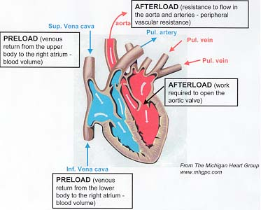
Cardiac Output

Slide 20
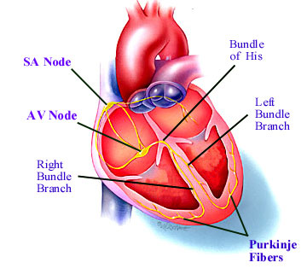
CARDIAC ELECTRICAL ACTIVITY

Slide 21
CARDIAC SYSTEM RECEPTORS
Alpha: in arteries, if stimulated, arteries constrict. Skeletal blood vessels lack alpha receptors since muscles need all time blood supply for movement
Beta 1: In the heart. When stimulated they increase the heart rate and increase the heart's strength of contraction or contractility.
Beta 2: In the bronchioles and blood vessels of skeletal muscles. When stimulated, they dilate the lumen of bronchioles and arteries.

Slide 22
If norepinephrine or epinephrine is the neurotransmitter of the sympathetic nervous system and it interacts with all the receptors we just described, then we know that norepinephrine or epinephrine stimulates the alpha, beta 1 and beta 2 receptors and thus it is an alpha agonist, a beta 1 agonist and a beta 2 agonist.

Slide 23
When we administer epinephrine or adrenaline to a patient, we expect alpha, beta 1 and beta 2 agonist effects; and so, an:
Increase in blood pressure
Increased heart rate
Increased cardiac contractility
Dilation of the bronchioles in the lungs
Dilation of the vessels in the skeletal muscles

Slide 24
CHARACTERISTICS OF CARDIAC CELLS.
Automaticity
Conductivity
Rhythmicity
Excitability (Irritability)
Contractility

Slide 25
Rhythm
Site of the pacemaker (a) sinus – sino-atrial node, (b) nodal or Junctional & c)Ventricular-purkinje system.
Automaticity
Ability of heart muscle to undergo spontaneous depolarization
SA node generates 70 to 89 impulses per minute
AV node 40 to 60
purkinje fibers 35 to 40

Slide 26
Heart sounds
First &: Closure of AV valves
Second : Classical; heard by a stethoscope
Is due to closure of aortic valve
Third: Due to rushing of blood into the ventricles. Is mild, can only be heard by a special microphone, amplifier & loudspeaker.
Fourth: Produced buy atrial contraction. Not audible unless in pathologic state like stiff ventricle due to HTN. The atria pump force fully into the ventricle.

Slide 27
murmur
An abnormal heart sound produced by turbulence of blood due to:-
an incompetent or stenosed valve so that there is regurgitation or backflow of blood.
Severe anemia due to reduced blood viscosity thus accelerated blood flow.
Ventricular-septal defects where blood flows through from left to right ventricle
Coarctation(narrowing )of aorta so that blood flows back to the left ventricle

Slide 28
arrythmia
Irregular heart beat or disturbance in the heart rhythm
In arrhythmia the SA may not be the pacemaker. In absence of SA node, the atrial muscle, AV Node and ventricular muscle become the pacemaker.
TYPES
Normotropic arrythmia occur when the SA is still the pacemaker
Ectopic arrythmia

Slide 29
Nomotropic
Types
Sinus arrythmia: Normal rhythmical increase and decrease in heart rate during respiration. H. Rate increases during inspiration and reduces during expiration due to changes in intrathoracic pressure changes
Sinus tachycardia: Increased Sinu Atrial Node Impulses due to exercise, emotions, high altitude, pregnancy. Also pathologically in fever, anemia, hyperthyroidism, hypersecretion of catecholamines, cardiomyopathy, valvular heart dse, hemorrhagic shock

Slide 30
Sinus bradycardia: Reduced impulses due to sleep, athletic heart(enlarged heart to cope up with exercise resulting to maximal stroke vol and cardiac output thus low heart beat at rest). Can be pathological in diseases of the SAN, Hypothermia, hypothyroidism, heart attack, congenital heart dse, aging, obstructive jaundice, Increased ICP, use of beta blockers like digitalis, atherosclerosis
People with sinus bradycardia have fatigue, shortness of breath, weakness, lack of concentration and difficulty exercising

Slide 31
ECTOPIC ARRTHYMIA
Another structure, other than the SAN is the pacemaker.
THE ARTIFICIAL PACEMAKER
A gadget with a lithium battery and a titanium casing planted on the chest under the skin and discharges impulses to the heart through electrodes that pass through a vein to the heart chambers. Battery can last 10 to 15 years.

Slide 32
Cardiac electrical activity
Cardiac electrical activity
Cardiac muscle does not require any nervous stimulation to contract.
Each beat is initiated by the spontaneous depolarisation of pacemaker cells in the sino-atrial (SA) node. These cells trigger the neighboring atrial cells by direct electrical contacts and a wave of depolarisation spreads out over the atria, eventually exciting the atrio-ventricular (AV) node.
Contraction of the atria precedes that of the ventricles, forcing extra blood into the ventricles and eliciting the Starling response.

Slide 33
The electrical signal from the AV node is carried to the ventricles by a specialized bundle of conducting tissue (the bundle of His)
The conducting tissues are derived from modified cardiac muscle cells, the Purkinje fibers.
The conducting bundles divide repeatedly through the myocardium to coordinate electrical and contractile activity across the heart.
Although each cardiac muscle cell is in electrical contact with most of its neighbors, the message normally arrives first via the Purkinje system.

Slide 34
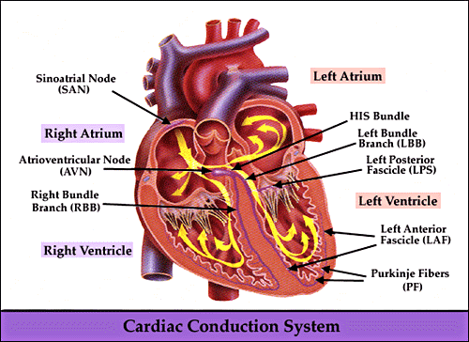
CONDUCTION SYSTEM

Slide 35
STRUCTURE FOR THE CARDIAC HISTORY
PRESENTING COMPLAIN
The symptom that prompts the patient to seek medical attention – commonly chest pain, breathlessness (dyspnoea), palpitation, dizziness or blackouts (syncope ).

Slide 36
HISTORY OF PRESENTING COMPLAINT
Chest pain: site, radiation, character, duration,
Provoking and relieving factors, associated symptoms?
Breathlessness: orthopnea, paroxysmal nocturnal dyspnea, ankle swelling, cough, wheeze, haemoptysis?
Palpitation: sudden onset and offset, or pauses, presyncope or syncope.

Slide 37
Dizziness / syncope: provoking factors, warning, duration, recovery?

Slide 38
RISK FACTORS FOR CARDIOVASCULAR DISEASES
Smoking- nicotine.
Age- serum cholesterol level rises, loss of arterial elasticity.
Hypertension
Hyperlipidemia( high cholesterol levels)
Diabetes
Family history of premature vascular disease.

Slide 39
Excessive alcohol consumption-excessive.
Unhealthy diet- saturated fats.

Slide 40
PAST MEDICAL HISTORY
Stroke or transient ischemic attack.
Renal impairment
Rheumatic fever
Peripheral vascular disease.
Operations
Hospital clinic attendances.

Slide 41
FAMILY HISTORY
Cardiac disease
Sudden death

Slide 42
DRUG HISTORY
Quantification of alcohol in take.
If a patient with known cardiovascular disease is not taking the recognized standard treatment, the reason for this should be established.

Slide 43
Cardiac signs and symptoms
Fatigue – earliest symptom
Chest pain and discomfort. Also other body parts eg left jaw, medial side of the left arm.
Shortness of breath and dyspnoea
Palpitations
Edema and weight gain- right ventricular failure
Dizziness and syncope– loss of consciousness.

Slide 44
Risk factors to heart disease
Non modifiable factors (have no control about).
- positive family history
-increasing age
-gender– men and post menopause women
- race- ?common in African

Slide 45
.
Modifiable factors.( one can have control)
-cigarettes smoking
-obesity
-physical inactivity
-hyperlipidemia
-elevated blood glucose
- use of oral contraceptives
-hypertension

Slide 46
Introduction
Heart diseases are major cause of death but not all kinds are fatal.
There are many causes as covered under various conditions.

Slide 47
.
Diagnosis of heart diseases is done by
-physical assessment
-laboratory test and
- imaging and fluoroscopy and ultrasound

Slide 48
Diagnostic tests
Electrocardiogram (ECG)-paper with graphical recording of heart sounds, blank paper is called ECG paper, electrocardiograph-machine
X-ray
Angiogram
Heart catheterization
Central venous pressure
Radio-Isotopes
Echocardiography: U/S of heart, heart images
Electrocardiography: (ECG) Heart
Phonocardiography: For heart sounds plots

Slide 49
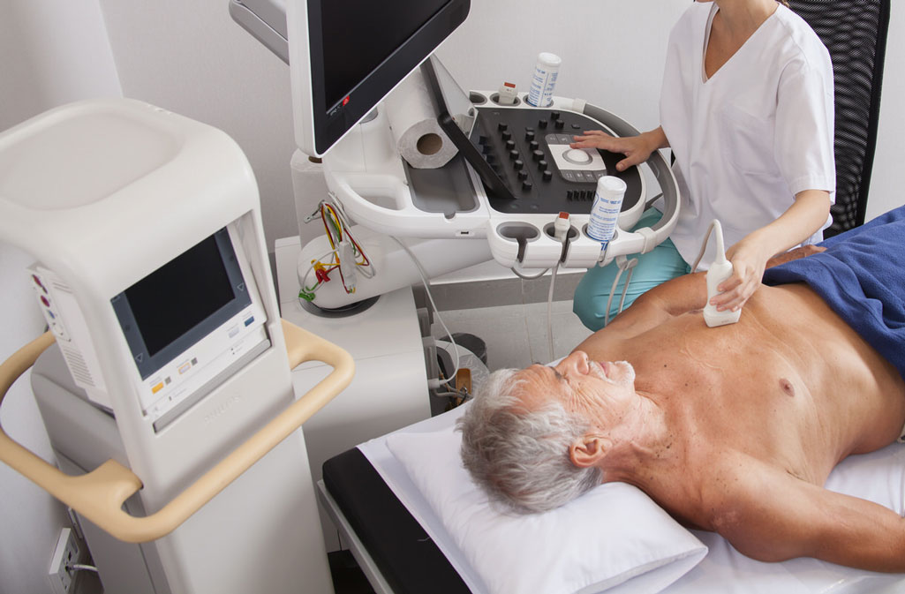
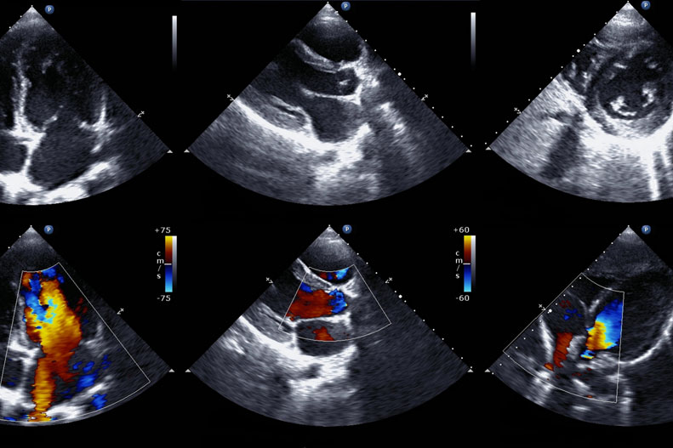
Echocardiography

Slide 50
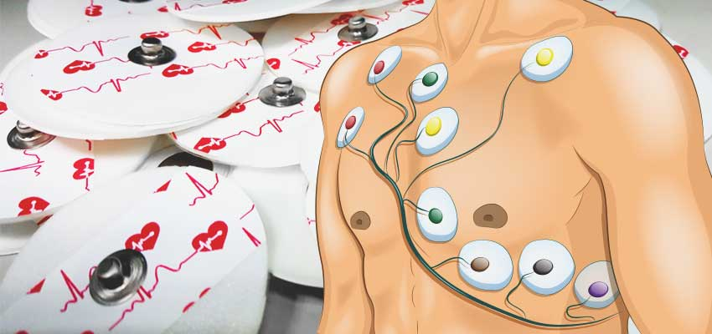
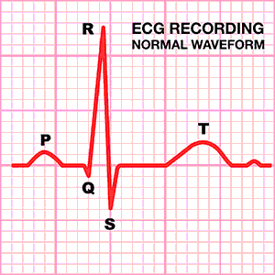
ELECTROCARDIOGRAM

Slide 51
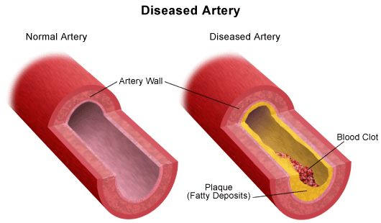
Diseases of the arteries
ATHEROSCLEROSIS AND ARTERIOSCLEROSIS
ATHEROSCLEROSIS
Is a disease of the arteries in which fatty plaques develop on their inner walls, eventually obstructing blood flow and interfering with absorption of nutrients.

Slide 52
.
ARTERIOSCLEROSIS
Literally means hardening of arteries with loss of elasticity within the middle layer of the small arteries, causing impaired blood supply to the organs and severe elevation of blood pressure.
It is associated with some degree of atheroma and old age.
Although the processes of atherosclerosis and arteriosclerosis differ, rarely does one occur without the other

Slide 53
RISK FACTORS
Damaged endothelium by:-
High blood pressure
Smoking
High cholesterol
Abdominal obesity
Stress
Lack of fruits and veges
Alcohol
Sedentary lifestyle
Atheromas may cause coronary heart dse, cerebrovascular dse, peripheral dse

Slide 54
mgt
Stenting
Bypass surgery: Getting an artery from elsewhere(often leg or chest) and putting around a blocked part to bypass

Slide 55
INTERMITENT CLAUDICATION
A muscular, cramp-type pain in the extremities consistently reproduced with the same degree of exercise or activity and relieved by rest is experienced by patients with peripheral arterial insufficiency.
The pain result from built up of metabolic waste within the muscle tissue.
There is local irritation by this toxic waste causing ischemic pain.

Slide 56
Mechanism: pathophysiology
Activity/exercise →Increased tissue oxygen demand →impaired oxygen supply due to obstruction →shift to anaerobic metabolism → build up of metabolic waste → local irritation of peripheral nerve endings → pain in extremity →rest → decreased tissue oxygen demand → return to aerobic metabolism → elimination of metabolic waste → relief of pain.

Slide 57
management
Give bed rest
Provide warmth to cold extremities
Elevate the feet
Moderate regular exercises for the limbs
Skin care
Low fat diet
Stop smoking

Slide 58
.
Medication
Vasodilators;- nifedipine
Nicotinic acid;- antilipemic to decrease serum lipids
Antiplatelets;- aspirin
Thrombolitics;-
Anticoagulant-- heparin

Slide 59
Surgical intervention
Peripheral Arterial Bypass Surgery
Synthetic graft is anstomosed to a patent arterial source both proximal and distal to the lesion.
Complications;-
            Infection
            Graft failure
            Amputation

Slide 60
.
Percutaneous Transluminal Angioplasty (PTA)
This use of a small catheter with an inflatable balloon is passed though the vessel to compress the lesion and widen the lumen followed by anticoagulation therapy.

Slide 61
Nursing care
Surgical cleaning of wounds
Antibiotics;- prophylaxis/treatment.
Vital observations
Pain management
Psychological support
Support lifestyle changes to reduce risk factors
Advice the patient to walk as tolerated

Slide 62
.
Nursing Diagnosis
• Ineffective peripheral tissue perfusion related to compromised circulation
• Chronic pain related to impaired ability of peripheral vessels to supply tissues with oxygen
• Risk for impaired skin integrity related to compromised
circulation
• Deficient knowledge regarding self-care activities

Slide 63
CORONARY ARTERY DISEASE (CAD)
Most prevalent cardiovascular disease
Coronary artery supplies the myocardium with blood
various types
1.CORONARY ARTHRESCLEROSIS
Abnormal accumulation of lipids or fatty substances
Narrows the vessels---less blood supply to the myocardium

Slide 64
pathophysiology
Fatty streaks deposited in the intima of the arterial wall.
This leads to inflammatory response. T- lymphocites ingests the lipids and die
This causes the smooth cells to proliferate and form fibrous cap over the dead fatty core.
These deposites , called atheromas or plaques protrudes into the lumen, narrowing the vessels and obstructing the blood flow

Slide 65
The plaque remains stable and resist the pressure from blood flow and the vessel mvt
If the cap is thin, the lipid core may rupture, allowing formation of thrombus that can block blood flow leading to sudden death.
Inadequate supply of O2 to the mycardium deprives them O2 needed for survival. This is called ischaemia.
Ishaemia causes angina pectroris. If it is severe, it leads to Myocardial infarction.

Slide 66
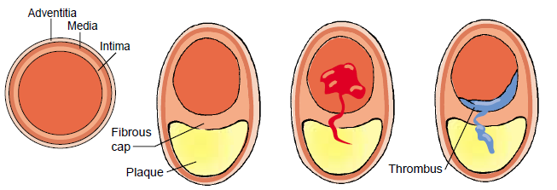
.

Slide 67
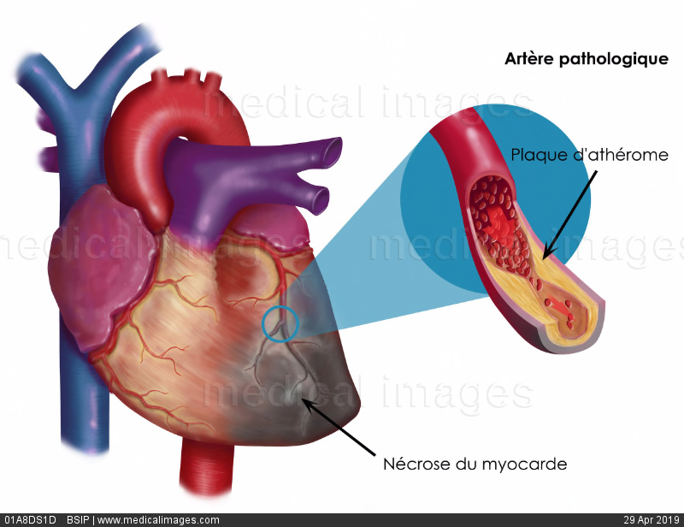
Necrosis of cardiac muscle

Slide 68
Clinical manifestation
Depends on the location, degree of narrowing, thrombus formation and obstruction to flow
It includes;
-Acute on set of chest pain
-high levels of cardiac enzymes
- abnormal electrocardiogram (ECG)
-Dysrhythmias
- sudden death
Risk factors as above

Slide 69
.
Elements of fat metabolism that affects artherosclesis. LDL,HDL, cholesterol and triglycelides.
LDL exerts harmful effects on arterial wall
HDL promotes use and degradation and excretion of cholesterol and LDL
Desired goal– LDL and HDL
LDL < 160mg/dl and HDL > 60mg/dl
LDL reduced by physical activity and diet

Slide 70
prevention
Controling cholesterol intake in the diet
Involvement in physical activities
Tobacco smoking cessation
Managing hypertension
Controlling of diabetes mellitus
Medication..reserved for the at risk patients
They includes;
a) statins eg levostatins, pravastatins, simvastatins..block cholesterol synthesis and increase LDL receptors in the liver.

Slide 71
.
b) nicotinic acid:- niacin– reduce lipoprotein synthesis
c) fibric acid / fibrates eg clifibrates—reduce sythesis of cholesterol
d) bile acid sequestrants or resins eg cholestyramine---binds cholesterol in the gut.
e) cholesterol absorption inhibitor eg ezetimibe ---inhibits intestinal absorption of cholesterol

Slide 72
ANGINA PECTORIS
Episodes of pain or pressure on the anterior chest wall due to insufficient coronary blood flow.
Causes.. less supply of O2 to the myocardium than the demand in response to physical activity or emotional stress
There is imbalance between supply and demand of O2
The pain is due to myocardial ischemia
Angina severity depends on the precipitation activity and its effects to ADL’s

Slide 73
Factors associated with typical angina pain (precipitating factors)
-Physical exertion- increases oxygen demand.
-Temperature Extremes, Exposure to cold- increases BP, vasoconstriction so O2 demand. Hot stimulus causes blood vessels to dilate and blood pools in the skin
-Eating a heavy meal- diverts more blood to the git mesenteric artery. Reduce supply to the heart
-Emotional stress- -production of adrenaline that increases heart rate, vasoconstriction.
Smoking cigarretes- nicotine is sympathomimetic.
Sexual activity-increase cardiac activity
Psychostimulants- cocain, amphetamines,cafeine.

Slide 74
pathophysiology
-There is increased demand of O2 than supply due to narrowing of coronary artery.
Why?
artherosclerosis, coronary spasms, low Bp, reduced blood volume, or vasoconstricting drugs
-Myocardial tissue deprived glucose
-Lactic acid accumulates, myocardial nerve fibres are irritated
-Transmit pain to the cardiac nerves and upper thoracic posterior root nerves (pain is referred to the left shoulder, jaw and the medial part of left arm)
-Cardiac cells are viable for 20 mins

Slide 75
causes
Arteriosclerosis of coronary artery
CO poisoning
Hypertension –leads to cardiomegaly- high O2 demand
Severe anemia. Less O2
Aortic stenosis and regurgitation..leads to pressure falls in the coronary arteries or aneurism
Artherosclerosis –artheroma/plaque that leads to reduced O2 supply.
Increased heart rate due to hyperthyroidsm, pheochromocytoma, exogenous adm of
catecolamines
- smoking –increases catecholamines release
-Eating heavy meals

Slide 76
Clinical features
a) Chest discomfort perceived as tightness/ heaviness on the chest. Pain is poorly localised and thus radiates
-Pain may radiate to the neck, jaw, and accompanied with discomfort in the arms esp left, wrist and sometimes the hand.
- Choking or strangling sensation.
Feeling of weakness or numbness on the wrist, arms and hands.
May also have shortness of breath, pallor, diaphoresis (sweating), lightnessheadedness, nausea and vomiting.

Slide 77
..
b)Occasionally the pain is epigastric or intrascapular. pain precipitated by exertion, and sometimes by vivid dreams
- pain relieaved by rest and nitroglycerides
-Left or right ventricular dysfunction may develop with transient ischemic episodes
-This explains the dyspnoea, tachycardia, orthopnoea, and alteration of BP.
c) Some patients develop murmurs or mitral or tricuspid regurgitation due to pupillary muscle dysfunction. S3 sound heard on auscultation

Slide 78
Differential diagnosis
Musculoskeletal pain-provoked by specific mvt
Esophageal pain. Burning in quality and relieved by anti acids
Herpes zoster
Pneumonia
Pericarditis( provoked by change in posture or heavy breathing)

Slide 79
Types of angina
Stable angina:
predictable pain that occurs by exertion. Relieved by rest
Unstable angina( pre-infarction angina or crescedo angina):
-chest pain precipitated by less afforts and provocation.
-pain may ocuur even at rest, last long and is difficult to relieve.
-may be first manifestation of MI
-medical emergency-hospitalization is warranted

Slide 80
.
c) Variant angina (prinzmental’s angina)
-There is pain at rest.ST segment of the ECG is elevated due to coronary spasms
d) Intractable angina or refractory angina: severe incapacitating angina
e) Silent ischemia: evidence of ischemia but the patient reports no symptoms. eg in ECG
Others: decubitous angina-due to lying flat
Nocturnal angina- occur at night following vivid dreams

Slide 81
Assessment and diagnosis
History of chest pain associated with exercise, stress, efforts and relieved by rest and nitroglycelides.
Monitoring the patients with 12 lead ECG or use echocardiogram.
Laboatory blood values eg FBC, ESR….helps exclude non artheromatus causes eg, anemia, polycythemia.
Chest X-ray..may show cardiomegaly.

Slide 82
Management.
Management of AP involves:
-assessment of its extent and severity of arterial disease and contributing factors
-identify and control of the risk factors eg smoking, hypertension and hyperlipidemia.
- use of measures to control symptoms
-treatment to improve life expectancy

Slide 83
Medical and surgical management
Aim at increasing O2 supply and reduce O2 demand.
By phamacological therapy and control of risk factors.
Nitrates
They remain main stay for Tx of AP
produce venous and arterial vasodilation thus increasing O2 supply by coronary dilataton. Eg
-sublingual glyceryl trinitrate (GTN)( nitroglycerine). Stat 0.5mg or spray, 0.4 mg intraorally. PRN up to ½ hrly

Slide 84
.
Isosorbide dinitrate 10- 20 mg tds
Isosorbide mononitrate 20-60mg 1-3 times a day
b) Beta blockers
-They reduce heart rate, bp,and myocardial contratility.
-They may exercebate heart failure and peripheral vascular disease.
-they can provoke bronchospasm in patients with obstructive airway disease
Contraidicated for asthma, left ventricular failure, bradycardia
They include
.Atenolol—50-100mg od
. SR metoprolol-----200mg od
. Bisoprolol 5-10 mg od
NB: a beta blocker should not be withdrawn abruptly, because it can precipitate arrythmias, worsen angina or MI (beta blocker withdrawal syndrome)

Slide 85
.
c) Calcium channel blockers
They inhibit slow channel Ca2+ entry into the cell. The reducing it release from the the sarcoplasmic reticulum. has the following effects:
-reduce contractility
-reduce O2 consumption
-dilation of coronary artery
-peripheral vasodilation hence reduced bp
They include: nifedipine(adalat)—10-20 mg tds
Nifedipine SR 20 mg od
others. Amlodipine 2.5-10mg od
Diltiazem 60-120mg tds
Verapamil 120-240mg tds
Nicardipine 20-40 mg tds

Slide 86
.
d) Anti platelets and anticoagulants medication:
They prevent platelets aggregation which impedes blood flow
i) Aspirin: 160-325mg reduces advesre events in MI. prescribed indefinately in ptns with CAD.
ii) clopidogrel: given to patients allergic to aspirin.
iii)Heparin:sc
e) Oxygen: to increase supply.

Slide 87
Surgical interventions
Coronary artery by pass grafting (CABG)
Consist of bypassing the obstructed portion using a length of sapheneous vein from the leg
One eng in aorta, the other on coronary artery beyond the blockage.
Recommended in: unstable angina, poor response to therapy, tripplevessel disease, two vessel disease, left main coronary artery obtruction.

Slide 88
.
Coronary angioplasty: involves insertion of a catheter into the constricted area, manipulate it to open.
Coronary arteriography: a catheter is inserted in the brachial artery, then to the aorta, then to the right coronary artery.
A radio opaque fluid is injected to reveal the point of obstruction.

Slide 89
Nursing intervention
Rest in semifowler’s position to reduce O2 demand.
Assess severeity and location of pain
Establish and maintain airway
Anticipate use of intubation incase of severe distress
Adm nitroglycelin sublingually and observe the ptnts responce
Adm O2 by nasal cannula
Iv line with large gauge needle
Remove clothing, comfort and reassure
Monitor cardiac rate and rhythm
ECG
Be ready for CPR and defibrillation
Good hx
Advice patient to cease smoking.

Slide 90
Nursing diagnosis
Ineffective myocardial tissue perfusion related to coronary artery disease evidenced by chest pain/discomfort, referred pain
Increased anxiety related to fear of death as evidenced by restlessness, asking question about the prognosis
Deficient knowledge about the underlying disease and methods of avoiding the complications

Slide 91
Potential complications
Ccf- congestive cardiac failure
Acute pulmonary edema
MI
Cardiac arrest
Pericardio effusion and pericardio tamponade

Slide 92
Assessing angina
P – position/location/provocation
Q-quality
R-radiation, relief
S-severity, symptoms
T-timing

Slide 93
MYOCARDIAL INFARCTION (MI)
Irreversible cellular injury and necrosis
Major branch of coronary artery blocks, leads to sudden death
Reduced blood flow due to artherosclerosis, embolus or thrombus. No adequate perfusion
Also called heart attack, or coronary occlusion

Slide 94
pathophysiology
Cardiac cell withstand ischemia for 20 min before necrosis begins
Contractile function stops in the area of necrosis
Degree of altered function depends on the area of the heart affected
Mostly affects left ventricle.
Time is of essence to improve the quality of life
Described according to where they occur…inferior, anterior, lateral and posterior infarction

Slide 95
causes
Coronary occlusion
Major reduction in blood circulation in certain areas of the heart
Coronary artery dissection
Coronary emboli
Coronary artery spasms
Hemmorrghage into artherosclerotic plaque
Systemic arterial hypotension..anemia, hypotention,
Thyrotoxicosis, psychostimulants

Slide 96
Clinical features
Chest Pain-cardinal sign. +++ most severe one has ever experienced, substernal.
Pain associated with nausea vomiting and diarrhea and dizziness
Pain present despite medication
May radiate to the back, jaw, left arm not relieved by rest
Palpitations
Breathlessness
Syncope
Bradycardia
Anxiety due to fear of impending death

Slide 97
.
Fever due to inflammation process
Decreased urine output due to cardiogenic shock
Pulmonary edema
Sudden death due to ventricullar fibrillation and asystole. death occur within1 hr
Initially BP is high due to impaired myocardial dysfunction, then drops due to reduced CO
Left ventricular failure
Pulsus alternus (alternating strength of pulse)
3th heart sound S3
Murmurs due to incompetent valves

Slide 98
investigations
ECG- ischemia causes inversion of T-wave ST segment.
Cardiac muscle injury causes elevation of ST segment
Chest X-ray – to exclude aortic dissection
Blood lab work, Urea creatinine and electrolytes
ESR-erythrocyte sedimentation rate may rise
Glucose may be elevated
Lipids levels
Serum enzymes changes due to damage of cardiac cells. (C-reactive protein)Enzymes leak into circulation

Slide 99
management
First aid(pre-hospital care)
Any person presenting with spontaneous angina or angina for the first time should be managed of acute MI
Aim;- relief pain
      Restoration of myocardial flow through;-
      CPR
      Oxygen
      Prevention of shock and complications

Slide 100
Hospital management
Admit in cardiac care unit (ccu)
Correct arrythmias and give thrombolytics to decrease mortality
Reassure the patient
Facility for defibrillation
Admin O2
Establish an IV line
Strong analgesics- diamorphine-5-10mg iv
Glycerine trinitrate 0.5 mg sublingual-potent coronary artery dilator
Stool softeners
Oral ASA (aspirin) 75-300mg

Slide 101
Thrombolytics eg streptokinase 1.5 m.u in 100mls NS
Heparin 5000iu until mobility is evidence
Monitor ECG
Detect and treat complication.
Continuous Temp, pulse, Resp and BP
Input and output chart
24hr bed rest

Slide 102
Surgical mgt
Percutaneous coronary intervention
Coronary artery bypass grafting

Slide 103
complications
Arrythmias- causes 5-10% death
Pain
Atrial fibrillation-digoxin is the rx of choice
Thrombosis
Hypertension
Heart failure
Cardiogenic shock
Pericarditis
Rupture of interventricular septum

Slide 104
HYPERTENSION
Hypertension (HTN) or high blood pressure is a chronic medical condition in which the systemic arterial blood pressure (tension in the arteries) is elevated.
a systolic blood pressure greater than 140 mm Hg and a diastolic pressure greater than 90 mm Hg over a sustained period, based on the average of two or more blood pressure measurements taken in two or more contacts with the health care provider after an initial screening. (120-140)mmg/ 80-90mmgh

Slide 105
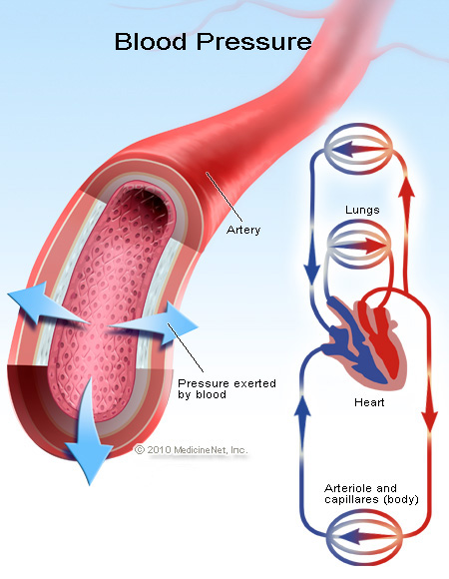
.

Slide 106
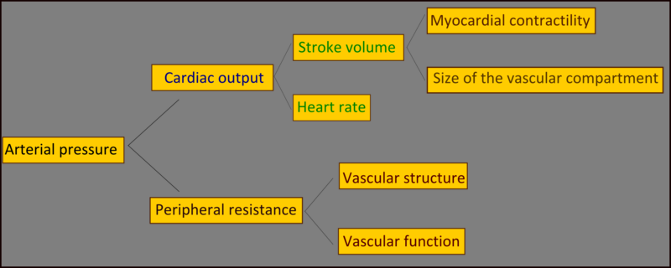
Conceptual framework.

Slide 107
Types
primary (essential) or secondary.
About 90–95% of cases are termed primary hypertension which refers to high blood pressure for which no medical cause can be found. (Idiopathic)
The remaining 5–10% of cases Secondary hypertension are caused by other conditions that affect the kidneys, arteries, heart, or endocrine system.

Slide 108
classification
hypertension stage I;- 140-159/90-99
hypertension stage II>160/>100
Hypertension stage III >180/>110

Slide 109
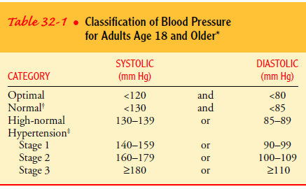
.

Slide 110
pathophysiology
Increase in BP due to change in CO or PR
BP= CO X PR
Increase in sympathetic nervous system stimulation
Increased renal reabsorption of sodium, chloride, and water
Increased activity of the renin-angiotensin-aldosterone system,RAAS resulting in expansion of extracellular fluid volume
Dysfunctional vascular endothelium hence reduced vasodilation
Resistance to insulin action –direct link btw DM II,glucose intolerance, hyperlipidemia to HTN.

Slide 111
Risk factors
Age-systemic blood pressure rises with age
Gender- males are more affected
Race- black more affected
Diet - high lipids and salts
Smoking
Positive family history
Diabetic hx
Pre-existing vascular disease
Alcohol use
Psychological Stress

Slide 112
Causes
a) Adrenocortical diseases eg.
Conns’ disease (hyperaldosteronism) - hypersecretion of aldosterone.
Cushing’s syndrome- hypersecretion of glucocorticoids
b) Phaeochromocytoma-catecholamine secreting tumors. Increases HR and SV
c) Narrowing of the renal arteries (structural)
d) Renal disease - glomerulonephritis, pyonephritis, polycystic disease
e) Severe polycythemia - high RBCs
f)Narrowing of aorta
g) Increased CO eg in thyrotoxicosis, anxiety

Slide 113
h) RAAS hyperactivity. Renin is an enzyme secreted by the kidneys (also the brain and blood vessels). It cleaves angiotensinogen to angiotensin I , which is a precursor. Angiotensin converting enzyme (ACE) from the lungs, converts angiotensin I to angiotensin II which is a potent vasoconstrictor and a stimulator of aldosterone synthesis and secretion.
i) Psychological stress (body in a flight mode)
j) Oral contraceptives stimulates angiotensinogen system
k) Chronic high sodium intake
l) Genetic factors..family hx

Slide 114
Clinical features
Occipital headache esp. morning on arising
Dizziness, fatigue
Palpitation
Angina
Dyspnoea on slight exertion
Blurring vision due to retinal changes e.g. hemorrhage and papilloedema (swelling of optic disc)
Epixtasis
Left ventricular hypertrophy
Pathologic changes in kidney.
Cerebrovascular involvement may lead to stroke(CVA) or transient ischaemic attack (TIA). May present with hemiplegia, alteration of speech and vision, sudden falls

Slide 115
Investigations
Thorough Hx
Correct BP measurement
Fundoscopy (ophthalmoscopy) to check the retina with an ophthalmoscope
Lab test eg, urinalysis, BUN, creatinine, blood glucose,
Echocardiography – heart ultrasound
ECG- electrical activity of the heart
Plasma choresterol
Plasma urea and electrolytes
S4 heart sound represents atria contraction against
Apical heave (visible sideways lifting) - LV hypertrophy

Slide 116
diagnosis
Done through diastolic pressure;-
mild 90-104mmHg
moderate 105-114mmHg
on 3 separate readings.
severe above 115mmHg (3 readings not necessary)
How to ensure correct Bp is taken????

Slide 117
Ensuring accurate blood pressure measurement.
Ensure appropriate cuff size for the patient
Ensure good calibrations on the sphygmomanometer
Cuff wrapped firmly on the arm and the cuff bladder over the brachial artery
Patient arm should be on the chest level
Initial recording on both arms..subsequent BPs on the arm with higher BP
Palpation of systolic pressure helps to detect the auscultatory gap more readily
Ask the patient not to talk….may increase BP
Record the BP, position of the patient, time, and site of measurement.

Slide 118
The equipment should be regularly inspected and validated.
The operator should be trained and regularly retrained.
The patient must be properly prepared and positioned and seated quietly for at least 5 minutes in a chair.
The auscultatory method should be used.
Caffeine, exercise, and smoking should be avoided for at least 30 minutes before BP measurement.
An appropriately sized cuff should be used.

Slide 119
management
  Primary hypertension: (idiopathic)
    Strategies for treatment based on the determinants of arterial pressure, i.e. reductions of:
      blood volume,
      sympathetic tone,
      vascular smooth muscle tone,
      angiotensin effects.
  Secondary HTN: (causes known)
    Identification and correction/treatment of the underlying cause

Slide 120
management
Beta blockers: the drugs includes:
    Non selective beta blockers: Propranolol, carteolol, pindolol, timolol
    Selective beta 1 blockers: atenolol, metoprolol, esmolol, acebutolol
    Beta and alpha receptor blockers: Labetalol, carvedilol
MOA is
    -Reduce cardiac output;
    -later have an effect on vascular resistance, due to reduced angiotensin (beta blockers reduce renin secretion)

Slide 121
Diuretics There are many different types of diuretics; but the most important for treating hypertension are the
  Thiazides (eg, hydrochlorthiazide) Often adequate in mild hypertension,
  loop agents: (eg, furosemide). Usually applied in moderate, severe, and malignant hypertension
The angiotensin-converting enzyme (ACE) inhibitors: Captopril, Enalapril, Lisinopril, Fosinopril
Angiotensin II receptor antagonists. ARB’s (blockers) losartan 50-100mg OD, lorsartan, Valsartan, Candesartan, Irbesartan
ACE’s and ARB’s cause resultant effect: vasodilation and decreased salt and water retention

Slide 122
Vasodilators
  Calcium channel blockers: Nifedipine, Verapamil, diltiazem. block voltage-gated L-type calcium channels, the calcium channels most important in cardiac and smooth muscle, thus decreasing calcium influx (and intracellular calcium concentration) and muscle contractility. They are used for both outpatient therapy and in emergencies.
  Oral vasodilators: Hydralazine and minoxidil. They are used for long term outpatient therapy of hypertension.
  Parenteral vasodilators: Nitroprusside, Diazoxide, and Fenoldopam. They are used to treat hypertensive emergencies.
  Centrally acting vasodilators…methyldopa. alpha receptor blocker

Slide 123
Complexity of Anti-Hyperetensive Therapy:
  Hypertension remains asymptomatic until in advanced stages (complications)
  Being long term therapy, drugs can be expensive and sometimes cause major compensatory responses and significant toxicities.
  However, overall toxicity can be reduced and compensatory responses minimized by the use of multiple drugs at lower dosages (approach usually applied in patients with severe hypertension).

Slide 124
Treatment steps usually include:
  (1) lifestyle measures such as salt restriction and weight reduction,
  (2) diuretics (a thiazide),
  (3) Sympathoplegics (a blocker),
  (4) ACE antagonists,
  (5) vasodilators.
The vasodilator of first choice is usually a calcium channel blocker.

Slide 125
Nursing care
Bed rest
Medication –antihypertensive
Dietary consideration and restrict fats and salts (adopt dash eating plan)
Weight control
Counseling and education e g to stop smoking
Encourage exercise - physical activity
Stress management
Risk factor management
Moderate alcohol consumption

Slide 126
Complications htn
Changes in the vessel wall leading to vessel trauma and arteriosclerosis throughout the vasculature
Complications arise due to the “target organ” dysfunction and ultimately failure.
Damage to the blood vessels can be seen on fundoscopy
CVS (Heart and Blood Vessels)-Coronary thrombosis, Ventricular hypertrophy; dysfunction and failure, Arrhythmias, Coronary artery disease, Acute MI, Arterial aneurysm; dissection, and rupture.

Slide 127
The kidneys -Renal failure, Glomerular sclerosis leading to impaired kidney function and finally end stage kidney disease. Ischemic kidney disease especially when renal artery stenosis is the cause of HTN
Nervous system Stroke, intracerebral and sub-aracnoid hemorrhage, Cerebral atrophy and dementia, Cerebral hemorrhage- can lead to CVA
The Eyes -Retinal hemorrhage, Retinopathy, retinal hemorrhages and impaired vision. Vitreous hemorrhage, retinal detachment, Neuropathy of the nerves leading to extra-occular muscle paralysis and dysfunction.

Slide 128
Hypertensive crisis
Hypertensive emergency/crisis- extreme hypertension (180/120mmhg) that requires immediate lowering of blood pressure to prevent damage of vital organs. E.g MI, cerebral hemorrhage, dissecting aortic aneurism
Drugs of choice-Intravenous vasodilators, including sodium nitroprusside (Nipride, Nitropress), nicardipine hydrochloride (Cardene), fenoldopam mesylate (Corlopam), enalaprilat (Vasotec I.V.),
Hypertensive urgency- the BP must be lowered within a few hours e.g. Severe perioperative hypertension. Managed with oral doses of antihypertensives eg diuretics

Slide 129
Congestive cardiac failure (CCF)
The inability of the heart to maintain an adequate output of blood from one or both ventricles
Manifests by distension of certain veins eg neck veins
Due to increased venous pressure, there is pulmonary and peripheral congestion hence the term CCF
Also called heart failure/ congestive heart failure
It is life long disease managed by life style changes and medications.

Slide 130
.
CO=HR×SV
Heart rate- a function of the autonomic nervous system (ANS)
If CO↓the sympathetic nervous system accelerates the heart rate to maintain adequate cardiac output
In cardiac failure, SV (stroke volume) is impaired.
SV is dependent on pre load, contractility, & aferload.
Preload- Amount of blood filling the heart(ventricles) i. e the end diastolic volume

Slide 131
.
Directly proportional to pressure created by the length of the stretch of myocardial fibers.
Contractility- is an alteration in the force of contraction that occurs at the cellular level and is unrelated to changes in myocardial fiber length.
Afterload- is the amount of pressure the ventricle must create in order to pump. The pressure on the wall of the ventricles during ejection.

Slide 132
pathophysiology
Myocardial dysfuction causes HF. Reduced contractility stimulate sympathetic NS
Adrenaline and noradrenaline produced to support the failing myocardium
Beta receptors fails due to the continuous response
There is Reduced kidney perfusion leading to Renin production
RAAS system..angiotensinogen---angiotensin I----(ACE) –angiotensin II----aldosterone.
Results,--vasoconstriction, salts, hence water retaining---increased end diastolic volume

Slide 133
Ventricular hypertrophy, with no increased perfusion hence ischemia.
Reduced contractility, reduced kidney perfusion
Vicious cycle of heart failure

Slide 134
Left-sided cardiac failure
(left ventricular failure)
Characterisied by reduced L.V output
Pulmonary congestion predominates when the left ventricle fails, the left ventricle is unable to adequately pump the blood coming from the lungs.
The increased pressure in the pulmonary circulation causes fluid to be forced into the pulmonary tissues.

Slide 135
Clinical manifestation of LVF
Dyspnea, cough, fatigability, tachycardia, anxiety and restlessness
Orthopnoea- difficulty breathing when lying flat
Paroxysmal nocturnal dyspnoea-sudden attack of orthopnea at night
Cough may be dry & non productive but is often moist
Some times Hemoptysis
Adventitious breath sounds eg crackles

Slide 136
Decreased kidney perfusion causes oliguria
Nocturia
Reduced CO causes-confusion, restlessness, anxiety, lightheadedness and dizziness

Slide 137
RIGHT VENTRICULAR FAILURE right sided heart failure
  It leads to Congestion of the viscera and the peripheral tissues predominates.
  Right side of the heart is unable to adequately empty its blood volume.
  Cannot accommodate all of the blood that normally returns to it from the venous circulation.
  Clinical manifestations: edema of the lower extremeties, weight gain, hepatomegally, distended neck veins, fluid in the abdominal cavity, anorexia, and nausea, weakness.

Slide 138
.
Clinical manifestations:
Edema of the lower extremeties feet and ankle when standing
Edema in thighs and sacral area in bed bound ptns
Edema becomes pitting after retaining 4.5 litre of fluid
Weight gain,
Hepatomegally,
Distended neck veins,
Fluid in the abdominal cavity- ascitis, and plural effusion.
Anorexia, and nausea, weakness

Slide 139
Causes of heart failure (summary)
Ventricular outflow obstruction;
-systemic or pulmonary obstruction
-Aortic or pulmonary valve stenosis
-ventricular hypertrophy
Ventricular inflow obstruction
- common cause -mitral and tricuspid stenosis.

Slide 140
.
Impaired ventricular function
-ventricular muscle diffusely affected eg in myocarditis, cardiomyopathy
-part of the ventricle affected eg in MI
Volume overload- where the pre load is increased eg in mitral regurgitation, aortic regurgitation, atria septal defects, ventricular septal defect.

Slide 141
investigations
Physical assessment
Echo cardiogram
ECG
CXR
Urea and electrolytes

Slide 142
management
Aim is to remove causative factor n reduce work load of the heart.
Pharmacotherapy
  Amynophylline-bronchodilator
  Diuretics
  ACE inhibitors
  Angiotensin II receptor blockers
  Beta blockers
  Oxygen 100%
  Vasodilators eg nitroglyceline
  Digitalis-digoxin..increases contratility

Slide 143
Nursing care
Bed rest to increase kidney blood flow
Advice on diet- Low salt intake, avoid alcohol and smoking
Avoid salt and fluid retaining drugs eg NSAIDS
Treat cause
Prop up in semifowler position
Easily digestible food
Promote some ambulation

Slide 144
Input output chart- strict maintenance
Careful observation of restlessness and dypnoea
Auscultate lungs for luncrackles
Monitor vital signs
Examining skin turgor and mucous membrane for dehydration
Assess signs of fluid overload eg orthopnea and PNO
Daily weighing

Slide 145
Nursing diagnosis
Activity intorelance
Excess fluid volume
Anxiety
Powerlessness related to inability to perform responsibility

Slide 146
complications
Uremia-poor kidney fuctions
Hypokalemia- drugs
Hyponatremia
Impared liver function
Arrythmias
Pleural effusions
Cardiogenic shock

Slide 147
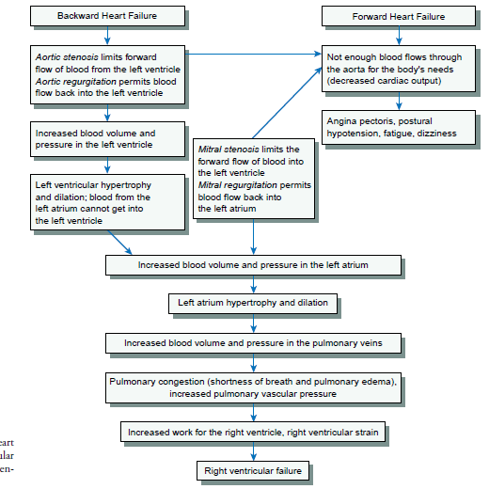
.

Slide 148
CARDIO RESPIRATORY ARREST
In this situation, the person stops breathing and the heart stops beating.
Breath movements are minimal/ not there at all.
Cardiac impulse not felt.
Causes
Traumatic- poisoning, road traffic accidents, drowning & suicides.
Non traumatic- lung disease, heart disease, CNS disease, severe dehydration & renal disease

Slide 149
management
Supportive treatment as for a coma patient
Identify and treat the cause
Drugs - adrenaline 0.1% as in asthma, i.v if possible slowly till heart beats are established.
Artificial respiration….mechanical respiration.

Slide 150
Structural disorders of the heart(congenital/acquired).
Disorders of
-the valves,
-septum,
-holes in the heart
-Affect blood flow

Slide 151
Mitral valve prolapse
A portion of mitra valve baloons back in the left atria and remains open during systole
Causes regurgitation of blood to left atrium
blood rarely progress . May result to sudden death
More in women than men

Slide 152
Clinical features
May be asymptomatic
Fatigue regardless of activity
lightheadedness
Dizziness
Syncope
Chest pain for the last few days
Palpitation
Anxiety
Shortness of breath

Slide 153
assessment
Extra heart sound (mitral)
Murmur of mitral regurgitation is heard
Echocardiography

Slide 154
management
Directly control symptoms
Anti-Arrythmia
Calcium blockers or beta blockers for chest pain that does not respond to nitrates
Mitral repair or replacement
Reduce caffeine
Smoking and alcohol cessation

Slide 155
Nursing care
Educate the patient of the symptoms
Emphasis importance of prophylactic antibiotics before surgery
Diet control balance
Activity
Reporting symptoms
Avoiding precipitating factors.

Slide 156
Mitral reguritation
Back flow of blood to LA from LV during systole
Due to problem with one or more leaflts, chordae tendinae, annulus or pappillary muscles.
Left atrium stretches to accommodate the blood. The lung becomes congested and LA also become strained.

Slide 157
Clinical features
Chronic cases may be asymptomatic
Severe CCF
Dyspnoea, fatigue, weakness,
Palpitation and shortness of breath in exertion

Slide 158
Assessment
Echo
Pulse maybe regular or irregular due to fibrillation
Systolic murmur heard as high pitched
Management:
Same as for CCF
Valvoplasty- surgical repair of the valve

Slide 159
Mitral stenosis
Narrowing of the MV obstructing blood flow from LA to LV.
Arises due to rheumatic endocarditis
Valve leaflets thicken.
LA hypertrophies– pulmonary congestion
Features: dyspnoea, fatigue, hemoptysis, cough, repeated respiratory infection
Assessment- as (MR) Mitral Regurgitation
Medical management-Antibiotic prophylaxis
Anticoagulants, valvoplasty to open the valves

Slide 160
Aortic regurgitation
backflow of blood from Aorta to LV during diastole.
Due to inflammatory lesions of the valves
May be due to
endocarditis, congenital anormalies, dx like syphylis, aneurism, failure of replaced valve.

Slide 161
Causes ventricle hypertrophy to accommodate blood.
Systolic pressure increases
Peripheral arterioles dilate reduces diastolic pressure
Presents with: palpitation…visible/ papable at temporal and carotid artery
Dyspnea, fatigue then signs of LV failure
Widened pulse pressure (ie sytole- diastole)
Water-hammer pulse..the pulse strikes the palpating fingure sharply &quickly then collapse.

Slide 162
mgt
Valvoplasty, valve replacement rx of choice
Antibiotic prophylaxis before tooth extraction

Slide 163
Aortic stenosis
Narrowing of the aortic valve
May be Due to infection eg rheumatic dx
Leads to LV hypertrophy
Asymptomatic for long time
Definitive mgnt is valvoplasty or valve repair

Slide 164
Infectious diseases of the heart
RHEUMATIC ENDOCARDITIS
Rheumatic heart disease is a complication of acute rheumatic fever.
Inflammation of the endocardium
RF follows group A-beta hemolytic streptococcus throat infection by Streptococcus pyogenes
It arises from cross-reactivity where the antibody produced against Streptococcus pyogenes in the upper respiratory tract cross-react with the patient’s heart tissue, leading to heart valve damage

Slide 165
Risk is higher with repeated episodes of acute rheumatic fever.
Chronic rheumatic heart disease is a major cause of mitral valve stenosis in children.
Rx with antibiotics necessary to prevent endocarditis
It leads to valve stenosis, with varying degrees of regurgitation, atrial dilatation, arrhythmia and ventricular dysfunction
Also affects the bony joints, producing polyarthritis
It is not infectious in that the causative agents is not involved directly.

Slide 166
It is a sensitivity response to hemolytic infection
Leucocytes accumulates in the in the affected tissue and form nodules
Myocardium and pericardium also gets inflamed causing rheumatic myocarditis and pericarditis respectively.
No serious consequence. Endocarditis has serous results e g valve stenosis. Regurgitation, heart failure

Slide 167
diagnosis
Should be suspected in any child with a previous history of rheumatic fever who presents with heart failure / is found to have a heart murmur.
Throat culture
Diagnosis important as penicillin prophylaxis can prevent further episodes of rheumatic fever and avoid worse damage to the heart valves
Mitral valve mostly affected
Patient may be at risk of embolic phenomenon in the lungs, kidneys, spleen, brain and peripheral arterioles.

Slide 168
Clinical features
Presentation depends on the severity. Mild disease may cause few symptoms except for a heart murmur in an otherwise well child & is rarely diagnosed.
Is characterized by a prototypic lesion, the vegetation, which is a mass of platelets, fibrin, microcolonies of microorganisms, and scant inﬂammatory cells.
They are starting point of gradual thickening of the valves
Leads to regurgitation, heart failure, dysrrthmias, pneumonia.

Slide 169
prevention
Recognising streptococcus infection early and treating it in the throat or skin
Be familiar with signs of streptococcal pharyngitis which includes:
  Fever---38.9 to 40 degrees.
  Chills
  Sore throat –sudden onset
  Enlarged and tender lymph nodes
  Abdominal pain
  Acute sinusitis and otitis media
Penicillin therapy can prevent all cases of rheumatic fever.

Slide 170
management
Long term antibiotics parenteral----penicillin
Give monthly benzathine benzyl penicillin at 600,000 u im every 3-4 weeks or oral penicillin v at 250 mg twice a day.
Patient teaching on the disease process and treatment.

Slide 171
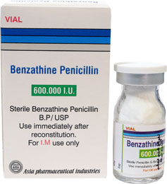
.

Slide 172
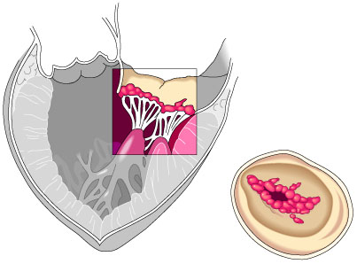
.

Slide 173
Infective endocarditis
Infection of the heart endothelium or valves
Develops in people with heart structural disorders.
Common in elderly
Can follow invasive procedures that causes bacterimia esp those involving mucosal surface
Also common in iv drug abusers.

Slide 174
pathophysiology
Involve direct invasion by bacteria (streptococci, staphylococci, pneumococci, enterococci)
The infection causes deformity of the valves and the chord tendinae.
Also caused by fungi and rickettsiae

Slide 175
Risk factors
History of bacterial endocarditis
Prosthetic heart valves
Mitral valves prolapse or thickened leaflets
Hypertrophic cardiomyopathy
Congenital malformation eg ventricular septal defects, patent ductus arteriosus
Acquired vulvular dysfuction.
Immunosuppressive medication

Slide 176
Clinical features
The features due to toxic effect of the infecting agent, valve damage or embolisation of the vegetative fragments
Malaise, anorexia, weight loss, back and joint pain, cough.
Fever is intermitent
Splinter hemorrhages ( reddish-brown streaks or lines) under fingure nails and toe nails.
Patechie on the conjuctiva and mucous membrane
Heart murmurs and cardiomegally
Headache, TIA, stroke

Slide 177
prevention
Prophylaxis before and sometimes after invasive procedures eg..
  Dental extraction, tonsilectomy,
  Git surgery
  Prostatic surgery
  Incision and drainage
  Vaginal hysterectomy
  Urethral catheterisation
Patient given 2g amoxicillin.
Nurses to ensure hygiene and aseptic techniques used during invasive procedures
Catheters removed as soon as they are not necessary

Slide 178
management
Aim is to eradicate the causative agent
Involve IV antibiotic. penicillin is the drug of choice.
Fungal endocarditis managed using antifungal e.g. Amphotericin B
Surgical magt for repair or replacement

Slide 179
Nursing management
Temperature monitoring—indicates effectivenss of therapy
Heart sound assessment
Assess signs of organ damage eg stroke, meningitis, heart failure, glomerulonephritis.
Assess all invasive line for signs of infection eg redness, warmth, swelling, tenderness, drainage..
Iv drug administration
Emotional support to the patient and family
Educate the family on prevention strategies
Pre and post operative care to the patient.

Slide 180
complications
Heart failure
Stroke CVA
Valvular stenosis and regurgitation
Myocardial damage
Embolism
Hemodynamic deterioration

Slide 181
MYOCARDITIS
Inflammation of the heart myocardium
May result from viral, bacterial and fungi infection
Leads to heart dilation, thrombi formation and damage of the muscles themselves.
Most patients are asymptomatic and the dx resolves
Moderate symptoms includes palpitations, dyspnea and chest & upper abdomen discomfort
Prevented by complete immunization
Managed by antibiotics ie penicillins

Slide 182
PERICARDITIS
Inflammation of pericardium
May be associated with the following:
- Idiopathic causes
- Infections
- Hypersensitivity states
- Disorders of adjacent structures e.g. MI
- Neoplastic disease eg metastasis from lung or breast cancer.
- Trauma- eg chest trauma, cardiac surgery
- Tuberculosis.
- Renal failure and uremia

Slide 183
Leads to accumulation of fluid in the space (pericardial effusion)
which increases pressure on the heart (cardiac tamponade)

Slide 184
Clinical manifestation
Chest pain- worsens with deep inspiration, and when lying flat-
Relieved by forward leaning
Friction rub- most characteristic sign
Dyspnoea and signs of heart failure due to cardiac tamponade
Increases ESR

Slide 185
management
Bed rest
Analgesics and NSAIDS to relieve pain
Pericardiocentesis…where the fluid from the pericardio space is drained
Patient also put on O2 to improve oxygen supply

Slide 186
Pulmonary edema
Its an abnormal accumulation of fluid in the alveoli or the interstitial space of the lungs.
May be due to LV failure or other conditions that causes hypervolemia
The blood accumulates in the lungs when the LV can not handle it all.
Increased hydrostatic pressure forces some fluid to the alveoli and the interstitial space of the lungs
Air mixes with fluid, which is expelled through the mouth or nose…classic symptom
The sputum is blood tinged.
Poor gasous exchange hence hypoxemia

Slide 187
CLINICAL FEATURES
Breathlessness
Sweating ( diaphoresis)
Cyanosis
Frothy blood tinged sputum
Respiratory distress
Rhonchi
Crepitations
Distended neck veins
Breathing becomes noisy, rapid and moist sounding

Slide 188
management
Prop up the patient
Oxygen-100% 3.5-5l/m to reduce hypoxemia
Morphine 2-5 mg reduces peripheral resistance, reduce anxiety
Diuretics.e g frusemide. to increase fluid excretion hence reduce fluid volume overload.
Digitalise with digoxin except in MI
IV aminophylline 250-500mg slow infusion

Slide 189
Nursing management
Position to reduce venous return..upright position in bed ..legs hanging from the bed
Psychological support
Administering and Monitoring medication

Slide 190
Cardiogenic shock
Shock that occurs due to failure of the heart to pump enough blood to supply tissues with enough O2
Heart failure reduces contractility of the heart. Reduces CO. Blood congestion in the lungs
Thus reduced BP
Reduced supply to vital organs
Reduced coronary perfusion reduces oxygen supply to the myocardium further reducing contractility
All causes inadequate emptying of ventricles hence hypoxia of organs

Slide 191
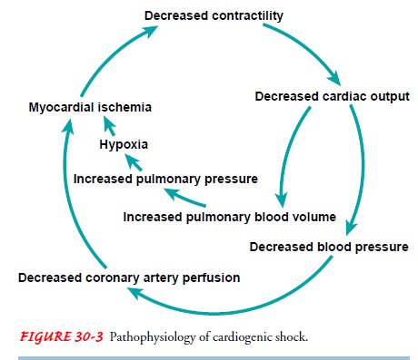
.

Slide 192
management
Oxygen administration
Bed rest to reduce heart oxygen demand
Bypass surgery
Diuretics
If hypovolemia is noticed---volume expanders eg RL, NS
Vasodilators

Slide 193
Deep vein thrombosis (dvt)
is a blood clot (thrombus) in a deep vein, usually in the legs.
Deep veins lead to the vena cava, your body's largest vein, which runs directly to your heart.
Deep vein thrombosis (DVT) is formation of a blood clot in one of the deep veins.
Usually, DVT occurs in your pelvis, thigh, or calf, but it can also occur less commonly in your arm, chest, or other locations.
DVT can cause sudden swelling, pain or a sensation of warmth
Can also cause pulmonary embolism

Slide 194
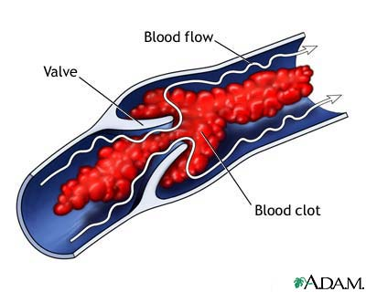
.

Slide 195
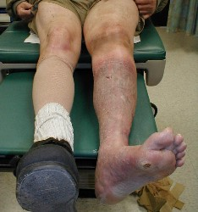
.

Slide 196
Causes of DVT
Injury to the blood vessel leading to phlebitis by
Accidents
Operations
Intravenous injections
Increased viscosity of blood eg
In surgical operations
Labor
Polycythemia
Stasis of blood flow in
Elderly and inactive post-op patients
Use of knee pillows
Tight bandages on legs
Congestive cardiac failure

Slide 197
Risk factors
Endothelial damage
Venous stasis eg due to obesity, immobility,
Coagulopathy
Cancer
Pregnancy and postpartum period
Oral contraceptives
Polycythemia
Septicemia
Major surgery and orthopedic surgery
Inactivity and immobilization with orthopedic cast, prolonged sitting

Slide 198
Signs and symptoms
Deep vein thrombosis often does not cause symptoms or causes only minimal symptoms. When symptoms occur, they include:
Swelling.
Warmth.
Pain or tenderness. The pain may be in the calf or thigh and may be present only when the affected area is touched or when standing or walking.
Redness or discolouration
Homans sign…pain in the culf after dorsiflexion..not specific for DVT.

Slide 199
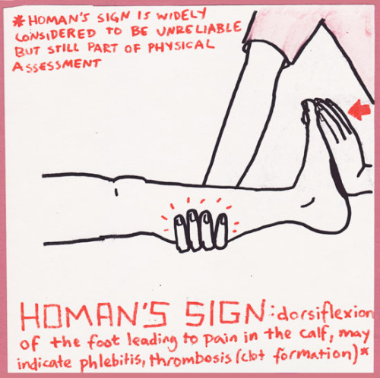
.

Slide 200
PREVENTION
Early movement and massage of lower limbs to prevent slowing of circulation
Early ambulation and exercise post-operatively
Supportive elastic/crepe bandage for phlebitis
Firm elastic stockings
Use of heparin post surgery (Anticoagulant) Prevent formation of clots

Slide 201
management
Anticoagulant therapy…
-unfractionated heparin sc
- warfarin oral anticoagulant
-fractionated heparin(low molecular weight heparin) has longer half life than unfractionated. E.g. Clexane
Thrombolytic therapy
unlike heparins, thrombolytics( fibrinolytics causes the thrombus to lyse or dissolve.
They include streptokinase, urokinase, staphylokinase, alteplase.etc
They reduce damage of the veins than the heparins…but they increase bleeding tendencies x3 than heparin
Surgical removal of the thrombus

Slide 202
Contra indications of anticoagulant therapy
Lack of cooperation from patient
Current bleeding in GIT, respiratory, reproductive, genitourinary system
Aneurisms
Severe trauma
Alcoholism
Recent or impending surgery
Recent delivery
Severe hepatic and renal disease
Recent cerebrovascular hemorrhage
Infection
Open ulcerative wounds

Slide 203
Absolute contraindication of thrombolytics
Prior intracranial hemorrhage (ICH)
Known malignant intracranial neoplasm
Ischemic stroke within 3 months (thrombolysis might have been done)
Suspected aortic dissection
Active bleeding (excluding menses)
Significant closed head trauma or facial trauma within 3 months
Intracranial or intraspinal surgery within 2 months
Severe uncontrolled hypertension (unresponsive to emergency therapy)
For streptokinase(thrombolytic), prior treatment within the previous 6 months

Slide 204
Nursing considerations
Observe for bleeding tendencies..need for protamin sulfate, heparin antidote
Observe for thrombocytopenia..prothrombin time(PT) and INR (international normalised ration)
Drug interaction

Slide 205
Complications of DVT
Pulmonary emboli from dislodged thrombi. The emboli may mabe dislodged to the lungss
Valvular destruction in the veins
Chronic venous occlusion
Venous obstruction---edema

Slide 206
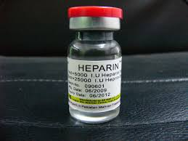
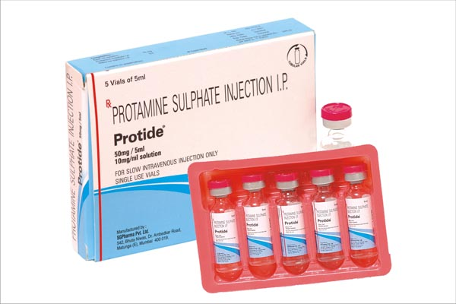
.
.
.

Slide 207
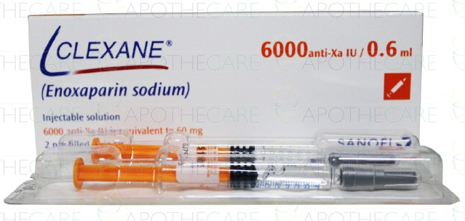
.

Slide 208
VARICOSE VEINS
Varicose veins are twisted, enlarged veins near the surface of the skin. They are most common in the legs and ankles. They are usually not serious, but they can sometimes lead to other problems.
PATHOPHYSIOLOGY
Varicose veins are caused by weakened valves and veins in the legs.
Normally, one-way valves in the veins keep blood flowing from your legs up toward the heart.
When these valves do not work as they should, blood collects in the legs, and pressure builds up.
The veins become weak, large, and twisted.

Slide 209
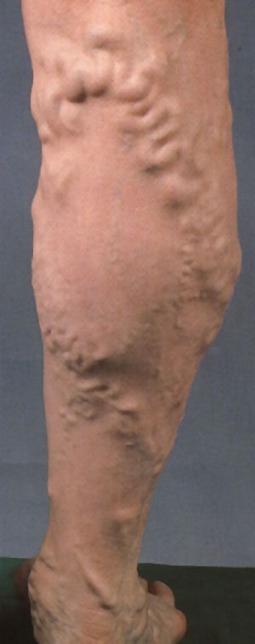
.

Slide 210
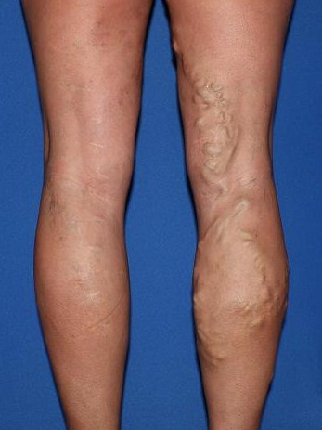
.

Slide 211
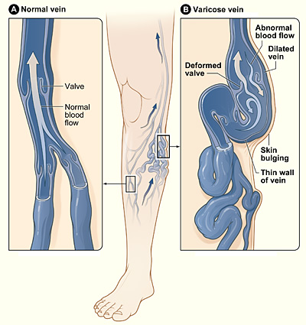
Varicose vein

Slide 212
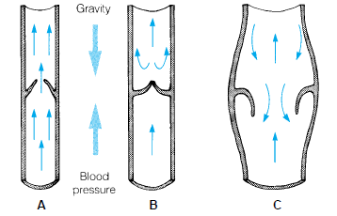
.

Slide 213
Risk factors
Family history
Advanced age
Any condition which impedes venous return from lower extremities eg
-Prolonged standing/ sitting.
-Obesity
-Pregnancy
-Constricting garments

Slide 214
Signs and symptoms
Heaviness, burning, aching, tiredness, or pain in the legs. Symptoms may worsen on standing or sittting for long periods of time.
Swelling in feet and ankles.
Itching over the vein.
Large twisted veins visible under the surface of the skin
More serious symptoms include:
Leg swelling and cramping
Swelling and calf pain after sitting or standing for long periods of time.
Skin changes, such as:
  Color changes.
  Dry, thinned skin.
  Inflammation.
  Scarling.
Profuse bleeding after a minor injury.

Slide 215
treatment
Life style changes
Avoid wearing of tight clothes especially on the pelvic girdle
Propping up (elevate) the legs.
Avoid long periods of sitting, standing, or crossing the legs
Avoid high heels
Plenty of exercise
Wearing of compression stockings help to propel blood
Medical procedures
Sclerotherapy
to close off the vein. Drug is injected to make the veins collapse. Blood re-routes to another vein.
Vein Stripping and Ligation
Vein stripping and ligation typically is done only for severe cases of varicose veins.
The procedure involves tying, cutting and removing the veins through small cuts in your skin.

Slide 216
Laser Surgery
This procedure applies light energy from a laser onto a varicose vein. The laser light makes the vein fade away.
Laser surgery mostly is used to treat smaller varicose veins. No cutting or injection of chemicals is involved.

Slide 217
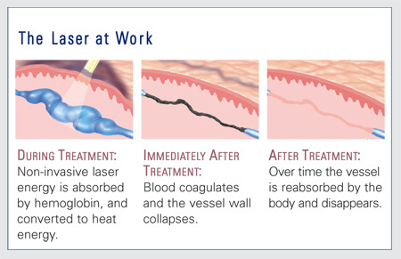
.

Slide 218
Nursing care
General and surgical
Support for leg (s)
Education on prevention as treatment is palliative
Avoid injury which could lead to infection.

Slide 219
TRANSIENT ISCHAEMIC ATTACKS (TIA)
A set of symptoms that lasts a short time and occurs because of a temporary lack of blood to part of the brain.
It is sometimes called a mini-stroke. However, unlike a stroke, the symptoms are short-lived and soon go
Patient becomes normal again
The most common cause is a tiny blood clot in a blood vessel in the brain

Slide 220
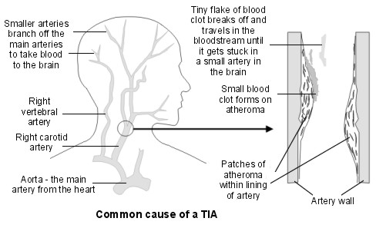
TIA

Slide 221
symptoms
Weakness or clumsiness of a hand, arm, or leg
Difficulties with speech
Difficulties with swallowing
Numbness or pins and needles of a part of the body
Brief loss of vision, or double vision

Slide 222
Diagnostic procedures
A scan of your brain. This will be either a CT scan or an MRI scan.
This is done to rule out stroke rather than a TIA.
In a few cases, a stroke can occur with complete and quick recovery.
The scan is also rules out other brain problems (e.g. a brain tumour) that may cause symptoms that mimic a TIA.

Slide 223
An ultrasound scan of the carotid arteries. To find out if there is severe narrowing of one of these arteries, caused by atheroma. Narrowing (stenosis) of the carotid arteries is a risk factor for TIA and stroke.
An electrocardiogram (ECG) to check for abnormal heart rhythms such as atrial fibrillations (an irregular heart beat).

Slide 224
Blood tests. blood is tested for diabetes or high cholesterol (these are risk factors for TIA and stroke), and to rule out anemia or kidney diseases
Blood pressure measurement. Although this is not strictly speaking a test, it is important that blood pressure is checked - high blood pressure is a risk factor for TIA and stroke, and needs to be treated.

Slide 225
management
Aspects of treatment include the following:
Medication to reduce the risk of blood clots forming.
To reduce any risk factors that one has.
Surgery in some cases.
MEDICATION
Medication reduces the risk of further blood clots forming.

Slide 226
Ant platelet medication
Platelets are tiny particles in the blood which help blood to clot.
Antiplatelet medication is usually advised if one have had a TIA.
Anti platelet medication reduces the stickiness of platelets.
This helps to prevent blood clots forming inside arteries, which helps to prevent a further TIA or a stroke.
They include aspirin, clopidogrel

Slide 227
Warfarin works by reducing some of the chemicals in the blood that are needed to make blood clot (it is an anticoagulant).
The aim is to get the dose just right so the blood is 'thinner' than normal (less able to form clots), but not so much as to cause bleeding problems.
Therefore, you need regular blood tests if you take warfarin.
( an oral anticoagulant.)

Slide 228
Smoking cessation
Regular BP check up
Weight management
Physical activity
Reduce intake of cholesterol

Slide 229
CONGENITAL HEART DISEASE
Structural disorders of the heart
Due to damage of the fetus by the Rubella virus when the mother is 1-3 months pregnant.
Or by chromosomal abnormality in children with Down’s syndrome
In most cases, the cause is idiopathic.

Slide 230
classification
NON-CYANOTIC GROUP
Anatomically, the following principal defects may be found:
Abnormal communications in the heart or between the big vessels
Atrial septal defect
Ventricular septal defect
Patent ductus arteriosus.
Co-archtation of aorta

Slide 231
Due to high pressure in the left heart, there is a shunt from the left to right heart with an increased blood load in the lungs.
In this group of congenital heart diseases, there is no cyanosis.

Slide 232
CYANOTIC GROUP
Combination of abnormal communications & stenosis.
Transposition of the great vessels
Tetralogy of Fallot - ventricular septal defect with a pulmonary stenosis.

Slide 233
Tetralogy of fallot
Is characterized by the combination of four (4) defects.
a) Pulmonary stenosis (obstruct right ventrical
b)Ventricular septal defect
c) Over- riding aorta
d)Hypertrophy of the right ventricle.

Slide 234
Ventricular septal defect (VSD). An opening in the ventricular septum, or dividing wall between the two lower chambers of the heart known as the right and left ventricles.
Pulmonary (or right ventricular outflow tract) obstruction. A muscular obstruction in the right ventricle, just below the pulmonary valve, that decreases the normal flow of blood. The pulmonary valve may also be small.
Overriding aorta. The aorta is shifted towards the right side of the heart so that it sits over the ventricular septal defect.
Hypertrophy of the right ventricle. the right ventricle becomes thickened as it tries to pump blood past the obstruction into the pulmonary artery.

Slide 235
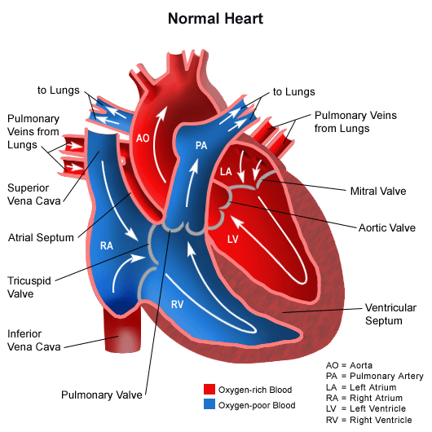
.

Slide 236
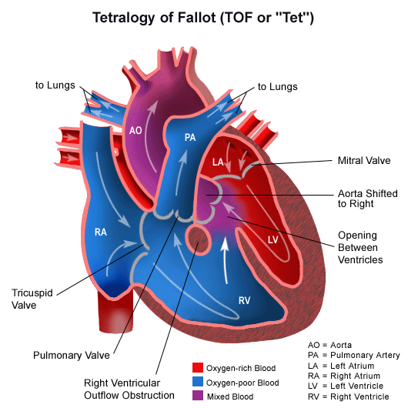
.

Slide 237
Some of the right ventricular output goes to the aorta.
Cyanosis occurs, most marked on exertion.
Is the most common defect causing cyanosis in patients surviving beyond 2 yrs of age.
Paroxysmal dyspnoea may occur, especially before the age of two years.

Slide 238
Child becomes distressed with deep cyanosis and air hunger followed by loss of consciousness and convulsions.
Place the child in knee chest position to increase cardiac efficiency and oxygen given.
Correction is through cardiac surgery.

Slide 239
TRANSPOSITION OF THE GREAT VESSELS
The aorta arises from the right ventricle instead of the left ventricle and pulmonary artery from the left ventricle.
Death occurs within a few weeks unless surgical treatment is done.
Correction is by cardiac surgery.

Slide 240
In fallots tetralogy, the de-oxygenated blood of the right ventricle cant pass easily through the narrow pulmonary artery.
So, the pressure in the right ventricle becomes pathologically increased, even higher than in the left ventricle, & blood is forced through the defect in the septum directly into the left ventricle without passing through the lungs.
This so called right to left shunt causes cyanosis.

Slide 241
Clinical features
Above mentioned features
Failure of normal growth and development
Repeated attacks of respiratory tract infections.
Loud murmur.

Slide 242
management
If ccf occurs, treat accordingly.
Treat respiratory tract infections with amoxycillin in normal doses.
Treat anaemia, if present.
Give antimalarial treatment after a positive blood slide.
Prophylaxis against Streptococcus viridans.

Slide 243
prognosis
Many children with congenital heart disease die in early childhood.
Prognosis depends on the type and extent of abnormalities and whether definitive surgical treatment is available or not.

Slide 244
prevention
Deformities caused by rubella virus can be prevented by rubella vaccination.
Avoid contact with anyone diagnosed as having rubella.
Avoid radiation/ giving unnecessary drugs to a pregnant mother in the first trimester.

Slide 245
ARRYTHMIAS
CHARACTERISTICS OF CARDIAC TISSUES FOR EFFECTIVE PUMPING OF BLOOD
Automaticity—ability of the cardiac cell to initiate its own electrical stimulus
Conductivity–ability to transmit impulse from one cell to the next within the heart
Rhythmicity- ability to repeat the cycle with regularity
Excitability (Irritability)- ability to respond to electrical stimulation
Contractility- ability to stretch as a single unit and recoil

Slide 246
NORMAL CONDUCTION
Electrical impulse originates from the depolarization of sino atrio node cells SA node, located In the right atria near the entry of the great vein
The SA node acts as the pacemakers.
It occurs at a rate ranging btw 60-100 times in one minute.
These cells trigger the neighbouring atrial cells by direct electrical contacts and a wave of depolarisation spreads out over the atria causing their contraction, eventually exciting the atrio-ventricular (AV) node.

Slide 247
The electrical signal from the AV node is carried to the ventricles by a specialised bundle of conducting tissue (the bundle of His)
It has right and the left branches and the purkinje fibres in the ventricular muscles
Electrical stimulation of the ventricular muscles causes mechanical contraction of the ventricles (systole)
The cells repolarize and the ventricles relax.
The cycle then starts again from the SA node.

Slide 248
This is called sinus rhythm….the rhythm starts at SA nodes
Electrical stimulation– depolarization
Electrical relaxation-- repolarisation

Slide 249
.

Slide 250
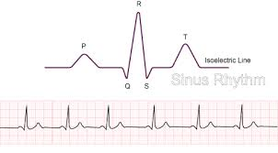
Normal sinus rhythm

Slide 251
Irregular rate and rhythm of the heart beat causes inefficient pumping of the heart .
Irregular heart beat, the heart is described as arrhythmic or dysrhythmic.
Disorders in the formation and/or conduction of the impulse in the heart is called dysrhythmias/ARRYTHMIAS

Slide 252
Common arrythmias
Sinus Bradycardia
Impulses are initiated at SA node
Rhythm is regular but rate is slow, less than 60bpm
This is normal for athletes who are asymptomatic
Pathologic incase of heart disorder, increased ICP, digitalis toxicity, or hypothyroidism
Can be slowed by vagal stimulation eg massaging carotid artery, Valsalva maneuver
Atropine sulphate IV restores the acceptable heart rate

Slide 253
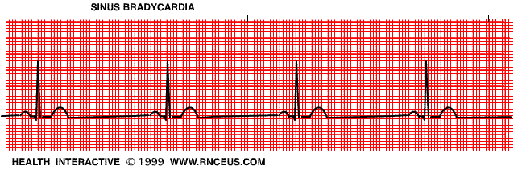
.

Slide 254
Sinus tachycardia
Impulses initiated at SA node
Rhythm is regular but increased 100-150 bpm
A physiologic response to exercise, anxiety and fear, pain, fever, hyperthyroidism, hemorrhage, shock and hypoxemia
> 150, has shortened diastole, no filling of ventricles
CO drops drastically
Leads to angina, tachycardia, syncope, reduced renal output
Drugs used to slow down– calcium channel blockers, beta blockers,

Slide 255
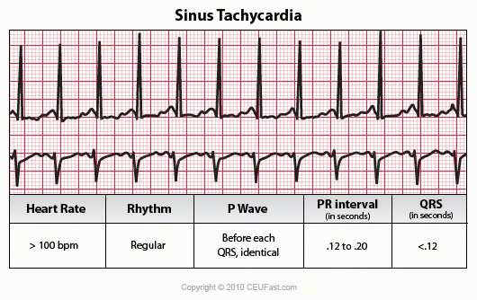
..

Slide 256
Atrial fibrillation
Totally disorganized atrial activity
Atria quiver/shake instead of contracting
Ventricles respond in an irregular manner
This reduces the cardiac output
Treated with digitalis or cardioversion i.e. introducing electric current
Patient are encouraged to take aspirin to prevent formation of clots which may result when blood is inadequately pumped

Slide 257
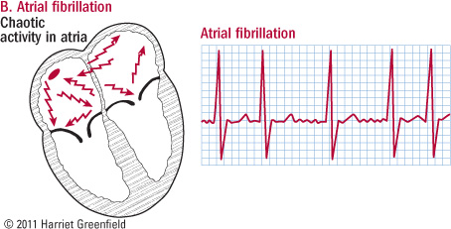
.

Slide 258
Heart block
Various degrees of heart block…first degree, second degree, and third degree (complete heart block)
All involve problem in transmitting impulse through the atriventricular (AV) node to the ventricles
In first and second degree heart block , the impulse is delayed
In complete heart block, the impulse never get through.

Slide 259
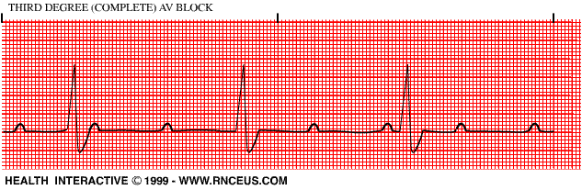
.

Slide 260
Ventricular depolarization is triggered by lower pathways spontaneously
There is no sequential relation between P wave and QRS complex but both rhythms are regular
If the client is on digitalis, it may be discontinued
If the drug adjustment does not work, a pacemaker may be inserted.

Slide 261
.
Premature ventricular contraction (PVC)
Ventricular contraction occurs early in cardiac cycle before the SA node initiates an impulse
No P wave precedes QRS complex that appears bizarre looking…unusual look
Many people experience PVC at one time or another
It causes a flip-flop sensation in the chest…fluttering of the heart
Maybe associated with pallor, nervousness, sweating and fainting
In healthy people PVC is harmless
They may be related to anxiety, fatigue, stress, alcohol withdrawal, tobacco smoking

Slide 262
.
When severe PVCs occur, the patient is given a bolus of lidocane intravenously followed by a drip if lidocane

Slide 263
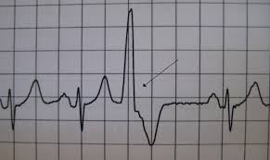
.

Slide 264
Cardiac arrest
Sudden cessation of heart beat and hence lack of effective CO
Always preceded by dangerous arrythmias eg PVC
It can be recognised in an ECG by an undulating line indicating chaotic rhythm called ventricular fibrillation, or a flat line indicating asystole
Blood ceases to be circulated
Most important role of the nurse is recognising the cardiac arrest and initiating cardiopulmonary resuscitation while waiting for further help.
BCLS…..C---A---B
Remember the patient is clinically dead.

Slide 265
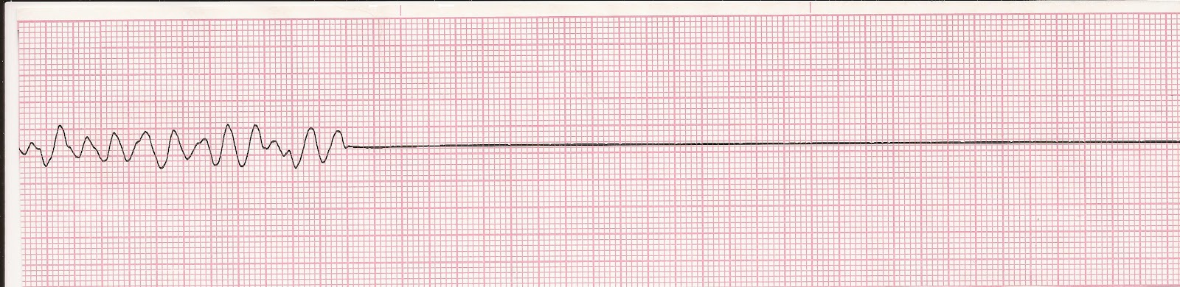
.

Slide 266
.
It occurs when the HR is very fast( ventricular tachycardia or ventricular fibrillation), or HR is too slow (brandycardia or AV block)
Coronary artery disease is the most common cause of cardiac arrest.
Conduction disorders also predisposes a patient to cardiac arrest

Slide 267
Pathophysiology of arrhythmias
Many clinical states can predispose to arrhythmias
Most common causes of arrhythmias is myocardial ischemia,
The conductive system is also susceptible to disturbances from anxiety, pain, electrolyte imbalance, valvular heart disease, and placement of invasive catheters in the heart
Arrhythmias affects the rhythmic pumping action and cardiac output

Slide 268
Management of arrhythmias
DRUG | ACTION | INDICATION
ADRENALINE | INCREASES HEART RATE, FORCE OF CONTRACTION, AND BP | ASYSTOLE
CALCIUM CHLORIDE | INCREASED CARDIAC CONTRACTION | DUE TO HYPOCALCEMEA, CALCIUM CHANEEL BLOCKER TOXOCITY OR HYPOKALEMIA
LIDOCANE | DECREASE VENTRICULAR EXCITABILITY | VENTRICULAR ARRYTHMIAS
PROCAINAMIDE | SLOWS ELECTRICAL CONDUCTION | VENTRICULAR TACHYARRYTHMIAS
ATROPINE SULFATE | BLOCKS THE EFFECTS IF VAGUS STIMULATION | BRADYARRYTHMIAS
SODIUM BICARBONATE | NEUTRALISED THE ACIDITY OF THE BLOOD | RESPIRATORY OR METABOLIC ACIDOSIS
.

Slide 269
DRUGS FOR cardiac emergencies
Elective cardioversion: this is introduction of electric current to a patient, to restore the correct rhythms. It is non emergency procedure
DEFIBRILLATION: the machine delivers the electric stimulation as soon as the button is pressed
Used during cardiac arrest when the patient is clinically dead and there is no identifiable R wave

Slide 270
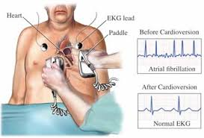
.

Slide 271
Pacemaker insertion: a pacemaker is a battery operated device, that provide electric stimulation to the heart muscle
It is implanted to restore a more effective cardiac rhythm.

Slide 272
Nursing diagnosis for patients with arrhythmias
Decreased cardiac output related to arrhythmias or ineffective response to treatment measure
Activity intolerance related to decreased cardiac output
High risk of impaired skin integrity related to conduction of electrical energy
High risk of infection related to impaired skin integrity secondary to insertion of invasive venous catheter or cutaneous incision
Knowledge deficit of treatment procedure
Anxiety or fear related to perception of diagnosis prognosis or treatment measure

Slide 273
facts
Morphine is the analgesic of choice In acute Myocardial Infarction
Reduces pain and anxiety
It reduces preload hence reducing oxygen demand for the myocardial tissue. also relaxes bronchioles to enhance oxygenation. This is the primary reason for using morphine
It is a vasodilator
Meditation decreases sympathetic system activation
Phlebostatic area… 5th intercostal space mid-axillary line

Slide 274
shock
A condition where the systemic pressure is inadequate to deliver oxygen and nutrients to the cells
Adequate blood flow depends on: adequate cardiac pump, effective vasculature and adequate blood volume
If one of this is affected, shock can result

Slide 275
Further reading
Read on cardiac catheterization…
Indications
Nursing care for a patient who is undergoing catheterization

Slide 276
(Cor-Pulmonale)
Pulmonary Heart Disease
Cor pulmonale is a condition in which the right ventricle of the heart enlarges (with or without right-sided heart failure) as a result of diseases that affect the structure or function of the lung or its vasculature. Any disease affecting the lungs and accompanied by hypoxemia may result in cor pulmonale
The most frequent cause is severe COPD in which changes in the airway and retained secretions reduce alveolar ventilation Other causes are conditions that restrict or compromise ventilatory function, leading to hypoxemia or acidosis (deformities of the thoracic cage, massive obesity)
Certain disorders of the nervous system, respiratory muscles, chest wall, and pulmonary arterial tree also may be responsible for cor pulmonale.

Slide 277
Pathophysiology
Pulmonary disease can produce physiologic changes that in time affect the heart and cause the right ventricle to enlarge and eventually fail
Any condition that deprives the lungs of oxygen can cause hypoxemia and hypercapnia resulting in ventilator insufficiency. Hypoxemia and hypercapnia cause pulmonary arterial vasoconstriction and possibly reduction of the pulmonary vascular bed, as in emphysema or pulmonary emboli.
Right ventricular hypertrophy may result, followed by right ventricular failure. In short, cor-pulmonale results from pulmonary hypertension, which causes the right side of the heart to enlarge because of the increased work required to pump blood against high resistance through the pulmonary vascular system.

Slide 278
Clinical Manifestations
Symptoms of cor pulmonale are usually related to the underlying lung disease, such as COPD. With right ventricular failure, the patient may develop increasing edema of the feet and legs, distended neck veins, an enlarged palpable liver, pleural effusion, ascites and a heart murmur, Headache, confusion, and somnolence .somnolence may occur as a result of increased levels of carbon dioxide (hypercapnia Patients often complain of increasing shortness of breath,). wheezing, cough, and fatigue

Slide 279
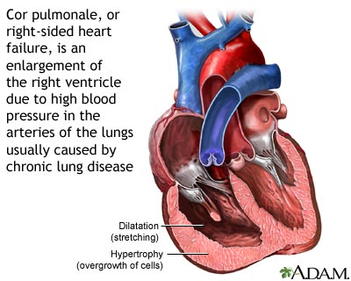

Slide 280
Medical Management
The objectives of treatment are to improve the patient’s ventilation and to treat both the underlying lung disease and the manifestations of heart disease .
Supplemental oxygen is administered to improve gas exchange and to reduce pulmonary arterial pressure and pulmonary vascular resistance.
Improved oxygen transport relieves the pulmonary hypertension that is causing the cor-pulmonale.

Slide 281
Further measures depend on the patient’s condition. If the patient is in respiratory failure, endo tracheal intubation and mechanical ventilation may be necessary. If the patient is in heart failure, hypoxemia and hypercapnia must be relieved to improve cardiac function and output. Bed rest, sodium restriction, and diuretic therapy also are instituted judiciously to reduce peripheral edema
Digitalis may be prescribed to relieve pulmonary hypertension if the patient also has left ventricular failure, or right ventricular failure that does not respond to other therapy.
ECG monitoring may be indicated because of the high incidence

Slide 282
Nursing Management
Nursing care of the patient with cor pulmonale addresses the underlying disorder leading to cor pulmonale as well as the problems related to pulmonary hyperventilation and right-sided
If intubation cardiac failure. and mechanical ventilation are required to manage ARF the nurse assists with the intubation procedure And she assesses the patient’s respiratory and cardiac status and administers medications as prescribed
During the patient’s hospital stay, the nurse instructs the patient about the importance of close monitoring (fluid retention, weight gain, edema) and adherence to the therapeutic regimen especially the 24-hour use of oxygen.

Slide 283
Teaching Patients Self-Care. Most of the care and monitoring of the patient with cor pulmonale is performed by the patient and family in the home because it is a chronic disorder.
If supplemental oxygen is administered, the nurse instructs the patient and the family in its use
Nutrition counseling is warranted if the patient is on a sodium-restricted diet or is taking diuretics. The nurse teaches the family to monitor for signs and symptoms of right ventricular failure and about emergency interventions and when to call for assistance Most importantly

Slide 284
During the home the patient’s status and the patient’s and family members understanding of the therapeutic visit, the home care nurse evaluates regimen and their adherence to it. If oxygen is used in the home, the nurse determines if it is being administered safely and as prescribed.

Slide 285
It is important to assess the patient’s progress in stopping smoking and to reinforce the importance of smoking cessation with the patient and family. The nurse identifies strategies to assist the patient and family. In addition, the patient is reminded
about the importance of other health promotion and screening

Slide 286
references
Sussanne, C (2010). Brunner and Saddarth’s text book of medical surgical nursing. New Yolk, NY: Wolters Kluwer Health.
Keith moore. The developing human
Katzung, G (2007). Basic and clinical pharmacology.

