Slide 1
Chronic Otitis Media
Dr Sitima- ENT, Head and Neck Surgeon, PGH Nakuru

Slide 2
INTRODUCTION
Definition: Chronic inflammation of the middle ear and mastoid cavity
Otitis-Greek Media -Latin
Majorly a sequelle of AOM
Can be
CSOM (not synonymous with COM)
COME
Adhesive disease

Slide 3
Risk factors
Interplay btn
Immunocompromise
Poor living conditions
Bottlefeeding
Young children
Innoculum exposure
Day care facilities
Family history of otitis media
Feeding in supine position
Inadequate ASOM treatment
Poor access to medical care/ LSES
Inadequate Dx and treatment
Maternal education level

Slide 4
Chronic otitis media
Acute Otitis Media
Resolution
Persistent effusion
Acute Perforation + Otitis Media
Resolution + Healing
Chronic suppurtive otitis media
Unsafe
Safe

Slide 5
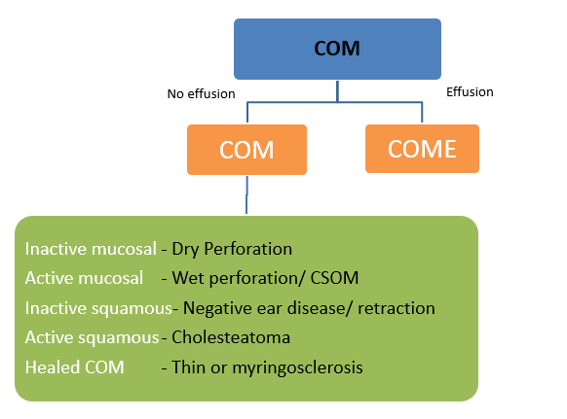
COM
Classification of COM^{1,2,7}
CSOM and Non-CSOM¹
By Perforation
Site -Tubotympanic(quadrant/centrality) -Atticoantral/ unsafe
Size- In 25% multiples, subtotal/ total
By Active disease-Inactive(dry ear) or active (wet)
By Cholesteatoma- +/- cholesteatoma
By Negative pressure disease- TM retraction graded by Sade and Tos classifications
By Histopathological subtypes- 5 subtypes

Slide 6
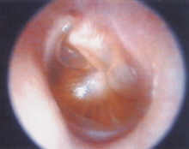
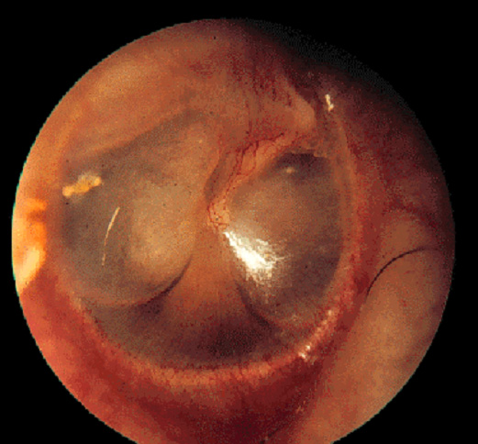
Otitis Media with Effusion (Chronic non-suppurative Otitis Media)
Chronic otitis media
Middle ear filled with serous or mucoid fluid
No purulence
Often present after acute otitis media is treated appropriately with antibiotics
Most will clear within 3 months
Adults ??Nasopharyngeal carcinoma

Slide 7
Otitis Media with Effusion (Chronic non-suppurative Otitis Media)
Chronic otitis media
Diagnosis :
History.
Clinical Examination.
Tuning fork tests.
Audiological assessment.

Slide 8
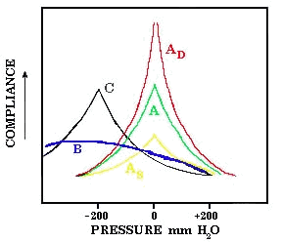
Otitis Media with Effusion (Chronic non-suppurative Otitis Media)
Chronic otitis media
Tuning fork tests
Audiological assessment:
1. Tympanometry

Slide 9
Otitis Media with Effusion (Chronic non-suppurative Otitis Media)
Chronic otitis media
Audiological assessment:
2.Pure tone audiogram

Slide 10
Otitis Media with Effusion (Chronic non-suppurative Otitis Media)
Chronic otitis media
Medical Treatment of OME :
Observation – many European countries wait 6-9 months prior to placement of ear tubes.
Antibiotics
Audiogram at 3 months with persistent effusion to determine impact on hearing

Slide 11
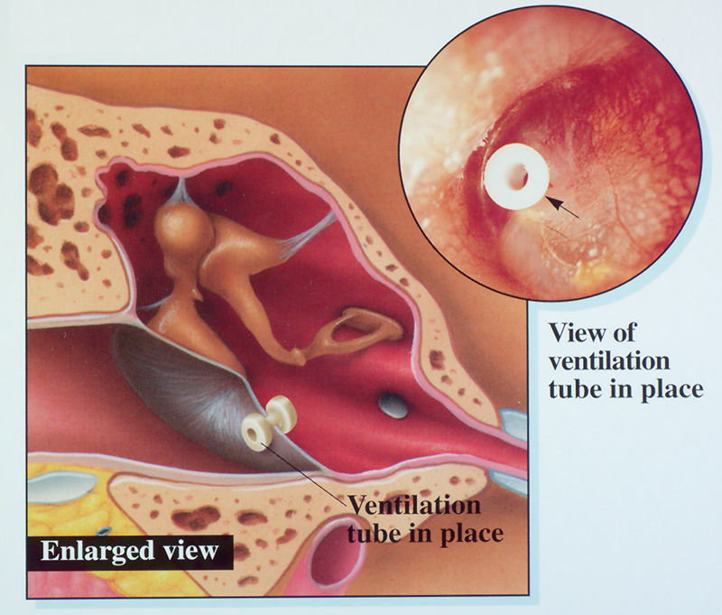
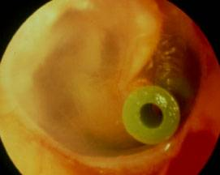
Otitis Media with Effusion (Chronic non-suppurative Otitis Media)
Chronic otitis media
Surgical treatment (Tympanostomy Tubes ) :
Bypass Eustachian tube to ventilate middle ear.
Indication : chronic OME >3mos with hearing loss and/or speech delay is an indication for tympanostomy tube placement.

Slide 12
Adhesive otitis media (Chronic non-suppurative Otitis Media)
Chronic otitis media
Lack of middle ear ventilation results in negative pressure within the tympanic cavity.
The ear drum retracts onto structures within the middle ear.

Slide 13
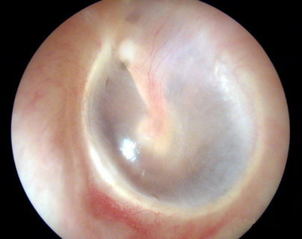
Adhesive otitis media (Chronic non-suppurative Otitis Media)
Chronic otitis media
The result of long standing Eustachian tube dysfunction.
The drum loses structural integrity and becomes flaccid.
Contact between the drum and the incus or stapes can cause bone erosion at the IS joint.
Can sometimes be treated with tympanostomy tubes.

Slide 14
Chronic suppurative otitis media
Chronic otitis media
3D :
Duration > 3 months despite treatment
Discharge mucopurulent otorrhea
Deafness Perforation /Ossicular chains

Slide 15
Chronic suppurative otitis media
Chronic otitis media
Pathogenesis :
ET dysfunction
Poor aeration
Mucosal edema and ulceration
Capillary proliferation
Osteitis

Slide 16
Chronic suppurative otitis media
Chronic otitis media
Etiology / microbiology :
Pseudomonas aeruginosa.
Staphylococcus aureus.
Proteus species.

Slide 17
Chronic suppurative otitis media
Chronic otitis media
Classification :
Chronic suppurative otitis media
Tubo-tympanic type (safe)
Attico- antral (un safe)

Slide 18
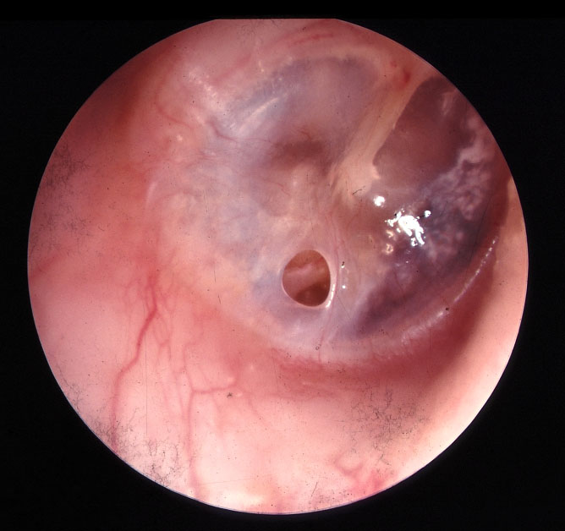
Chronic suppurative otitis media
Chronic otitis media
A- Tubotympanic type (Safe) :
Simple perforation.
Intermittent non offensive non bloody ear discharge.
On examination (central perforation ).

Slide 19
Chronic suppurative otitis media
Chronic otitis media
B- Attico-antral (unsafe) :
Chronic ,Scanty, offensive and bloody ear discharge.
On examination marginal perforation.
You may see cholesteatoma.

Slide 20
Cholesteatoma
Chronic otitis media
Cholesteatomas are epidermal inclusion cysts of the middle ear and/or mastoid with a squamous epithelial lining.
Sac of squamous epithelium in fibrous matrix seen as white cheesy substrate occurring when keratinocytes lose apoptosis
Contain keratin and desquamated epithelium.

Slide 21
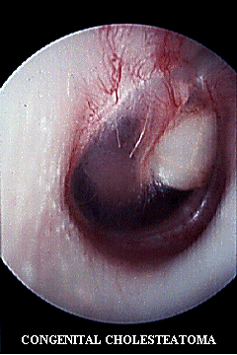
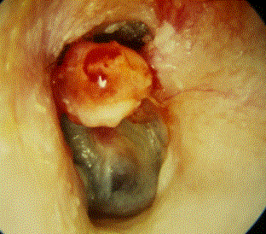
Cholesteatoma
Chronic otitis media
Can be congenital or acquired

Slide 22
Cholesteatoma
Chronic otitis media
Pathogenesis of cholesteatoma :
Natural history is progressive growth with erosion of surrounding bone due:
Pressure effects.
Osteoclast activation.

Slide 23
Cholesteatoma
Chronic otitis media
Diagnosis :
History
Examination
Otoscopic
Microscopic
Tuning fork test
Investigation
Audiological assessment
Radiological assessment

Slide 24
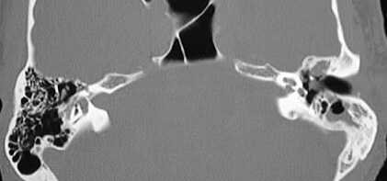
Cholesteatoma
Chronic otitis media
Cholesteatoma Imaging :

Slide 25
Chronic suppurative otitis media without cholesteatoma ( safe )
Chronic otitis media
Aural toilet
Ototopic drops
Surgical repair of the TM perforation.
Myringoplasty
Tympanoplasty
If persistent otorrhea >8 weeks ? compliance, recurrent URTI, aural debri, marked granulation, cholesteatoma, FB, ?resistance

Slide 26
Chronic suppurative otitis media with cholesteatoma ( Unsafe )
Surgery- Mastoidectomies
Follow-up
Rehabilitation

Slide 27
