Slide 1
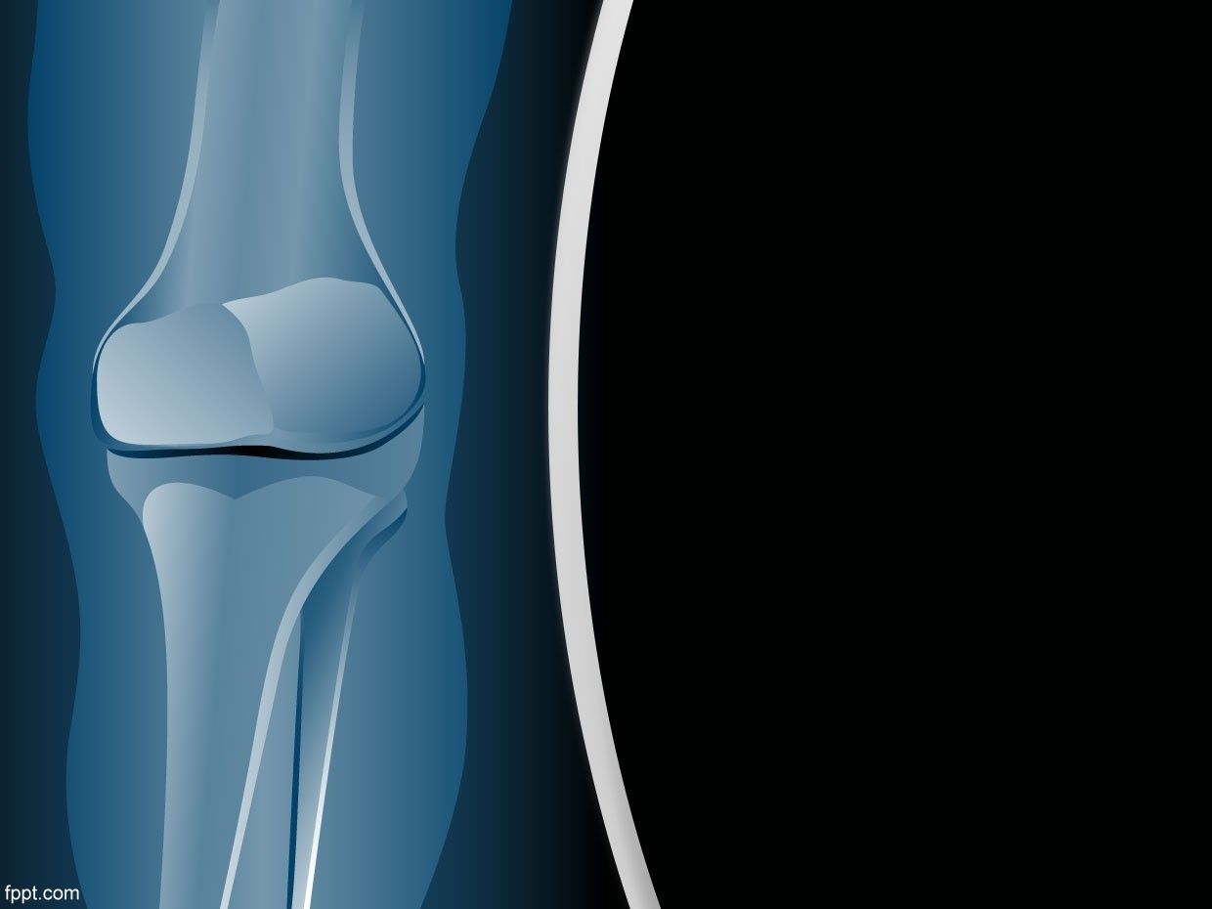
CLASSIFICATION OF BONES PRESENTATION
DPT Batch# 01
GROUP # 03(C)

Slide 2
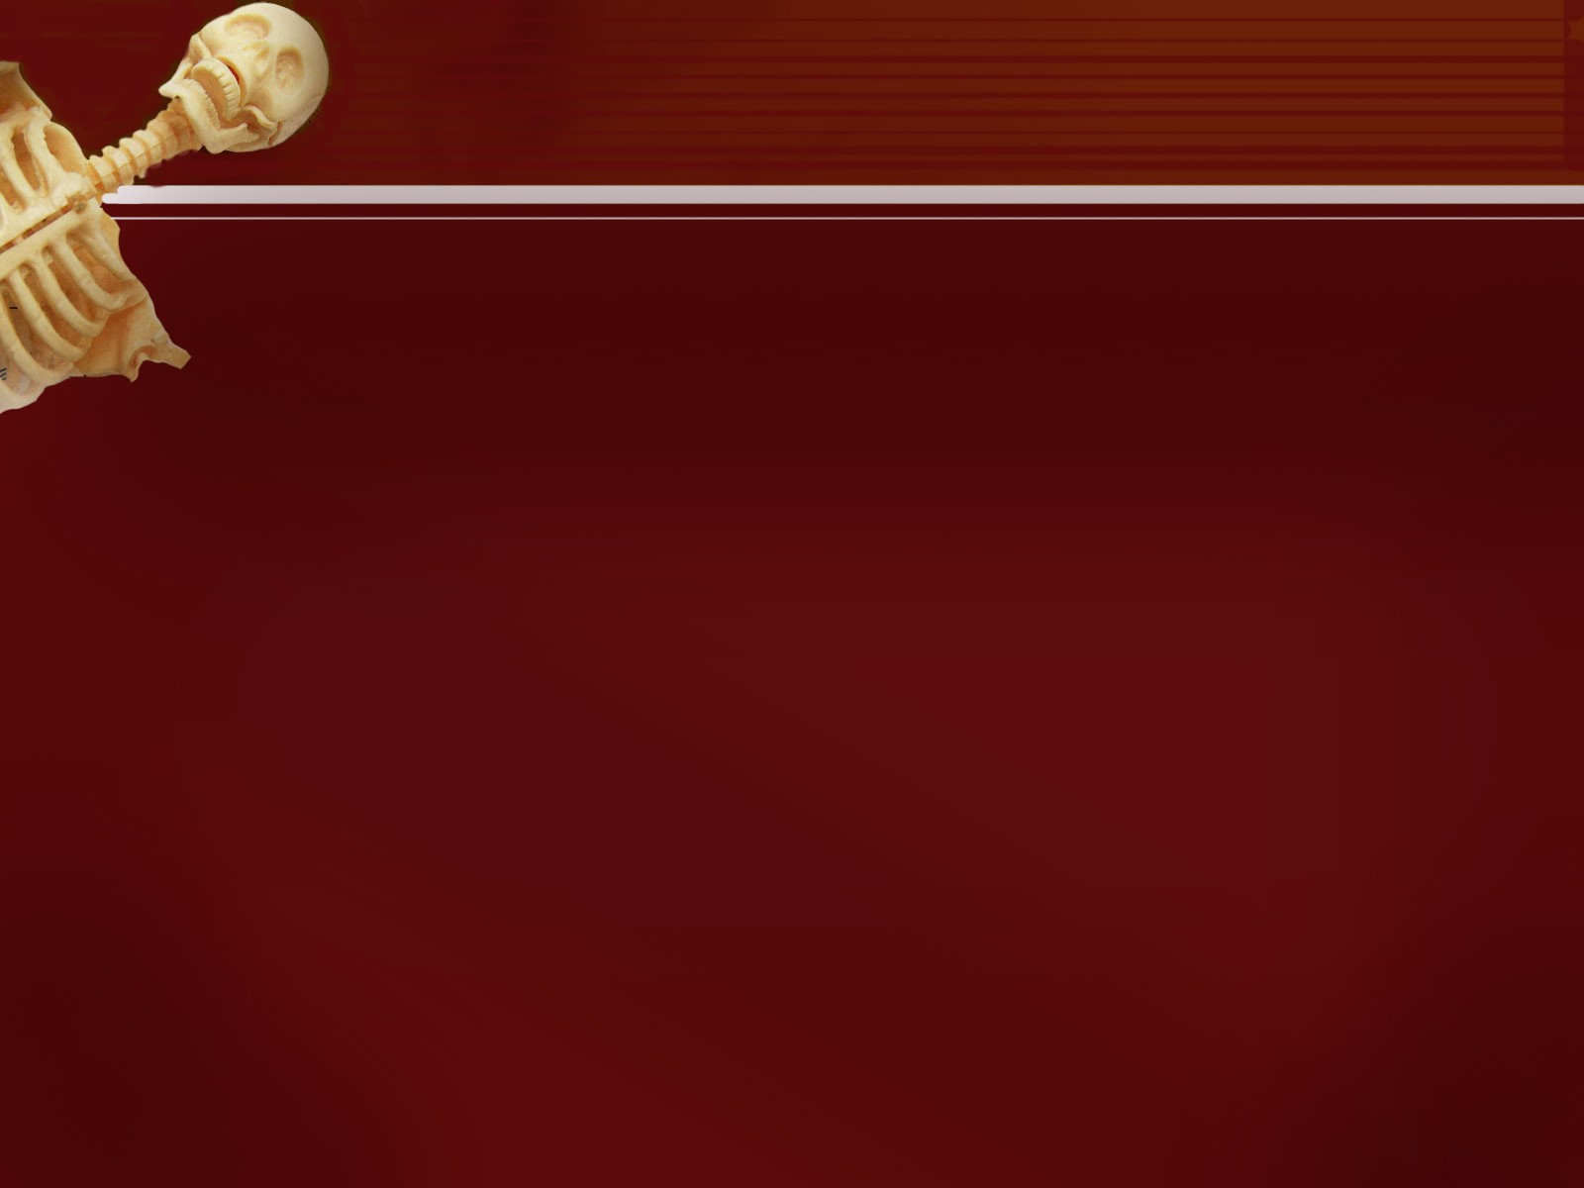
PRESENTED BY:
1. Saadiya Naeemi.

Slide 3
OUTLINE
Introduction.
Types Of Bones:
A.Types of bone on the basis of shape:
Long bones,
Short bones,
Flat bones,
Irregular bones,
Pneumatic bones,
Sesamoid bones.

Slide 4
OUTLINE
Types on the basis of development:
Membranous bones,
Cartilaginous bones,
Membro-cartilaginous bones.
Types on the basis of region:
Bones of Axial skeleton,
Bones of Appendicular skeleton.
Types on the basis of structure:
According to Macroscopic approach:
Compact bone,
Spongy bone.

Slide 5
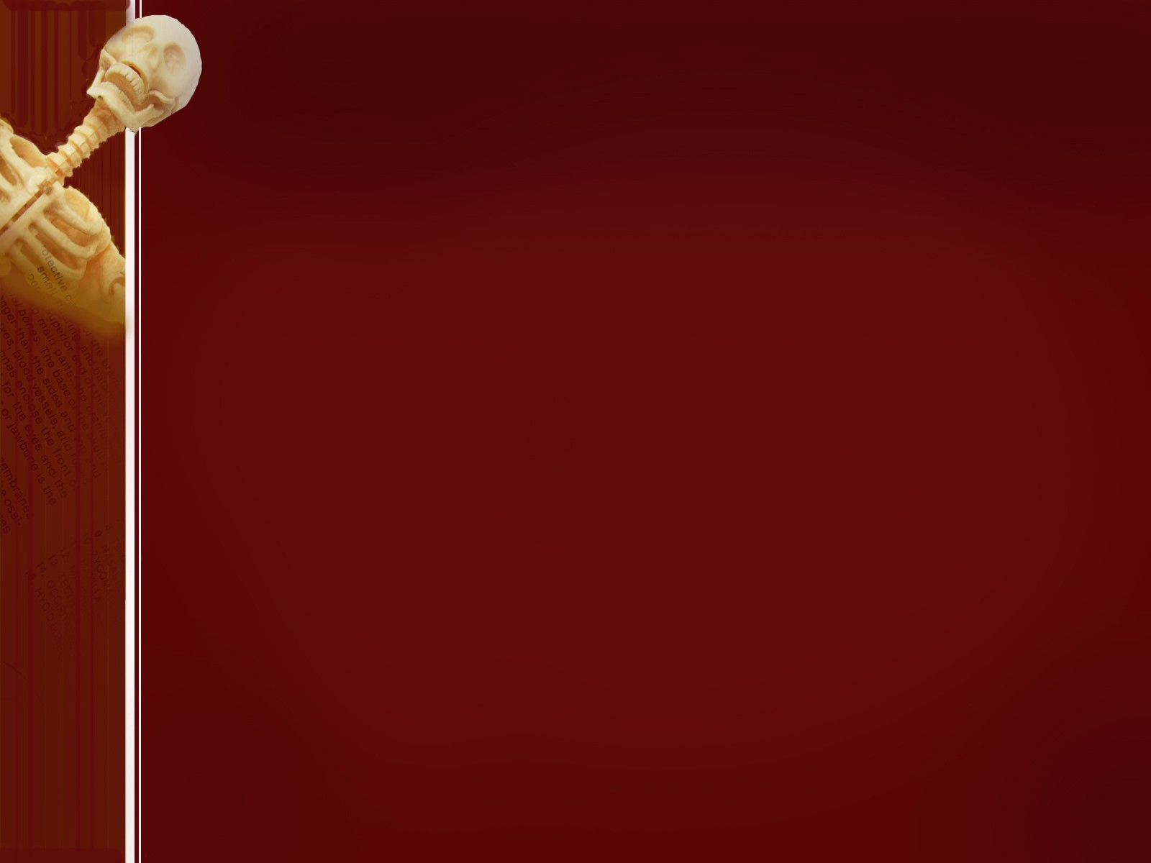
According to Microscopic approach:
Fibrous bone,
Lamellar bone.
Woven bone.
Dentine and Cement.

Slide 6
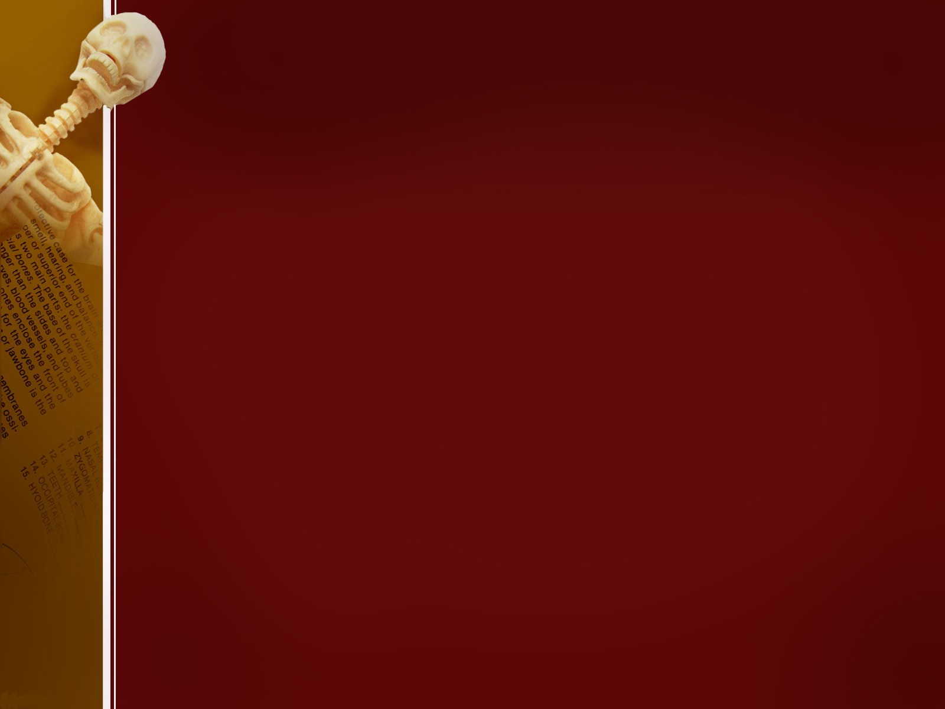
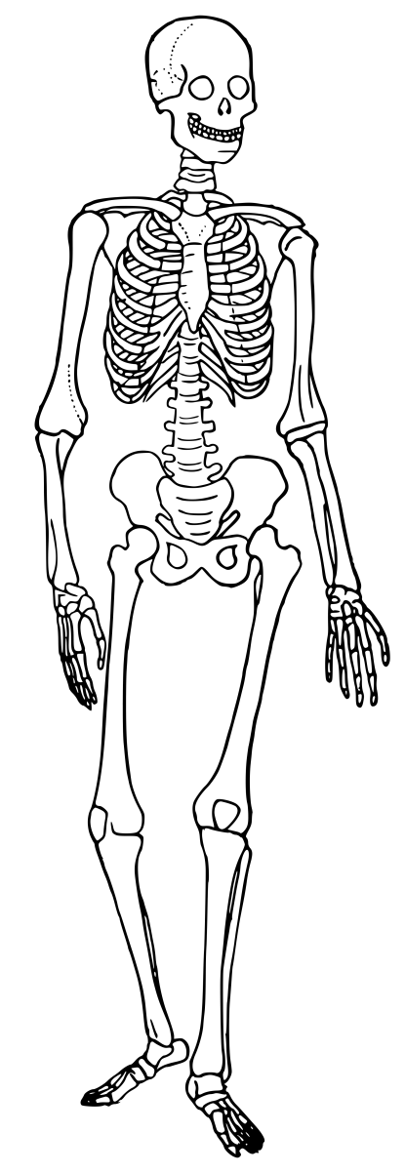
INTRODUCTION
Bones:
Bone is the one-third connective tissue, forming the main supporting framework of the body. The in-organic Calcium salts make it hard and rigid.
Osteology:
The scientific study of bones is known as Osteology.

Slide 7
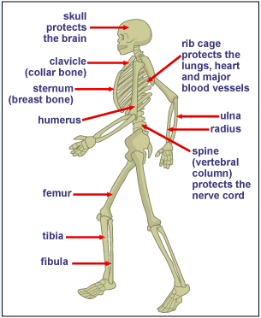
Functions Of Bones:
Support, Protection & Movement:
Gives shape to the body.
Supports body weight.
Protects sensitive parts of the body.
Blood Cell Formation:
The red bone marrow found in the
connective
tissue of certain bones is the site of blood cell production.

Slide 8
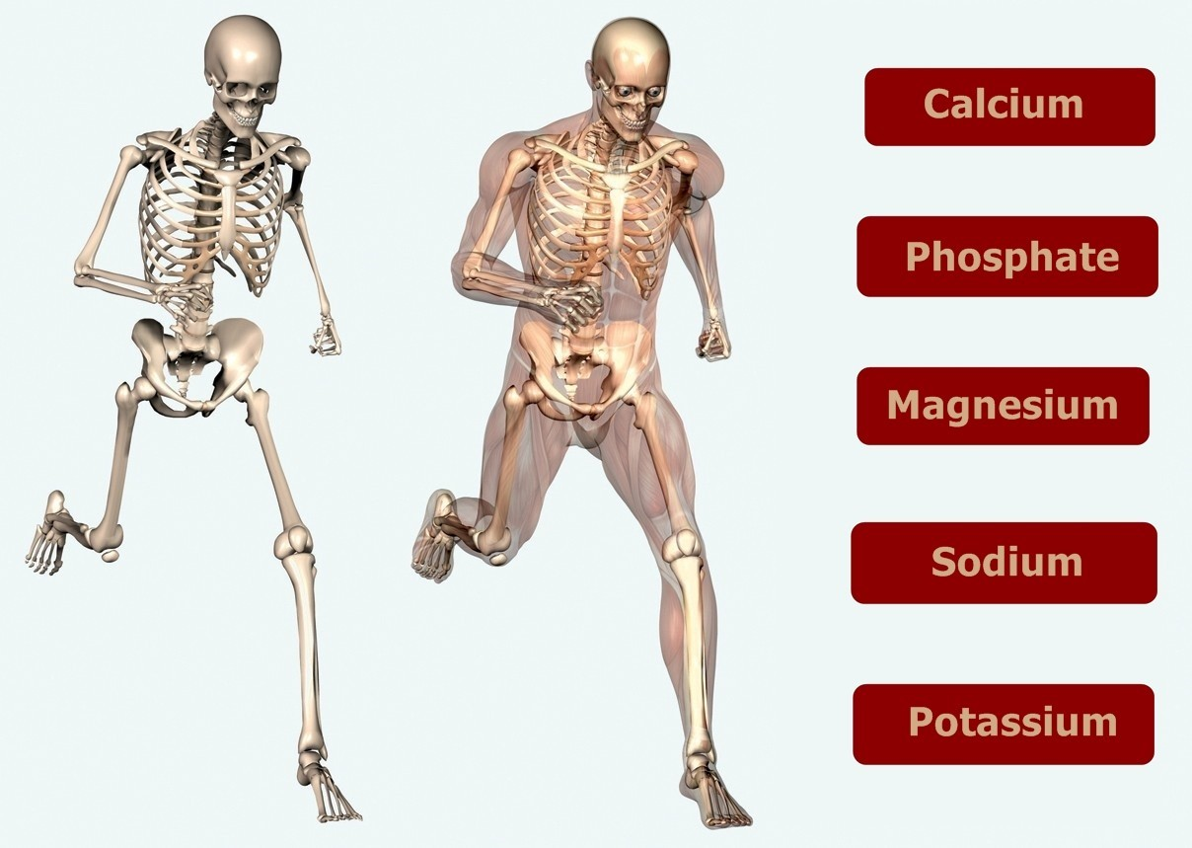
c. In-organic Salt Storage:
Functions as a storage depot for many of the body
needs. For example: (Calcium, Potassium, Sodium etc).

Slide 9
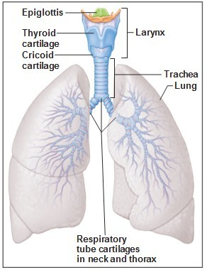
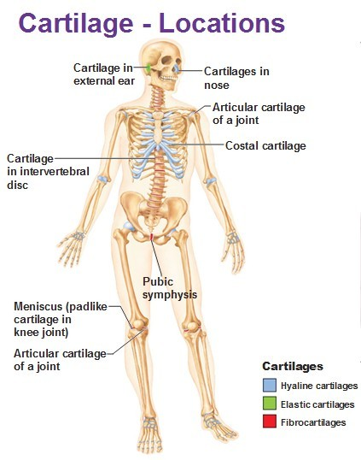
Cartilage:
Cartilage is a connective tissue composed of cells & fibers embedded in Nucleopolysachharide.
There are three main types of cartilages which are mentioned below:
Hyaline Cartilage: Covers the atricular Surface of synovial membrane.
Fibro-Cartilage: Present in the Epiglottis etc.
Elastic Cartilage: Present in the ear
Pinna etc.

Slide 10
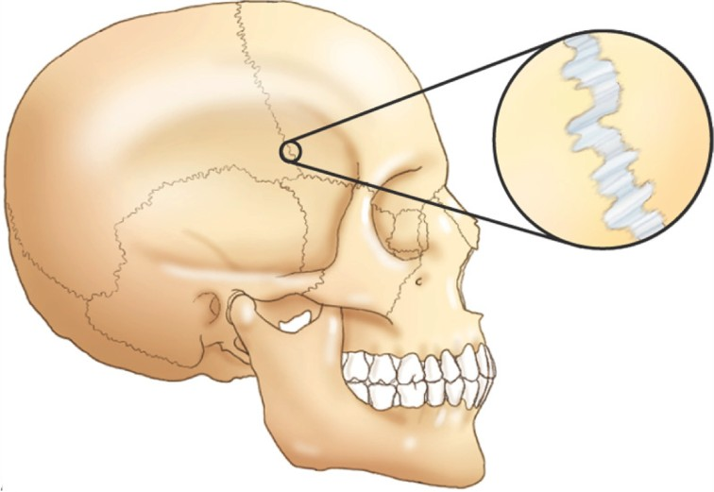
Functional Classification of Joints:
The point in human skeleton where two bones join together is called a joint.
There are three types of joints which are mentioned below:
1. Synarthroses:
Immoveable Joints. Example: Suture
Fig. Example of Synarthroses.

Slide 11
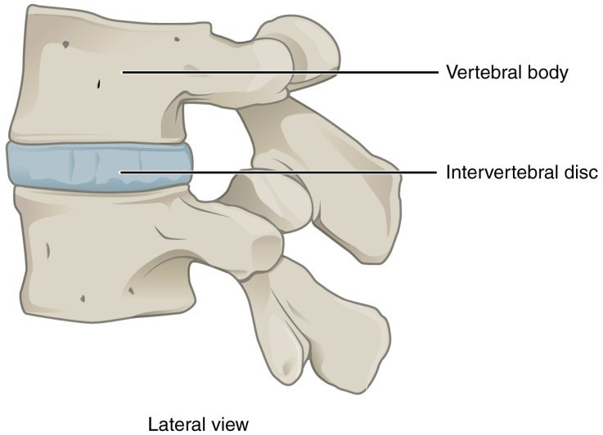
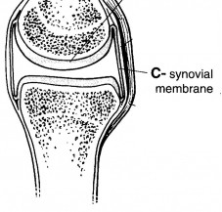
2. Amphiarthrosis:
Slightly/Partially moveable joints. Example: Intervertebral disc.
.
Fig. Example of Amphiarthrosis.
3. Diarthrosis:
Freely moveable joints. Example: Synovial membrane
Fig. Example of Diarthrosis.

Slide 12
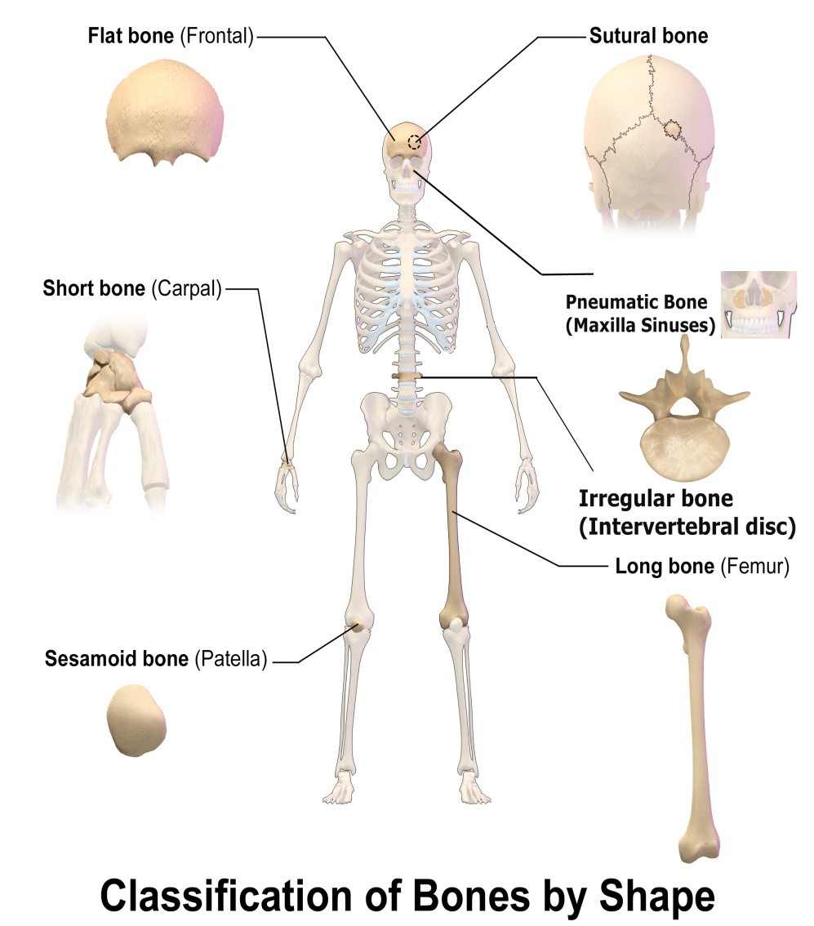
Types Of Bones:
A. Types On The Basis Of Shape:
There are 6 basic types which are mentioned below:
Long Bones.
Short Bones.
Flat Bones.
Irregular Bones.
Pneumatic Bones.
Sesamoid Bones.

Slide 13
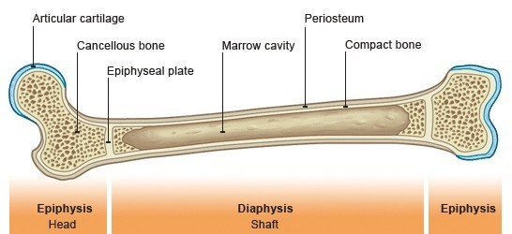
Fig. Femur, Long Bone.
1. Long Bones:
These bones typically have an elongated shaft
and
two expanded ends one on either side of the shaft. The shaft is known as diaphysis and the ends are called epiphyses.
Examples: Humerus, femur etc.

Slide 14
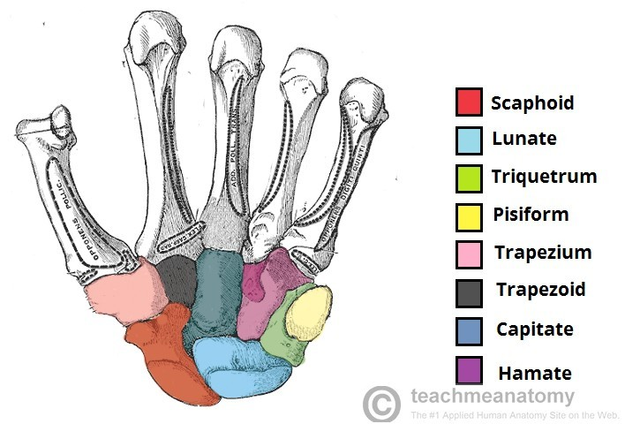
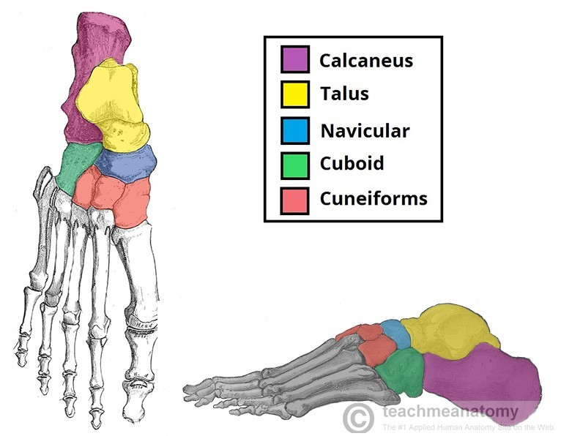
2. Short Bones:
These bones are short in posture and can be of any
shape.
Examples: The carpal and tarsal bones.
Fig. Carpal Bones, Short Bones.
Fig. Tarsal Bones, Short Bones.

Slide 15
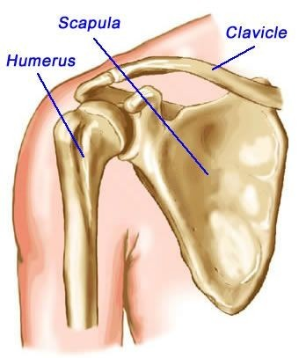
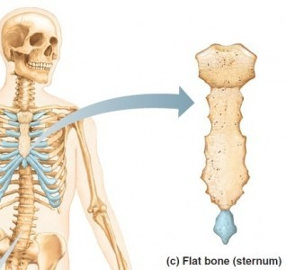
3. Flat Bones:
These bones are flat in appearance.
Examples: Scapula, Ribs, Sternum etc.
Fig. Scapula, Flat Bone.
Fig. Sternum & ribs, Flat bones.

Slide 16
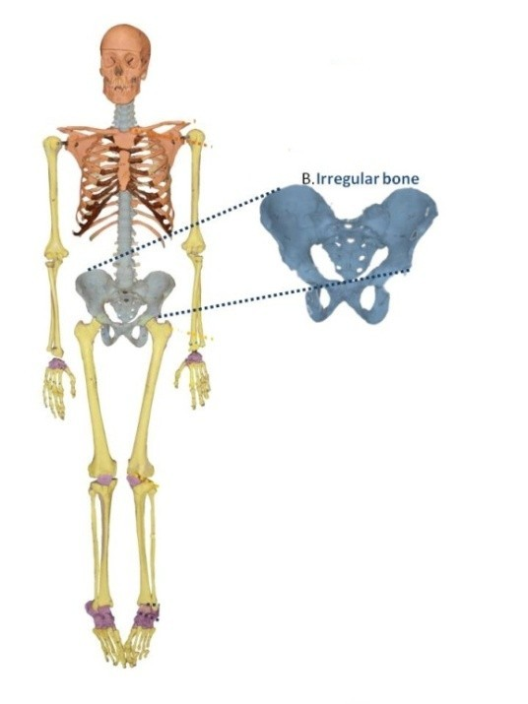
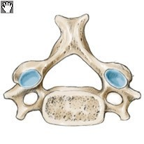
4. Irregular Bones:
These bones are completely irregular in shape.
Examples: vertebrae, hip bone and bones in the
base of skull.
Fig. Hip bone, Irregular bone.
Fig. 1st & 2nd Cervical of vertebra, Irregular bone.

Slide 17
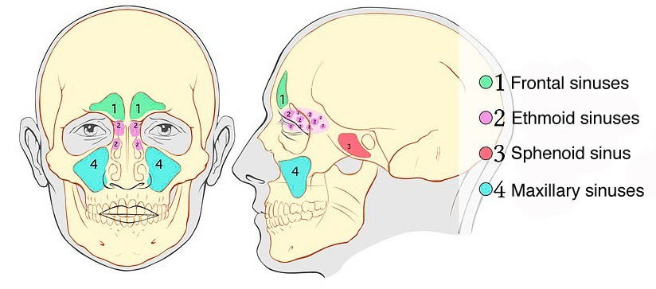
5. Pneumatic Bones:
Pneumatic bones can also be categorized under the irregular
bones.The characteristic difference is the presenceof large air spaces in
these bones which make them light in weight and thus they form the major
portion of skull
Examples: Sphenoid, Ethmoid, Maxila etc.
Fig. Sphenoid, Ethmoid, Maxila , Pnematic Bones.

Slide 18
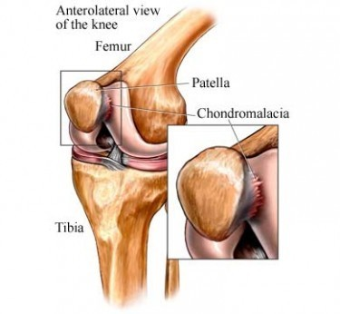
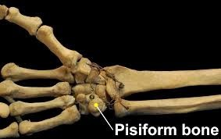
6.Sesamoid Bones:
These are in the form of nodules embedded in
tendons and joint capsules.
Examples: Patella, Pisiform, Fabella etc.
Fig. Patella, Sesamoid Bone.
Fig. Pisiform, Sesamoid Bone.

Slide 19
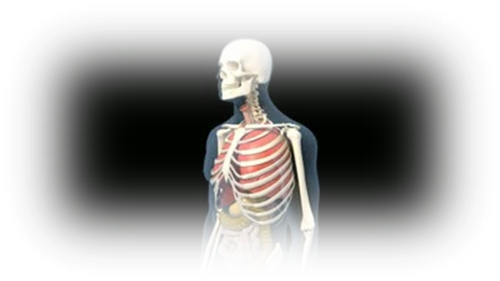
B. On The Basis Of Development:
There are three basic types which are mentioned below:
Membranous bones,
Cartilaginous bones,
Membro-cartilaginous bones.

Slide 20
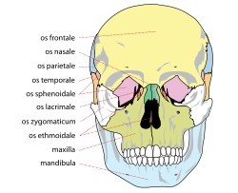
1. Membranous bones:
These bones ossify in membrane from mesenchymal
condensations.
Examples: Bones of the vault of skull and Facial bones.
Fig. Bones of Skull & Face, Membranous bones.

Slide 21
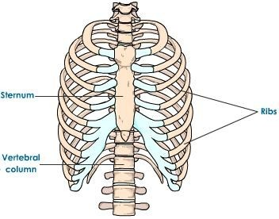
2. Cartilaginous Bones:
They ossify in cartilage and thus derived from performed
cartilaginous models.
Examples: Thoracic cage etc.
Fig. Thoracic cage, Cartilaginous bones.

Slide 22
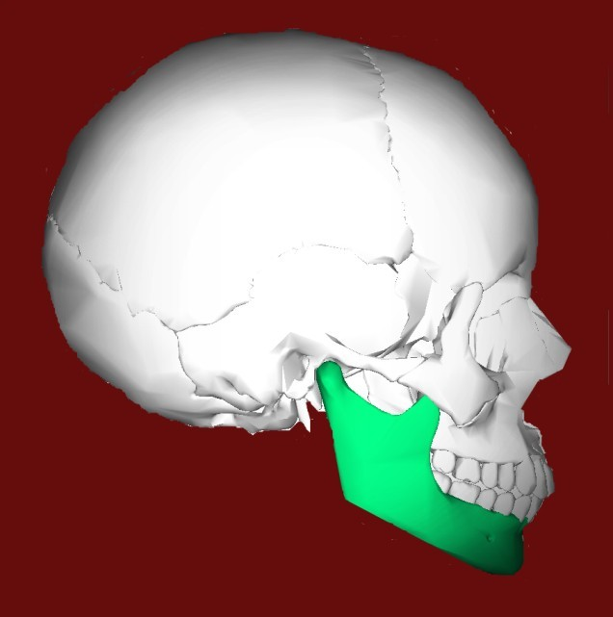
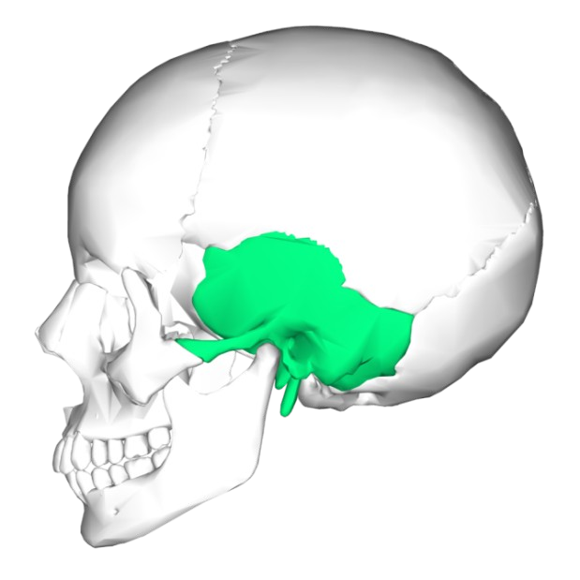
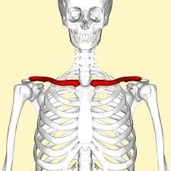
Fig. Clavicle, Membrano- Cartilaginous bone.
Fig. Mandible, Membrano-cartilaginous bone.
Fig. Temporal, Membrano-Cartilaginous bone.
3. Membrano-cartilaginous Bones:
They ossify partly in membrane and partly in cartilage.
Examples: Clavicle, Mandible, Temporal etc

Slide 23
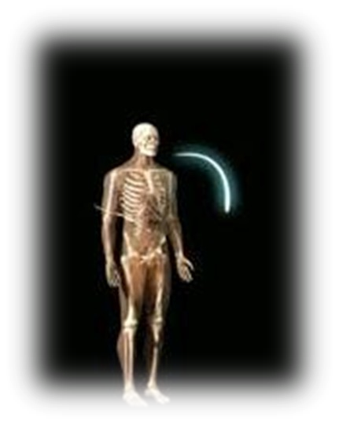
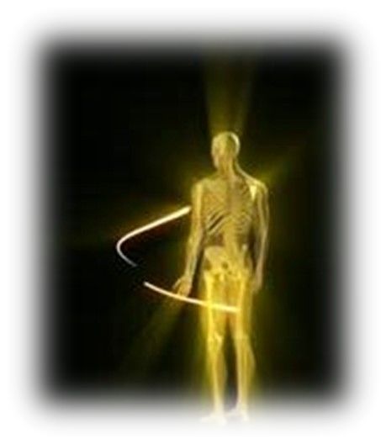
C. On The Basis Of Region:
It is divided into two types, they are:
Axial Skeleton.
Appendicular Skeleton.

Slide 24
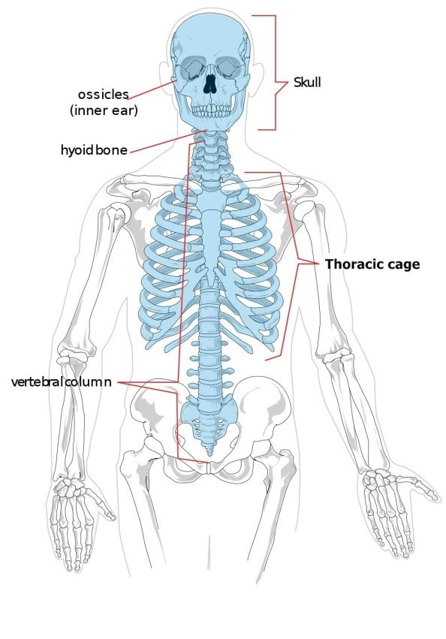
1. Bones Of Axial Skeleton:
These bones forms the axial skeleton of the human body.
Examples: Bones of skull, Thoracic cage & Vertebral Column
Fig. Bones of Axial Skeleton.

Slide 25
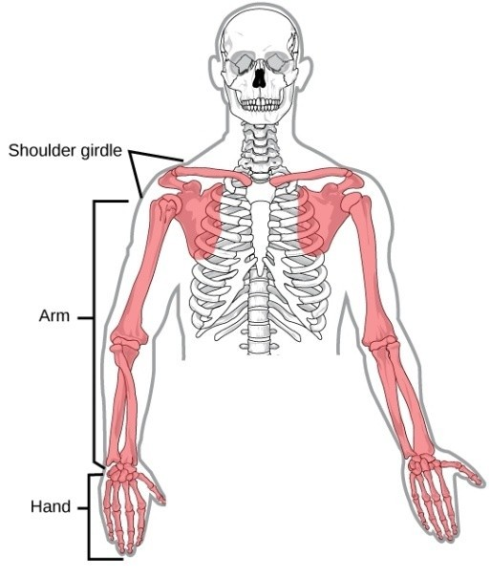
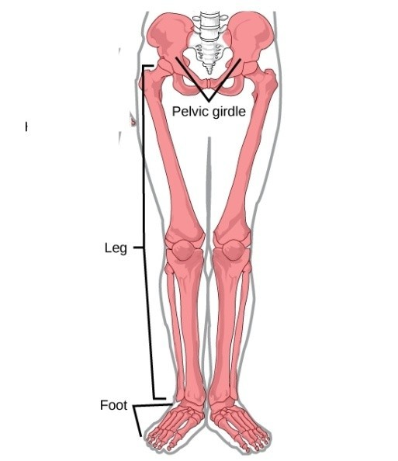
Fig. Upper limb, Clavicle & Scapula Girdle bones of Appendicular Skeleton.
Fig. Lower limb, Pelvic Girdle bones of Appendicular Skeleton.
2.Bones Of Appendicular Skeleton:
These bones forms the Appendicular skeleton of the human
Body.
Examples: bones of the limbs and girdles of
limbs.

Slide 26
D. On The Basis Of
Structure:
They are sub divided into two parts, which are:
Macroscopic Approach.
Microscopic Approach.

Slide 27
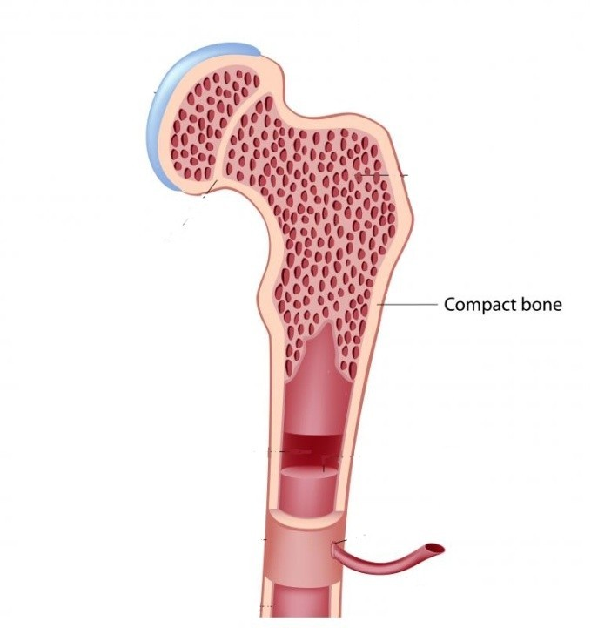
Macroscopic Approach:
a. Compact Bone:
Compact bone is dense in texture but is extremely
porus.
Example: In the cortex of long bones.
Fig. Macroscopic structure of the cortex of femur(Long Bone).

Slide 28
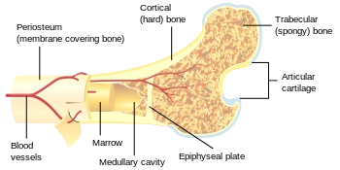
b. Cancellous OR Spongy Bone:
The part of bone where there is more empty space and
less bone tissue.
Example: The inner part of Long
Bones.
Fig. The Macroscopic Structure of the inner part of Femur(Long Bone).

Slide 29
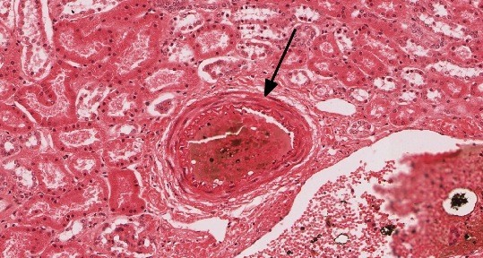
2. Microscopic Approach:
Fig. Microscopic structure of Fetus of Human.
a. Fibrous Bone:
These have more fibers in them. Also known as immature bones.
Example: Found only in fetus, sockets of alveolar bones and
sutures of the skull.

Slide 30
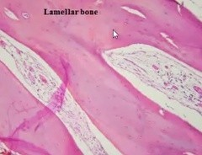
Fig. Microscopic structure of Lamellar arranged in piles in a cancellous bone.
b. Lamellar Bone:
Most of the mature human bones, whether compact or Cancellous, are composed
of thin plates of bony tissue called lamellae.
Example: Formed on the periosteal surface of diaphysis.

Slide 31
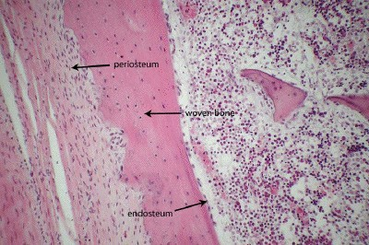
c. Woven Bone:
Occurs initially in fetal bones. In adults woven bone is created
after fractures.
Example: Seen in fetal bone, fracture repair and in cancer
of bone.
Fig. Microscopic structure of Woven bone.

Slide 32
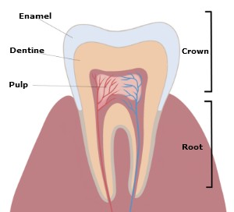
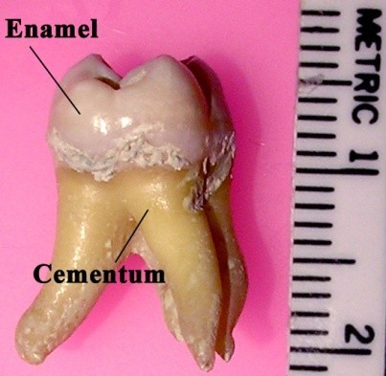
d. Cementum and Dentine:
Cementum is a specialized calcified substance covering the
root of a tooth. It hardens to act as an adhesive glue.
Dentine is
one of the hard tissues of the teeth which
constitutes most of its bulk.
Example: Occur in teeth.
Fig. Dentine of a tooth.
Fig. The Cementum of a human tooth.

Slide 33
Do you know?
Hyaline cartilage is the most abundant cartilage.
By age 25 the skeleton is completely hardened.
206 bones make up the adult skeleton (20% of body mass)
80 bones of the axial skeleton
126 bones of the appendicular skeleton
The largest bone in the human skeleton is Femur.
Babies are born with about 300 bones.
Almost a third of bones of babies eventually fuse together to
form the 206-bone skeleton of an adult.

Slide 34
Do you know?
Hyaline cartilage is the most abundant cartilage.
By age 25 the skeleton is completely hardened.
206 bones make up the adult skeleton (20% of body mass)
80 bones of the axial skeleton
126 bones of the appendicular skeleton
The largest bone in the human skeleton is Femur.
Babies are born with about 300 bones.
Almost a third of bones of babies eventually fuse together to
form the 206-bone skeleton of an adult.

Slide 35
Do you know?
Hyaline cartilage is the most abundant cartilage.
By age 25 the skeleton is completely hardened.
206 bones make up the adult skeleton (20% of body mass)
80 bones of the axial skeleton
126 bones of the appendicular skeleton
The largest bone in the human skeleton is Femur.
Babies are born with about 300 bones.
Almost a third of bones of babies eventually fuse together to form the 206-bone skeleton of an adult.

Slide 36
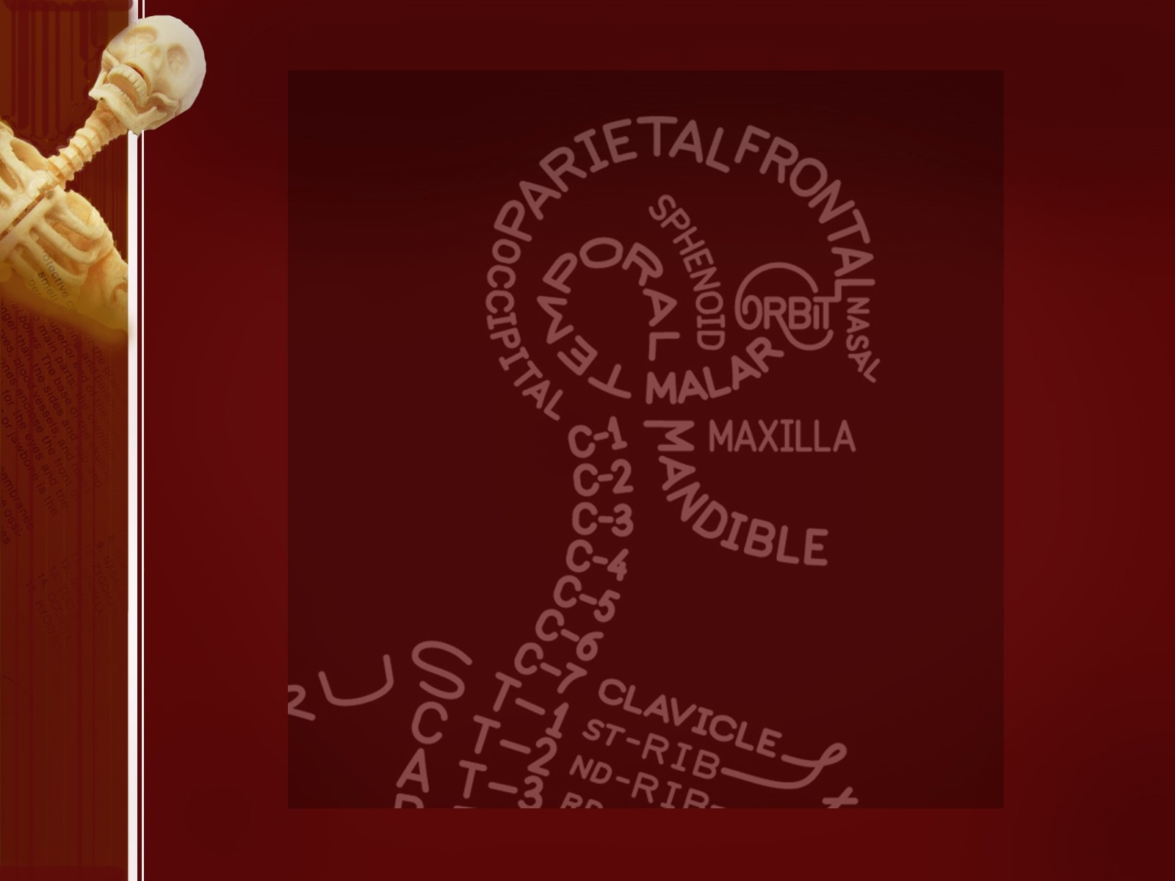
Do you know?
Hyaline cartilage is the most abundant cartilage.
By age 25 the skeleton is completely hardened.
206 bones make up the adult skeleton (20% of body mass)
80 bones of the axial skeleton
126 bones of the appendicular skeleton
The largest bone in the human skeleton is Femur.
Babies are born with about 300 bones.
Almost a third of bones of babies eventually fuse together to form the 206-bone skeleton of an adult.

