Slide 1
Pathology of fractures and fracture healing
P. J. OKOTH

Slide 2
Classification of fractures
P. J. Okoth

Slide 3
Definition of fracture
A bone fracture (#) is a break in the continuity of the bone.
It may be a complete break or an incomplete break of the bone.
A bone fracture can be the result of:
high force impact or stress, or
trivial injury as a result of certain medical conditions that weaken the bones, where the fracture is then properly termed a pathological fracture.

Slide 4
Classification of fractures
Fractures can be classified according to:
Aetiology
Whether open or closed
Fracture pattern

Slide 5
CLASSIFICATION
Fractures may be classified, according to their aetiology, into four groups:
Traumatic fractures
Fragility fractures
Fatigue or stress fractures
Pathological fractures

Slide 6
Classification…
Traumatic fracture - This is a fracture due to sudden injury or trauma. e.g.- Fractures caused by a fall, road traffic accident, fight etc.
They occur through bone that was previously free from disease.
May occur by direct violence or by indirect violence

Slide 7
Classification…
Fragility fractures – these are fractures associated with generalized bone weakness due to osteoporosis.
Seen most commonly in elderly patients

Slide 8
Classification…
Fatigue or stress fractures – occur from oft-repeated stress and not from a single violent injury.
Commonly occur in athletes or new military recruits
They occur when the rate of microdamage exceeds the rate of repair. The microdamage accumulates and progresses to a complete fracture across the full width of the bone.
Mostly occur in the metatarsals (mostly 2nd and 3rd).
May also occur in the shaft of fibula, tibia and neck of femur

Slide 9
Classification…
Pathological fractures – fractures through bone already weakened by disease.
Occurs following trivial violence, or even spontaneously.
Usually occur in conditions that weaken the bones, such as bone cancer, osteogenesis imperfecta, bone cysts, chronic bone infection.

Slide 10
CLOSED AND OPEN FRACTURES
All fractures can be broadly described as:
Closed (simple) fractures:
Are those in which the skin is intact.
There is no communication between the site of fracture and the exterior of the body.
Open (compound) fractures:
There is a wound on the skin surface that communicates with the fracture.
may thus expose bone to contamination.
Open injuries carry a higher risk of infection.

Slide 11
PATTERNS OF FRACTURE
Fractures can be designated by descriptive terms denoting the shape or pattern of the fracture.
The following are the terms in common use:
Transverse fracture: A fracture that is at a right angle to the bone's long axis.
Oblique fracture: A fracture that is diagonal to a bone's long axis.

Slide 12
Patterns of fracture…
Spiral fracture: A fracture where at least one part of the bone has been twisted.
Comminuted fracture: A fracture in which the bone has broken into several pieces (more than 2).
Compression or crush fracture: usually occurs in the vertebrae, for example when the front portion of a vertebra in the spine collapses due to osteoporosis

Slide 13
Patterns of fractures…
Greenstick fractures – A greenstick fracture occurs when a bone bends and cracks, instead of breaking completely into separate pieces. They are peculiar to children below 10 years. Their bones are springy and resilient like branches of a young tree (a green stick)
Impacted fractures – the bone fragments are driven so firmly together that they become interlocked and there is no movement between them.

Slide 14
Patterns of fracture…
Segmental fracture
Segmental fracture is a fracture composed of at least two fracture lines that together isolate a segment of bone, usually a portion of the diaphysis of a long bone.
It is a comminuted fracture with middle fragment having the full circumference intact.

Slide 15
Fracture patterns…
Avulsion fracture: A fracture where a fragment of bone is separated from the main mass as a result of a tendon or ligament pulling off a piece of the bone.
Linear fracture: A fracture that is parallel to the bone's long axis.

Slide 16
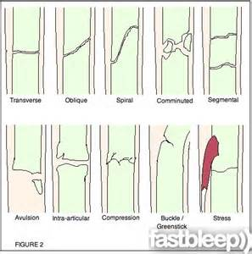
Patterns of fractures …

Slide 17
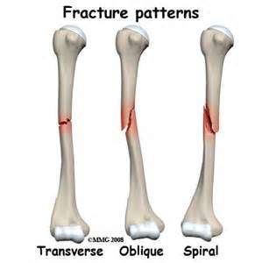
Fracture patterns

Slide 18
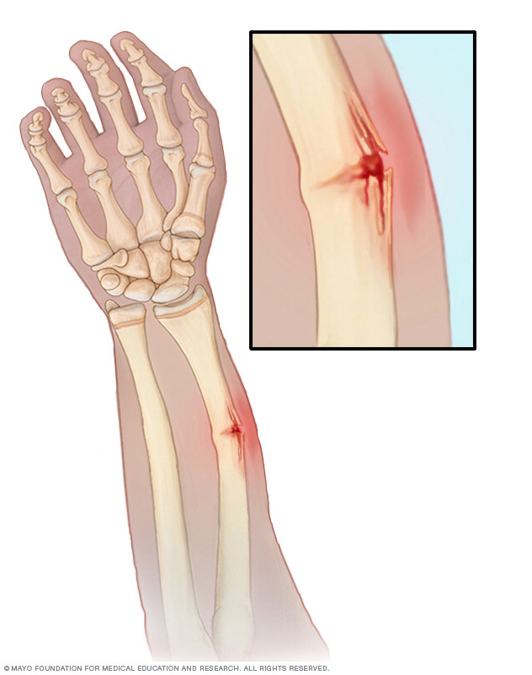
Greenstick fracture

Slide 19
Greenstick #

Slide 21
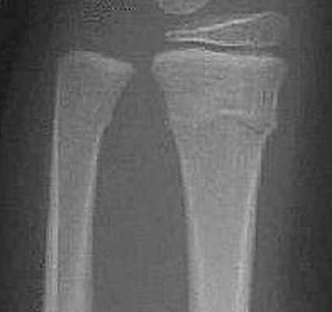
Torus fracture

Slide 22
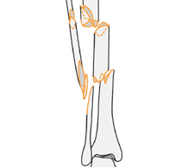
Segmental fracture

Slide 23
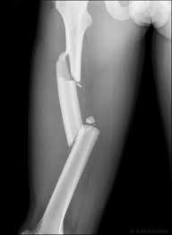
Segmental fracture

Slide 24
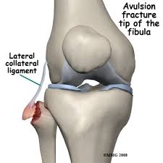
Avulsion fracture

Slide 25
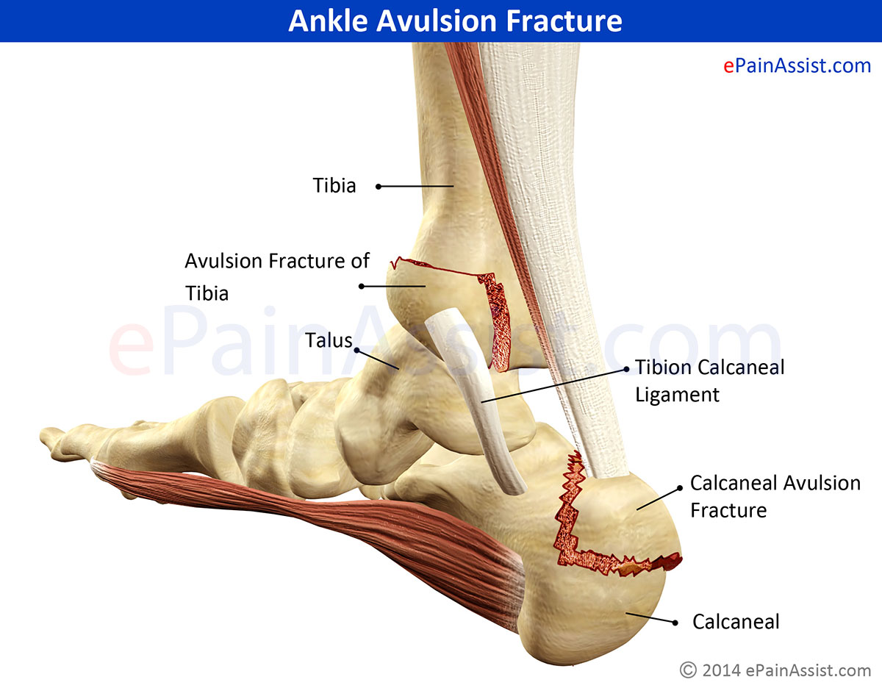
Avulsion fracture

Slide 26
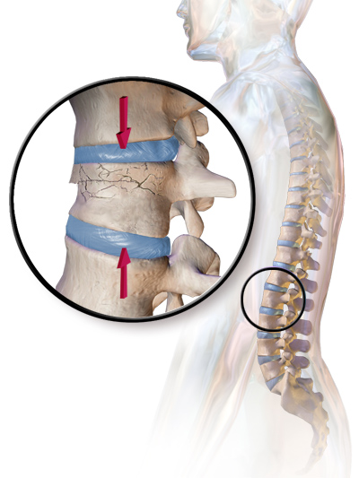
Compression fracture

Slide 27
Healing of fractures
Mr. Okoth

Slide 28
Healing of fractures
A fracture begins to heal as soon as the bone is broken.
Healing proceeds through several stages until the bone is consolidated.
Fracture healing, is a proliferative physiological process in which the body facilitates the repair of a bone fracture.

Slide 29
REPAIR OF TUBULAR BONE
Occurs in five stages:
Stage of haematoma
Stage of subperiosteal and endosteal cellular proliferation
Stage of callus
Stage of consolidation
Remodelling

Slide 30
Stage of haematoma
Bleeding torn vessels form a haematoma between and around the fracture surfaces
Haematoma is contained by the periosteum, which may be stripped up
Where the periosteum is torn, the haematoma extravasates into soft tissues and is contained by muscles, fascia and skin.
Deprived of blood supply, about 1or 2 millimeters of bone at the fracture surfaces dies.

Slide 31
Stage of subperiosteal and endosteal cellular proliferation
Within 8 hours of the fracture there is an acute inflammatory reaction with migration of inflammatory cells and the initiation of proliferation and differentiation of mesenchymal stem cells.
Cells proliferate from the deep surface of the periosteum and the breeched medullary canal [in the endosteum and marrow tissue].
The cells are precursors of osteoblasts, which later lay down the intercellular substance.

Slide 32
Stage of subperiosteal and endosteal cellular proliferation …
The cellular tissue form a collar of active tissue around each fragment, which grows out towards the other fragment and this creates a scaffold across the fracture site.
The clotted haematoma is gradually absorbed and fine new capillaries grow into the area.

Slide 33
Stage of callus
The differentiating stem cells give rise to osteoblasts and chondroblasts.
The osteoblasts lay down an intercellular matrix of collagen and polysaccharide, which soon becomes impregnated with calcium salts to form the immature bone or osteoid of fracture callus.
Osteoclasts also begin to mop up dead bone.

Slide 34
Stage of callus…
As the immature fibre bone [woven bone] becomes more densely mineralized, movement at the fracture site decreases progressively and the fracture becomes rigid.
At about 4 weeks after injury the fracture fragments unite and the fracture is said to be ‘sticky’.
The callus may be felt as a hard mass surrounding the fracture.
The mass of callus is also visible in radiographs and gives the first indication of union.

Slide 35
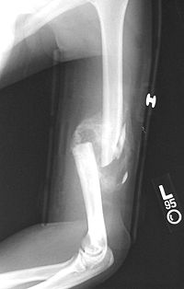
Callus …

Slide 36
Stage of consolidation
With continuing osteoclastic and osteoblastic activity, the woven bone is transformed into lamellar bone [a more mature bone with a typical lamellar structure]

Slide 37
Stage of remodelling
Newly formed bone often forms a bulbous collar which surrounds the bone and obliterates the medullary canal.
The mass of callus tends to be large when:
There is marked periosteal stripping
When the fracture haematoma has been large
When there is marked displacement of the fragments.

Slide 38
Remodelling…
The mass tends to be small when:
Bone fragments are in exact anatomical aposition
The fragments are rigidly fixed in close aposition by a metal plate with screws or by an intramedullary nail.
Callus is usually profuse in children because the periosteum is easily stripped from the bone by extravasated blood, allowing bone to form beneath it.

Slide 39
Remodelling…
In the months that follow, the bone is gradually strengthened along the lines of stress.
Surplus bone outside the line of stress is slowly removed.
The medullary cavity is gradually reformed.
Eventually the bone assumes a shape as close to normal as possible.

Slide 40
Remodelling…
In children, remodelling is usually so perfect that eventually the site of the fracture becomes indistinguishable on radiographs.
In adults the site of fracture is usually permanently marked by an area of thickening or sclerosis.

Slide 41
REPAIR OF CANCELLOUS BONE
Healing of cancellous bone follows a different pattern from that of tubular bone.
Because the bone is of uniform spongy texture and has no medullary canal, there is a relatively much broader area of contact between the fragments, and the open meshwork of trabeculae allows easier penetration by bone forming tissue.
Union can occur directly between the bone surfaces and it does not have to take place through the medium of external callus.

Slide 42
Repair of cancellous bone…
The first stage of healing is the formation of a haematoma, into which new blood vessels and proliferating osteogenic cells from the fracture surfaces penetrate until they meet and fuse with similar tissue growing out from the opposing fragment.
Osteoblasts then lay down the intercellular matrix, which becomes calcified to form woven bone.

Slide 43
Assignment
Discuss the rate of union of fractures, outlining factors that influence the speed of union.
Classify the common causes of pathological fractures.
REFERENCES:
Adam’s Outline of Fractures
Apley’s System of Orthopaedics and Fractures
THE END!

