Slide 1
THE KENYA MEDICAL TRAINING COLLEGE
COMMUNICATION SKILLS COURSE
YEAR 1 SEMESTER 1
LECTURER:

Slide 2
Course objective
By the end of the course;
The learner will be able to apply concepts and principles of communication to enable him/her communicate effectively in their respective profession

Slide 3
Module Units
Introduction to communication 4 hrs.
Modes of communication 10 hrs.
Patterns of communication 4 hrs.
Listening skills 4 hrs.
Reading and writing 4 hrs.

Slide 4
Introduction to communication

Slide 5
Specific objectives
Define communication
Discuss communication theories and models
State the elements of communication
Describe the communication process and Importance
Explain the one way two way communication
Explain the advantages and disadvantages of two way communication
Discuss characteristics of Effective communication
Explain barriers to effective communication

Slide 6
What is communication ?
An interaction between two or more persons that involves the exchange of information between a sender and a receiver.
It is derived from the Latin word communicare, which means "to make common".
Generally it can also be defined as the process of understanding and sharing meaning.

Slide 7
Cont’
Communication is a complicated process.
It is variable, active and dynamic.
It starts long before the words begin to flow and can last long after the words stop.
Communication is a process that requires understanding - perceiving, interpreting, and comprehending the meaning of the verbal and nonverbal behaviour of others.

Slide 8
Cont’
Communication is considered a process because it is an activity, an exchange or a set of behaviours

Slide 9
cont’
Understanding the meaning of another person's message does not occur unless the two communicators can elicit common meanings for words, phrases and non-verbal codes.
In addition to understanding, communication involves sharing and interaction between people in order to exchange meaning.

Slide 10
Communication Theories And Models
Models of communication are conceptual framework used to explain the human communication process.
The first major model for communication came in 1948 by Claude Elwood Shannon and published with an introduction by Warren Weaver for Bell telephone Laboratories.

Slide 11
Cont
The model was referred to as “A Mathematical Theory of Communication” and also called as “Shannon-Weaver model of communication”.
Following the concept, communication is the process of sending and receiving messages or transferring information from one part (sender) to another (receiver).

Slide 12
Cont’
This model is designed to develop the effective communication between sender and receiver.
Also they find factors affecting the communication process called “Noise”.
At first the model was developed to improve the Technical communication.
Later it’s widely applied in the field of Communication.

Slide 13
Concepts in Shannon Weaver Model
Sender (Information source) – Sender is the person who makes the message, chooses the channel and sends the message.
Encoder (Transmitter) –Encoder is the sender who uses machine, which converts message into signals or binary data.
- It might also directly refer to the machine.

Slide 14
Cont’
Channel –Channel is the medium used to send message.
Decoder (Receiver) – Decoder is the machine used to convert signals or binary data into message or the receiver who translates the message from signals.

Slide 15
Cont’
Receiver (Destination) –Receiver is the person who gets the message or the place where the message must reach.
-The receiver provides feedback according to the message.

Slide 16
Cont’
Noise –Noise is the physical disturbances like environment, people, etc. which does not let the message get to the receiver as what is sent

Slide 17
Explanation of Shannon Weaver Model
The sender encodes the message and sends it to the receiver through a technological channel like telephone and telegraph.
The sender converts the message into codes understandable to the machine.
The message is sent in codes through a medium.

Slide 18
Cont’
The receiver has to decode the message before understanding it and interpreting it.
The receptor machine can also act as a decoder in some cases.
The channel can have noise & the receiver might not have the capacity to decode which might cause problems in communication process.

Slide 19
Example 1
Thomson made call to his assistant “come here I want to see you”.
During his call, noise appeared (transmission error) and his assistant received “I want” only.
Again Assistant asked Thomson (feedback) “what do you want Thomson”.

Slide 20
Cont’
Sender : Thomson
Encoder : Telephone (Thomson)
Channel : Cable
Noise : Distraction in voice
Reception : Telephone (Assistant)
Receiver : Assistant.

Slide 21
Example 2
Brain might be the sender, mouth might be the encoder which encodes to a particular language, air might be the channel, another person’s ear might be the receptor and his brain might be the decoder and receiver.
the noise present in his environment that disturbs them is the noise whereas his response is the feedback

Slide 22
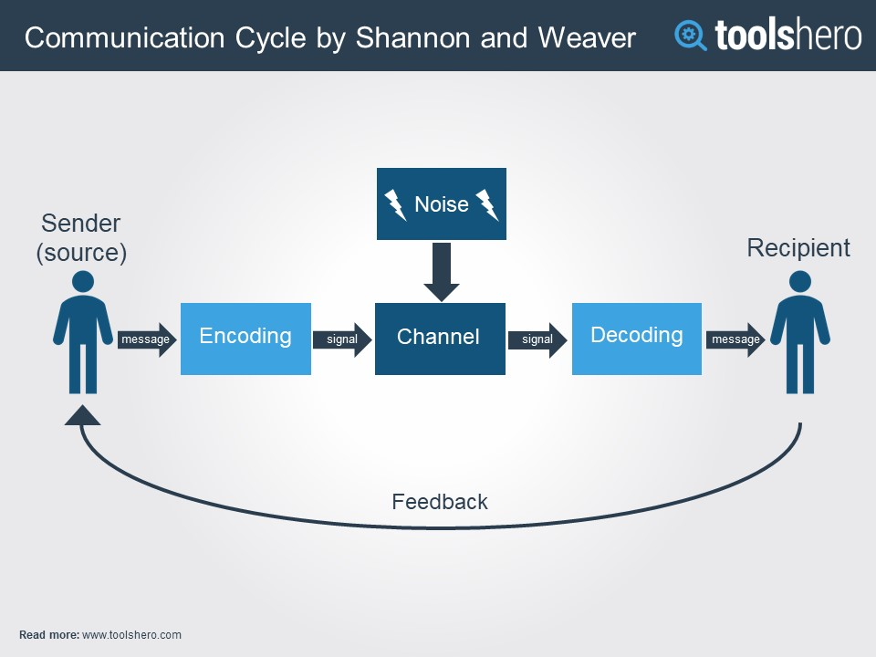

Slide 23
Advantages of Shannon Weaver Model
Concept of noise helps in making the communication effective by removing the noise or problem causing noise.
This model takes communication as a two way process. It makes the model applicable in general communication.
Communication is taken as quantifiable in Shannon Weaver model.

Slide 24
Elements Of The Communication Process
Encoding and Decoding
Encoding refers to the process of taking an idea or mental image, associating that image with words, and then speaking those words in order to convey a message.

Slide 25
Example
So, if you wanted to explain to your aunt the directions to your new apartment, you would picture in your mind the landscape, streets and buildings, and then you would select the best words that describe the route so your aunt could find you.

Slide 26
Cont’
Decoding is the reverse process of listening to words, thinking about them, and turning those words into mental images.

Slide 27
Example
If your aunt were trying to find her way to your apartment, she would listen to your words, associate these words with streets and landmarks that she knows, and then she would form a mental map of the way to get to you.

Slide 28
B) Communicator
The term communicator refers to all of the people in the interaction or speech setting.
It is used instead of sender and receiver, because when we are communicating with other people we are not only sending a message, we are receiving messages from others simultaneously.

Slide 29
Cont’
When we speak, we observe others’ nonverbal behaviour to see if they understand us and we gauge their emotional state.
The information we gain from these observations is known as feedback.
Over the telephone, we listen to paralinguistic cues, such as pitch, tone, volume and fillers (i.e., “um,” “uh,” “er,” “like,” and so on).

Slide 30
Cont’
This means communication is not a one-way process.
Even in a public speaking situation, we watch and listen to audience members’ responses.
If audience members are interested, agree, and understand us, they may lean forward in their seats, nod their heads, have positive or neutral facial expressions

Slide 31
Cont’
They may also provide favourable vocal cues ( laughter, “That’s right,” “Uh huh,” or “Amen!”).
If audience members are bored, disagree, or are confused by our message;
They may be texting or looking away from us, shake their heads, have unhappy or confused expressions on their faces, or present oppositional vocal cues (like groans, “I don’t think so,”

Slide 32
Cont’
Thus, communication is always a transactional process—a give and take of messages.

Slide 33
C) Message
The message involves those verbal and nonverbal behaviours, enacted by communicators, that are interpreted with meaning by others.
The verbal portion of the message refers to the words that we speak

Slide 34
Cont’
The nonverbal portion includes our tone of voice and other non-vocal components such as personal appearance, posture, gestures and body movements, eye behavior, the way we use space, and even the way that we smell.

Slide 35
Example 1
For instance, the person who gets up to speak wearing a nice suit will be interpreted more positively than a person giving the exact same speech wearing sweats and a graphic t-shirt.

Slide 36
Example 2
If a speaker tries to convince others to donate to a charity that builds wells in poor African villages using a monotone voice, she will not be as effective as the speaker who gives the same speech but speaks with a solemn tone of voice.

Slide 37
Cont’
The message can also be intentional or unintentional.
When the message is intentional, it means we have an image in our mind that we wish to communicate and we can successfully convey the image from our mind to others’ minds with relative accuracy.

Slide 38
Cont’
An unintentional message is sent when the message that we wish to convey is not the same as the message the other person receives.

Slide 39
Example 1
Let’s say you are returning from an outing with your significant other and she or he asks, “Did you have a good time?”
You did have a good time but are distracted by a TV commercial when asked, so you reply in a neutral tone, “Sure, I had fun.”

Slide 40
Cont’
Your significant other may interpret your apathetic tone of voice and lack of eye contact to mean that you did not enjoy the evening, when in fact you actually did.
Thus as communicators, we cannot always be sure that the message we wish to communicate is interpreted as we intended.

Slide 41
d) Channel
The channel is very simply the means through which the message travels.
In face-to-face communication the channel involves all of our senses
so the channel is what we see, hear, touch, smell and perhaps what we taste.

Slide 42
Cont,
When we’re communicating with someone online, the channel is the computer;
when texting the channel is the cell phone
when watching a movie on cable, the channel is the TV.
The channel can have a profound impact on the way a message is interpreted.

Slide 43
Cont’
Listening to a recording of a speaker does not have the same psychological impact as listening to the same speech in person or watching that person on television.

Slide 44
E) Noise
Noise refers to anything that interferes with message transmission or reception (i.e., getting the image from your head into others’ heads).
There are several different types of noise.
Physiological b) Psychological
c) Physical d) cultural

Slide 45
Cont’
The first type of noise is physiological noise, and this refers to bodily processes and states that interfere with accuracy of a message.

Slide 46
Example 1
For instance, if a speaker has a headache or the flu, or if audience members are hot or they’re hungry, these conditions may interfere with message accuracy.

Slide 47
Cont’
The second type of noise is psychological noise.
Psychological noise refers to mental states or emotional states that impede message transmission or reception.

Slide 48
Example
if someone has just broken up with a significant other, or if they’re worried about their grandmother who is in the hospital, or if they are thinking about their shopping list, this may interfere with communication processes as well.

Slide 49
Cont’
The third type of noise is actual physical noise, and this would be simply the actual sound level in a room.

Slide 50
Example
Loud music playing at a party, a number of voices of people talking excitedly, a lawnmower right outside the window, or anything that is overly loud will interfere with communication.

Slide 51
Cont’
The last type of noise is cultural noise. Cultural noise refers to message interference that results from differences in peoples’ worldviews (perspective).
Worldview is to say that the greater the difference in worldview, the more difficult it is to understand one another and communicate effectively.

Slide 52
F) Worldview
Although the encoding & decoding process may appear to be fairly straightforward, it is actually much more complicated than it seems.
The reason is because of different worldviews.
Worldview is the overall framework through which an individual sees, thinks about, and interprets the world and interacts with it.

Slide 53
Cont’
There are five core components to our worldview.
Epistemology-the way that we acquire knowledge and/or what counts as knowledge
-the philosophical study of the nature, origin, and limits of human knowledge
Ontology refers to our belief system, how we see the nature of reality or what we see as true or false

Slide 54
Cont’
Cosmology signifies the way that we see our relationship to the universe(like universal health care and the death penalty) and to other people.
Praxeology denotes our preferred method of completing everyday tasks or our approach to solving problems.
Axiology represents our value system, or what we see as right or wrong, good or bad, and fair or unfair.

Slide 55
Cont’
i.e Some speech writers may begin working on their outlines as soon as they know they will need to give a speech, while others may wait until a few days before their speech to begin preparing
Praxeology may also have an impact on a speaker’s preference of delivery style, methods of arranging main points, and choice of slideware

Slide 56
g) Context
The last element of the communication process is the context in which the speech or interaction takes place.
In the 1980’s context was taught as the actual physical setting where communication occurred, such as in a place of worship, an apartment, a workplace, a noisy restaurant, or a grocery store.

Slide 57
Cont’
People communicate differently in each one of these places as there are unwritten rules of communication (called norms) that govern these settings.
More recently the concept of context has evolved and expanded to include the type of relationships we have with others and the communicative rules that govern those relationships.

Slide 58
Cont’
So you do not speak the same way to your best friend as you do to a small child, your parent, your boss, your doctor or a police officer.
And you may speak to your best friend differently in your apartment than you do in your parents’ home, and your communication may also change when you are both out with friends on the weekend.

Slide 59
Cont’
In sum, the context refers to the norms that govern communication in different situations and relationships.

Slide 60
H) Feedback
A better word might be “reaction” or “responses.”
The source judges its success based on the feedback it receives, so pay close attention.

Slide 61
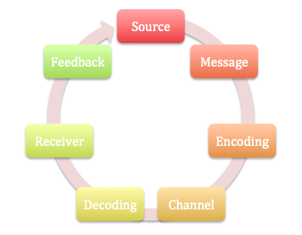
Stages of communication

Slide 62
One way-Two way communication
Communication can travel in two directions
That is one-way and two way communication
a) One-way Communication
A one-way communication is where there is no facility and/or expectation of a reply or feedback.
An advertisement or notice on a board is an example.

Slide 63
One-way communication is linear and limited because it occurs in a straight line from sender to receiver and serves to inform, persuade or command.

Slide 64


Slide 65


Slide 66
Advantage
It is simple
quick
cheap
Sender has no problem, they can carry on their work and not have to worry about anything

Slide 67
Disadvantages
It allows no clarification or opportunity to correct inaccuracies and this may cause frustration in the receiver.
It is often associated with authoritarian leadership and downward channels of communication.

Slide 68
b) Two-way Communication
Two-way communication is more time-consuming because the receiver has the opportunity to feedback and to question what has been said or written.
The receiver is invited to contribute to the process so this kind of communication is often associated with democratic forms of leadership.

Slide 69
If the message is complex, two-way communication is far more effective, and probably accurate, than one-way communication.
Two-way communication always includes feedback from the receiver to the sender and lets the sender know the message has been received accurately.

Slide 70
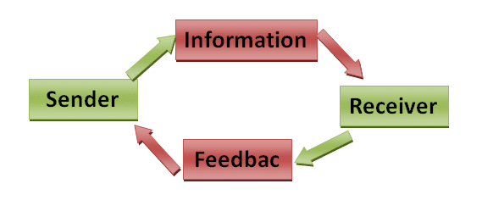

Slide 71
Advantages
In two-way communication, communication is negotiated.
Both sender and receiver listen to each other, gather information and are willing to make changes to work together in harmony.
Their intent is to negotiate a mutually satisfactory situation.

Slide 72
Disadvantages
The sender gets bothered and has to focus on what receiver wants more than what he or she wants
Everyone has a different opinion and the sender has to work to make everyone happy

Slide 73

Effective communication

Slide 74
Effective communication
Communication needs to be effective and efficient for better and smooth functioning
Effective communication is defined as:
-Communication between two or more persons in which the intended message is properly encoded, delivered through appropriate channel, received properly decoded &understood by the recipient(s)

Slide 75
Cont’
Therefore, it means that communication is not mere talking, chattering or blabbering in a nonsensical manner.
But It is systematic process with an objective that a piece of communication aims to achieve.

Slide 76
Cont’
Hence , communication is said to be effective when all the parties (sender and receiver) in the communication,
  Assign similar meanings to the message
  listen carefully to what all have been said
  make the sender feel heard and understood.

Slide 77
Characteristics of Effective Communication
The major characteristics are as follows −
Completeness of the Message
Clearness and Integrity of the Message
Conciseness of the Message
Consideration of Physical Setting & recipient
Clarity of the Message
Courtesy to be Maintained
Correctness of the Message

Slide 78
Cont’
a)Completeness of the Message- must be complete so as not to baffle the recipient.
- Better communication helps in better decision-making by the latter.

Slide 79
Cont’
b) Clearness and Integrity of the Message
The message to be conveyed or sent must have clarity and integrity for better understanding.
Clarity of thoughts and ideas enhances the meaning of the message.
The pith and substance of the message should be based on honesty and accuracy.

Slide 80
Cont’
c) Conciseness of the Message
The intended message must be free from verbosity and should be so written that it is intelligible at the first sight.
Short and intelligible message sent to the receiver is ever appealing and comprehensible.
It saves time and cost as it is understood at the first instance.

Slide 81
Cont’
d) Consideration of Physical Setting & Recipient
In order to make communication more effective, the overall physical setting, i.e., the media of communication and the work environment, must be considered.
The content of the message must take into account the attitude, knowledge, and position of the recipient.

Slide 82
Cont’
e) Clarity of the Message
The message should have clarity of thoughts and ideas in order to be understood clearly.
Clear message makes use of exact, appropriate and concrete words and symbols.

Slide 83
Cont.’
f) Courtesy to be Maintained
The sender's message should be so drafted or prepared that it should be polite, reflective, and enthusiastic.
It must show the sender's respect for the receiver and be positive and focused at the receiver.

Slide 84
Cont’
g) Correctness of the Message
The drafting of the message should be done in such a manner that the final message doesn't have any grammatical errors and repetitions of sentences.
The message should be exact, correct and well-timed.

Slide 85
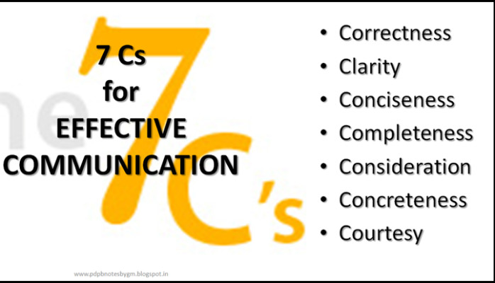
Cont’

Slide 86
Advantages of Effective Communication
Excellent communication skills prevents misunderstanding. It gives clarity and direction.
Effective communication skills provide clear and defined policies thus helps organization to be successful.
Effective interpersonal communication skills such as listening skills, making eye contact gives boost to your personality.

Slide 87
4)If you are an effective communicator helps to make understand and understood things. It gives self satisfaction
5) If you have good communication skills you are able to communicate a goal in an organisation. The people you communicate will perform their jobs more effectively.

Slide 88
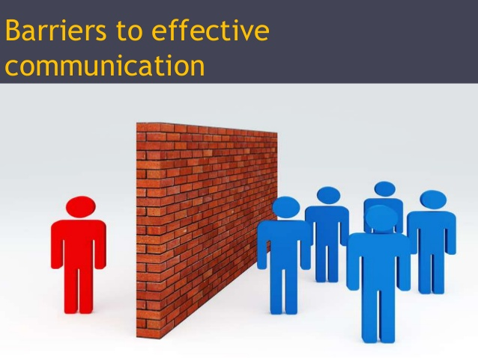

Slide 89
Barriers To Effective Communication
Semantic barriers
Organizational barriers
Psychological or emotional barriers
Personal barriers
Cultural barriers
Gender barriers
Perceptual barriers

Slide 90
Cont’
8) Language Barriers
9) Environmental barriers
10) Physical Barriers
11)Physiological Barriers

Slide 91
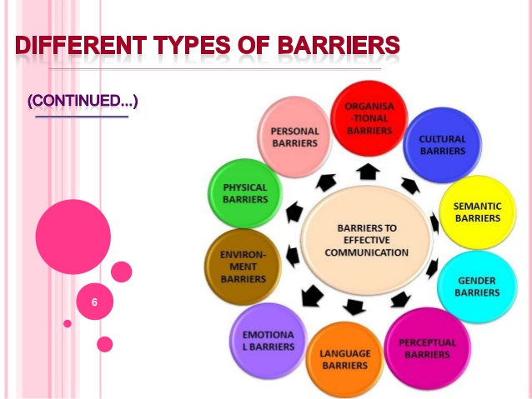

Slide 92
Cont’
Physical Barriers: It has to do with poor or outdated equipment used during communications, background noise, poor lighting, temperatures that are too hot or too cold.
Emotional Barriers : emotions like anger or sadness can taint objectivity.
-Being extremely nervous, having a personal agenda or “needing to be right no matter what” can make communications less than effective.

Slide 93
c) Language:
Also people speaking the same language can have difficulty understanding each other if they are from different generations or from different regions of the same country.
Slang, professional jargon and regional colloquialisms can even hurt communicators with the best intentions.

Slide 94
Cont.’
d)Physiological Barriers: ill health, poor eyesight or hearing difficulties, pain.
e) Organisational Barrier : institutions can have organization structures that are not clear, which can make communications difficult.
Also to blame for faulty communications are bad information systems, and lack of supervision or training of the people involved.

Slide 95
f) Cultural Noise: people sometimes make stereotypical assumptions about others based on their cultural background.
g) Semantic Barriers refers to the misunderstanding between the sender and receiver arising due to the different meanings of words, and other symbols used in the communication.

Slide 96
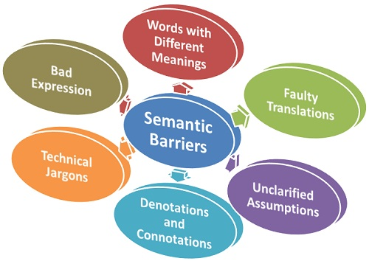

Slide 97
Modes of communication

Slide 98
a) Intrapersonal communication
Can be defined as communication with one’s self
It may include:
self-talk
acts of imagination
visualization,
even recall and memory

Slide 99
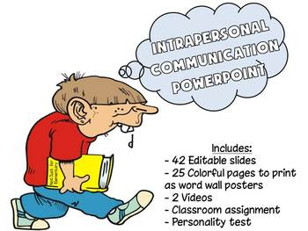

Slide 100
Example 1
You read on your cell phone screen that your friends are going to have dinner at your favourite restaurant. What comes to mind? Sights, sounds, and scents? Something special that happened the last time you were there? Do you contemplate joining them? Until the moment when you hit the “send” button, you are communicating with yourself.

Slide 101
During intrapersonal communication all the interaction of the basic component of communication process occurs within the individual
i.e., source, receiver, message, channel, feedback, environment, context, and noise

Slide 102
Explanation
Perhaps, as you consider whether to leave your location & join your friends (restaurant), you are aware of all the work that sits in front of you.
You may hear the voice of your boss, admonishing you about responsibility and duty
On the other hand, you may imagine the friends at the restaurant saying something to the effect of “you deserve some time off!”

Slide 103
From the illustration, from planning to problem solving, internal conflict resolution, evaluations & judgments of self and others, we communicate with ourselves through intrapersonal communication.
All this interaction takes place in the mind without externalization, and all of it relies on previous interaction with the external world.

Slide 104
Key Takeaway
In intrapersonal communication, we communicate with ourselves.

Slide 105
Exercises
1st column
Describe what you are doing, pretending you are another person observing yourself. Write your observations down. Discuss the exercise with your classmates.

Slide 106
2nd column
2) Think of a time when you have used self-talk—for example, giving yourself “I can do this!” messages when you are striving to meet a challenge, or “what’s the use?” messages when you are discouraged. Did you purposely choose to use self-talk, or did it just happen? Discuss your thoughts with classmates.

Slide 107
2nd column
3) Take a few minutes and visualize what you would like your life to be like a year from now, or five years from now. Do you think this visualization exercise will influence your actions and decisions in the future? Compare your thoughts with those of your classmates.

Slide 108
b) Interpersonal Mode
Two-way communication between individuals using receptive skills (listening and reading) and productive skills (speaking and writing).
The Interpersonal Mode is characterized by active negotiation of meaning among individuals.
Participants observe and monitor one another to see how their meaning and intentions are being communicated.

Slide 109
Cont’
Adjustments and clarifications can be made accordingly.
As a result, there is a higher probability of achieving the goal of successful communication in this mode than in the other two modes.
The interpersonal mode is most obvious in conversation

Slide 110
However, both the interpersonal & negotiated dimensions can be realized through reading & writing, such as the exchange of personal letters or of electronic mail (e-mail) messages.

Slide 111

Interpersonal communication

Slide 112
C) Mass Communication
It is a process of transmitting message to a large number of scattered audiences.
Through mass communication, information can be transmitted quickly to a large number of people who generally stay far away from the sources of information.
Mass communication is done through radio, television, newspaper, magazine, leaflets etc.

Slide 113
Therefore Mass communication is a process of sending a message, thought and attitude through some media at a time to a large number of heterogeneous audiences

Slide 114
Mass communication must contains at least following five things:
  Large audience
  Similar audience exists
  Some form of message reproduction
  Quick distribution of message
  Low unit cost to the customers.
  The Flow Of Mass Communication

Slide 115
Kinds/ Types Of Communication
a) Verbal Communication
Verbal communication can also be called as Oral communication.
In very simple terms, any communication that happens orally between people is known as verbal communication.

Slide 116
Ct’
The objective of such communications is to ensure that people understand whatever you want to convey.
Because of its very nature, verbal communications is more quick and precise then email communication
Normally, a verbal communication takes place in real time.

Slide 117
Cont’
In the era of messaging people still prefer personal meetings or phone calls (skype calls) because they are effective and convenient
The higher up an organization you go, the better should be the verbal skills that you have.
It is because you need to ensure speech is precise and does not leave any scope for any misunderstanding.

Slide 118
An M.D may be giving a television interview which is being watched by stakeholders
Their speech and verbal communication need to be precise so that they are not misunderstood.
Even in tough times, the verbal communication skills of these leaders play a major part in consoling the crowd.
i.e Nelson Mandela, Mahatma Gandhi

Slide 119


Slide 120
b)Written Communications
In contrast to verbal communications, written business communications are printed messages.
Examples of written communications include memos, proposals, e-mails, letters, training manuals, and operating policies.
They may be printed on paper, handwritten, or appear on the screen.

Slide 121
Written communication, by contrast, can be constructed over a longer period of time.
Written communication is often asynchronous (occurring at different times).
That is, the Sender can write a Message that the Receiver can read at any time, unlike a conversation that is carried on in real time.

Slide 122
A written communication can also be read by many people (such as all employees in a department or all customers).
It’s a “one-to-many” communication, as opposed to a one-to-one verbal conversation.
There are exceptions, of course: a voicemail is an oral Message that is asynchronous.

Slide 123
C) Non-verbal communication
What you say is a vital part of any communication.
But what you don’t say can be even more important
Research also shows that 55% of in-person communication comes from nonverbal cues like facial expressions, body stance, and tone of voice

Slide 124
According to one study, only 7% of a Receiver’s comprehension of a Message is based on the Sender’s actual words; 38% is based on paralanguage (the tone, pace, and volume of speech), and 55% is based on nonverbal cues (body language) (Mehrabian, 1981).

Slide 125
Research shows that nonverbal cues can also affect whether you get a job offer.
Judges examining videotapes of actual applicants were able to assess the social skills of job candidates with the sound turned off.
They watched the rate of gesturing, time spent talking, &formality of dress to determine which candidates would be the most successful

Slide 126
For this reason, it is important to consider how we appear in business as well as what we say.
The muscles of our faces convey our emotions.
We can send a silent message without saying a word.
change in expression can change emotional state.

Slide 127
Before an interview, for example, if we focus on feeling confident, our face will convey that confidence to an interviewer.
Adopting a smile (even if we’re feeling stressed) can reduce the body’s stress levels.
To be effective communicators, we need to align our body language, appearance, and tone with the words we’re trying to convey.

Slide 128
Elements of Non-Verbal Communication
“It’s not what you say, it’s how you say it”
This saying is given new meaning when you think about it in terms of body language.
In addition to words spoken, you need to be aware of seven key things that convey messages.

Slide 129
Elements of Non-Verbal Communication
Facial Expressions.
Facial expressions are universal across all cultures and nationalities.
They express emotions: happiness, sadness, anger, surprise, fear &disgust to name a few.
You do not have to understand the verbal language to understand the non-verbal expressions.

Slide 130
2) Body Movements and Posture
Your stance, posture, the way you walk, even subtleties such as the way you hold your head all convey an unspoken message.
3) Gestures
We wave, point, beckon, and use our hands when we are arguing or speaking animatedly
we express ourselves with gestures often without thinking.

Slide 131
Cont’
However, the meaning of gestures can be very different across cultures and regions
so it is important to be careful to avoid misinterpretation.
4)Eye Contact.
Eye contact is an important form of nonverbal communication.

Slide 132
Cont’
The way you look at someone communicates interest, affection, hostility, or attraction.
Eye contact is also important in maintaining the flow of conversation and for gauging the other person’s response.

Slide 133
Cont’
5)Touch.
Touch is another important part of nonverbal com.
Think about what the following conveys:
  a firm handshake
  a timid tap on the shoulder
  a warm bear hug,
  a reassuring pat on the back
  a patronizing pat on the head
  a controlling grip on your arm.

Slide 134
cont
6) Space.
We all have a need for physical space
That need differs depending on the culture, the situation, and the closeness of the relationship.
You can use physical space to communicate many different nonverbal messages, including signals of intimacy, aggression, dominance, or affection.

Slide 135
7) Voice.
Nonverbal speech such as tone, pitch, volume, inflection, rhythm, and rate are important communication elements.
When we speak, other people “read” our voices in addition to listening to our words.
These nonverbal speech sounds provide subtle but powerful clues into our true feelings and what we really mean.

Slide 136
Cont’
Think about how tone of voice, for example, can indicate sarcasm, anger, affection, or confidence.

Slide 137
summary
Successful nonverbal communication depends on self-awareness & an understanding of the cues you are sending and reading the cues others are sending
If you are planning what you are going to say next, daydreaming, or thinking about something else, you may miss nonverbal cues & other subtleties
You need to stay focused on the moment to fully understand what is going on.

Slide 138
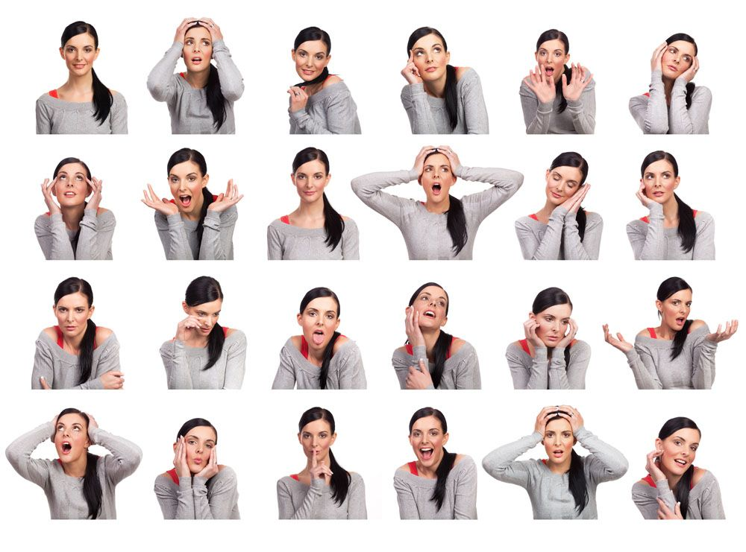

Slide 139
Importance of non-verbal communication
Important in expressing our emotions
Communicating interpersonal relationships
Reflects individual’s personality.
non-verbal communication is main supporter of verbal interaction. In fact they supplement each other and give full meaning.
Plays greater role in performing rituals such as greetings and goodbyes.

Slide 140
d) Interview
It is a face-to-face interaction between interviewee and interviewer
If handled carefully, it can be a powerful technique in having accurate information
. At the same time, if the interview is not handled carefully, it can be a source of bias, restricting or distorting the flow of communication.

Slide 141
Objectives of Interview
Verify the information
Obtain additional information
Gives the candidate necessary facts & information
Establish mutual understanding

Slide 142
E) Public Speaking
It's a presentation given live before an audience.
Public speeches cover a wide variety of different topics
The goal is to educate, entertain, influence listeners
Often, visual aids such as slideshow are used to supplement the speech and make it interesting

Slide 143
Cont’
A public speaking presentation is different from an online presentation
online presentation may be viewed and/or listened to at the viewer's convenience, while a public speech is limited to a specific time or place.

Slide 144
The Benefits of Public Speaking
Improves confidence
Better research skills
Stronger deductive skills
Ability to advocate for causes

Slide 145
How to Become Better at Public Speaking
Public speaking is a skill & it can be learned.
While some people may have more natural speaking ability than others, or a more pleasing voice, or are more charismatic—anyone who can speak can learn to be a better public speaker than they are right now.
It just takes some know-how and some effort.

Slide 146
Cont.’
To help you become better at public speaking, we'll take a look at these four areas:
    Writing the speech
    Overcoming a fear of speaking
    Practicing the speech
    Giving the speech

Slide 147
cont’
1. Write an Effective Speech
The first thing you'll want to do is work on writing a well-organized, engaging speech.
Because even if you've got a great speaking voice or a great deal of charisma, you won't give a good speech if your material isn't any good.

Slide 148
2. Overcome the Fear of Speaking
Fear of public speaking is very real and can hold you back.
If you don't feel confident when giving your speech, your listeners may pick up on that, making your presentation less effective.
Fortunately, there are some techniques that'll help most people manage their fear

Slide 149
3. Practice the Speech
Even if not afraid of public speaking, practicing speech is still an important step to having an effective speech.
If you're in a rush, you may be tempted to skip practicing your speech to save time.
While skipping practice may seem like a good idea, it's really not.

Slide 150
By practicing speech not only does it improve public speaking skills, but it also increases familiarity with the presentation
Thus making it more likely that your speech will go smoothly.
Watch recordings of your speeches

Slide 151
4. Give the Speech
Engage with your audience
Pay attention to body language
Think positively

Slide 152
Listening skills

Slide 153
“The most basic and powerful way to connect to another person is to listen. Just listen. Perhaps the most important thing we ever give each other is our attention”

Slide 154
Listening
Listening is the ability to accurately receive and interpret messages in the communication process.
Listening is key to effective communication.
Without the ability to listen effectively, messages are easily misunderstood
As a result, communication breaks down and the sender of the message can easily become frustrated or irritated.

Slide 155
If there is one communication skill you should aim to master, then listening is it.
Good listening skills can lead to
better customer satisfaction
greater productivity with fewer mistakes
increased sharing of information that in turn can lead to more creative and innovative work

Slide 156
Benefits In Our Personal Lives
A greater number of friends and social networks
Improved self-esteem and confidence
Higher grades at school and in academic work
Better health and general well-being.
Studies have shown that, whereas speaking raises blood pressure, attentive listening can bring it down.

Slide 157
Note!!!!
Listening is Not the Same as Hearing
Hearing refers to the sounds that enter your ears.
It is a physical process that, provided you do not have any hearing problems, happens automatically.

Slide 158
Listening, however, requires more than that: it requires focus and concentrated effort, both mental and sometimes physical as well.
Listening means paying attention not only to the story, but how it is told, the use of language and voice, and how the other person uses their body.
It means being aware of both verbal and non-verbal messages.

Slide 159
Listening is not a passive process.
In fact, the listener can, and should, be at least as engaged in the process as the speaker.
The phrase ‘active listening’ is used to describe this process of being fully involved.

Slide 160
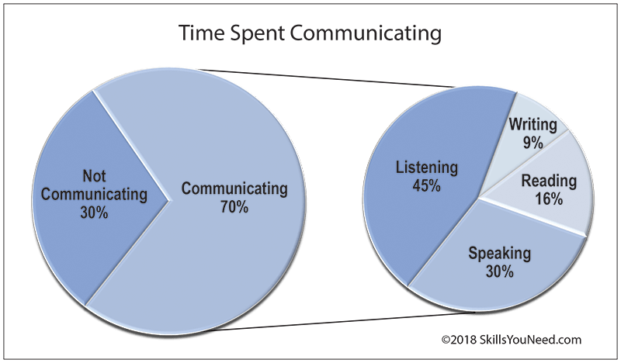

Slide 161
Adults spend an average of 70% of their time engaged in some sort of communication.
Of this, (45%) is spent listening compared to 30% speaking, 16% reading and 9% writing (Adler, R. et al. 2001).
That is, by any standards, a lot of time listening.
It is worthwhile, therefore, taking a bit of extra time to ensure that you listen effectively.

Slide 162
The Purpose of Listening
To gain a full and accurate understanding into the speakers point of view and ideas.
To critically assess what is being said.
To observe the non-verbal signals accompanying what is being said to enhance understanding.
To focus on the messages being communicated, avoiding distractions and preconceptions.

Slide 163
5) To show interest, concern and concentration.
6) To encourage the speaker to communicate fully, openly and honestly.
7) To develop an selflessness approach, putting the speaker first.

Slide 164
Barriers to Effective Listening
1)Distractions
2) Difference between average speech rate and average processing rate.
-Average speech rates are between 125 and 175 words a minute whereas we can process on average between 400 and 800 words a minute.

Slide 165
-It is a common habit for the listener to use the spare time while listening to daydream or think about other things, rather than focusing on what the speaker is saying.
4)Clarity of what the speaker is saying
-Generally it is easier to focus if the speaker is fluent in their speech, has a familiar accent, and speaks at an appropriate loudness for the situation.

Slide 166
-It is more difficult, for example, to focus on somebody who is speaking very fast and very quietly, especially if they are conveying complex information.
5) We may also get distracted by the speaker’s personal appearance or by what someone else is saying, which sounds more interesting.

Slide 167
Improving listening skills
The following ten guidelines, adapted from Thill and Bovee’s book, will help you become a better listener:

Slide 168
Minimize both internal and external distractions.
Adjust your listening to the situation.
Show you’re listening by your nonverbal communication..
If you’re listening to a speech or attending a business meeting, determine the most important points and develop a method to remember them. You might repeat them mentally or even jot them down briefly.

Slide 169
5. When you’re listening to a friend with a problem, demonstrate empathy. Show her you understand what she is going through.
6. Realize that people don’t necessarily want you to solve their problem. They may simply want to share how they are feeling. Save advice for another time, unless you’re asked for it.

Slide 170
Cont’
7. Don’t interrupt. Let the person finish what he is saying before you explain your point
8. Don’t prejudge a person’s message by the way he looks. You can learn something from anyone.
9. Stay focused on the subject. It’s easy to let your mind wander, especially if the subject isn’t important to you. Train yourself to concentrate.

Slide 171
10. Remain clearheaded, even if the topic is emotional.
When emotions become involved, you may end up in the middle of a shouting match, which will resolve nothing.
Present your points calmly. You’ll gain credibility by doing so.

Slide 172
    Patterns of communication

Slide 173
Introduction
Communication means transferring messages from one to another
It is classified into verbal, non-verbal and written
It has several forms such as intrapersonal, interpersonal, group and mass communication.
When it comes to group communication it has a certain patterns in its own.
it shows how comm. flows within a group

Slide 174
In other words, comm. Pattern are the communication links in work teams according to the organizational structures.
The patterns are related to work efficiency and who is responsible towards whom or who talks to whom.
It also relates to satisfaction of group members and decision-making process.

Slide 175
The communication patterns that have been given by Harold J. Leavitt for four-and-five member group are
    circle
    chain
    wheel
    Y
    network

Slide 176
a) Circle
In circle communication pattern, there is a leader and hierarchies in the group members.
Here, the leader can only communicate to the members who are next to him/her like their direct subordinates.
He/she cannot talk with any other members too, like the lowest level of workers.

Slide 177
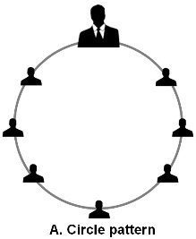

Slide 178
b) Chain (line)
Chain pattern of communication has similar problems as circle pattern as it also follows a certain chain of command.
In the circle, a person can send a message that reaches all members of the group whereas, in the chain, it is either top to bottom level staffs or bottom to top level staffs.

Slide 179
It is a one-way flow of communication.
all members cannot communicate with the leader of the group like in a circle.
So, the members might not get the exact message sent by the leader but an altered version of it.
The leader won’t even be aware what distorted message others lower in the command got.
Feedbacks can also be distorted.

Slide 180
c)Wheel (star)
In wheel pattern, there is a leader at the centre of all communication.
All others are members that stand at the same level in the structure.
Here, all members can communicate with the leader and vice versa.

Slide 181
Cont’
But, members cannot interact with each other. Sometimes, members do not even know of the existence of other members of the same group.
This pattern is taken as the best pattern of communication for any organization as a leader can have direct contact with all.

Slide 182


Slide 183
Assignment Read and make notes on communication patterns
    Y
    network

Slide 184
Directions of communication include
      Vertical Communication
      Horizontal Communication
      Diagonal Communication
      Grapevine Communication
While the first three channels of communication are formal ways, the last one is an informal way of communication.

Slide 185
a)Vertical Communication
Vertical communication can be divided into two categories i.e. upward communication and downward communication.
Downward communication refers to communication that flows from the superior authority to the subordinate authority or from the higher level to the lower level.

Slide 186
Cont’
It is the most important direction of comm. and the very nature of the organisation.
No organisation can function without it.
Downward communication is mostly used give instructions - both written and spoken, letters, memorandum, policy matters, speeches, meeting, information etc.

Slide 187
Cont’
Upward communication refers to communication that flows from the subordinate to the superior or from the lower level to the upper level.
It is mainly used by employees to give feedback about various responsibilities also to give suggestion
It includes reports, proposals, suggestions, grievances, etc

Slide 188
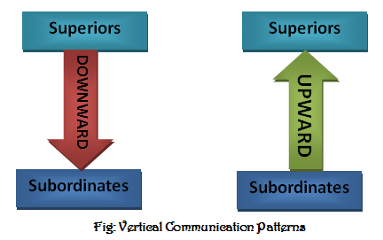

Slide 189
b) Horizontal Communication
Takes place between two or more persons who are subordinates working in the same section or dept.
It is a frequently used channels of communication to maintain coordination between people of the same level.
In this process message flows not only up and down but also sideways.

Slide 190
Cont’
During such interactions the views of each other are made known & decisions are arrived quickly.
Here there is no superior or subordinate relationship.

Slide 191
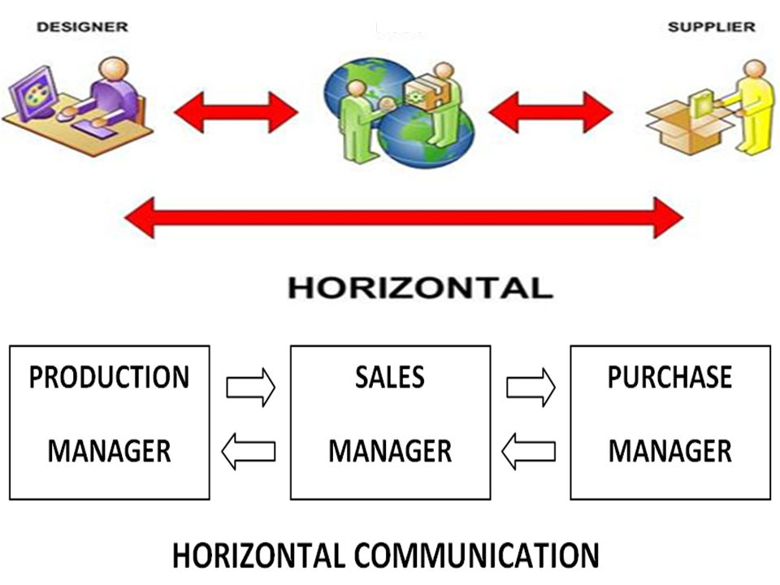

Slide 192
c) Diagonal Communication
It includes the horizontal flow of information as well as interaction across different levels of an organisation's hierarchy.
Diagonal communication is used to speed up the flow of communication.
It makes effective efforts for achieving organisational goals.

Slide 193
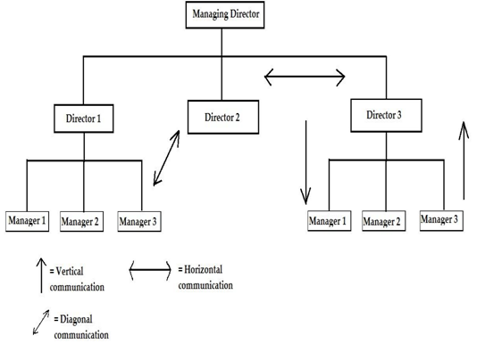

Slide 194
d) Grapevine Communication
It is a type of informal business communications which develops within an organisation.
It means gossip.
Usually gossip that spreads and covers a lot of ground (a lot of people) like vines do.
However there are disadvantages or limitations to grapevine communication.

Slide 195
It has the potential to spread unnecessary gossips.
It can be dangerous to the organisation if allowed to grow without monitoring.
It may result in character assassination and personal vilification of individuals.
It may provoke sudden unwanted and unexpected reactions from emotionally unstable people.
Grapevine channel can be moderated but not eliminated.

Slide 196
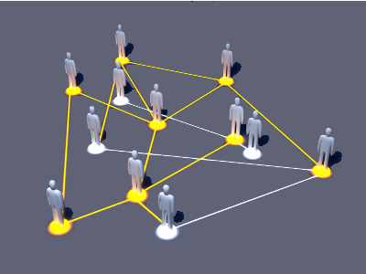

Slide 197
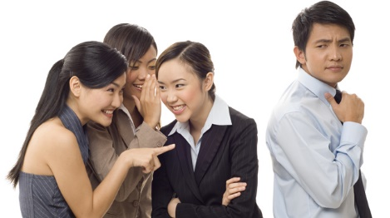

Slide 198
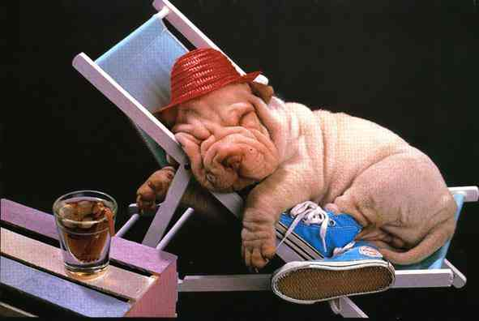
All the best in your studies.

Slide 199
To encourage the speaker to communicate fully, openly and honestly.
To develop an selflessness approach, putting the speaker first.
To arrive at a shared and agreed understanding and acceptance of both sides views.
Read more at: https://www.skillsyouneed.com/ips/listening-skills.html
To encourage the speaker to communicate fully, openly and honestly.
To develop an selflessness approach, putting the speaker first.
To arrive at a shared and agreed understanding and acceptance of both sides views.
Read more at: https://www.skillsyouneed.com/ips/listening-skills.html
5. To show interest, concern and concentration.

Slide 200
Notes
………………………………………………………………………………………………………………………………………………………………………………………………………………………………………………………………………………………………………………………………………………………………………………………………………………………………………………………………………………………………………………………………………………………………………………………………………………………………………………………………………

