Slide 1
COMMUNITY HEALTH II
DIPLOMA IN CLINICAL MEDICINE & SURGERY
KMTC
1ST YEARS [YEAR 1 SEMESTER 2]
MODULE 23: COMMUNITY HEALTH II
Code: CHE 123; Hours - 30; Credits – 3
Pre-requisite: Community Health I

Slide 2
Module Competence
This Module is designed to enable the learner identify determinants of disease in the community, plan community health education, design and deliver health promotion messages.

Slide 3
Module Outcomes
By the end of this module the learner should: -
Carry out community nutrition assessment and implement nutritional program in the community
Identify and assess the various factors that influence health in relation to environment and housing, as well as recommending hygienic methods in food handling, storage, and water supply.

Slide 4
Module Units
Module Name Hours
Theory Practical
Human Nutrition 8 2
Environmental Health 14 6

Slide 5
Module Content
Human Nutrition: Introduction, food groups, common nutritional disorders, prevention and control, Diet for special groups
Introduction to environmental health: definitions, types of environment, factors influencing the environment, pest and rodents control, pollution: sources of pollution and its control.
Waste management and housing: Definition, types of waste, disposal methods and sewage treatment. Housing: definitions, house patterns in the community, characteristics of a good house and diseases associated with housing.
Water supply and food hygiene: Definition, sources, protection, sampling, treatment and storage, water borne diseases. Food hygiene: definition, handling and storage, food spoilage, hygiene principles, common poisonous foods, milk and milk products. Public Health Act (Cap 242)

Slide 6
Reference
Cannolly, M.A. (ed), (2005). Communicable Disease Control in Emergencies: A Field Manual. Geneva: WHO
Service, M. (2008). Medical Entomology, 4th Cambridge: Cambridge University Press.
Afubwa, S.O.and Mwanthi, A.M. (2014). Environmental Health and Occupational Health & Safety. Nairobi: Acrodile Publishing Ltd.
Peirce. J., Vesilind, P.A. and Weiner, R (1997). Environmental Pollution and Control, 4th ed. Madison: Butterworth-Heinemann
Government of Kenya. (1999). Environmental Management and Coordination Act. Nairobi: Government Printers.
Chesworth, N. (1999). Food Hygiene Auditing. Philadelphia: Springer Publishing.

Slide 7
Reference – Continued
Mortimore, S. and Wallace, C. (1998). HACCP: A Practical Approach (Practical Approaches to Food Control and Food Quality Series), 2nd ed. Philadelphia: Springer Publishing.
Blanch, S. (2003). Food Hygiene> London: Hodder Education.
Ministry of Health. (2008). The National Healthcare Waste Management Plan for 2008-2012. Nairobi: Government Printers.

Slide 8
Mode of Learning
1. Interactive lecture
2. Small groups discussions
3. Power point presentation
4. E-learning
5. Problem based learning
6. Study guides

Slide 9
Content Delivery:
Week | Dates |  | Unit
 | From | To
Week 1: |  |  | Nutrition, introduction, food groups
Week 2: |  |  | Common nutritional disorders
 |  |  | Nutritional disorders, prevention and controls
Week 4 |  |  | Diet for special groups
Week 5: |  |  | Video, various food classes, charts, posters
Week 6: |  |  | Introduction environmental health, definitions, types of environment.
Week 7: |  |  | Pests and rodents control
Week 8: |  |  | Pollution, sources and its control
Week 9: |  |  | cats
Week 10: |  |  | Waste managements and housing, definitions, types, disposal, sewage, treatment
Week 11 |  |  | Housing, patterns, good housing, diseases associated with housing
Week 12: |  |  | Water supply and food hygiene, definitions, sources, protection, sampling, treatment, storage
Week 13: |  |  | Food hygiene, definition, handling, storage, spoilage, hygiene, principles, common poisonous foods, milk and milk products,
Week 14: |  |  | Public Health Act (Cap 242)
Week 15: |  |  | Field trips
Week 16: |  |  | Field trips
Week 17: |  |  | Study week
Week 18: |  |  | End of Semester Examinations

Slide 10
SECTION 1: HUMAN NUTRITION

Slide 11
HUMAN NUTRITION:
Introduction:
Nutrition is the sum of all processes involved in how organisms obtain nutrients, metabolize them, and use them to support all of life’s processes.
Includes food ingestion, food and nutrient digestion, nutrient metabolism and nutrient utilization by body cells and tissues to support growth, repair and maintenance of body tissue
Nourishment that sustains life
Its the sum of the processes involved in taking in food nutrients, assimilation and using them to maintain body tissue and provide energy

Slide 12
Nutrients are compounds in foods that are needed by human body for energy to work, for growth of body tissue, for repair and maintenance of body tissues and also to support body’s immune function all that works towards a healthy living. Basically nutrients are substances required by the body to perform its basic functions
Chemical substances in food that are essential for energy, growth, normal functioning of the body, and maintenance of life.

Slide 13

Therefore, Human Nutrition is the study of food in relation to health of individual and groups of people particularly the infants, adolescents, pregnant and lactating mothers(vulnerable groups) and functioning of the body organs and provide the energy the body requires.
Diet: Sum of food consumed by an organism or group
What you eat everyday!

Slide 14
SOME NUTRITION TERMINOLOGIES:
MALNUTRITION:
Is an impairment of health resulting from a deficiency, excess or imbalance of nutrients.
Malnutrition is a broad term commonly used as an alternative to under-nutrition but technically it also refers to over-nutrition.
Malnutrition refers to:
Poor nutrition
OVERNUTRITION
UNDERNUTRITION
Too much or too little of a nutrient can interfere with health and well-being.

Slide 15
BALANCED DIET: Is a diet that provides all the essential nutrients in sufficient quantity and in the correct proportions consumed at the same time in a meal to promote good health.
A calorie is a unit of energy. In nutrition, calories refer to the energy people get from the food and drink they consume, and the energy they use in physical activity.
In dietary terms, calories are the amount of energy that a food provides.
Calories are the amount of energy released when your body breaks down (digests and absorbs) food. The more calories a food has, the more energy it can provide to your body. When you eat more calories than you need, your body stores the extra calories as body fat. Even a fat-free food can have a lot of calories.
Recommended calorie intake depends on factors such as age, size, height, sex, lifestyle, and overall general health.
The amount of energy in an item of food or drink is measured in calories.

Slide 16
Understanding Calorie:
CALORIE (KILO - CALORIE): Is the amount of heat required to raise the temperature of 1 kg of water to 1ºC. The calorie is a unit of energy defined as the amount of heat needed to raise the temperature of a quantity of water by one degree.
For historical reasons, two main definitions of calorie are in wide use.
(1): The small calorie or gram calorie (usually denoted cal) is the amount of heat needed to raise the temperature of one gram of water by one degree Celsius (or one kelvin).
(2): The large calorie, food calorie, or kilocalorie (Cal, Calorie or kcal), most widely used in nutrition is the amount of heat needed to cause the same increase in one kilogram of water. Thus, 1 kilocalorie (kcal) = 1000 calories (cal).
In most countries, labels of industrialized food products are required to indicate the nutritional energy value in (kilo or large) calories per serving or per weight.
The SI unit of energy is the joule. One calorie is defined as exactly 4.184 J, and one Calorie (kilocalorie) is 4184 J.

Slide 17
Depending on where you live, energy may also be measured in kilocalories (kcal) and kilojoules (kJ).
When it comes to calories, they may be “small” or “large.”
If the “c” in calories is uppercase, it indicates a large calorie, and if it’s lowercase, it indicates a small calorie.
A large calorie estimates the amount of energy required to raise the temperature of 1 kg (2.2 pounds) of water by 1°C (or an increase of 1.8°F)
On the other hand, a small calorie estimates the amount of energy it takes to raise the temperature of 1 gram (0.035 ounces) of water by 1°C (or an increase of 1.8°F).
By these definitions, 1 large calorie equals 1,000 small calories, as 1 kg equals 1,000 grams.
As a guide, an average man needs around 2,500kcal (10,500kJ) a day to maintain a healthy body weight.
For an average woman, that figure is around 2,000kcal (8,400kJ) a day.

Slide 18
The science of nutrition:
The chemical content of food
The use of food by the body
The relationship of food to health
The selection of food (socio-cultural factors)
Factors affecting food security
The diet as treatment for disease
The relationship between medication and food intake
Factors That Influence Nutrition
Social
Eat what your parents eat, out with friends, advertisement
Economical
What you can afford to eat, processed foods less expensive, time
Psychological
Bored, stressed, upset
Or do you eat less?

Slide 19
Why is nutrition becoming a major world concern?
Nutrition and infection: public health and preventive medicine
Malnutrition (UNICEF, 1992), morbidity and mortality
Nutrition and Development (MDGS and World Bank 2006)
World food and nutrition security
Access to adequate as food Human right (UN, 1999)

Slide 20
Classification of foods by their nutrient supply
Food groups are divided based on the nutritional properties they offer.
Foods that humans take can be classified based on the amount of nutrients and the type of nutrients they provide for subsistence and survival.
The major classes of nutrients include: Carbohydrates, Proteins, Fats, Vitamin And Minerals.
The nutrient classes can be classified into Macronutrients and Micronutrients.
Macronutrients are nutrients that are required in large quantities. These include: proteins, fats and carbohydrates. These are energy yielding

Slide 21
Micronutrients are nutrients that are needed in small amounts. The two classes of small non-energy yielding elements and compounds: vitamins and minerals essential in very small amounts for regulation and control functions in cell metabolism and building certain body structures.
Functions and Sources of Nutrients
Nutrient characteristics:
essential or non essential
specific metabolic functions
interact with one another to support life
Nutrients include:
Proteins, carbohydrates, fats
Vitamins, minerals and water

Slide 22
3 major roles of nutrients
They serve as a source of energy or heat
They support growth and maintenance of tissues
Aid the regulation of basic body processes
These functions collectively fall under metabolism which is the sum of all the physical and chemical changes taking place in the body

Slide 23
Carbohydrates
Group of compounds of elements carbon, hydrogen and oxygen
Found in foods either as sugars, starch or glycogen
The major food sources of carbohydrates are grains, milk, fruits, and starchy vegetables like potatoes. Non-starchy vegetables also contain carbohydrates, but in lesser quantities.
Simplest form is monosaccharide (simple sugars).
The most basic form of carbohydrates. These are passed through the Gastrointestinal (GI) without being changed by digestive juices. e.g.: glucose, fructose and galactose. Disaccharides: Also called double sugar or biose is the sugar formed when two monosaccharide are joined by glycosidic linkage. They are simple sugars soluble in water. examples: sucrose, lactose and maltose
Disaccharide is any substance that is composed of two sugars linked to each other.
Notes:
A glycosidic bond or glycosidic linkage is a type of covalent bond that joins a carbohydrate (sugar) molecule to another group, which may or may not be another carbohydrate.

Slide 24
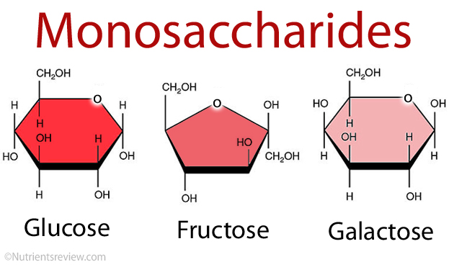
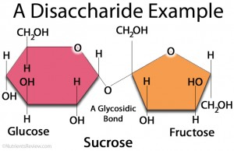
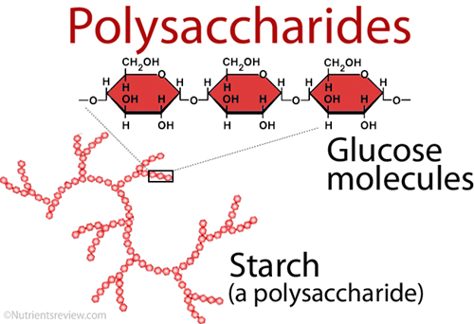
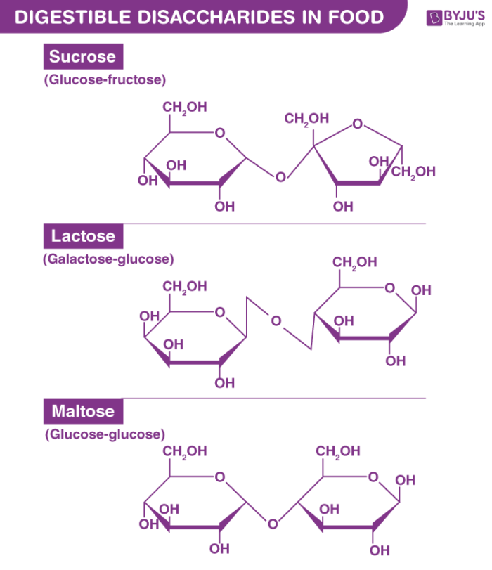
Polysaccharides are insoluble in water. They are long chains of monosaccharides linked by glycosidic bonds.
Examples: starch, glycogen and cellulose.

Slide 25
Functions of Carbohydrates
Source of energy
Serves as lubricants for joints
Serves as transport media
Serves as catalysts
Serves in regulatory and protective mechanism
Maintains body temperature
Carbohydrate metabolism
Metabolism denotes the various biochemical processes responsible for the formation, breakdown and conversion of carbohydrates in living organisms
NB:
Carbohydrates are stored as glycogen.
Excess is converted as fats and stored in the body.
Notes:
Glycogen: multibranched polysaccharide of glucose that serves as a form of energy storage in animals, fungi, and bacteria
interversion (plural interversions) The swapping of positions within a sequence; transposition or permutation.

Slide 26
Proteins
Macromolecules composed of chains of subunits called amino acids
Amino acids are simple subunits composed of carbon, oxygen, hydrogen, and nitrogen.
The food sources of proteins are meats, dairy products, seafood, and a variety of different plant-based foods, most notably soy.
Essential amino acids are those that cant be synthesized by the body whereas non essential are those that can be synthesized by the body.
Proteins in the diet
9 of the 20 amino acids must be obtained from the diet

Slide 27
These are referred to as the essential amino acids.
– Histidine
– Isoleucine
– Leucine
– Lysine
– Methionine
– Phenylalanine
– Threonine
– Tryptophan
– Valine
Proteins are also the major source of nitrogen in the diet
Nonessential amino acids include: alanine, arginine, asparagine, aspartic acid, cysteine, glutamic acid, glutamine, glycine, proline, serine, and tyrosine.
Functions of Proteins
Source of energy
Growth and development of the body
For body maintenance, repair and replacement of worn out of damaged tissue
To produce metabolic and digestive enzymes
Constituents of certain hormones like insulin and thyroxin

Slide 28
Lipids (fats)
A family of organic compounds composed of carbon, hydrogen, and oxygen. They are insoluble in water. The three main types of lipids are triglycerides, phospholipids, and sterols
Lipids are found predominately in butter, oils, meats, dairy products, nuts, and seeds, and in many processed foods
Fats may either be saturated or unsaturated according to the carbon and hydrogen atoms are arranged
Saturated fatty acids –all carbon atoms are saturated with hydrogen atoms and cannot accept any more
These are mostly solid at room temperature

Slide 29
Examples- butyric acid - milk, butter; palmitic acid - animal fats; lauric acid - dairy foods, coconut oil; searic acid - beef fat
Unsaturated fatty acids-some of the carbon atoms are joined to others by a double bond and so are not completely saturated with hydrogen atoms. They can therefore accept more hydrogen atoms.
Monounsaturated fats have one double bond in the molecule e.g. Oleic acid found in most animal and plant fats and oils e.g. Olive oil
Poly unsaturated fats have more than one double bond in the molecule e.g. Linoleic acid both found mainly in vegetable oils
Unsaturated fatty acids may either be cis or trans depending on how the atoms are arranged at the double bonds. Cis are thought to be more better for us.
Notes:
Cis: characterized by having certain atoms or groups of atoms on the same side of the longitudinal axis of a double bond or of the plane of a ring in a molecule
Trans- (prefix): From the Latin meaning "across, over, or beyond."

Slide 30
Functions of Lipids (fats)
To provide a convenient source of energy
Fat beneath the skin acts as an insulator against cold
Acts as a solvent for fat soluble vitamins ADEK
Maintenance of cell structure and synthesis of hormones.
Forms an insulating layer(adipose tissue) beneath the skin to help preserve body heat and protect the skeleton and organs
Surrounds and protects certain vital organs eg kidneys
Forms part of the structure of cell membranes through the body especially in the brain
Provide a reserve for energy for long term storage, which can be used f energy intake is restricted
Provides texture and flavor in food and helps make it palatable
Foods containing fats provide a feeling of fullness(satiety)after a meal, as fat digestion is slow

Slide 31
Water
Is composed of two hydrogens and one oxygen per molecule of water.
Essential constituent of food and human body
Your body is made up of more than 50% water. It is necessary for so many processes that take place moment by moment inside our bodies.
Functions of water
Acts as a carrier of nutrients in foods
Maintains the structure of the food material
Acts as a reactant and a reaction medium for many biological reactions
Acts as a stabilizer of biological polymers
Make up 50-70 percentage of our body
Need it growth and body maintenance
Vital component of our diets

Slide 32
Specific water functions:
(1) There is water in your blood—more than 80%--that carries oxygen and nutrients throughout your system.
(2) Your kidneys require water to remove waste products that are ultimately excreted in urine.
(3) Water is part of metabolism and helps to keep your body temperature normal.
(4) It is part of the structure of your eyes, lungs and muscles and
(5) helps keep a baby afloat inside the womb.
(6) Water is in the fluids of your body including lymph, sweat, tears, spinal fluid and synovial fluid around your joints.
(7) Water helps solid waste products to travel smoothly through your intestines and out of your body.

Slide 33
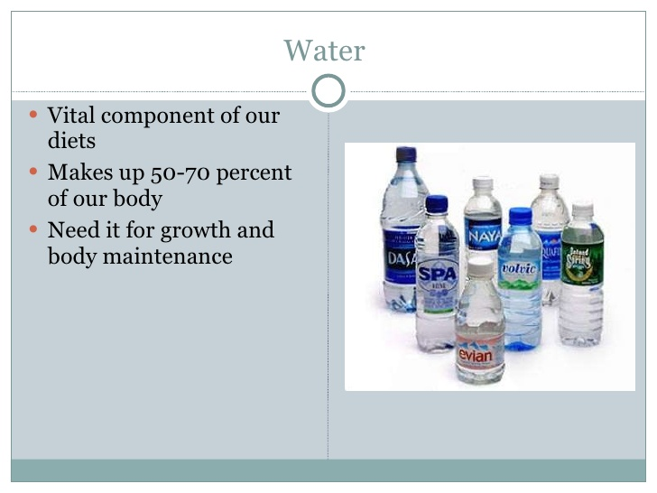
Water

Slide 34
Vitamins
The thirteen vitamins are categorized as either water-soluble or fat-soluble.
The water-soluble vitamins are vitamin C and all the B vitamins, which include thiamine, riboflavin, niacin, pantothenic acid, pyroxidine, biotin, folate and cobalamin.
The fat-soluble vitamins are A, D, E, and K
Functions of vitamins
Biocatalysts
Enzyme co factors in metabolism
Pro hormones- precursors of hormones
Aid in mineral absorption like vitamin D aid in Calcium absorption
Notes:
Biocatalysis refers to the use of living (biological) systems or their parts to speed up (catalyze) chemical reactions. In biocatalytic processes, natural catalysts, such as enzymes, perform chemical transformations on organic compounds.
A cofactor is a non-protein chemical that assists with a biological chemical reaction. Co-factors may be metal ions, organic compounds, or other chemicals that have helpful properties not usually found in amino acids.
A precursor is something that happens before something else. A precursor is usually related to what it precedes

Slide 35
Minerals
Minerals are solid inorganic substances that form crystals and are classified depending on how much of them we need.
Trace minerals, such as molybdenum, selenium, zinc, iron, and iodine, are only required in a few milligrams or less and
macro minerals, such as calcium, magnesium, potassium, sodium, and phosphorus, are required in hundreds of milligrams.
Notes:
A crystal or crystalline solid is a solid material whose constituents (such as atoms, molecules, or ions) are arranged in a highly ordered microscopic structure, forming a crystal lattice that extends in all directions.

Slide 36
Functions of minerals
Enzyme function,
others are used to maintain fluid balance, build bone tissue, synthesize hormones, transmit nerve impulses, contract and relax muscles, and protect against harmful free radicals

Slide 37
FOOD | SOURCE | FUNCTION | EFFECTS OF DEFICIENCY AND TOXICITY
CARBOHYDRATES | maize, rice, wheat, sorghum cassava, potatoes Sugars, honey fruit juices, milk | - important source of energy = 1g=4kcal, sole source of energy for the brain - integrity of the nerve tissue | PEM (Marasmic kwashiorkor and marasmus Excess: obesity, hypertension,
PROTEIN | Eggs, milk, meat, fish, rice, beans, nuts | build and maintain tissues, source of energy (1g=4kcal), formation of enzymes and hormones, antibodies, transport of triglycerides, homeostasis – maintains normal osmotic relations among body fluids, maintains acid-base balance in tissues and blood. | PEM (Marasmic kwashiorkor and kwashiorkor

Slide 38
FATS | Fish oils, butter fat, coconut oil, vegetable oil, lard, | Source of energy 1g=9kcal), adipose tissue protects organs, subcutaneous fat insulates the body, transport and absorption of fat-soluble vitamins, feeling of satiety and fullness, reserve energy, spares protein for tissue synthesis | Excess – arteriosclerosis and Coronary Heart Disease

Slide 39
Micronutrient (fat soluble) | source | Functions | Effects of deficiency & toxicity
Vitamin A(retinol) | Fish liver oils, egg yolk, butter, cream, vitamin A fortified foods, green leafy veg, yellow fruit etc. | Promotes health of epithelial tissues, eyes, glycoprotein synthesis | Night blindness, xeropthalmia, keratomalacia, increased morbidity and mortality in children Toxicity: headache, peeling of the skin, bone thickening
Vitamin D (calciferol) | Ultraviolet irradiation of the skin, milk and milk products, fish liver oils, egg yolk, liver | Calcium and phosphorus absorption, mineralization and collagen maturation of bone | rickets, osteomalacia (softening of bones) toxicity: anorexia, renal failure

Slide 40
Vitamin E (tocopherol) | Vegetable oil, leafy veg, egg yolk, legumes | Antioxidant: scavenger of free radicals in biological membranes | Lipid malabsorption and transport abnormalities, neurological damage Toxicity: interferes with enzyme activity
Vitamin K | Leafy veg, pork, liver, veg oils, intestinal flora of microorganism | Formation of prothrombin and other coagulation factors, normal blood coagulation (clotting) | Hemorrhage from deficient prothrombin, Toxicity: kernicterus (jaundice in infants)

Slide 41
Micronutrient (water soluble vitamins) | Source | Functions | Effects of deficiency & toxicity
Vitamin B₁ (thiamin) | Dried yeast, whole grains, meat, nuts, legumes, potatoes | CHO metabolism, central nerve cells functions, myocardial function | Beriberi, infantile and adult neuropathy, cardiac failure,
Vitamin B₂ (Riboflavin) | Milk, cheese, liver, meat, eggs, enriched cereal products | Energy and protein metabolism, integrity of mucous membrane | Cheilosis-fissuring of lips, burning and itching of eyes, angular stomatitis, purple swollen tongue

Slide 42
Vitamin B₆ (pyridoxine) | Dried yeast, liver, meat, fish, legumes, whole-grains, enriched cereals | Nitrogen metabolism, heme synthesis, conversion of tryptophan to niacin, | Convulsions in infants, dementia, Toxicity-peripheral neuropathy
Vitamin B₁₂ (cobalamin) | Liver, kidney, milk, eggs, fish, cheese | Cell metabolism, red blood cell maturation, use of carbon, neural function, DNA synthesis | Megaloblastic anemia, GI disorders, neurological disorders(numbness & tingling of feet),
Vitamin C (ascorbic acid) | Citrus fruits, egg yolk, milk and milk products | Collagen synthesis, wound healing, reduces infections, facilitates iron absorption, | Scurvy – swollen and inflamed gums, loose teeth, dryness of eyes, loss of hair, dry itchy skin, neurotic disturbances

Slide 43
Minerals | Source | functions | Effects of deficiency & toxicity
Sodium/chloride and potassium | Sodium: Salt – beef, pork, sardines, cheese, corn bread, potato chips Chloride: salt Potassium: milk, bananas, raisin | Acid-base balance, osmotic pressure, blood pH, muscle contractility, nerve transmission, water balance & distribution | Confusion, coma, paralysis, cardiac disturbance
Calcium | Milk and milk products, meat, fish, eggs, cereal products, beans, fruits and vegs | Bone and tooth formation. Blood coagulation, muscle contractility, myocardial function | Def: hypocalcaemia, and tetany, Toxicity: renal failure, psychosis
Iron | Soybean flour, beef, kidney, liver, beans, | Hemoglobin, myoglobin formation, | Def: anemia, decreased work performance, impaired learning ability Toxicity: cirrhosis, diabetes mellitus, skin pigmentation

Slide 44
Iodine | Sea food, iodized salt, dairy products | Formation of energy control mechanism – thyroxine hormone | Def: goiter, cretinism, deaf-mutism, impaired fetal growth and brain development
Magnesium | Green leafy veg, nuts, cereal grains, sea food | Bone and tooth formation, nerve conductivity, muscle contraction, enzyme activation | Def: hypomagnesemia, neuromuscular irritability, Toxicity: hypotension, respiratory failure, cardiac disturbance

Slide 45
Topic recap
Differentiate between the terms nutrition and nutrients
List the six classes of nutrients and 2 functions of each
Giving an example of each, differentiate between a macronutrient and micronutrient
Describe vitamins and their classification
What determines whether a mineral is a macro mineral or a micro-(trace)mineral?
How many kilocalories are in 1 gram of carbohydrate, of protein and of fat?
Outline the food sources, functions and effects of calcium deficiency in humans

Slide 46
The concepts of a balanced diet
Quality (hygiene, sanitation, proper processing, preservation, storage, etc.)
Quantity (RDA) - Recommended Dietary Allowance
Diversity (variety, access, availability)
Notes:
The recommended dietary allowance (RDA) is the average daily dietary intake level that suffices to meet the nutrient requirements of nearly all (97–98%) healthy persons of a specific sex, age, life stage, or physiological condition (such as pregnancy or lactation).

Slide 47
Food Quality
Factors:
Hygiene & sanitation,
Proper processing, preservation & storage etc
Environmental factors
  Physical: weather (sunshine, wind, rain etc)
  Chemical: poisonous component
  Biological : insects

Slide 48
Food Quantity
Nutritional guidelines for health promotion
e.g. nutrition standards such as:
  RDA’s
  Food group guides (food pyramid)
  Health promotion guidelines
    They are either country specific or developed for management of nutrition related diseases such as dietary guidelines for HIV/AIDS, cancer, diabetes and CHD

Slide 49
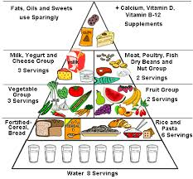
Food Pyramid

Slide 50
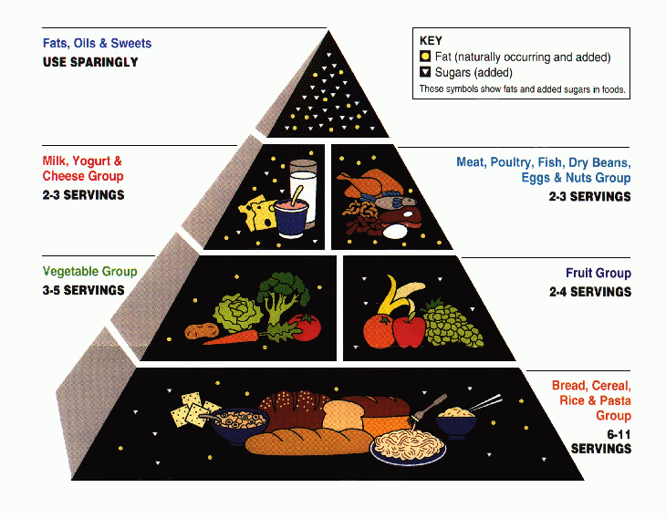
Food Pyramid

Slide 51
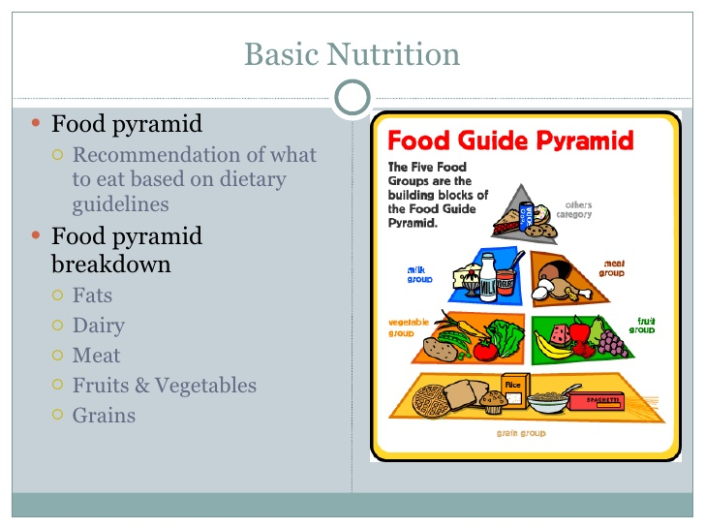
Food Pyramid

Slide 52
Food diversity
Variety: balanced diet, education
Access determined by: income, infrastructure, etc.
Availability determined by: land, water, political stability, education.

Slide 53
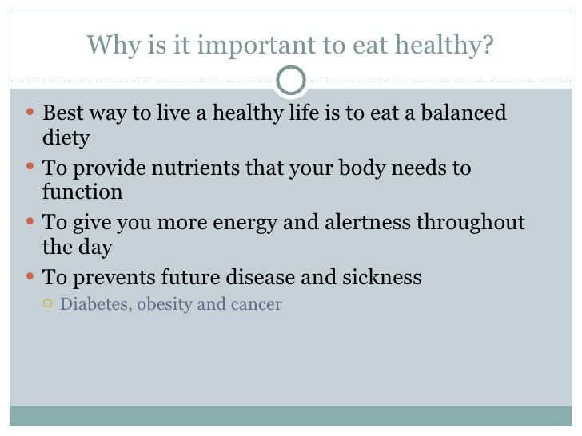
Eating Healthy

Slide 54
NUTRITION ASSESSMENT
Nutritional status is a condition in the body resulting from intakes, absorption and use of food.
Malnutrition is a term encompassing under nutrition (wasting, stunting, underweight and deficiencies of essential vitamins and minerals) and over nutrition(obesity)
Acute malnutrition (wasting) is the result of recent rapid weight loss or failure to gain weight and is associated with an increased risk of mortality. can be moderate or severe
Chronic malnutrition (stunting) is the result of inadequate nutrition over a much longer period of time and is associated with an increased risk of disease/eventual death

Slide 55
Underweight is the outcome of wasting or stunting or a combination of both and is associated with poor growth and development.
Undernutrition can be identified by assessing an individual’s nutritional status, meaning the internal state of an individual as it relates to the availability and utilisation of nutrients at the cellular level.
This state cannot be observed directly so observable indicators are used instead. There are four indicators, however none of them, by themselves or in combination, are capable of providing a full picture of an individual's nutritional status.
They are instead proxy indicators of nutritional status.
‘‘Underweight, stunting, wasting and overweight’’
Notes:
undernutrition indicators: The indicators stunting, wasting, overweight and underweight are used to measure nutritional imbalance; such imbalance results in either undernutrition (assessed from stunting, wasting and underweight) or overweight.

Slide 56
Nutritional Assessment includes A, B, C, D approach
  Anthropometry
  Biochemical analysis (Laboratory data)
  Clinical assessment (Physical examination)
  Dietary evaluations (History taking)
Purpose of Nutritional assessments:
Identify nutritional problems
Assess prevalence
Identify causative factors (immediate, underlying and basic)
Identify most appropriate intervention
Assess food security situation
Identify most affected group/at risk
Evaluate an existing nutritional program

Slide 57
Community Nutrition Assessment Methods
1. Anthropometry
The method that is most widely used in an emergency. It implies assessing the attainment of growth based on measures of physical characteristics of the body (e.g., weight, height, etc.)
Anthropometry is the use of body measurements such as weight, height and mid-upper arm circumference (MUAC), in combination with age and sex, to gauge growth or failure to grow
Anthropometry cannot be used to detect all forms of undernutrition. It cannot be used to measure micronutrient malnutrition, but it can be used to assess:
  Wasting
  Stunting
  Underweight

Slide 58
Anthropometry
Measuring the weight, height and proportion of the human body in relation to age.
Height & circumference is a measure of chronic malnutrition.
Weight & skin fold thickness is a measure of acute malnutrition.
Advantage of anthropometry
Simple
Less expensive equipment
Can be performed by persons with shorter training
Results are expressed in numbers so it can be easily interpreted

Slide 59
Wasting
Wasted children are extremely thin for their height.
Wasting is the result of recent rapid weight loss or a failure to gain weight due to acute infection and/or inadequate dietary intake.
Wasting is readily reversible once conditions improve.
Wasting is evidence of acute malnutrition.
Wasting is measured by the weight for height index or MUAC.
Stunting
Stunted children are short of their age
Stunted children may have a normal body proportions but may look younger than their actual age
Develops over a long period as a result of inadequate nutrition or repeated infections or both
Measured by height for age

Slide 60
Underweight
Underweight children are too light for their age
Underweight is due to either wasting or stunting or a combination of both
Underweight is measured by the weight for age index
Indicators | Indices
Wasting Acute malnutrition | Weight for height
Stunting Chronic malnutrition | Height for age
Underweight Acute/chronic | Weight for age

Slide 61
Anthropometric Measurements
Weight
Height
Mid- Upper Arm Circumference
Head And Chest Circumference
Triceps Skin Fold (Tsf)

Slide 62
Main anthropometric indices:
Anthropometric indices are compared for identifying factors of nutritional status of children.
Weight-for-height (wasting)
Height-for-age (stunting)
Weight-for-age (underweight)
BMI
Birth weight
MUAC
Triceps skin-fold
Head circumference

Slide 63
BMI (ADULTS)
Body mass index = weight in (kg)/height in meters (m2).
Categories
Underweight =Less than 18.5
Normal weight =18.5 – 24.9
Overweight =25 – 29.9
Obese =30 and over
Weight-for-height (wasting)
Used for both adults and children in relation to accepted reference values
It’s a measure of acute undernutrition
used mainly in emergencies
Normal if less than 2% of the pop. fall below -2SD
Moderate if 5-10% of the pop are below -2SD more than 10% is severe

Slide 64
Height-for-age (stunting)
It’s a measure of chronic undernutrition in children
An effect of environmental and socio-economic factors
Moderate = 25-50% below -2SD
Severe = 50% and above fall below -2SD
Weight-for-age (underweight)
Its difficult to interpret its an effect of both chronic and acute undernutrition
Moderate = 20-40% are below -2SD
severe = 40% and above are below -2SD

Slide 65
Weight
Tells us about child’s total body mass
Sensitive indicator of changes in the Nutritional status.
Affected by illness, food intake
Serial record can identify child failing to gain weight
Equipment:- Beam scale, Salter spring balance with scale, Bathroom scale

Slide 66
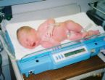

Scales

Slide 67

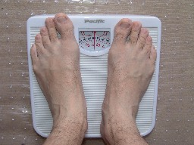

Mobile clinics
Salter spring balance
<6yrs
Mobile clinics
Bathroom scale->6 yrs

Slide 68
Height/ Length
Less sensitive index to changes over short period of time.
It is affected if there is prolonged nutritional deficiency
< 2 years- supine length wooden board – Infantometer
> 2 years- Standing height – Stadeometer
Observed Weight & Height is compared with expected Weight & height of child of that age—Shows child’s position in relation to the reference population

Slide 69

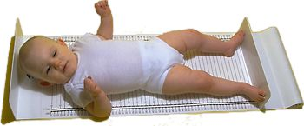
Technique of measurements
Length - <2yrs (Infantometer)
Infantometer

Slide 70
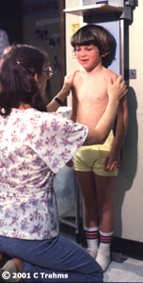
Standing height
Standing height->2yrs
(Stadiometer)

Slide 71
Mid Upper Arm Circumference (MUAC)
Measures muscle mass & subcutaneous tissue in upper arm.
Between elbow and shoulder by tape.
Arm should hang limply by the side.
Shakir’s tape is used.
For children (MUAC for adults recently developed)
Its easy but less accurate
Interpretation:-
>13.5cm (Green) - adequate nutritional Status
12.5-13.5cm (Yellow) - Boderline
<12.5cm (red) - malnourished
Above 13.5 = not wasted
13.5 – 12.3 = moderately wasted
Below 12.5 = severely wasted

Slide 72
Head circumference
Related to brain size mainly to a small extent to thickness of scalp tissues & skull
Steady child’s head & measure greatest circumference place tape firmly around forehead just above the level of child’s eyebrows & behind maximal protuberence
Equipment: Non-stretchable measuring tape

Slide 73
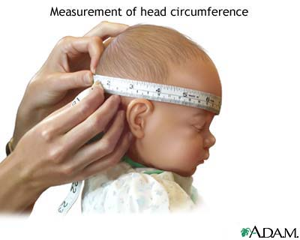

Slide 74
Chest circumference
Related to growth of rib cage, muscle mass, subcutaneous fat & lung tissue
At the level of the nipple line, preferably in mid respiration.
At birth Head Circumference is 3 cm>Chest Circumference
By 9 months Head Circumference=Chest Circumference,
>9 months Head Circumference grows slowly and chest expands rapidly
Interpretation:-
Detects malnutrition in 1st 5 years of life. If CC/HC <1 means child is malnourished.

Slide 75
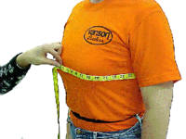
Chest circumference
At birth HC 3 cm > CC
9 months HC= CC
>9 months CC>HC
Triceps skin fold (TSF)
Measures triceps skin fold thickness
>10mm in 1-6 years
6-10mm- mild malnutrition
<6mm- Moderate- severe malnutrition

Slide 76
2. Individual assessment
Growth monitoring and promotion as part of a mother and child health (MCH) programme where the growth of infants and young children are monitored over time in order to identify and address growth faltering and growth failure.
Nutritional screening - where each child is measured in order to identify and refer individuals for further check-ups or to services such as supplementary or therapeutic feeding as needed

Slide 77
3. Population assessment
Nutritional surveillance for famine early warning systems in order to measure changes in nutritional status of populations over time to mobilize appropriate preparation and/or response.
Rapid nutrition assessments which are carried out to quickly in order to establish whether or not there is a major nutrition problem and to identify immediate needs.
Nutrition surveys in emergencies in order to assess the extent of undernutrition or estimate the numbers of children who might require supplementary and therapeutic feeding or other nutritional support

Slide 78
Nutritional indices are calculated by comparing an individual’s measurements with that of a reference population.
The nutritional indices commonly calculated for young children are: weight for height – a measure of wasting or acute malnutrition;
height for age – a measure of stunting or chronic malnutrition;
weight for age – a measure of underweight or wasting and stunting combined.
MUAC is also a measure of wasting or acute malnutrition. MUAC is not an index by itself.
Oedema is the retention of water and sodium in the extra-cellular spaces. Generally it accounts for 10–30% of bodyweight, but in the most severe cases of kwashiorkor the proportion can reach 50%. A child with oedema of both feet is automatically considered severely acutely malnourished

Slide 79
4. Biochemical tests (Biochemical analysis)
Assessing specific components of blood and urine samples of an individual. However this is generally expensive and time consuming and not possible in an emergency
Laboratory tests as a measure of Nutritional Status (confirming deficiency)
E.g. blood and urine to determine hemoglobin and vitamin levels
Levels of vitamin C and B reflect current dietary intakes
Protein levels reflect long-term intake
(refer to page 301 Food, Nutrition & Diet Therapy 8th edition)

Slide 80
5. Clinical signs (Clinical assessment)
Assessing signs and symptoms of illness (e.g. oedema). There are few ‘field friendly’ methods for clinical detection of micronutrient malnutrition in an emergency as it does not allow identification of those with subclinical levels of micronutrient malnutrition.
This includes complete physical examination and a medical history
Special attention should be given to areas where signs of nutritional deficiencies appear – skin, hair, tongue, teeth, gums, lips, eyes etc. (REFER TO PAGE 304 – Food, Nutrition & Diet Therapy)
Note: its important to distinguish between signs of pathological states and nutritional deficiencies

Slide 81
6. Dietary intake (Dietary evaluations)
Assessing food intake of individuals over a specific period of time in order to determine whether the quantity or quality of intake is adequate. This information however can only reflect short term intake.
24-hour recall:
The respondents recalls food eaten the last 24 hours
used to determine general eating patterns of individuals.
Respondents can give wrong information
Recall can be improved by use of measuring cups or spoons.

Slide 82
Food frequency questionnaire
collects information on intake of particular food groups on a daily, weekly or monthly basis
Food diary or Record
everything consumed during a particular time period is noted.
The nutrient contribution of each food is calculated.
The total day’s intake for each nutrient is then obtained and is divided by the number of days to give an average daily intake. Three day or four day records are used.

Slide 83
Observation of food intake
accurate method but time consuming and expensive.
It is carried when meals are provided.
The presented food is weighed and the leftovers weighed and the difference is recorded as amount eaten.
Diet history
Respondent gives a typical or usual food intake
Can be used with 24 hour recall
Yield qualitative than quantitative data

Slide 84
Tools For Data Collection
Observation
Questionnaire
Interview schedule
Focus group discussions

Slide 85
NUTRITIONAL DISORDERS
Disorders occur due to nutritional imbalance - when you consume too much or too little or
The body does not utilize nutrients properly
Iron deficiency has been documented to be the most common (over 1,000 million)
Disorders include:
PEM (Protein–energy malnutrition)
Iron, Iodine, calcium, and zinc deficiency
Vitamins A, B1, C and D deficiencies
Other disorders include: dental caries, fluorosis
Other micronutrient deficiencies include:
Riboflavin
Pyridoxine ( vit.B6) deficiencies

Slide 86
Chronic diseases with nutritional implications
Cancer
Arteriosclerosis (heart disease)
High bloods pressure (Hypertension)
Diabetes Mellitus
Osteoporosis
Obesity

Slide 87
MALNUTRITIONAL DISORDERS
Kwashiorkor
Marasmus
Goitre
Rickets
Anemia
Obesity
Scurvy
Xerophthalmia (Night blindness)
Pellagra (Keratomalacia)
Osteoporosis
Osteomalacia

Slide 88
Protein–energy malnutrition (PEM), sometimes called protein-energy undernutrition (PEU), is a form of malnutrition that is defined as a range of conditions arising from coincident lack of dietary protein and/or energy (calories) in varying proportions. The condition has mild, moderate, and severe degrees.
PEM Sign and symptoms
Failure to thrive is the first sign
Others include:
Muscle wasting (marasmus)
Apathy
Irritability
Edema (kwashiorkor)
Hair changes
Weight reduction
Height reduction
Small arm circumference
Reduced skinfold thickness

Slide 89
Causes of PEM
Inadequate intake of nutrients
Poor utilization of nutrients
Infection
Inadequate care and
Poor feeding practices (weaning + breastfeeding etc.)
Nutritional marasmus is more common than kwashiorkor
Occurs mainly in children. Why?
PEM occurs characteristically in children under five (5) years of age.
High need for nutrients
Inappropriate feeding
Giving food low in energy
Inadequate child care (time constraint)
Poverty
Frequent infections
Famine

Slide 90
Other diagnostic measures
Besides the clinical signs and symptoms others tests e.g. biochemical indicators such as vitamin A, zinc and nutritional anemia
Serum levels of insulin (low in marasmus and high in kwashiorkor).
Anthropometric measurements such as skinfold and arm circumference are used
Treatment of PEM
Incase of a severe case of PEM
Hospitalization is necessary
Antibiotics to prevent infection
Dietary intervention
Social and political problems to be management

Slide 91
KWASHIORKOR
Kwashiorkor is an acute form of childhood protein-energy malnutrition characterized by
Edema
Irritability,
Anorexia
Ulcerating dermatoses, and
An enlarged liver with fatty infiltrates.
The presence of edema caused by poor nutrition defines kwashiorkor.
It is due to a quantitative and qualitative deficiency of protein but in which energy intake may be adequate.
Kwashiorkor is mainly a disease of rural/slum areas occurring in the second year of life.

Slide 92
KWASHIORKOR: SIGNS AND SYMPTOMS
Typical ulcerating dermatosis seen on a patient with kwashiorkor
The defining sign of kwashiorkor in a malnourished child is pedal edema (swelling of the feet).
Other signs include a distended abdomen, an enlarged liver with fatty infiltrates, thinning hair, loss of teeth, skin de-pigmentation and dermatitis
Children with kwashiorkor often develop irritability and anorexia
NOTE:
Generally, the disease can be treated by adding food energy and protein to the diet; however, it can have a long-term impact on a child's physical and mental development, and in severe cases may lead to death

Slide 93
MARASMUS:
Marasmus is a form of severe protein-energy malnutrition characterized by energy deficiency.
It is a condition primarily caused by a deficiency in calories and energy.
These conditions are frequently associated with infections, mainly the gastro-intestinal tract.
It is due to a continued restriction of dietary energy and protein, as well as other nutrients.
This marasmic form of syndrome occurs mostly in infants less than one year frequently found in towns.
Cause: Marasmus is caused by a severe deficiency of nearly all nutrients, especially protein and calories.

Slide 94
MARASMUS SIGNS AND SYMPTOMS
Marasmus is caused by an inadequate intake of protein and calories.
Some symptoms include
Stunted growth
Pronounced weight loss including also drastic loss of adipose tissue
Loss in muscle formation in shoulders and buttocks
Hair loss
Dry skin/darkened skin and
Apathy.
Loose skin folds hanging over the glutei, axillae, etc.
The afflicted are often fretful, irritable, and voraciously hungry.
The malnutrition associated with marasmus leads to extensive tissue and muscle wasting, as well as variable edema.

Slide 95
MARASMUS TREATMENT: It is necessary to treat not only the symptoms but also the complications of the disorder, including infections, dehydration, and circulation disorders, which are frequently lethal and lead to high mortality if ignored.

Slide 96
PROTEIN–ENERGY MALNUTRITION (PEM) PREVENTION:
Oral rehydration therapy helps to prevent dehydration caused by diarrhea
Exclusive breast feeding for 6 months thereafter supplementary foods may be introduced along with breast feeds
Immunization for infants and children
Nutritional supplements
Early diagnosis and treatment
Promotion and correction of feeding practices
Family planning and spacing of birth

Slide 97
CLINICAL SIGNS
Kwashiorkor | Marasmus
Age 2 -3 years | Age 1 and below
Child is miserable | Growth failure that is retarded
Lack of appetite | Limbs are very thin with waste of muscles
Growth failure that is retarded/stunted | Child has good appetite
Oedema of the face and limbs | Child is alert, happy and active
Enlargement of belly | Face is like that of an old man’s face with deep sunken eyes and wider
Hair change in colour and texture | Hair change in texture than in colour
 | Slightly anaemic
 | Very under-weight

Slide 98
Comparison of the features of kwashiorkor and marasmus
Feature | Kwashiorkor | Marasmus
Growth failure | Present | Present
Wasting | Present | Present, marked
Oedema | Present (sometimes mild) | Absent
Hair changes | Common | Less common
Mental changes | Very common | Uncommon
Dermatosis, flaky-paint | Common | Does not occur
Appetite | Poor | Good
Anaemia | Severe (sometimes) | Present, less severe
Subcutaneous fat | Reduced but present | Absent
Face | May be oedematous | Drawn in, monkey-like
Fatty infiltration of liver | Present | Absent

Slide 99
Iron deficiency and nutritional anemia
Most prevalent
Caused by insufficient iron in the diet or
Deficiencies of folates (or folic acid), vitamin B12 and protein may also cause anaemia.
Ascorbic acid, vitamin E, copper and pyridoxine are also needed for production of red blood cells (erythrocytes).
Classification
Anaemias can be classified in numerous ways,
some based on the cause of the disease
others based on the appearance of the red blood cells

Slide 100
Some anaemias are caused by congenital abnormalities or inherited characteristics; such anaemias, which include sickle cell diseas
Based on the characteristics of the blood cells or other features, such as
microcytic (having small red blood cells),
macrocytic (having large red blood cells),
haemolytic (having many ruptured red blood cells)
hypochromic (having pale-coloured cells with less haemoglobin).
Macrocytic anaemias are often caused by folate or vitamin B12 deficiencies.
In anaemia the blood has less haemoglobin than normal.

Slide 101
Does not necessarily occur due to lack of iron in the diet
Diet could be rich of iron but factors that inhibit absorption could be present
Other forms of iron are more absorbable than others
Iron could be lost due to hookworm infection, bleeding ulcers etc.
Consequences of Anaemia
Research now indicates that iron deficiency has very important implications,
Including poorer learning ability and
Behavioural abnormalities in children,
Lower ability to work hard
Poor appetite
Poor growth.

Slide 102
Dietary sources of iron
Heme (haem)
Liver
Red meat
Blood products
Non heme
Pulses
Dark green vegs
Millet
Note: milk and milk products are a poor source
Factors affecting iron status
Heme iron is well absorbed than non heme
Phytates and phosphates in cereals inhibit absorption
Notes:
Heme (haem): an iron-containing compound of the porphyrin class which forms the non-protein part of haemoglobin and some other biological molecules.
Phytate or phytic acid is the principal storage form of phosphorus in many plant tissues, especially bran and seeds

Slide 103
Protein and ascorbic acid enhances absorption
Egg yolk inhibits iron absorption as well as
Tea - Tea interferes with iron absorption and can lead to iron deficiency anemia when consumed in large quantities.
Signs and symptoms
Tiredness and fatigue ;
Breathlessness following even moderate exertion;
Dizziness and/or headaches;
Palpitations, with the person complaining of being aware of his or her heartbeat;
Oedema (in chronic and severe)
Diagnosis: Biochemical: hematocrit and hemoglobin levels

Slide 104
Intervention: (for anaemia)
Ferrous sulphate based supplements 300mg twice daily
Transfusion for severe cases or intravenous injections
Folate and iron supplements given as prophylaxis (pregnant women etc)
Incase of vit B12 the vitamin supplements are given
Food-based approaches
Foods rich in iron and vitamin B12:
- Cereals and root crops
- Legumes
Vitamin C rich foods to enhance absorption

Slide 105
Suggested criteria for diagnosis of anaemia using haemoglobin (Hb) and haematocrit (PCV) determinations
Subject | Hb below | PCV below
 | (g/dl) | (%)
Adult male | 13 | 42
Adult female (non-pregnant) | 12 | 36
Pregnant female | 11 | 30
Child 6 months to 6 years | 11 | 32
Child 6 to 14 years | 12 | 32

Slide 106
SCURVY:
It is caused by a dietary lack of vitamin C (ascorbic acid), a nutrient found in many fresh fruits and vegetables, particularly the citrus fruits.
Scurvy is a disease resulting from a deficiency of vitamin C, which is required for the synthesis of collagen in humans.
Early symptoms are malaise and lethargy.
After 1-3 months, patients develop shortness of breath and bone pain.
Scurvy can be prevented by a diet that includes certain citrus fruits such as oranges or lemons.
Other sources rich in vitamin C are fruits such as blackcurrants, guava, kiwifruit, papaya, tomatoes, and strawberries.

Slide 107
PELLAGRA:
Pellagra is a disease which occurs when a person does not get enough niacin (one of the B complex vitamins) or tryptophan (an amino acid).
Pellagra is a nutritional wasting illness caused by a deficiency of niacin (Vitamin B3) and tryptopan, in the body.
BERI BERI
Beriberi is a nervous system ailment caused by a thiamine deficiency (deficiency of vitamin B1) in the diet.
Symptoms of beriberi include severe lethargy and fatigue, together with complications affecting the cardiovascular, nervous, muscular, and gastrointestinal systems.

Slide 108
RICKETS:
Rickets is a disorder caused by a lack of vitamin D, calcium, or phosphate. It leads to softening and weakening of the bones.
Vitamin D and sunlight together with an adequate diet are curative, provided that the parathyroid glands are functioning properly.
The disease is marked by bending and distortion of the bones under muscular action
OSTEOPOROSIS:
Osteoporosis is the thinning of bone tissue and loss of bone density over time.
This can result in brittle, fragile bones that are more prone to fractures, even without injury.
Usually, the loss occurs gradually over years.

Slide 109
OSTEOMALASIA:
Osteomalacia is softening of the bones due to a lack of vitamin D or a problem with the body's ability to break down and use this vitamin.
GOITRE:
A goitre or goiter is a swelling in the thyroid gland, which can lead to a swelling of the neck or larynx (voice box).
Over 90% cases of goitre are caused by iodine deficiency.

Slide 110
OBESITY
Obesity is an excess proportion of total body fat.
A person is considered obese when his or her weight is 20% or more above normal weight.
Obesity is most commonly caused by a combination of excessive food energy intake, lack of physical activity, and genetic susceptibility, although a few cases are caused primarily by genes, endocrine disorders, medications or psychiatric illness.
The most common measure of obesity is the body mass index or BMI. A person is considered overweight if his or her BMI is between 25 and 29.9; a person is considered obese if his or her BMI is over 30.

Slide 111
Facts about Obesity
Leading cause of preventable illness and death in North America
Worldwide obesity has nearly doubled since 1980
Obesity cost the Canadian economy somewhere between $4.6-billion and $7.1-billion a year.
About 1 in 11 children - 8.6 per cent - are considered obese
Income can affect your weight
Increased Risk of
Hypertension
Stroke
Type 2 Diabetes
Breathing Problems
Cancer
Breast, colon, endometrium, esophagus, gallbladder, liver, prostate, ovarian, pancreas, kidney

Slide 112
Prevention of Obesity
Make healthy options easily accessible
Promote the importance of physical activity
Teach children how to prepare healthy food
Make nutritional information accessible
Put water everywhere
Reduce screen time

Slide 113
NUTRITIONAL DISORDERS PREVENTION AND CONTROL
Methods of nutrition intervention
Food fortification
Fortification is the addition of one or more nutrients to food to make it richer.
Food for work
Price subsidization
Supplementation
Family planning
Integration of nutrition with health
Price policy

Slide 114
How can we prevent nutritional disorders?
Maintain a Healthy Weight
Maintain Daily Physical Activity
Eat a Healthy Diet
Ensure generous consumption of fruits and vegetables and adequate folic acid intake. ...
Consume cereal products in their whole-grain, high-fiber form
Limit consumption of sugar and sugar-based beverages
Limit excessive caloric intake from any source. ...
Limit sodium intake.
NB:
Each particular nutritional disorder has a specific prevention and control measures

Slide 115
Nutrition in Vulnerable groups
Vulnerability is the degree to which a population or organisation is unable to anticipate, cope with, resist and recover from the impacts of disasters (WHO, 2002
Certain vulnerable groups in the population have special nutritional needs.
  Pregnant and lactating women
  Infants and children
  School age children
  Refugees and displaced persons

Slide 116
1. Pregnant and lactating mothers
During pregnancy and lactation, a woman’s nutritional needs are greater.
Food required by the foetus to grow and production of milk must come from the mother
A child born to a poorly nourished mother is likely to have low birth weight.
During pregnancy there is an increase in the weight of the woman and the basal metabolic rate also increases.
Hence the increase requires extra food to provide extra energy, proteins and other nutrients

Slide 117
Anaemia is common among pregnant women hence need to give iron supplements routinely to expectant mothers in form of ferrous sulphate. Ferrous one of the vitamin B is also required for making red blood cells is also given together with iron .
Vitamin A deficiency in pregnancy is bad for the baby hence multivitamin tablets should be given during pregnancy and encourage pregnant women to eat foods rich in Vitamin A.
Mothers who have just delivered need to eat foods rich in Iron and Vitamin A.
The nutritional cost of pregnancy and lactation is great as the woman’s store of nutrients is depleted

Slide 118
Repeated pregnancy ,combined with heavy work quickly makes a woman weak and sick.
To prevent this the woman must be well fed during their reproductive years.
2. Infants and children
Correct Norms for Infant and Young Child Feeding involves:
Initiation of breastfeeding immediately after birth, preferably within one hour.
Exclusive breastfeeding for the first six months i.e., the infants receives only breast milk and nothing else, no other milk, Food, drink or water.
Appropriate and adequate complementary feeding from six months of age while continuing breastfeeding.
Continued breastfeeding up to the age of two years or

Slide 119
A newborn infant, or neonate, is a child under 28 days of age. During these first 28 days of life, the child is at highest risk of dying. It is thus crucial that appropriate feeding and care are provided during this period, both to improve the child’s chances of survival and to lay the foundations for a healthy life.
3. School age children
Growth is the best global indicator of children’s well-being.
Adequate food intake is essential for proper growth
Low food intake can affect their physical and mental growth
Impaired growth and development in children can affect the rest of their lives Child’s Health and Future

Slide 120
UNICEF estimates that malnutrition affects physical and mental function of 2 billion children
Malnutrition and Child: According to WHO and UNICEF estimates, 60% of child deaths are malnutrition associated
Child and Physical Development: Rapid growth happens between infancy and adolescence.
Nutrition is vital during the growth phase
Inadequate nutrition affects growth and muscle development.
Child and Mental Development: it’s the critical Periods for Brain Growth.
Nutritional status of children during the critical period is of paramount importance for later physical, mental & social development.
Diet: Choose a diet with plenty of grain products, vegetables and fruits. Choose a diet low in fat, saturated fat, and cholesterol. Buy low-calorie and low-fat meals, snacks and deserts, low fat or skim milk and diet drinks. Choose a diet that provides enough calcium and iron to meet their growing body's requirements.
Require A healthy, balanced diet

Slide 121
4. Refugees and displaced persons
Food security and nutrition interventions in camps aim to improve the immediate food security and nutritional well-being of refugees, mainly by tackling the immediate and underlying causes of malnutrition.
A person's nutritional status is highly influenced by his or her environment, water sanitation and hygiene (WASH), access to health services, food and nutrition security and care, and shelter. Where these are inadequate, risk of malnutrition increases.
Nutrition interventions aim to prevent malnutrition in the refugee population, especially among women, young children and other groups with specific needs; to identify, refer and treat malnutrition in individuals; and to monitor the nutrition situation in camps.
Require adequate nutrient-rich food

Slide 122
5. Nutritional needs aged people
Nutritional needs change throughout life. For the elderly, these changes may be related to normal aging process, medical conditions, chronic health conditions ,changes associated with aging process or life style.
Adequate nutrition and a well balanced diet is of vital importance even during old age so as prevent and control the common problems of ageing
Under nutrition, obesity, diabetes, cardiovascular diseases and osteoporosis have been identified as the most important and commonly prevalent nutrition related to health problems among them.
Old people age, multiple changes occur that affect the nutritional status of an individual.
Many changes occur throughout the digestive system. A decrease in saliva production- xerostomia - and changes in dentition or loss of teeth alter the ability of chew and may lead to changes in food choices.
Diet: Eat a wide variety of foods from the five food groups : plenty of colourful vegetables, legumes/beans; fruit; grain (cereal) foods, mostly wholegrain and high fibre varieties; lean meats and poultry, fish, eggs, tofu, nuts and seeds; milk, yoghurt, cheese or their alternatives, mostly reduced fat.

Slide 123
SECTION 2: ENVIRONMENTAL HEALTH

Slide 124
Definition:
Health: (WHO) - A state of complete physical, mental, and social well-being and not merely the absence of disease or infirmity.
Environmental Health:
Comprises those aspects of human health, including quality of life, that are determined by physical, chemical, biological, social, and psychosocial factors in the natural environment. Or
It also refers to the theory and practice of assessing, correcting, controlling, and preventing those factors in the environment that can potentially affect adversely the health of present and future generations.
Involve the study of all the physical, chemical, and biological factors external to a person, and all the related factors impacting behaviour.

Slide 125
It encompasses the assessment and control of those environmental factors that can potentially affect health.
It targets preventing disease and creating health-supportive environments.
It encompasses the assessment and control of those environmental factors that can potentially affect health.
It targets preventing disease and creating health-supportive environments.
Environmental health describes the aspects of health related to or emanating from your interaction with the environment.

Slide 126
Scope of practice of Environmental Health.
The practice of environmental health in the public and private sector includes prevention of environmental health hazards, the promotion and protection of the public health and the environment in the following areas:-
Food protection.
Housing.
Institutional environmental health.
Land use.
Community noise control.
Recreational swimming areas and waters.
Electromagnetic radiation control.
Solid, liquid, and hazardous materials.
management
Underground storage tank control.
Onsite septic systems.
Vector control.
Drinking water quality.
Environmental sanitation.
Emergency preparedness.
Milk and dairy products, etc.
Broad Scope of practice
Sanitation and hygiene promotion
Food safety & quality control
Occupational Health & Safety
Water safety & quality control
Vector & Vermin Control
Pollution Control and Housing
Disease control
Institutional /general inspections
Public health law enforcement

Slide 127
Community health
This is the science and art of preventing disease, prolonging life and health efficacy through organized community effort. Or
It’s the science and art of promoting health and preventing diseases through organized community participation.
The term ‘community health’ is also referred to as:
  Population medicine
  Social medicine
  Community medicine
  Preventive medicine

Slide 128
Public Health:
Field of medicine and hygiene dealing with
Prevention of disease
Promotion of health
Treatment of minor ailments
The promotion of health and the prevention of disease through the organized efforts of society
Public Health focuses on the health of populations and communities rather than individuals. ….social, physical and political environments play major roles in the amelioration of the problem.

Slide 129
Community
A community is a group of people (a large or small group) living in a certain geographical area and working together for a common goal.
They share the same resources such as water, climatic and geographic conditions, health services, administration and leadership, as well as disadvantages such as shortages, risks and dangers.

Slide 130
Environment
The sum total of all surroundings of a living organism, including natural forces and other living things, which provide conditions for development and growth as well as of danger and damage.
Also defined as "the sum of all external conditions affecting the life, developments and survival of an organism".
is all that which is external to the individual human host
The term environment comes from the French word "environmer" which means 'surroundings'.
Comprises all things that make up your surroundings,
Everything, which surrounds us whether, living or a non-living is a component of our environment.
It includes the air we breathe, the water we use for our needs, the soil we cultivate, the flora and the fauna we enjoy.

Slide 131
The external conditions include both physical and biological. By physical conditions (also called physical environment) we mean non-living attributes like air, water, soil, climate, heat, light, noise, housing, radiations, and debris, whereas the biological factors (also called biological environment) include all types of flora, fauna and the micro-organisms.
The physical and the biological environments are interdependent. For example, deforestation leads to decline in wildlife population (biological environment) as well as increase in atmospheric temperature (physical environment).
In the human environment social conditions like customs, religion, habit, and occupation are also included since they affect the living conditions.

Slide 132
Types of Environment:
Biological environment
Physical environment
Socio-cultural environment
Economic / political environment
Technological environment

Slide 133
Biological environment
  All types of flora, fauna and the micro-organisms.
  Plants, animals, micro-organisms
Physical environment
  Air, water, soil, climate, heat, light, noise, housing, radiations, and debris, rocks, minerals, temperature, humidity, wind, rain, other related non-living elements
Socio-cultural environment
  Customs, religion, habit, culture, family, kinship, cultural pressures on lifestyle, factors like personal, domestic.
Economic / political environment
  Occupation, resources, governance, infrastructure
Technological environment
  Internet, new technology

Slide 134
1. Biological Environment
is made up of living things, which include plants, people and animals.
Includes the influence of all biological factors such as warmth, moisture and humidity.
It influences vectors, humans and plants serving as reservoirs of infection. It is the interaction of the agent, the host and the environment which determines whether or not a disease develops, and this can be illustrated using the epidemiologic triangle.
The epidemiologic triangle depicts the relationship among three key factors in the occurrence of disease or injury - agent, environment and host.
An agent is a factor whose presence or absence, excess or deficit is necessary for a particular disease to occur. The agents comprises of the disease causing organisms like bacteria, viruses, parasites, protozoa, fungi etc.

Slide 135
Plants provide vegetables, fruits, tubers and seeds as food. Trees act as windbreakers, provide firewood, charcoal, timber and paper among others. They also influence weather patterns.
Human beings (people) and their activities can be a big source of infection. For example, overcrowding and slum settlements brought about by urbanisation, can promote the transmission of diseases, especially those diseases that are spread through droplets and contact.
Animals: Domestic animals such as cattle, sheep, goats and poultry provide meat, milk and eggs for consumption. Cats and dogs are kept as pets, but they can also transmit diseases such as cat scratch fever and rabies, respectively. Other hazards include snakebites, which can be fatal and insect bites, which may act as vectors of various diseases.

Slide 136
Biological Environment:
Epidemiological Triangle
Host
Agent Environment

Slide 137
2. Physical Environment:
It is the product of nature where there is no direct or indirect effect of human activity
It relates to the material and tangible conditions in which we live in.
It also refers to geographical climate and weather or physical conditions wherein and individual lives.
The physical components of the environment are divided into geographical and man-made components.
Land is used for settlements. The type of soil, climate and altitude determine the type of crops that can be grown in a specific area.
cold climates encourage respiratory diseases and joint problems such as arthritis. Some diseases are associated with hot climates like malaria.
Each type of climate has its own pattern of vegetation and animals to control. Man has to adjust to the animals and the vegetation since they affect health. Additionally, to adjust to the different temperatures man has to use appropriate clothing.

Slide 138
Physical Environment:
Remember: Most micro-organisms that cause disease are transmitted through air, water and food.
Therefore, constructing houses too close to a dam or where animals are kept facilitates the transmission of vector borne diseases. Industrial wastes that consist of chemicals and toxic substances, may also pollute the water, air and food.

Slide 139
The concerns of physical environment are;
Built environment – houses, roads, transport systems, buildings, infrastructure etc.
Socio-economic and Cultural – the social and economic characteristics of the societies and communities in which we live in.
A clean, beautiful and healthy environment- is attractive and important for people's physical and emotional wellbeing. Factors such as clean air and good quality drinking water are vital for people's physical health.
Noisy environment- can cause both physical harm and psychological stress.
A healthy environment also provides recreational opportunities, allowing people to take part in activities they value.
The 'clean, green' environment is also an integral part of national identity, and guardianship of the land and other aspects of the physical environment.

Slide 140
Physical environmental effects on health.
The physical environment is an important determinant of health influencing the prospects of health in many ways;
Air quality affects people’s health and especially that of people with respiratory diseases.
Infectious diseases may be transmitted through water, air and food.
Quality of housing affects many aspects of people’s health.
The attractiveness of the environment influences people’s readiness to be physically active and to socialize with their neighbours.
Toxic materials in the environment can cause disease and interfere with development.
Road design and transport systems affect the risk of accidents.
Access to green space is good for mental health, fresh air and friendly environment.

Slide 141
Note
Greenhouse gases and climate change.
One important way in which man is damaging his physical environment is through emissions of carbon dioxide and other greenhouse gases like CFCs (Chlorofluorocarbons)
The rise in carbon dioxide concentration in the atmosphere is resulting in global warming and climate change.
Unless we drastically reduce the rate of carbon dioxide emission into the atmosphere the ability of the planet to support life will be seriously damaged.
The United Nations Organization has therefore set a target to reduce carbon dioxide emissions by 80% by 2050.

Slide 142
3. Socio-Cultural Environment
The social environment, sociocultural context refers to the immediate physical and social setting in which people live or in which something happens or develops. It includes the culture that the individual was educated or lives in and the people and institutions with whom they interact.
Social environment includes an individual’s social, economic and political condition wherein he lives. The moral, cultural and emotional forces influence the life and nature of individual behaviour.
Solidarity - People with the same social environment often develop a sense of social solidarity. They often tend to trust and help one another and to congregate in social groups. They will often think in similar styles and patterns even when their conclusions differ.
Customs and beliefs have an effect on human health.
It is important to listen to the community’s reasons for their beliefs and practices. This will facilitate the choice of the health measures and suitable solutions after
Some of the health issues affected by these Socio-Cultural environment are food habits and cooking practices. Different communities have different food habits and cooking practices.

Slide 143
Socio-cultural Environment
The impact of social and cultural environment on health.
The influence of social and cultural variables on health involves dimensions of both time as well as place. The contexts in which social and cultural variables operate to influence health outcomes are called the social and cultural environment.
The social determinants of health can be conceptualized as influencing health and the life course.

Slide 144
4. Economic / political environment
These components include work, money and government.
The economic factor relates to both rural and urban economies as well as local community organisation. Rural and urban economics will determine to a great extent the quality of environmental health. People can change their environment either positively or negatively. Some of these changes are described as development.
Some development projects may make the environment healthier, while others make it a suitable habitat for diseases.
The government involves political influences into development policies.
The government develops policies, which enforce environmental health. It also plays a great part in influencing the implementation of health activities. Political instability causes unrest, insecurity and psychological problems. Management of disease outbreaks may be lacking as health facilities may be destroyed.

Slide 145
Political Environment
Refers to the actions taken by the Government, which potentially affects the daily business activities of any business, company or public facilities.
According to the Law, such actions occur on a local or international scale depending on the governmental authority.
The political environment is the state, government, its institutions, public and private stakeholders who operate that system.
Political environment includes the political culture i.e. "widely held views, beliefs and attitudes concerning what governments should try to do and the relationship between the citizens and the government."
Political culture includes peoples participation and involvement in the electoral process and the level of government acceptance by the population. This is of importance in countries where democratic processes are practiced, like Kenya.
The political process is important in policy development, implementation and reform.
Policy reform is inevitably political because it seeks to change who gets valued goods in the society.

Slide 146
The Political Spectrum
Political constructs are integrated bodies of ideas (ranging from simple to very complex) that constitute socio-political platforms for different societies. A variety of political ideologies exists in the same society.
Political ideologies practiced in Kenya:
Democracy.
Involves wide participation by citizens in the decision-making process.
Freedom of expression.
Voting rights for election of representatives.
Independence of judiciary.
Limited terms of elected officials.
Empowerment of the citizens.

Slide 147
Assurance of political rights of citizens as indicated by:
  Fair and competitive elections.
  Power for elected representatives.
  Safeguards on rights of minorities.
  Freedom of press.
  Equal rights of everyone under the law.
  Personal social freedom.
Democracy in its purest form hardly exists. Various forms of representative in our Governments exists. The major forms include:
Presidential: Direct election of a president who is in power for a limited period of time.
Governorship: Direct election of a Governor who is in power for a limited period of time.
Senatorial: Direct election of a Senator who is in the senate for a limited period of time.
Parliamentary: Members of Parliament. Party with a majority of elected representatives and higher numbers of votes form the Government.
Member of County Assembly (MCA): Represents the people’s views at County Assembly level.
Women representative: Represents women views at national level.

Slide 148
Economic Environment
It’s the totality of economic factors, such as employment, income, inflation, interest rates, productivity, and wealth, that influence the buying behavior of consumers and institutions.
Environmental economics undertakes theoretical studies of the economic effects of national or local environmental policies around the world.
Particular issues include the costs and benefits of alternative environmental policies to deal with air pollution, water quality, toxic substances, solid waste and global warming.
Market failure.
Central to environmental economics is the concept of market failure.
Market failure means that markets fail to allocate resources efficiently. A market failure occurs when the market does not allocate scarce resources as per the demand.

Slide 149
Economic Market Development
Global markets can be divided into five categories based on the criterion of gross national product per capita:-
Pre-industrial countries - Limited industrialization, low literacy rates, high birth rates, heavy reliance on foreign aid, political instability, little market potential – (parts of Sub-Saharan Africa).
Less developed countries - Early stages of industrialization, growing domestic market, mature product markets, increasing competitive threat.
Developing countries - Decrease in percentage of agricultural workers, industrialization, rising wages, high literacy rates, lower wage rates than developed countries, formidable competitors.
Industrialized countries - Moving towards post industrialization, high standard of living.
Advanced countries - Post industrialization, information processors, knowledge based, less machine based. Product opportunities are in new products, innovations and raw materials plus fresh foods.

Slide 150
5. Technological Environment (Internet, New Technology).
It’s the development in the field of technology which affects business by new inventions of productions and other improvements in techniques to perform the business work.
We see that in 21st century, technology is changing fast. Now, all work is done online and business shops are using machinery at high level.
Health and Technology.
(How technological environment is affecting health positively and negatively)
Technology can have a large impact on users' mental and physical health.
Being overly connected can cause psychological issues such as distraction, narcissism, expectation of instant gratification, and even depression.
Besides affecting users' mental health, use of technology can also have negative repercussions on physical health causing vision problems, hearing loss, and neck strain. Fortunately, there are steps that can be taken to help alleviate these health issues.

Slide 151
Technology and psychological issues
Digital technology can be harmful to your health.
1. Digital eyestrain.
When we gaze at a screen for long periods of time, we often forget to blink. In fact, research has shown we blink 10 times less than usual, which means the tears that protect our eyes evaporate without being replaced. Additionally, reading the smaller fonts on a smartphone or other portable device can intensify the strain.
2. Sleep disorders.
We love our devices so much that many of us even sleep with them.
It might seem like a harmless habit, but late-night technology use can interfere with your ability to sleep.
“Artificial light exposure between dusk and the time we go to bed at night suppresses release of the sleep-promoting hormone melatonin, enhances alertness and shifts circadian rhythms to a later hour, making it more difficult to fall asleep.
To avoid sleep disruption, try replacing late-night technology use with sleep-conducive activities such as taking a bath or reading in bed.

Slide 152
3. Physical inactivity
When we’re using technology, we generally aren’t exercising. That’s why there’s an increasing body of research linking overuse of digital devices to a drop in exercise and fitness levels.
4. Neck and back problems
According to research, smartphones are responsible for the rise in the number of young people with back and neck problems, as the amount of time spent leaning over small phone screens can put spinal discs under pressure.
5. Tunes tinnitus.
Unfortunately, most hearing loss or tinnitus caused by noise exposure is permanent.
Listening to any sound at a high volume, more than 89 decibels for more than five hours a week can damage hearing permanently over time. Listening to music at a loud volume is a common risk factor yet research has found that 39 per cent of 18 to 24 year olds listen to their favourite tunes at a dangerously loud volume.

Slide 153
6. E-mentia.
Our ability to read a map and even remember phone numbers faces extinction due to our reliance on modern technology.
Overreliance on computer aids of all kinds may rob our brains of the stimulation they need to stay healthy.
Research suggests that people who don’t regularly challenge themselves intellectually through work or learning are more likely to suffer from dementia (insanity) in later life.
7. Laptop laziness.
While fitness trackers and running apps can encourage exercise, the chances are that modern technology is only contributing to your sedentary lifestyle. Gaming, online shopping and mindless eating in front of laptops and tablets mean that you’re probably moving about less. Studies shows that physical inactivity causes twice as many deaths as obesity.
8. Screen strain.
We spend nearly 50 hours a week looking at computer screens, according to research conducted by the College of Optometrists. But prolonged use can result in what has been dubbed “computer vision syndrome”, with symptoms including eye strain, double vision and temporary short-sightedness.

Slide 154
ELEMENTS OF ENVIRONMENT
Environment is constituted by the interacting systems of physical, biological and cultural elements inter-related in various ways, individually as well as collectively.
These elements include:-
1. Physical elements
Physical elements are as space, landforms, water bodies, climate soils, rocks and minerals.
They determine the variable character of the human habitat, its opportunities as well as limitations.
2. Biological elements
Biological elements such as plants, animals, microorganisms and men constitute the biosphere.
3. Cultural elements
Cultural elements such as economic, social and political elements are essentially man-made features, which make cultural milieu.

Slide 155
FACTORS INFLUENCING ENVIRONMENT:
Environmental factors. An identifiable element in the physical, cultural, demographic, economic, political, regulatory, or technological environment that affects the survival, operations, and growth of an living things.
An environmental factor, ecological factor or eco factor is any factor, abiotic or biotic, that influences living organisms. Abiotic factors include ambient temperature, amount of sunlight, and pH of the water soil in which an organism lives.
Environmental factors entail everything that changes the environment. Some factors are visible, while others cannot be seen. In some situations, only the effects of environmental changes are evident. Environmental factors may affect living things either directly or indirectly.
Many aspects of the physical and social environment can affect people’s health.
Environmental factors make up the physical, social and attitudinal environment in which people live and conduct their lives. They can act as facilitator and barrier

Slide 156
1. Physical environmental factors.
The factors in the physical environment that are important to health include harmful substances, such as air pollution or proximity to toxic sites (the focus of classic environmental epidemiology); access to various health-related resources (e.g., healthy or unhealthy foods, recreational resources, medical care); and community design and the “built environment” (e.g., land use mix, street connectivity, transportation systems).
Examples: more buildings, road system, drought, more rain, factories, physical insecurity, etc.
Factors that can affects air, water, soil, housing, climate, geography, heat, light, noise, debris, radiation, etc.

Slide 157
2. Social Environmental Factors
Factors in the social environment that are important to health include those related to safety, violence, and social disorder in general, and more specific factors related to the type, quality, and stability of social connections.
Social participation and integration in the immediate social environment (e.g., school, work, neighborhood) appear to be important to both mental and physical health
This including social participation, social cohesion, social capital, and the collective efficacy of the neighborhood, environment Social participation and integration in the immediate social environment (e.g., school, work, neighbourhood).These appears to be important to both mental and physical health.
Example: increase in the availability of professional expertise in different occupations; women present in every sector of the government, appreciation and enjoyment once again of music and the arts. People are exposed to more of what’s going on through TV and mobile communications
Can include: cultural values, customs, beliefs, habits, attitudes, morals, religion, education, lifestyles, community life, health services, social and political organization.

Slide 158
3. Biological environmental factors.
Biological factors are microorganisms (bacteria, viruses, fungi and microscopic parasites), cell cultures, human endoparasites and components from microorganisms that can cause damage to health in humans.
Factors that affect man, microbial agents, insects, rodents, animals and plants, etc.
Organic objects such as timber, paper, textiles, bone in response to relative humidity (RH) is an indication of how much water vapour is in the air at a particular temperature.
Ideally the RH reading should be between 40-60%. High RH (above 65%) can encourage the growth of moulds and other fungi, cause swelling of moisture-absorbent materials and corrosion in metals, whereas low RH (below 40%) can lead to some organic materials drying out and becoming brittle.
Examples: growth of fungi, moulds, etc.

Slide 159
Other Factors
Political/Legal Factors
  Rules and regulations that govern government and business operations
Economic Factors
  inaccurate and incomplete reporting on progress and funds used on some projects
Technological Factors
  Increased availability of and accessibility to electronic technology, more building equipment available

Slide 160
COMPONENTS OF THE ENVIRONMENT.
The environment is composed of four basic components:
Atmosphere.
Hydrosphere.
Lithosphere.
Biosphere.
There is a continuous interaction among the various components of the environment and ultimately, it is the biosphere that gets influenced by the other components.
1. Atmosphere:
The atmosphere consists of a blanket of gases, suspended liquids and solids that envelope the earth. The atmosphere is basically derived from the earth itself by various chemical and biochemical reactions. The major components of the atmosphere include the gases nitrogen, oxygen, argon, carbon dioxide, water vapour and suspended particulates (dust, soot).

Slide 161
The composition of the atmosphere depends on time and space, and is highly variable. A litre of air weights around 1.3 g. The atmosphere is vertically divided into four layers - troposphere, stratosphere, mesosphere and thermosphere. This division is mainly based on the increase in the temperature.
2. Hydrosphere:
The hydrosphere primarily consists of the water on the earth’s surface. Thus, the hydrosphere includes oceans, seas, rivers, streams, lakes, reservoirs and polar ice caps. Water is the most abundant substance on the earth’s surface, which may be present as ice, liquid and vapour.
The actual water available for human consumption is around 1% of the total earth’s water. This includes the ground water, water from lakes and rivers and soil moisture. Human uses water in the homes, industries, agriculture and recreation. There is a continuous decrease in the consumable global water. Therefore, there is a need for precious use of water, and its conservation

Slide 162
3. Lithosphere:
The outer boundary layer of the solid earth on which the continents and the ocean basins rest constitutes the lithosphere. In a broad sense, lithosphere includes the land mass and the ocean floor. However, in a general usage, the term lithosphere refers to the land surface which is approximately 3/10th of the total surface of the earth.
The soil is the most important part of the lithosphere because it contains the organic matter and supports growth of plants and microorganisms. Lithosphere is involved in the production of food for human and animals, besides the decomposition of organic wastes.

Slide 163
4. Biosphere:
The biosphere comprises of all the zones on earth in which life is present. Biosphere is spread over the lower part of the atmosphere, the top of the lithosphere and the entire hydrosphere. In other words, the broad spectrum of bio resources of the earth, supporting life constitutes the biosphere.
The biosphere provides the essential requisites (water, light, heat, air, food, space etc.) for the existence of life.
The biosphere is very vast, and for the sake of understanding, it is divided into smaller units namely ecosystems. An ecosystem may be considered as the smallest unit of biosphere that possesses the requisite characteristics to sustain life e.g., ponds, seas, deserts, cities.

Slide 164
POLLUTION:
This is the introduction of contaminants into the environment in such amount and duration that affect health or adverse change.
Can take the form of chemical substances or energy, such as noise, heat or light.
Environmental pollution: The introduction of different harmful pollutants into certain environment that make the environment unhealthy to live in.
Pollutants: These are the components of pollution. They can be either foreign substances/energies or naturally occurring contaminants.
Is a waste material that pollutes air, water or soil.

Slide 165
Contaminants: Biological, chemical, physical, or radiological substance (normally absent in the environment) which, in sufficient concentration, can adversely affect living organisms through air, water, soil, and/or food.
Pollution is often classed as point source or nonpoint source pollution.
Point source Pollution - any single identifiable source of pollution from which pollutants are discharged, such as a pipe, ditch, ship or factory smokestack.
Factories and sewage treatment plants are two common types of point sources.
Non point source (NPS) pollution – this is pollution caused by rainfall or snowmelt moving over and through the ground.
As the runoff moves, it picks up and carries away natural and human-made pollutants, finally depositing them into lakes, rivers, wetlands, coastal waters, and even our underground sources of drinking water.

Slide 166
Nature of Pollutants:
The pollutants that occur in the environment may be chemical, biological and physical in their nature.
1. Chemical pollutants:
Gaseous pollutants (sulfur dioxide, nitrogen dioxide), toxic metals, pesticides, herbicides, hydrocarbons, toxins, acidic substances, carcinogens.
2. Biological pollutants:
Pathogenic organisms, products of biological origin.
3. Physical pollutants:
Heat (thermal), sound, odours, radiation and radioactive substances.
____________________________________________________
NB: Three factors that determine the severity of a pollutant:
1. Its chemical nature,
2. The concentration.
3. The persistence.

Slide 167
Types of pollutants:
Ecologically, pollutants can be divided into three types
1. Degradable or non – persistent pollutants
2. Slowly degradable or persistent pollutants
3. Non – degradable pollutants.
Degradable or non – persistent pollutants
Pollutants that can be rapidly decomposed by natural processes. Example – domestic sewage, discarded vegetable,
Slowly degradable pollutants
Pollutants that remain in environment for longer time because they decompose very slowly by the natural processes.
Example: plastics, pesticides, etc.
Non-degradable pollutants
Pollutants that cannot be decomposed by natural processes
Example – Lead, mercury, nuclear wastes etc.
Pollutants can also be broadly classified into two categories - particulate and gaseous. Particulate pollutants (such as dust, dirt and fluff) can form an unsightly surface film and encourage fungal growth and insect attack. Gaseous pollutants include many of the woods, glues, paints and other materials often used in the construction of buildings, cases, frames and in the objects themselves.

Slide 168
THE CONCEPT OF POLLUTION.
The concept of environmental pollution is any change in the physical, chemical, or biological characteristics of the air, water, or soil that can affect the health, survival or activities of humans or other forms of life in an undesirable way.
Terms:
Biodegradable - to break down some types of pollution to acceptable forms.
Acute - occurs shortly after exposure, such as a burn, illness or death.
Chronic- a condition that lasts a long time and takes a long time to appear.
Synergistic- pollutants, acting together, produce a harmful effect greater than the sum of their individual effects. (e.g. asbestos workers who smoke).

Slide 169
Sources of Pollution:
Environmental pollution is mostly due to direct or indirect human activities, arising out of the built-world created by him.
There are six major sources of environmental pollution:
1. Industrial sources
2. Agricultural sources
3. Biogenic sources
Produced or brought about by living organisms. Emissions from natural sources, such as plants and trees.
Biogenic volatile organic compounds (BVOCs) from vegetation for natural areas, crops, and urban vegetation.
4. Anthropogenic sources
Resulting from human activities. Emissions that are produced as a result of human activities. e.g. transportation, fuel combustion
5. Unnatural sources
Not made or caused by humankind
Such unnatural ingredients may be gases (causing air pollution), solids / liquids (causing water, food and land pollution) or sound (causing sound pollution).
6. Extra-terrestrial sources.
Refers to natural objects now on Earth that originated in outer space. Such materials include cosmic dust and meteorites, as well as samples brought to Earth by sample return missions from the Moon, asteroids and comets, as well as solar wind particles.

Slide 170
Classification of Environmental Pollution:
(Types of Pollution)
There are several types of pollution which may come from different sources and have different consequences.
The environmental pollution may be categorized into six major groups: (but three major types of pollution are:-)
Air/ atmosphere pollution
Water pollution
Land / soil pollution
Others include:-
Noise pollution
Thermal pollution
Radioactive pollution
Visual pollution, light pollution, marine pollution

Slide 171
Brief Summary of Forms/types/classes of Pollution
Air pollution: The release of chemicals and particulates into the atmosphere. Common gaseous pollutants include carbon monoxide, sulfur dioxide, chlorofluorocarbons (CFCs) and nitrogen oxides produced by industry and motor vehicles.
Soil contamination: Occurs when chemicals are released by spill or underground leakage. Among the most significant soil contaminants are hydrocarbons, heavy metals, herbicides, pesticides etc.
Water pollution: By the discharge of wastewater from commercial and industrial waste (intentionally or through spills) into surface waters; discharges of untreated domestic sewage, and chemical contaminants, such as chlorine, from treated sewage; release of waste and contaminants into surface runoff flowing to surface waters (including urban runoff and agricultural runoff, which may contain chemical fertilizers and pesticides); waste disposal and leaching into groundwater; eutrophication and littering.

Slide 172
Brief Summary of Forms/types/classes of Pollution
Thermal pollution: Is a temperature change in natural water bodies caused by human influence, such as use of water as coolant in a power plant.
Visual pollution: Which can refer to the presence of overhead power lines, motorway billboards, landforms, open storage of trash, municipal solid waste or space debris.
Light pollution: Includes light trespass, over-illumination and astronomical interference.
Noise pollution: This encompasses roadway noise, aircraft noise, industrial noise, worshipers etc.
Radioactive contamination: Resulting from 20th century activities in atomic physics, such as nuclear power generation and nuclear weapons research, etc.
Littering: The criminal throwing of inappropriate man-made objects, un removed, onto public and private properties.
Plastic pollution: involves the accumulation of plastic products in the environment that adversely affects wildlife, wildlife habitat, or human.

Slide 173
Air pollution:
It is any contamination of the atmosphere that disturbs the natural composition and chemistry of the air.
It occurs when gases, dust particles, fumes (or smoke) or odour are introduced into the atmosphere in a way that makes it harmful to humans, animals and plant.
Pure air which exists in nature becomes adulterated (contaminated or unclean).
The pollutants dilute the natural/original air.
These particulate matter cannot be effectively removed through natural cycles, such as the carbon cycle or the nitrogen cycle.
Air pollutants
These are the things that pollute the air.

Slide 174
There are two types of air pollutants:
Primary Pollutants
Secondary pollutants
Primary pollutants
These are those gases or particles that are pumped into the air to make it unclean.
They include carbon monoxide from automobile (cars) exhausts and sulfur dioxide from the combustion of coal.
Secondary pollutants:
Occurs when pollutants in the air mix up in a chemical reaction and they form an even more dangerous chemical.
Photochemical smog is an example of this, and is a secondary pollutant.

Slide 175
SOURCES of air pollution
Air pollution can result from both human and natural actions
Natural events that pollute the air include:-
Forest fires
Volcanic eruptions
Wind erosion
Pollen dispersal
Evaporation of organic compounds
Natural radioactivity.
Pollution from natural occurrences are not very often.

Slide 176
Human activities that result in air pollution include:
1.Emissions from industries and manufacturing activities
2. Burning Fossil Fuels
3. Household and Farming Chemicals
4. Deforestation
SIX COMMON AIR POLLUTANTS
Carbon monoxide
Lead
Sulfur Dioxide
Particulate Matter
Nitrogen Dioxide
Ozone (Ground-level ozone)

Slide 177
GENERAL EFFECTS OF AIR POLLUTION
1. Acidification:
Chemical reactions involving air pollutants can create acidic compounds which can cause harm to vegetation and buildings.
2. Eutrophication:
Rain can carry and deposit the Nitrogen in some pollutants on rivers and soils.
This will adversely affect the nutrients in the soil and water bodies.
3. Ground-level Ozone
Chemical reactions involving air pollutants create a poisonous gas ozone (O3).
Gas Ozone can affect people’s health and can damage vegetation types and some animal life too.

Slide 178
4. Particulate Matter
Air pollutants can be in the form of particulate matter which can be very harmful to our health.
Short-term effects include irritation to the eyes, nose and throat, and upper respiratory infections such as bronchitis and pneumonia.
Others include headaches, nausea, and allergic reactions.
Long-term health effects can include chronic respiratory disease, lung cancer, heart disease, and even damage to the brain, nerves, liver, or kidneys.
5. Economic Effects
Damage to properties, equipment's and facilities
Affects zinc coatings
Steel corrodes 2-3times faster
Paints pigments are destroyed
Building materials, surfaces and arts works corrodes

Slide 179
6. Effects on plants
Plants could be used as good indicators of air pollution since they are very sentive.
Sulphur dioxide, hydrogen sulphide, harm plants.
Crops and vegetations are affected.
7. EFFECTS ON ANIMALS
Lead and arsenic affects sheep and cattle.
Flouride may lead skeletal flourisis to animals
8. Aesthetic and Climatic effects
Smog and dusts cause reduced visibility causing accidents.
Carbon dioxide causes the green house effects by forming a blanket in the atmosphere, thus reducing radiation and causing increase in temperature resulting to global warming which affects ecosystems in many ways.

Slide 180
Prevention and control of air pollution
Since smoke is as result of unburned flue, then Prevention and control measures can be:-
Improvement in burning
Ban open fires e.g. refuse fires
Provide stacks –this will dilute and disperse smoke
NOx control
          Low NOx burners
Acid Gas/SO2control
            scrubbers
            Flue-gas desulfurization
Reducing air pollutants from industry

Slide 181
The following items are used as pollution control devices by industry or transportation devices.
Can either destroy contaminants or remove them from an exhaust stream before it is emitted into the atmosphere.
1. Particulate control
        Mechanical collectors
        Settling chambers
        Electrostatic precipitators - removes particles from a flowing gas (such as air) using the force of an induced electrostatic charge.
        can easily remove fine particulates such as dust and smoke from the air stream.
        Baghouses Designed to handle heavy dust loads,
        Particulate scrubbers
        High pressure water spry is applied to the waste gas passing through washers and the gas gets cleared.
2. Mercury control
3. Health education
4. Good policies on vehicles

Slide 182
SOIL POLLUTION
This is the contamination of soil causing adverse effects on living organisms in it.
It is the degradation of the earth's surface caused by a misuse of resources and improper disposal of waste.
Causes of soil pollution
1. Soil erosion
2. Industrial wastes
3. Urban wastes
4. Agricultural practice
5. Biological agents:

Slide 183
Effects of soil pollution
1. Toxic compounds affect plant growth and human life also.
2. Water logging and salinity makes soil infertile.
3. Hazardous chemicals enter into food chain from soil disturbing the biochemical process.
-Environmental toxins, like the chemicals sprayed on food crops, are absorbed by the plants, the primary producers. ... While these chemicals may not kill the guys at the bottom of the food chain, the higher up the food chain a consumer sits, the greater its exposure to accumulative toxins
4. Nervous disorders, gastrointestinal disorder, joint pain, respiratory problems are the effects seen on human beings.

Slide 184
Control measures for preventing soil pollution
1. Soil erosion must be prevented or controlled by proper tree plantation.
2. All the wastes from industry, domestic, must be dumped with proper treatment.
3. Use of synthetic fertilizers must be avoided instead natural fertilizers must be preferred.
4. Educate people regarding consequences of soil pollution and to prevent soil pollution.
5. Strict enforcement of environment protection law.
6. Toxic and non-degradable materials must be totally banned. Non-biodegradable things include of plastics, polystyrene, plastic, metals, and aluminum cans. Toxic materials like chemicals (carbon monoxide, hydrogen sulfide, chlorine and sodium cyanide), paints, tyres, etc.
7. Recycling and reuse of industrial and domestic wastes can minimize soil pollution
considerably.

Slide 185
Examples of soil / land pollution
Litter found on the side of the road
Illegal dumping in natural habitats
Oil spills that happen inland
The use of pesticides and other farming chemicals
Damage and debris caused from unsustainable mining and logging practices
Radiation spills or nuclear accidents
Soil /Land pollution is responsible for damage done to natural habitat of animals, deforestation and damage done to natural resources, and the general ugly-ing up of our communities.

Slide 186
WATER POLLUTION
It is the contamination of water bodies (e.g. lakes, rivers, oceans, aquifers and groundwater).
Occurs when pollutants are discharged directly or indirectly into water bodies without adequate treatment to remove harmful compounds.
Sources and causes of water pollution
The causes of water pollution is directly related to the type of water pollution in question.
Pollutants may be natural or human caused.
May include nutrients, sediments, organochlorines, heavy metals, oil and hydrocarbons, chemical constituents and pathogens.
1. Microbial
2. Persistent organic chemicals
3. Solid waste
4. Chemical
5. Oxygen demanding substances
6. Oil pollution
7. Plants Nutrients (Eutrophication)
8. Suspended Matter
Some examples of water pollution:
Raw sewage running into lake or streams.
Industrial waste spills contaminating groundwater.
Radiation spills or nuclear accidents.
Illegal dumping of substances or items within bodies of water.
Biological contamination, such as bacteria growth.
Farm runoff into nearby bodies of water.

Slide 187
Effects of water pollution:
1. Death of aquatic (water) animals
Animals, including water animals die when water is poisoned for various reasons.
Stress endangered species.
2. Disruption of food-chains
Disrupts the natural food chain as well.
Pollutants such as lead and cadmium are eaten by tiny animals.
Later, these animals are consumed by fish and shellfish, and the food chain continues to be disrupted at all higher levels.
3. Human Health
Many people often get water-borne disease outbreaks such as cholera and tuberculosis from drinking contaminated water
Taking toxins emitted by algae growth for instance can cause stomach aches and rashes.
Excess nitrogen in drinking water also pose serious risks to infants.

Slide 188
4. Destruction of ecosystems
Nutrient pollution from upstream often flow downhill and even travel miles into other larger water bodies.
It breeds algae growth and causes the growth of many more water organism.
Algae attack affects fish and other aquatic animals by absorbing and reducing their oxygen supply.
It also clogs fish gills.
5. Economic cost
It can cost a lot more to purify drinking water that takes its source from nutrient polluted water bodies.

Slide 189
Prevention and control of water pollution
Do not throw waste water into drains.
Compost organic waste or follow laid down instructions given by your local council on how to dispose off organic waste.
Ensure that you comply with the waste disposal arrangements made by your council.
Maintain your vehicle so as to prevent any leakages.
Control Oils and other toxic fluids like antifreeze from automobiles
Proper sewage treatment plants so that most of the household and industrial wastes can be treated prier to disposal.

Slide 190
Reduce waste creation. We all have a rather bad culture of want and waste.
Proper disposal of hazardous chemicals and medicines
Don’t dispose paints, oils, polish and any cleaning products in the toilet, sink or down the drain.
Governments to invest in research and assist with the provision of logistics for industries, farms and businesses to dispose off waste.
Planning with these industries and farms creates an awareness of the consequences of their actions and establishes a commitment to reducing the negative impact of nutrient pollution.

Slide 191
11. Education on the dangers of water pollution
It helps people to apply the right attitudes when dealing with the environment.
Education activities that get people informed and empowered to help protect water should be encouraged and invested in.
12. Laws enforcement
With very hefty fines and actions for industries that do not comply with water pollution prevention laws.
If industries know that they are being monitored and checked regularly, they will usually ensure best practices of waste and chemical dumping at all cost

Slide 192
NOISE POLLUTION
Noise pollution is any loud sounds that are either harmful or annoying to humans and animals.
Sound becomes unwanted when it either interferes with normal activities such as sleeping, conversation, or disrupts or diminishes one’s quality of life.
Not all noise can be called noise pollution.
Not only humans who are affected e.g., water animals are subjected to noise by submarines and big ships on the ocean, and chain-saw operations by timber companies also create extreme noise to animals in the forests
Generally, noise is produced by household gadgets, big trucks, vehicles and motorbikes on the road, jet planes and helicopters hovering over cites, loud speakers etc.
Noise (or sound) is measured in the units of decibels and is denoted by the dB. Noise which is more than 115 dB is tolerant. The industrial limit of sound in the industries must be 75 dB according to the World Health Organization.

Slide 193
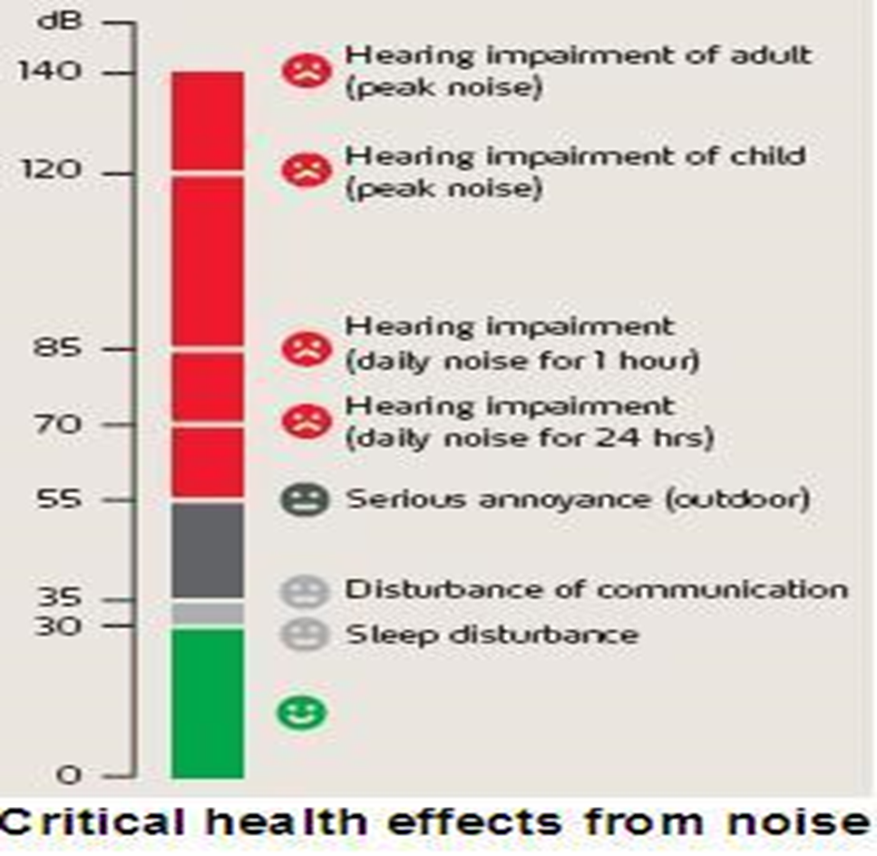

Slide 194
Some examples of noise pollution:
    Airplanes, helicopters, and motor vehicles.
    Construction or demolition noise.
    Human activities such as sporting events or concerts.
Noise pollution can be disruptive to humans' stress levels, may be harmful to unborn babies, and drives animals away by causing nervousness and decreasing their ability to hear prey or predators.
Sources of noise pollution
1. Household sources:-
Gadgets like food mixer, grinder, vacuum cleaner, washing machine and dryer, cooler, air conditioners, can be very noisy and injurious to health.
2. Social events:
Places of worship, discos and gigs, parties and other social events also create a lot of noise for the people living in that area.
3. Commercial and industrial activities:
Printing presses, manufacturing industries, construction sites, contribute to noise pollutions in large cities.
4. Transportation
Aero planes, trains, vehicles on road—these are constantly making a lot of noise and people always struggle to cope with them.

Slide 195
Effects of noise pollution
Generally, problems caused by noise pollution include stress related illnesses, speech interference, hearing loss, sleep disruption, and lost productivity.
Most importantly, there are two major effects we can look at:
1. Hearing
The immediate and acute effect of noise pollution to a person, over a period of time, is impairment of hearing.
Prolonged exposure to impulsive noise to a person will damage their eardrum, which may result in a permanent hearing.
2. Effects on general health
Health effects of noise include anxiety and stress reaction and in extreme cases fright. The physiological manifestations are headaches, irritability and nervousness, feeling of fatigue and decreases work efficiency. For example, being pounded by the siren of fire fighters, police or ambulance in your city all night everyday leave people (especially elderly people) stresses and tired in the morning.
Its is worth noting that these effects may not sound troubling, but the truth is, with time, the consequences can be very worrying.

Slide 196
Noise pollution prevention and control tips
Below are a few things people and governments can do to make our communities and living laces quieter:
Construction of soundproof rooms for noisy machines in industrial and manufacturing installations must be encouraged.
This is also important for residential building — noisy machines should be installed far from sleeping and living rooms, like in a basement or garage.
Use of horns with jarring sounds, motorbikes with damaged exhaust pipes, noisy trucks to be banned.
Noise producing industries, airports, bus and transport terminals and railway stations to sighted far from where living places.
Community law enforcers should check the misuse of loudspeakers, worshipers, outdoor parties and discos, as well as public announcements systems.
Community laws must silence zones near schools / colleges, hospitals etc.
Vegetation (trees) along roads and in residential areas is a good way to reduce noise pollution as they absorb sound

Slide 197
THERMAL POLLUTION
This is the rising air/water temperature so that it becomes harmful to human being and other organisms.
Thermal pollution is the increase of temperature caused by human activity.
A few examples of this include:
  Warmer lake water from nearby manufacturing (using cool water to cool the plant and then pump it back into the lake).
  Included in thermal pollution should also be the increase in temperatures in areas with lots of concrete or vehicles, generally in cities.
These kinds of environmental pollution can cause aquatic life to suffer or die due to the increased temperature, can cause discomfort to communities dealing with higher temperatures, and will affect plant-life in and around the area.
Sources of thermal pollution
Thermal power station, Nuclear power plants, Petroleum refiners, Domestic sewage.
Effects of Thermal pollution
Affects aquatic ecosystems in a variety of ways.
Species composition changes as species tolerant of warmer waters replace those unable to adapt e.g. algae, fish
Reduces dissolved oxygen (DO).
The water properties changes
Toxic chemical becomes soluble at high temperatures
Disrupts natural reproductive cycle of water animals by premature hatching of eggs.
Control measures for thermal pollution
Precooling the warm water prior to its discharge, e.g. use of cooling ponds and cooling towers

Slide 198
Radioactive Pollution (Nuclear Hazards)
Radioactivity is produced by the spontaneous decay of the isotopes of some elements, whose nuclei are unstable.
The radiation can take a number of different forms. In some cases it is as particles and in others it is electromagnetic.
Five types of radiation may occur: alpha, beta particles, neutrons, gamma rays and x-rays.
Sources of man-made Radiation
Nuclear reactors
Commercial and military reactors both operate by the fission of uranium or plutonium atoms.
The reaction create a range of new elements or radio nuclides and some all have different properties to the original element.
Nuclear installations also result in atmospheric discharges

Slide 199
Health Effects of Radiation
Disrupts molecules within cells, thus causing chemical changes
At high doses, radiation causes burning, nausea and other rapidly produced symptoms due to extensive, immediate death of body cells
At lower doses, radiation results in health problems such as cancer.
Disruption of DNA, leading to the development of radionuclide exposure
Detrimental damage to cells
Effect of Radiation in the Environment
There is a very wide degree of response to radioactive substances by different plant and animal species.
poses may long-term risks

Slide 200
Light Pollution
Light pollution is the brightening of the night sky inhibiting the visibility of stars and planets by the use of improper lighting of communities. Some examples of what causes light pollution:
  Street lamps that shine light in all directions, instead of with a hood to point light downward toward the street.
  Extra, unnecessary lights around the home.
  Cities that run lights all night long
Light pollution uses more energy (by shining more light up instead of down, meaning you need brighter bulbs for the same amount of light), may affect human health and our sleep cycles, and most importantly, corrupts our kids telescopes and their curiosity. (I grew up in a city. My first no-light night in the country blew my mind).

Slide 201
Visual pollution:
Visual pollution is what you would call anything unattractive or visualizing damaging to the nearby landscape.
Some examples of visual pollution:
  Skyscrapers that blocks a natural view.
  Carving on trees, rocks, or other natural landscapes.
  Billboards, litter, abandoned homes, and junkyards could also be considered among three kinds of environmental pollution.
Mostly, visual kinds of environmental pollution are annoying and ugly, although some may say they are also depressing, and they of course affect the surrounding landscape with the changes they cause.

Slide 202
Some of the effects of environmental pollution:
A. Human health
Ozone pollution can cause respiratory disease, cardiovascular disease, throat inflammation, chest pain, and congestion.
Water pollution causes approximately 14,000 deaths per day, mostly due to contamination of drinking water by untreated sewage in developing countries.
Oil spills can cause skin irritations and rashes.
Noise pollution induces hearing loss, high blood pressure, stress, and sleep disturbance.
Mercury has been linked to developmental deficits in children and neurologic symptoms.
Older people are majorly exposed to diseases induced by air pollution. Those with heart or lung disorders are at additional risk. Children and infants are also at serious risk.
Lead and other heavy metals have been shown to cause neurological problems.
Chemical and radioactive substances can cause cancer and as well as birth defects.
Adverse air quality can kill many organisms including human beings.

Slide 203
B. Environment:
Pollution has been found to be present widely in the environment. There are a number of effects of this:
Carbon dioxide emissions cause ocean acidification, the ongoing decrease in the pH of the Earth's oceans as CO2 becomes dissolved.
The emission of greenhouse gases leads to global warming which affects ecosystems in many ways.
Invasive species can out-compete native species and reduce biodiversity. Invasive plants can contribute debris and biomolecules that can alter soil and chemical compositions of an environment, often reducing native species competitiveness.
Nitrogen oxides are removed from the air by rain and fertilize land which can change the species composition of ecosystems.
Smog and haze can reduce the amount of sunlight received by plants to carry out photosynthesis.
Sulfur dioxide and nitrogen oxides can cause acid rain which lowers the pH value of soil. Soil can become infertile and unsuitable for plants. This will affect other organisms in the food web.

Slide 204
POLLUTION PREVENTION AND CONTROL STRATEGIES:
Industrial prevention & control strategies
Waste minimization
Done through
Source reduction - is activities designed to reduce the volume or toxicity of waste generated, including the design and manufacture of products with minimum toxic content, minimum volume of material, and/or a longer useful life e.g. bringing a reusable bag to the grocery store.
Toxic chemical substitution
Production process modification
Production modernization
Improvements in operations and maintenance
Recycling-In-process recycling of production material
Reuse

Slide 205
2. Cleaner production
It is a preventive, company-specific environmental protection initiative.
It is intended to minimize waste and emissions maximizing product output.
Examples for cleaner production options are:
Documentation of consumption (as a basic analysis of material and energy flows.
Use of indicators and controlling (to identify losses from poor planning, poor education and training, mistakes)
Substitution of raw materials and auxiliary materials (especially renewable materials and energy)
Increase of useful life of auxiliary materials and process liquids (by avoiding drag in, drag out, contamination)
Improved control and automatisation
Reuse of waste (internal or external)
New, low waste processes and technologies

Slide 206
3. Capacity training and development
4. Improvement in operation and maintenance of plants e.g.
Use of Pollution control devices
Dust collection systems
Vapor recovery systems
Other devices e.g. to reduce noise, Scrubbers etc.
5. Treatment of waste to an acceptable levels before discharging
Sewage treatment
          Sedimentation (Primary treatment)
          Activated sludge biotreaters (Secondary treatment; also used for industrial wastewater)
          Aerated lagoons
Industrial wastewater treatment
          API oil-water separators
          Biofilters
          Dissolved air flotation
          Powdered activated carbon treatment
          Ultrafiltration

Slide 207
6. Enacting legislation to regulate various types of pollution as well as to mitigate the adverse effects of pollution.
7. Awareness
8. Environmental Statistics and Mapping
For sound Environmental Management, reliable information base and the mapping of areas needing special attention for pollution prevention and control are a pre-requisite.
As a step in the direction, projects and pilot studies should be initiated through various research institutions and organizations.

Slide 208
Pollution Prevention and Control Strategies at home
Purchase products with less packaging.
Recycle cardboard, glass, and plastic packaging.
Recycle aluminum, tin cans, and newspapers.
Purchase products made from recycled materials.
Properly dispose of waste oil and fluids from vehicles.
Maintain your septic tank in good condition.
Fix leaking faucets and toilets.
Run full loads of laundry. Install a low-flow shower head.
Mulch or compost your yard waste and vegetable scraps.
Apply herbicides and pesticides properly; more is not better.

Slide 209
Pollution prevention strategies in agricultural activities
Apply pesticides and herbicides at the proper concentrations.
Explore non-chemical methods of agricultural production.
Use alternative fuels when possible.
Maintain vehicles for maximum fuel efficiency.
Consider protecting sensitive environmental areas by planting "timber crops" or native grasses.
Mix and apply pesticides carefully, keeping in mind that they are potential contaminants.
Get involved in a pesticide container recycling program.
Manage animal wastes properly.
Apply nutrients and fertilizers with care since high concentrations can cause problems in ground water and streams.

Slide 210
Role of an individual in prevention of pollution
Reduce your dependency on fossil fuel especially coal or oil
Use eco-friendly products e.g. do not use polystyrene cups that has CFCs molecules as they destroy the ozone layer
Adopt and popularize renewable energy sources.
Promote reuse and recycling whatever possible and reduce the production of wastes.
Use mass transport system - decrease the use of automobiles.
Plant more trees as trees can absorb many toxic gases and can purify the air.
Use less hazardous chemicals wherever possible

Slide 211
Cleansing Technology of the Environment.
If there are no pollutants, there will be no pollution. What comes to mind now to serve as reminders include the following:
1. Stop smoking or at least follow the “No Smoking” sign.
2. Use unleaded gasoline in your cars.
3. Keep your car properly maintained to keep it in good running condition to avoid smoke emissions.
4. Instead of using your cars, choose to walk or ride a bicycle whenever possible.
5. Avoid using open fires to dispose/burn wastes.
6. Adopt the 3Rs of solid waste management: reduce, reuse and recycle. Inorganic materials such as metals, glass and plastic; also organic materials like paper, can be reclaimed and recycled.
7. Reconnect with nature. Live green by using green power supplied abundantly and freely by wind and the sun. Hang your laundry to dry to minimize use of gas or electricity from your dryers.
8. Enjoy fresh air from open windows to lessen the use of air conditioning system.
9. Patronize local foods and goods. In this manner, transporting goods and foods prepared with GMOs which uses fuel from conventional energy sources will be minimized.

Slide 212
10. Use eco-friendly or biodegradable materials instead of plastic which are made up of highly toxic substances injurious to your health.
11. Create your green space. Value your garden. Plant more trees and put indoor plants in your homes. They clean the air, provide oxygen and beautify your surroundings.
12. Have a proper waste disposal system especially for toxic wastes.
13. Take very good care of your pets and their wastes.
14. Never throw, run or drain or dispose into the water, air, or land any substance in solid, liquid or gaseous form that shall cause pollution.
15. Do not cause loud noises and unwanted sounds to avoid noise pollution.
16. Do not litter in public places. Anti-litter campaigns can educate the populace.
17. Industries should use fuel with lower sulphur, lead content etc.
18. Industries should monitor their air emissions regularly and take measures to ensure compliance with the prescribed emission standards.
19. Industries should strictly follow applicable government regulations on pollution control.
20. Organic waste should be dumped in places far from residential areas.
21. Say a big “NO” to GMOs or genetically modified organisms. Genetically engineered crops are not only bad for the environment since they require massive amount of fungicides, pesticides, and herbicides; but GMO altered foods are also health risks and negatively impact farmers’ livelihood.

Slide 213
Emerging issues, policy and legislative framework:
Pollution emerging issues
Environmental exposure is increasing and affecting human’s environmental health all over the world and emerging risks are being identified everyday.
Increasing industrialization
explosive urban population growth
lack of pollution control
global climate change
ozone depletion
electromagnetic radiation
unabated waste dumping
non-sustainable consumption of natural resources
unsafe use and contamination of chemicals
Physical inactivity
poor nutrition
spread of the disease e.g. HIV/AIDS pandemic
use of dangerous substances
All these contribute to affecting the environment and health of humans.

Slide 214
Global Pollution Concerns:
1. Global Warming: Climate changes like global warming is the result of human practices like emission of Greenhouse gases. Global warming leads to rising temperatures of the oceans and the earth’ surface causing melting of polar ice caps, rise in sea levels and also unnatural patterns of precipitation such as flash floods, excessive snow or desertification.
We must help fight Global Warming by doing the following steps:-
  Plant more trees.
  Don’t waste water.
  Use cloth bag and don’t burn plastic.
  Observe environmental pollution problems and control measures.
2. Natural Resource Depletion: Fossil fuel consumption results in emission of Greenhouse gases, which is responsible for global warming and climate change. Globally, people are taking efforts to shift to renewable sources of energy like solar, wind, biogas and geothermal energy.
3. Waste Disposal: The over consumption of resources and creation of plastics are creating a global crisis of waste disposal.

Slide 215
4. Climate Change: this is yet another environmental problem that has surfaced in last couple of decades. It occurs due to rise in global warming which occurs due to increase in temperature of atmosphere by burning of fossil fuels and release of harmful gases by industries. It has various harmful effects but not limited to melting of polar ice, change in seasons, occurrence of new diseases, frequent occurrence of floods and change in overall weather scenario.
5. Loss of Biodiversity: Human activity is leading to the extinction of species and habitats and loss of bio-diversity. Eco systems, which took millions of years to perfect, are in danger when any species population is decimating. Balance of natural processes like pollination is crucial to the survival of the eco-system and human activity threatens the same. There is also destruction of coral reefs in the various oceans, which support the rich marine life.
6. Deforestation: Our forests are natural sinks of carbon dioxide and produce fresh oxygen as well as helps in regulating temperature and rainfall. At present forests cover 30% of the land but every year tree cover is lost due to growing population demand for more food, shelter and cloth

Slide 216
7. Ocean Acidification: It is a direct impact of excessive production of CO2. 25% of CO2 produced by humans. The main impact is on shellfish and plankton in the same way as human osteoporosis.
8. Ozone Layer Depletion: The ozone layer is an invisible layer of protection around the planet that protects us from the sun’s harmful rays. Depletion of the crucial Ozone layer of the atmosphere is attributed to pollution caused by Chlorine and Bromide found in Chloro-floro carbons (CFC’s).
9. Acid Rain: It occurs due to the presence of certain pollutants in the atmosphere. Acid rain can be caused due to combustion of fossil fuels or erupting volcanoes or rotting vegetation which release sulfur dioxide and nitrogen oxides into the atmosphere.
10. Urban Sprawl: Refers to migration of population from high density urban areas to low density rural areas which results in spreading of city over more and more rural land. Results in land degradation, increased traffic, environmental & health issues
11. Genetic Engineering: This is genetic modification of food using biotechnology. Genetic modification of food results in increased toxins and diseases as genes from an allergic plant can transfer to target plant.

Slide 217
12. Public Health Issues: The current environmental problems pose a lot of risk to health of humans, and animals. Dirty water is the biggest health risk of the world and poses threat to the quality of life and public health.
13. Water Pollution: Clean drinking water is becoming a rare commodity. Water is becoming an economic and political issue as the human population fights for this resource.
14. Overpopulation: The population of the planet is reaching unsustainable levels as it faces shortage of resources like water, fuel and food.
15. Pollution: Pollution of air, water and soil require millions of years to recoup. Industry and motor vehicle exhaust are the number one pollutants. Heavy metals, nitrates and plastic are toxins responsible for pollution.

Slide 218
Other Issues in Pollution
Cost of pollution.
Pollution has cost. Manufacturing activities that cause air pollution impose health and clean-up costs on the whole society, whereas the neighbors of an individual who chooses to fire-proof his home may benefit from a reduced risk of a fire spreading to their own houses. If external costs exist, such as pollution, the producer may choose to produce more of the product than would be produced if the producer were required to pay all associated environmental costs.

Slide 219
PEST CONTROL
Introduction:
Insects and pests can cause a great deal of damage to objects. Damage may be caused by the insects or pests eating materials, marking them by leaving droppings and regurgitated matter, boring into organic matter, making nests and so on.
Pest control: implies a two-strand approach, which combines the use of technology (such as use of pesticides, and pesticide application equipment) with biological knowledge (informing where, when and how to apply the technology) to reduce pest impact (by killing the pest).

Slide 220
Pest management: - aims to reduce pest impact and injury levels to a tolerable level through multiple tactics, which are not solely dependent on killing the pest.
While Pest control seeks to eliminate a pest organism from an area by a single — often chemical control — strategy, pest management seeks to utilize various strategies in a sustainable manner to suppress the population of the pest below the impact level.

Slide 221
Pest: any unwanted and destructive insect or other animal that attacks food or crops or livestock, etc.
Pest is an organism (virus, bacteria, fungus, plant or animal) that injures or spreads disease to humans, domestic animals or plants of aesthetic or economic value, or damages structures and products of economic value.
Vector: is any agent (person, animal microorganism) that carries and transmits a disease.
Vermin: any of various small animals or insects that are pests e.g. cockroaches, rats
Vector control is any method to limit or eradicate the mammals, birds, insects or other arthropods (here collectively called "vectors") which transmit disease pathogens. The most frequent type of vector control is mosquito control using a variety of strategies. Several of the "neglected tropical diseases" are spread by such vectors.

Slide 222
Pesticide: A substance or mixture of substances intended for preventing, destroying, repelling, or mitigating pests, or intended for use as a plant regulator, defoliant, or desiccant.
Insecticides: are substances or an agent that kill insects or other arthropods.
Rodents: Comprise a great number of mammals, ranging in size from the rats and mice to as large as the Porcupines and which belong to the order rodentia.
Insect: is an arthropod with 3 pairs of legs. It belongs to the phylum arthropoda and the class insecta.
Any of a group of small and often winged animals that are arthropods having six jointed legs and a body formed of a head, thorax, and abdomen. Flies, bees, and lice are true insects

Slide 223
INSECTS OF PUBLIC HEALTH IMPORTANCE
Common insects
1. Housefly.
2. Mosquitoes.
3. Cockroaches.
4. Bed bugs.
5. Lice.
6. Black flies.
7. Tsetse fly.
8. Sand fly.

Slide 224
A pest is anything that:
competes with humans, domestic animals, or desirable plants for food or water.
Injures humans, animals, desirable plants, structures, or possessions.
Spreads disease to humans, domestic animals, wildlife, or desirable plants.
Annoys humans or domestic animals.
Types of Pests
1. Insects (insecticides)
beetles, caterpillars, aphids
2. Insect-like organisms
spiders, ticks, mites

Slide 225
3. Microbial organisms (fungicides)
bacteria, fungi, nematodes, viruses, mycoplasmas
4. Weeds (herbicides)
Plant growing where it is not wanted
5. Mollusks
snails, slugs
6. Vertebrates (rodenticides, predicides)
Rats, mice, birds, coyotes

Slide 226
PEST CONTROL - Refers to the regulation or management of a species defined as a pest and can be perceived to be detrimental to a person's health, the ecology or the economy.
A practitioner of pest control is called an exterminator.
Pest Control is:
To control a pest only when it is causing or is expected to cause more harm than is reasonable to accept.
To use a control strategy that will reduce the pest numbers to an acceptable level.
To cause as little harm as possible to everything except the pest.

Slide 227
Types of pest control:
1. Use of pest-destroying animals.
Early days cats were being used to control pests of grain stores such as rodents. In 1939/40 a survey discovered that cats could keep a farm's population of rats down to a low level, but could not eliminate them completely.
However, if the rats were cleared by trapping or poisoning, farm cats could stop them returning.
2. Biological pest control.
Involves the control and management of natural predators and parasites. For example: mosquitoes are often controlled by putting a bacterium that infects and kills mosquito larvae, in local water sources.
The point of biological pest control, or any natural pest control, is to eliminate a pest with minimal harm to the ecological balance of the environment in its present form.

Slide 228
3. Mechanical pest control.
This is the use of hands-on techniques as well as simple equipment and devices, that provides a protective barrier between human beings and insects, like nets.
4. Physical pest control.
This is a method of getting rid of insects and small rodents by removing, attacking, setting up barriers that will prevent further insect infestations to become visual.
5. Elimination of breeding grounds.
Proper waste management and drainage of still water, eliminates the breeding ground of many pests.

Slide 229
Garbage provides food and shelter for many unwanted organisms, as well as an area where still water might collect and be used as a breeding ground by mosquitoes.
Communities that have proper garbage collection and disposal, have far less of a problem with rats, cockroaches, mosquitoes, flies and other pests than those that don't.
6. Poisoned bait.
This is a common method for controlling rat populations, however is not as effective when there are other food sources around, such as garbage.
Poisoned meats have been used for centuries for killing off wolves, birds that were seen to threaten crops, and against other creatures.

Slide 230
This can be a problem, since a carcass which has been poisoned will kill not only the targeted animal, but also every other animal which feeds on the carcass.
7. Field burning.
Traditionally, after a sugar cane harvest, the fields are all burned, to kill off any rodents, insects or eggs that might be in the fields.
8. Hunting.
In some nations, teams of rat-catchers work at chasing rats from the field, and killing them with dogs and simple hand tools. Some communities have in the past employed a bounty system, where a town clerk will pay a set fee for every rat head brought in as proof of a rat killing.

Slide 231
9. Traps.
Unlike trap crops, most traps used to control pests are man-made, and used by rat catchers.
A variety of mouse traps and rat traps are available for mice and rats, including snap traps, glue traps and live catch traps.
Sticky traps are used to attract the pest.
10. Pesticides.
Spraying pesticides by hand is a common method of pest control. Many people spray residual pesticides to kill off pests for a period of time.
11. Space fumigation.
A project that involves a structure be covered or sealed airtight followed by the introduction of a penetrating, deadly gas at a killing concentration a long period of time (24-72hrs.).

Slide 232
Although expensive, space fumigation targets all life stages of pests.
12. Sterilization.
Research into sterilization bait is ongoing. The sterilization method doesn't poison the rats or humans. The product ContraPest was approved for the sterilization of rodents by the United States Environmental Protection Agency in August 2016.
13. Repellants.
These are applied on skin of human beings to repel insects from landing and biting them.
They are applied whenever one is visiting insects infested areas at specific times like evenings and at night.

Slide 233
Consequences of pest infestation
Pests in association with man are unwelcome, and in a hospital situation where patients may have lowered auto immunity, they pose an unacceptable and unnecessary public health risk.
In addition; there is anxiety and distress caused to staff and patients
Their potential to spread disease has been acknowledged their exact 'involvement 'in the transmission of hospital-acquired infection remains uncertain addition to the possibility of disease transmission, allergic reactions may occur, food may be tainted, and spoiled, fabrics, and building structure damaged and sterile packs and dressings contaminated
Reputation is destroyed especially for businesses
Acts as vectors that cause diseases
Cause damage

Slide 234
Vector Control.
Vector control is any method to limit or eradicate the mammals, birds, insects or other arthropods (here collectively called "vectors") which transmit disease pathogens. The most frequent type of vector control is mosquito control using a variety of strategies. Several of the "neglected tropical diseases" are spread by such vectors.

Slide 235
Methods of Vector Control.
Vector control focuses on utilizing preventative methods to control or eliminate vector populations. Common preventative measures include:
1. Habitat / Environmental Control.
Removing or reducing areas where vectors can easily breed helps to limit population growth. For example, stagnant water removal, destruction of old tires and cans which serve as mosquito breeding environments and good management of used water can reduce areas of excessive vector incidence.
2. Reducing Contact.
Limiting exposure to insects or animals that are known disease vectors can reduce infection risks significantly. For example, bed nets, window screens on homes, or protective clothing can help reduce the likelihood contact with vectors. To be effective this requires education and promotion of methods among the population to raise the awareness of vector threats.

Slide 236
3. Chemical Control.
Insecticides, larvicides, rodenticides, traps and repellents can be used to control vectors. For example, larvicides can be used in mosquito breeding zones; insecticides can be applied to house walls or bed nets, and use of personal repellents can reduce incidence of insect bites and thus infection. The use of pesticides for vector control is promoted by the World Health Organization (WHO) and has proven to be highly effective.
4. Biological Control.
The use of natural vector predators, such as bacterial toxins or botanical compounds, can help control vector populations. Using fish that eat mosquito larvae or reducing breeding rates by introducing sterilized male tsetse flies have been shown to control vector populations and reduce infection risks.

Slide 237
Importance of vector control.
1. Some disasters give rise to increases in the populations of vector species, usually insects or rodents.
2. Floods may create new mosquito breeding sites in disaster rubble and stagnant pools.
3. A general breakdown of sanitation may favour the multipli-cation of houseflies and rodents.
4. People living in partially destroyed houses or primitive shelters may have lost the normal protection afforded by screened windows or mosquito nets.
5. Serious infection hazards may arise when massive migrations bring people of different origins together in temporary camps infested with disease vectors. Under such conditions, people who are relatively immune carriers of parasites can set off a disease transmission cycle to which weaker people who are not immune fall victim.
6. Fly control is likely to have a positive impact on health in most post disaster situations, particularly when sanitary conditions are poor and diarrhoea, dysentery, or typhoid prevalence are high.

Slide 238
7. Other vectors may be important in specific locations, depending on the prevalence of the vector and the disease before the disaster, and the susceptibility of the population.
8. Standing water rich in organic matter can produce massive numbers of biting midges which do not transmit any disease, but cause extreme nuisance and often trigger allergic reactions in sensitive people. Several mosquito species can also be a great nuisance without presenting a direct risk to health.
9. Some of the most serious disease vectors are hardly considered a nuisance in many areas as their bites are almost painless (e.g. Anopheles mosquitoes, the vectors of malaria).
10. When wild or domestic host animals have been killed or driven away by disaster, ectoparasites, such as ticks, bugs, lice and fleas, may invade a community and produce a serious additional risk of zoonotic vector-borne disease.
11. Another, related, vector-borne disease risk may arise when refugees enter territory formerly occupied only by wildlife and accompanying parasites. Examples of diseases that may then emerge include plague (from rats) and Lyme disease (from ticks)

Slide 239
Vector-borne diseases control.
The control of a vector-borne disease can be achieved by various means. In emergencies, these include, in order of priority:
1. Diagnosis and treatment.
2. Vector control.
3. Environmental hygiene.
4. Personal protection.
Vector Main diseases.
Mosquitoes - Malaria, yellow fever, dengue, viral encephalitis, filariasis.
Houseflies - Diarrhoea, dysentery, conjunctivitis, typhoid fever, trachoma, cholera etc.
Cockroaches - Diarrhoea, dysentery, salmonellosis, cholera.
Lice - Endemic typhus, pediculosis, relapsing fever, trench fever, skin irritation.
Bedbugs - Severe skin inflammation.
Ticks - Rickettsia fever, relapsing fever, viral encephalitis (brain inflammation).
Rodent (fleas) - Bubonic plague, endemic typhus.
Sand fly – Kalaazar.

Slide 240
Vectors and the diseases they transmit

Slide 241
Pest-Related Diseases (Disease Caused by Rodents)

Slide 242
Available control measures.
Although environmental management is the preferred strategy for reducing vector the use of insecticides for longevity reduction is often called for in emergencies, due to the urgent nature of the problem and the risk of epidemics of vector-borne disease among susceptible populations. Following control measures are applied:-
Insecticides for killing adult vectors must be applied in places where the vector will rest, such as the inside surfaces of houses in the case of mosquitoes.
In addition, the target species must be susceptible to the chemical and the chemical must not be a health hazard to the population or personnel carrying out the spraying.

Slide 243
Find out where the vector or rodent breeds.
Establish where the Vector/rodent feeds, what it feeds on and how.
How does the Vector/rodent transmit diseases.
Baits laced with chemicals can be applied to control rodents, e.g. rats. The design and implementation of these measures must be the responsibility of specialized personnel, to avoid poisoning of human food/water.

Slide 244
WASTE MANAGEMENT:
Waste – Something no longer wanted in a given place & time and has no current value
Waste is any unwanted or useless material. Those materials no longer required by an individual, institution or industry.
Also referred to as refuse, rubbish, trash, garbage, junk
Waste Management – This is the collection, transport, processing, recycling or disposal, managing and monitoring of waste materials
Solid Waste – all the wastes arising from human and animal activities that are normally solid and are discarded as useless or unwanted.
Also refers to non liquid, non-soluble materials ranging from municipal garbage to industrial wastes that contain complex & sometimes hazardous substances.

Slide 245
Solid Waste Management - term that is used to refer to the process of collecting and treating solid wastes.
It also offers solutions for recycling items that do not belong to garbage or trash.
Special wastes: Are wastes from residential and commercial sources. They include;
Bulky items (large worn out or broken household, commercial, and industrial items like, Furniture, lamps, bookcases, filing cabinets, etc.)
Consumer electronics (includes worn-out, broken, and other no- longer wanted items such as radios, stereos, TV sets.
White goods (large worn – out a broken household, commercial, and industrial appliances such as stoves, refrigerators, dishwashers, clothes washers.
Organic waste: Food waste, paper, cardboard, plastics, textiles, rubber, leather, wood, yard wastes.
Inorganic waste: Glass, crockery (cups, plates, etc.) tin cans, aluminum and other metals.
Dead bodies: dead animals like dogs, cows, donkey, etc.

Slide 246
Infectious wastes: are wastes that contain or carry pathogenic organisms in part or in whole such as wastes from hospitals and biological laboratories soiled with blood or bodily fluids.
GARBAGE: Animal & vegetable wastes resulting from the handling, storage, sale, preparation, cooking and serving of food.
REFUSE: Solid or semisolid waste matter produced in the normal course of human activities. It is a general name given to all wastes except liquid waste.
RUBBISH: Solid wastes originating in houses, commercial establishments, industries, excluding garbage and ash. Can be Combustible or Non-combustible

Slide 247
Other Terminologies used in waste management
Waste segregation - is the process of dividing garbage and waste products in an effort to reduce, reuse and recycle materials.
Waste minimization - is a set of processes and practices intended to reduce the amount of waste produced.
Waste disposal - Removing and destroying or storing damaged, used or other unwanted domestic, agricultural or industrial products and substances
Waste treatment - refers to the activities required to ensure that waste has the least practicable impact on the environment.

Slide 248
Institutional solid waste is a waste generated from public and government institutions: healthcare facilities, offices, religious institutes, schools, universities, etc.
Classification of Solid Waste
Taxonomically, waste can be categorized in terms of state of matter i.e.: solid, liquid and gaseous and this can be classified as either hazardous or non-hazardous waste. Also, it can be toxic, hazardous or volatile.
Solid waste can be classified as biodegradable or non-biodegradable depending units properties.
Classified as hazardous and Non-hazardous waste depending on the toxicity of the waste.
Non-Hazardous solid waste can also be classified as organic or non-organic depending on the composition

Slide 249
Types/ Categories / Classification of wastes:
1. Solid waste
These are useless and unwanted substances discarded by human society. These include urban wastes, industrial wastes, agricultural wastes, biomedical wastes and radioactive wastes. The term refuse is also used for solid waste.
2. Liquid waste
Wastes generated from washing, flushing or manufacturing processes of industries are called liquid wastes. Such a waste is called sewage.
3. Gaseous waste
These wastes are released in the form of gases from automobiles, factories, burning of fossil fuels etc. and get mixed in the atmosphere. These gases include carbon monoxide, CO2, sulphur dioxide, nitrogen dioxide, ozone, methane, etc
NB:
Waste is classified by its source and by its properties. In general, the wastes are classified on the basis of their biological, chemical and physical properties and also on the basis of nature.

Slide 250
Types and Sources of solid waste
In all cases the following sources of solid wastes are universal:
1. Residential waste: generated from living households (domestic), generally contain non-hazardous solid wastes; kitchen waste, and ash are common in Kenya.
2. Agricultural waste: solid wastes due to agricultural activities: food residues, animal dung, crop residues, etc. Such wastes are usually non-hazardous and negligible in rural parts of Kenya. These wastes are usually reused as livestock feeds, fuels, manures and hence pose minimal risk to the environment.
3. Commercial waste: wastes generated from business establishments: food establishments, shops, etc., that generate generally non-hazardous waste such as paper, cardboard, wood, metals and plastic.

Slide 251
4. Industrial wastes: from various types of industrial processes. The nature of the waste depends on the type of industry and kind of raw material involved. There may be toxic and hazardous wastes that have adverse effects to the environment.
5. Institutional solid waste: generating from public and government institutions: offices, religious institutes, schools, universities, etc.
6. Hospital solid wastes: Also referred biomedical wastes as discarded, unwanted solid wastes from hospitals. Consists of both non-hazardous and hazardous waste. It helps to identify whether the waste is hazardous or not.
7. Electronic waste, e-waste: Fastest growing solid waste problem arising from disposal of used electronic gadgets e.g. used computers, batteries etc.

Slide 252
For solid waste to be produced, it depends on:
Geographical location
Climate
Degree of industrialization
Available resources
Social economic conditions,
Lifestyle
Behaviors of consumers
Risks associated with poor management of solid waste
Breeding ground for disease carriers : Rats, flies, Mosquitoes, cockroaches , pigs, birds and other disease vectors breed in open dumps, waste storage facilities and piles of rotten refuse.
Spread of disease by animals and other vectors and food: The above vectors transmit diseases and pathogenic bacteria from households, consumption of meat from animal eating infected waste.
Spread of disease by direct contact: waste workers and scavengers risk accidents for they are in direct contact with waste. People using recycle materials which are not well disinfected risk infections.
Air pollution: Dumping site smell awful, smoke from decomposing and burning of solid waste like tyres pollute the environment.
Contaminated water: solid waste buried under the ground may leak to main water line.
Fire risks: piles of waste and gas cylinders may trigger fires
Connection to other services: blockage of drains increase workload.

Slide 253
SOLID WASTE DISPOSAL
Disposal of solid waste has to be accomplished without the creation of nuisance and health hazards
Solid waste disposal methods:
Generally there are several methods of solid waste disposal that can be utilized. These methods are:
1. Ordinary open dumping
2. controlled tipping/burial
3. Hog feeding
4. Incineration
5. Sanitary landfill
6. Composting
7. Grinding and discharge in to sewer
8. Dumping into water bodies
9. Disposal of corpus

Slide 254
Open dumping: Is the indiscriminate disposal of waste
Controlled tipping/burial: It is a sanitary disposal process of solid waste entailing hygienic placement, deposition on land in an environmentally acceptable and protective to health. It involves compacting the waste manually or mechanically and covering with adequate depth of earth or ash at the end of each day’s work.
Hog feeding: The feeding of garbage to hogs has been practiced for many years in different parts of the world.
Incineration: Incineration is a process of burning the combustible components of garbage and refuse.
Sanitary landfill: Involves the methods of land filling and designing the landfill interface (soil foundation, liners), leachate collection and treatment systems, and gas collection and venting system.
When the landfill has exhausted its life, a final cover is placed on top of the landfill; topsoil is replaced on the site and the site is landscaped; groundwater is continuously monitored; leachate is continuously collected and treated; and, gases are continuously collected and vented

Slide 255
Composting: biodegradable materials break down through natural processes and produce humus. It involves the aerobic biological decomposition of organic materials to produce a stable humus-like product.
Grinding and discharge into sewers lines: involves Installation of grinders in houses and commercial establishments, municipally operated station and sewage treatment plant to break down waste into very small pieces.
Dumping into water bodies: The dumping of solid waste into water bodies such as streams, rivers, lakes, seas, and oceans was once been one of the means of disposal.
Disposal of dead bodies: There are certain methods that can be practiced in relation to disposal of dead bodies (embalming, cremating, disposal into water bodies, burial into the ground).

Slide 256
Challenges in waste management
Lack of awareness and knowledge
Political influence and lack of good will
Disposal sites: Availability, siting and management.
Funding
High poverty levels
Lack of segregation
Low technical competences
Slow adoption of modern technological options

Slide 257
Integrated waste management
The solid waste management hierarchy is an integrated approach to protecting and conserving the environment through implementation of various approaches of sustainable waste management.
It establishes the preferred order of solid waste management alternatives as follows: waste reduction, reuse, recycling, resource recovery, incineration, and landfilling. i.e.
Waste avoidance and reduction
Recovery, reuse and recycling
Disposal

Slide 258
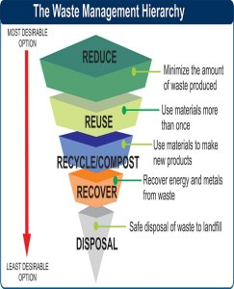
Waste management hierarchy

Slide 259
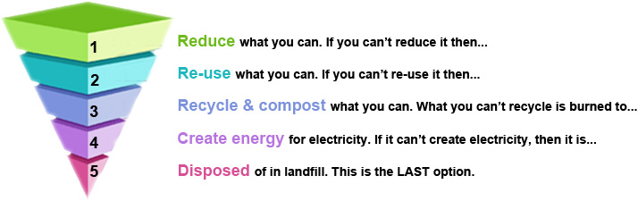
-

Slide 260
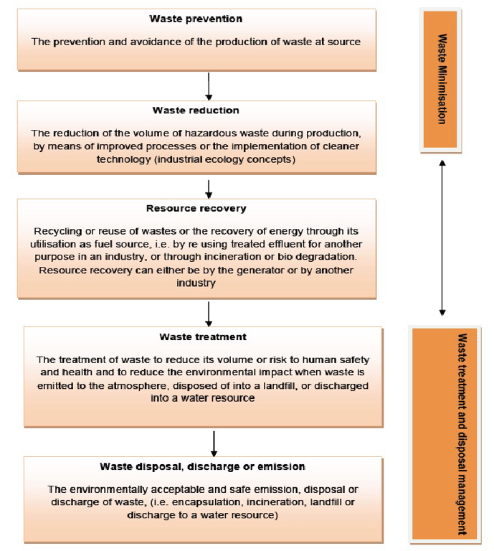
b

Slide 261
The waste management cycle
(Waste generation, Waste collection, Waste transportation, Waste treatment, Waste disposal)
1. Waste generation
Most of the waste is generated at household, market places, cities, towns, institutions and industrial zones. The waste generator should endeavor to minimize waste by reducing, reusing, refusing, returning waste or by adopting cleaner production technologies. All waste generated should be segregated at source
2. Waste collection
main point of interface between the public and waste service providers who are either the Government or the private sector. Collection centers/transfer stations should be established at strategic areas within a town
3. Waste transportation
The County Governments should provide adequate transport for the various segregated waste streams. The waste transportation trucks should be closed and suitable for the transportation of the various waste streams to the waste treatment facilities and landfills.

Slide 262
4. Waste treatment
Some of waste treatment technologies recommended to enable a Country achieve reduction of waste directed to landfills and other disposal facilities are.
(i) Material recovery technologies:
(a) Recycling: processing of waste material into a new product of similar chemical composition.
(b)Composting: biological decomposition of biodegradable solid waste under controlled aerobic conditions to produce compost
(ii) waste to energy / energy recovery technologies:
(a) Thermal treatment of waste: combustion of waste at specific temperatures with or with no air- supply as part of the process and includes waste incineration, gasification and pyrolysis.
-Incineration is controlled burning of solids, liquids and gaseous waste. Gasification is a process of reacting waste at high temperatures greater than (>700 °C), without combustion, with a controlled amount of oxygen and/or steam to generate useful products such as electricity, chemicals, fertilizers and natural gas. : Pyrolysis is a form of treatment that chemically decomposes organic materials by heat in the absence of oxygen.
(iii)Biological treatments.
This is a natural process that occurs where plant and animal materials (biomass) are broken down in the presence of micro-organisms. Biological treatment of waste can either be anaerobic (absence of air) or aerobic (presence of oxygen).
5. Waste disposal
Depositing or burial of waste on land.

Slide 263
INSTITUTIONAL BASED SOLID WASTE MANAGEMENT:
Institutional solid waste is a waste generated from public and government institutions: healthcare facilities, offices, religious institutes, schools, universities, etc.
It consists of both nonhazardous and hazardous solid waste.
Sources of health care solid wastes
Major sources of health-care waste
Hospitals: general, district
University
Emergency services, health-care centers, dialyses centers, first-aid posts, hospices, blood transfusion centers, dental clinics,
Laboratories and research centre’s
Animal research and testing institutes
Blood banks and blood collection services
Specialized health-care establishments: Nursing homes, psychiatric hospitals, disabled persons’ institutions

Slide 264
Categories of health care solid wastes:
Medical wastes: These wastes are usually produced in patient rooms, treatment rooms and nursing stations, the operating room may also be a contributor, and items include soiled dressings, bandages, catheters, swabs, plaster casts receptacles, and masks. The hazardous waste is generated from both OPD and inpatient wards as a result of diagnosing, treating, or handling the patient.
Surgical and autopsy (Pathologic wastes) these wastes may be produced in surgical or autopsy rooms, items that may be included are placenta, tissues and organs, amputated limbs, fetus and similar material.
Laboratory wastes: these wastes are produced in diagnostic or research laboratories, items that may be included are cultures, spinal-fluid samples, dead animals, and animal bedding.
Infectious solid wastes: proportion of medical waste that is infectious (dressings, laboratory and pathological wastes, contaminated blood discarded equipment's, etc.)
Domestic/general wastes: offices, kitchen wastes (non hazardous)
Radio-active wastes: radiating residues produced as a result of radio therapy and diagnosis.
Pharmaceutics
Sharps

Slide 265
Management of health care solid wastes:
Waste minimization, recycling, and reuse:
A. Waste minimization
Significant reduction of the waste generated in health-care establishments and research facilities may be encouraged by the implementation of certain policies and practices, including the following:
Source reduction: measures such as purchasing restrictions to ensure the selection of methods or supplies that are less wasteful or generate less hazardous waste.
Recyclable products: use of materials that may be recycled, either on-site or off-site.
Good management and control practices: apply particularly to the purchase and use of chemicals and pharmaceuticals.
Waste segregation: careful segregation (separation) of waste matter into different categories helps to minimize the quantities of hazardous waste.

Slide 266
B. Safe reuse and recycling:
Reusable items may include certain sharps, such as scalps and hypodermic needles, syringes, glass bottles and containers, etc. After use, these should be collected separately from non-reusable items, carefully washed and sterilized particularly in the case of hypodermic needles, in which infectious droplets could be trapped.
Although reuse of hypodermic needles is not recommended, it may be necessary in establishments that cannot afford disposable syringes and needles.
Plastic syringes and catheters should not be thermally or chemically sterilized; they should be discarded.

Slide 267
C. Reduce, Reuse and Recycling (3R) programme
Reduce the generation of unnecessary waste, e.g. carry your own shopping bag when you go to the market and put all your purchases directly into it.
Reuse - Do not throw away the soft drink cans or the bottles; cover them with homemade paper or paint on them and use them. Reuse the plastic bags for shopping again and again. It is better if you use shopping bags made of cloth or jute, which can be used over and over again.
Recycle - Segregate your wastes so that non-perishable wastes are easily collected and taken for recycling. Dig a small pit to compost your organic wastes like kitchen wastes at your home.

Slide 268
Handling, storage, and transportation of health-care facility waste:
The most appropriate way of identifying the categories of health-care facility waste is by sorting out the waste into color-coded plastic bags or containers.
In addition to the color coding of waste containers, the following practices are recommended:
• General health-care facility waste should be part of the stream of domestic refuse for disposal.
• Sharps should all be collected together, regardless of whether or not they are contaminated. Containers should be puncture-proof (usually made of metal or high density plastic) and fitted with covers. They should be rigid and impermeable so that they safely retain not only the sharps but also any residual liquids from syringes. To discourage abuse, containers should be tamper-proof (difficult to open or break) and needles and syringes should be rendered unusable. Where plastic or metal containers are unavailable or too costly, containers made of dense cardboard are recommended; these folds for ease of transport may be supplied with a plastic lining.
• Bags and containers for infectious waste should be marked with the international infectious substance symbol.
• Highly infectious waste should, whenever possible, be sterilized immediately by autoclaving. It therefore needs to be packaged in bags that are compatible with the proposed treatment process: red bags, suitable for autoclaving, are recommended.
• Small amounts of chemical or pharmaceutical waste may be collected together with
infectious waste.
• Large quantities of obsolete or expired pharmaceuticals stored in hospital wards or
departments should be returned to the pharmacy for proper disposal.

Slide 269
Colour Codes
Colour codes – of Bin & Bin liners
Black: General waste: include food, paper, packaging materials, litter
Yellow: Infectious waste: includes used gauze,/dressing, used gloves.
Red: Highly infectious waste: includes-anatomical waste, pathological waste
Safety Box: Sharp waste: e.g. infusion sets, broken slides, broken vials, ampoules, lancet, needles and blades

Slide 270
Treatment and disposal technologies for health-care facility waste
The final choice of treatment system should be made carefully, on the basis of various factors, many of which depend on local conditions:
• Disinfection and sterilization efficiency;
• Health and environmental considerations;
• Volume and mass reduction;
• Occupational health and safety considerations;
• Quantity of wastes for treatment and disposal/capacity of the system;
• Types of waste for treatment and disposal;
• Infrastructure requirements;
• Locally available treatment options and technologies;
• Options available for final disposal;
• Training requirements for operation of the method;
• Operation and maintenance consideration;
• Available space;
• Location and surroundings of the treatment site and disposal facility;
• Investment and operating cost;
• Public acceptability;
• Regulatory requirements

Slide 271
Treatment technologies:
1. Incineration
Incineration uses controlled, high-temperature combustion process to destroy organisms in waste materials.
Modern incineration systems are well engineered; high-technology processes designed to maximize combustion efficiency and completeness with a minimum of emissions of waste.
2. Open dumps
Uncontrolled and scattered deposit of wastes at a site
Mostly practiced in health care delivery systems
Leads to acute pollution problems, fires, high risks of disease transmission and open access to scavengers animals.

Slide 272
3. Placenta pit
Certain basic rules should be fulfilled
Access to the disposal site should be restricted to authorized personnel only
The pit should be lined with a material of low permeability, such as clay.
Only hazardous health-care facility waste including placenta should be buried
The pit should be managed as a landfill process, with each layer of waste being covered with a layer of earth to prevent odors, as well as to prevent rodents and insects breeding

Slide 273
4. Steam Sterilization:
The advantages of steam sterilization, or autoclaving are relatively low capital investment, operating cost, relatively small space requirements, and simplicity of operation.
Disadvantages include:
limited capacity, the requirement of special waste packaging and handling, and odor and drainage problems. Autoclaving is not recommended for pathological wastes, waste with high liquid content, and waste contaminated with volatile chemicals.
After autoclaving, the appearance of waste remains unchanged. Although needles, syringes, blood bags, and the like, are sterilized, they also are recognizable.
This has the effect of making much of the waste unacceptable for disposal in a landfill or other disposal means.
Also, compacting autoclaved waste tends to break open waste bags and other containers, exposing and spilling their contents. Consequently, waste haulers and landfill operators may not be willing to accept
autoclaved waste in spite of its sterile condition
Kmtc Kitui – SWM I

Slide 274
Liquid Waste Management
Liquid Waste Management: Procedures and practices to prevent discharge of pollutants to the storm drain system or to watercourse as a result of the creation, collection and disposal of non-hazardous wastes.
Liquid Waste: waste water resulting from all domestic and industrial activities but without any excreta.
Refers fluids as waste water, fats, oils, or grease and hazardous house holds liquid
Sewage - Is used to indicate the liquid waste from the community that is combination of domestic, industrial wastes liquid wastes and storm water
Effluent: Liquid waste discharged from a sewage system, factory, nuclear power station, or other industrial plant.

Slide 275
CATEGORIES OF LIQUID WASTE
Domestic waste
Industrial liquid waste
Storm water
DOMESTIC WATER: is generated from domestic and other non-industrial uses mainly from house holds, institutions, and commercial buildings. The include black water ( from the toilet), and grey water from the kitchen and bath room.

Slide 276
Hierarchy of liquid waste management
Liquid waste water minimization
Managing collection of liquid into main sewer by reducing
Treat liquid waste water
Resume liquid waste waste after treatment through agriculture or industrial
Dispose treated waste water on land or water

Slide 277
CHARACTERISTICS OF LIQUID WASTE [DOMESTIC & INDUSTRIAL]
Physical, Chemical And Biological Like:
  Colour
  Odour
  Turbidity
  PH
  BOD (Biological Oxygen Demand)
  COD (Chemical Oxygen Demand)
  DO (Dissolved Oxygen)
  TDS (Total Dissolved Solids)
  TSS (Total Soluble Solids)

Slide 278
Sewage Treatment:
Sewage treatment is the process of removing contaminants from municipal wastewater, containing mainly household sewage plus some industrial wastewater. Physical, chemical, and biological processes are used to remove contaminants and produce treated wastewater that is safe enough for release into the environment.
Types of microorganisms in breeding sewage
  1. Plants Like Algae, Fungi
  2. Animals
  3. Bacteria & Virus

Slide 279
PURPOSE OF TREATING SEWAGE
1. To prevent pollution of the receiving water with either pathogenic, organic matter or toxic substances, which may result to either:
  Disease outbreak like cholera, typhoid
  Color change and smells of the receiving water bodies
  interfere with recreation facilities (water bodies for recreation)
  Pollution of water
2.To reduce aesthetic nuisance or nuisance of smell
3.To preserve aquatic life and ensure self-purification of receiving water
4.For reuse purposes
5.To conform to national river board standards

Slide 280
FACTORS THAT INFLUENCE SEWAGE TREATMENT
Rainfall-introduction of carbonic acid
Sunlight-used for manufacture of food by certain aquatic autotrophy like algae
Presents of other aquatic organisms
Vegetation like trees
Presents of other animals
Air change-assist in aeration
FACTORS THAT DETERMINE PRODUCTION OF SEWAGE
Seasonal variations
Time of the day
Classes of people(economic status)
Cultural practices
Activities(sports, domestic, industrial)
Type of plumbing systems(single or separate)

Slide 281
ENVIRONMENTAL FACTORS THAT AFFECT TREATMENT OF SEWAGE
TEMPERATURE
LIGHT
OXYGEN
PH
MOISTURE
TOXIC SUBSTANCES
FACTORS TO CONSIDER WHEN DESIGNING SEWAGE TREATMENT PLANT
Hygienic factors
Nuisances factors
Traditional factors
The receiving water body
Use of effluent
Operation& maintenance cost of the plant
Finance availability to start and continue the running cost
Type of waste to be treated, industrial, domestic or combination
Population to be served &yield to be produced

Slide 282
FACTORS USED TO MEASURE THE QUALITY OF EFFLUENT
BOD-Used to measure organic matter content (determine the measure of organic matter)
SUSPENDED SOLIDS(SS)-Used to measure the amount of suspended solid material in the effluent
BACTERIAL LOAD-Expressed as the number of feacal coli form bacteria (F.C.B) per 100mls of the effluent
SEWAGE TREATMENT METHODS:
CONVECTIONAL SEWAGE TREATMENT PLANT
OXIDATION PONDS
SEPTIC TANKS
DILUTION – Natural purification of water bodies

Slide 283
WASTE WATER TREATMENT PROCESSES.
Sewage is generated by residential, institutional, commercial and industrial establishments. It includes household waste liquid from toilets, baths, showers, kitchens, and sinks draining into sewers.
Waste water (liquid waste) from flushing the toilet, bathing, washing sinks and general cleaning goes down the drain and into a pipe, which joins a larger sewer pipe under the road. The larger pipe also joins a major pipe that leads to the treatment center.
Stages: [Waste water treatment Stages]
Stage one: Screening.
Stage two: Primary treatment.
Stage Three: Secondary treatment.
Stage four: Tertiary treatment (final treatment).

Slide 284
1. Pre-treatment (Screening)
Is the process of removing solid matter such as wood, clothes or sticks so as to protect pumps fro clogging and preventing the pipes from breakage. It is also used to remove fats, grit and grease.
2. Primary treatment
The sewerage water is relieved of course materials such as sand, pebbles, organic and inorganic matter and fatty substances that are remaining after pre-treatment.
The sewerage is passed through a grit chamber that are used to remove sand and other organic matter.
3. Secondary treatment
This uses aerobic biological process to degrade the biological content of the sewerage such as human waste, food wastes , soaps and detergent. In this process bacteria and Protozoa are used to convert the biodegradable soluble organic contaminants which can be converted into flocs.
4.Tertiary treatment
Is done to enhance quality before the sewerage is discharged into the environment. It is used to remove nitrogen and phosphorus.
Nitrogen is removed through biological oxidation from Ammonia to nitrite

Slide 285
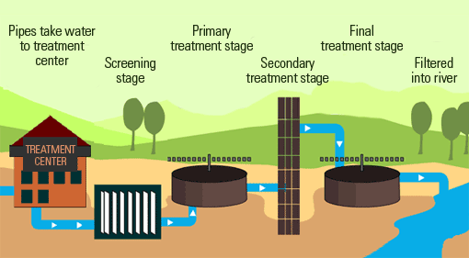
Waste water treatment Stages

Slide 286
2. OXIDATION / STABILIZATION PONDS (LAGOONS)
It is a small scale treatment plant
It is important to consider the following points when designing oxidation ponds because they affect the size and layout of the pond system
  The volume of sewage to be treated
  The strength of the sewage to be treated (BOD)
  The desired quality of the final effluent
  The climatic condition
Before discharging into the treatment ponds, sewage is subjected to some preliminary treatment to remove large objects such as rags, maize cobs, piece of wood, stones and plastic materials which would hinder the anaerobic process
Screening can be done mechanically or manually. screeds are buried or burnt. Grit is also removed in a grit chamber

Slide 287
TYPES OF SEWAGE STABILIZATION PONDS
There are three types of ponds used for sewage treatment especially in tropical countries like East Africa
1.Anaerobic ponds (primary digestion ponds)
2.Facultative ponds (secondary treatment ponds)
3.Aerobic(maturation) ponds (tertiary ponds)
Anaerobic ponds: The ponds are used for the settling down and breaking up of organic matter in the sewage.
Facultative ponds: These ponds are used for the removal of BOD and pathogenic organisms
Aerobic ponds are used mainly for the removal of pathogens. Pathogenic organisms die out with time and therefore they are gradually eliminated as the effluent passes slowly through the maturation ponds

Slide 288
3. SEPTIC TANKS:
These are rectangular chambers sited just below the ground level and are water tight
They receive both excreta and flush water from flush toilets and other wastes from household waste water receptacles
The mean hydraulic retention time in the tank is usually 1-3 days
Hydraulic retention time means time taken by the waste water received to stay in the septic tank
The bio degradable material in the sewage is said to be 0.04kg/day
During this retention time, the solids settle at the bottom and they are digested anaerobically

Slide 289
A septic tank consists of one or more concrete or plastic tanks of between 4000 and 7500 liters. One end is connected to an inlet waste water pipe and the other to a septic drain field. Generally these pipe connections are made with a T pipe, allowing liquid to enter and exit without disturbing any crust on the surface. The design of the tank usually incorporates two chambers; each equipped with a manhole cover, and separated by a dividing wall with openings located about midway between the floor and roof of the tank.
Wastewater enters the first chamber of the tank, allowing solids to settle and scum to float. The settled solids are anaerobically digested, reducing the volume of solids. The liquid component flows through the dividing wall into the second chamber, where further settlement takes place. The excess liquid, now in a relatively clear condition, then drains from the outlet into the cesspool or septic drain field, or seepage field, depending upon locality.

Slide 290
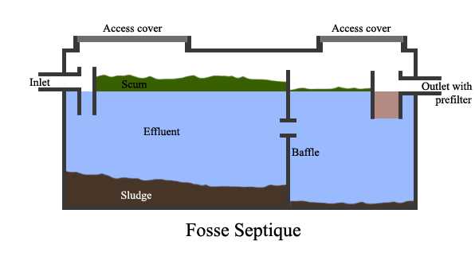
Septic Tank

Slide 291
SANITATION AND HEALTH
Sanitation and disease transmission
Sanitation refers to all conditions that affect health, especially with regard to dirt and infection and especially to the drainage and disposal of sewage and refuse from houses.
Sources of disease.
Inadequate and insanitary disposal of infected human faeces leads to the contamination of the ground and sources of water.

Slide 292
Excreta disposal
Excreta - Waste matter from the body: any waste matter discharged from the body, e.g. feces or urine.
Human excreta are faeces and urine. They are a source of pathogenic organisms.
Excreta are offensive to both sight and smell and can also lead to the contamination of water and foods. Faecal organisms may infect people directly or indirectly.
Faeces should not be accessible to fingers, feet, flies and food. The fingers and flies transfer the faeces to the food through the faecal-oral route transmission, known as the 4F connection
Urine carries the infective ova of schistosoma heamatobium while faeces spread the schistosoma mansoni.

Slide 293
It is, therefore, necessary to help people understand the importance of proper excreta disposal by use of simple and cheap facilities.
As a clinical officer, you should be able to identify possible customs and beliefs, which hinder proper excreta disposal in the community and educate the people accordingly.

Slide 294
The 4 F Connections

Slide 295
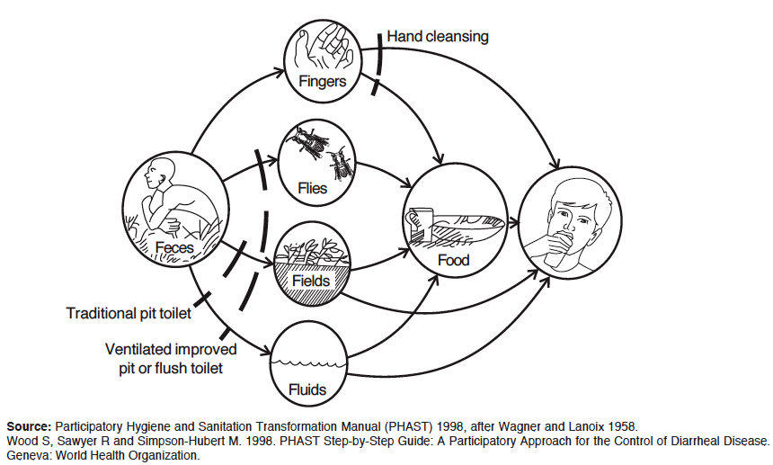
Faecal-oral transmission routes.

Slide 296
Diseases caused by poor excreta disposal
Human excreta may spread the following diseases:
Typhoid fever
Cholera
Intestinal worms
Poliomyelitis
Infective hepatitis A
Bacillary and amoebic dysentery

Slide 297
Factors that influence the types and construction methods of any sanitation system.
1. Social, cultural, beliefs, values and practices.
2. Religious customs.
3. Population density and settlement pattern.
4. Climatic conditions.
5. Topography and soil conditions.
6. Geological formations.
7. Abundance or scarcity of water.
8. Economic standards.
9. Political and social organizations.
10. Educational level of communities.
11. Level of health awareness.
12. Safety to users.
13. Availability of resources, and infrastructure that may support sanitation system (Skilled power, construction materials, on-going water or Hygiene programs etc.).

Slide 298
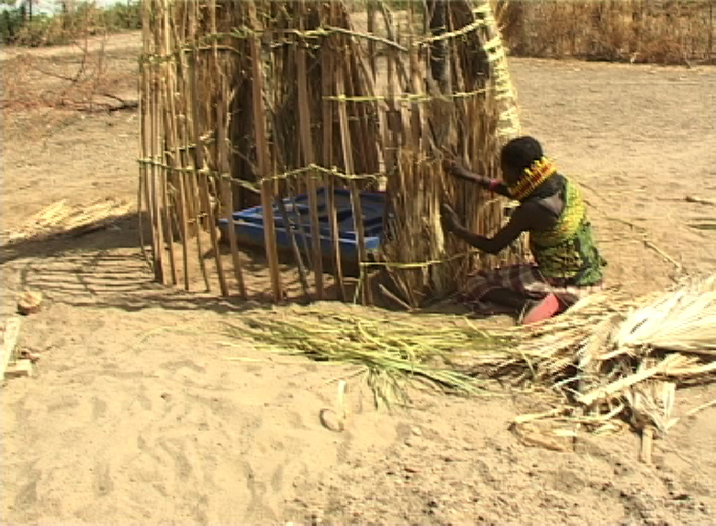
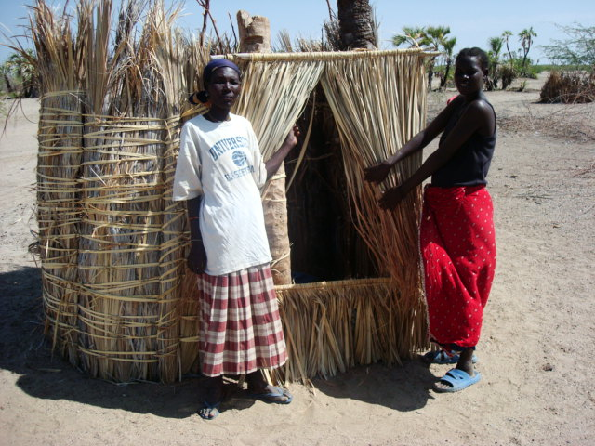
Latrines Constructed in Turkana: Latrines Constructed in Coast:

Slide 299
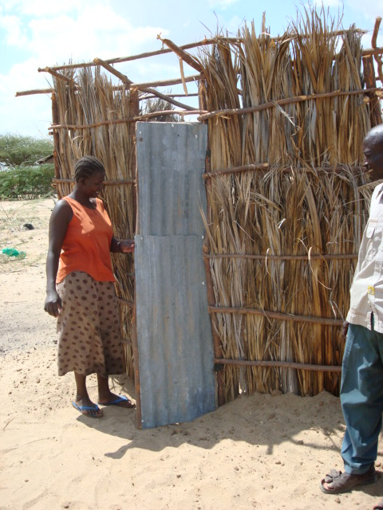
Latrine Construction in Tana River District: Bangladesh

Slide 300
SANITARY SYSTEM REQUIREMENTS.
Excreta disposal system should satisfy the following requirements as adapted from Ehlers and Steel.
1. The surface soil should not be contaminated because of the technology used.
2. There should be no contamination of ground water that may enter springs or wells.
3. There should be no contamination of surface water.
4. Excreta should not be accessible to flies or animals.
5. There should be no handling of fresh excreta or, when this is indispensable, it should be kept to a strict minimum.
6. There should be freedom from odours or unsightly conditions.
7. The method used should be simple and inexpensive in construction and operation.
8. Should serve at least 4 to five years to be cost effective.

Slide 301
TECHNOLOGIES.
The available technologies are grouped according to the technology involved and their overall function.
1. Drop-and-Store Systems.
  1.1 Pit latrines/pit privy.
  1.2 VIP latrines.
  1.3 Compost latrines.
  1.4 Aqua Privy.
  1.5 Bucket latrine.
  1.6 Trench latrine.
  1.7 Overhung latrine.
  1.8 Borehole latrine.

Slide 302
2. Drop-Flush-and-Discharge Systems.
  2.1 Water carriage (Water closet).
  2.2 Pour-flush latrine.
3. Individual containment and Treatment Systems.
  3.1 Cesspools.
  3.2 Septic tanks.
  3.3 Soak pits.
  3.4 Seepage pits.
4. Community Treatment Systems
  4.1 Waste water treatment process.

Slide 303
Pit Latrine:
This system is known as traditional pit latrine, pit privy, ordinary latrine or out-house.
Pit latrine is the cheapest type of excreta disposal system known. It is also considered the most common sanitation system in the world. It is based on containment and indefinite storage of human excreta. It is now given another name based on its function- “DROP-AND-STORE”.

Slide 304
Size Determination of a pit latrine.
How quickly the pit fills depends on many factors including the size, number of people using it, how much other material are added to it and what type of anal cleaning material is used.
In the African situation 0.025 to 0.040 M3 of waste will accumulate each year per user.
Depth of a pit required could be calculated using following formula;
Depth = (P x S x N) divide by A + 0.5 meter.
Where:
  P = average number of users.
  S = Solid accumulation rate in M3 per person per year (0.025M3 to 0.040M3).
  N = Minimum useful life required.
  A = Cross sectional area of the pit (based on the plot available)
  0.5 meter - This is added into the calculated depth for the service year required because the pit has to be filled with soil when the pit is full up to 0.5 meters from the top.

Slide 305
Pit latrine, a Drop and store requires for a hole to be dug in the ground. The excreta is deposited in the hole for until it is full after which the content will be pumped out or filled up by soil to remain underground forever. Pit Latrine among other things requires:-
A reasonable amount of open space.
Soil condition that can be dug easily.
A low ground water level.
Site that is never flooded.
Determinants of a pit latrine lifespan.
The lifespan of a pit latrine depends not only on the volume but also on:-
1. The maintenance and care taken.
2. How and where it is built (technology and soil).
3. The materials used in its construction.
4. The design period or the time required for the pit to fill.
5. The anal cleansing material used.

Slide 306
Advantages of a Pit Latrine.
Low cost.
Can be built easily.
Can use all type of anal cleansing materials (stone, corn cob, leaves, grass, mud, sticks etc.)
Minimal water requirement.
Disadvantage of a Pit Latrine.
Fly and mosquito nuisance.
Waste cannot be easily recycled.
Smell problem.
Lack of space for relocating new ones when full.
Potential for ground water pollution.
Difficulty to sink/dig in rocky or sandy soil.

Slide 307
Guidelines for a latrine site
Pit latrines should be at least 2-3m respectively above the water table.
Latrines should be located at least 6metres away from the buildings
Wells should be located upstream to avoid contamination of the well by ground water passing through the pit latrine.
Distance between the latrine and the water source should be at least 20 meters.

Slide 308
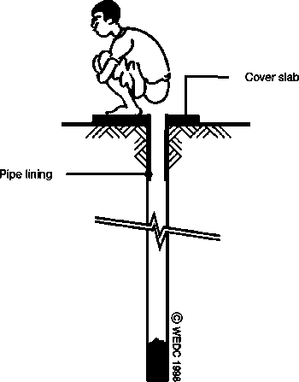
Borehole latrine :
About 18 inches in diameter and from 15 to 20 feet deep.
It has a smaller volume and fills up faster than a pit.
It is faster to install, and is appropriate following disasters
Advantages
Can be excavated easily if the boring equipment is available
Suitable for short term use, as in disaster situations.
Disadvantages
Sides liable to be fouled with consequent fly nuisance
Greater risk of ground water pollution owing to depth of hole.
Short life owing to small cross sectional area.

Slide 309
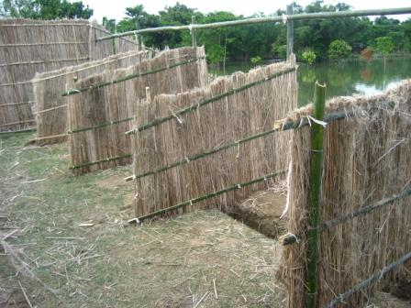
Trench latrine:
A trench is dug
A number of holes with dividing partitions constructed over it.
Used in temporary work camps.

Slide 310
Bucket latrines:
Also known as pail closets
Used where the water tables are high.
A squatting slab or seat is placed above the bucket.
Fills within a few days.
It is unpleasant to emptying it
Causes spillage which attracts flies
Advantages | Disadvantages
Low initial cost | Malodorous
 | Creates fly nuisance
 | Danger to health of those who collect or use the night soil.
 | Collection is environmentally and physically undesirable.

Slide 311
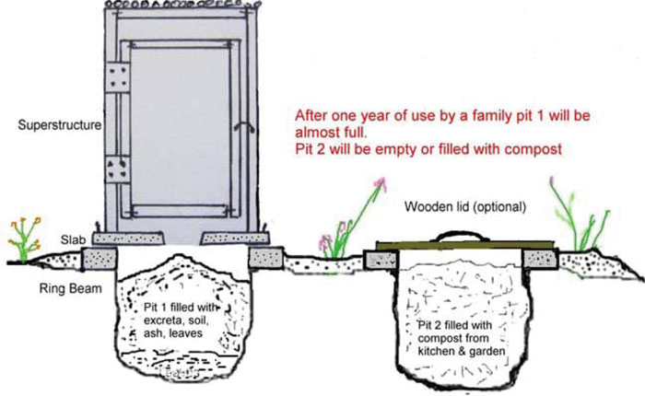
Composting pit latrine
It uses a predominantly aerobic processing system that treats excreta, typically with no water .
Suitable where the water table is too high.
Composting toilets may be used as an alternative to flush toilets in situations where there is no suitable water supply or waste treatment facility available or to capture nutrients in human excreta as human manure
Advantages | Disadvantages
Valuable humus is produced | Careful operation is essential
 | Urine has to be collected separately in the batch system
 | Ash or vegetable matter must be added regularly.

Slide 312
Ventilated pit latrine (VIP)
Fly and odor nuisance may be substantially reduced if the pit is ventilated by a pipe extending above the latrine roof, with fly proof netting across the top.
The inside of the superstructure is kept dark, hence VIP.
Advantages
Low cost
Can be built by householder
Does not need water for operation
Absence of smell in latrine and controlled flies
Disadvantages
Does not control mosquitoes
Extra cost of providing vent pipe.
Need to keep interior dark.

Slide 313
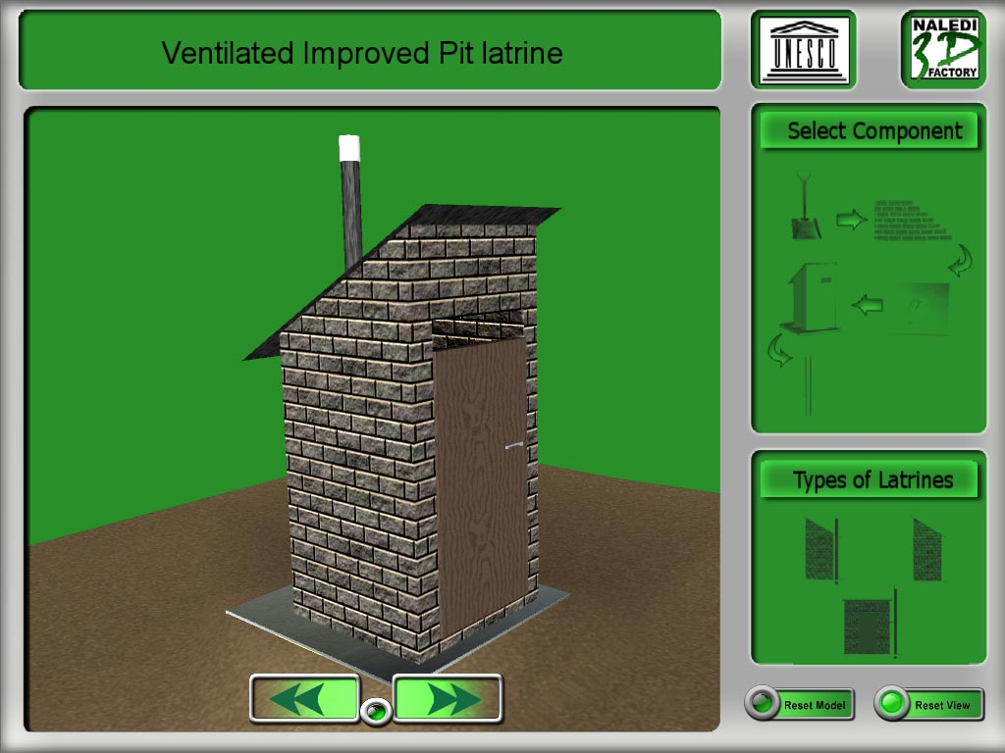
Ventilated improved pit latrines(VIP)
VIP LATRINE.
Ventilated Improved Pit (VIP) is a technical modification of simple pit latrine. It is also a drop-and-store technology.
Advantages
Eliminates fly breeding problem.
Reduces odour nuisance problem
Disadvantages
Costly to construct / maintain

Slide 314
The difference of VIP from the traditional one is the ventilation arrangement and a concrete slab cover. The pit is ventilated using a vent pipe extending above the roof of the VIP.
As a result of the vent technology added, VIP has advantages over the ordinary pit latrine by:
Eliminating fly breeding problem.
Reduction of odour nuisance problem.
But to control flies and reduce odor,
The vent pipe should be fitted with fly proof net (mesh).
The inside of the superstructure should be kept dark.
The door should face towards the prevailing wind and kept always closed to keep the inside area dark living space at floor level for air entrance.
It is not necessary to cover the squat hole.

Slide 315
Key Features of VIP Latrine
V.I.P smell control: One of the important features of a VIP latrine is its ventilation arrangement.
Fly Control: The inside of the superstructure should be relatively dark to discourage flies staying there.
VIP Latrine parts, which need periodic inspection;
Fly screen: [At the top the vent should be kept clear of Blockages and be quickly replaced if the screen has any holes in it]
Foundation: [any sign of erosion of the foundation around the edge of the slab should be filled immediately]
The Door: [should be self closing always]
Sunlight/heat: [Trees or any features which can block sunlight from reaching the vent pipe directly should be removed to facilitate heating of the air in the vent pipe.]

Slide 316
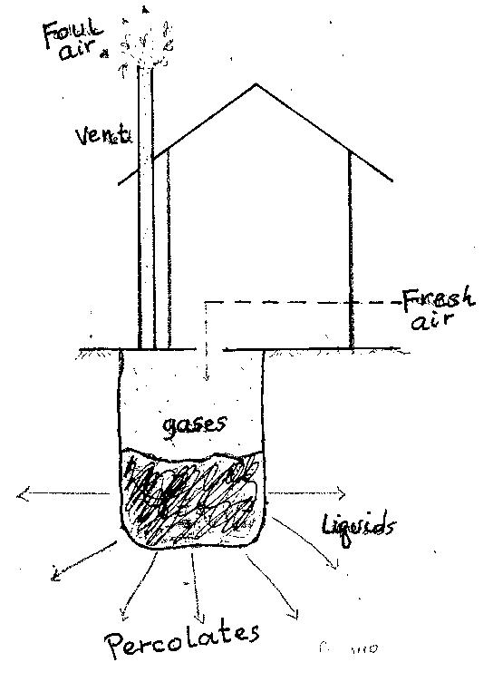
Parts of a VIP Latrine.

Slide 317
Pour – flush latrine
A latrine may be fitted with a trap providing a water seal, which is cleared of faeces by pouring in sufficient quantities of water to wash the solids into the pit and replenish the water seal.
Advantages | Disadvantages
Low cost | A reliable water supply must be available
Control of flies and mosquitoes | Unsuitable where solid anal cleaning material is used.
Absence of smell and latrine | Content of pit not visible.
Pan supported by ground | Can be upgraded by connection to sewer when sewerage becomes available.
Latrine can be in the house

Slide 318
Aqua - privy
An aqua – privy has a watertight tank immediately under the latrine floor.
Excreta drop directly into the tank through a pipe. The bottom of the pipe is submerged in the liquid in the tank, forming a water seal to prevent escape flies, mosquitos and smell. The tank functions like a septic tank.
Advantages | Disadvantages
Does not need piped water on site | Water must be available nearby
Less expensive than a septic tank | More expensive than VIP or pour flash
 | Fly mosquito and smell nuisance if seal is lost because insufficient water is added.
 | Regular desludging required and sludge needs careful handling.
 | Permeable soil required to dispose of effluent.

Slide 319
HOUSING:
Introduction:
The provision of good housing is an essential aspect of environmental health.
Good housing is a requirement for every human being because it provides shelter and protection from environmental hazards.
It is important to improve the quality of housing. You can help your community live in safe houses, by making simple improvements using locally available materials.
Housing includes houses and other buildings where people live, considered collectively including the provision of places to live.

Slide 320
Some health problems that would be associated with the following poor housing conditions:
Overcrowding and poor ventilation
Unscreened windows
Cooking fires on the floor
Earth walls and dirty floors
Housing Condition | Health Risk
Overcrowding and poor ventilation | Airborne droplet infections
Unscreened windows | Malaria
Cooking fires on the floor | Accidents and burns in children
Earth walls and dirty floors | Breeding of flies and bedbugs

Slide 321
A combination of dampness, lack of light, poor ventilation and overcrowding will contribute to the spread of airborne and droplet infections.
Earth floors and walls permit the entry and breeding of flies and bedbugs, while unscreened windows permit entry of mosquitoes.
Cooking fires on the floor are hazards to small children.
Inadequate space to talk and play, especially in town houses, is one of the reasons why fathers and children leave home thereby adding to social problems.

Slide 322
Definitions:
Housing is the physical structure that man uses for shelter and the environment of that structure including all necessary services, facilities, equipment and devices needed and desired for the physical and mental health and social wellbeing of the family and the individual.
Examples: caves (natural or artificial), simple sheds, huts or tukuls, modern buildings, tents, caravans, vans and etc. have all temporarily or permanently been used as residential environment although they might not satisfy all the basic needs.
Housing can be also be referred to as Residential Environment

Slide 323
Dwelling:- is any part of a house, which is occupied by an individual family.
Premises:- is any house with building or land near to it that is owned by the same person.
Slum:- is an area in which substandard housing predominates and frequently accompanied with overcrowding.
Standard Housing:- is a house that is properly planned and
constructed, comfortable, safe to live in and fulfill the basic
housing necessities (constructed in proper site, provided with safe and adequate water supply, safe and proper waste
disposal , adequate light, space, well ventilated, etc.
Substandard Housing:- is a house, which is poorly sited, planned and constructed, inadequate floor space for the family (overcrowded), poorly maintained and does not in general comply with the more important sanitary facilities.

Slide 324
Blighted area:- an area, which is undesirable for residential, agricultural, commercial, industrial or recreational purpose. Examples:- Marshy and rocky areas, gorges and mountainous areas, and plots nearer to sources of noise.
Housing Sanitary Code:- is the set of rules which deals with the sanitary conditions of the housing from public health point of view.
Zoning Code:- involves the division of the area into a series of zones or districts according to the desired plan. Example: residential zone, market zone, industrial zone, etc.

Slide 325
Public Health Importance of Housing
Improved housing decreases risk of communicable diseases, fire hazards, accident, reduces the creation of slum and cost of municipal services, reduce crime since it may not be easily accessible to robbers, rapists etc.
The WHO, in its book Health Principles of Housing (WHO, 1989), outlined a set of six principles regarding the relationship between housing condition and human health. These principles of housing include:

Slide 326
Protection against communicable diseases;
Protection against injuries,
Prevention of poisonings and chronic diseases;
Reducing psychological and social stresses to a minimum;
Improving the housing environment;
Making informed use of housing;
Protecting population at special risk.

Slide 327
Types of Housing:
Permanent
Semi-permanent
Temporary
Permanent Houses
Has a stone foundation
A cemented floor
Plastered walls.
The roof is covered with iron sheets, tiles or stones in the case of flats or maisonettes..
This type of house has advantages in that it is easy to keep the floor and walls clean.
The floor should be kept dry to avoid accidental falls.
Are not cheap to construct and it is necessary to budget for the activity.

Slide 328
Semi-Permanent Houses
The floor is usually cemented but does not necessarily have a stone foundation.
The walls are made of iron sheets or sometimes timber or mud bricks
The house is iron roofed.
Easy to keep clean.
Appropriate preservatives for timbers have to be used or else termites destroy it
It is less expensive than a permanent house.
Temporary Houses
The floor is earthen
the walls are made of cardboard, polythene paper, grass or mud.
The roof is thatched with the same material as the walls.
This type of a house does not provide for privacy
Can easily catch fire.
Are a health hazard and do not meet the requirements for good housing. They should be discouraged as much as possible.
This type of house may be found in rural and slums areas.

Slide 329
Criteria for an Adequate House:
A good house should meet biological, physical and social criteria.
Biological criteria
Physical criteria
Social criteria
Biological Criteria
Good housing minimizes the risk of transmission of diseases.
The spread of gastro-intestinal infections for instance is minimized by the following factors.
Good water supply
Good food storage, preservation and preparation
Adequate facilities for washing utensils and well designed kitchens
Adequate methods of refuse disposal

Slide 330
Physical Criteria
The house should be safe for every occupant.
This means that home accidents should be prevented.
It is, therefore, necessary that appropriate safety devices be provided for.
The house should also be free from air pollution.
Social Criteria
Good housing should be designed to enable the family function effectively in regard to its cultural background.
This means that the required privacy for adults should be catered for.
It should have a suitable setting for bringing
up children.

Slide 331
Characteristics of Adequate Housing
The following are the characteristics of a good house.
Good Lighting
Natural Light
The sun provides natural light, which is essential for physical growth, especially in young children.
Lighting is also essential for proper vision.
The presence of sunlight into the house kills some micro-organisms.
Some insects are also driven away by adequate lighting.
Artificial Lighting
This type of lighting is needed at night.
The sources are electricity, oil lamps and gas.
The type of lighting used should correspond to the purpose for which it is needed in the house

Slide 332
2. Ventilation
Fresh air is necessary for our health.
Ventilation of a house is the removal of impure air and pouring in pure air.
Good ventilation in the house is important, because it keeps the air on continuous movement without creating draught, cools the housing and maintains the room temperature at a constant.
3. Room Separation
The house should have adequate rooms to provide separate accommodation for adults and children.
The shelter for animals should be separate from the main house.
There should also be separate rooms for food storage and preparation.

Slide 333
Others:
4. Cemented floor and plastered walls to protect against insects and should be rodent-proof.
5. It should also have water supply in adequate and reliable quantity and quality.
6. Clean compound.
7. It should be equipped with proper methods of refuse and human waste disposal
8. The house should be dry.
9. The cooking arrangements should be satisfactory to avoid home accidents. Generally, there should be an effort to protect against all types of home accidents, for instance, those caused by fire, tools and chemicals.

Slide 334
Suitable Building Sites:
The soil should be suitable for construction.
The site should be dry, sunny and exposed to free air.
The surroundings should be hygienic
and healthy.
The site should be away from noisy factories, cinema halls and heavy traffic.
It should be on high ground to avoid water from standing and stagnating. This will prevent breeding of mosquitoes.

Slide 335
Characteristics of poor housing:
Dampness due to poor drainage.
Overcrowding
Earthen floors and unscreened windows
Unprotected fire places with poor cooking arrangements and improperly stored working tools.
Water supply and storage, which lacks hygiene.
Improper storage of clean utensils accompanied by poor personal hygiene in the preparation and serving of food.
The home environment may lack a good latrine, usually accompanied by improper excreta and inadequate refuse disposal.
Compounds with tall grass, pools of water and sprawling litter

Slide 336
Diseases Associated With Housing:
Inadequate housing conditions expose people to physical, chemical and biological hazards, and to various adverse psychological and social factors.
Increased length of exposure to poor housing leads to worsened health
Excess winter mortality due to poor heating, ventilation, increased respiratory infection
Mold: respiratory problems, asthma, allergies, eczema
Indoor pollutants and infestation: asthma
Overcrowding: increased risk of infectious disease
Affects mental well-being, depression
Stress
Unsafe outside, unhealthy inside
Injury

Slide 337
Substandard housing conditions are intimately linked with three of the leading pediatric health concerns:
Asthma
Lead poisoning
Household Injuries
Estimated 40% of doctor diagnosed asthma is due to residential exposure

Slide 338
WATER SUPPLY:
Water supply is the provision of water by public utilities, commercial organisations, community endeavors or by individuals, usually via a system of pumps and pipes. Irrigation is covered separately.
Water is also essential for the healthy growth of farm crops and farm stock and is used in the manufacture of many products
Every country has to take preventive measures to avoid pollution and contamination of the available water resources.
Therefore, public water supply must be potable, palatable and wholesome.
Water must not have disagreeable physical change and must be hygienically safe.

Slide 339
Definitions
Raw water: water that has not been purified.
Potable: water safe for drinking, free from pathogens which are introduced to the water through feces, dirty containers, etc.
Water table: is the top (upper) limit of the zone of saturation in the groundwater formation.
Water treatment: The process of removing all those substances whether biological, physical, or chemical which are potentially dangerous or undesirable in water supply for human and domestic use.
Water purification is the process of removing undesirable chemicals, biological contaminants, suspended solids, and gases from water. The goal is to produce water fit for specific purposes.
Water is a transparent, tasteless, odorless, and nearly colorless chemical substance, which is the main constituent of Earth's streams, lakes, and oceans, and the fluids of most living organisms.
It is vital for all known forms of life, even though it provides no calories or organic nutrients.

Slide 340
Properties of water
Water is a chemical compound consisting of two gases, hydrogen and oxygen in ratios 2;1 hence H2O.
Pure water should be, odourless, colourless, tasteless, and neutral ( PH7).
Water freezes at OC or 32 0 F and boils at 100C or 212 F.
Density of water is I gm/cc at 40 c ( max density )
Water is the greatest solvent known to science and due to this, it is never found pure in nature.
Temperature – the higher the temperature of water the more it dissolves.
softness – the softer water is, the more soluble it becomes.

Slide 341
6. As water passes through the atmosphere, it absorbs CO2, forming carbonic acid which increases the solubility and enables water to dissolve lime and magnesium to form bicarbonates. Referred to as hard water.
7. Water is found in three forms in nature.
  Solid – when frozen
  Liquid – in aqueous form
  Gaseous – in vapor form.

Slide 342
Physical characteristics of water.
1. Temperature
Pure water freezes at Oc and boils at 100 c.
2. Taste and odour.
Should be odourless and tasteless. But due to fact that, it dissolves impurities, organic in nature e.g. phenols and chloraphenols it may not be so.
3. Colour
Even pure water is not colorless. It has a pale green – blue tint in large volumes. It is necessary to differentiate between true color due to material in solution and apparent color due to the suspended matter.
4. Turbidity – the presence of colloidal solids gives water cloud appearance which aesthetically unattractive and may be harmful.
5. Solids – these may be present in suspension or dissolved.
6. Electrical conductivity – the conductivity of solutions depends with TDS.

Slide 343
CHEMICAL CHARACTERISTICS OF WATER
PH: this measures the hydrogen ion concentration in water. Ranges in scale of 0 – 14 with 7 being neutral.
Hardness: this is the property of water being unable to form lather easily with soap and produces scale in hot water system.
Oxygen demand (OD): organic compounds are generally unstable and may be oxidised biologically or chemically to stable ,inert end product eg CO2, NO3, H2O.
Dissolved oxygen – this is most important element in water quality control. Its presence is essential to maintain the higher forms of biological life.
Biological oxygen Demand – this is the amount of water required by micro organisms to break down ( oxidize ) organic matter in given sample of water.
Chemical oxygen demand – sometimes chemical oxidizing agents are added to samples in attempt to oxidize chemically the material contained in the sample.

Slide 344
7. Total organic carbon (TOC) – this is equivalent to the total organic matter contend in water.
8. Total oxygen demand – this is amount of oxygen required to oxidize fully a sample of water.
9. Nitrogen – it has to be present for biological treatment of water to proceed.
10. Chlorides – they make water blackish and are an indication of sewage pollution because of the chloride content of urine.

Slide 345
Water storage is a broad term referring to storage of both potable water for consumption, and non potable water for use in agriculture.
There are three types of storage, namely:
1) Storage in reservoirs, such as earth dams and ponds.
2) Storage in tanks.
3) Storage in situ, such as in soil and sand.
Water source protection involves the protection of surface water sources (e.g. lakes, rivers, man made reservoirs) and groundwater sources (e.g. spring protection, dug well protection, and drilled well protection) to avoid water pollution (see also pathogens and contaminants).

Slide 346
Methods of water protection (Ways to Keep Our Water Clean)
Pollution Prevention
Land use controls
Public ​Education
Recycle Used Items
Minimize Chemical Use
Dispose of Hazardous Materials Correctly
Reduce Water Use
Keep Runoff Minimal
Reuse Water
Participate in Clean-up Efforts
Keep Wetlands Intact
Advocate for Clean Water
Participate in Community Development

Slide 347
Water sources:
Water resources are natural resources of water that are potentially useful.
Rain water
surface water
Underground water
Sea water
Rain Water:
Purest natural water if collected from clean iron sheets & stored well
Soft and effective in cleaning and washing
No micro-organisms if collected well

Slide 348
Disadvantages of Rain water:
Difficult to collect from some roofs (thatched)
Buildings require gutters & large tanks
Not tasty
Lacks essential minerals
Prone to atmospheric pollution

Slide 349
Underground water:
Water found beneath the ground
Stored in porous rocks called acquifers
Will flow to the surface naturally at springs, seeps & wetlands
Wells can be contracted to tap it from the ground
Advantages of Underground water:
Usually clean
In plenty
Useful in times of draught
NOTE: may come from far away and may not dependent on local rain.

Slide 350
Disadvantages of underground water
Hard water due to the dissolved minerals.
Expensive to purify.
Costly in pumping from the ground to users
Surface water
Water in lakes, rivers, ponds, dams and shallow wells
Advantages
Commonest source of water
Easily accessible
Can be obtained by use of simple pumps.
Water in permanent lakes & rivers ensures.
Constant supply all year

Slide 351
Disadvantages
Easily polluted (human, animal, industrial &agricultural waste)
Needs treatment before drinking
Sea water
Water collected in oceans
Very concentrated in salts(salty water)
Expensive to purify

Slide 352
Water Treatment:
The process of removing all those substances whether biological, physical, or chemical which are potentially dangerous or undesirable in water supply for human and domestic use.
Factors to consider in selecting suitable water treatment method.
Quality of water- physical, biological or chemical
Quantity of water to be treated.
Population to be served. The more the pop, the more are be served, the more the frequency of check-up.
Distance from the source to the consumers due to residual of chlorine
Types of water treatment
Small scale -used in the household
Large scale - used to treatment large amount of water -conventional treatment.

Slide 353
CONVENTIONAL / LARGE SCALE WATER TREATMENT
Water treatment typically consist of several steps in the treatment process. These include:
(1) Collection;
(2) Screening and Straining;
(3) Chemical Addition;
(4) Coagulation and Flocculation;
(5) Sedimentation and Clarification;
(6) Filtration;
(7) Disinfection;
(8) Storage;
(9) and finally Distribution.

Slide 354
Steps: Conventional Large /Scale Water Treatment Plant
A. PHYSICAL/CLARIFICATION
1.Preliminary water treatment
-Source and intake raw water-Screening
2. Aeration and pre-chlorination
3. Coagulation and flocculation
4. Sedimentation
B. FILTRATION
SLOW SAND FILTERS
RAPID SAND FILTER
C. DISINFECTION

Slide 355
Preliminary Water Treatment: Removal of large floating and suspended solids present in the inflow.
Source and Intake of the Raw Water: Intake phase of water treatment starts with a careful survey of the sanitary condition of the entire catchments basin or drainage area of the source of the raw water, whether it is river, lake or artificial pond.
Screening: Screening is the first step in treating water containing large solids. These solids can clog and damage pumps or impede the hydraulic flow in open channels and pipes. River water contains suspended and floating debris varying in size from logs to small rags.
The main purpose of screening is to remove solid materials that could: Cause damage to other process equipment.
Aeration and pre-chlorination: From the free atmosphere, water absorbs gases released to the atmosphere. Pre-chlorination replaces aeration in some water purification plants and it helps to control the growth of algae, which cause the clogging of filter sand.

Slide 356
Coagulation and flocculation: Many impurities in water and wastewater are present as colloidal solids, which will not settle. Their removal is achieved by promoting agglomeration of such particles by flocculation with or without the use of a coagulant followed by sedimentation or flotation.
Sedimentation: When the impurities are separated from the suspending fluid by gravitational or natural aggregation of the settling particles, the operation is called plain sedimentation. When chemical or other substance are added to induce aggregation and settling of finely divided suspended matter, colloidal substance, and the large molecule, the operation is called coagulation.
Clarification: Sedimentation units have a dual role: the removal of settleable solids and the concentration of the removed solids into a smaller volume of sludge.
Flotation: Particles that are denser than the surrounding liquid will sediment. Very small particles and low-density particles, flotation may offer a more satisfactory clarification process.
Filtration: Suspended matter is separated or purified by passing it through a minute porous material or medium.
DISINFECTION: The destruction of pathogenic and other kinds of microorganisms by physical and chemical means.
Post-chlorination: The purpose is destroy pathogenic organisms. Previous treatment processes described previously will remove most of the microorganisms to some extent. Very small numbers of microorganisms that are viable and pathogenic are not removed and may bring disastrous epidemic. Post–chlorination is a done as final step to kill these pathogens before water distributed.

Slide 357
Main objectives of water treatment.
Remove pathogenic organisms in order to prevent water associated diseases.
Remove substances that impact color, taste or odours to water.
Remove excess or undesirable chemicals or minerals from water.
Regulate essential elements or chemicals in certain water supply systems
Remove excess or undesirable dissolved gases
Methods of treating household water supplies
Boiling
Filtration
Chemical Disinfection
Household Water Storage

Slide 358
Water Purification:
There are 3 simple methods of purifying water are:
Storage
Filtration
Sterilization
Storage
Standing water kills many bacteria which are deprived of air
Suspended material settle (turbid water turns clear)
In small scale, can be done using the 3 pot system to stand water for 24 hours
In large scale, tanks can be used where the water stands for 3-7 days

Slide 359
Filtration:
Filtration is any of various mechanical, physical or biological operations that separates solids from fluids by adding a medium through which only the fluid can pass.
Can be done on small scale & large scale
Small scale –water filters can be used at home
In a large scale, sand filters are used
Layers of stone at the bottom, coarse sand, & fine sand at the top
Sterilization
Sterilization refers to any process that eliminates, removes, kills, or deactivates all forms of life (in particular referring to microorganisms such as fungi, bacteria, viruses, spores, unicellular eukaryotic organisms such as Plasmodium, etc.)
In large scale done by chlorinating the filtered water.
Amount of chlorine proportionate to the volume.
Chlorine left for 30 minutes for it to be effective
In small scale done by boiling or adding chlorine or iodine.

Slide 360
Diseases associated with water:
These can be classified as:
Water washed diseases
Water borne diseases
Water related diseases
Water based diseases
Water washed diseases
Diseases caused by lack of or inadequate water
Transmitted by fecal oral route due to lack of washing hands, dirty foods & utensils
Lack of personal hygiene (failure to wash hands, eyes, body)
These diseases are prevented by increasing Quantity water available for use

Slide 361
Examples of Water washed diseases:
Diarrhoea
Cholera
Bacillary dysentery
Skin diseases (e.g. scabies)
Eye diseases (e.g. trachoma)
Water borne diseases
They occur when the pathogen is in water , drunk by a person or animal eventually they become infected.
Water carries the organisms that cause these diseases.
Due to dirty water contaminated with the pathogen.
These diseases are prevented by increasing the Quality of water available for use.

Slide 362
Examples of Water borne diseases:
Typhoid
Cholera
Poliomyelitis
Amoebiasis
Hepatitis A
Water related diseases
The final mechanism of water – related diseases is spread by insects which either breed in water or bite near water.
Water is essential in the life cycle of these organisms
  Malaria
  Schistosomiasis
  Onchocerciasis(river blindness)
  Dracunculosis(guinea worm)
  Trypanosomiasis(sleeping sickness)

Slide 363
Water based diseases:
This is the one which the pathogen spends a part of its lifecycle or in an intermediate host which lives in water. Examples
Parasitic worms ( helminths ) e.g. shistomiasis which develop in snails until they are shed in to water as infective carcariae and reinfect man through the skin.
Guinea worm – its intermediate host is Cyclops, human infection occurs when following ingestion of water containing Cyclops.

Slide 364
.

Slide 365
Uses of Water:
Human consumption for body needs
Animal watering
Industrial use for manufacturing
For recreational activities such as swimming
To produce electricity
Sustaining of aquatic life, for example, fish for consumption and export
Household purposes like washing and cooking
Uses of water include agricultural, industrial, household, recreational and environmental activities. All living things require water to grow and reproduce.

Slide 366
Water requirements:
Every person requires about 2 litres of water a day for basic physiological needs
If water is fetched far, at least 1 KM away, people can manage with 6 litres per day
People who have a tap in the compound, use up to 25 litres a day
In houses with many taps & flush toilets, people will use 100 litres or more
NOTE:
Water washed diseases are the most common, the health of communities can be improved by increasing the quantities of water and then improving its quality
Water can have less minerals & lead to deficiency diseases (e.g. goitre) or excess minerals (e.g. fluorosis)

Slide 367
Water sampling & Testing:
Water sampling, the process of taking a portion of water for analysis or other testing
Water testing is a broad description for various procedures used to analyze water quality.
Used for large scale supplies of water
Mainly 2 methods
Bacteriological analysis
Chemical analysis
Bacteriological analysis
Bacteriological water analysis is a method of analysing water to estimate the numbers of bacteria present and, if needed, to find out what sort of bacteria they are
Water sample collected in 500 ml flask
Must be kept cold(4 C to 10 C)
Must be analysed in 30 minutes
Mainly done to detect E. Coli
Presence of E. Coli in large amounts indicates contamination by excreta

Slide 368
Chemical analysis:
Water chemistry analyses are carried out to identify and quantify the chemical components and properties of water samples
5 litres collected in a clean container
Water tested for various substances
Including
Ammonia
Softness & or hardness of water
Examination for cyanide & pesticides normally done within 24 hours

Slide 369
Pollution types (water)
These include point and non- point source
Point source – from recognizable point e.g. effluent from industries
Non point source – pollutants diffusing to water sources from unidentified sources. E.g. agricultural sources.
Some water pollutants
Heavy metals – include lead, cadmium, manganese, copper, mercury etc. they have a tendency of being deposited on the surface of some soft and bone tissues and organs such as liver, kidney, lings etc.
Persistent organic pollutants – including poly – chloro – biphenyls ( PCBs) and organic pesticides such as chlorinated hydrocarbons e.g. dieldrins, DDT. They are cumulative in nature and can be passed from herbivores to secondary consumers.
Pathogens - biological pollutants e.g. E-coli counts exceeding WHO ranges. Others include streptococci, pseudomonas etc.

Slide 370
4. Decomposable organic matter - food remains and food processing effluents, rich in carbohydrates, as they decompose, they use dissolved oxygen from the water, causing a deficit in for the aquatic organisms hence creating oxygen demand.
5. Thermal pollutants – introduction to hot or cold effluents into a system causes changes in composition of aquatic organisms hence mesophils dominating.
6. Suspended matters – clay silt from soil erosion cause turbidity, reduce depth of sunlight penetration and thus affect photosynthesis.
7. Acids and bases – change the PH of the water body, thereby shifting the species composition within the system.
8. Oil pollution - block the air – water interaction hence interfering with gaseous exchange, reducing the amount of dissolved oxygen.
9. Nutrients – includes nitrates and phosphates which cause eutrophia.
10. helminthes/ worms – the infective stages of many parasitic roundworms and flat worms can be transmitted to man through drinking water.

Slide 371
FOOD HYGIENE:
Introduction:
Food hygiene are the conditions and measures necessary to ensure the safety of food from production to consumption.
Food can become contaminated at any point during slaughtering or harvesting, processing, storage, distribution, transportation and preparation.
Food safety is used as a scientific discipline describing handle, preparation, and storage of food in ways that prevent food-borne illness. The occurrence of two or more cases of a similar illnesses resulting from the ingestion of a common food is known as a food-borne disease outbreak

Slide 372
FOOD HYGIENE DEFINITIONS
Food: is any substance consumed to provide nutritional support for an organism. Material that provides living things with the nutrients they need for energy and growth.
Any substance whether simple, mixed or compounded that is used as food, drink, confectionery or condiments. (LOK -CAP 242/254)
Safety – is overall quality of food fit for consumption.
Food preservation is the process of treating and handling food to stop or slow down Food spoilage , loss of quality, edibility or nutritional value and thus allow for longer food storage.
Food borne Illness – A disease carried or transmitted to people by food.
Food Infection - microbial infection resulting from ingestion of contaminated foods.
Food Intoxication - type of illness caused by toxins. Under favorable condition certain bacteria produce chemical compounds called toxins
Food Spoilage - means the original nutritional value, texture, flavor of the food are damaged, the food become harmful to people and unsuitable to eat.

Slide 373
Food preservation
Purpose :
Increase its shelf-life, for example, canned foods
Render the food safe for consumption, for example, highly perishable foods like milk
Conserve the food for use during the periods of scarcity, for instance, dried cereals and vegetables
Avail seasonal foods, like fruits, throughout the year
Principles of Food Preservation
Destroy organisms responsible for spoilage through heat treatment.
Inhibit the micro-organisms through cold treatment

Slide 374
Micro-organisms that can cause food spoilage:
Moulds: Affect the surfaces of foods containing high sugar and salt. They also affect dry foods that may become damp due to poor storage.
Yeasts: Affect foods that have acid or sugar in high concentration, for example, dried fruits, and concentrated fruit juices.
Bacteria: Affect foods under various conditions apart from dry food.
Food Preservation:
A. Heat Treatment
1. Cooking.
Destroys or reduces micro-organisms and potential toxins in food.
Inactivates undesirable enzymes in food.
It alters the colour, texture and flavor of food.
Improves the digestibility of food.
Cause degradation of food nutrients

Slide 375
2. Blanching
Vegetable foods are heat treated at 70 - 100°C for 2 - 10 minutes.
This is done by immersing food in boiling water or exposing it to steam.
Used before freezing, canning or drying.
It inactivates enzymes,
Drives out air bubbles trapped in food
Enhances retention of green colours
Reduces micro-organisms.
3. Smoking and Drying
Makes food unsuitable for the bacteria to grow and multiply. E.g. Fish and meat .
In smoking heat is used to dry the food, and the smoke gets inside the food to act as a preservative.
Green vegetables, cereals and legumes can be preserved by drying them in the sun.
If food is preserved by drying, it must be stored in a dry place until it is used.

Slide 376
4. Pasteurization:
Partial sterilization of foods at a temperature that destroys harmful microorganisms without major changes in the chemistry of the food.
Generally carried out at a temperature of below 100°C.
This method reduces organisms that cause spoilage and eliminates pathogens.
5. Sterilization.
Heat is used to kill all micro-organisms and their spores at a temperature of above 100°C.
The sterilized food is then stored in an airtight container to prevent the entry of and recontamination by micro-organisms.

Slide 377
6. Canning.
The food is first heated at a temperature that kills all bacteria
It is then sealed up in sterile cans or bottles.
This prevents bacteria from getting into it and enables it to remain safe for a long time at room temperature.
B. Cold treatment
1. Freezing
The most satisfactory method currently available for long-term preservation of food.
When properly done, freezing is effective for retaining the colour, texture, flavour and nutritive value.
Food must be deep-frozen at 0-4°C to remain palatable. This keeps food fresh for weeks or months.

Slide 378
2. Salting
This is the saturation of food with salt or sugar, for example, ham, jam and jelly.
The added solute reduces microbial activity due to its dehydrating effect.
Food Safety
1. Health: Individuals suffering from respiratory infections such as colds or sore throat as well as people with infected cuts, skin eruptions and diarrheal diseases like dysentery and typhoid should not work with food until they get well.
2. Clothing
Wear clean washable outer garments.
Every worker in the kitchen or washing dishes should wear a clean uniform or apron
Head Covering - To avoid hair from getting into food, hair bands, caps or nets should be used to cover the head when handling food.

Slide 379
3. Personal Hygiene: Individuals handling food should:
Wash hands before handling the food
A daily bath
Use clean utensils
Avoid habits such as nose picking
Nails should be kept short and clean.
4. Proper Food storage and preparation
Raw food should be separated from cooked food.
All vegetables should be cleaned thoroughly before preparation for cooking.
Fruits should be washed before eating.
The food should be hygienically prepared and cooked adequately.
All food utensils should be cleaned properly after use and left to dry before being stored in a clean place.

Slide 380
5. Proper environment
The environment pertaining to the preparation of food should be clean throughout.
The area should be dust free.
The facility itself should be clean and with adequate ventilation and lighting.
FOOD SAFETY REGULATIONS
The safety of food is so important that our government has passed laws to protect the public. These laws cover many aspects of food handling.
The following are some of the areas that need close supervision:-
1. Meat: it is important to inspect slaughterhouses and butcheries.
2. Milk:
Inspection of shops where milk is sold.
It should be obtained from healthy cows as it can transmit bovine tuberculosis among other diseases.

Slide 381
The room for handling milk should be clean, dustless and separate from the barn.
The pails, cans, bottles, coolers and other equipment, which comes into contact with the milk, should be thoroughly cleaned.
3. Homes
These include maintenance of personal hygiene as covered earlier, that is cleaning the utensils, handling them with clean hands, and storing them in clean and dry cupboards or containers.

Slide 382
4. Farms and food hygiene
The community should follow the regulations on the use of insecticides and pesticides in form of sprays and fertilizers.
Encourage the community to adhere to the instructions from the agricultural field educators.
Teach the community about regulations of food storage and preservation of different types of food.
The harvest should be carried out when the crops are completely ripe or ready to facilitate longer preservation.
Cereals and legumes should be dried properly before storage to avoid spoilage.
All perishable foods should be consumed at the right time.

Slide 383
5. Markets and food hygiene
The markets should be designed in a manner that considers stations where similar types of food should be stored and sold, for example, vegetables of all kinds, dry foods like cereals, fruits and cooked foods.
The market should be kept clean and proper refuse disposal maintained.
The food sold should be clean and fit for human consumption.
Inspection of markets should be done by public health officers. These officers have the power to close markets and condemn foods to prevent disease outbreaks.

Slide 384
6. Hotels
Hotels, restaurants and food shops should also be inspected under hygiene regulations.
They require regular inspection by the public health officers.
All the food handlers should be supervised and a regular medical examination is mandatory for them to prevent spread of diseases through food handling.
Licenses should only be given to hotel owners who have met the requirements
Laboratory examinations may be necessary for food such as pre-cooked meat. The use of uniforms, aprons, head coverings, as described earlier, should be observed in the hotels.
Proper personal and environmental hygiene in the hotel premises should be maintained.
The hotel should store, preserve, prepare, cook and serve the food according to public health regulations.
The law a empowers closure of hotels which do not meet the regulations.

Slide 385
Common Food Borne Diseases and Their Causes

Slide 386
Handling and storage:
Main types of food storage
Storage will depend on the type and packaging of the food.
Dry staples
Dry staples are the base necessities of your food storage. These consist of things like flour, sugar, rice, beans, coffee, pancake mix, or even instant potato flakes.
Freeze dried
Freeze dried rations are prepared by freezing the food, placing it in a vacuum chamber, and then drying off any excess moisture. They are often sold in nitrogen sealed cans
Dehydrated
Dehydrated food shares many of the same characteristics as freeze dried, and is lightweight and long lasting.
Canned.
Canned food is a durable and cheap type of storage. Canned foods are not only the most readily available, but they are easy to use and rotate out, and they often require no water, heat, or preparation.

Slide 387
Food Handling. Any aspect of the operations in the preparation, transport, storage, packaging, wrapping, exposure for sale, service, or delivery of food.
A safe handling practice refers to the handling guidelines and accessing processes of food product in order to prevent and rescue them from all the unwanted and unhealthy factors. These practices and actions can minimize risk from potential hazards and will enhance the quality and productivity of food.
Proper food handling, storage, and heating is the mainstay in preventing food poisoning.
Four issues / steps to keep food safe:
Clean — Wash hands and surfaces often.
Separate — Don't cross-contaminate.
Cook — Cook to the right temperature.
Chill — Refrigerate promptly.

Slide 388
FOOD SPOILAGE
Spoilage is the process in which food deteriorates to the point in which it is not edible to humans or its quality of edibility becomes reduced. OR
Means the original nutritional value, texture, flavour of the food are damaged, the food become harmful to people and unsuitable to eat. OR
Food spoilage is a change in a food that makes it unfit or undesirable for consumption.
Food spoilage occurs when a contaminant or naturally occurring enzymes cause the food to deteriorate or change in undesirable ways.
Various external forces are responsible for the spoilage of food
For instance, fruits are often contaminated with yeasts because yeasts ferment the carbohydrates in fruits.
Most of the time, food is described as spoiled when its appearance, texture, flavor, or odor has changed
Food that is capable of spoiling is referred to as perishable food.
Artificial contamination occurs when food is handled or processed, such as when fecal bacteria enter food through improper handling procedures.

Slide 389
Natural contamination occurs when microorganisms attach themselves to foods while the foods are in their growing stages
Food Spoilage agents
^{Microorganisms}
    Bacteria- main food spoilage agents
    ^{Viruses}
    ^{Fungi- Yeasts and moulds}
^{Enzymes}
^{Chemical Reactions}
^{Physical Reactions}
^{Insects, rodents, and birds}

Slide 390
Signs of Spoilage
Discoloration
Off odor
Fuzzy growth on the surface
Slimy feel on the surface
Foaming or gas bubbles in the product
Bulging or corroded can
Cloudy appearance
Off flavor
Mushy texture
Soft spots or breaks in the skin on fruits and vegetables
If you suspect a food is spoiled, DO NOT TASTE IT.

Slide 391
Types of food spoilage
1. Microbial Spoilage
Three types of microorganisms that cause food spoilage are yeasts, moulds and bacteria.
2. Enzymic and Chemical Spoilage
Also referred to as autolysis. Autolysis is self-digestion emanating from factors within the food tissues themselves.
These factors are mainly enzymes and chemical compounds.
Enzymes are proteins found in all plants and animals.
Examples of such spoilage are:
Enzymatic browning- it is initiated by the enzyme polyphenol oxidase (polyphenolase).
The action of this enzyme results in slightlyly brown discoloration accompanied by undesirable changes in flavor and texture in fruits and vegetables e.g. apples, potatoes, avocadoes, beetroot etc

Slide 392
3. Insects, rodents and birds
Insects and rodents may infect food by infecting organisms with their saliva or deposit them with their excreta.
They also greatly destroy the quality of grains e.g. weevils burrowing in maize grains
Rodents lower the nutritive value of maize by eating the germ.
Birds can significantly lower the amount of harvest of some cereals by feeding on them while still in the field.
4. Physical Injuries
These can be in form of:-
Crushing/breaking due to excessive mechanical forces
Bruises arising from poor handling methods
Injuries from preservation methods e.g. “freezer burn” and “cold shortening” resulting from freezing

Slide 393
Factors affecting the rate of food spoilage
The nature of the food itself- in providing nutrients for microbial growth
The initial microbial load in food
Moisture content of food
PH of the food
Composition of air in storage environment.
Humidity of the storage environment.
Exposure to sunlight
Temperature of air in storage environment.

Slide 394
HYGIENE PRINCIPLES
These are the basic principles behind reducing the potential of a food hygiene hazard to cause adverse human health effects.
Entails HACCP – (Hazard Analysis and Critical Control Point)
The HACCP principles provide a systematic way of identifying food safety hazards, making sure they are being managed responsibly by the food business operator and showing this is being done day-in, day-out.
HACCP involves the following steps:
Plan: Decide what needs to be done to maintain food safety and write it down;
Do: Do what you said you would do;
Check: Check that you are doing what you planned to do and write down what was checked and when;
Act: Take action to correct any food safety problems and write down what has been done about the problem and when.

Slide 395
All who are involved in producing and preparing food are responsible for making sure that, as far as possible, the food supplied is safe to eat.
Food hygiene are the conditions and measures necessary to ensure the safety of food from production to consumption.
Objectives of food hygiene
Prevent food losses during harvesting, processing, storage, transportation and handling.
Protect consumers against being offered food that is harmful to health, not fit for human consumption, adulterated or presented in a deceptive manner.
Improve nutrition of the population Stimulate foreign exchange earning through export of foods that comply with acceptable standards.
Prevent importation of substandard foods

Slide 396
The five key principles of food hygiene, according to WHO, are:
Prevent contaminating food with pathogens spreading from people, pets, and pests.
Separate raw and cooked foods to prevent contaminating the cooked foods.
Cook foods for the appropriate length of time and at the appropriate temperature to kill pathogens.
Store food at the proper temperature.
Use safe water and safe raw materials.
Sources of food contamination:
Contamination – is the presence of harmful substances in the food
Types of Food Contaminants
Biological Contaminants
Physical Contaminants
Chemical Contaminant

Slide 397
Common poisonous foods
Food – poisoning is an acute gastro-enteritis caused by the ingestion of the food or drink contaminated with either living bacteria or their toxins or inorganic chemical substances and poison delivered from the plant and animals
Potato -a potato turned into green becomes a toxic food that can kill. Well, apparently potatoes contain a poisonous alkaloid named solanine which leads to headache, fatigue, nausea and stomach problems if consumed.
Almonds - Also known as bitter almonds, raw almonds contain major portions of hydrogen cyanide, which makes it a toxic food that can kill.
Apple and Stone Fruit Seeds - Apples and other stone fruits including cherries, plums, peaches and apricots have seeds that contain amygdalin, a substance which transforms into hydrogen cyanide when consumed.
Rhubarb - Most of the times, we consume Rhubarb in the form of jams, drinks and pies. However, what brings it into the category of deadly foods we eat is a chemical compound oxalate present in the plant. If consumed, oxalate may lead to illness or death.

Slide 398
Tomato: Leaves, stem or green fruits in tomato plants contain a poisonous chemical named glycoalkaloid which leads to extreme nervousness and stomach infections.
Lima Beans: contain a good amount of cyanide that diminishes only after cooking.
Nutmeg: is hallucinogenic. It can incur many discomforting symptoms which include vomiting, headache and hallucinations.
Tuna: What brings tuna into the category of foods not to eat is the mercury that fish absorbs.
Cassava: tapioca, Cassava contains high levels of cyanide which is a lethal compound to consume. Two cassava roots turns into a fatal dose.
Ackee: t is unsafe to consume unripe Ackee as it contains hypoglycin, which in turn leads to severe vomiting, coma or death

Slide 399
POTENTIALLY HAZARDOUS FOODS:
Food most likely to become unsafe typically has the following characteristics:
Water activity level of .85, PH level 4.6 to 7.5, High protein content
Examples:
1. Fish
2. Meat (beef, pork, lamb)
3. Milk & milk products
4. Cooked rice, beans
5. Textured Soy Protein
6. And meat alternatives
7. 6. Poultry
8. 7. Sea foods
9. 8. Sprouts & raw seeds
10. 9. Sliced melons
11. Eggs
12. Baked/boiled potatoes
13. Garlic in Oil Mixture 8

Slide 400
Inspection of food premises:
Hygiene of food premises – such health related principles applied in a food premises as to prevent or minimize such conditions or circumstances likely to cause contamination or spoilage of food.
Types of food premises
Processing or preparation, packaging, storage, sale, transportation (conveyance) and a combination of two or more of these. Specifically the following are food premises: -
Hotels, Motels, Bars, Restaurants, Inns, Eating houses, Taverns, Milk bars, Butcheries, slaughterhouses, abattoirs, food warehouses, food godowns, food wagon, food tankers, breweries, bakeries, kitchens, food processing factories, food drying fields, etc.

Slide 401
Requirements of various food premises:
In hygiene of food premises, areas of concern are: -
Construction – a wide range of structural methods and materials are used
Design and layout
Situation (locality)
General Service provision – water, electricity, drainage, solid waste management, etc.
The basic requirement for any place to be used for the handling of food must comply with ordinary standards of stability, durability and protection against weather.
Inappropriate construction of has the adverse effect on the sanitation of the building, hence the following areas must be considered: -
Floor, walls, Ceilings, Doors and windows, Decorative finishes for walls and ceilings, Lighting, Structure and layout of food premises,

Slide 402
Floors: Smooth and impervious surfaces, durable, hard enough to resist damage from trolleys.
Walls: Smooth, impervious, durable
Ceilings: Should be sound, absorbent (to prevent condensation), and vermin proof where possible.
Doors and windows: To be made of good quality materials, in good state of repair, well fitting, self-closing and outward opening.
Decorative finishes for walls and ceilings: Use oil-paints because they are easy to clean; white paints are best for reflecting light (especially from artificial sources).
Lighting: To be sufficient and suitable to improve concentration and safety. Both natural and artificial to be adequate as to assist in cleaning, improving efficiency, preventing accidents, lessening fatigue.
Structure and layout of food premises: Food safety is promoted by sound, clean and attractive structure designed for ease of work

Slide 403
Things considered in planning a catering premises include: -
Amount of natural lighting and ventilation
Access
Possible storage areas
Water supply and quality of water
Refuse container storage
Surrounding should not contain potential or actual breeding grounds of rodents, insects and other pests.
Premises to be planned so that they are easy to clean and keep clean.
Arrangements should be made such that food moves in an orderly progression from point of delivery to preparation, to cooking, to serving and washing up.
Food delivery entrance to be separated from customers’ entrance.
Delivery entrance should open on to a yard, so that delivery vans can pull up at the door.
The yard should have an impervious, even and well drained surface.
Water standpipe, hose pipe for washing down surfaces, raised and covered accommodation for refuse bins of wet wastes
If possible a compactor machine for waste packaging
Therefore all the store for raw incoming foods should be near the food delivery entrance, e.g. vegetable store, dry store and chilled & frozen food store.

Slide 404
Milk and milk products.
Milk - is a white liquid produced by the mammary glands of mammals.
Milk is a whitish liquid containing proteins, fats, lactose various vitamins and minerals that is produced by the mammary glands of all mature female to nourish their young for a period beginning immediately after birth.
Milk and any of the foods made from milk, including butter, cheese, ice cream, yogurt etc. are the products of milk.

Slide 405
Importance of studying milk as food
Is an important part of the human diet for some many years
It’s a part of the official nutritional recommendations in many countries worldwide.
Milk provides a package of key nutrients that are difficult to obtain in other diets foods products. Indeed, dairy products are rich in calcium, protein, potassium and phosphorus.
Need to sustain Purity of Milk as there is a huge demand for safe, high- quality foods with a long shelf-life.
It is critically important to understand the health effects of milk and dairy products in the diet.
Milk is the food which exclusively sustains us during the first few months of life.
Milk best source for healthy nutritional products.
Milk is the Complete Food.

Slide 406
Uses of milk
As a drink, On breakfast cereals, Desserts e.g. milk Pudding, Sauces e.g. cheese sauce, In soup, For baking, Savoury dishes e.g. Lasagne, As a milk product e.g. yoghurt, cheese, butter
Types of consumption
1. Nutrition for infant mammals 2. Food product for humans
Physical Properties of Milk
Acidity: fresh milk pH is 6.5-6.7 at 25°C
Viscosity: depends on the amount of fat, size of fat globules & extent of clustering of globules. Homogenisation & ageing ↑ the viscosity
Freezing point: -0.55°C addition of 1% of water to milk ↓ FP by -0.0055°C.
Boiling point: 100.2°C
Composition of Milk
Water: 87-88%
Carbohydrate: (approx. 5% )
Fat: 3-4% in whole milk
Protein: (3-4%)
Vitamins: (0.5%)
Minerals (0.5% Calcium)
Enzymes
Others – e.g. Milk cells - mostly leukocytes (white blood cells)

Slide 407
Types or Different Forms of Milk
Raw Milk: Unpasteurized milk straight from cow.
Whole Milk: Milk from which no constituent removed
Dry Milk: Dehydrated milk from which 95% of water is removed
Evaporated Milk: Dehydrated milk from which 60% of water removed
Condensed Milk: Evaporated milk with sugar added.
Fortified Milk: Milk enriched with one or more nutrients
Flavored Milk: is a sweetened drink made with milk, sugar, coloring and artificial flavoring added to it.
Organic Milk: Milk comes from a cow. Organic milk is produced by dairy farmers that use only organic fertilizers and organic pesticides, and their cows are not given supplemental hormones
Skim Milk: Milk from which all cream has been removed. Skimmed milk has a fat content of between 0.1-0.3 %.

Slide 408
Purpose of clean milk production:
To produce dirt free milk.
To secure milk of low bacterial count.
To keep milk free of disease organism.
To prevent bad odour.
To prevent spread of milk borne diseases.
To increase shelf-life of milk.
To make good quality dairy products.
MILK-BORNE DISEASES:
Major diseases of animal origin:
Brucellosis.
Bovine tuberculosis.
Salmonellosis.
Q- Fever.
Campylobacter enteritis.
Foot and mouth disease (FMd).
Anthrax.

Slide 409
A. Bacterial diseases of human origin:
1- Typhoid.
2- Paratyphoid.
3- Cholera.
4- Diphtheria.
5- Shigellosis (Dysentery).
6-Streptococcus pygenes infection:
-Scarlet fever.
- Septic Sore Throat.
7- Staphylococcal enterotoxaemia.
8- Human tuberculosis (TB).
B. Viral disease of human origin:
1 -Poliomyelitis.
2 –Hepatitis A.
C. Environment:
Some of the common air-borne pathogens include Group A streptococci, Corynebacterium diphtheria, Mycobacterium tuberculosis, Coxiella burnetti and some viruses of respiratory origin.

Slide 410
Methods used in milk processing
PASTEURIZATION - It is the process of heating liquids to a particular temperature for given time to destroy disease-producing bacteria as well as yeasts, molds, viruses, and less harmful bacteria.
Homogenization - is the process by which whole pasteurized milk is treated so that the fat globules are decreased in size to the extent that there is no separation of fat from the milk serum.
Fortification - milk is fortified to increase its nutritional value or to replace nutrients lost during processing. Vitamin A and D is added to the most milk. The purpose of homogenisation is to disintegrate or finely distribute the fat globules in the milk in order to reduce creaming.

Slide 411
Milk Treatments Methods
Stassanisation - This is a method of treating milk by heat which was introduced by Dr. STASSANO of Strasbourg
Irradiation - is the process by which an milk is exposed to radiation.
Sterilization
Boiling
Freezing
MILK PRODUCTS
Skimmed milk, Condensed milk, Cream, Ice cream, Yohurt, Butter, Dried, Ghee, Margarine, Fermented, Milk chocolate, Cheese
Fermented milk products: Butter, Ghee, Buttermilk, Yogurt, Cheese
Non fermented products: Cream, Khoa

Slide 412
PUBLIC HEALTH ACT
CHAPTER 242 (PUBLIC HEALTH ACT)
An Act of Parliament to make provision for securing and maintaining health
This Act concerns the protection of public health in Kenya and lays down rules relative to, among other things, food hygiene and protection of foodstuffs, the keeping of animals, protection of public water supplies, the prevention and destruction of mosquitos and the abatement of nuisances including nuisances arising from sewerage.
The Act establishes the Central Board of Health and a district health management board in each district.
It also establishes and defines functions of health authorities.

Slide 413
Public Health Act (Cap. 242): is a Legislation document.
It deals with different subjects such as Livestock, Food & nutrition, Water, Waste & hazardous substances
It addresses issues such Basic legislation, Hygiene/sanitary procedures, Potable water, Processing/ handling, Data collection/ reporting, Transport/ storage, Offences/ penalties, Food quality control/ food safety, Animal health, Dangerous animal/ harmful animal, Disinfection/ disinfestation, International trade, Pollution control, Institution, Enforcement/compliance, Inspection, Water supply, Sewerage, Irrigation.
Country/Territory – Kenya
Date of Commencement: 6th September, 1921. (Revised 2012)

Slide 414
The Public Health Act (PHA), the primary legislation applicable to matters of public health crises, authorizes public health authorities, particularly the Minister of Health, to take various actions during public health crises, including declaring an infectious disease a “notifiable infectious disease” or a “formidable epidemic, endemic or infectious disease,” and taking the necessary prevention and suppression measures to fight the disease. Specific powers accorded to health authorities for the purpose of prevention and suppression of an infectious disease include search, seizure, and detention powers; the power to designate any place as a quarantine area, including ships and aircraft; and the power to restrict or ban immigration into the country.

Slide 415
Kenyan and international laws impose certain transparency requirements on the country’s government. Chief among these are the requirement under the PHA to periodically publish information regarding infectious diseases in Kenya, neighboring countries, and around the world, and the obligation under the International Health Regulations to report any public health emergency to the World Health Organization (WHO).
The Public Health Act (PHA) of 1921, including its subsidiary legislation, is the primary law that governs matters of public health crises in Kenya.
The PHA requires that health authorities take all the necessary, lawful actions imposed on them under any law to prevent or deal with an outbreak or the prevalence of “any infectious, communicable or preventable disease, to safeguard and promote the public health and to exercise the powers and perform the duties in respect of the public health.

Slide 416
Notifiable Infectious Diseases (NIDs):
In July 1987, the Minister declared AIDS an NID under section 17(1) of the Public Health Act
With such a declaration AIDS joined the ranks of other diseases already on the NID list.
A disease can be added to this list in one of two ways: by legislative action or ministerial notice.
Diseases already listed as NIDs under the PHA are:
Smallpox, plague, cholera, scarlatina or scarlet fever, typhus fever, diphtheria or membranous croup, measles, whooping-cough, erysipelas, puerperal fever (including septicaemia, pyaemia, septic pelvic cellulitis or other serious septic condition occurring during the puerperal state), enteric or typhoid fever (including para-typhoid fever), epidemic cerebro-spinal meningitis or cerebro-spinal fever, acute poliomyelitis, leprosy, anthrax, glanders, rabies, Malta fever, sleeping sickness or human trypanosomiasis, beri-beri, yaws and all forms of tuberculosis which are clinically recognizable apart from reaction to the tuberculin test.

Slide 417
In addition to the 1987 declaration of AIDS as an NID, the Minister has used this authority to add to the list of NID the following diseases:
Influenza, Relapsing fever, Blackwater fever, Encephalitis lethargica, Yellow fever, Kala-azar, Malaria, microscopically diagnosed within the municipality of Kitale, Bacillary dysentery and amoebic dysentery (within the municipality of Nairobi), SARS
Statutory regime (power) of PHA
Powers of Authorities in a Public Health Crisis
Central Board of Health (advise the Minister of Health on “all matters affecting public health)
The Medical Department (responsibilities to prevent and/or play a key role in managing public health crises)
Minister of Health and General Delegated Authority (inquiry regarding any public health matter)
Notifiable Infectious Diseases (NIDs)
Prevention and Suppression of Infectious Disease
Formidable Epidemic, Endemic or Infectious Disease
Ports and Borders

Slide 418
Public health law typically has three major areas of practice: police power, disease and injury prevention, and the law of populations.
Public health laws are such legal forces and duties of organized society, by which conditions for maintaining citizen’s health are ensured.’’
Public health law refers to a statute, or rule or local ordinance that has the purpose of promoting or protecting the public health.
PHA has Parts, Sections and sub sections
Example: Part IX, contains provision regarding sanitation and housing. Section 115 of the Act states that no person shall cause nuisance or cause to exist on any land or premises any condition liable to be injurious or dangerous to human health. Section 116 requires that Local Authorities take all lawful, necessary and reasonably practicable measures to maintain their jurisdiction clean and sanitary to prevent occurrence of nuisance or condition liable to be injurious or dangerous to human health.

Slide 419
PUBLIC HEALTH ACT – CAP 242 LAWS OF KENYA.
The Public Health Act Cap 242 is an Act of Parliament to make provision for securing and maintaining health. This act is divided into 15 parts. Each part deals with a specific aspect of public health.
SOME IMPORTANT PARTS & SECTIONS
PART III – NOTIFICATION OF INFECTIOUS DISEASES.
17. Application of Part.
18. Notification of infectious diseases.
17. Application of Part.
18. Notification of infectious diseases.
PART IV – PREVENTION AND SUPPRESSION OF INFECTIOUS DISEASES
21. Inspection of infected premises and examination of persons suspected to be suffering from infectious disease.
22. Health authority to cause premises to be cleansed and disinfected.
23. Destruction of infected bedding.
24. Provision of means of disinfection.
25. Provision of conveyance for infected persons.
26. Removal to hospital of infected persons.
27. Isolation of persons who have been exposed to infection.
28. Penalty for exposure of infected persons and things.
37. Health authority to see to execution of rules.
38. Power of entry.

Slide 420
PART V – VENEREAL DISEASES.
43. Venereal diseases.
44. Persons suffering from venereal disease to have themselves treated until cured.
45. Duties of medical practitioners.
46. Duties of parents or guardians of infected children.
PART VII – LEPROSY.
76. Interpretation of Part-
PART IX – SANITATION AND HOUSING.
PART X – PROTECTION OF FOODSTUFFS.
PART XI – PUBLIC WATER SUPPLIES, MEAT, MILK AND OTHER ARTICLES OF FOOD.
PART XII – PREVENTION AND DESTRUCTION OF MOSQUITOES.
PART XIII – CEMETERIES………………………………………….
PART XIV – GENERAL……………………………………………….
PART XV – MISCELLANEOUS PROVISIONS…………………….

Slide 421
OBJECTIVES OF PUBLIC HEALTH ACT:-
To protect and promote public health
Control the risk to public health
Promote the control of infectious diseases
Prevent the spread of infectious diseases
Recognizes the role of local governments in protecting public health
CHARACTERISTICS OF PUBLIC HEALTH LAWS:-
GOVERNMENT- Public health activities are the primary responsibility of government.
POPULATION- Public health focus on the health of populations.
RELATIONSHIP- Public health contemplates the relationship between the state and the population.
SERVICES- Public health deals with the provision of public health services.
COERCION- Public health possesses the power to coerce the individual for the protection of the community.

Slide 422
CONTENTS OF PUBLIC HEALTH LEGISLATION:-
1) General information about laws
General health code, rules, laws, constitution, fundamental rights, duties etc.
Social & economic aspects of health laws
Health care systems and the systems of implementing laws
2) Rules related to disease control and medical care
Infectious disease
Non-infectious disease
3) Mental health.
4) Care of aged and handicapped persons.
5) Laws related to smoking, tobacco, alcoholism and drug addiction.
6) Legal implication in family health. ( eg. Child health and protection.
7) Death and issues related to it.
8) Nutrition and food safety.
9) Consumer protection.
10) Drug preparation and different aspects related to it.
11) Occupational health and safety.
12) Environmental protection.
13) Training of health personnel.
14) Code of ethics and professional responsibilities.

Slide 423
OBSTACLES OF PUBLIC HEALTH LAWS:-
Health laws have to face many hindrances at local, regional, national and international levels.
Hindrances produced due to social, political, administrative and economic fields are included in this.
In addition to these obstacles, trade and commerce, communication, technical and such globalization related problems also create obstacle in implementing health laws properly.

Slide 424
DEFINITIONS.
Act: this is a bill that has been enacted into law. Once a bill has been enacted into law, it is called an act of the legislature, or a statute
Bill: A bill is proposed legislation under consideration by a legislature. A bill does not become law until it is passed by the legislature and, in most cases, approved by the executive.
Law.
This is the system of rules that a particular country or community recognizes as regulating the actions of its members and it is enforced by the imposition of penalties.
Rules.
These are accepted principles or instructions that states the way things are or should be done, and tells you what you are allowed or not allowed to do.
Regulations.
These are official or authoritative instructions. They are "moral and ethical directives, instruction, directions, command, order, charge, injunction, prescription, ruling, decree, formal ordinance, etc ".

Slide 425
By- laws.
The rules and regulations enacted by an association or a corporation to provide a framework for its operation and management.
By-laws may specify the qualifications, rights, and liabilities of membership, and the powers, duties, and grounds for the dissolution of an organization.
Orders.
The arrangement or disposition of people or things in relation to each other according to a particular sequence, pattern, or method, or a state in which the laws and rules regulating the behavior of members of a community are observed and authority is obeyed.
Declaration.
In law, a declaration refers to a judgment of the court, usually referred to as a declaratory judgment.

Slide 426
WHY LEARN LAW?
To know court procedures when prosecuting.
To avoid breaking the law.
To assist somebody in need.
To be aware of ones rights to avoid exploitation, harassment, intimidations etc.
To defend oneself in court of law.
For general knowledge.
To teach others.
PURPOSE OF LAW
To promote desired behavior of the community.
To protect the individual from outside aggression (robbery, assault, etc.) and vice versa.
Present uniformity of action in case of breach of law.
Prevents errors of judgement.
Accumulate experience for faster administration of justice.
To punish people who commit crimes.

Slide 427
CHARACTERISTICS OF LAW.
It represents the wish and desire of the community and commands and varies through time and space.
Are abiding in nature and affects all people uniformly.
Normally backed fully by government and state.
Provide the procedures of administration of justice.
SOURCES OF LAW
The Constitution.
Legislation.
Delegated Legislation.
Substance of Common Law and doctrines of equity.
African Customary Law.
Islamic Law.
Hindu Law.
Judicial Precedent (Case Law).

Slide 428
Key words in law,
Bill: - a draft law or legislation.
Delegated legislation: - law made by parliament indirectly.
Ultra vires: - Latin term which means “beyond the powers”.
Common law: - a branch of the law of England which was developed from customs, usages and practices of the English people.
Stare decisis; - Latin term which means “the decision stands”.
Precedent: - An earlier decision of a court e.g S.M. Otieno case.
Prima facie evidence - strength of evidence.
Inter alia - among other things.

Slide 429
FUNCTIONS OF ENVIRONMENTAL HEALTH LAW.
Ensure healthful living and working environment through;
1. Control of air and water quality.
2. By regulations of domestic, industrial waste and agricultural effluents.
3. Control of marine pollution.
4. Regulation of radiation emissions.
5. Control of toxic substances.
6. Noise reduction.
7. Conservation of natural environmental resources.
8. Land use control and regulation governing housing.

Slide 430
PUBLIC HEALTH PROSECUTION.
Crime scene.
This is the place of offence and it includes any place, land, building, where a certain Act of Kenyan law is being or has been violated by a known or unknown person who should be made to face the law. The Act enforcement officer ought to visit and take a legal action.
Purpose of scene visit.
You visit scene to:-
1. Confirm the situation.
2. Carry out enquiries.
3. If true, proceed with investigation.
4. Regulate, restrict or prohibit movements of person or criminals.

Slide 431
5. Impose requirements or conditions on entry of person or animals.
6. Perform medical examination, detention, quarantine, isolation of persons.
7. Summon the offender through notices.
8. Collect evidence or exhibits.
9. Take affected persons for treatment or places of safety.
10. Stop offence from continuing by condemning premises.
PROCEDURE FOR PROSECUTION.
1. Making a report.
2. Enclose the inspection report.
3. Enclose a copy of served notice.
4. Enclose any reply received.
5. Prepare and enclose charge sheet.
6. Consult the Public prosecutor.

Slide 432
7. Submit sermons for prosecution.
8. File the charge sheet in the court of law.
9. Prosecute.
10.Obtain the copy of judgment.
11.Review the judgment.
12. Renew action if further prosecution is necessary.
FACTORS INFLUENCING PROSECUTION.
Decision to prosecute or not to depends on;
1.Existence of prima facie evidence (strength of evidence) – are there weaknesses in the case.
2.Attitude of the complainant – Are there relatives involved in the case.
3.The health of the accused- Terminal or mental illness can weaken the case.
4.Humanitarian factors – Fair and not suppressive e.g. a Mother with a young child.
5.Public interest – To avoid public claim or reaction.
6.Gravity of the offence – Very minor offences may not need prosecution.
7.Impact on international relations – Involving two sovereign states.

Slide 433
CLASSES OF LAW.
Criminal law.
Substantive and procedural law.
Deals with the relationship between people and the society.
Deals with court cases that are between the government and the defendant.
Government prosecutes the offender.
The guilty defendant is jailed, fined or sentenced to death in exceptional cases.
Covers cases such as assault, homicide and sexual offences among others.

Slide 434
Civil law.
Deals with the relationship between an individual with the state.
Concerned with court cases that are between two private parties.
There is no execution of the defendant.
Losing defendant (accused) only reimburses the plaintiff (accuser) for losses.
Covers cases such as contract disputes, accidents and cases concerning will.
Why are people reluctant to take cases to court.
• Expensive.
• Time consuming.
• Ignorance.
• Social relationship.
• Injustice in court.
• Victimization fear.

Slide 435
THE CONSTITUTION.
This is a body of the basis of rules and principles by which a society has resolved to govern itself or regulate its affairs.
It contains the agreed contents of the political system.
It sets out the basic structure of Government.
It is the supreme law.
The Kenya Constitution is the supreme law of Kenya. It establishes the structure of the Kenyan government, and also defines the relationship between the government and the citizens of Kenya.
CONSTITUTION CHAPTERS.
The Kenyan Constitution is comprised of the following 18 Chapters:-
Chapter One: Sovereignty of the people and supremacy of the constitution.
Chapter Two: The republic.
Chapter Three: Citizenship.
Chapter Four: The bill of rights.
Chapter Five: Land and environment.

Slide 436
Chapter Six: Leadership and integrity.
Chapter Seven: Representation of the people.
Chapter Eight: The legislature.
Chapter Nine: The executive.
Chapter Ten: Judiciary.
Chapter Eleven: Devolved government.
Chapter Twelve: Public finance.
Chapter Thirteen: The public service.
Chapter Fourteen: National security.
Chapter Fifteen: Commissions and independent offices.
Chapter Sixteen: Amendment of the constitution.
Chapter Seventeen: General provisions.
Chapter Eighteen: Transitional and consequential provisions.
Kenya’s new constitution was enacted on 27th August 2010 replacing the old one that had been in place since Kenya’s Independence in 1963.

Slide 437
SUPREMACY OF THE CONSTITUTION.
The supremacy of the Constitution as source of law is manifested in various ways:-
1)All other laws derive their validity from the Constitution.
2)It proclaims its supremacy. Section 2 of the Constitution provides inter alia (among other things) “The Constitution is the Constitution of the Republic of Kenya and shall take the force of law throughout Kenya, if any other law is inconsistent with this Constitution, this Constitution will prevail and the other law shall to the extent of its inconsistency be void”.
The rights Guaranteed by the Constitution
Right to life.
Right to personal liberty.
Right to property.
Right to protection of law.

Slide 438
END

Slide 439
THANKS

