Slide 1
COMMUNITY HEALTH III
DIPLOMA IN CLINICAL MEDICINE & SURGERY
KMTC
2ND YEARS [YEAR 2 SEMESTER 2]
MODULE 37: COMMUNITY HEALTH III
Code: CHE 223; Hours - 30; Credits – 3
Pre-requisite(s): successfully covered and passed all units in CHE 113 and CHE 213 (Community Health I & II), Research and statistics

Slide 2
Module Competence
This Module is designed to enable the learner acquire knowledge and applications of epidemiological approaches in the management, prevention and control of communicable and non-communicable diseases.

Slide 3
Module Outcomes
By the end of this module the learner should: -
Apply epidemiological data and concepts in investigation and control measures of disease determinants in a community
Apply the principles of epidemiology in prevention, control and management of communicable diseases in the community.
Apply the principles of epidemiology in prevention, control and management of non-communicable diseases in the community.

Slide 4
Module Units
Module Name Hours
Theory Practical
Principles of epidemiology 10 0
Communicable diseases 12 0
Non communicable diseases 8 0

Slide 5
Module Content
Principles of epidemiology: Definitions of terms, purpose of epidemiology, differences between epidemiological and clinical focus, sources of epidemiological information, mortality and morbidity statistics, epidemiological concepts, epidemiological studies.
Communicable diseases: Definition, standard case definition, classification, principles in management, prevention and control, notification and reporting of emerging and re-emerging infections, infestations, specific communicable diseases.

Slide 6
Module Content - Continued
Non-communicable diseases (NCDs): Definition, classification, causes, direct and risk factors, types of risk factors, modifiable risk factors, shared risk factors, metabolic risk factors, social determinants of health, urbanization and its impact on NCDs, tobacco, alcohol, obesogenic environment, childhood obesity, the nutrition transition, food marketing and advertisements, physical inactivity, mental health and other NCDs, finances, the role of youth as a vulnerable group with an operational role, principles of management, prevention, control, notification, specific non-communicable diseases.

Slide 7
Reference
DiClemente, R.J., Crosby R.A. and Kegler, M.C. (eds). (2002). Emerging Theories in Health Promotion Practice and Research: Strategies for Improving Public Health. San Francisco: Jossey-Bass, John Wiley & Sons.
Green, L. W., and Ottoson, J. M. (1998). Community and Population Health, 8th ed. St. Louis New York and Toronto: WCBMcGraw-Hill.
Taylor, R. & Taylor, B. (1994). AUPHA Manual of Health Services Management. Massachusetts: Jones and Burtlett Publishers
Bowden, J. C. and Manning, V. (2006). Health Promotion in Midwifery: Principles and Practice, New York: Hodder Amold

Slide 8
Reference – Continued
Elwes, I.,(ed.) (2005). Key Topic in Public Health: Essential Briefings on Prevention and Health Promotion. Edinburgh: Elsevier
Naidoo, J. and Wills, J. (2009). Foundations of Health Promotion. Oxford: Saunders.
Hawker, J., Begg, N., Blair, I., Reintjes, R. and Weinberg, J (2005). Communicable Disease Control Handbook. Massachusetts: Blackwell Publishing.
Heymann, D. (Ed) (2004). Control of Communicable Diseases Manual. Washington, DC: American Public Health Association.
Nordberg, E. and Kingondu, T. (2007) Communicable Diseases, 4th ed. Nairobi: AMREF

Slide 9
Mode of Learning
Interactive Lectures
Participatory learning
Group Discussions
Assignments
ELearning Session

Slide 10
Content Delivery:
Week | Dates |  | Unit
 | From | To
Week 1: |  |  | Principles of epidemiology, introduction, definitions, purpose of epidemiology, epidemiological focus, clinical focus
Week 2: |  |  | Objective of epidemiology, uses of epidemiology
Week 3 |  |  | Sources of epidemiological data
Week 4 |  |  | Mortality and morbidity statistics, epidemiological concept
Week 5: |  |  | Epidemiological studies
Week 6: |  |  | Communicable diseases, definition, standard case definition, classification,
Week 7: |  |  | Principles of management, management and control of an epidemic, specific communicable diseases-faeco-oral route diseases
Week 8: |  |  | Emerging and re-emerging disease
Week 9: |  |  | cats
Week 10: |  |  | specific communicable diseases-airborne diseases
Week 11 |  |  | Water-related diseases
Week 12: |  |  | Non-communicable diseases, Definitions, classification, causes, direct and risk factors,
Week 13: |  |  | types of risk factors, modifiable risk factors, shared risk factors, metabolic risk factors, Social determinants of Health, Urbanization and its impact on NCDs, tobacco, alcohol, obesogenic environment, childhood obesity, the nutrition transition,
Week 14: |  |  | Food marketing and advertisements, Physical inactivity, Mental Health and other NCDs, Finances, The role of youth as a vulnerable group with an operational role, principles of management, prevention, control,
Week 15: |  |  | Specific non-communicable diseases.
Week 16: |  |  | Specific non-communicable diseases.
Week 17: |  |  | Study week
Week 18: |  |  | End of Semester Examinations

Slide 11
Introduction:
Epidemiology
The word epidemiology comes from the Greek words epi, meaning on or upon, demos, meaning people, and logos, meaning the study of.
In other words, the word epidemiology has its roots in the study of what befalls a population.
Epidemiology is: the branch of medicine that studies the patterns of disease occurrence in human population and the factors that influence these patterns.
OR
The study of distribution and determinants of disease in human population
OR

Slide 12
The study of distribution and determinants of health and disease states in human populations
OR
The study of the factors that influence the occurrence and distribution of disease among the human population
It studies the disease distribution and determinants in the populations.
Epidemiology tend to use the 5 W’s in characterizing epidemiologic events: diagnosis or health event (what), person (who), place (where), time (when), and causes, risk factors, and modes of transmission (why/how).
It is also important to note that although epidemiology is a discipline, it has an Historical Evolution. Epidemiology’s roots are nearly 2500 years old.
Disease is the inability of the individual to function, physically, mentally and socially at a level that is both individually satisfying and appropriate to the stage of growth and development of the individual. (Hardley,1974).

Slide 13
Definitions:
Epidemiology is the study of the distribution and determinants of health-related states or events in specified populations, and the application of this study to the control of health problems
Major components of the definition
  Key terms in this definition reflect some of the important principles of epidemiology.
Study: Epidemiology is a scientific discipline with sound methods of scientific inquiry at its foundation. Epidemiology is data-driven and relies on a systematic and unbiased approach to the collection, analysis, and interpretation of data.

Slide 14
Distribution: Epidemiology is concerned with the frequency and pattern of health events in a population:
  Frequency refers not only to the number of health events such as the number of cases of meningitis or diabetes in a population, but also to the relationship of that number to the size of the population. The resulting rate allows epidemiologists to compare disease occurrence across different populations.
  Pattern refers to the occurrence of health-related events by time, place, and person.
Determinants: Epidemiology is also used to search for determinants, which are the causes and other factors that influence the occurrence of disease and other health-related events.

Slide 15
Health-related states or events: Health related conditions (states or events) are conditions which directly or indirectly affect or influence health. These may be injuries, births, health related behaviors like smoking, unemployment, poverty etc. Epidemiology is concerned not only with disease but also with other health related conditions because every thing around us and what we do also affects our health.
Specified populations: The main focus of epidemiology is on the effect of disease on the population rather than individuals. For example malaria affects many people in Place A but lung cancer is rare. If an individual develops lung cancer, it is more likely that he/she will die.
Epidemiology is concerned about the collective health of the people in a community or population.

Slide 16
Application: Epidemiology is not just “the study of” health in a population; it also involves applying the knowledge gained by the studies to community-based practice. Epidemiology involves application of the studies to the promotion of health and to the prevention and control of health problems. This means the whole aim in studying the frequency, distribution, and determinants of disease is to identify effective disease prevention and control strategies.
Summary
Epidemiology is the study (scientific, systematic, data-driven) of the distribution (frequency, pattern) and determinants (causes, risk factors) of health-related states and events (not just diseases) in specified populations (patient is community, individuals viewed collectively), and the application of (since epidemiology is a discipline within public health) this study to the control of health problems.

Slide 17
Basic Epidemiology Terms – Disease Frequency
Endemic – disease or condition present among a population at all times
Outbreak – (localized epidemic) – more cases of a particular disease than expected in a given area or among a specialized group of people over a particular period of time.
Epidemic – large numbers of people over a wide geographic area affected.
Pandemic - An epidemic occurring over a very wide area (several countries or continents) and usually affecting a large proportion of the population.
Sporadic – a disease that occurs infrequently and irregularly

Slide 18
Level of Disease
Pandemic
Epidemic
Increasing amount of disease
Endemic
Sporadic

Slide 19
Endemic vs Epidemic vs Pandemic

Slide 20

Knowledge Check
Match each term with the correct example.
A. endemic
B. pandemic
C. epidemic
Malaria is present in Africa at all times because of the presence of infected mosquitoes. Malaria is _____ in Africa.
2. The Ebola virus in parts of Africa is in excess of what is expected for this region. This virus is a/an ________.
3. HIV/AIDS is one of the worst global diseases in history. It is a/an _________.
20
Notes:
SAY:
<READ the first knowledge check question and wait for participant responses.>
<CLICK for the correct answer to appear.>
The correct answer is A, endemic.
<READ the second knowledge check question and wait for participant responses.>
<CLICK for the correct answer to appear.>
SAY:
The correct answer is C, epidemic.
<READ the third knowledge check question and wait for participant responses.>
<CLICK for the correct answer to appear.>
SAY:
The correct answer is B, pandemic.
GO to next slide.

Slide 21
Cluster – an aggregation of cases over a particular period esp. cancer & birth defects closely grouped in time and space regardless of whether the number is more than the expected number. (often the expected number of cases is not known.)
Risk - The probability that an individual will be affected by, or die from, an illness or injury within a stated time or age span.
Rate – number of cases occurring during a specific period; always dependent on the size of the population during that period.
Ratio – value obtained by dividing one quantity by another – a ratio often compares two rates.
Proportion – the comparison of a part to the whole as the number of cases divided by the total population – does not have a time dimension, It can be expressed as a decimal, a fraction, or a percentage.

Slide 22
Knowledge Check
Choose the correct answer.
A. distribution
B. cluster
C. determinant
In March 1981, an outbreak of measles occurred among employees at Factory X in Fort Worth, Texas.
This group of cases in this specific time and place can be described as a ________________.
22
Notes:
<READ the knowledge check question and wait for participant responses.>
<CLICK for the correct answer to appear.>
The correct answer is B, cluster.
GO to the next slide.

Slide 23
Uses (Purposes) of epidemiology
Description of health status of a population
  To describe the distribution and extent of a disease problem in human population. Assessing the community’s health. To make a community diagnosis.
Evaluation of program or treatment
  To provide the data essential to the planning, implementation and evaluation of services for the prevention, control and treatment of disease and to set up priorities among these services. Making individual decisions
Assessing causation
  To identify aetiological factors in the pathogenesis of disease. Searching for causes
Outbreak investigation
Surveillance
Interpreting public health literature
Screening
Natural history studies
  Contributes to understanding of the clinical picture and natural history of disease. Complete the clinical picture

Slide 24
Objectives (aims) of epidemiology
Epidemiology helps to
Determine the magnitude and trends
  To know the magnitude of the problem
  To know the distribution of the disease in the community
Identify the aetiology or cause of disease
  To identify the etiological and risk factors in the development of disease
Determine the mode of transmission
Identify risk factors or susceptibility
Determine the role of the environment
Evaluate the impact of the control measures
  To plan for the implementation of prevention and control measures
  To evaluate the control measures
To promote the health and well-being of the people
To eliminate or eradicate the disease

Slide 25
Core Epidemiologic Functions
In the mid-1980s, five major tasks of epidemiology in public health practice were identified:
Public Health Surveillance
  is the ongoing, systematic collection, analysis, interpretation, and dissemination of health data to help guide public health decision making and action.
Field Investigation
  Investigations often lead to the identification of additional unreported or unrecognized ill persons who might otherwise continue to spread infection to others.
Analytic Studies
  Rigorous methods are needed to evaluate credibility of hypotheses.
Evaluation
  Is the process of determining, as systematically and objectively as possible, the relevance, effectiveness, efficiency, and impact of activities with respect to established goals
Linkages. Epidemiologists rarely act in isolation.
Policy Development (A Sixth Task, Was Recently Added)
  Regularly provide input, testimony, and recommendations regarding disease control strategies, reportable disease regulations, and health-care policy.

Slide 26
Epidemiological focus verses and clinical focus
One defining differences is the primary unit of concern. The primary unit of concern in epidemiology is the group, while the primary unit of concern in clinical is the individual.
One major difference between the clinician’s and the epidemiologist’s perspective is the focus on individual patients versus the population at large.
Epidemiology focus on the distribution and determinants of disease. Epidemiology may also be considered the method of public health—a scientific approach to studying disease and health problems. The primary unit of concern in epidemiology is the group.
Clinical Approach – primary role is diagnosis and treatment of illness in individuals

Slide 27
Clinic vs. Epidemiology
S/No. | Clinician | Epidemiologist
1 | Person (Individuals) | Population
2 | Medical history, physical examination | Surveillance descriptive epidemiology
3 | Differential diagnosis | Comparison
4 | Diagnostic test | Analytical epidemiology
5 | Treatment | Intervention (prevention/control)

Slide 28
Sources of Epidemiological Information
There are different sources of data (health information) on health and health related conditions in the community. Each source has advantages and limitations. The information obtained from these sources is used for health planning, programming and evaluation of health services.
Major sources are the following:
Census
Vital statistics
Health Service Records
Health Surveys

Slide 29
1. Census
Census is defined as a periodic count or enumeration of a population.
It is a process of collecting, compiling and publishing demographic, economic and social data pertaining at a specified time to all persons in a country.
Census data are necessary for accurate description of population’s health status and are principal source of denominator for rates of disease & death.
It provides information on: (1) Size and composition of a population (2) The trends anticipated in the future.
Examples of data found in census: Age, sex and size of the population; Mortality, fertility; Language, ethnicity; Housing.

Slide 30
From these data different health indices could be calculated. Crude birth rate, crude death rate, age specific mortality rate and sex specific mortality rate are some of the examples of the indicators that could be calculated.
Advantages of census
It is the most accurate count of a country's population on which official planning can be based upon.
It captures a wide spectrum of a country's population data and characteristics.
It has a wider coverage of a country's population as well as other variables such as housing, income, sanitation etc.
Limitation / Disadvantages of census
Conducting nationwide census is very expensive and it generates a large amount of data which takes a very long time to compile and analyze.
It is carried in intervals of many years. Therefore it can’t assess yearly changes.

Slide 31
2. Vital statistics (Registration of vital events)
This is a system by which all births and deaths occurring nationwide are registered, reported and compiled centrally. Certificate is issued for each birth and death. It is the source of information for the calculation of birth and death rates.
Registration of vital events keeps continuous check on demographic changes. Complete and accurate registration is a reliable source of health data
Vital events include legal registration, statistical recording and reporting of the occurrence of and the collection, compilation, presentation, analysis and distribution of statistics pertaining to vital events such as live births, deaths, foetal deaths, marriages, divorces, adoptions, separations

Slide 32
The main characteristics of vital statistics are:
Comprehensive – all births and deaths should be registered.
Compulsory by law – should be enforced by law.
Compiled centrally so that it can serve as a source of information.
Continuous – it should be an ongoing process.
3. Health Service Records (Hospital records)
Data constitute a basic and primary source of information about disease prevalence
All health institutions report their activities to the Ministry of Health through the various health facilities. The Ministry compiles, analyzes and publishes it in the health service directory. It is therefore the major source of health information.

Slide 33
Provide information on geographic sources of patients, age and sex distribution of disease and duration of hospital stay, distribution if diagnosis, association between different diseases, period between disease and hospital admission, distribution of patient according different social and biological characteristics and cost of care.
Considered A poor guide to the estimation of disease frequency
Advantages:
Easily obtainable
Available at low cost
Continuous system of reporting
Causes of illness and death available

Slide 34
Limitations of health service records:
Lack of completeness – health service coverage is low.
Lack of representativeness – a small proportion of diseased population seeks medical advice. Those patients who remained at home are not reported.
Lack of denominator – catchment area is not known in the majority of cases.
Lack of uniformity in quality.
Diagnosis varies across the level of health institutions.
Lack of compliance with reporting.
Irregularity and incompleteness of published compilations.

Slide 35
4. Health Surveys
Health surveys are studies conducted on a representative sample population to obtain more comprehensive data for monitoring the health status of a population.
There are two types of health surveys:
1. Surveys of specific diseases: These are studies conducted on each specific disease. Examples are: EPI target diseases, Diarrheal Diseases, HIV/AIDS, Trachoma, Tuberculosis / Leprosy
2. Surveys of general health status: These are studies on general health status of the population. They are based on interview, physical examination and laboratory tests. They are expensive. These Population surveys are for evaluating health status of a population – community diagnosis and for investigation of factors affecting health and disease- environment, occupation

Slide 36
Helpful for studying the natural history of disease , obtaining new information about disease aetiology and risk factors
Advantages of surveys based on interview:
They are more representative of the health condition of the community.
The denominator is known.
Data are more uniform in quality.
Limitations:
Data accuracy is dependent on the memory and cooperation of the interviewee.
Surveys are expensive.

Slide 37
Other Sources of Epidemiological Information
5. Notification (Notification of Infectious Diseases)
A notification is the reporting of certain diseases or other health-related conditions by a specific group, as specified by law, regulation, or agreement.
There are some internationally notifiable diseases. WHO member states report on Plague, Cholera, and Yellow fever. Moreover, every country has its own list of notifiable diseases. A few others such as Lassa fever, SARS, H1N1 influenza , etc. are placed under international surveillance.
Provides valuable information about fluctuation of disease frequency and early warning about new occurrences or outbreaks of disease
The major problems related to this source (health service records) are low compliance and delays in reporting.

Slide 38
6) Epidemiological surveillance
Particular diseases are endemic, targeted for control, elimination and eradication.
Surveillance systems are set up to report on occurrence of new cases and efforts to control the diseases
7) Active epidemiological surveillance
In-depth search for cases of a few selected diseases likely to cause epidemics e.g. sentinel surveillance for EPI diseases
8) Computerized bibliographic database
DHS – Demographic Health Survey; DOLPHIN- Data online for Population, Health and Nutrition, GIDEON – Global Infectious Disease and Epidemiology Network
9) Reanalysis or Secondary Use of Data
Surveillance for a health problem can use data originally collected for other purposes — a practice known as the reanalysis or secondary use of data. This approach is efficient but can suffer from a lack of timeliness, or it can lack sufficient detail to address the problem under surveillance.

Slide 39
10) Record linkage
It is used to describe the process of bringing together records relating to one individual, the records originating in different times and places.
11) Registries (e.g. – Disease registers)
Maintaining registries is a method for documenting or tracking events or persons over time
Certain registries are required by law (e.g., registries of vital events).
Registries are more specific because they are intended to be a permanent record of persons or events.
Morbidity registers are a valuable source of information as to duration of illness, case fatality and survival
Registers allow follow up of patients and provide continuous account of frequency of disease in the absence of population base, useful information may be obtained from registers on natural course of disease.
It can provide data on morbidity from the particular diseases, treatment given and disease –specific mortality

Slide 40
Methods of data collection
Data collection is the process of gathering and measuring information on variables of interest, in an established systematic fashion that enables one to answer stated research questions, test hypotheses, and evaluate outcomes.
The main methods of collecting information are:
Observation
Interview and questionnaires
Documentary sources - Clinical records and other personal records, death certificates, publications etc.
Data collected for health-related purposes typically come from three sources, individual persons, the environment, and health-care providers and facilities. Moreover, data collected for non health–related purposes (e.g., taxes, sales, financial, legal or administrative data) might also be used for surveillance of health-related problems.

Slide 41
Below is a Summary of health and non-health-related sources of data with examples that can be used for surveillance of specific health problems.
Data Sources and Collection Methods
Source | Method | Example
Individual persons | Questionnaire Survey | Foodborne illness outbreak CDC’s National Health and Nutrition Examination Survey Health data on U.S. residents
Environment | Samples from the environment (river water, soil) Sensors for environmental changes | Collection of water from area streams — check for chemical pollutants Air-quality ratings
Health care providers | Notifications to health department if cases of certain diseases are observed | Report cases of meningitis to health department
Nonhealth–related sources (financial, legal) | Sales records Court records | Cigarette sales Intoxicated driver arrests
41
Notes:
SAY:
We have covered definitions, key terms, and approaches to epidemiology. Let’s turn now to the sources epidemiologists use and the methods they use to collect data for studies.
How are the data from all of these sources collected? Here are some methods and examples for each of the main sources of data. Please note that this list is by no means exhaustive.
We often collect data from individual persons by using questionnaires and surveys.
Environmental data are collected in multiple ways. An epidemiologist might collect a sample of water from a stream to test for certain contaminants.
Health care providers collect considerable amounts of data during the course of daily clinical practice.
Data from nonhealth–related sources, such as financial and legal records, are gathered and reviewed from sales, court proceedings, arrests, and so forth. Examples of nonhealth-related sources that provide key data are cigarettes sales and the number of intoxicated driver arrests.
GO to next slide.

Slide 42
MORTALITY AND MORBIDITY STATISTICS
Epidemiology is mainly a quantitative science. Measures of disease frequency are the basic tools of the epidemiological approach. Health status of a community is assessed by the collection, compilation, analysis and interpretation of data on illness (morbidity), death (mortality), disability and utilization of health services.
The most basic measure of disease frequency is a simple count of affected individuals. Such information is useful for public health planners and administrators for proper allocation of health care resources in a particular community.
However, to investigate distributions and determinants of disease, it is also necessary to know the size of the source population from which affected individuals were counted

Slide 43
One of the central concerns of epidemiology is to find and enumerate appropriate denominators in order to describe and compare groups in a meaningful and useful way. Such measures allow direct comparisons of disease frequencies in two or more groups of individuals.
The Basic Epidemiologic Methods used are:-
  ♦Count cases (events)
  ♦Define involved population
  ♦Determine rates/proportions
  ♦Compare rates
  ♦Make inferences
Epidemiology involves “3 Steps”
♦Counting number of events or conditions in populations or subgroups of persons. (C)

Slide 44
♦Dividing the number of events by the number of persons in the population to make rates. (D)
♦Comparing rates from different populations to make inferences about the cause for the observed differences in rates. (C)
This 3 steps leads us in to understanding measurement of disease occurrence.
MEASUREMENT OF DISEASE OCCURRENCE
Measurement is fundamental to Epidemiologic practice
Epidemiological studies are designed to Identify disease determinants, describe and compare disease trends and evaluate public health interventions aimed at controlling health problems

Slide 45
Measures of disease occurrence are used when we are interested only in quantifying an event (the outcome), and our analysis does not extend further to take into account exposures. When we want to relate the effect of a certain exposure to an outcome, we will then need to use what we call measures of effects.
Different measures may be used to describe how often disease (or another health event) occurs in a population.
Incidence expresses the development of new cases and is mostly used against the background of prevention, to assess disease etiology or to determine the risk factors of disease

Slide 46
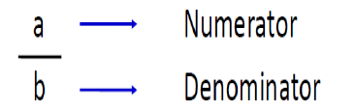
MEASURES OF DISEASE FREQUENCY
Measures of disease frequency are used to describe how common an illness (or other health event) is with reference to the size of the population (the population at risk) and a measure of time.
Measures of disease frequency in mathematical terms – count, proportion (percentage), rate and ratio
Measures of disease frequency in epidemiology - prevalence and incidence
Importance of Denominator
Numerator = upper portion of a fraction
Denominator = lower portion of a fraction
Example : 500 cases of malaria in Turkana and 120 cases of malaria in Moshi . Which one is more infected? Turkana: 500/800,000 = 0.25/1,000 (25%) and Moshi: 120/300,000 = 0.4/1,000 (40%)

Slide 47
Measures of disease frequency: Discussion
  Counts
  Rate
  Proportion
  Ratio
COUNTS
Number of cases
On its own offers little information
Counting number of events or conditions in populations or subgroups of persons
The first step in descriptive epidemiology
How many persons experienced a particular condition?
Count = ‘numerator’

Slide 48
RATE
The division of 2 numbers
Time included in the denominator
Speed of occurrence of an event over time
Rate may be expressed in any power of 10: - 100, 1000, 10000, 100 000…
Dividing the number of events by the number of persons in the population to make rates.
The second step in descriptive epidemiology.
  What group of persons experienced the event?
  Population group = denominator.
  Use events and population to make: proportions, rates, odds.
Rates help us compare health problems among different populations that include two or more groups who differ by a selected characteristic

Slide 49
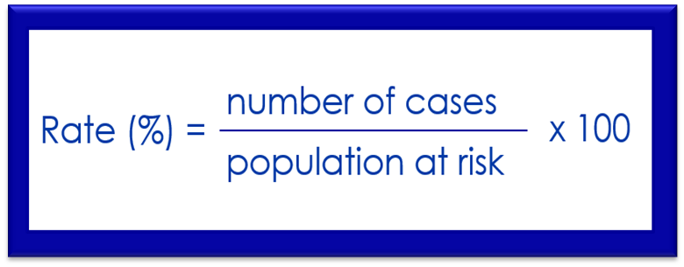
Rate Formula
To calculate a rate, we first need to determine the frequency of disease, which includes
  The number of cases of the illness or condition
  The size of the population at risk
  The period during which we are calculating the rate
Rate = Number of events in a specified period x K
Population at risk of the events in a specified period
K = any power of 10: e.g. 100, 1,000, 10,000 etc.

Slide 50
Rate is the most important epidemiological tool used for measuring diseases. Rate is a special form of proportion that includes time.
It is the measure that most clearly expresses probability or risk of disease in a defined population over a specified period of time, hence, it is considered to be a basic measure of disease occurrence. Accurate count of all events of interest that occur in a defined population during a specified period is essential for the calculation of rate.
Example of rate:
The number of newly diagnosed pneumonia cases in 1999 per 1000 under five children.

Slide 51
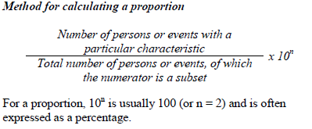

PROPORTION
The division of 2 numbers (related)
Numerator always included in the denominator
Quantities have to be of same nature
Proportion always ranges between 0 and 1
Percentage = proportion x 100
A proportion quantifies occurrences in relation to the populations in which these occurrences take place. It is a specific type of ratio in which the numerator is included in the denominator and the result is expressed as a percentage.
Example: The proportion of all births that was male

Slide 52
RATIO
The division of two numbers (unrelated)
Numerator not included in the denominator
Allows comparison of quantities of different nature
A ratio quantifies the magnitude of one occurrence or condition to another. It expresses the relationship between two numbers in the form of x: y or x/y X k
Example:
-The ratio of males to females (M:F) in Kenya.
-The ratio of male malaria patients to female malaria patients
This makes Epidemiology: Step 3 –Comparing
Comparing rates from different populations to make inferences

Slide 53
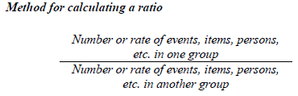
Comparison of rates to make rate ratios or rate differences.
Comparison of odds to make odds ratios.
Use ratios or differences to identify risk factors.
Use statistical tests to determine reliability of ratios or differences.
Analytic epidemiology
  Cohort (exposed vs. non-exposed)
  Case-control (sick vs. healthy)
After the numerator is divided by the denominator, the result is often expressed as the result “to one” or written as the result “:1.”

Slide 54
MEASUREMENT OF MORBIDITY (DISEASE OCCURRENCE)
Is the measurement of the amount of disease in a given population. It is measured in terms of incidence and prevalence rates.
Morbidity rates are rates used to quantify the occurrence of disease. Measures of morbidity include incidence, prevalence (period prevalence and point prevalence rates).
Morbidity has been defined as any departure, subjective or objective, from a state of physiological or psychological well-being. In practice, morbidity encompasses disease, injury, and disability.
INCIDENCE RATES
Number of new cases of a disease occurring in a specified time period divided by the number of individuals at risk of developing the disease during the same time

Slide 55


Incidence of a disease is defined as the number of new cases of a disease that occur during a specified period of time in a population at risk for developing the disease
The critical element in the definition of incidence is new cases of disease. Because incidence is a measure of new events (i.e. transition from a non-diseased to a diseased state), incidence is a measure of risk.
Incidence refers to the occurrence of new cases of disease or injury in a population over a specified period of time.

Slide 56
The appropriate denominator for incidence rate is population at risk but knowing the population at risk is difficult at this level. Hence, total population can be used as a denominator.
Another important issue in incidence is the issue of time. For incidence to be a measure of risk we must specify a period of time and we must know that all of the individuals in the group represented by the denominator have been followed up for that entire period.
The choice of time period is arbitrary: We could calculate incidence rate in one week, one month, one year, 5 years, and so on.
Incidence rates can be used to make statements about the risk of disease. If the incidence rate of a certain disease is high in one area, then the risk of acquiring that disease by other healthy individuals will be high.

Slide 57
Example. In Ginbot 1995 there were 50 new cases of relapsing fever in “Kebele X”. The average total population of “Kebele X” was 5000. Calculate the incidence rate of relapsing fever in “Kebele X” in Ginbot 1995.
Answer:
Incidence rate = 50 X 1000 = 10 new cases per 1000 population
5,000
That means out of every 1000 people living in “Kebele X”, 10 of them acquired relapsing fever in Ginbot 1995.
Uses incidence rate
Incidence rate is important as a fundamental tool for eatiologic studies of diseases since it is a direct measure of risk. If the incidence rate is significantly higher in one area, then the cause of that disease can be systematically searched.

Slide 58
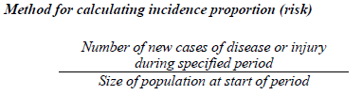
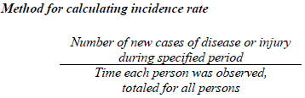
Two types of incidence are commonly used — incidence proportion and incidence rate.
Incidence proportion is the proportion of an initially disease-free population that develops disease, becomes injured, or dies during a specified (usually limited) period of time.
Incidence rate or person-time rate is a measure of incidence that incorporates time directly into the denominator. A person-time rate is generally calculated from a long-term cohort follow-up study, wherein enrollees are followed over time and the occurrence of new cases of disease is documented.

Slide 59


Another commonly used measure of morbidity is attack rate. Attack rate is a type of incidence rate which is mainly used during epidemics.
On Tir 7, 1995, 100 people were invited by Ato Alemitegnaw for dinner. All of them ate the food that was served for dinner. The next day (Tir 8, 1995) 90 of the 100 people who ate that food developed diarrhea. Calculate the attack rate of diarrhea which occurred on Tir 8, 1995.
That means out of 100 people who ate the food served by Ato Alemitegnaw, 90 of them developed diarrhea on Tir 8, 1995.

Slide 60

PREVALENCE
Total number of affected individuals in a population at a specified time period divided by the number of individuals in the population at the time
This is the proportion of a defined group having a disease at a given point in time
It is the number of affected persons present in the population at a specific time divided by the number of persons in the population at that time
Chronic diseases have high prevalence rates
Low prevalence rate of a disease indicates that the disease is fatal or gets cured easily

Slide 61

Prevalence rate measures the number of people in a population who have a disease at a given time. It includes both new and old cases.
The major type of prevalence is point prevalence rate.
Point Prevalence rate: measures the proportion of a population with a certain condition at a given point in time. Point prevalence rate can be determined by conducting cross-sectional study.
Example: One health extension worker conducted a survey in one of the nearby elementary schools on Hidar 10, 1996 to know the prevalence of trachoma in that school. The total number of students in that school was 200.

Slide 62
The health extension worker examined all the 200 students for trachoma. Hundred students were found to have trachoma. Calculate the point prevalence rate of trachoma for that school.
Point prevalence rate
= 100 X 100 = 50 trachoma patients per 100 students
200 on Hidar10,1996
That means 50 % of the students in that elementary school were affected by trachoma on Hidar 10, 1996.
Period prevalence refers to prevalence measured over an interval of time. It is the proportion of persons with a particular disease or attribute at any time during the interval.

Slide 63
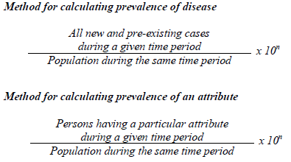
Uses of prevalence rate
Planning health facilities and human resource
Monitoring chronic disease control programs like tuberculosis control program
The value of 10n is usually 1 or 100 for common attributes. The value of 10n might be 1,000, 100,000, or even 1,000,000 for rare attributes and for most diseases.

Slide 64
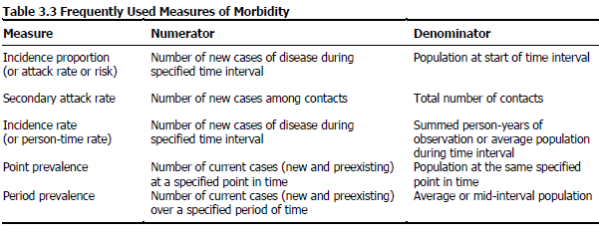
Frequently Used Measures of Morbidity

Slide 65
MEASUREMENT OF MORTALITY
This is the measure of the amount death in a community
Mortality rates and ratios measure the occurrence of deaths in a population using different ways.
Rates whose denominators are the total population are commonly calculated using either the mid - interval population or the average population. This is done because population size fluctuates over time due to births, deaths and migration.
Population count at the beginning + population Average Population: count at the end of the time interval considered
2
A mortality rate is a measure of the frequency of occurrence of death in a defined population during a specified interval.

Slide 66

The formula for the mortality of a defined population, over a specified period of time, is:
Below are given some formulas for the commonly used mortality rates and ratios.
Mortality rates include crude death rate (CDR), case specific death rate (CSDR), crude fatality rate (CFR), infant mortality rate (IMR) and maternal mortality rate (MMR)
Crude Death Rate (CDR)
CDR is the total number of deaths to residents in a specified geographic area (country, state, county, etc.) divided by the total population for the same geographic area (for a Specified time period, usually a calendar year) and multiplied by 1000

Slide 67
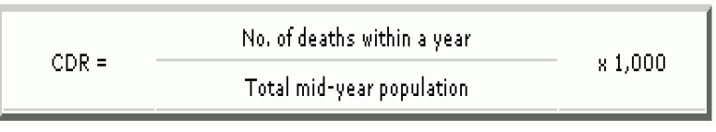

The Crude Death Rate measures the proportion of the population dying every year, or the number of deaths in the community, per 1000 population. It reflects the risk of death in that community or country.
CDR

Slide 68
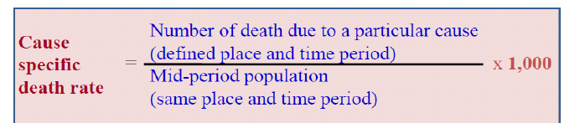
Case Specific Death rate (CSDR)
Measures the number of deaths attributed to a specific cause in a year divided by the total population that year
Crude Fatality rate (CFR)
Measures the proportion of episodes of illness that result in death
Number of people who die from a disease out of those who had the disease within a given period of time divided by the number of cases of that disease in a given period

Slide 69
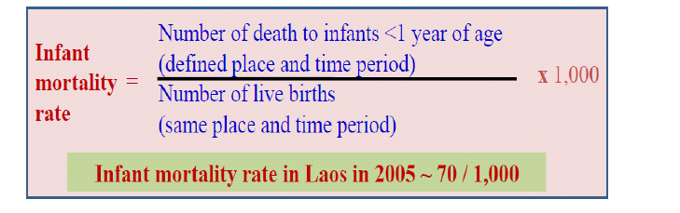
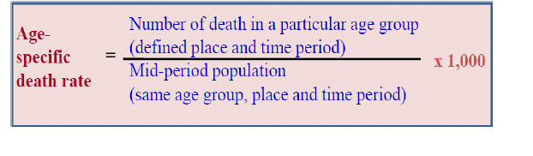

Infant Mortality rate (IMR)
Number of children who die who are less than one year old per 1000 live births
Age Specific death rate (Age- specific mortality rate)
One example of age specific mortality rate is Infant Mortality Rate.

Slide 70

Sex- specific mortality rate
Example: The average total population of “Kebele Y” in 1996 was 6000 (3500 female & 2500 male). In the same year 300 people died (100 female & 200 male). Calculate the mortality rate (Crude death rate) for females.
CDR for females = 100 X 1000 = 29 per 1000 female population
3500
That means out of 1000 female population living in “Kebele Y”, 29 females died in 1996.

Slide 71
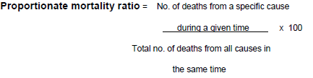

Proportionate mortality ratio
The proportionate mortality ratio asks the question: What proportion of deaths are due to a certain cause? For example when we say the proportionate mortality ratio for HIV/AIDS is 30 %, this means out of 100 total (of all) deaths 30 of them died from HIV/AIDS.
Case Fatality Rate (CFR)

Slide 72
Case fatality rate represents the probability of death among diagnosed cases or the killing power of a disease.
Example: In 1996 there were 1000 tuberculosis patients in one region. Out of the 1000 patients 100 died in the same year. Calculate the case fatality rate of tuberculosis.
CFR = 100 x 100 = 10 %
1000
That means 10% of tuberculosis patients will die once they develop the disease

Slide 73

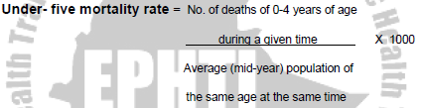
Neonatal Mortality Rate
Under- five mortality rate

Slide 74

Maternal Mortality rate (MMR)
Number of women who die as a result of child bearing in a given year per 1000 live births
No. of deaths from (pregnancy, labour, etc) x 1000
No. of live births during that year
Causes of maternal morbidity and mortality
The major direct causes of maternal morbidity and mortality include hemorrhage, infection, high blood pressure (eclampsia), unsafe abortion, prolonged and obstructed Labour.
Indirect causes including HIV/AIDS, malaria and TB, heart disease, anemia

Slide 75
Factors Contributing To Maternal Mortality
Difficulty of predicting and/or preventing obstetric complications
Lack of access to good quality maternal health services
Poor health before and during pregnancy
Women’s low social and economic status
Biological factors e.g. age, parity

Slide 76
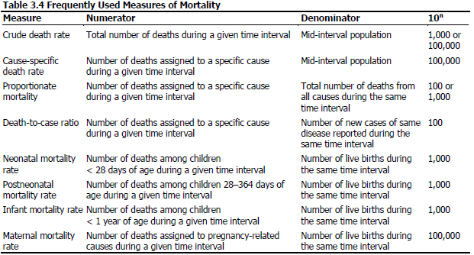
Frequently Used Measures of Mortality

Slide 77

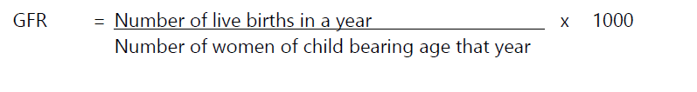
MEASUREMENT OF FERTILITY
Crude Birth rate (CBR)
Number of live births in a year divided by the total population in a year
General Fertility rate (GFR)
Measure of fertility

Slide 78
RISK OF A DISEASE
Risk is the probability that an individual with some characteristics (e.g. age, race, gender, etc. ) will experience a health status change over a specified follow-up time (risk period)
Estimated by observing events among a population during a specified time
Measures of risk in epidemiology include absolute risk, relative risk and attributable risk
Absolute Risk
This is the incidence or prevalence of a disease in a population
Indicates the magnitude of the risk in a group of people with a certain disease

Slide 79
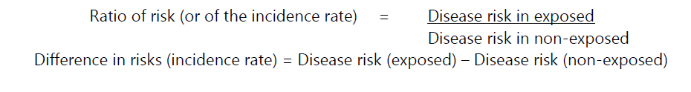
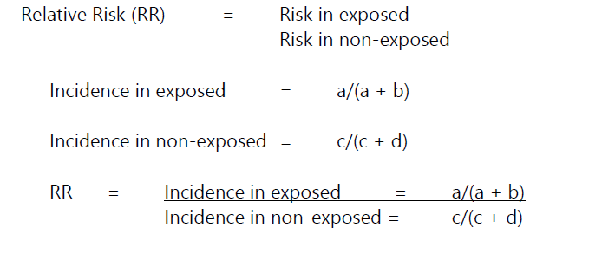
Relative Risk (RR) or Odds Risk (OR)
RR is the ratio of incidence of disease in exposed individuals to the incidence of disease in non-exposed individuals (from a cohort/prospective study)

Slide 80
Interpretation
RR = 1 - Risk in exposed equal risk in non-exposed (No association)
RR > 1 - Risk in exposed greater than risk in non-exposed (positive association, possibly causal)
RR < 1 - Risk in exposed less than risk in non-exposed (Negative association, possibly protective)

Slide 81
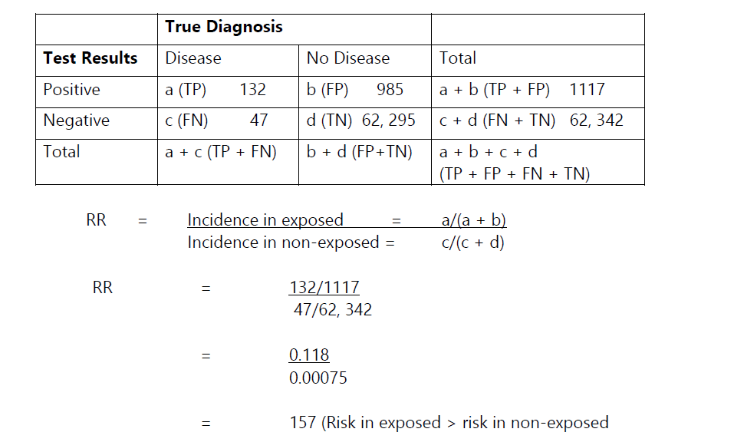
Example
OR is the ratio of the odds that cases were exposed to the odds that controls were exposed(from a case control/retrospective study), is an estimate of the RR

Slide 82
Attributable Risk (AR) / Attributable Fraction (AF)
AR is the amount of disease incidence that can be attributed to a specific exposure
AF is the proportion of disease incidence that can be attributed to a specific exposure (among those who were exposed)

Slide 83
EPIDEMIOLOGICAL CONCEPTS
It is concerned with the systematized study of:
Whole population in their living and working environment
Factors that determine a state of health and disease
Patterns of health and those of illness
Mass phenomena and effect of diseases or conditions of groups or individuals, as small as family or as large as a whole community, nation, or groups of nations
Distribution and causes of human health problems
Multiple factors of causation
Measures of causation and prevention

Slide 84
EPIDEMIOLOGICAL STUDIES
TYPES OF EPIDEMIOLOGY
Epidemiology is divided into two components: descriptive and analytic epidemiology
Descriptive epidemiology focuses on identifying and reporting both the pattern and frequency of health events in a population
Analytic epidemiology focuses on the search for the determinants of health outcomes.
The intention in carrying out epidemiological investigation of a disease may either be to describe its patterns of occurrence in a population, or to analyze the influences which determine that one person is infected while another is not.

Slide 85
Descriptive and Analytic Epidemiology
Descriptive epidemiology | Analytic epidemiology
When was the population affected? | How was the population affected?
Where was the population affected? | Why was the population affected?
Who was affected?
85
Notes:
SAY:
Time, place, and person is the mantra of the epidemiologist. Another way of comparing descriptive and analytic epidemiology is to say that, during the descriptive process, we are concerned with
when the population was affected,
where they were affected, and
who specifically was affected.
From the observations gathered during the descriptive process, a hypothesis is generated about the causes of observed patterns and the factors that increase risk for disease or injury.
To test a hypothesis, epidemiologists must use an analytic epidemiology process in which they ask how and why the population was affected.
GO to next slide.

Slide 86
Types of Epidemiological Studies
Epidemiological studies can be classified as either observational or experimental.
Observational studies: the investigator measures but does not intervene. They include studies that can be called descriptive or analytical:
A descriptive study is limited to a description of the occurrence of a disease in a population and is often the first step in an epidemiological investigation.
An analytical study goes further by analysing relationships between health status and other variables.
Experimental or intervention studies involve an active attempt to change a disease determinant – such as an exposure or a behaviour – or the progress of a disease through treatment, and are similar in design to experiments in other sciences.

Slide 87
Epidemiology Study Types
Experimental
Epidemiology study
types
Descriptive
Observational
Analytic
87
Notes:
SAY:
Now, let’s examine the different types of epidemiology studies.
In an experimental study, the investigators can control certain factors within the study from the beginning. An example of this type is a vaccine efficacy trial that might be conducted by the National Institutes of Health. In such a trial, the investigators randomly control who receives the test vaccine and who does not among a limited group of participants; they then observe the outcome to determine if it should to be used more widely.
In an observational study, the epidemiologist does not control the circumstances. These studies can be further subdivided into descriptive and analytic.
Descriptive epidemiology is the more basic of these categories and is fundamental to what epidemiologists do. In a descriptive study, the epidemiologist collects information that characterizes and summarizes the health event or problem.
In the analytic study, the epidemiologist relies on comparisons between different groups to determine the role of different causative conditions or risk factors.
GO to next slide.

Slide 88
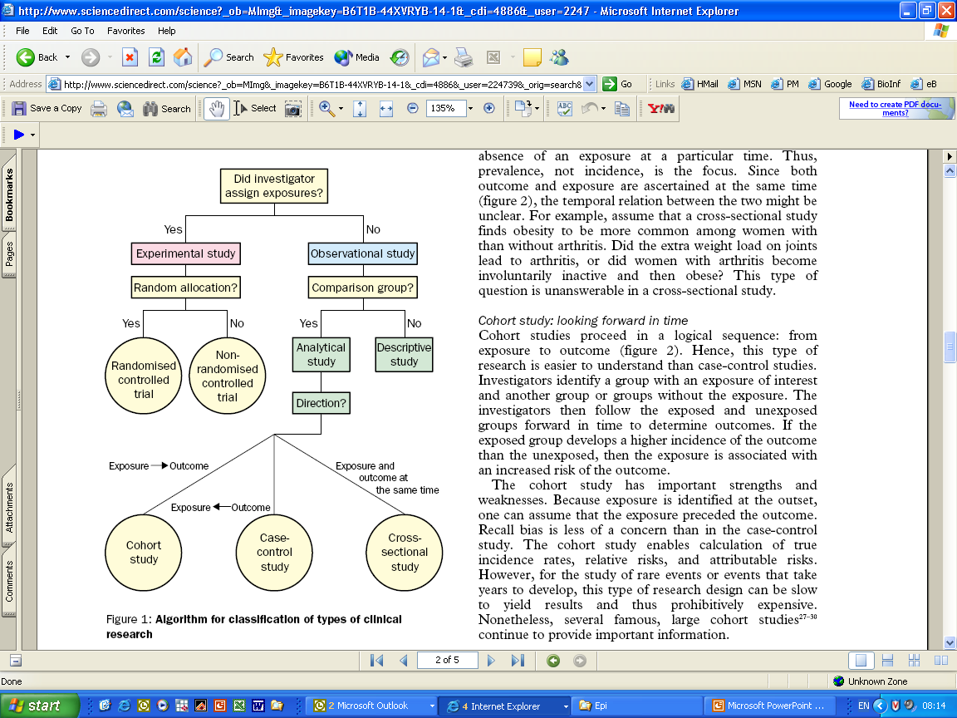
Epidemiologic Study Designs
Grimes & Schulz, 2002 (www)

Slide 89
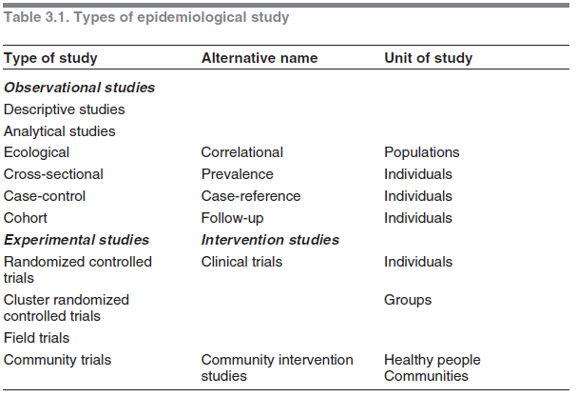

Slide 90
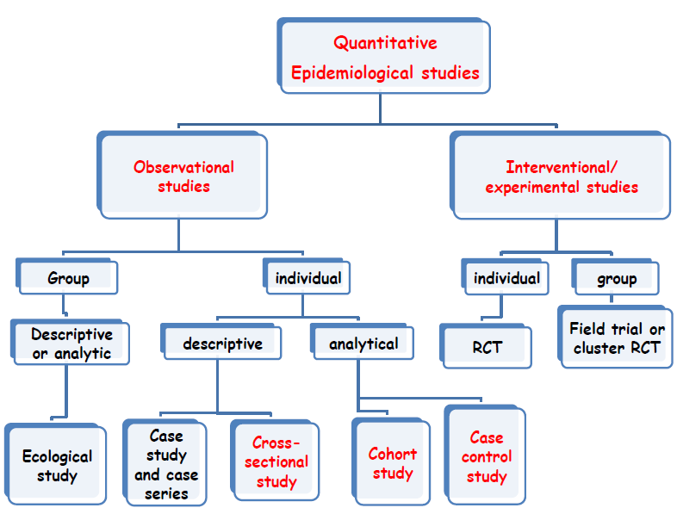

Slide 91
Classification of Study Designs
Observational studies
  Descriptive or case-series
  Retrospective (case-control)
  Cross-sectional (prevalence), surveys
  Prospective (cohort)
  Retrospective cohort
Experimental studies
  Controlled trials
    Parallel designs
    Sequential designs
    External controls
  Studies with no controls

Slide 93
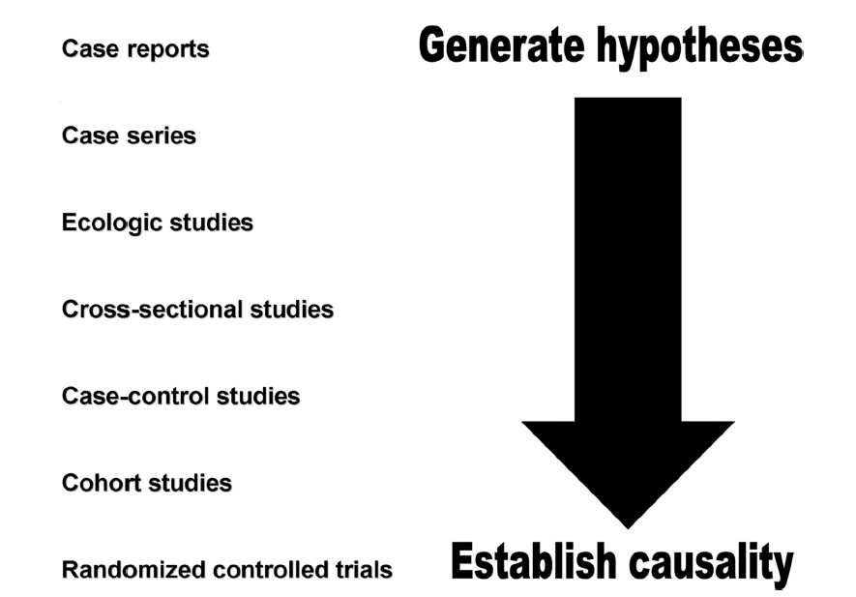
Hierarchy of Epidemiologic Study Design
Tower & Spector, 2007 (www)

Slide 94
A study design is a specific plan or protocol for conducting the study, which allows the investigator to translate the conceptual hypothesis into an operational one.
Observational/Analytical studies look towards finding out the causes of observed rates.
Called "observational" since the epidemiologist does not intervene in the assignment of exposure.
Descriptive studies describe the events and rates of disease. Tend to be the first sets of studies done.
Experimental studies are formal research experiments. The classic example is the randomized control trial where one group is randomly assigned a treatment and a control group gets the placebo or "usual" treatment.

Slide 95
Descriptive studies:
The major purpose of descriptive research is description of the state of affairs as it exists.
This is the first phase of epidemiological studies in which the distribution of diseases is described in terms of the three major variables: person, place and time
Descriptive studies yield information which is of immediate relevance to planning of medical services, disease classification and natural history of the disease.
Descriptive studies are important in hypothesis generation which can be tested by analytical studies
Descriptive study will usually comprise observations made at a point in time, so-called cross-sectional studies

Slide 96
Cross-sectional study design
Is also referred to as a prevalence studies
The feature of this study design is that it includes only a single period of observation.
This obtains measurement of disease and exposure at individual level (individual is the unit of analysis in this study design).
Cross-sectional studies are mainly descriptive in nature i.e. their primary usefulness is to provide quantitative estimates of the magnitude of the problem.
Mainly uses primary data and tends to be expensive.
Examples of studies that use this study design: surveys

Slide 97
2. Analytical Studies
Are carried out to test hypothesis about factors that determine that one person is affected by a disease while another is not.
Analytic studies aim at determining causal association between a risk factor and a disease or health status of interest and they tend to be longitudinal in nature.
They are designed to show whether a particular events (such as consumption of certain foods), or states (such as overcrowded houses), acts as ‘causes’ whose ‘effect’ is the resulting disease.
The study designs that have been used to suggest that a particular event or state is causally associated with and may be a determinant of a disorder include:

Slide 98
Case-control study design
Cohort study design
Ecological study design
Analytical studies tend to be longitudinal
Longitudinal Study Designs: These are studies in which observations are repeated in the same community over a prolonged period. Examples include:
a) Ecological Study Design
Is a study design in which the unit of analysis is a group of people.
It involves the assessment of exposure rates and disease rates in a group of people or a population; usually more than 10 groups or populations to allow for comparison.

Slide 99
The important characteristic of this study design is that the level of exposure for each individual in the population/unit being studied is unknown.
Ecological studies mainly use secondary data that have been collected by the government, some other agencies or investigators. In terms of cost and duration, they are more advantageous.
b) Cohort study Design
Is also known as prospective study
It is an analytic study design since it tends to determine the causal association of a disease and a risk factor.
Cohort studies usually have 2 groups i.e. the exposed and non-exposed. The exposed group is the study population and the non-exposed group is the control group to allow for comparison.

Slide 100
The unit of analysis/observation in this study design is the individual.
They involve the use of primary data but secondary data may also be used.
c) Case –Control Study Design
A case-control study design considers 2 groups i.e. case (people with the disease) and the controls (comparable group but are free from the disease).
This study design seeks to identify possible causes of the disease by finding out how the two groups differ.
This is because disease does not occur randomly; the case group must have been exposed to some factor either voluntary or involuntary that contributed to the causation of disease.

Slide 101
In case control study design, one starts from effect to cause i.e. start with the people with disease and determine the past exposure to a risk factor.
In the recent years, case-control study design has proven to be useful and efficient for evaluation vaccine effectiveness, treatment effectiveness, evaluation of screening programs and outbreak investigation.
Experimental studies
In this design, subjects are randomly assigned to an experimental group which receives the treatment or to a control group which receives standard of care or placebo or no treatment.
Assuming the two groups were initially equivalent, the researcher can compare their performance.

Slide 102
The study designs used in experimental studies include:
Randomized Clinical Trial
Community Trial
a) Clinical trials
Is a planned experiment designed to assess the efficacy of a treatment in man by comparing the outcomes in a group of patients treated with the test treatment and those patients in the control treatment.
Once the eligible participants have agreed to participate, they are then randomly assigned to one of the study groups (test treatment group and control treatment group).
They are then observed over the same period of time.

Slide 103
This Study Design has been used in testing drug or vaccine efficacy/effectiveness and effectiveness of a prevention program.
b) Community trials
Although clinical trials play an important part in efforts to improve health and delivery of medical care, they are limited in terms of scope of their potential impact.
They also require greatest control over the study subjects hence are not typically employed to evaluate the potential efficacy of large scale public health interventions. Community trials are therefore used in such cases.
The word community is used but is not literary referring to community but also mean a single unit e.g. a school, a country, a state or even a district.

Slide 104
Like clinical trials, community trials start by determining eligible communities and their willingness to participate.
To evaluate the impact of the intervention or treatment, it is desirable to have a baseline measure of the problem to be addressed in the intervention community and control community.
The communities are then randomized to receive or not receive the intervention. The two groups i.e. control and treatment communities are followed for a period of time and the outcome of interest measured.

Slide 105
CASE SERIES
It is a sequence of case reports with common elements e.g. similar clinical features and suspected common exposures
Can form useful early evidence for associations between exposures and diseases
May also refer to qualitative study of the experience of a single patient, small group of patients with a similar diagnosis, or to a statistical technique comparing periods during which pts are exposed to some factor with the potential to produce illness with periods when they are unexposed.
It does not have control subjects

Slide 106
CASE CONTROL STUDIES
Advantages:
Quick and cheap
Only feasible method for very rare disorders or those with long lag between exposure and outcome
Fewer subjects needed than cross-sectional studies.
Disadvantages
Reliance on recall or records to determine exposure status
Confounders (a variable that can cause or prevent outcome of interest and is associated with the factor under investigation)
Selection of control groups is difficult
Potential bias (deviation of results from the truth) eg recall bias (Cases are more likely to remember exposure than controls), selection bias.

Slide 107
COHORT STUDIES
Advantages of cohort studies
Ethically safe
Subjects can be matched
Can establish timing and directionality of events
Eligibility criteria and outcome assessments can be standardised
Administratively easier and cheaper than randomized controlled trial.
Disadvantages of cohort studies
Controls may be difficult to identify
Exposure may be linked to a hidden confounder
Blinding is difficult
Randomisation not present
For rare disease, large sample sizes or long follow-up necessary.

Slide 108
CROSS-SECTIONAL STUDIES
Advantages:
Cheap and simple;
Ethically safe.
Disadvantages:
Establishes association at most, not causality;
Recall bias susceptibility;
Confounders may be unequally distributed
Types of Clinical trials
Trials may be open, blind or double-blind.
Blind trials: (i) Single-blind trial; (ii) Double-blind trial; (iii) Triple-blind trial

Slide 109
COMMUNICABLE DISEASES

Slide 110
Introduction:
A communicable disease is one due to a specific agent or its product which arises through the transmission of that agent or its product from a reservoir to a susceptible host, either through the agent of an intermediate host, vector or inanimate environment.
A disease that is passed from one person to another person is called a communicable or transmissible disease. Transmissible diseases include: measles, HIV infection, tuberculosis, chickenpox, gonorrhea, scabies, malaria, cholera, and roundworms among others.
They are among the major cause of illnesses in Kenya and the entire Africa.
These diseases affect people of all ages but more so children due to an increased intensity of exposure and a poorly developed immunity.
Notes:
Inanimate: showing no sign of life; lifeless. dead or inert: not in a physically live state

Slide 111
Characteristics of communicable diseases
They are common
Some of them cause death (untreated complicated malaria) and disability (poliomyelitis)
Some of them cause epidemics ( sudden outbreak of Cholera)
Most of them are preventable when using fairly simple interventions. (Hand washing protects on from diahorreal disease)
Many of them affect infants and children(helminthic and airborne diseases)
N/B: the above explains why communicable diseases are among the most important diseases in this country.

Slide 112
Classification of communicable diseases
There are various ways of classifying communicable diseases:
Contact (contagious) diseases - parasitic and fungal skin infections, trachoma and acute bacterial conjunctivitis.
Sexually transmitted diseases and HIV/AIDS
Vector borne diseases - malaria, relapsing fever, Bancroftian filariasis, onchocerciasis, yellow fever, trypanosmiasis, plague, schistosomiasis, and drancunculosis
Diseases caused by Fecal-oral contamination - acute gastroenteritis, Trachoma, polio, bacillary dysentery, campylobacter jejuni, giardiasis, amoebiasis, cholera. Enteric fevers, food poisoning and viral hepatitis, Acute Bacterial Conjunctivitis

Slide 113
Helminithic diseases - ascariasis, enterobiasis, truchuriasis, strongyloidiasas, taeniasis, hydatidosis
Air borne diseases such as acute respiratory infections, meningitis tuberculosis and leprosy.
Zoonotic diseases (diseases of contact with animals or animal products. Anthrax brucellosis, hydatidosis, tetanus.

Slide 114
PATTERNS OF COMMUNICABLE DISEASES IN THE COMMUNITY
Different diseases are common in different places and at different times.
To understand why this happens, you need to consider (a) the disease causative organisms (the agents); (b) the people they infect (the hosts); and (c) the surroundings in which they live (the environment) that make it favourable or unfavourable for the transmission of the agent.
A delicate balance exists between the agent, the host and the environment and it can change in different ways.
For instance, the agent needs a suitable environment in which to grow and multiply and thus be able to spread and infect other hosts. If the environment does not support the agent it dies or transforms to a dormant state.
The host (person) is also affected by the environment. For example, a person may live in a hot, wet climate where there are many mosquitoes.

Slide 115
However they can change this environment by draining swamps, clearing the vegetation and adding competing hosts such as animals.
If the balance is shifted against the agent, the disease will be controlled and the number of cases will go down.
When the balance between the agent, the host and the environment is fairly constant, you tend to see approximately the same number of cases of the disease every month. When this happens the disease is said to be endemic.
When the balance is shifted in favour of the agent (organism), for example, when many nonimmune children have been born in an area since the last measles epidemic, a large number of cases of measles may occur in a short time. This is called an epidemic. Epidemic diseases occur during certain periods or seasons and cause sudden deaths and much suffering in the community.

Slide 116
An endemic disease can be termed as that which occurs in a given population at a constant rate over a period of several years.
An epidemic disease is that which occurs in a population at a higher rate than is usually the normal for that population over a given time interval.
Some Common Epidemic Diseases in Kenya
Cholera
Typhoid fever
Highland malaria
Acute bacterial meningitis
In Kenya, malaria is endemic in the lowlands, such as the Tana River basin, the coastal strip, and the Lake Victoria region.

Slide 117
Schistosomiasis which is related to water use is endemic around the Lake Victoria region and the Mwea irrigation scheme.
Leishmaniasis is endemic in Baringo, along Tana River, and along the River Athi in Machakos.
In some parts of the country, some disease outbreaks occur only occasionally without a regular pattern. Such diseases are said to be sporadic in their occurrence.
NB: Agent: Is an organism mainly a micro-organism but including helminths that is capable of producing the disease.
Reservoir or definitive host: Is any human, animal, arthropod, plant, or soil in which an agent normally lives and multiplies and on which it depends primarily for survival reproducing in such a manner that it can be transmitted to a susceptible host.

Slide 118
HOST AND INFECTION
A person who is invaded by a disease micro-organism is called a host.
An infection occurs when this micro-organism begins to reproduce (multiply) and grow.
When an organism infects a person, there are three possible stages to consider:
Incubation Period
The incubation period is the time between infection and the appearance of symptoms and signs of an illness.
During the incubation period the host does not realize that they have an infection until several days later when detectable symptoms and signs of the illness occur.

Slide 119
Sub-clinical Infection
At this stage, infection does not produce clear signs and symptoms. The host's immune system is trying to fight off the agent. In some cases, the organism is overcome by the host immune cells hence no signs and symptoms are felt and the infection process is terminated.
Clinical Infection
This is the period when the host develops detectable symptoms and signs of an illness. At this time the agent has multiplied within the host overcoming the host's immune system and has started causing abnormal functioning of some body cells and tissues. This produces overt signs and symptoms of the disease

Slide 120
It is important for you to understand these stages because:
People with symptoms are easier to identify as they come to your health facilities for treatment.
People with subclinical infections do not always know they are infected and hence are a danger to other people. They are also difficult to detect in the general population without special tests.
An individual who is suffering from a subclinical infection is also likely to infect others, as in the case of HIV infection. They are therefore known as carriers.
An individual who develops a clinical or subclinical infection is said to be susceptible to the disease. A susceptible individual is one whose body lacks resistance to the disease. Resistance of the body to a disease occurs due to various immunity mechanisms

Slide 121
DISEASE CAUSATION CYCLE
It is also referred to as an epidemiologic cycle, epidemiologic triangle.
It is an illustration of the interaction between disease determinant factors.
The determinant factors are; the host, agent and environment.
These factors have to be conducive for the disease to occur.
All communicable diseases require that the 3 factors are present for individuals to be affected.

Slide 122
THE DISEASE CAUSATIVE CYCLE
Agent
(The organism causing the disease)
Enviroment
(Surrounding in which the host and agent live)
Host
(Human susceptible to infection)
VECTOR: the vehicle that some agents require so as to be moved from one point to another.
Vector

Slide 123
Types of hosts:
Definitive / primary - host in which the agent reaches maturity and if applicable reproduces sexually
Intermediate /secondary - host that harbors agent for a short transition period during which some developmental stage is complete. For trypanosomes, the cause of sleeping sickness, humans are the intermediate host, while the tsetse fly is the definitive host
Paratenic / reservoir - similar to intermediate but there is no developmental cycle of the agent.
Dead end host / incidental - an intermediate host that does not allow transmission to definitive host. humans are dead-end hosts for Echinococcus canine tapeworms. As infected humans are not usually eaten by dogs

Slide 124
THE DISEASE TRANSMISSION CYCLE
It’s a series of steps that a disease-causing organism undergoes in its disease-causing process.
It describes how an organism grows, multiplies and spreads.
It has 3 components; the source, transmission route and susceptible host.
The source (spreads from)
It is the origin of the diseases causing organism. This could be the infected person, animal, place or object.
Transmission routes include; (way in which an organism leaves the source and passes to a new susceptible host)
Direct contact
Vectors such as mosquitoes
Fecal-oral

Slide 125
Transmission routes-
Airborne
Trans-placental
Blood contact (transfusion, surgery, injection)
Contact with animals or their products
A susceptible host
This is an individual who has low resistance to a particular disease. This may be due to various factors such as:
Lack of previous contact with the disease hence no immune cells
Immunosuppression
Malnutrition
Drugs that a person may be consuming.

Slide 126
PRINCIPLES OF COMMUNICABLE DISEASE CONTROL
Principles in Management, prevention and control (CONTROL AND PREVENTION PRINCIPLES / MEASURES)
Each and every communicable disease has its own unique source, route of transmission and susceptible host.
Prevention and control principles are geared towards;
Attacking the source of the disease causing organism(clearing & spraying mosquito breeding sites).
Interrupting the transmission cycle (spraying and killing the mosquitoes).
Protecting the susceptible host (LLTN, prophylactic treatment)

Slide 127
Attacking the Source:
There are various specific measures which can be used to control the spread of an infectious disease.
They include:
Treating the infected person/s
Treating the carrier
Mass treatment of persons at risk (chemoprophylaxis)
Isolating the infected person/s
Treating the sick animal such as cows
Immunizing animals such as dogs and cattle
Killing the animal reservoir such as rats
Separating humans and animals
Notification to local health authorities

Slide 128
Interrupting the Transmission Cycle
A number of methods are used to interrupt the transmission cycle.
They include the following:
Personal hygiene -Immunization -behaviour change
Environmental health – (environmental sanitation, etc.)
Water and sanitation
Vector control
Good and adequate housing
Effective food handling and adequate nutrition
Sterilization of medical equipment an use of sterile surgical equipment (Disinfection and sterilization)
Remember: A clean environment and good personal hygiene are the most important measures in the primary prevention of diseases.

Slide 129
Protecting the Host
All susceptible hosts must be protected from contracting the infection.
Remember: The most effective way of controlling communicable diseases is to use a combination of methods: attacking the source of the infecting organism, interrupting the route of transmission, and protecting the susceptible host.
There are various specific and general measures for protecting the host.
Specific Measures
Immunisation using vaccines such as the KEPI vaccine
Chemoprophylaxis using for example: - Proguanil (PaludrineR) to suppress malaria parasites - Tetracycline during cholera outbreaks - Cotrimoxazole during plague outbreaks
Personal protection
Better nutrition

Slide 130
General Measures
Use of barriers such as bed nets, gowns, gloves to prevent insect bites (especially mosquitoes)
Use of chemicals for example insect repellents to prevent mosquito bites
Wearing shoes to prevent penetration by hookworms from the soil
Adequate housing to reduce overcrowding
Improved nutrition
Adequate ventilation
Health education

Slide 131
Other Control Measures
There are other useful measures that can be taken to control the spread of communicable disease. Among these is the notification of disease.
Notification requires you to keep watch (surveillance) on the number of new cases of communicable diseases in your area of work and to immediately inform the local health authority when you come across a patient suffering from an infectious disease.
One of the main reasons for notification is to help the health authorities take measures to confirm your suspicion and to control the spread of the disease.
Notification of infectious communicable diseases is the responsibility of all health care workers. It is also a legal requirement according to the Public Health Act, Chapter (cap) 242, section eight of the laws of Kenya.

Slide 132
Remember: It is your responsibility to notify your local health authority immediately should you suspect the presence of an infectious disease
Notifiable Diseases in Kenya
Plague
Cholera
Measles
Poliomyelitis
Diphtheria
Tuberculosis
Anthrax
Trypanasomiasis
Typhoid fever
Whooping cough

Slide 133
Meningococcal meningitis
Rabies
Yellow fever
NB: The diseases in bold spread so quickly that they need international control measures. These diseases are reported by the Ministry of Health to the World Health Organisation (WHO).

Slide 134
Application of communicable disease control measures
The actual application of the control methods can be undertaken by different groups of people and institutions at various levels.
These include individuals and village level, dispensary and health centre level, the sub county and county level and central government (Ministry of Health) level.
Remember: A successful communicable disease control program is the one that involves members of the community.

Slide 135
Control measures at individual and village level
At this level, each person and indeed every member of the village is responsible for:
Completing the immunisation
Personal and environmental hygiene
Food hygiene and adequate nutrition
Using bed nets and protective wear
Abstaining from casual sex, being faithful to one sexual partner or using condoms
Protecting water supply and using clean water
Digging and using pit latrines
Controlling vectors
Healthy habits, for example not smoking, consuming alcohol and abuse of drugs

Slide 136
Controlling measures at dispensary and health centre level
The health care workers should support and encourage their clients and community to establish and sustain community based disease control programs. In addition, the health care workers should:
Increase immunisation coverage
Participate in vector and reservoir control
Emphasise water protection and purification
Inspect food, markets and eating places
Encourage sanitation and refuse disposal
Promote health and prevent diseases using Information, Education and Communication (IEC)
Notify diseases

Slide 137
Control measures at sub county, county, and national level
At these higher levels, health care workers are responsible for:
Vector control schemes
Mass immunisation campaigns
Mass treatment and chemoprophylaxis
Mass media IEC programmes
Health statistics registration
Research on disease control methods
Emergency, epidemiology and control teams
Manpower training and continuing education for staff

Slide 138
Standard case definition
A case definition is a set of uniform criteria/measure used to define a disease for public health surveillance.
Case definition enable public health officials to classify and count cases consistently (time & again) across reporting jurisdictions (control).
Case definition lists the clinical criteria by which public health professionals determine whether a person's illness is included as a case in an outbreak investigation.
That is, whether a person is considered directly affected by an outbreak.
Case definitions are used in the surveillance of public health (i.e. health of the population) in order to categorize those conditions present in a population (e.g., incidence and prevalence).

Slide 139
HOW CASE DEFINITION ARE USED
A case definition defines a case by placing limits on time, person and place. HOW?
Time criteria may include all cases of a disease identified from a certain period of time, for example, January 1, 2008 to March 1, 2008.
Person criteria may include age, gender, ethnicity, and clinical characteristics such as symptoms (e.g. cough and fever) and the results of clinical tests (e.g. pneumonia on chest X-ray).
Place criteria will usually specify a geographical entity/unit such as a town, state, or country, but may be as small as an institution, a school class, or a restaurant.

Slide 140
Case definitions are often used to label individuals as suspect, probable, or confirmed cases according to clinical, epidemiological and laboratory test
For example, in the investigation of an outbreak of pneumococcal pneumonia in a nursing home the case definition may be specified as:
Suspect Case: These are cases in which recovery is adequate/achieved but illness cannot be fully explained by an alternative diagnosis.
Probable Case: A clinically compatible case without laboratory confirmation, but is epidemiologically linked to a confirmed case i.e. through surveillance
Confirmed Case: Is a clinically compatible case with laboratory confirmation.

Slide 141
By creating a case definition, public health professionals are better equipped to study an outbreak and determine possible causes.
As investigations proceed, a case definition may be expanded or narrowed when taking action.

Slide 142
Definition of Terms Used in Case Classification
Clinically compatible case: a clinical syndrome /condition generally as described in the clinical description.
Confirmed case: a case that is classified as confirmed for reporting purposes.
Epidemiologically linked case: a). a case in which the patient has had contact with one or more persons who either have/had the disease or have been exposed to a point source of infection (i.e., a single source of infection, such as an event leading to a food borne-disease outbreak, to which all confirmed case-patients were ex-posed)
Probable Case: A clinically compatible case without laboratory confirmation, but is epidemiologically linked to a confirmed case.

Slide 143
Laboratory-confirmed case: a case that is confirmed by one or more of the laboratory methods listed in the case definition under Laboratory Criteria for Diagnosis. Although other laboratory methods can be used in clinical diagnosis, only those listed are accepted as laboratory confirmation for national reporting purposes.
Supportive or presumptive laboratory results: specified laboratory results that are consistent with the diagnosis
Suspect Case: These are cases in which recovery is adequate but illness cannot be fully explained by an alternative diagnosis

Slide 144
NATURAL HISTORY OF DISEASE
It refers to the process of disease/condition progression from the time it affects an individual to the time the individual recovers or dies if appropriate measures are not instituted.
The process has 2 distinctive periods;
Pre-pathogenesis
Pathogenesis
Pre-Pathogenesis period
This is the period before the disease infects an individual.
The agent & host are interacting in the environment
At this level the host’s immunity handles the agent hence no disease.

Slide 145
Pathogenesis period
This period starts when the host’s immunity has been overcome by the agent, resulting in the host cells dying.
This period has 4 stages;
Subclinical
Clinical horizon
Early disease stage
Advanced disease.
Subclinical horizon - host cells start dying but no major effects are felt and no signs or symptoms of the disease. Only laboratory test reveal extent of damage

Slide 146
Clinical horizon- Damage of host cells is so much that host’s body functions start failing. There are signs and symptoms of the disease and the host feels sick. If not treated the host can advance to the next stage
Early disease stage- the disease effects are as a result of massive cell damages that are affect tissue functions. If the host does not receive intervention to correct tissue damage the disease advances to the next level.
Advanced disease stage - at this level damage to the host system is massive and may be irreversible, leading to disability or permanent change.
The host may have one of three outcomes at this stage:
Recovery
Permanent disability
Convalescence or in worst cases death

Slide 147
DISEASE PREVENTION:
This is the deliberate action to halt disease progression from one stage to the next.
The three levels of disease prevention are:
Levels: Primary prevention, Secondary and tertiary prevention
1. Primary prevention.
It is the most common prevention method. It targets the pre-pathogenesis period. Interventions include:
General measures- health education, safety measures and healthy behavior.
Specific measures- vaccination and prophylaxis medication

Slide 148
2. Secondary prevention.
It targets the 2-4 stages of the disease process. The purpose is to prevent further damage to host cell and tissues and thus avoid disease complication
Measures include early diagnosis, screening and prompt treatment.
3. Tertiary prevention.
It targets the advanced stage to minimize the complication or reverse the effects.
Measures are rehabilitative and include: physiotherapy, occupational therapy, psychotherapy and rehabilitative surgery.

Slide 149
A fourth level, called primordial prevention, was later added.
Primordial prevention consists of actions and measures that inhibit the emergence of risk factors in the form of environmental, economic, social, and behavioral conditions and cultural patterns of living etc.
Key terminologies
Outbreak
Epidemic
Pandemic
Endemic
Hyperendemic - persistently high level of occurrence
Holoendemic - is when the occurrence of a disease is common in a population, occurring early in life and decreasing as age increases, indicating development of immunity among younger victims and less disease among the adult population. e.g. Malaria, epilepsy etc.
Disease notification
Disease surveillance
Emergency preparedness and response

Slide 150
Levels of prevention
Primordial prevention
Primary prevention
Secondary prevention
Tertiary prevention

Slide 151
OUTBREAK MANAGEMENT
An outbreak is the occurrence of a number of cases of a disease, known or suspected that is larger that expected for a given time in a given place.
Factors that determine decision making during outbreaks
Severity of the disease
Risk of spread
Number of cases expected to occur
Risk of social and economic disruption
MANAGEMENT
Set up an investigative team to include:
Clinician; laboratory technician;
Public health expert
Nurses

Slide 152
Verify the presence of the outbreak by
Get information from the local people and medical staff.
Check medical and laboratory records
Confirm the nature of the illness by assessing the affected
Manage all cases without referring
Determine the extent of the outbreak- Time, place person description (TPP)
Determine the source and mode of transmission-examine contacts and sources.
Determine the areas and persons at risk.
Control the epidemic
Communicate with the community and relevant authorities
Prevent future outbreaks by health education
Observe for surveillance.

Slide 153
DISEASE SURVEILLANCE
The process of continuous data collection, analysis, presentation, interpretation, and dissemination of information about a particular disease and the use of such results to make decisions and taking action to Monitoring the level of disease in a population to detect rise early.
It measures success of preventive strategies in a community
Active – planned, frequent and in-depth searches for selected cases.
Passive- regular collection of statistics at all levels of the health services

Slide 154
Notification and reporting of emerging and re-emerging infections and infestations
Notification of Diseases
Is the act of reporting the occurrence of a communicable disease or of an individual affected with such a disease that is required by law to be reported to government authorities.
All medical practitioners, including clinical directors of diagnostic laboratories, are required to notify the Medical Officer of Health(MOH)/Director of Public Health (DPH) of certain diseases.
This information is used to investigate cases thus preventing spread of infection and further cases.
The information will also facilitate the early identification of outbreaks.

Slide 155
It is also used to monitor the burden of diseases which can provide the evidence for public health interventions such as immunisation.
Many government have enacted regulations for reporting of both human and animal (generally livestock) diseases.
This usually happens during pandemic
Emerging infectious disease
Newly identified & previously unknown infectious agents that cause public health problems either locally or internationally

Slide 156
The WHO list of some emerging diseases that can cause severe outbreaks
Ebola virus disease
Marburg disease
Chikungunya
Lassa fever
Hemorrhagic fevers
Severe Acute Respiratory Syndrome (SARS)-
Avian influenza
Rift Valley fever among others
Re-emerging infectious disease
Infectious agents that have been known for some time, had fallen to such low levels that they were no longer considered public health problems & are now showing upward trends in incidence or prevalence worldwide. Eg Malaria and Tuberculosis

Slide 157
OTHER RE-EMERGING DISEASES INCLUDE.
Cholera
Influenza
Schistosomiasis
TB
Malaria
Typhoid fever among others
REPORTING OF EMERGING & RE-EMERGING DISEASES
Through Surveillance
Disease Surveillance is the ongoing systematic collection, analysis, and interpretation of health data.
This includes the timely dissemination of the resulting information to those who need them for action.

Slide 158
The main role of disease surveillance is to predict, observe and minimize the harm caused by outbreak, epidemic, and pandemic situations, as well as increase knowledge about which factors contribute to such circumstances
Disease surveillance is the foundation for prevention and control
The changes that have occurred in the health sector in the last twenty years have included the emergence of new diseases that have resulted in the need to review mechanisms for surveillance and response to these diseases.

Slide 159
Integrated Disease Surveillance and Response (IDSR)
The World Health Organization Regional Office for Africa proposed an Integrated Disease Surveillance and Response (IDSR) approach for public health surveillance and response in the African Region in order to improve health facilities at subcounty and national levels
IDSR involves carrying out disease surveillance activities using an integrated approach.
An integrated approach means that data on all important diseases will be collected, analysed, interpreted and reported in the same way, by the same people who normally submit routine report forms on health-related data.
The goal of IDSR is to improve the ability of all levels of health care system to detect and respond to diseases and conditions that cause high morbidity and mortality

Slide 160
IDSR Core Functions
Case detection
Case registration and reporting
Lab Confirmation
Data analysis and interpretation
Response
Provide feedback
Evaluate and monitor

Slide 161
IDSR Priority Diseases for reporting In Kenya
Epidemic Prone Diseases
Cholera
Typhoid Fever
Dysentery
Meningococcal Meningitis
Plague
Measles
Yellow Fever
Anthrax
Other VHFs among others
Diseases earmarked for Eradication/elimination
Leprosy
Poliomyelitis
Neonatal Tetanus

Slide 162
Diseases of Public Health Importance
Malaria
Childhood Pneumonia
HIV/ AIDS
Childhood Diarrhoea
Tuberculosis
STIs
Other infection
Immediate preliminary notification to a medical officer of health
Acute poliomyelitis
Anthrax
Cholera
Diphtheria
Neisseria meningitidis
Paratyphoid
Plague
Rabies

Slide 163
Severe Acute Respiratory Syndrome (SARS)
Smallpox
Typhoid
Viral haemorrhagic fevers
Yellow fever
Who to notify
Clinicians should notify cases of notifiable diseases to the Director of Public Health/Medical Officer of Health for the area of residence of the patient using the notification of infectious disease form.
How to notify
Notifications may be made in writing, by email or by telephone to the MOH/DPH.

Slide 164
Laboratory notifications are made electronically through the Computerised Infectious Disease Reporting System (CIDR).
Clinical notifications are entered into CIDR in the Departments of Public Health.
When to notify
Notification should be made by a medical practitioner as soon as he becomes aware or suspects that a person on whom he is in professional attendance is suffering from or is the carrier of an infectious disease.
Notification should be made by a clinical director of a diagnostic laboratory as soon as an infectious disease is identified in that laboratory
Timely notification is important to facilitate timely public health action

Slide 165
Use of the data/ information
The information collected on notifiable diseases from doctors and laboratories is used to detect and investigate outbreaks, and prevent spread of infection, hence reducing further cases of disease.
It is also used to examine disease epidemiology, implement and monitor interventions such as immunisation to protect public health
Reporting methods
1. (List A)
24 hour reporting - are diseases for immediate notification & reporting

Slide 166
Each national health administration should inform WHO within the first 24 hours of being informed of the first suspected case on its territory of a disease subject to the Regulations.
This includes both indigenous and imported cases. All subsequent cases and deaths should be reported to WHO
Three diseases that are currently subject to the International Health Regulations are yellow fever, plague, and cholera, hemorrhagic fevers, and neonatal tetanus.
For these diseases the report from the health professional to the next higher administrative level is done by a rapid method such as phone, e-mail, fax or telex.

Slide 167
2. List B
Includes diseases for weekly notification & reporting
They are as follows:
Malaria, Acute watery diarrhoea,
Acute bloody diarrhoea,
Acute flaccid paralysis,
Neonatal tetanus,
Measles, Diphtheria,
Whooping cough (pertussis)
Pulmonary tuberculosis,
Meningitis,
Acute respiratory tract infection (ARI),
Schistosomiasis,
Haemorrhagic fever,
Typhoid,
Food poisoning,
Jaundice (infectious hepatitis),
Rabies, Scabies, Chickenpox,

Slide 168
How Disease reporting is carried out in Kenya
Kenya adopted the IDSR strategy in 1998 following the world health organization resolution in Harare and implementation began in 2002.
In Kenya, IDSR seek to capture health information of priority communicable diseases for prevention and control by linking communities, health facilities, counties and national levels .
Each health facility detects, confirms, and records these diseases on specific predesigned forms using standard case definitions.
These reports are then sent to sub-county disease surveillance coordinator (SDSC) each Monday who aggregates all reports and sends to the national level by Wednesday

Slide 169
These weekly reports are submitted to the sub-county through various modes which includes:
Short messaging services (sms), email, fax or hand delivery of hand copy report
Each facility must retain a copy of the reporting form and submit the original copy to the sub-county within the following week
From the sub-county, the aggregated sub-county weekly report is send to the national level via a web based platform.
The SDSC provides feedback on the weekly reporting to health facilities and arrange support supervision in liaison with sub-county health management team (SHMT) at least once in three months (quarterly)

Slide 170
Factors contributing to poor reporting
Stock outs of the forms results in poor reporting and is considered a significant factor to poor surveillance reporting
A facility without a designated surveillance focal person is factor associated to inadequate reporting
Understaffing may also lead to poor reporting
Reporting late or not reporting at all, may partly be due to lack of awareness of their roles in the prevention and control of disease outbreaks through disease surveillance and notification activities
Ignorance of both on the reporting guidelines and list of notifiable diseases
Lack of feedback information regarding notification.

Slide 171
Essential human, technical, and financial resources
NB: under reporting of disease increases the risk of disease outbreaks and prevents timely public health intervention, resulting in increased morbidity, disability and mortality
CAUSES OF UNDER REPORTING TO WHO
Because of the fear of:
economic and political consequences, such as the
loss of tourism and trade, and
the imposition of travel restrictions.
This causes underreporting and reporting delays. Therefore reported data for the diseases covered need to be interpreted with caution.

Slide 172
Surveillance Methods
1. Passive surveillance
This system has proven to be useful in identifying outbreaks and trends over time.
Health care providers report notifiable diseases on a case-by-case basis.
Often gathers disease data from all potential reporting health care workers.
Passive surveillance is advantageous because it occurs continuously, and requires few resources.
However, it is impossible to ensure compliance by health care providers;
Moreover, cases occurring in people without access to care will frequently go unreported.
Consequently, passive systems tend to under-report disease frequency

Slide 173
2. Active surveillance
An active surveillance system provides motivation to health care workers in the form of individual feedback or other incentives.
Often reporting frequency by individual health workers is monitored;
Health workers who consistently fail to report or complete the forms incorrectly are provided specific feedback to improve their performance.
There may also be incentives provided for complete reporting.
Active surveillance requires substantially more time and resources and is therefore less commonly used in emergencies.
But it is often more complete than passive surveillance.

Slide 174
It is often used if an outbreak has begun or is suspected to keep close track of the number of cases.
Community health workers may be asked to do active case finding in the community in order to detect those patients who may not come to health facilities for treatment
3. Sentinel surveillance
Sentinel surveillance also requires more time and resources, but can often produce more detailed data on cases of illness because the health care workers have agreed to participate and may receive incentives.
It may be the best type of surveillance if more intensive investigation of each case is necessary to collect the necessary data.
For example, sentinel influenza surveillance in the United States collects nasopharyngeal swabs from each patient at selected sites to identify the type of influenza virus. Collection of such data from all health workers would not be possible.

Slide 175
Source of communicable disease surveillance data
Data is obtained from the health facility level from:
The Outpatient register book,
Laboratory register book,
Admission forms,
Death Certificate register and
Case investigation sheets for diseases
Functions of surveillance system
Guide immediate action for cases of public health importance;
Measures the burden of a disease including changes in related factors, the identification of populations at high risk, and the identification of new or emerging health concerns;

Slide 176
Monitor trends in the burden of a disease, including the detection of epidemics
(outbreaks) and pandemics
Guide the planning, implementation, evaluation of programmes to prevent and control disease, injury, or adverse exposure;
Evaluate public policy; (course of action)
Detect changes in health practices and the effects of these changes;
Prioritize the allocation of health resources;
Describe the clinical course of disease; and
Provide a basis for epidemiologic research.

Slide 177
Challenges facing IDSR in Kenya
Communication from health facilities
Inadequate analysis at the peripheral level
Weak laboratory capacity and network
Inadequate involvement of clinicians in
Surveillance
Limited resources to carry out support
Supervision
Feedback to lower levels is poor, usually Internet based

Slide 178
SPECIFIC COMMUNICABLE DISEASES
Areas of discussion:
Introduction
Epidemiology
Clinical picture
Diagnosis
Management / Treatment
Prevention & control

Slide 179
CONTACT DISEASES
Also known as contagious diseases.
This is a group of communicable diseases that are transmitted through direct or indirect contact between susceptible and infected persons.
Transmitted by direct or indirect contact
Direct contact is by skin –to- skin contact for example, by touching an infected person
Indirect contact is by handling contaminated objects such as clothing, bedding, utensils etc.
Contact diseases tend to occur within households, children's playgroups, schools and workplace

Slide 180
Transmission of contagious diseases are facilitated by high population density (urban areas), overcrowding (poor housing), poor personal hygiene (e.g. during sexual intercourse).
Transmission of Contact Diseases
Contact diseases tend to occur in clusters within households, children’s play groups, schools and workplaces.
They are passed from one person to another either directly by skin-to-skin contact or indirectly by handling contaminated objects such as clothing, bedding or combs.
Such groups of infected people are known as clusters.

Slide 181
Factors increasing the transmission of contact diseases
Close personal contact (for example: sexual intercourse)
Inadequate housing leading to overcrowding
Poor personal hygiene usually due to inadequate water supply
High population density as in urban (slums) areas.
CONTACT (CONTAGIOUS) DISEASES.
TRACHOMA
FUNGAL SKIN INFECTIONS (dermatomycosis) i.e. ringworms and candidiasis
SCABIES
PEDICULOSIS
BEDBUGS, FLEAS, FLIES
Fungal skin infections
ACUTE BACTERIAL CONJUNCTIVITIS

Slide 182
Diseases transmitted by contact:
1. SCABIES:
Definition
Is a parasitic infestation of the skin characterised by severe itching with a typical distribution
Epidemiology
Scabies is common in rural Africa.
The prevalence in some village is very high, especially if there is shortage of water.
Infection and symptoms are more severe in children than in adult
Causative organism
Caused by a small arthropod, the itch mite, sarcoptes scabiei.
The female mite enters the skin & makes a small burrow (hole or tunnel)

Slide 183
The burrow is always superficial
The skin selected for burrow is always thin and wrinkled, giving the scabies rash its typical distribution
In the burrows, eggs and faeces are produced
The eggs hatch in 4-5days
The larvae leave the parent tunnel and burry themselves in other places of the skin
Transmission
The infection is spread by direct close body contact, like
sharing a bed
contact between children and their parents
Children in playgroups or in school
Indirect transmission is through:
Bedclothes and clothing
NB: Scabies is a disease of the whole family

Slide 184
Clinical picture/presentation
Intense itching at night leading to scratching & secondary infection with bacteria almost inevitable
Eczema –like signs
Thick crusts form on the skin
Diagnosis
Should be confirmed by identifying the mite or mite eggs or faecal matter.
This can be done by carefully removing the mite from the end of its burrow using the tip of a needle or
By obtaining a skin scraping to examine under a microscope for mites, eggs, or mite feacal matter.

Slide 185
Treatment
10% benzyl benzoate emulsion (BBE), after the patient has taken a warm bath.
A handful of BBE should be rubbed all over the whole body preferably using bare hands
After 24 hours the patient should bath again and put on clean clothes.
BBE has little effect on the eggs and therefore treatment should be repeated after 4-7 days to kill the larvae which have hatched since the first treatment
Treat the itching symptomatically with calamine lotion
For infants ensure to treat the scalp for scabies, but remember to protect the eyes
Lindane lotion (1%) or 30g cream applied in a thin layer to the whole body & thoroughly washed off after 8hrs ( should not be used as a 1st line therapy because of the toxicity)

Slide 186
Precautions for lindane 1% lotion or 30g cream
Should not be applied immediately after bath or applied on the skin with extensive dermatitis.
This is because lindane is absorbed through the skin and can lead to seizures (fits) and aplastic anaemia (is a blood disorder in which the body's bone marrow doesn't make enough new blood cells).
Also its use should be avoided in pregnant women , lactating or children aged less than 2yrs
Prevention and control
Regular bathing, washing of clothes and frequent use of soap.
Health education stressing the use of soap and regular bathing of children.

Slide 187
Treat the whole household even the apparently healthy
If the disease is a problem at the village, treat as many families as possible by making house to house visit and discussing personal hygiene
Carry a survey of the primary school children by looking at the hands and wrists.
Stress to the local development committee the importance of improvement of water supply.

Slide 188
2. PEDICULOSIS
Is the infestation of the scalp, hairy parts of the body, or clothing with adult lice (blood- sucking parasites), and their larvae or eggs
Caused by:
Various parasites which includes:
Head lice –pediculus humanus capitis
Body louse- pediculus corporis
Pubic lice- phthirus pubis
The head lice and body louse are transmitted by direct contact with an infected person or personal belongings especially clothing where as pubic lice is usually acquired during sexual intercourse.
The female parasite produces about 100 eggs (nits) daily.

Slide 189
Each of these is attached to the hair with a special glue thus making it very difficult to remove.
A larva hatches in 6-9 days and develops into a mature louse in 1-2 week
Epidemiology
Head lice is common in school children and people with long hair which is seldom (rarely) washed
Lice are especially common where people are crowded in unhygienic condition for example the displaced people.
Its also common in cold areas where people seldon wash and change clothes
Body louse is a vector of some important diseases like relapsing fever and typhus.
These two diseases have been reported in some countries in Africa e.g. Uganda, Rwanda, and Ethiopia
Pubic lice do not transmit disease

Slide 190
Clinical picture
Irritating bites which form red papules which may lead to secondary infection due to scratching
Nits can be seen on the shafts of hair
Treatment
Head lice
Rub 0.1-1% lindane lotion into the hair and scalp, allow to dry and remove by washing after 24 hrs, repeat after 7 days
Rub 0.5% malathion lotion into dry hair and scalp, comb and allow to dry ,remove by washing after 12 hrs, repeat after one week

Slide 191
2. Body lice
Instruct the patient to take a hot bath and put on clean clothes, that are washed and ironed
Apply 25% benzyl benzoate to the affected area for 24hrs, remove by washing, repeat 2-3times.
Rub 0.1-1% lindane lotion on the affected area , allow to dry and remove by washing after 24 hrs, repeat after once per week
Rub 0.5% malathion lotion on the affected area ,allow to dry ,remove by washing after 7-9 days
3. Pubic lice
Malathion 0.5% applied 8-12 hrs and washed off in 10 minutes , repeated after 2weeks
Ivermectin 250 micro-gram /kg, repeated after 2 weeks

Slide 192
Prevention and control
Health education regarding cleanliness, this will remove nits and lice
Case finding by direct inspection of bodies and clothing of schoolchildren and adults living in congested camps
Examination of household contact
Organising school survey
Household contacts of children with lice

Slide 193
3. FUNGAL SKIN INFECTIONS
Dermatomycosis is a term applied to fungal infection of the skin and mucous membrane
Fungal skin infections are usually problems of appearance rather than illness
They are sometimes indicators of immuno-suppression as occurs in AIDS, Cancer, diabetes, and TB.
Fungal skin infection includes:
Tinea capitis- ringworm of the scalp
Tinea corporis- ringworm of the body
Tinea pedis- ringworm of the foot or athletes foot
Tinea unguium- ringworm of the nails
Candidiasis (thrush, or yeast infection)

Slide 194
EPIDEMIOLOGY
All fungi may be spread by direct or indirect contact
Genital infection may be spread during sexual intercourse.
Clinical picture
Ringworm of the scalp (tinea capitis)
Begins as a small papule which spread to a larger area
Hair in the affected skin becomes brittle (weak) and break off easily.
Occurs mainly in children under 10yrs and disappears after puberty

Slide 195
Ringworm of the body- tinea corporis
Characterized by flat, ring shaped spreading lesions
The lesions are reddish, may be dry and scaly or moist and crusted (thick)
The central area is clear, leaving apparently normal skin
Ringworm of the foot or athletes foot (tinea pedis)
Characterized by scaling and cracking of the skin between the toes,
Ringworm of the nails (tinea unguium)
Characterized by thickening, discoloration and brittleness of one or more nails.
There is accumulation of material beneath the nail which becomes chalky and disintegrate (break up)

Slide 196
Candidiasis
Also known as thrush or yeast infection.
Has four (4) main manifestation
1. Oral thrush
Characterized by patchy white dots on a red background that appears on the mucous membrane of the mouth.
Ulcers are rare.
Its common in AIDS patients, newborns, malnourished children or after antibiotic therapy.
2. Vulvo- vaginitis
Characterized by genital itching and a white thick vaginal discharge
3. Balanitis
Produces itching and redness of the penis ,
Swelling of the prepuce , and eventually secondary bacterial infection with ulceration

Slide 197
4. Intertrigo
Occurs in deep body folds e.g. axillae , under the breast or groin.
The skin is moist and eroded.
Diagnosis
Can be confirmed by laboratory investigation.. specimen collected are:
Skin scrapings and pus from the lesions
Treatment
Tinea capitis (ringworm of the scalp)
Griseofulfin is the drug of choice although oral therapy with itraconazole 200mg and terbinafine 250mg are effective alternatives

Slide 198
Oral fluconazal seems to have similar efficacy to griseovulvin
Griseovulvin is given at a dose of 250mg bd for 6-12 weeks adults
And for children at 20-25mg/kg body weight for 6-12 weeks
Plus whitefield ointment applied bd for 3-6weeks
Tinea corporis (ringworm of the body)
Responds well with topical antifungals
Clotrimazole 1% cream, lotion or solution used bd
And ketoconazole 2% cream used od
Tinea pedis (ringworm of the foot or athletes foot)
Topical agents applied for a duration of 4 weeks

Slide 199
Chronic or extensive disease may require oral systemic therapy with griseovulvin 250-500mg bd, terbinafine 250mg od, itraconazole 200mg od
Tinea unguium (ringworm of the nails)
Systemic anti-fungals are indicated
Terbinafine and itraconazole have been shown to be the best than other agents
Terbinafine is given at dose of 250mg od for 6 weeks for fingernails infections and for 12 weeks for toenails infections
Itraconazole can be given at a dose of 200mg same way with terbinafine
Candidiasis
Topical or systemic azole agents are the drug choice

Slide 200
For oral candidiasis
Nystatin suspension may be effective at a dose of 100,000 -200,000 IU 6hrly for 2-4 weeks
Vaginal candidiasis
Single dose of fluconazole 150mg or clotrimazole pessaries inserted every night for 6days
For AIDS patients,
Fluconazole 100-200mgdaily or
Ketoconazole 200-400 mg daily for 2weeks

Slide 201
Prevention and control
General personal hygiene and treatment of indivuduals
Mass school treatment may be rewarding
Oral thrush of the newborn can be prevented by treating maternal vulvo vaginitis in the 3rd trimester of pregnancy.
Refer all skin diseases of uncertain (not sure)
Diagnosis for investigation but treat fungal infection

Slide 202
DISEASES CAUSED BY FAECAL – ORAL CONTAMINATION
Acute gastro-enteritis,
Bacillary dysentery,
Campylobacter jejuni,
Giadiasis, amoebiasis,
Cholera, enteric fevers,
Food poisoning,
Poliomyelitis,
Viral hepatitis
Introduction:
Causative organisms of the diseases in this group are excreted in the infected stools of infected person.
Portal entry of these organisms is the mouth

Slide 203
Therefore the organism has to pass through the environment from the faeces of an infected person to the gastro-intestinal tract of a susceptible person. ‘’This is known as faecal oral transmission route’’.
Faecal oral transmission occurs through:
In apparent faecal contamination of food, water, and hands
Very small quantities of faeces can carry enough organisms to establish infection.
Sparkling clear water may be dangerously polluted
Hands that appear clear may carry and transmit enough micro-organisms to spread disease
Contaminated food may smell, look, and taste normal and yet harbour pathogenic organisms.

Slide 204
DIAGNOSIS
Stool are examined under the microscope using direct saline preparation, dark field microscopy, concentration methods and modified ziehl-Nielsen staining.
Examination of stool in acute watery diarrhoea is usually not helpful unless cholera is suspected
It is usually useful to examine stool in dysentery cases or patients with persistent diarrhoea (more than 2weeks duration)
TREATMENT
Whatever the cause of diarrhoea or while waiting for investigation, rehydration must be started
Oral Rehydration Salt (ORS) is the best fluid for preventing and treating all forms of dehydration.
Breastfeeding and additional fluids to babies and other foods are also essential.

Slide 205
PREVENTION AND CONTROL
Improvement of stool disposal by use of properly constructed pit latrines.
Hand washing facilities (soap & water) should be provided outside toilets and latrines
Control flies by disposal of refuse and faeces and spraying the refuse with insecticides
Proper cooking of food
Health education is always a helpful preventive measure
Raw vegetables and fresh fruits with intact peels should only be eaten if they can be thoroughly washed e.g. Apple
Public eating places should be inspected thoroughly

Slide 206
ACUTE GASTRO-ENTERITIS:
Introduction:
Is a clinical syndrome/symptom of diarrhoea (more than 3 liquid stools in 24hrs), nausea, vomiting and often fever.
It may affect any member of the population, but severity varies in different age groups.
Dehydration occurs rapidly in children and is a common cause of death
GROUP AT RISK
Infants
Weanlings
Bottle-fed children
Travelers

Slide 207
Low birth weight children and premature children easily get Escherichia coli
In premature infants, case fatality rate may be high.
In the weaning period, new types of food are introduced to children.
In this case children are exposed to a variety of micro-organisms
Malnutrition is common during this period due to lack to knowledge about the best weaning foods
The incidence of diarrhoea in this period may be as high as 3 attacks per child per year
Diarrhoea is more frequent during hot and dry periods clearly associated with a shortage of water

Slide 208
Bottle-feeding is particularly dangerous in rural communities and among urban poor (mothers are poor and of low education standard)
Its associated with a high mortality rate due to diarrhoea and should be firmly discouraged in favour of breastfeeding
Travellers diarrhoea occurs in people who are exposed to a new environment.
The situation can arise from human caused disasters (e.g. war refugees) or among migrants (seasonal labourers) and holidaymakers.
Travellers diarrhoea is usually due to enterotoxic E.coli, a bacterial infection of the bowel acquired through feacal-oral contact,

Slide 209
Acute gastro enteritis is endemic in all areas where sanitation is poor
Diarrhoeal disease are important because they are a leading cause of infant mortality through dehydration.
Numerous episodes interfere with nutrition and so they are an important cause of malnutrition (protein energy malnutrition & vitamin A deficiency)
EPIDEMIOLOGY
Many organisms can cause diarrhoea, and it may be difficult to prove any particular organism is responsible
In infants, diarrhoea may be caused by viruses such as rotavirus, enteroviruses, and bacteria such as enteropathic E. coli
All these organisms are caused by faecal oral route

Slide 210
Disease like bacillary dysentery, food poisoning, cholera infections may also be present as gastro-enteritis.
In children, diseases like malaria and otitis media may cause diarrhoea
Therefore it is vital that children with acute diarrhoea and fever are properly examined by a health work to rule out local infection that can cause diarrhoea
CLINICAL PICTURE
Depends on the cause of the diarrhoea
E.coli infection of babies causes profuse watery diarrhoea with mucous but no blood
Onset of diarrhoea is acute and may progress rapidly to severe diarrhoea with as many as 20 motions a day.

Slide 211
Protein-caloric malnutrition is commonly associated with weaning diarrhoea and frank kwashiokor may follow as attack.
Severe dehydration
In adult mild abdominal disturbances to a dysentery like disease is present.
MANAGEMENT
1. Treatment of choice of diarrhoea is oral rehydration therapy (ORT) with ORS solution
For babies-use a dropper or syringe to put small amount of solution into the mouth
Children <2yrs: teaspoonful every 1-2 minutes
Children >2yrs: may take sips directly from the cup

Slide 212
2. Supplemental zinc 10-20mg or syrup daily for 10-14 days
Give antibiotics only if there is an indication of blood in the stool,
If there is fever, look for the cause and treat
Give vitamin A if the child has several episodes
NB: can refer cases if no improvement with ORT with ORS
Prevention and control
For infants:
Prevent low birth weight and prematurity by improved antenatal care
Prevent malnutrition in the weaning period by nutrition education and improved care
Continue breastfeeding up to the second year. Discourage bottle feeding

Slide 213
Control of diarrhoeal disease (CDD) programmes are now an active part of child survival in the health ministries of several countries in Africa.
The activities included in these programmes are:
1.Oral rehydration therapy to reduce diarrhoea related deaths
Improvement of water and sanitation to reduce transmission and number of episodes of diarrhoea
3. Improved weaning practices and nutrition of children
4. Investigation of diarrhoea outbreaks
5. Immunization against measles
6. Sustained breastfeeding
7. Antenatal care reduce low birthweight

Slide 214
BACILLARY DYSENTRY (shigellosis)
Introduction:
Is an acute diarrhoeal disease characterised by bloody stools, fever, vomiting and abdominal cramps.
Common in areas where sanitation conditions are poor
Factors to its occurrence are methods used in the disposal of faeces, availability of water, fly population, seasonal changes and nutrition.
Group at risk
Poorly nourished children
Old people
Undernourished groups living in poor & overcrowded conditions such as prisoners, refugee
Immune-suppressed patients

Slide 215
Epidemiology
Bacillary dysentery is caused by non-motile Gram-negative bacilli of shigella spp
Those responsible for outbreaks include:
Shigella sonnei
S.dysenteriae
S.flexneri
Human are the only reservoir
Following infection, people may be asymptomatic carriers for up to 3 months
Transmission
By faecal oral contact
The disease multiply in food.
The food may be contaminated directly by flies or unwashed hands carrying the bacteria or unwashed dishes

Slide 216
Children form the main reservoir of infection because they often defecate in and around the houses.
As the bacilli are present in the stool of children, contamination of food and water can easily occur
CLINICAL PICTURE
The Incubation period is short 1-4 days
Mild diarrhoea in well nourished adult
In undernourished child, it may result in a fatal disease
Onset is sudden with fever, colicky abdominal pain and diarrhoea.
After few motions the diarrhoea stops and dysentery syndrome sets in characterised by abdominal cramps and tenesmus (is painful contractions of the sphincter ani, producing irresistible and continous urge to defaecate,

Slide 217
However no faecal matter is produced only small mucous and blood.
Vomiting
Convulsions may occur in children
Dehydration is common and may cause muscle craps, oliguria (reduced urine output) and shock
Diagnosis
Confirmed by a positive stool culture for shigella spp
Management/Treatment
Prevention or treatment of dehydration is all that is necessary in mild infection
In severe infection, rehydration must be combined with antibiotics

Slide 218
Spasmolytics will relieve pain
Fluoroquinolones such as ciprofloxain
Prevention and control
Take antibiotics as prescribed
Dispose off faeces adequately
Whenever there is an outbreak of the diseases, check the water supply.
Give health education on use of latrines, safe water, safe food, refuse disposal and personal hygiene.
At village development committee meetings stress the importance of prolonged breastfeeding etc.
Inspect public eating places, markets and boarding institutions (schools, camps)

Slide 219
COMPYLOBACTER JEJUNI INFECTION
Introduction:
Is an enteric Gram-negative micro-aerophilic bacterium
Caused by Campylobacter jejuni
Presents with various symptoms ranging from mild gastro-enteritis to severe dysentery
Asymptomatic carriers may serve as a significant reservoir for the infection
In many countries this organism is becoming recognised as an important cause of bloody diarrhoea
The disease exist as a non-pathogen in cattle, sheep, pigs, dogs etc.
Human may carry it as a commensal organism (asymptomatic carriers )

Slide 220
The disease is particularly common in children under 2 years of age
In many parts of Africa, poultry are a common source.
Epidemiology
Ingestion of low bacterial loads (less than 500) is sufficient to cause clinical illness
Symptoms and signs are related to dose bacterial virulence as well as host factors like immune responses
Low gastric pH (high acidity) kills many of the bacteria
Once the bacteria have passed through the stomach , they colonise the distal small intestine and colon
The incubation period ranges from 1-7 days
The bacteria may invade the intestinal wall, making small ulceration in the mucosa

Slide 221
Transient blood invasion may occur .
During this period large numbers of bacteria are shed into the stool.
Symptoms are related to the time taken for the intestines to be ulcerated and it usually last 1-3 weeks
Clinical picture
Abdominal pains
Diarrhoea and fever
Bloody stool are not common
DIAGNOSIS
Stool culture is one of the best procedure used to confirm the diagnosis

Slide 222
MANAGEMENT/TREATMENT
For severe illness give:
Erythromycin 500mg orally QID for seven days.
Tetracycline 500mg QID for one week
Ciprofloxacin 500mg orally BD for 5days
PREVENTION AND CONTROL
Reducing household contamination by domestic animals
Improved food hygiene techniques
Environmental control including reducing the number of animals and poultry coming into houses and yard
Ensure poultry products are cooked properly
Regard all purchased chicken as potentially infected and observe good hygienic preparation & cooking methods

Slide 223
Poliomyelitis
Occurrence: Worldwide
Organism: Poliovirus
Reservoir: Man
Transmission: Food, water, droplets
Control: Notification, isolation, safe disposal of faeces, hygiene, immunization
Poliomyelitis is a viral disease that can affect nerves and can lead to partial or full paralysis.
Poliomyelitis is a disease caused by infection with the poliovirus.
The virus spreads by direct person-to-person contact, by contact with infected mucus or phlegm from the nose or mouth, or by contact with infected feces.

Slide 224
The virus enters through the mouth and nose, multiplies in the throat and intestinal tract, and then is absorbed and spread through the blood and lymph system. The time from being infected with the virus to developing symptoms of disease (incubation) ranges from 5 - 35 days (average 7 - 14 days).
Signs and symptoms:
Flaccid paralysis occurs in less than 1% of infections, greater than 90% of infections are in apparent consisting of fever, malaise, headache nausea and vomiting.
If disease progresses to major illness, severe muscle pain and stiffness of neck and back with or without flaccid paralysis may occurs. The maximum extend of paralysis is reached in 3-4 days.
The site of paralysis depends on the location of nerve destruction in the spinal cord or brainstem
Legs are affected more than arms.

Slide 225
Paralysis of muscles of respiration / swallowing is life threatening.
Polio in pregnancy is associated with increased risk of abortion, prematurity and stillbirth.
Occurrence/Epidemiology:
Between 1840 and the 1950s, polio was a worldwide epidemic.
Since the development of polio vaccines, the incidence of the disease has been greatly reduced. Polio is on the verge of eradication in western Europe, North Africa, Arabian peninsula, southern and eastern Africa, East Asia and island nations of pacific Ocean.
The greatest risk now occurs in Indian sub continent and, to a lesser extent, in the countries of West and Central Africa.

Slide 226
War torn countries where health infrastructure has been destroyed are at particular risk of Epidemics.
RISK Groups:
Polio remains primarily a disease of infants and young children. In many polio endemic areas 80-90% of cases are less than 5 years of age.
Other susceptible persons include groups refusing immunization, nomads, refugees.
Urban poor especially those living in slums. This is due to overcrowding of non immune groups and collapse of sanitary infrastructure.

Slide 227
Prevention and control
Educate the public on advantages of immunization in early stage.
Currently, both trivalent live, attenuated oral(OPV) and an injectable, inactivated poliovirus vaccine(IPV) are commercially available. Their use in different countries. Most use OPV alone, a limited number use IPV alone, and a few use a combination of both vaccines.
Obligatory case report of paralytic cases as a disease under surveillance by WHO. In countries undertaking polio eradication a single case is considered a public health emergency. Mass immunization with OPV are indicated to stop transmission

Slide 228
HELMINTHIC DISEASES
INTRODUCTION:
Are the largest of human parasites
The parasite are a major health hazard in low-income countries where malnutrition is also prevalent (common)
Intestinal helminthic infections worsens malnutrition
Helminths are grouped into 3 zoological classes namely
1. Nematodes (roundworm) e.g. Ascaris lubricoides,
2. Cestodes (tapeworm) e.g. taenia saginata, and
3. Tremadodes (flukes) e.g. schistosoma mansoni
The definitive host of all the helminths is the human being except for dog tapeworm for which the human is an accidental intermediate host.

Slide 229
The Eggs are excreted in stools
Control measures in African include school-based and community- based approaches, environmental sanitation, nutritional supplementation and health education.
Proper disposal of human waste
The true prevalence of worm infection in the community is unknown as most persons are asymptomatic and do not seek health care.
Hookworm prevalence is dependent on climate because the larvae require moist warm soil for development and are more common in tropical coastal regions of east Africa.
Prevalence rate of 60%

Slide 230
Ascaris infestation is more perennial ( persistent) in the damp humid areas of the tropics, where sanitation is poor.
Its likely that an average of 25% of the rural population of any African country may be infected
Taenia prevalence is depended on cattle keeping area of the savannah where meat consumption is high

Slide 231
1. ASCARIASIS
INTRODUCTION:
Commonest and most widespread nematode infection of the small intestine
Common in all areas of Africa
Its prevalence is related to poor sanitation and hygiene.
Children are more frequently infected with high burden than adults
CAUSE
By Ascaris lumbricoides, a large intestinal roundworm that lives in the small intestine.
LIFE CYCLE OF ASCARIS LUMBRICOIDES
Adult worms live in the lumen of the small intestine. A female may produce approximately 200,000 eggs per day, which are passed with the faeces .

Slide 232
Unfertilized eggs may be ingested but are not infective. Fertile eggs embryonate (early stage of growth in an egg) and become infective after 18 days to several weeks
After infective eggs are swallowed
The larvae hatch
Attack the intestinal mucosa, and then carried via the portal, then systemic circulation to the lungs .
The larvae mature further in the lungs (10 to 14 days), penetrate the alveolar walls, climb the bronchial tree to the throat, and are swallowed .
Upon reaching the small intestine, they develop into adult worms . life cycle begins

Slide 233
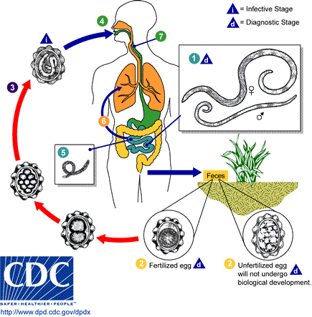

Slide 234
CLINICAL PICTURE
Depends on the life cycle stage of the ascariasis
The migration phase is associated with pneumonitis
Presenting with fever, cough, wheezing and shortness of breath
Abdominal discomfort
Occasionally the worm may leave the body through stool or vomitus
Malnutrition states such as kwashiorkor and vit A deficiency by interfering with absorption of nutrients in the small intestines.
DIAGNOSIS
Stool microscopy that shows the characteristic of ascaris eggs.

Slide 235
MANAGEMENT/TREATMENT
Mebedazole is most commonly used and it’s a broad spectrum antihelminthic.
Its given in a dose of 100mg bd daily for 3 days
Albedazole (zentel) 400mg single dose (alternative)
Levamizole (ketrax) 3 tablets as a single dose (5mg/kg) or
Piperazine (antepar) syr. 150mg/kg single dose to a maximum of 4g
PREVENTION AND CONTROL
Provision of adequate and safe water supplies
Provision of facilities for the proper disposal of faeces and prevention faecal contamination of food
The use of fresh human faeces as manure should be discourages, however composting for more than six months is sufficient to kill Ascaris eggs
health education
Periodic de-worming of children whose growth is not satisfactory is done in some clinics in areas where ascariasis is endemic
Inspection of latrines in schools and markets in the community should be undertaken periodically.

Slide 236
2. ENTEROBIASIS
INTRODUCTION:
Is a benign (not harmful) intestinal disease with a worldwide distribution
More common in temperate countries (developed) than tropics (developing)
It’s a person-to-person spread
Common among family members and boarding institutions.
Control is by personal hygiene and treatment
EPIDEMIOLOGY:
Caused by enterobius vermicularis , the threat-worm or pinworm.

Slide 237
Initial infection occurs by the faecal oral route
Infection is by direct transfer of infective eggs from the anus to the mouth
Or indirect faecal-oral contact through clothing, bedding, food etc.
Airborne infection through inhalation of dust containing eggs and consequent swallowing is also possible
The larvae hatch and mature within the intestines.
The young worm mature in the lower small intestine and upper colon
Gravid worms (mature worm) migrate to the rectum to discharge eggs on the peri-anal-skin during the night
This cause itching and consequent scratching
The life cycle takes 3-6 weeks

Slide 238
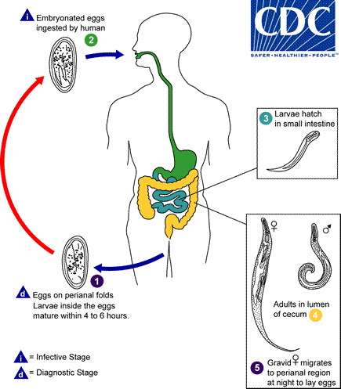
ENTEROBIASIS LIFE CYCLE

Slide 239
CLINICAL PICTURE:
Pruritus ani is the main symptom
This provokes the scratching of the peri-anal region
Resulting in secondary bacterial infection
Disturbance of sleep, restlessness,
Loss of appetite and weight loss
DIAGNOSIS
Since pinworm eggs are not usually released in the bowel, diagnosis cannot be made by looking for eggs in the faeces.
Instead, eggs deposited in the peri-anal region are detected by application of transparent adhesive tape or clear cellulose acetate tape over the anus early in the morning

Slide 240
The tape is then transferred to a microscope slide and characteristic pinworm eggs are detected.
MANAGEMENT:
Mebendazole 100mg as a single dose for all ages
PREVENTION AND CONTROL
Personal hygiene is essential i.e. Regular bathing and hand washing
Cut nails short
proper disposal of faeces
Treat the whole family
Give health education to infected individuals to prevent re-infection

Slide 241
TRICHURIASIS
INTRODUCTION:
Is a nematode infection of the large intestine
Usually asymptomatic
However, heavy infections may cause gastro-intestinal symptoms
Most common among children from low-income families
Proper faecal disposal and personal hygiene are key to its control
EPIDEMIOLOGY:
Its caused by trichuris trichiuria
Its also referred to as whipworm
Transmission is indirect, as eggs passed in the faeces require embryonation in soil

Slide 242
In the soil, the eggs develop into a 2-cell stage , an advanced cleavage (split or division) stage , and then they embryonate ; eggs become infective in 15 to 30 days
When embryonated eggs are ingested, they hatch in the duodenum, releasing larvae that mature before migrating to the large bowel.
The mature worms attach themselves to the mucosa of the cecum and colon and live for several years.

Slide 243
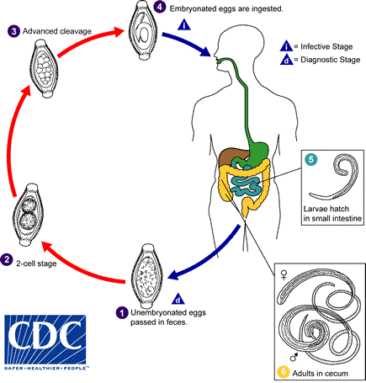
Lifecycle of Trichuriasis

Slide 244
CLINICAL PICTURE
Tissue reaction to whipworm is mild
Its asymptomatic to individuals infected
Abdominal discomfort
Bloody diarrhoea
Loss of weight
Anaemia
DIAGNOSIS:
Stool examination through the microscope
Presence of more than 200 eggs in an ordinary faecal smear indicates heavy infestation
MANAGEMENT:
Mebendazole 100mg twice or three times daily will eliminate infection
PREVENTION AND CONTROL
As for ascariasis: sanitation disposal of faeces and personal hygiene is key

Slide 245
HOOKWORM
INTRODUCTION
Most infected individuals are asymptomatic
The diseases develops from a combination of factors which includes:
A heavy worm burden
Prolonged duration of infection
Nutritional state of the patient
The chronic deliberating disease is characterised by iron deficiency anaemia and loss of protein leading to malnutrition
Hookworm anaemia is one of the important causes of anaemia in many communities

Slide 246
EPIDEMIOLOGY
Two types of hookworm which both of them are nematodes, they include: Necator americana and Ankylostoma duodenale
The eggs are already embryonated when passed out with feaces
The larvae leave the faeces and burry themselves in moist damp soil.
These larvae are not infective before they have changed into filariform stage
This occurs after about 5 days.
The filariform larvae attach themselves to the grass and as soon as they are touched by human leg or foot, they penetrate actively through the skin and reach the lungs via blood stream through the venous system

Slide 247
In the lungs, they penetrate the alveoli and carried up passively through bronchioli, and trachea to the larynx
Next they are swallowed and reach the duodenum 3-5days after penetrating the skin
The worms are attached to the mucous with hook-like teeth in their buccal cavity..
and the whole cycle is complete in 40days

Slide 248
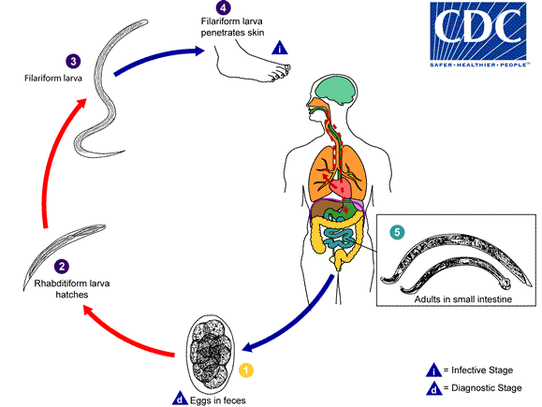
HOOKWORM LIFE CYCLE

Slide 249
CLINICAL PICTURE:
Pruritic dermatitis or ground itch at the site of penetration
Ground itch is most common in the toes and on the sole of the feet
Coughing, and wheezing, especially when the larvae is migrating through the lungs
Abdominal pains, distension and diarrhoea
In heavy infection diarrhoea is mixed with blood
The symptoms may be mistaken with those for duodenal and gastric ulcers
Iron deficiency anaemia, usually occurs when the heavy hookworm load overtakes the iron reserves

Slide 250
DIAGNOSIS
Established by finding out the characteristics of hookworm eggs in the faeces through stool examination under a microscopy.
Management/Treatment
Mabendazole 100mg twice a day for 3 days
Levamisole (ketrax) 3 tablets single dose. Can be used in mixed infection though not effective to Nacator, the most common hookworm
Oral iron (ferrous sulphate) 200mg 3 times a day for at least two months (adults)
For children, 200mg once or twice a day for at least 2 months

Slide 251
PREVENTION AND CONTROL
Protective shoes should be worn during work in the field or around the house
Proper disposal of faeces is the only way to eradicate hookworm infections
Deworming campaigns or mass treatment should be advocated.
Health education on balanced diet to prevent anaemia and personal hygiene
Regular examination by mothers and health workers to detect anaemia

Slide 252
STRONGYLOIDIASIS
INTRODUCTION:
Is an infection caused by strongyloides stercoralis.
The adult female worm live in the duodenum and jejunum
Most infections are asymptomatic
Can persist for decades without further exposure of the host to infective larvae.
The rest of the cycle is like hookworm
Endogenous re-infection occurs within the bowel when the larvae became infective and penetrate the bowel wall.

Slide 253
LIFE CYCLE
Strongyloides can undergo a free living cycle of development in addition to the parasitic cycle of development found in other nematodes.
This adaptability facilitates the parasites survival in the absence of mammalian host.
The larvae may therefore develop into free-living adults which continue to reproduce outside the body or they may develop directly into infective filariform larvae which penetrate the skin.

Slide 254
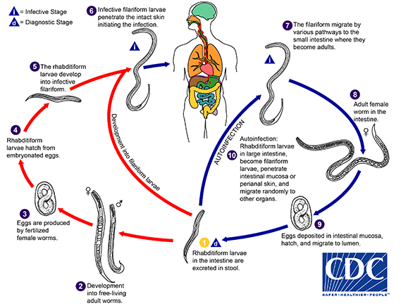

Slide 255
EPIDEMIOLOGY
Is common in warm, moist environments
Humans are the principle hosts.
The disease is prevalent in overcrowded areas with poor sanitation
CLINICAL PICTURE
In heavy infections, the number of worms in the mucosa may interfere with the normal function of the bowel resulting in mal-absorption and diarrhoea
The continuous re-infection may cause urticaria and other hypersensitivity reactions
DIAGNOSIS
Examination of a fresh stool specimen

Slide 256
MANAGEMENT
Both asymptomatic and symptomatic strogyloides must be treated because of the potential for fatal hyper-infection
Drug of choice is Ivermectin 200mcg/kg once a day for 2 days
Alternatives are: Albendazole 400mg twice a day for 2-3 days
Mebendazole 100mg 3 times a day for 3 days
Thiabendazole 25mg/kg twice daily for 2 days

Slide 257
TAENIASIS
INTRODUCTION:
Is an infection of humans by tapeworms
The cysticercus stage of taenia solium in human can cause serious problems such as epilepsy and death
EPIDEMIOLOGY
Most cases of taeniasis reported in eastern Africa are caused by Taenia saginata (beef tapeworm).
The disease is common in areas where beef is eaten raw or lightly cooked

Slide 258
LIFE CYCLE
The adult ribbon-shaped tapeworms live in the small intestine of humans
Broken segments of the worm containing the gravid uterus and the eggs are passed in the stool
The eggs are ingested by cows (Taenia saginata) or pigs (T. solium)
In the GIT of the animals, the embryo develops into a 6-hooked larva, the oncosphere (larval form of a tapeworm) which penetrates the bowel wall and carried via bloodstream to striated muscles
Here the larvae, grow and form the infective cysts, known as cysticerci

Slide 259
When a human ingests meat containing cysticerci, the cyst are dissolved by the gastric acid in the stomach to release embryos.
The Taenia saginata embryo attaches itself to the wall of the bowel by its head and grows into an adult worm
The Taenia solium embryos behave differently, by penetrating the bowel wall of the human as it does in the pig. Its then carried in the bloodstream to organs like striated muscle(e.g. skeletal or cardiac) or the brain.

Slide 260
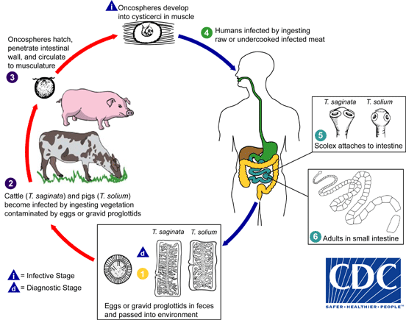
TAENIASIS LIFECYCLE

Slide 261
CLINICAL PICTURE
1. For Taenia saginata
Loss of weight
Abdominal discomfort
Pruritus ani (itching of the anus)
2. For Taenia solium
They are dangerous especially when the cysticerci invade the brain.
The patient may present with seizures or muscular pains
DIAGNOSIS
Is by microscopy of stool
MANAGEMENT/TREATMENT
1. Praziquantel is the drug choice
Given as a single dose of 5-10mg/kg.

Slide 262
2. Niclosamide is an alternative, effective against both T. saginata and T. solium infection,
The dose is 2g (4tablets) for adult,
For children 11-34 kg should get 2 tablet,
while children more than 34kg are given 3 tablets.
PREVENTION & CONTROL
Proper disposal of faeces (see ascrariasis) and meat inspection.
All infected meat should be condemned
Health education should be given about the dangers of eating meat (beef & pork) that is uninspected or not thoroughly cooked
Deep freezing of meat will kill all cysticerci in 24 hrs.

Slide 263
AIRBORNE DISEASES
INTRODUCTION:
Are of a great public health important in sub-Sahara Africa.
The 2 most common cause of death in children include pneumonia and measles.
The two accounts for about 1/4 of all deaths occurring in hospitals across Eastern Africa.
Pneumonia accounts for 1/3 of all death in children under 5yrs in developing countries.
Pneumonia is worse in a malnourished child.
The diseases causing organism is airborne.
It enters the body via the respiratory tract.

Slide 264
When the patient or carrier of pathogens talk, cough, laugh or sneezes, droplets of fluid are discharged into the air.
The smallest of these droplets remain in the air for some time and may be inhaled by a new host.
The bigger droplets fall to the ground and mix with the dust which may later be inhaled with the dust
Airborne diseases spreads more easily when there is overcrowding, like in congested houses, classroom, public transport, dance halls etc.
Good ventilation can do much to counteract the effect of overcrowding
Airborne diseases are mostly acquired through respiratory tract although not all that are acquired through respiratory tract

Slide 265
MEASLES:
INTRODUCTION
Is an acute general infection caused by a virus
It’s a disease which mainly affect children.
Its also called Rubeola or morbilli
Found all over the world.
The high fatality rate of measles in Africa has been attributed to malnutrition and under- nutrition.
In malnourished children, the defence mechanisms are slow and week, so the virus has more opportunity to do damage before its arrested.
Children are more likely to suffer from under-nutrition during the weaning period.

Slide 266
This is the time when unimmunised African children get measles most
in Africa most children develop measles before the age of 3 yrs
In Europe, most children are immunised and a few who are infected by disease is after 5 yrs of age
The overall fatality rate of measles in eastern Africa is between 3% and 5%. This is about 400 times higher than that of Europe.
Thus there is an urgent need to increase immunization coverage for children under 1yr old to 80%

Slide 267
EPIDEMIOLOGY
Measles is spread by invisible droplets containing virus particles.
The virus particles come from the secretion of respiratory tract of patients suffering from measles
The disease spreads very easily.
Before it becomes clear that a child is suffering from measles, the disease has already spread to close contact.
The disease gives a life long immunity once one is immunized
Nearly everybody gets the disease once a lifetime, if not immunized

Slide 268
CLINICAL PICTURE
Uncomplicated measles generally occurs in a well-nourished or slightly underweight child
Fever
Skin rash
Conjunctivitis
Rhinitis (is an inflammation of the nasal passages caused by allergic reaction to airborne substances)
Cough
Complicated measles occurs in a very underweight child or one with signs of malnutrition and they include:
Dyspnoea (shortness of breath)
Nasal flaring (burn)
Rapid respiration
Accompanied by hoarseness
barking cough
Sour mouth leading to inability to suck

Slide 269
MANAGEMENT
Treat individuals as outpatients if there is uncomplicated measles
Ensure proper fluid intake and nutritious food
Apply tepid sponging, give paracetamol and follow up daily
Give a single oral dose of 200,000 units of vitamin A
Advise on extra meals 5 times a day
In complicated measles:
Admit to hospital and give a balanced diet with protein and energy rich food
Observe for signs of pneumonia
If there is stomatitis,(inflammation of the mouth) clean mouth 4-6 hourly
If there is diarrhoea and /or vomiting suspect gastro-enteritis and give oral fluids

Slide 270
If there is convulsions, exclude malaria & meningitis and give phenobarbitone 30mg
If there is xerophthalmia (a condition where the eye fails to produce tears due to vit A deficiency), give vitamin A 200,000 units/day orally and chloraphenicol or Atropine eye Ointment
Treat Otitis media with fortified procaine penicillin inj. (ppf)
NB: With very serious cases suspect TB

Slide 271
PREVENTION AND CONTROL
Immunising all children both the health and the sick who have not been previously immunised
Carry out a regular supply of measles vaccine ( work of subcounty health officer)
Ensure periodic checks of the cold box, vaccine carriers and icepacks.
If the vaccine is given between 6 and 9 months, it must be repeated at age of 1yr to ensure effective protection
Ensure to prevent and treat under nutrition. This is done through nutritional education to mothers and by weighing the children

Slide 272
PNEUMONIA:
INTRODUCTION:
Is an acute respiratory infection with fever, cough and dyspnoea. (shortness of breath)
It’s a common disease of infancy and old age.
It is the commonest cause of death in patients admitted to many hospitals in Africa
Low birth-weight infants, those anaemic from malaria or hookworm infection are very susceptible and have high mortality.
PREDISPOSING FACTORS
Upper respiratory tract infection (URTI) e.g. influenza in elderly people
HIV/AIDS
Measles

Slide 273
Whooping cough in children
NB: These infection cause damage to the epithelium of the lungs and clear the way for bacterial super-infection.
Transmission is by droplet spread, direct oral contact, or indirect freshly infected articles.
CLINICAL PICTURE:
Cough, Fever,
In-drawing of the inter-costal muscles (is the rapid respiratory rate)
Types of pneumonia:
Bronchopneumonia
Lobar pneumonia

Slide 274
Bronchopeumonia
Most common form of pneumonia
Occurs in chronically ill patient
Onset is usually not abrupt
It presents with continuous fever
The sputum is purulent
LOBAR PNEUMONIA
Onset is very sudden with the following symptoms
Body chills,
stabbing pains in the chest in a health person
Fever is high and continuous (39-40 degrees C )
Headache
Anorexia
Insomnia and vomiting
Dry cough in the 1st day but becomes productive later
Sputum is brick-coloured

Slide 275
DIFFERENTIAL DIAGNOSIS ( is distinguishing of a particular disease or condition from others that present similar clinical features
Severe malaria
Typhoid fever
HIV/AIDS lung infection
COMPLICATIONS OF PNEUMONIA
Pleural effusion (a condition in which excess fluid builds around the lung)
Lung abscess
Heart failure ( inability of the heart to pump enough blood to meet body's needs.
Arthritis etc.

Slide 276
MANAGEMENT
Cotrimoxazole twice daily for 5 days
Amoxicillin 500mg three times daily for 5 days
Benzyl penicillin 6 hrly in severe pneumonia
Administration of oxygen to children with signs and symptoms of pneumonia and where supply is limited
Oxygen is administered at a rate of 0.5 litres/min for children less than 2 months and 1 litres/min for those older than 2months
CONTROL AND PREVENTION
Immunization to prevent diseases frequently complicated by pneumonia e.g. measles and whooping cough
Early diagnosis and treatment at community, dispensary and health centre level

Slide 277
3. Health education program should be started to both parents and community health workers on:
What supportive measure can be given at home
The importance of breastfeeding and immunization
How to distinguish mild and serious pneumonia

Slide 278
INFUENZA
Introduction
Is an acute RTI of specific viral origin characteristed by sudden onset of headache, myalgia (muscle pain), fever and cough
Its often referred to as flu.
Its important because of its high attack rate
EPIDEMIOLOGY:
Influenza are associated with a rise in general mortality
Deaths occur in elderly and those with chronic diseases
CLINICAL PICTURE
The incubation period is 1-3 days
There is sudden onset of headache, malaise, muscle pains, fever,
Congested nose and cough

Slide 279
DIFFERENTIAL DIAGNOSIS (used to distinguishing of a particular disease or condition from others that present similar clinical features).
They Includes:
Malaria
relapsing fever,
And other viral URTIs
MANAGEMENT
Encourage bed rest
Give paracetamol tablet 500mg/suspension to relieve pain and diminish fever
Give antibiotics if there are signs of pneumonia

Slide 280
PREVENTION AND CONTROL:
Immunization is possible though not considered cost effective in Africa (due to its expense & limited protection)
Ventilation
Health education

Slide 281
STAPHYLOCOCCAL DISEASES
Are bacteria which produce different clinical pictures depending on where they are
They often produce pus
Diseases caused by staphylococci are common
Infections of the skin are of minor importance but are the portals of entry for the bacteria into the inner organs.
Staphylococci infections of the internal organs are dangerous and are likely seen in people with a weakened defence system like chronically ill, inpatients undergoing major surgery etc.
Staphylococci may be spread by flies, through the figures of the nursing and medical staff or by invisible droplets containing the bacteria

Slide 282
CLINICAL PICTURE
Depends on site of the infection
e.g. a). if an unripe abscess is incised, or squeezed, bacteria may enter the blood stream and give rise to a septicaemia with fever, malaise and headache.
b). When the bacteria are only causing superficial infection of the skin, toxins are not absorbed into the blood stream and therefore no signs of general infection appear.
DIAGNOSIS
From gram stain of pus, sputum or CSF
MANAGEMENT
For superficial skin infection no systemic antibiotic treatment is needed

Slide 283
Local application of antiseptics e.g. gentian violet, and frequent changes of dressing will do
Use of broad spectrum antibiotic in cases of localised bacteria in the internal organs
Such as erythromycin, tetracycline 500mg and chloramphenicol
In a newborn with generalised skin infection, systemic cloxaccillin or ampiclox treatment is indicated
PREVENTION AND CONTROL
Known patients with purulent lesions must be isolated
Dressings from purulent wounds must be handled with care
Aseptic techniques should be taught to and practised by all nursing staff.

Slide 284
NON COMMUNICABLE DISEASES

Slide 285
Introduction:
Non-communicable Diseases (NCD):
        A non-communicable disease (NCD) is a medical condition or disease that is not caused by infectious agents (non-infectious or non-transmissible).
        NCDs also known as chronic diseases last for long periods of time and progress slowly. NCDs are the leading cause of death globally.
        NCDs are distinguished only by their non-infectious cause
        These diseases are not passed from person to person.
        Are usually caused by more than one ‘agent’. (risk factors)
In some definitions, NCDs also include:
Chronic mental illness
Injuries, which have an acute onset, but may be followed by prolonged convalescence and impaired function

Slide 286
Introduction:
Non-communicable diseases are a diverse group of chronic diseases that are not communicable, meaning you can't catch them from another person.
They are defined as diseases of long duration, generally slow progression and they are the major cause of adult mortality and morbidity worldwide.
Non-communicable diseases are identified by WHO as Group II Diseases, a category that aggregates the following conditions/causes of death:
Diabetes mellitus, endocrine disorders, neuropsychiatric conditions, sense organ diseases, cardiovascular diseases, respiratory diseases (e.g. COPD, asthma, other), digestive diseases, genitourinary diseases, skin diseases, musculoskeletal diseases (e.g. Rheumatoid arthritis), congenital anomalies (e.g. Cleft palate, down syndrome), and oral conditions (e.g. Dental caries).

Slide 287
Four main diseases are generally considered to be dominant in NCD mortality and morbidity:
Cardiovascular diseases (including heart disease and stroke), diabetes, cancer and chronic respiratory diseases (including chronic obstructive pulmonary disease and asthma).
In addition to these 4 main diseases, mental disorders are considered to be major contributors to the economic losses stemming from NCDs.
Five types of mental illness (major depressive disorder, anxiety disorders, schizophrenia, dysthymia, bipolar disorder) that appeared in the top 20 causes of global burden of disease
NON- COMMUNICABLE DISEASE (NCDs): Chronic conditions that do not result from an acute infectious process and hence are not communicable
Diseases that have a prolonged course, that do not resolve spontaneously, and for which a complete cure is rarely achieved

Slide 288
CLASSIFYING DEATHS AND DISEASES
(WHO)
Communicable diseases [Group I]
Those where death is directly due to the action of a communicable agent
Non-communicable diseases
Diseases [Group II]
Cancer, diseases of various organ systems (e.g. respiratory, cardiovascular etc.), diabetes, mental health, Heart Attacks, High Blood Pressure, Stroke, Arthritis, etc.
External causes (injuries, poisonings and violence) [Group III]
How people get Non-Communicable Diseases:
Genetics or Heredity - Passed down through family
Environment - Where you live and work
Lifestyle - Decisions that you make regarding your health

Slide 289
Who is at risk of such diseases
People of all age groups, regions and countries are affected by NCDs.
These conditions are often associated with older age groups, but evidence shows that 15 million of all deaths attributed to NCDs occur between the ages of 30 and 69 years.
Of these premature deaths, over 80% are estimated to occur in low- and middle-income countries.
Children, adults and the elderly are all vulnerable to the risk factors contributing to NCDs, whether from unhealthy diets, physical inactivity, exposure to tobacco smoke or the harmful use of alcohol.

Slide 290
These diseases are driven by forces that include rapid unplanned urbanization, globalization of unhealthy lifestyles and population ageing.
Unhealthy diets and a lack of physical activity may show up in people as raised blood pressure, increased blood glucose, elevated blood lipids and obesity.
These are called metabolic risk factors that can lead to cardiovascular disease, the leading NCD in terms of premature deaths.

Slide 291
NCD Risk Factors
These disease groups are linked by common risk factors:
Social Determinants of Health (this is the environment in which we are born, live and grow and the opportunities we are given in those environments)
Tobacco use
Alcohol – the harmful use of alcohol
Poor Nutrition (unhealthy diets)
Physical Inactivity

Slide 292
KEY RISK FACTORS FOR NCDs
Risk Factor: The WHO defines a risk factor as “any attribute, characteristic or exposure of an individual that increases the likelihood of developing a disease or injury”.
        “An aspect of personal behaviour or lifestyle, an environmental exposure, or a hereditary characteristic that is associated with an increase in the occurrence of a particular disease, injury, or other health condition.”
        Major risk factors: Blood pressure, Cholesterol, Smoking
Intervention: An act/ treatment/ drug, etc. that is deliberately introduced to change/ modify a situation/ condition.
Examples: Health education, treatment with prescription drugs (medicines), vaccines, etc.

Slide 293
Modifiable Risk Factor:
A risk factor (behavioural) that can be reduced or controlled by intervention, thereby reducing the probability of disease.
Refer to characteristics that societies or individuals can change to improve health outcomes.
The WHO has prioritized the following four:
Physical inactivity
Tobacco use
Alcohol use
Unhealthy diets (increased fat and sodium, with low fruit and vegetable intake).

Slide 294
Non-Modifiable Risk Factor:
A risk factor that cannot be reduced or controlled by intervention
Refer to characteristics that cannot be changed by an individual (or the environment)
For example:
Age
Gender (sex)
Race
Family history (genetics) – Genetic makeup

Slide 295
Metabolic Risk Factors: (physiological risk factors)
        “Metabolic" refers to the biochemical processes involved in the body's normal functioning
        Behaviours (modifiable risk factors) can lead to metabolic/physiologic changes.
        WHO has prioritized the following four metabolic risk factors: (i.e. Metabolic risk factors contribute to four key metabolic changes that increase the risk of NCDs:)
Raised blood pressure (Hypertension)
Hyperlipidemia (Raised total cholesterol)
Hyperglycemia (Elevated glucose)
Overweight and obesity
These are also called intermediate risk that can lead to cardiovascular diseases
In terms of attributable deaths, the leading metabolic risk factor globally is elevated blood pressure (to which 19% of global deaths are attributed), followed by overweight and obesity and raised blood glucose.

Slide 296
Behavioral risk factors (modifiable)
Tobacco: accounts for almost 6 million deaths every year (including 600,000 deaths from second hand smoke) projected to increase to 8 million by 2030
Insufficient physical activity - 3.2 million
Low fruit and vegetable consumption- 3.2 million
Half of the 2.32 million deaths annual deaths from harmful drinking are from NCDs
Cancer-associated infections:
At least 2 million cancer cases per year
18% of the global cancer burden, are attributable to a few specific chronic infections
this fraction is substantially larger in low-income countries..
The principal infectious agents are human papilloma virus, Hepatitis B virus, Hepatitis C virus and Helicobacter pylori.
These infections are largely preventable through vaccinations and measures to avoid transmission, or treatable.

Slide 297
Common Risk Factors

Slide 298
Leading Causes of Attributable Global Mortality and Burden of Disease, 2004:
Attributable Mortality Attributable DALYs

Slide 299
        The disability-adjusted life year (DALY) is a measure of overall disease burden, expressed as the number of years lost due to ill-health, disability or early death. It was developed in the 1990s as a way of comparing the overall health and life expectancy of different countries.
        In NCDs, all disease/events are generally independent of one another.
        In NCDs, the risk of disease largely depends on population characteristics and other health behaviours;
NB: (Refer to Common Risk Factors chart – 4 diseases, 4 modifiable shared risk factors)
Four Leading NCDs: (The four major chronic NCDs)
Cardiovascular diseases
Chronic Respiratory disease
Diabetes
Cancer

Slide 300
Types of NCDs:
        Cardiovascular disease (Coronary heart disease, Stroke)
        Cancer
        Chronic lung disease
        Diabetes
        Chronic neurologic disorders (Alzheimer’s, dementias)
        Arthritis/Musculoskeletal diseases
        Unintentional injuries (e.g., from traffic crashes)
        ___________________________________________________
        Other NCDs include:
        Nutritional Diseases: rickets, goiter, beriberi, pellagra, and dental caries among others
        Congenital Problems: congenital heart diseases, hernias, down syndrome, spina bifida, Some of them as a result of mother’s lifestyle during pregnancy.

Slide 301
Mental Illnesses: Such as psychosis (mania, schizophrenia) neurosis (Anxiety, depression) and puerperal psychosis.
Accidents/ Unintentional injuries: Road traffic, industrial and home accidents.
Arthritis/musculoskeletal diseases
Chronic neurologic disorders (e.g., Alzheimer’s, dementias)
________________________________________
Cardiovascular diseases account for most NCDS or 17.3% million people annually (HTN is the leading risk factor,
Followed by cancers(7.6 million)
Respiratory diseases (4.2)
And diabetes (1.3 million)

Slide 302
Lifestyle disease types
Lifestyle diseases: diseases associated with the way a person or group of people lives
conditions usually attributed to dramatic shifts in the way humans live their lives, often due to advancements in a society or its scientific progress
Conditions like certain forms of cancer, most types of heart disease, high blood pressure, obesity, and Type 2 diabetes are “contracted” from the way people live. Poor diet, lack of exercise, smoking, and excess alcohol, and in the late 2000s even poor sleep may contribute to these illnesses or be their primary cause
Lifestyle diseases include:
Atherosclerosis,
Heart disease,
And stroke;
Obesity and type 2 diabetes;
And diseases associated with smoking, alcohol and drug abuse, and lack of regular physical activity.

Slide 303
Characteristics of NCDs:
Complex aetiology (causes)
Multiple risk factors
Long latency period
Non-contagious origin (non-communicable)
Prolonged course of illness
Functional impairment or disability
Incurability
Insidious (gradual and harmful) onset

Slide 304
Implications of increased burden of NCDs
Increased budgetary allocation to prevention and control of NCDs
Impoverishment/economic failure of already poor on account of continued Treatment over long periods
Increased investment in human resources for health sector i.e. more doctors, nurses, nutrition etc.
Increased investment on drugs- further increase in non affordability of many for Treatment
Effect on society- especially nuclear families
DRIVERS OF NCDS AND LIFESTYLE DISEASES
Nutrition transition/ globalization of unhealthy lifestyles.
Rapidly growing and unplanned urbanization
Demographic Change

Slide 305
NCDs: - Parameters for estimation of behavioural and metabolic risk factors:
        Current daily tobacco smoking: the percentage of the population aged 15 or older who smoke tobacco on a daily basis.
        Physical inactivity: the percentage of the population aged 15 or older engaging in less than 30 minutes of moderate activity per week or less than 20 minutes of vigorous activity three times per week, or the equivalent.
        Raised blood pressure: the percentage of the population aged 25 or older having systolic blood pressure ≥ 140 mmhg and/or diastolic blood pressure ≥90 mmhg or on medication to lower blood pressure.

Slide 306
      NCDs: - Parameters for estimation of behavioural and metabolic risk factors:
      Raised blood glucose: the percentage of the population aged 25 or older having a fasting plasma glucose value ≥ 7.0 mmol/L (126 mg/dl) or on medication for raised blood glucose.
      Overweight: the percentage of the population aged 20 or older having a body mass index (bmi) ≥ 25 kg/m2.
      Obesity: the percentage of the population aged 20 or older having a body mass index (bmi) ≥30 kg/m2.
      Raised cholesterol: the percentage of the population aged 25 or older having a total cholesterol value ≥ 5.0 mmol/L (190 mg/dl).

Slide 307
Epidemiology of NCD:
The epidemiologic transition:
Change in the balance of disease in a population
from
communicable diseases
to
non-communicable disease
There is decline in proportion of total mortality due to infectious diseases
Different countries are at different stages of the epidemiological transition
Drivers of the epidemiological transition in low and middle income countries:
Population ageing
Major socio-economic changes (especially urbanisation)
      changes in risk factors such as diet, physical activity, smoking etc.

Slide 308
        NB:
        Non-communicable diseases are now the most common cause of death world wide
        Increasing rates in low and middle income countries because of change in lifestyles (urbanisation)
        Key risk factors have very large effects
        Interventions are effective and can reduce burden
        The need to combine results and have large studies

Slide 309
Why NCDs Are Important in Public Health?
57 million deaths that occurred globally in 2008
36 million – 63.2%, almost two thirds – were due to NCDs
9 million death that occurred among people under age 60
Mainly cardiovascular diseases, cancers, diabetes and chronic lung diseases
expected to become the leading cause of death in Africa by 2030
Socioeconomic impacts of NCDS
NCDs threaten progress towards the 2030 Agenda for Sustainable Development, which includes a target of reducing premature deaths from NCDs by one-third by 2030.
Poverty is closely linked with NCDs. The rapid rise in NCDs is predicted to impede poverty reduction initiatives in low-income countries, particularly by increasing household costs associated with health care

Slide 310
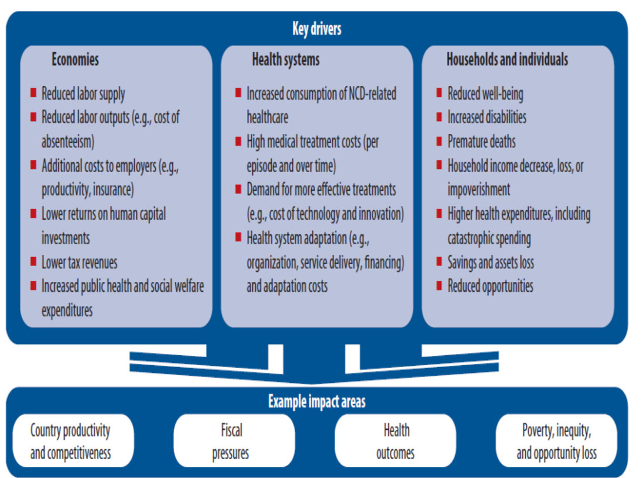
Impacts of NCDS

Slide 311
Prevention and Control of NCDs:
      Millions of deaths can be prevented by stronger implementation of measures that exist today.
      These include policies that promote government-wide action against NCDs:
Stronger anti-tobacco controls
Promoting healthier diets,
Physical activity,
Reducing harmful use of alcohol;
Along with improving people's access to essential health care.
There is the 2008-2013 Action Plan for the implementation of the WHO Global Strategy on the Prevention and Control of Non communicable Diseases. This Action Plan was endorsed by the 2008 World Health Assembly.

Slide 312
Prevention and control of NCDs – Continued
An important way to control NCDs is to focus on reducing the risk factors associated with these diseases.
Low-cost solutions exist for governments and other stakeholders to reduce the common modifiable risk factors.
Monitoring progress and trends of NCDs and their risk is important for guiding policy and priorities.
To lessen the impact of NCDs on individuals and society, a comprehensive approach is needed requiring all sectors, including health, finance, transport, education, agriculture, planning and others, to collaborate to reduce the risks associated with NCDs, and promote interventions to prevent and control them
Investing in better management of NCDs is critical. Management of NCDs includes detecting, screening and treating these diseases, and providing access to palliative care for people in need.

Slide 313
High impact essential NCD interventions can be delivered through a primary health care approach to strengthen early detection and timely treatment.
Evidence shows such interventions are excellent economic investments because, if provided early to patients, they can reduce the need for more expensive treatment.
Countries with inadequate health insurance coverage are unlikely to provide universal access to essential NCD interventions.
NCD management interventions are essential for achieving the global target of a 25% relative reduction in the risk of premature mortality from NCDs by 2025, and the SDG target of a one-third reduction in premature deaths from NCDs by 2030.

Slide 314
Challenges in control & prevention
Lack of partnership between different sectors
Weak surveillance
Limited access to prevention and treatment
Limited fund allocation
Burden of NCDs
Disease occurrence- incidence and prevalence is increasing
Lifestyle are changing- in absolute nos. of elderly persons
Crude birth rate- compounded with increase in life expectance, increase in proportion of geriatric/elderly population who are dependants

Slide 315
KEY INTERVENTIONS FOR PREVENTION AND CONTROL OF NCDS AND LIFESTYLE DISEASES:
POPULATION-LEVEL PREVENTION
Their characteristics include:
They are not reliant on health system for delivery
Costs are relatively low and they may even generate funds
They have relatively little “downside” and most people will be exposed to them
People who are at high risk or already suffering from NCDs will benefit
The various interventions targeting specific risk factors:

Slide 316
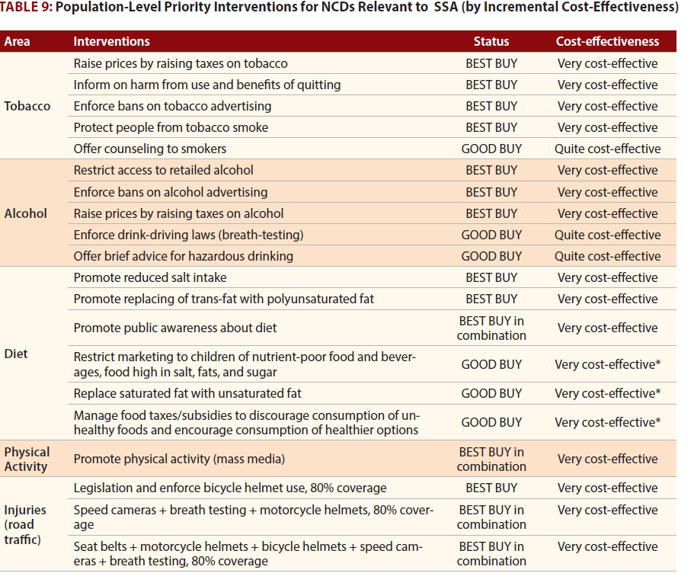
Population-level priority interventions

Slide 317
Population-level priority interventions

Slide 318
Other interventions include
Vaccination against hepatitis B and human papilloma virus
Screening for various cancers such as prostate, cervical, breast etc.
Healthy nutrition environments in schools
Nutrition information and counseling in health care
National physical activity guidelines
School-based physical activity programs for children
Workplace programs for physical activity and healthy diets
Community programs for physical activity and healthy diets
Designing the built environment to promote physical activity
Protection against environmental or
Protection against occupational risk factors for cancer, such as aflatoxin, asbestos and contaminants in drinking-water

Slide 319
INDIVIDUAL HEALTH-CARE INTERVENTIONS
Hospital centered acute care:
Very expensive approach
Denies people the health benefits of taking care of their conditions at an early stage.
Integration into primary healthcare:
Expanding the package of primary health care services to include essential NCDs interventions is central to any health system strengthening initiative.
Counseling and multidrug therapy
Aspirin therapy for acute myocardial infarction
Screening for cervical cancer, once, at age 40
Early case finding for breast cancer

Slide 320
Early detection of colorectal and oral cancer
Treatment of persistent asthma with inhaled corticosteroids and beta-2 agonists
Individuals uptake of vaccinations
PRIORITIES FOR ACTION
Actions to be taken in the three components of national NCD programs: surveillance, prevention, and health care
A comprehensive approach:
Risk factors for NCDs are spread throughout society,
and they often begin early in life and continue throughout adulthood
Evidence indicates that both prevention and treatment interventions are necessary.

Slide 321
Multi-sectoral action
Government (Health, Education, Foreign Affairs, Agriculture, planning…
Civil society and
The private sector
Role of Civil society and private sector
Mobilize political and public awareness, and support for NCD prevention and control efforts
Play a key role in supporting NCD programs
Strong, united advocacy
Responsible marketing
Surveillance and monitoring
Measuring key areas of the NCD epidemic
integration into national health information systems
Monitoring and surveillance of behavioral and metabolic risk factors

Slide 322
Health systems:
Strengthening of country health-care systems
Through reorienting existing organizational and financial arrangements
Through conventional and innovative means of financing
Strengthening the capacity of primary healthcare
Improvements in health-system performance
Prevention and control (Best Buys)
With clear evidence of effectiveness and high cost-effectiveness
Population-wide interventions must be complemented by individual health-care interventions.

Slide 323
Sustainable development
Included as a priority in national development initiatives and related investment decision
Strengthening the prevention and control of NCDs should also be considered an integral part of poverty reduction
KENYA’S POLICY DIRECTION ON NCDS
The current Kenya health policy 2012-2030 has for the very first time recognized the rising burden of NCDs in the country.
Emerging trends point to the fact that non communicable conditions and injuries/ violence related conditions will increasingly, in the foreseeable future, be the leading contributors to high burden of disease in the country

Slide 324
NCDs contribute to 26% of the annual mortality rates in the country.
Consequently, the policy objective number two is on halting and reversing the rising burden of non- communicable conditions(MOMS & MOPHS, 2012)
Policy Objective 2: Halt and reverse the rising burden of non- communicable conditions
This is to be achieved by implementing strategies to address all the identified non communicable conditions in the country
The priority policy strategies include the following:
Ensure universal access to interventions addressing recognized non communicable conditions in the country

Slide 325
Ensure that services relating to non-communicable conditions are of high quality standards with a view to maximize utilization of services the population has access to
Strengthen advocacy for health promoting activities aimed at preventing increased burden due to non-communicable conditions
Put in place programs for non-communicable diseases prevention and control
Put in place interventions directly addressing marginalized and indigent populations affected by non-communicable conditions
Design and implement integrated health services provision tools, mechanisms and processes with a view to enhance comprehensive control of non-communicable diseases
Decentralize screening for non-communicable diseases to the lower levels to increase access

Slide 326
COMMON NON-COMMUNICABLE DISEASES:
Cardiovascular disease
Cancer
Chronic Respiratory Diseases
Diabetes
Disease Highlight:
Definition
Key facts and figures {Statistics} / Burden of disease
Risk factors
Symptoms
Prevention / Control
Treatment
326

Slide 327
CARDIOVASCULAR DISEASE (CVD):
Caused by disorders of the heart and blood vessels.
CVDs are group of disorders / diseases of the heart, vascular diseases of the brain and diseases of blood vessels.
Includes:-
        Coronary heart disease (heart attacks)
        Cerebrovascular disease (stroke)
        Raised blood pressure (hypertension)
        Peripheral artery disease
        Rheumatic heart disease
        Congenital heart disease
        Heart failure.
327

Slide 328
Cardiovascular disease (CVD): - Continued’
Coronary heart disease | Disease of the blood vessels supplying the heart muscle
Cerebrovascular disease (Stroke) | Disease of the blood vessels supplying the brain
Peripheral arterial disease | Disease of blood vessels supplying the arms and legs
Congenital heart disease | Malformations of heart structure existing at birth
328

Slide 329
Facts and figures: Global Burden of CVD
CVDs are the #1 cause of death globally.
An estimated 17.3 million people died from CVDs in 2008. (30% of all global deaths)
        7.3 million were due to coronary heart disease
        6.2 million were due to stroke
Over 80% CVD deaths occur in low- and middle- income countries.
By 2030, almost 25 million people will die from CVDs.
Cardiovascular disease (CVD) causes more than half of all deaths across the European Region.
80% of premature heart disease and stroke is preventable.
Although heart attacks and strokes are major killers in all parts of the world, 80% of premature deaths from these causes could be avoided by controlling the main risk factors: tobacco, unhealthy diet and physical inactivity.
329

Slide 330
CVD - Risk Factors:
Major modifiable risk factors High blood pressure Abnormal blood lipids Tobacco use Physical inactivity Obesity Unhealthy diet (salt) Diabetes | Other modifiable risk factors Low socioeconomic status Mental ill health (depression) Psychosocial stress Heavy alcohol use Use of certain medication Lipoprotein(a)
Non-modifiable risk factors Age Heredity or family history Gender Ethnicity or race | “Novel” risk factors Excess homocysteine in blood Inflammatory markers (C-reactive protein) Abnormal blood coagulation (elevated blood levels of fibrinogen)
330

Slide 331
Cardiovascular diseases: - Continued’
Contributing factors:
A person’s genetic make-up
The foundations of adult health are laid in early life
Socioeconomic group
Mental health
Diet
Overweight and obesity
Inactivity
Tobacco
Alcohol
Diabetes
Globalization and urbanization
331

Slide 332
Cardiovascular diseases: - Continued’
Prevention:
Focusing on a combination of risk factors for cardiovascular disease (e.g. decrease in cholesterol, reduction in smoking)
Implementing medical screening for individuals at risk
Providing effective and affordable treatment to those who require it
Effective measures are available for people at high risk. For example, combination drug therapy (such as aspirin, beta blocker, diuretic and statin) can lead to a 75% reduction in myocardial infarction (heart attack) among those at high risk of having one.
332

Slide 333
Treatment: CVD
        Effective measures are available for people at high risk. For example, combination drug therapy (such as aspirin, beta blocker, diuretic and statin) can lead to a 75% reduction in myocardial infarction (heart attack) among those at high risk of having one.
        But many such interventions are not being implemented, and about half of coronary patients in the world still require more intensive blood pressure management.
333

Slide 334
CANCER:
334

Slide 335
Cancer:
        Cancer is the uncontrolled growth and spread of cells that arises from a change in one single cell.
        The change may be started by external agents and inherited genetic factors and can affect almost any part of the body.
        Generic term for a large group of diseases that can affect any part of the body.
        The transformation from a normal cell into a tumour cell is a multistage process where growths often invade surrounding tissue and can metastasize to distant sites.
        “Rapid creation of abnormal cells that grow beyond their usual boundaries, and which can then invade adjoining parts of the body and spread to other organs.” (WHO, 2012)
        Also referred to as Tumor
335

Slide 336
        Tumor is (a swelling) made of mass of cells. “Abnormal growth of cells”, “Unlimited growth of cells”, disorder of cells.
Two types of tumor: - 1) Benign 2) Malignant
Benign Tumors:
        Do not penetrate (invade) adjacent tissue borders, nor do they spread (metastasize) to distant sites.
        They remain localize overgrowths in the area in which they arise
        Are more differentiated than malignant tumors, that is, they are more closely resemble their tissue of origin.
        Malignant Tumors
        Malignant tumors (cancer) are capable of invasion (spread of the neoplasms into adjacent structures) and metastasis (implantation of the neoplasms into non contiguous sites).
336

Slide 337
Cancer – Continued’
        A neoplasm (Greek, Neo-New, plasma, thing formed) is the autonomous growth of tissue that have escaped the normal restraints on cell proliferation and exhibit varying degrees of fidelity to their precursors.
        It is usually appears as a tumor
In general, neoplasms are irreversible, and their growth is for the most part, autonomous.
Global Burden of Cancer:
        12.7 million new cases in 2008
        7.6 million deaths from cancer (13.3% of overall deaths) in 2008
        70% of all cancer deaths occur in low- and middle-income countries.
        Deaths from cancer are estimated to reach 13.1 million by 2030.
        About 30% of cancers are attributable to behaviour risk factors.
337

Slide 338
Cancer:
338

Slide 339
Cancer Epidemiology:
Estimated age-standardised incidence and mortality rates: total population:
Kmtc Kitui – Non-communicable diseases
339

Slide 340
Cancer: Interaction between a person’s genetic factors and any of three categories of external agents:
        Physical carcinogens, such as ultraviolet and ionizing radiation or asbestos;
        Chemical carcinogens, such as vinyl chloride, or betnapthylamine (both rated by the International Agency for Research into Cancer as carcinogenic), components of tobacco smoke, aflatoxin (a food contaminant) and arsenic (a drinking-water contaminant); and
        Biological carcinogens, such as infections from certain viruses, bacteria or parasites.
        Most chemicals to which people are exposed in everyday life have not been tested for their long-term impact on human health.
340

Slide 341
The majority of cancer deaths:
        Lung, breast, colorectal, stomach and liver cancers
        In high-income countries, the leading causes of cancer deaths are lung cancer among men and breast cancer among women.
        In low- and middle-income countries cancer levels vary according to the prevailing underlying risks. In sub-Saharan Africa, for example, cervical cancer is the leading cause of cancer death among women.
341

Slide 342
Risk factors for cancer:
Tobacco use
Unhealthy diet
Insufficient physical activity
The harmful use of alcohol
Infections (hepatitis B, hepatitis C (liver cancer), human papillomavirus (HPV; cervical cancer), helicobacter pylori (stomach cancer)
Radiation
Variety of environmental and occupational exposures of varying importance
342

Slide 343
Cancer: Policy
WHO’s approach to cancer has four pillars:
Prevention,
Early Detection,
Screening,
Treatment
Palliative Care.
        At least one third of the 10 million new cases of cancer each year are preventable through reducing tobacco and alcohol use, moderating diet and immunizing against viral hepatitis B.
        Early detection and prompt treatment where resources allow can reduce incidence by a further one third.
        Effective techniques are sufficiently well established to permit comprehensive palliative care for the remaining more advanced cases.
343

Slide 344
National cancer control programme
WHO has consolidated tools for countries in a framework known as the national cancer control programme, which focuses government attention and services on all facets of the fight.
A national cancer control programme is a public health programme designed to reduce cancer incidence and mortality and improve cancer patients’ quality of life, through the systematic and equitable implementation of evidence-based strategies for prevention, early detection, diagnosis, treatment and palliation, making the best use of available resources.
344

Slide 345
CERVICAL CANCER: DEFINITION
Cancer of the female reproductive system:
Two cell types present (squamous and glandular)
Tend to occur where the two cell types meet
99% of cases linked to genital infection with human papillomavirus (HPV)
345

Slide 346
Cervical Cancer: Risk Factors
Human papilloma virus infection (HPV)
Smoking
Immune Deficiencies
Poverty
No access to PAP screening
Family history of cervical cancer
LUNG CANCER: DEFINITION
        Cancer that forms in tissues of the lung, usually in the cells lining air passages
        Leading cause of cancer death globally,1.37 million deaths in 2008
        Affects more men than women
        Two main types:
          Small cell lung cancer
          Non-small cell lung cancer
346

Slide 347
Lung Cancer: Risk Factors:
Smoking cigarettes, pipes, or cigars - now or in the past
Being exposed to second-hand smoke
Being treated with radiation therapy to the breast or chest
Being exposed to asbestos, radon, chromium, nickel, arsenic, soot, or tar
Living where there is air pollution
BREAST CANCER: DEFINITION:
Cancer that forms in the tissues of the breast, usually in the ducts or in the lobules
Occurs commonly in women, rarely occurs in men
1 of 8 women will be diagnosed with breast cancer in her lifetime.
347

Slide 348
Breast Cancer: Risk Factors:
Hormone therapies
Weight and physical activity
Race
Genetics or family history
‒ BRCA1 and BRCA2 genes
Age is the most reliable risk factor!
‒ Risk increases with age
PROSTATE CANCER
2nd most common cancer among men
The cancer develops inside of the prostate gland.
Risk factors: age, race, obesity, weight gain
COLORECTAL CANCER
3rd most common type of cancer
Forms in the lower part of the digestive system (large intestine)
348

Slide 349
Colorectal Cancer Risk Factors include:
‒ Aging
‒ Black race
‒ Unhealthy diet and low exercise
‒ Diabetes
‒ Family history of colorectal cancer
349

Slide 350
Chronic Respiratory Diseases
350

Slide 351
Global Burden of Chronic Respiratory Disease
A leading cause of death
High under-diagnoses rates
90% of deaths occur in low-income countries
Chronic Respiratory Diseases: Shared Risk Factors
Genes
Infections
Socio-economic
status
Aging Populations
351

Slide 352
Chronic Respiratory Diseases
Facts and Figures:
        According to the WHO Global Status Report on NCDs 2010, smoking is estimated to cause about 71% of all lung cancer deaths and 42% of chronic respiratory disease worldwide. Of the six WHO regions, the highest overall prevalence for smoking in 2008 was estimated to be the in the European Region, at nearly 29%.
        Survey data from 2002–2007 indicate that over half of all children aged 13–15 years in many countries in the European Region are exposed to second-hand tobacco smoke at home. Second-hand smoke causes severe respiratory health problems in children, such as asthma and reduced lung function; and asthma is now the most common chronic disease among children throughout the Region.
352

Slide 353
Chronic Respiratory Diseases: Facts and Figures:
        According to the latest available data for 1997–2006, over 12% of infant deaths in the world are due to respiratory diseases.
        Increasing evidence suggests that allergic sensitization, which is the most common precursor to the development of asthma, can already occur antenatally. Emphasis on the health, nutrition and environment of the pregnant woman and the unborn child are therefore essential.
        Ozone pollution causes breathing difficulties, triggers asthma symptoms, causes lung and heart diseases, and is associated with about 21 000 premature deaths per year in 25 countries in the WHO European Region.
        An estimated 64 million people have CRD worldwide in 2004.1
        More than 3 million people died of CRD in 2005, which is equal to 5% of all deaths globally that year.
353

Slide 354
        Chronic Respiratory Diseases: Facts and Figures:
        Most countries in the world and the European Region have introduced a wide range of comprehensive policies to reduce and eliminate tobacco smoke. For example, the advertising of cigarettes and the sale of tobacco products to minors have been banned in more than 80% of the countries in the Region. Smoking in restaurants and bars continues to be regulated less strictly, however. Ireland, Turkey and the United Kingdom are the first countries to make public places 100% smoke free.
        The primary cause of CRD is tobacco smoke (through tobacco use or second-hand smoke).
        CRD is not curable, but treatment can slow the progress of the disease.
354

Slide 355
Risk Factors for Chronic Respiratory Diseases:
        Second-hand smoke
        Indoor air pollution from biological agents related to damp and mould
          Indoor air pollution from biological agents related to damp and mould increases the risk of respiratory disease in children and adults. Children are particularly susceptible to the health effects of damp, which include respiratory disorders such as irritation of the respiratory tract, allergies and exacerbation of asthma. Damp is often associated with poor housing and social conditions, poor indoor air quality and inadequate housing hygiene.
355

Slide 356
CHRONIC OBSTRUCTIVE PULMONARY DISEASE (COPD)
COPD: Definition:
        Chronic obstructive pulmonary disease
        COPD – term used for lung diseases that prevent proper lung airflow
        Chronic bronchitis, emphysema
        More than just “smoker’s cough”
        COPD: Burden
        Accurate epidemiologic data on COPD prevalence, morbidity, and mortality are difficult and expensive to collect.
        65 million people worldwide have moderate to severe COPD.
        More than 3 million people died of COPD in 2005 (3% of all deaths globally).
        Almost 90% of COPD deaths occur in low- and middle-income countries.
356

Slide 357
Chronic Respiratory Diseases:
ASTHMA
Recurrent attacks of “breathlessness and wheezing” (WHO, 2012)
A gradient of severity
Can cause sleepiness, fatigue
Low fatality rates, but often underdiagnosed
235 million people affected
Medications can help control asthma
357

Slide 358
Diabetes
358

Slide 359
Diabetes:
        Diabetes is a disorder of metabolism— the way the body uses digested food for growth and energy.
        Diabetes is a chronic disease that occurs when the pancreas does not produce enough insulin (a hormone that regulates blood sugar) or alternatively, when the body cannot effectively use the insulin it produces.
        The overall risk of dying among people with diabetes is at least double the risk of their peers without diabetes.
        There are 4 types: Type 1, Type 2, Gestational, and Pre-Diabetes (Impaired Glucose Tolerance).
        Type 2 is caused by modifiable risk factors and is the most common worldwide.
359

Slide 360
        Diabetes:
        >90% of all adult diabetes cases are Type 2
        Type 2 diabetes results from the body's ineffective use of insulin.
        Type 1 diabetes is characterized by a lack of insulin production
        Gestational diabetes. This type is characterized by hyperglycaemia, or raised blood sugar, which has first appeared or been recognized during pregnancy.
360

Slide 361
Diabetes:
      Type 2 diabetes is much more common than type 1 diabetes.
      Type 2 accounts for around 90% of all diabetes worldwide.
      Reports of type 2 diabetes in children – previously rare – have increased worldwide. In some countries, it accounts for almost half of newly diagnosed cases in children and adolescents.
      Cardiovascular disease is responsible for between 50% and 80% of deaths in people with diabetes.
      Diabetes has become one of the major causes of premature illness and death in most countries, mainly through the increased risk of cardiovascular disease (CVD).
      Diabetes is a leading cause of blindness, amputation and kidney failure.
361

Slide 362
Diabetes:
Lack of awareness about diabetes, combined with insufficient access to health services and essential medicines, can lead to complications such as blindness, amputation and kidney failure.﻿
Type 2 diabetes can be prevented.
Thirty minutes of moderate-intensity physical activity on most days and a healthy diet can drastically reduce the risk of developing type 2 diabetes. Type 1 diabetes cannot be prevented.
362

Slide 363
Diabetes:
Kmtc Kitui – Non-communicable diseases
363

Slide 364
Diabetes Quick facts and figures:
        About 347 million people worldwide have diabetes.
        There is an emerging global epidemic of diabetes that can be traced back to rapid increases in overweight, obesity and physical inactivity.
        Diabetes is predicted to become the seventh leading cause of death in the world by the year 2030.
        Total deaths from diabetes are projected to rise by more than 50% in the next 10 years.
        80% of diabetes deaths occur in low- and middle-income countries.
        In developed countries most people with diabetes are above the age of retirement, whereas in developing countries those most frequently affected are aged between 35 and 64.
364

Slide 365
Diabetes: Burden of Disease
347 million people worldwide have diabetes.
In 2004, an estimated 3.4 million people died from consequences of high blood sugar.
More than 80% of diabetes deaths occur in low- and middle-income countries.
WHO projects that diabetes deaths will increase by two thirds between 2008 and 2030.
Healthy diet, regular physical activity, maintaining a normal body weight and avoiding tobacco use can prevent or delay the onset of type 2 diabetes.
365

Slide 366
Diabetes: Risk Factors:
Major modifiable Risk Factors Unhealthy diets Physical Inactivity Obesity or Overweight High Blood Pressure High Cholesterol | Other Modifiable Risk Factors Low socioeconomic status Heavy alcohol use Psychological stress High consumption of sugar-sweetened beverages Low consumption of fiber
Non-modifiable Risk Factors Increased age Family history/genetics Race Distribution of fat | Other Risk Factors Low birth weight Presence of autoantibodies
366

Slide 367
      Diabetes Health Complications:
      Elevated blood sugar is a common effect of uncontrolled diabetes, and over time can damage the heart, blood vessels, eyes, kidneys, and nerves.
      Some health complications from diabetes include:
      Diabetic retinopathy
      Diabetic neuropathy
      Diabetes is among the leading causes of kidney failure; 10-20% of people with diabetes die of kidney failure.
      Diabetes increases the risk of heart disease and stroke; 50% of people with diabetes die of cardiovascular disease (primarily heart disease and stroke).
367

Slide 368
Diabetes: Prevention
Without urgent action, diabetes-related deaths will increase by more than 50% in the next 10 years. To help prevent type 2 diabetes and its complications, people should:
        Achieve and maintain healthy body weight.
        Be physically active - at least 30 minutes of regular, moderate-intensity activity on most days.
        Early diagnosis can be accomplished through relatively inexpensive blood testing.
        Treatment of diabetes involves lowering blood sugar and the levels of other known risk factors that damage blood vessels.
        Tobacco cessation is also important to avoid complications.
368

Slide 369
Diabetes: Control
People with type 1 diabetes require insulin; people with type 2 diabetes can be treated with oral medication, but may also require insulin.
Blood pressure control
Foot care
Other cost saving interventions include:
Screening and treatment for retinopathy (which causes blindness);
Blood lipid control (to regulate cholesterol levels);
Screening for early signs of diabetes-related kidney disease and treatment.
These measures should be supported by a healthy diet, regular physical activity, maintaining a normal body weight and avoiding tobacco use.
369

Slide 370
Obesity
370

Slide 371
Obesity:
      Obesity is one of the greatest public health challenges of the 21st century. Its prevalence has tripled in many countries of the WHO European Region since the 1980s, and the numbers of those affected continue to rise at an alarming rate, particularly among children.
      In addition to causing various physical disabilities and psychological problems, excess weight drastically increases a person’s risk of developing a number of NCDs, including cardiovascular disease, cancer and diabetes.
      The risk of developing more than one of these diseases (co-morbidity) also increases with increasing body weight.
      Overweight and obesity are defined as "abnormal or excessive fat accumulation that may impair health“
371

Slide 372
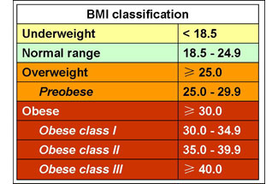
Obesity:
      Body mass index (BMI) – the weight in kilograms divided by the square of the height in meters (kg/m2) – is a commonly used index to classify overweight and obesity in adults. WHO defines overweight as a BMI equal to or more than 25, and obesity as a BMI equal to or more than 30.
372

Slide 373
    Obesity – Continued’
    Body Mass Index (BMI) is a number calculated from a person's weight and height. BMI provides a reliable indicator of body fatness for most people and is used to screen for weight categories that may lead to health problems.
    Body Mass Index (BMI) is a simple index of weight-for-height that is commonly used to classify underweight, overweight and obesity in adults. It is defined as the weight in kilograms divided by the square of the height in metres (kg/m2). For example, an adult who weighs 70kg and whose height is 1.75m will have a BMI of 22.9.
    BMI = 70 kg / (1.75 m2) = 70 / 3.06 = 22.9
373

Slide 374
Obesity: Quick Facts and Figures
      More than 1.4 billion adults were overweight in 2008, and more than half a billion obese
      In 2008, more than 1.4 billion adults were overweight and more than half a billion were obese. At least 2.8 million people each year die as a result of being overweight or obese. The prevalence of obesity has nearly doubled between 1980 and 2008. Once associated with high-income countries, obesity is now also prevalent in low- and middle-income countries.
      Globally, over 40 million preschool children were overweight in 2008
      Childhood obesity is one of the most serious public health challenges of the 21st century. Overweight children are likely to become obese adults. They are more likely than non-overweight children to develop diabetes and cardiovascular diseases at a younger age, which in turn are associated with a higher chance of premature death and disability.
374

Slide 375
Obesity: Quick Facts and Figures:
      Overweight and obesity are linked to more deaths worldwide than underweight.
      65% of the world's population live in a country where overweight and obesity kills more people than underweight. This includes all high-income and middle-income countries. Globally, 44% of diabetes, 23% of ischaemic heart disease and 7–41% of certain cancers are attributable to overweight and obesity.
      Obesity is preventable.
375

Slide 376
Obesity: Prevention:
        Supportive environments and communities are fundamental in shaping people’s choices and preventing obesity
        Individual responsibility can only have its full effect where people have access to a healthy lifestyle, and are supported to make healthy choices.
        WHO mobilizes the range of stakeholders who have vital roles to play in shaping healthy environments and making healthier diet options affordable and easily accessible.
        The global obesity epidemic requires a population-based multi-sectoral, multi-disciplinary, and culturally relevant approach
376

Slide 377
Obesity: Prevention:
        WHO's Action Plan for the Global Strategy for the Prevention and Control of Non communicable Diseases provides a roadmap to establish and strengthen initiatives for the surveillance, prevention and management of non communicable diseases, including obesity.
377

Slide 378
HYPERTENSION
378

Slide 379
Hypertension
Raised Blood Pressure
(Systolic)/(Diastolic) in mm of Hg (mercury)
Systolic = amount of force your arteries use when the heart pumps
Diastolic = amount of force your arteries use when the heart relaxes
Measurement | Normal | Pre-Hypertensive | Hypertensive
Systolic mmHg | <120 | 120-139 | 140+
Diastolic mmHg | <80 | 80-89 | 90+
379

Slide 380
Blood pressure is the force exerted by the blood against the walls of blood vessels, and the magnitude of this force depends on the cardiac output and the resistance of the blood vessels
Hypertension is defined as having a blood pressure higher than 140 over 90 mmHg, with a consensus across medical guidelines.
A diagnosis of hypertension may be made when one or both readings are high: systolic (the pressure as the heart pumps blood around the body), given first; or diastolic (pressure as the heart relaxes and refills with blood), given second.
Modern lifestyle factors are responsible for a growing burden of hypertension: physical inactivity, salt-rich diets with processed and fatty foods, and alcohol and tobacco use.
380

Slide 381
High blood pressure can also be secondary to other conditions - kidney disease, for example - and can be associated with some medications.
Hypertension itself does not cause symptoms but in the long-term leads to complications caused by narrowing of blood vessels.
Doctors diagnose high blood pressure over a number of visits using a sphygmomanometer, which involves applying an inflatable cuff to the upper arm.
Lifestyle measures are used first to treat high blood pressure, including salt restriction and other dietary changes, moderation of alcohol, and stress reduction.
One or more drugs from a number of different classes may be used for treatment.
381

Slide 382
Raised Blood Pressure: Health Effects:
Leading risk factor for stroke
Major risk factor for coronary heart disease
In some age groups, the risk of CVD doubles for each increment of 20/10 mmHg of blood pressure
Other complications of raised blood pressure:
‒ Heart failure
‒ Peripheral vascular disease
‒ Renal impairment
‒ Retinal hemorrhage
‒ Visual impairment
382

Slide 383
SCHIZOPHRENIA
383

Slide 384
Schizophrenia
Key facts
Schizophrenia is a severe mental disorder affecting more than 21 million people worldwide.
Schizophrenia is characterized by distortions in thinking, perception, emotions, language, sense of self and behaviour. Common experiences include hearing voices and delusions.
Worldwide, schizophrenia is associated with considerable disability and may affect educational and occupational performance.
People with schizophrenia are 2-2.5 times more likely to die early than the general population. This is often due to physical illnesses, such as cardiovascular, metabolic and infectious diseases.
Stigma, discrimination and violation of human rights of people with schizophrenia is common.
Schizophrenia is treatable. Treatment with medicines and psychosocial support is effective.
Facilitation of assisted living, supported housing and supported employment are effective management strategies for people with schizophrenia.
384

Slide 385
Schizophrenia:
Symptoms
Schizophrenia is characterized by distortions in thinking, perception, emotions, language, sense of self and behaviour. Common experiences include:
Hallucination: hearing, seeing or feeling things that are not there.
Delusion: fixed false beliefs or suspicions that are firmly held even when there is evidence to the contrary.
Abnormal Behaviour: strange appearance, self-neglect, incoherent speech, wandering aimlessly, mumbling or laughing to self.
Causes of schizophrenia
Research has not identified one single factor. It is thought that an interaction between genes and a range of environmental factors may cause schizophrenia.
Psychosocial factors may also contribute to schizophrenia
385

Slide 386
Schizophrenia:
Management:
Schizophrenia is treatable. Treatment with medicines and psychosocial support is effective. However, the majority of people with chronic schizophrenia lack access to treatment.
Magnitude and Impact
Schizophrenia affects more than 21 million people worldwide but is not as common as many other mental disorders. It is more common among males (12 million), than females (9 million). Schizophrenia also commonly starts earlier among men.
People with schizophrenia are 2-2.5 times more likely to die early than the general population. This is often due to physical illnesses, such as cardiovascular, metabolic and infectious diseases.
386

Slide 387
EPILEPSY
387

Slide 388
Epilepsy is a chronic disorder of the brain that affects people worldwide.
It is characterized by recurrent seizures, which are brief episodes of involuntary movement that may involve a part of the body (partial) or the entire body (generalized), and are sometimes accompanied by loss of consciousness and control of bowel or bladder function.
Signs and symptoms
Characteristics of seizures vary and depend on where in the brain the disturbance first starts, and how far it spreads. Temporary symptoms occur, such as loss of awareness or consciousness, and disturbances of movement, sensation (including vision, hearing and taste), mood, or other cognitive functions.
388

Slide 389
Key facts
Epilepsy is a chronic non communicable disorder of the brain that affects people of all ages.
Approximately 50 million people worldwide have epilepsy, making it one of the most common neurological diseases globally.
Nearly 80% of the people with epilepsy live in low- and middle-income countries.
People with epilepsy respond to treatment approximately 70% of the time.
About three fourths of people with epilepsy living in low- and middle- income countries do not get the treatment they need.
In many parts of the world, people with epilepsy and their families suffer from stigma and discrimination.
389

Slide 390
Causes:
Epilepsy is not contagious. The most common type of epilepsy, which affects 6 out of 10 people with the disorder, is called idiopathic epilepsy and has no identifiable cause.
Epilepsy with a known cause is called secondary epilepsy, or symptomatic epilepsy. The causes of secondary (or symptomatic) epilepsy could be:
Brain damage from prenatal or perinatal injuries (e.g. A loss of oxygen or trauma during birth, low birth weight),
Congenital abnormalities or genetic conditions with associated brain malformations,
A severe head injury
390

Slide 391
A stroke that restricts the amount of oxygen to the brain,
An infection of the brain such as meningitis, encephalitis, neurocysticercosis,
Certain genetic syndromes,
A brain tumor.
Treatment
It’s treated with anti-epileptic drugs (AEDs). Epilepsy can be treated easily and affordably with inexpensive daily medication.
Prevention
Idiopathic epilepsy is not preventable. However, preventive measures can be applied to the known causes of secondary epilepsy.
391

Slide 392
Preventing head injury is the most effective way to prevent post-traumatic epilepsy.
Adequate perinatal care can reduce new cases of epilepsy caused by birth injury.
The use of drugs and other methods to lower the body temperature of a feverish child can reduce the chance of febrile seizures.
Central nervous system infections are common causes of epilepsy in tropical areas, where many low- and middle-income countries are concentrated.
Elimination of parasites in these environments and education on how to avoid infections can be effective ways to reduce epilepsy worldwide
392

Slide 393
BURNS
393

Slide 394
A burn is an injury to the skin or other organic tissue primarily caused by heat or due to radiation, radioactivity, electricity, friction or contact with chemicals.
Thermal (heat) burns occur when some or all of the cells in the skin or other tissues are destroyed by:
Hot Liquids (Scalds)
Hot Solids (Contact Burns), or
Flames (Flame Burns).
Facts and Figures:
Burns are a global public health problem, accounting for an estimated 265 000 deaths annually.
Burns are among the leading causes of disability-adjusted life-years (DALYs) lost in low- and middle-income countries.
In 2004, nearly 11 million people worldwide were burned severely enough to require medical attention.
394

Slide 395
Who is at risk?
Gender
Females and males have broadly similar rates for burns according to the most recent data
Age
Along with adult women, children are particularly vulnerable to burns.
Risk factors
Socioeconomic factors - people living in low- and middle-income countries are at higher risk for burns than people living in high-income countries.
Occupations that increase exposure to fire;
Poverty, overcrowding and lack of proper safety measures;
placement of young girls in household roles such as cooking and care of small children
395

Slide 396
Underlying medical conditions, including epilepsy, peripheral neuropathy, and physical and cognitive disabilities;
Alcohol abuse and smoking;
Easy access to chemicals used for assault (such as in acid violence attacks);
Use of kerosene (paraffin) as a fuel source for non-electric domestic appliances;
Inadequate safety measures for liquefied petroleum gas and electricity.
Prevention:
Enclose fires and limit the height of open flames in domestic environments.
Promote safer cook stoves and less hazardous fuels, and educate regarding loose clothing.
Apply safety regulations to housing designs and materials, and encourage home inspections.
396

Slide 397
Improve the design of cook stoves
Lower the temperature in hot water taps.
Promote fire safety education and the use of smoke detectors, fire sprinklers, and fire-escape systems in homes.
Promote the introduction of and compliance with industrial safety regulations
Avoid smoking in bed and encourage the use of child-resistant lighters.
Promote legislation mandating the production of fire-safe cigarettes.
Improve treatment of epilepsy, particularly in developing countries.
Encourage further development of burn-care systems,
Support the development and distribution of fire-retardant aprons to be used while cooking around an open flame or kerosene stove.
397

Slide 398
First aid
Stop the burning process by removing clothing and irrigating the burns.
Extinguish flames by allowing the patient to roll on the ground, or by applying a blanket, or by using water or other fire-extinguishing liquids.
Use cool running water to reduce the temperature of the burn.
In chemical burns, remove or dilute the chemical agent by irrigating with large volumes of water.
Wrap the patient in a clean cloth or sheet and transport to the nearest appropriate facility for medical care.
398

Slide 399
ANEMIA
(Anemia, also spelled anaemia)
399

Slide 400
Anemia is a condition that develops when your blood lacks enough healthy red blood cells or haemoglobin.
If you have too few or abnormal red blood cells, or your haemoglobin is abnormal or low, the cells in your body will not get enough oxygen.
this blood related disorder affects the haemoglobin molecule, and causes the entire blood cell to change shape under stressed conditions. The haemoglobin molecule is defective. After haemoglobin molecules give up their oxygen, some may cluster together and form long, rod-like structures which become stiff and assume sickle shape.
Unlike healthy red blood cells, which are usually smooth and donut-shaped, sickled red blood cells cannot squeeze through small blood vessels.
400

Slide 401
They stack up and cause blockages that deprive organs and tissues of oxygen-carrying blood. This process produces periodic episodes of pain and ultimately can damage tissues and vital organs and lead to other serious medical problems. Normal red blood cells live about 120 days in the bloodstream, but sickled red cells die after about 10 to 20 days. Because they cannot be replaced fast enough, the blood is chronically short of red blood cells.
Symptoms and Signs
Feel tired or lightheaded (sometimes with fainting)
Weakness
Fatigue easily
Have decreased energy
Appear pale
Develop palpitations or rapid heart rate
Experience shortness of breath
401

Slide 402
Children with chronic anemia are prone to infections and learning problems.
Anemia can be detected by a simple blood test called a complete blood cell count (CBC).
The treatment of the anemia varies greatly and very much depends on the particular cause.
Causes:
In general, anemia has four basic categories of causes. Sometimes more than one of these problems are causing the anemia:
Bleeding (haemorrhage)
Excessive destruction of red blood cells (haemolysis)
Underproduction of red blood cells (such as from bone marrow disorders)
Not enough normal haemoglobin
402

Slide 403
Risk factors for anemia:
Anemia can occur in people of all ages and race, males and females. However, there are certain factors that raise the risk for anemia:
Women of childbearing age - due to menstruation
Pregnancy and childbirth - due increased demands of iron, women should supplement with folic acid
Preterm infants
Children aged 1-2
Individuals with poor diets, low in vitamins, mineral, and iron
Blood loss from surgery or injury
Long-term or serious illnesses, such as AIDs, diabetes, kidney disease, cancer, rheumatoid arthritis, heart failure, and liver disease
A family history of inherited anemias
Intestinal disorders-affects absorption of nutrients
403

Slide 404
Diagnosis of anemia:
To diagnose anemia, several methods can be used; the most common of which is a complete blood count (CBC), which measures a number of blood components, including the patient's hemoglobin and hematocrit levels (ratio of the volume of red blood cells to the total volume of blood).
The results of a CBC are examined and compared with the recommended healthy levels.
TREATMENTS FOR ANEMIA:
There is a range of treatments for anemia, all ultimately aimed at increasing the red blood cell count which in turn increases the amount of oxygen the blood carries.
Depending on the type of anemia, the treatment has to match the cause.
404

Slide 405
ARTHRITIS
405

Slide 406
Arthritis is a term often used to mean any disorder that affects joints; a painful inflammation and stiffness of the joints
Although the word "arthritis" means joint inflammation, the term is used to describe around 200 rheumatic diseases and conditions that affect joints, the tissues that surround the joint, and other connective tissue.
Rheumatic conditions are typically characterized by pain, aching, stiffness and swelling in and around one or more joints. The symptoms can develop gradually or suddenly. Certain rheumatic conditions can also involve the immune system and various internal organs of the body.
Arthritis is more common among adults aged 65 years or older, but people of all ages (including children) can be affected.
406

Slide 407
Types of arthritis:
There are around 200 types of arthritis - or musculoskeletal conditions - which are split into seven main groups:
Inflammatory arthritis
Degenerative or mechanical arthritis
Soft tissue musculoskeletal pain
Back pain
Connective tissue disease
Infectious arthritis
Metabolic arthritis.
407

Slide 408
Causes
There is no single cause of all types of arthritis; the cause or causes in any given case vary according to the type or form of arthritis. Potential causes for arthritis may include:
Potential causes for arthritis may include:
Injury - leading to degenerative arthritis
Abnormal metabolism - leading to gout and pseudogout
Inheritance - such as in osteoarthritis
Infections - such as in the arthritis of Lyme disease
Immune system dysfunction
408

Slide 409
Risk factors for arthritis:
Non-modifiable arthritis risk factors:
Age: the risk of developing most types of arthritis increases with age
Sex: most types of arthritis are more common in females; 60% of all people with arthritis are female. Gout is more common in males than females
Genetic: specific genes are associated with a higher risk of certain types of arthritis, such as rheumatoid arthritis (RA), systemic lupus erythematosus (SLE) and ankylosing spondylitis.
409

Slide 410
Modifiable arthritis risk factors:
Overweight and obesity: excess weight can contribute to both the onset and progression of knee osteoarthritis
Joint injuries: damage to a joint can contribute to the development of osteoarthritis in that joint
Infection: many microbial agents can infect joints and trigger the development of various forms of arthritis
Occupation: certain occupations that involve repetitive knee bending and squatting are associated with osteoarthritis of the knee
410

Slide 411
Signs and symptoms:
Pain. Pain from arthritis can be constant, or it may come and go. Pain might be isolated to one place or felt in many parts of the body
Swelling. Some types of arthritis cause the skin over the affected joint to become red and swollen, and to feel warm to the touch
Stiffness. Stiffness is a typical arthritis symptom, with some forms of arthritis causing increased stiffness upon waking up in the morning, after sitting at a desk, or after sitting in a car for a long time, and others resulting in stiffness after exercise or characterized by persistent stiffness
Difficulty moving a joint. Moving a joint or getting up from a chair should not be hard or painful and can indicate arthritis or other joint problem.
411

Slide 412
Diagnosis
Most cases of arthritis are diagnosed with a detailed medical history of current and past symptoms, physical examination and particular radiographic and laboratory studies.
It is possible to have more than one form of arthritis at the same time, and only a few rheumatic diseases have a definitive diagnosis, such as gout.
The tests are ordered during the diagnostic process that depend on the type of arthritis suspected.
Examples of Test:
Rheumatoid factor
Anti-CCP antibody
Complete blood count (CBC)
412

Slide 413
Treatment:
The focus of treatment for arthritis is to control pain, minimize joint damage and improve or maintain function and quality of life.
Whether you have a non-inflammatory or inflammatory type of arthritis or even a painful case of gout, there are numerous medications and recommendations to relieve pain and ensure that your joints do not become damaged further.
Treatment may involve:-
Medications
Non-pharmacologic therapies
Physical or occupational therapy
Splints or joint assistive aids
Patient education and support
Weight loss
Surgery - joint replacement and joint surgery
413

Slide 414
TRAUMA:
414

Slide 415
Trauma is a distressing event in which a person feels severely threatened emotionally, psychologically, or physically.
It’s the emotional response someone has to an extremely negative event.
While trauma is a normal reaction to a horrible event, the effects can be so severe that they interfere with an individual’s ability to live a normal life.
In a case such as this, help may be needed to treat the stress and dysfunction caused by the traumatic event and to restore the individual to a state of emotional well-being.
Trauma can manifest days, months or even years after the actual event.
Longer term reactions include unpredictable emotions, flashbacks, strained relationships and even physical symptoms like headaches or nausea.
415

Slide 416
Main Sources of Trauma:
Rape
Domestic violence
Natural disasters
Severe illness or injury
The death of a loved one
Witnessing an act of violence
Signs and Symptoms:
Person appear shaken and disoriented
Anxiety
Emotional Symptoms of Trauma
Denial, anger, sadness and emotional outbursts.
Physical Symptoms of Trauma
Paleness, lethargy, fatigue, poor concentration and a racing heartbeat.
416

Slide 417
Trauma Medication:
It can be treated through the use of certain medications.
Not all trauma requires medication, but it can be a useful tool in treating the symptoms of trauma, such as anxiety and depression.
It is important to work with a healthcare professional to determine whether medication is necessary.
Drug options will depend on the individual’s psychological and medical history as well as the severity of the symptoms.
417

Slide 418
EYE DISORDERS AND CANCER.
418

Slide 419
Many eye diseases have no early symptoms. They may be painless, and you may see no change in your vision until the disease has become quite advanced.
The single best way to protect your vision is through regular professional eye examinations.
People with eye cancer may experience the following symptoms or signs.
Bulging of one eye
Complete or partial loss of sight
Pain in or around the eye (rare with eye cancer)
A pale raised lump on the surface of the eye (the conjunctiva or cornea)
Blurred vision
Change in the appearance of the eye
419

Slide 420
Eye cancer can also cause
Seeing spots or flashes of light or wiggly lines in front of your eyes
Blinkered vision (loss of peripheral vision) – you can see what is straight ahead clearly, but not what is at the sides
A dark spot on the coloured part of the eye (the iris) that is getting bigger
Eye irritation, red eye or chronic inflammation of the conjunctiva (conjunctivitis)
Causes of Eye Problem:
Eyestrain
Reading for hours, working at a computer, or driving long distances. It happens when you overuse your eyes. They get tired and need to rest, just like any other part of your body.
420

Slide 421
NON COMMUNICABLE DISEASES:
SPECIFIC RISK FACTORS
421

Slide 422
Tobacco Use:
Tobacco kills up to half of its users.
Tobacco kills nearly 6 million people each year.
Annual death toll could rise to more than 8 million by 2030.
Nearly 80% of the world’s 1 billion smokers live in low- and middle-income countries.
Tobacco Use: Health Effects
Among smokers:
Cancer
Coronary heart disease
Diseases of the lungs
Peripheral vascular disease
Stroke
Fetal complications and stillbirth
Second-hand smoke causes:
Heart disease, including heart attack
Lung cancer
422

Slide 423
DISEASE CAUSED BY TOBACCO USE:
Cigarette smoking increases the risk of:
        Coronary heart disease
        Atherosclerotic peripheral vascular disease
        Cerebrovascular disease
        Cancers of the lung, larynx, mouth, esophagus, bladder, pancreas, kidney, and cervix
        Chronic obstructive pulmonary disease
        Intrauterine growth retardation, premature rupture of membranes
        Low-birthweight babies, perinatal mortality
        Cataract, macular degeneration; hip fracture
        Peptic ulcer disease
        Possibly liver, stomach, and colorectal cancers and acute myelocytic leukemia
423

Slide 424
DISEASE CAUSED BY TOBACCO USE: - Continued’
Involuntary smoking (environmental tobacco smoke) is a cause of:
        Lung cancer and coronary heart disease in non smokers
        Respiratory infections and symptoms in the children of parents who smoke
Smokeless tobacco causes:
✓ Oral Cancer
✓ Oral leukoplakia
✓ Dental caries (possibly)
Cigars cause:
✓ Cancers of the mouth, larynx, and lung
✓ Coronary heart disease
✓ COPD
424

Slide 425
The Benefits of Physical Activity
Regular physical activity is one of the most important things you can do for your health.
        Control your weight
        Reduce your risk of cardiovascular disease
        Reduce your risk for type 2 diabetes and metabolic syndrome
        Reduce your risk of some cancers (colon, breast, endomentrial and lung cancers)
        Strengthen your bones and muscles
        Improve your mental health and mood
        Improve your ability to do daily activities and prevent falls, if you're an older adult
        Increase your chances of living longer
425

Slide 426
PHYSICAL INACTIVITY:
Global Changes in Physical Activity:
31% of the world’s population does not get enough physical activity.
Many social and economic changes contribute to this trend:
Aging populations,
Transportation, and
Communication technology.
Approx. 6-10% of major NCDs worldwide is attributable to physical inactivity
426

Slide 427
Physical Activity: Health Effects:
Reduces:
High blood pressure
Adverse lipid profile
Arthritis pain
Psychiatric issues
Reduces risk of:
Type 2 diabetes
Certain cancers
Heart attacks
Stroke
Falls
Early death
427

Slide 428
Global Changes in Diet:
Most countries have increased overall daily consumption of:
Daily calories,
Fat and meats, and
Energy dense and nutrient-poor foods such as:
‒ Starches
‒ Refined sugars
‒ Trans-fats
Unhealthy Diet: Health Effects
Coronary heart disease
Stroke
Cancer
Type 2 diabetes
Hypertension
Diseases of the liver and gallbladder
Obesity
428

Slide 429
HARMFUL USE OF ALCOHOL:
Global Alcohol Consumption
11.5% of all global drinkers are episodic, heavy users.
2.5 million people die from alcohol consumption per year
The majority of adults consume at low-risk levels.
Estimated worldwide consumption of alcohol has remained relatively stable.
Harmful Use of Alcohol: Effects
Immediate effects:
Diminished brain function
Loss of body heat
Fetal damage
Risk for unintentional injuries
Risk for violence
Coma and death
Long-term effects:
Liver diseases
Cancers
Hypertension
Gastrointestinal disorders
Neurological issues
Psychiatric issues
429

Slide 430
END

Slide 431
THANKS

