Slide 1
Community Health
Nursing (K.R.C.H.N- Basic)
March, 2021 class
26th April, 2021

Slide 2
Brain storming

Slide 3
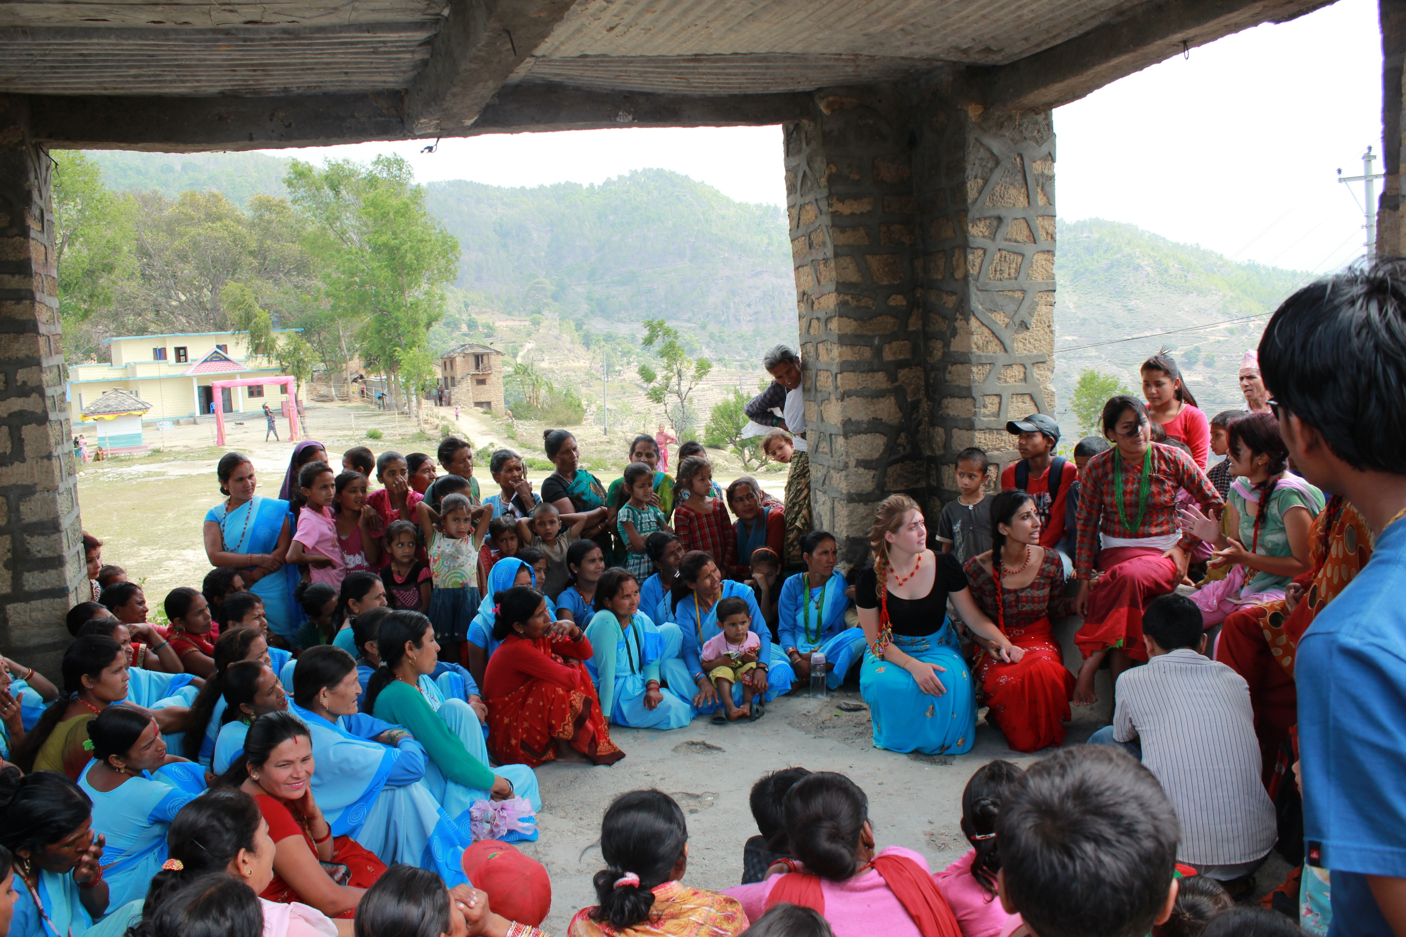

Slide 5
Objectives
By the end of the lesson the learners should be able to:
Define terms; community, community health, health
Describe the pathway of disease and health
Describe factors that influence individual
Describe factors that influence community health
Describe and appreciate the community health process

Slide 6
Definitions
Community health – part of health care concerned with the health of the whole population and the prevention of diseases
Involves:-
Promotive
Preventive
Curative
Rehabilitative services.

Slide 7
Definitions
Community- group of people sharing goals, needs and resources;
can be a small or a large group of people or families
The group should be within a certain geographic area
Components of a community include:-
People
Goals
Environment
Boundaries
Social structures

Slide 8
CONTINUATION…
The component interact to influence health of the community
There are various entities in a community that work together
Members
Government agencies
Faith- based organisations
Private organisations
Non- governmental organisations

Slide 9
Continuation…
These entities work together to improve prevailing health status
Multisectoral approach together with community participation and involvement ensure well being of the population
To interact with a community effectively ;
A health worker should understand:-
Leadership/administration
Communication
Health structures

Slide 10
Continuation..
Through its members a community;
uses/utilizes the available resources to improve the living conditions
This brings about the functions of a community
recreation,
procreation,
socialization,
education,
income generating activities,
environmental health activities,
administrative and discipline of rogue members

Slide 11
Note:
Community components, structure and functions influence community health
Therefore need for effective health services to;
Improve
Correct
Promote the health of the people

Slide 12
Health
According to WHO, health is a state of complete physical,
mental and social well being of an individual and
not merely the absence of disease of infirmity

Slide 13
Disease pathway
Process through which a disease or illness takes
From onset till recovery / disability/death

Slide 14
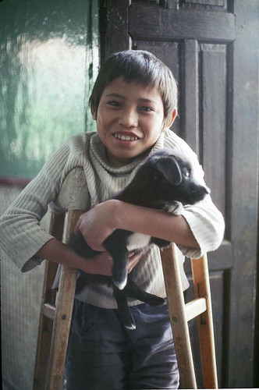
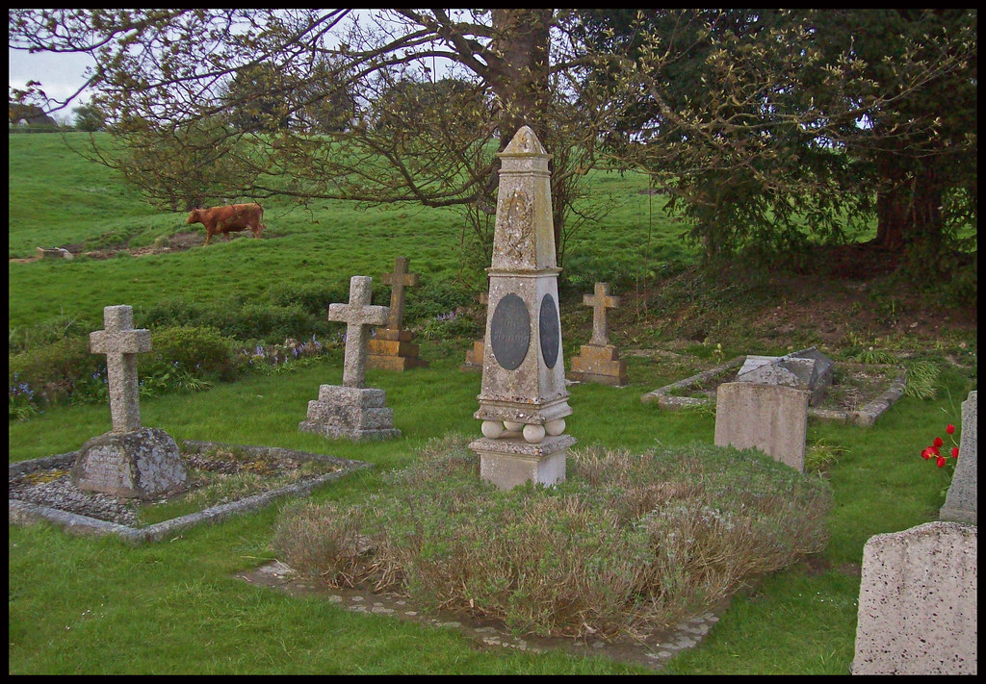
 | Types of prevention |  |  | Outcome
 | Primary | Secondary | Tertiary
Development of the diseaese | Health immunisation Chemoprophylaxis Nutrition Personal hygiene / child spacing Environmental control( food, water, excreta and rubbish disposal, disinfection and sterilization, vector control, living and working conditions | Sub clinical | clinical
 |  | Screening surveillance
 |  |  | Death Diagnosis Treatment Management Rehabilitation
Pathway of health
Full recovery
Path way of health
Permanent disability
Passage of time

Slide 15
Continuation..
At first there is a healthy individual (well and healthy)
Ideally this is the way it should be along the pathway of health
Something goes wrong when an infection sets in:-
Initially the infected individual might be unaware (the disease is sub clinical or pre-symptomatic.
Some diseases will remain without symproms and individual is termed as asymptomatic

Slide 16
Continuation …
When symptoms appear, the disease is termed as clinical
Some of signs and symptoms that appear are fever, cough, diarhoea.
Symptoms lead to health services seeking behaviour
This is the most known stage since patients are inpatients or outpatients
Patient are treated and manged at different level

Slide 17
Continuation..
During and after treatment some individuals get to:-
Full recovery
Permanent disability
Death

Slide 18
Individual sickness and community health
What individuals do or fail to do determines their health
This plays a vital role in development of a disease
When maintenance of health fails people visit health institutions to seek health care.
Some take home remedies and still recover at home.
It is therefore not easy to know the number of sick people in a population
This hinders effort of controlling diseases especially communicable diseases

Slide 19
Factors influencing individual health
Social
Cultural
Economic
Education
Environment
Genetics
Perceptions
Health facility
Physical condition
Healthy behaviour
Un healthy behaviour

Slide 20
Factors influencing community health
Nutrition
Water
Environment
Transport
Communication network
Leadership
Housing
Social structure

Slide 21
Community health process
Community diagnosis
Monitoring and evaluation
Health factors and resources identified
Planning and implementation

Slide 22
Comparison between community and individual health care
 | Individual | Community
Objective | Solve health problems | Solve health problems
Diagnosis | History taking,examination and investigations | Demographic data, local environment, disease patterns, available health services
Planning and implementation | Differential diagnosis and diagnosis | Community diagnosis and priorities
implementation | Treatment and rehabilitation | Community health interventions
Evaluation | Followup and assessmentmonitoring and evaluation

Slide 23
Summary
Community health is concerned with :
the health of the population
Prevention of diseases in the community
Health of individuals is determined by their behaviour, lifestyle and practises

Slide 24
Congratulations you have reached the end of the lesson

Slide 25
Questions?

Slide 26
Assignment
Read and make short/brief notes on primary methods of disease prevention.
Should be a write up of at least 500 words and should be submitted on or before Friday 30th April, 2021.

Slide 27
References /further reading
Wood, C.(2008) communicable diseases, AMREF
Mackenzie, J and Green, w. (2016) Community health (Online) Available at:
Community Health | Encyclopedia.com [Accessed April 2021].

