Slide 1
Babies with special needs
Low birth weight babies less than 2.5kgs
Premature babies
Babies with jaundice
Babies with infections
Babies with low blood sugar
Babies with birth injuries
Babies with poor Apgar score
Congenital anomalies

Slide 2
Congenital abnormalities/Congenital anomalies /birth defects, congenital disorders or congenital malformations
mm

Slide 3
Course unit learning outcomes:
By the end of this unit the student will be able to:
Manage a babies admitted in the special care baby unit with various congenital anomalies

Slide 4
Congenital anomalies
Structural or functional anomalies that occur during intrauterine life and can be identified prenatally, at birth or later in life.

Slide 5
Causes
Genetic/inheritance- abnormalities in the ovum or sperm can lead to conditions like down syndrome, turner syndrome
Environmental factors-noxious substances affect organ development-pesticides
Hypoxia: constant oxygen supply is essential for correct organ development
Infections: rubella,cytomegalovirus
Radiation: radioactive substances have harmful effect on the foetus
Drugs:carbamazepine,valproic acid

Slide 6
CNS MALFORMATIONS
1.Anencephaly: absence of a major portion of the brain skull and scalp that occurs during embryonic period
Diagnosis antenatally
Raised alpha fetoprotein in maternal blood
Ultra sound
Prognosis: infant dies within few days or is a stillbirth
Notes:
Alpha feto protein blood checks the amount of AFP in a pregnant woman’s blood.AFP is a substance made in th eliver of an unborn baby.the amount of AFP in the blood of a pregnant woman can help see whether the baby may have problems like spina bifida and anencephaly.it can aslo be done to find out other chromosomal disorders such as down syndromelevels of the protein can be measured to detect certain congenital defects such as spina bifida and down syndrome.normally low levels of AFP can be found in the blood of pregnant woman.no amount of AFP should be found in the blood of healthy men or healthy non pregnant women.normal ranges:adults:under 50 nanograms/ml,and children under 10 and under 5 nanograms/ml
AFP is found both in fetal serum and amniotic fluid.
.

Slide 7
2.Microcephaly:
The occipital frontal circumference is more than two standard deviations below normal for gestational age
vault of the skull is small. Associated with reduction in amount of brain tissue.
May be caused by rubella infection or autosomal recessive condition or fetal alcohol syndrome
Baby survives but tend to be mentally retarded and lack muscle coordination.
May have seizures

Slide 8
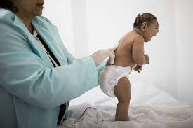

Slide 9
3.Encephalocoele:
Brain tissue covered with meninges protrudes through lambdoidal sutures on the foetal skull. Contains brain tissue, pulsates ,is opaque, does not fluctuate, usually has a pedicle

Slide 10
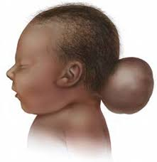
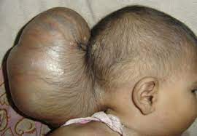

Slide 11
4.Spina bifida:part of one or more vertebrae fails to develop completely leaving a portion of the spinal cord unprotected.
Associated lack of folic acid deficiency in diet during pregnancy
Site: lumbosacral area
Base of the skull-encephalocoele
Diagnosis
Ultrasound scanning
After birth
Symptoms
Weakness
Paralysis

Slide 12
Management:
Cover the open lesion with non adherent dressing
Surgery to close opening
Physiotherapy to keep joints mobile and strengthens functioning muscles
Types of spina bifida
a)spina bifida aperta: failure of fusion of the vertebral column
If there is no skin covering ,the defect allows protrusion meninges- meningocele.The meningeal membrane may be flat or appear as a membraneous sac with or without cerebrospinal fluid but it doesn’t contain neural tissue.

Slide 13
Meningomyelocoele: involves protrusion of meninges and spinal cord. gives rise to neural damage leading to paralysis distal to the defect and impaired function of urinary bladder and bowel.
II.Spina bifida occulta:
Minor type of defect.no spinal cord involvement.a tuft of hair or sinus at the base of the spine may be noted on first examination of the baby.confirmed via ultrasound
5.Hydrocephalus

Slide 15
Gastrointestinal defects
Osephageal atresia :incomplete development of oesophagus.
Associated with tracheo-esophageal fistula which connects the trachea to the oesophagus
Should be suspected in maternal polyhydramnios
s/s
Excessive saliva
Coughs after attempts to swallow
cyanosis

Slide 16
Oesophageal atresia

Slide 17
Management
No oral fluids to be given to the baby
Intravenous infusion/gastrostomy
Surgery
Placing a continous catheter in the upper oesophagus to suction out saliva before it reaches lungs

Slide 18
Congenital Diaphragmatic hernia
A defect in the diaphragm that allows some of the abdominal organs to protrude into the chest the hernia is large enough the affected side is usually incompletely developed.
The stomach ,loop of the intestine, liver and spleen protrude the hernia.
Common on the left side of the diaphragm
s/s
Respiratory distress
Cyanosis
Reduced respiratory movement
Management:surgical intervention

Slide 19
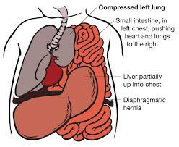

Slide 20
Tongue tie(ankyloglossia)
Restricts the tongue's range of motion.
An unusually short, thick or tight band of tissue (lingual frenulum) tethers the bottom of the tongue's tip to the floor of the mouth.
Difficulty sticking out his or her tongue.
Affect the way a child eats, speaks and swallows, as well as interfere with breast-feeding.
Management
a surgical cut to release the frenulum (frenotomy).

Slide 21
Rectal/anal atresia and imperforate anus:
Rectal atresia:congenital absence or closure of a rectum
Anal atresia :incomplete development of the anus
Imperforate anus:abnormally closed or absent
Notes:
Bile carries away the liver waste products and breaks down fats in the small intestine

Slide 23
Omphalocoele/exomphalos: herniation of abdominal viscera through an open umbilical ring.
Gastroschisis: a defect in anterior abdominal wall through which abdominal contents protrude freely with no overlying sac or peritoneum.common in SGA and preterm

Slide 24
gastroschisis

Slide 25
Hirschsprung’s disease:
A section of the large intestine is missing the nerve network that controls the intestine rhythmic contractions in order to move food along. Without innervation the intestines can’t contract normally.
Fecal matter builds up resulting in severe constipation and vomiting.(bile stained)
Management: surgery(colostomy)

Slide 26
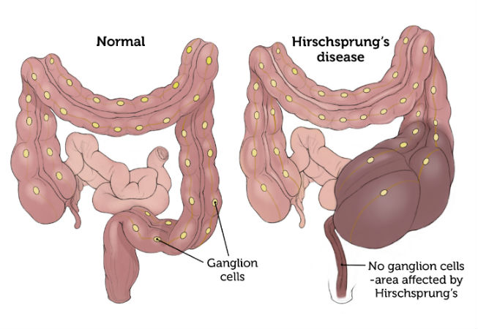

Slide 27
Biliary atresia
Failure of bile ducts to develop or abnormal development
Bile fluid secrete d by the liver carries away livers waste products and breaks down fats in the small intestine.bile ducts within the liver collect bile and carry it to the small intestine
In biliary atresia bile ducts develop partially or not at all.hence bile cant reach the intestines and instead bilirubin accumulates in the liver and eventually escapes into the blood causing jaundice

Slide 28
Ct. Biliary atresia…Symptoms
Urine is progressively dark
Pale stools
Jaundiced skin
Enlarged liver
High blood pressure in the portal vein
Diagnosis/S
Management :
surgery to relieve pressure within the liver
Repositioning the the liver so that its surface directly touches the intestine to allow the bile to ooze from the liver surface into the intestine despite lack of bile ducts

Slide 29
Duodenal atresia
Persistent vomiting occurs within the first 24-36 hours of life after birth
Vomit contains bile unless the obstruction is proximal to the entrance of bile duct
Detected through x-ray
Management: surgical repair of atresia
Common in children with down syndrome

Slide 30
Musculoskeletal malformations:
Facial abnormalities
Cleft lip : cleft lip is incomplete joining of the upper lip, just below the nose
Cleft palate: abnormal passage way through the roof of the mouth into the airway of the nose
Clefts occur due to failure of union in development of the face and mouth
Cleft lip interferes with feeding while cleft palate interferes with feeding and speech
Can be unilateral or bilateral

Slide 31
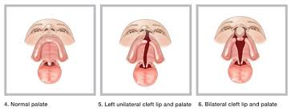

Slide 32
Management
Orthodontic plate can provide false palate
Plastic surgery to correct defect

Slide 33
Pierre Robin syndrome
Characterized by triad of abnormalities i.e
Cleft palate and micrognathia(underdevelopment of mandibular processes)
Abnormal attachment of the tongue muscles making the tongue to fall back and occlude the airway
The receding jaw causes feeding problems and respiratory distress

Slide 34
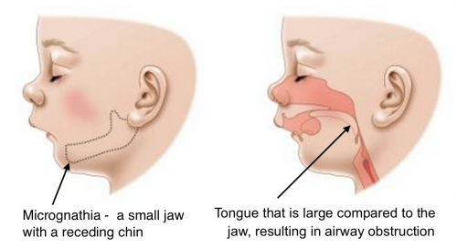

Slide 35
Management
Keep airway clear
Nurse baby in prone position
Suction catheter and oxygen ready
Orthodontic plate to correct cleft palate
The action of sucking stimulates mandibular development
ETT to keep airway patent-replaced every 2 weeks

Slide 36
Pyloric stenosis
Arises from genetic defect which causes hypertrophy of the muscles of pyloric sphincter
Baby presents with projectile vomiting around 6 weeks of age or earlier
Occur mostly in boys
Management is by surgery

Slide 37
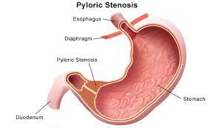

Slide 38
Spinal abnormalities
1.Congenital torticollis: a newborn’s neck is twisted to one side and the head is tilted unnaturally towards one side
Causes:
injury to the neck muscles during birth
Joining of the neck vertebrae(Klippel Feil syndrome)
Joining of the first vertebrae to the skull

Slide 40
2.Congenital scoliosis: an abnormal curvature of the spine in a newborn
Causes: polio, cerebral palsy, juvenile osteoporosis
Management: plaster cast to hold spine straight , surgery to fuse vertebrae together

Slide 41
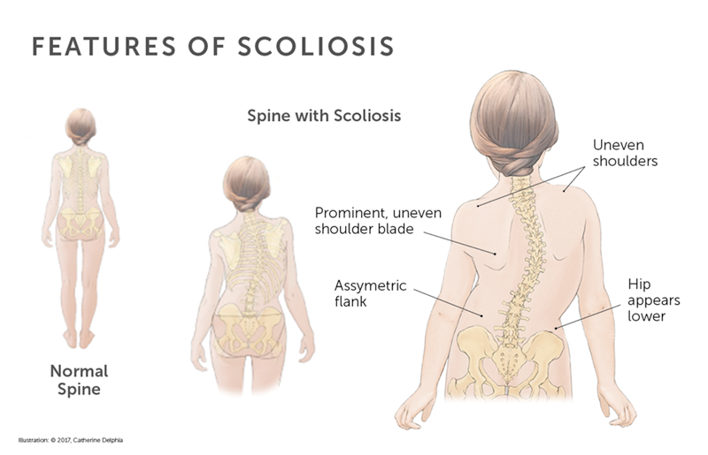

Slide 42
Hip and foot abnormalities
1.Congenital dislocation of the hip- newborns hip socket and femoral head are separated. Common in breech deliveries
It is diagnosed through ortolani’s and barlow’s test
Baby should be referred for ultra sound and then to an orthopeadic surgeon
Treatment:pavlic harness application-to hold hips in a flexed position and abducted

Slide 43
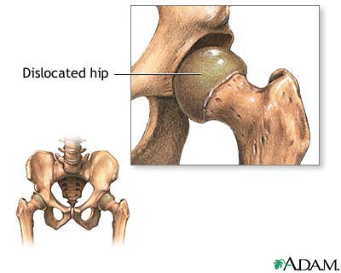

Slide 44
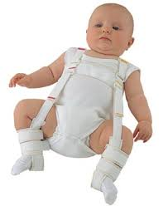
Pavlick harness for congenital dislocation of the hip

Slide 45
2.talipes (clubfoot)
-foot is twisted out of shape and position
Talipes equinovarus: the ankle is bent downwards and the front part of the foot is turned inwards
Talipes valgus:eversion of the foot inner side alone
Talipes calcaneovalgus: foot is dorsiflexed and everted
Management:application of cast as soon as possible after of birth

Slide 46
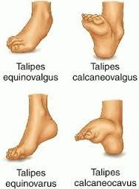

Slide 47
Osteogenesis imperfecta: bone are abnormally fragile.They break so easily that infants with this condition are usually born with many broken bones.
Due to mutation in gene that codes for type I-IV collagen
During birth head trauma and bleeding in the brain may occur because the skull is soft.
These children die within days or weeks after birth. If the baby survives, multiple fractures often cause deformities and dwarfism
Intelligence is normal if child’s brain is not injured.

Slide 48
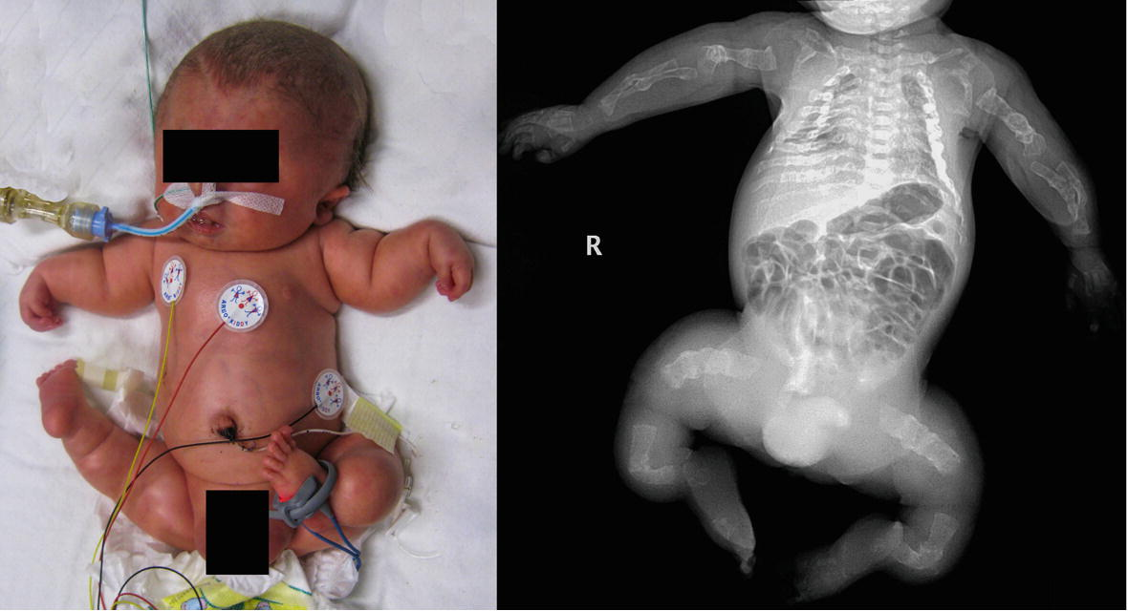

Slide 49
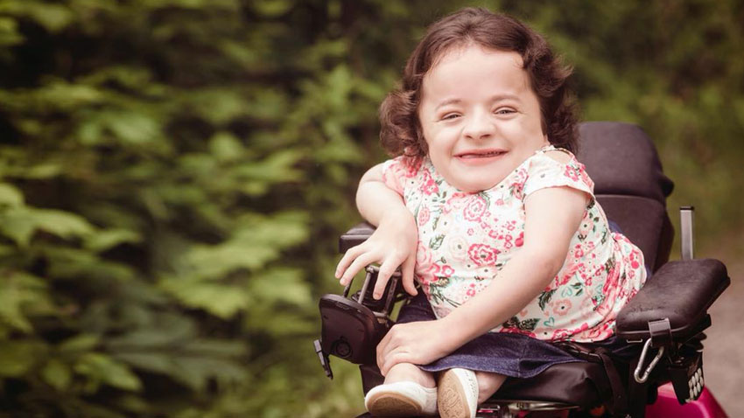

Slide 50
Polydactyly-extra digits- ligated with a silk suture if they don’t include a bone. Surgery is required if bones are present
Syndactyly-webbed digits-management is by surgical division.

Slide 51
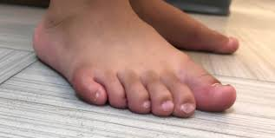
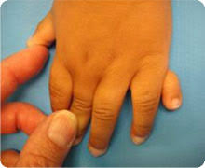

Slide 52
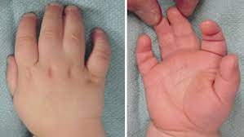
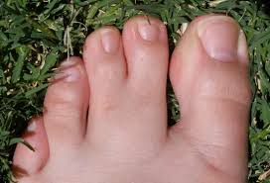

Slide 53
Achondroplasia
Is an autosomal dominant condition where the baby is generally small with disproportionately large head and short limbs
These babies often develop a marked lordosis
Cognitive development is not usually impaired
Notes:
Other chromosomes apart from sex chromosomes autosomes are 22 pairs

Slide 55
Eye defects
Congenital glaucoma: a rare condition. There is raised pressure within the eyeball
If not corrected the eyeballs may enlarge leading to complete blindness
Management: surgery to relieve pressure inside the eye and preserve infants’ vision

Slide 56
Genital urinary defects
Bladder defects:
exstrophy of the bladder
bladder may not form completely so that it opens on the surface of the abdomen.
The bladder wall may be abnormal with outpouchings that allow urine to stagnate and increase risk of urinary infection
The bladder outlet( passageway of urine) maybe narrowed leading to incomplete emptying of bladder-predispose to infections
Management :surgery

Slide 57
Ct…
Urethral defects: hypospadias-opening of urethral meatus opens onto the under surface of the penis
Epispadias:urethral meatus is located on the upper aspect of the penis
Management is through surgical correction

Slide 58
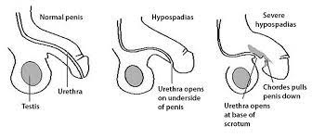
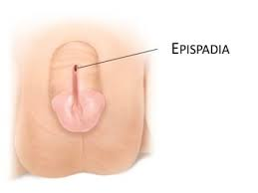

Slide 59
Ct…kidney defects
Kidney and ureter defects-defects may occur in the way kidneys form
Wrong place:ectopia-An ectopic kidney is a birth defect in which a kidney is located below, above, or on the opposite side of its usual position.
Wrong position:malrotation
Joined together:horseshoe kidney
Missing kidneys-kidney agenesis
Both kidneys may be missing-potters syndrome

Slide 61
Kidneys tissue may develop abnormality-kidney may develop many cysts-polycystic kidney disease
Kidneys will be palpable on abdominal exam,radiology and u/s are carried out to confirm diagnosis.prognosis is poor will renal failure being the outcome
Ureter abnormalities:
Extra ureters
Misplaced ureters
Narrowed or widened ureters
Urine may flow back from from the bladder into the abnormal ureters leading to infection of the kidneys and kidney damage

Slide 62
Cryptorchidism/undescendend testes
Can be unilateral or bilateral
If on first exam the testes are empty the undescended testes may be found in the inguinal pouch
Sometimes the testis in this position can be manipulated into the scrotal pouch. If neither testis is palpable further investigation to exclude endocrine or chromosomal causes is required.
In unilateral undescended testis parents should be encouraged to have the baby examined at regular intervals. If descent of the testis has not occurred by the time the child is one year old,arrangements for orchidopexy may be made

Slide 63
Intersex problems
True hermaphrodites: have both ovarian and testicular tissue and both male and female internal reproductive organs
Pseudohermaphrodites:they have ambigous external,genital organs but either ovarian or testicular tissue.for females is due to exposure to high levels of male hormones

Slide 64
END
????????????????????????

Slide 65
CARDIAC DEFECTS
Mirriam

Slide 66
Congenital heart disease
Pathological condition of the heart present at birth
These abnormalities in the heart and great vessels may be due to intrauterine developmental errors or failure of the heart and blood vessels to adapt to extra uterine life.

Slide 67
Cyanotic cardiac defects
Transposition of great arteries
Tetralogy of Fallot
Total anomalous pulmonary venous drainage
Tricuspid atresia–
Pulmonary atresia
Unventricular heart

Slide 69
Transposition of great arteries
Reversal of the normal connections of the aorta and the pulmonary artery with the heart.
Thus the pulmonary artery is the outflow tract for left ventricle and the aorta is the outflow tract for right ventricle
Oxygen depleted blood returning from the body flows from the right ventricle to the aorta, which carries the oxygen-depleted back to the body, by passing the lungs.
The infant has a lot of oxygenated blood but it only re-circulates through the lungs

Slide 70
Diagnostic evaluations
X-rays-reveal heart size
Electrocardiography-records electrical activity of the heart, identifies arrythmias
Echocardiography: identifies heart structures, the pattern of movement and presence of defects
Cardiac catheterization: measures oxygen saturation, cardiac output & pressures on each chamber

Slide 71
Management
Surgical procedure-attaching the aorta and pulmonary artery to the appropriate ventricles and re-implanting the coronary arteries which supply the heart itself in the aorta after it has been repositioned.
Alprostadil(prostaglandin)-given prior to surgery to keep ductus arteriousus open
Enlarging the opening between the atria with balon tipped catheter to allow more oxygenated blood to reach aorta

Slide 72
Tetralogy of Fallot: it’s a combination of four concurrent abnormalities that interfere with the flow of blood from the left ventricle causing severe general hypoxia and heart failure.
Ventricular septal defect just below the atrioventicular valves-defect in partition separating the ventricles
Aortic displacement-the origin of the aorta is displaced to the right so that it is immediately above the ventricular septal defect
Stenosis of the pulmonary artery at its point of origin
Right ventricular hypertrophy to counteract the pulmonary stenosis(thickening of the wall of the right ventricle)
Notes:
Only three are always present

Slide 74
Diagnosis
Cyanosis
Breathlessness
Loss of consciousness
Management
Oxygen therapy
Drugs-propranolol
Surgical intervention-repair the tetralogy
Temporary artificial connection between aorta and pulmonary artery to increase the amount of blood going to the lungs for oxygenation
Notes:
Beta blocker for treatment of high blood pressure and cardiac arythymias

Slide 75
Total anomalous pulmonary venous drainage
congenital malformation of the four vessels with attachment in the wrong heart chambers

Slide 76
Tricuspid atresia
Tricuspid valve is missing or abnormally developed.
There is tissue between the chambers restricting blood flow to right ventricle.

Slide 77
Pulmonary atresia
Pulmonary valve is malformed or missing
The fused valve leaflets form a solid tissue that block normal blood flow to the lungs

Slide 78
Univentricular heart
One ventricle with very small ventricular septum

Slide 79
Acyanotic heart defects
Defect are suspected on routine medical examination
Some babies present with history of breathlessness
Failure to thrive
Signs of congestive cardiac failure
Tachypnea tachycardia
Especially following exertion of crying or feeding

Slide 80
1.Patent ductus arteriosus
it’s a connection between the aorta(the large artery that carries oxygenated blood to the body)and pulmonary artery(carries oxygen-depleted blood to the lungs)
Before birth ductus arteriosus, joining the arch of aorta and pulmonary artery, allows blood to pass from the pulmonary artery to the aorta.This is oxygenated blood from the placenta.
At birth after establishment of pulmonary circulation, the ductus arteriosus should close completely

Slide 82
If it remains patent, blood regurgitates from the aorta to the pulmonary artery where the pressure is lower, reducing volume of systemic circulation. This leads to pulmonary congestion and eventually cardiac failure.
Common in sick preterm infants especially those with respiratory distress syndrome-because respiratory function is compromised leading to hypoxaemia which inhibits closure of the ductus.
The ductus arteriosus normally closes in response to an increase in oxygen tension after birth

Slide 83
Management
Restrict fluids
Diuretics
Intravenous indomethacin-a prostaglandin synthetase inhibitor which helps in ductus closure
Surgical closure in very ill babies
Antibiotics prophylaxis

Slide 84
2.Coarctation of aorta(narrowing)
Common site is between the left subclavian artery and ductus arteriosus
Leads to hypertension of the upper body because of increased force of contraction of the heart is needed to push the blood through the coarctation
Hypotension in the rest of the body

Slide 86
Diagnosis
In severe cases-respiratory distress, pallor, metabolic acidosis
Xrays
Echocardiography
Electrocardiography
Management
Surgical intervention
Prostaglandin drug to reopen ductus arteriosus

Slide 87
3.Atrial and ventricular septal defects
These are holes in the walls (septa)that separate the heart into the right and left sides
Atrial septal defects-between atria
Ventricular septal defects-between ventricles
Blood returning from the lungs is short circuited and sent back to the lungs rather than pump to the rest of the body
S/S
Shortness of breath
Difficult in breathing
Excessive sweating
Poor weight gain

Slide 88
Diagnosis
Echocardiography
Electrocardiography
Management
Surgical repair

Slide 89
4.Aortic valve stenosis: narrowing of aortic valve that opens blood to flow from the left ventricle into the aorta and then to the body.
Valve has two leaflets instead of three-hence narrow opening which obstruct blood flow

Slide 90
5.Pulmonary valve stenosis
Narrowing of pulmonary valve that allows blood to flow from the right ventricle to the lungs
Severe cases-surgical intervention

Slide 91
Complications
Developmental problems
Repeated respiratory tract infections
Heart infections(endocarditis)
Pulmonary hypertension
Heart failure

Slide 92
References
Core reading
Ed Berkow et al, The Merck Manual of Medical Information, Home edition, 1997, Merck & Co
Further Reading Materials
Fraser DM & Cooper MA (Ed), Myles Textbook for Midwives, 15th Edition, 2009, Churchill Livingstone
Fraser DM, Cooper MA & Nolte AGW (Ed) Myles Textbook for Midwives, Africa Edition, 2nd Edition, 2010,Churchill Livingstone
http://www.nhs.uk/Conditions/Spina-bifida/Pages/Introduction.aspx
http://www.medicalnewstoday.com/articles/287991.php

Slide 93
END
QUESTIONS ?????

