Slide 2
Cranial nerves
The first set of peripheral nerves are the twelve cranial nerves: olfactory (CN I), optic (CN II), oculomotor (CN III), trochlear (CN IV), trigeminal (CN V1, CN V2, CN V3), abducens (CN VI), facial (CN VII), vestibulocochlear (CN VIII), glossopharyngeal (CN IX), vagus (CN X), spinal accessory (CN XI), and hypoglossal (CN XII) nerves.

Slide 4
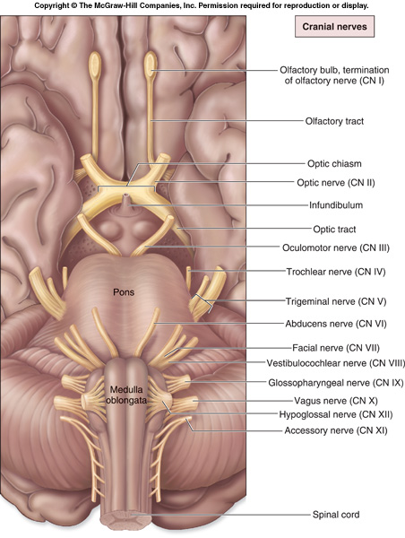
Cranial Nerves
Indicated by Roman numerals I-XII from anterior to posterior
May have one or more of 3 functions
Sensory (special or general)
Somatic motor (skeletal muscles)
Parasympathetic (regulation of glands, smooth muscles, cardiac muscle)
Proprioception
Positional information of body parts

Slide 6
Mnemonic Aids for Cranial Nerves
OLd
OPie
OCcasionally
TRies
TRIGonometry
And
Feels
VEry
GLOomy
VAGUe
And
HYPOactive

Slide 7
Mnemonic Aids for Sensory and /or Motor Functions of Cranial Nerves
Some Say Marry Money, But My Brother Says Big Business Matters More
The first letter of each word signifies whether the particular cranial nerve is sensory only (S); motor (M); or both sensory and motor (B)

Slide 9
Cranial Nerve I

Slide 10
Component: Sensory
Function: Smell
Origin: Olfactory receptor nerve cells
Opening to the Skull: Openings in cribriform plate of ethmoid

Slide 12
Cranial Nerve II

Slide 13
Component: Sensory
Function: Vision
Origin: Back of the eyeball
Opening to the Skull: Optic Canal

Slide 15
Cranial Nerve III

Slide 16
Component: Motor
Function:
Raises upper eyelid
Turns eyeball upward, downward and medially
Constricts pupil
Accommodates the eye
Origin: Anterior surface of the midbrain
Opening to the Skull: Superior orbital fissure

Slide 18
Cranial Nerve IV

Slide 19
Component: Motor
Function: Assisting in turning eyeball downward and laterally
Origin: Posterior surface of the midbrain
Opening to the Skull: Superior orbital fissure

Slide 21
Cranial Nerve V

Slide 22
V. Trigeminal Nerve

Slide 23
Component: Sensory
Function:
Cornea
Skin of forehead
Scalp
Eyelids and nose
Mucous membranes of paranasal sinuses and nasal cavity
Origin: Anterior aspect of the pons
Opening to the Skull: Superior orbital fissure

Slide 25
V1. Ophthalmic Nerve

Slide 26
Component: Sensory
Function:
Skin of the face over maxilla
Teeth of the upper jaw
Mucous membrane of the nose, the
maxillary sinus and palate
Origin: Anterior aspect of the pons
Opening to the Skull: Foramen ovale

Slide 27
V2. Maxillary Nerve

Slide 28
Component: a. Motor
Function:
Muscles of mastication
Mylohyoid
Anterior belly of digastric
Tensor veli palatine
Tensor tympani
Origin: Anterior aspect of the pons
Opening to the Skull: Foramen Rotundum

Slide 29
Component: b. Sensory
Function:
Skin of cheek
Skin over mandible and side of head
Teeth of lower jaw and TMJ
Mucous membrane of mouth and anterior part of tongue
Origin: Anterior aspect of the pons
Opening to the Skull: Foramen Rotundum

Slide 30
V3. Mandibular Nerve

Slide 31
Cranial Nerve VI

Slide 32
Component: Motor
Function: Lateral rectus muscle turns eyeball laterally
Origin: Medulla oblongata
Opening to the Skull: Superior orbital fissure

Slide 33
VI. Abducent Nerve

Slide 34
Cranial Nerve VII

Slide 35
Component: Mixed
Function: Motor
muscles of the face and scalp
Stapedius muscle
Posterior belly of digastric
Stylohyoid muscles
Function: Sensory
Taste from ant. 2/3 of tongue, from the floor of the mouth and palate

Slide 36
Function: Secretomotor
Submandibular and sublingual salivary glands
Lacrimal gland
Glands of nose and palate
Origin: Medulla oblongata
Opening to the Skull: internal acoustic meatus, facial canal, stylomastoid foramen

Slide 37
VII. Facial Nerve

Slide 38
Cranial Nerve VIII

Slide 39
Component: Sensory
Function:
Vestibular - Saculae, saccule, semicircular canals – position of head
Cochlear – Organ of Corti - hearing
Origin: Medulla oblongata
Opening to the Skull: Internal acoustic meatus

Slide 40
VIII. Vestibulocochlear Nerve

Slide 41
Cranial Nerve IX

Slide 42
Component: Mixed
Function:
Sensory
General sensation and taste from post. ½ of the tongue and pharynx
Carotis sinus and carotid body
Function:
Motor
Stylopharyngeus muscle – assists swallowing
Function:
Secretomotor
Parotid gland

Slide 43
Origin: Medulla oblongata
Opening to the Skull: Jugular foramen

Slide 44
IX. Glossopharyngeal Nerve
Y

Slide 45
Cranial Nerve X

Slide 46
Component: Motor
Function:
Heart and great thoracic blood vessels
Larynx, trachea, bronchi and lungs
Alimentary tract from pharynx to splenic
flexure of colon
Liver, kidney, pancreas
Origin: Medulla oblongata
Opening to the Skull: Jugular foramen

Slide 47
X. Vagus Nerve

Slide 48
Cranial Nerve XI

Slide 49
Component: Motor
Function:
Cranial root
Muscles of soft palate (except tensor veli palatini)
Muscles pharynx (except styopharyngeus)
Muscles of larynx (except cricothyroid)
Spinal root
Sternocleidomastoid and trapezius muscle
Origin: medulla oblongata
Opening to the Skull: Jugular foramen

Slide 51
Cranial Nerve XII

Slide 52
Component: Motor
Function: Muscles of tongue (except palatoglossus controlling its shape and movement)
Origin: Medulla oblongata
Opening to the Skull: Hypoglossal canal

