Slide 1
DEMOGRAPHY
CLINICAL MEDICINE
KMTC VOI, MARCH 2019

Slide 2
By the end of the session.
Be able to define demography and other terms- population pyramid, dependence ratio
Look at world population trends,
Kenya population trends
sources and uses of demography data,
census, types and limitation of census data
Population measurements in health-(hsm)
Migration

Slide 3
Definition
Demography- derived from latin , Demos-people and Grapho-to write
It’s the study of human populations in relation to changes brought about by the interplay of births, deaths and migration.
Its also the statistical description and analysis of the human population
A mathematical study of the size, composition and distribution of human populations and the changes over time through the operation of fertility, mortality, marriage, migration and social mobility(socio economic, ethnic, education level, occupation etc).

Slide 4
Demography indicators
Crude Birth rate-the annual number of live births per 1,000 population.
General fertility rate-is the average number of children currently being born to women of reproductive age expressed per 1,000 women age 15-44.
Crude death rate- Crude death rate indicates the number of deaths occurring during the year, per 1,000 population estimated at midyear.
Infant mortality rate- Infant mortality rate (IMR) is the number of deaths per 1,000 live births of children under one year of age
Life expectancy- the average period that a person may expect to live (66.7% in Kenya 2009)

Slide 5
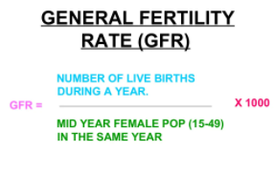
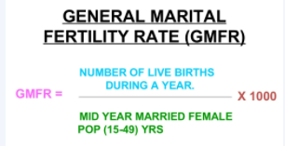
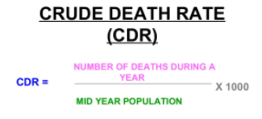
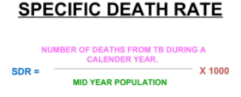
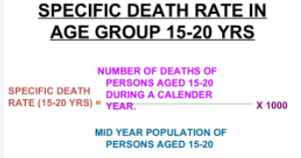
formulas

Slide 6
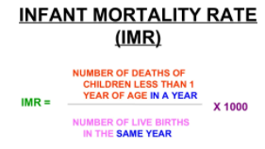
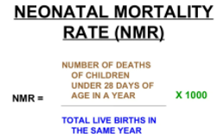
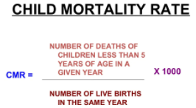
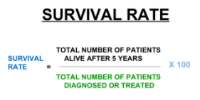
.

Slide 7
ct
Total fertility rate- the average number of children per woman which makes it an intuitive measure of fertility. The TFR is calculated by adding up all the age-specific fertility rates, multiplying this sum by five (the width of the age-group interval), and then dividing by 1,000.
Gross reproduction rate- is the average number of daughters that would be born alive to a hypothetical cohort of women

Slide 8
Demography indicators
Measurement of mortality
Measurement of Morbidity
Measurement of disability
Measurement of Natality
Measurements of the presence, absence or distribution of the characteristics or attributes of disease
Measurement of medical needs, health care facilities and utilization of health care services
Measurement off presence and absence of distribution of environmental factors suspected to causing disease
Measurement of demographic variables

Slide 9
Population pyramid
A population pyramid is a way to visualize two variables: age and sex. ... A population pyramid is a graph that shows the distribution of ages across a population divided down the center between male and female members of the population
Population pyramids are graphical representations of the age and sex of a population( m/f)
Expansive p.p- depicts populations that have a larger percentage of people in the younger age groups-have high fertility rates with lower life expectancies-254
Types- constrictive-lower percentage of younger people-due to declining birth rates. USA
Stationary p.p-shows a somehow equal proportion in each age group.-Austria.

Slide 10
Kenya's population pyramid

Slide 11
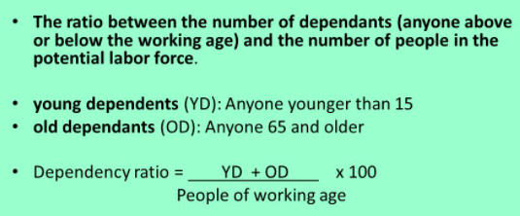
DEPENDANCY RATIO
Its a comparison btn productive(working) and non working population. Often expressed in non productive per 100 productive
Non productive population are the Very old above 65 years and the very young below 15 yrs-are not considered in the labor force.

Slide 12
World population trends

Slide 13
Population trends

Slide 16
World population trend

Slide 18
Kenya population trends
The current rate of change of 2.52% annually is predicted to drop to 2.20% by 2030. During this time, however, the population should grow from 53,491,697 in 2020 to 66,959,993 in 2030. The current population of Kenya is 55,595,271 based on projections of the latest United Nations data.
According to current projections, the population of Kenya will surpass 100 million people by the end of 2058 and will reach 125 million by the end of the century. Kenya’s annual population growth rate is 2.28% per year. The population growth rate was as high as 3.94% in 1981 and 1982 but has since decreased.

Slide 19
254
The total fertility rate in Kenya has also decreased over the years. In 1977, the fertility rate was 8.1 births per woman. The current fertility rate is 3.416 births per woman, contributing to the lower population growth rate.
Although the fertility rate is less than half of what it was decades ago, Kenya still sees rapid population growth. This is because there are many more families in Kenya today because of high fertility rates in the past, so women are having fewer children but there are more families having kids. Additionally, Kenyan life expectancy is increasing.
Although Kenya's extreme growth is expected to slow in the coming years, it will still be significant. The current rate of change of 2.52% annually is predicted to drop to 2.20% by 2030. During this time, however, the population should grow from 53,491,697 in 2020 to 66,959,993 in 2030.

Slide 20
254 cont.
Over the past 20 years, Kenya's population has doubled. Although Kenya has sustained population growth, but it has both high birth and infant mortality rates. This is consistent with Africa as a whole. There has been a marked improvement in life expectancy, particularly in recent years. In 2006, the average level stood at 48.9 years. This figure rose, however, to around 59 years in 2016. This has increased to 64 years of age in 2018. The current median age is only 19.7 years of age in Kenya.

Slide 21
CENSUS
Is a well organized procedure of gathering, recording and analyzing information regarding the members of the population.
National census in Kenya is undertaken after every 10 years, lastly conducted in Aug 24th-25th 2019 recorded at 47,564,296. as per Kenya National bureau of statistics
1st census in Kenya was conducted in 1948

Slide 22
Merits and limitations
Intensive Study – Under census investigation, you must obtain data from each and every unit of the population. Further, it enables the statistician to study more than one aspect of all items of the population. To give you an example, the Indian Government conducts a census investigation once every 10 years. The authorities collect the data regarding the population size, males, and females, education levels, sources of income, religion, etc.
Reliable Data – The data that a statistician collects through a census investigation is more reliable, representative, and accurate. This is because, in a census, the statistician observes every item personally.
Suitable Choice – It is a great choice in situations where the different items of the population are not homogeneous.
The basis of various surveys – Data from a census investigation is used as a basis in various surveys.

Slide 23
limitations
Demerits of a Census Investigation
A census investigation also has certain demerits. Some of these demerits are:
Costs – Since the statistician closely observes each and every item of the population before collecting the data, it makes a census investigation a very costly method of investigation. Usually, government organizations adopt this method to collect detailed data like the population census or agricultural census or the census of industrial protection, etc.
Time-consuming – A census investigation is time-consuming and also requires manpower to collect original data.
Possibilities of Errors – There are many possibilities of errors in the census investigation method due to non-response, measurement, lack of preciseness of the definition of statistical units or even the personal bias of the investigators.

Slide 24
MIGRATION
Is permanent or temporary movement of people from one place to another.

Slide 25
types
Notes:
Which age is mostly affected, why

Slide 38
lastly

Slide 39
End of sem-curricula
Read on
Nacada ACT
Alcohol control Act
Abuse of prescription drugs
Q/A

