Slide 1
HNS B401: DERMATOLOGY

Slide 2
Learning outcomes
Apply knowledge and use appropriate skills in assessment of skin conditions
Describe common conditions of the skin
Apply nursing process in management of the conditions

Slide 3
Functions of the skin
Regulation of body temperature
storage of blood
protection-physical,chemical,infection.
Sensation-specialized nerve ending
excretion and absorption
synthesis of vitamin D.

Slide 4
The integumentary system includes
the skin
hair
oil and sweat glands
nails
sensory receptors.

Slide 5
Types of skin
Thick skin
Thin skin
NB- read more on these
Skin is the largest and the most visible organ of the body.

Slide 6
Skin consists of two different layers:
The epidermis is categorized as epithelial tissue and covers the external surface of the body.
The epidermis also includes the mucous membranes that line the walls of internal cavities that connect to the outside of the body.
The dermis is categorized as connective tissue.

Slide 7
Epidermis
This is the thin, outermost layer of the skin.
It contains cells that have no nuclei and are filled with keratin, a hard, fibrous protein.
These cells form a protective layer, but they are dead cells, so they are constantly being shed or sloughed off in the process known as exfoliation.

Slide 8
The deepest part (basal layer) of the epidermis is composed of living cells that are constantly dividing and being forced to the surface (exfoliation).
Does not contain any blood vessels; it receives nutrients and oxygen from the blood vessels in the dermis

Slide 9
Dermis
A thicker layer beneath the epidermis
Contains collagen fibers (firm, white protein) and elastin fibers (elastic, yellow protein)
Contains arteries, veins, and neurons (nerve cells), as well as hair follicles, sebaceous glands, and sweat glands
A dermatome is a specific area on the skin that sends sensory information to the spinal cord.

Slide 10
Sebaceous and Sweat Glands
Sebaceous glands are a type of exocrine gland in the dermis that secrete sebum through a duct into a hair follicle.
Also known as oil glands.
Sweat glands are also exocrine glands.
Sweat contains water, sodium, and small amounts of body waste (urea, ammonia, creatinine).

Slide 11
Sweat glands help to regulate the body temperature.
The process of sweating and the sweat itself are both known as perspiration.
The sweat glands are also known as the sudoriferous glands.

Slide 12
Anatomy

Slide 13
Hair
Covers most of the body
Additional facial, axillary, and pubic hairs appear during puberty.
Forms in a hair follicle in the dermis
Melanocytes give color to the hair.
Hair cells are filled with keratin, which makes the hair shaft strong.

Slide 14
Usually, the hair lies flat on the surface of the skin, but when the skin is cold, a tiny erector muscle at the base of the hair follicle contracts and causes the hair to stand up (piloerection).

Slide 15
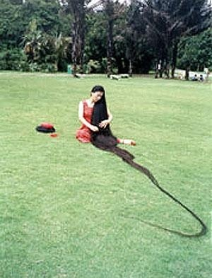
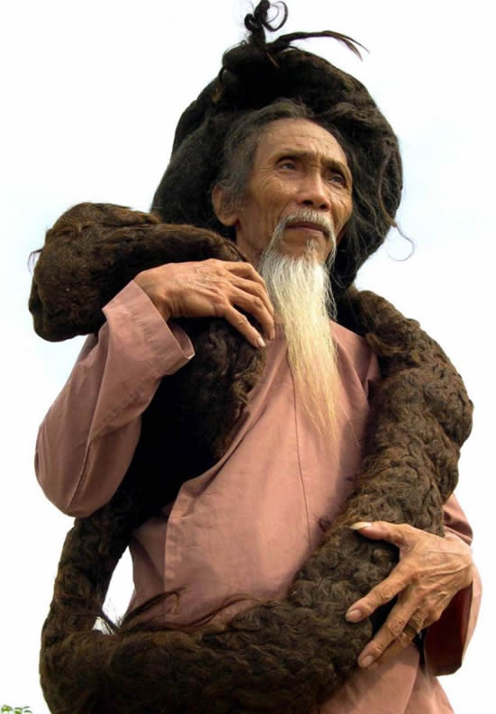
Xie Qiuping Hair Length = 18’ 5.54”
Tran Van Hay
Hair Length = 20’ 3.6”

Slide 16
Nails
Cover and protect the distal ends of the fingers and toes
Each nail consists of a nail plate, nail bed, cuticle, lunula, and nail root.

Slide 17
Figure: Nail

Slide 18
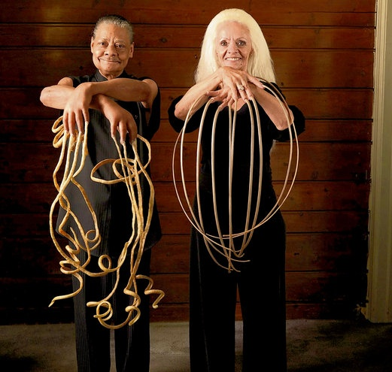
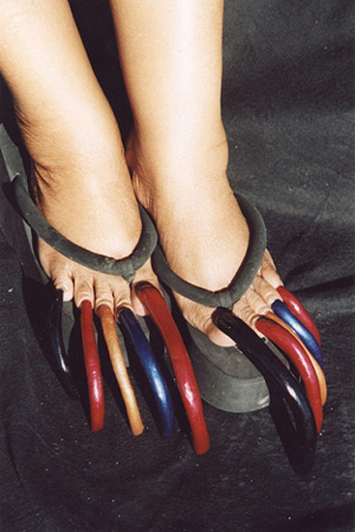

Slide 19
Subcutaneous Tissue
A loose, connective tissue directly beneath the dermis of the skin
Composed of adipose tissue or fat that contains lipocytes (fat-storing cells)
Provides a layer of insulation to conserve internal body heat

Slide 20
Can be thin or as thick as several inches
Subcutaneous layer also acts as a cushion to protect the bones and internal organs

Slide 21
Skin Diseases
Non-Infectious
Infectious

Slide 22
Scope
nomenclature
kinds of lesion
scaling lesions
blistering lesions
dermatitis

Slide 23
Learning Objectives
to be familiar with the description of different kinds of rashes and spots
to be acquainted with the underlying mechanism of pathology in dermatoses
to know particular examples of skin disease

Slide 24
Diagnosis
There is systematic approach involving;
visual interpretation of lesion characteristics
physical examination
history
biopsy
diagnostic tests
A special and specific lexicology of terms for diagnostic description

Slide 25
History and Examination
Relevant information;
- systemic disease diabetes, hepatitis - use of medications toxic epidermal necrolysis - similar cases in family atopy - long term sun exposure tumours - occupation contact dermatitis - geographic location insect bites, lyme disease - previous skin diseases - sexual history syphilis, gonorrhea history of particular lesion, movement, size

Slide 26
Description
Particular terminologies developed to define skin lesions
Primary lesions: describes morphology or lesion type
Initial (and sometimes the only) manifestation of skin disorder
macule, papule, plaque, wheal, cyst, nodule, tumor, vesicle, bulla and pustule.

Slide 27
Secondary lesions: configuration, texture,
Changes in skin which are superimposed upon or occur subsequently to primary lesions
scale, crust, lichenification, scar, excoriation, fissure, ulceration, ulcer, erosion and atrophy.
vascular lesions: blood sequellae, pathology
purpura, petechiae, ecchymoses, telangiectasia
Shape (arrangement of lesions): annular, serpiginous, flat-topped, domed

Slide 28
Primary Characteristics
Macule: flat and well-demarcated lesion < 10 mm diameter. characterised by color change Eg: ephelid or "freckle" vitiligo
flat lesion, can be any shape, size, or color
Flat, circumscribed non-palpable lesion

Slide 29
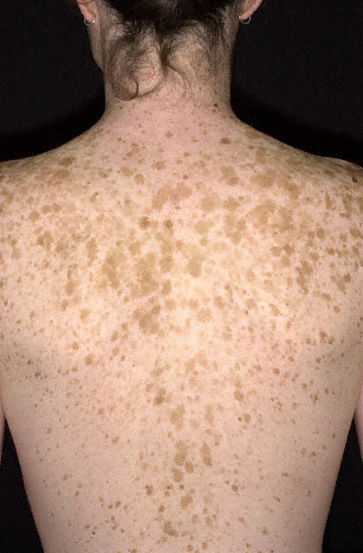
Macule
Flat, circumscribed non-palpable lesion

Slide 30
Primary Characteristics
Papule: elevated, solid and circumscibed lesion, usually 1 cm or less
raised lesion, any shape or color. 1 cm is the cutoff (papule is smaller than a plaque)
Eg: hyperkeratotic: warts, seborrheic keratoses purple: drug eruptions, Kaposi's sarcoma

Slide 31
Papule
Small palpable circumscribed lesion <0.5cm

Slide 32
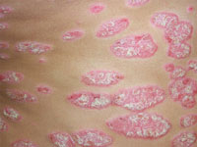
Primary Characteristics
Plaque: elevated, flat-topped, firm and superficial lesion, usually <1cm Eg: psoriasis eczematous dermatitis
Large flat topped elevated palpable lesion

Slide 33
Primary Characteristics
Wheal: transient, solid, itchy, raised area of cutaneous edema and erythema. Irregular shape, variable diameter and blanching. Eg: urticaria insect bites
= “hive” round lesion results from edema in dermis

Slide 34
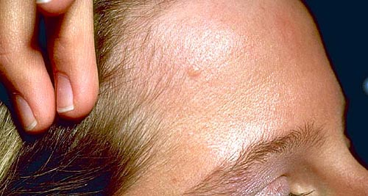
Primary Characteristics
Nodule: raised, circumscribed, firm lesion of variable diameter deeper in dermis than papule. Seen or palpated Eg: erythema nodosum, lipoma
spherical-ish lesion from dermis or subQ fat. If large = “tumor”
Large papule >0.5cm

Slide 35
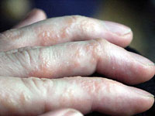
Primary Characteristics
Vesicle: elevated, thin-walled lesion; filled with serous fluid, <1 cm Eg: Herpes simples, Miliaria Dermatitis herpetiformis
Small fluid filled blister

Slide 36
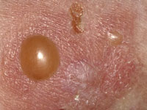
Primary Characteristics
Bulla: elevated lesion filled with clear fluid, >1 cm Eg: blister, pemphigus drug eruptions
A large fluid filled blister

Slide 37
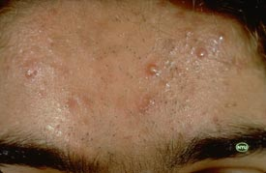
Primary Characteristics
Cyst: elevated, encapsulated lesion with semisolid or liquid fill Eg: sebaceous cyst cystic acne
Pustule: elevated lesion filled with purulent fuid. Eg: acne vulgaris impetigo
a bulla or vesicle filled with pus
Yellowish white pus-filled lesion

Slide 38
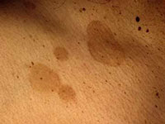
patch
Large macule

Slide 39
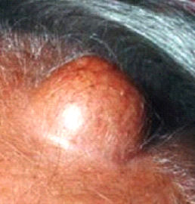
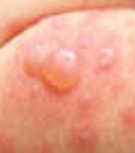
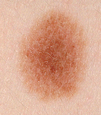
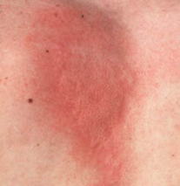
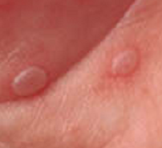
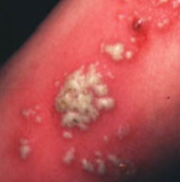
Primary Skin Lesions
nodule
cyst
bullae
macule
plaque
wheal
vesicle
pustule

Slide 40
Secondary Skin Lesions
Scale: plate like excrescence of flaky exfoliation composed of accumulated stratum corneum.
thick stratum corneum Eg: psoriasis, corns, callus
Crust: a solid consolidation of dried serum, blood,
scab: dried stuff Eg: eczema, scab
Lichenification: thickened and rough epidermis with accentuation of skin markings.
thickening of skin. exxaggeration of normal skin markings, results from repeated rubbing or scratching Eg: atopic dermatitis, scabies

Slide 41
Secondary Skin Lesions
Excoriation: loss of epidermis caused by a traumatic lesion
linear erosion from scratching Eg: deep scratch, abrasion
Erosion: discontinuity of the skin with loss of epidermis, usually follows rupture of vesicle or bulla.
all or part of epidermis is lost. heals WITHOUT scarring (dermis not involved) Eg: varicella, herpes

Slide 42
Secondary Skin Lesions
Fissure: a linear split or crack in the epidermis and dermis.
crack/split in skin Eg: acute eczema
Ulceration: round skin discontinuity, loss of hypodermis
hole in skin: loss of full thickness of epidermis + part/all of dermis. heals WITH scarring
Eg: syphilitic chancre, yaws
Atrophy: reduction of skin thickening leaving an easily wrinkled and/or shiny surface
thinning of skin. generalized: physiologic aging; or localized: stretch marks
Eg: aged skin

Slide 43
Secondary Skin Lesions
Scaring: hard plaque of dense fibrotic tissue covered by thin epidermis secondary to dermis injury, pink, red or white; atrophic or hypertrophic (keloid) Eg: healed wound
Vegetating: lushly growing, process, usually elevated Eg: leishmaniasis, melanoma

Slide 44
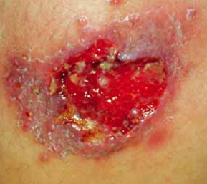
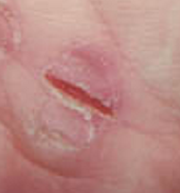
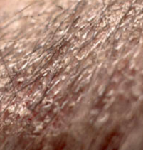
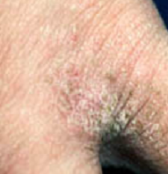
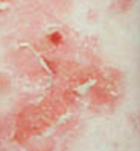
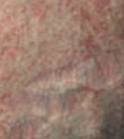
Secondary Skin Lesions
ulcer
fissure
scale
lichenification
erosion
atrophy

Slide 45
Vascular Lesions
Purpura: red-purple non-blanching coloured lesions extravation of blood into the tissue. Eg: thrombocytopenia, trauma
Ecchymoses: purpura greater than 1 cm in diameter. Eg: trauma, vasculitis
Petechiae: small nonblanching erythematous macules <0.5 cm rupture of small blood vessels leading to hemorrhage Eg: age, thrombocytopaenia
Telangiectasia: permanent dilated superficial blood vessels. Eg: liver disease, breast cancer

Slide 46
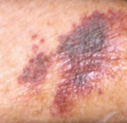
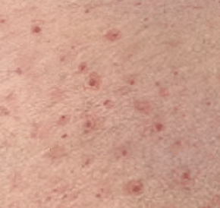
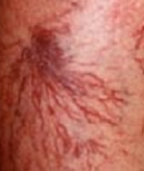
Vascular Lesions
purpura
petechiae
telangiectasia:

Slide 47
Shape (arrangement of lesions):
Annular - ring-shaped
Serpiginous - wandering or twisting, like a snake
Dermatomal - lesions in a dermatome: shingles!

Slide 48
Herpetiform - tight clustering of lesions heaped on top of on another; taken from the fashionable style of paris herpes
flat-topped,
domed

Slide 49
Diseases
blistering diseases: Pemphigus Bullous Pemphigoid Erythema Multiformes Dermatitis Herpetiformis Bullous Drug Reactions Phytophoto Dermatitis
scaling diseases
dermatitis

Slide 50
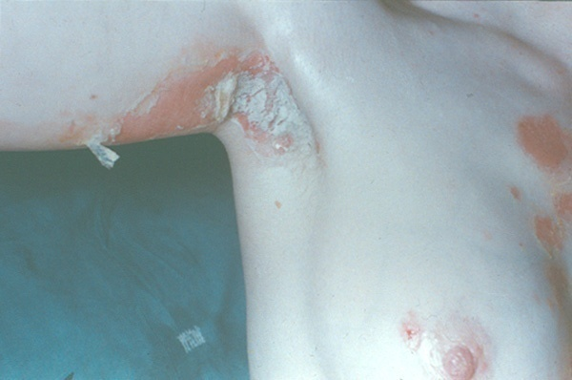
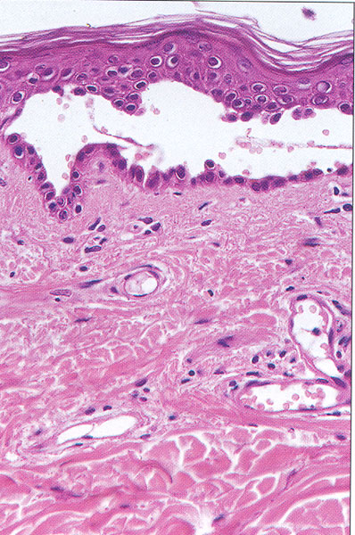
Pemphigus
Rare autoimmune disease affecting young adults and middle aged
immune attack of the desmosomal adhesion between epidermal cells
fragile blisters, which rupture easily leaving red eroded areas
Rapid, life threatening
60mg prednisolone day

Slide 51
Pemphigus
Characterized by the appearance of bullae (blisters) of various sizes on apparently normal skin and mucous membranes.
Pemphigus is an autoimmune disease involving IgG.
It is thought that the pemphigus antibody is directed against a specific cell-surface antigen in epidermal cells.

Slide 52
The level of serum antibody is predictive of disease severity.
Occurs in men and women in middle and late adulthood.
The condition may be associated with penicillins and captopril (Capoten) and with myasthenia gravis.

Slide 53
Vesicles on the chin (in pemphigus). From Hall, J. C. (2006). Sauer’s manual of skin diseases. Philadelphia: Lippincott Williams & Wilkins.

Slide 54
Clinical Manifestations
Most present with oral lesions appearing as irregularly shaped erosions that are painful, bleed easily, and heal slowly.
The skin bullae enlarge, rupture, and leave large, painful eroded areas that are accompanied by crusting and oozing.

Slide 55
A characteristic odor emanates from the bullae and the exuding serum.
There is blistering or sloughing of uninvolved skin when minimal pressure is applied (Nikolsky’s sign).

Slide 56
Complications
Secondary bacterial infection
Fluid and electrolyte imbalance results from fluid and protein loss as the bullae rupture.
Hypoalbuminemia

Slide 57
Management
The goals of therapy are:
to bring the disease under control as rapidly as possible
to prevent loss of serum
Prevent development of secondary infection,
to promote reepithelization (i.e. renewal of epithelial tissue).

Slide 58
Corticosteroids are administered in high doses to control the disease and keep the skin free of blisters.
Immunosuppressive agents (eg, azathioprine [Azasan], cyclophosphamide [Cytoxan], gold [Aurasol]) may be prescribed to help control the disease and reduce the corticosteroid dose.

Slide 59
Plasmapheresis temporarily decreases the serum antibody level and has been used with variable success, although it is generally reserved for life-threatening cases.

Slide 60
Bullous Pemphigoid
An acquired disease of flaccid blisters appearing on normal or erythematous skin.
It appears more often on the flexor surfaces of the arms, legs, axilla, and groin.
Oral lesions, if present, are usually transient and minimal.
Common in the elderly, with a peak incidence at about 60 years of age.

Slide 61
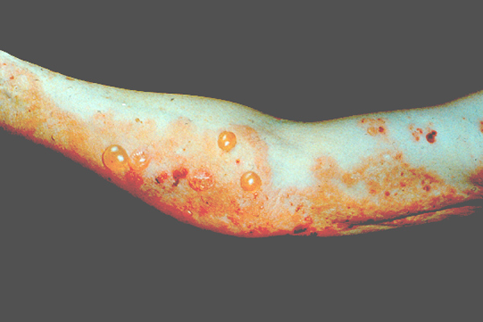
Bullous Pemphigoid
Acute blistering disease of elderly
large tense blisters, often blood stained
blisters burst leaving denuded areas prone to 2nd infection
blisters between the epidermis and the dermis filled with fibrin and mixed inflammatory infiltrate of neutrophils, lymphocytes and histiocytes
C3b and IgG bound to the basement membrane of skin

Slide 62
Management
Treatment by longterm high-dose oral steroids
topical corticosteroids for localized eruptions and systemic corticosteroids for widespread involvement.
Systemic corticosteroids (eg, prednisone [Deltasone])may be continued for months, in alternate-day doses.
patient needs to understand the implications of longterm corticosteroid therapy

Slide 63
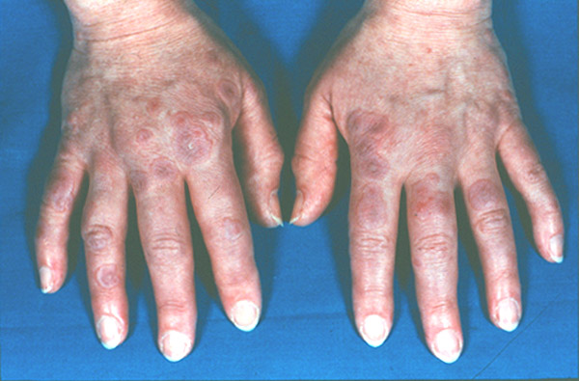
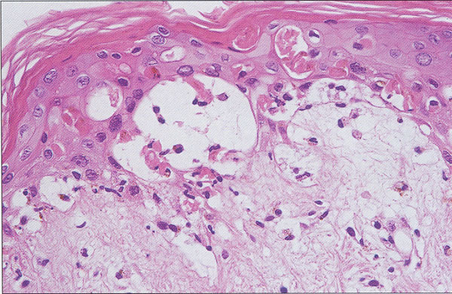
Erythema Multiformes
Multiple small round blisters of red/pink rings in "target" lesions
often occurs on the hands also palms, arms, feet, dorsum
inflammatory response herpes simplex, streptococcal throat
small subdermal blisters
spontaneous resolution 10-14d
non steroidal anti-inflammatories asprin, ibuprofen and antibiotics

Slide 64
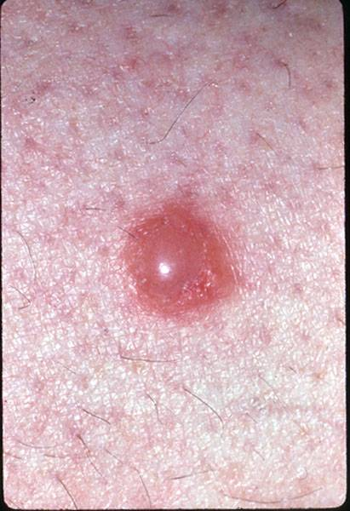
Insect Bites
A variety of insect bite can cause a blisters; fleas (pets) bedbugs scabies, knats/midges,
bees wasps
more common in young children
sometimes misdiagnosed eg as chickenpox.

Slide 65
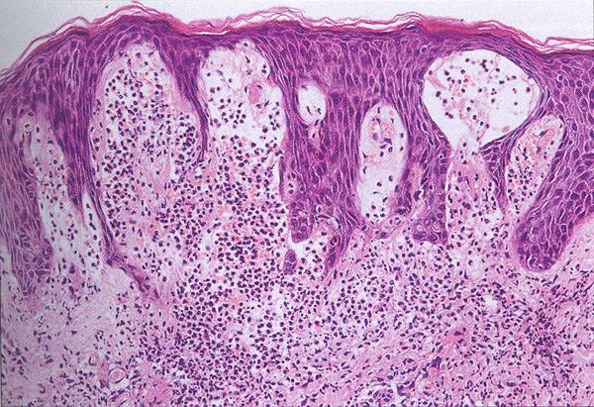
Dermatitis Herpetiformis
Rare itchy condition of grouped blisters on localised symmetrical sites; elbows, knees, buttocks, shoulders and scalp
subepidermal blisters with cavity contains oedema fluid and fibrin
marked inflammatory infiltrate with lymphocytes, histiocytes and many neutrophils.
gluten-sensitive enteropathy similar to coeliac disease but no malabsorption
often blisters not seen as so itchy that scratched out leaving excoriations

Slide 66
An intensely pruritic, chronic disease that manifests with small, tense blisters that are distributed symmetrically over the elbows, knees, buttocks, and nape of the neck.
It most commonly occurs between 20 and 40 years of age but can appear at any age.
Most patients with dermatitis herpetiformis have a subclinical defect in gluten metabolism.

Slide 67
Management
Most patients respond to Dapsone and to a gluten-free diet.
Screen for glucose-6-phosphate dehydrogenase (G6PD) deficiency because dapsone can induce severe hemolysis in those with this deficiency.
Dietary counseling because the dietary restrictions are lifelong, and a gluten-free diet is often difficult to follow.
Notes:
67

Slide 68
Emotional support as they deal with the process of learning new habits and accepting major changes in their lives.

Slide 69
CARE OF THE PATIENT WITH BLISTERING DISEASES
Nursing Diagnoses
Acute pain of skin and oral cavity related to blistering and erosions
Impaired skin integrity related to ruptured bullae and denuded areas of the skin
Anxiety and ineffective coping related to the appearance of the skin and no hope of a cure
Deficient knowledge about medications and side effects

Slide 70
Infection and sepsis related to loss of protective barrier of skin and mucous membranes
Fluid volume deficit and electrolyte imbalance related to loss of tissue fluids

Slide 71
Planning and Goals
Relief of discomfort from lesions,
skin healing
reduced anxiety and improved coping capacity
Absence of complications.

Slide 72
Nursing Interventions
Relieving Oral Discomfort
Meticulous oral hygiene is important to keep the oral mucosa clean and allow the epithelium to regenerate.
Frequent rinsing of the mouth with a solution of salt and baking soda is prescribed to rid the mouth of debris and to soothe ulcerated areas.

Slide 73
The lips are kept moist with lanolin, petrolatum, or lip balm.
Cool mist therapy helps humidify environmental air.

Slide 74
Enhancing Skin Integrity and Relieving Discomfort
Cool, wet dressings or baths are protective and soothing.
patient with painful and extensive lesions should be premedicated with analgesics before skin care is initiated.
patient’s skin is bathed, it is dried carefully and dusted liberally with nonirritating powder

Slide 75
keep the patient warm and comfortable – hypothermia common
Reducing Anxiety
psychological needs of the patient requires listening to the patient, being available, providing expert nursing care, and educating the patient and the family.

Slide 76
Monitoring and Managing Potential Complications
infection and sepsis.
fluid and electrolyte imbalance - Extensive denudation of the skin leads to fluid and electrolyte imbalance because of significant loss of fluids and sodium chloride from the skin. IV administration of saline solution.

Slide 77
A large amount of protein and blood is also lost from the denuded skin areas.
Blood component therapy may be prescribed to maintain the blood volume, hemoglobin level, and plasma protein concentration.
Serum albumin, protein, hemoglobin, and hematocrit values are monitored.
patient is encouraged to maintain adequate oral fluid intake.

Slide 78
Small, frequent meals or snacks of high-protein, high-calorie foods help maintain nutritional status.
Parenteral nutrition is considered if the patient cannot eat adequate diet.

Slide 79
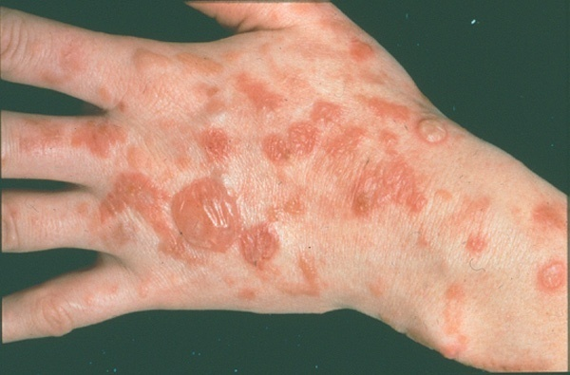
Phytophoto Dermatitis
Photochemical reaction due to contact with a plant chemical and sun exposure
bizarre streaky patterns of blisters on sun exposed skin
PUVA therapy-contains psoralen(p) and then expose the skin to UVA(Long wave ultraviolet radiation)
spontaneous resolution leaving long-term hyperpigmentation

Slide 80
Bullous Drug Reactions
STEVENS-JOHNSON SYNDROME small multiple subdermal blisters with extensive involvement of the mouth and mucus membranes.
TOXIC EPIDERMAL NECROSIS very severe blisters with extensive involvement. mortality of about 30-50%

Slide 81
Toxic epidermal necrolysis (TEN) and Stevens-Johnson syndrome (SJS) are potentially fatal skin disorders and the most severe forms of erythema multiforme.
Are mucocutaneous reactions that constitute a spectrum of reactions, with TEN being the most severe.

Slide 82
TEN and SJS are triggered by a reaction to medications.
Antibiotics, especially sulfonamides, antiseizure agents and nonsteroidal anti-inflammatory drugs (NSAIDs) are the most frequent medications implicated

Slide 83
TEN and SJS occur in all ages and both genders.
The incidence is increased in older people because of their use of many medications.
High risk of TEN and SJS - immunosuppressed, HIV infected, AIDS

Slide 84
Acne-like rash may follow high dose prednisolone or phenytoin therapy.
Measles –like rash by ampicillin
Urticaria by penicillins

Slide 85
Drugs which may sensitize the skin to sunlight (phototoxic reaction )include:
Tetracycline
Sulphonamides
Nalidixic acid

Slide 86
Clinical Manifestations
TEN and SJS are characterized initially by conjunctival burning or itching, cutaneous tenderness, fever, cough, sore throat, headache, extreme malaise, and myalgias (ie, aches and pains).
Followed by a rapid onset of erythema involving much of the skin surface and mucous membranes, including the oral mucosa, conjunctiva, and genitalia.

Slide 87
Severe cases of mucosal involvement, there may be danger of damage to the larynx, bronchi, and esophagus from ulcerations
Large, flaccid bullae develop in some areas; in other areas, large sheets of epidermis are shed, exposing the underlying dermis.
Fingernails, toenails, eyebrows, and eyelashes may be shed along with the surrounding epidermis.

Slide 88
The skin is excruciatingly tender, and the loss of skin leaves a weeping surface similar to that of a total- body, partial-thickness burn; hence, the condition is also referred to as “scalded skin syndrome.”

Slide 89
Complications
Sepsis
Keratoconjunctivitis - impaired vision and result in conjunctival retraction, scarring, and corneal lesions.

Slide 90
Medical Management
The goals of treatment include control of fluid and electrolyte balance, prevention of sepsis, and prevention of ophthalmic complications.
Supportive care is the mainstay of treatment.
discontinue immediately all nonesssential medications.
Treat in a regional burn center because aggressive treatment similar to that for severe burns is required.

Slide 91
Surgical débridement or hydrotherapy may be done to remove involved skin.
Culture tissue samples to identify organism
IV fluids administered to maintain fluid and electrolyte balance (severe cases)
Fluid replacement is carried out by nasogastric tube and then orally as soon as possible.

Slide 92
Administration of IV immunoglobulin (IVIG) may provide rapid improvement and skin healing.
Protecting the skin with topical agents is crucial.
Topical antibacterial and anesthetic agents are used to prevent wound sepsis and to assist with pain management.

Slide 93
Meticulous oropharyngeal and eye care is essential when there is involvement of the mucous membranes and the eyes.

Slide 94
Nursing Diagnoses
Impaired tissue integrity (ie, oral, eye, and skin) related to epidermal shedding
Deficient fluid volume and electrolyte losses related to loss of fluids from denuded skin
Risk for imbalanced body temperature (ie, hypothermia) related to heat loss secondary to skin loss
Acute pain related to denuded skin, oral lesions, and possible infection
Anxiety related to the physical appearance of the skin and prognosis

Slide 95
Planning and Goals
The major goals for the patient may include:
Skin and oral tissue healing
Fluid balance
Prevention of heat loss
Relief of pain
Reduced anxiety
Absence of complications

Slide 96
Nursing Interventions
Maintaining Skin and Mucous Membrane Integrity
Take special care to avoid friction involving the skin when moving the patient in bed.
Skin should be checked after each position change to ensure that no new denuded areas have appeared.
Apply appropriate topical agents to reduce the bacterial population of the wound surface.

Slide 97
Topical antibacterial agent may be used in conjunction with hydrotherapy in a tank, bathtub, or shower.
Encourage exercises on the extremities during hydrotherapy.
Careful oral hygiene- mouthwashes, anesthetics, or coating agents are used frequently to rid the mouth of debris, soothe ulcerative areas, and control foul mouth odor
Petrolatum or a prescribed ointment is applied to the lips.

Slide 98
Attaining Fluid Balance
The vital signs, urine output, and sensorium are observed for indications of hypovolemia.
The patient is weighed daily (with a bed scale if necessary).
Oral lesions may result in dysphagia, making tube feeding or parenteral nutrition necessary until oral ingestion can be tolerated.
A daily calorie count and accurate recording of all intake and output are essential

Slide 99
Preventing Hypothermia
Patient with TEN is prone to chilling.
Dehydration may be made worse by exposing the denuded skin to a continuous current of warm air.
Cotton blankets, ceiling-mounted heat lamps, and heat shields, are useful in maintaining body temperature.
The patient’s temperature is monitored frequently

Slide 100
Relieving Pain
Assesses the patient’s pain, its characteristics, factors that influence the pain, and the patient’s behavioral responses.
analgesics are administered on a regular schedule.
Offering emotional support and reassurance and implementing measures that promote rest and sleep are basic in achieving pain control.

Slide 101
Reducing Anxiety
Reassurance
Nursing support, honest communication
Emotional support is helpful to promote coping during the long recovery period.
Monitoring and Managing Potential Complications
SEPSIS - Monitor vital signs, Hand hygiene, wearing sterile gloves, Antibiotics when necessary.

Slide 102
CONJUNCTIVAL RETRACTION, SCARS, AND CORNEAL LESIONS - inspected daily for signs of pruritus, burning, and dryness, which may indicate progression to keratoconjunctivitis, the principal eye complication.
Applying a cool, damp cloth over the eyes may relieve burning sensations.
Administering an eye lubricant.
Using eye patches or reminding the patient to blink periodically may also counteract dryness.

Slide 103
Promoting Home and Community-Based Care
TEACHING PATIENTS SELF-CARE - patient and family members are also provided with instructions about pain management, nutrition, measures to increase mobility, and prevention of complications, including prevention of infection.
CONTINUING CARE - Interdisciplinary follow-up care is imperative to ensure that the patient’s progress continues..

Slide 104
Scaling Diseases
sharply marginated scaling papules or plaques without wetness, crusts, fissures and excoriations
psoriasis
parapsoriasis
pityriasis rosea
lichen planus
dissimilar disorders grouped together by lesions with similar primary characteristics
Appearance and distribution of lesions distinguish the diseases

Slide 105
Lichen Planus
Recurrent, pruritic, inflammatory rash small polygonal flat violaceous papules may coalesce in scaly patches
Often accompanied by oral lesions
T cell autoimmune reaction to basal keratinocytes + genetic disposition
Triggered by a variety of
β blockers antimalarials NSAIDS
drugs;
hepatitis C liver disease graft versus host disease
Symmetrically distributed on wrists, legs, trunk, penis

Slide 106
Lichen Planus
Oral mucosa is involved in ~50% cases reticulated, lacy, blue-white esp. tongue
chronic exacerbations and remissions
New papules occur after minor skin injury
lesions change over time becoming hyperpigmented, hyperkeratotic, vesicular plaques that are violaceous and shiny
Treatment by topical corticosteroids

Slide 107
Parapsoriasis
Poorly understood group of plaque forming diseases
2 types; a small plaque; benign, a large plaque; CTCL precursor
cutaneous T-cell lymphoma
Treatment by phototherapy or topical corticosteroids

Slide 108
Pityriasis Rosea
Mild inflammatory skin disease diffuse scaly plaques or papules
unknown cause, virus suspected
mostly women 10-35 yr, peaks in cooler months
begins with ‘herald patch’on trunk centripetal eruption 7 -14 days later prodromal malaise and headache
Rose or fawn coloured, raised edge collarette (tinea)
Remits in 5 weeks, recurrence rare, sun hastens resolution

Slide 109
Psoriasis
Noninfectious inflammatory dermatoses.
This chronic disease stems from a hereditary defect that causes overproduction of keratin.
Psoriasis has a tendency to improve and then recur periodically throughout life.

Slide 110
Psoriasis
Well demarcated, raised, red, scaly plaques typically elevated, >10 mm with thick silvery scale
Hyperproliferation, inflammation of dermis and epidermis
Common, ~1 to 5% population bimodal onset 16-22 & 57-60 yrs
Unknown cause, ~50% familial
non-mendelian inheritance, associated MHC CW6, B13, B17
Environmental trigger; injury, sunburn, HIV, β haem Strep., stress, alcohol, drugs; β blockers chloroquine

Slide 111
Pathophysiology
Immunologic defects is basis for psoriasis
Aggravated by emotional stress, anxiety conditions, trauma, infections, seasonal and hormonal changes.
The cells in the basal layer of the skin divide too quickly, and the newly formed cells move so rapidly to the skin surface that they become evident as profuse scales or plaques of epidermal tissue.

Slide 112
Due to increased number of basal cells and rapid cell passage, the normal events of cell maturation and growth cannot occur, which prevent formation of the normal protective layers of the skin.

Slide 113
Clinical Manifestations
Lesions appear as red, raised patches of skin covered with silvery scales.
The scaly patches are formed by the buildup of living and dead skin.
If the scales are scraped away, the dark-red base of the lesion is exposed, producing multiple bleeding points.
Patches are not moist and may be pruritic.

Slide 114
The nails may be involved, with pitting, discoloration, crumbling beneath the free edges, and separation of the nail plate.
Bilateral symmetry is a feature of psoriasis.
Sites most affected include the scalp, the extensor surface of the elbows and knees, the lower part of the back, and the genitalia, as well as the nails.

Slide 115
Psoriasis. Courtesy of Roche Laboratories.

Slide 116
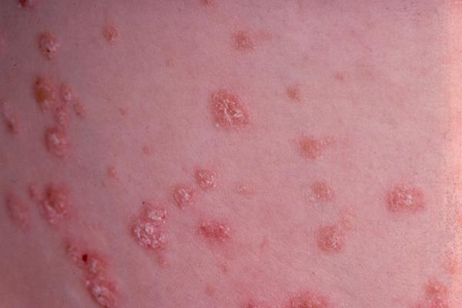
Clinical Variants
Plaque psoriasis; large well-demarcated plaques usually on arms, legs, back or scalp is the most common form
Gutate psoriasis; lesions appear as multiple small red raised scaly patches, usually all over the trunk. Occurs in young people following a Strep throat infection.

Slide 117
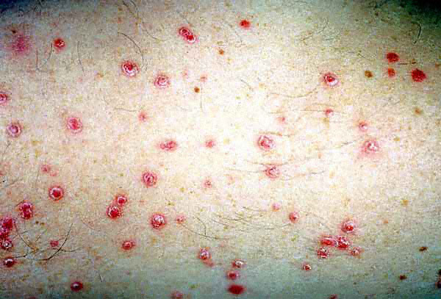
Gutate psoriasis

Slide 118
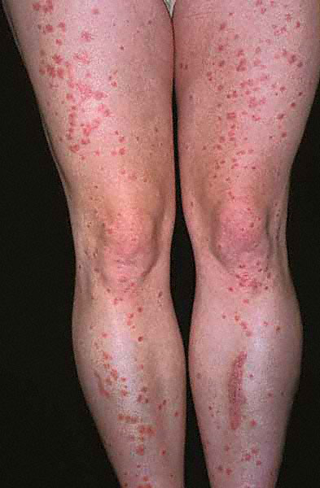

Slide 119
Clinical Variants
Pustular psoriasis; widespread areas of pustules over the trunk and limbs, sudden onset often accompanied by severe systemic upset with fever and joint pain
Erythrodermic Psoriasis; widespread red scaly skin often affecting the whole body. Skin function can be affected with risk of hypothermia, dehydration, heart failure.

Slide 120
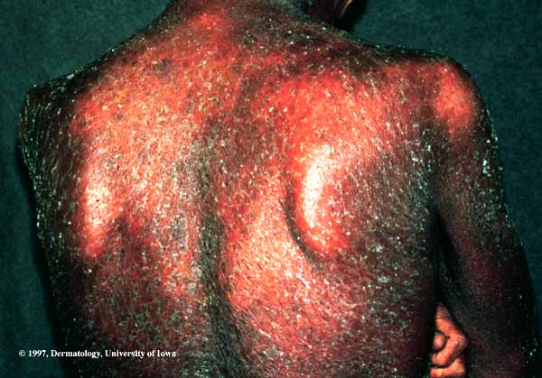

Slide 121
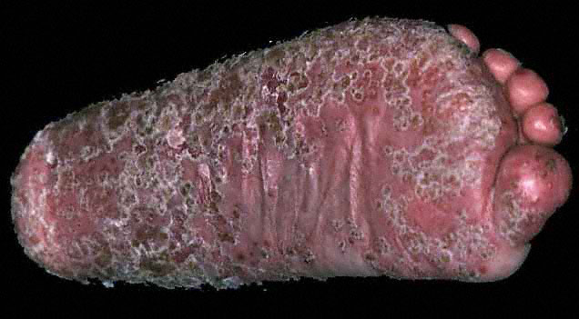

Slide 122
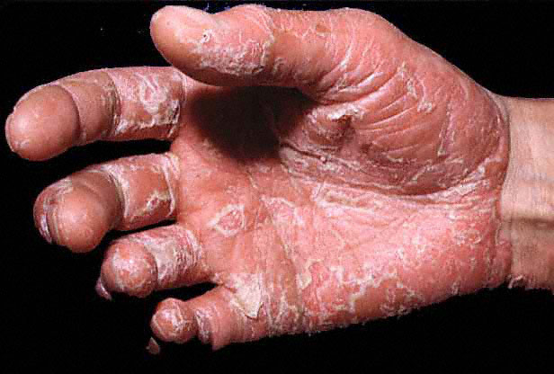

Slide 123
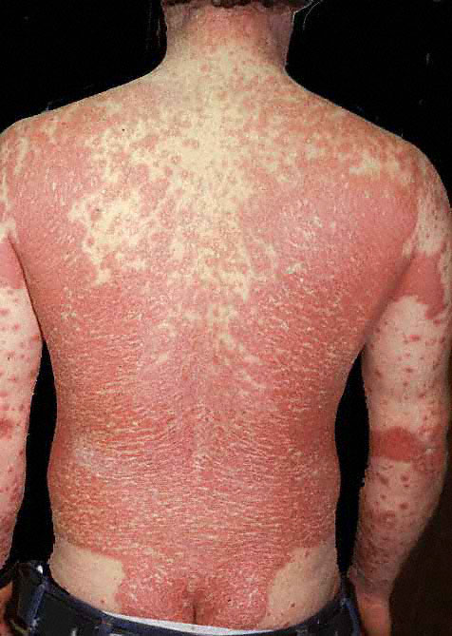

Slide 124
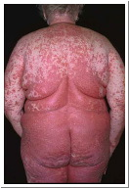

Slide 125
Medical Management
The goals are to slow the rapid turnover of epidermis, to promote resolution of the psoriatic lesions, and to control the natural cycles of the disease.
There is no known cure.
Management of emotional factors should be addressed as part of the overall treatment of psoriasis.

Slide 126
The most important principle of psoriasis treatment is gentle removal of scales.
This can be accomplished with baths.
Pharmacologic Therapy
Three types of therapy are commonly used: topical, systemic, and phototherapy in addition to biological medications.
Topically applied agents are used to slow the overactive epidermis.

Slide 127
Occlusive dressings may be applied to increase the effectiveness of the corticosteroid.
Topical nonsteroidal treatments are calcipotriene (Dovonex) and tazarotene (Tazorac).
Treatment with these agents tends to suppress epidermopoiesis (ie, development of epidermal cells) and cause sloughing of the rapidly growing epidermal cells.

Slide 128
Systemic corticosteroids may cause rapid improvement of psoriasis – risk of flare-up
Systemic cytotoxic preparations, such as methotrexate, used in treating extensive psoriasis that fails to respond to other forms of therapy.

Slide 129
Biological Agents. The newest line of treatment. Derived from immunomodulators and bioengineered proteins (such as antibodies or recombinant cytokines) and their targeted action directly on the T cells.
Act by inhibiting activation and migration, eliminating the T cells completely, slowing postsecretory cytokines or inducing immune deviation.

Slide 130
Infliximab (Remicade), Etanercept (Enbrel) Efalizumab (Raptiva), Alefacept (Amevive), Adalimumab (Humira).
Oral Agents. Methotrexate appears to inhibit DNA synthesis in epidermal cells, thereby reducing the turnover time of the psoriatic epidermis.

Slide 131
Oral retinoids modulate the growth and differentiation of epithelial tissue.
Etretinate (Tegison,Tigason) is especially useful for severe pustular or erythrodermic psoriasis.

Slide 132
Photochemotherapy
More than 50% of the body surface involved.
Combine a photosensitizing oral medication with exposure to ultraviolet-A light (PUVA).
Patient takes a photosensitizing medication (usually 8-methoxypsoralen [8- mop, Houva-caps, meladinine, meloxine]) in a standard dose and is subsequently exposed to long-wave ultraviolet light as the medication plasma levels peak.

Slide 133
Nursing Management
Nursing Interventions
Promoting Understanding – life time mgt, information about condition, treatment
Increasing Skin Integrity - avoid injury, prevent dry skin, use bath oil and emollient
Improving Self-Concept and Body Image – education and support to promote acceptance and positive outlook of the disease.

Slide 134
Monitoring and Managing Potential Complications
Teaching Patients Self-Care.

Slide 135
Summary Treatment of Psoriasis
Arthritis develops in 5 to 30% of cases, can be disabling
rarely life-threatening but severely affects self-image
time required to treat extensive skin lesions and maintain clothing and bedding may adversely affect quality of life
treatments extensive, include emollients, salicylic acid, coal tar, anthralin, corticosteroids, methotrexate
emollient creams, parafin, petrolatum, hydrogenated oils reduce scaling, best applied after bathing
Salicyclic acid is a keratinolytic, softens scales.
Coal tar and corticisteroids are anti-inflammatory and reduce proliferation.
Used in combination with UV light.

Slide 136
Dermatitis
Superficial inflammation of the skin
characterized by redness oedema oozing crusting scaling (vesicles)
Eczema used interchangeably with dermatitis
pruritis

Slide 137
Atopic Dermatitis
A type I immediate hypersensitivity disorder characterized by inflammation and hyperreactivity of the skin.
familial, major genetic link to maternal atopy (asthma)
pruritus major symptom; ranging from mild erythema to severe lichenification
2 forms: IgE mediated, extrinsic, 70-80% cases
non-IgE mediated intrinsic, non-familial

Slide 138
appears in infancy, ~ 3 mo, acute phase lasting 1-2 mo, red, weeping, crusted lesions often on the face spreads to the neck, scalp, extremities, abdomen.
Pruritus and hyperirritability of the skin are the most consistent features of atopic dermatitis and are related to large amounts of histamine in the skin.
Excessive dryness of the skin with resultant itching is related to changes in lipid content, sebaceous gland activity, and sweating.

Slide 139
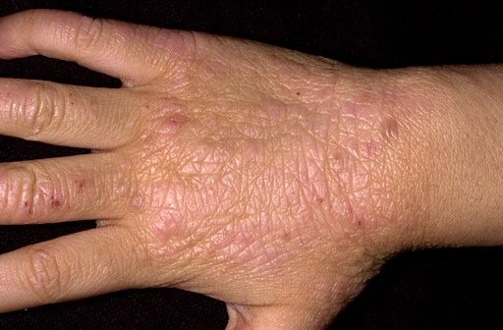
Atopic Dermatitis
Chronic phase, scratching rubbing causes skin to lichenify
may become generalised, often present in flexural creases
associated food intolerance, wool, sensitivity to sweating
often improves by age 5; early asthma, history
treatment by emollients, creams moisturising, anti-histamines, corticosteroids
prolonged

Slide 140
Management
Guidelines for treatment include decreasing itching and scratching by wearing cotton fabrics, washing with a mild detergent, humidifying dry heat in winter, maintaining room temperature at 20C to 22.2C (68F to 72F), using antihistamines such as diphenhydramine (Benadryl), and avoiding animals, dust, sprays, and perfumes.

Slide 141
Keeping the skin moisturized with daily baths
Hydrate the skin
Use topical skin moisturizers.
Topical corticosteroids are used to prevent inflammation,
Antibiotics to eliminate Staphylococcus aureus when indicated.

Slide 142
Use of immunosuppressive agents, such as cyclosporine (Neoral, Sandimmune), tacrolimus (Prograf, Protopic), and pimecrolimus (Elidel), may be effective in inhibiting T cells and mast cells involved in atopic dermatitis.
Counseling to improve on self esteem
Health education on signs of secondary infection, side effects of medications used in treatment

Slide 143
Contact Dermatitis
A type IV delayed hypersensitivity reaction,
an acute or chronic skin inflammation that results from direct skin contact with chemicals or allergens.
There are four basic types: allergic, irritant, phototoxic, and photoallergic
Eighty percent of cases are caused by excessive exposure to or additive effects of irritants (eg, soaps, detergents, organic solvents).

Slide 144
Clinical Manifestations
itching, burning, erythema, skin lesions (vesicles), and edema, followed by weeping, crusting, and finally drying and peeling of the skin.
In severe responses, hemorrhagic bullae may develop.
Repeated reactions - thickening of the skin and pigmentary changes.

Slide 145
TYPES OF CONTACT DERMATITIS
Allergic
Results from contact of skin and allergenic substance.
Has a sensitization period of 10–14 days.
Presentation:
Vasodilation and perivascular infiltrates on the dermis
Intracellular edema Usually seen on dorsal aspects of hand

Slide 146
Treatment
Avoidance of offending material
Burow’s solution or cool water compress
Systemic corticosteroids (prednisone) for 7–10 days
Topical corticosteroids for mild cases
Oral antihistamines to relieve pruritus

Slide 147
Irritant
Results from contact with a substance that chemically or physically damages the skin on a nonimmunologic basis.
Occurs after first exposure to irritant or repeated exposures to milder irritants over an extended time.

Slide 148
Presentation
Dryness lasting days to months
Vesiculation, fissures, cracks
Hands and lower arms most common areas

Slide 149
Treatment
Identification and removal of source of irritation
Application of hydrophilic cream or petrolatum to soothe and protect
Topical corticosteroids and compresses for weeping lesions
Antibiotics for infection and oral antihistamines for pruritus

Slide 150
Phototoxic
Resembles the irritant type but requires sun and a chemical in combination to damage the epidermis.
Photoallergic
Resembles allergic dermatitis but requires light exposure in addition to allergen contact to produce immunologic reactivity.

Slide 151
Contact Dermatitis
Any site affected, hands and face
Two types of reaction: - irritant contact -allergic
irritant contact; stratum corneum repeated exposure red cracked skin e.g. nappy rash
Allergic; type IV cell-mediated hypersensitivity reaction following sensitisation
e.g; cosmetics, nickel,

Slide 152
Management
Objectives of management are to soothe and heal the involved skin and protect it from further damage.
Soap is not generally used until healing occurs.
a bland, unmedicated lotion is used for small patches of erythema.
Cool, wet dressings also are applied over small areas of vesicular dermatitis.

Slide 153
Finely cracked ice added to the water often enhances its antipruritic effect.
Wet dressings usually help clear the oozing eczematous lesions.
A thin layer of cream or ointment containing a corticosteroid then may be used.
Medicated baths at room temperature are prescribed for larger areas of dermatitis.
For severe, widespread conditions, a short course of systemic corticosteroids may be prescribed.

Slide 154
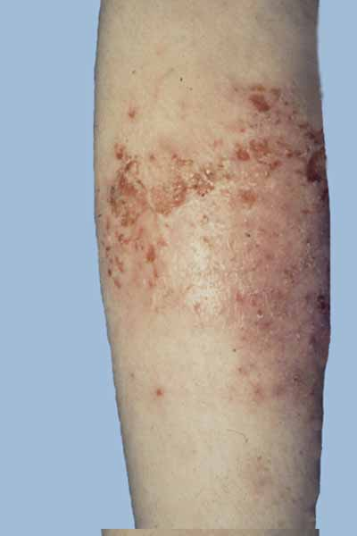
Adult Dermatitis
Eczema on the arm
Becoming more common
Itchy, inflammatory dermatoses where the lesions are red, lichenified, excoriated, flaky or cracked.
lesions lack well demarcated borders as they fade into the surrounding skin.

Slide 155
Secondary infection with Staphylococcus aureus is common causing the eczema plaques to develop yellowish crusting or weepy areas.
Most common is flexural sites such as antecubital and popliteal fossae, wrists, ankles , neck and face but the trunk and any skin surface can be affected.

Slide 156
Allergic Contact
Airborne substances; pollen, insecticide spray Chemicals; tanning agents, formaldehyde in press finishes
Cosmetics; depilatories, nail polish, deodorant
Dyes; p-Phenylenediamine in hair and textile dyes
Fragrances, acrylic monomers, epoxy, formaldehyde
Antibiotics; bacitracin, neomycin, penicillin, sulfonamides Antihistamines; diphenhydramine, promethazine Antiseptics; thimerosal, hexachlorophene
Latex; gloves, condoms, catheters, balloons
Metals; nickel, cobalt, chromates, mercury
Plants; poison ivy, oak, sumac, ragweed, primrose

Slide 157
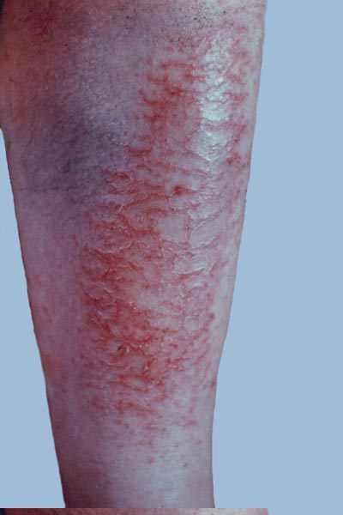
Asteatotic Eczema
occurs on limbs of elderly people especially the shins
skin is red and roughened with a characteristic "crazed" and fissured appearance.

Slide 158
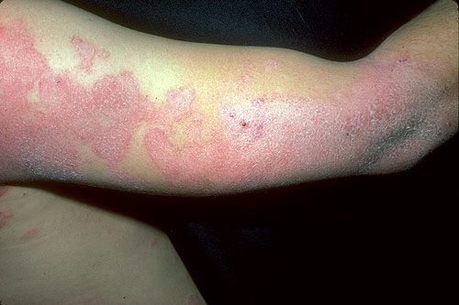
Nummular Dermatitis
Discoid dermatitis
inflammation characterized by coin- or disc-shaped lesions
middle-aged patients with dry skin, especially in winter
prominent on arms, buttocks but also trunk
reccurs on previous sites
No universally useful treatment. UV A radiation with oral psoralen (PUVA) and oral corticosteroids are given

Slide 159
Seborrheic Dermatitis
Inflammatory scaling disease
principally in scalp, face
Pityrosporum ovale, yeast commensal implicated
application of zinc pyrithione, selenium sulfide, sulfur and salicylic acid, or tar shampoo

Slide 160
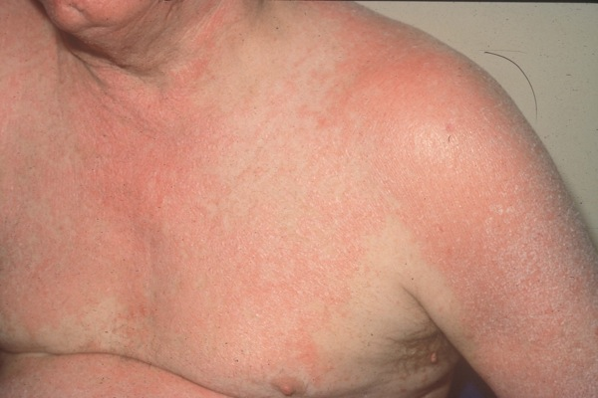
Exfoliative Dermatitis
Erythroderma:
characterized by progressive inflammation in which generalized erythema and scaling occur.
occurs with prior skin diseases eg, atopic dermatitis, psoriasis
dilation of cutaneous blood vessels, pruritus, diffuse erythema, epidermal slough

Slide 161
Associated with chills, fever, prostration, severe toxicity, and a pruritic scaling of the skin.
There is a profound loss of stratum corneum (ie, outermost layer of the skin), which causes capillary leakage, hypoproteinemia, and negative nitrogen balance.

Slide 162
Presentation
Starts acutely as a patchy or generalized erythematous eruption accompanied by fever, malaise, and occasionally gastrointestinal symptoms.
The skin color changes from pink to dark red.
After a week, the characteristic exfoliation (ie, scaling) begins, usually in the form of thin flakes that leave the underlying skin smooth and red, with new scales forming as the older ones come off.

Slide 163
Systemic effects include high-output heart failure, other gastrointestinal disturbances, breast enlargement, elevated levels of uric acid in the blood (ie, hyperuricemia), and temperature disturbances.

Slide 164
Due to drug reaction; penicillin, sulfonamides, barbiturates or malignancy; mycosis fungoides, leukemia, diffuse erythema starts in patches but spreads all body.
Affects thermoregulation, nutritional status.

Slide 165
Management
Objectives of management are to maintain fluid and electrolyte balance and to prevent infection.
Discontinue implicated medications
Maintain a comfortable room temperatures
Maintain fluid and electrolytes balance
Administration of plasma volume expanders may be indicated

Slide 166
Administer antibiotics as per culture and sensitivity tests
Closely monitor vital signs
Topical therapy is used to provide symptomatic relief.
Soothing baths, compresses, and lubrication with emollients are used to treat the extensive dermatitis.

Slide 167
Oral or parenteral corticosteroids if not controlled by conservative methods
Treat as per specific cause once known

Slide 168
Summary
Many types of skin lesion,
Many with unknown cause
Many with element of autoimmunity
Diagnosis requires thorough knowledge of symptoms, history and terminology

