Slide 1
DEVELOPMENT AND REGULATION OF DRUGS
Pharmacology and Therapeutics I

Slide 2
Development of drugs
Among the first steps in the development of a new drug is the discovery or synthesis of a potential new drug molecule and seeking an understanding of its interaction (mechanism) with the appropriate biologic targets.
Repeated application of this approach leads to compounds with increased potency and selectivity.

Slide 3
Factors considered before drug marketing
By law, the safety and efficacy of drugs must be defined before marketing.
Relevant biologic effects,
Drug metabolism, and
Pharmacokinetic profiles and particularly an assessment of the relative safety of the drug must be characterized in animals before human drug trials can be started.
With regulatory approval, human testing can then go forward in three phases before the drug can be considered for approval for general use.
A fourth phase of data gathering and safety monitoring is becoming increasingly important and follows after approval for general use.

Slide 4
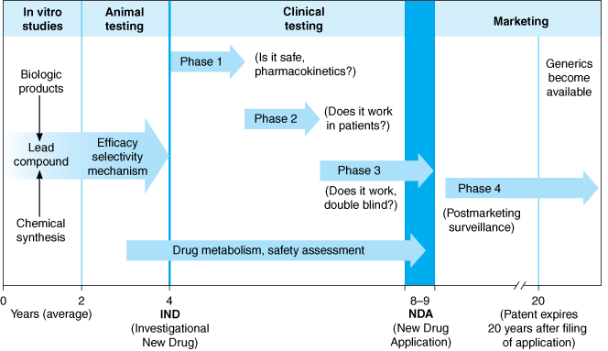
Process of drug development

Slide 5
Process of drug development
In vitro means performed or taking place in a test tube, culture dish, or elsewhere outside a living organism.
A lead compound in drug discovery is a chemical compound that has pharmacological or biological activity likely to be therapeutically useful, but may nevertheless have suboptimal structure that requires modification to fit better to the target.
In the context of a clinical trial, double-blind means that neither the patients nor the researchers know who is getting a placebo and who is getting the treatment. This removes bias about the expected results.

Slide 6
Drug Discovery
Most new drugs or drug products are discovered or developed through one or more of six approaches:
Identification or elucidation of a new drug target
Rational drug design of a new drug based on an understanding of biologic mechanisms, drug receptor structure, and drug structure
Chemical modification of a known molecule
Screening for biologic activity of large numbers of natural products, banks of previously discovered chemical entities, and large libraries of peptides, nucleic acids, and other organic molecules

Slide 7
Drug Discovery
Biotechnology and cloning using genes to produce peptides and proteins. Efforts continue to focus on the discovery of new targets and approaches, from studies with genomics, proteomics, nucleic acids and molecular pharmacology for drug therapy. Significantly increasing the number of useful disease targets should be a positive driver for new and improved drugs.
Combinations of known drugs to obtain additive or synergistic effects or a repositioning of a known drug for a new therapeutic use.

Slide 8
Pharmacologic profile
Studies are performed during drug screening to define the pharmacologic profile of the drug at the molecular, cellular, system, organ, and organism levels.
For example, a broad range of tests would be performed on a drug designed to act as an antagonist at vascular-adrenoceptors for the treatment of hypertension.

Slide 9
Drug screening
Regardless of the source or the key idea leading to a drug candidate molecule, testing it involves a sequence of iterative experimentation and characterization called drug screening.
A variety of biologic assays at the molecular, cellular, organ system, and whole animal levels are used to define the activity and selectivity of the drug.
The type and number of initial screening tests depend on the pharmacologic and therapeutic goal.
Anti-infective drugs may be tested against a variety of infectious organisms some of which are resistant to standard agents; hypoglycemic drugs for their ability to lower blood sugar; etc.
Notes:
Iteration is the repetition of a process in order to generate a sequence of outcomes. Each repetition of the process is an iteration.

Slide 10
Pharmacologic Profile Tests
Experimental Method or Target Organ | Species or Tissue | Measurement
Molecular
Receptor binding (example: -adrenoceptors) | Cell membrane fractions from organs or cultured cells; cloned receptors | Receptor affinity and selectivity
Enzyme activity (examples: tyrosine hydroxylase, dopamine-3-hydroxylase, monoamine oxidase) | Sympathetic nerves; adrenal glands; purified enzymes | Enzyme inhibition and selectivity
Cytochrome P450 | Liver | Enzyme inhibition; effects on drug metabolism
Cellular
Cell function | Cultured cells | Evidence for receptor activity—agonism or antagonism (example: effects on cyclic nucleotides)
Isolated tissue | Blood vessels, heart, lung, ileum (rat or guinea pig) | Effects on vascular contraction and relaxation; selectivity for vascular receptors; effects on other smooth muscles

Slide 11
Pharmacologic Profile Tests
Experimental Method or Target Organ
Species or Tissue
Measurement
Systems/disease models
Blood pressure | Dog, cat (anesthetized) | Systolic-diastolic changes
 | Rat, hypertensive (conscious) | Antihypertensive effects
Cardiac effects | Dog (conscious) | Electrocardiography
 | Dog (anesthetized) | Inotropic, chronotropic effects, cardiac output, total peripheral resistance
Peripheral autonomic nervous system | Dog (anesthetized) | Effects on response to known drugs and electrical stimulation of central and peripheral autonomic nerves
Respiratory effects | Dog, guinea pig | Effects on respiratory rate and amplitude, bronchial tone
Diuretic activity | Dog | Natriuresis, kaliuresis, water diuresis, renal blood flow, glomerular filtration rate
Gastrointestinal effects | Rat | Gastrointestinal motility and secretions
Circulating hormones, cholesterol, blood sugar | Rat, dog | Serum concentration
Blood coagulation | Rabbit | Coagulation time, clot retraction, prothrombin time
Central nervous system | Mouse, rat | Degree of sedation, muscle relaxation, locomotor activity, stimulation

Slide 12
Pre clinical toxicity studies
The goals of preclinical toxicity studies include identifying potential human toxicities; designing tests to further define the toxic mechanisms; and predicting the specific and the most relevant toxicities to be monitored in clinical trials. Several quantitative estimates are desirable. These include:
The "no-effect" dose—the maximum dose at which a specified toxic effect is not seen;
The minimum lethal dose—the smallest dose that is observed to kill any experimental animal; and, if necessary,
The median lethal dose (LD50)—the dose that kills approximately 50% of the animals. Presently, the LD50 is estimated from the smallest number of animals possible. These doses are used to calculate the initial dose to be tried in humans, usually taken as one hundredth to one tenth of the no-effect dose in animals.

Slide 13
The Food & Drug Administration (FDA)
It is the responsibility of those seeking to market a drug to test it and submit evidence on its relative safety and effectiveness.
The FDA is the administrative body that oversees the drug evaluation process in the USA and grants approval for marketing of new drug products.
The FDA's authority to regulate drugs derives from specific legislation.
If a drug has not been shown through adequately controlled testing to be "safe and effective" for a specific use, it cannot be marketed in interstate commerce for this use.

Slide 14
Other drug administrative bodies
Outside the USA, the regulatory and drug approval for marketing process is generally similar to that in the USA. For example,
The European Agency for the Evaluation of Medical Products (EMEA) is responsible for biologicals and optional for synthetic drugs.
In Japan, the marketing and manufacture of drugs is regulated by the Ministry of Health, Labor and Welfare (MHLW) and advised by the Central Pharmaceutical Affairs Council (CPAC), which evaluates scientific data.
In Kenya the Pharmacy and poisons board is responsible for drug regulation and administration

Slide 15
The end
Thank you.

