Slide 1
DISORDERS OF THE GALL BLADDER
MEDICINE 2

Slide 2
INTRODUCTION
Disorders of the biliary tract affects significant portion of the world’s population.
>95% of biliary tract disease is due to cholelithiasis (gallstone)
Bile is secreted by liver and in between meals, it is stored in gall bladder

Slide 3
CHOLEDOCHOLITHIASIS
OVERVIEW

Slide 4
CHOLEDOCHOLITHIASIS
definition: stones inside the common bile duct and billiary tree.
Important Cause for developing Obstructive Jaundice

Slide 5
CHOLEDOCHOLITHIASIS
CLASSIFICATION
PRIMARY
  Formed in CBD and biliary tree itself
  Rare
  Brown pigment or mixed type stones..
  Multiple, often sludge like, extends into hepatic duct.

Slide 6
CHOLEDOCHOLITHIASIS
PRIMARY STONES
Etiology:
Defective pathophysiology of biliary tree causing stasis, biliary dyskinesia, benign biliary stricture, sclerosing cholangitis, biliary dilatation etc.
Congenital conditions like Caroli’s disease, choledochal cyst.
Infections & infestations like clonorchiasis, ascariasis.
Others: Low protein diet, malnutrition, obesity, females, old age.

Slide 7
CHOLEDOCHOLITHIASIS
SECONDARY STONES
They are from gallbladder (gall stones), pass through Cystic Duct to CBD. Here CBD & biliary tree are otherwise normal.
Common
black pigment stones/cholesterol stones (75% are cholesterol & 15% are pigment stones)
15% of gall stone disease
Secondary stones are better and easier to manage than primary stones
Commonly gall stones get impacted in supraduodenal portion of the CBD.

Slide 8
CHARACTERISTICS AND COMPOSITION
1. CHOLESTEROL STONES
Cholesterol gallstones usually contain >50% cholesterol monohydrate plus an admixture of calcium salts, bile pigments, and proteins
2. PIGMENT STONES
Composed almost entirely of calcium bilirubinate. They are mostly small, black and multiple. Some are hard and coral like, others are soft and really concretions of sludge rather than stones. Two types
Hemolysis and liver disease are associated with the black stones
the brown, earthy stones more frequently are formed outside the gallbladder and often are associated with bacterial infections of the biliary tract

Slide 9
CHARACTERISTICS AND COMPOSITION
3. MIXED STONES
Cholesterol is the major component. Other components includes calcium bilirubinate, calcium palmitate, calcium carbonate, calcium phosphate and proteins. They are usually multiple and often they are faceted.

Slide 12
CHOLEDOCHOLITHIASIS
CLINICAL FEATURES
50% asymptomatic
Biliary colic because of CBD obstruction by stone →pain in Right Hypochondrium & Epigastrium
Jaundice due to choledocholithiasis more likely to be painful with rapid distension of biliary duct Stimulating pain fibres.
Clinical Manifestations of jaundice like scleral icterus, clay coloured stool, Dark coloured urine, pruritis etc..
Jaundice most common symptom of choledocholithiasis.
Fever with chills & rigor also common

Slide 13
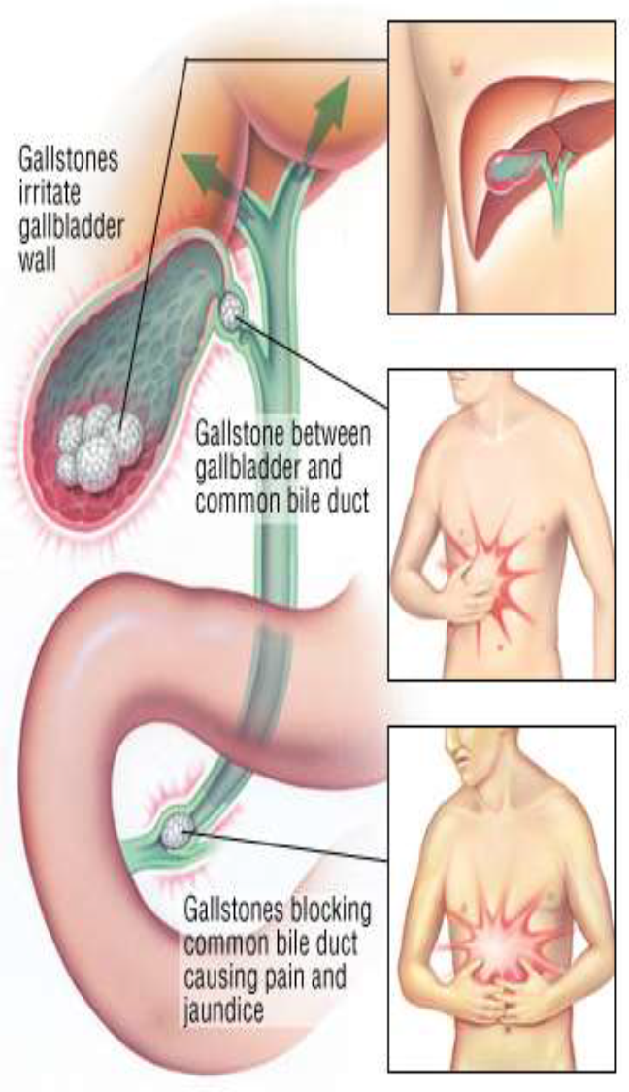
CHOLEDOCHOLITHIASIS
CLINICAL FEATURES
Charcot’s Triad.:-
  Intermittent Fever with chills
  Intermittent jaundice &
  Intermittent colicky pain
Feature of Ascending Cholangitis.. If untreated may progress to Septic Shock..
Reynold’s Pentad.:-
  hypotension &
  altered mental status with Charcot’s Triad.
Both evidence of shock from a biliary source.. Found in Suppurative Cholangitis.

Slide 14
CHOLEDOCHOLITHIASIS
CLINICAL FEATURES
A palpable gall bladder is unusual in patients with obstructive jaundice from CBD stone because the obstruction causes inflammation, thickening, fibrosis, contraction & non-distensible gall bladder..
COURVOISIER’S LAW: “In a patient with Jaundice if gall bladder is palpable , it is not due to stones.”
Exceptions to this Rule:
  Double impacted stone-one in CBD & one in Cystic Duct, with mucocele of gall bladder .
  Large stone in Hartman’s Pouch
  Empyema Gall bladder

Slide 15
CHOLEDOCHOLITHIASIS
COMPLICATIONS
Liver Dysfunction & Biliary atresia
White Bile formation & liver failure
Suppurative Cholangitis
Liver abscess
Septicemia
Pancreatitis if CBD stone is near sphincter of Oddi blocking drainage of Bile & Pancreatic Duct..

Slide 16
CHOLEDOCHOLITHIASIS
INVESTIGATIONS
1.RADIOLOGICAL:
USG Abdomen:
It may show Gallstones,
Dilated CBD>8mm with symptoms
Dilated CBD even without biliary colic in presence of gall stones highly suggestive of biliary obstruction
Sensitivity for gall stones only 65%

Slide 17
CHOLEDOCHOLITHIASIS
MRCP(Magnetic Resonance Cholangiopancreatography)
Non contrast non invasive imaging method better than ERCP in Diagnostic tool in biliary & pancreatic diseases
It delineates biliary tree anatomy & pathology clearly
but not therapeutic
Highly(>90%) sensitive & almost 100% specific

Slide 18
CHOLEDOCHOLITHIASIS
CT Scan
It shows stones , location, ductal stricture or block , ductal dilatation, intra hepatic biliary changes & stones.
Helical CT cholangiography is also useful but bilirubin level should be normal which is the limitation.
EUS(Endoscopic Ultrasonography)→ Useful & accurate but is invasive
PTC(Percutaneous Transhepatic Cholangiography)→done only when indicated like in case of previous Gastrectomy , failed ERCP. Not routinely done..
ERCP(Endoscopic Retrograde Cholangio Pancreatography)→now a days mostly Therapeutic use.

Slide 19
CHOLEDOCHOLITHIASIS
2.LABORATORY
CBC- TC WBC; Platelet Count
LFT: S. Bilirubin; S. ALP & GGT; S. ALT & AST; S. Protein; Prothombin Time
TREATMENT
Endoscopic Sphincterotomy & Bile duct stone extraction
Open Cholecystectomy with Bile duct exploration

Slide 21
Biliary lithotripsy

Slide 22
CHOLELITHIASIS
OVERVIEW

Slide 23
PREDISPOSING FACTORS
1. Obesity
2. Female sex hormones – estrogen & OCPs
3. Increasing age
4. Pregnancy
5. Drugs- octreotide, clofibrate
6. High fat diet
7. Diabetes mellitus

Slide 25
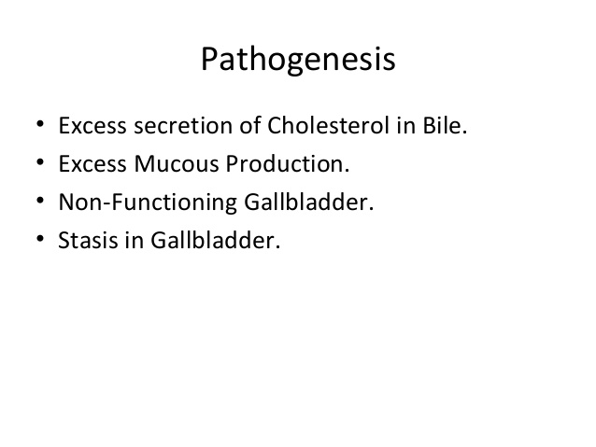

Slide 26
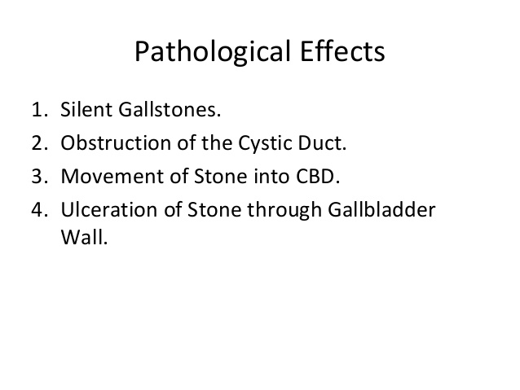

Slide 27
CLINICAL FEATURES
More common in females
Fat, fertile, forty, flatulent
10% Gallstones are RADIO-OPAQUE
Asymptomatic in 10 to 20% cases
Symptoms:
Biliary colic- Right hypochondrium & epigastrium, radiating to chest, back & shoulder, severe , on & off, spasmodic, occurs within hours after meal, usually self limiting and recurring, precipitated by fatty meal.
vomiting
Fever
Increased WBCs

Slide 28
MURPHY’s SIGN
Patient winces in pain with catch of breath when inflamed gall bladder strikes palpating fingers on inspiration

Slide 29
COMPLICATIONS OF GALL STONES
In Gall Bladder
Acute cholecystitis
Chronic cholecystitis
Empyema of gall bladder
Mucocele gall bladder
Perforation – leading to biliary peritonitis
Gangrene of gall bladder
Carcinoma
In Bile duct
Obstructive jaundice
Cholangitis
Acute pancreatitis
In Intestine
Acute intestinal obstruction

Slide 31
INVESTIGATIONS
USG abdomen → posterior acoustic shadowing
Plain X RAY abdomen
LFT
  Increased conjugated bilirubin
  Increased Alkaline Phosphate,
  GGT, 5’-Nucleotidase
TLC

Slide 32
D/D OF RADIO-OPAQUE SHADOW ON X-RAY
Renal stone
Calcified 12th rib tip
Phlebolith
Faecolith
Calcified lymph node
Renal cell Ca - calcification
Calcified Adrenal tumor

Slide 33
TREATMENT
Medical therapy
GALL STONE DISSOLUTION
Ursodeoxycholic acid (UDCA) – with a functioning Gall bladder with stone less than 10 mm
10-15 mg/kg/day
Pigment stones are non responsive to medical therapy

Slide 34
TREATMENT
Surgical therapy
Laparoscopic cholecystectomy is ideal.
Open cholecystectomy is done if patient unfit for laparoscopy through Right Sub-costal(KOCHERS’s) incision.

Slide 35
CHOLECYSTITIS
OVERVIEW

Slide 36
CHOLECYSTITIS
Def: Inflammation of the gall bladder
Can be divided into
  Acute cholecystitis
  Chronic cholecystitis
  Acute superimposed on chronic

Slide 37
CHOLECYSTITIS
ACUTE CHOLECYSTITIS
Classification
  Acute Calculous Cholecystitis
  Acute Acalculous Cholecystitis
Occurs in:
Patients with pre existing chronic cholecystitis
As first episode
Most Common Cause→ Impacted Gallstone in Hartmann’s Pouch
  Temporary impaction→ Only Biliary Colic; No INFLAMMATION
  Prolonged impaction→ INFLAMMATION ENSURES; Edema of GB; Subserosal Hemorrhage

Slide 38
CHOLECYSTITIS
Causitive Organisms:
E Coli (most common)
Klebsiella,Pseudomonas,Proteus
Strep.Faecalis
Salmonella
Clostridium Welchii
Mode of Infection
A. Hematogenous
Hepatic Artery →Cystic Artery
B. Portal Vein
C. Through Bile

Slide 40
CHOLECYSTITIS
Acute Calculous CS: 85-90% of the cases. Most common complication of gall stones and emergency cholecystectomy
Acute Acalculous CS (10-15% of cases)
CLINICAL FEATURES :
progressive right upper quadrant or epigastric pain
Mild fever
Anorexia
Tachycardia
Sweating
Nausea

Slide 41
CHOLECYSTITIS
Vomiting
Guarding
Rigidity
Murphy’s sign (arrest of inspiration with gentle pressure under the r costal margin due to tenderness)
Boaa’s sign- hyperasthesia at 9th to 11th rib posteriorly on r side
Palpable tender gallbladder

Slide 42
CHOLECYSTITIS
INVESTIGATIONS
LAB STUDIES
  leukocytosis
  Mild elevation of bilirubin , ALP, SGOT/PT
USG→ Sensitive; Inexpensive; Reliable
  Sensitivity 85% and Specificity 95%
CT is less sensitive than USG for the diagnosis of Acute Cholecystitis

Slide 43
CHOLECYSTITIS
MANAGEMENT OF ACUTE CHOLECYSTITIS
1. NPO
2. Ryles tube aspirate
3. IV Fluids
4.Broad spectrum antibiotics
5.IV analgesics
6. Observation
SURGERY IN A/C CHOLECYSTITIS
When presents within 2 to 3 days LAP CHOLECYSTECTOMY
When presents more than 3 days INTERVAL CHOLECYSTECTOMY after 6 weeks
Empyema, Persisting and Progressing Symptoms EMERGENCY CHOLECYSTECTOMY

Slide 44
CHOLECYSTITIS
COMPLICATIONS
Perforation
Peritonitis
Pericholecystic abscess
Cholangitis and septicemia
Pancreatitis
Empyema GB
Gangrenous GB

Slide 45
CHOLECYSTITIS
Chronic Cholecystitis→ Chronically Inflammed Thickened Gallbladder which is NON-Functioning NON- distending
May be a sequelae of repeated bouts of mild to severe acute cholecystitis
Associated with cholelithiasis > 90% of cases
Pathogenesis : supersaturation of bile predisposes to both chronic inflammation and stone formation.
1/3 of cases : E.coli and enterococci can be isolated from the bile

Slide 46
CHOLECYSTITIS
CAUSES
Gall stones
Cholecystosis
Chronic acalculous cholecystitis
Organisms:
Klebsiella
Steptococci
Salmonella
CLINICAL FEATURES
Colicky Pain
Murphy’s Sign
Dyspeptic Symptoms
Intolerance to fatty meal

Slide 47
CHOLECYSTITIS
COMPLICATIONS
CBD Stones
Cholangitis
Pancreatitis
Mirizzi’s Syndrome
Treatment of Chronic Cholecystitis is CHOLECYSTECTOMY

Slide 48
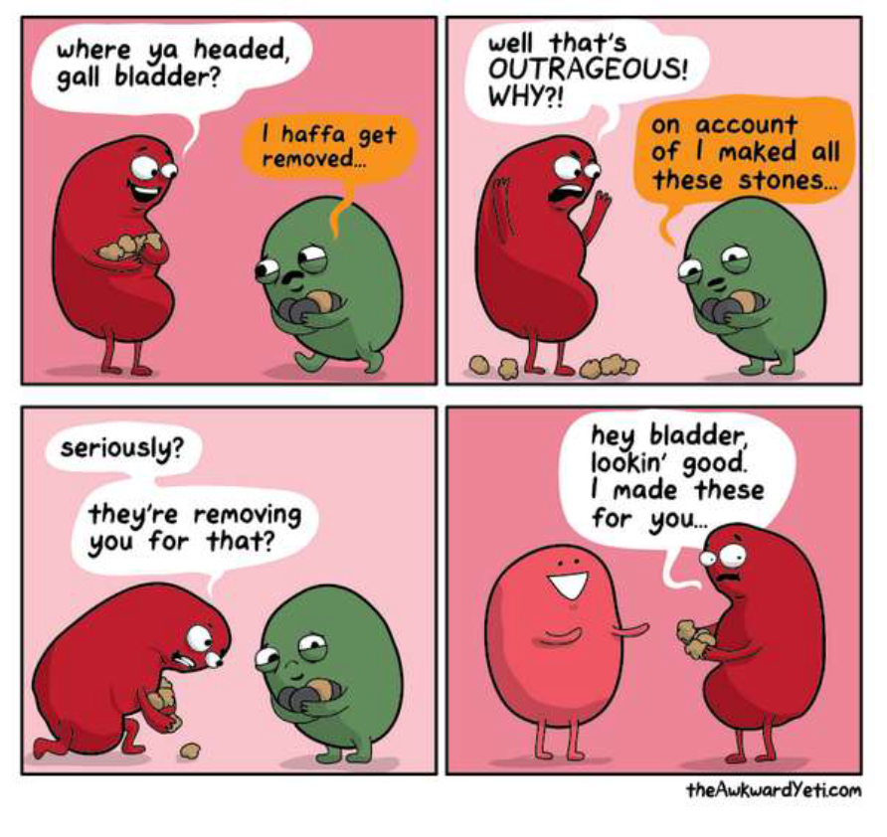

Slide 49
CHOLANGITIS
ACUTE & CHRONIC

Slide 50
ACUTE CHOLANGITIS
Bacterial infection superimposed on an obstruction of the biliary tree most commonly from a gallstone.
May be associated with neoplasm or stricture

Slide 51
PATHOPHYSIOLOGY
Ascending bacterial infection association with partial or complete obstruction of bile ducts.
Hepatic bile is sterile, bile in the bile ducts is kept sterile by continuous bile flow and by the presence of antibacterial substances in bile such as immunoglobulin.
Mechanical hindrance to bile flow facilitates bacterial contamination

Slide 52
PATHOPHYSIOLOGY
The most common organisms cultured from bile in patients with cholangitis include
Escherichia coli
Klebsiella pneumoniae
Streptococcus faecalis
Bacteroides fragilis
Enterococcus species
Pseudomonas aeruginosa

Slide 53
CLINICAL PRESENTATION
Cholangitis may present as anything from a mild, intermittent, and self-limited disease to a fulminant, potentially life-threatening septicemia.
The patient with gallstone-induced cholangitis is typically older and female.

Slide 54
CLINICAL PRESENTATION
The most common presentation is fever, epigastric or right upper quadrant pain, and jaundice.
Charcot's triad are present in about two thirds of patients→ fever, RUQ pain, and jaundice
Progress rapidly with septicemia and disorientation, known as Reynolds pentad.
Mild hepatomegaly
Peritonitis (uncommon)

Slide 55
CLINICAL PRESENTATION
History of the following increases the risk of cholangitis:
  Gallstones, CBD stones
  Recent cholecystectomy
  Endoscopic manipulation or ERCP, cholangiogram
  History of cholangitis
  History of HIV or AIDS: AIDS-related cholangitis is characterized by extrahepatic biliary edema

Slide 56
DIFFERENTIAL DIAGNOSIS
Cholecystitis
Diverticular disease
Hepatitis
Mesenteric ischemia
Pancreatitis

Slide 57
LAB INVESTIGATION
CBC→ Leukocytosis
Liver function test → hyperbilirubinemia, elevation of alkaline phosphatase and transaminases are common
PT PTT → Do not expect to be elevated unless sepsis is associated with disseminated intravascular coagulation or underlying cirrhosis exists.

Slide 58
RADIOLOGICAL INVESTIGATION
Imaging studies are important to confirm the presence and cause of biliary obstruction and to rule out other conditions.
Transabdominal ultrasonography is the initial imaging study of choice→ excellent for gallstones and cholecystitis.
It is highly sensitive and specific for examining the gallbladder and assessing bile duct dilatation.
ERC→ The definitive diagnostic test
In cases in which ERC is not available, PTC is indicated.

Slide 59
RADIOLOGICAL INVESTIGATION
Both ERC and PTC will show the level and the reason for the obstruction, allow culture of the bile, possibly allow the removal of stones if present, and drainage of the bile ducts with drainage catheters or stents
Endoscopic retrograde cholangiopancreatography (ERCP) → is both diagnostic and therapeutic and is considered the criterion standard for imaging the biliary system.
ERCP has a high success rate (98%) and is considered safer than surgical and percutaneous intervention.
Complications include pancreatitis, bleeding, and perforation.

Slide 60
RADIOLOGICAL INVESTIGATION
CT scanning and MRI will show pancreatic and periampullary masses, if present, in addition to the ductal dilatation.
Gallstones are poorly visualized with traditional CT scan.
Magnetic resonance cholangiopancreatography (MRCP) → is a noninvasive imaging modality that is increasingly being used in the diagnosis of biliary stones and other biliary pathology.
MRCP is accurate for detecting choledocholithiasis, neoplasms, strictures, and dilations within the biliary system
HIDA and DISIDA scans are functional studies of the gallbladder

Slide 61
TREATMENT
The initial treatment: intravenous antibiotics and fluid resuscitation.
Patients with mild cholangitis, 80-90% respond to medical therapy.
Approximately 15% do not respond and subsequently require immediate surgical or endoscopic decompression.
In severely ill patients, treatment is immediate

Slide 62
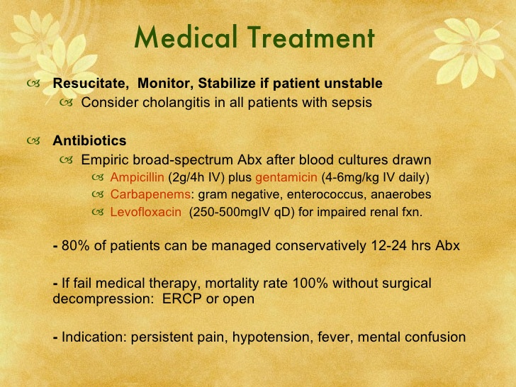

Slide 63
TREATMENT
The selection of procedure should be based on the level and the nature of the biliary obstruction.
Patients with choledocholithiasis or periampullary malignancies are best approached endoscopically, with sphincterotomy and stone removal, or by placement of an endoscopic biliary stent.
In patients in whom the obstruction is more proximal or perihilar, or stricture in a biliary-enteric anastomosis is the cause or the endoscopic route has failed, percutaneous transhepatic drainage is used.

Slide 64
TREATMENT
Where neither ERC nor PTC is possible, an emergent operation and decompression of the common bile duct with a T tube may be necessary and life-saving.
Definitive operative therapy should be deferred until the cholangitis has been treated and the proper diagnosis established.

Slide 65
CARCINOMA OF THE GALL BLADDER
OVERVIEW

Slide 66
CARCINOMA OF THE GALL BLADDER
Uncommon
Most common malignant tumour of the biliary tract
2-6x in women
7th decades of life
Etiology : (recurrent trauma and chronic inflammation)
  Gallstones are present in 60-90% of the cases
  Parasitic disease of the biliary tree

Slide 67
CARCINOMA OF THE GALL BLADDER
CLINICAL FEATURES
Insidious onset
Similar to cholelithiasis (Abd pain, jaundice, anorexia, nausea and vomiting)
Sx of Acute cholecystitis
Accidental finding during cholecystectomy for symptomatic gall stone
TREATMENT
surgical resection (including adjacent liver)
+- chemotherapy.

Slide 68


