Slide 1
DISORDERS OF THE GIT
MEDICINE 2

Slide 2
SEMESTER REFLECTION
“To study the phenomenon of diseases without books is to sail uncharted sea, while to study books without patients, is not to go to the sea at all”
William Osler

Slide 3
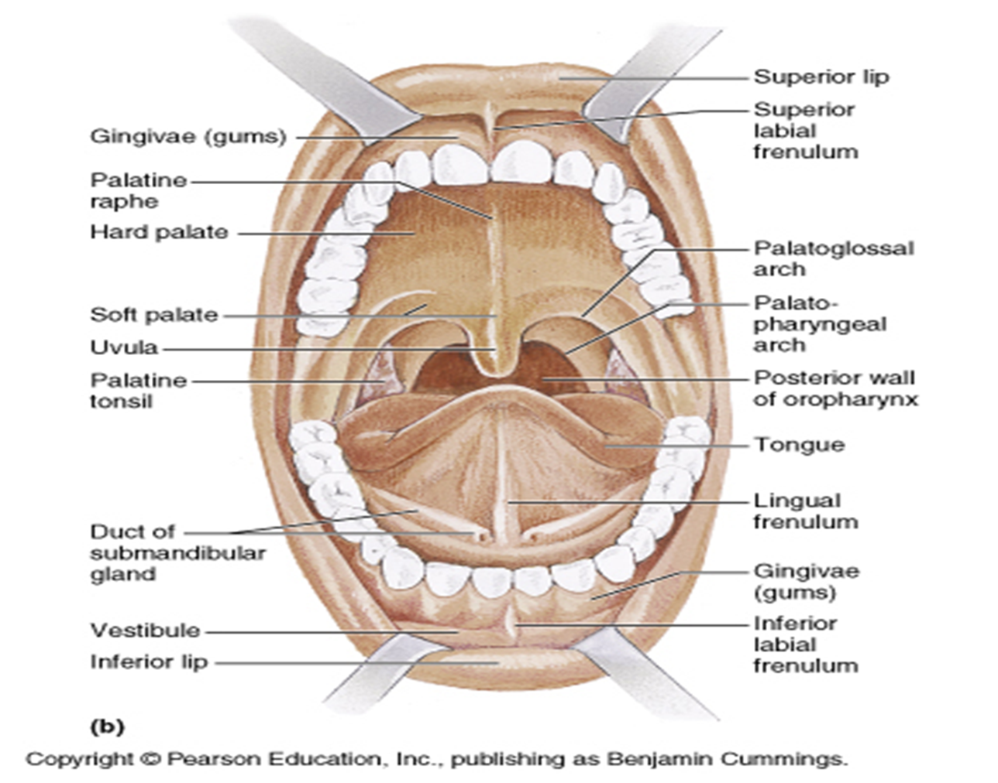
DISORDERS OF THE ORAL CAVITY
OVERVIEW

Slide 4

ANATOMICAL OVERVIEW
Oral cavity consist of
1. Lips
2. Gums
3. Tongue
4. Salivary glands
5. teeth

Slide 5
STOMATITIS
Definition: Stomatitis is an inflammation of the mucous lining of the mouth , which may involve the cheeks, gums ,tongue ,lips , and roof or floor of the mouth.
The word“ stomatitis “ literally means inflammation of the mouth

Slide 6
STOMATITIS
CAUSES
1. Chemotherapy
2. Radiotherapy
3. Loose-fitting dental prosthetics
4. Trauma
5. Poor dental hygiene
6. Smoking
7. Dehydration
8. Medication
9. Burns

Slide 7
STOMATITIS
SIGN & SYMPTOMS
1. Pain or discomfort in the mouth.
2. The presence of open sores or ulcers in the mouth.
3. Fever ,sometimes as high as 101– 104°F .
4. Irritability and restlessness
5. Blisters in the mouth
6. Swollen gums , which may be irritated and bleed.
7. Drooling.
8. Dysphagia.
9. Foul-smelling breath.

Slide 8
STOMATITIS
Management of Stomatitis
1. Medical management
bismuth salicylate , sucralfate, antacids
Water –Soluble lubricants from mouth and lips
Topical analgesics, such as benzamine hydrochloride
Topical anesthetics, such as lidocaine viscous
Oral or parenteral analgesics, including opioids if needed, for pain not controlled with above
2. Other management
Antiseptic mouth wash
Avoid excessive brushing
Denture hygiene measures

Slide 10
GINGIVITIS
Gingivitis is a non-destructive type of periodontal disease, but untreated gingivitis can progress to periodontitis.

Slide 12
GINGIVITIS
TYPES OF GINGIVITIS
1. Dental plaque-induced gingival disease
This can be caused by plaque, systemic factors, medications, or malnutrition.
2. Non-plaque induced gingival lesions
This can be caused by a specific bacterium, virus, or fungus. It might also be caused by genetic factors, systemic conditions.

Slide 13
GINGIVITIS
CAUSES
Accumulation of bacterial plaque
Some diseases like diabetes , HIV
Drugs
Smoking
Ages
Poor diet
Family history

Slide 14
GINGIVITIS
SYMPTOMS
Swollen or puffy gums
Dusky red or dark red gums
Gums that bleed easily when you brush or floss
Halitosis
Receding gums
tender gums

Slide 15
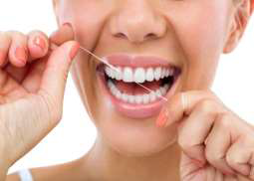
GINGIVITIS
PREVENTION /MANAGEMENT
Good oral hygiene
Regular dental visit
Good health practices
Brush twice a day after meal and snack
Use soft brush or electric toothbrush
Use electric brush and floss daily
Stop smoking

Slide 16
GINGIVITIS
COMPLICATIONS
Abscess
Peri-odontitis can lead to loss of teeth
Recurrent gingivitis
Ulceration of gums

Slide 17
GLOSSITIS
Glossitis is a condition in which the tongue is swollen and changes color.
Finger-like projections on the surface of the tongue (called papillae) are lost, causing the tongue to appear smooth.
Glossitis refers to inflammation of the tongue.
Cause change in Size, shape, color, taste, movement

Slide 18
GLOSSITIS
TYPES
According to their severity its divided into 2 types
ACUTE:- Acute glossitis is characterized by swollen papillae occurs
CHRONIC :- Chronic inflammation not of the surface of the tongue, but of the mucous covering of that organ

Slide 20
GLOSSITIS
CAUSES
1. Primary causes
Bacterial /viral infection
Mechanical irritation from dentures
Tobacco, hot food, alcohol, burns
Allergy to toothpaste, mouthwash
2. Secondary causes
Iron deficiency anemia
Pernicious anemia
Vitamin B deficiency
Syphilis
Ulcer
HIV /TB

Slide 21
GLOSSITIS
SYMPTOMS
Tongue swelling
Difficulty in talking ,swallowing, taste, chewing
Pain
Fatigue
Weight loss
Sore throat
DIAGNOSIS
History
Examination
Blood test
Oral swab

Slide 22
GLOSSITIS
TREATMENT
1. Good oral hygiene is essential
2. Steroids may be used to reduce the inflammation.
3. An oral suspension of Prednisolone may be used in mild cases
4. Antibiotics, antifungal
5. Proper nutrition
6. Avoid irritant like tobacco, hot, spicy food, alcohol

Slide 23
GLOSSITIS
COMPLICATION
Discomfort
Airway obstruction
Dysphagia
Dysphonia
Recurrent oral infection
Abscess
Oral cancer

Slide 24
PAROTITIS
Parotitis is inflammation of the parotid salivary gland
TYPES
Based on the onset:
  Acute
  Chronic
  Chronic with acute exacerbations.
Based on the causative agents:
  Bacterial parotitis
  Viral parotitis

Slide 25
PAROTITIS
CAUSATIVE AGENT
Staphylococcus aureus is the most common bacterial pathogen.
Viral parotitis is more common worldwide than bacterial parotitis with mumps being the most common viral cause of parotitis in children.
PREDISPOSING CONDITIONS
Dehydration
Malnutrition
Immunosuppression
Dental infections
Tracheostomy
Medications that suppress salivary flow (antihistamines, diuretics, anticholinergic medications)

Slide 26
PAROTITIS
PATHOPHYSIOLOGY
Acute bacterial
Bacteria spread from the oral cavity to the parotid gland via Stensen’s duct.
Another potential mechanism, especially in newborns, is hematologic spread from transient bacteremia
Chronic bacterial
Chronic bacterial parotitis may exist in the presence of calculi or stenosis of the ducts secondary to injury, and less likely as a sequela of acute bacterial infection.
In most instances, the chronic disease is autoimmune with superimposed bacterial infections.

Slide 27
PAROTITIS
SIGNS OF SYMPTOMS
There is a sudden onset of indurated, warm, erythematous swelling of the pre- and postauricular areas, with intense local pain and tenderness.
high fevers
chills,
marked systemic toxicity.
The infection is usually unilateral; bilateral infections are more associated with neonatal cases. Late in the course of the infection, massive swelling of the neck and respiratory obstruction may occur.
Other late manifestations include: septicemia, osteomyelitis of adjacent bones, and organ failure.

Slide 28
PAROTITIS
DIAGNOSTIC EVALUATIONS
Cultures may be obtained from parotid needle aspiration
Ultrasound demonstrates solid masses or fluid collections within the gland, and detects hypoechoic areas
CT scanning and MRI with gadolinium enhancement may be used to determine the size, shape, and presence of a neoplasm or abscess within the gland

Slide 29
PAROTITIS
MANAGEMENT
Adequate hydration
Antimicrobial therapy→ antistaphylococcal antibiotic
Surgical drainage and decompression of the gland are occasionally required if spontaneous drainage does not occur
Parotidectomy may eventually be required for people with long-standing infection

