Slide 1
DISORDERS OF THE LIVER, PANCREAS & GALL BLADDER

Slide 2
DISORDERS OF THE LIVER

Slide 3
PORTAL HYPERTENSION
Elevated pressure in the portal vein associated with increased resistance to blood flow through the portal venous system
Its an increase in pressures in the portal system above 5mm/hg.

Slide 4
Review of Portal circulation
The hepatic portal vein drains venous blood from the gastrointestinal tract, spleen, pancreas, and gallbladder to the sinusoids of the liver; from here, the blood is conveyed to the systemic venous system by the hepatic veins that drain directly to the inferior vena cava.

Slide 5
Causes
  Liver cirrhosis
  Blood clot in the portal vein
  Blockage of veins that carry blood from the liver to the heart
  Parasitic infections (schistosomiasis)

Slide 6
    Causes
    Pre hepatic
    Intra hepatic
    Post hepatic

Slide 7
Pathophysiology
Blockage of vessels high pressures in portal system varices, umbilical hernia. The portal vein drain blood from the stomach intestine, spleen and it is usually under low pressure five to ten mmhg. Any obstruction to blood flow may cause the blood to rise. Obstruction lead to esophageal, gastric and hemorrhoid varicose veins due to increased venous pressure and there is accumulation of fluid in the abdominal cavity; ascites.
The spleen and other organs that empty into the portal system also undergo the effects of congestion.

Slide 8
Symptoms
GI bleeding dark stool
Splenomegaly
Ascites
Shifting dullness or fluid wave on abdominal percussion
Dilated abdominal vessels radiating from the umbilicus (e.g. caput medussae)
Bruits detected over the upper abdominal area because of esophageal and gastric varicosities.
Encephalopathy/confusion
Reduced platelets, reduced WBC cells
Hepatic venous wedge pressure
Abnormal LFTS

Slide 9
Investigations
MRIS
Ultrasound
Doppler ultrasound
Liver biopsy

Slide 10
Management
Medication
  Beta blockers e.g. propranolol
  Vasopressin
  Octreotide
Endoscopic therapy
  Banding; block bld vessels with a rubber band
  Sclerotherapy; is the techniques of injecting sclerosing drugs into the varices, causing a narrowing of the swollen veins thus preventing bleeding and reducing swelling.

Slide 11
Transjugular intrahepatic portosystemic shunt (TIPS), a catheter is introduced by a radiologist into the jugular vein and advanced to the hepatic vein.
The catheter is threaded into a large branch of the portal vein, and a stent is placed connecting the portal vein (bringing blood to the liver from the digestive tract) with the hepatic vein (returning blood from the liver to the heart).

Slide 12
Nursing Diagnosis
Risk for infection
Activity
Risk for imbalanced fluid volume

Slide 13
Nursing Management
Administer medications, which may include diuretics.
Assist the health care provider with paracentesis; the volume usually is limited to 2 to 3L of fluid, but it may be more. Observe the client closely for signs and symptoms of vascular collapse.
Measure and record abdominal girth and body weight daily, assess for abdominal fluid wave.
Promote measures to prevent or reduce edema.
Encourage the client to elevate the lower extremities and wear support hose to prevent lower-extremity edema.
Administer salt-poor albumin, which temporarily elevates the serum albumin level. This increases serum osmotic pressure, helping to reduce edema by causing ascetic fluid to be drawn back into the bloodstream and eliminated by the kidneys.

Slide 14
ESOPHAGEAL VARICES
Bleeding esophageal varices are hemorrhagic processes involving dialted, tortuous veins in the submucosa of the lower esophagus. .
Risk Factors
Portal hypertension resulting from obstructed portal venous circulation

Slide 15
Pathophysiology
In portal hypertension, collateral circulation develops in the lower esophagus as venous blood, which is diverted from the GI tract and spleen because of portal obstruction, seeks an outlet.
Because of excessive intraluminal pressure, these collateral veins become tortuous, dilated, and fragile. They are particularly prone to ulceration and hemorrhage. Rupture of esophageal varices is the most common cause of death of clients with hepatic cirrhosis.

Slide 16
Clinical Manifestations
Hematemesis and melena, if ulcerated massive hemorrhage occurs
Signs of hepatic encephalopathy
Dilated abdominal veins
Ascites

Slide 17
Laboratory and diagnostic study findings
Endoscopy identifies the cause and site of bleeding
Ultrasound and computed tomography assist in identifying the site of bleeding

Slide 18
Medical Management
Non-surgical treatment is preferred because of the high mortality associated with emergency surgery to control bleeding from esophageal varices and because of the poor physical condition of most of these patients.

Slide 19
Nonsurgical measures include:
Pharmacologic therapy: somatostatin, vasopressin, beta-blocker and nitrates, octreotide
Balloon tamponade, saline lavage, endoscopic sclerotherapy (A drug is injected into the bleeding vein, causing it to constrict (narrow). This slows the bleeding and allows a blood clot to form over the ruptured vessel)
Transjugular intrahepatic portosystemic shunting (TIPS) (implants a wide tube (a stent) within the liver so that much of the blood traveling through the liver can flow quickly through the liver)
Esophageal banding therapy, variceal band ligation (A rubber band is used to tie off the bleeding portion of the vein)

Slide 20
If necessary, surgery may involve:
Bypass procedures (e.g. portacaval shunts, splenorenal shunt, mesocaval shunt)
Devascularization and transection

Slide 21
Nursing Diagnosis
Risk for bleeding
Imbalanced nutrition: less than body requirements

Slide 22
Nursing Management
Provide ongoing assessment
Assess for ecchymosis, epistaxis, petechiae, and bleeding gums
Monitor level of consciousness, vital signs, and urinary output to evaluate fluid balance.
Monitor the client during blood transfusion administration if prescribed.
Institute measure to address bleeding.
Use small-gauge needles, and apply pressure or cold for bleeding.

Slide 23
Provide nursing care for the client undergoing a prescribed balloon tamponade to control bleeding.
Explain the procedure to the client to reduce fear and enhance cooperation with insertion and maintenance of the esophageal tamponade tube.
Monitor the client closely to prevent accidental removal or displacement of the tube with resultant airway obstruction.
Provide nursing intervention for the client undergoing a prescribed iced saline lavage.
Ensure nasogastric tube patency to prevent aspiration
Observe gastric aspirate for evidence of bleeding.
Protect the client from chilling.

Slide 24
After injection sclerotherapy, assess for:
Aspiration
Esophageal perforation
Continued bleeding
After portal-systemic surgical intervention, monitor for complications.
Development of systemic encephalopathy
Liver failure
Continued bleeding
Administer prescribed medications, which may include vasopressin and vitamin K.

Slide 25
Read and make notes on Ascites

Slide 26
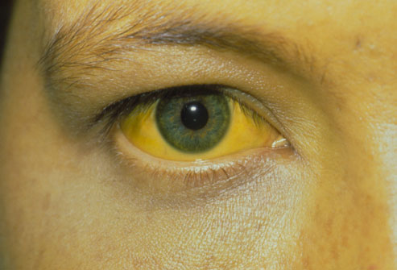
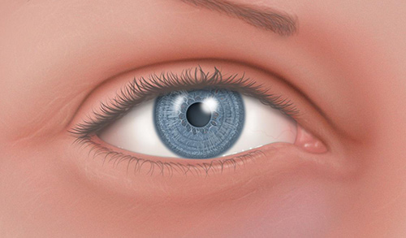
JAUNDICE
Yellowish coloration of the skin, sclera and mucous membrane. Different methods of classification:
Notes:
Serum bilirubin exceeds 2.5mg/dl

Slide 27
Classification of jaundice
According to source in relation to the liver:
Pre hepatic: Hemolysis
Hepatic: Infection in the liver
Post hepatic: Block to bile flow from gall bladder

Slide 28
According to cause
Pathological: Infection e.g malaria
Physiologic: Neonatal RBC hemolysis
Obstructive: Gall bladder stones

Slide 29
Conjugation of bilirubin
Breakdown of RBC’S haem>biliverdin> bilirubin
in the Liver it is conjugated with glucoronic acid by enzyme glucuronyl transferase making it soluble in water.
Much of it goes to the bile and out into the small intestine.
The conjugated bilirubin is not absorbed and passes into the colon and gives the color of the stool

Slide 30
Causes
Breakdown of RBCS
Damage of the liver/muscles
Under absorption of bilirubin by GIT
Investigations
Bilirubin levels
LFTS
Complete blood count

Slide 31
LFTs Normal values

Slide 32
Investigations
Abdominal U/S
Abdominal CT
Percutaneous transhepatic cholangiogram
Liver biopsy
Cholesterol levels

Slide 33
Prothrombin time
Hepatitis A,B,C tests
Endoscopic retrograde cholangiopancreatography

Slide 34
Clinical manifestations
Yellowish coloration of the sclera, skin and mouth
Dark or brown coloured urine
Pale or clay coloured stools
Pruritus
Weight loss
Abdominal pain
Fever
Management
NB according to the cause

Slide 35
HEPATITIS
Inflammation of liver tissue
The most common types are viral. A,B,C
Many cases are asymptomatic and therefore remain undiagnosed.
Pathophysiology
The virus enters the liver cells causing degenerating
Changes. Inflammation process follows
Accompanied by exudates containing lymphocyte, plasma cells and granulocytes.

Slide 36
There is reactive hyperplasia of the macrophages in the sinusoids.
Later there is necrosis of the liver cells and tissue. Macrophages tries to remove the necrotic materials causing the collapse of the lobules.
Blood supply in the lobules is interfered with causing hypoxia and further liver damage.

Slide 37
HEPATITIS A
Caused by RNA virus
Spread through the oral faecal route
Clinical manifestations
Flu like symptoms
Low grade fever
Anorexia
Jaundice
Dark urine
Splenomegally

Slide 38
Management
Complete bed rest
IV fluids
Diet low in protein
Gradual mobilization
Health education
Other nursing care as per the patient needs

Slide 39
Prevention
Administration of hepatitis A vaccine

Slide 40
HEPATITIS B
Caused by DNA virus
Spread through blood, mucous membrane and skin
Also found in semen and vagina
Predisposed people
Health workers
Patients on hemodialysis
Homosexuals
IV drug abusers

Slide 41
Clinical manifestations
Fever
Rashes
Arthralgia
Anorexia
Dyspepsia
General malaise and weakness
Jaundice
Hepatomegally
Splenomegally

Slide 42
Management
Complete bed rest
Diet restricted in protein
Medication( antacids, antiemetics, antispasmoidals)
Ambulation
Involve family in care

Slide 43
Patients education
Nutrition
Ways of transmission
Avoid alcohol
Protected sex

Slide 44
Prevention
Control chain of transmission
Early screening
Vaccination
Contact tracing
Treatment of the affected
Health education

Slide 45
HEPATITIS C & D
Hepatitis C
Is associated with blood infusions
Clinical symptom and management are like for hepatitis B
Hepatitis D
Only people with hepatitis B contracts the disease because this virus needs the antigen surface for hepatitis B to attach.
Transmission-sexual intercourse with an infected person
Symptoms and management are like in hepatitis B

Slide 46
Hepatitis C
Affect both the RNA and DNA strands
Target is the liver mostly the B lymphocytes
CAUSES
Sexual intercourse
Sharing needles
Blood and blood products
Mother to child transmission
Signs and symptoms
Usually asymptomatic

Slide 47
Assignment –hepatitis E &G

Slide 48
LIVER CIRRHOSIS
Damage to the liver tissue and replacement of the normal tissue with scarred tissue. Scar tissue partially blocks the flow of blood through the liver and impairs the liver’s ability to:
control infections
remove bacteria and toxins from the blood
process nutrients, hormones, and drugs
make proteins that regulate blood clotting
produce bile to help absorb fats and fat-soluble vitamins

Slide 49
stages
Stage 1
The first stage of cirrhosis is characterized by the presence of inflammation, characterized by swelling, an influx of inflammatory-promoting immune cells and some destruction of liver tissue. Additionally, there may also be the growth of abnormal connective tissue. These two factors, inflammation and abnormal connective tissue, are confined to the portal area of the liver.

Slide 50
Stage 2
Also characterized by inflammation, but fibrosis is also beginning to occur. Fibrosis is the replacement of normal liver tissue with scar tissue.
No symptoms because the remaining normal liver tissue is able to compensate.
However, scar tissue will not become normal functioning liver tissue, meaning this transformation is permanent.

Slide 51
Stage 3
Damage is more severe.
Fibrosis forms “bridges,” and is called bridging fibrosis. These bridges develop abnormal connections between the hepatic artery, vein and other vessels that cause abnormal blood flow and Hepatic portal hypertension.

Slide 52
Stage 4 (End Stage Liver Disease)
Gross liver malfunction
Many symptoms, including bleeding in the digestive tract, jaundice -- yellow coloring of the eyes and skin, mental effects such as confusion, unusual sleepiness and slurring of speech, build-up of fluid in the body -- edema; and intense and unexplained skin itching.

Slide 53
Types of Cirrhosis(Also etiologic factors)
Alcoholic- involves the production of high levels of metabolites.
Post-necrotic- severe necrosis linked to viral or toxic damage most commonly as a result of hepatitis B or C.
Biliary Cirrhosis- Chronic autoimmune destruction of the inter-hepatic bile ducts.

Slide 54
Pathology
Liver cirrhosis is defined by two principal factors: Portal Hypertension and Hepatic Dysfunction. Portal hypertension is the result of restricted flow of blood through the liver to the hepatic veins and then to the inferior vena cava.
The resulting portal congestion increases portal pressures and decreases blood flow to the liver. With reduced blood flowing to the cirrhotic liver, the hepatocytes have minimal access to blood, severely hampering their capacity to detoxify harmful chemicals.

Slide 55
As a result, toxins become more concentrated in the blood producing damaging effects particularly the production of ammonia (from amino acid breakdown). Instead of being excreted, ammonia stays in the blood causing hepatic encephalopathy and a noticeable foul breath. Furthermore, the hepatocytes continue to die leading to a progressive deterioration of the liver’s regulatory capabilities resulting in hypocoagulation and hypoalbuminemia.

Slide 56
Congestion in the hepatic portal system causes blood to be diverted to the collateral vessels forcing them to accommodate larger volumes. This engorgement causes:
a) the veins to bulge producing easily visible hemorrhoids.
b) dilation of the thin-walled esophagus causing esophageal varices which are subjected to trauma as food is swallowed and can rupture.
With prolonged bleeding time, esophageal varices is a very serious complication of liver cirrhosis.

Slide 57
Portal hypertension in liver cirrhosis also causes ascites (accumulation of fluid in the peritoneal cavity) and splenomegaly.
Ascites is caused by hampered albumin production, the osmotic pressure decreases reducing the return of fluid to the blood from the tissues. It results in a significant and pronounced abdominal distention, compressing the abdomen and compromising breathing.

Slide 58
Splenomegaly is the enlargement of the spleen as a result of the inability of the veins that drain the spleen to empty into a congested portal system.
The enlarged spleen increasingly takes up and hold formed elements of the blood causing thrombocytopenia and anemia.

Slide 59
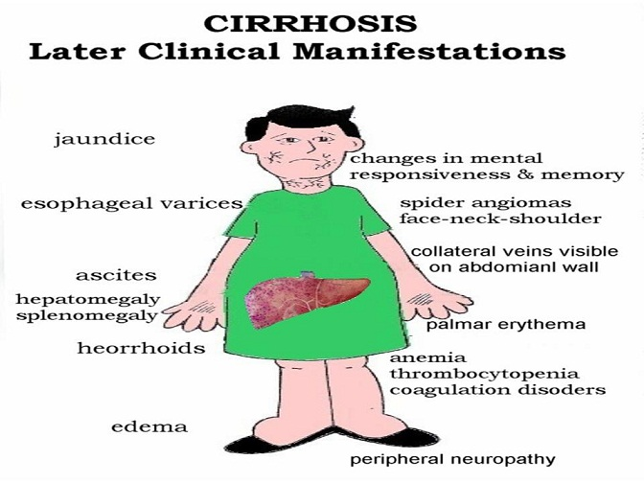

Slide 60
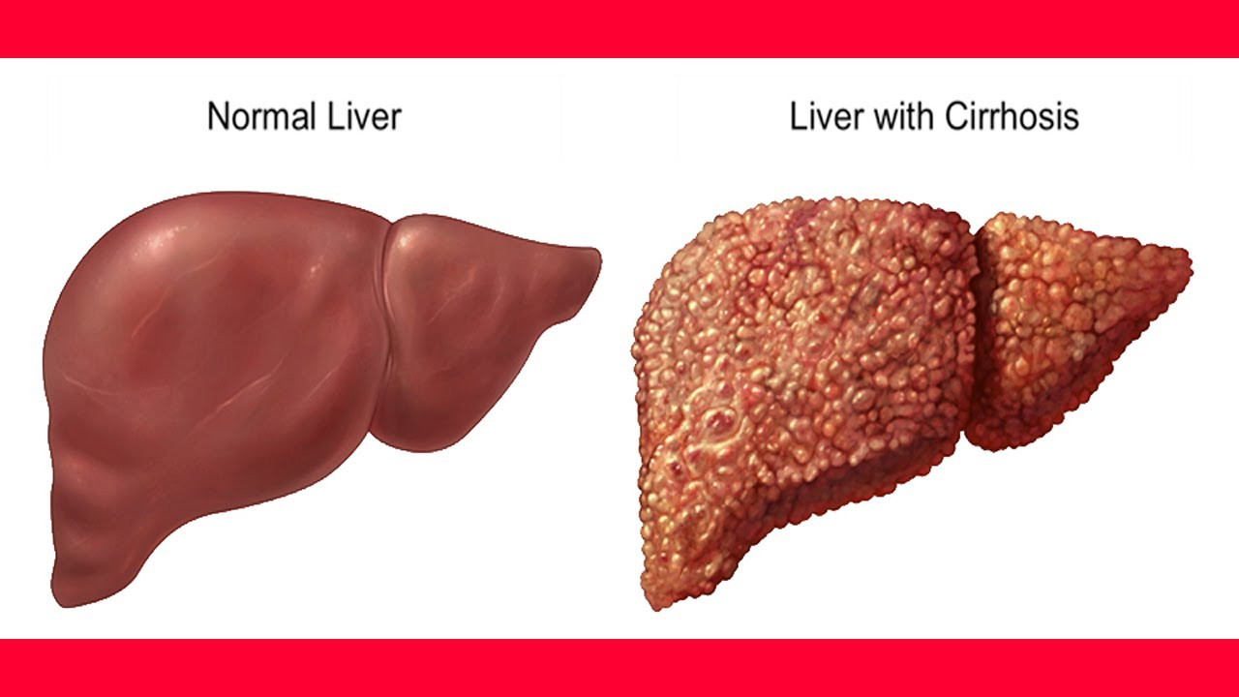

Slide 61
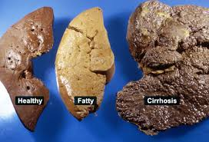

Slide 62
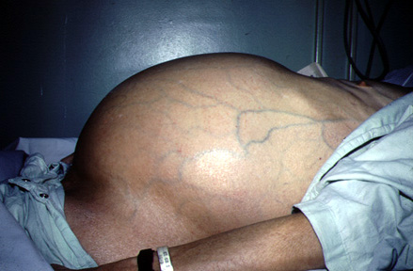
Ascites

Slide 63
S/S
Early
generally feeling unwell and tired all the time
loss of appetite
loss of weight and muscle wasting
feeling sick (nausea) and vomiting
tenderness/pain on the RUQ
spider-like small blood capillaries on the skin above waist level (spider angiomas)
blotchy red palms
disturbed sleep pattern
Late
Foul breath
Jaundice
Fatigue
Pain
High Grade Fever
Loss of appetite
Edema
Anemia
Confusion

Slide 64
Diagnosis
Blood tests
LFTs: should include SGOT (serum glutamic oxaloacetic transaminase ) aspartate transaminase (AST), alanine transaminase (ALT), alkaline phosphatase (ALP), bilirubin, gamma-glutamyltransferase (gamma-GT); AST and ALT are raised due to hepatocyte damage; gamma-GT is high in active alcoholics.
Albumin: there is hypoalbuminaemia in advanced cirrhosis.
FBC: occult bleeding may produce anaemia; hypersplenism may cause thrombocytopenia; macrocytosis can suggest alcohol abuse.

Slide 65
Renal function tests and electrolytes: hyponatraemia may be present (due to increased activity of antidiuretic hormone). Poor renal function may represent hepatorenal syndrome.
Red cell folate: alcohol abuse is often associated with a diet inadequate in folate.
Coagulation screen: abnormalities of coagulation are a sensitive test of liver function; prothrombin time is reduced in advanced cirrhosis.
Ferritin: low ferritin may indicate iron deficiency from diet or blood loss; ferritin is raised in haemochromatosis

Slide 66
Viral antibody screen for hepatitis
U/S
P/E
Chest x-ray will show a raised diaphragm

Slide 67
Management
Nothing can reverses the damaged liver cells state
Treatment aims at preventing the progression and providing symptomatic relief
Class brainstorming

Slide 68
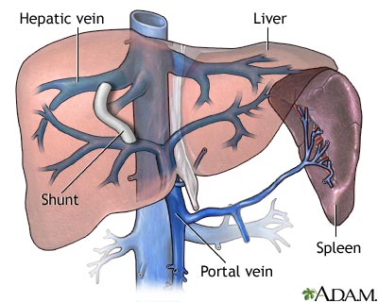
T.I.P.S
Transjugular intrahepatic Portosystemic shunt
The goal of TIPS placement is to divert portal blood flow into the hepatic vein, so as to reduce the pressure gradient between portal and systemic circulations

Slide 69
Complications
Discussion on complications

Slide 70
Fulminant Hepatic Failure
The development of encephalopathy within 8wks of the onset of symptoms in a patient with a previously healthy liver.
The appearance of encephalopathy within two weeks of developing jaundice, even in a patient with previous underlying liver dysfunction.

Slide 71
Hepatic Failure
Exocrine: bile is secreted by the liver and contains cholesterol, bile salts and waste products such as bilirubin. Bile salts aid in the digestion of fats.
Accumulation of bile salts resulting in hypercholesterolemia, steatorrhea, fat soluble vitamine deficiencies, and prurities(due to build up of bile salts in the skin).
Execratory: failure to excrete bilirubin resulting in hyperbilirubinemia (hemoglobin breakdown product=bilirubin).

Slide 72
Synthesis: Liver makes almost all plasma proteins, therefore, hepatic failure leads to albumin and coagulation factor deficiencies.
Metabolic: Impaired glucose metabolism, glucose synthesis, ketone body synthesis, fatty acid synthesis, drug metabolism, and estrogen metabolism.
Acute hepatic failure is characterized by loss of greater than 90% of hepatocytes ; consequently , loss of excretory , exocrine , synthetic and metabolic functions.

Slide 73
HEPATIC ENCEPHALOPATHY AND COMA
Hepatic encephalopathy, a life-threatening complication of liver disease, occurs with profound liver failure and may result from the accumulation of ammonia and other toxic metabolites in the blood.
Hepatic coma represents the most advanced stage of hepatic encephalopathy.
Portal-systemic encephalopathy, the most common type of hepatic encephalopathy, occurs primarily in patients with cirrhosis with portal hypertension and portal-systemic shunting

Slide 74
Pathophysiology
Ammonia accumulates because damaged liver cells fail to detoxify and convert to urea the ammonia that is constantly entering the bloodstream.
Ammonia enters the bloodstream as a result of its absorption from the GI tract and its liberation from kidney and muscle cells.
The increased ammonia concentration in the blood causes brain dysfunction and damage, resulting in hepatic encephalopathy.
Circumstances that increase serum ammonia levels tend to aggravate or precipitate hepatic encephalopathy.
The largest source of ammonia is the enzymatic and bacterial digestion of dietary and blood proteins in the GI tract. Ammonia from these sources is increased as a result of GI bleeding (ie, bleeding esophageal varices or chronic GI bleeding), a high-protein diet, bacterial infections, and uremia.

Slide 75
The ingestion of ammonium salts also increases the blood ammonia level. In the presence of alkalosis or hypokalemia, increased amounts of ammonia are absorbed from the GI tract and from the renal tubular fluid. Conversely, serum ammonia is decreased by elimination of protein from the diet and by the administration of antibiotic agents, such as neomycin sulfate, that reduce the number of intestinal bacteria capable of converting urea to ammonia
Other factors unrelated to increased serum ammonia levels that may cause hepatic encephalopathy in susceptible patients include excessive diuresis, dehydration, infections, surgery, fever, and some medications (sedative agents, tranquilizers, analgesic agents, and diuretic medications that cause potassium loss).

Slide 76
Clinical Manifestations
The earliest symptoms of hepatic encephalopathy include minor mental changes and motor disturbances. The patient appears slightly confused, has alterations in mood, becomes unkempt, and has altered sleep patterns. The patient tends to sleep during the day and have restlessness and insomnia at night.
As hepatic encephalopathy progresses, the patient may be difficult to awaken.
Asterixis (flapping tremor of the hands) may occur. Simple tasks, such as handwriting, become difficult.
A handwriting or drawing sample (eg, star figure), taken daily, may provide graphic evidence of progression or reversal of hepatic encephalopathy. Inability to reproduce a simple figure is referred to as constructional apraxia.
In the early stages of hepatic encephalopathy, the deep tendon reflexes are hyperactive; with worsening of hepatic encephalopathy, these reflexes disappear and the extremities may become flaccid.

Slide 77
Assessment and Diagnostic Findings
The electroencephalogram (EEG) shows generalized slowing, an increase in the amplitude of brain waves, and characteristic triphasic waves.
Occasionally, fetor hepaticus, a sweet, slightly fecal odor to the breath presumed to be of intestinal origin may be noticed. The odor has also been described as similar to that of freshly mowed grass, acetone, or old wine.
In a more advanced stage, there are gross disturbances of consciousness and the patient is completely disoriented with respect to time and place.
With further progression of the disorder, the patient lapses into frank coma and may have seizures.
Approximately 35% of all patients with cirrhosis of the liver die in hepatic coma.

Slide 78
Medical Management
Lactulose (Cephulac) is administered to reduce serum ammonia levels.
It acts by several mechanisms that promote the excretion of ammonia in the stool: (1) ammonia is kept in the ionized state, resulting in a fall in colon pH, reversing the normal passage of ammonia from the colon to the blood; (2) evacuation of the bowel takes place, which decreases the ammonia absorbed from the colon; and (3) the fecal flora are changed to organisms that do not produce ammonia from urea.

Slide 79
Other aspects of management include intravenous administration of glucose to minimize protein breakdown, administration of vitamins to correct deficiencies, and correction of electrolyte imbalances (especially potassium)

Slide 80
Additional principles of management of hepatic encephalopathy include the following:
Neurologic status is assessed frequently. A daily record is kept of handwriting and performance in arithmetic to monitor mental status.
Fluid intake and output and body weight are recorded each day.
Vital signs are measured and recorded every 4 hours.
Potential sites of infection (peritoneum, lungs) are assessed frequently, and abnormal findings are reported promptly.
Serum ammonia level is monitored daily.

Slide 81
Protein intake is restricted in patients who are comatose or who have encephalopathy that is refractory to lactulose and antibiotic therapy (Chart 39-4).
Reduction in the absorption of ammonia from the GI tract is accomplished by the use of gastric suction, enemas, or oral antibiotics.
Electrolyte status is monitored and corrected if abnormal.
Sedatives, tranquilizers, and analgesic medications are discontinued.
Benzodiazepine antagonists (flumazenil [Romazicon]) may be administered to improve encephalopathy whether or not the patient has previously taken benzodiazepines.

Slide 82
LIVER ABSCESS
Liver abscess is a localized collection of necrotic inflammatory pus-filled mass in the liver.
Classifications:
Based on the duration of symptoms
Acute (Less than a month)
Chronic (Greater than a month)
Based on Associated conditions
Primary Liver Abscess: if patient was previously healthy
Secondary Liver Abscess: When associated with any systemic diseases or risk factors that could compromise the immune system such as HIV infection, Neoplasm etc

Slide 83
Types
There are several types of liver abscesses based on the causative organism:
a) Pyogenic abscess –accounts for 80% of hepatic abscess.
b) Parasitic abscess :
Parasitic protozoa: Entamoeba histolytica (also known as amebic abscess) is common and accounts for 10% of cases.
Parasitic helminthes: Hepatic abscess is rarely associated with it.
c) Fungal abscess – accounts for less than 10% of cases and most often due to yeasts (Candida species) and immunosuppression.

Slide 84
Pyogenic liver abscess and parasitic abscess are the common occurring type
Amebic abscess has an insidious onset and common in Entamoeba histolytica endemic area while pyogenic abscess has a sudden onset and common in developed countries.
Amebic liver abscess is more prevalent in individuals with immunosuppression while pyogenic abscess severity is dependent on the bacterial source and the underlying condition of the patient.

Slide 85
Prevalence
Abscesses involve:
~70% of the right hepatic lobe
20% of the left lobe
5% of the caudate lobes
5% of bilateral involvement
The right hepatic lobe is affected more often than the left hepatic lobe by a factor of 2:1.

Slide 86
The prevalence can be attributed to anatomic considerations:
The right hepatic lobe receives blood from both the superior mesenteric and portal veins, whereas the left hepatic lobe receives from inferior mesenteric and splenic drainage.
The right hepatic lobe also contains a denser network of biliary canaliculi and accounts for more hepatic mass.

Slide 87
Risk factors
For pyogenic liver abscess
Crohn’s disease
Abdominal or gastrointestinal infection
Recent abdominal surgery
Diabetes
For amebic liver abscess
Poor nutritional status
Immunosuppression
Travel to regions where amebic infections are common
Alcoholism
Advanced age

Slide 88
Pathogens involved
Amebic liver abscesses are caused by Entamoeba histolytica.
Fungal abscesses are commonly due to Candida albicans primarily and Aspergillus species.
Pyogenic abscess can be caused by the following:
Anaerobes (including Bacteroides species) are prominent when the infection is of biliary origin
Escherichia species most common organism isolated
Klebsiella species - common in patients with diabetes and have been associated with Endophthalmitis
Proteus species
Pseudomonas species
Staphylococcus species (Opportunistic Pathogens)
Streptococcus species (including Enterococcus)

Slide 89
Route of infection
Biliary tract is the most common source of liver abscess and accounts for about 40% of all cases. It can occur from bile flow obstruction by biliary stone, benign or malignancy tumors, postoperative stricture or congenital
Hematogenous (via hepatic artery) route accounts for 20% of cases and results from seeding of the pathogens into the liver. Appendicitis and pylephlebitis are the predominant causes.

Slide 90
Cryptogenic abscesses account for about 20% and there is increased incidence in patients with diabetes or metastatic cancer.
Blunt or penetrating trauma can inoculate organisms directly into the liver parenchyma, resulting in pyogenic liver abscess.
Biliary tract or hematogenous route usually causes
small multiple abscesses.
Direct infiltration and penetrating injuries tend to
cause a large abscess.

Slide 91
Pathophysiology
The liver receives blood from both systemic and portal circulations.
Increased susceptibility due to increased exposure to infections would be expected.
Multiple processes have been associated with the development of hepatic abscesses.
However, Kupffer cells lining the hepatic sinusoids clear pathogens so efficiently that infection rarely occurs.

Slide 92
But when pathogens exceed the capacity of the Kupffer cells, they destroy hepatic tissue.
Producing a Necrotic filled cavity, with the infectious organism, liquefied liver cells and leukocytes, which walls off from the rest of the liver forming a liver abscess

Slide 93
Clinical features
There is usually a history of:
Right upper quadrant pain in 80% of cases, may extend to the left side or
referred to right shoulder especially in amebic abscess.
Fever (100.4 F either continuous or spiking) with prominent evening rise
Chills and rigors
Profuse sweating
Nausea with or without vomiting

Slide 94
Loss of appetite
Unexplained weight loss
Dark urine
Diarrhea is present in about 25% of the cases.
Clay-colored stools
Dry painful Cough or hiccups (due to hepatic friction rub associated with
diaphragmatic irritation or inflammation of Glisson capsule)
Pleuritis chest pain (hurts to breathe)

Slide 95
ON EXAMINATION
A restless child in painful distress
Pale
Jaundiced (in about 25% of cases and usually with biliary tract disease or presence of multiple abscesses or Liver damage)
Febrile
Earthy complexion
There could be tenderness on the right hypochondrium, epigastrium or intercostal spaces overlying the liver.

Slide 96
An epigastric mass (may be found on left-lobe)
Upward enlargement of the liver which may cause bulging of the right chest wall with raised upper level of liver dullness on percussion.
Dyspnea
Right pleural effusion, or pulmonary consolidation
Decreased breath sounds or crepitations at the right lung base zones.

Slide 97
Diagnosis
This is often delayed, though depends on the combination of history, clinical presentation, investigation findings, radiologic imaging and the cultured abscess.
Complete blood count (CBC) with differentials will reveal neutrophilic Leukocytosis, anemia of chronic disease and raised Erythrocyte Sedimentation Rate.
Liver function test will reveal hypoalbuminemia and raised alkaline phosphatase as the common findings; mild elevations of serum aspartate aminotransferase and alanine aminotransferase could exist.
Blood cultures are positive in identifying the bacterial agent in roughly 50% of cases.

Slide 98
Microscopic stool examinations for trophozoites and cysts are performed in 3 to 6 stool samples for concentration and specificity and are positive in 25% cases.
WHO recommends that intestinal amoebiasis should be diagnosed with specific stool E. histolytica testing (such as cultures, serology, antigen testing, and Enzyme immunoassay, hemagglutination tests or PCR) rather than microscopy for ova and cysts.

Slide 99
Serology is the best method of confirming the diagnosis of liver abscess.
Indirect hemagglutination and gel diffusion precipitation are the most commonly used tests with 85–95% sensitivity and specificity detecting antibodies to E. histolytica.

Slide 100
Radiograpic imaging
The radiographic general rule of liver abscess:
Bacterial and fungal abscesses are often multiple, whereas
Amoebic abscesses are often single though spread through the diaphragm and into the chest.
Radioisotope scanning was mostly used in the past until new imaging techniques were introduced. These techniques include:
Plain abdominal x-rays which may demonstrate gas within the abscess cavity, biliary tree (pneumobilia) or beneath the diaphragm (elevating the diaphragm) and right pleural effusion and calcification (hydatid cyst).

Slide 101
Chest radiograph which may show:
Basilar atelectasis
Right hemidiaphragm elevation
Right pleural effusion is present
Both Computed tomography (CT) and ultrasonography remain the radiologic modalities of choice as screening procedures (80-90% sensitive but non-specific in differentiating pyogenic and amebic abscesses), although can be used as techniques for guiding percutaneous aspiration and drainage.

Slide 102
CT scan is superior in detecting abscess (es) as small as 0.5 cm and reveals the abscess as:
Lobar involvement
Solid appearance (mimicking a hepatic tumour)
Contain gas in 20% of lesions
Association with thrombophlebitis, and
Hematogenous appearance.

Slide 103
Ultrasonography is better for intrahepatic abscesses larger than 2 cm with limitation in abscesses located in the dome of the liver.
Hypoechoic round or oval lesions (still with some internal echoes however), and irregularly shaped well defined borders. Internal septations or cavity debris may be detected but the liquefied necrotic area does not enhance. Doppler will demonstrate absence of central perfusion.

Slide 104
Contrast imaging characterizes lesion, measures the size of the necrotic area, and depict internal septations for management purposes.
Contrast-aided magnetic resonance imaging may soon become an accurate method for diagnosing hepatic abscesses as its characteristics findings include:
T1: hypointense centrally though may be slightly hyperintense in fungal abscess
T2: tends to have hyperintense signal
T1+C (Gd): enhancement of the capsule, although this may be absent in immunocompromised patients and multiple septations may be visible
DWI: tends to have high signal within the abscess cavity
ADC: tends to have low signal within the abscess cavity
Notes:
Diffusion weighted MRI
Apparent diffusion coefficient

Slide 105
Magnetic resonance cholangiopancreatography (MRC) shows a voluminous and heterogeneous collection.
Proctoscopy, Sigmoidoscopy or colonoscopy: mucosal scrapings for biopsy and E. histolytica testing.
Barium studies are contra-indicated because of the risk of perforation.

Slide 106
Complications of abscess
Due to delayed onset of treatment, 10–20% cases of liver abscess rupture and disseminate into the peritoneum, pericardium and the brain.
7–11% complication occurs at the inferior surface of the liver; where the ruptured abscess disseminates into the intraperitoneal cavity leading to peritonitis and peritonitis.
4–7% complication is at the dome of the liver which could disseminate through the diaphragm into the pericardium and cause empyema, pleural effusion, bronchopleural fistula, pericarditis, Endocarditis.
1-2% cases develop Brain abscess and Endophthalmitis especially when an abscess is associated with Klebsiella pneumoniae.
Liver failure can also occur.

Slide 107
Differential diagnoses
These include other causes of fever, abdominal pain and yellowness of the eye, such as:
Trauma to the abdomen
Glucose-6-Phosphate Dehydrogenase Deficiency
Acute Gastritis
Intestinal Obstruction
Biliary Obstruction
Acute Cholecystitis
Acute Pancreatitis
Liver cysts
Liver metastasis (especially necrotic metastases)
Bacterial Pneumonia (because of the chest radiographic finding)

Slide 108
Management
Treatment involves antibiotics with/without drainage.
Fluid and electrolyte replacement, gastric suction and blood transfusion may be required.
ANTIBIOTICS
This is usually sufficient in treating patients with good clinical condition and those with solitary or micro (less than 2 cm) abscess. Before identification of the causative organism, a wide spectrum antibiotic is/are commenced to treat aerobic and anaerobic bacilli.

Slide 109
Antibiotics could consist of Cephalosporin, Aminoglycoside, Metronidazole Or Penicillin .
Metronidazole (Flagyl) remains the first choice of treatment though it has an antabuse -like action and alcohol should be avoided during its use. Cardiovascular symptoms are rare. When the causative organism(s) is/are identified, the choice of antibiotics is determined and the antibiotic regimen is modified to match the patient's sensitivities.

Slide 110
Diloxanide furoate is the drug of choice for asymptomatic patients with E. histolytica cysts in the faeces and also given as a 10-day course for chronic infections.
Use of amebicidal drugs is indicated in amebic liver abscess.
Antifungal drugs may be commenced after drainage of a fungal abscess.

Slide 111
DRAINAGE
Though not recommended in very small uncomplicated abscesses (less than 2 cm), it is the mainstay of the treatment, accomplished either percutaneously or Open Laparotomy
Since the mid-1970s (late 20th century), PAIR (Percutaneous puncture with computed tomography or ultrasonography guidance which allows close evaluation of the biliary tree, followed by needle Aspiration and/or with catheter, Injection of a proto scolicidal agent such as hypertonic saline or ethanol, and finally Re-aspiration 15 minutes later) has become the more acceptable therapeutic treatment option sufficient to drain uncomplicated abscess.

Slide 112
Despite the high success rates (70–90%) of PAIR with low morbidity, complications could arise from the procedure such as:
Perforation of adjacent abdominal organs
Leakage of abscess contents in the peritoneum
Hemorrhage
Pneumothorax
Also PAIR is contraindicated in:
Flail chest
Elderly multiple and/or complicated medical problems or conditions
Multilocular cysts
Septic shock

Slide 113
Open laparotomy is the standard care required when PAIR is not suitable, and it is indicated in:
Multiple abscesses
Abscess (es) at risk of rupture and complications
Abscess that is not amenable to percutaneous drainage because of its location
Coexistence of intra-abdominal pathology that requires operative management
Failure to respond to conservative methods after 72 hours
Persistent fever (lasting longer than 2 weeks)
Failure of percutaneous aspiration and drainage
Abscesses > 5 cm

Slide 114
Post operative complications of Open laparotomy could also arise such as Hemorrhage and Sepsis
Open or percutaneous procedures should be combined with albendazole treatment.
Repeat aspiration is required in about 50% cases.
Aspirate should be cultured for causative organism as E. histolytica is considered based on epidemiologic factors.
Gram stain Analysis of the aspirate will demonstrate polymorphonuclear leukocytes and bacteria in pyogenic abscesses.

Slide 115
Duration of therapy and follow-up
The clinical and radiographic progress of the patient should guide the length of therapy.
Intravenous medication should be administered for 14 days, and then replaced with oral medications to complete a 4-6 week course following adequate drainage.
Multiple abscesses require up to 12 weeks of therapy.
A 10-day course of Diloxanide furoate should be given at the completion of metronidazole to destroy any amoebae in the gut.

Slide 116
Follow up will include:
Patients prolonged parenteral medications that may continue after discharge.
Monitoring of vital organ functions and complete blood count will be needed.
Imaging studies especially in patients with suboptimal clinical response.

Slide 117
CA LIVER
Causes
Hepatitis B virus
Hepatitis C virus
Cirrhosis
Smoking
Chemical agents

Slide 118
Clinical features
Diagnosis
Abdominal u/s
CT scan
Arterial partography
Liver biopsy
LFTS
Anorexia
Nausea and vomiting
Weakness and general malaise
Abdominal mass
Splenomegally
Hepatomegally
Ascites
Jaundice

Slide 119
Management
Surgical
Wedge resection
Lobectomyresection
Major liver resection
Total hepatoctomy and liver transplant
Cryotherapy
Chemotherapy
-Regional
Intra –arterial
Radiation

Slide 120
HEPATOCELLULAR CARCINOMA (HCC)
Hepatocellular Carcinoma is a primary malignancy of the liver meaning it is originated in the Liver (arises from the liver cells itself)
As opposed to liver metastases, a secondary liver cancers which have spread to liver from other organs.
It has a rich blood supply coming from both arterial and venous systems, namely the hepatic artery and portal vein, making it a common site of spread for cancers from other organs, such as the colon and breast.

Slide 121
Causes
Hepatitis B & C viruses – chronic liver infection
Liver cirrhosis – excessive alcohol consumption
Ingestion of aflatoxin - a substance which is found in moldy nuts and grain.
Metabolic disease – hemochromatosis
Androgenic steroids

Slide 122
Clinical Features
The symptoms are often non-specific
Asymptomatic
Discomfort or pain - enlarged liver.
Loss of appetite
Loss of weight
Advanced – jaundice, upper GI bleeding

Slide 123
Hepatomegaly – irregular and hard liver
Ascites – due to hypoalbuminemic state
Low grade fever – liver cell necrosis
Jaundice – in chirrotic liver secondary to liver failure
Hypoglycemia – compromised state of liver as metabolic organ

Slide 124
FBC – hb is usually low
LFT – evidence of liver failure : high bilirubin, low albumin and high globulin.
Alpha-fetoprotein
Fetal antigen which disappears after birth.
Normally not present.
> 20ng/ml is suggestive
> 400ng/ml is diagnostic (with hypervascular mass >2cm)

Slide 125
Chest X-Ray : to exclude pulmonary metastasis
Abdominal U/S :
Diffuse distortion of hepatic parenchyma
Well-circumscribed, hyper-echogenic mass
Hyper vascular mass
Contrast enhanced CT of the abdomen
An alternative to a CT imaging study would be the MRI

Slide 126
Liver biopsy
Guided by U/S or CT scan
Images from contrast CT and MRI, with raised level of alpha-fetoprotein can diagnose HCC

Slide 127
Management
RADICAL TREATMENT :
Surgical resection
Removal of tumor with 1-2 cm normal liver
Remaining liver must be healthy/non-cirrotic
Liver transplantation
Milan Criteria :
Single HCC ≤5 cm or
Up to three nodules ≤3 cm
No extra hepatic spread
About 10 % qualify for listing. The major drawback of transplantation is;
The scarcity of donors & long waiting time

Slide 128
PALLIATIVE TREATMENT :
Percutaneous ablation
Alcohol injection
Radiofrequency ablation
Transarterial embolization and chemoembolization
Introduce gel foam into branches of hepatic artery to induce tumour necrosis
Add chemotherapeutic agent such as doxorubicin for better result

Slide 129
Chemotherapy
SORAFERIB – drug of choice in advance HCC with good liver function
Sunitinib, Doxorubicin, Cisplatin, Flurouracil – commonly used chemotherapeutic agents.
Unfortunately HCC is relatively chemotherapy resistant

Slide 130
DISORDERS OF THE PANCREAS

Slide 131
PANCREATITIS
Acute
Pancreatitis is the inflammation of the pancreas leading to the obstruction of the pancreatic juices.
Predisposing factors to acute
Gallstones
Biliary tract diseases
Alcohol (long-term)
Viral infections e.g. Mumps
Abdominal trauma

Slide 132
Pathophysiology
Self-digestion of the pancreas by its own proteolytic enzymes, principally trypsin, causes acute pancreatitis.
Eighty percent of patients with acute pancreatitis have biliary tract disease; however, only 5% of patients with gallstones develop pancreatitis.
Gallstones enter the common bile duct and lodge at the ampulla of Vater, obstructing the flow of pancreatic juice or causing a reflux of bile from the common bile duct into the pancreatic duct, thus activating the powerful enzymes within the pancreas.
Normally, these remain in an inactive form until the pancreatic secretions reach the lumen of the duodenum.
Activation of the enzymes can lead to vasodilation, increased vascular permeability, necrosis, erosion, and hemorrhage
Notes:
Autodigestion by exocrine enzymes it produces (trypsin)

Slide 133
Signs and symptoms
Abdominal pain + distension
Abd guarding & rigidity
Unexplained abdominal mass
Vomiting
Fever
Jaundice
Respiratory distress
Ecchymosis (Cullen’s sign & Grey turner’s sign)
Hypotension
Investigations
Serum amylase & lipase
Full hemogram
Urinalysis
Serum calcium
Peritoneal tap
X-ray
Ultra sound

Slide 134
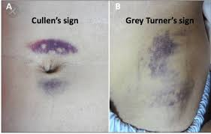

Slide 135
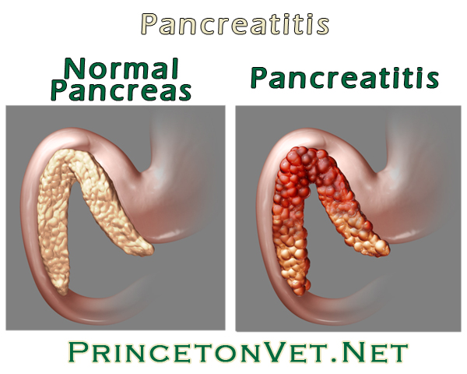

Slide 136
COMPLICATIONS
Pseudo cysts
Infected pancreatic necrosis
Systemic inflammatory syndrome; xterised by fever, tachypnea, tachycardia.

Slide 137
Patient is on NBM.
Parenteral feeding
Administer a free drainage
Cimetidine is given to reduce HCL
H2 anatagonist & PPIs
Pain management

Slide 138
Management
Pain relief
Insulin
Fluid/electrolyte balance
Gastric suction
Respiratory care
Pancreatectomy

Slide 139
Chronic pancreatitis
Inflammatory disorder characterized by progressive anatomic and functional destruction of the pancreas.
Risk factors
Chronic alcohol consumption

Slide 140
As cells are replaced by fibrous tissue with repeated attacks of pancreatitis, pressure within the pancreas increases.
The end result is mechanical obstruction of the pancreatic and common bile ducts and the duodenum.
Additionally, there is atrophy of the epithelium of the ducts, inflammation, and destruction of the secreting cells of the pancreas.
Long-term alcohol consumption causes hypersecretion of protein in pancreatic secretions, resulting in protein plugs and calculi within the pancreatic ducts.

Slide 141
Symptoms
Investigations
OGTT - evaluates pancreatic islet cell function
Ultrasound
CT scan
MRI
X-ray of the abdomen
Endoscopy
ERCP
Severe abdominal pains
recurring attacks of severe upper abdominal and back pain, accompanied by vomiting.
Weight loss
Steatorrhoea
Frothy, foul smelling stool
Calcification of the gland

Slide 142
COMPLICATIONS
Diabetes
Jaundice
Pseudocyst
Cancer of the Pancreas

Slide 143
Management
Hypoglycemics and insulin
Pancreatic enzyme replacement
Diet low in proteins
Pancreaticojejunostomy
Health education

Slide 144
Nursing diagnoses
Acute pain related to inflammation, edema, distention of the pancreas, and peritoneal irritation
Ineffective breathing pattern related to severe pain, pulmonary infiltrates, pleural effusion, atelectasis, and elevated diaphragm
Imbalanced nutrition, less than body requirements, related to reduced food intake and increased metabolic demands
Impaired skin integrity related to poor nutritional status, bed rest, and multiple drains and surgical wound

Slide 145
CANCER PANCREASE
The 5 year survival is only 6.7%
Life time risk of developing this cancer is 1.5%
Ca head of pancreas is the commonest 75%

Slide 146
Risk factors
Cigarette smoking -gender ( male )
Exposure to industrial chemicals
High fat diet
Race ( African/ American
Chronic pancreatitis
Personal history of diabetes or chronic pancreatitis

Slide 147
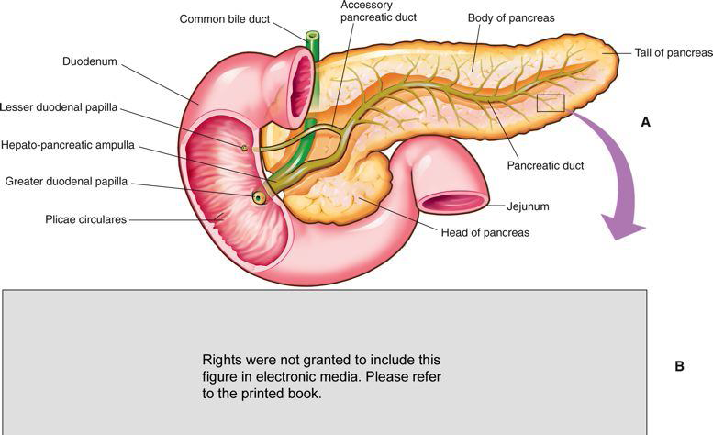
May develop in the head, body or tail of the pancreas.

Slide 148
Symptoms
Investigations
Routine blood tests – LFTs
Ultrasound
CT scan
Percutaneous biopsy
ERCP
Elevated tumor markers (CA 19-9 or CEA)
Pain – in the back
steatorrhoea
Jaundice -nausea and vomiting
Weight loss -pale and gray tools
Asthenia
Signs of diabetes

Slide 149
Tumors in the head of the pancreas are more likely to have jaundice
Those that arose in the body or tail, more likely pain and weight loss
Bile: passes through the common bile duct through the head of the pancreas on it’s way to the duodenum
Bile duct carries the bilirubin through the head of the pancreas on it’s way to the duodenum

Slide 150
Ductal adenocarcinoma accounts for about 85% of all neoplasms. And more than 95% of all pancreatic cancers arise from the exocrine (digestive enzymes) elements.
Cancers that arise from the endocrine cells (neuroendocrine, islet cells) account for 5% or less
60 to 70 percent of exocrine pancreatic cancers are localized to the head
20 to 25 percent are in the body/tail and the remainder involve the whole organ

Slide 151
Management
Resection is the only chance for a cure - Whipple Procedure
Unresectable patients may benefit from chemotherapy or chemoradiation
Metastatic disease may benefit from chemotherapy or other palliative treatments
Monitor for hyper and hypoglycemia – in pancreatic islet tumor
Diet( low proteins, carbohydrates and vitamins) – TPN
Adequate hydration
Pancreatic enzymes
Monitor weight
Fluid balance
Inspect suture line
Infection control

Slide 152
Pain management and attention to nutritional requirements are important nursing measures to improve the level of comfort.
Skin care and nursing measures are directed toward relief of pain and discomfort associated with jaundice, anorexia, and profound weight loss.
PAC.
Patient controlled analgesia should be considered for the patient with severe, escalating pain.
If surgery was performed, teach on drainage management and monitoring for complications
Because of the poor prognosis and likelihood of short survival, end-of-life preferences are discussed and honored.
Psychological support

Slide 154
DISORDERS OF THE GALL BLADDER

Slide 155
The Gallbladder
Hollow organ that beneath the liver.
In adults, measures approximately 8 cm (3.1 in) in length and 4 cm (1.6 in) in diameter when fully distended.
Divided into three parts: fundus, body and neck.
The neck tapers and connects to the biliary tree via the cystic duct which then joins the common hepatic duct to become the common bile duct.
At the neck of the gallbladder is a mucosal fold called Hartmann's pouch, where gallstones commonly get stuck.

Slide 156
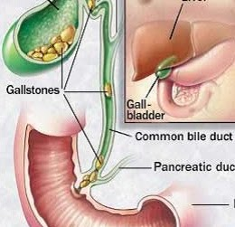

Slide 157
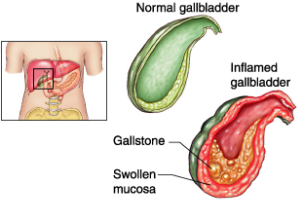

Slide 158
CHOLECYSTITIS
Cholecystitis-inflammation of the gall bladder
Associated with sedentary life style. Obese persons are more predisposed
Incidences are high at the age of 50’s and 60’s

Slide 159
Cholecystitis is the inflammation of the gallbladder, usually resulting from a gallbladder stone blocking the cystic duct.
Lasts for long time and characterized by repeated attacks of pain (biliary colic).
It may become thick walled, scarred and small. The gallbladder usually contains sludge (a microscopic particles or materials similar to gallstones)
These block its opening into the cystic duct or reside in cystic duct itself.

Slide 160
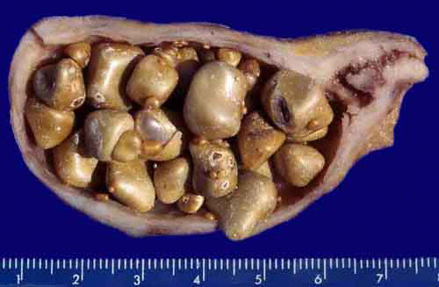
Notice thickness of gall bladder wall, abundant polyhedric stones
and small papillary tumor in the cystic duct.

Slide 161
Calculous cholecystitis is the cause of more than 90% of cases of acute cholecystitis. In calculous cholecystitis, a gallbladder stone obstructs bile outflow.
Bile remaining in the gallbladder initiates a chemical reaction; autolysis and edema occur; and the blood vessels in the gallbladder are compressed, compromising its vascular supply. Gangrene of the gallbladder with perforation may result.

Slide 162
Acalculous cholecystitis describes acute gallbladder inflammation in the absence of obstruction by gallstones.
Acalculous cholecystitis occurs after major surgical procedures, severe trauma, or burns.
Other factors associated with this type of cholecystitis include torsion, cystic duct obstruction, primary bacterial infections of the gallbladder, and multiple blood transfusions.
Alterations in fluids and electrolytes and in regional blood flow in the visceral circulation. Bile stasis (lack of gallbladder contraction) and increased viscosity of the bile are also thought to play a role.

Slide 163
Pathophysiology
Obstruction of the bile flow, more water absorption causing increased concentration of the bile and irritation of gall bladder
Bacteria and irritants are trapped thus further inflammation

Slide 164
Clinical features
Fever, tachycardia, and tenderness in the RUQ(right upper quadrant) or epigastric region, often with guarding or rebound.
The Murphy sign described as tenderness and an inspiratory pause elicited during palpation of the RUQ.
A palpable gallbladder or fullness of the RUQ .
Jaundice may be noted in approximately 15% of patients.
Patients with chronic cholecystitis frequently have a palpable RUQ mass secondary to fibrosis involving the gallbladder.

Slide 165
Pain : sharp, cramping, steady
Spread to the back or below the right shoulder blade
Other symptoms : clay-colored stools, fever, nausea or vomiting, yellowing of skin(jaundice)

Slide 166
Diagnostic Assessments
P/examination.
Ultrasonography is the best way to detect gallstones in the gallbladder or the thickening of its wall.

Slide 167
If possible, the patient should not eat for 6 or more hours before the test, which takes only about 15 minutes. During the procedure, the doctor can check the liver, bile ducts, and pancreas, and quickly scan the gallbladder wall for thickening (characteristic of cholecystitis.

Slide 168
Liver blood test are often normal unless the person has an obstructed bile duct. Other blood test can detect some complications such as high level of a pancreatic enzyme (lipase or amylase) in pancreatitis.
A high count of WBC suggest inflammation, an abscess, gangrene or a perforated gallbladder.

Slide 169
Management
Surgical – removal of the gallbladder (cholecystectomy) is usually done by using a flexible tube called a laparoscope.
This surgery uses a smaller surgical cuts, which results in a faster recovery. Patients are often sent home from the hospital on the same day as surgery or the next morning. Open cholecystectomy requires larger cut in the upper-right part of the abdomen.
Gall stones may also be dissolved with medication taken by mouth. But may take 2 years or longer to work.

Slide 170
Complications
Pain after surgery : a few people have new or recurring episodes of pain that felt on gallbladder even thought the gallbladder and the stones have been removed.
It may be the malfunction of the sphincter of Oddi, the muscle that control the released of bile and pancreatic secretion.

Slide 171
Other possible complications
Cancer of gallbladder (rarely)
Jaundice
Pancreatitis
Worsening of the condition:
NB;The pancreas and liver drain into the same duct into the gut. When the pancrease becomes inflamed and swollen the outflow from the liver does not drain into the gut. The bile salts do not get into the gut and stay in the body leading to jaundice.

Slide 172
Management
The condition is not always preventable.
Eating less fatty food may relieve symptoms who have not had their gallbladder removed.

Slide 173
CHOLELITHIASIS
Dfn-collection or presence of stones in the gall bladder
Causes
Altered solubility of the bile content
High levels of blood and dietary cholesterol
Dm
Hemolytic diseases
Female gender
Obesity

Slide 174
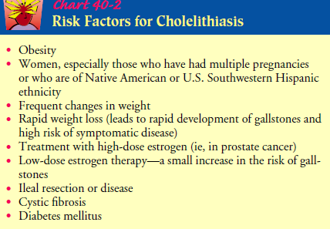

Slide 175
There are two major types of gallstones: those composed predominantly of pigment and those composed primarily of cholesterol.
Pigment stones probably form when unconjugated pigments in the bile precipitate to form stones.
The risk of developing such stones is increased in patients with cirrhosis, hemolysis, and infections of the biliary tract.
Pigment stones cannot be dissolved and must be removed surgically.

Slide 176
Cholesterol, a normal constituent of bile, is insoluble in water. Its solubility depends on bile acids and lecithin (phospholipids) in bile.
In gallstone-prone patients, there is decreased bile acid synthesis and increased cholesterol synthesis in the liver, resulting in bile supersaturated with cholesterol, which precipitates out of the bile to form stones.
The cholesterol-saturated bile predisposes to the formation of gallstones and acts as an irritant, producing inflammatory changes in the gallbladder.

Slide 177
Clinical manifestations
Intolerance to fatty foods
Nausea and vomiting
Flatulence
Fever
Right upper quadrant discomfort
Right upper quadrant pain
Jaundice
Clay colored stool
Dark colored urine

Slide 178
Diagnosis
A) cholecystitis
-High WBC
-High LFTs

Slide 179
B) cholelithiasis dx
X-ray
Cholecystogram
Cholangiogram
Ultrasonography

Slide 180
Management
Bed rest
Pain control
Antibiotics
Gallstone resolution therapy
Cholecystectomy- removal of the gallbladder
Cholecystotomy- opening and drainage of the gallbladder
Choledochostomy: into common bile duct
Choledocholithotomy: resection of common bile duct

Slide 181
Pre-op care
Restrict food or drinks
Skin preparation
Cleansing enema
Catheterization
Monitor prothrombin time
Administer vitamin k

Slide 182
Post-op care
Management of pain
Semi fowlers position
Splint incision site
Change dressing
Anti embolic stocking
Observe for bleeding
Vital signs
Other nursing care as per the patient’s needs
Health messages

Slide 183
CARCINOMA OF THE GALL BLADDER
Aetiology
Gall stones
– Calcification of gall bladder is associated with carcinoma gall bladder.
Chemicals
– High incidence of gall bladder and biliary cancer is noted in people who work in rubber industries.
Dietary
– Adulterated mustard oil for cooking is found to precipitate carcinoma gall bladder.

Slide 184
Clinical Features
Significant weight loss, jaundice and mass in the right upper quadrant are common presentations.
Clinically, it is palpable as a hard irregular mass.
Obstructive jaundice, bleeding, ascites are late features.

Slide 185
Investigations
CA 19-9 is elevated in 80% patients.
U/S-guided FNAC can be done for histological diagnosis in suspected cases of gall bladder mass.
CT scan is useful for staging – lymph nodes metastasis in the liver.
ERCP if there is obstructive jaundice to localize the exact site and nature of obstruction.
Diagnostic laparoscopy - If peritoneal metastasis is present, it is not worth resecting.
MRCP can be done. It visualises bile duct better than CT scan.

Slide 186
Management
IF mucosa alone is involved - cholecystectomy is sufficient.
If gall bladder wall is involved, then extended cholecystectomy is done.
Radiation has very small benefits.
Chemotherapy - 5-FU, mitomycin C, doxorubicin

Slide 187
Questions?

