Slide 1
DISORDERS OF THE STOMACH

Slide 2
Assignment;
Read and make notes on pyloric stenosis

Slide 3
1. GASTRITIS
Inflammation of the stomach mucosal surface
Etiology
Reduced mucus secretion (to act as a barrier against HCL)
Surface protection HCL
Destroys the epithelium

Slide 4
Predisposing factors
Nsaids
Excessive alcohol consumption
Food poisoning
Cigarette smoking
Cytotoxic drugs
Ingestion of corrosive poisons, acids and alkalis
Regurgitation of bile into the stomach
Helicobacter associated gastritis
Autoimmune causes

Slide 5
Clinical manifestations
Anorexia
Abdominal discomfort
Epigastric pain
Hemorrhage
Signs of anemia

Slide 6
Diagnostic tests
Endoscopy, Gastroscopy
Serological tests for antibodies to the H. Pylori antigen
Acid levels
Ct scan- upper abdominal

Slide 7
Management
Restrict the patient from the irritants
-If it is persistence IV fluids
-dilute the alkaline(lemon juice or vinegar) or acids( aluminium hydrochloride).
-Lavage is indicated if the corrosion is extensive
-NG feeding
-Drugs (analgesics, antacids and sedatives)
-Surgery (gastric resection or gastrojejunostomy) if there is a gangrene or perforation.
-H.Pylori kit( clarithromycin,amoxyl and esomeprazole)

Slide 8
2. PEPTIC ULCER DISEASE
Erosion of the mucosa and sub mucosal lining of the GIT tract. An “ulcer” is an open sore.
The word “peptic” means that the cause of the problem is due to acid.
Sites
Duodenal ulcers
Gastric ulcers
Esophageal ulcer

Slide 9
Contrary to general belief, more peptic ulcers arise in the duodenum (first part of the small intestine, just after the stomach) than in the stomach.
Duodenal ulcers usually first occur between the ages of 30-50 years and are twice as common in men as in women.
Stomach (or gastric) ulcers usually occur in people older than 60 years and are more common in women.
Ulcers come when the defense mechanisms fail

Slide 10
Stomach defense mechanisms
Pre-epithelial factors:-mucus-bicarbonate-phospholipid barrier, HCL that makes environment unfriendly to most organisms
Epithelial:- layer of simple columnar cells that is hydrophobic and interconnected by tight joints with continuous, and well-coordinated cell renewal which maintains constant structural integrity of the mucosa

Slide 11
Post-epithelial factors
Include;
continuous blood flow that delivers oxygen and nutrients with the simultaneous removal of toxic substances
an endothelial barrier that produces nitric oxide and prostacyclin to oppose the damaging effects of vasoconstrictors and inflammation in the microcirculation
sensory innervation which helps regulate mucosal blood flow and gastric motility. These critical mechanisms exist under normal conditions to balance out injurious factors and prevent the development of ulcers and their complications.

Slide 12
Etiology
Increased gastric juices/intestinal juices
Erosion and inflammation of the mucosa
Causes
Helicobacter pylori
Stress
Diet
Cigarette smoking
Alcohol
Nsaid
Pancreatic gastric secreting tumor

Slide 13
Pathophysiology
Whatever the etiologic factor is, the following happens:
Peptic ulcers are produced by an imbalance between the gastro-duodenal mucosal defense mechanisms and damaging forces of gastric acid and pepsin, combined with superimposed injury from environmental or immunologic agents.
The mucous membrane lining the digestive tract erodes and causes a gradual breakdown of tissue. This breakdown causes a gnawing or burning pain in the upper middle part of the belly (abdomen).

Slide 14
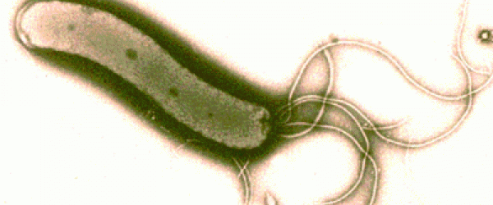
H. pylori
80% of ulcers are associated with Helicobacter pylori, a spiral-shaped bacterium that lives in the acidic stomach. Requires a little oxygen for survival
It is capable of forming biofilms and can convert from spiral to a possibly viable but nonculturable coccoid form, both likely to favor its survival and spread
Infection is usually contracted in childhood, perhaps through food, water, or close contact with an infected individual.
H. pylori associated with a 1-2% lifetime risk of stomach cancer and a less than 1% risk of gastric MALT lymphoma

Slide 15
Usually doesn't cause problems in childhood, if left untreated it can cause ulcers by:
-- infecting and inflaming the stomach and duodenal lining which weakens their defenses.
--Disturbing the mechanism which normally switches off acid and pepsin production after a meal has been digested so that more acid is produced on empty stomach

Slide 16
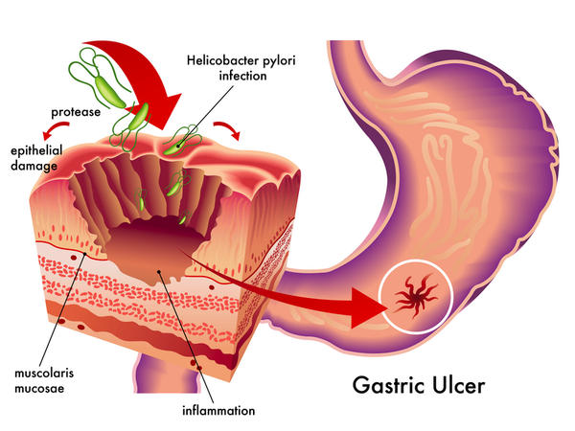

Slide 17
Stress
Stress related mechanisms: increased catecholamine release, vasoconstriction, and secretion of pro-inflammatory cytokines .
These effects are initially beneficial because they shift blood away from the GI tract and to critical organs such as the brain . However, when they persist they cause damage by breaking down gastric mucosal defenses, leading to injury and ulceration.

Slide 18
NSAIDS
Topical irritant effect on the epithelium,
Destroys the tight junctions
Suppression of gastric prostaglandin synthesis,
Reduction of gastric mucosal blood flow and interference with the repair of superficial injury.
NSAIDs acids contribute to ulcers pathogenesis and bleeding, by impairing the restitution process, interfering with hemostasis and inactivating several growth factors that are important in mucosal defense and repair.

Slide 19
Smoking
Smoking and chronic nicotine treatment stimulate gastric and HCL acid output which is more pronounced in the smokers having duodenal ulcer.
Nicotine stimulates pepsinogen secretion by increasing chief cell number or with an enhancement of their secretory capacity.
Smoking also increases bile salt reflux rate and gastric bile salt concentration thereby increasing duodeno-gastric reflux that raises the risk of gastric ulcer in smokers.
Smoking and nicotine not only induce ulceration, but they also potentiate ulceration caused by H. pylori, alcohol, nonsteroidal anti-inflammatory drugs

Slide 20
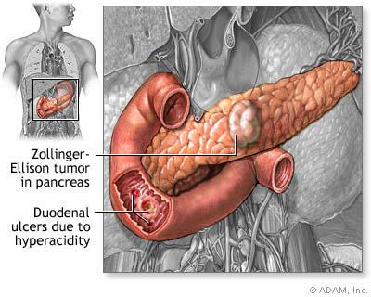
Gastrinomas (Zollinger Ellison syndrome), rare gastrin-secreting tumors, also cause multiple and difficult to heal ulcers.

Slide 21
Diet
Beverages and foods that contain caffeine can stimulate acid secretion in the stomach. This can aggravate an existing ulcer, but the stimulation of stomach acid can't be attributed solely to caffeine.

Slide 22
Classification of peptic ulcers
Ulcers are named for their location within the body. Sometimes ulcers can also be diagnosed by examining the mouth and tongue of the effected patient to detect and find the type of Ulcer.
Some other type of Ulcers however will take other method for diagnoses. There are also other types of ulcers which are relatively less common and among them are Stress Ulcers, Bleeding Ulcers, esophageal ulcers and Refractory Ulcers.

Slide 23
Peptic Ulcers
Strictly, pepsin exposed ulcers are called peptic ulcers, although the term is applied to mean all esophageal, gastro, duodenal ulcers. Peptic Ulcer is the most common type in the gastrointestinal tract area. Relieved by anti acids.
Found on stomach or duodenum wall.
Pepsin and HCL, when barrier is damaged, digest epithelium.

Slide 24
Duodenal Ulcers
In duodenum.
Duodenum ulcers are usually benign however doctors may take a biopsy to make sure that they are benign.
Usually patients feel a burning sensation and heartburn feelings .Duodenum ulcers will usually begin in the starting point of the small intestine and are this type of Ulcer is much common in western societies than any other.
Four less common types are following:

Slide 25
Esophageal Ulcer
Occurs in the lower end of esophagus.
H. pylori common etiology
Patients may feel a lot of pain if acid from stomach refluxes
Causes difficulty and pain in swallowing.

Slide 26
Bleeding Ulcer
Internal bleeding occurs if an ulcer is untreated.
Must be attended to fast
Refractory ulcers Simple peptic ulcers that have not healed after at least 3 months of treatment are called refractory ulcers
Stress ulcers
consist of a group of lesions and usually found in the esophagus, the stomach or the duodenum.
Common in those with other illness or are critically ill and on ventilation.

Slide 27
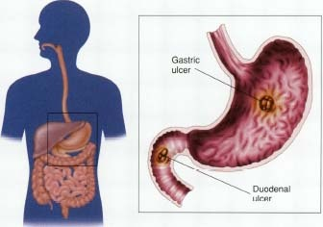
SYMPTOMS

Slide 28
Duodenal ulcers
-Age-30 to 60
-Male: female= 3:1
-Incidence-80%
-May have weight gain
-Pain-2 to 3 hrs after meals
-Nocturnal awakening
-Vomiting uncommon
-Hemorrhage less likely
-Perforation more likely
Gastric ulcers
-Usually 50 and over
-1:1
-15%
-May have weight loss
-1/2-1 hrs after meals
-No nocturnal awakening
-Vomiting common
-Hemorrhage more likely
-Perforation less likely

Slide 29
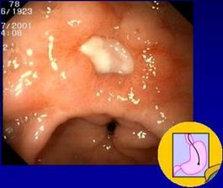
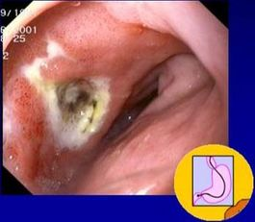
Endoscopy

Slide 30
Predisposing factors
Are age 60 or older (your stomach lining becomes more fragile with age).
Have had past experiences with ulcers and internal bleeding
Take steroid medications, such as prednisone.
Take blood thinners, such as warfarin.
Consume alcohol or use tobacco on a regular basis.
Experience certain side effects after taking NSAIDs, such as upset stomach and heartburn.
Take NSAIDs in amounts higher than recommended or for long period

Slide 31
Stress doesn’t cause ulcers, but a contributing factor
Chronic disorders: liver disease, emphysema, R. arthritis may predispose one to ulcers
Improper diet, irregular or skipped meals
Type O blood (for duodenal ulcers)

Slide 32
COMPLICATIONS
GI bleeding is the most common complication. It occurs when the ulcer erodes one of the blood vessels.
Perforation Erosion of the gastro-intestinal wall by the ulcer leads to spillage of stomach or intestinal content into the abdominal cavity. The first sign is often sudden intense abdominal pain. Posterior wall perforation leads to pancreatitis; pain in this situation often radiates to the back.

Slide 33
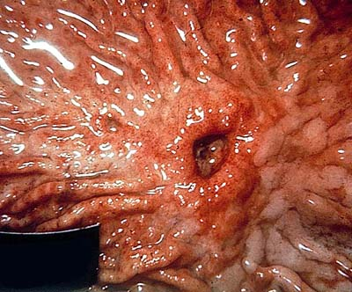

Slide 34
Penetration is when the ulcer continues into adjacent organs such as the liver and pancreas
Scar tissue Scarring and swelling due to ulcers causes narrowing in the duodenum and gastric outlet obstruction. Patient often presents with severe vomiting. Peptic ulcers can also produce scar tissue that can obstruct passage of food through the digestive tract, causing one to become full easily, to vomit and to lose weight.

Slide 35
WARNING SIGNS
vomit blood
sudden, severe pain
vomit food eaten hours or
days before
ongoing nausea or
repeated vomiting.
feel cold or clammy
feel unusually weak or
dizzy
blood in your stools
losing weight
pain doesn't go away
With medication

Slide 36
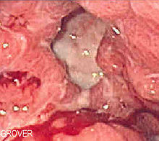
TESTS AND DIAGNOSIS CHART

Slide 37
Noninvasive
Urea Breath Test (UBT)
Blood test
Invasive
Histology
Biopsy Urease Test

Slide 38
Culture
Other tests
Stool antigen test
Endoscopy
Upper gastrointestinal (upper GI) X-ray

Slide 39
GOALS OF TREATMENT
Lowering the amount of acid that stomach makes,
-Neutralizing the acid
-protecting the injured area so it can heal
It's also very important to stop smoking and drinking alcohol
Prevent complications (bleeding, perforation, penetration, obstruction)
Minimize recurrences
Reduce financial costs

Slide 40
Antibiotic medications. Combinations of antibiotics to treat H. pylori because one antibiotic alone isn't always sufficient to kill the organism.
-amoxicillin (Amoxil), clarithromycin (Biaxin) and metronidazole (Flagyl). Combination drugs that include two antibiotics together with an acid suppressor or cytoprotective agent (Helidac, Prevpac) have been designed specifically for the treatment of H. pylori infection.

Slide 41
Acid blockers. Also called histamine (H-2) blockers — reduce the amount of HCL released into GI. This relieves ulcer pain and encourages healing.
MOA: keeping histamine from reaching histamine receptors.
NB: Histamine is a substance normally present in body. When it reacts with histamine receptors, the receptors signal acid-secreting cells in stomach to release hydrochloric acid. Available by prescription or over-the-counter (OTC), acid blockers include the medications ranitidine (Zantac), famotidine (Pepcid), cimetidine (Tagamet) and nizatidine (Axid).

Slide 42
Antacids. An antacid may be taken in addition to an acid blocker or in place of one. Instead of reducing acid secretion, antacids neutralize existing stomach acid and can provide rapid pain relief.
Proton pump inhibitors. Reduce acid by blocking the action of these tiny pumps. These drugs include the prescription and over-the-counter medications omeprazole (Prilosec), lansoprazole (Prevacid), rabeprazole (Aciphex) and esomeprazole (Nexium). They also inhibit H. pylori.

Slide 43
Cytoprotective agents. Protect the GI mucosa.
sucralfate (Carafate) and misoprostol (Cytotec). bismuth subsalicylate (Pepto-Bismol).
Bowel rest: Bed rest and clear fluids with no food at all for a few days. This gives the ulcer a chance to start healing without being irritated.
Nasogastric tube: Decompression
Urgent endoscopy or surgery if indicated: Damaged, bleeding blood vessels can usually be repaired with an endoscope. The endoscope has a small heating device on the end that is used to cauterize a small wound.

Slide 44
Surgery
Vagotomy
Antrectomy
Pyloroplasty
Tying off an
artery
Other modes
Of treatment
Acupuncture
Chiropracting
Homeopathy
Herbs
Notes:
Chiroprotractor deals with the disorders of the MS and Nervous systems. Manipultes for example spinal joints that have become hypomobile due to injury etc
Using irritants to cure the dsame condition

Slide 45
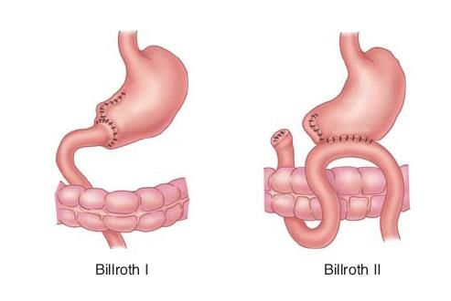

Slide 46
LIFE STYLE AND HOME REMEDIES

Slide 47
Use of Olive Oil
Don't smoke
Limit or avoid alcohol
Less
Coffee and
Carbonated
Beverages
Avoid nonsteroidal
anti-inflammatory
drugs (NSAIDs)
Exercise
Fruits and
Vegetables
Stress Relief

Slide 48
Nursing Diagnoses
Acute pain related to effects of gastric acid secretion on damaged tissue.
Anxiety related to acute illness
Imbalanced nutrition changes in diet.
Deficient knowledge on prevention of symptoms and mx of conditions
Risk of potential complications.

Slide 49
GASTRIC CANCER
Affect ages 40 – 70 years but can also occur in men under 40years have a higher incidence
Predisposing factors
Diet – high in smoked, salted or pickled foods and low in fruits & vegetables
Chronic gastric inflammations
H. pylon infection
Pernicious anaemia
Smoking
Achlorhydria
Gastric ulcers
Previous gastrectomy
Genetics
Prognosis – poor because it’s usually diagnosed late

Slide 50
Pathophysiology
Majority of gastric cancers are adenocarcinomas can occur anywhere in the stomach
Adjacent organs are infiltrated e.g. liver, pancreases, duodenum and oesophagus
Metastasis through lymph to the peritoneal cavity occurs later.

Slide 51
Clinical Manifestations
Resemble those of benign ulcers
Presents with pain because gastric tumours begin on lesser curvature of the stomach.
Symptoms of progressive disease include dyspepsia (indigestion) weight loss, abdominal pain just above the umbilicus, loss or decrease in appetite, bloating after meals nausea and vomiting and symptoms similar to those of P.U.D.

Slide 52
Diagnosis
P/E – palpable mass
Ascites
Hepatomegally
Palpable nodules around umbilicus
Biopsy – oesophagugastro-duodenoscopy
Cytologic washing – test of choice
Ba – x ray of upper G.I.T
Endoscopic ultrasound
Computed tomography (CT)

Slide 53
Medical Management
Most successful treatment is removal of the tumor if it is localized.
Total gastrectomy if the tumor is in the mid-portion or body of the stomach
Entire stomach along with duodenum, section of oesophagus attached to stomach, supporting mesentery and lymph nodes
Reconstruction of the G.I.T is done by anastomosing the end of the jejunum to the end of oesophagus a procedure called oesophagojejunostomy
Radical subtotal gastrectomy is performed if tumor is in the middle and distal portions of stomach
Billroth I or II is performed
If surgical Rx does not help – chemotherapy may control the disease e.g 5 – fluorouracil (5 - fu), adriamycin (doxorubian)
Radiotherapy is also a mode of treatment.

Slide 54
Nursing Intervention
Explanation & reassurance involve family members and relative
Patient to eat small frequent portions of non-irritating foods to decrease gastric irritation
Parenteral nutrition is necessary if patients is unable to feed
Record input/output chart
Daily weights
Observe for signs of dehydration
Regular monitoring of V/Es administer anti-emsis

Slide 55
Relieve pain by administering a narcotic
Manage pain by offering non pharmacologic methods e.g relaxation exercises – use of audiotapes, periods or rest and relaxation
Provide psychosocial support – help patient to express fears, concerns and grief about the diagnosis. Answer patient’s questions honestly. Help patient to participate in Rx decisions.
Offer emotional support – involve family members and significant other services of a priest/imam, psychiatrist e.t.c are necessary
Teach patient on self care – patient can engage home care nurses, diet regime, medications, pain management, follow-up

Slide 56
Nursing Diagnosis
Anxiety related to the disease and form of Rx
Imbalance nutrition less than body requirements related to nausea, anorexia
Pain related to tumor mass
Anticipatory grieving related to the diagnosis of cancer
Deficient knowledge regarding self care activities

